Slide 1
CAPE WINELANDS
BREEDEKLOOF

Slide 2
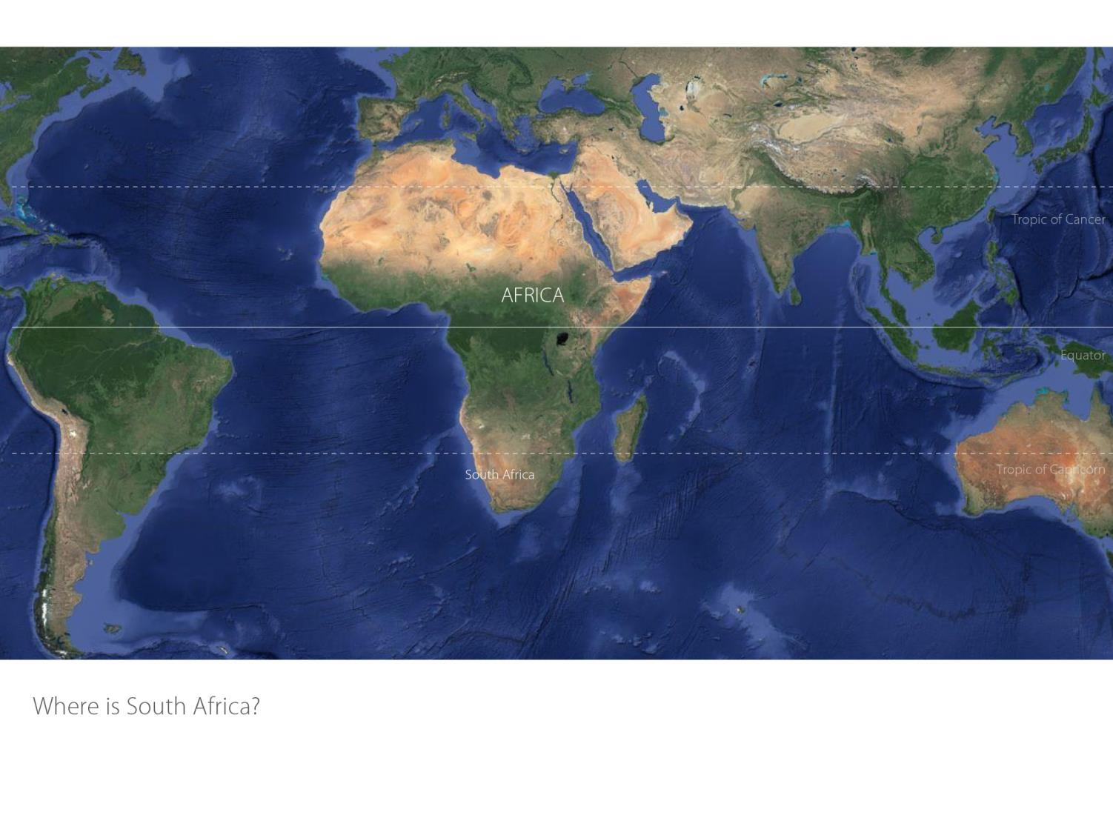

Slide 3
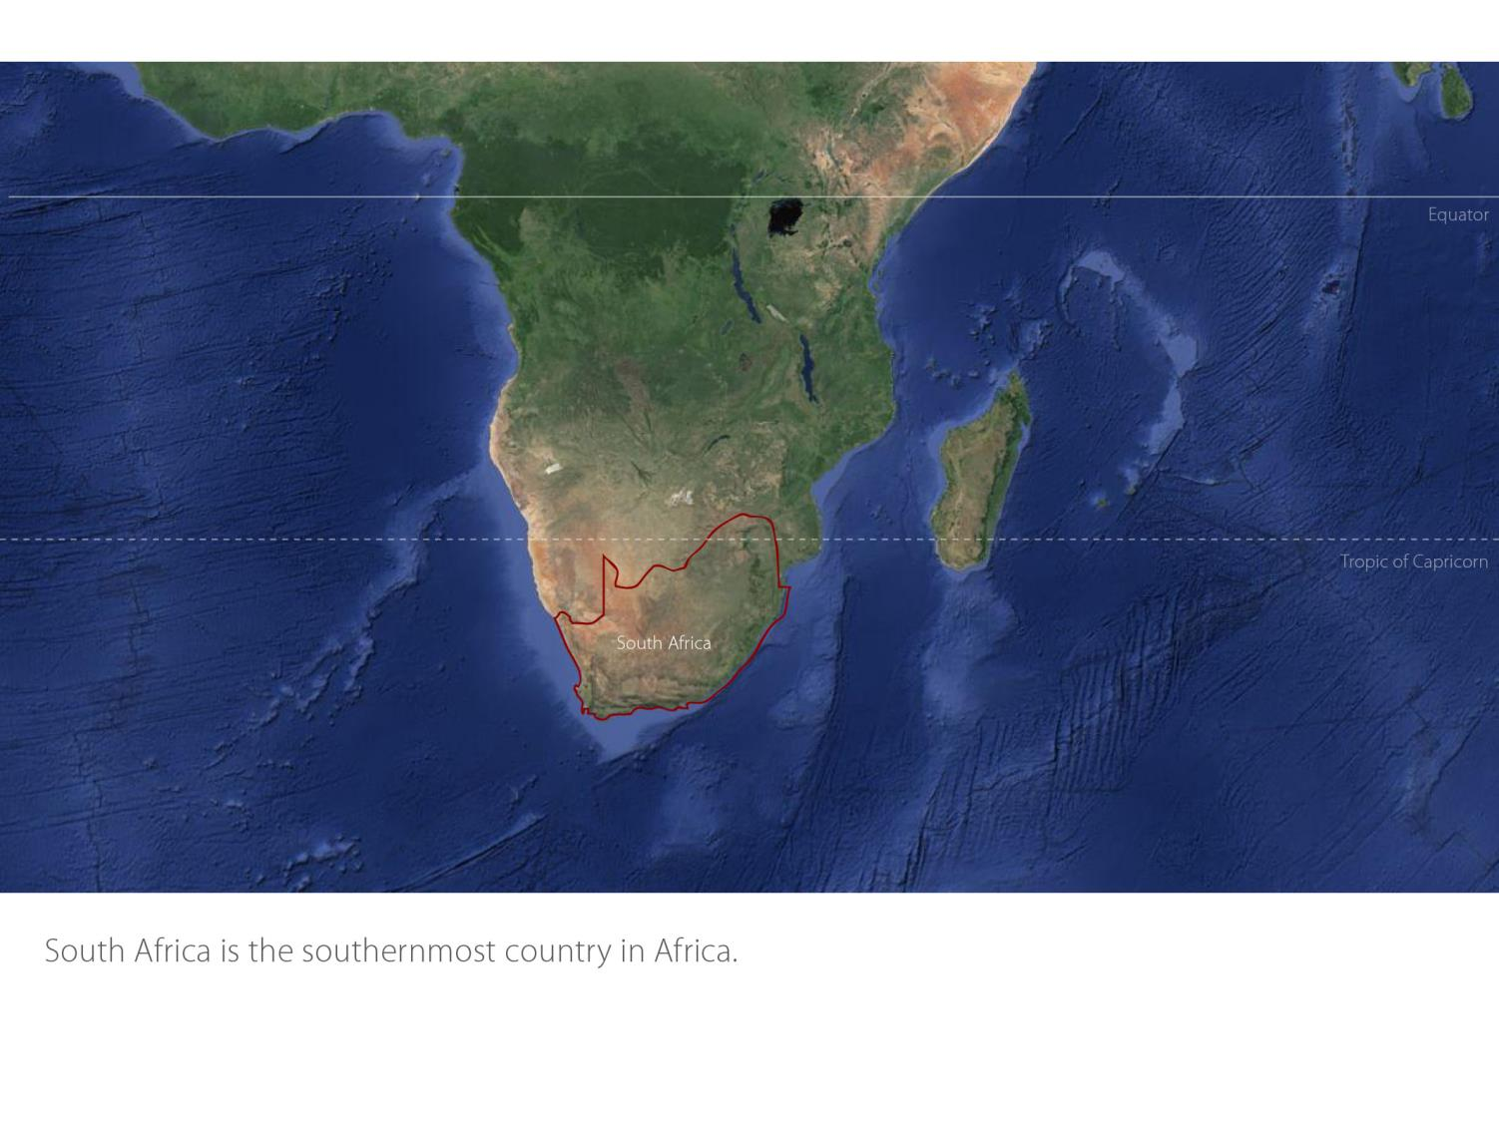

Slide 5
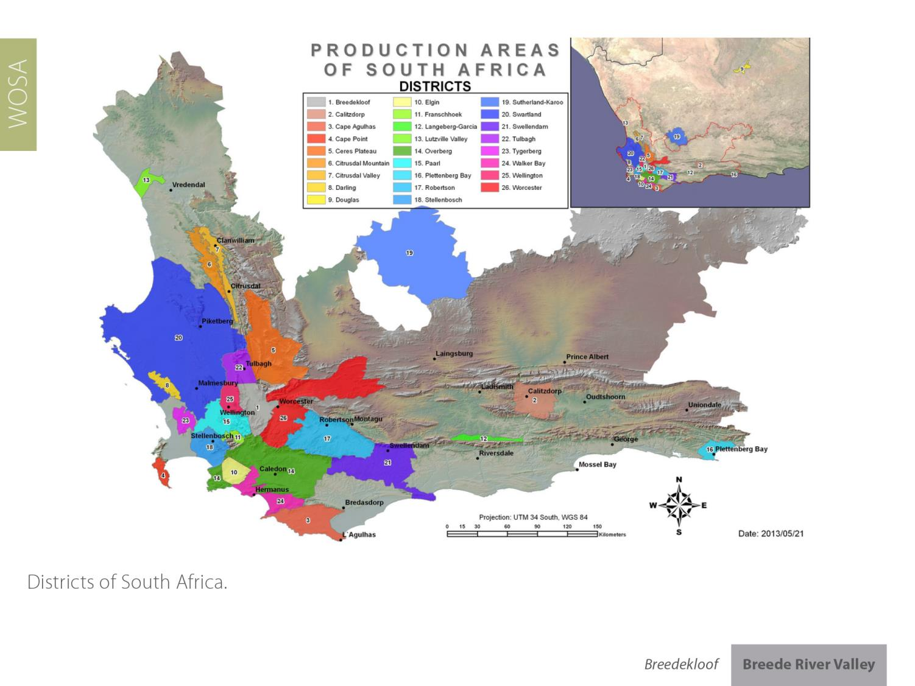

Slide 13
The wards of Goudini and Slanghoek lie within the rain belt caused by the first range of north-south lying mountains next to the south-western coast, where the rain is still sufficient enough for vineyards to flourish without irrigation. The average annual rainfall is 784 mm.

Slide 14
Summers are warm and the mean February temperature is 21.6⁰C.

Slide 22
Breedekloof represents 13.5% of all hectares planted in SA – 17.8% of all white wine hectares and 16.8% of all red wine hectares.

Slide 23
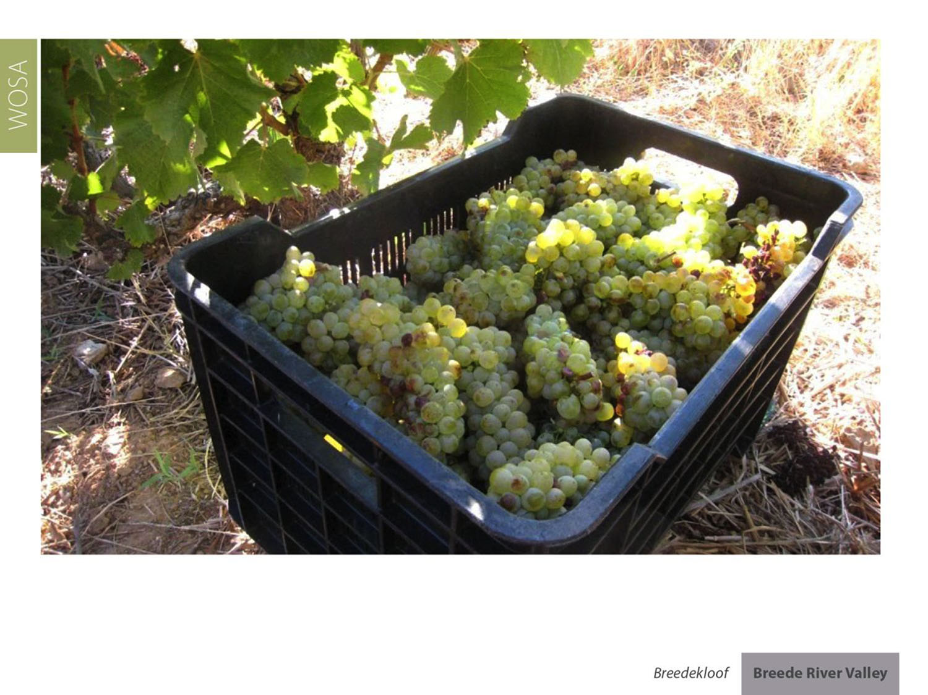
Chenin Blanc represents 18.5% of South Africa’s vineyards. Breedekloof has 19.8% of all Chenin plantings and supplies 24.3% of all wine made from Chenin.

Slide 27
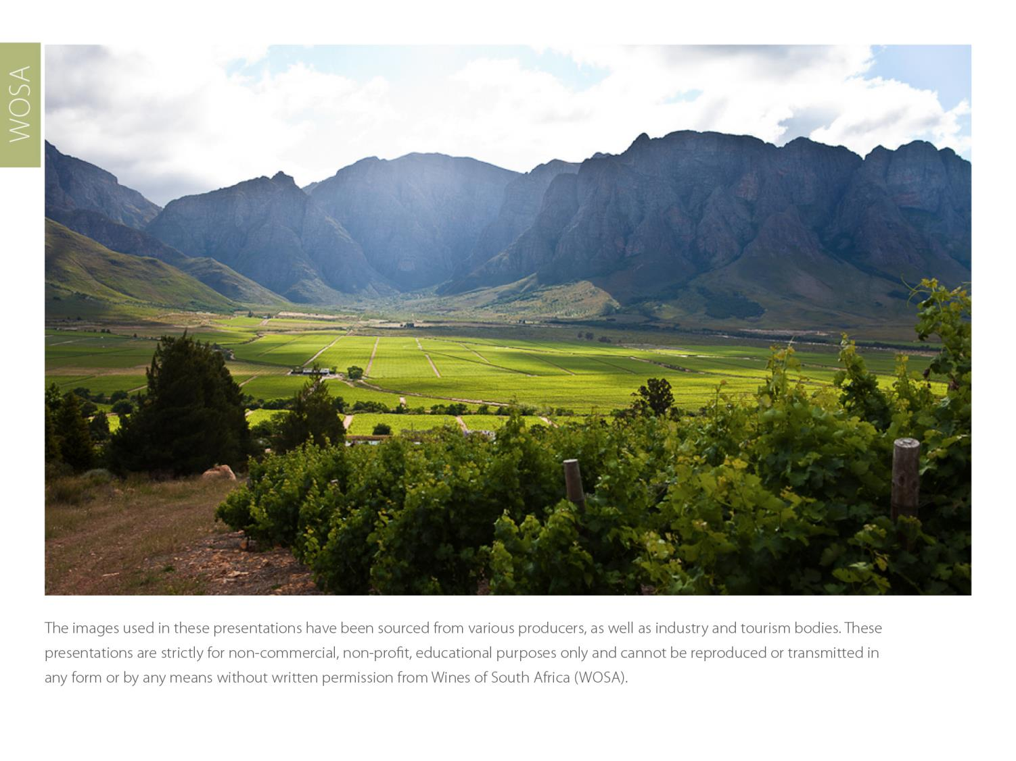
The images used in these presentations have been sourced from various producers, as well as industry and tourism bodies. These presentations are strictly for non-commercial, non-profit, educational purposes only and cannot be reproduced or transmitted in any form or by any means without written permission from Wines of South Africa (WOSA).

Slide 28
The Cape winelands, considered by many to be
the most beautiful in the world, has a network of
diverse and well-run wine routes, affording visitors
a varied and unforgettable experience.
The End

Slide 29
THE END

