Slide 1
CAPE WINELANDS
WELLINGTON

Slide 2
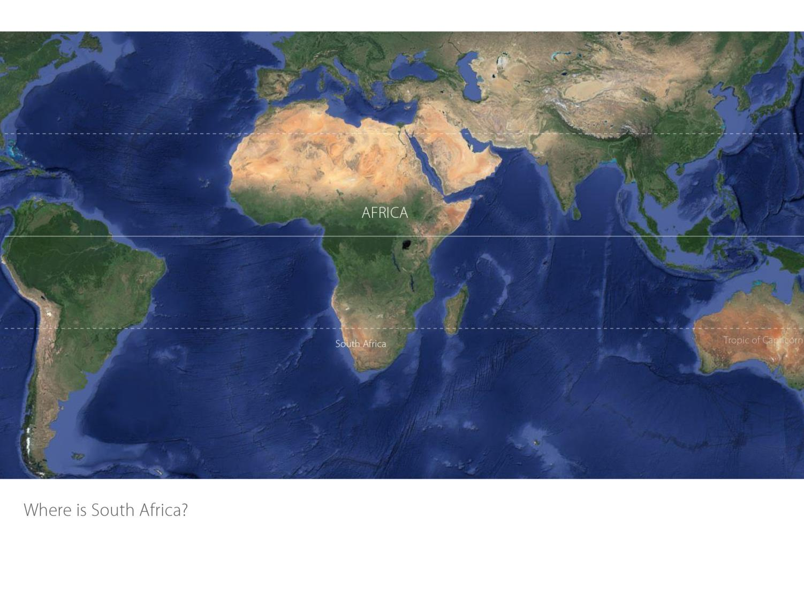

Slide 3
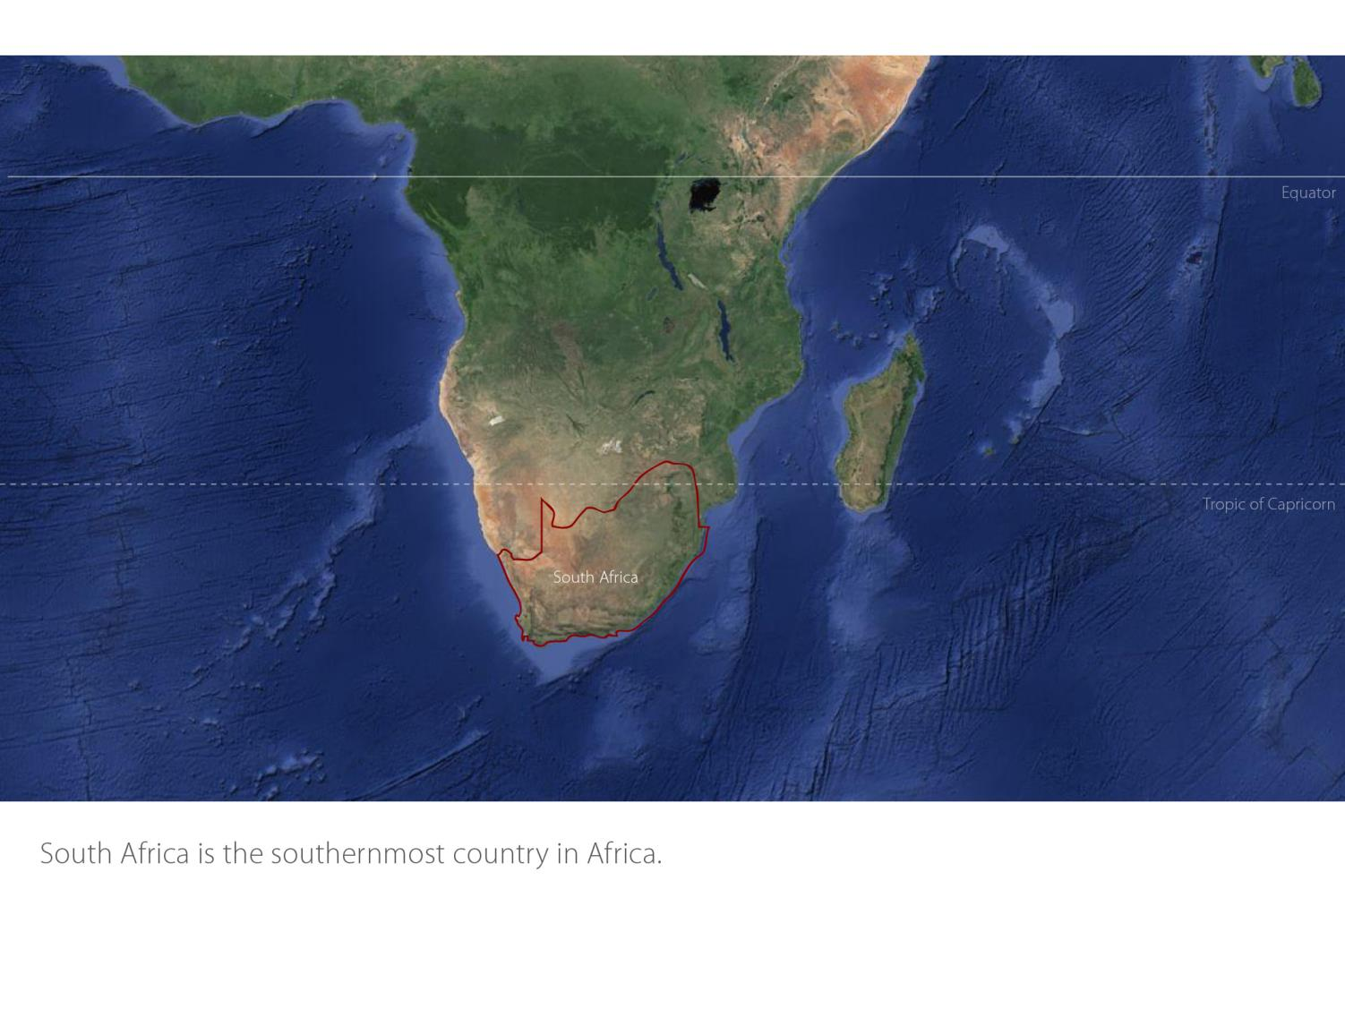

Slide 4
Coastal
Region: Coastal
District: Wellington
Wards: Wellington Bovlei
Groenberg
Limietberg
Mid-Berg River
Wellington
Coastal

Slide 5
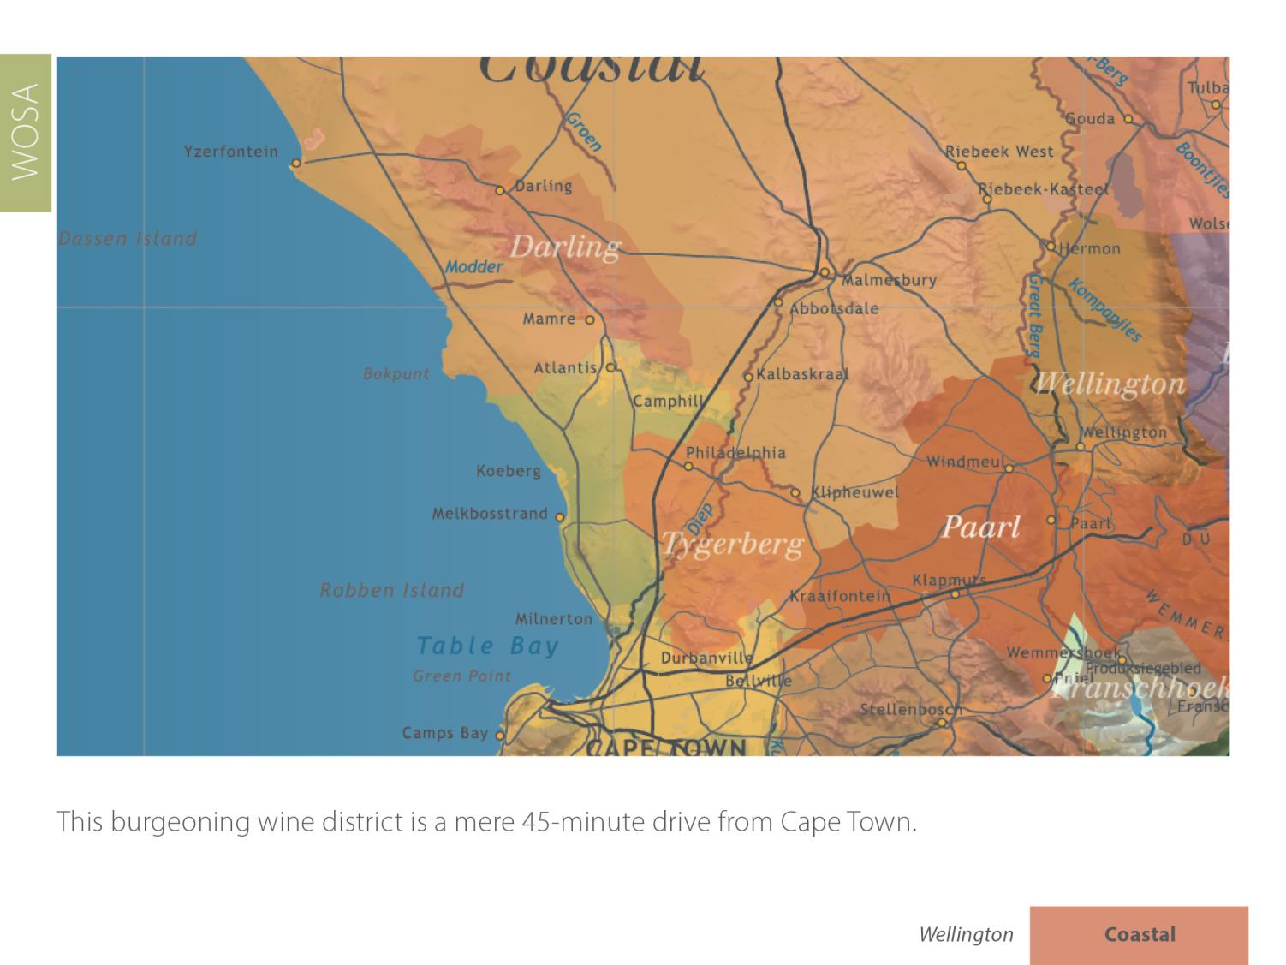

Slide 6
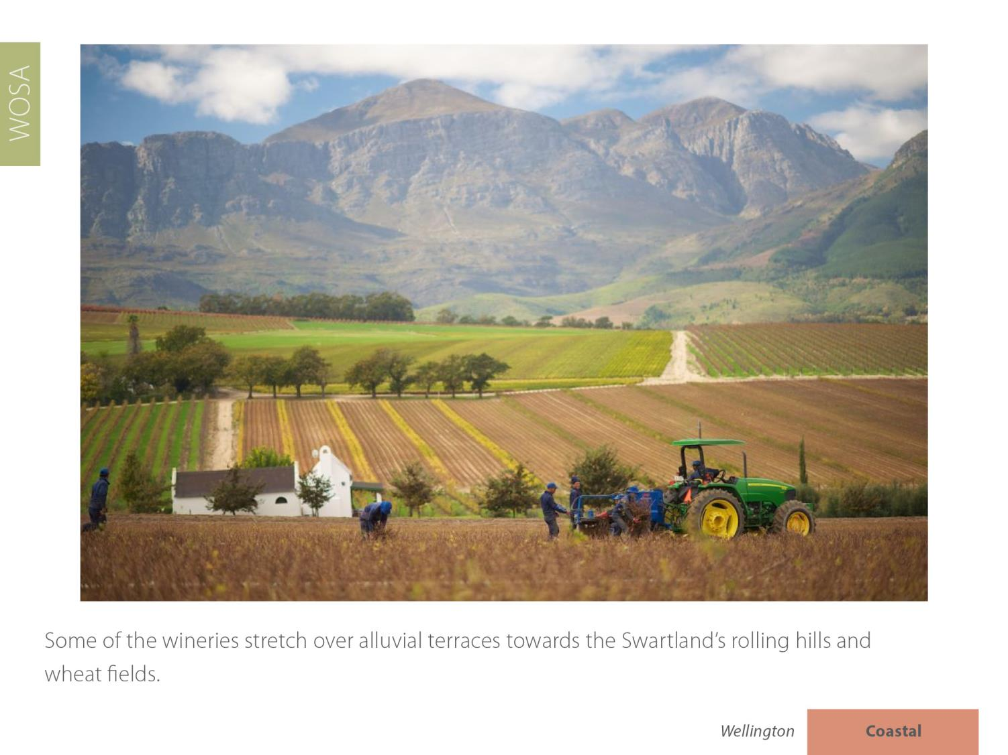

Slide 8
Wellington supplies 85% of the South African wine industry with cuttings.

Slide 14
The average rainfall is 741 mm and the mean February temperature is 23.2⁰C (Abenrude Weather Station).

Slide 15
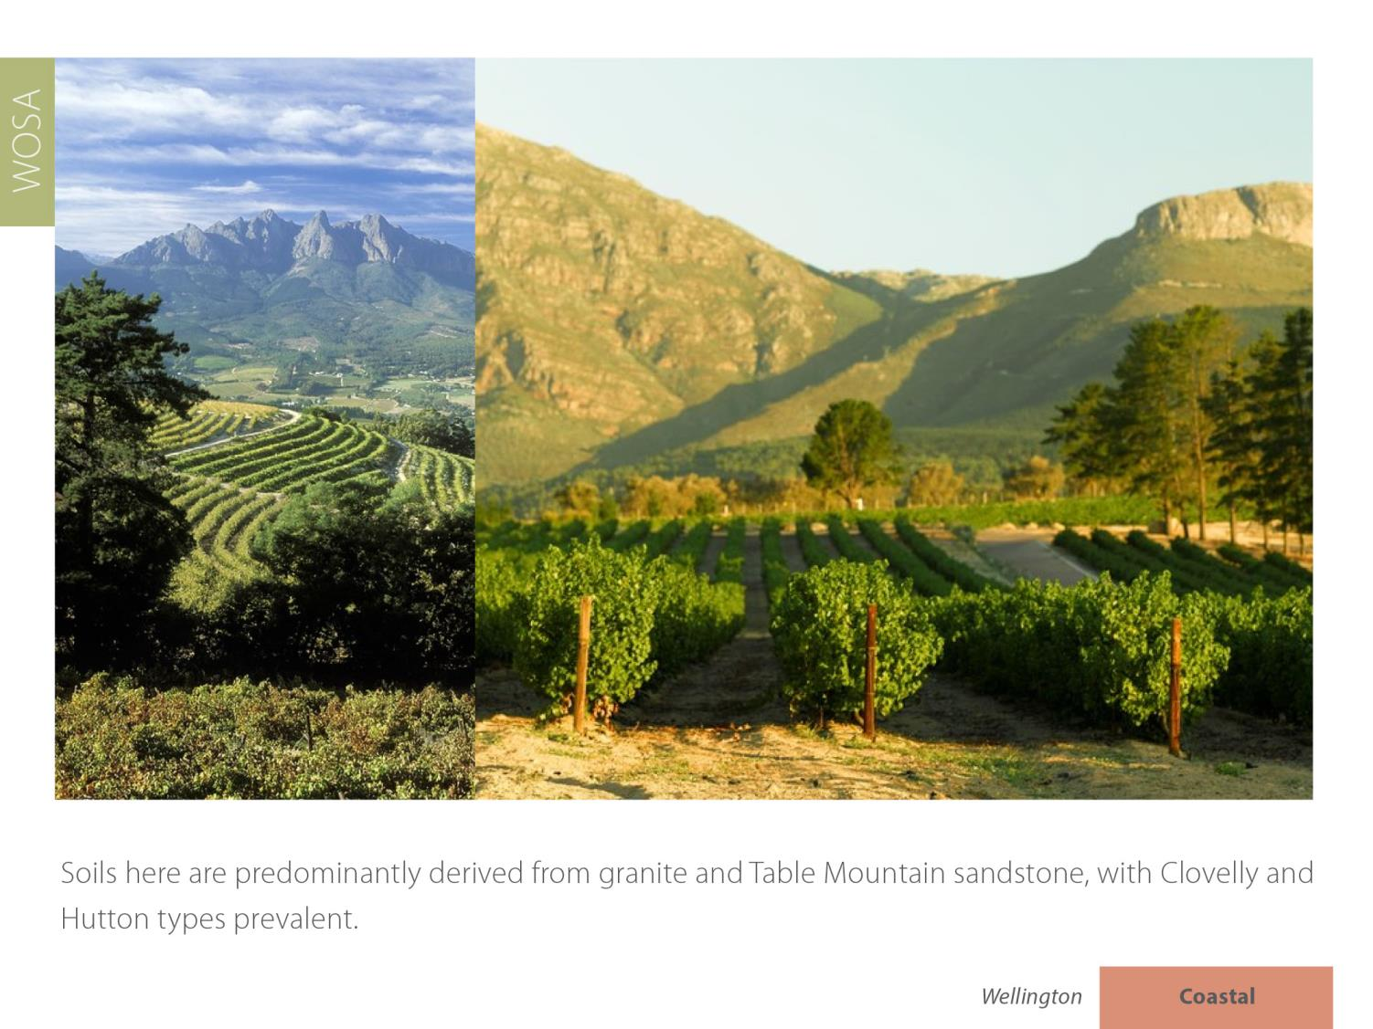

Slide 18
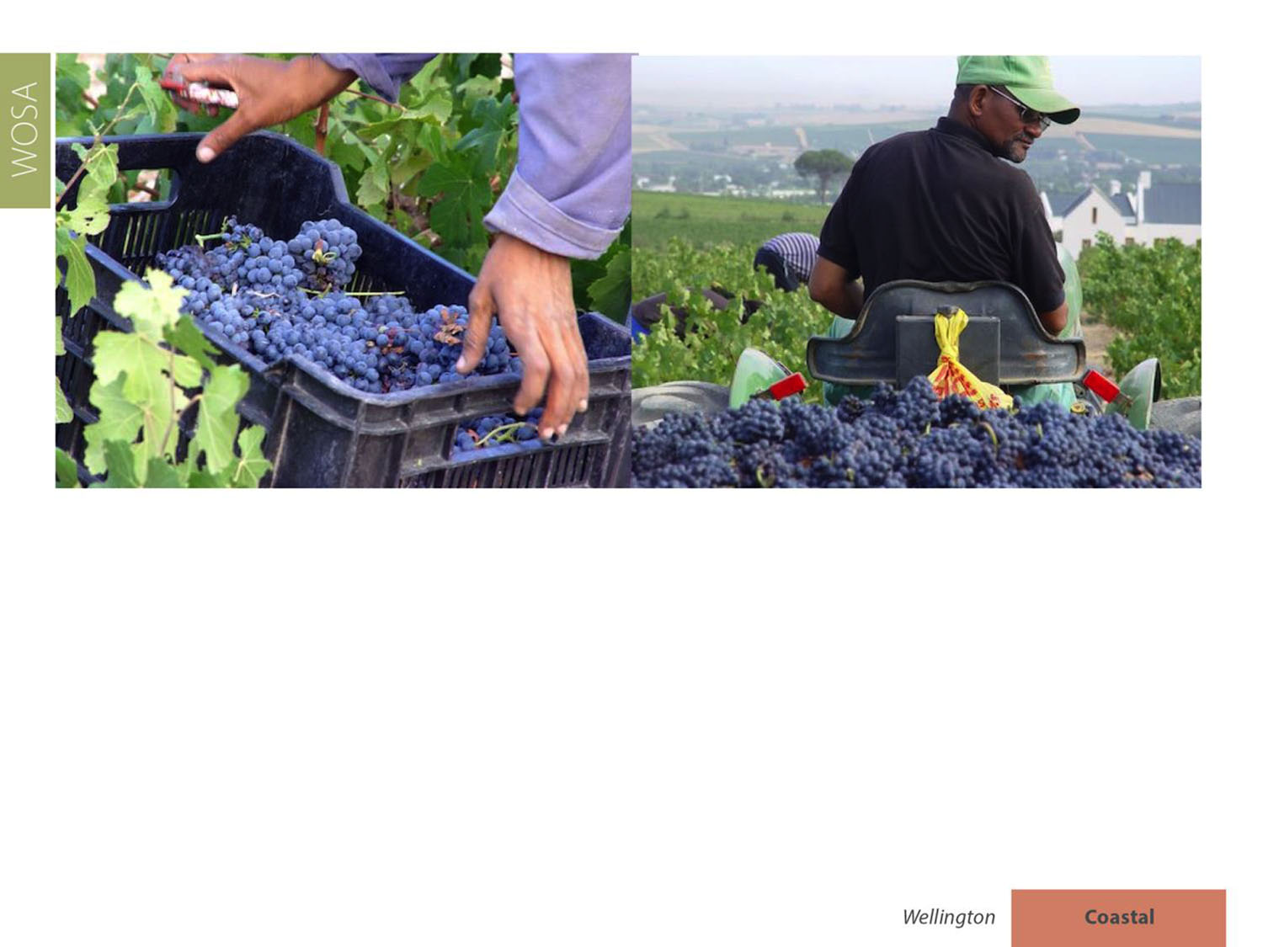
When it comes to red-wine varieties, Cabernet Sauvignon leads the way, followed by Shiraz and Pinotage.

Slide 20
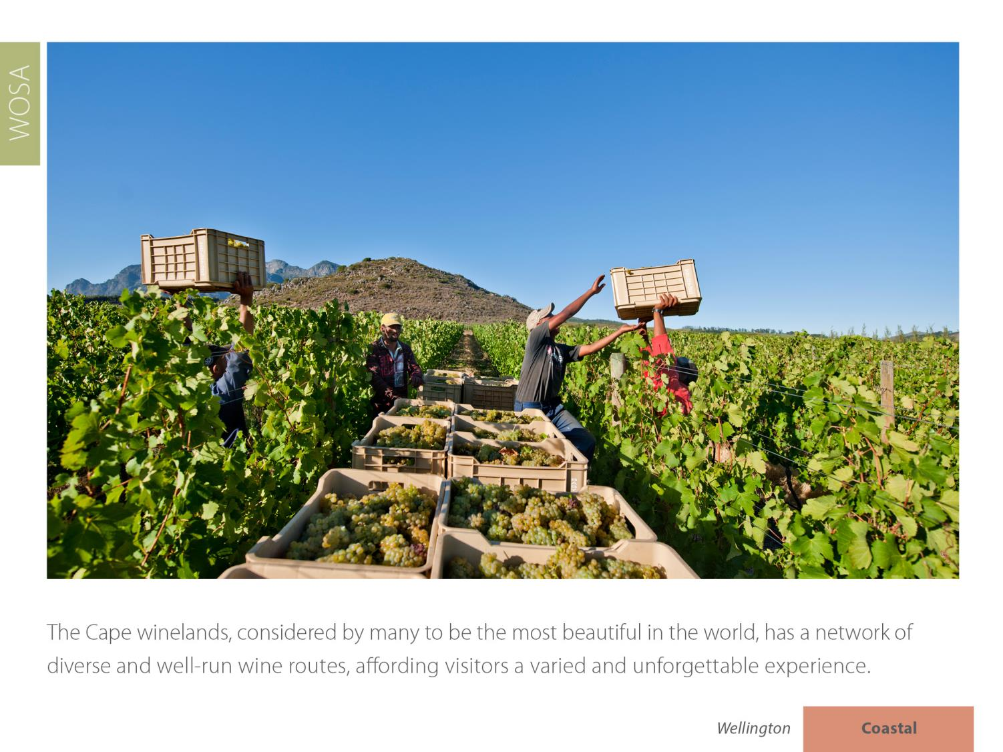

Slide 21
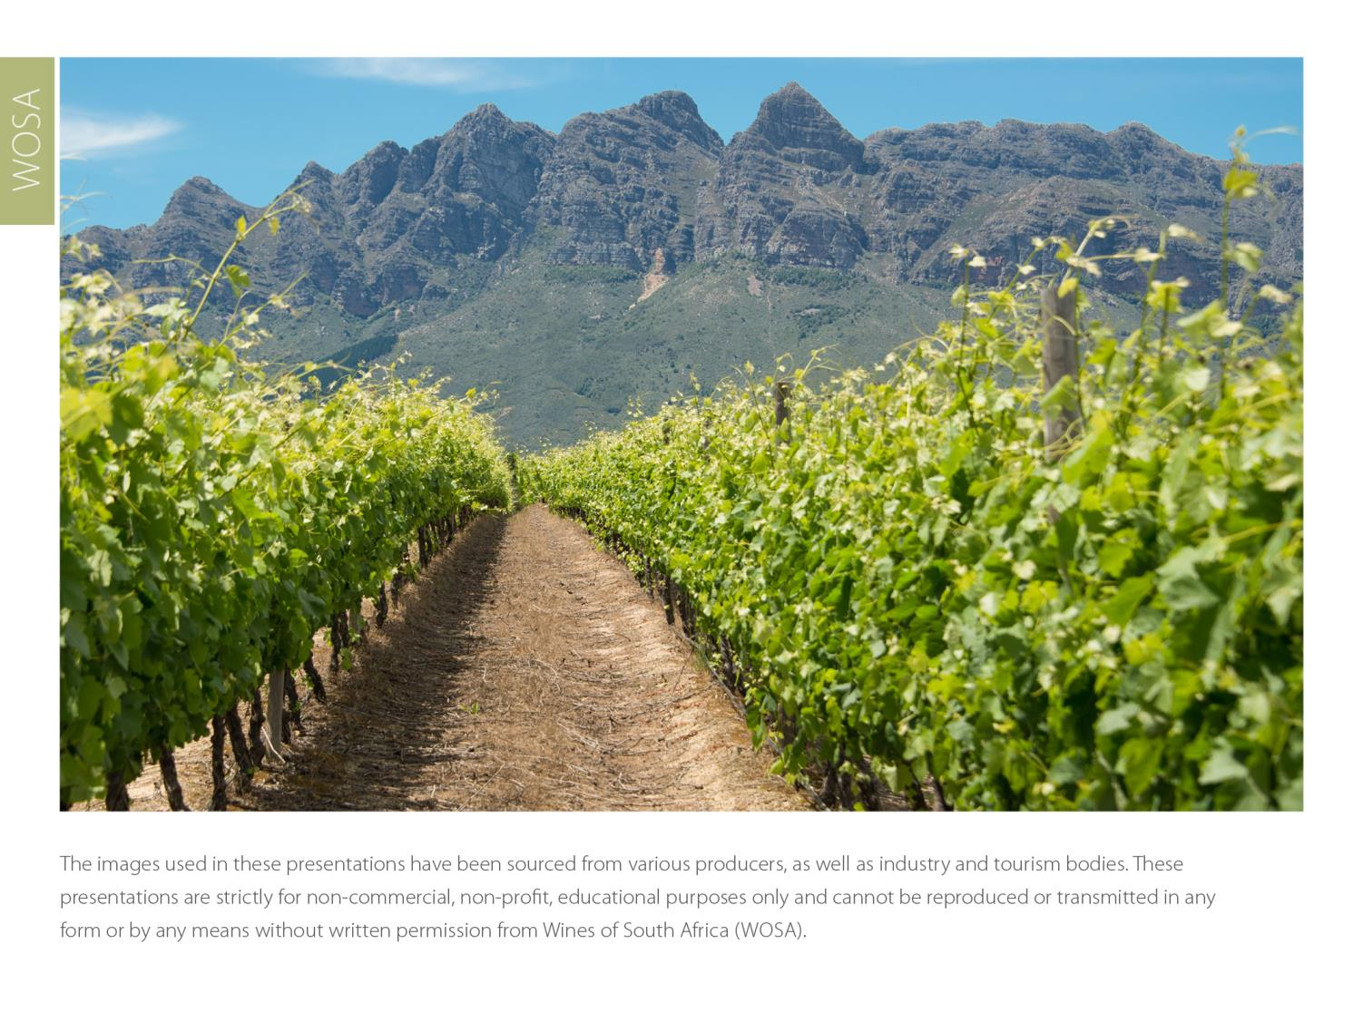
The images used in these presentations have been sourced from various producers, as well as industry and tourism bodies. These presentations are strictly for non-commercial, non-profit, educational purposes only and cannot be reproduced or transmitted in any form or by any means without written permission from Wines of South Africa (WOSA).

Slide 22
The Cape winelands, considered by many to be
the most beautiful in the world, has a network of
diverse and well-run wine routes, affording visitors
a varied and unforgettable experience.

Slide 23
THE END

