Slide 1
CAPE WINELANDS
WORCESTER

Slide 2
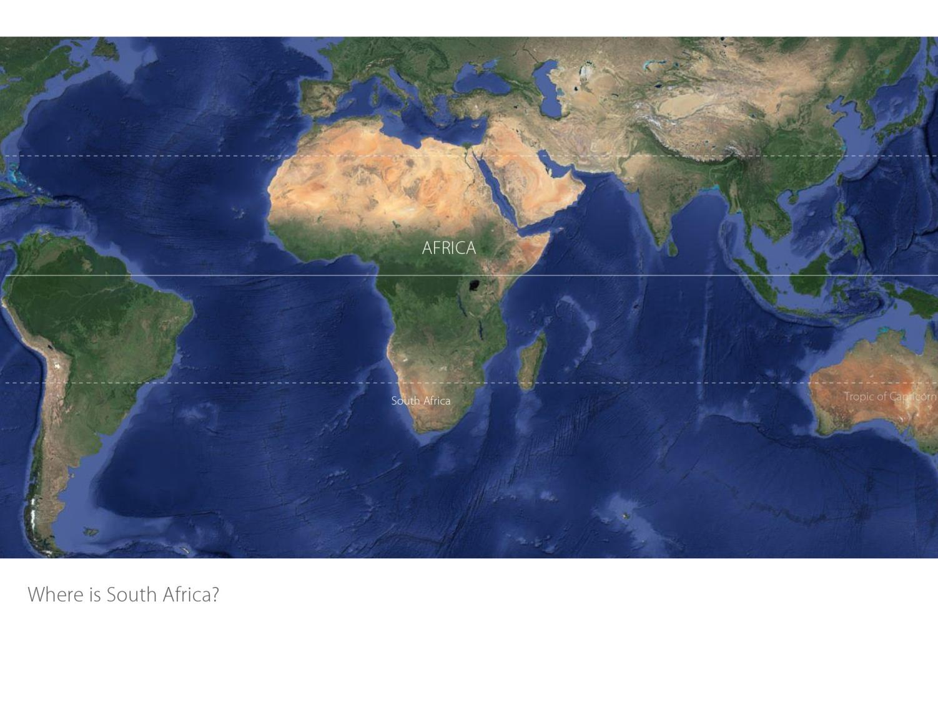

Slide 3
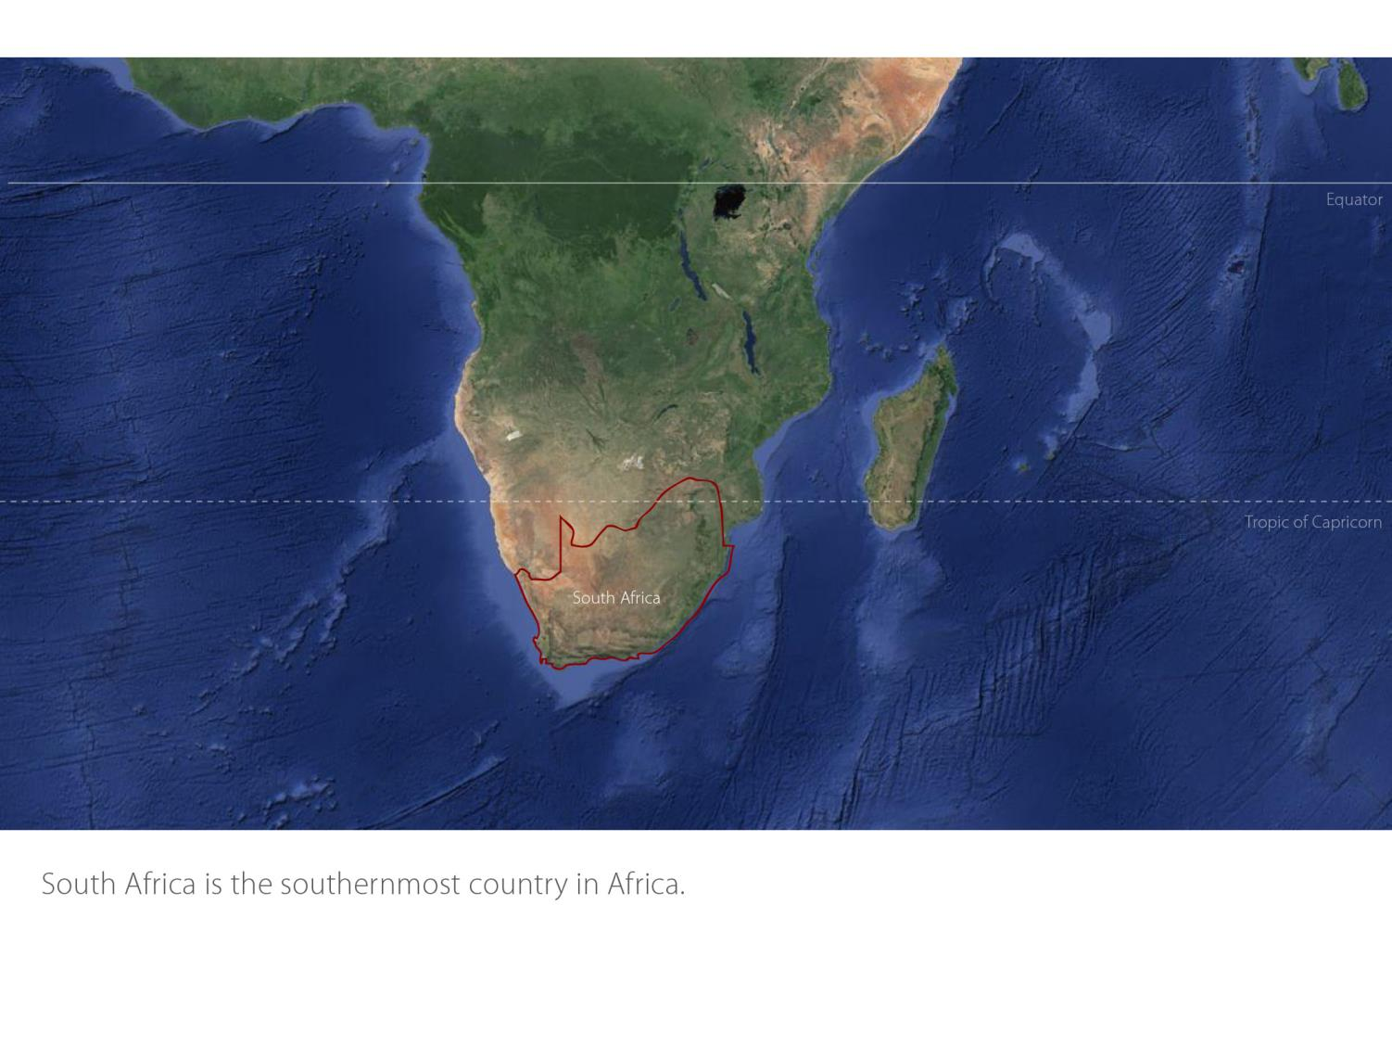

Slide 4
Coastal
Region: Coastal
District: Worcester
Wards: Hex River Valley
Nuy
Scherpenheuvel
Stettyn
Worcester
Coastal

Slide 5
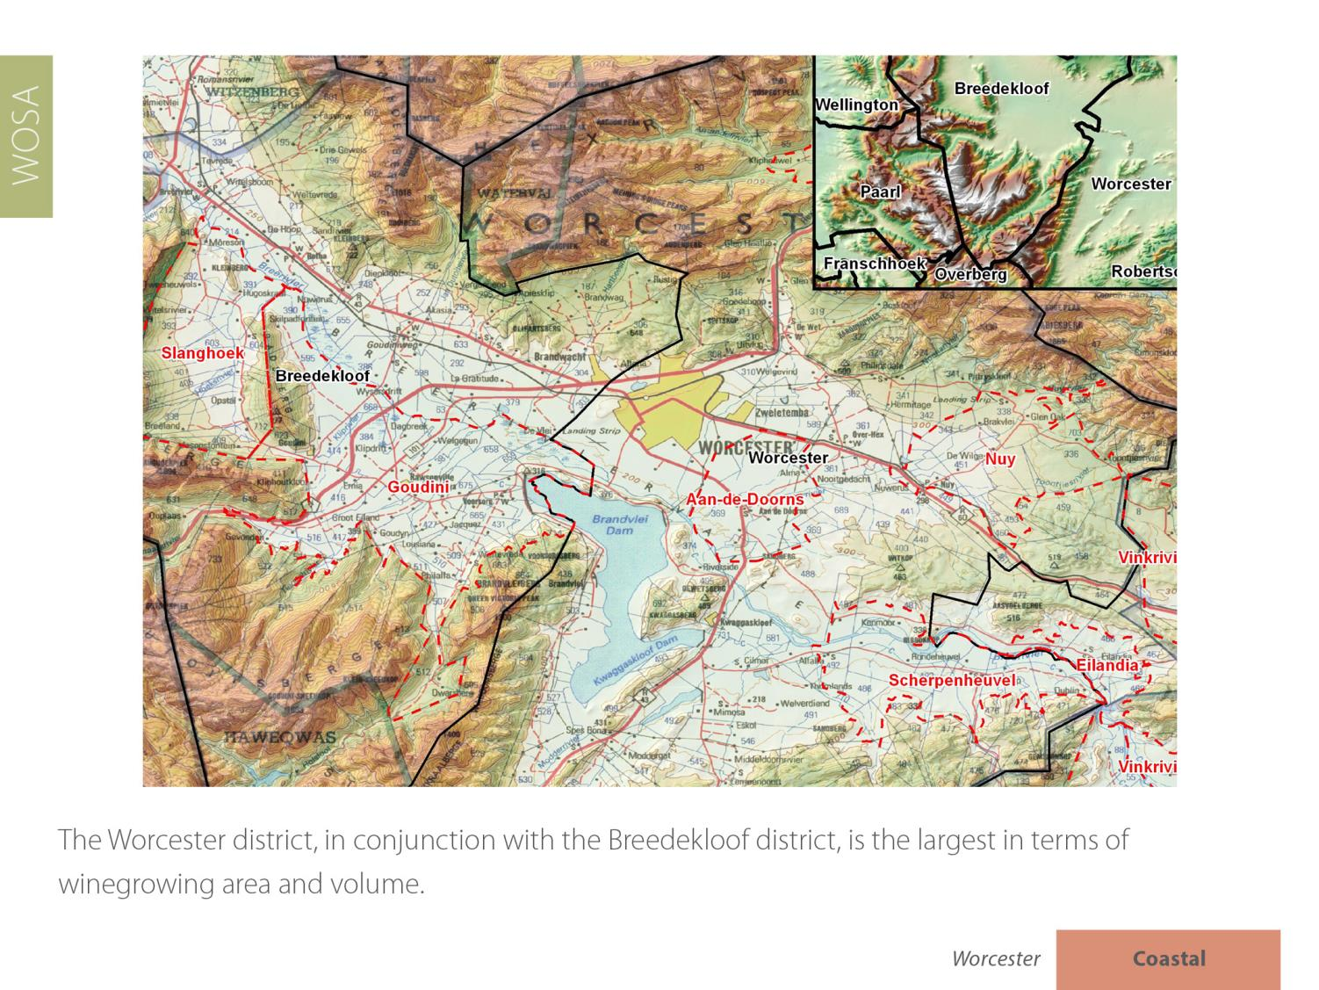

Slide 6
With around 19 109 ha planted, it accounts for nearly 21% of the national vineyards and produces close on 33% of South Africa's total volume of wine and spirits.

Slide 7
The Worcester district is the most important brandy-producing area in the winelands.

Slide 9
There are some 15 wine cellars on the Worcester Wine & Olive Route.

Slide 11
Between Worcester and Robertson in the Breede River Valley the climate is Mediterranean with a mean February temperature of 23.6⁰C for Worcester Weather Station and 22.2⁰C for Nuy Weather Station.

Slide 12
The rainfall is low, with an annual average of 201 mm (Nuy Weather Station).

Slide 16
Shiraz is the dominant red-wine variety, followed by Pinotage and Cabernet Sauvignon.

Slide 19
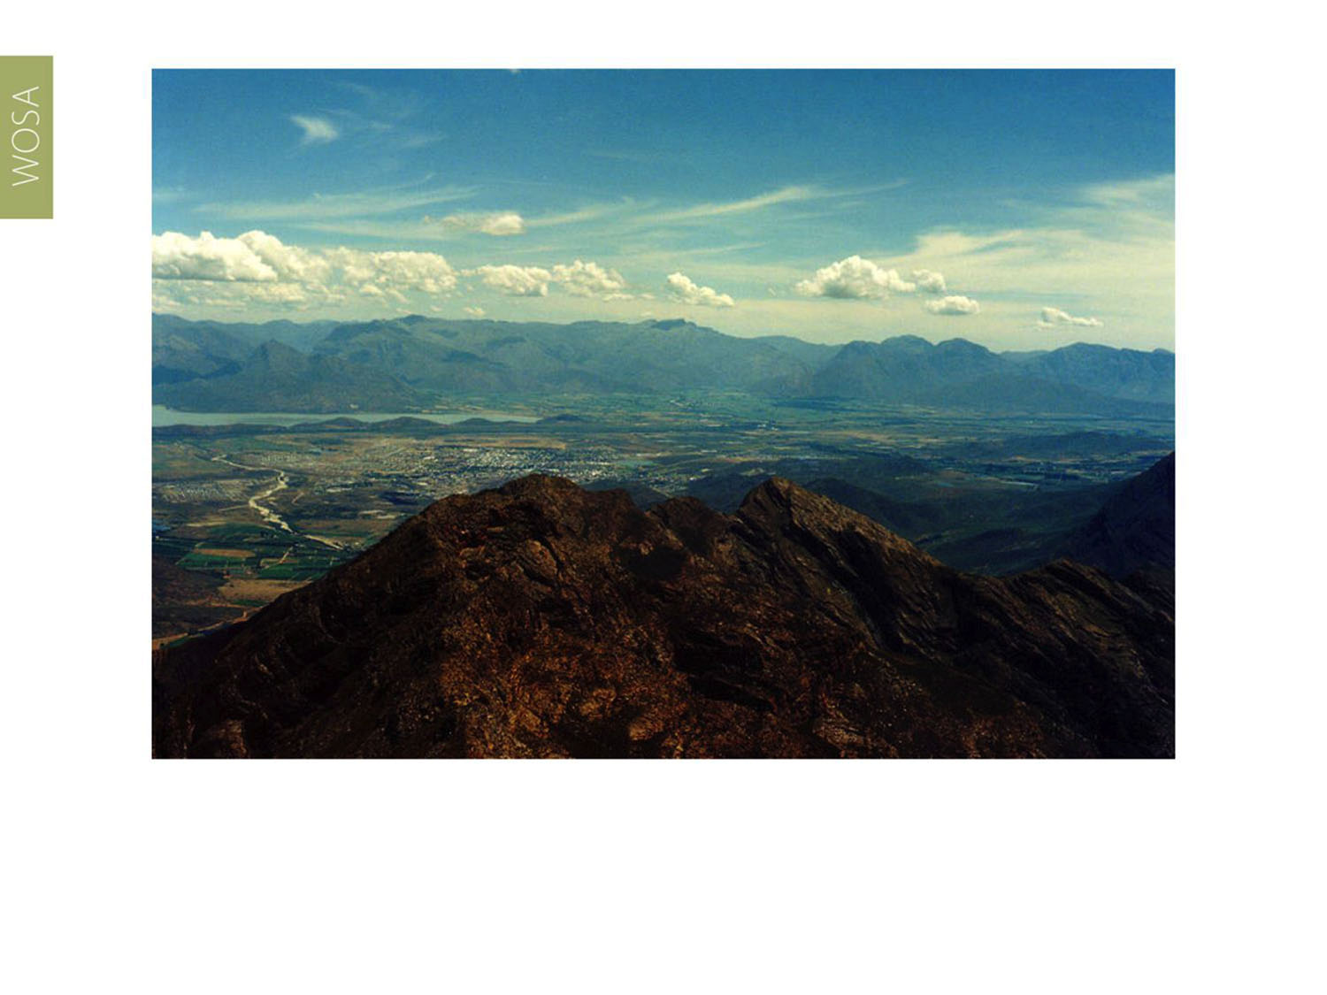
The images used in these presentations have been sourced from various producers, as well as industry and tourism bodies. These presentations are strictly for non-commercial, non-profit, educational purposes only and cannot be reproduced or transmitted in any form or by any means without written permission from Wines of South Africa (WOSA).

Slide 20
The Cape winelands, considered by many to be
the most beautiful in the world, has a network of
diverse and well-run wine routes, affording visitors
a varied and unforgettable experience.

Slide 21
THE END

