Slide 1

CAPE WINELANDS
CONSTANTIA

Slide 2
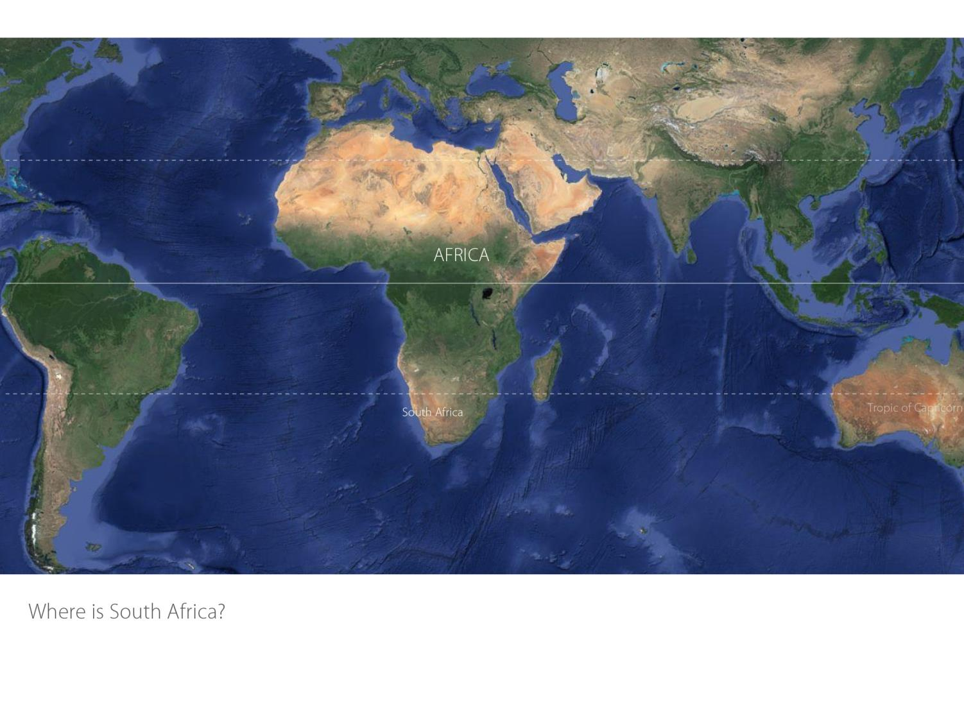

Slide 3
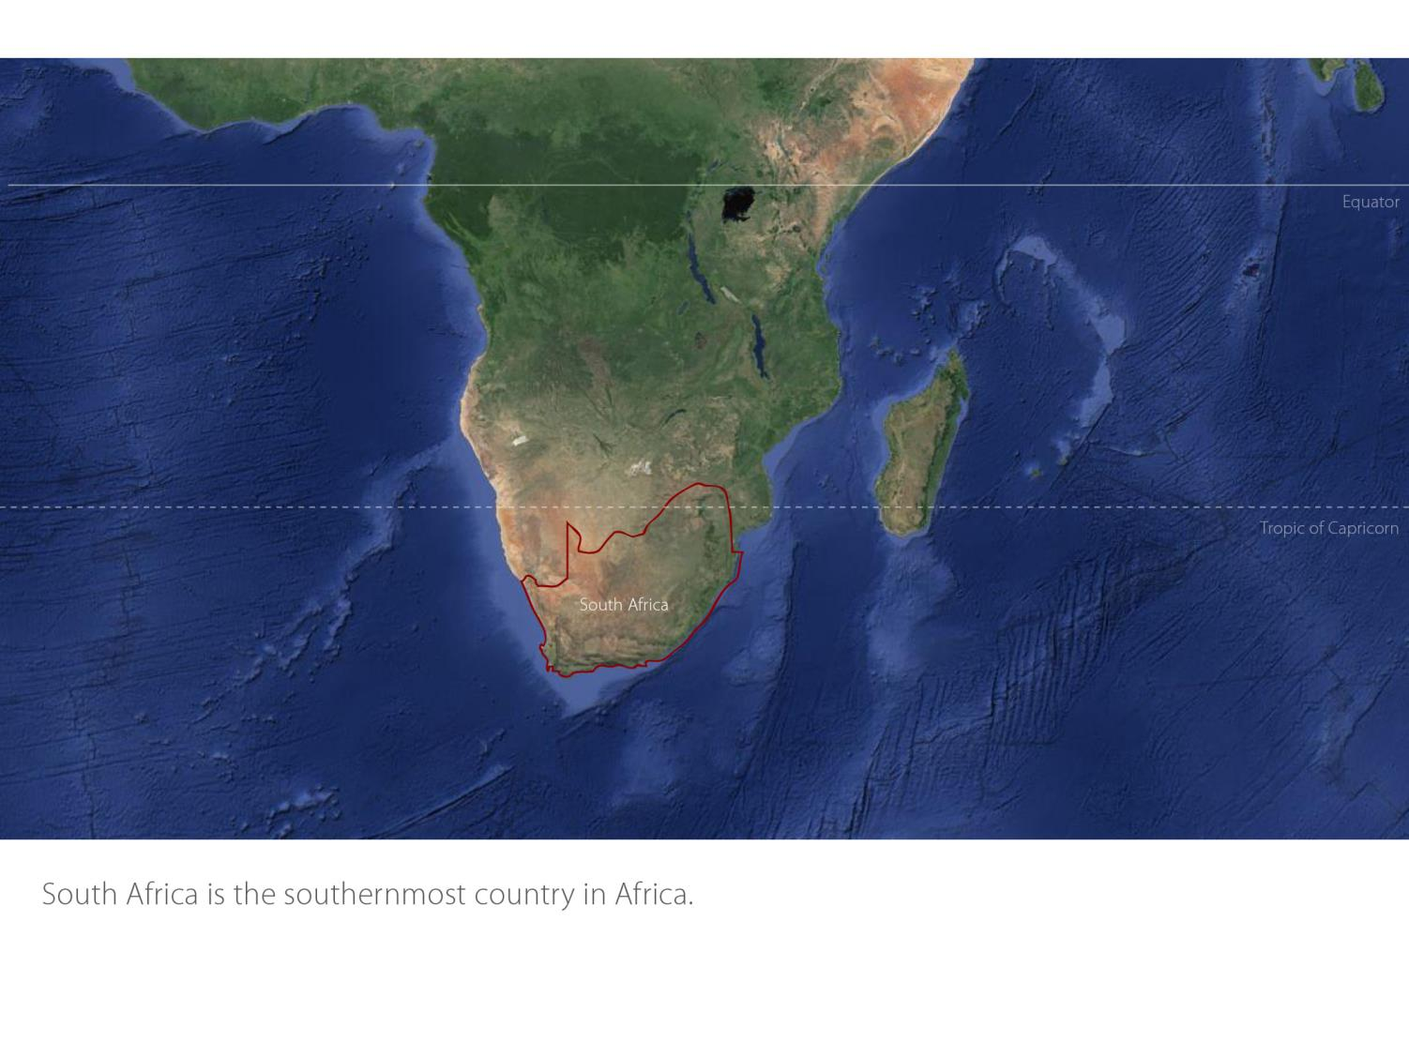

Slide 4
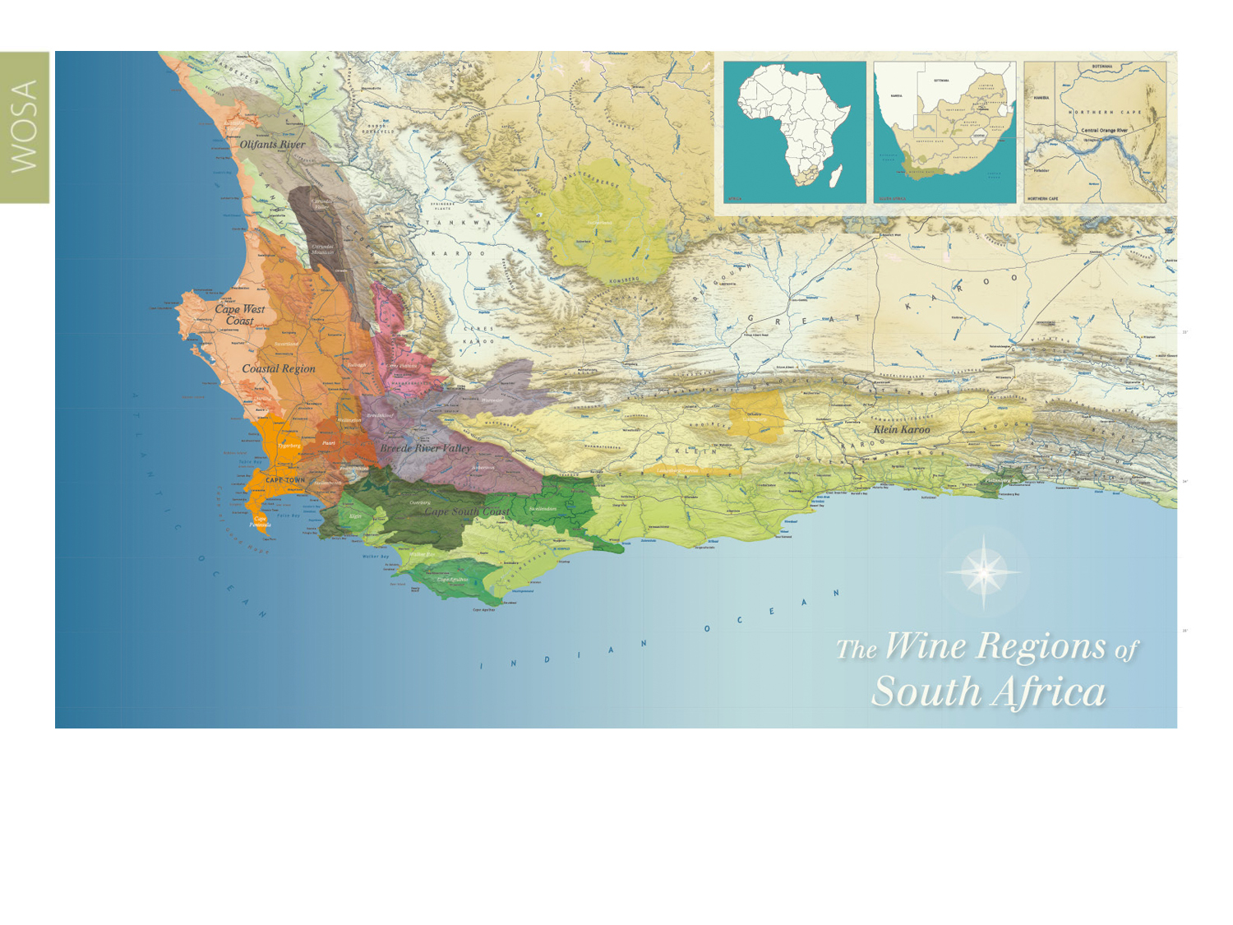
Our winelands are located at the very tip of South Africa.
Constantia
Coastal

Slide 5
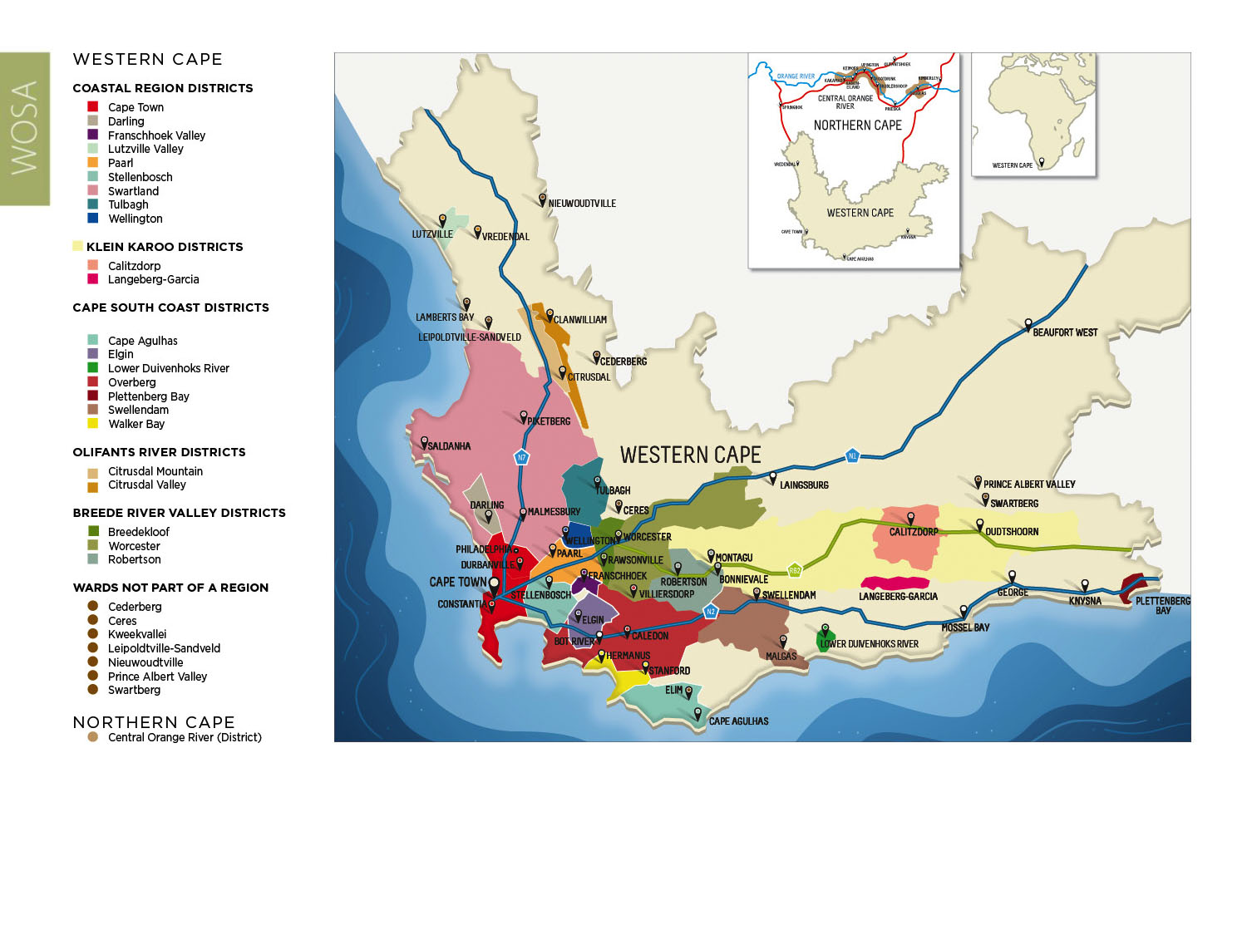
PRODUCTION AREAS: Districts of South Africa.
Constantia
Coastal

Slide 6
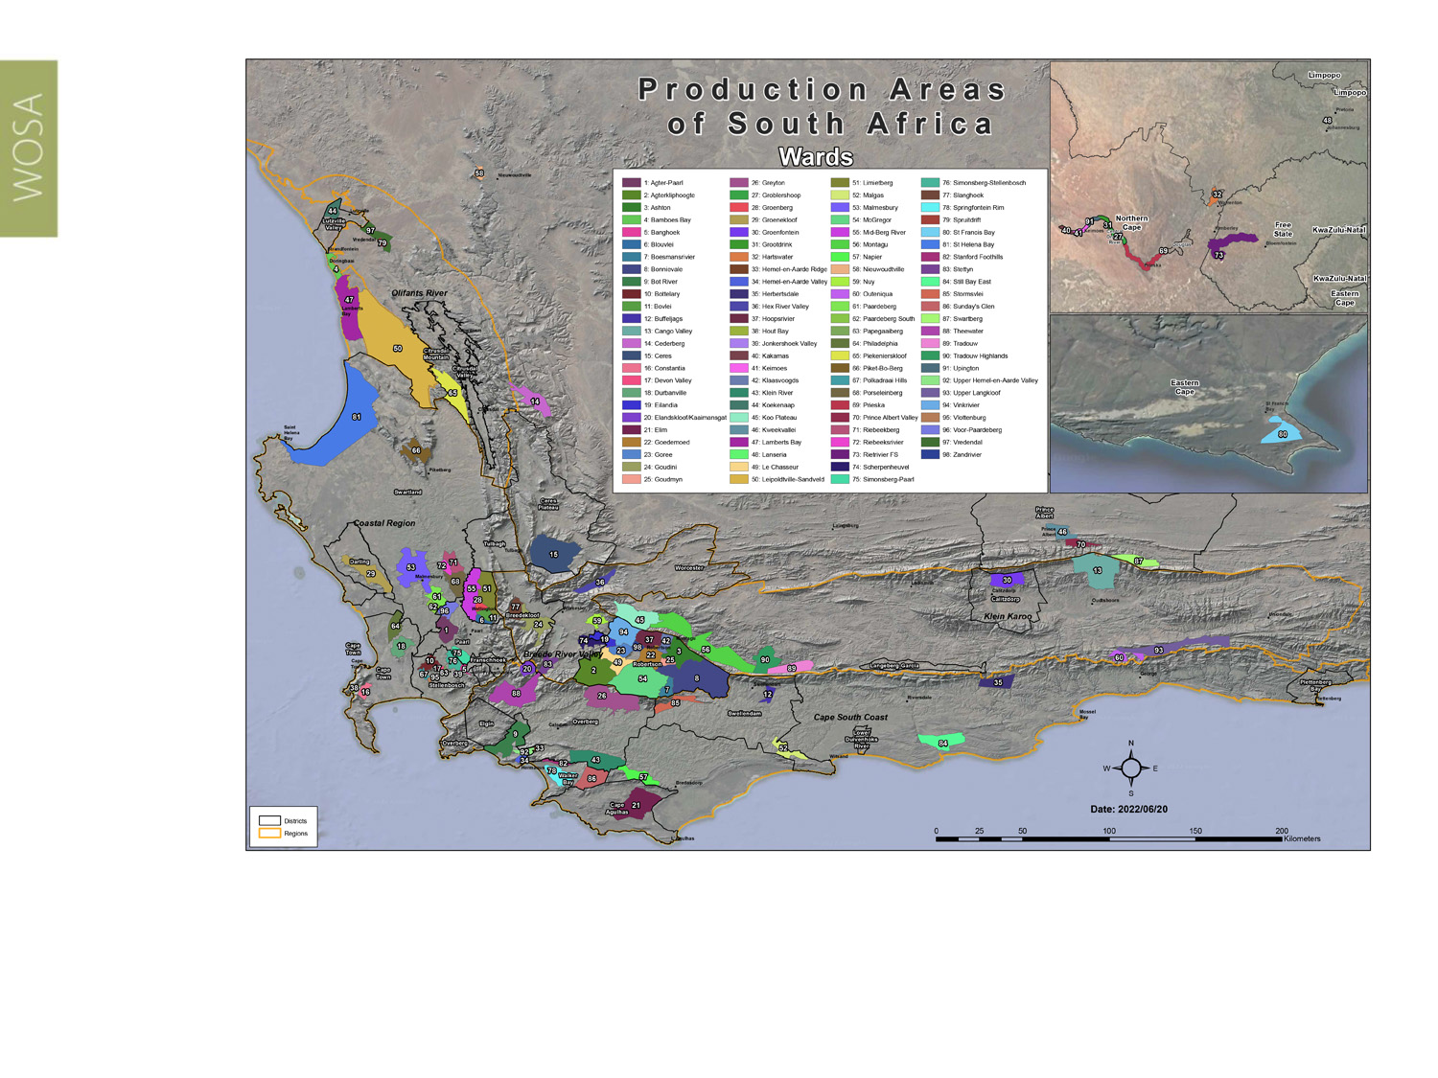
Wards of South Africa.
Constantia
Coastal

Slide 7
Coastal
Region: Coastal
District: Cape Town
Wards: Constantia
Hout Bay
Constantia
Coastal

Slide 8
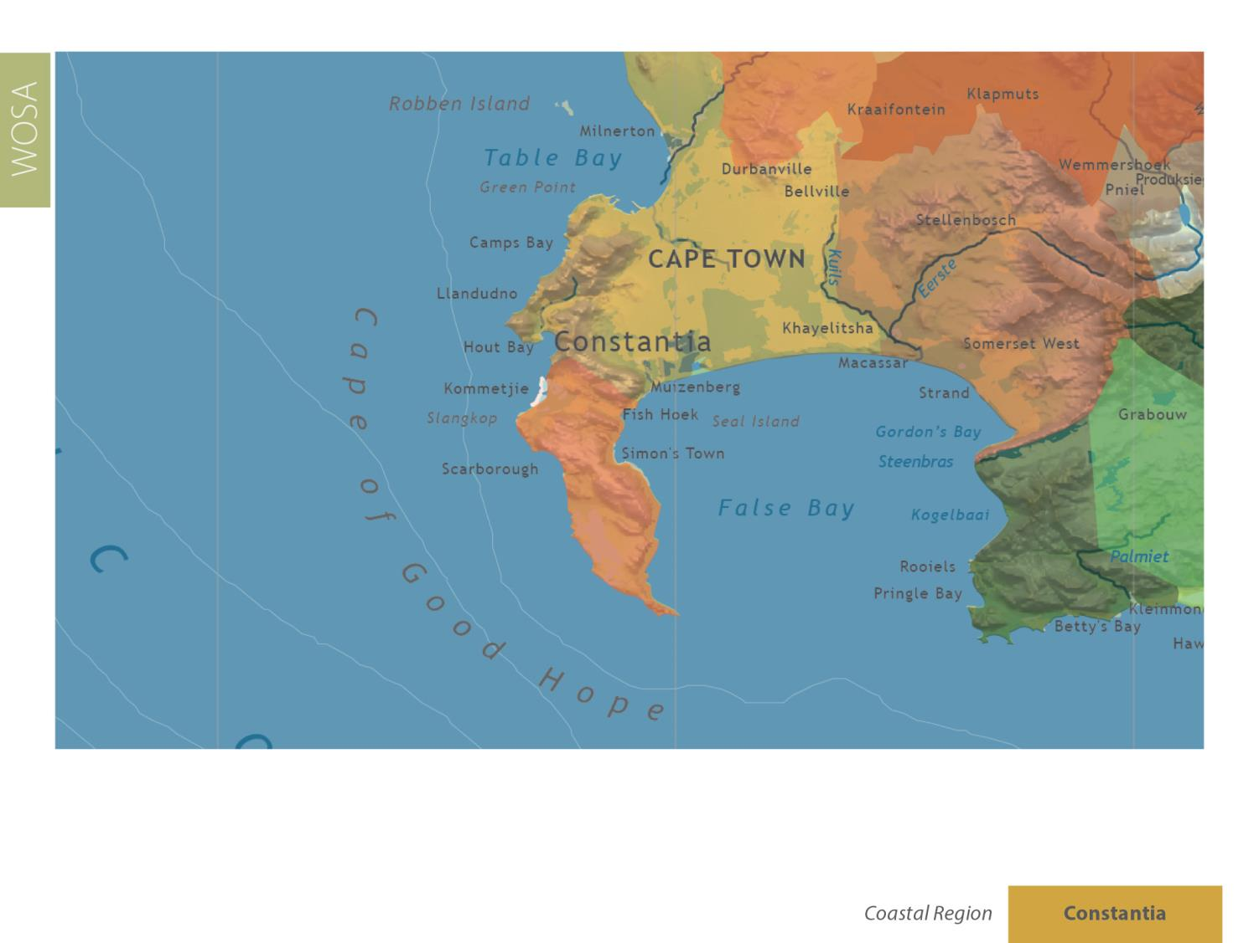
Constantia
Coastal

Slide 9
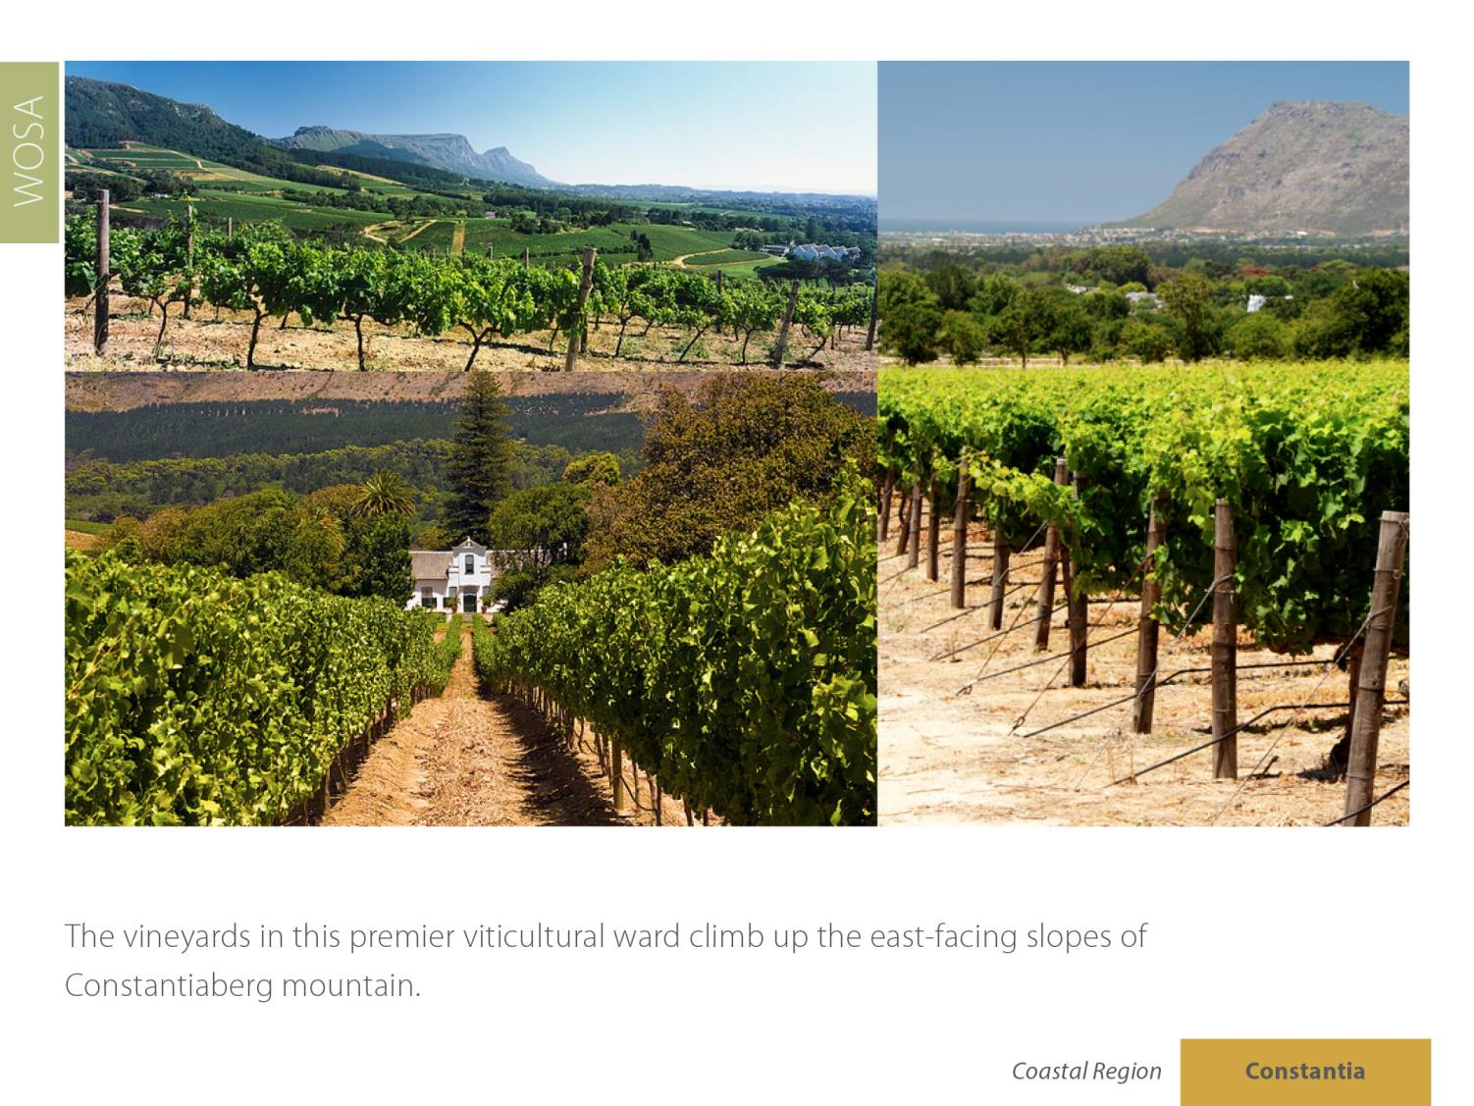
Constantia
Coastal

Slide 10
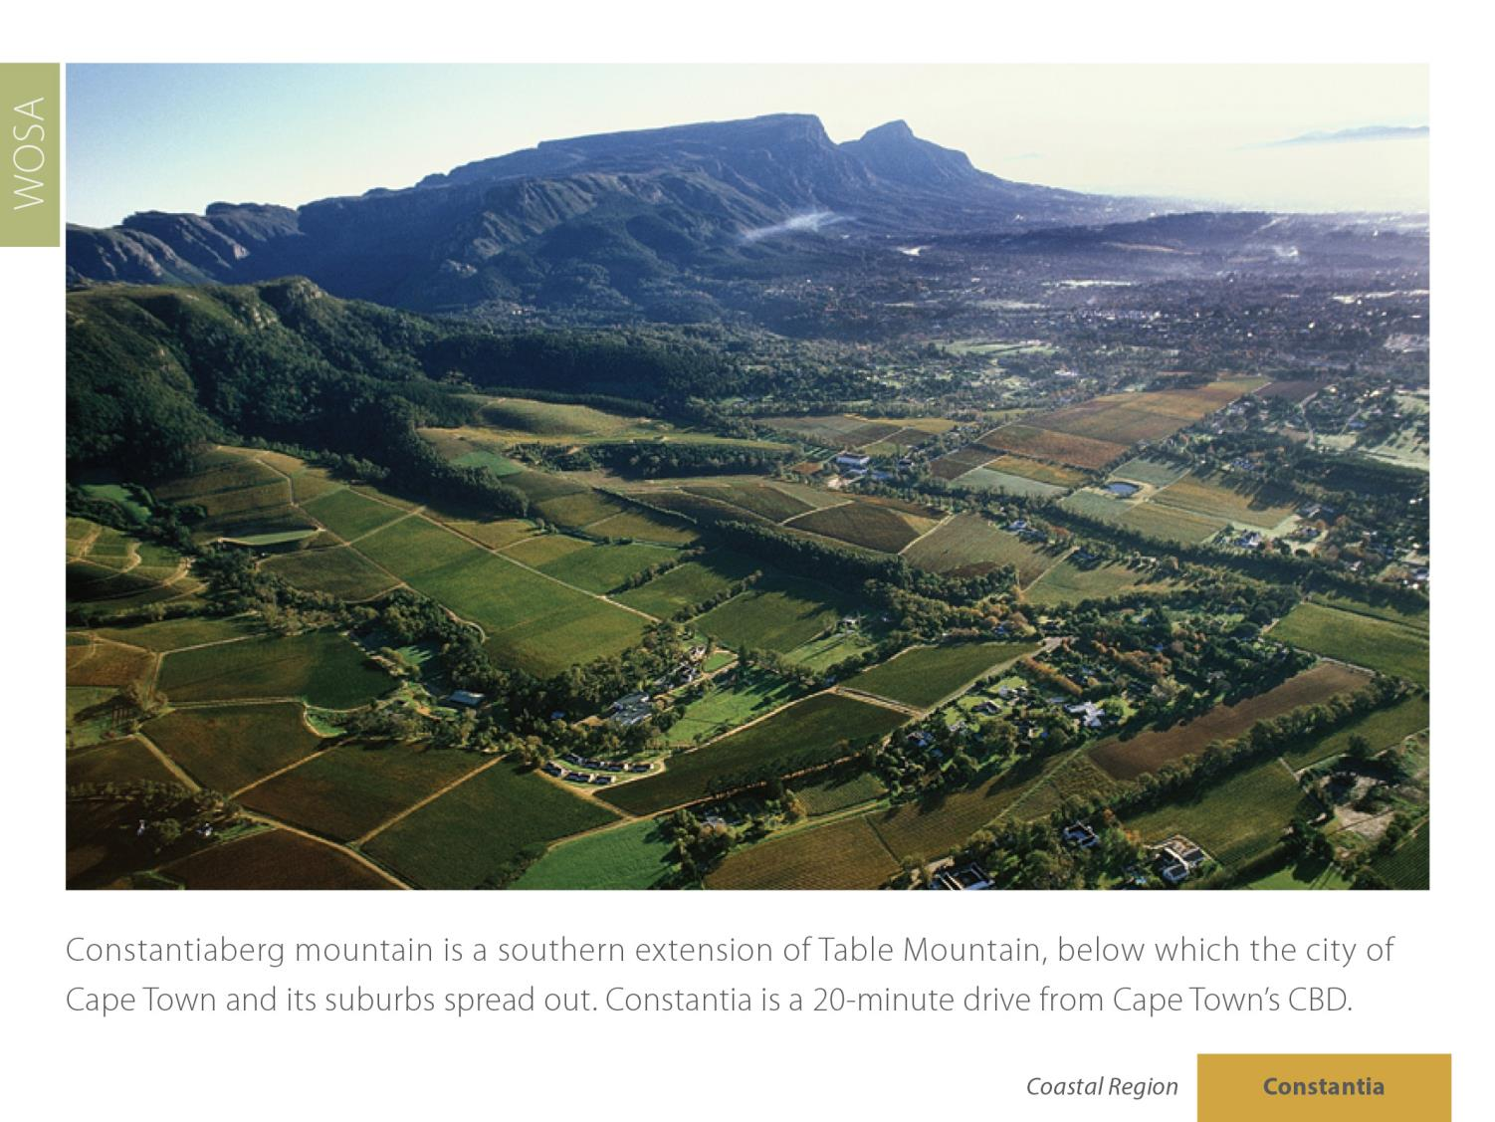
Constantia
Coastal

Slide 11
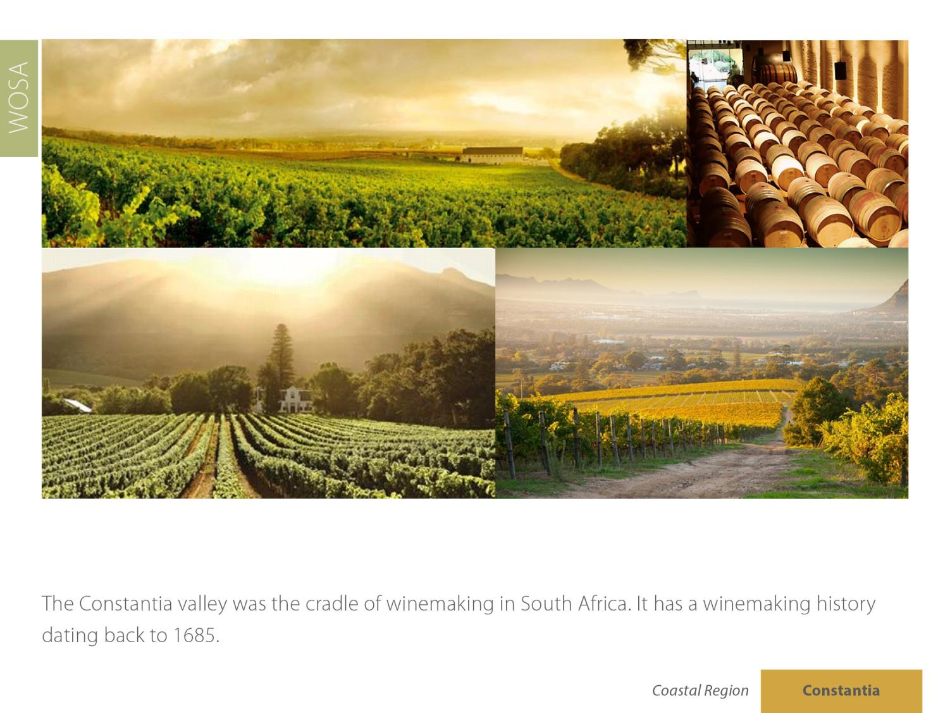
Constantia
Coastal

Slide 12
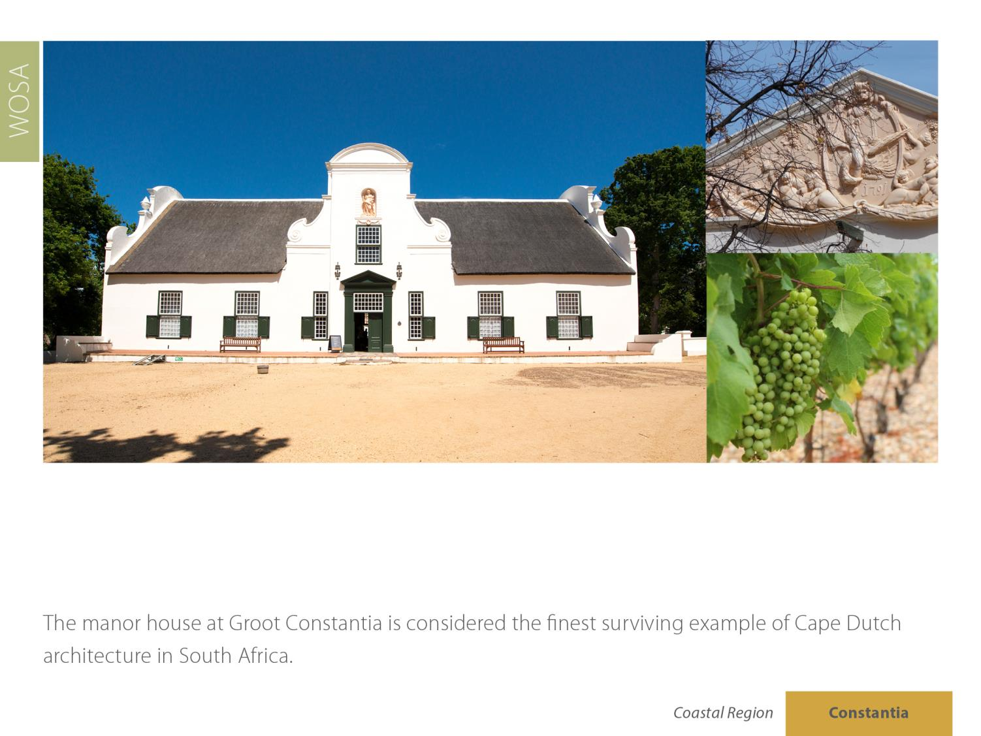
Constantia
Coastal

Slide 13
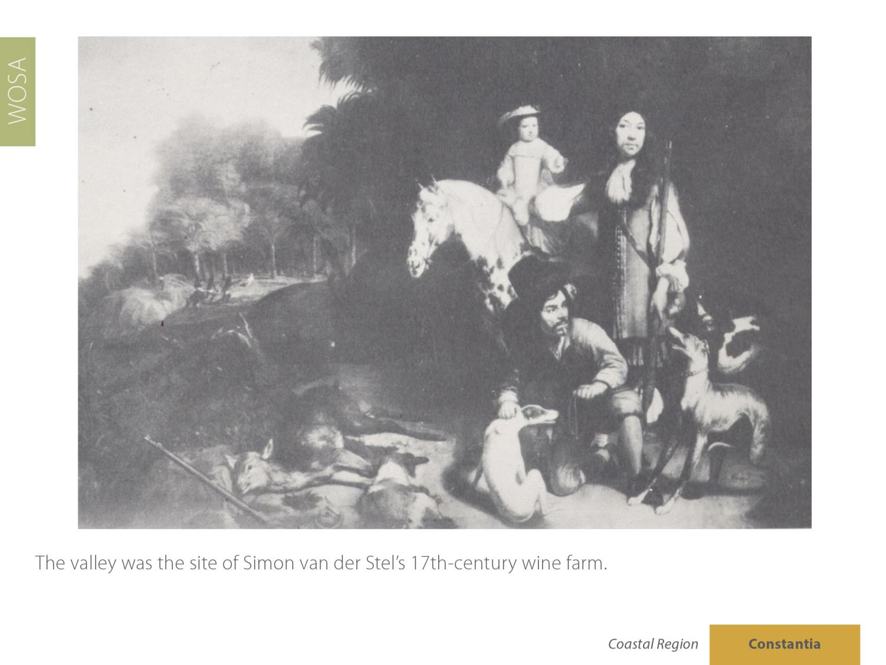
Constantia
Coastal

Slide 14
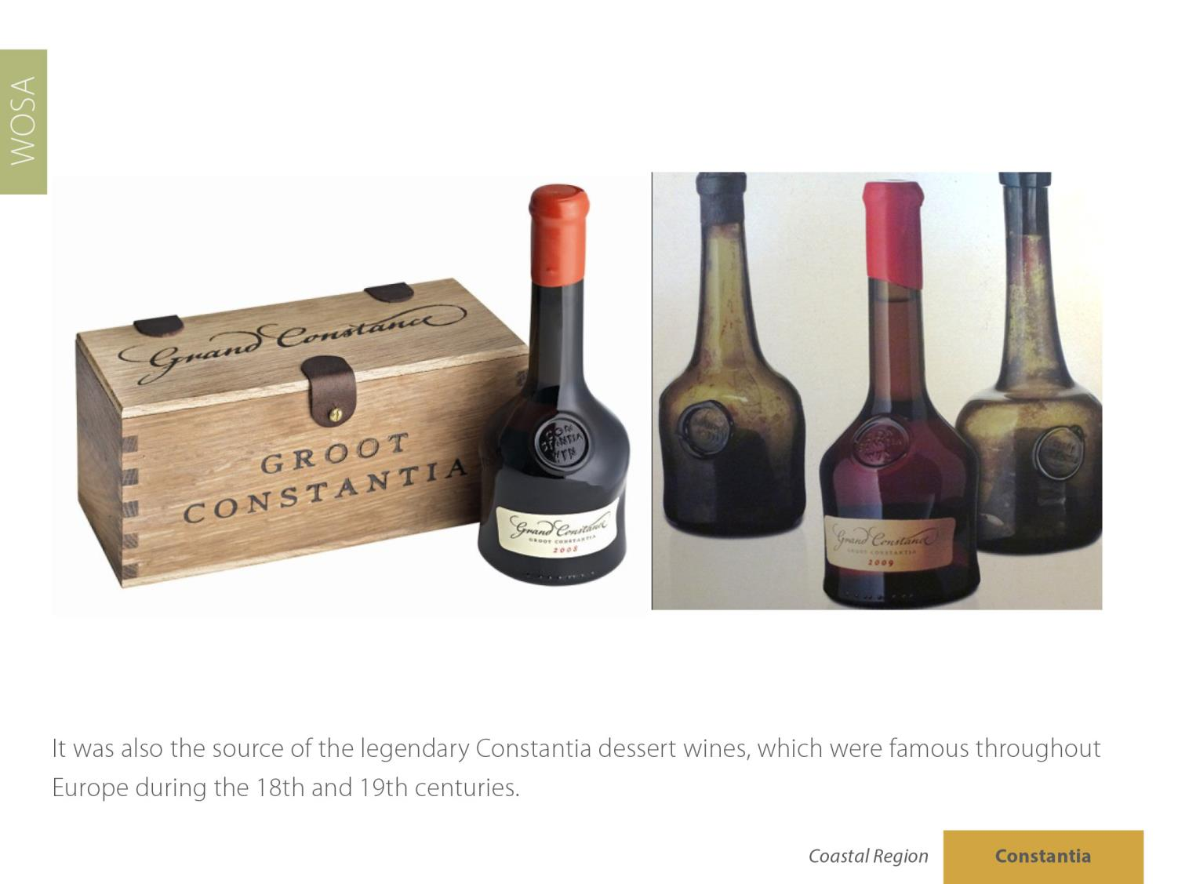
Constantia
Coastal

Slide 15
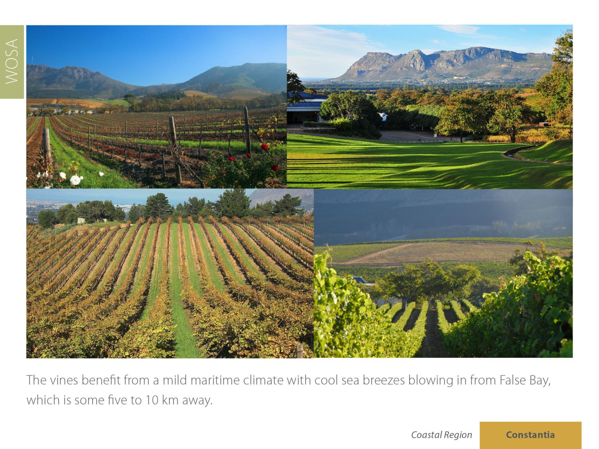
Constantia
Coastal

Slide 16
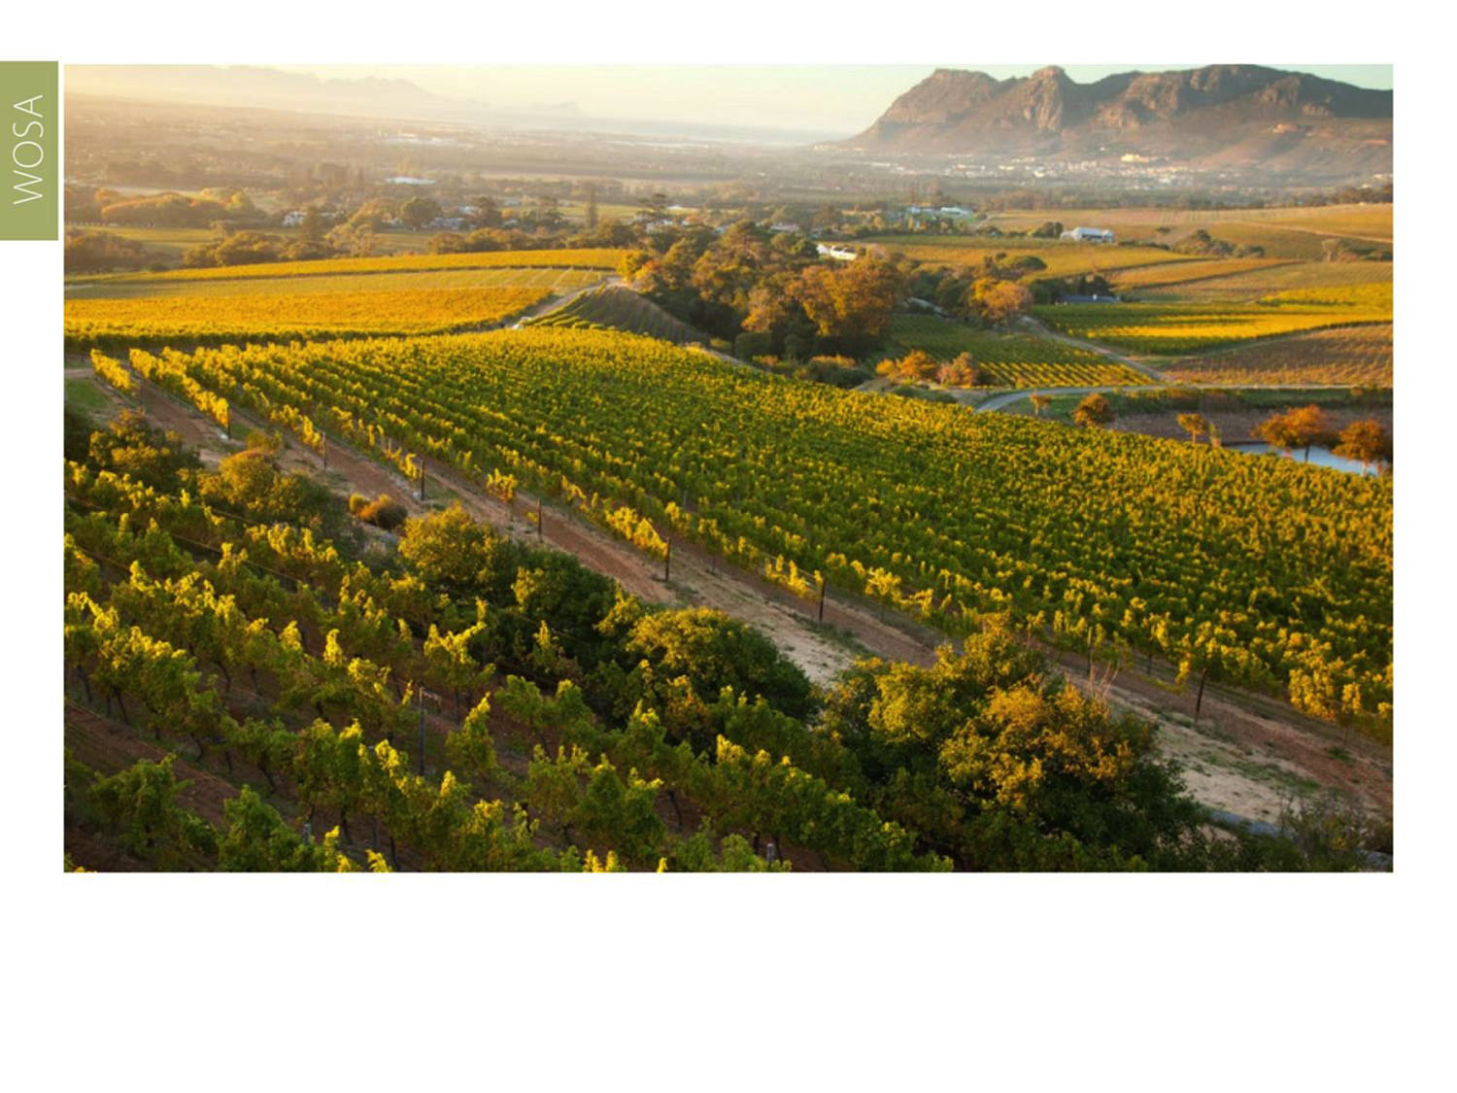
The ward receives an average of 1 000 mm of rain annually, making irrigation unnecessary.
Constantia
Coastal

Slide 17
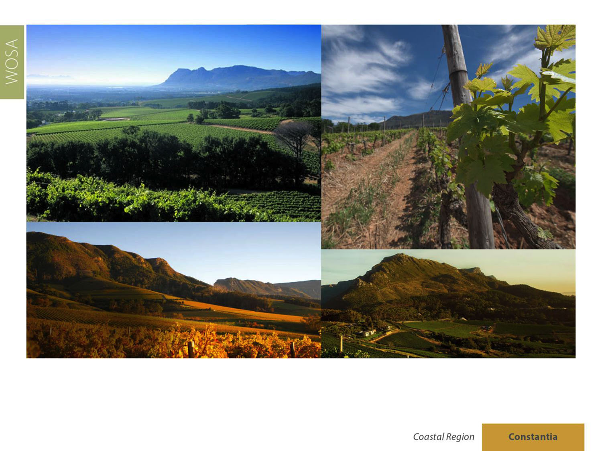
Constantia ward has a mean February temperature of 20.6˚C (Groot Constantia Weather Station).
Constantia
Coastal

Slide 18
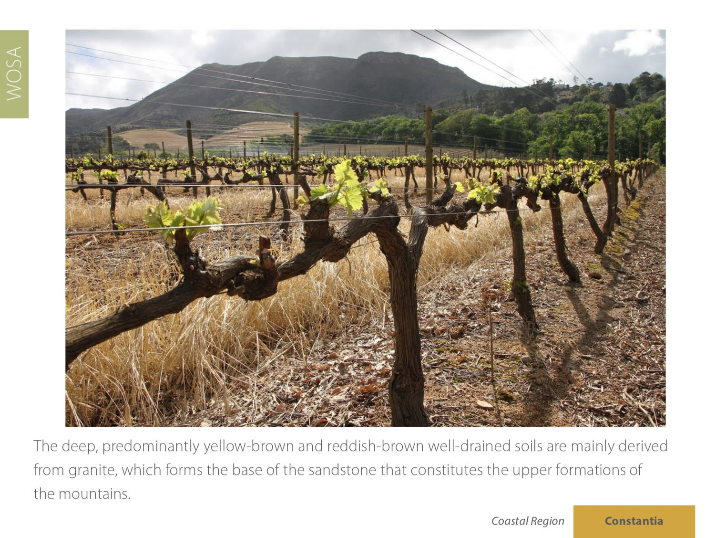
Constantia
Coastal

Slide 19
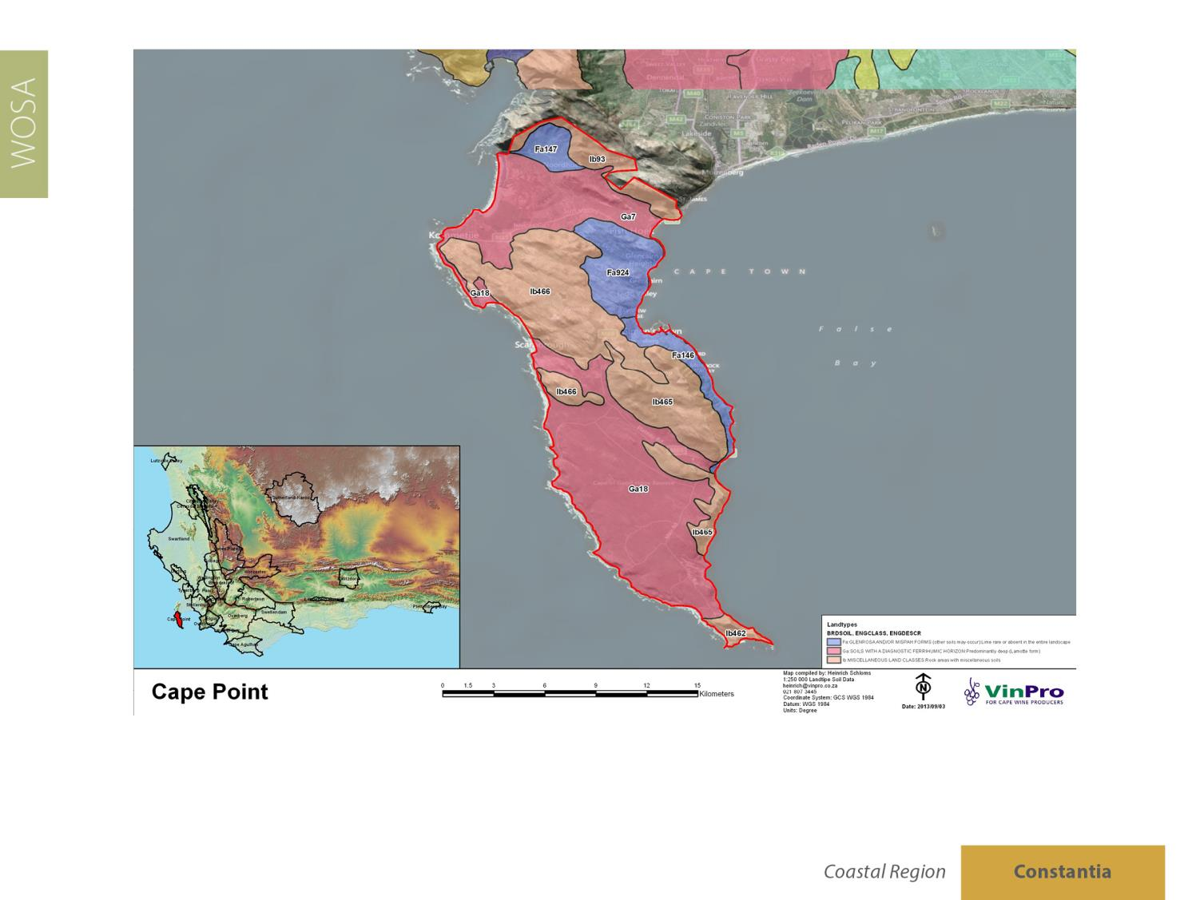
Constantia
Coastal

Slide 20
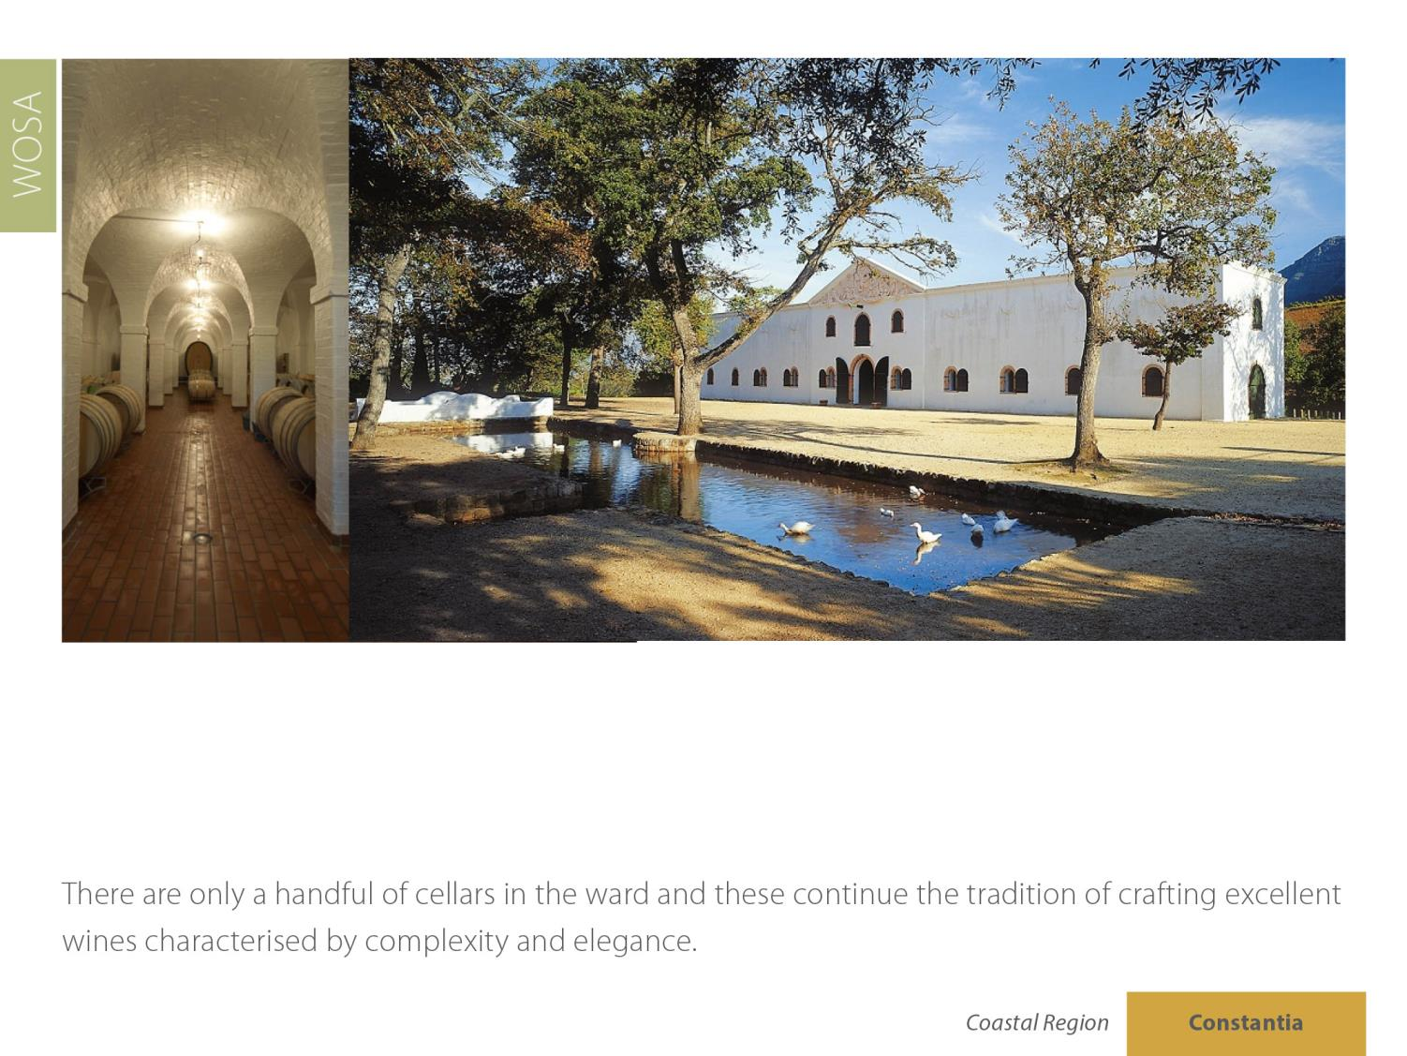
Constantia
Coastal

Slide 21
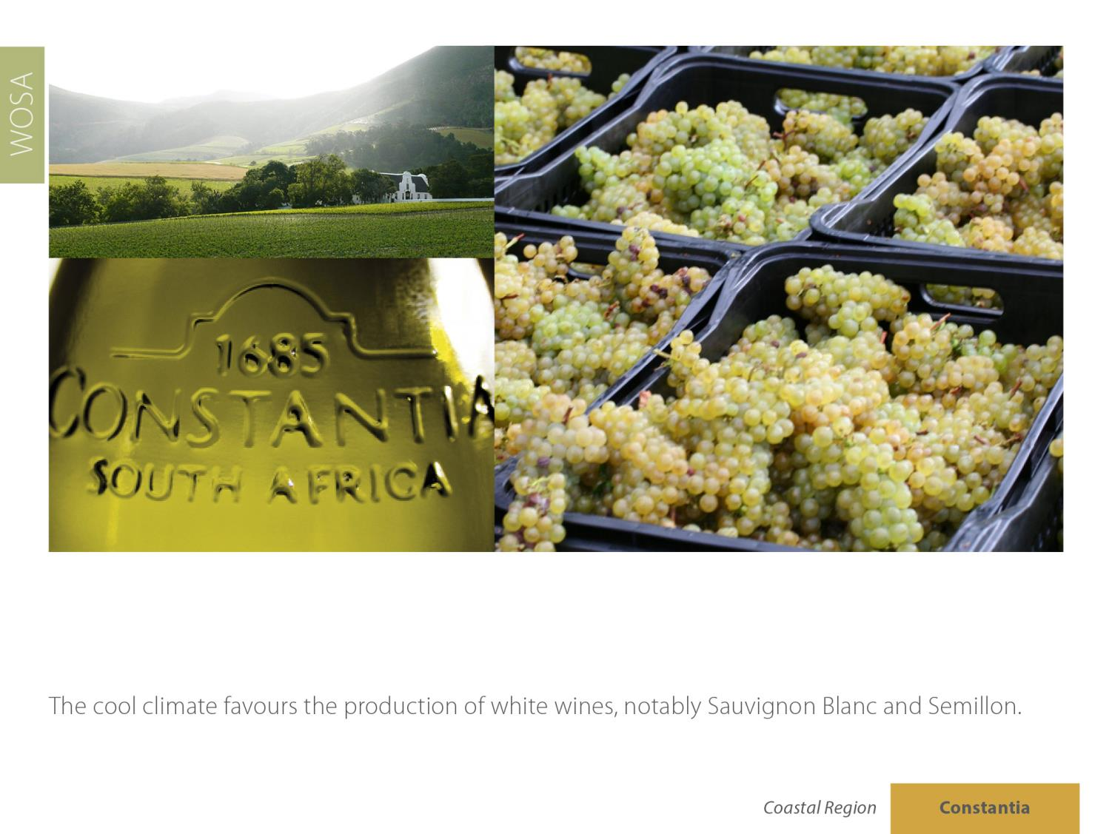
Constantia
Coastal

Slide 22
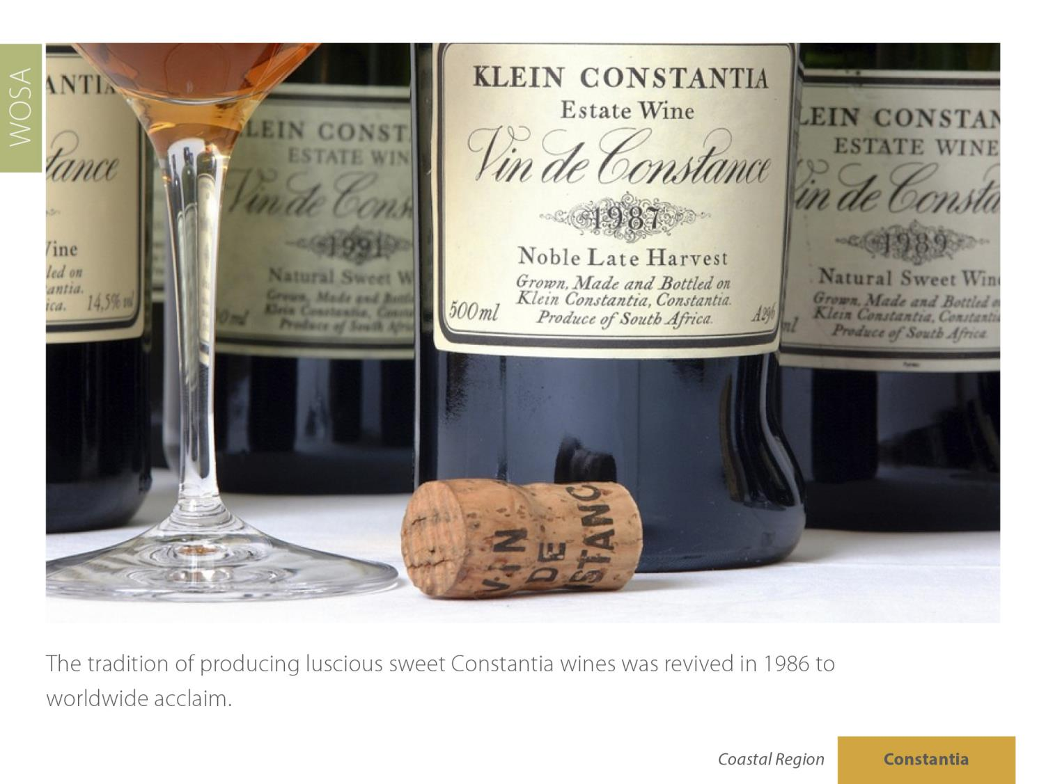
Constantia
Coastal

Slide 23
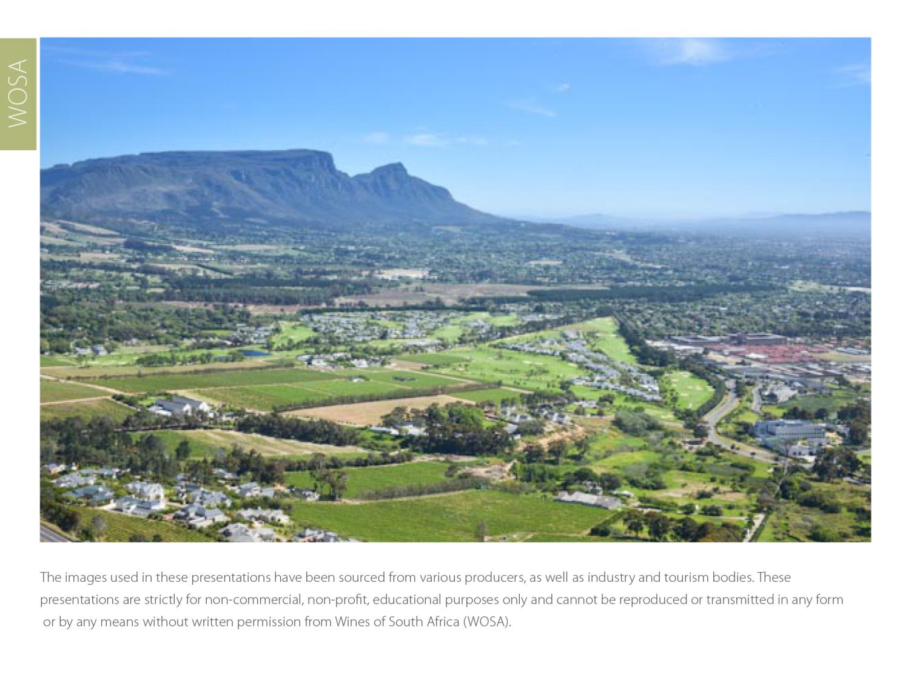
The images used in these presentations have been sourced from various producers, as well as industry and tourism bodies. These presentations are strictly for non-commercial, non-profit, educational purposes only and cannot be reproduced or transmitted in any form or by any means without written permission from Wines of South Africa (WoSA).

Slide 24
The Cape winelands, considered by many to be
the most beautiful in the world, have a network of
diverse and well-run wine routes, affording visitors
a varied and unforgettable experience.

Slide 25
THE END

