Slide 1

CAPE WINELANDS
ELIM

Slide 2
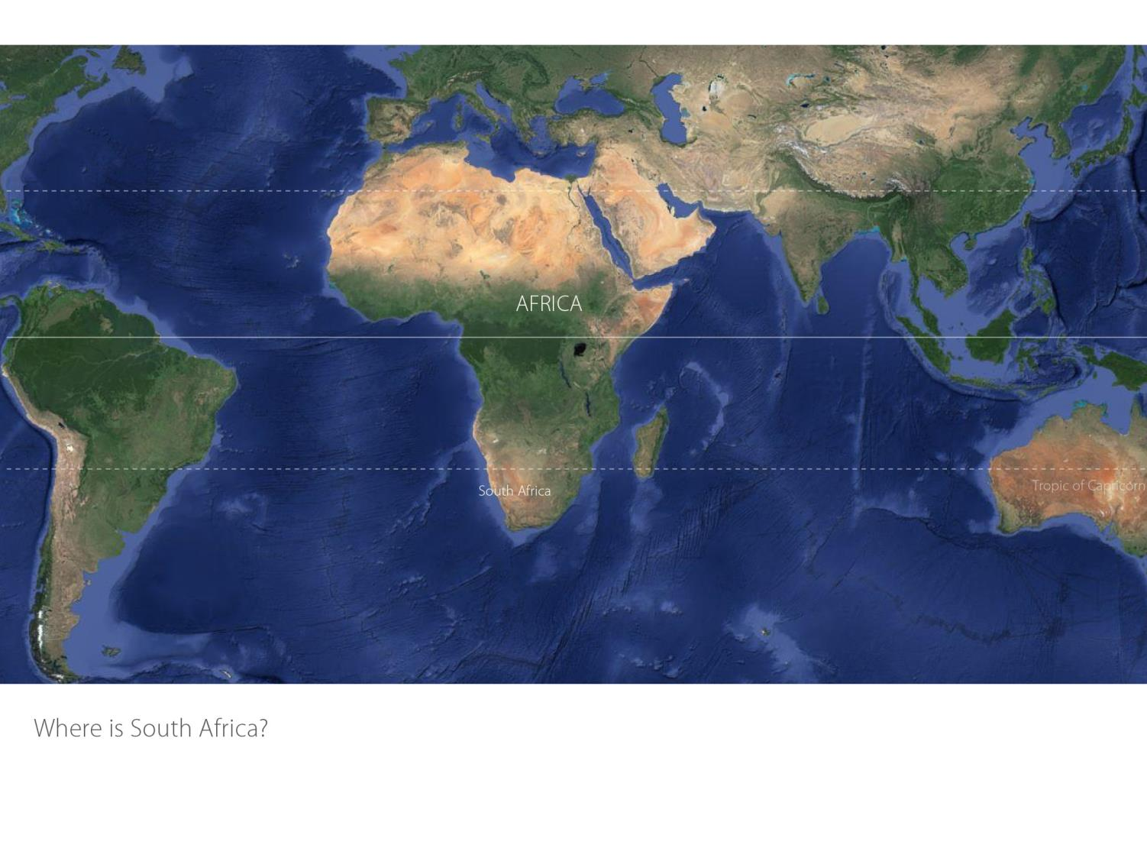

Slide 3
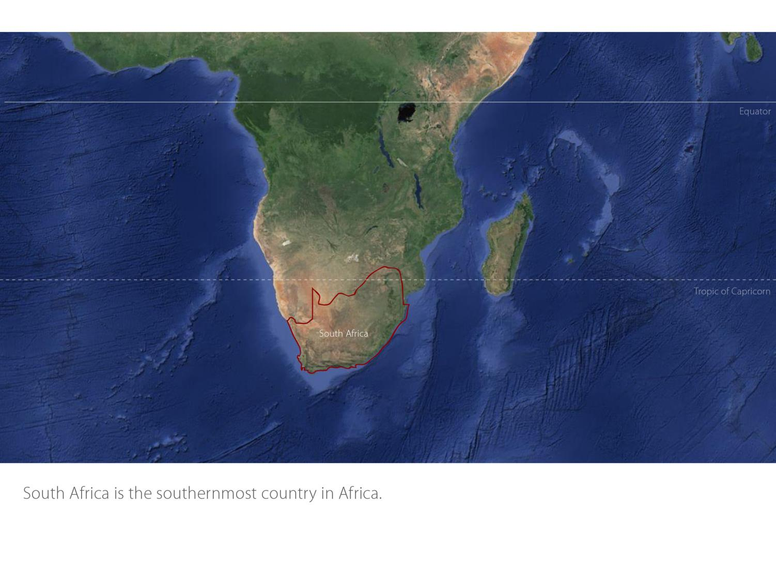

Slide 4
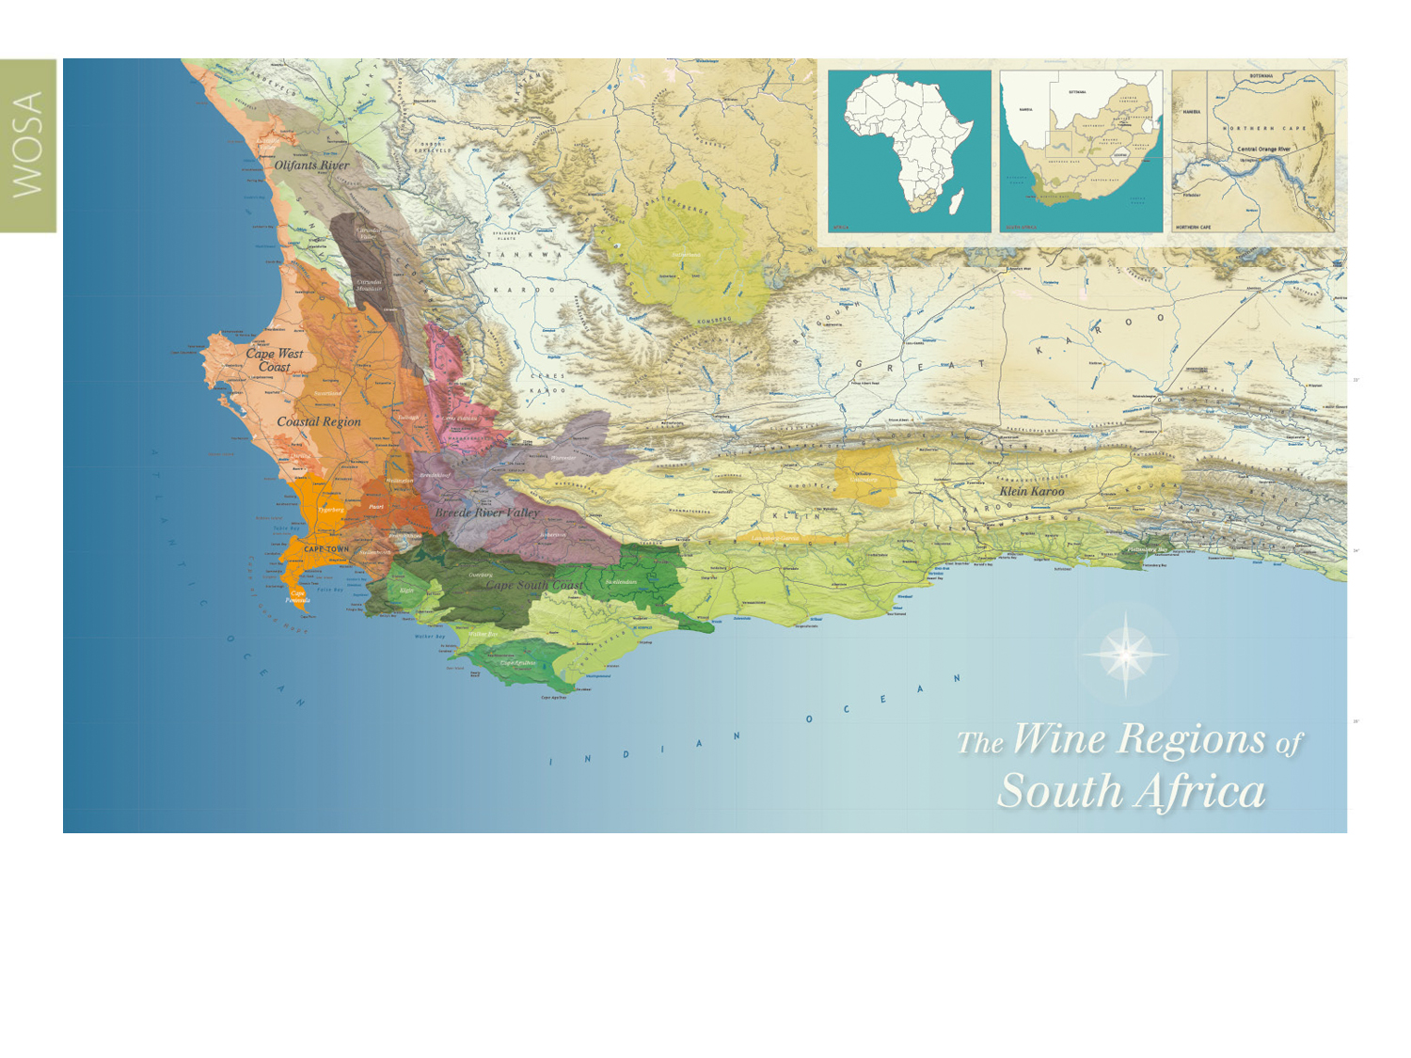
Our winelands are located at the very tip of South Africa.
Elim
Cape South Coast

Slide 5
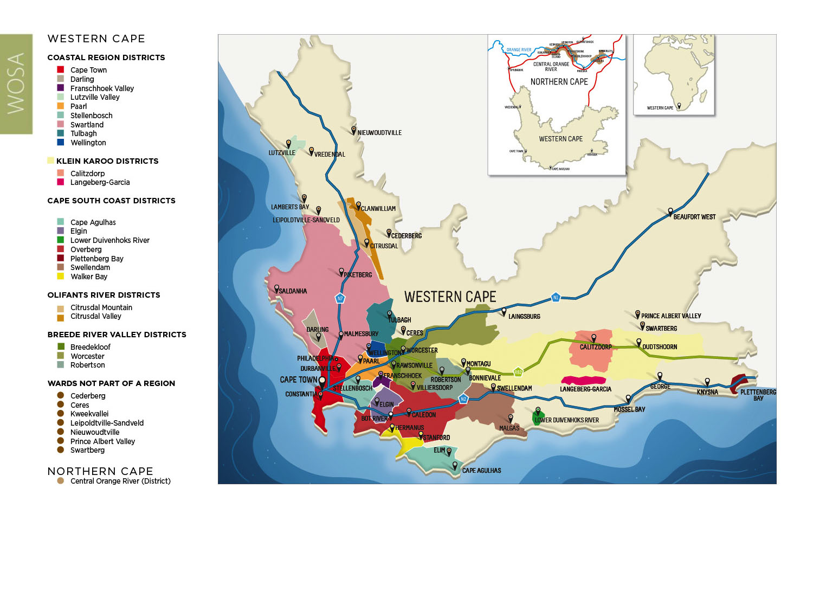
PRODUCTION AREAS: Districts of South Africa.
Elim
Cape South Coast

Slide 6
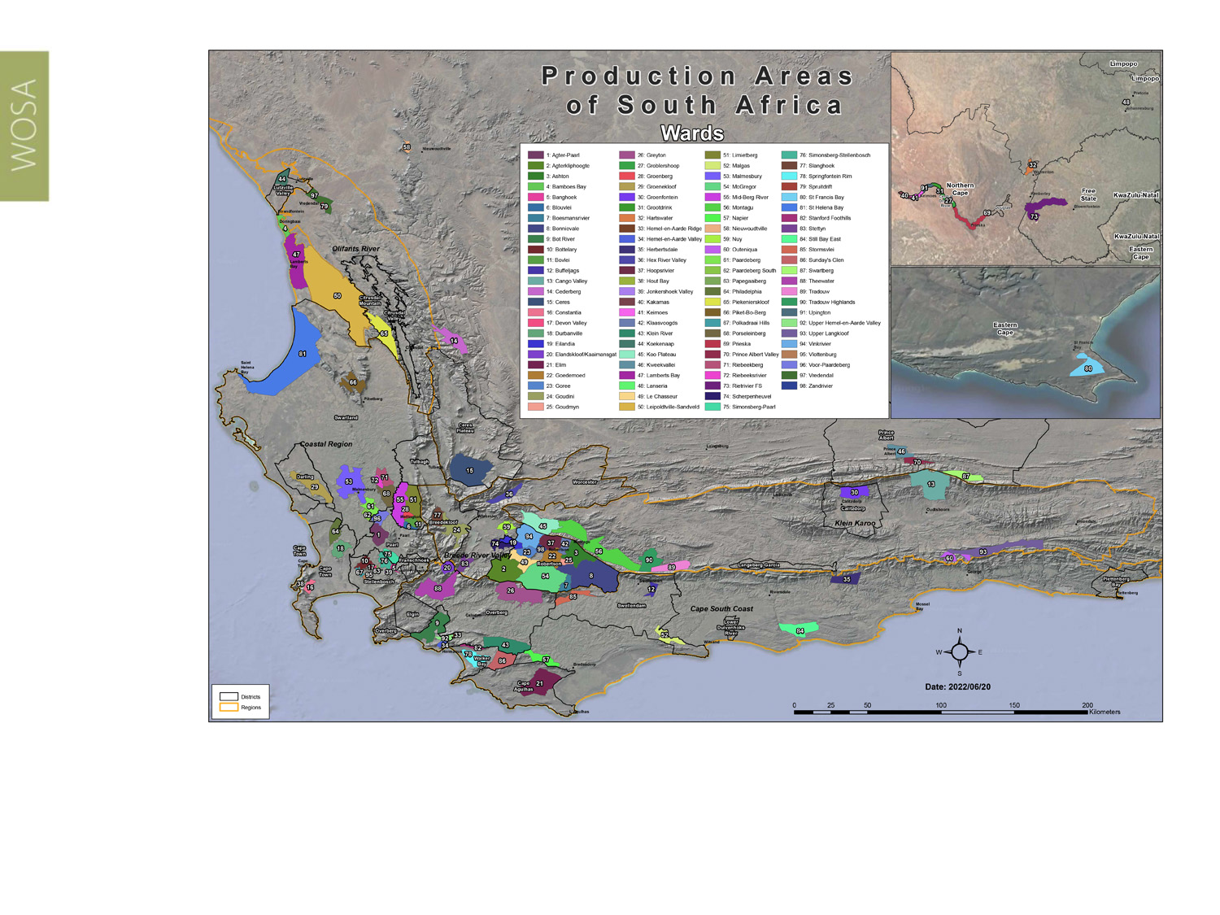
Wards of South Africa.
Elim
Cape South Coast

Slide 7
Cape South Coast
Region: Cape South Coast
District: Cape Agulhas
Ward: Elim
Elim
Cape South Coast

Slide 8
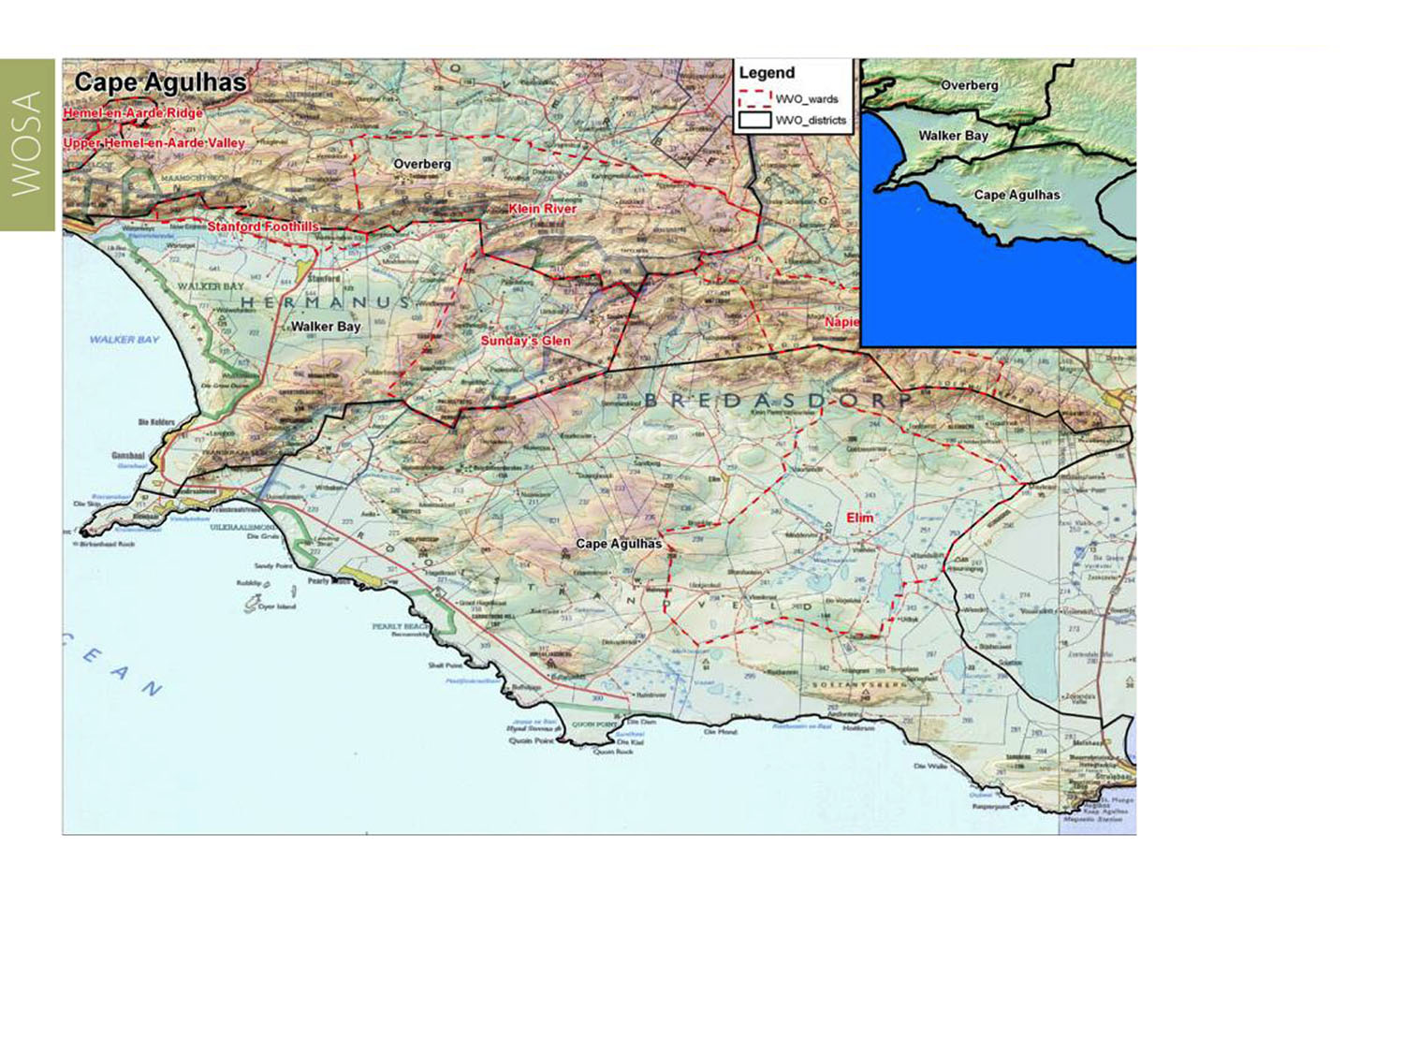
Elim
Cape South Coast

Slide 9
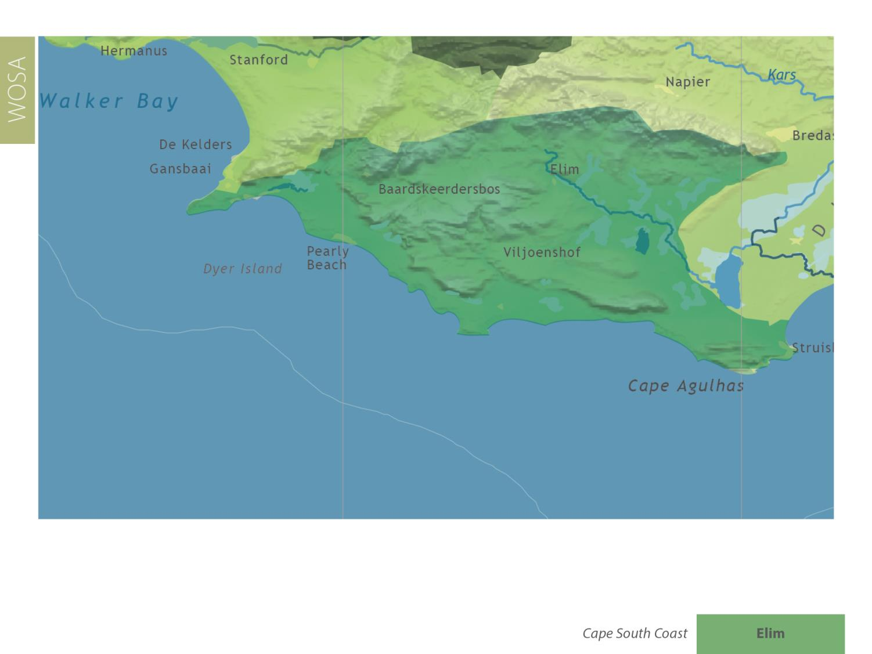
Elim
Cape South Coast

Slide 10
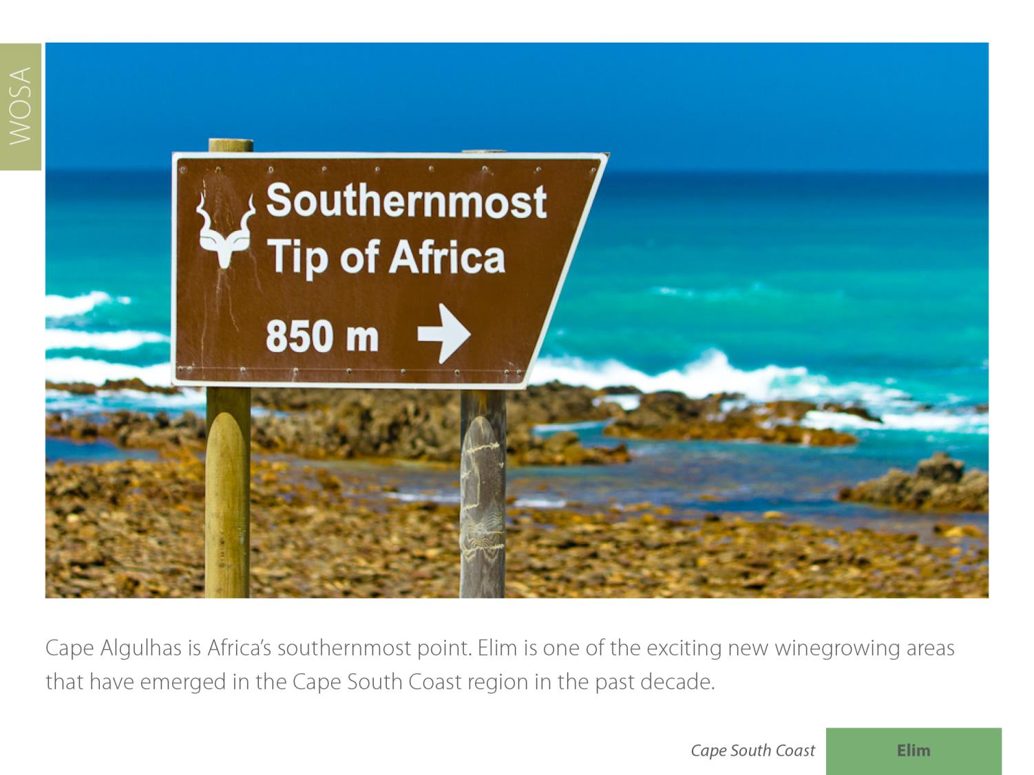
Cape Agulhas is Africa’s southernmost point. Elim is one of the exciting new winegrowing areas that have emerged in the Cape South Coast region since the turn of the century.
Elim
Cape South Coast

Slide 11
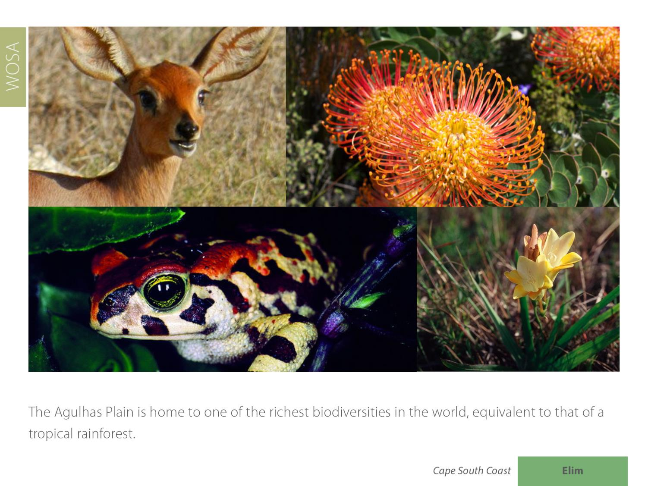
Elim
Cape South Coast

Slide 12
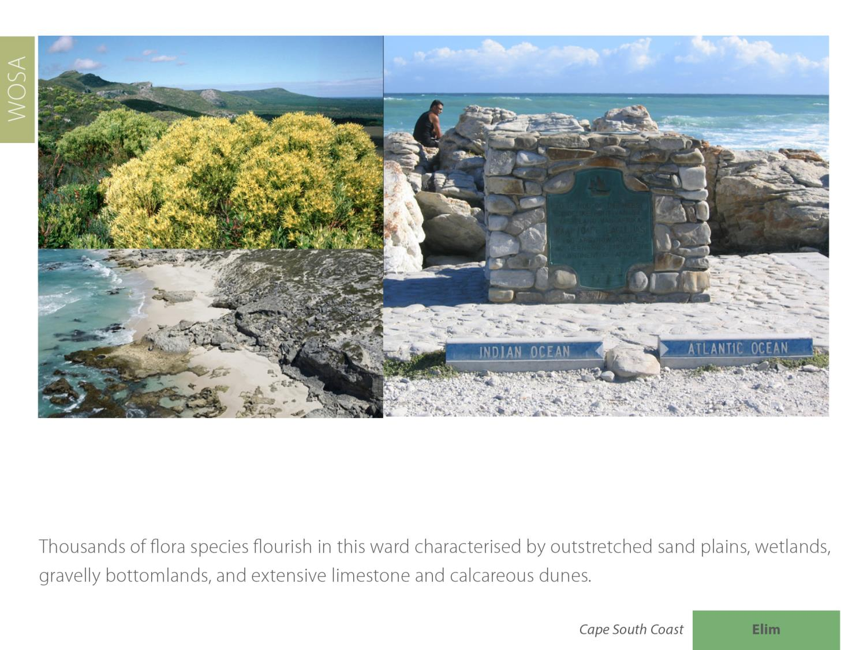
Elim
Cape South Coast

Slide 13
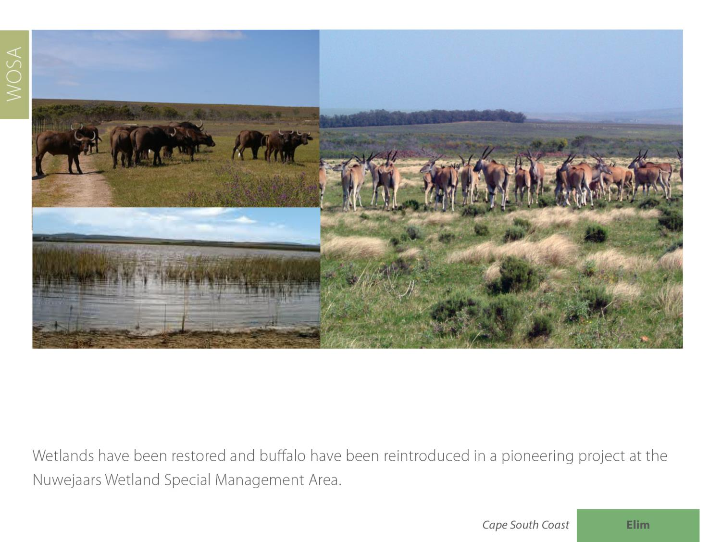
Elim
Cape South Coast

Slide 14
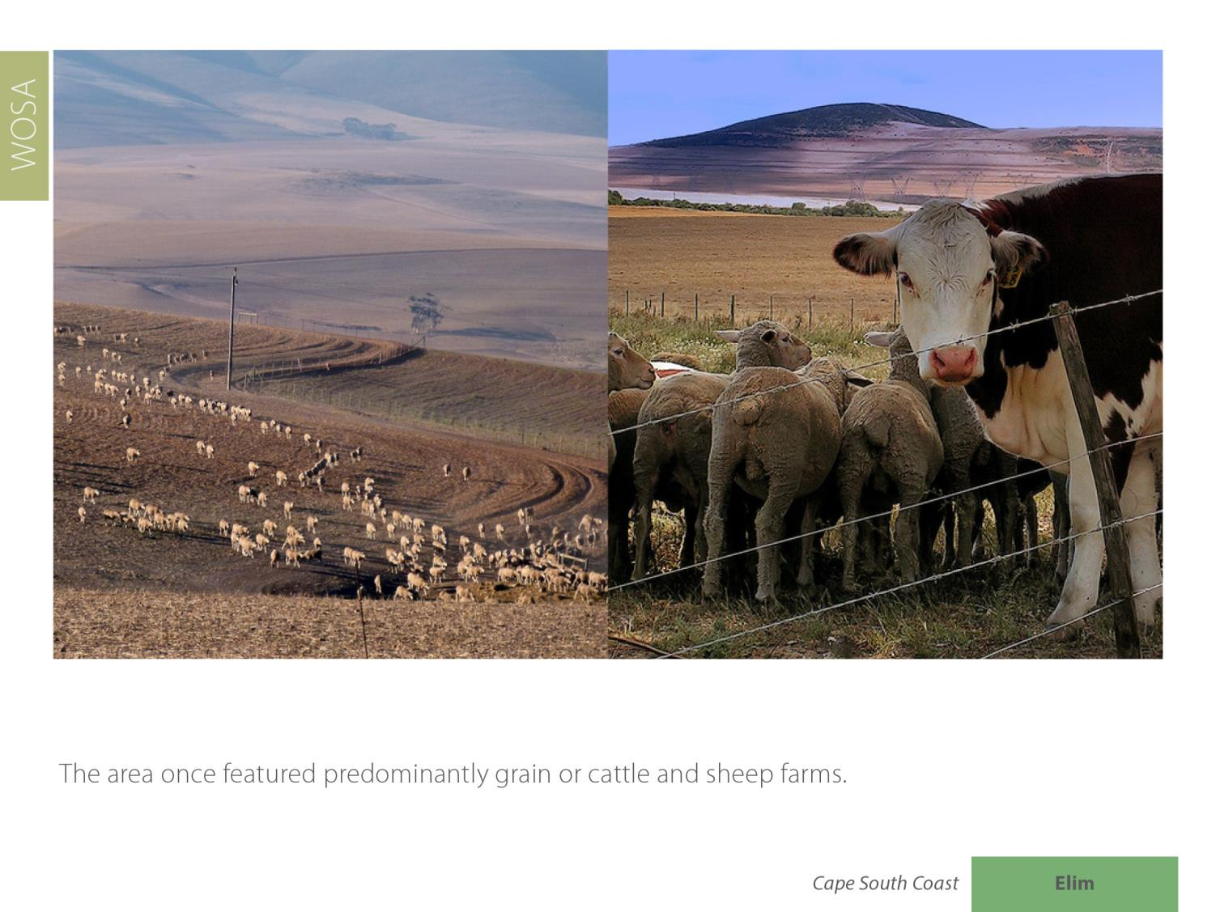
Elim
Cape South Coast

Slide 15
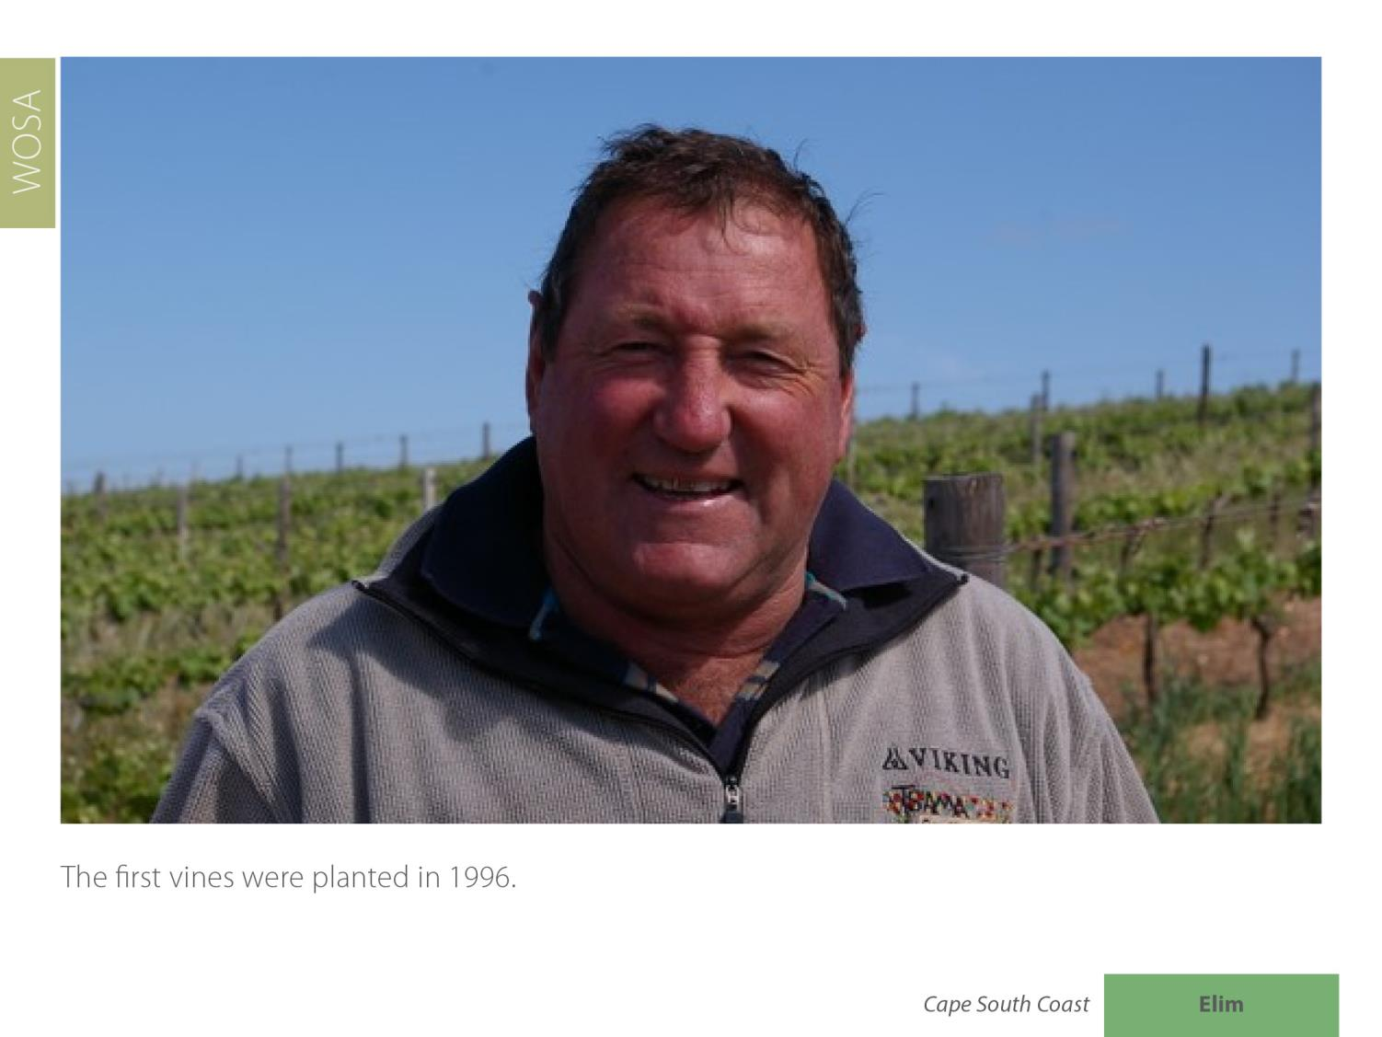
Elim
Cape South Coast

Slide 16
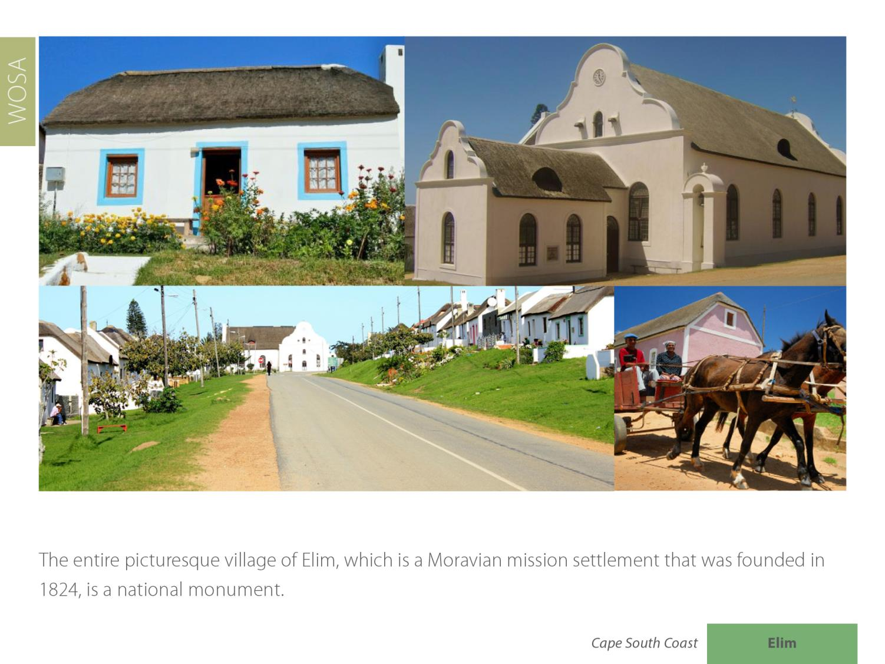
Elim
Cape South Coast

Slide 17
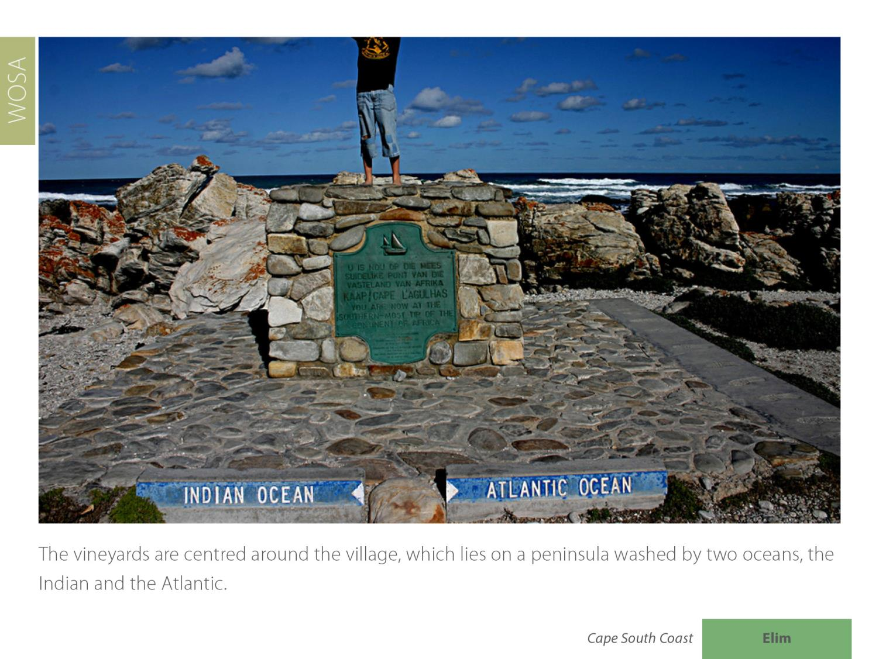
Elim
Cape South Coast

Slide 18
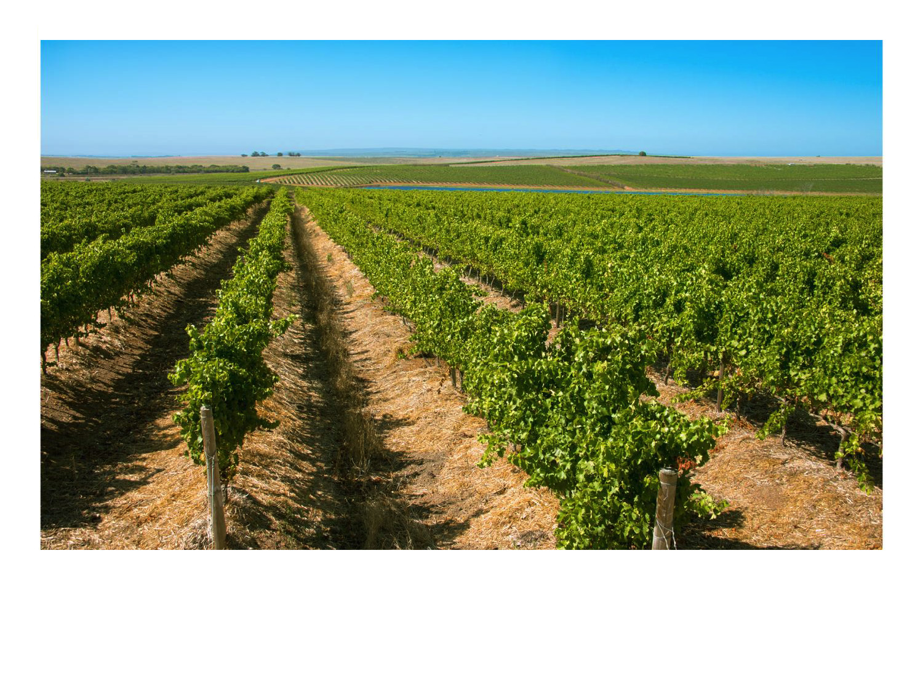
The Elim ward is the southernmost of the maritime vineyards.
Elim
Cape South Coast

Slide 19
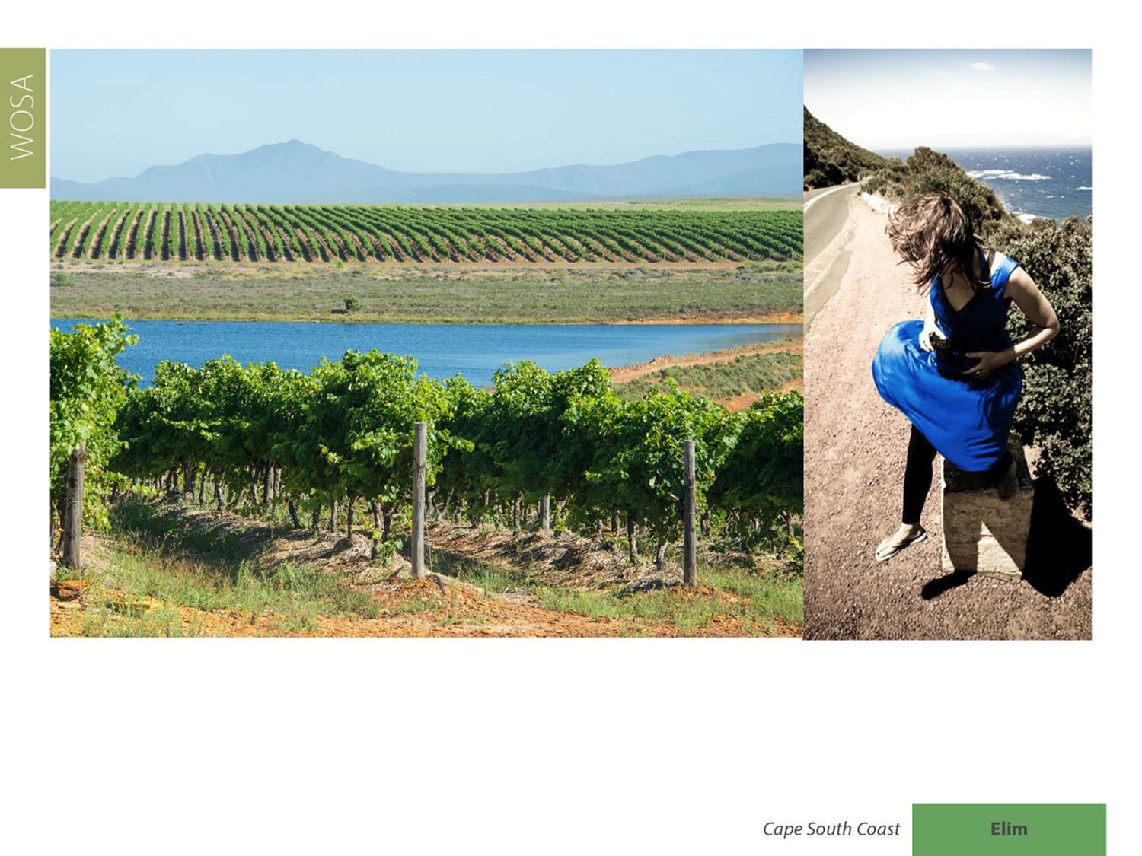
The vineyards are exposed to very strong south-easterly winds. These strong, cooling winds are prevalent in summer, ensuring a very cool ripening season. The mean February temperature is 20.3⁰C and the average annual rainfall is 535mm.
Elim
Cape South Coast

Slide 20
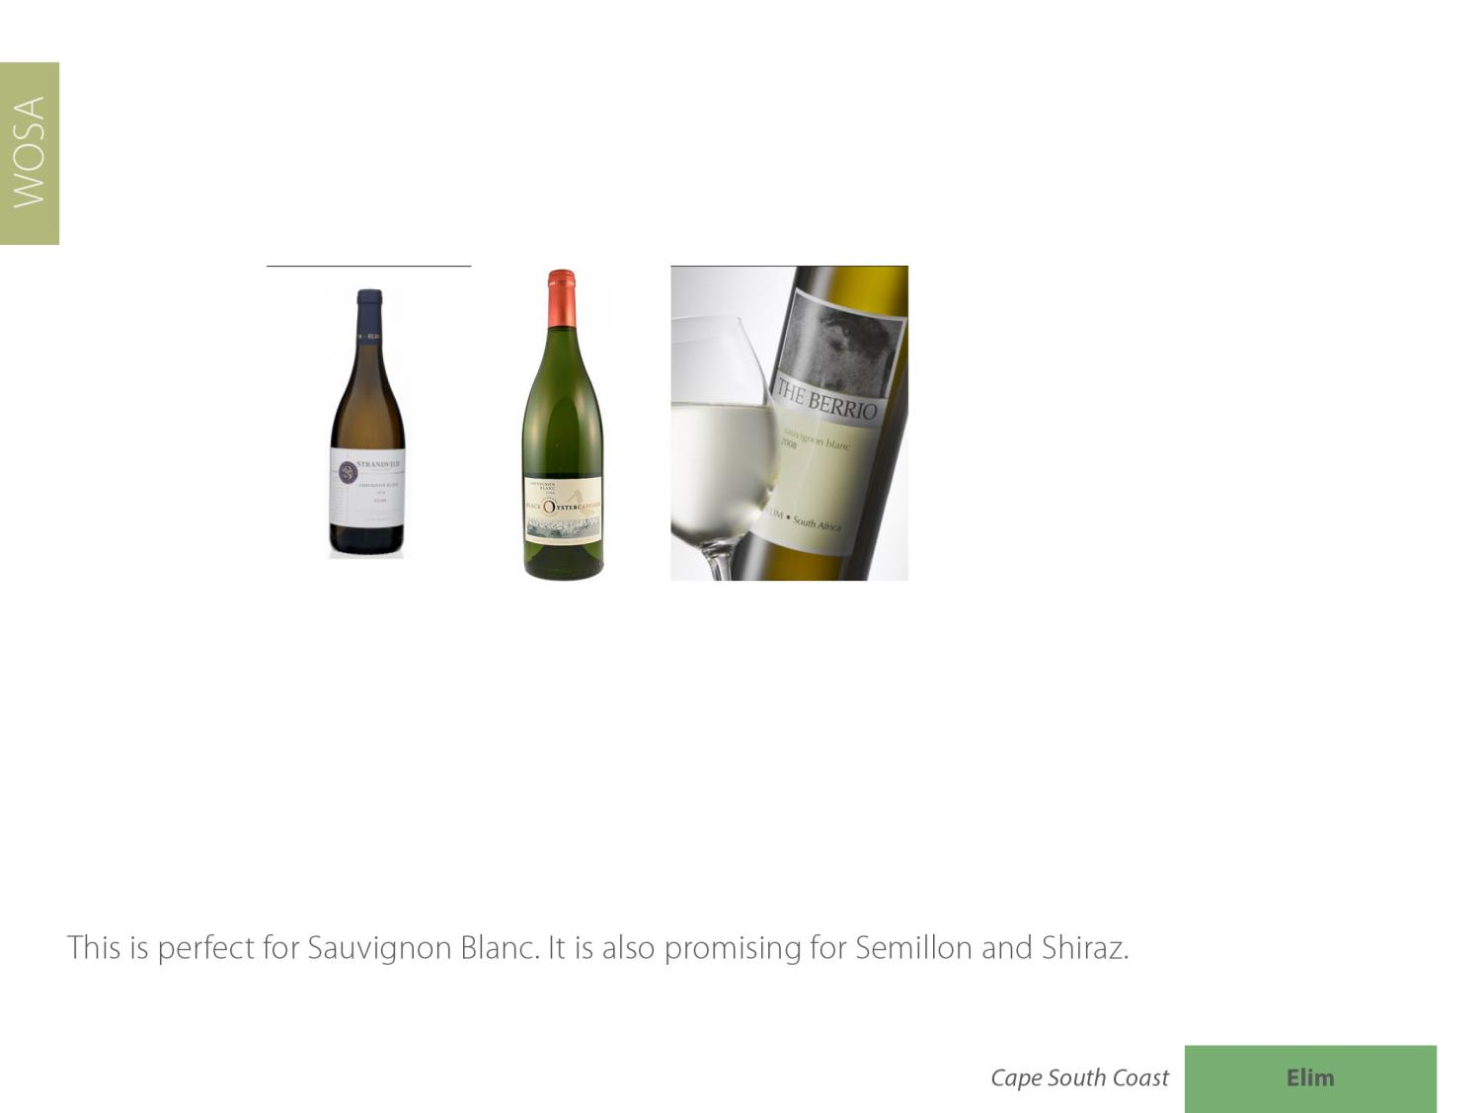
Elim
Cape South Coast

Slide 21
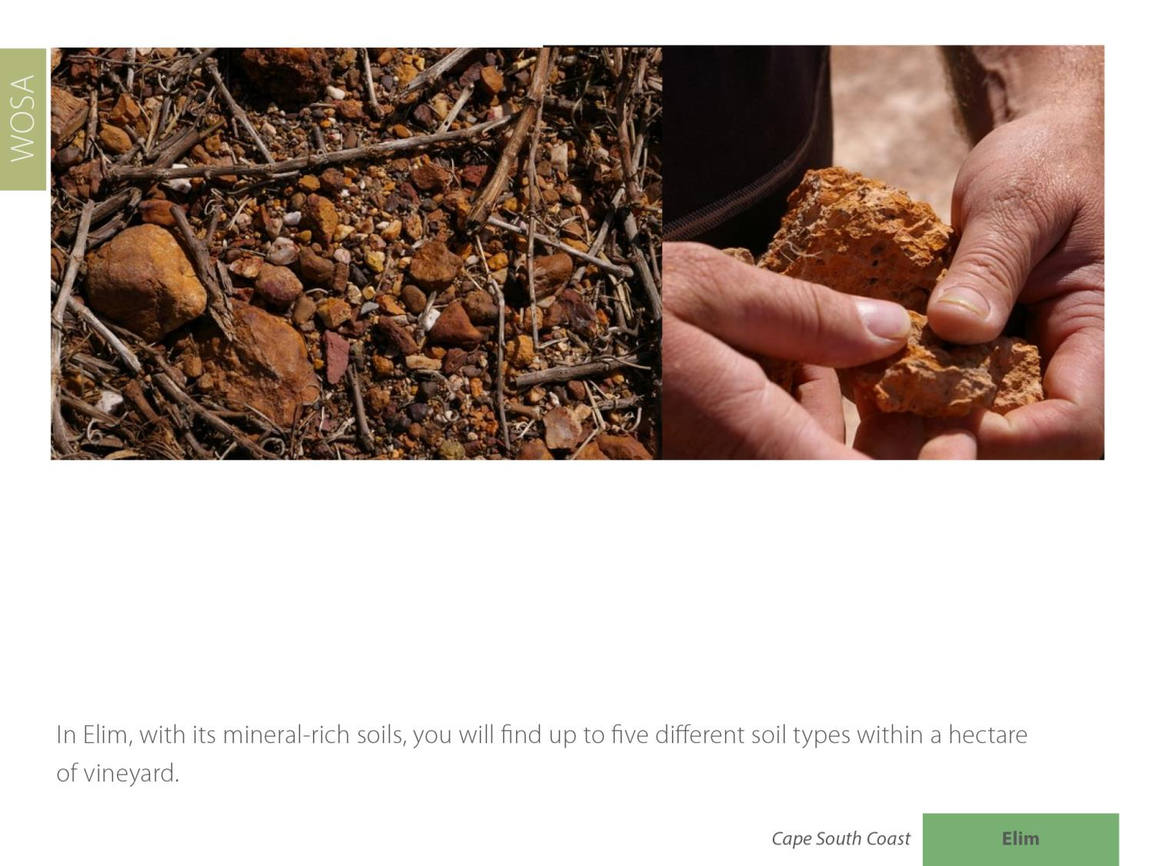
Elim
Cape South Coast

Slide 22
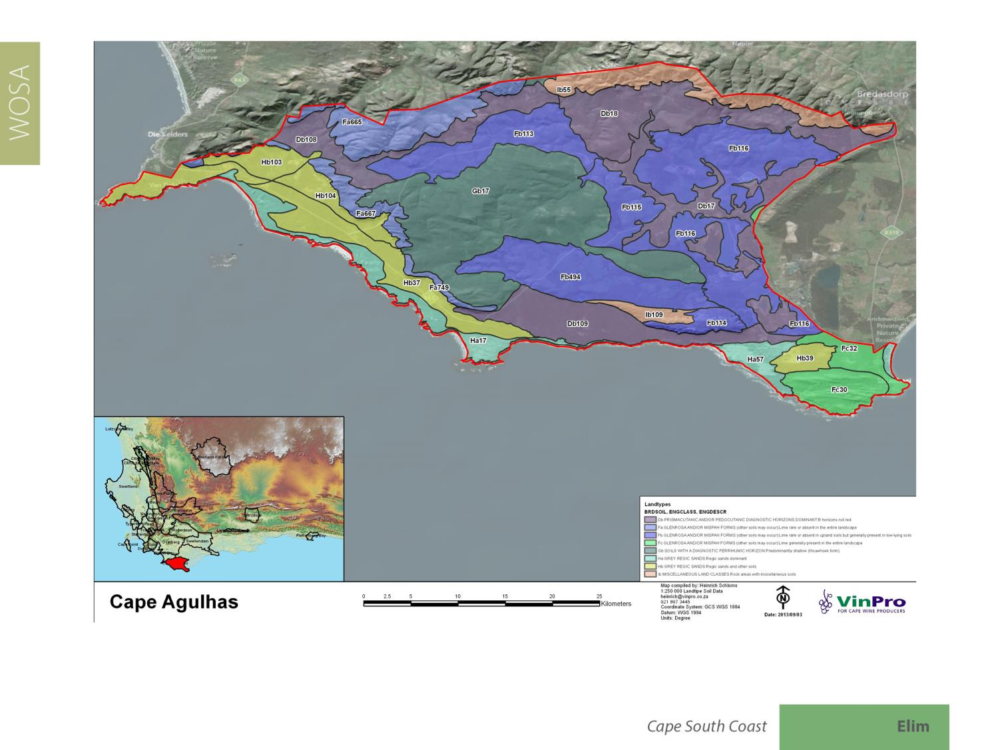
Elim
Cape South Coast

Slide 23
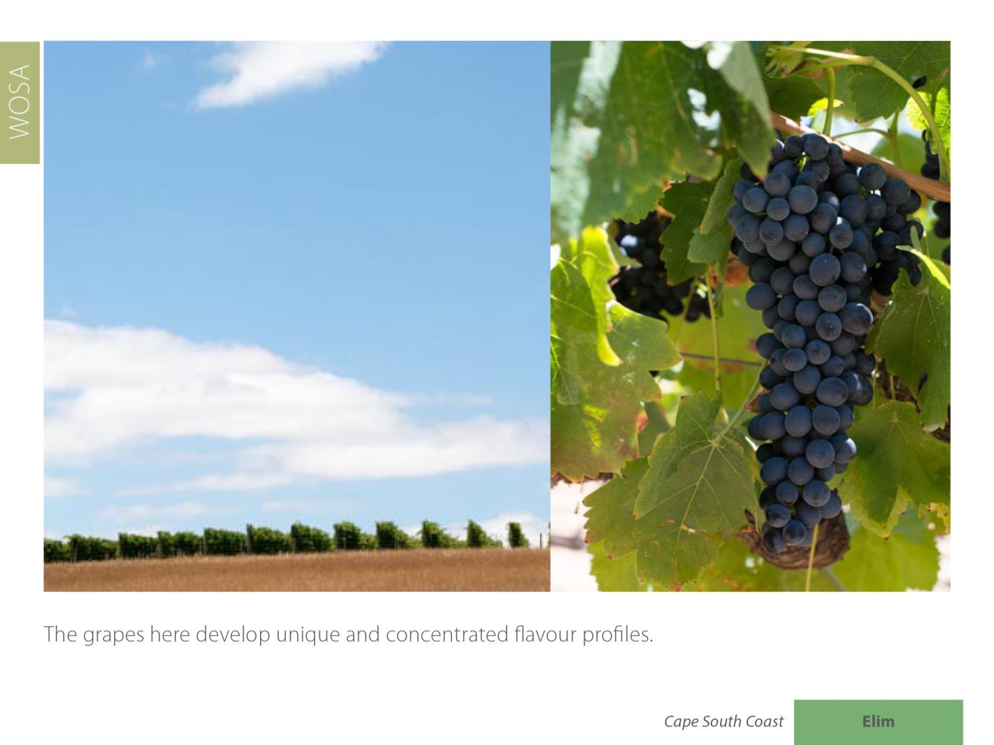
Elim
Cape South Coast

Slide 24
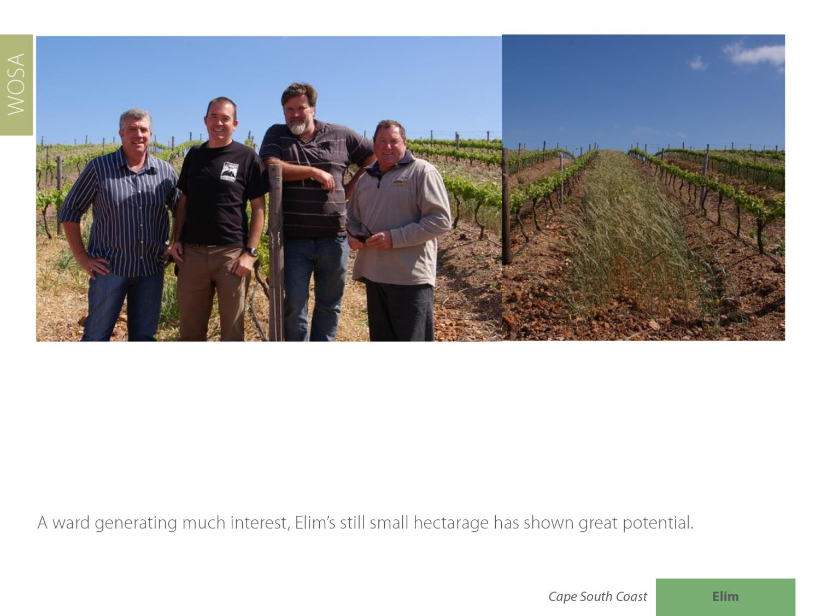
Elim
Cape South Coast

Slide 25
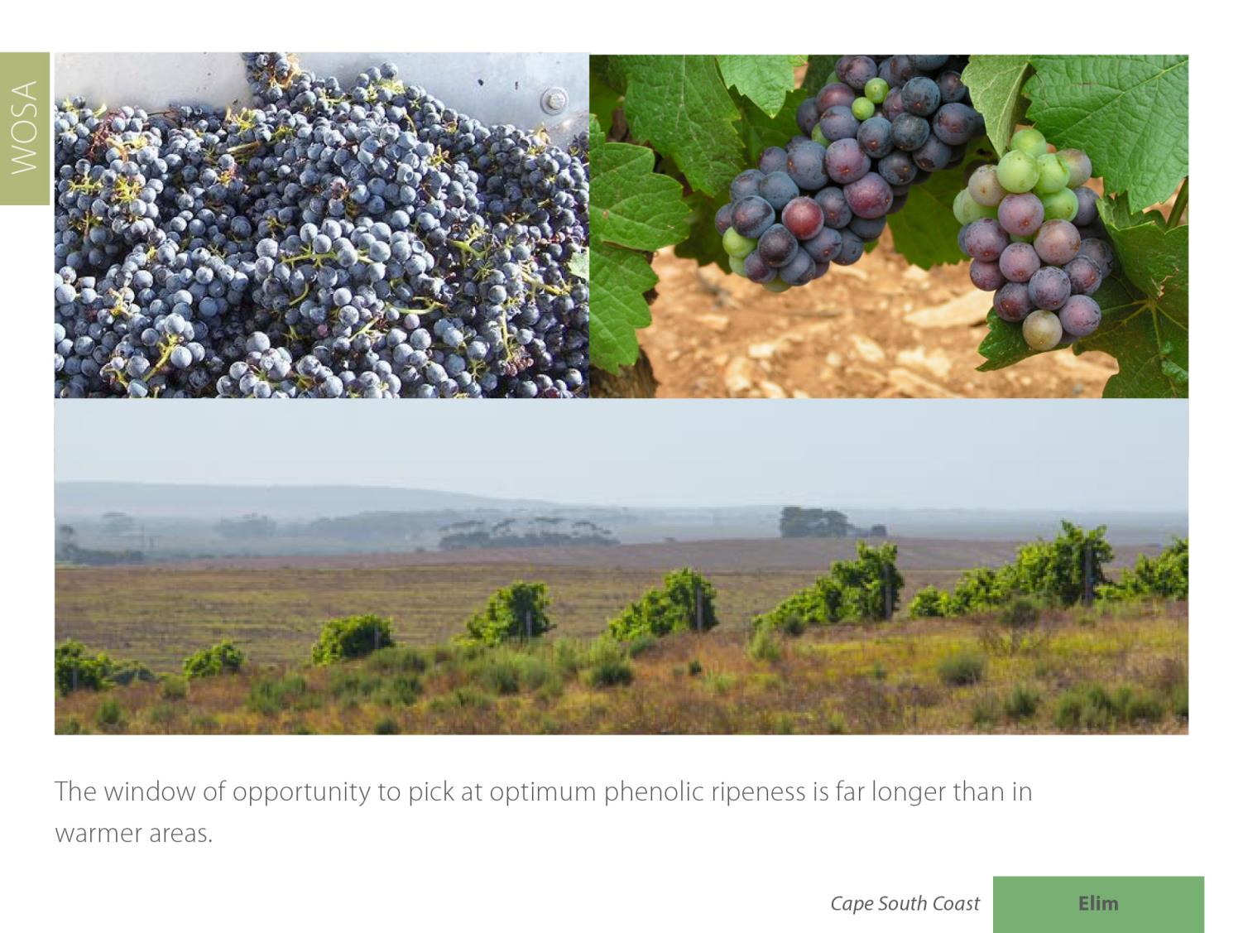
Elim
Cape South Coast

Slide 26
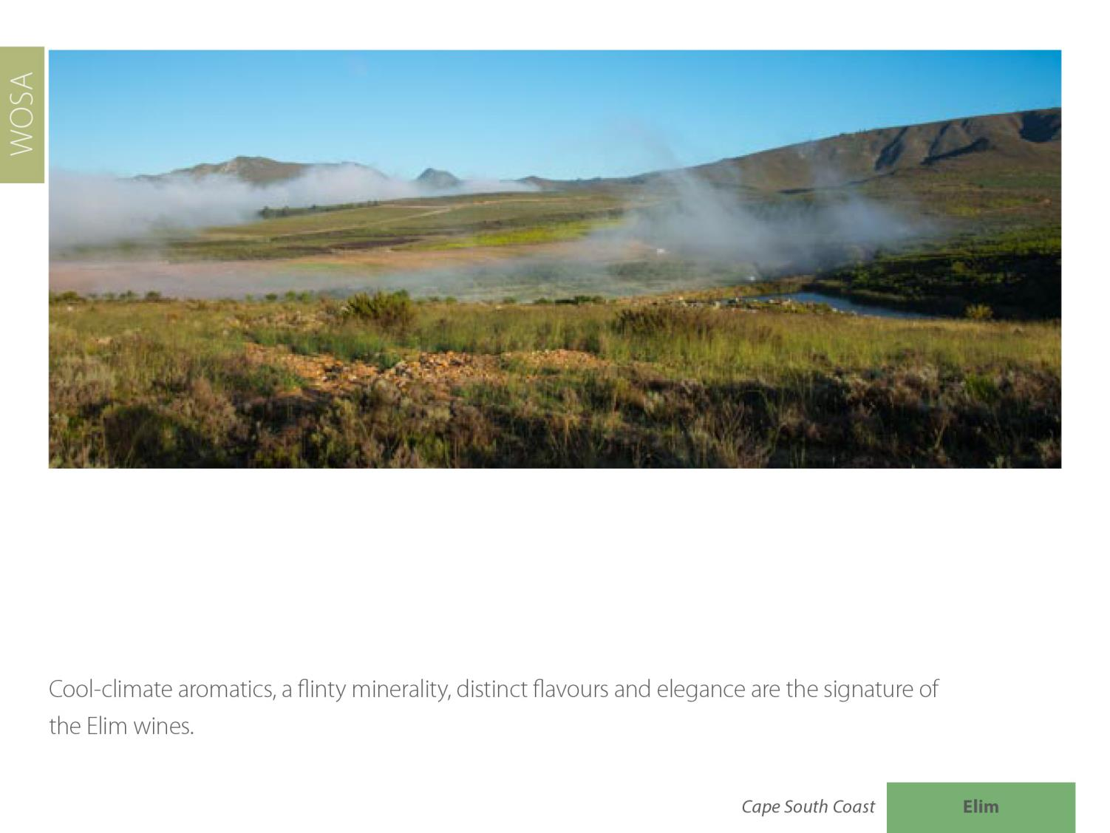
Elim
Cape South Coast

Slide 27
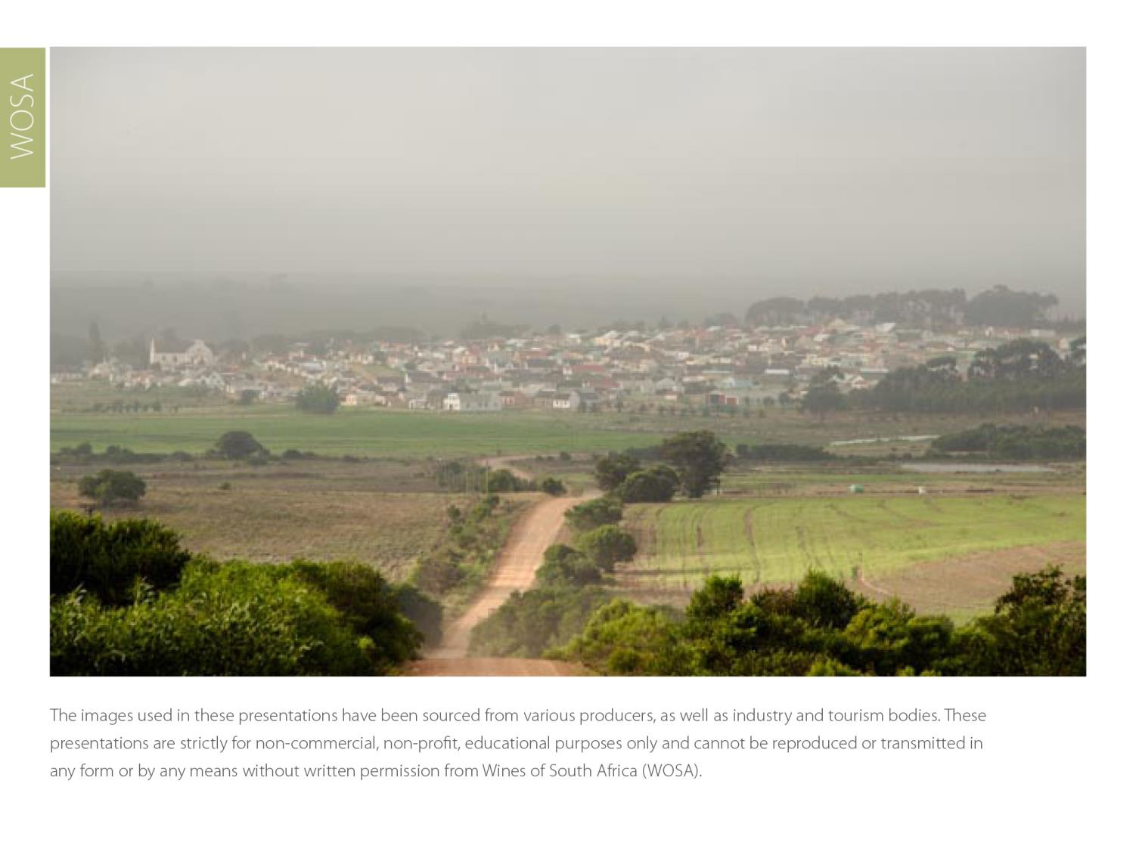
The images used in these presentations have been sourced from various producers, as well as industry and tourism bodies. These presentations are strictly for non-commercial, non-profit, educational purposes only and cannot be reproduced or transmitted in any form or by any means without written permission from Wines of South Africa (WoSA).

Slide 28
The Cape winelands, considered by many to be
the most beautiful in the world, have a network of
diverse and well-run wine routes, affording visitors
a varied and unforgettable experience.

Slide 29
THE END

