Slide 1

CAPE WINELANDS
ROBERTSON

Slide 2
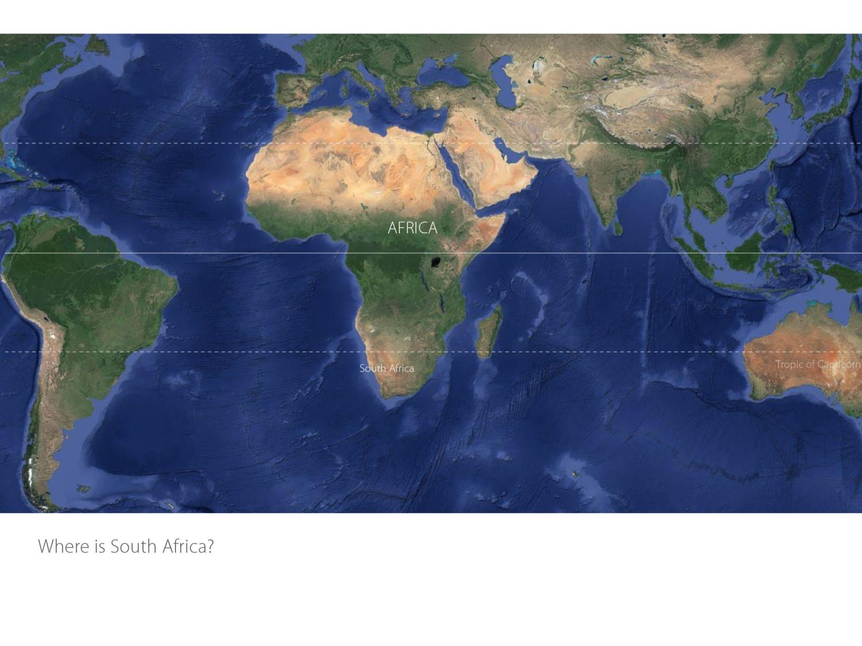

Slide 3
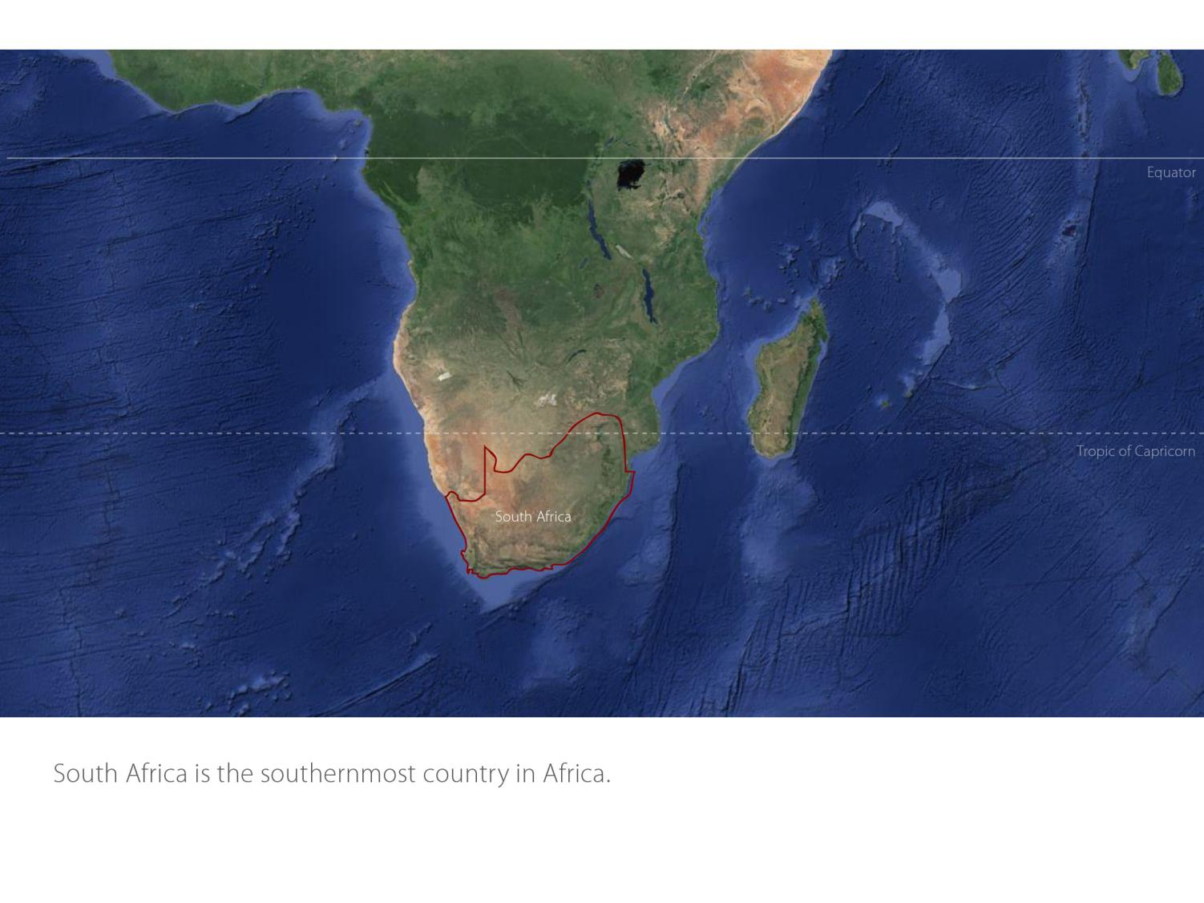

Slide 4
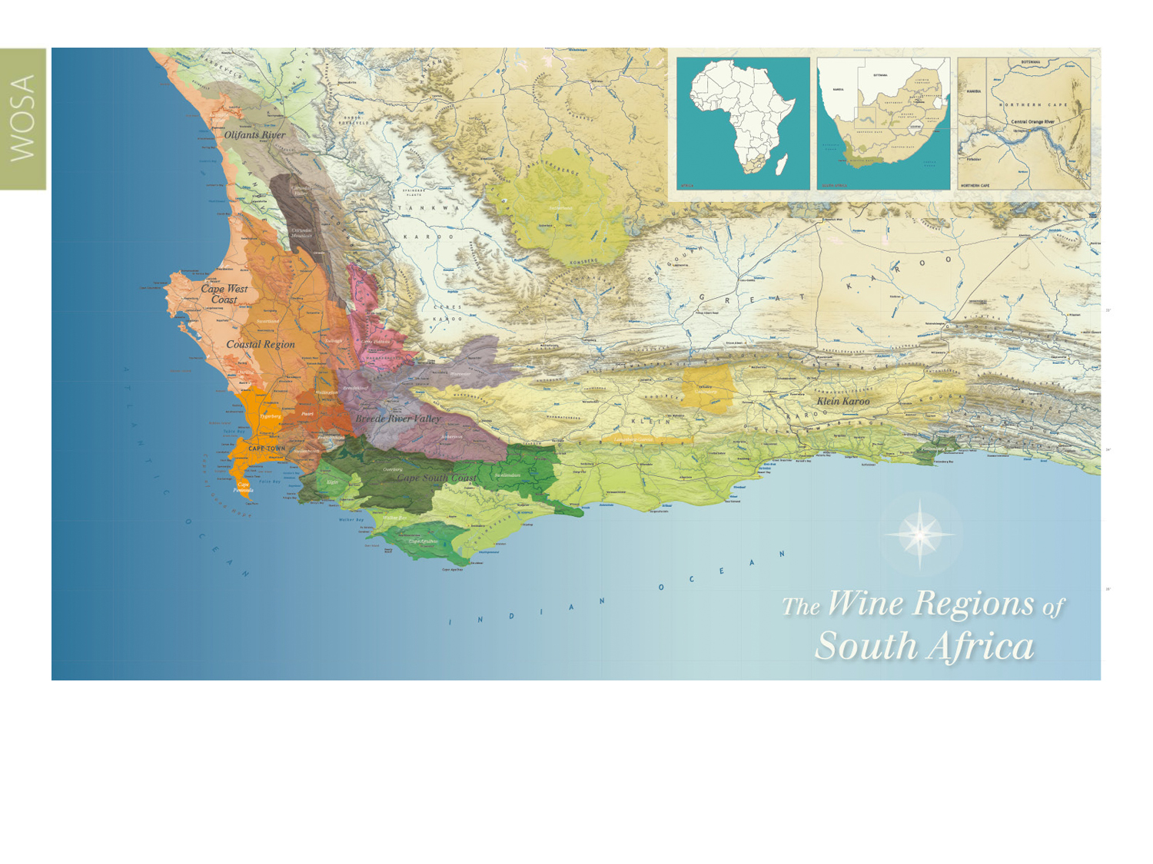
Our winelands are located at the very tip of South Africa.
Robertson
Breede River Valley

Slide 5
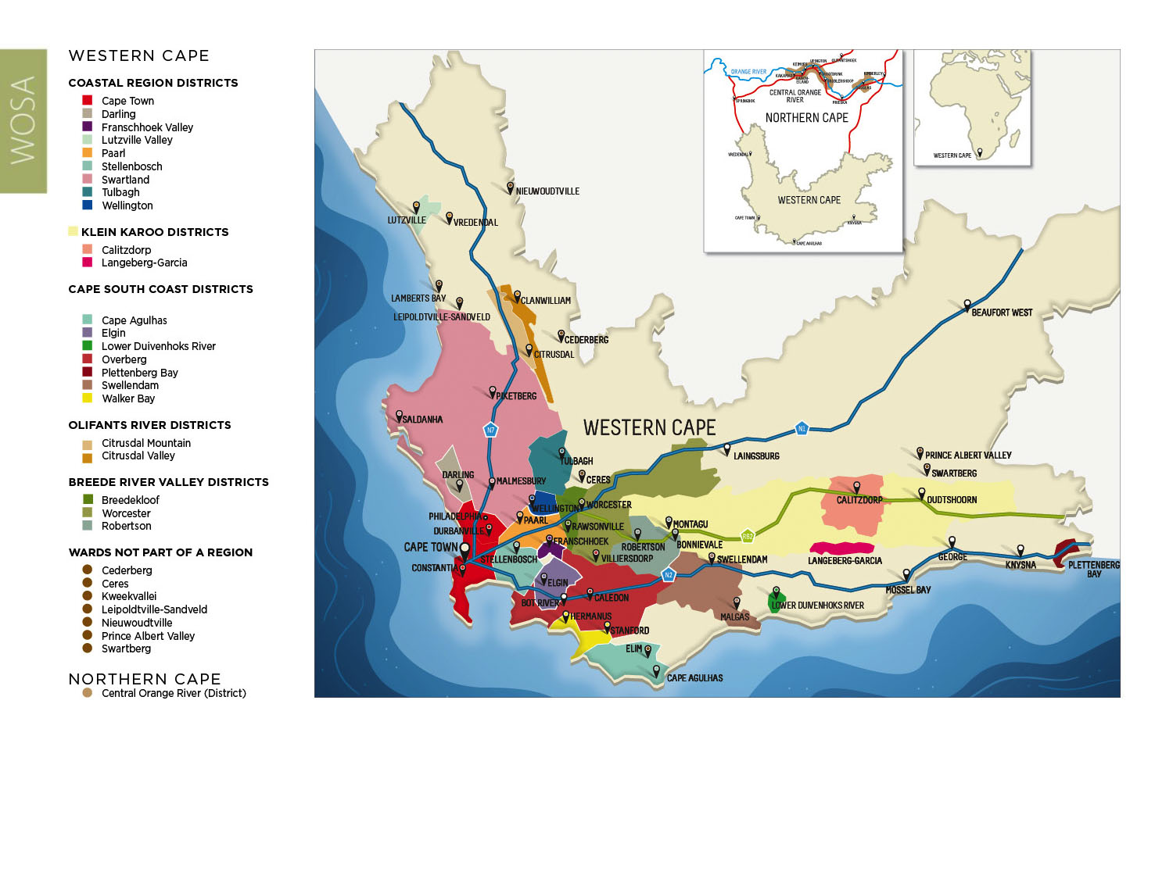
PRODUCTION AREAS: Districts of South Africa.
Robertson
Breede River Valley

Slide 6
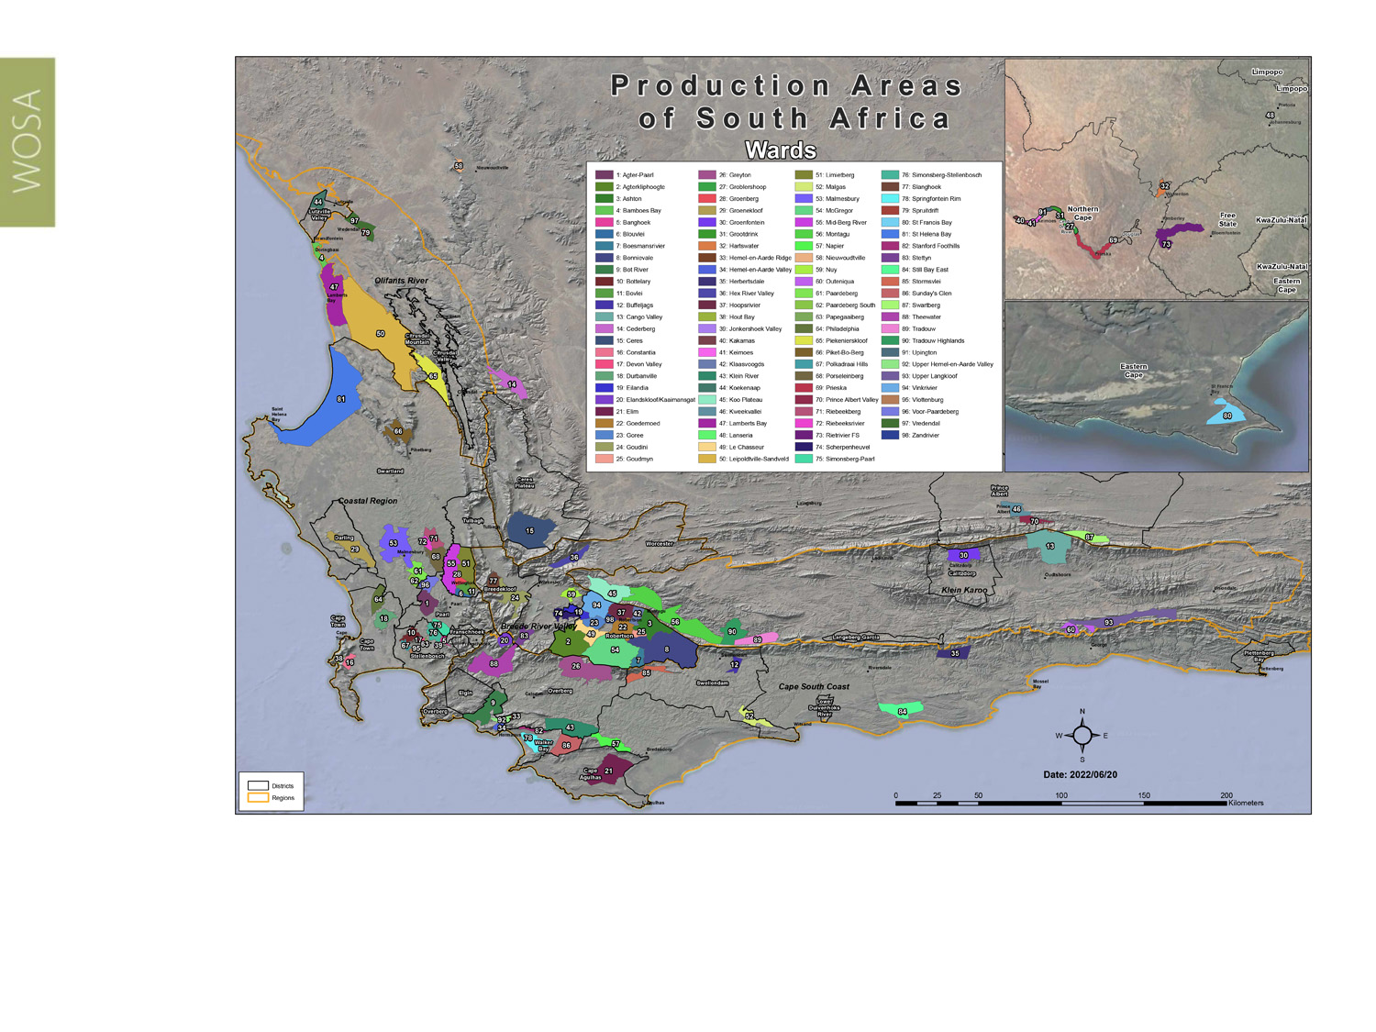
Wards of South Africa.
Robertson
Breede River Valley

Slide 7
Breede River Valley
Region: Breede River Valley
District: Robertson
Wards: Agterkliphoogte
Ashton
Bonnievale
Boesmansrivier
Eilandia
Goedemoed
Goree
Goudmyn Hoopsrivier
Klaasvoogds
Le Chasseur McGregor
Vinkrivier
Zandrivier
Robertson
Breede River Valley

Slide 8
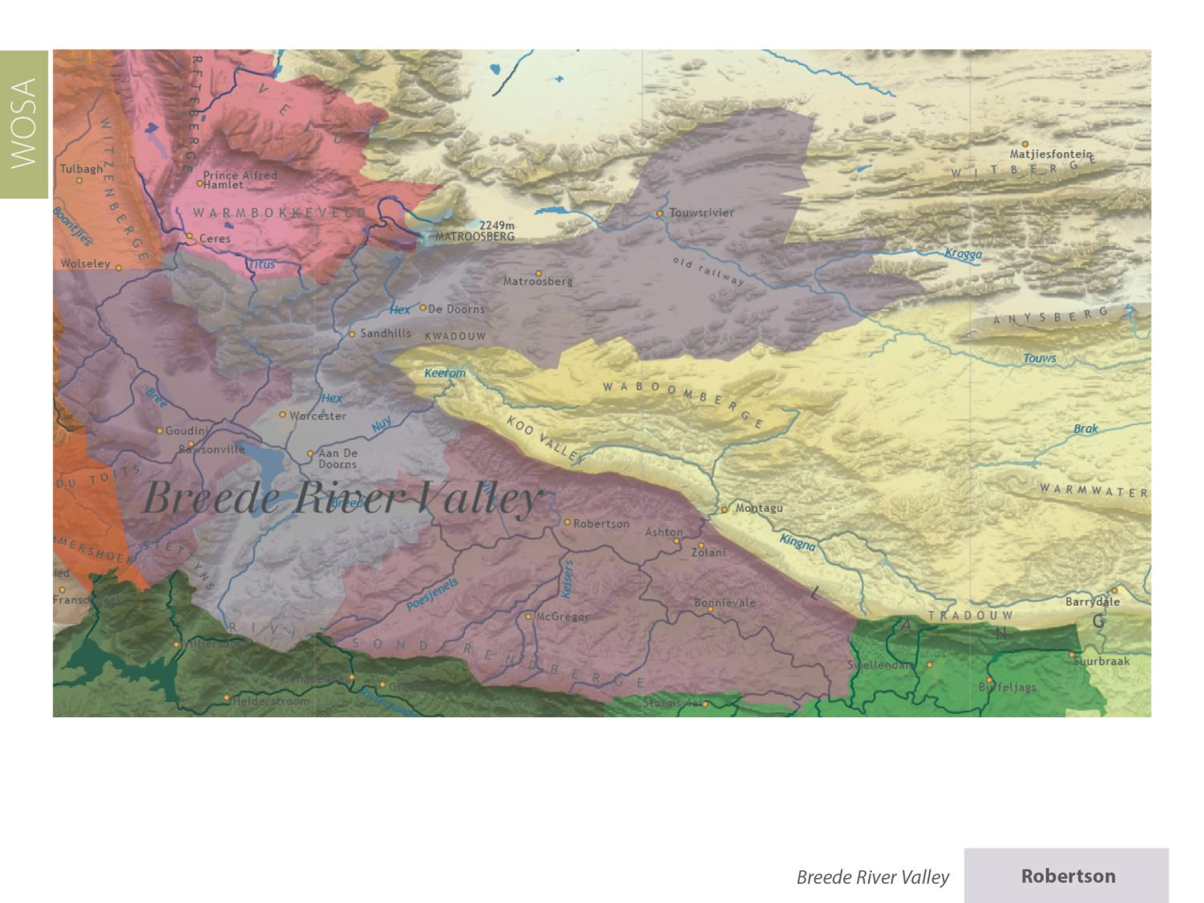
Robertson
Breede River Valley

Slide 9
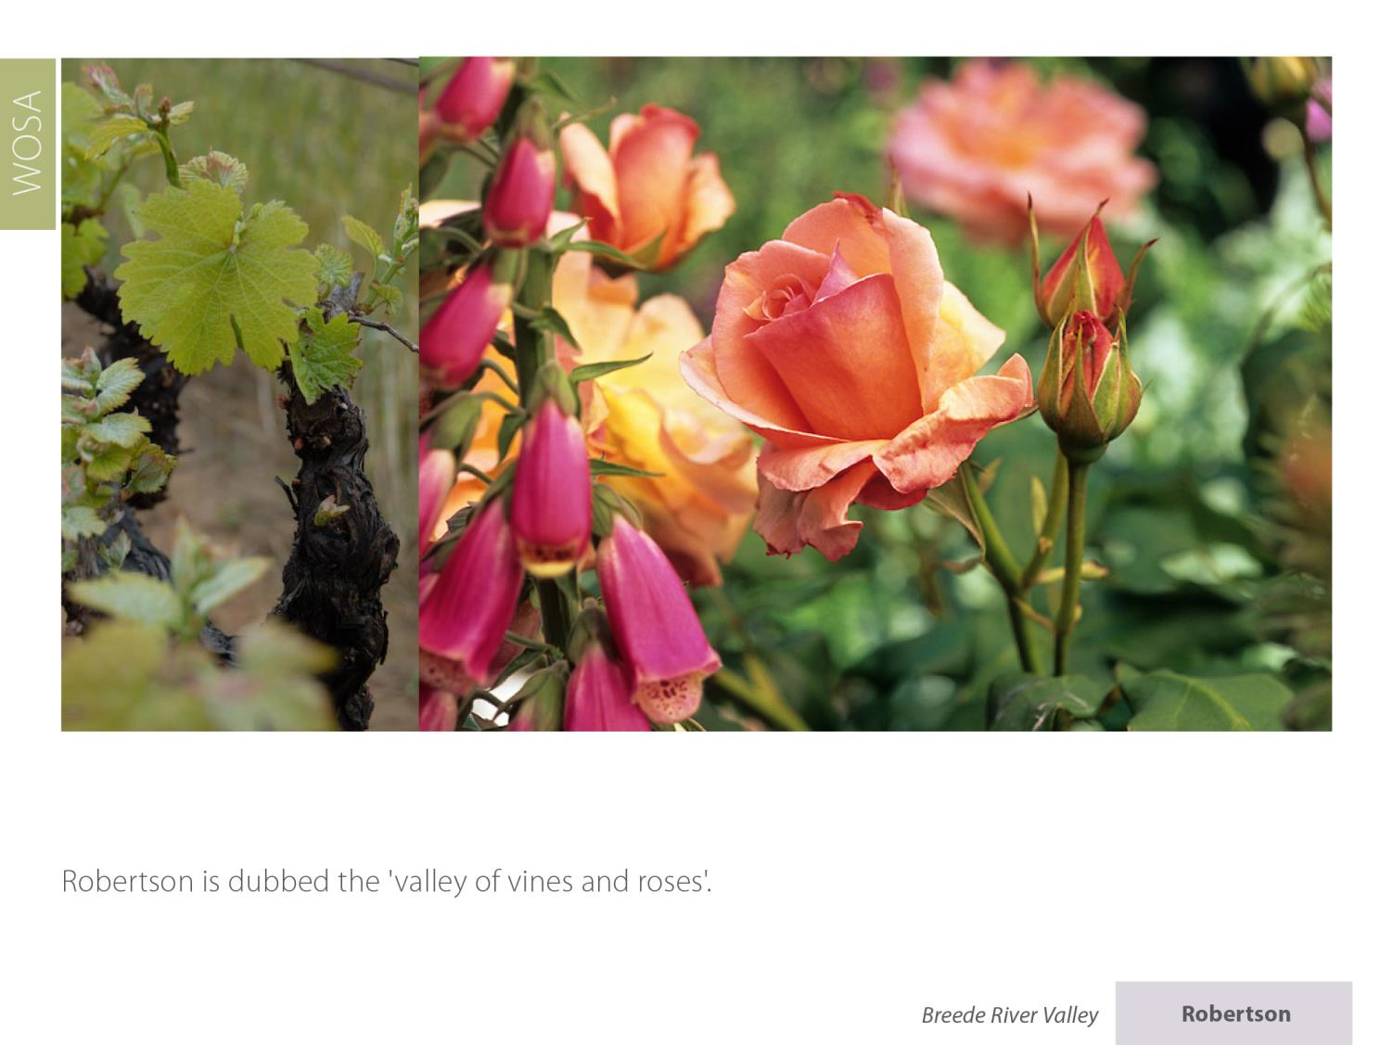
Robertson
Breede River Valley

Slide 10
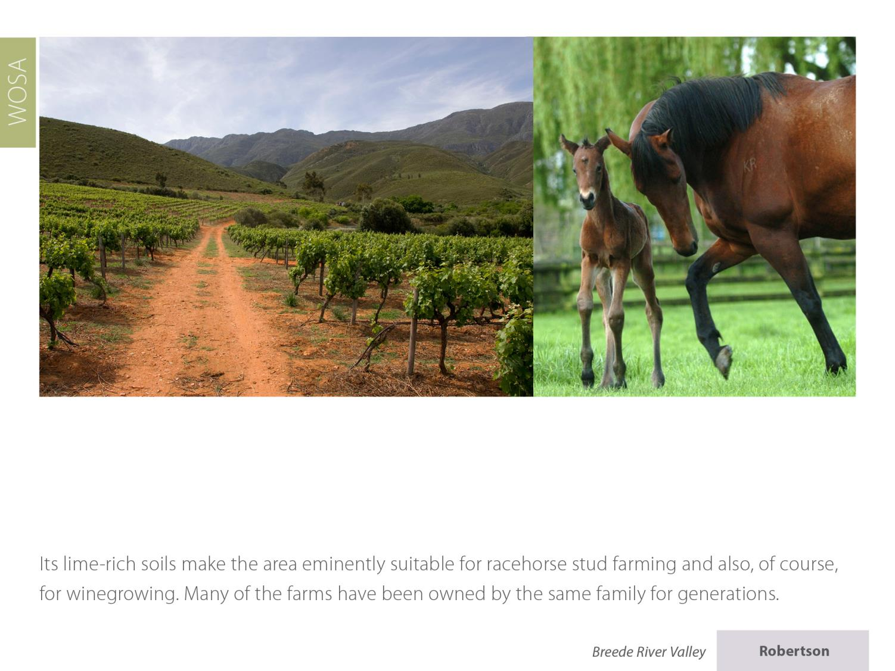
Robertson
Breede River Valley

Slide 11
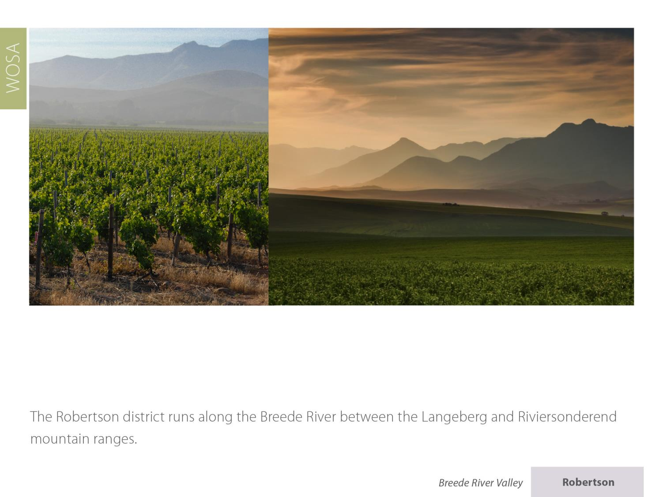
Robertson
Breede River Valley

Slide 12
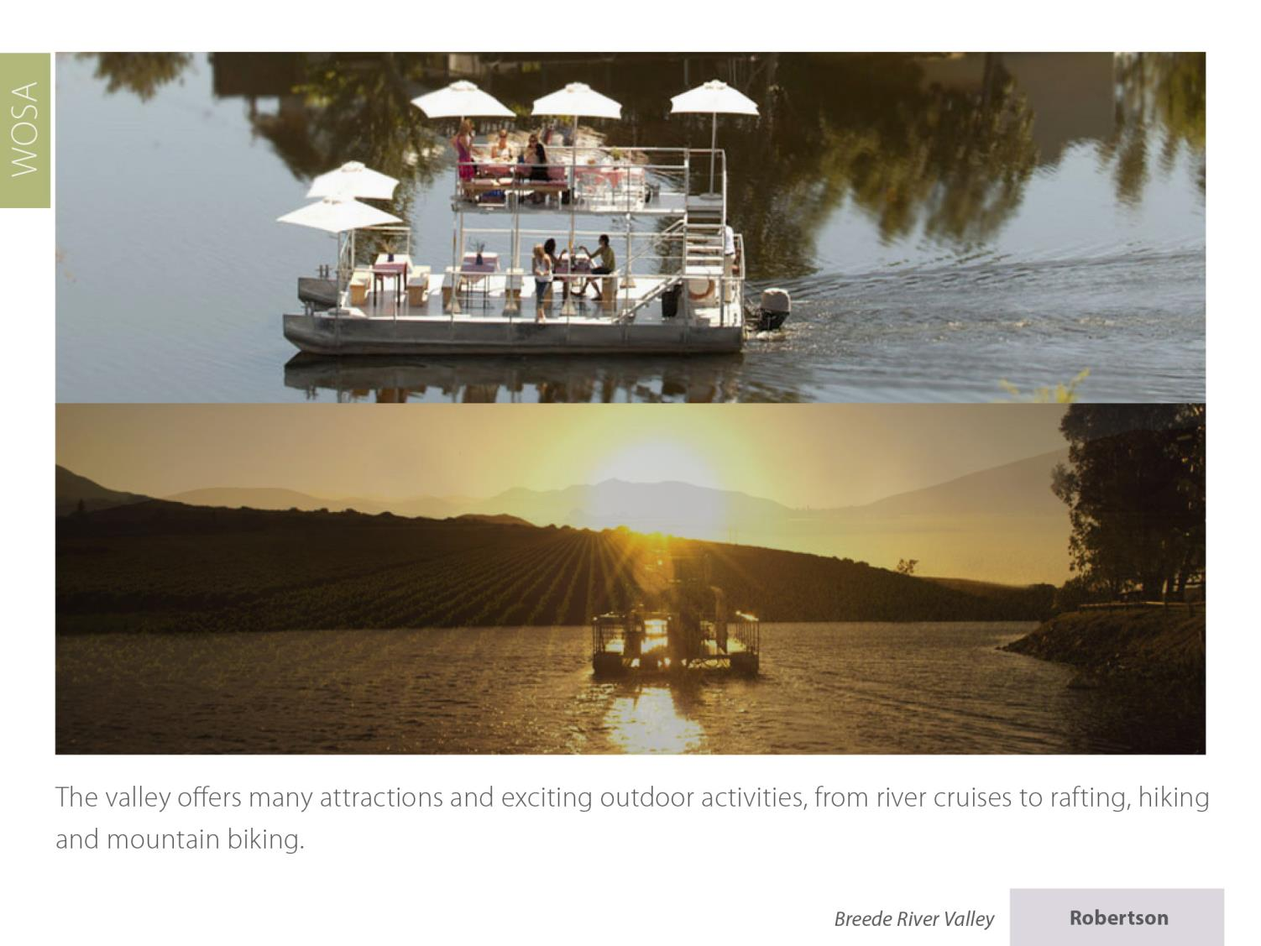
Robertson
Breede River Valley

Slide 13
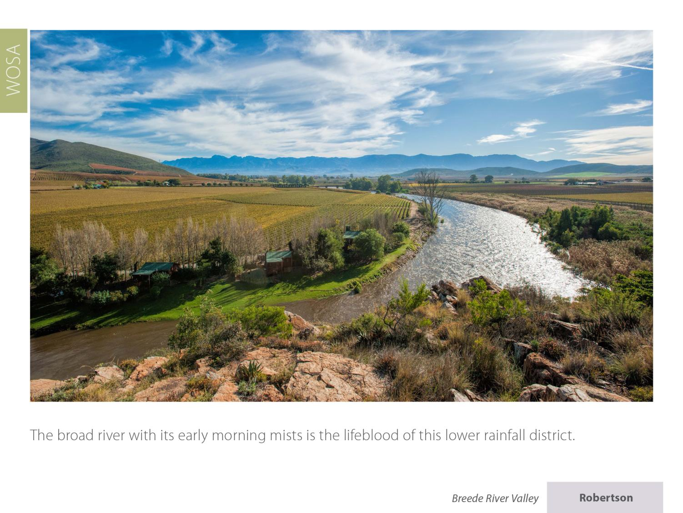
Robertson
Breede River Valley

Slide 14
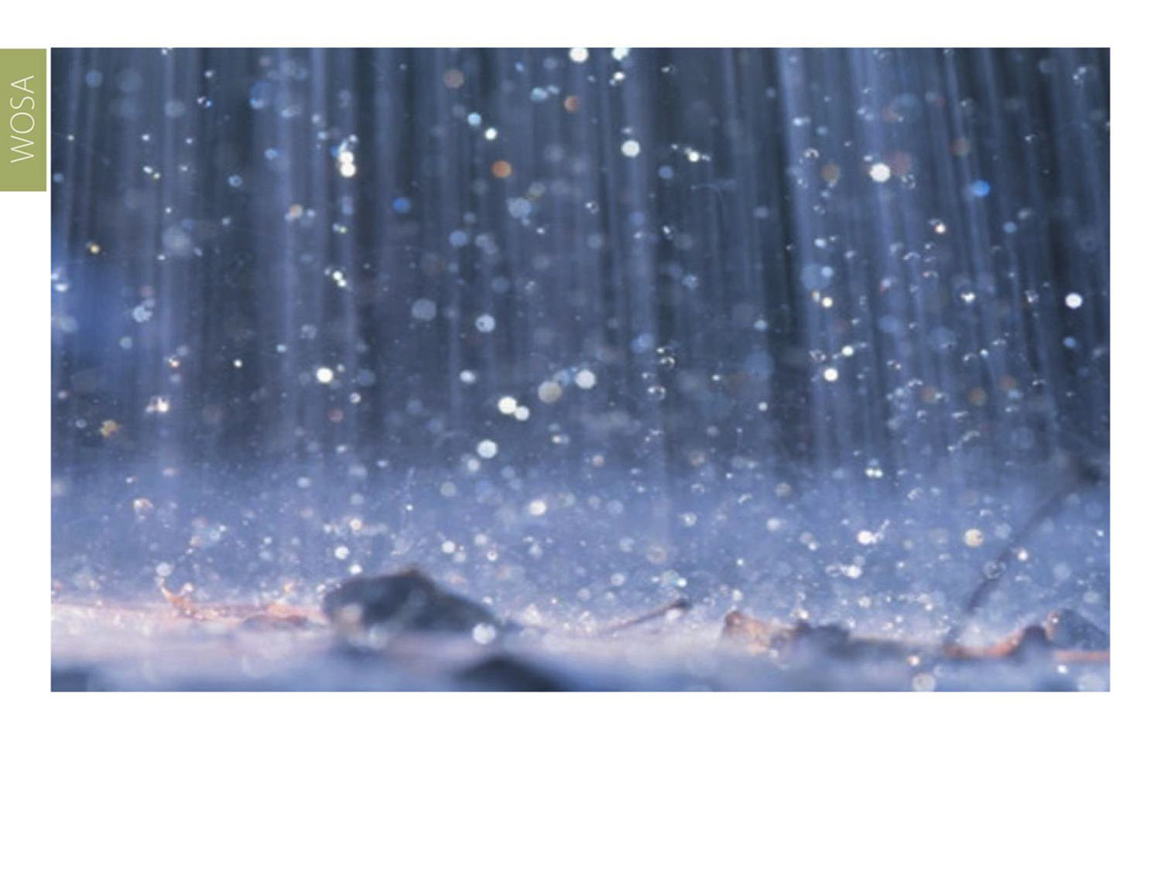
It has an average annual rainfall of around 280–400 mm.
Robertson
Breede River Valley

Slide 15
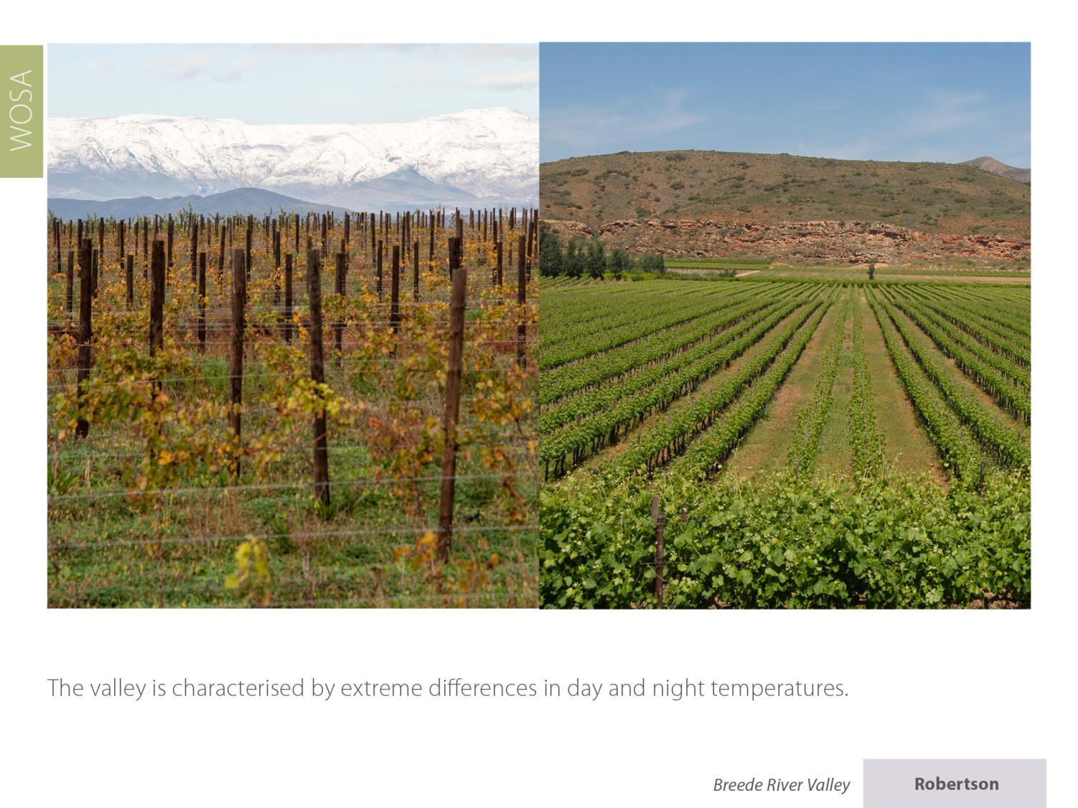
Robertson
Breede River Valley

Slide 16
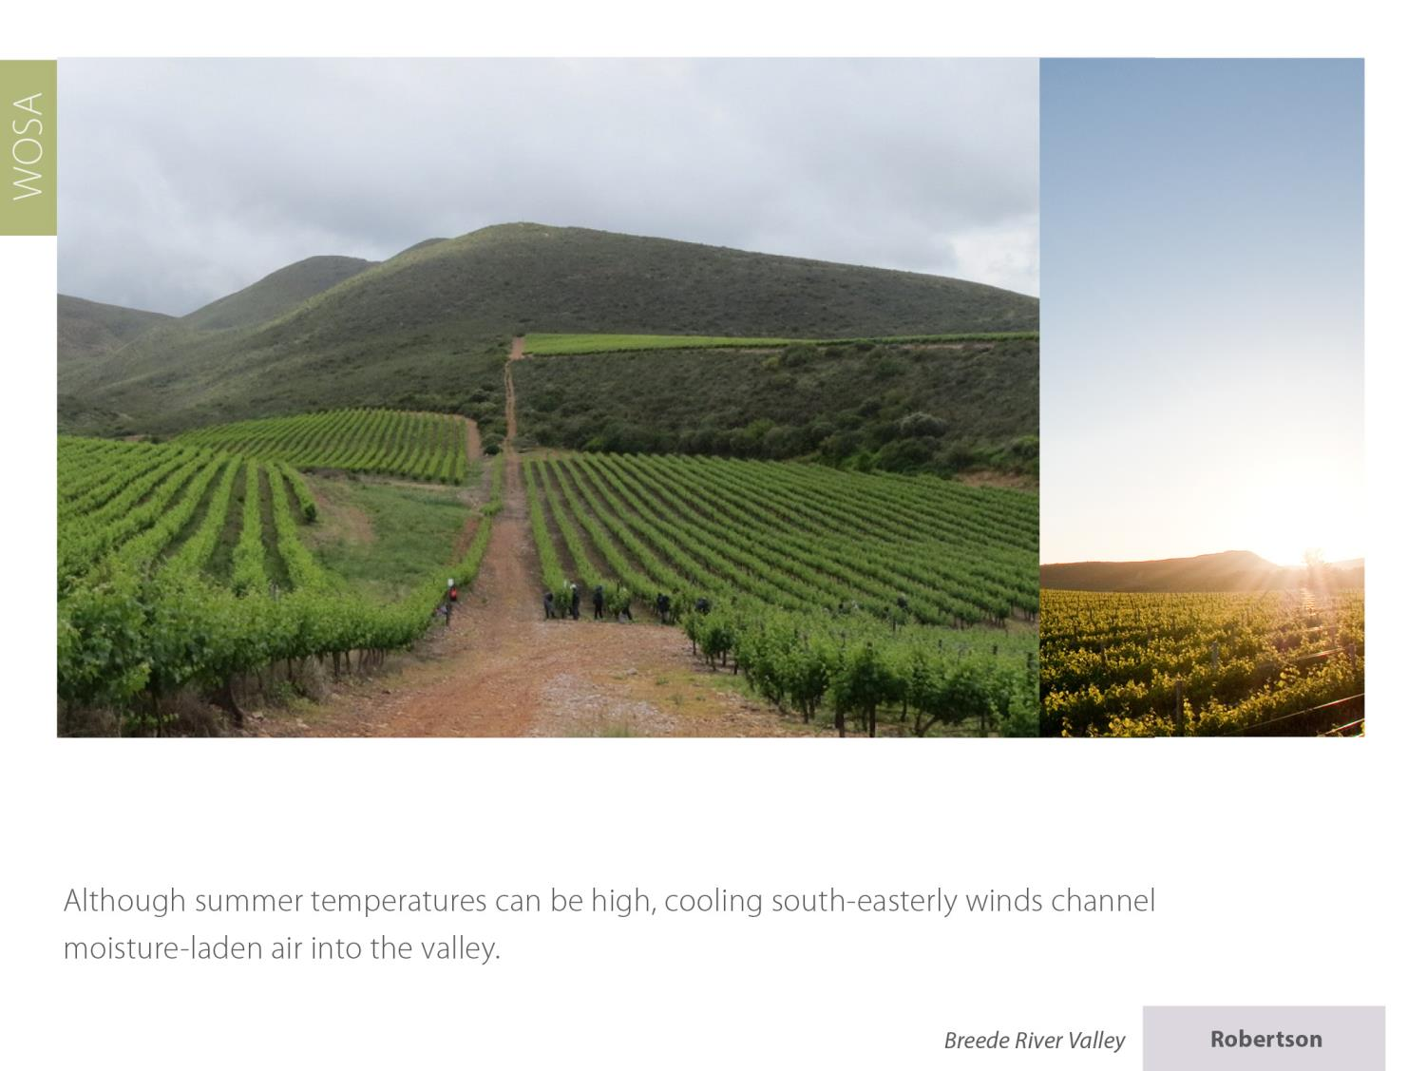
Robertson
Breede River Valley

Slide 17
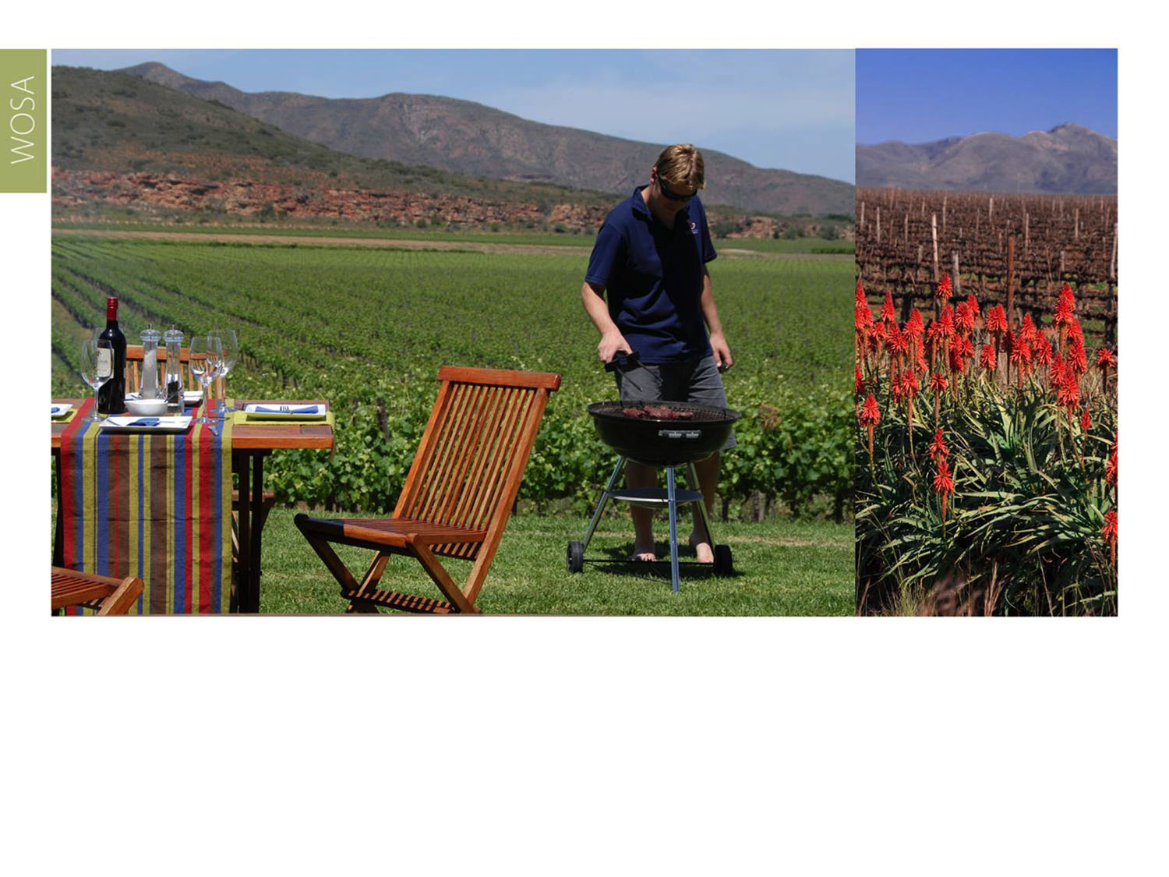
The mean February temperature is 23⁰C.
Robertson
Breede River Valley

Slide 18
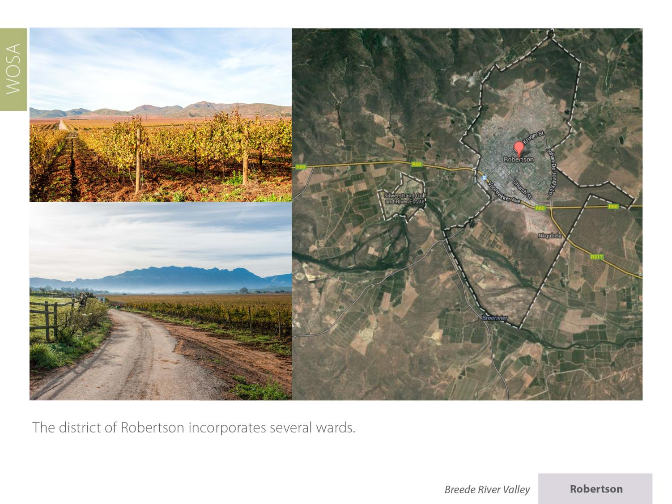
Robertson
Breede River Valley

Slide 19
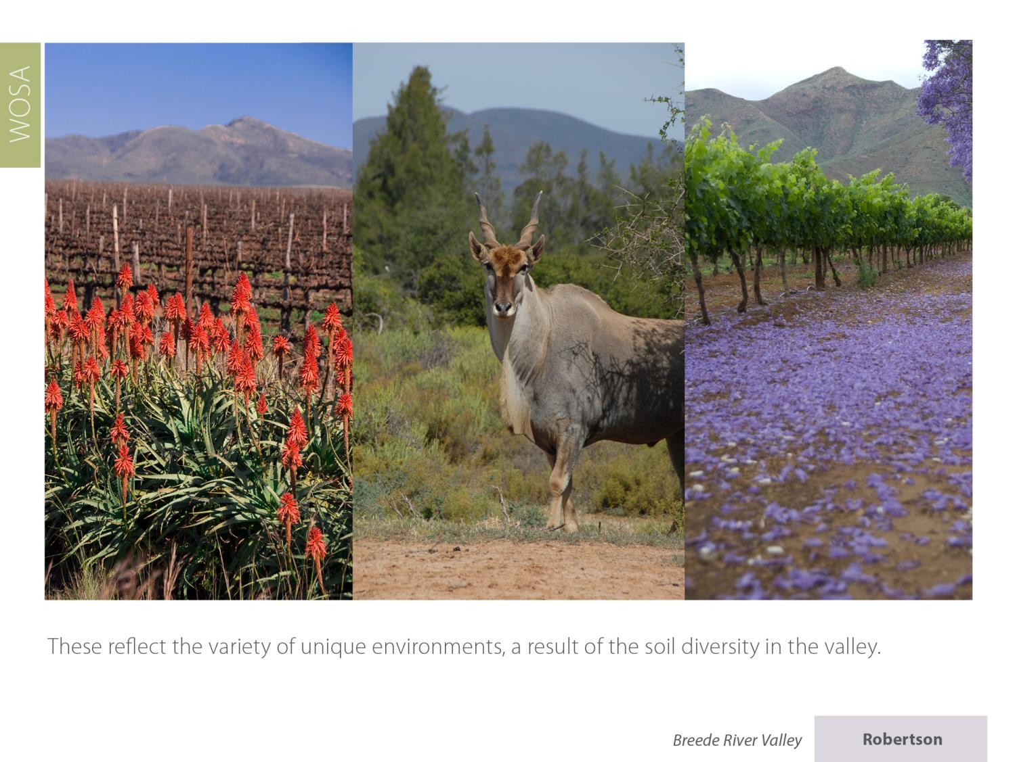
Robertson
Breede River Valley

Slide 20
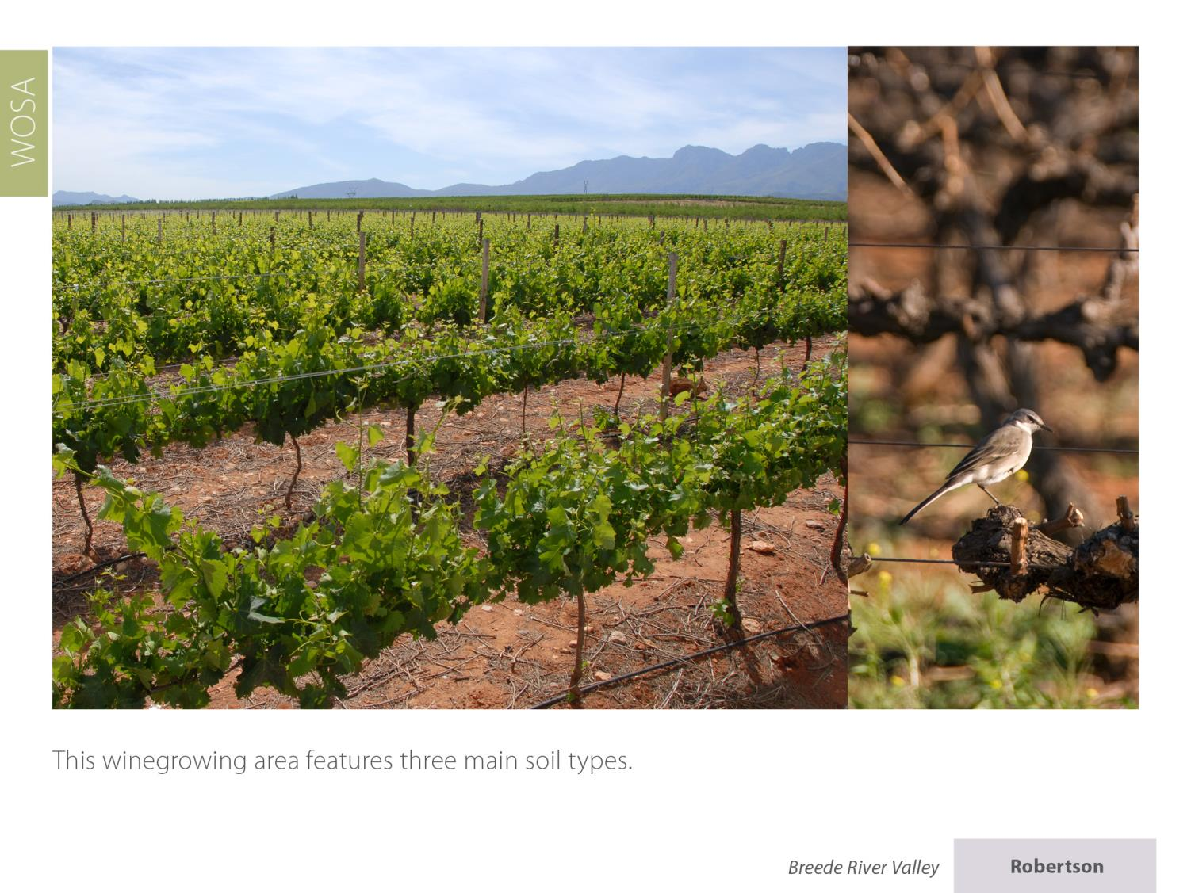
Robertson
Breede River Valley

Slide 21
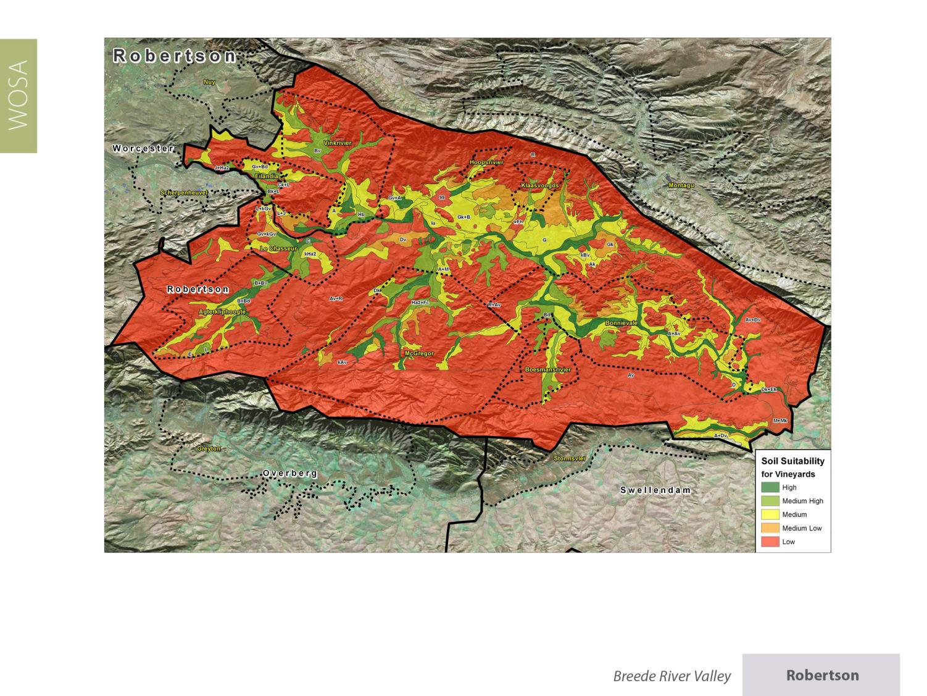
Robertson
Breede River Valley

Slide 22
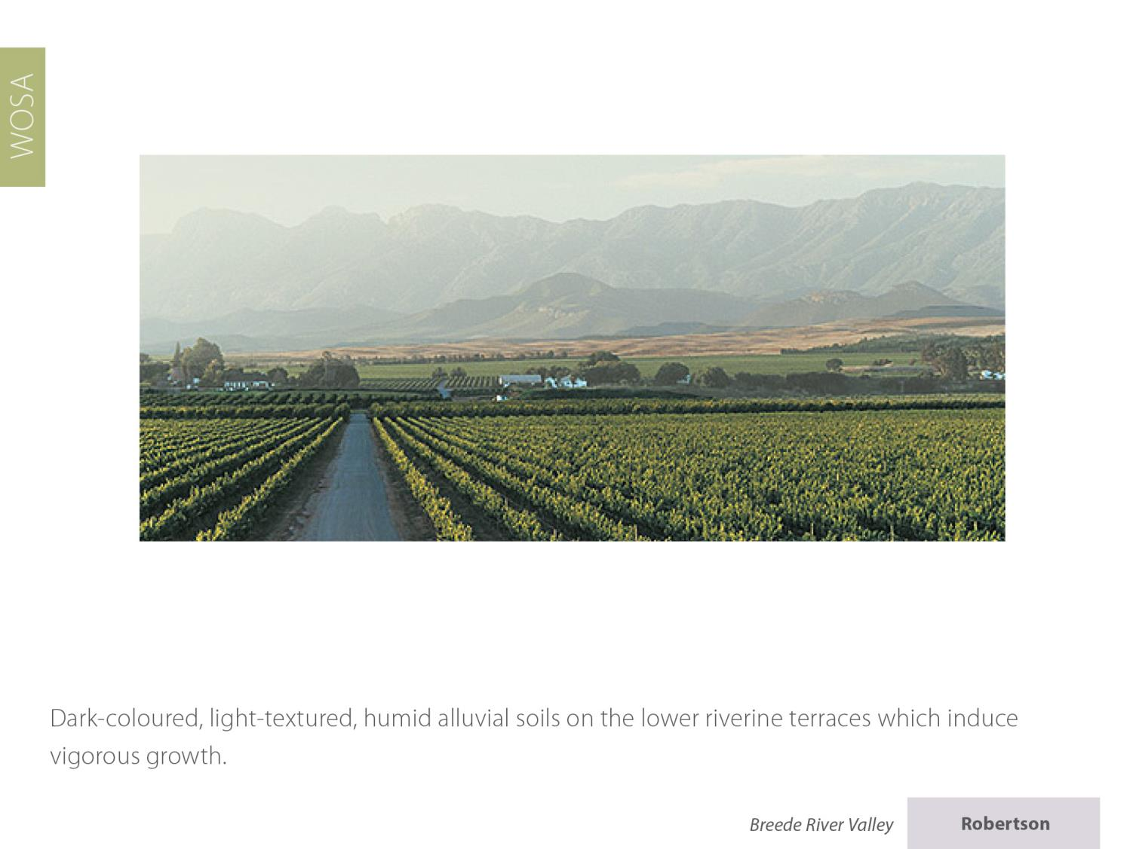
Robertson
Breede River Valley

Slide 23
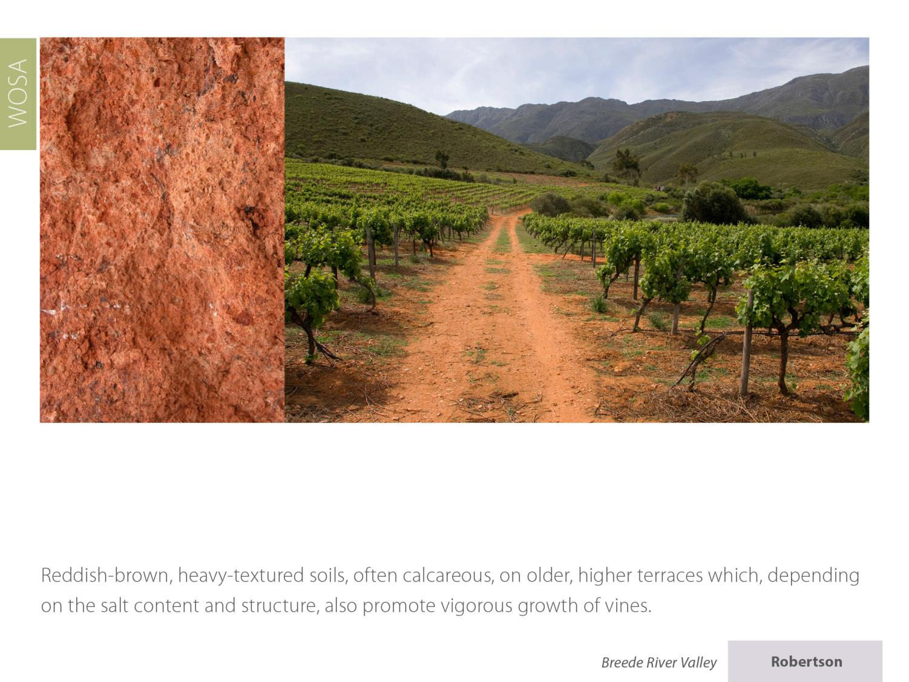
Robertson
Breede River Valley

Slide 24
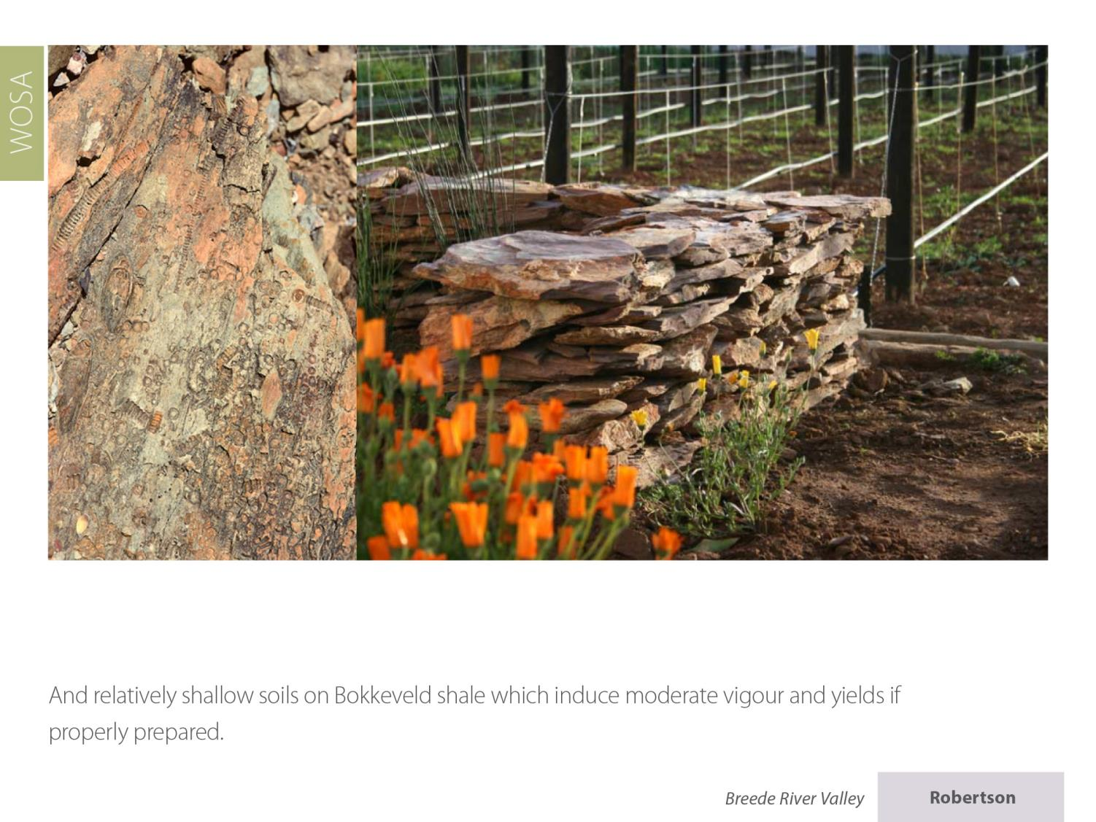
Robertson
Breede River Valley

Slide 25
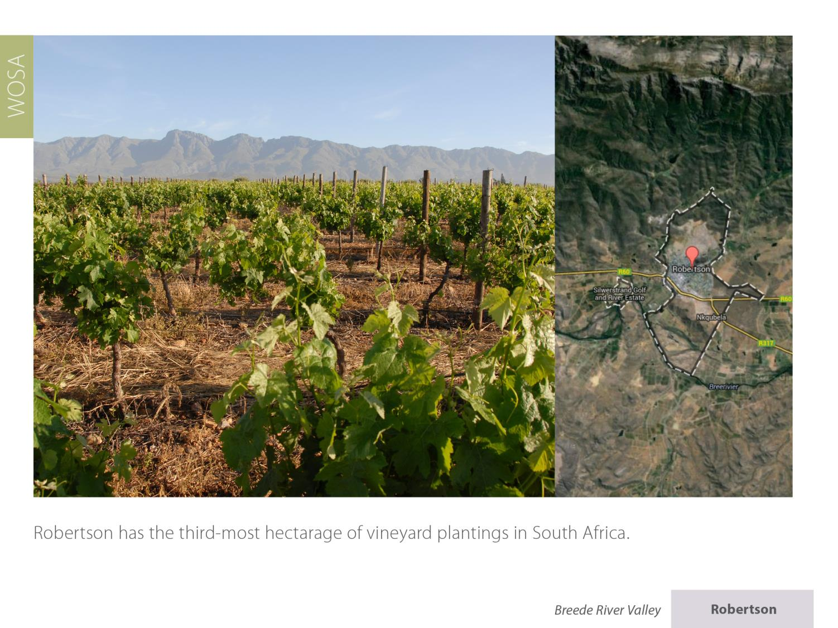
Robertson
Breede River Valley

Slide 26
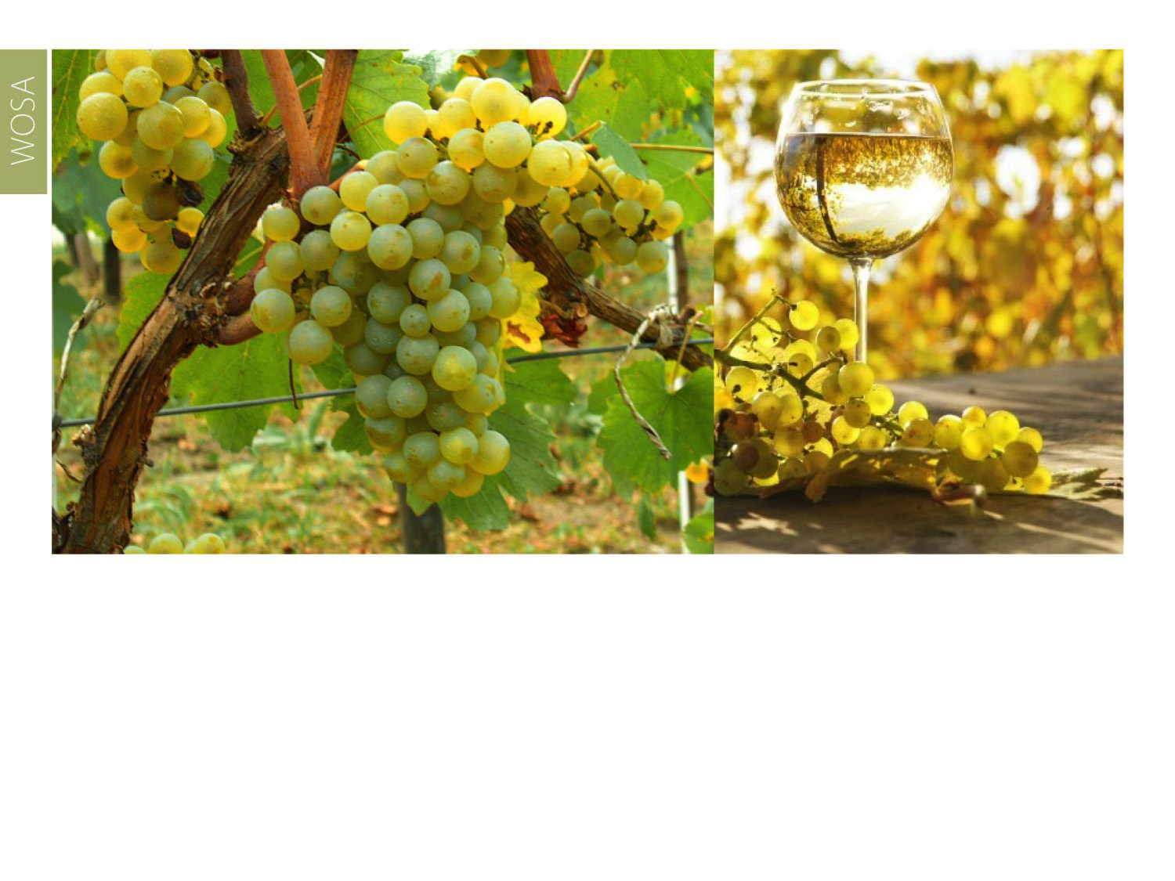
Plantings of Colombard account for the most hectarage of white-wine varieties, followed by Sauvignon Blanc, Chardonnay and Chenin Blanc.
Robertson
Breede River Valley

Slide 27
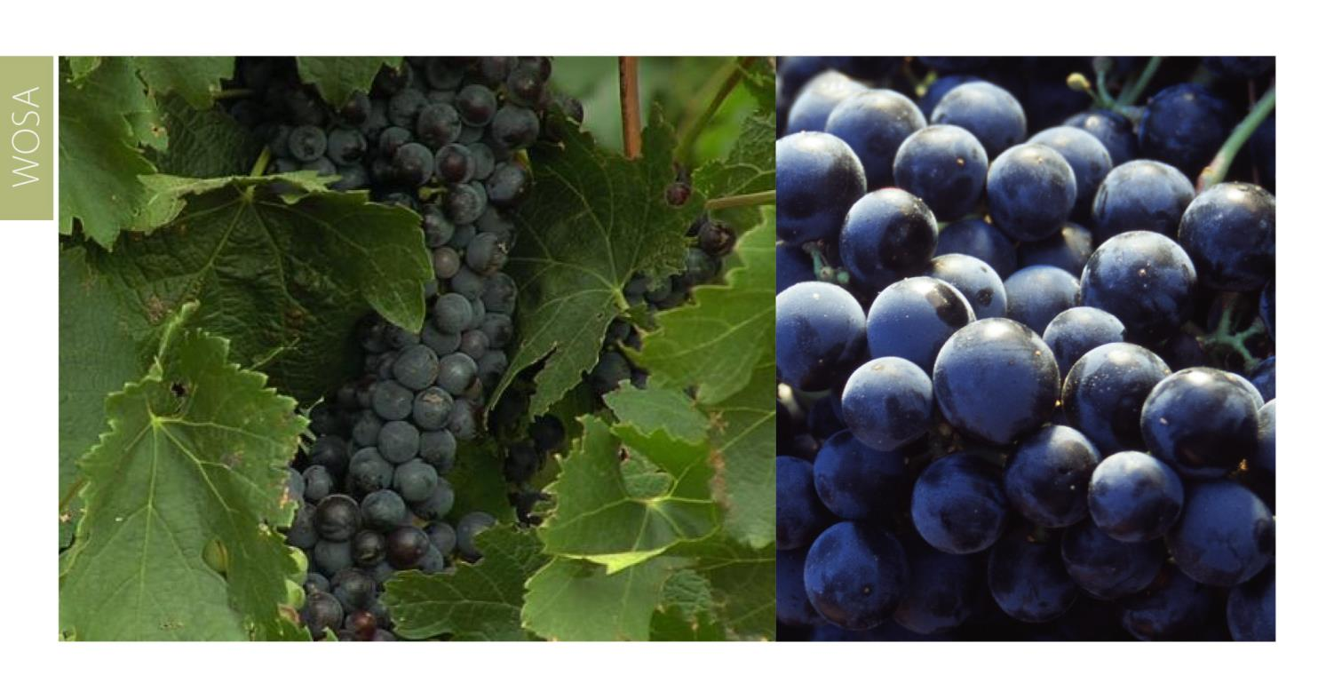
The most widely planted red-wine variety is Cabernet Sauvignon, followed by Shiraz and Pinotage.
Robertson
Breede River Valley

Slide 28
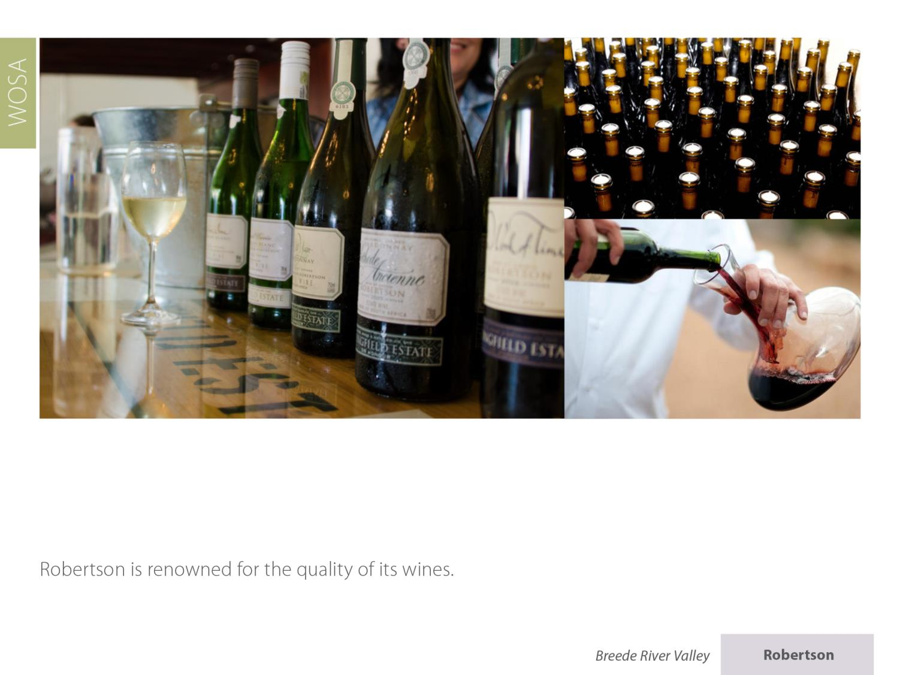
Robertson
Breede River Valley

Slide 29
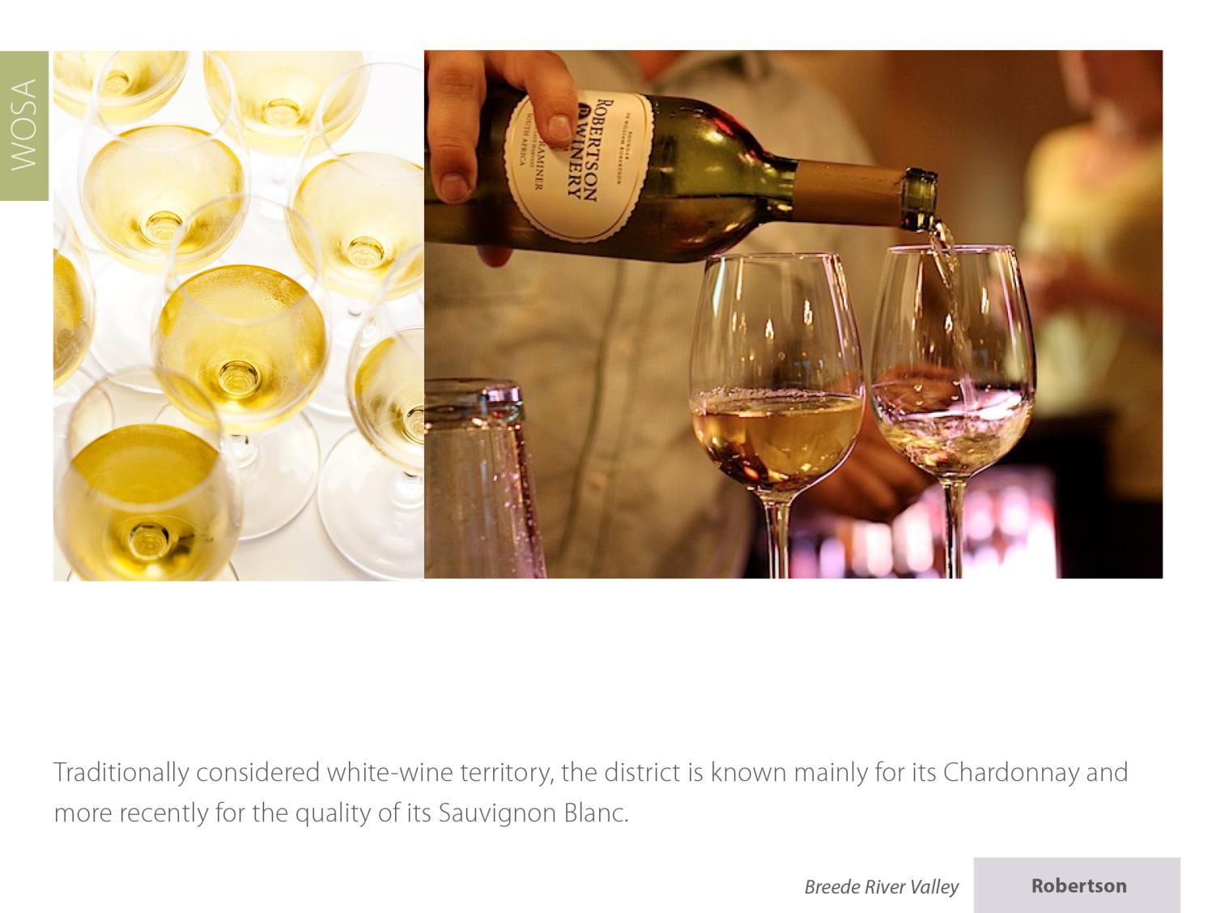
Robertson
Breede River Valley

Slide 30
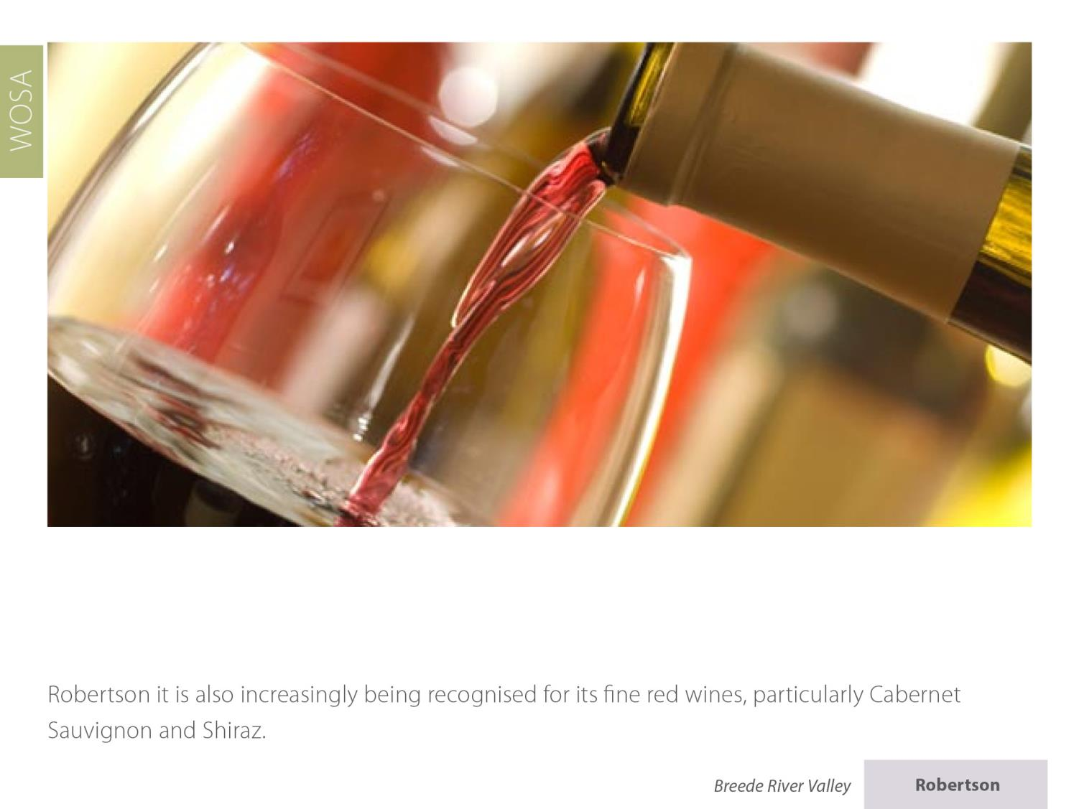
Robertson
Breede River Valley

Slide 31
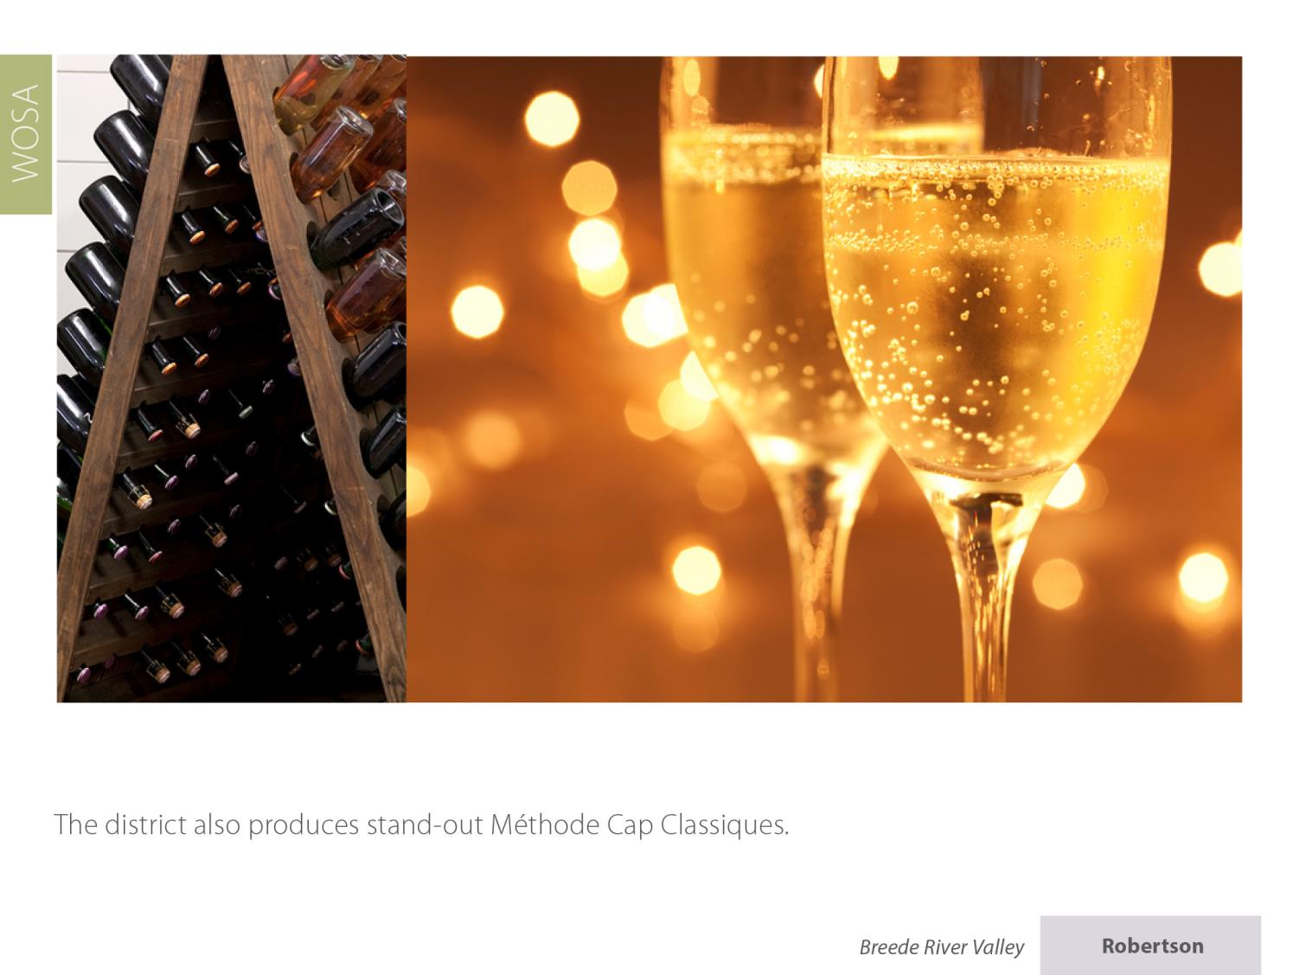
The district also produces stand-out Cap Classiques.
Robertson
Breede River Valley

Slide 32
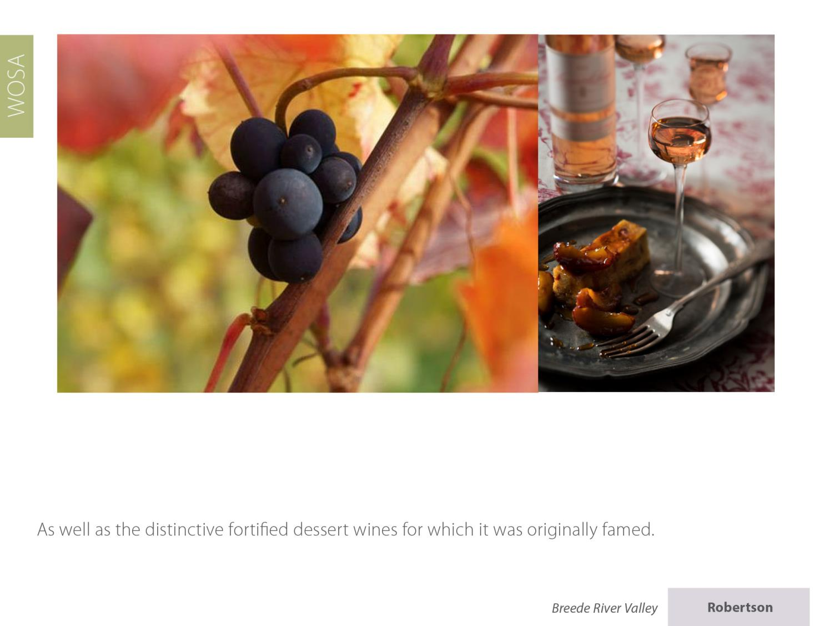
Robertson
Breede River Valley

Slide 33
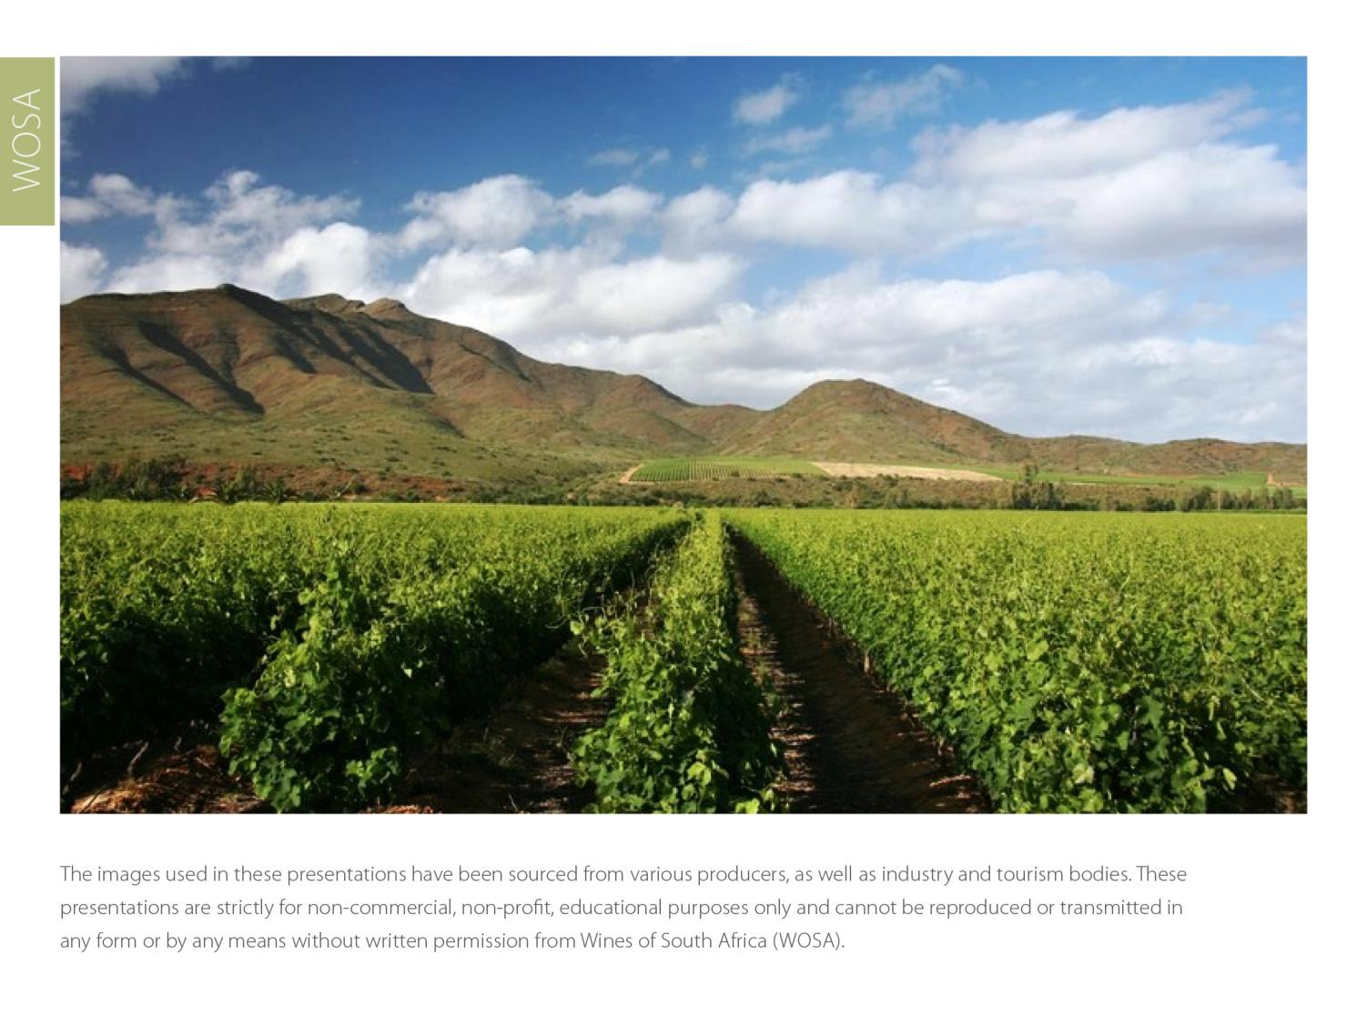
The images used in these presentations have been sourced from various producers, as well as industry and tourism bodies. These presentations are strictly for non-commercial, non-profit, educational purposes only and cannot be reproduced or transmitted in any form or by any means without written permission from Wines of South Africa (WoSA).

Slide 34
The Cape winelands, considered by many to be
the most beautiful in the world, have a network of
diverse and well-run wine routes, affording visitors
a varied and unforgettable experience.

Slide 35
THE END

