Slide 1
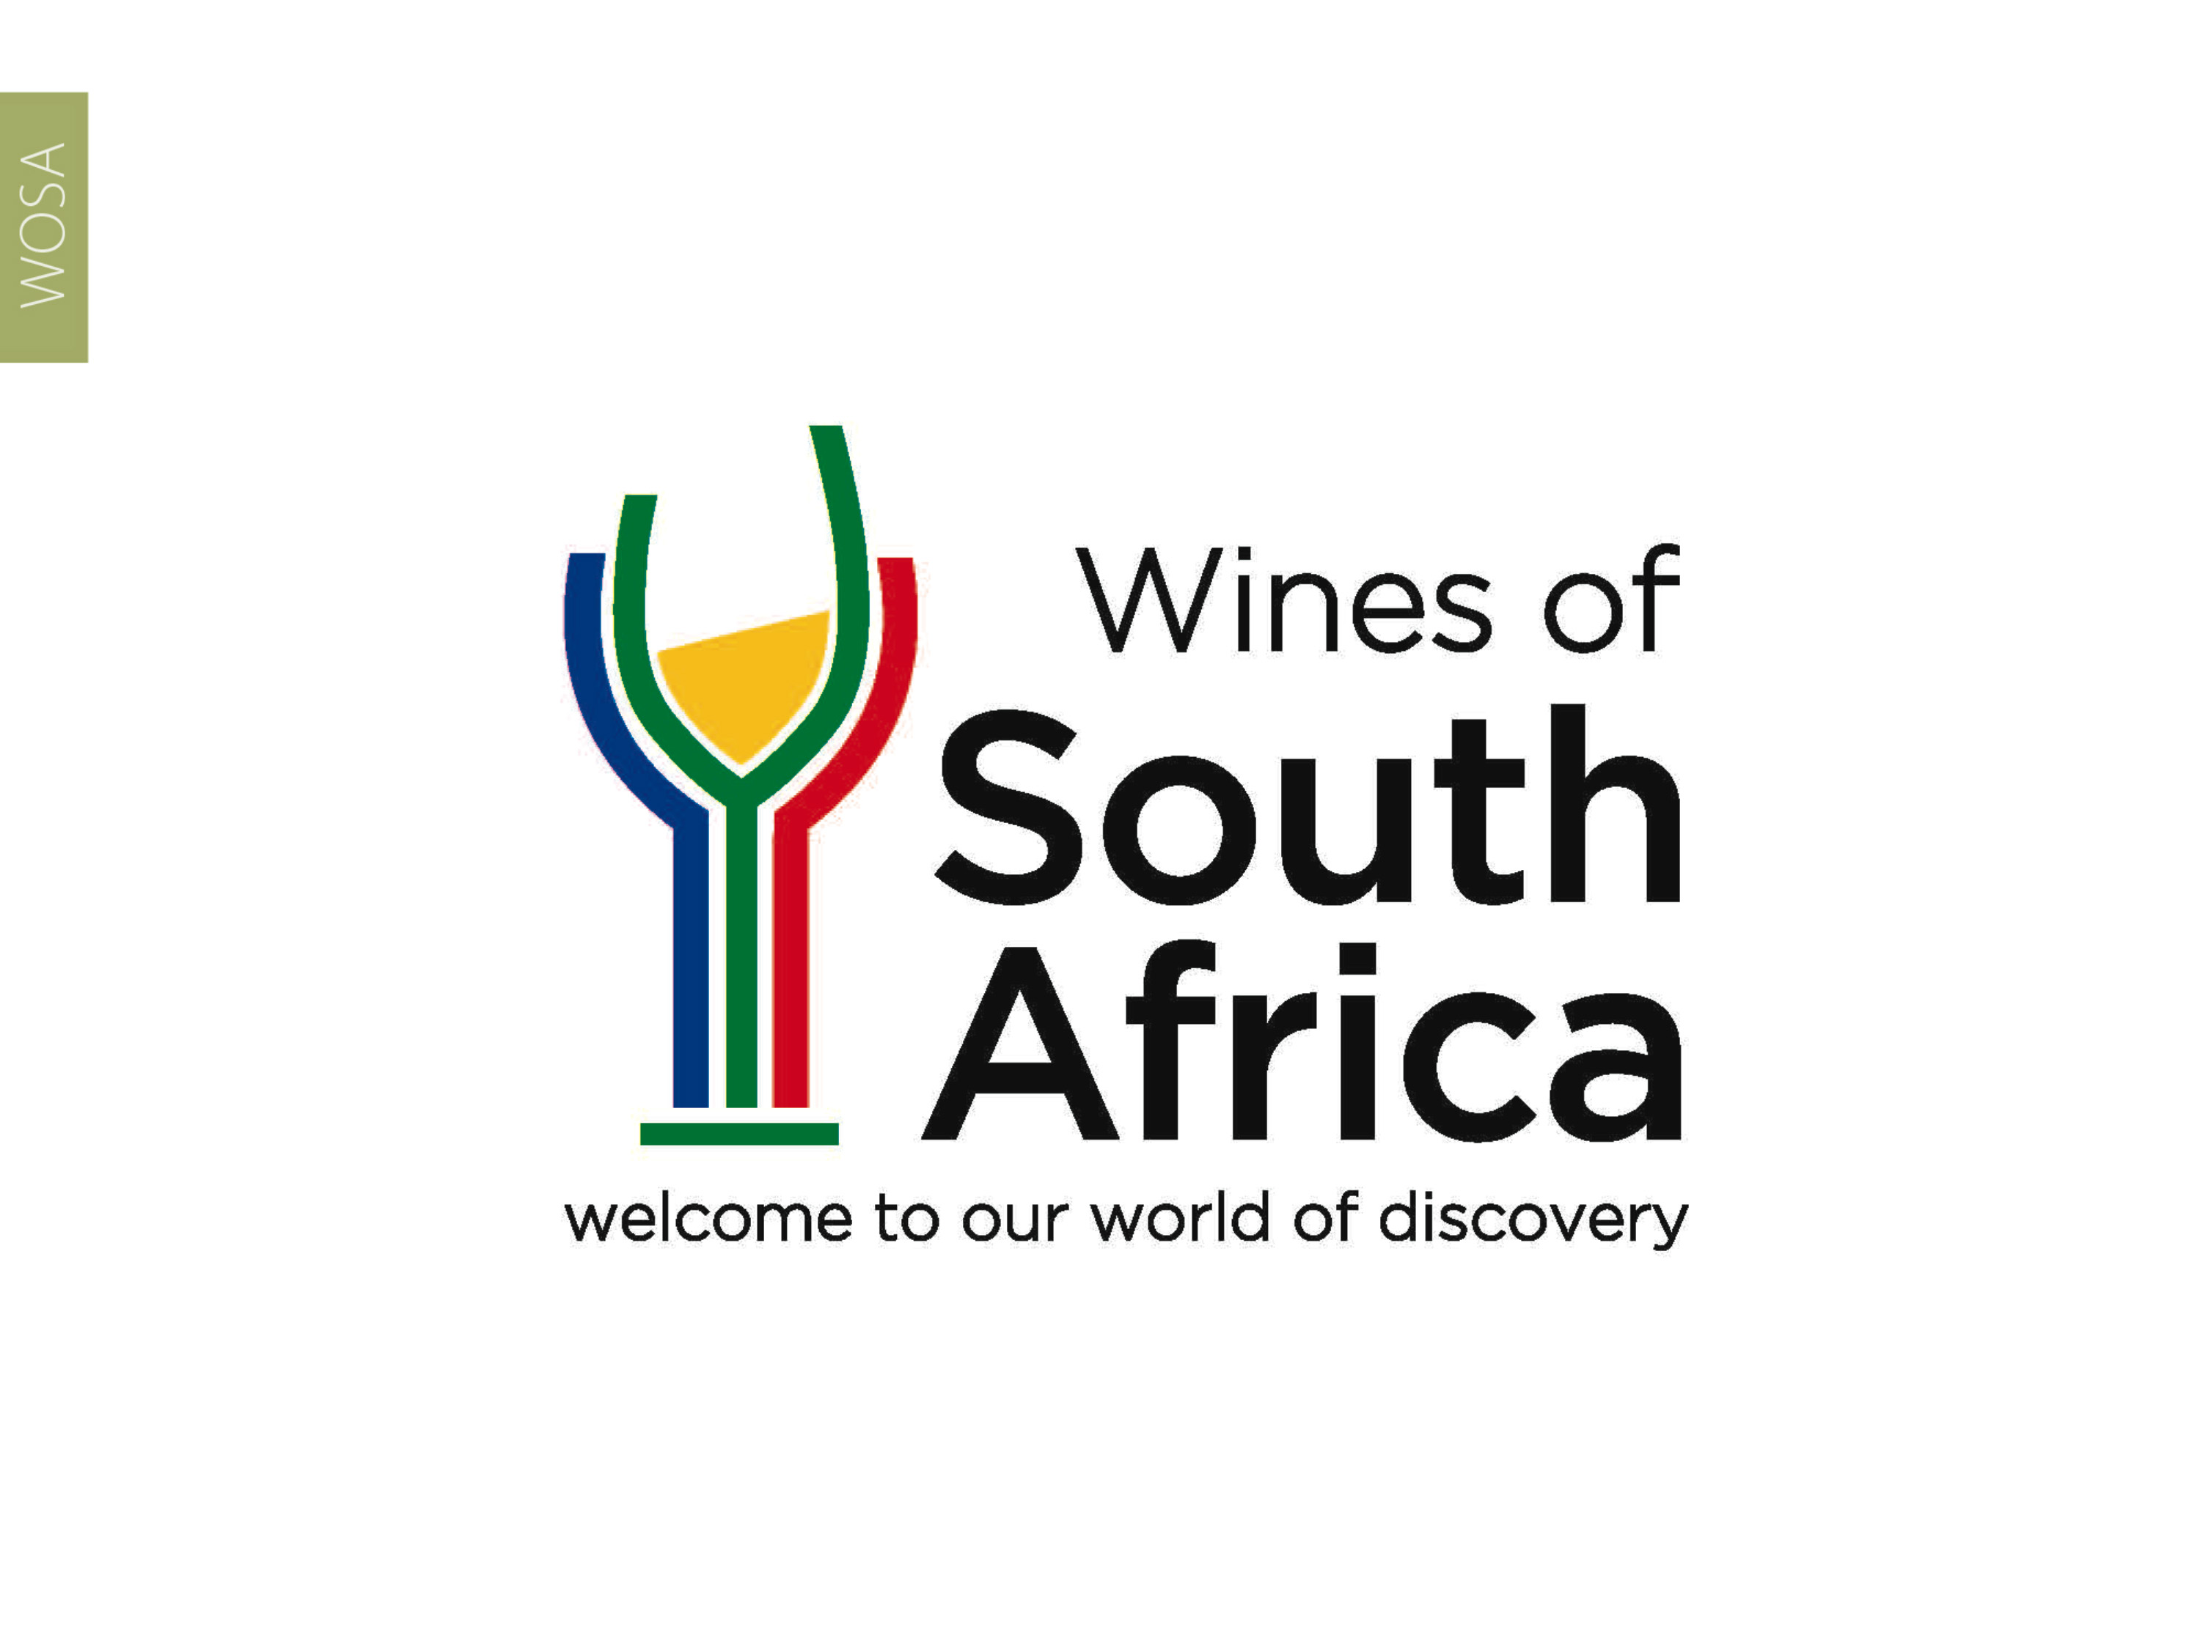
CAPE WINELANDS
WELLINGTON

Slide 2
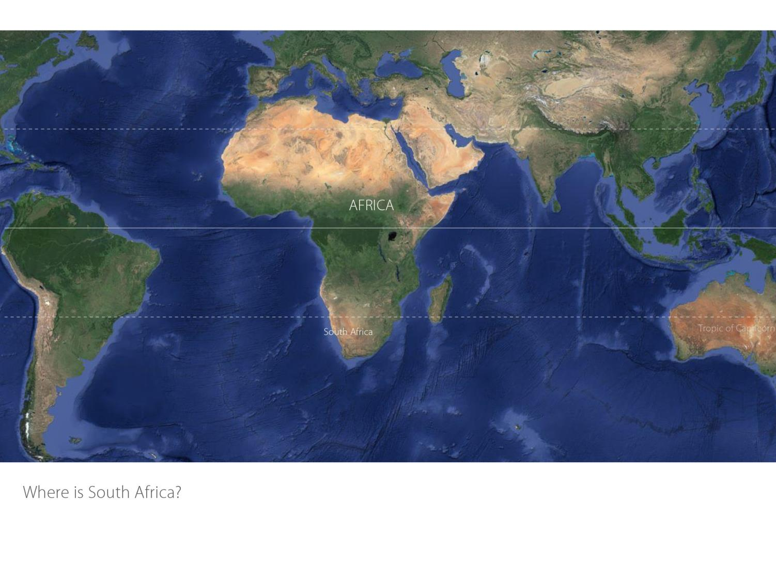

Slide 3
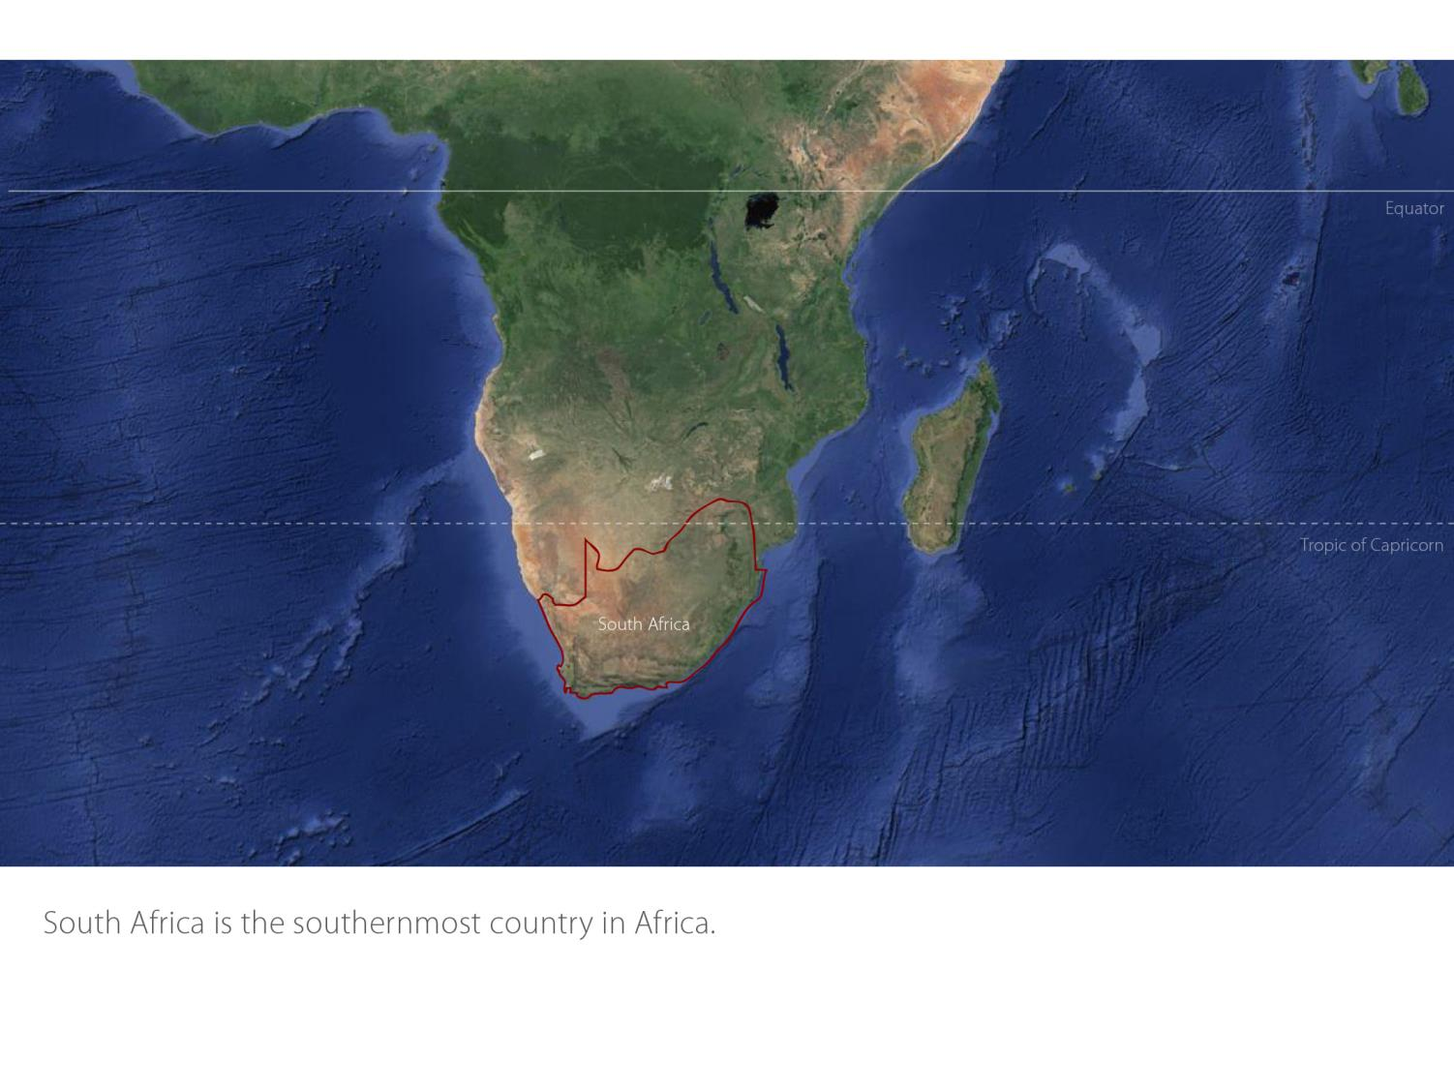

Slide 4
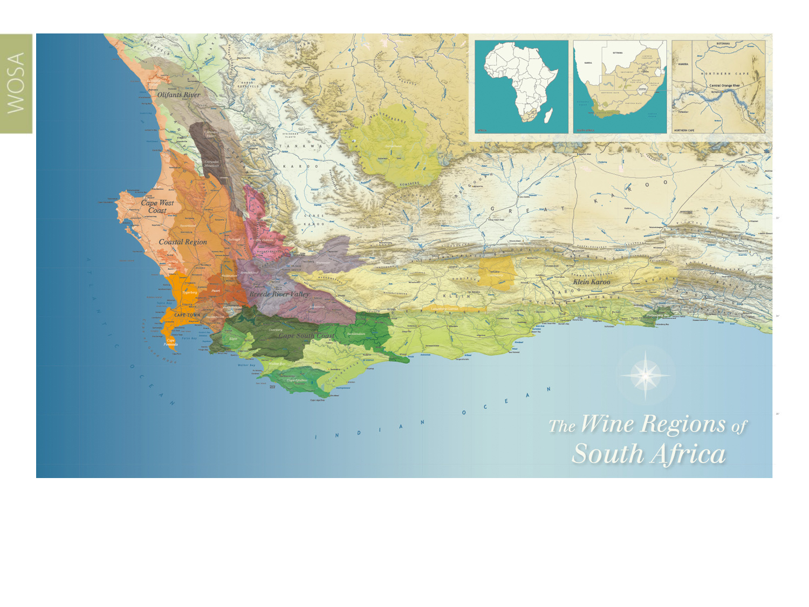
Our winelands are located at the very tip of South Africa.
Wellington
Coastal

Slide 5
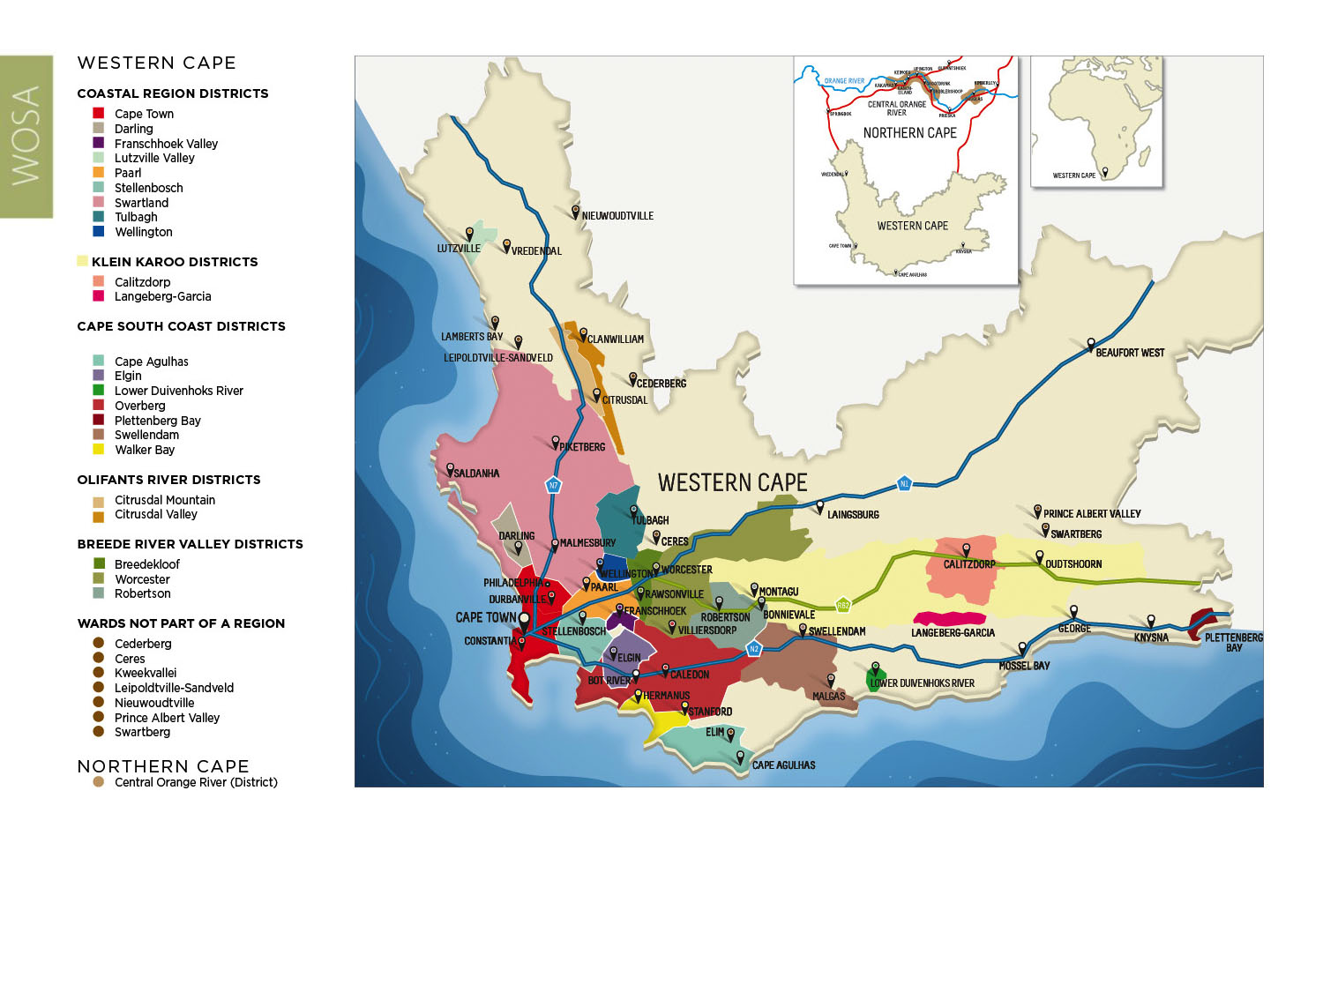
PRODUCTION AREAS: Districts of South Africa.
Wellington
Coastal

Slide 6
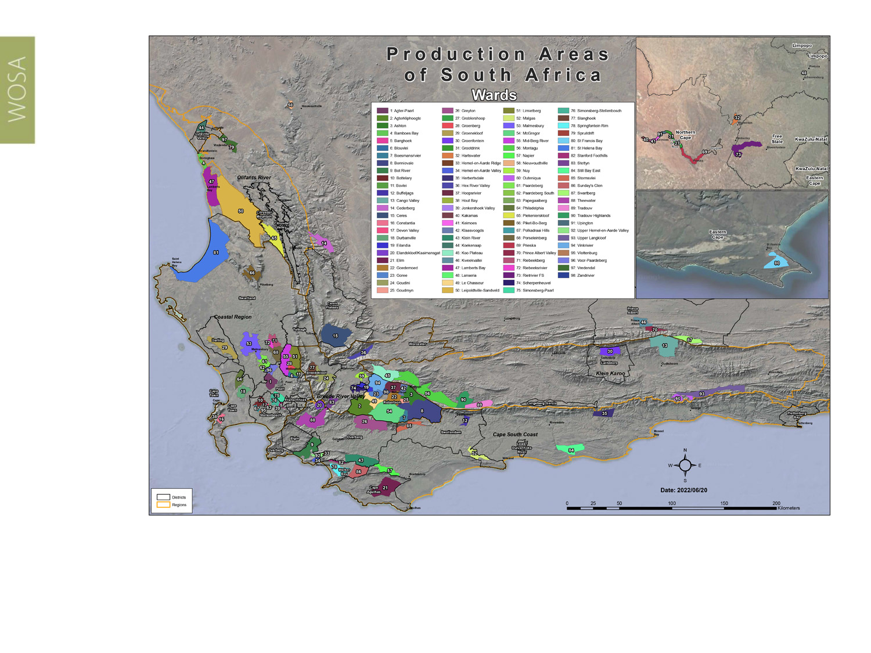
Wards of South Africa.
Wellington
Coastal

Slide 7
Coastal
Region: Coastal
District: Wellington
Wards: Wellington
Bovlei
Groenberg
Limietberg
Mid-Berg River
Wellington
Coastal

Slide 8
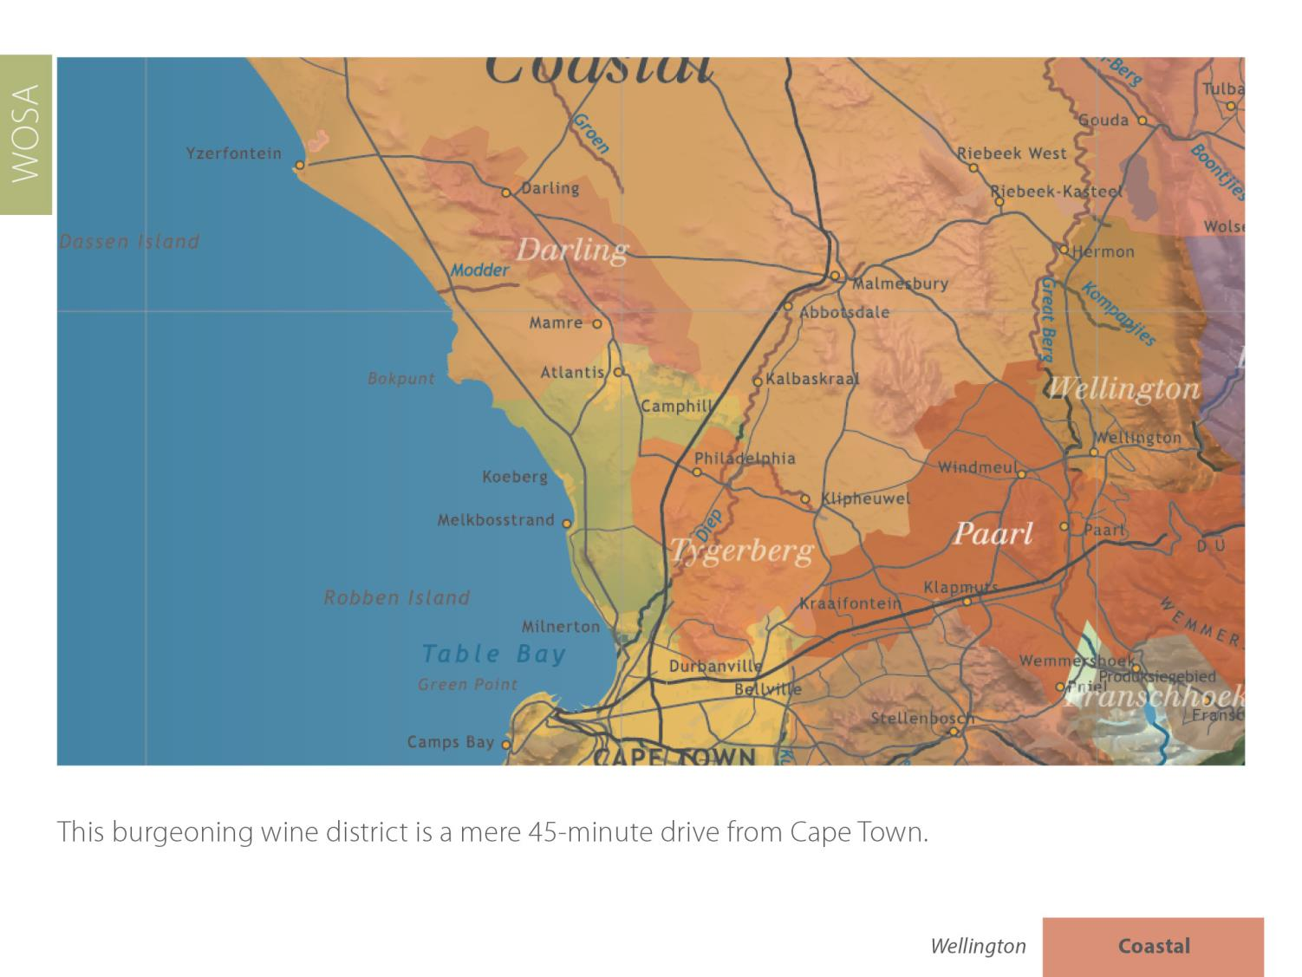
Wellington
Coastal

Slide 9
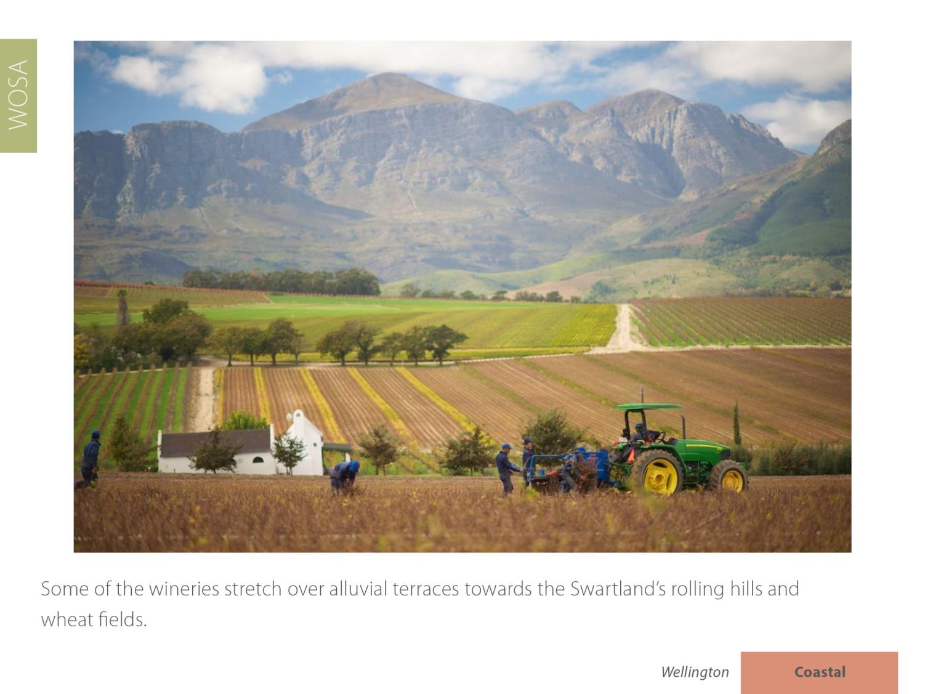
Wellington
Coastal

Slide 10
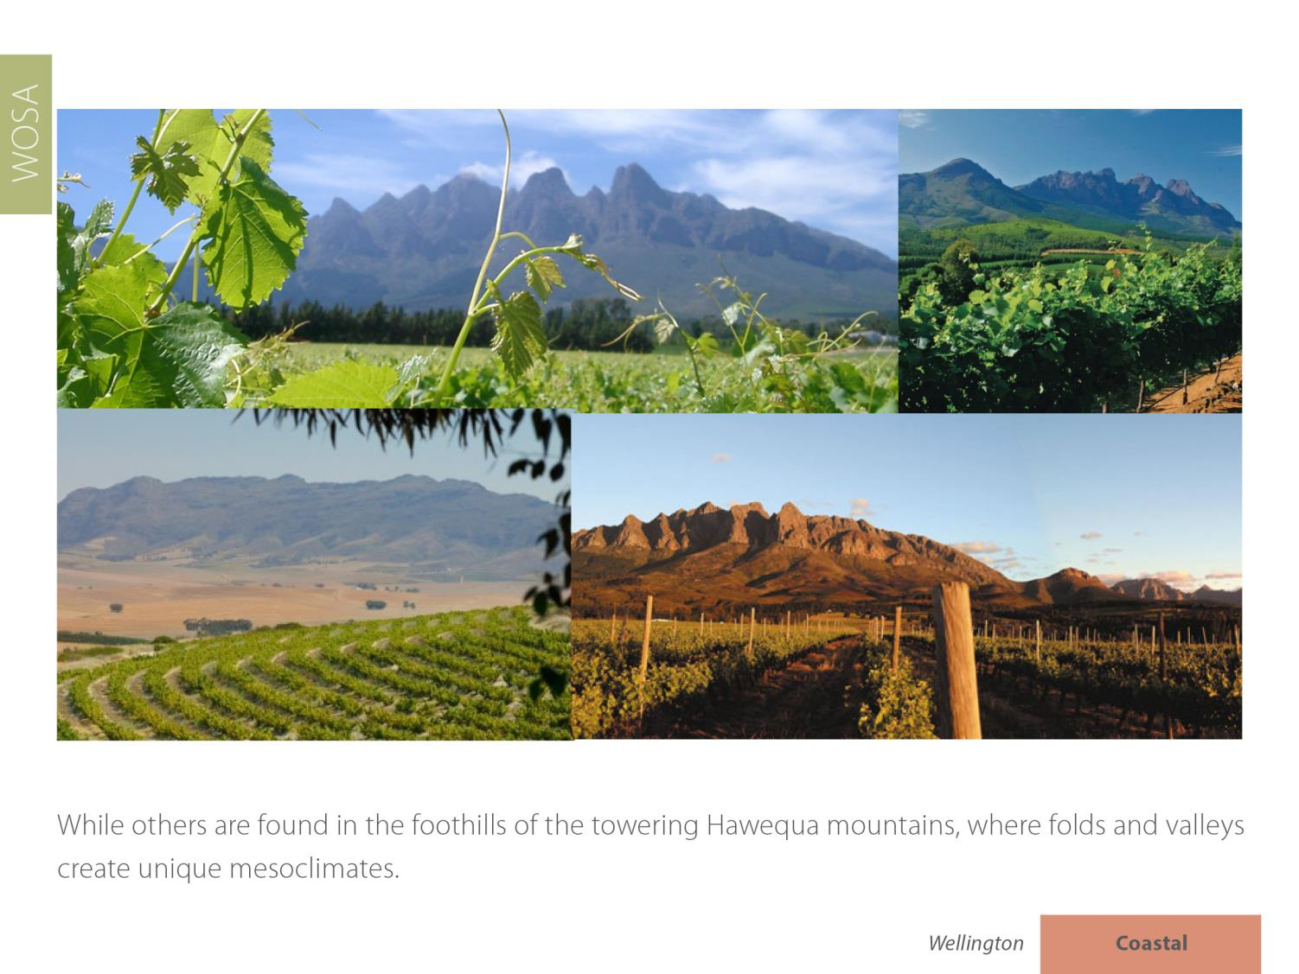
Wellington
Coastal

Slide 11
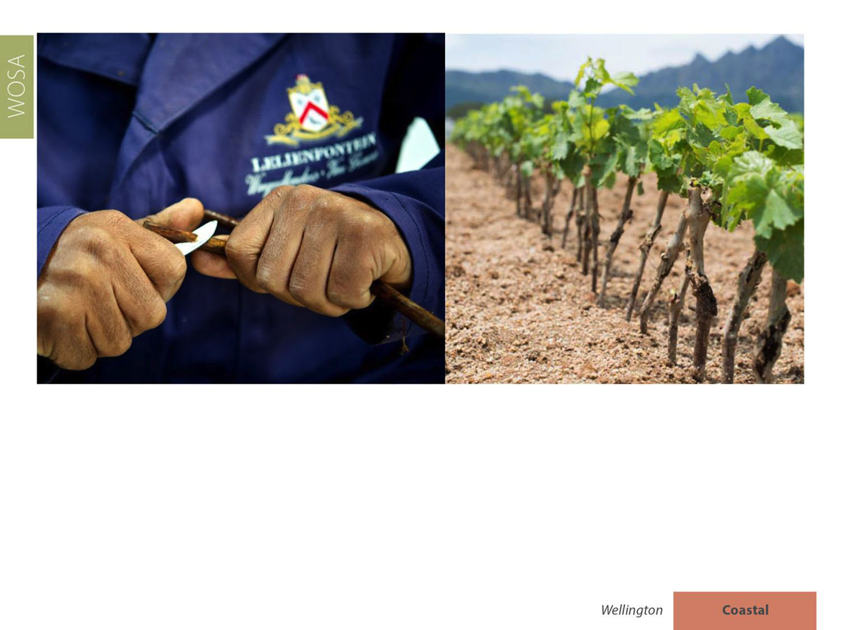
Wellington supplies 85% of the South African wine industry with cuttings.
Wellington
Coastal

Slide 12
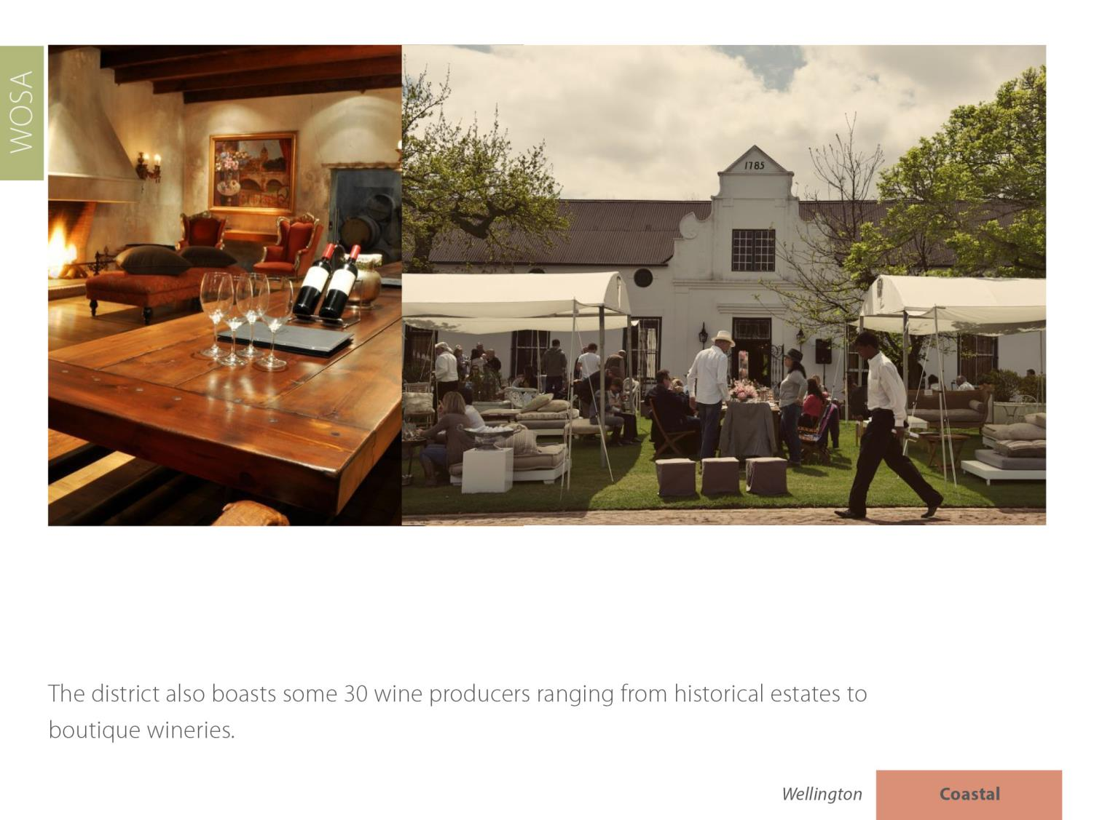
The district also boasts some 19 wine producers ranging from historical estates to boutique wineries.
Wellington
Coastal

Slide 13
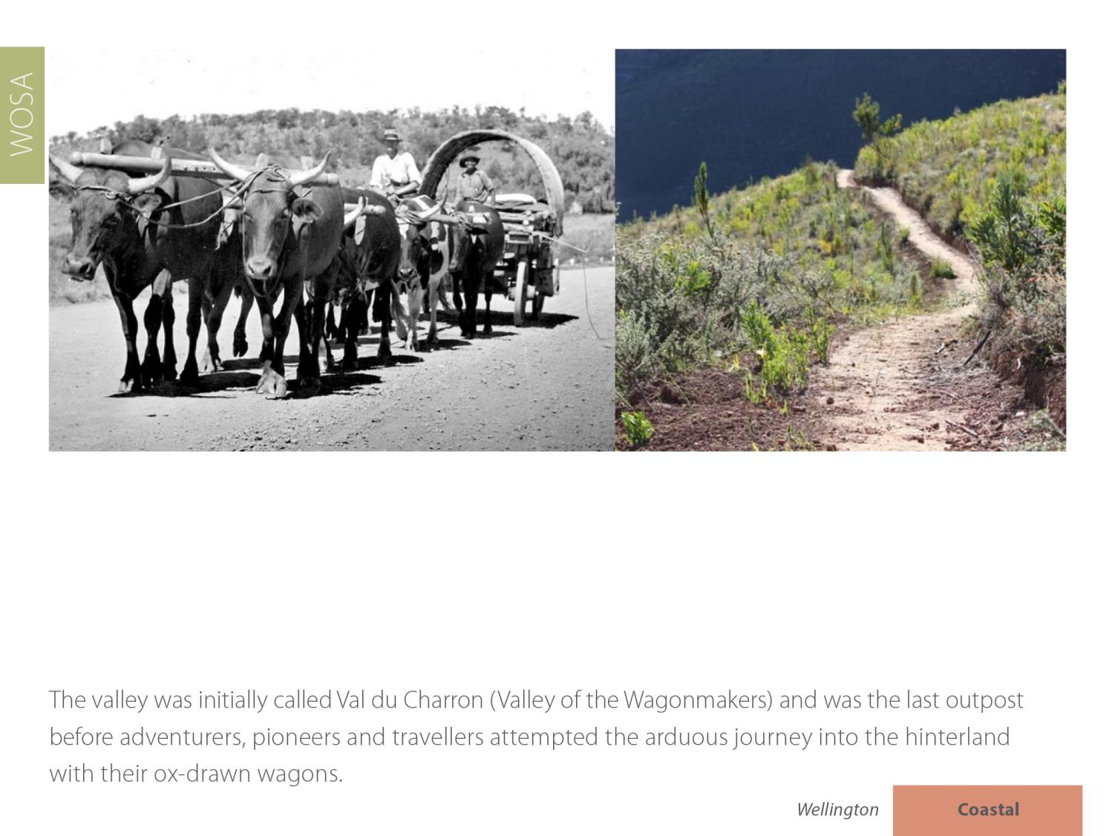
Wellington
Coastal

Slide 14
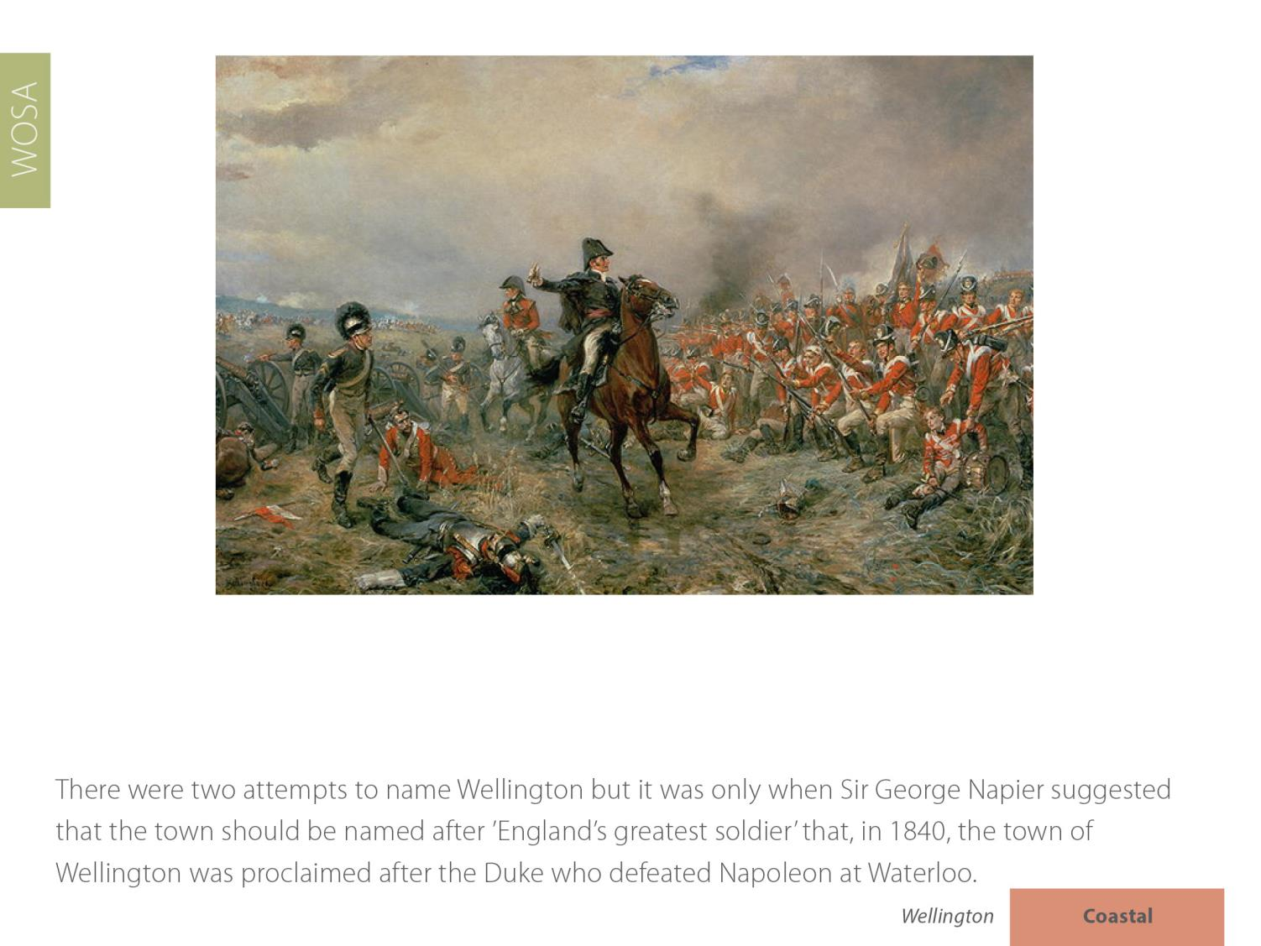
Wellington
Coastal

Slide 15
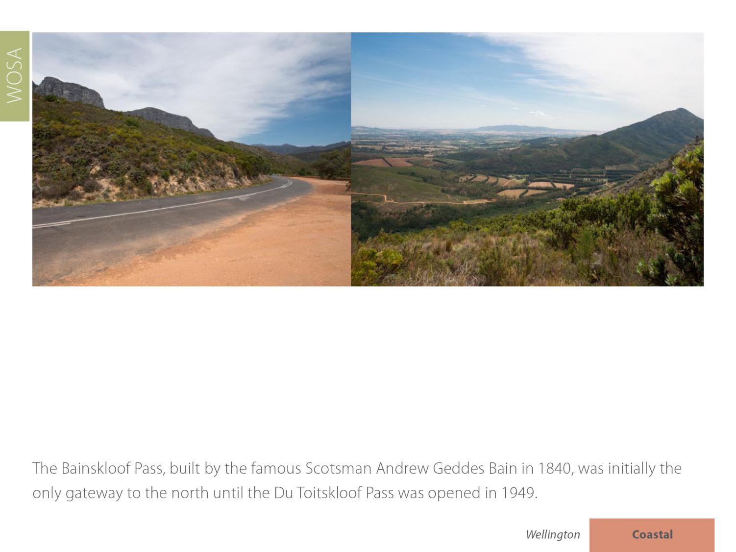
Wellington
Coastal

Slide 16
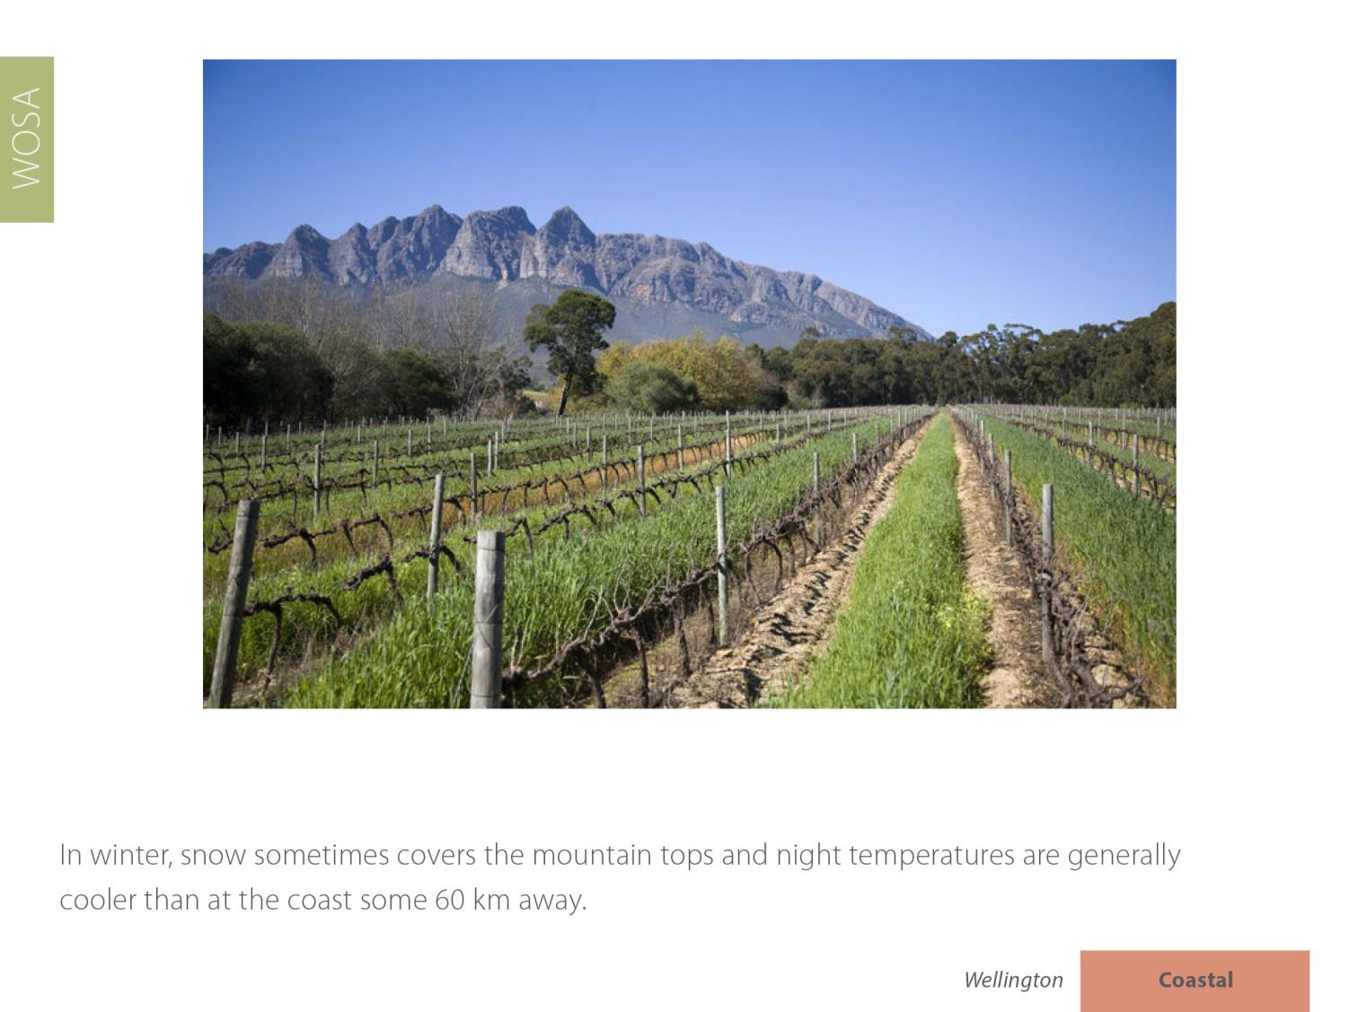
Wellington
Coastal

Slide 17
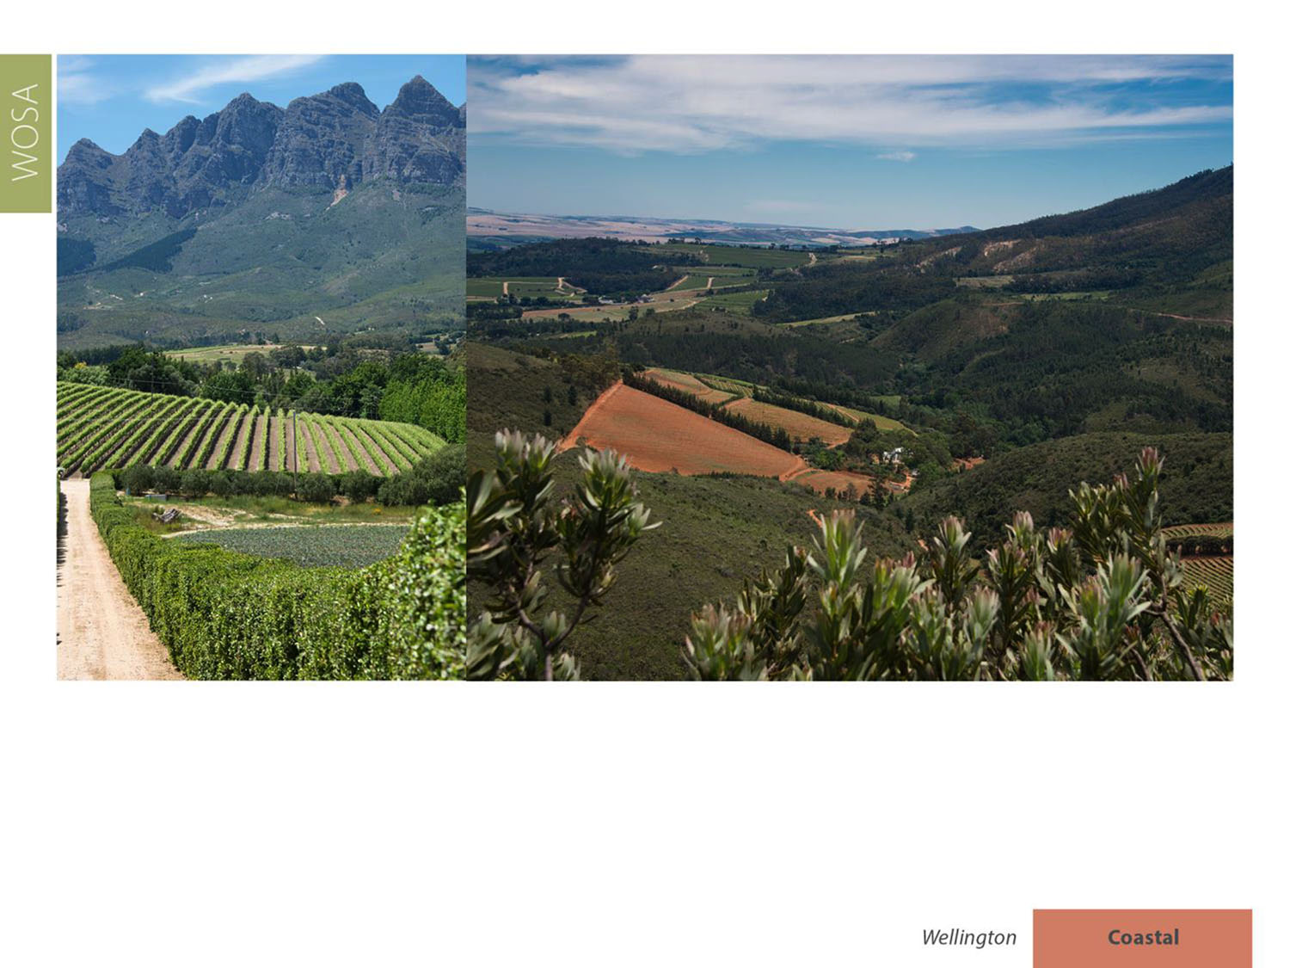
The average rainfall is 741 mm and the mean February temperature is 23.2⁰C
(Abenrude Weather Station).
Wellington
Coastal

Slide 18
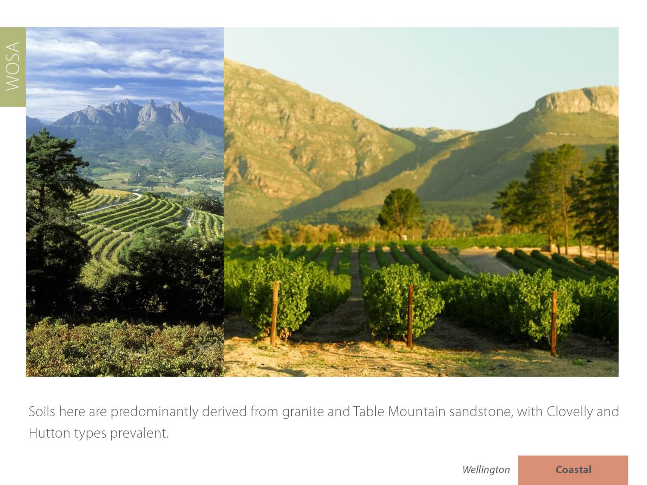
Wellington
Coastal

Slide 19
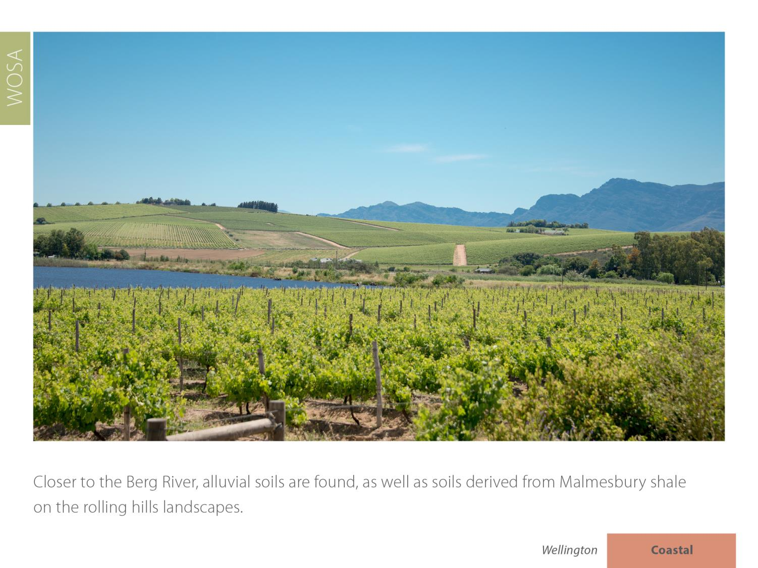
Wellington
Coastal

Slide 20
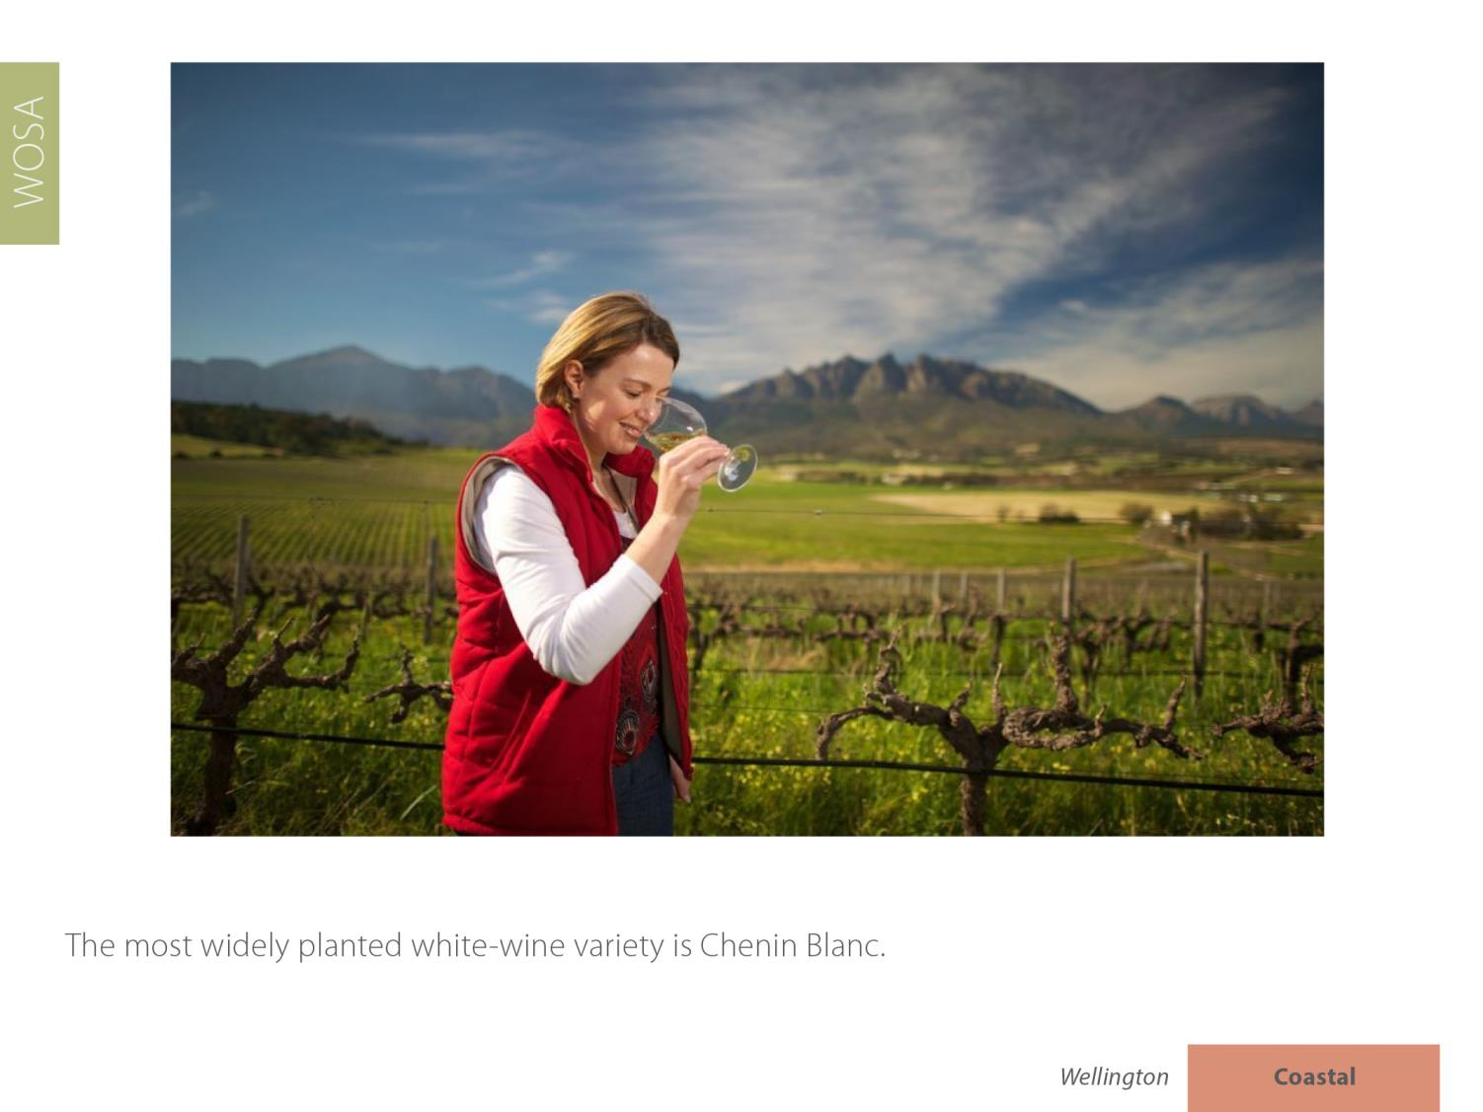
Wellington
Coastal

Slide 21
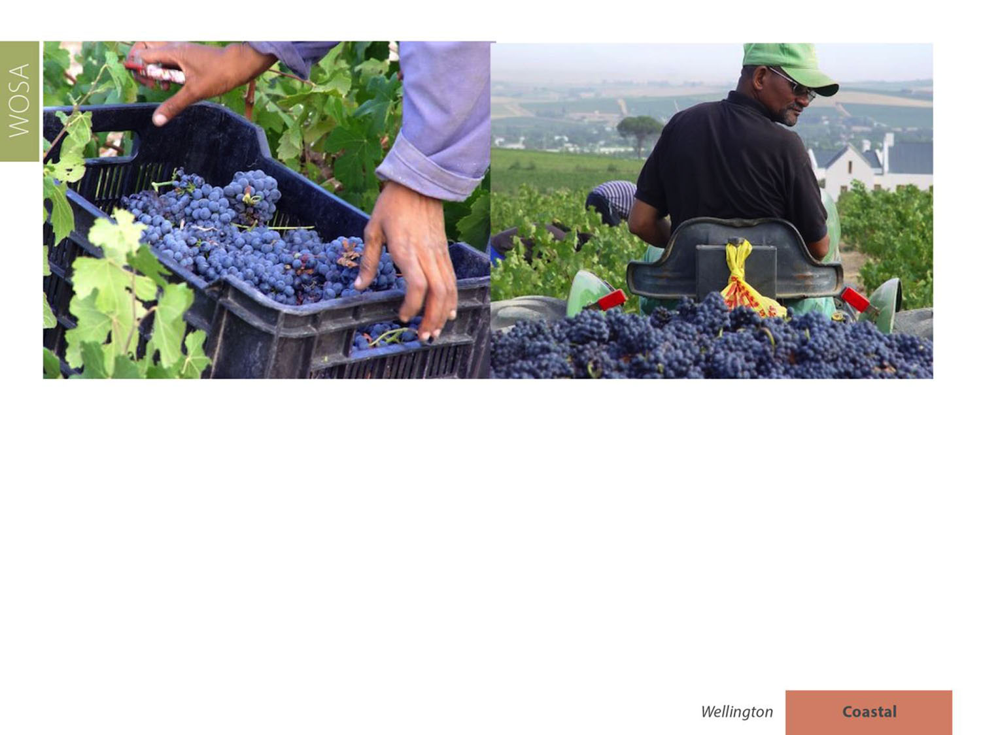
When it comes to red-wine varieties, Shiraz leads the way, followed by Cabernet Sauvignon and Pinotage.
Wellington
Coastal

Slide 22
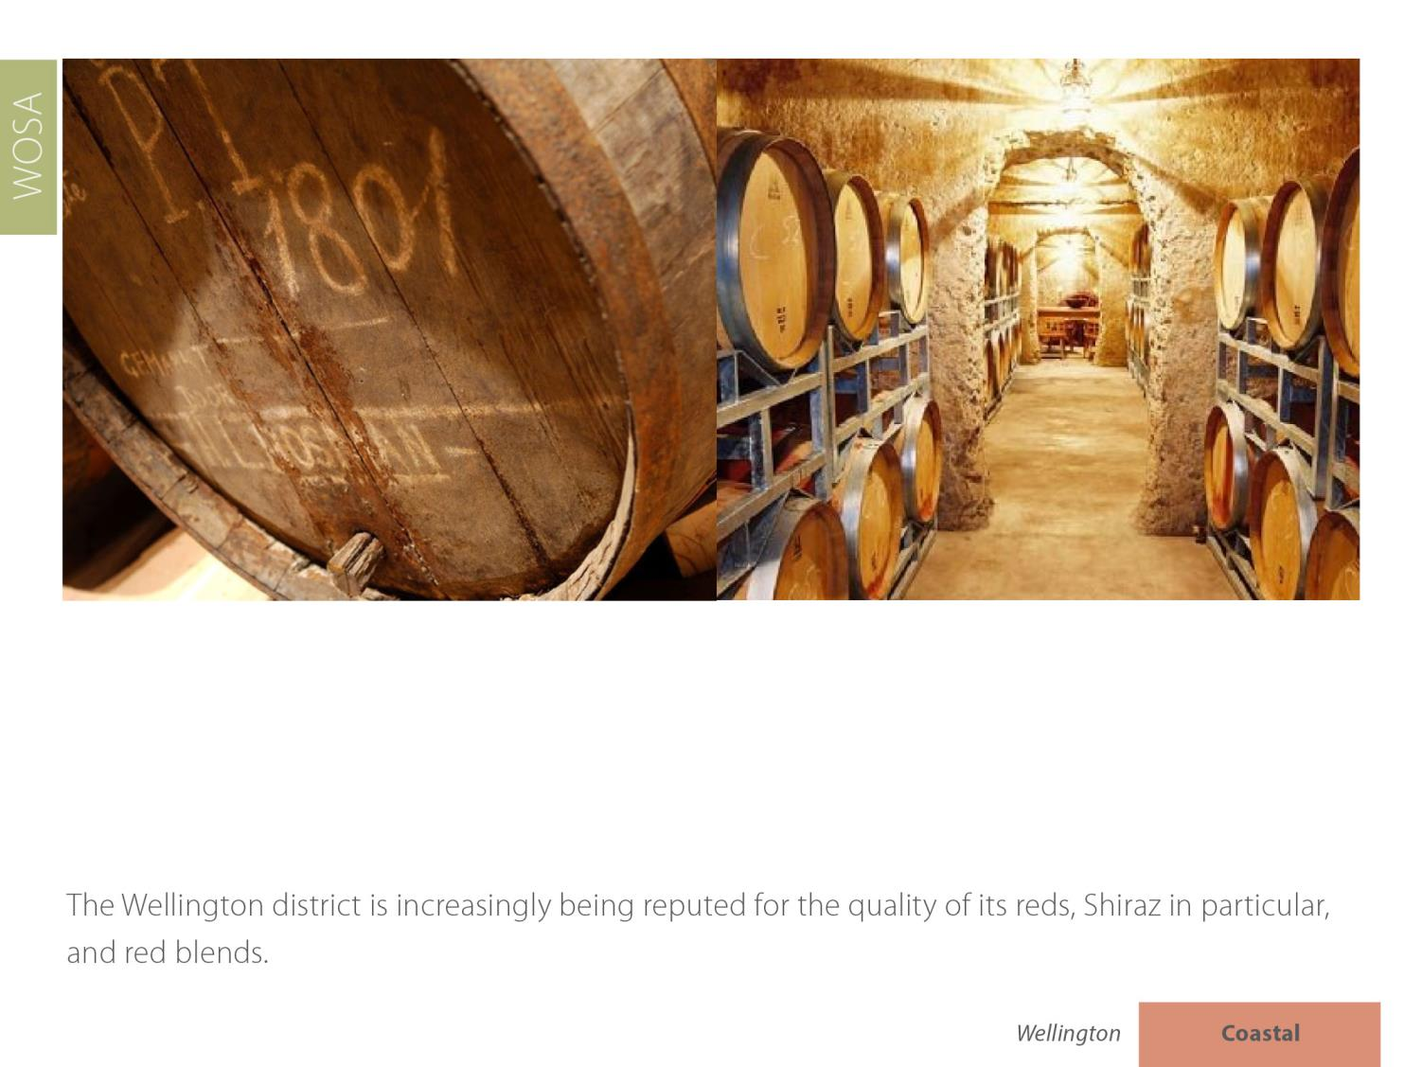
Wellington
Coastal

Slide 23
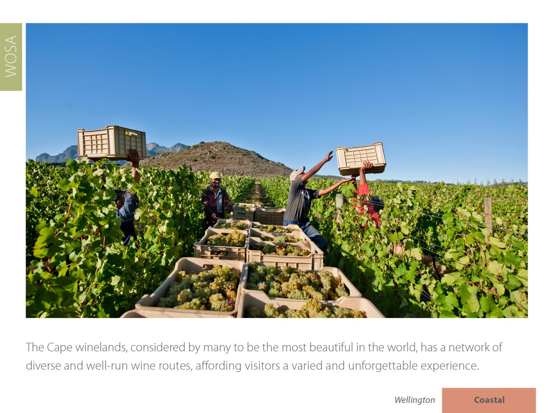
Wellington
Coastal

Slide 24
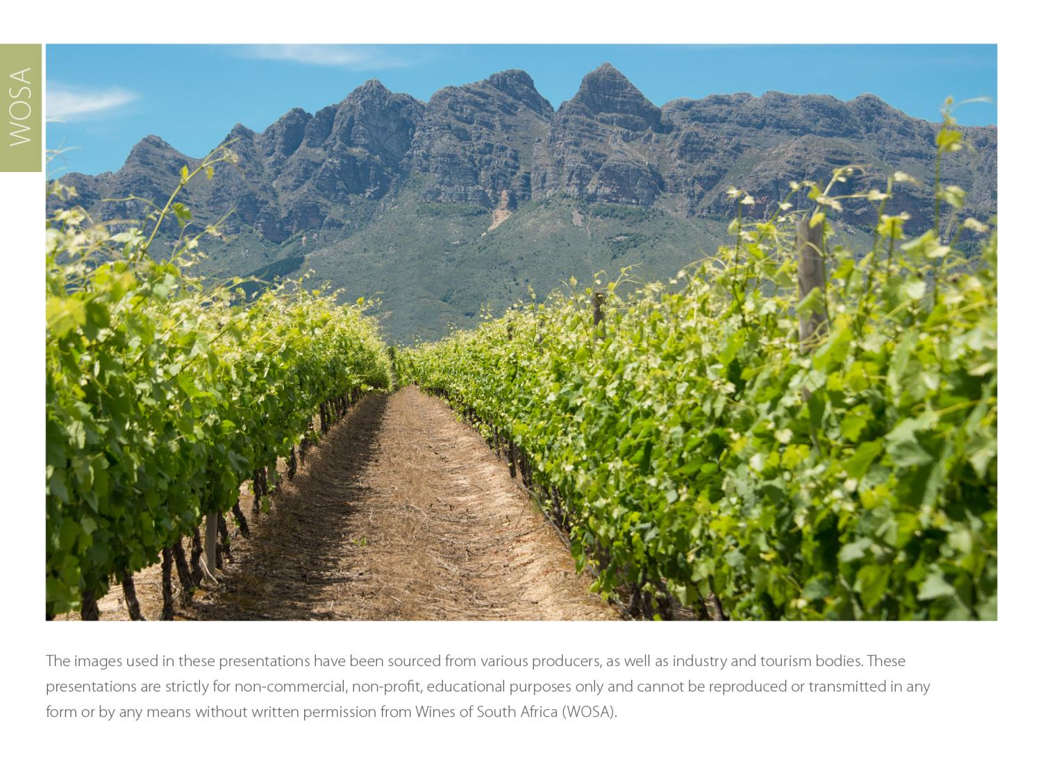
The images used in these presentations have been sourced from various producers, as well as industry and tourism bodies. These presentations are strictly for non-commercial, non-profit, educational purposes only and cannot be reproduced or transmitted in any form or by any means without written permission from Wines of South Africa (WoSA).

Slide 25
The Cape winelands, considered by many to be
the most beautiful in the world, have a network of
diverse and well-run wine routes, affording visitors
a varied and unforgettable experience.

Slide 26
THE END

