Slide 1
CAPE WINELANDS
DURBANVILLE

Slide 2
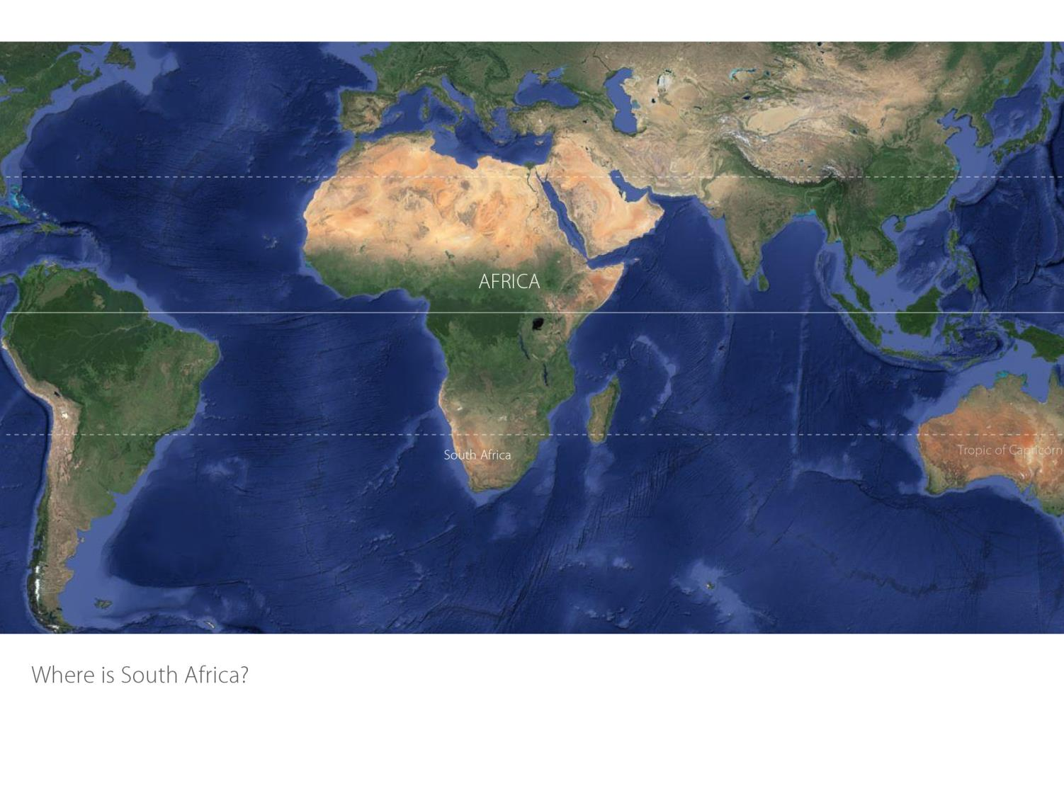

Slide 3
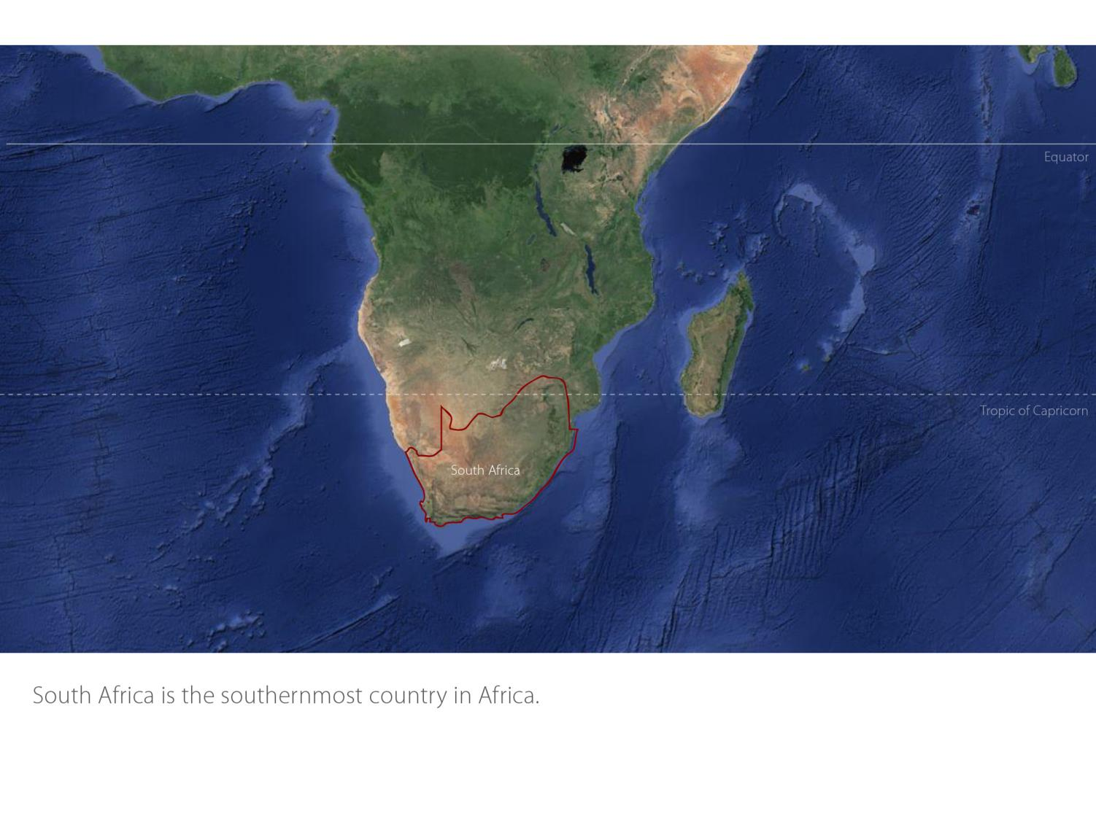

Slide 4
Our winelands are located at the very tip of South Africa.
Durbanville
Coastal

Slide 5
Coastal
Region: Coastal
District: Cape Town
Wards: Durbanville Philadelphia
Durbanville
Coastal

Slide 6
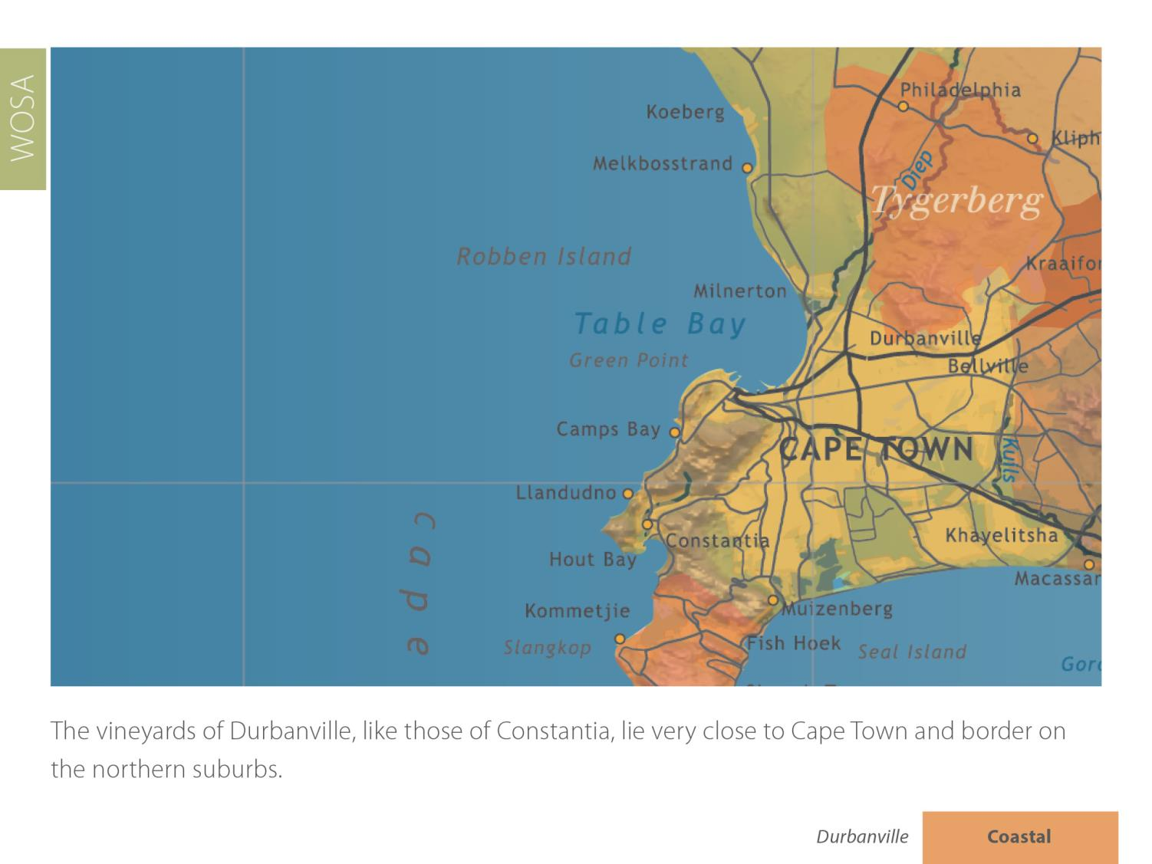
Durbanville
Coastal
Durbanville
Coastal

Slide 7
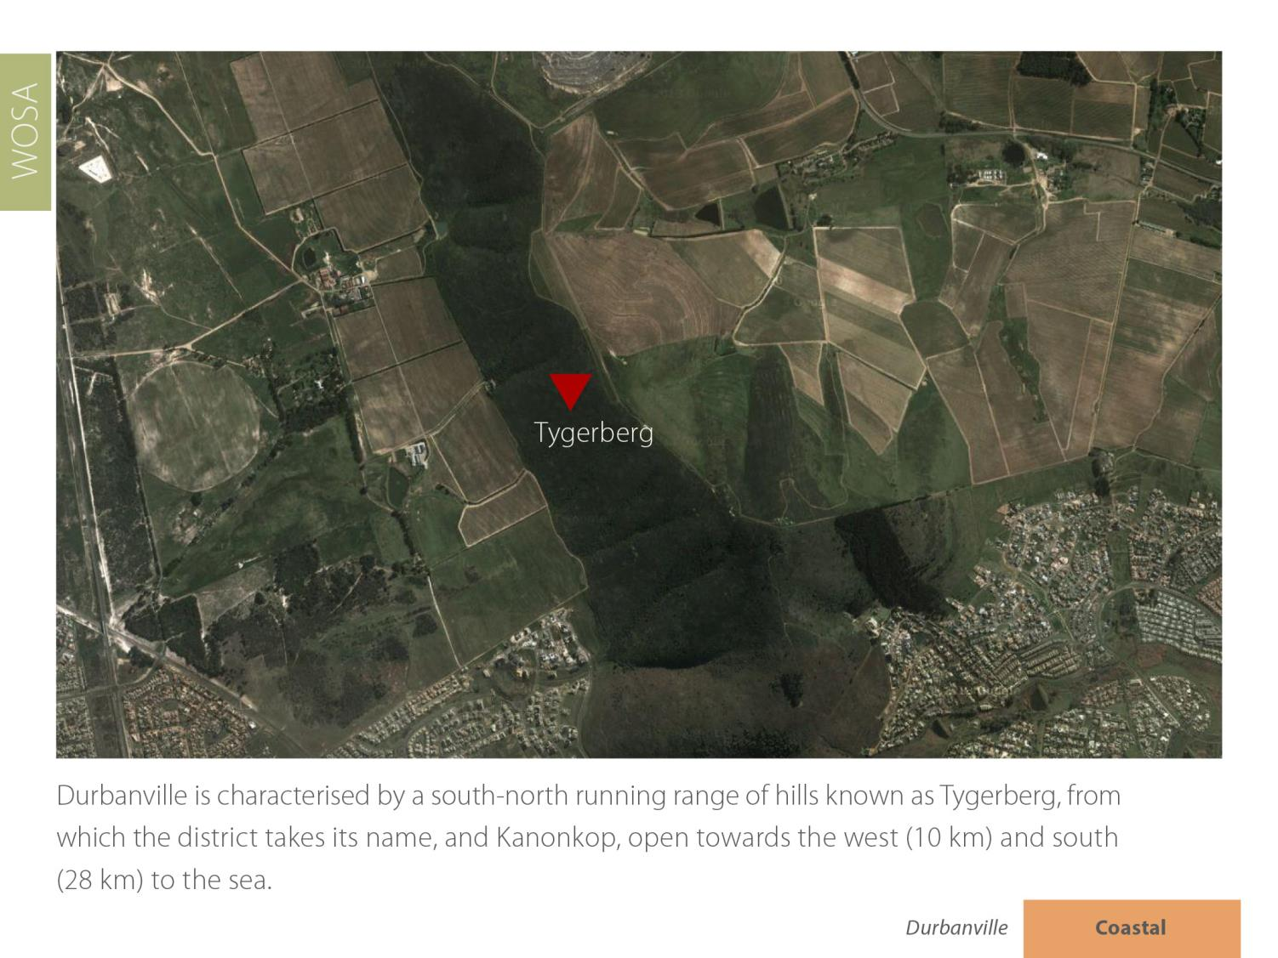
Durbanville
Coastal

Slide 8
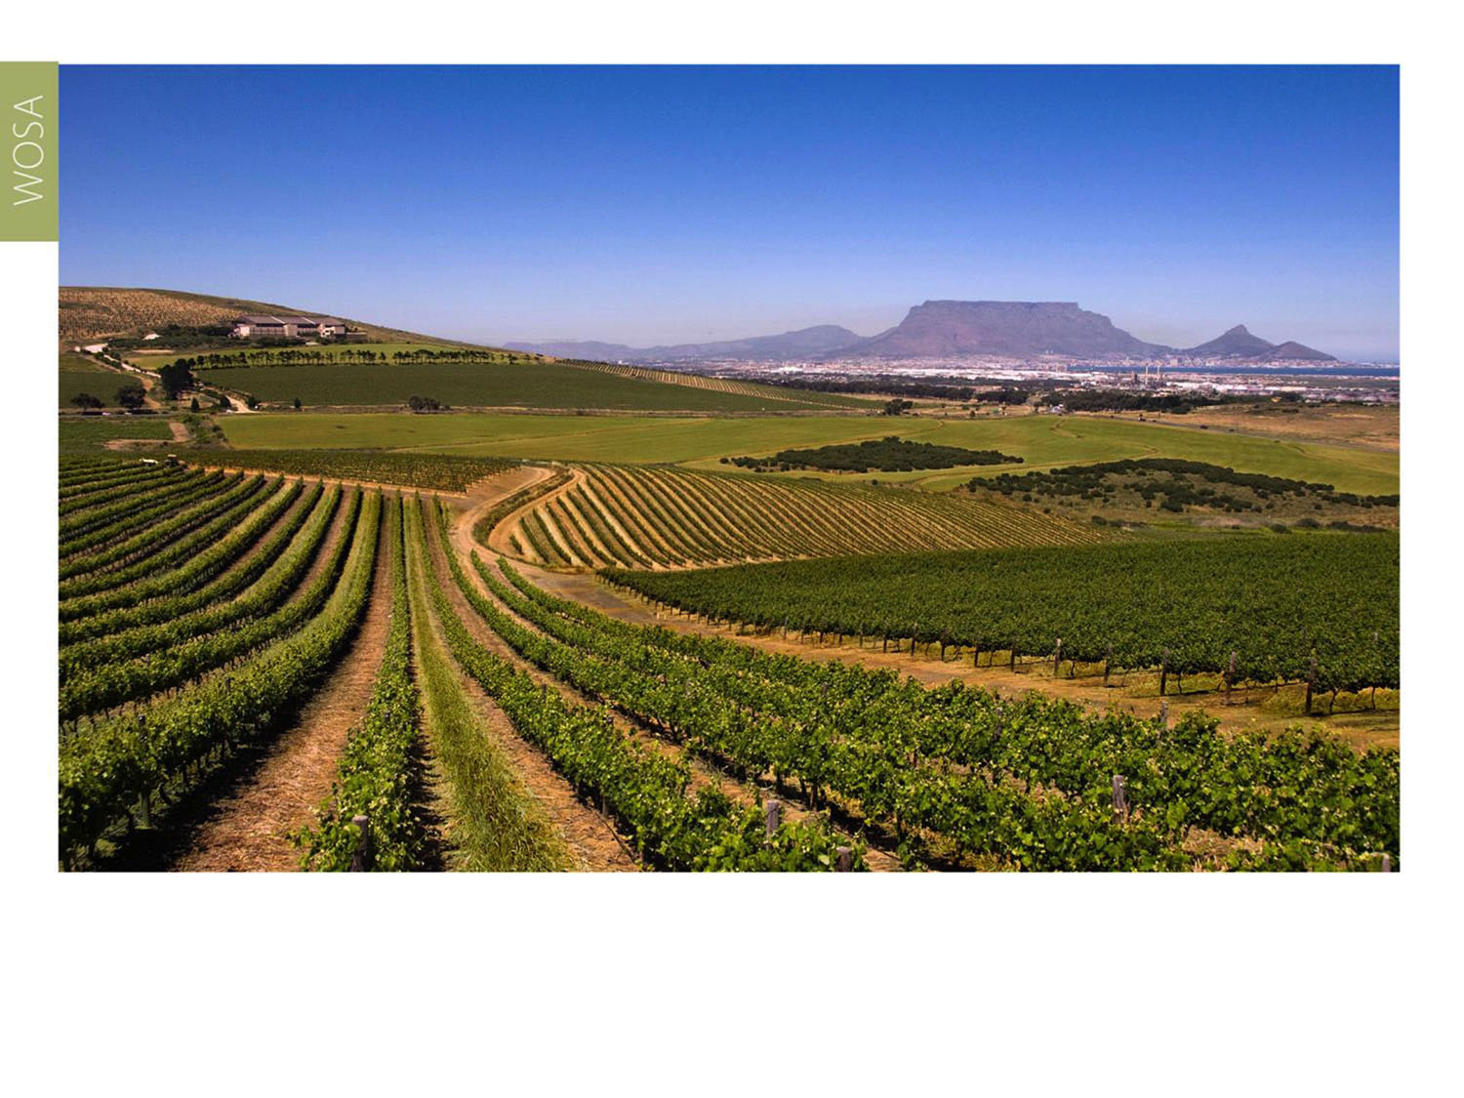
Although the mean February temperature is given as 22.8˚C, the duration of high temperatures during the day is short.
Durbanville
Coastal

Slide 9
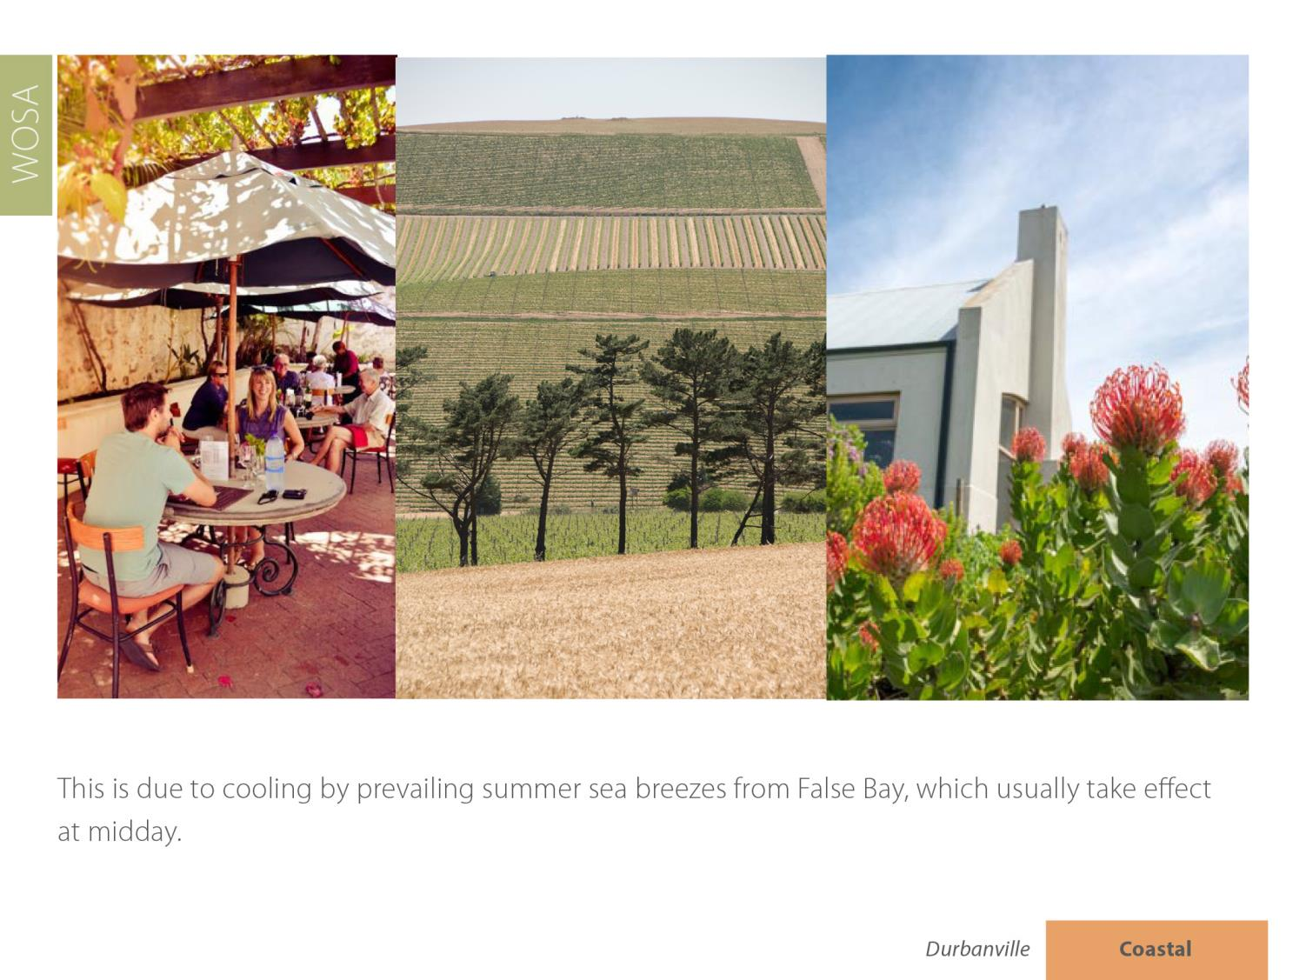
Durbanville
Coastal

Slide 10
Durbanville
Coastal

Slide 11
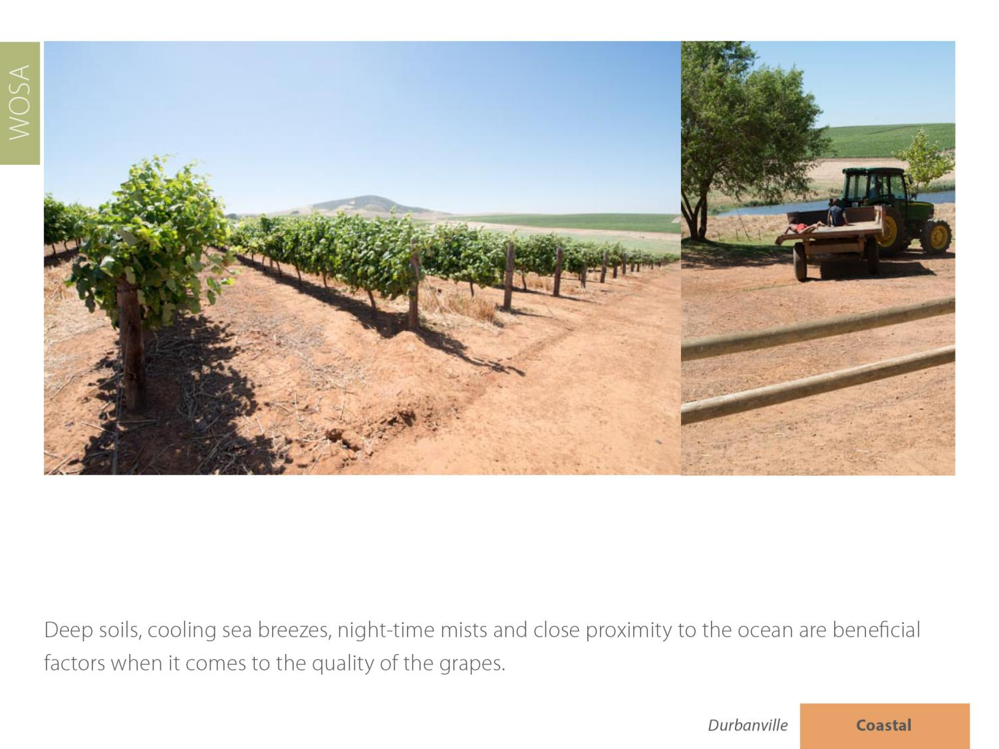
Durbanville
Coastal

Slide 12
Durbanville has an average rainfall of only 481 mm on the eastern slopes and even less on the western slopes.
Durbanville
Coastal

Slide 13
Durbanville
Coastal

Slide 14
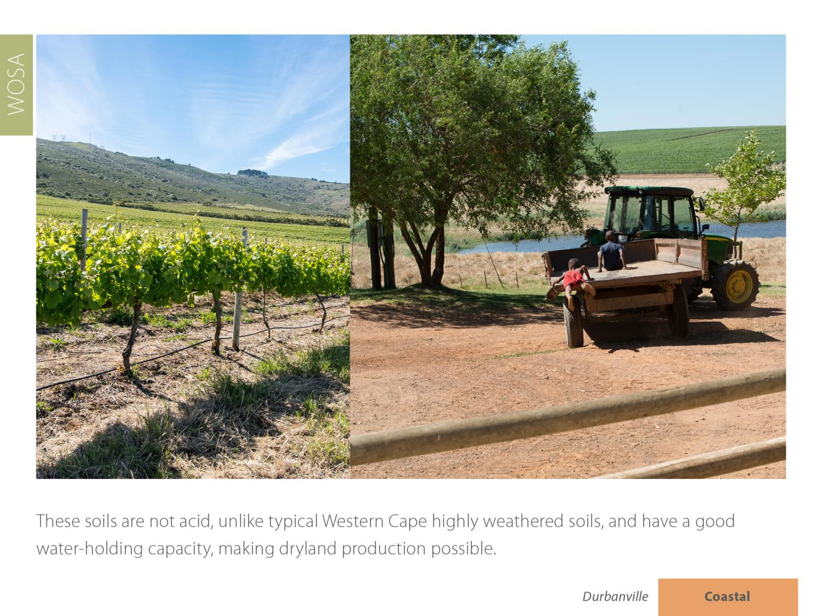
Durbanville
Coastal

Slide 15
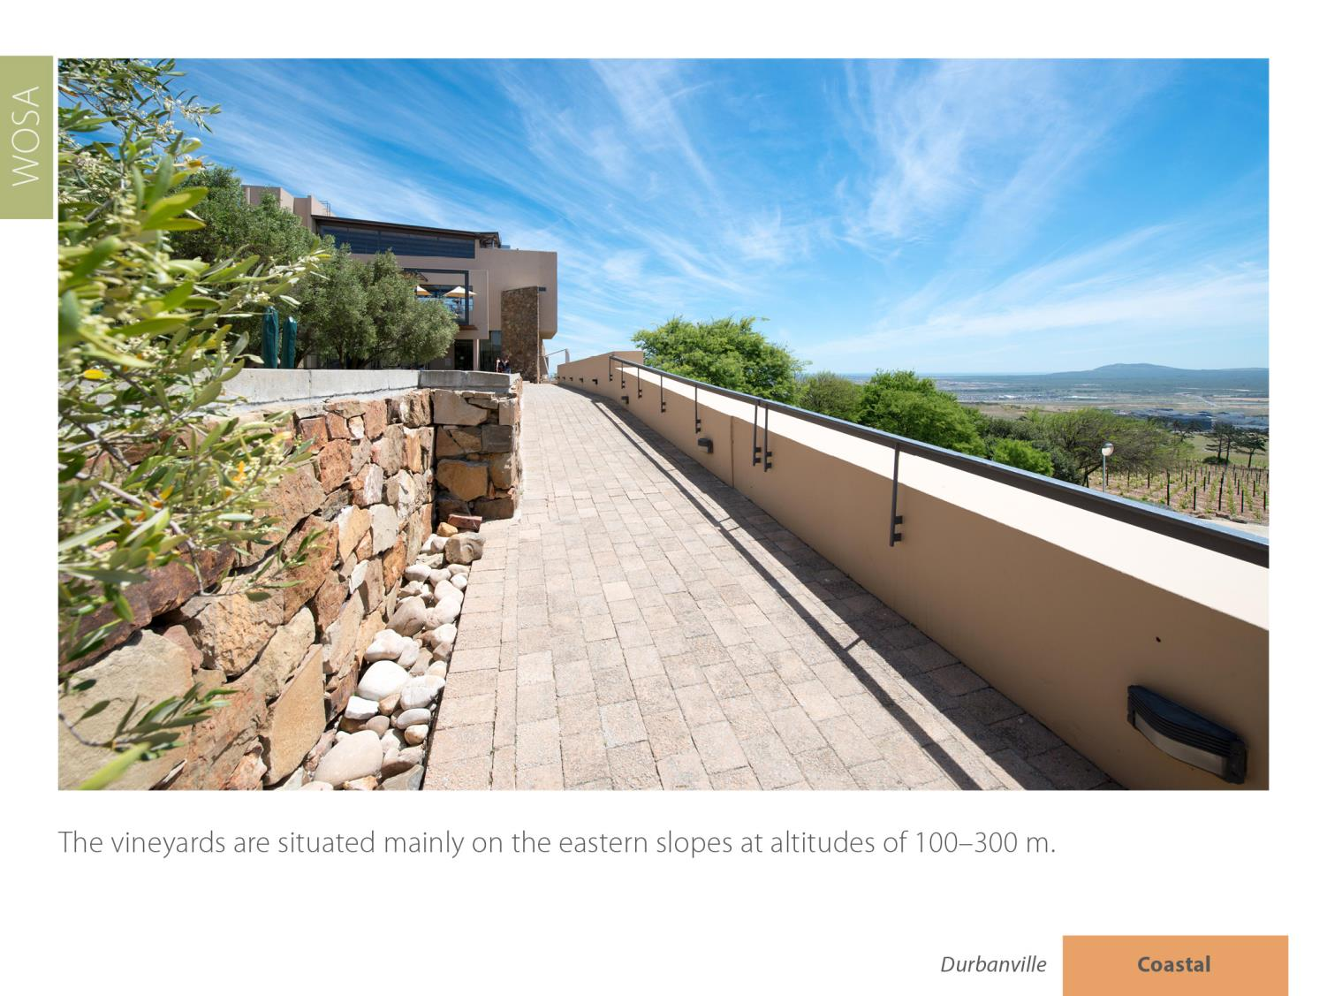
Durbanville
Coastal

Slide 16
Durbanville
Coastal

Slide 17
Some 16 estates and wineries, situated mainly on the rolling slopes with their various aspects and altitudes, continue to make a wide variety of wine styles.
Durbanville
Coastal

Slide 18
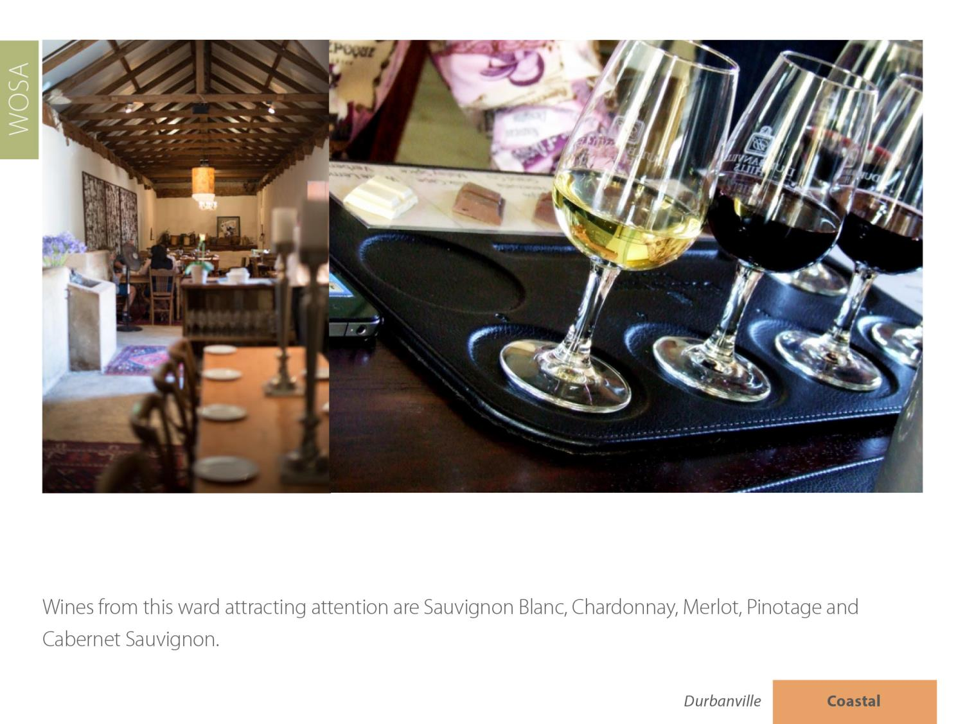
Durbanville
Coastal

Slide 19
The images used in these presentations have been sourced from various producers, as well as industry and tourism bodies. These presentations are strictly for non-commercial, non-profit, educational purposes only and cannot be reproduced or transmitted in any form or by any means without written permission from Wines of South Africa (WOSA).

Slide 20
The Cape winelands, considered by many to be
the most beautiful in the world, have a network of
diverse and well-run wine routes, affording visitors
a varied and unforgettable experience.

Slide 21
THE END

