Slide 1
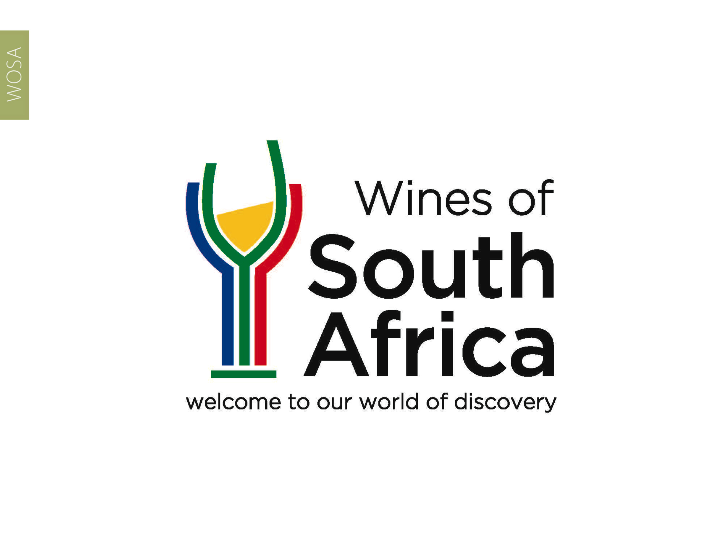
CAPE WINELANDS
ELGIN

Slide 2
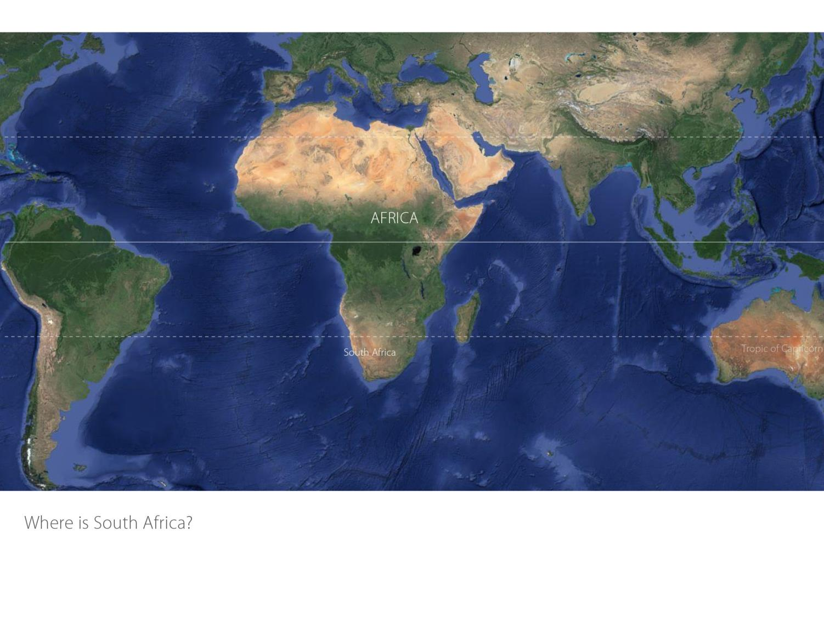

Slide 3
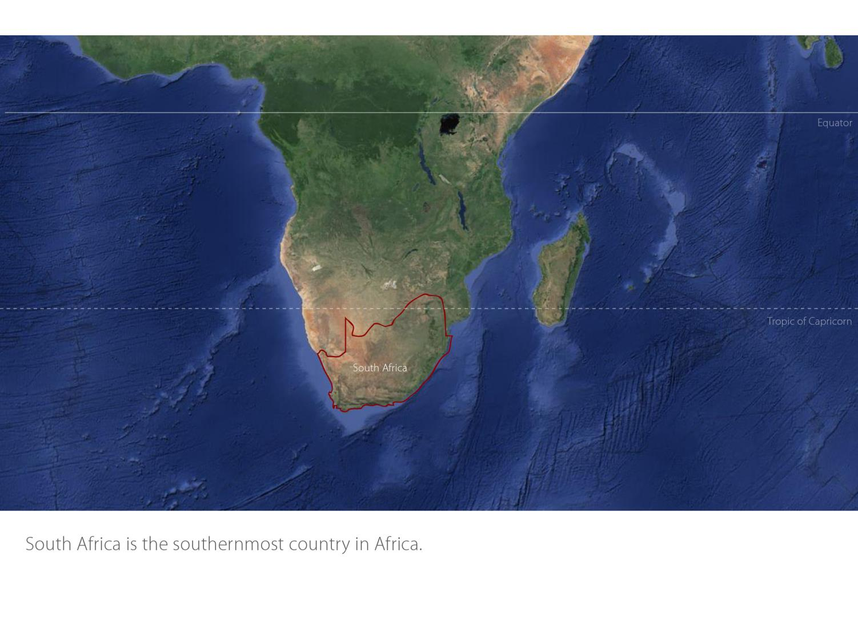

Slide 4
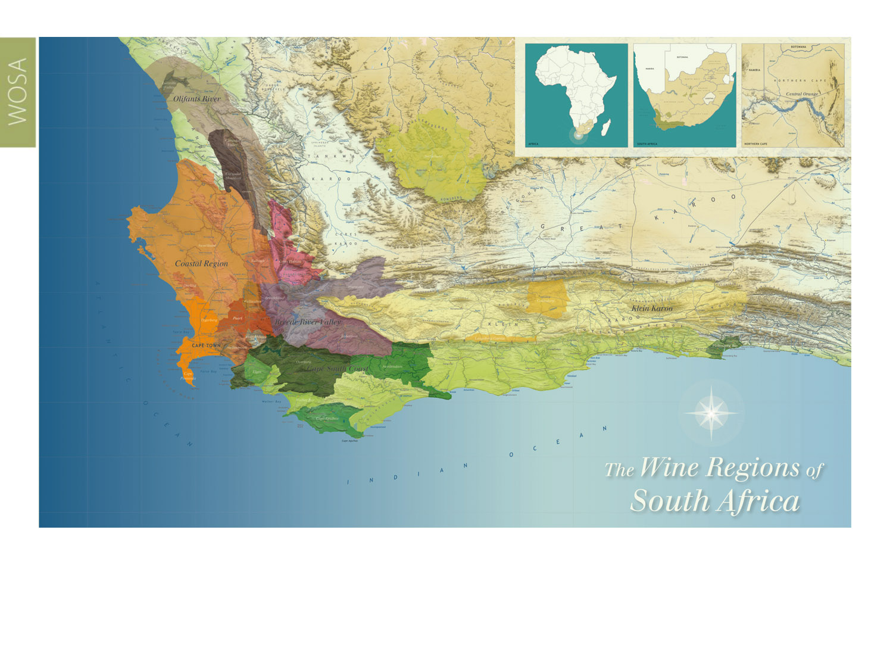
Our winelands are located at the very tip of South Africa.
Elgin
Cape South Coast

Slide 5
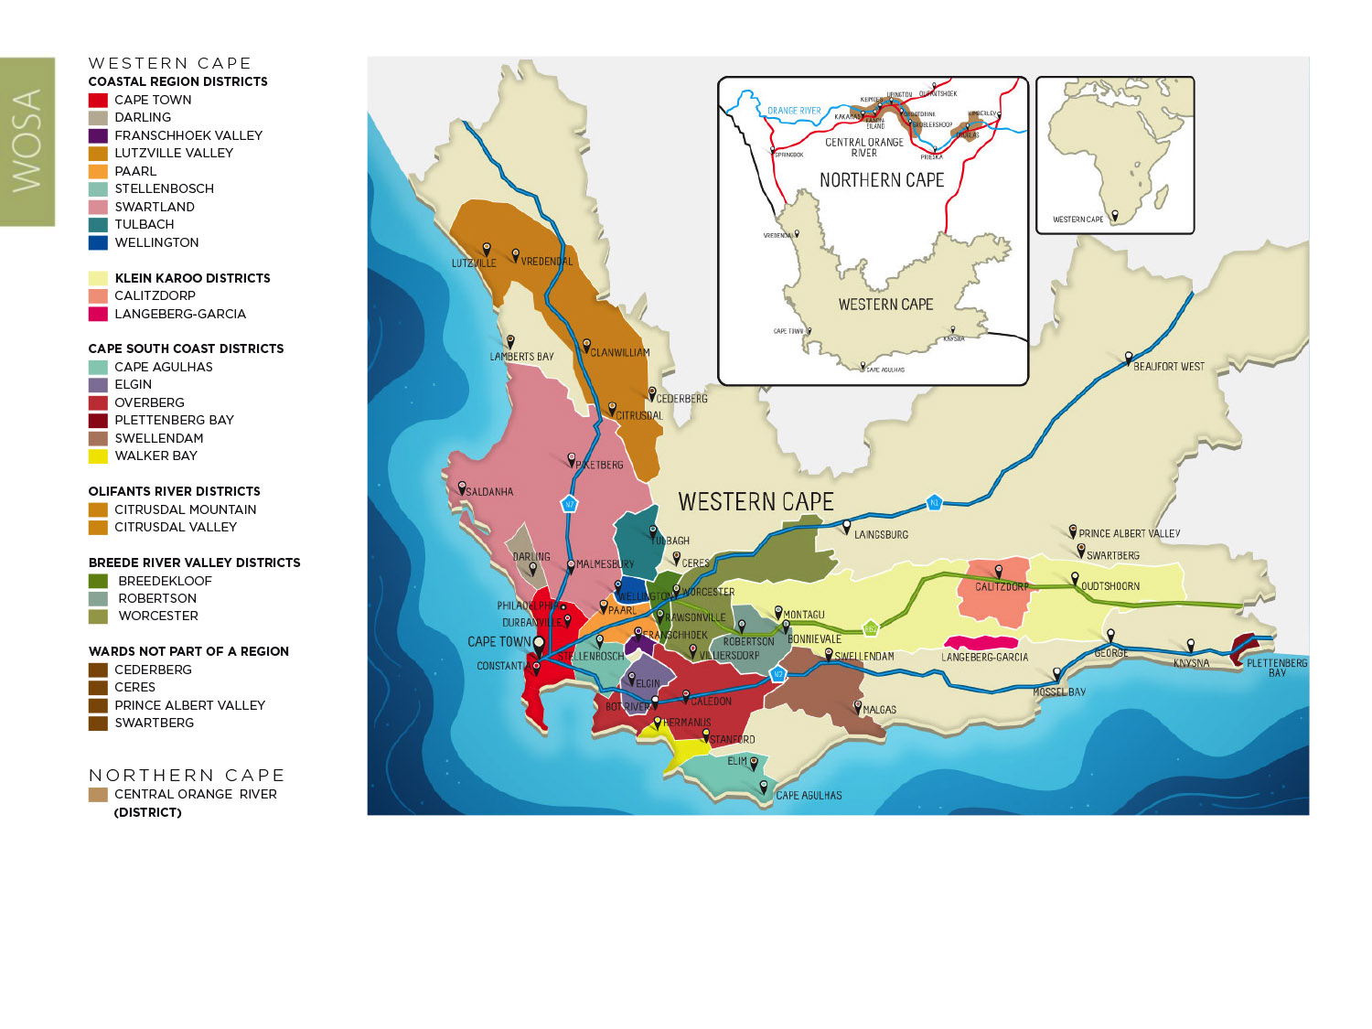
PRODUCTION AREAS: Districts of South Africa.
Elgin
Cape South Coast

Slide 6
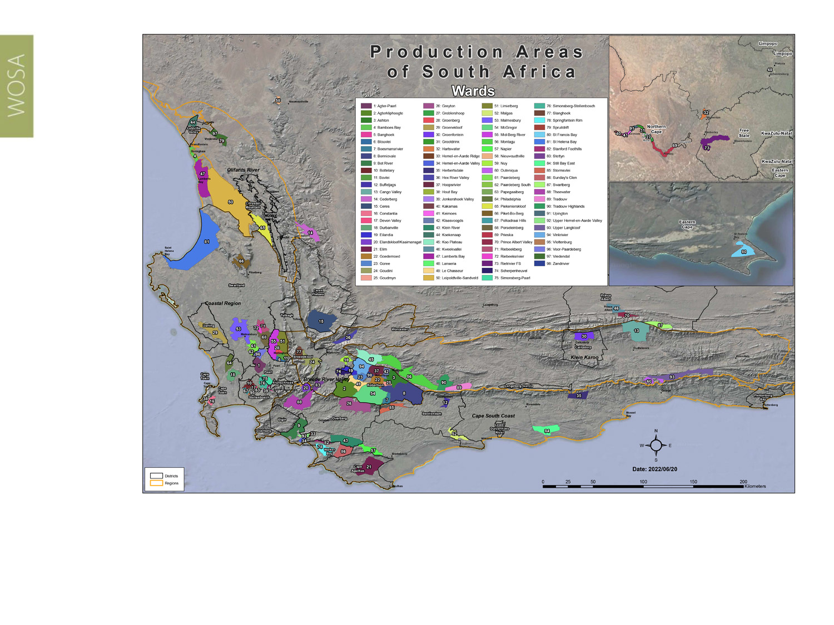
Wards of South Africa.
Elgin
Cape South Coast

Slide 7
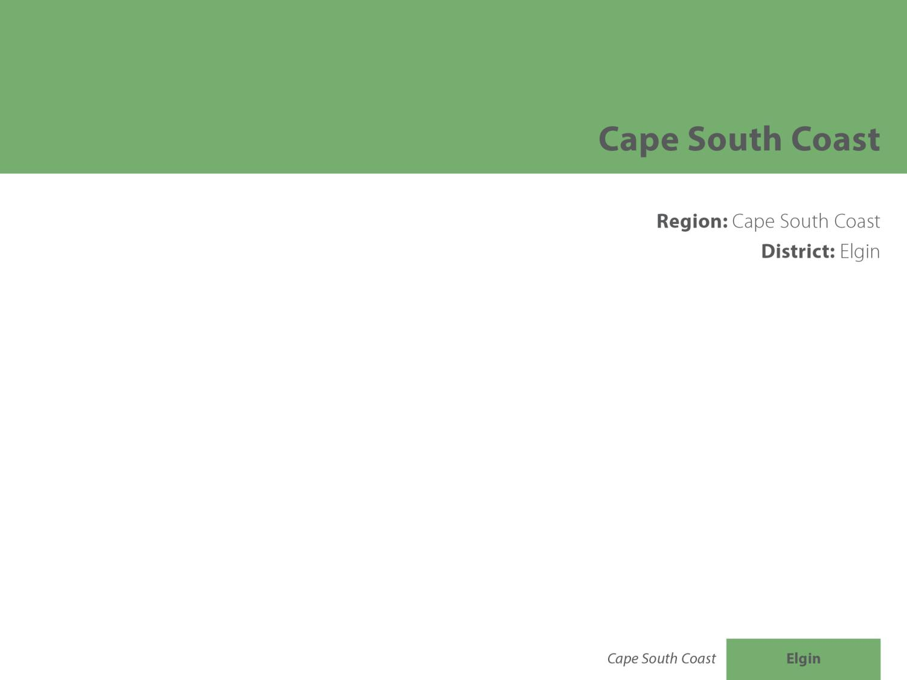
Elgin
Cape South Coast

Slide 8
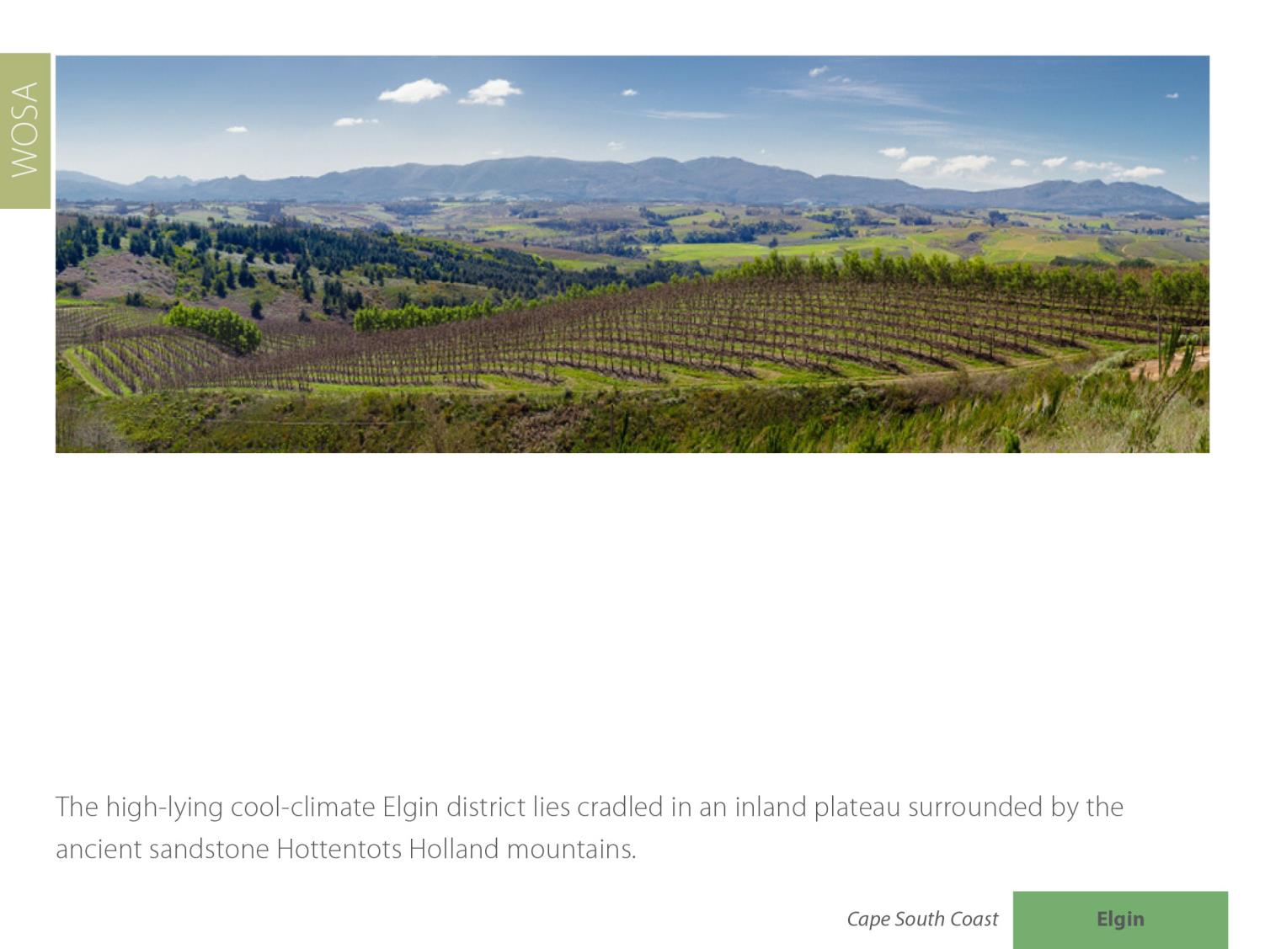
Elgin
Cape South Coast

Slide 9
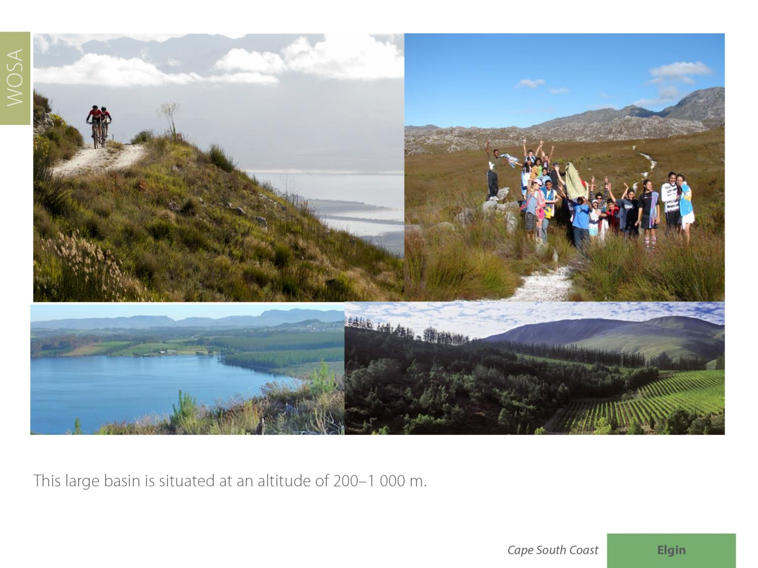
Elgin
Cape South Coast

Slide 10
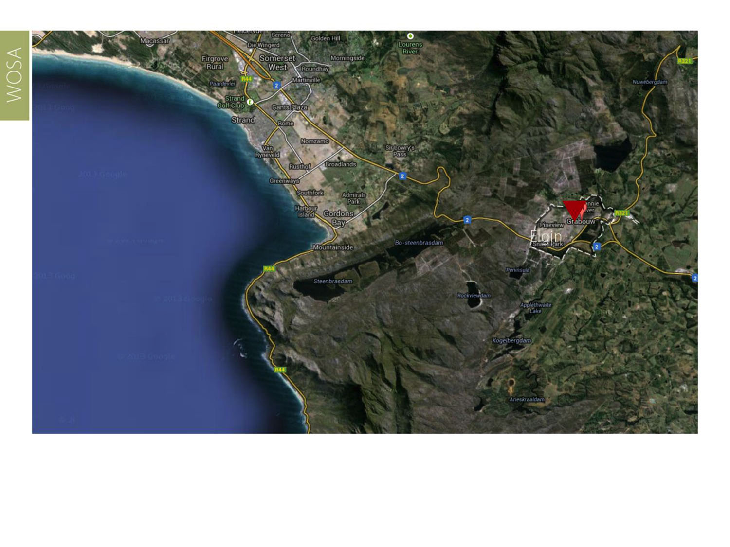
Elgin is approximately 70 km south-east of Cape Town and the southern part of the valley is only 4.5 km from the Atlantic Ocean.
Elgin
Cape South Coast

Slide 11
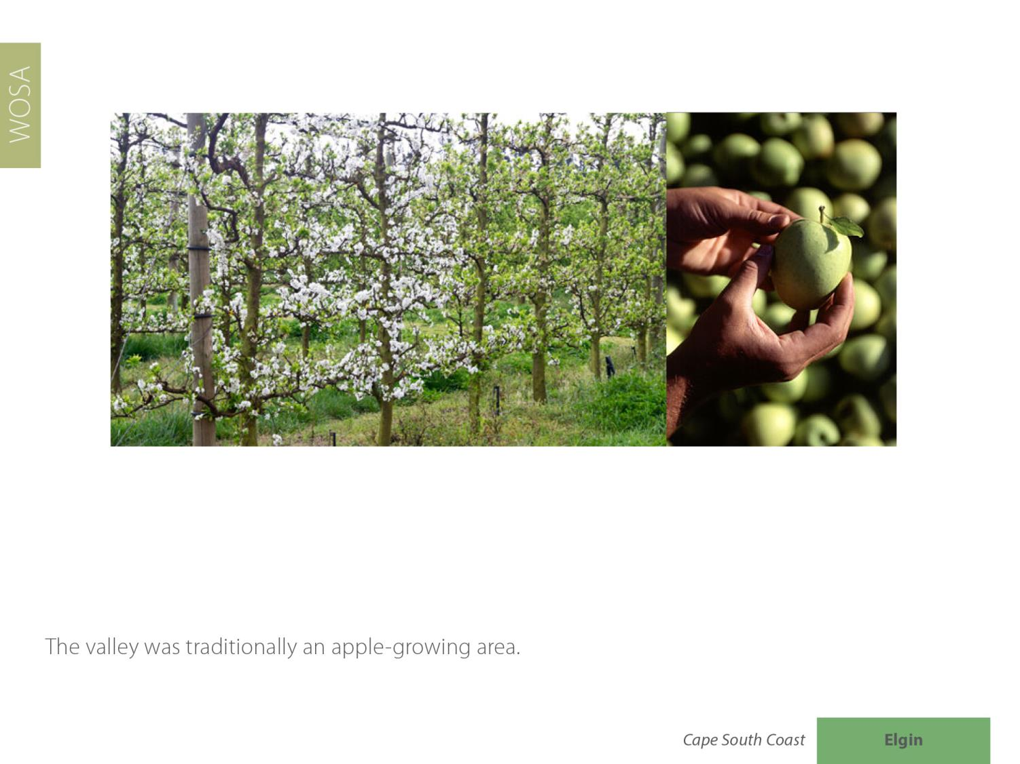
Elgin
Cape South Coast

Slide 12
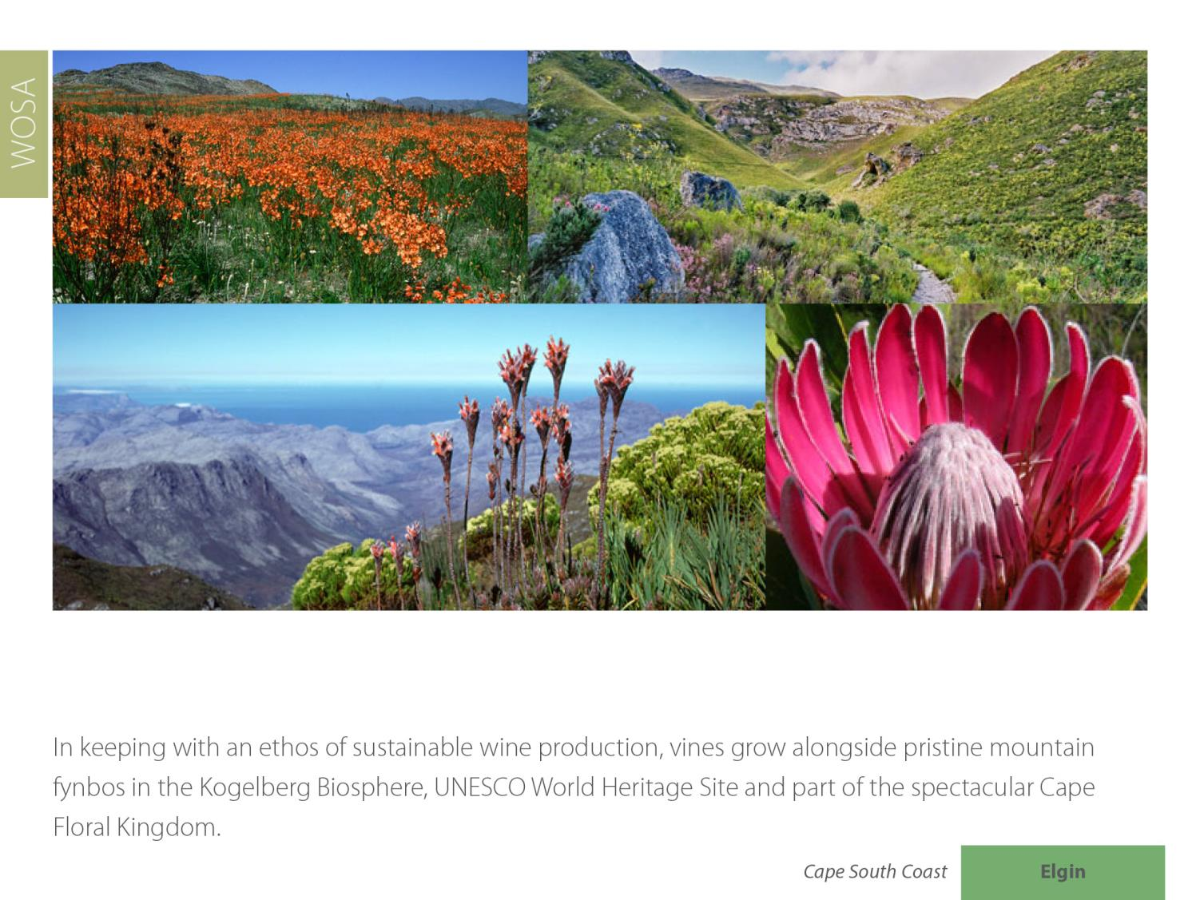
Elgin
Cape South Coast

Slide 13
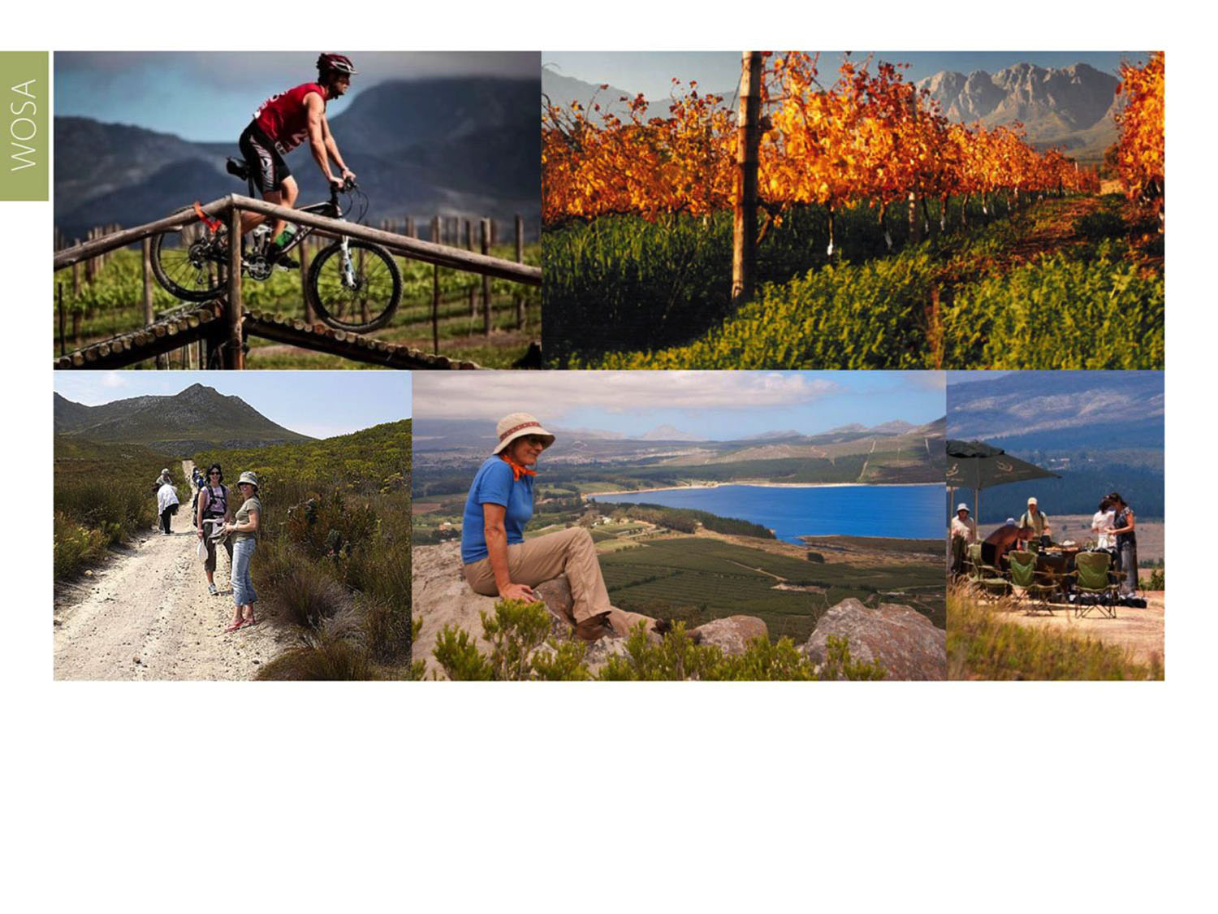
Elgin is part of the Green Mountain Trail, the world’s first biodiversity wine route.
Elgin
Cape South Coast

Slide 14
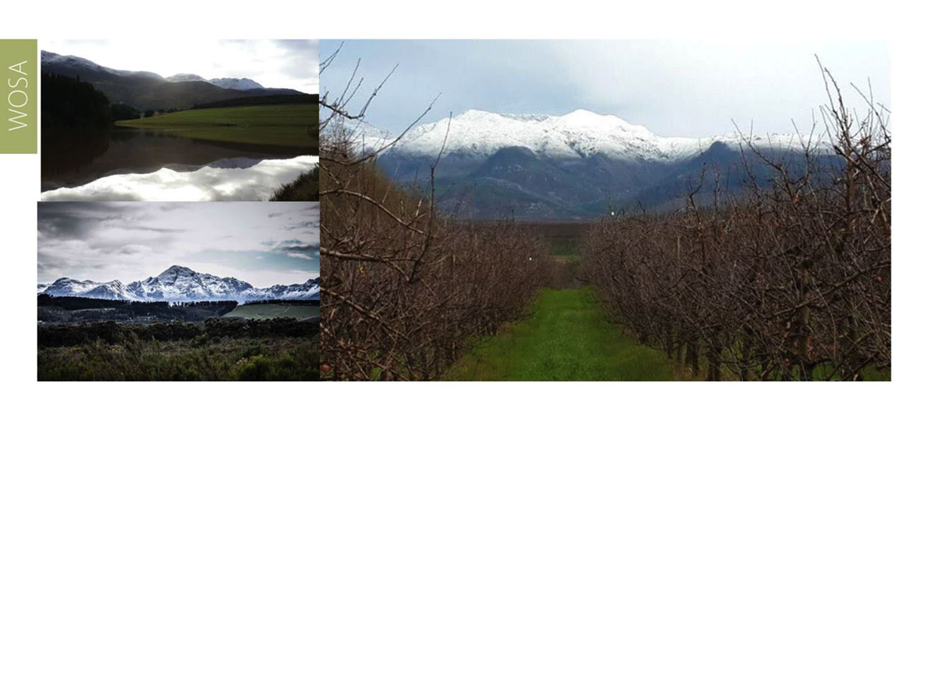
Winters are cold with abundant rain and average annual rainfall is 1 011 mm (Elgin Weather Station).
Elgin
Cape South Coast

Slide 15
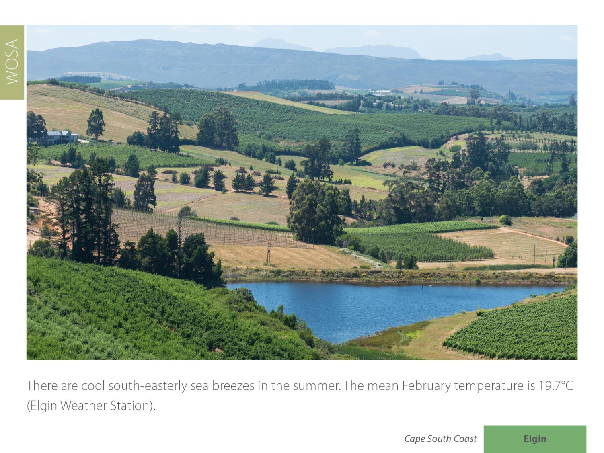
Elgin
Cape South Coast

Slide 16
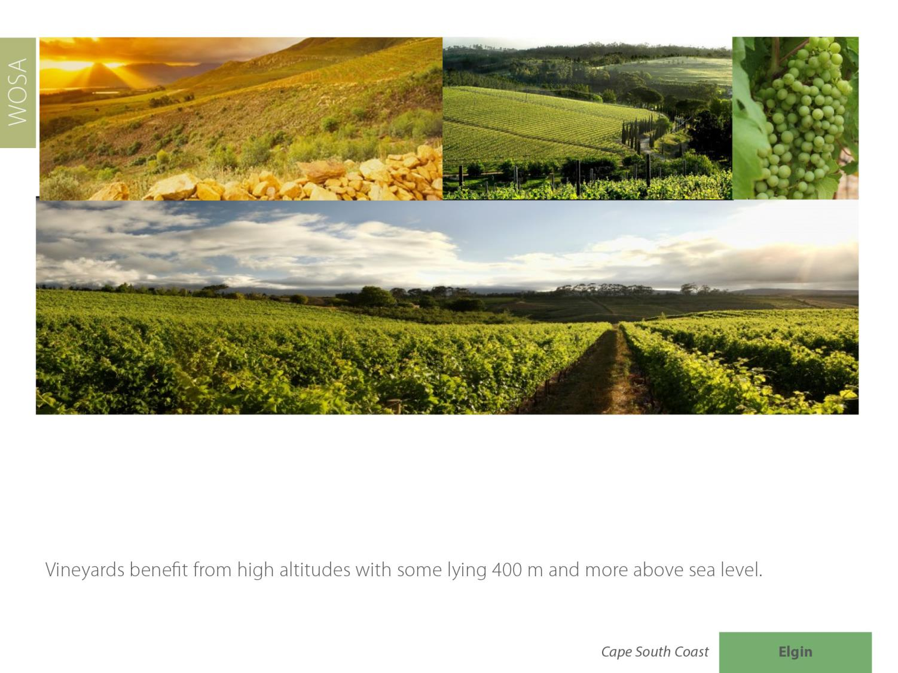
Elgin
Cape South Coast

Slide 17
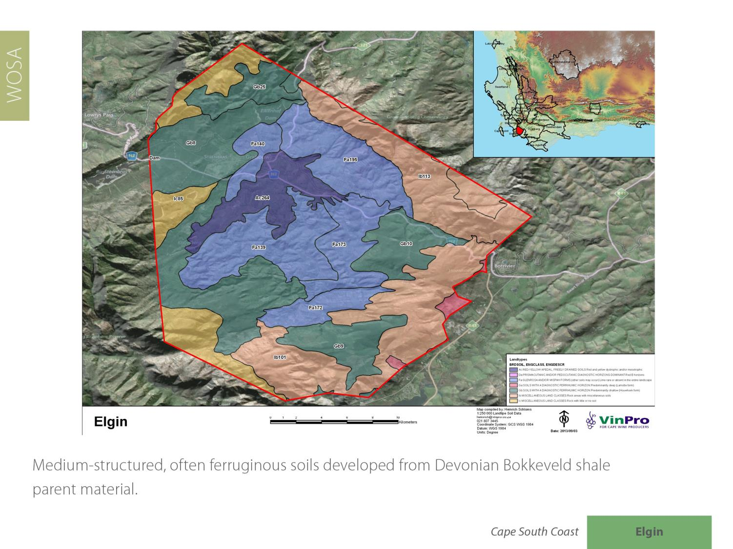
Elgin
Cape South Coast

Slide 18
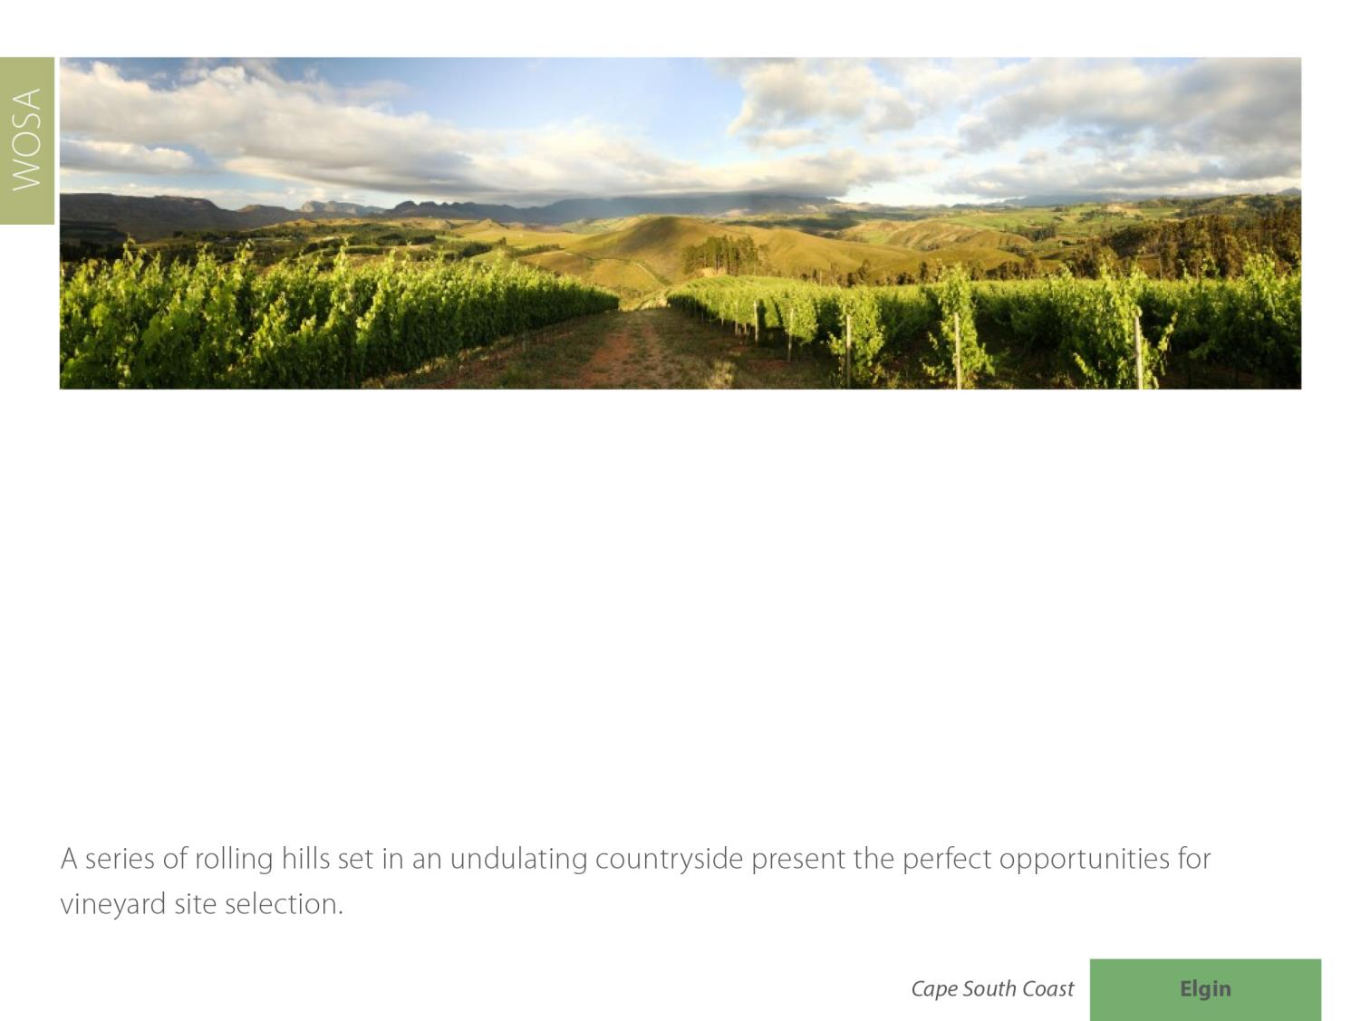
Elgin
Cape South Coast

Slide 19
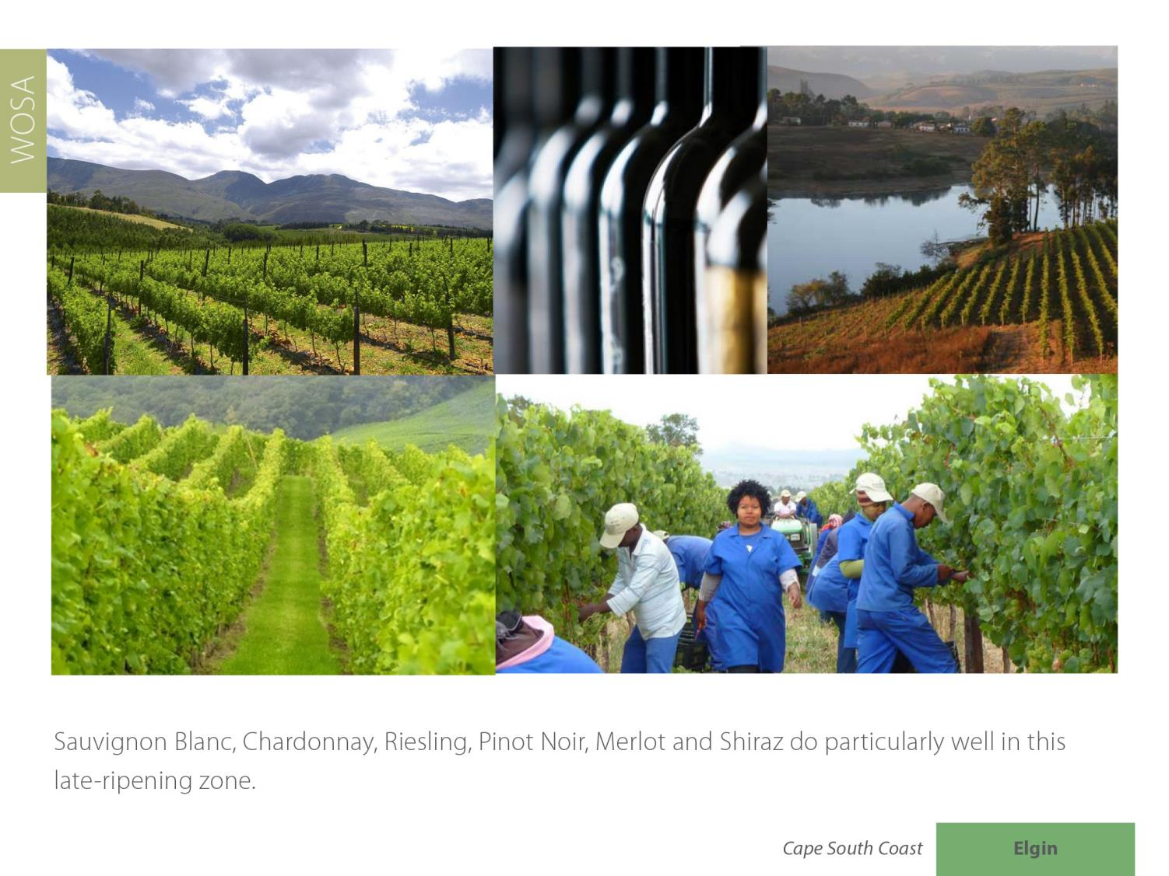
Elgin
Cape South Coast

Slide 20
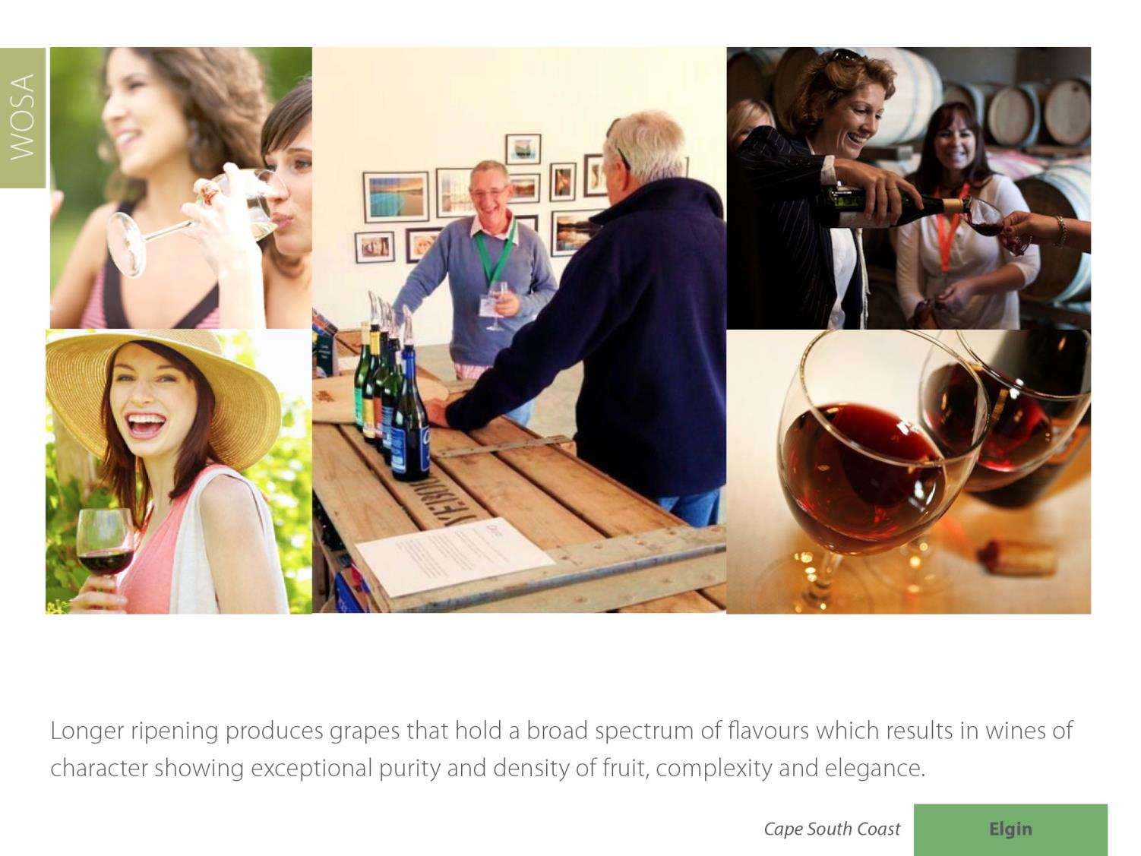
Elgin
Cape South Coast

Slide 21
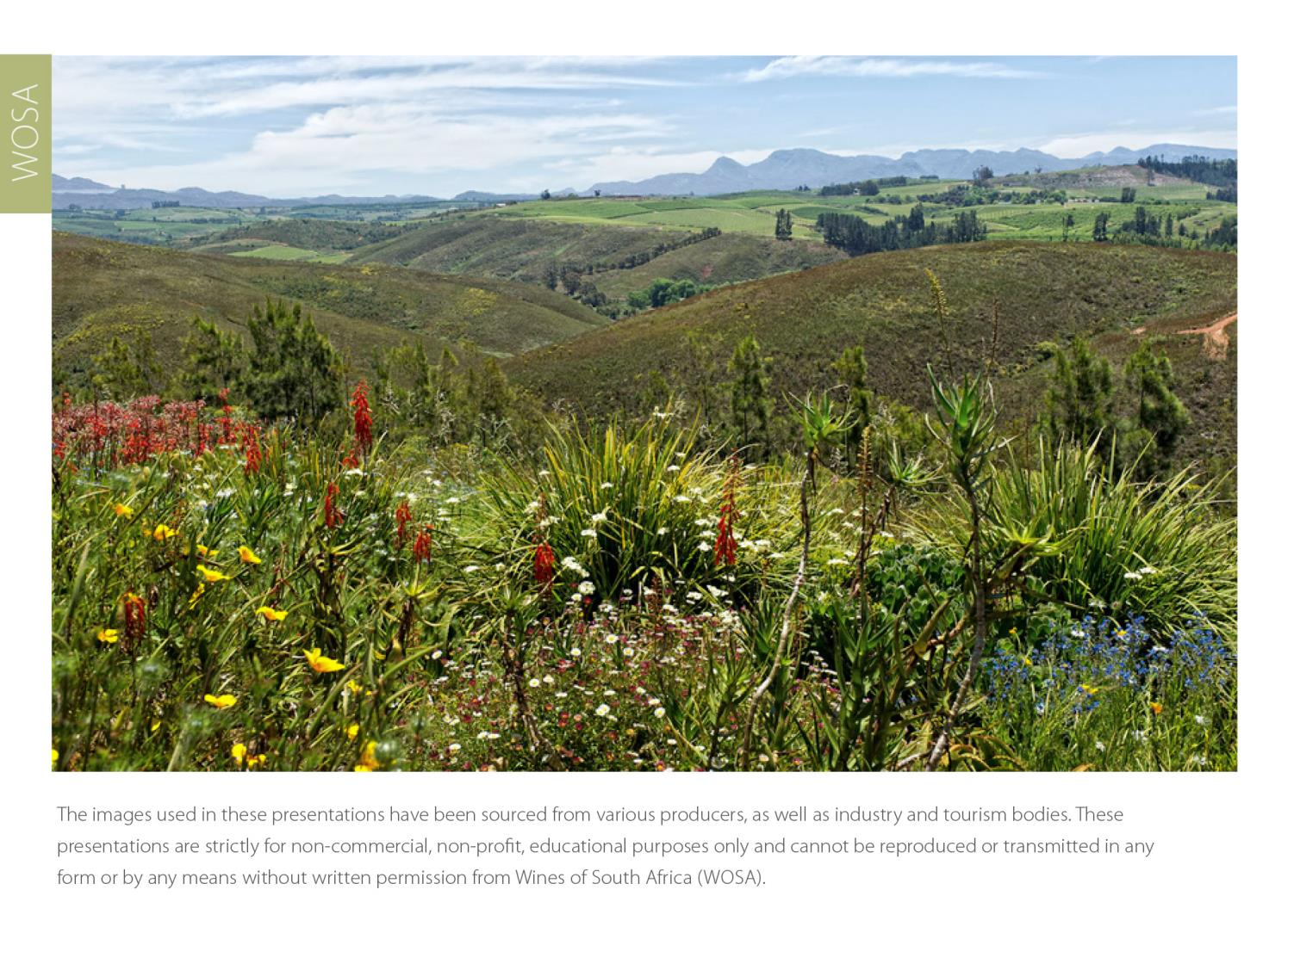
The images used in these presentations have been sourced from various producers, as well as industry and tourism bodies. These presentations are strictly for non-commercial, non-profit, educational purposes only and cannot be reproduced or transmitted in any form or by any means without written permission from Wines of South Africa (WoSA).

Slide 22
The Cape winelands, considered by many to be
the most beautiful in the world, have a network of
diverse and well-run wine routes, affording visitors
a varied and unforgettable experience.

Slide 23
THE END

