Slide 1
CAPE WINELANDS
HEMEL-EN-AARDE

Slide 2
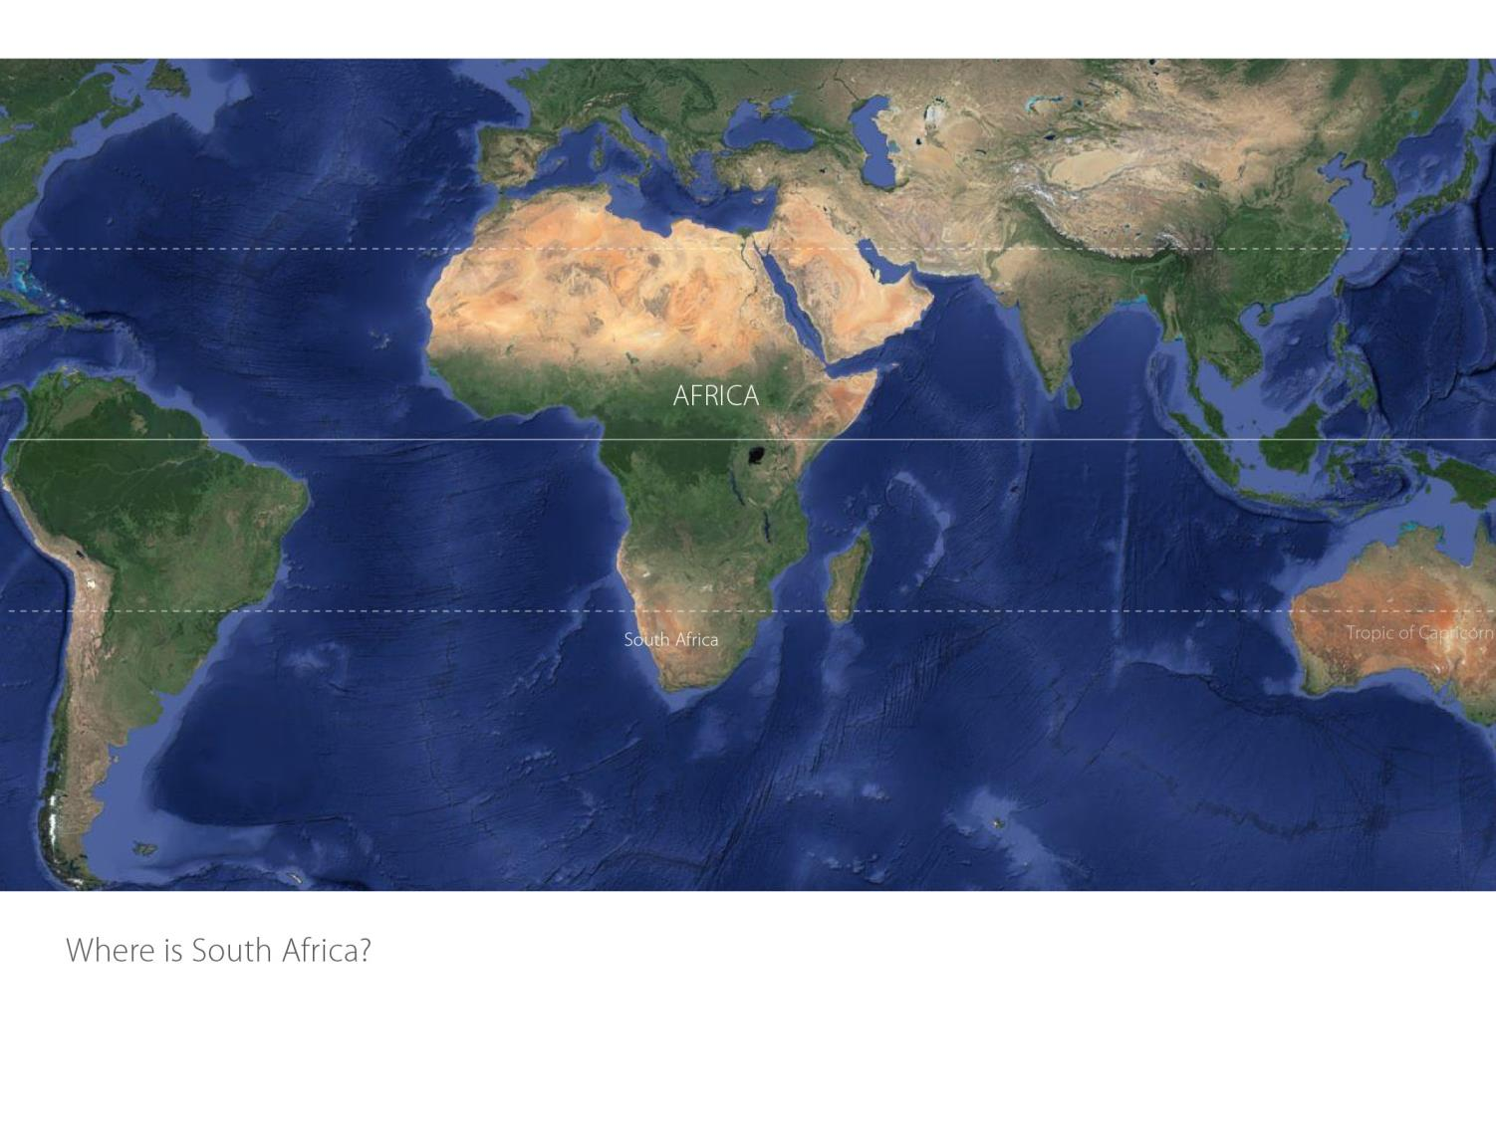

Slide 3
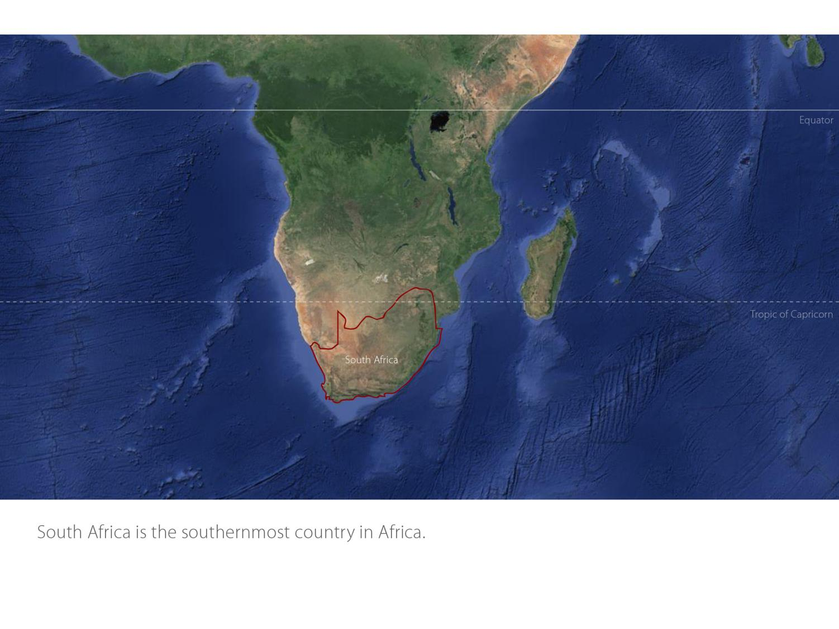

Slide 4
Our winelands are located at the very tip of South Africa.
Hemel-en-Aarde
Cape South Coast

Slide 5
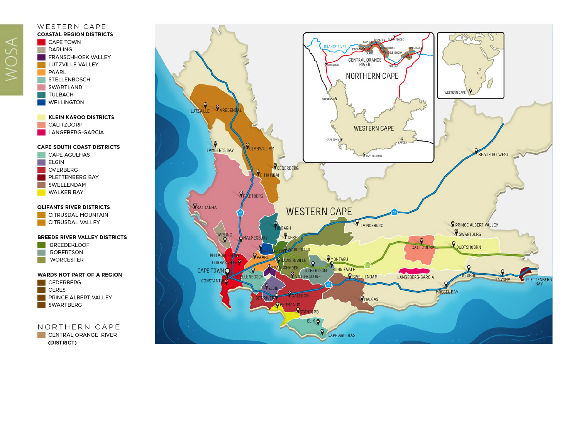
PRODUCTION AREAS: Districts of South Africa.
Hemel-en-Aarde
Cape South Coast

Slide 6
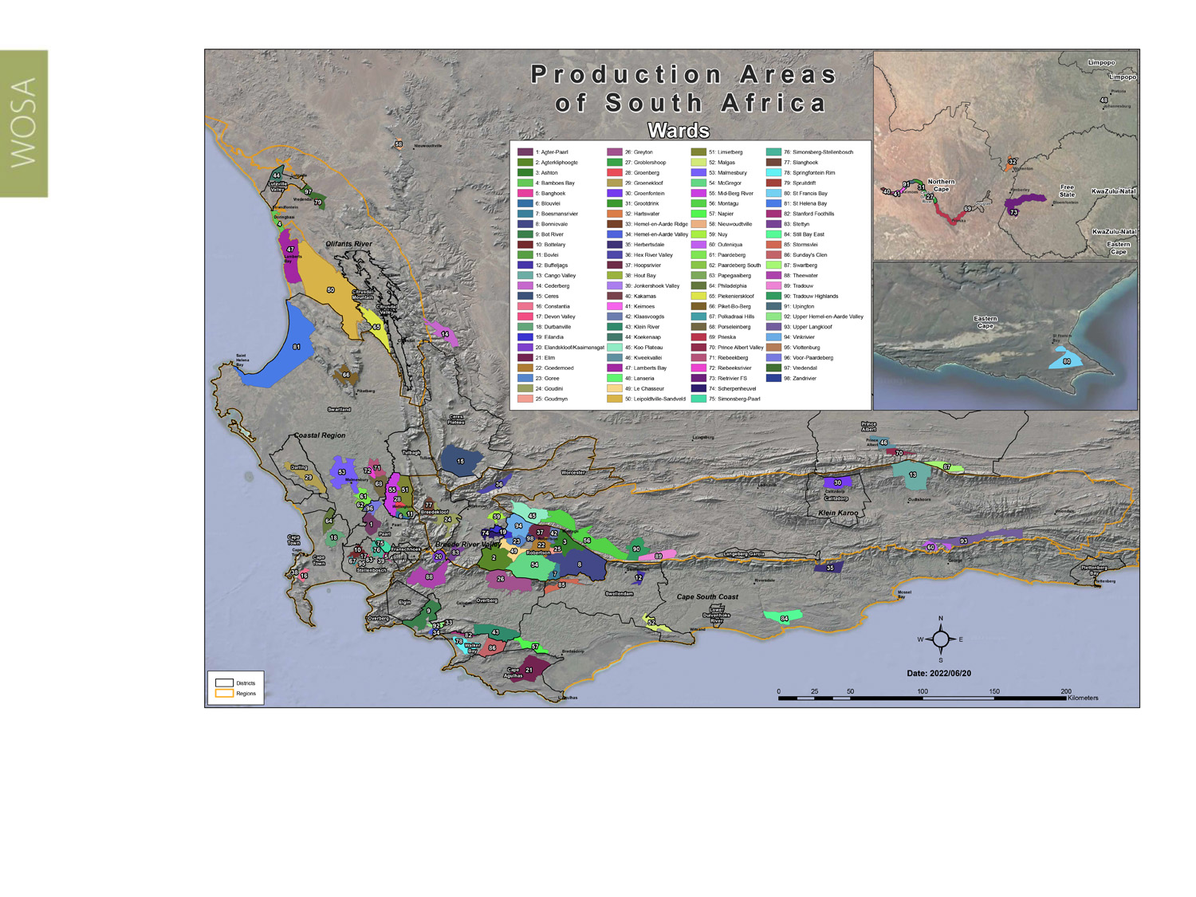
Wards of South Africa.
Hemel-en-Aarde
Cape South Coast

Slide 7
Hemel-en-Aarde
Cape South Coast

Slide 8
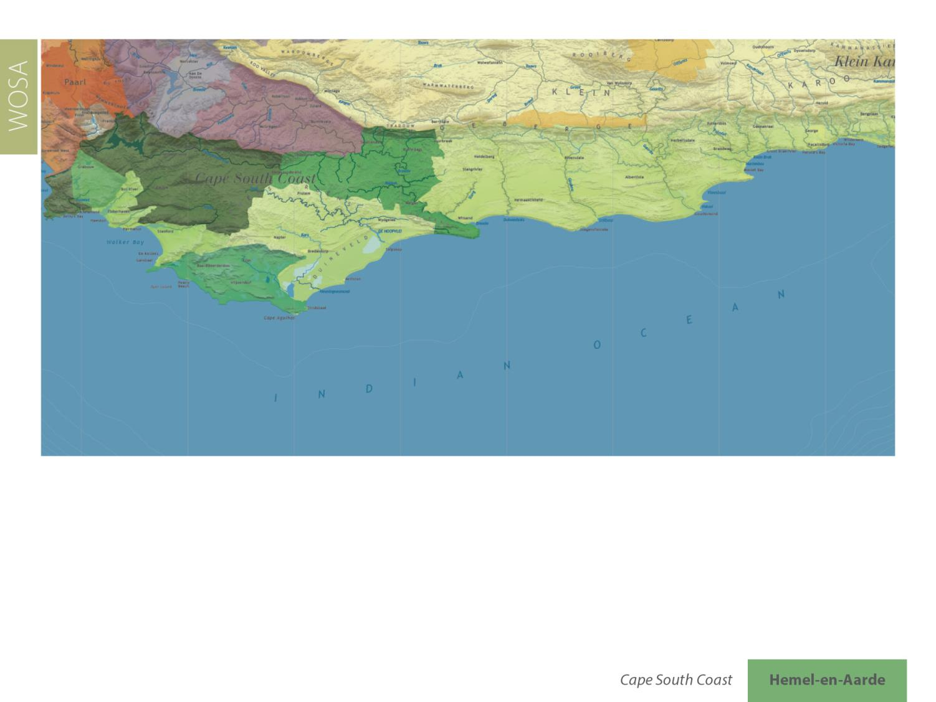
Hemel-en-Aarde
Cape South Coast

Slide 9
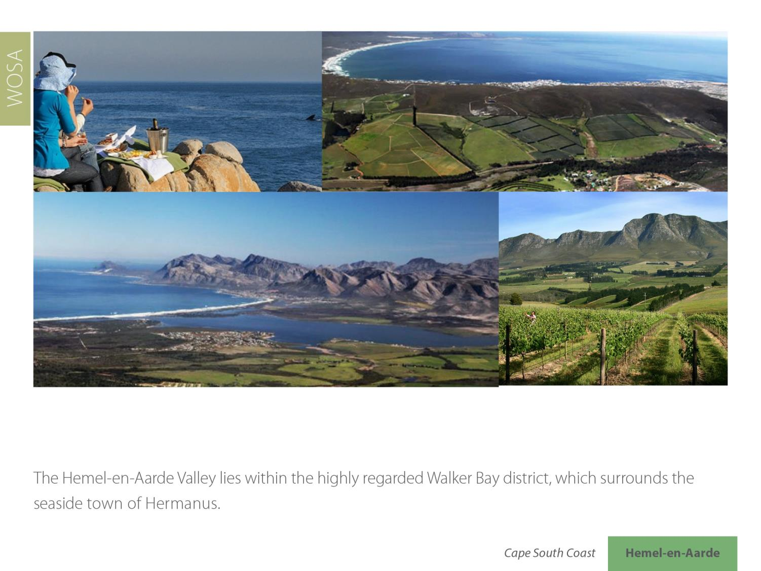
Hemel-en-Aarde
Cape South Coast

Slide 10
Hemel-en-Aarde
Cape South Coast

Slide 11
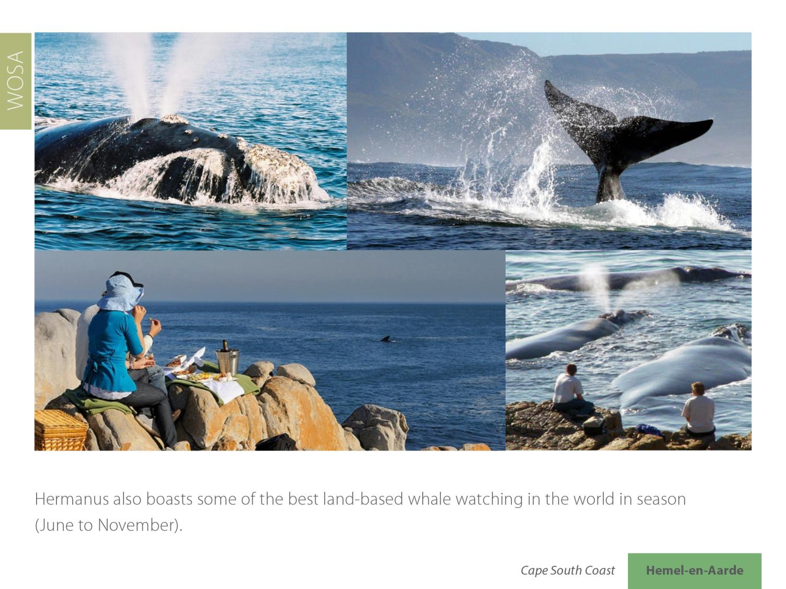
Hemel-en-Aarde
Cape South Coast

Slide 12
Hermanus is recognised as a UNESCO Creative City for Gastronomy, the first on the African continent to receive this distinction.
Hemel-en-Aarde
Cape South Coast

Slide 13
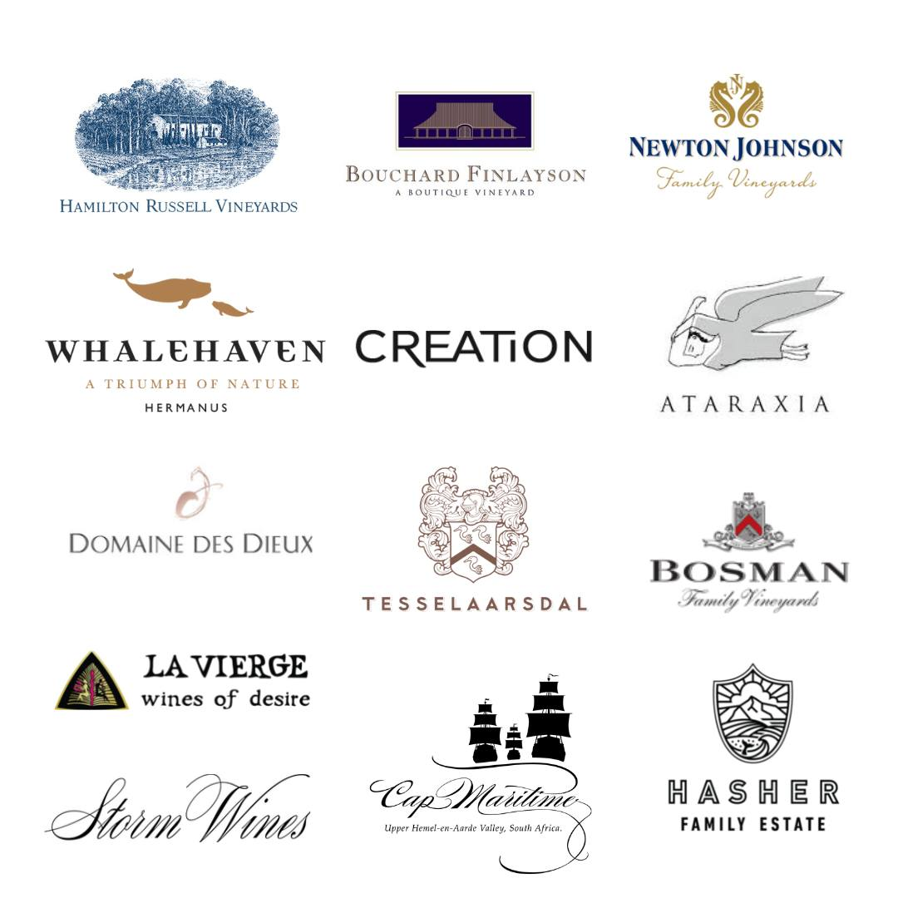
The valley encompasses three wards: Hemel-en-Aarde Valley, Upper Hemel-en-Aarde Valley and Hemel-en-Aarde Ridge.
Hemel-en-Aarde
Cape South Coast

Slide 14
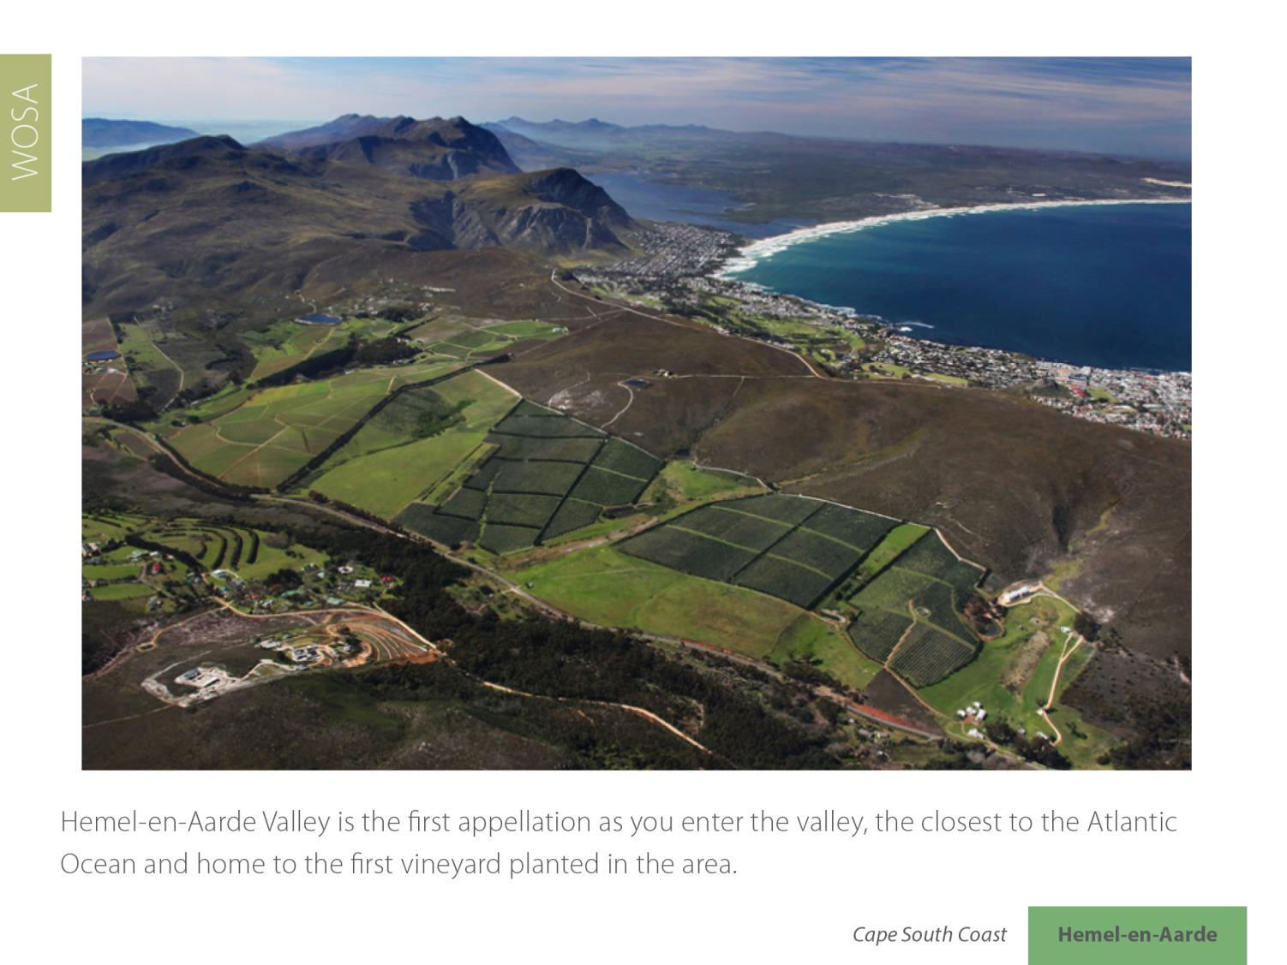
Hemel-en-Aarde
Cape South Coast

Slide 15
Hemel-en-Aarde
Cape South Coast

Slide 16
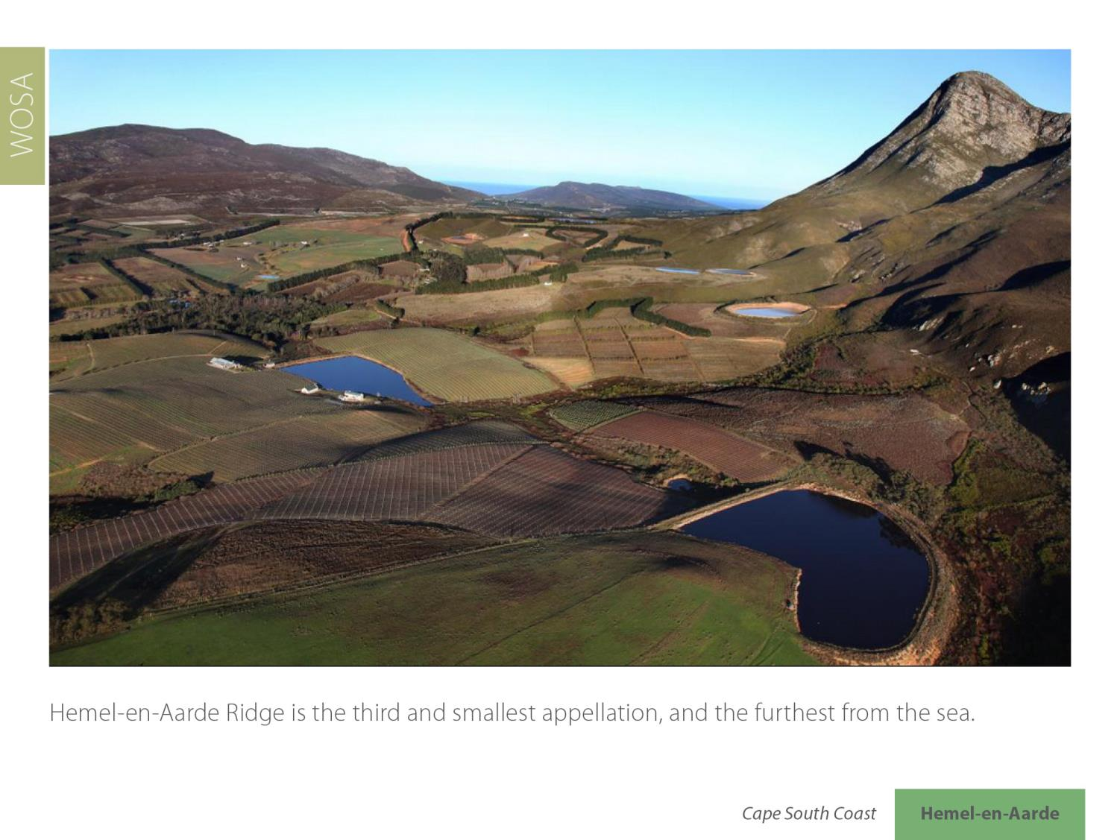
Hemel-en-Aarde
Cape South Coast

Slide 17
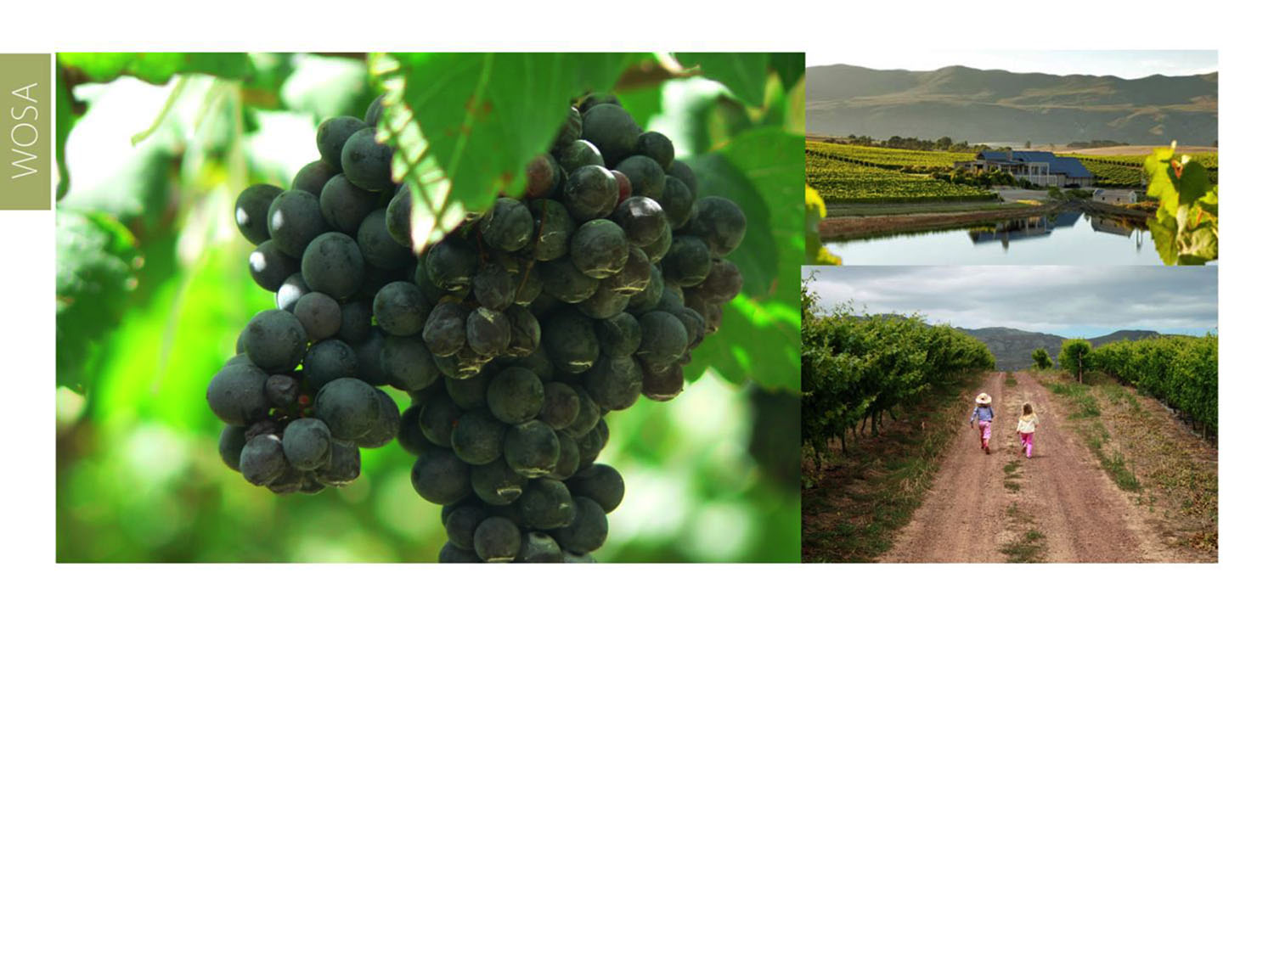
Ripening here generally occurs later than for the other two Hemel-en-Aarde appellations.
Hemel-en-Aarde
Cape South Coast

Slide 18
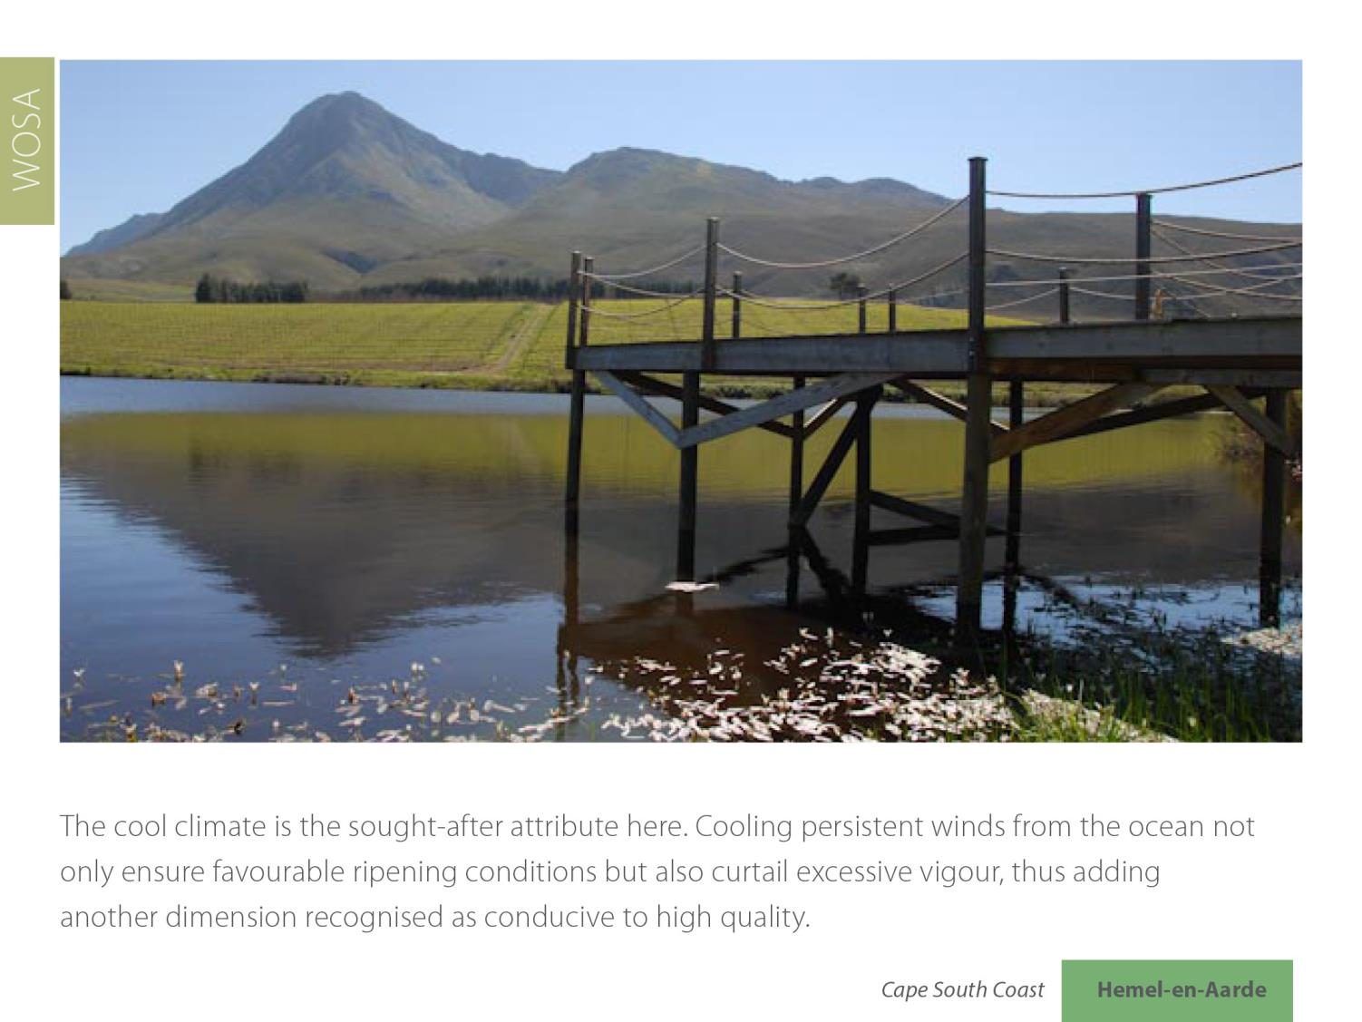
Hemel-en-Aarde
Cape South Coast

Slide 19
The average mean February temperature is 20.3⁰C (Oude Hemel-en-Aarde Weather Station).
Hemel-en-Aarde
Cape South Coast

Slide 20
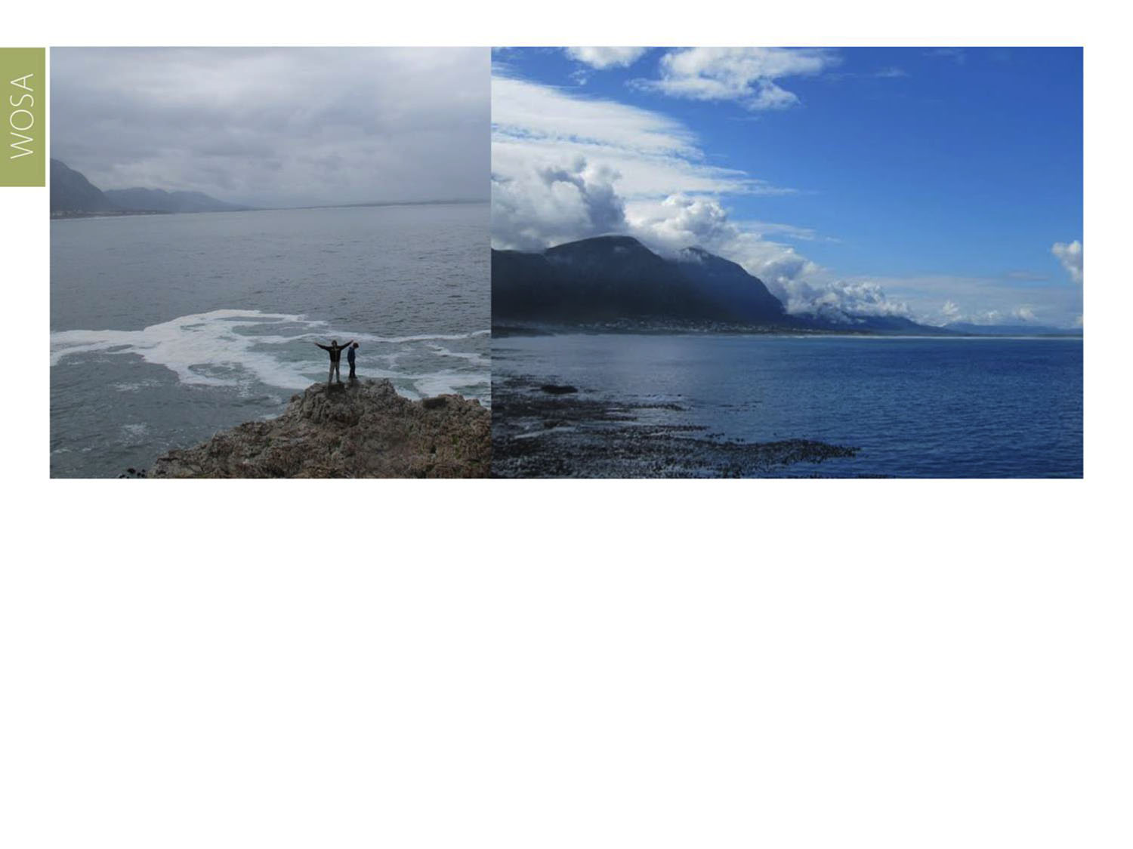
The average annual rainfall is 722 mm (Oude Hemel-en-Aarde Weather Station).
Hemel-en-Aarde
Cape South Coast

Slide 21
Hemel-en-Aarde
Cape South Coast

Slide 22
Hemel-en-Aarde
Cape South Coast

Slide 23
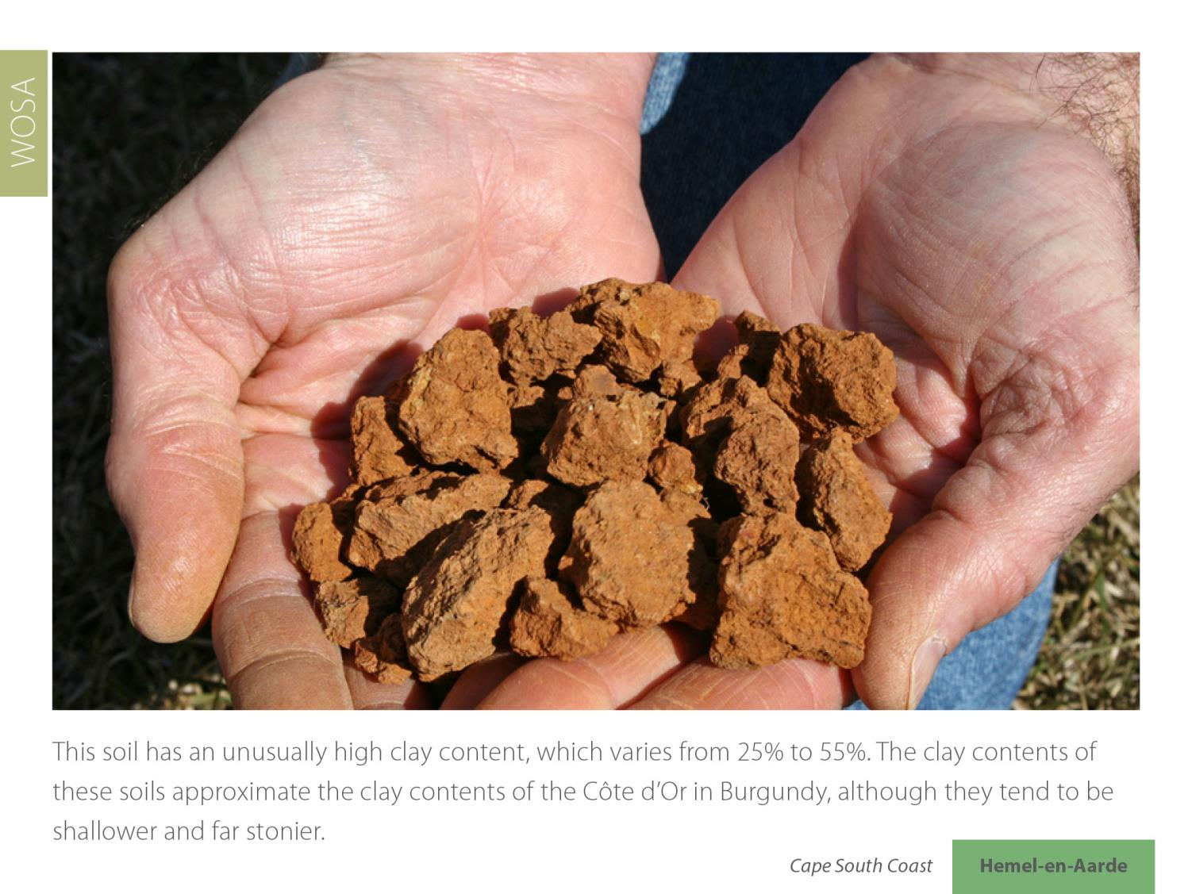
Hemel-en-Aarde
Cape South Coast

Slide 24
Hemel-en-Aarde
Cape South Coast

Slide 25
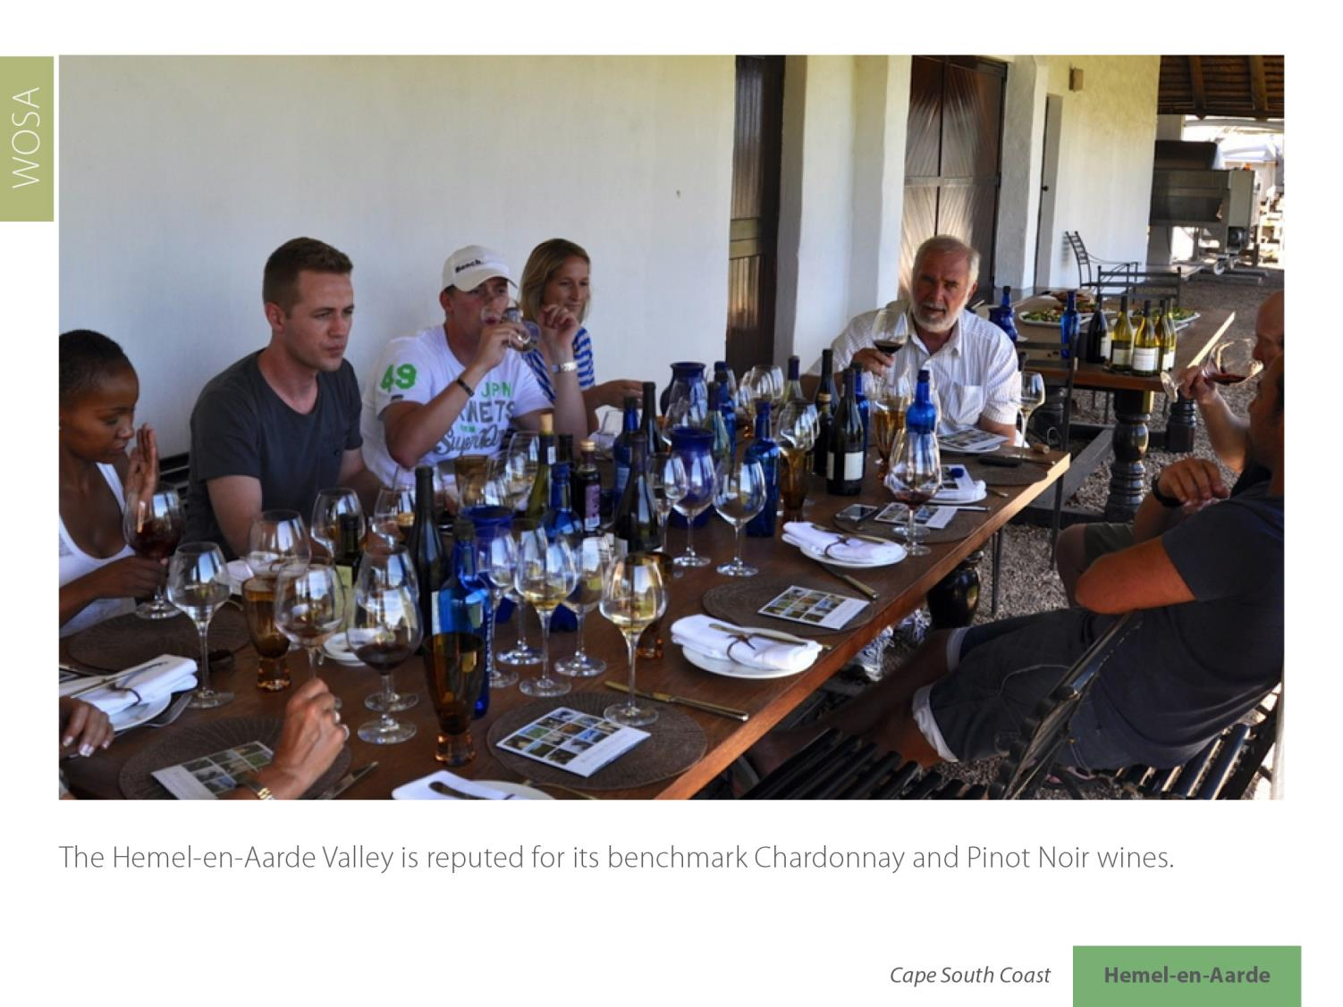
Hemel-en-Aarde
Cape South Coast

Slide 26
Hemel-en-Aarde
Cape South Coast

Slide 27
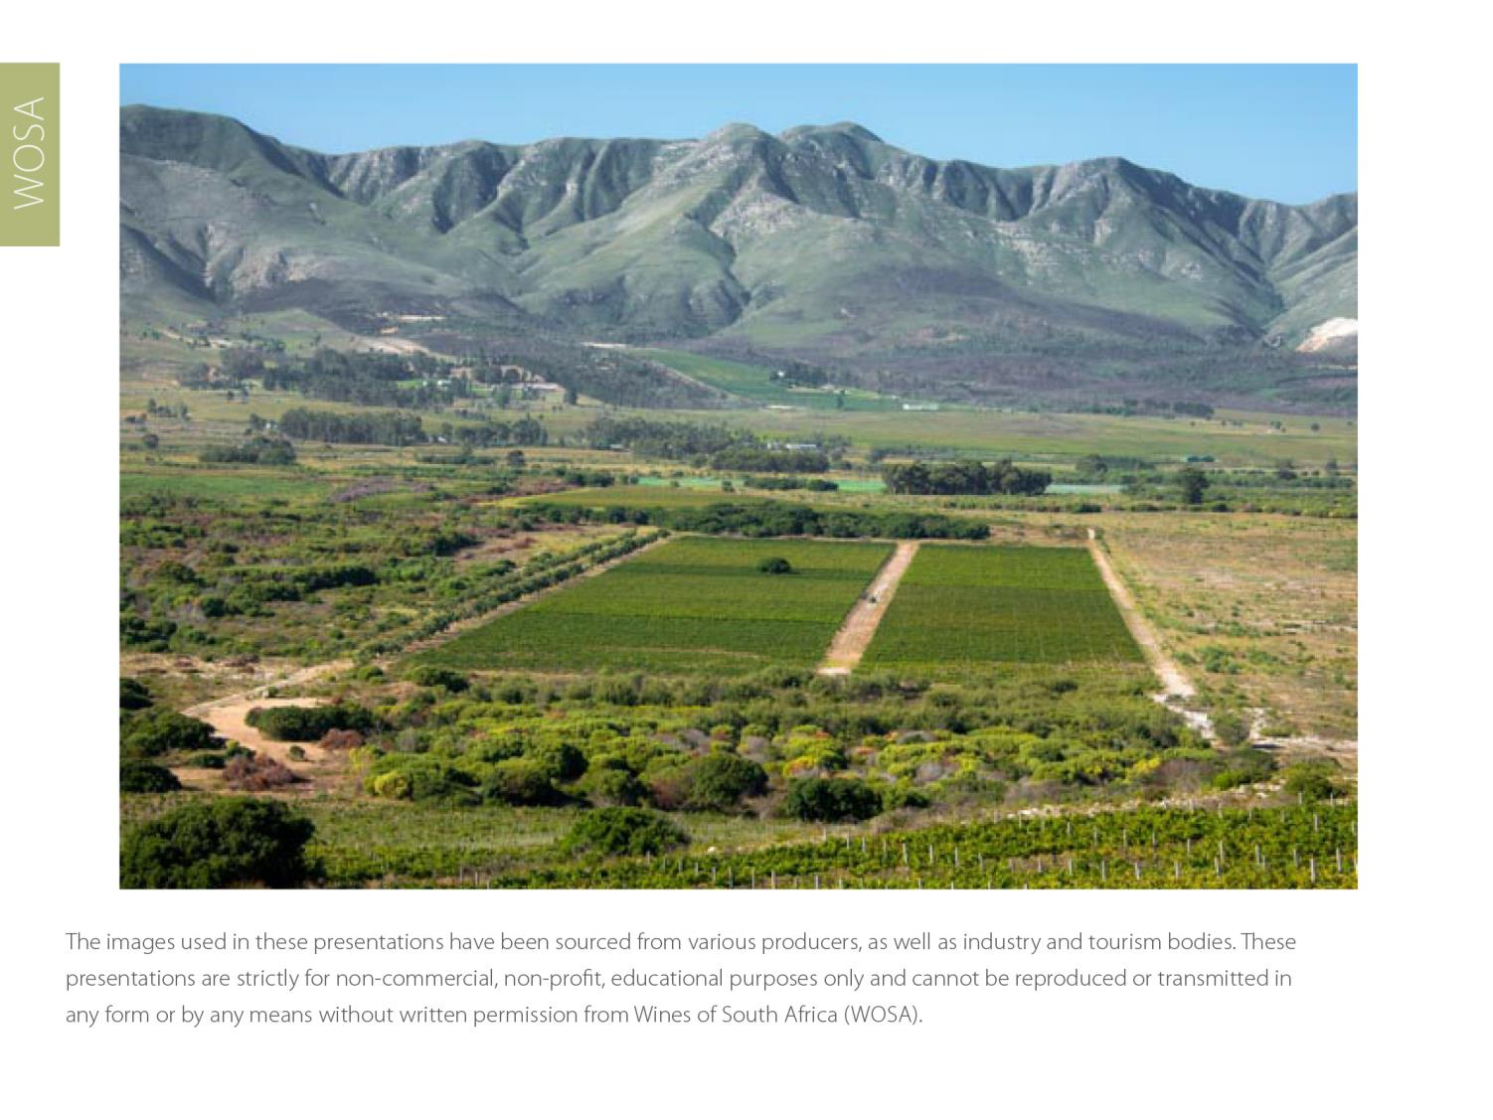
The images used in these presentations have been sourced from various producers, as well as industry and tourism bodies. These presentations are strictly for non-commercial, non-profit, educational purposes only and cannot be reproduced or transmitted in any form or by any means without written permission from Wines of South Africa (WoSA).

Slide 28
The Cape winelands, considered by many to be
the most beautiful in the world, have a network of
diverse and well-run wine routes, affording visitors
a varied and unforgettable experience.

Slide 29
THE END

