Slide 1

CAPE WINELANDS
PAARL

Slide 2
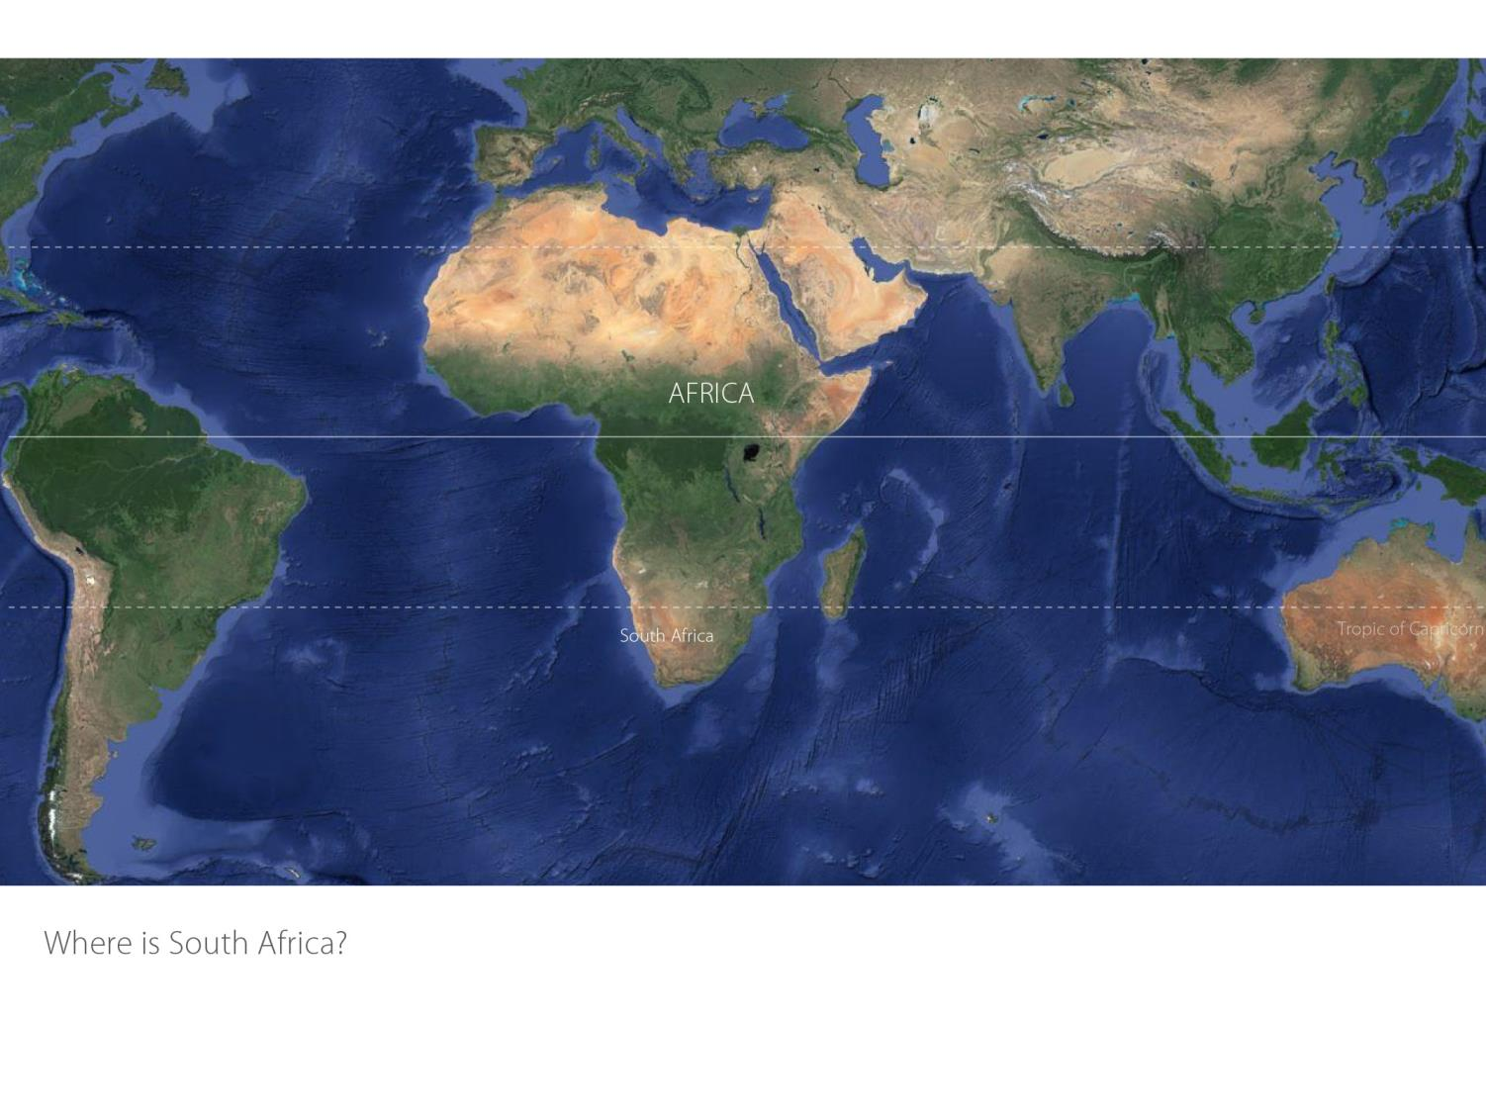

Slide 3
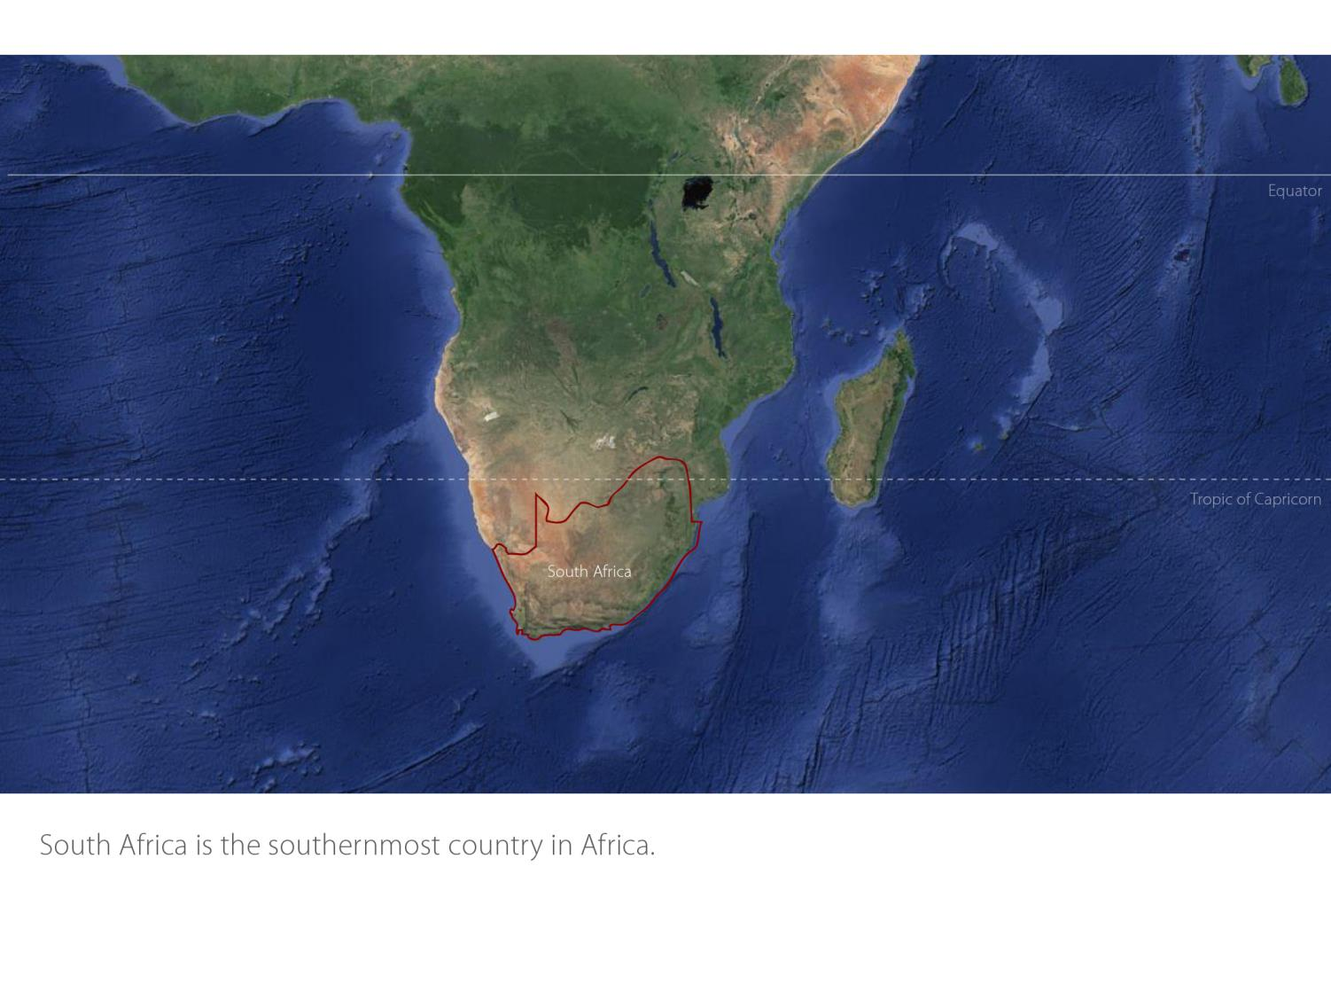

Slide 4
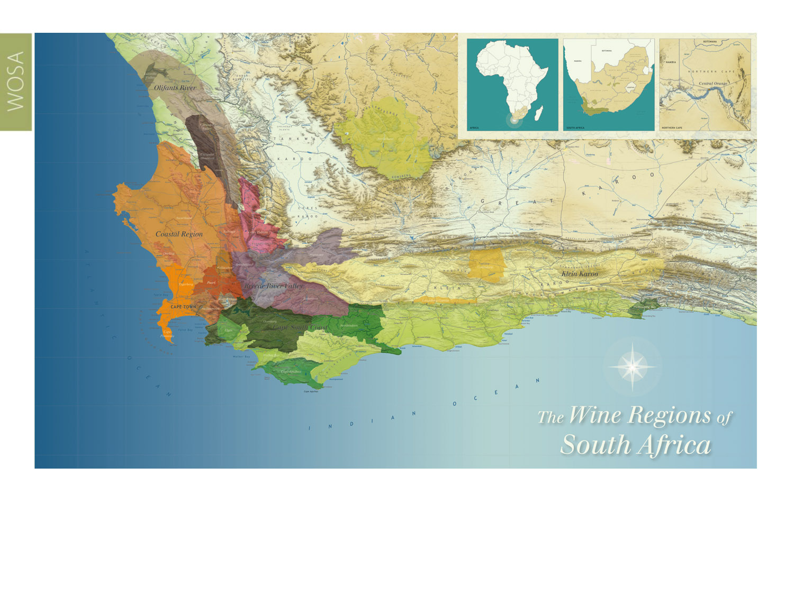
Our winelands are located at the very tip of South Africa.
Paarl
Coastal

Slide 5
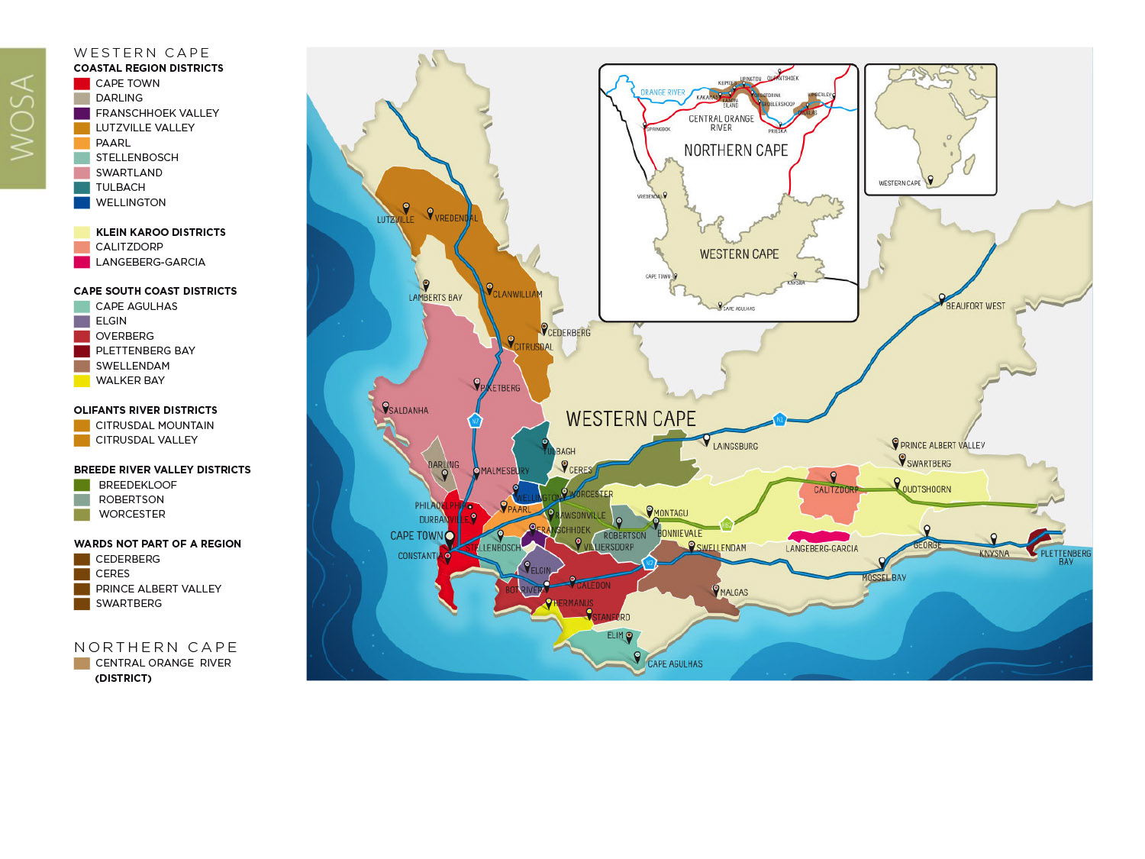
PRODUCTION AREAS: Districts of South Africa.
Paarl
Coastal

Slide 6
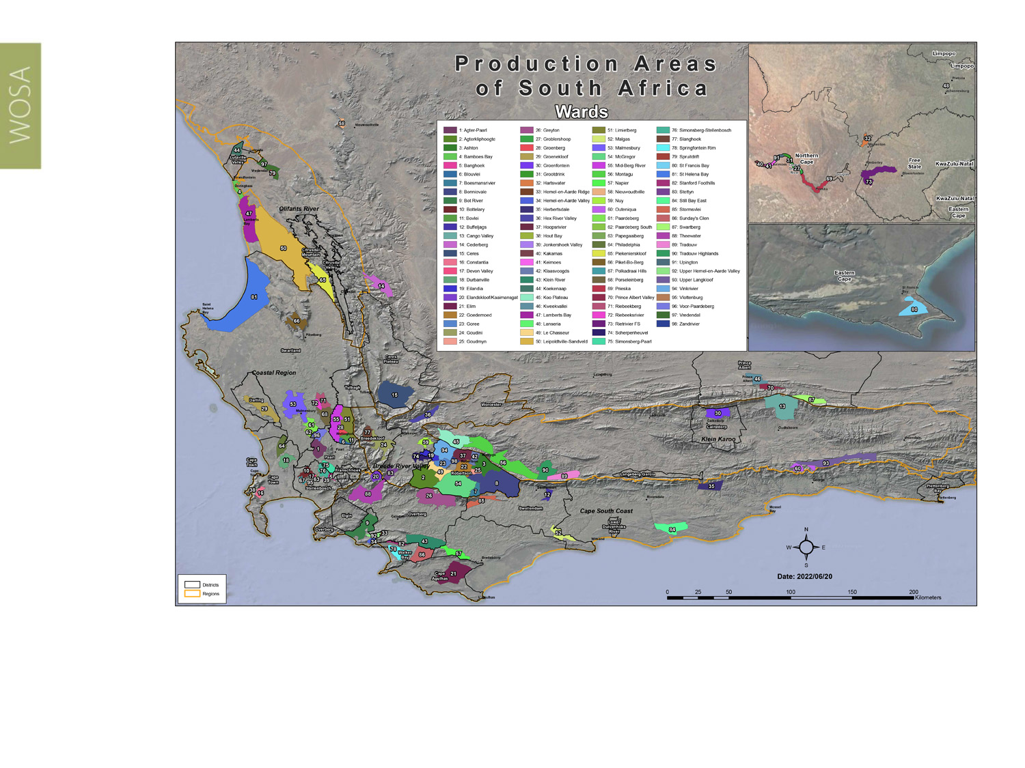
Wards of South Africa.
Paarl
Coastal

Slide 7
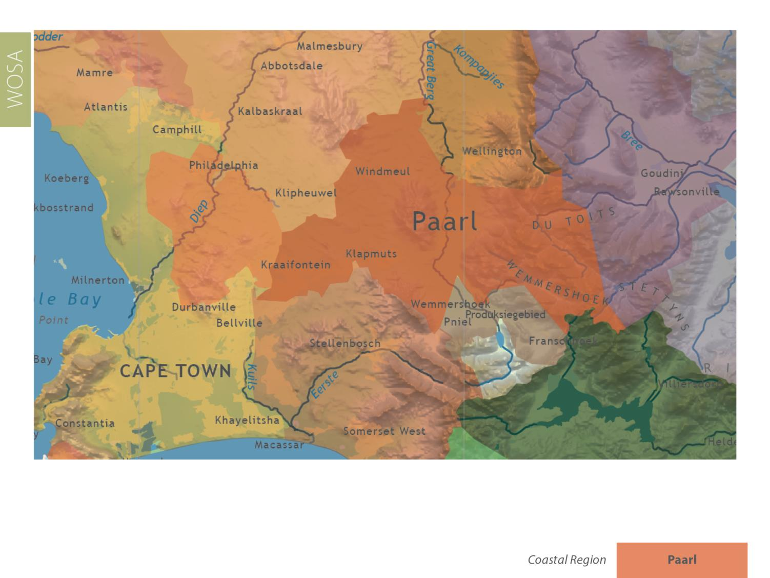
Paarl
Coastal

Slide 8
Coastal Region
Region: Coastal
District: Paarl
Wards: Agter-Paarl
Simonsberg-Paarl
Voor-Paardeberg
Paarl
Coastal

Slide 9
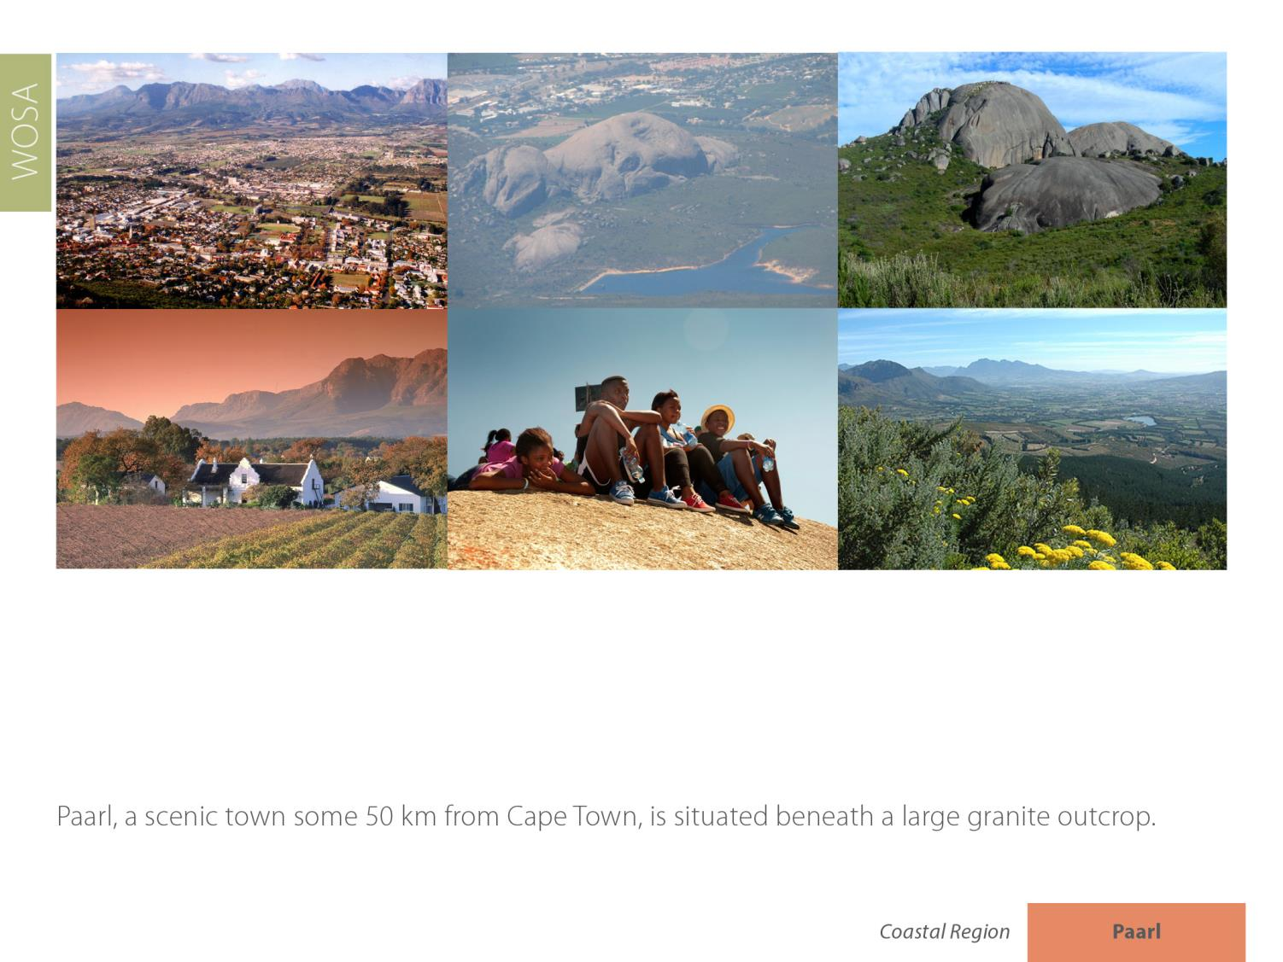
Paarl
Coastal

Slide 10
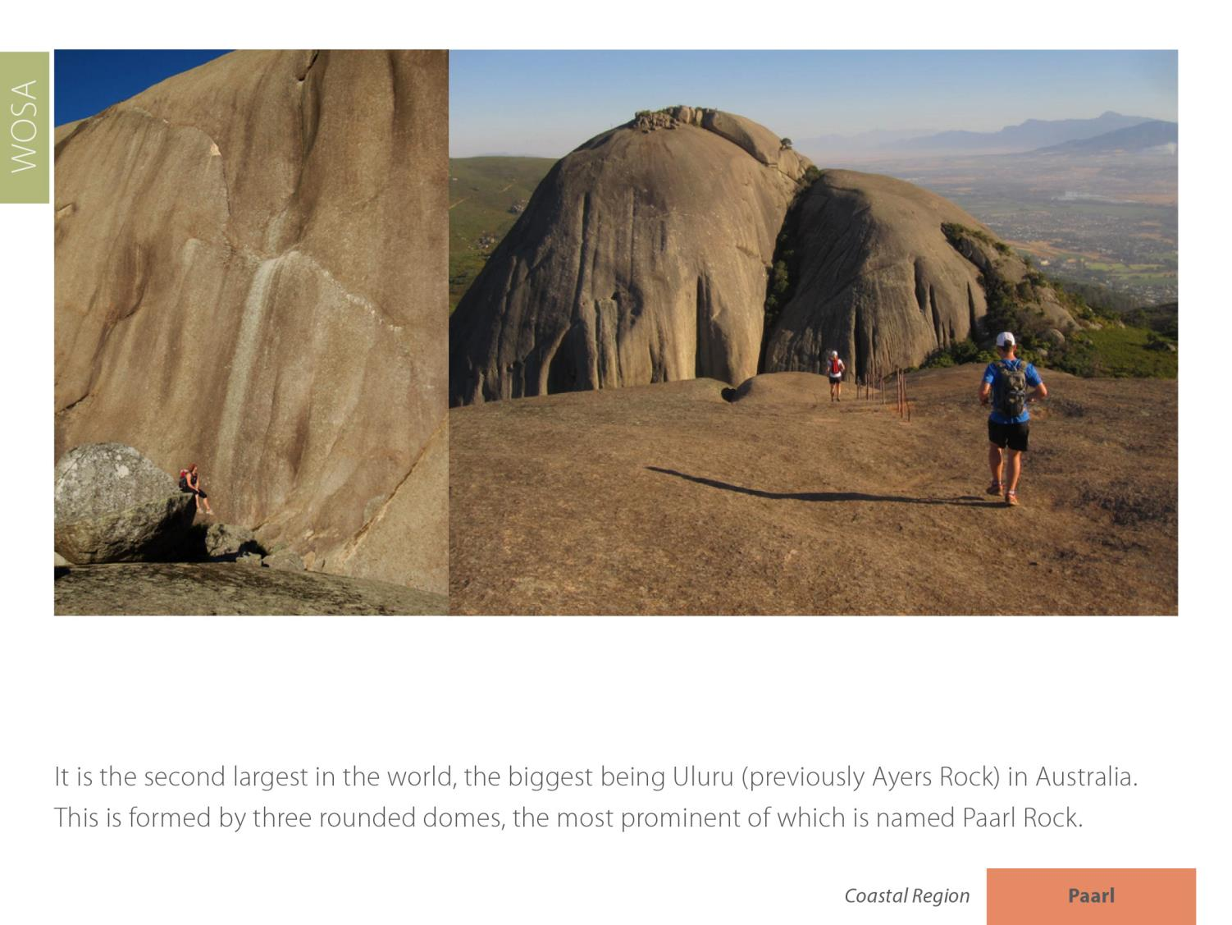
Paarl
Coastal

Slide 11
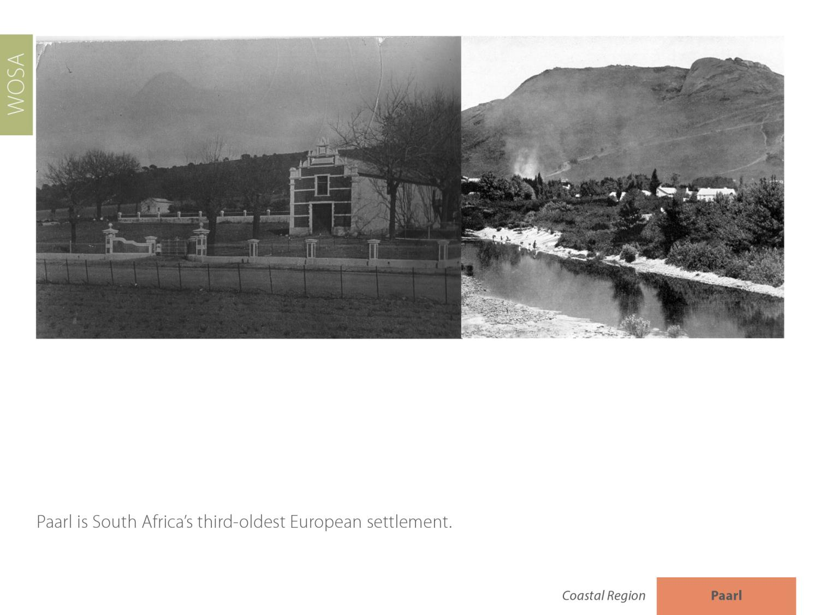
Paarl
Coastal

Slide 12
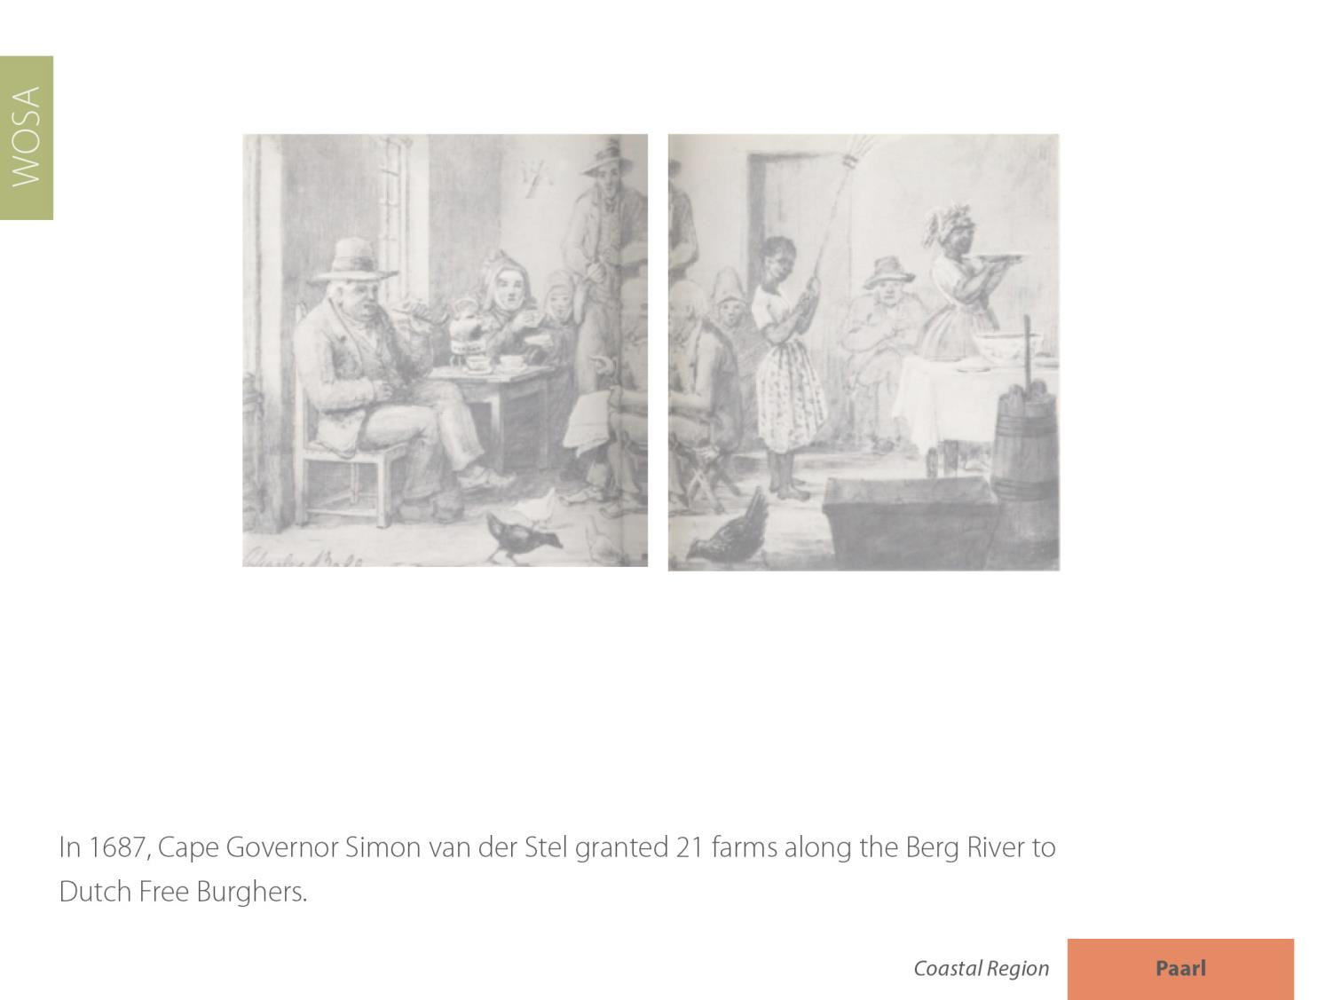
Paarl
Coastal

Slide 13
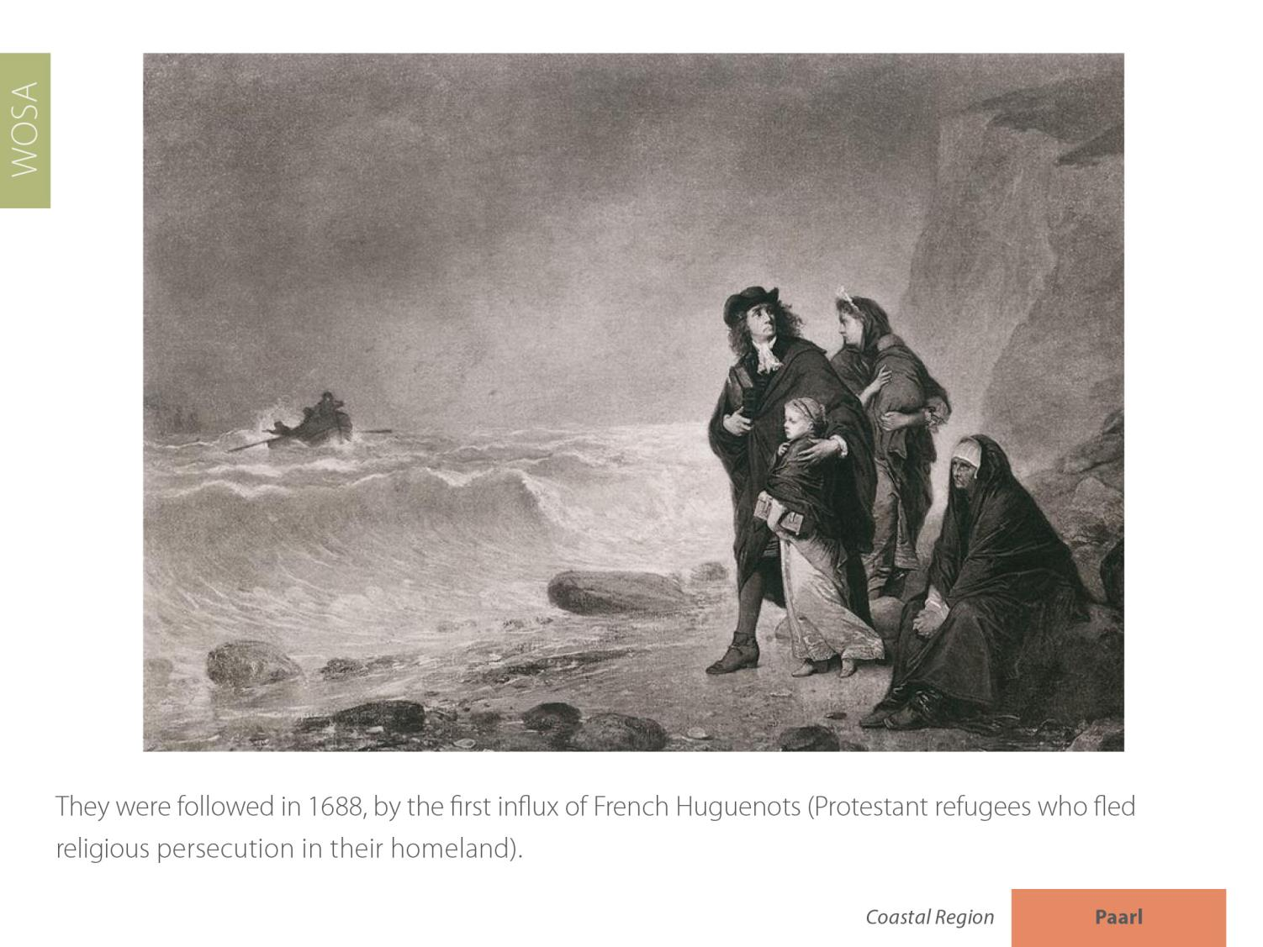
Paarl
Coastal

Slide 14
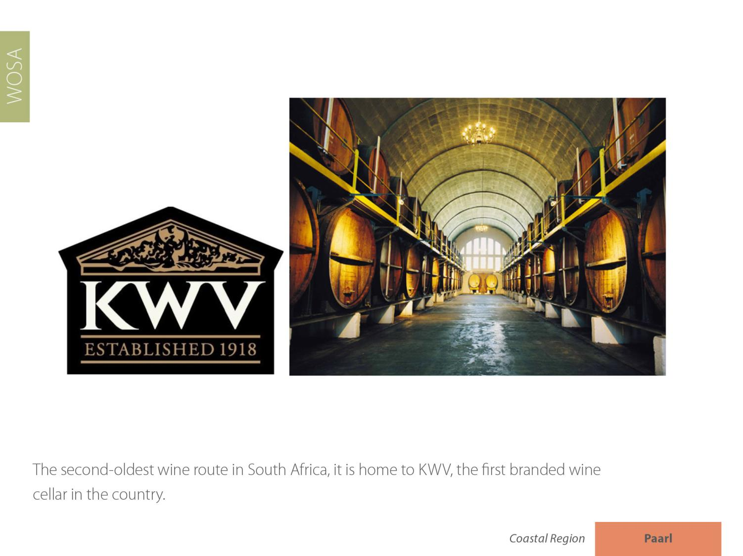
Paarl
Coastal

Slide 15
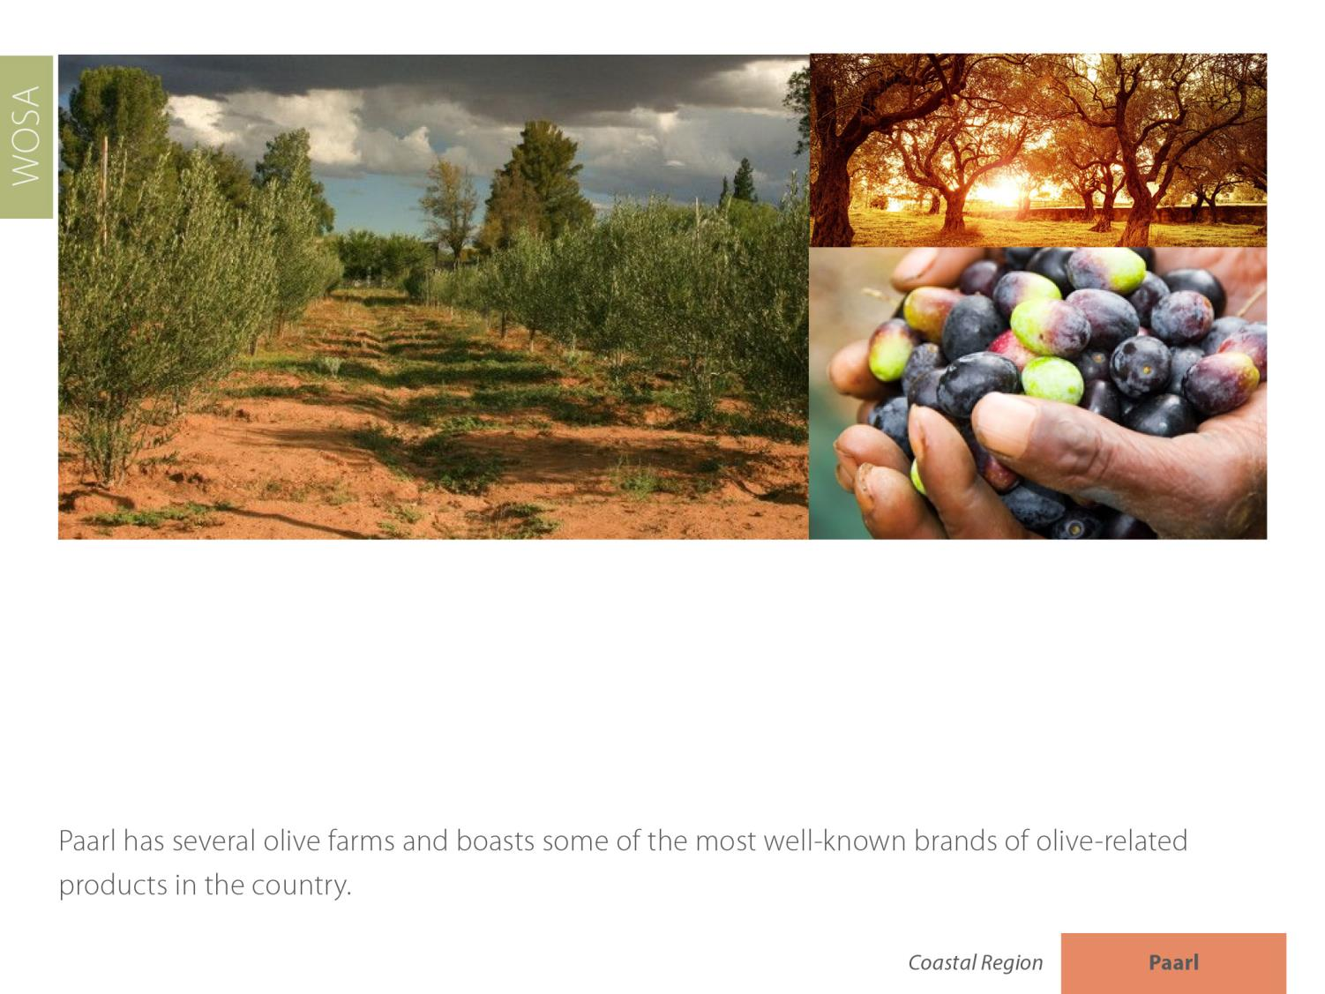
Paarl
Coastal

Slide 16
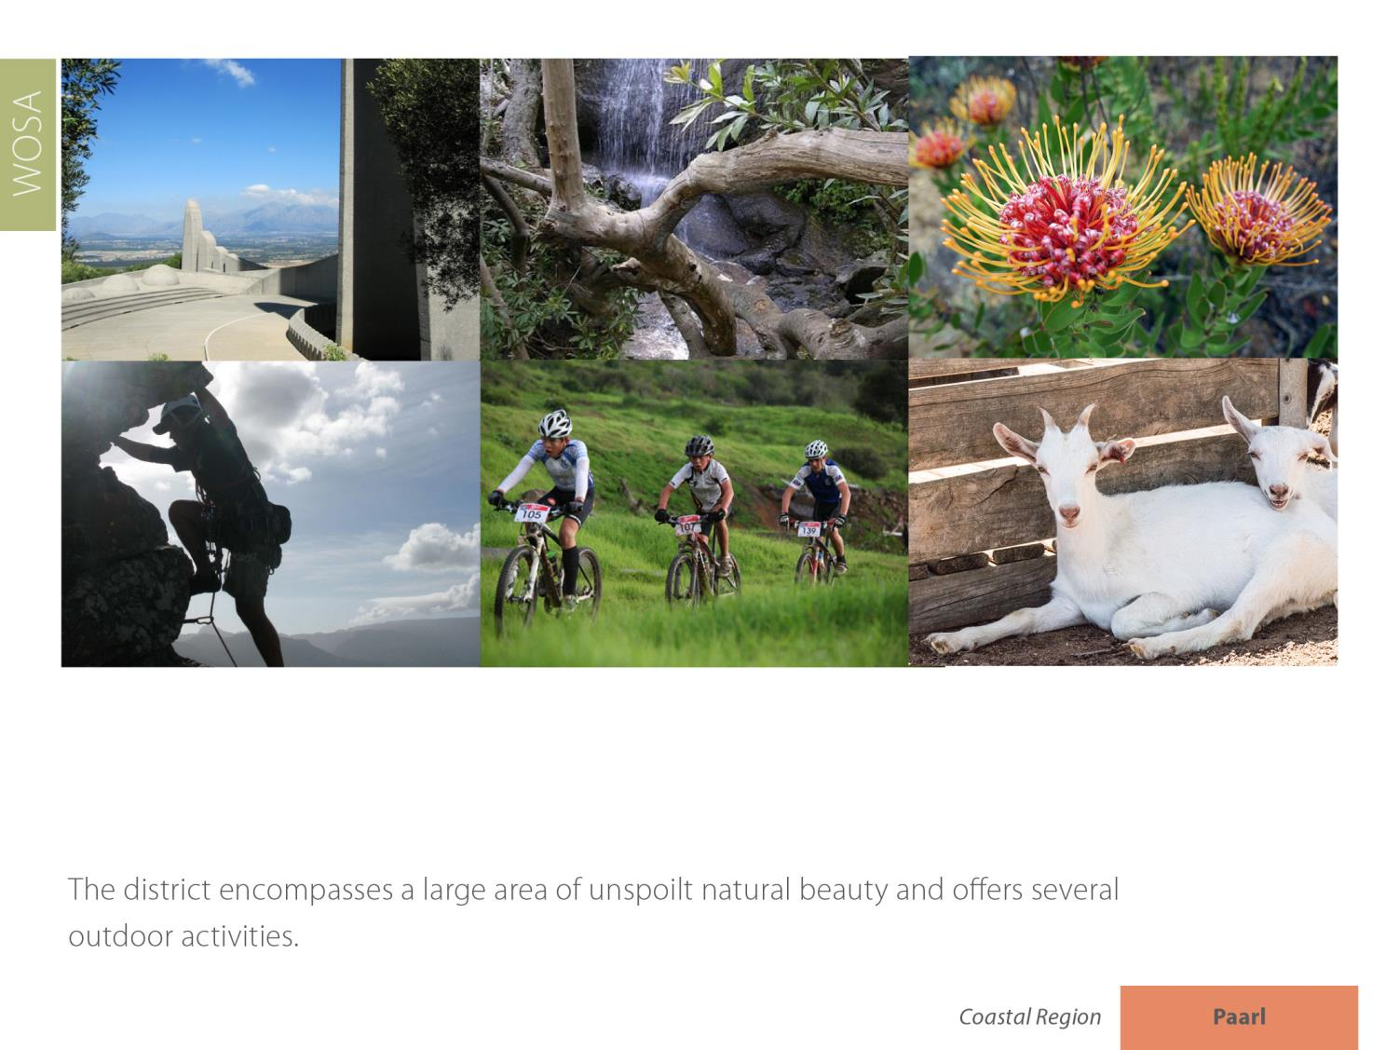
Paarl
Coastal

Slide 17
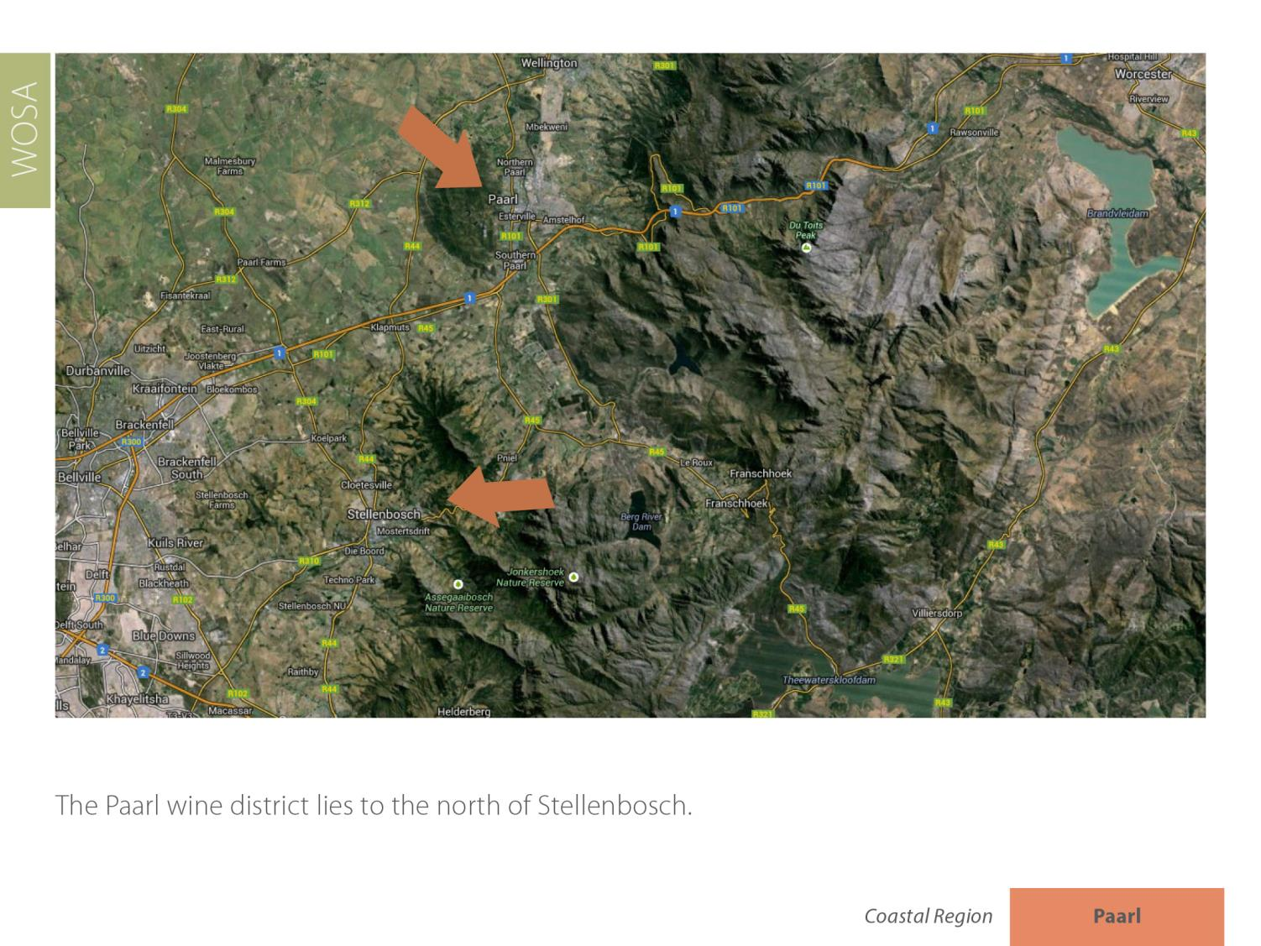
Paarl
Coastal

Slide 18
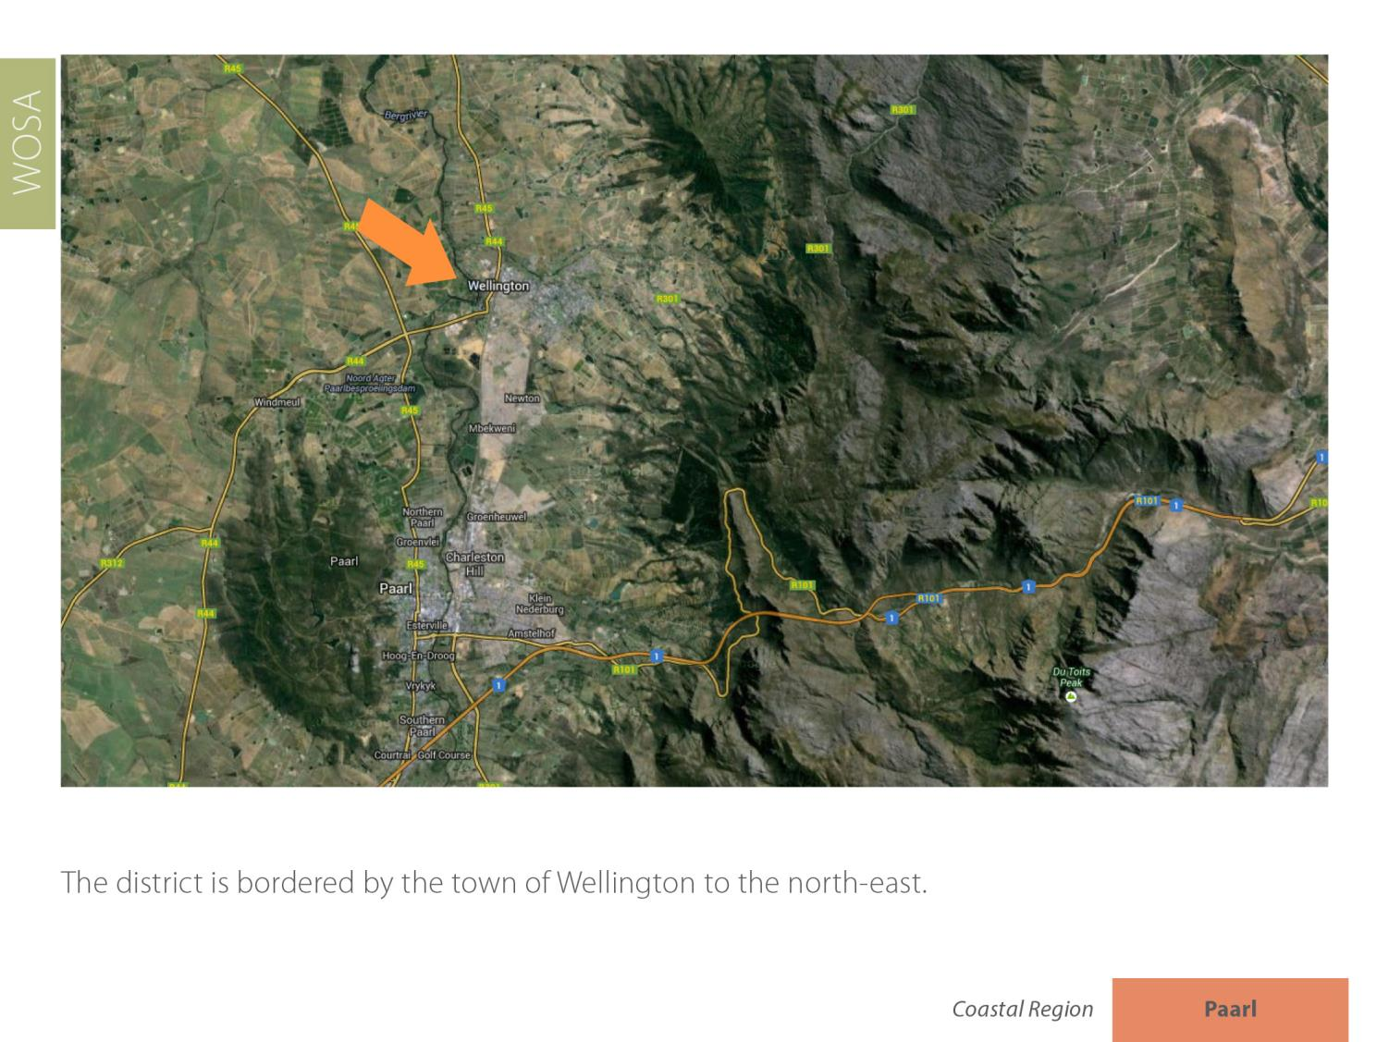
Paarl
Coastal

Slide 19
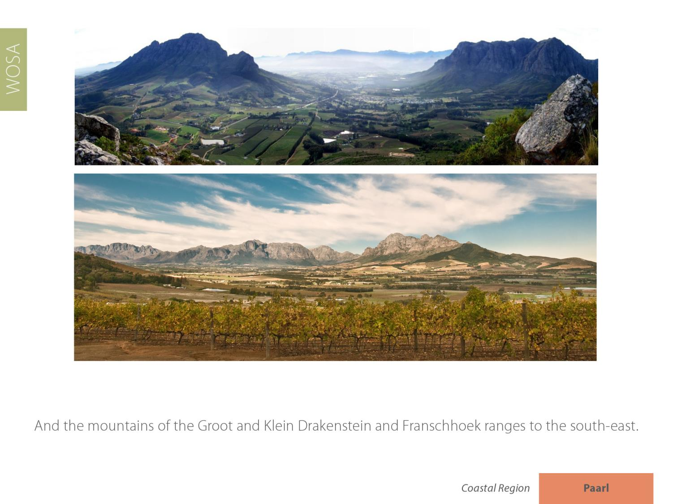
Paarl
Coastal

Slide 20
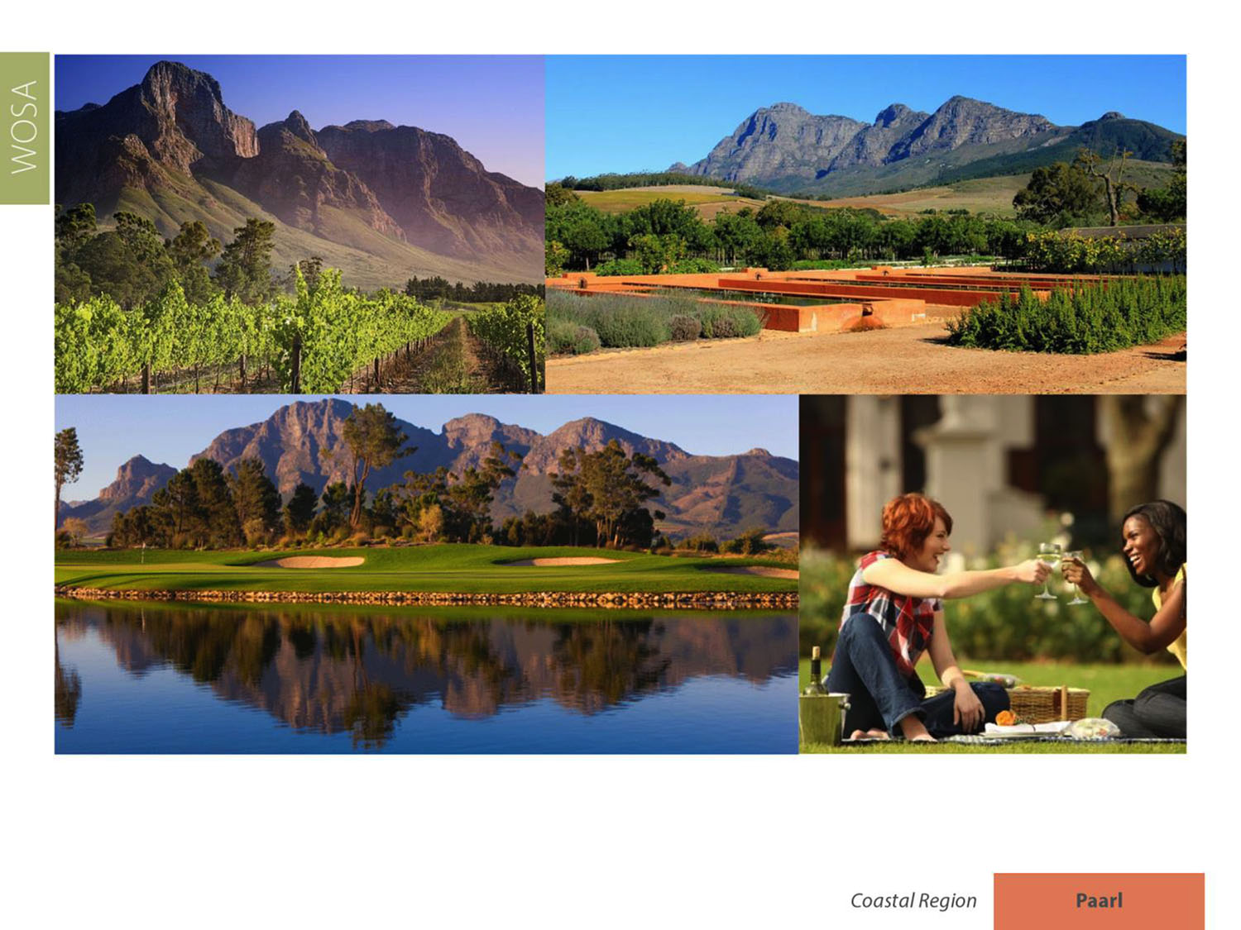
Paarl enjoys a typically Mediterranean climate. The summers are long and warm, and the mean February temperature is 23.2⁰C (Bellevue Weather Station).
Paarl
Coastal

Slide 21
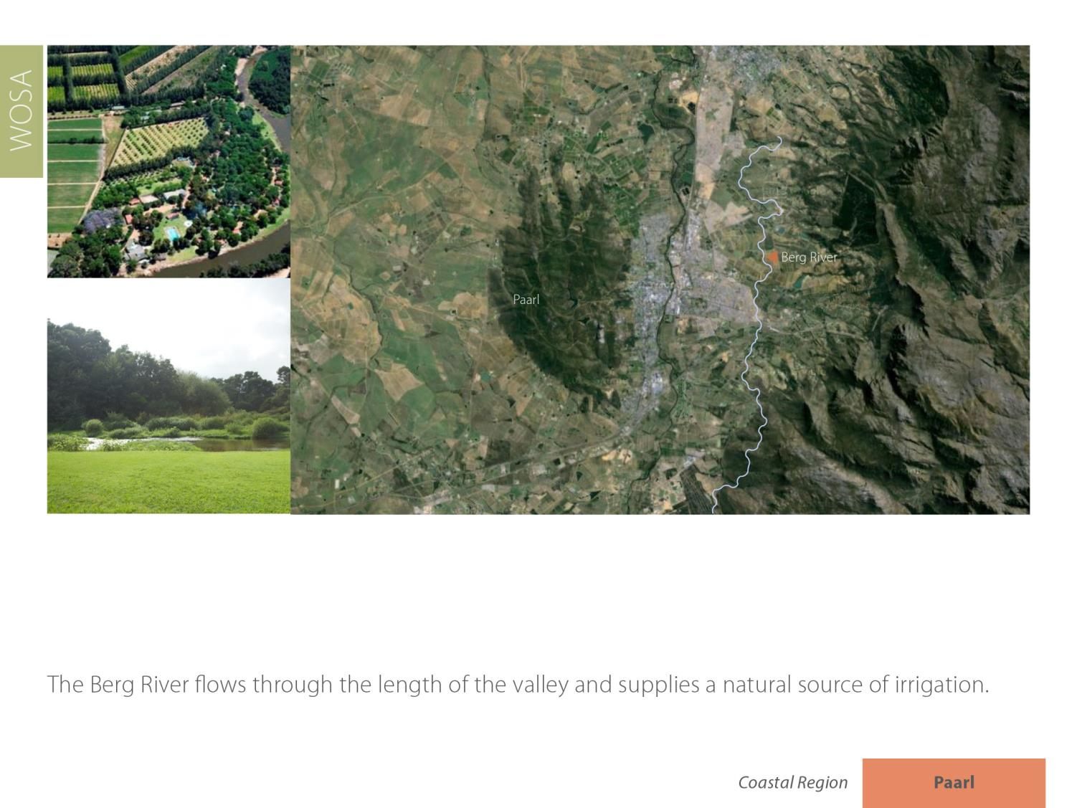
Paarl
Coastal

Slide 22
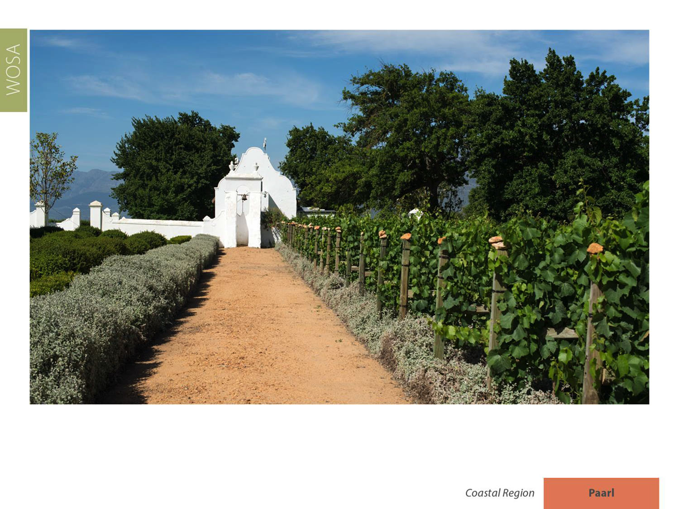
Annual rainfall varies between 800–900 mm (890 mm for Paarl Weather Station) – not as high as Constantia’s, for example, but enough to make irrigation advantageous only in exceptional circumstances.
Paarl
Coastal

Slide 23
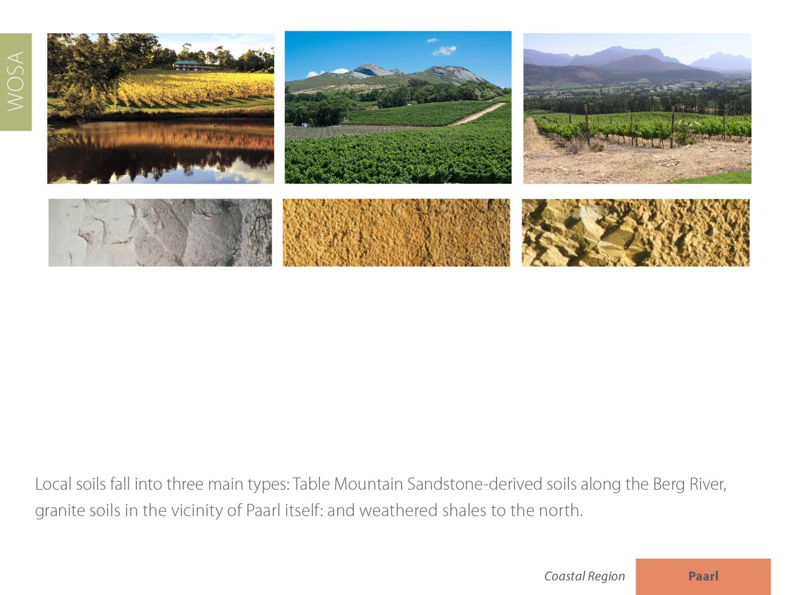
Paarl
Coastal

Slide 24
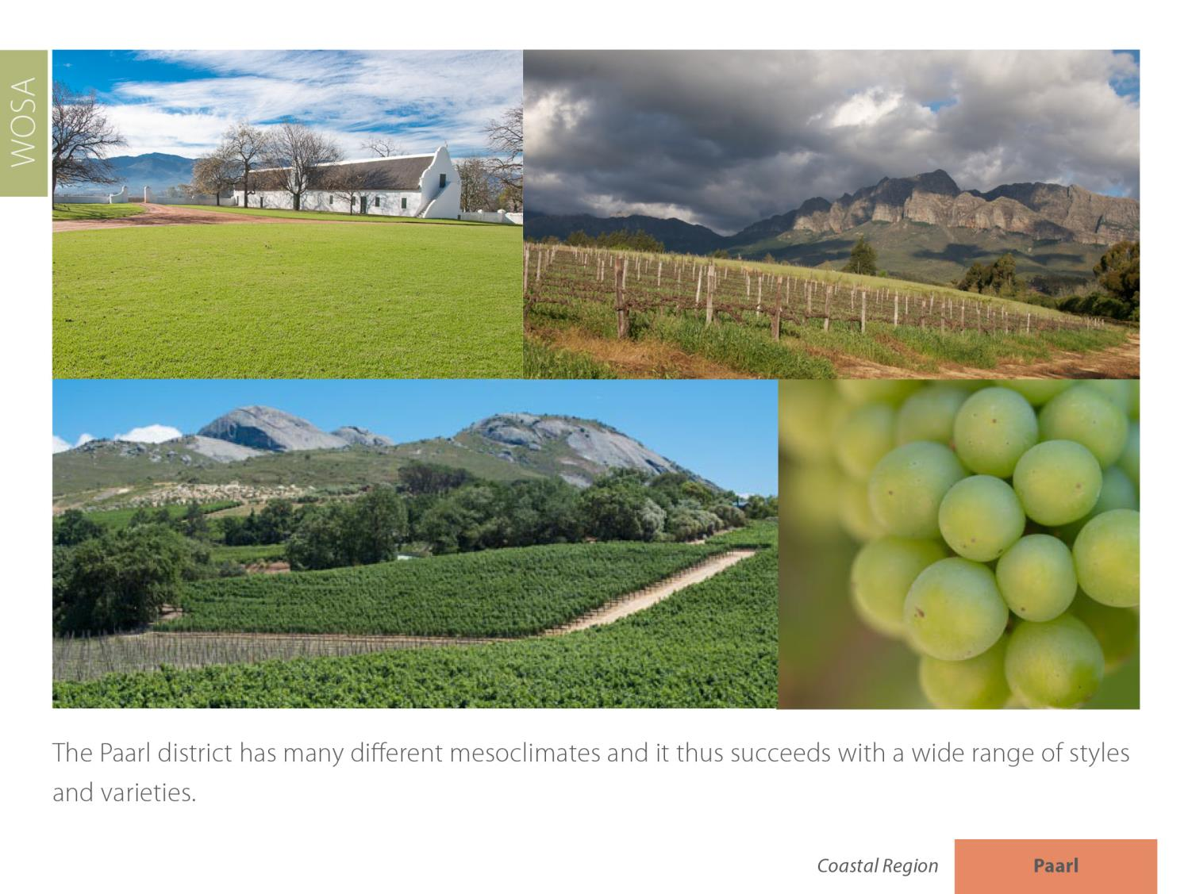
Paarl
Coastal

Slide 25
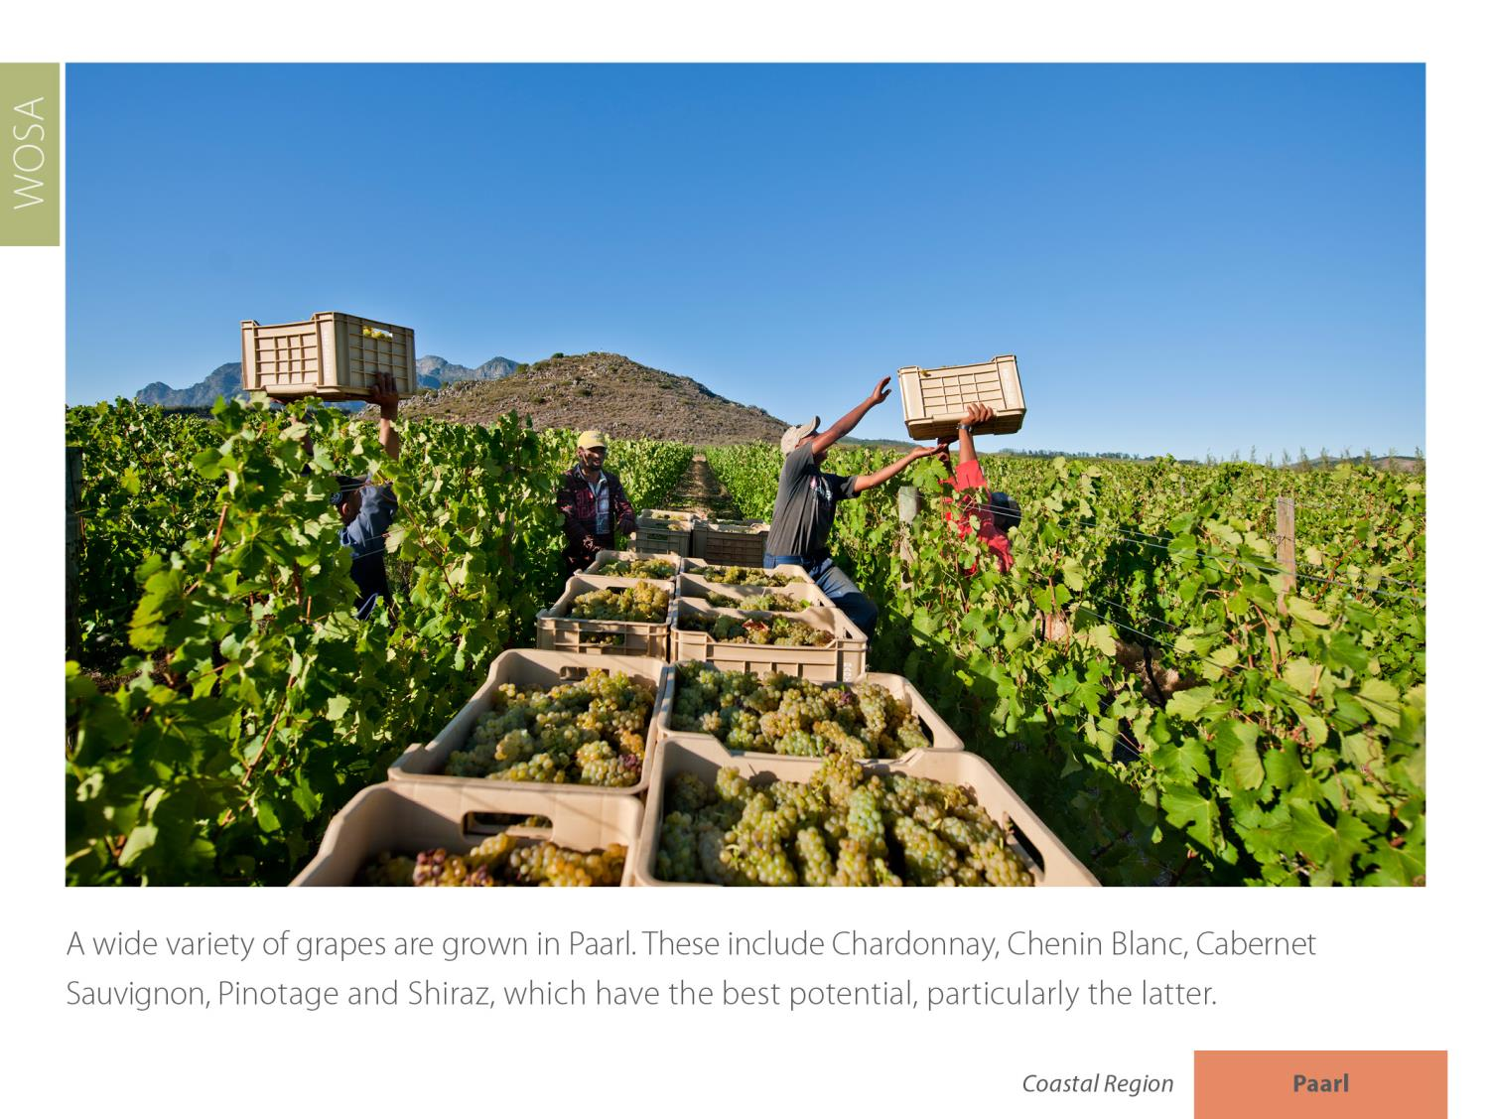

Paarl
Coastal

Slide 26
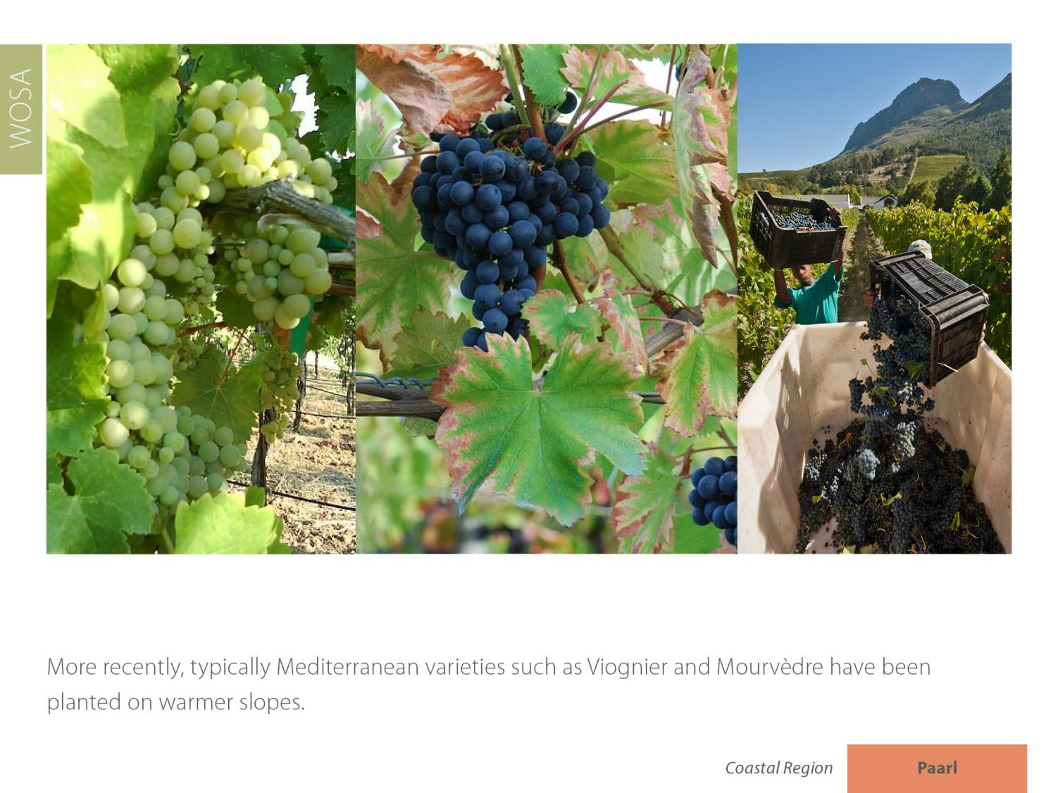
Paarl
Coastal

Slide 27
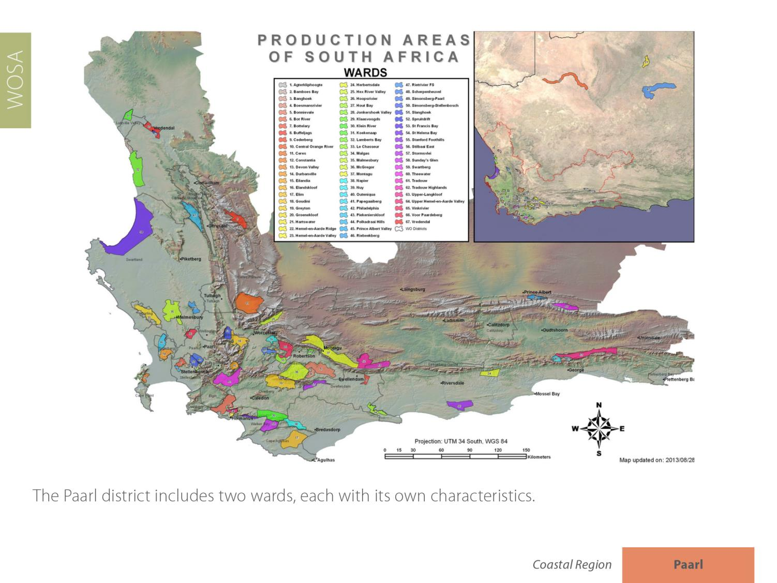
The Paarl district includes three wards, each with its own characteristics
Paarl
Coastal

Slide 28
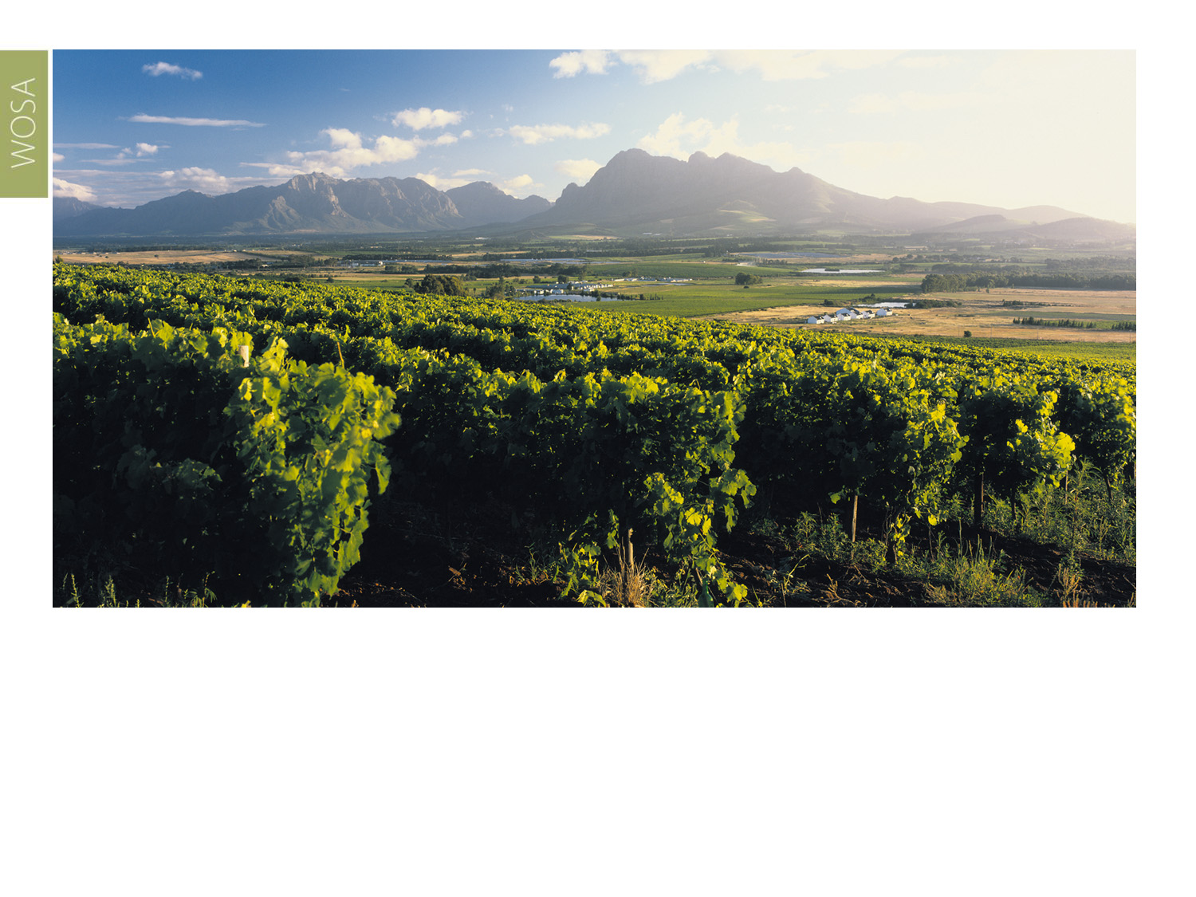
The most recently proclaimed of the three wards, Agter-Paarl encompasses the southwestern slopes of Paarl mountain.
Paarl
Coastal

Slide 29
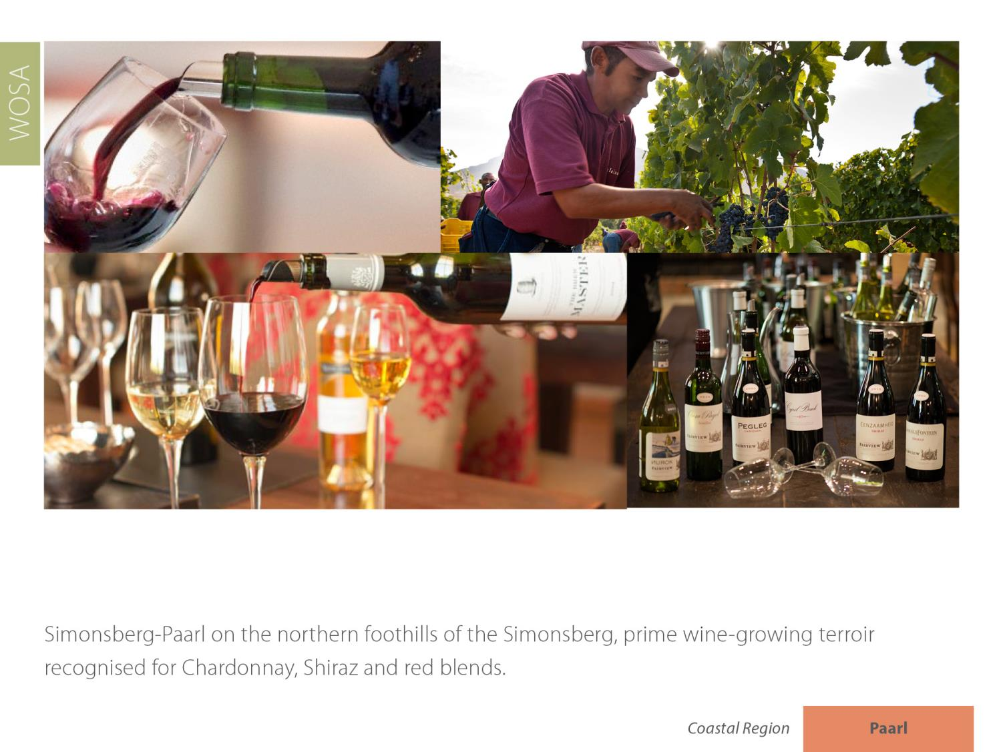
Paarl
Coastal

Slide 30
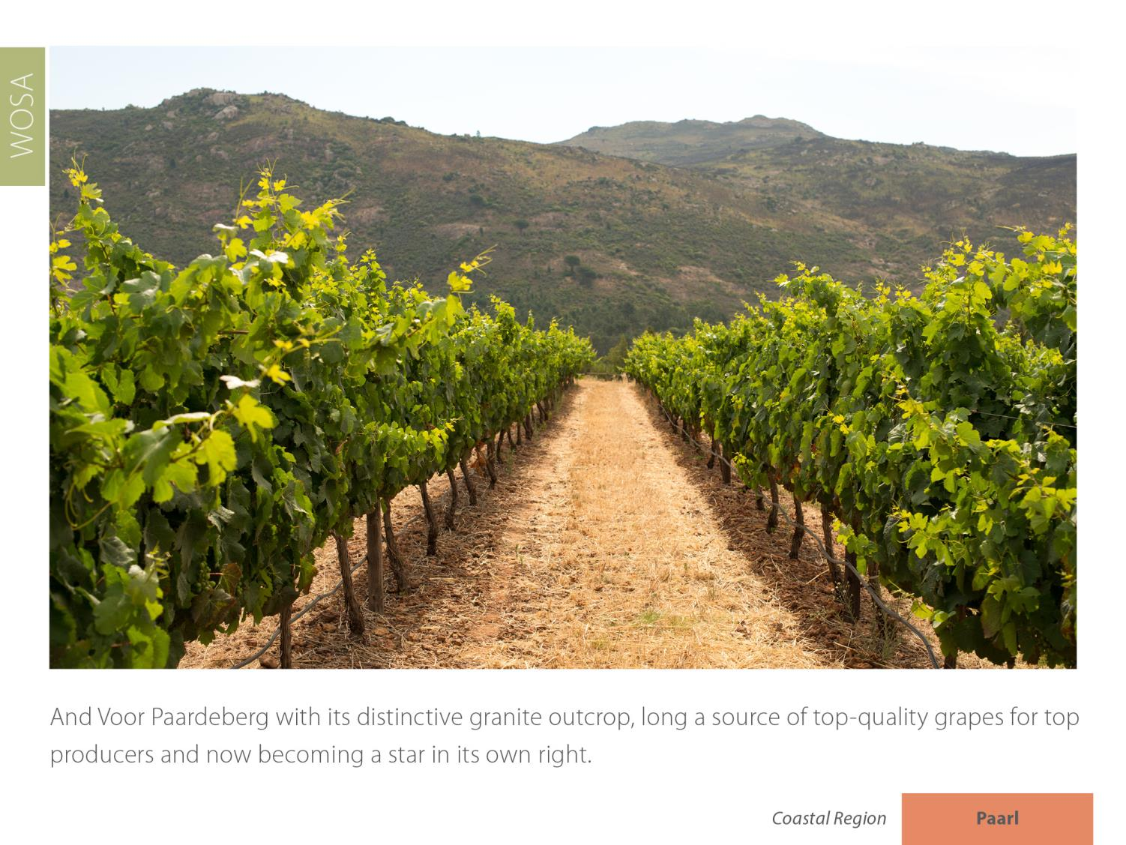
And Voor-Paardeberg with its distinctive granite outcrop, long a source of top-quality grapes for top producers and now becoming a star in its own right.
Paarl
Coastal

Slide 31
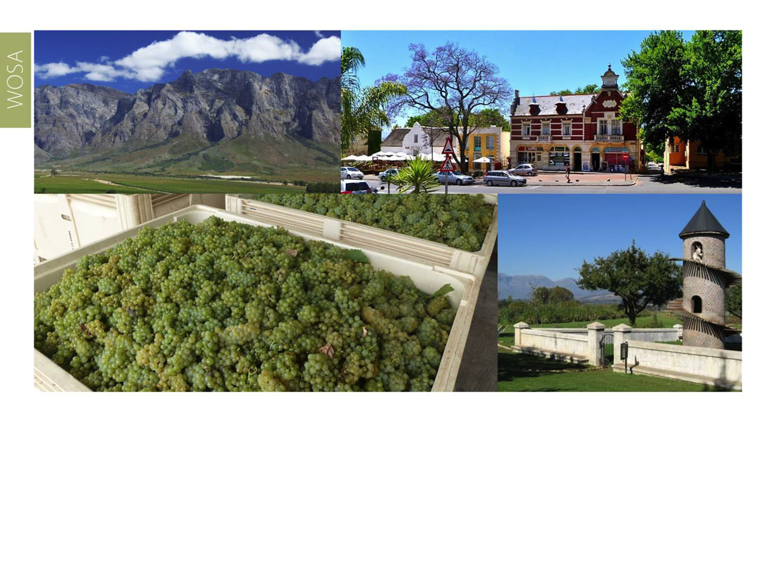
The images used in these presentations have been sourced from various producers, as well as industry and tourism bodies. These presentations are strictly for non-commercial, non-profit, educational purposes only and cannot be reproduced o transmitted in any form or by any means without written permission from Wines of South Africa (WoSA).

Slide 32
The Cape winelands, considered by many to be
the most beautiful in the world, have a network of
diverse and well-run wine routes, affording visitors
a varied and unforgettable experience.

Slide 33
THE END

