Slide 1
CAPE WINELANDS
ROBERTSON

Slide 2
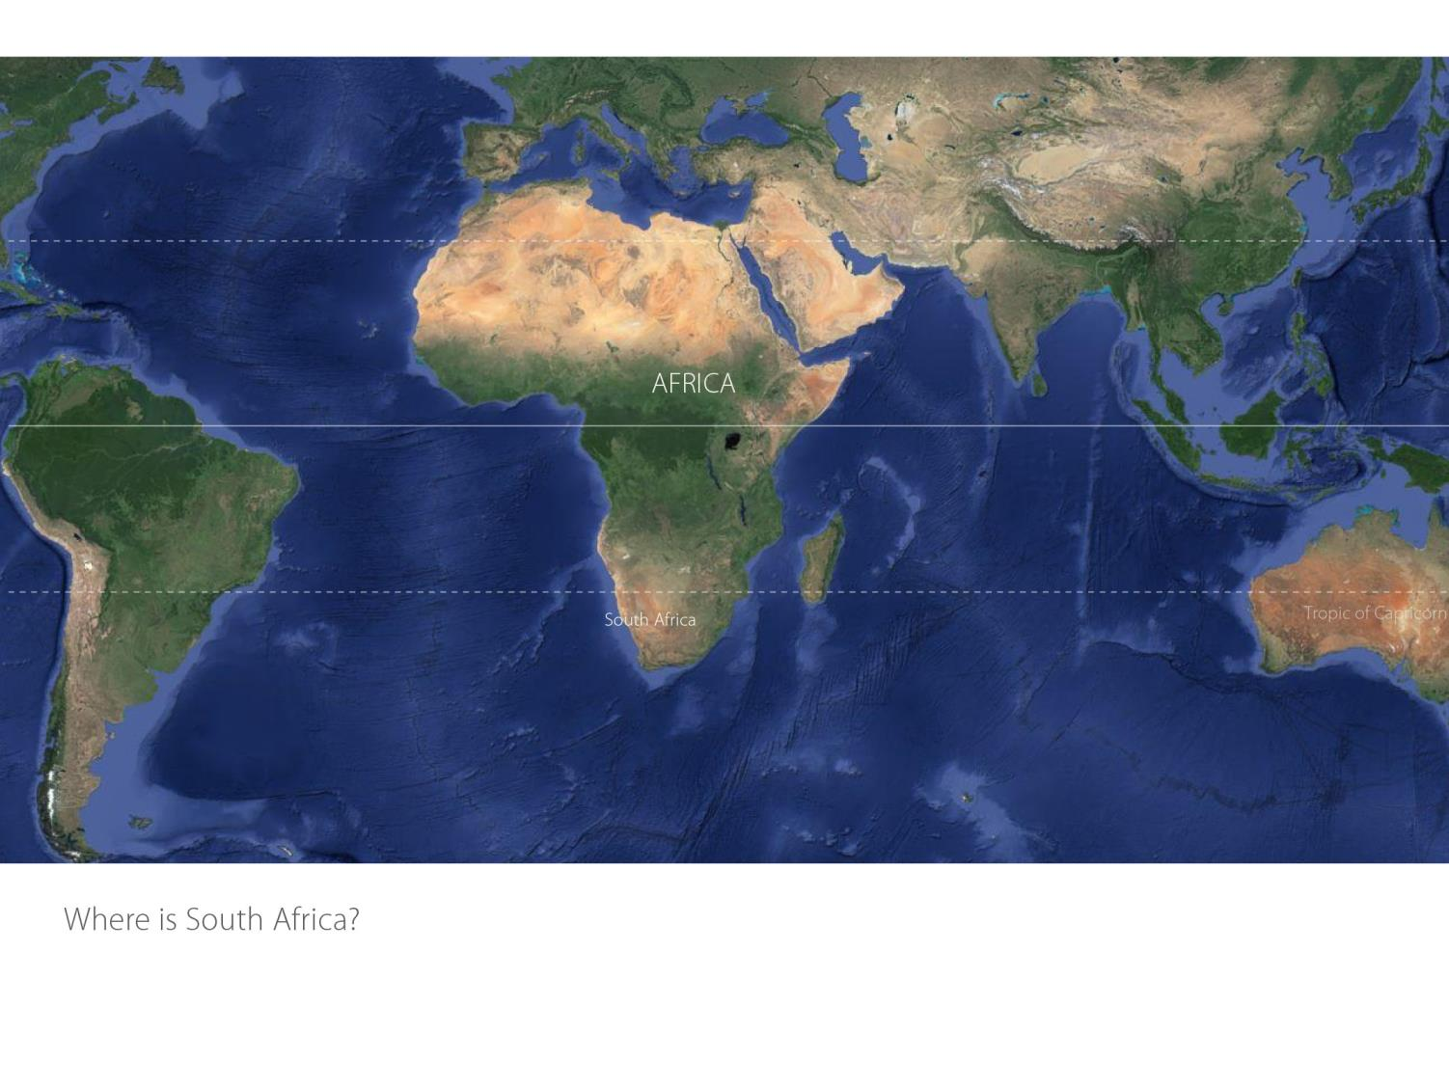

Slide 3
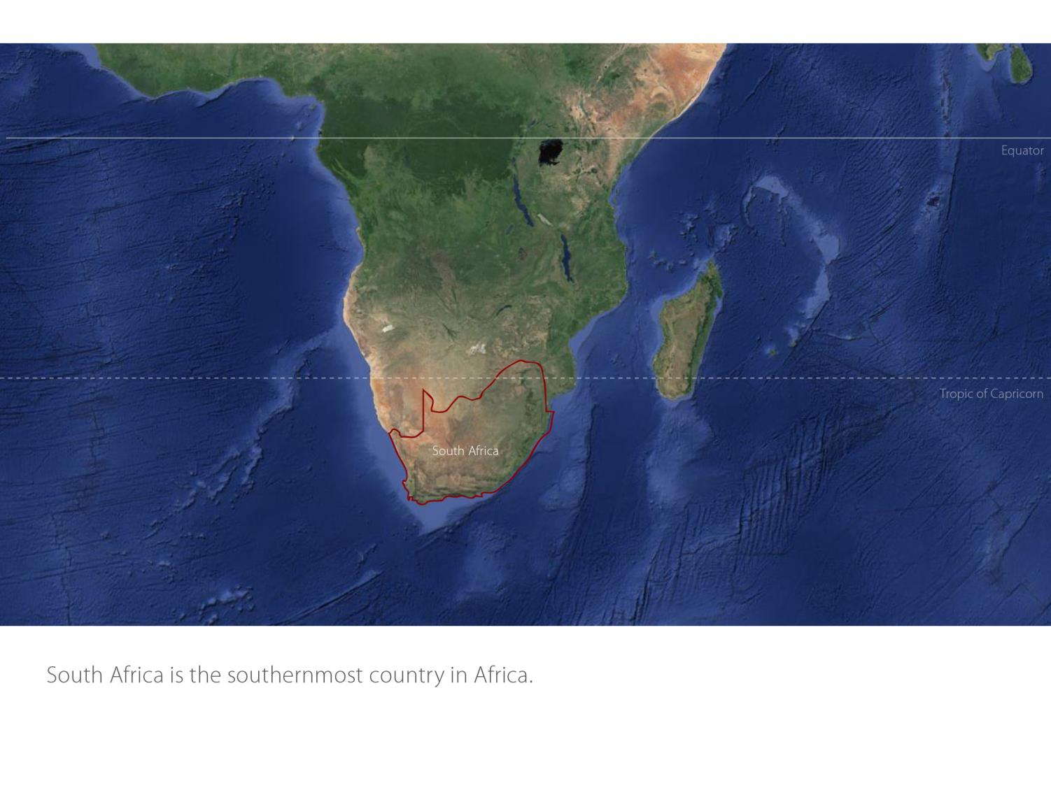

Slide 4
Our winelands are located at the very tip of South Africa.
Robertson
Breede River Valley

Slide 5
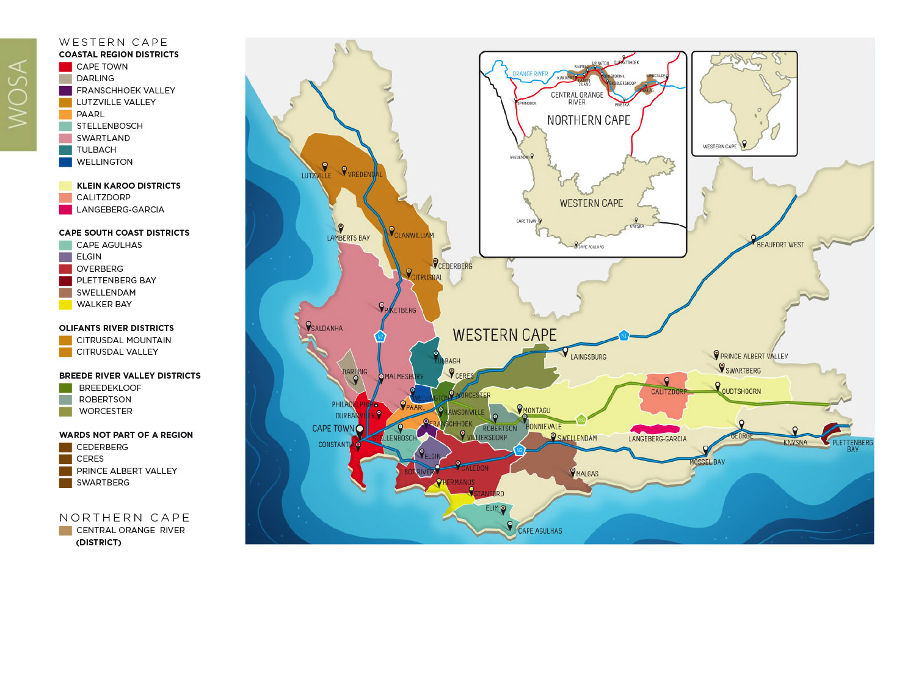
PRODUCTION AREAS: Districts of South Africa.
Robertson
Breede River Valley

Slide 6
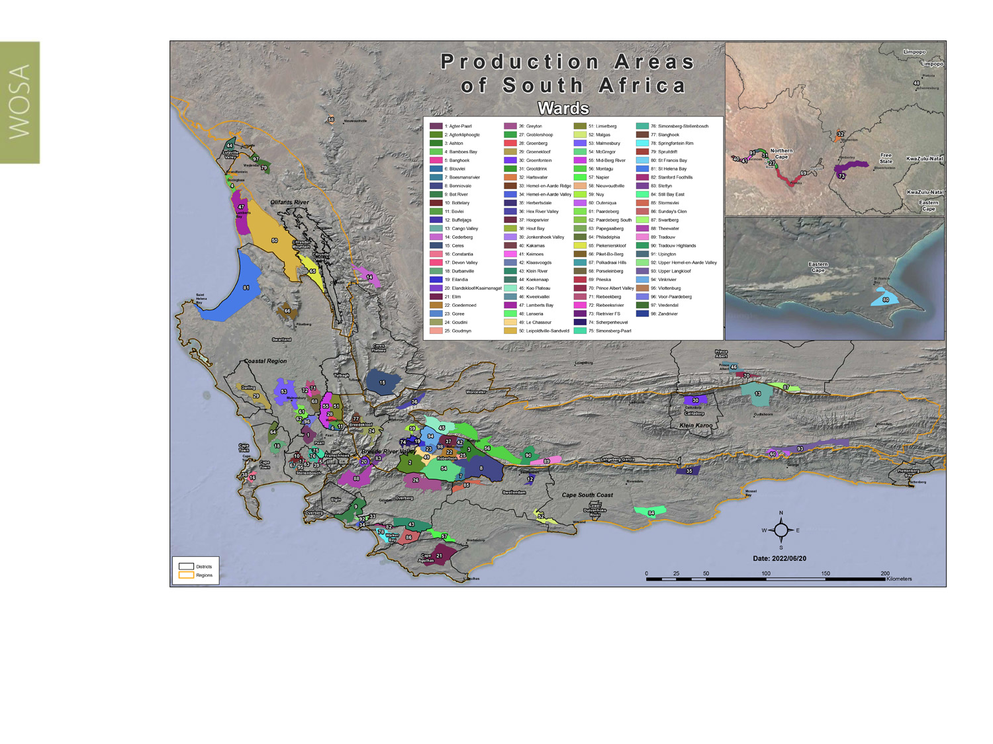
Wards of South Africa.
Robertson
Breede River Valley

Slide 7
Breede River Valley
Region: Breede River Valley
District: Robertson
Wards: Agterkliphoogte
Ashton
Bonnievale
Boesmansrivier
Eilandia
Goedemoed
Goree
Goudmyn Hoopsrivier
Klaasvoogds
Le Chasseur McGregor
Vinkrivier
Zandrivier
Robertson
Breede River Valley

Slide 8
Robertson
Breede River Valley

Slide 9
Robertson
Breede River Valley

Slide 10
Robertson
Breede River Valley

Slide 11
Robertson
Breede River Valley

Slide 12
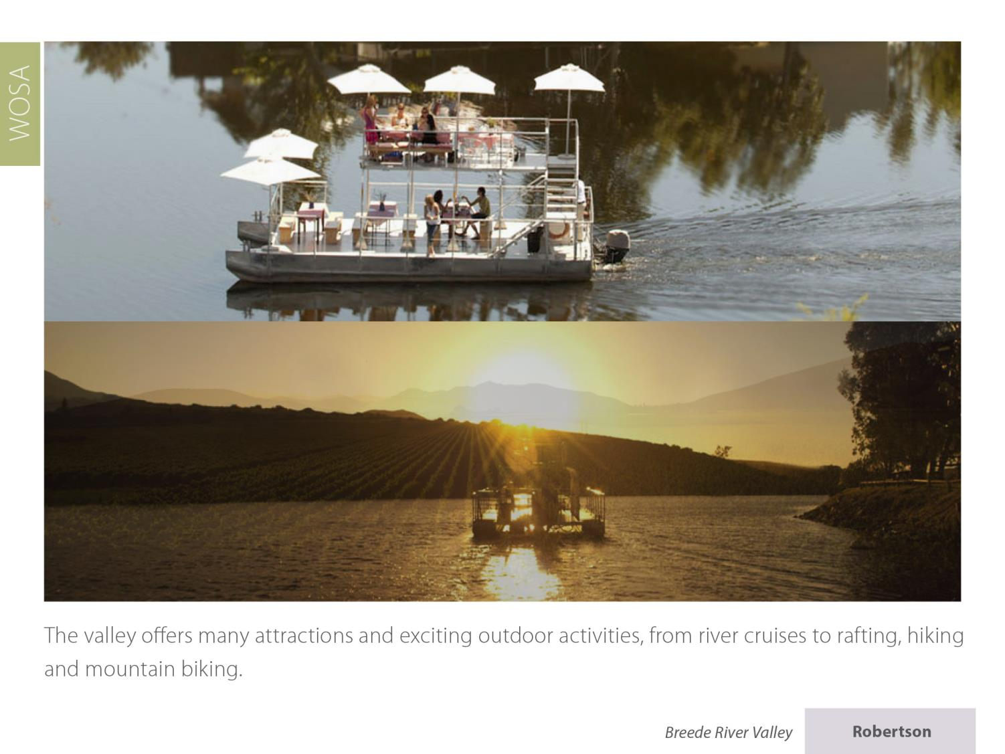
Robertson
Breede River Valley

Slide 13
Robertson
Breede River Valley

Slide 14
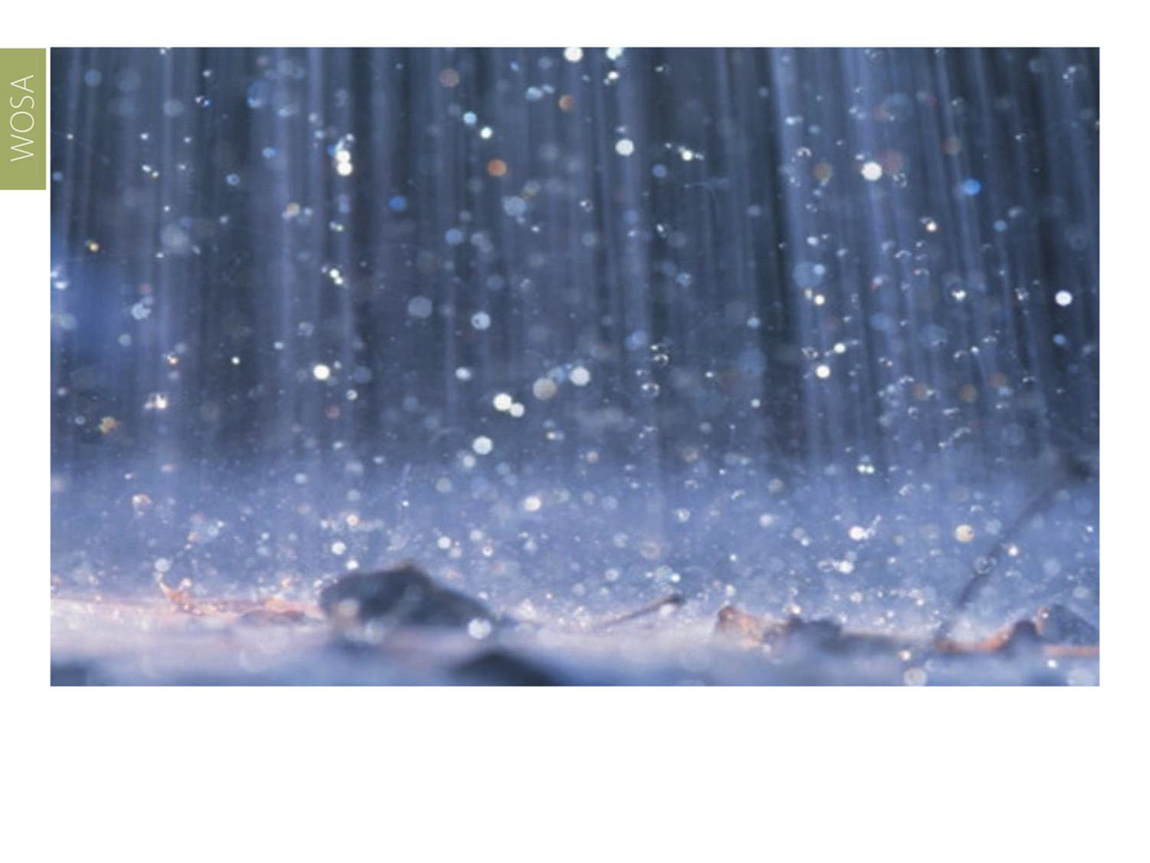
It has an average annual rainfall of around 280–400 mm.
Robertson
Breede River Valley

Slide 15
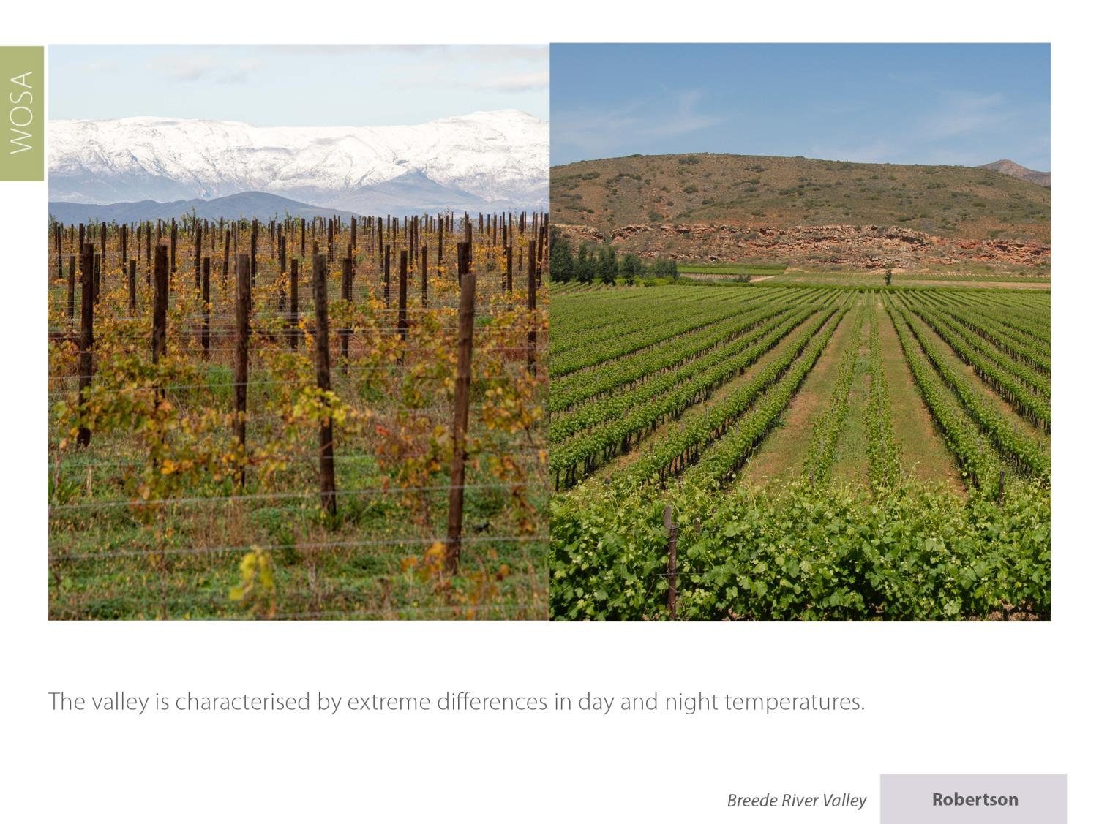
Robertson
Breede River Valley

Slide 16
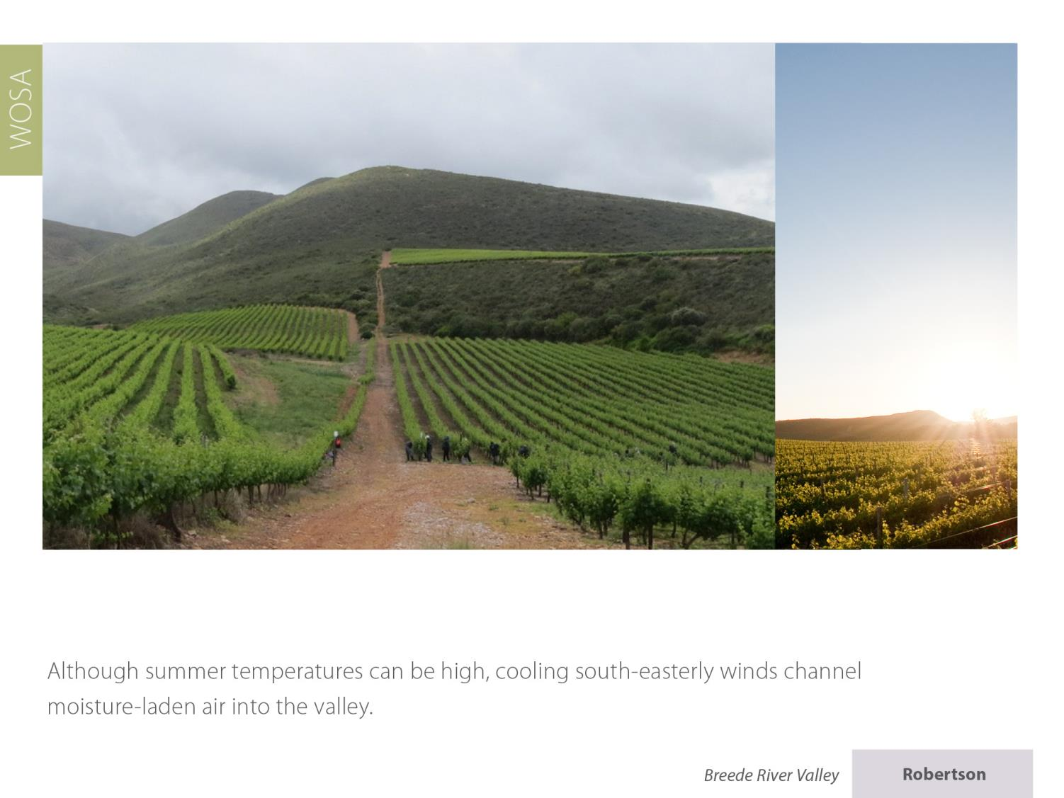
Robertson
Breede River Valley

Slide 17
The mean February temperature is 23⁰C.
Robertson
Breede River Valley

Slide 18
Robertson
Breede River Valley

Slide 19
Robertson
Breede River Valley

Slide 20
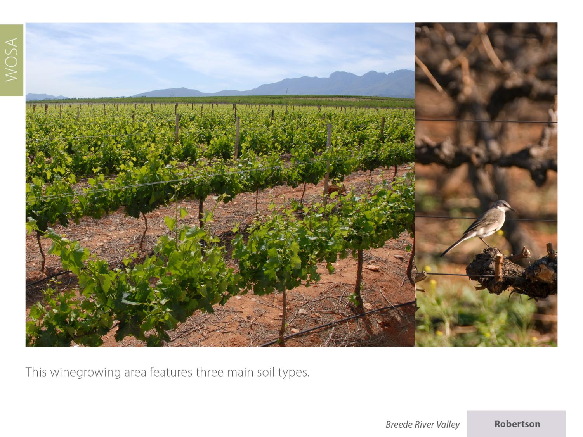
Robertson
Breede River Valley

Slide 21
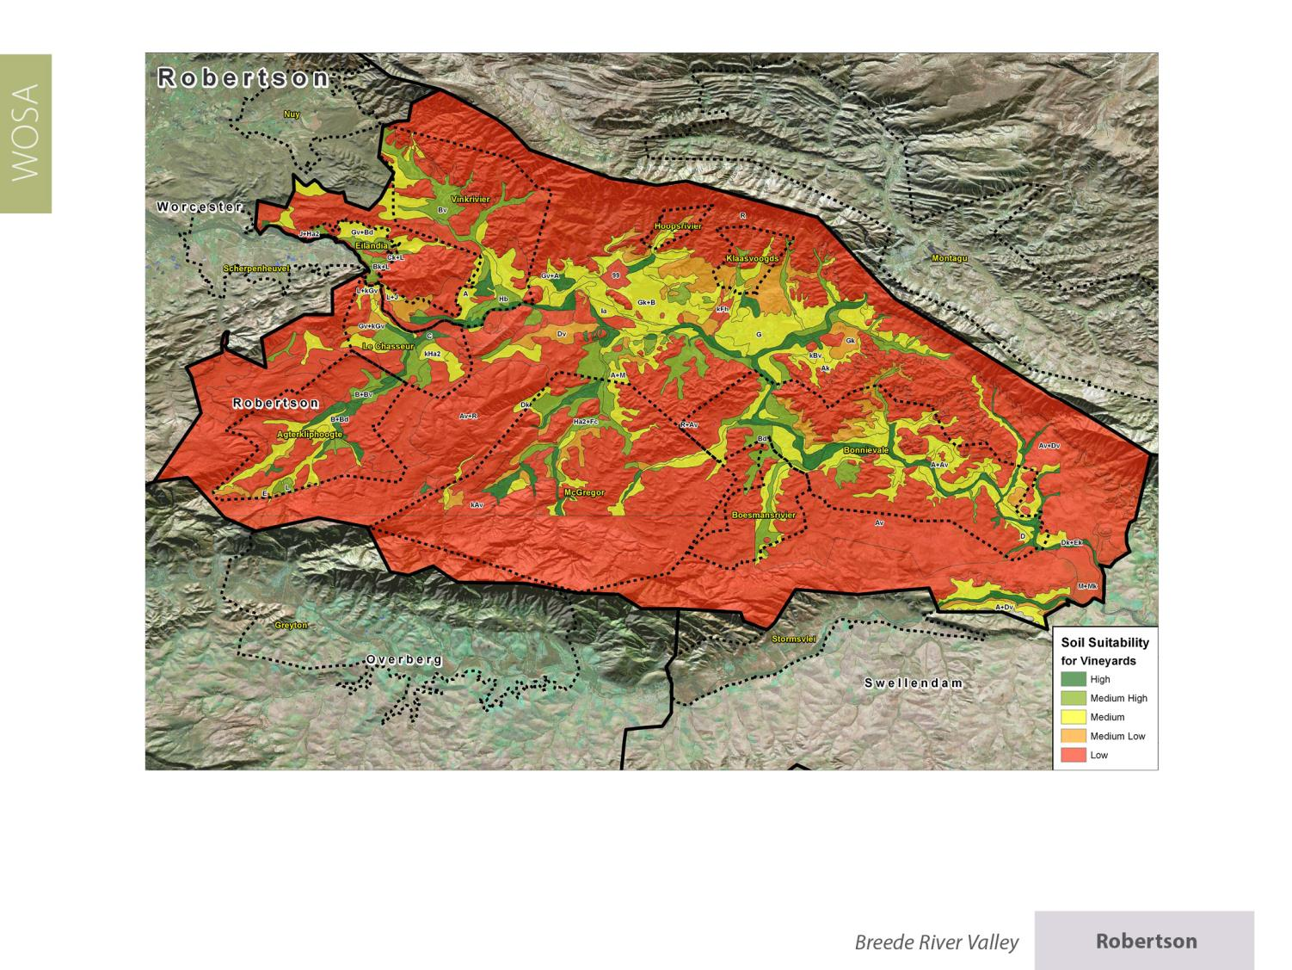
Robertson
Breede River Valley

Slide 22
Robertson
Breede River Valley

Slide 23
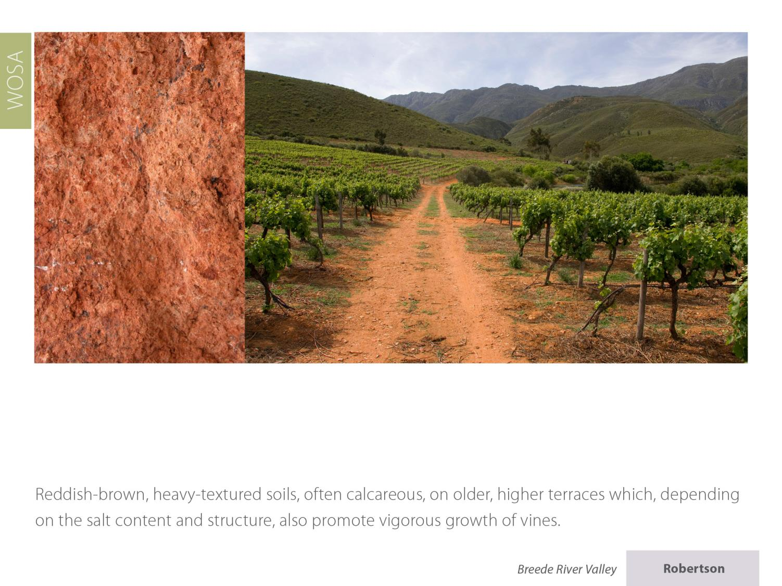
Robertson
Breede River Valley

Slide 24
Robertson
Breede River Valley

Slide 25
Robertson
Breede River Valley

Slide 26
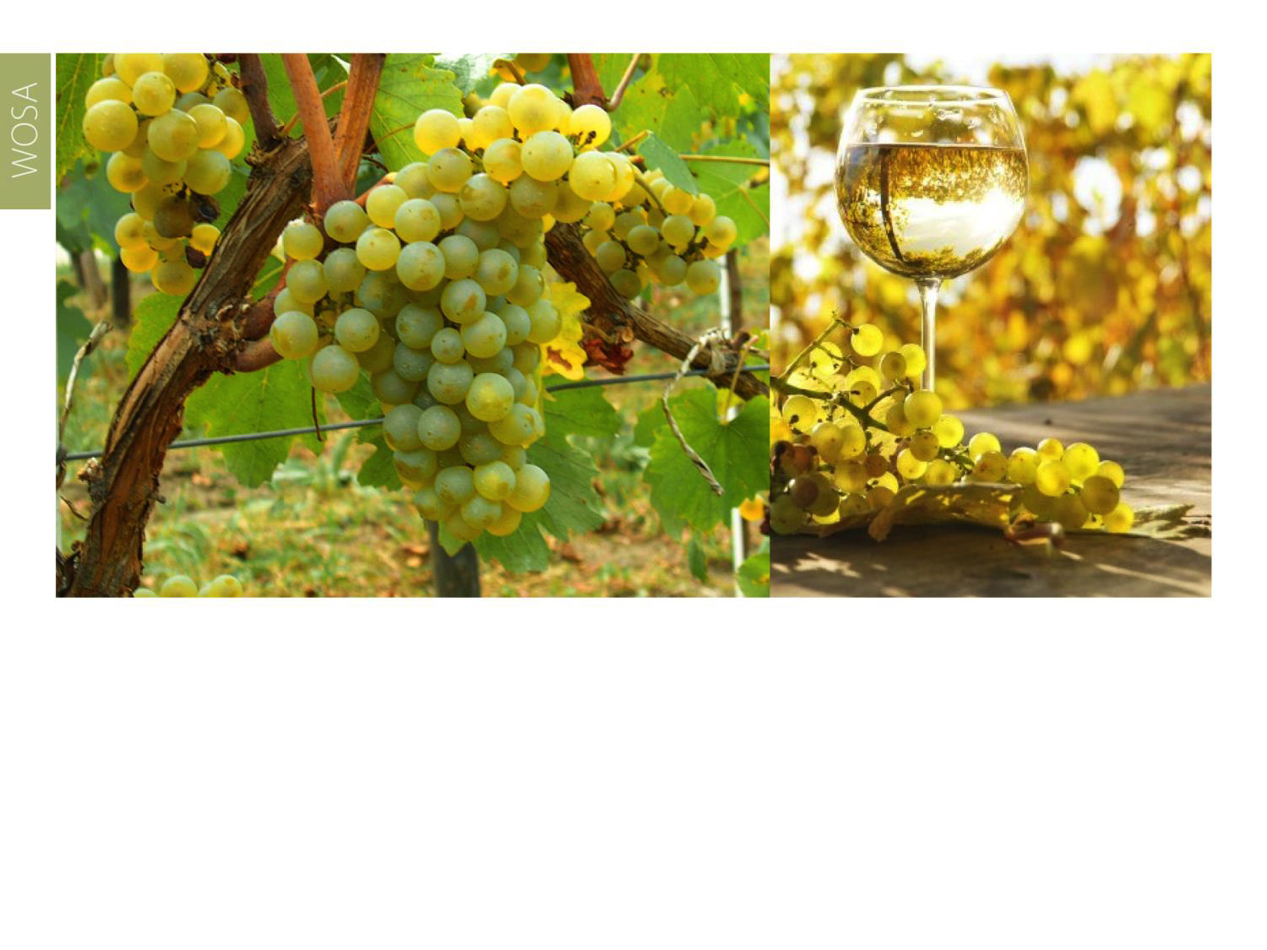
Plantings of Colombard account for the most hectarage of white-wine varieties, followed by Chardonnay, Sauvignon Blanc and Chenin Blanc.
Robertson
Breede River Valley

Slide 27
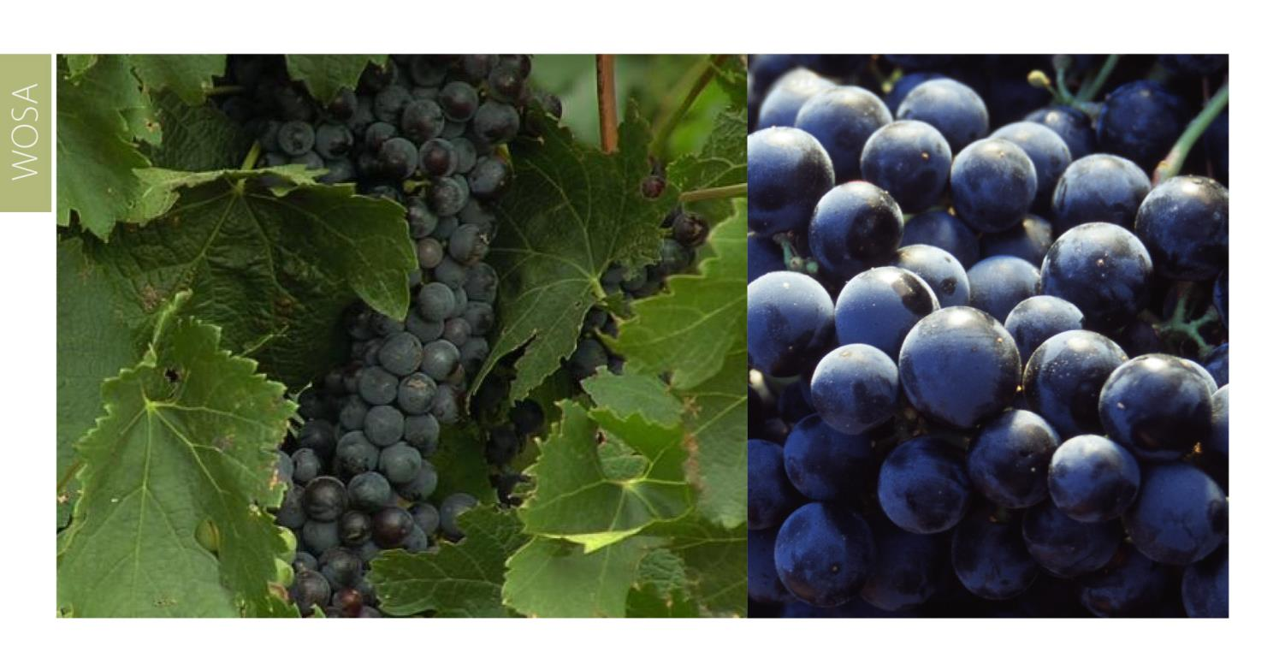
The most widely planted red-wine variety is Cabernet Sauvignon, followed by Shiraz and Pinotage.
Robertson
Breede River Valley

Slide 28
Robertson
Breede River Valley

Slide 29
Robertson
Breede River Valley

Slide 30
Robertson
Breede River Valley

Slide 31
The district also produces stand-out Cap Classiques.
Robertson
Breede River Valley

Slide 32
Robertson
Breede River Valley

Slide 33
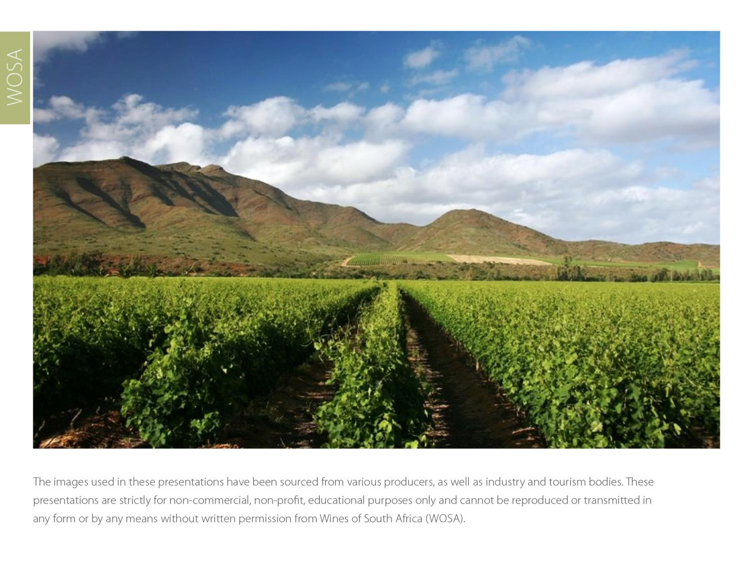
The images used in these presentations have been sourced from various producers, as well as industry and tourism bodies. These presentations are strictly for non-commercial, non-profit, educational purposes only and cannot be reproduced or transmitted in any form or by any means without written permission from Wines of South Africa (WoSA).

Slide 34
The Cape winelands, considered by many to be
the most beautiful in the world, have a network of
diverse and well-run wine routes, affording visitors
a varied and unforgettable experience.

Slide 35
THE END

