Slide 1

CAPE WINELANDS
STELLENBOSCH

Slide 2
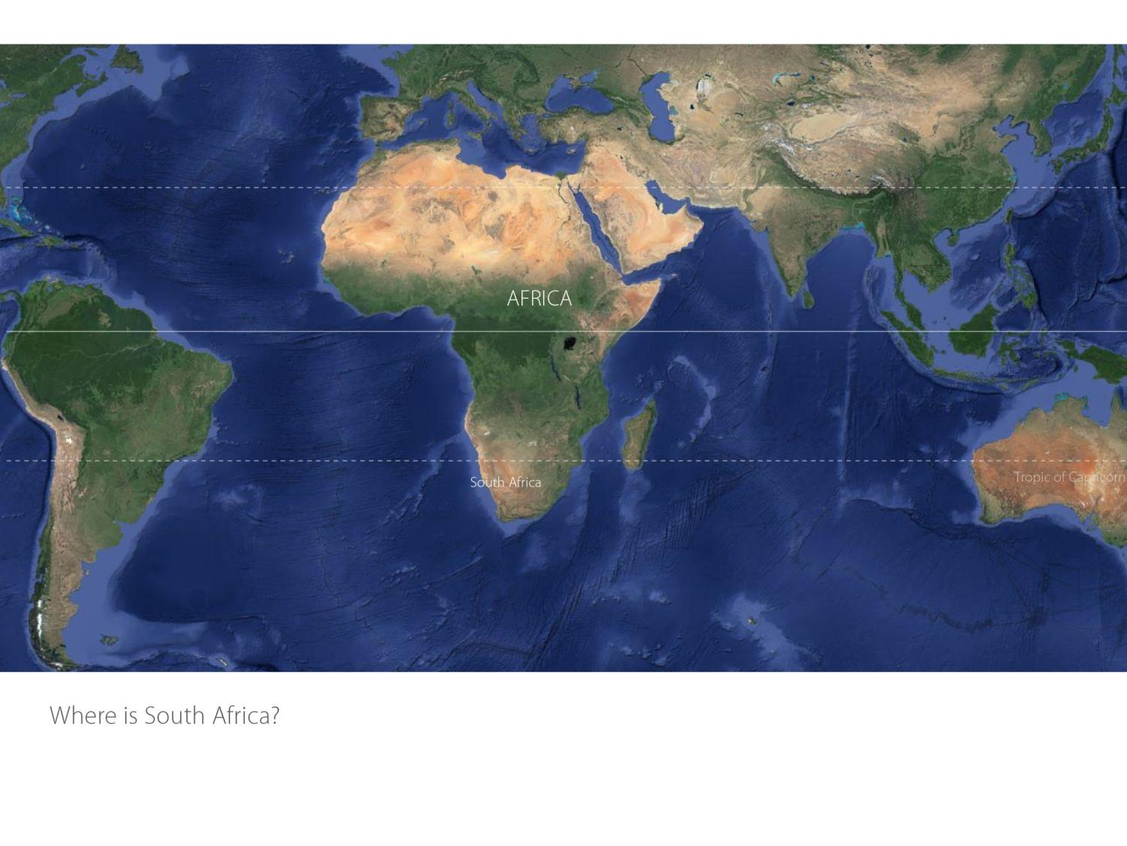

Slide 3
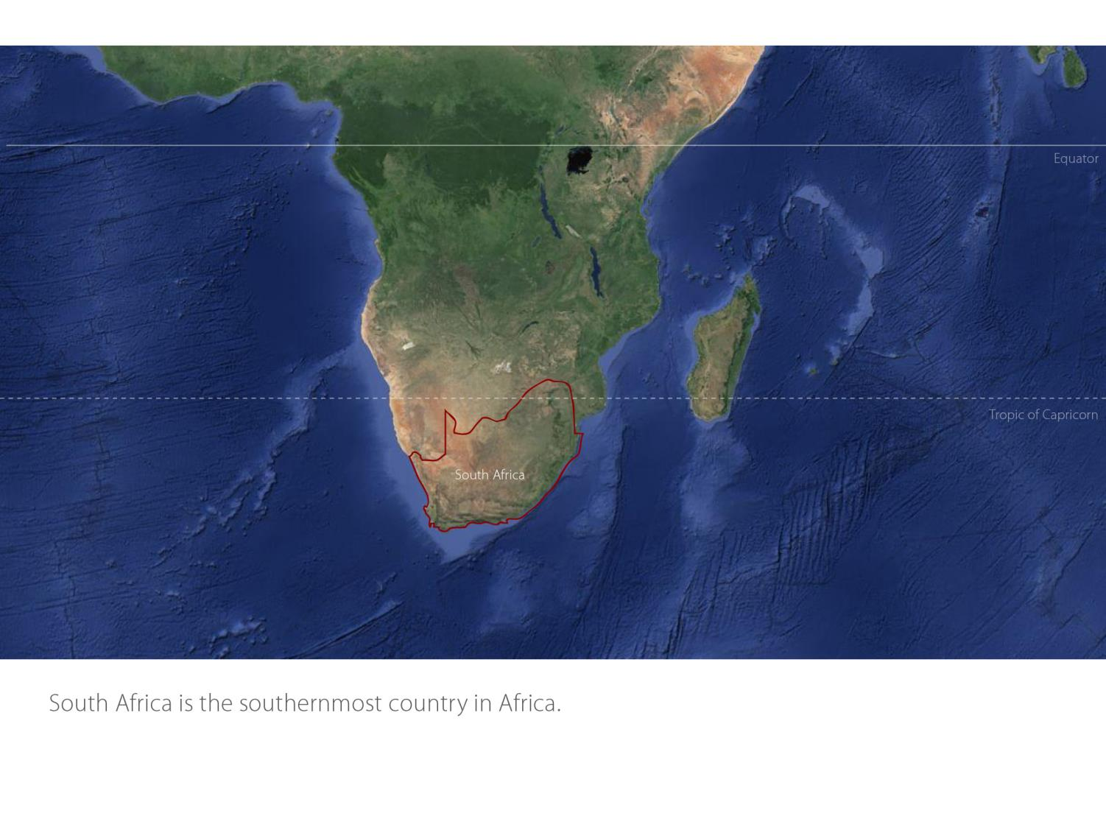

Slide 4
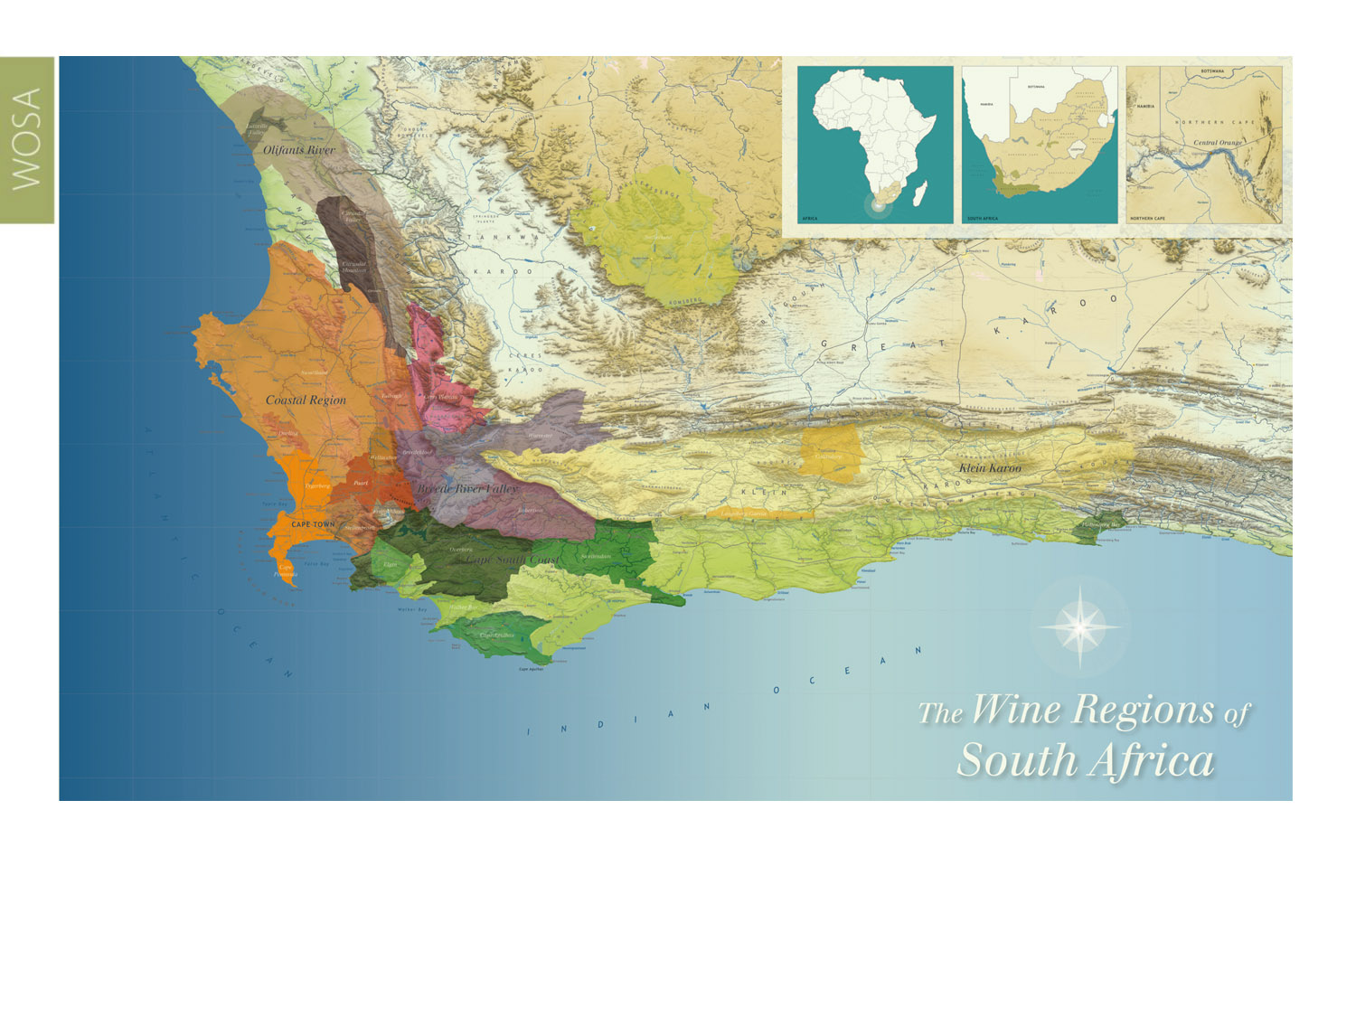
Our winelands are located at the very tip of South Africa.
Stellenbosch
Coastal

Slide 5
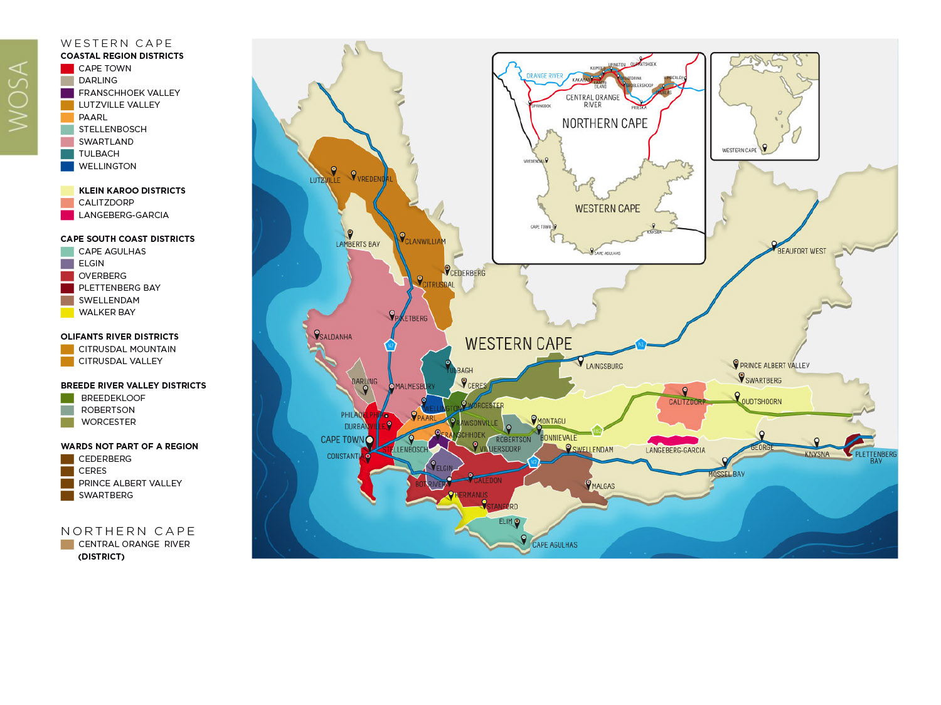
PRODUCTION AREAS: Districts of South Africa.
Stellenbosch
Coastal

Slide 6
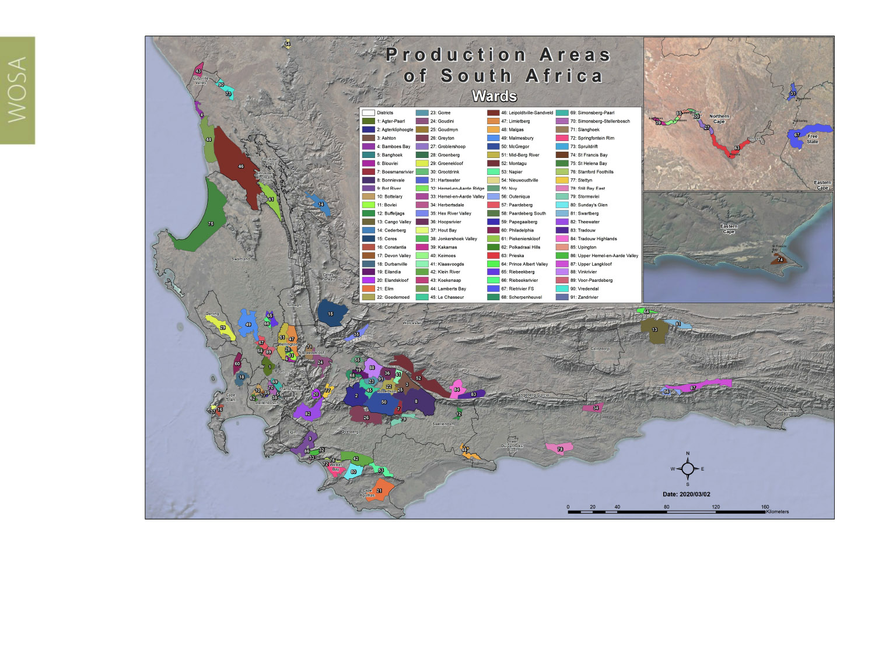
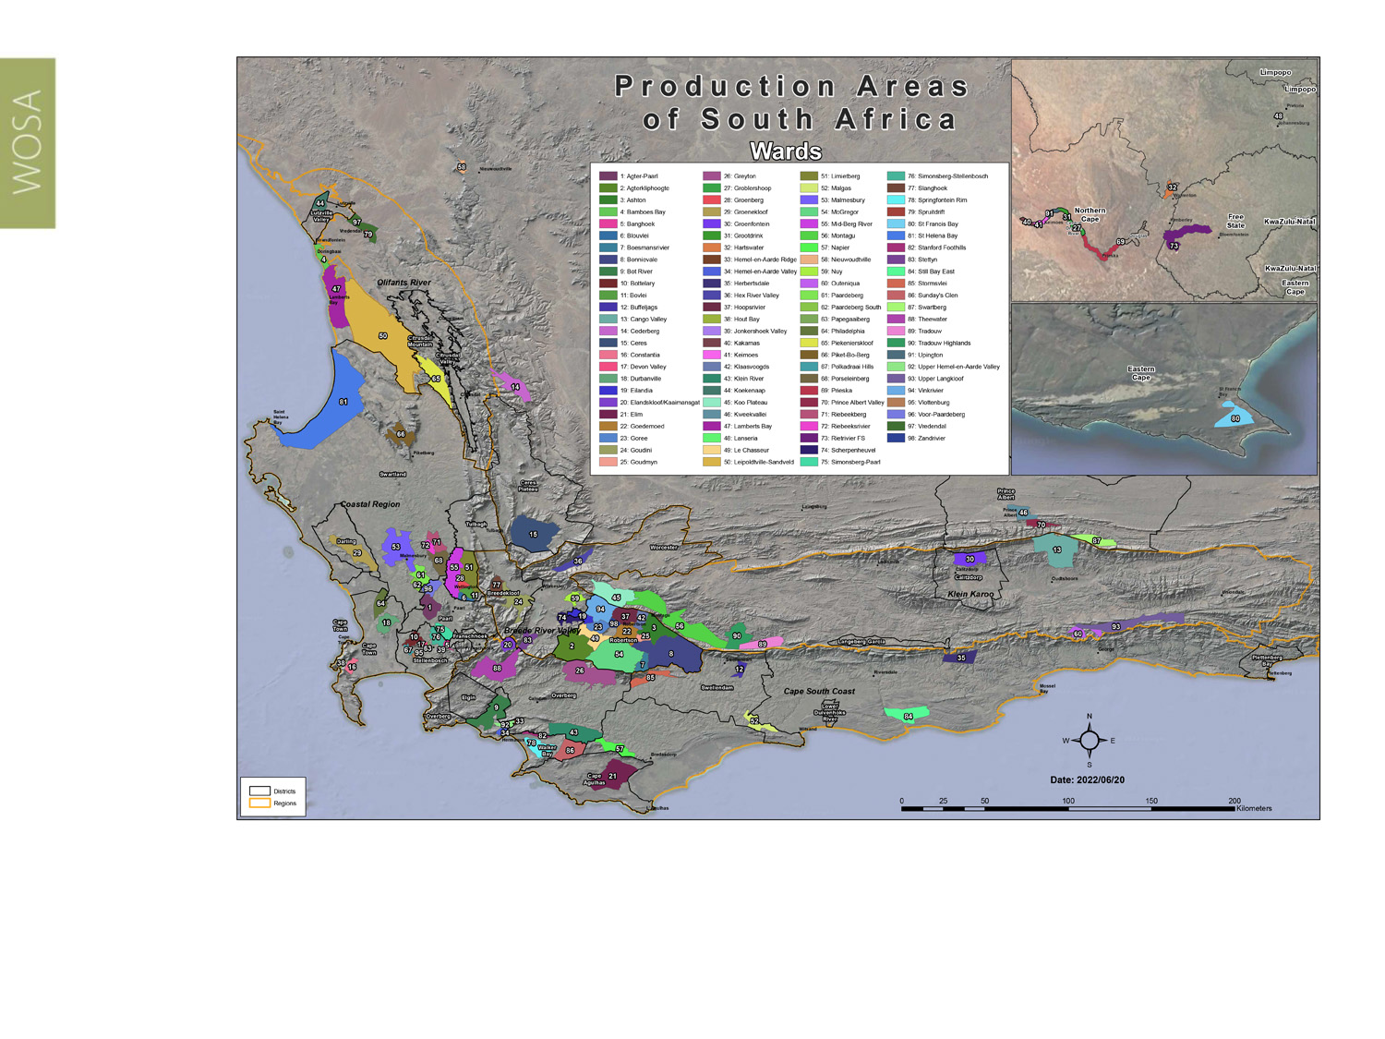
Wards of South Africa.
Stellenbosch
Coastal

Slide 7
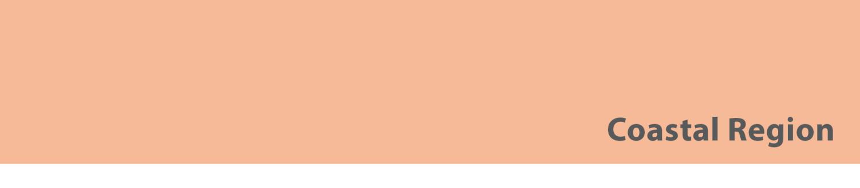
Region: Coastal
District: Stellenbosch
Wards: Banghoek
Bottelary
Devon Valley
Jonkershoek Valley
Papegaaiberg
Polkadraai Hills
Simonsberg-Stellenbosch
Vlottenburg
Stellenbosch
Coastal

Slide 8
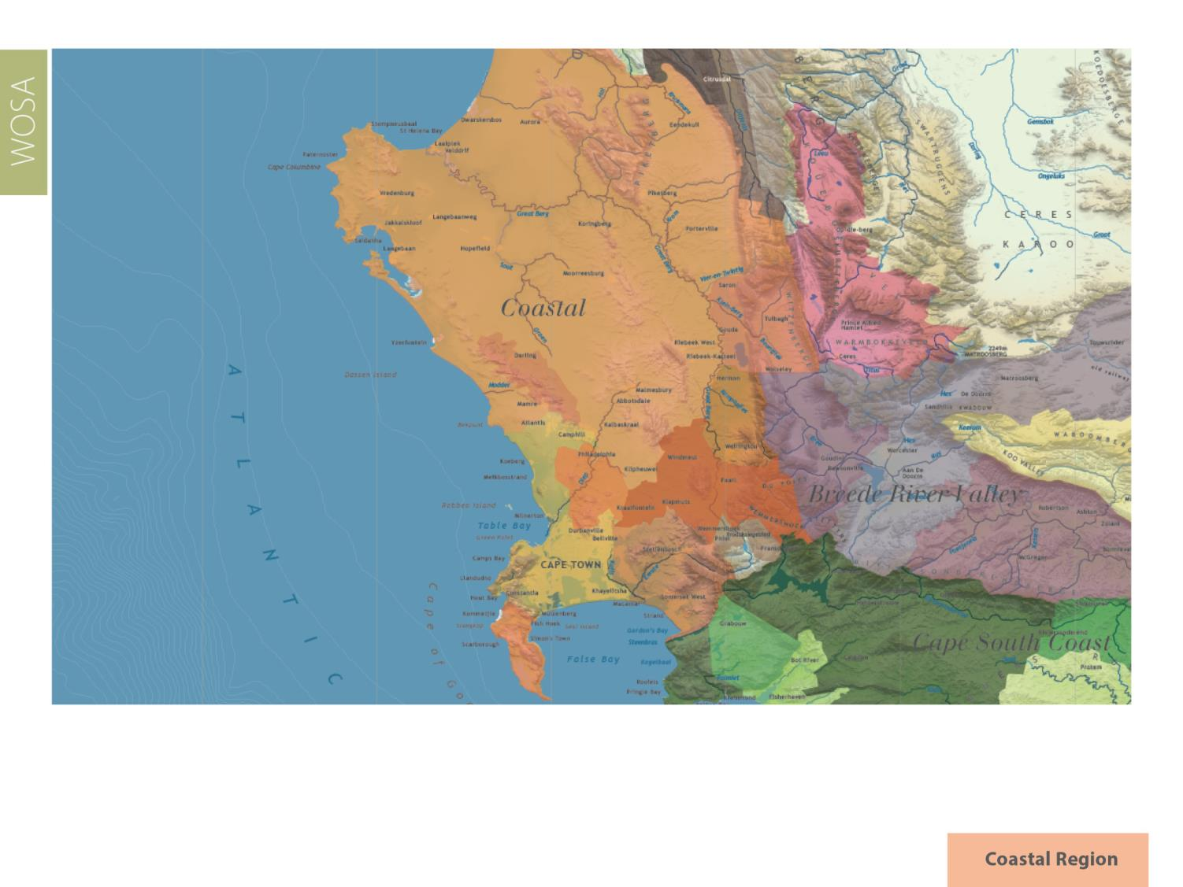
Stellenbosch
Coastal

Slide 9
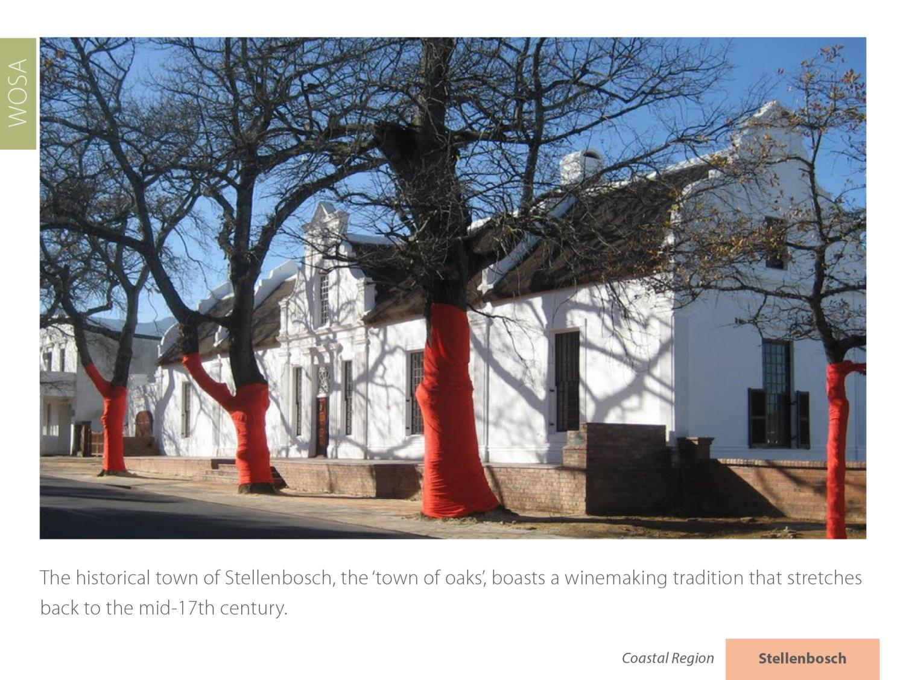
Stellenbosch
Coastal

Slide 10
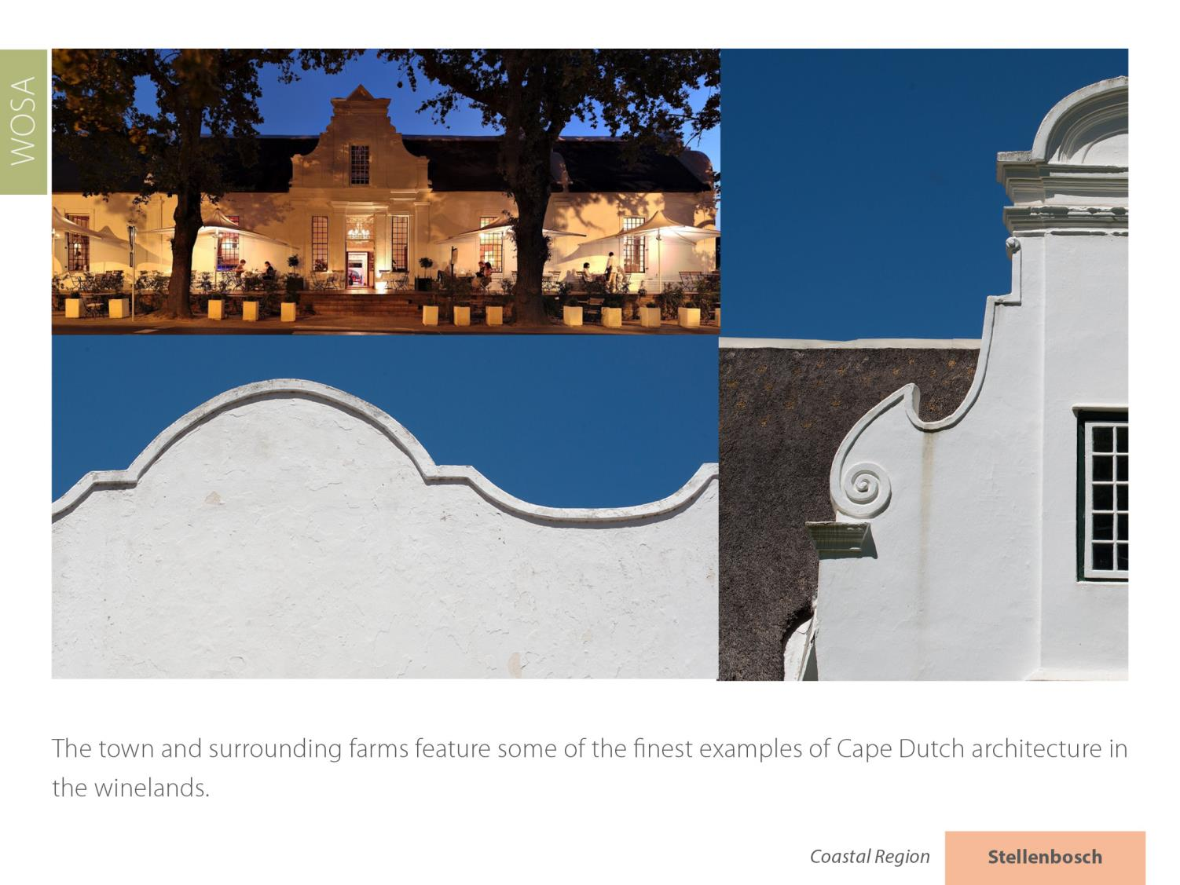
Stellenbosch
Coastal

Slide 11
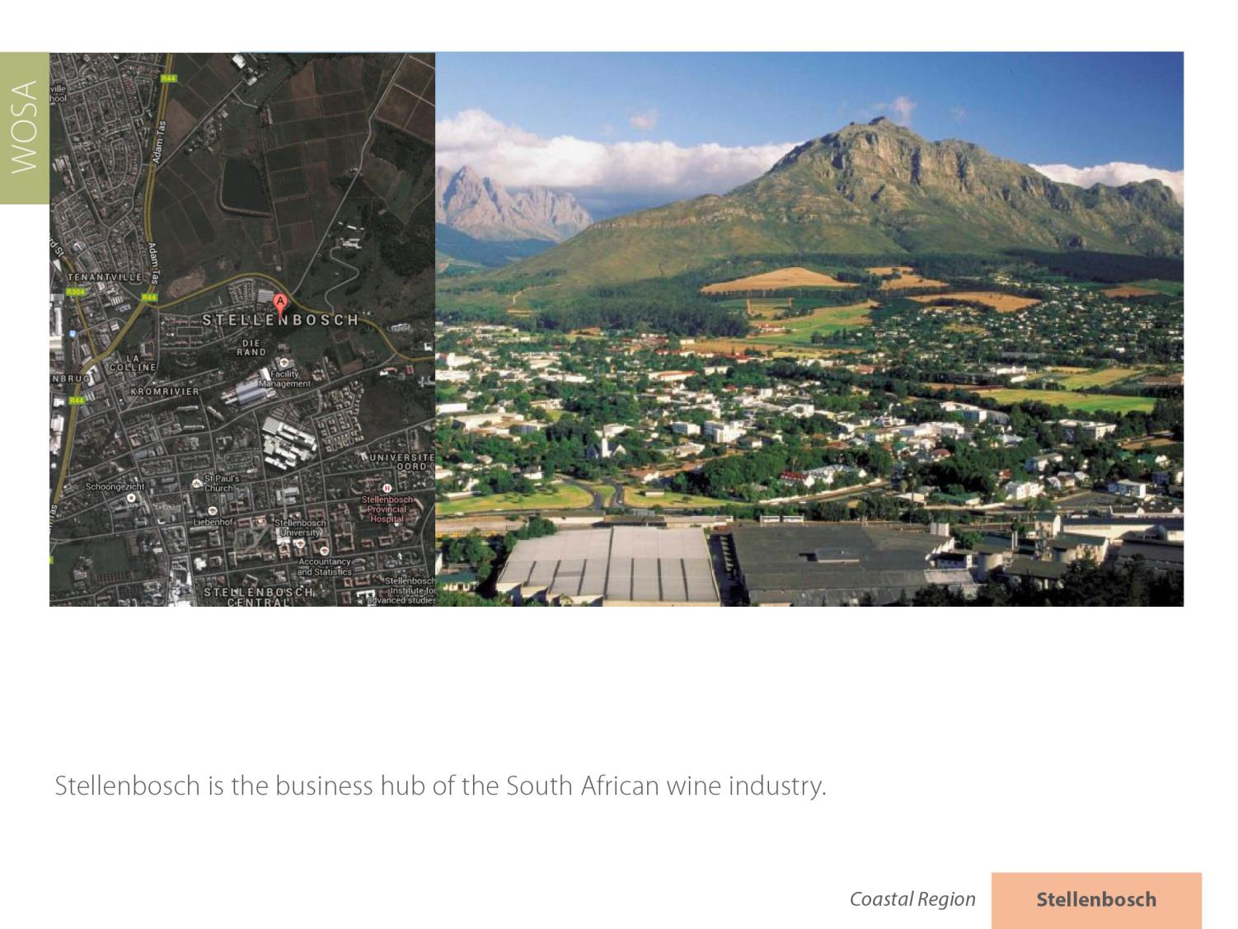
Stellenbosch
Coastal

Slide 12
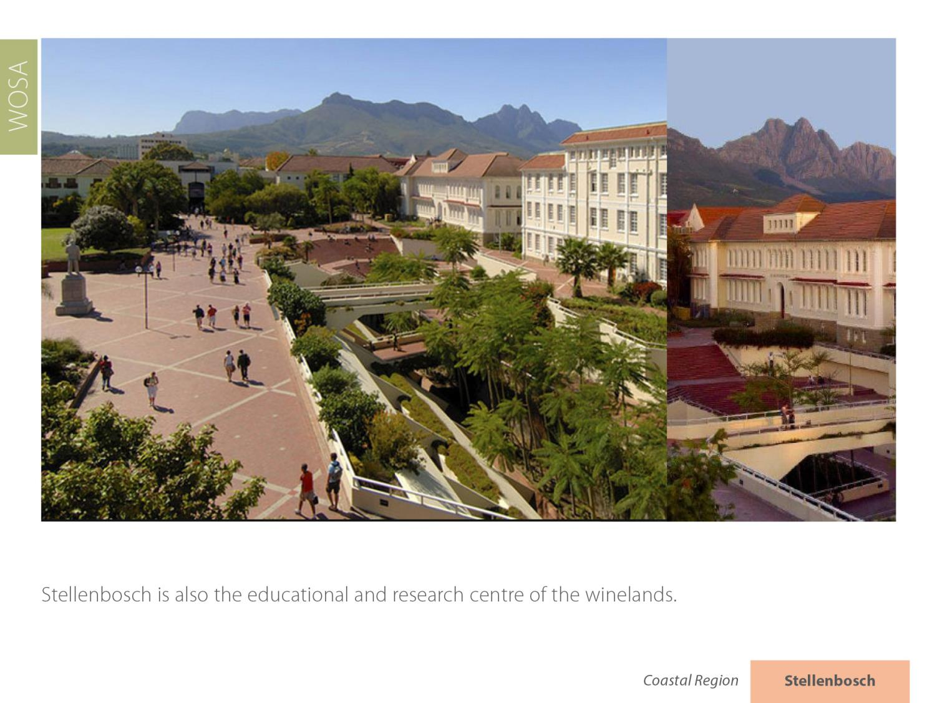
Stellenbosch
Coastal

Slide 13
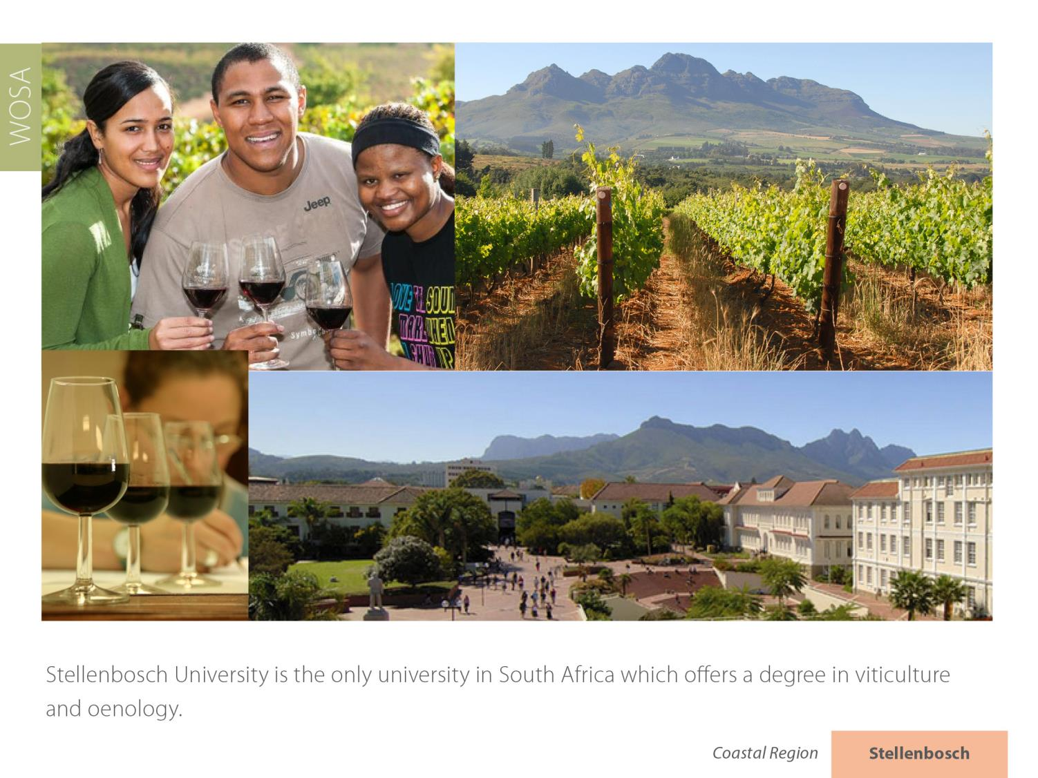
Stellenbosch
Coastal

Slide 14
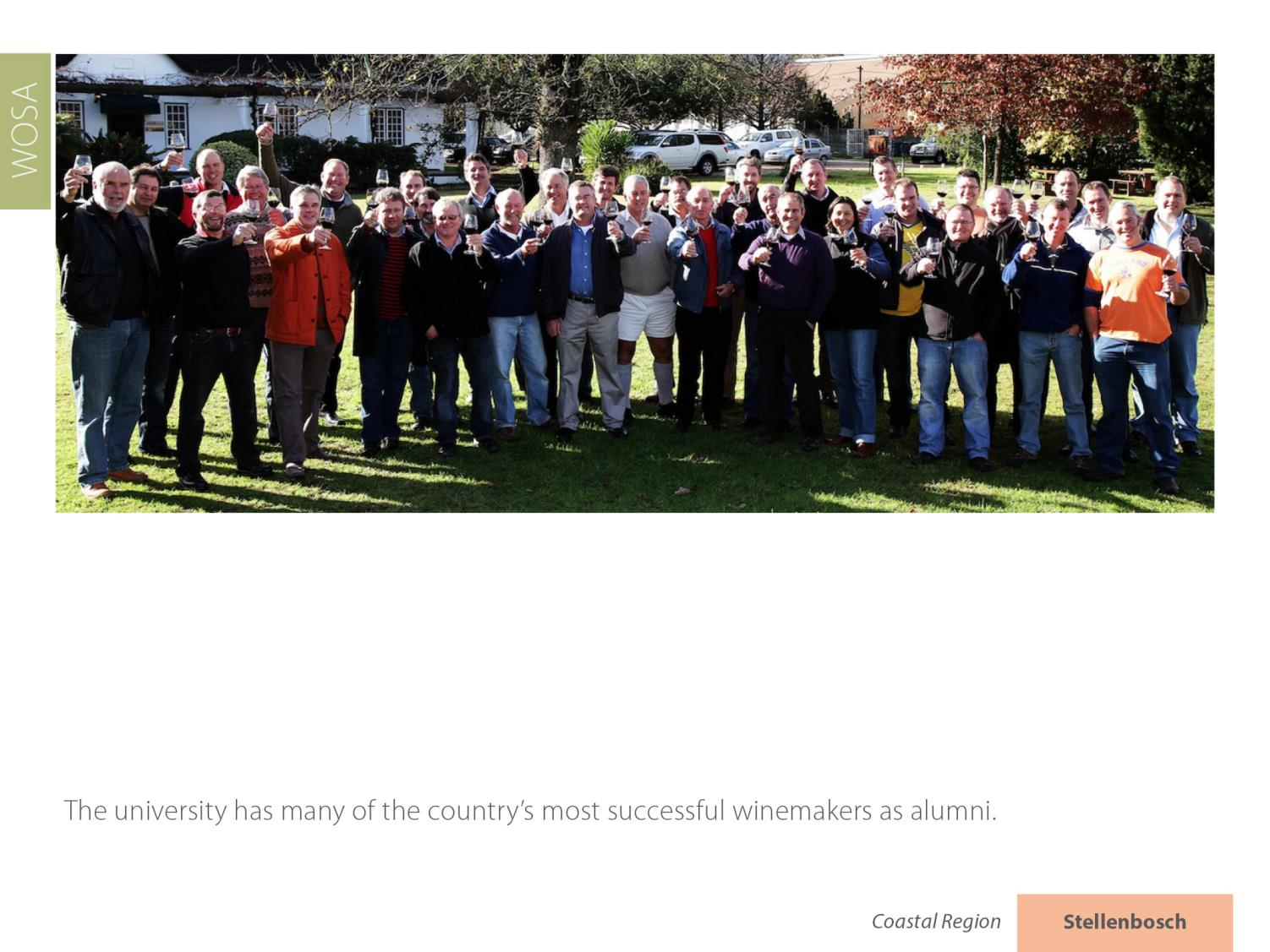
Stellenbosch
Coastal

Slide 15
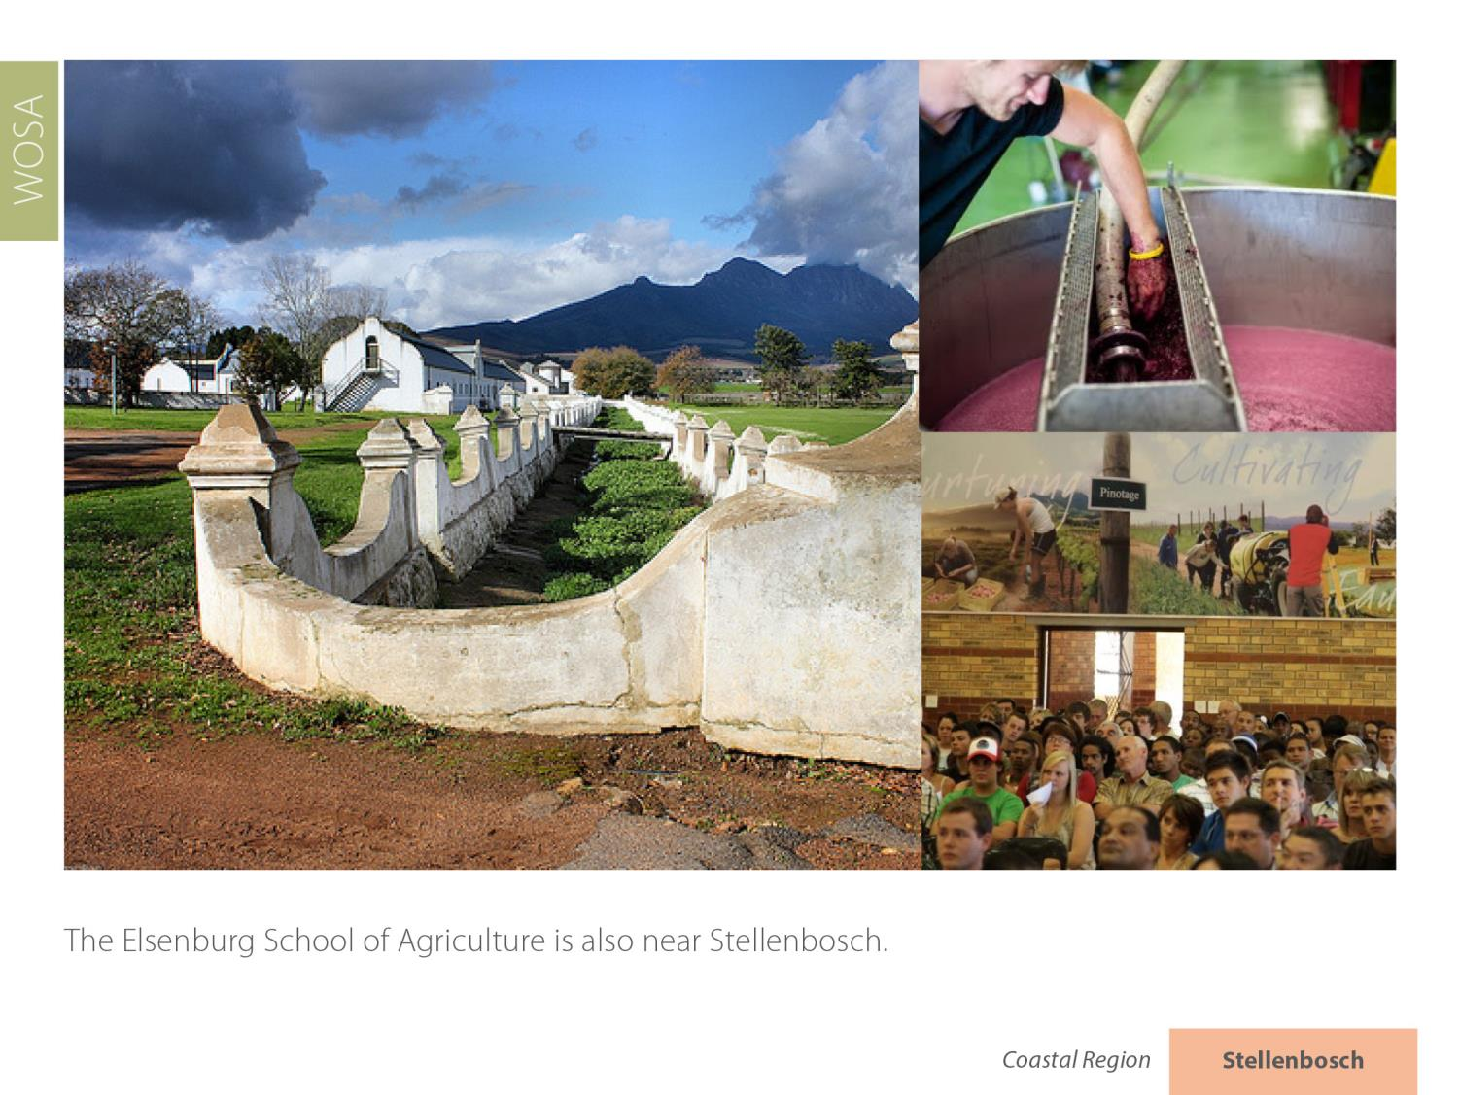
Stellenbosch
Coastal

Slide 16
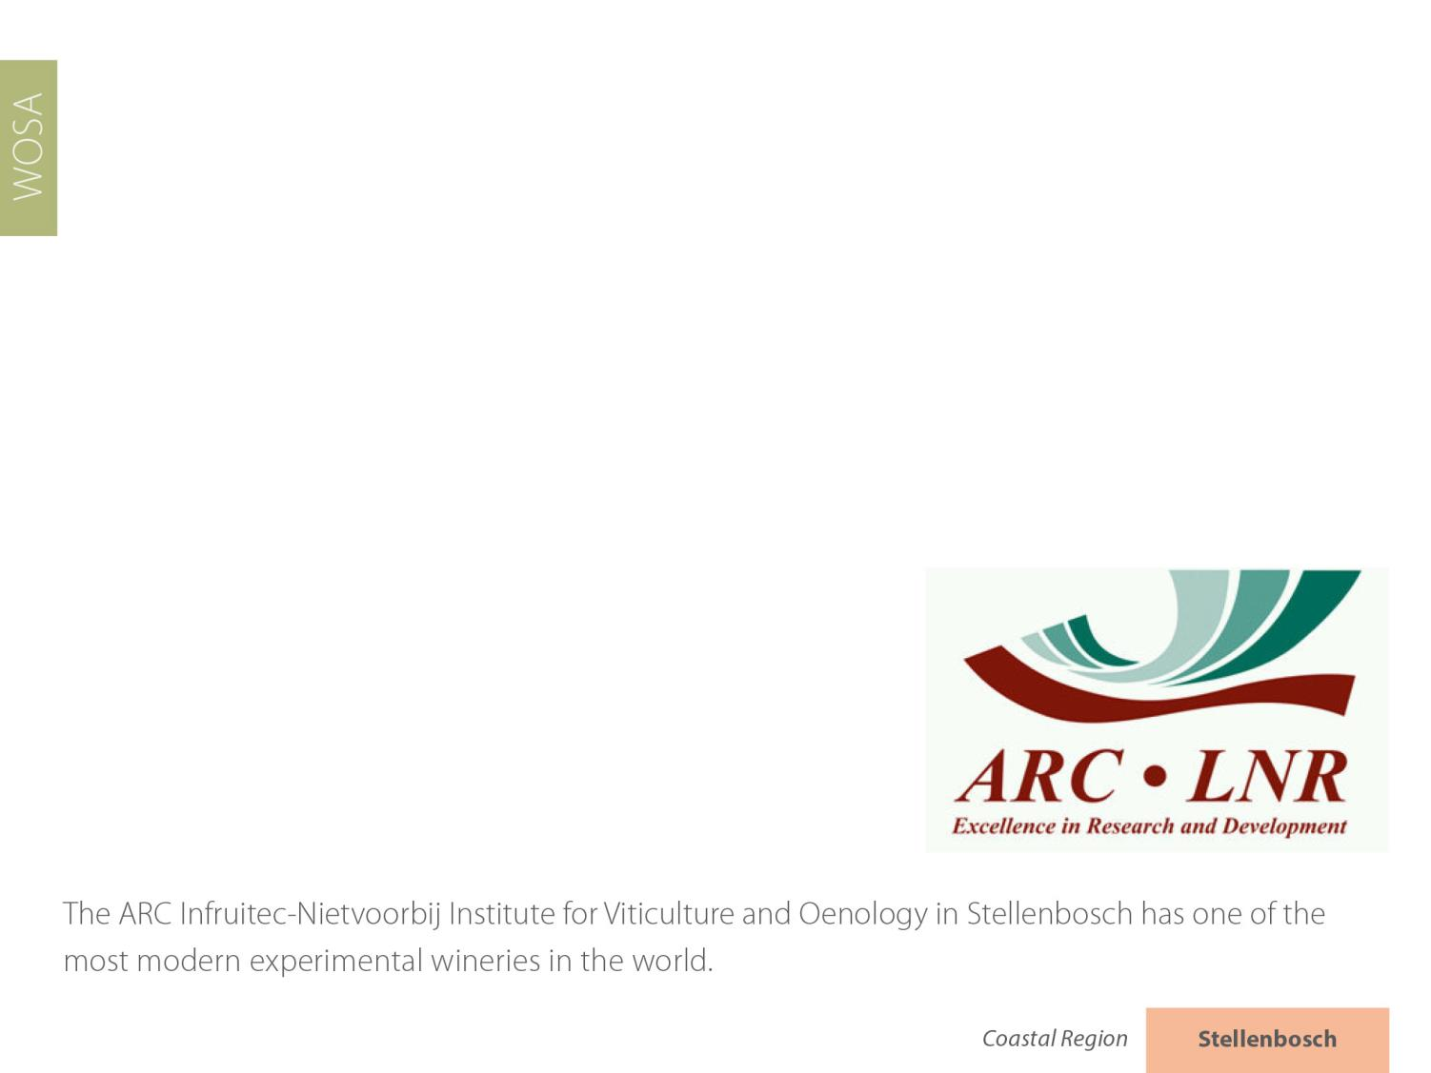
Stellenbosch
Coastal

Slide 17
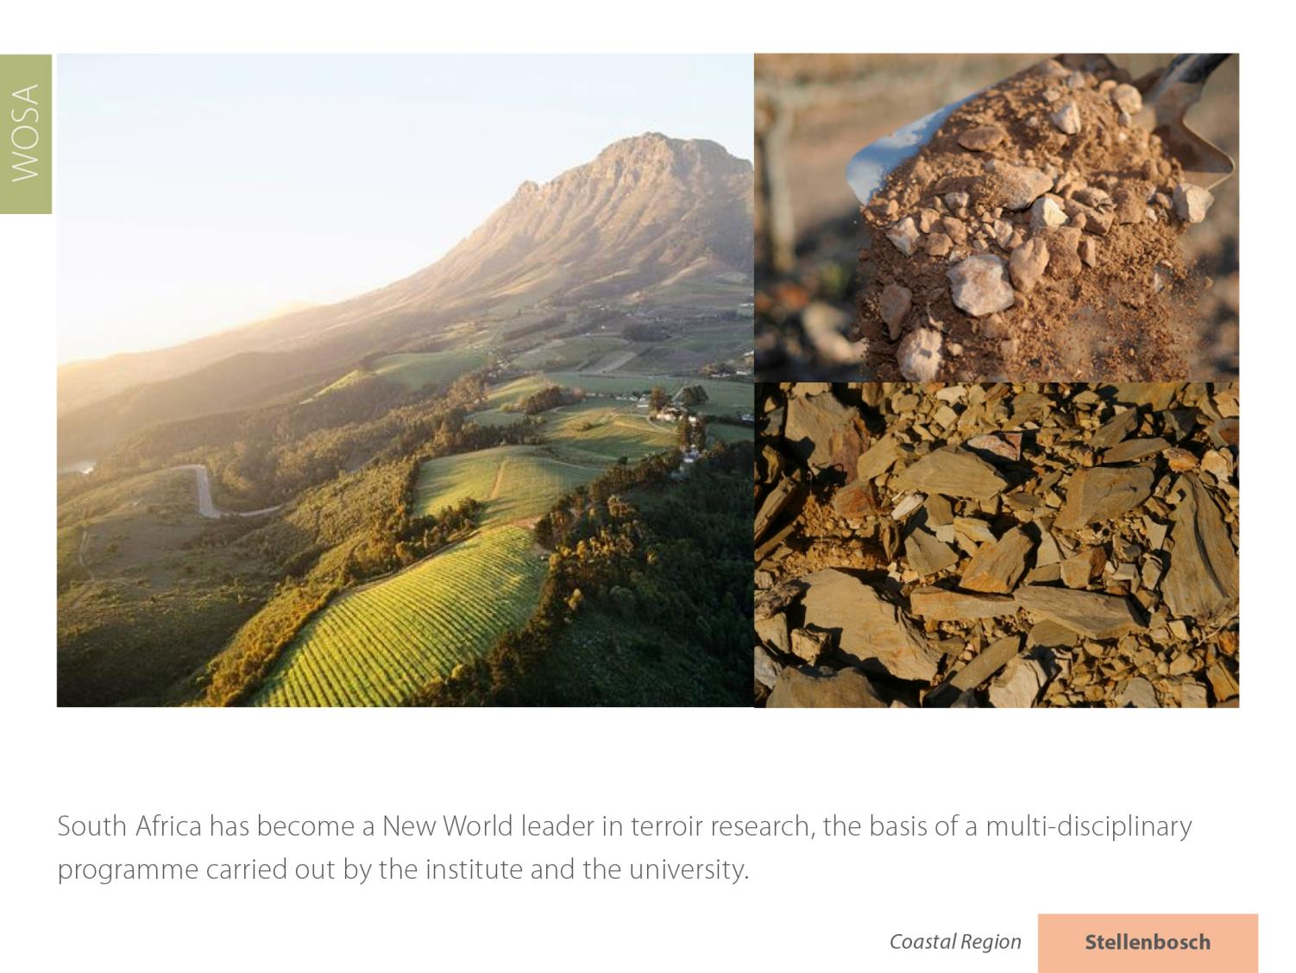
Stellenbosch
Coastal

Slide 18
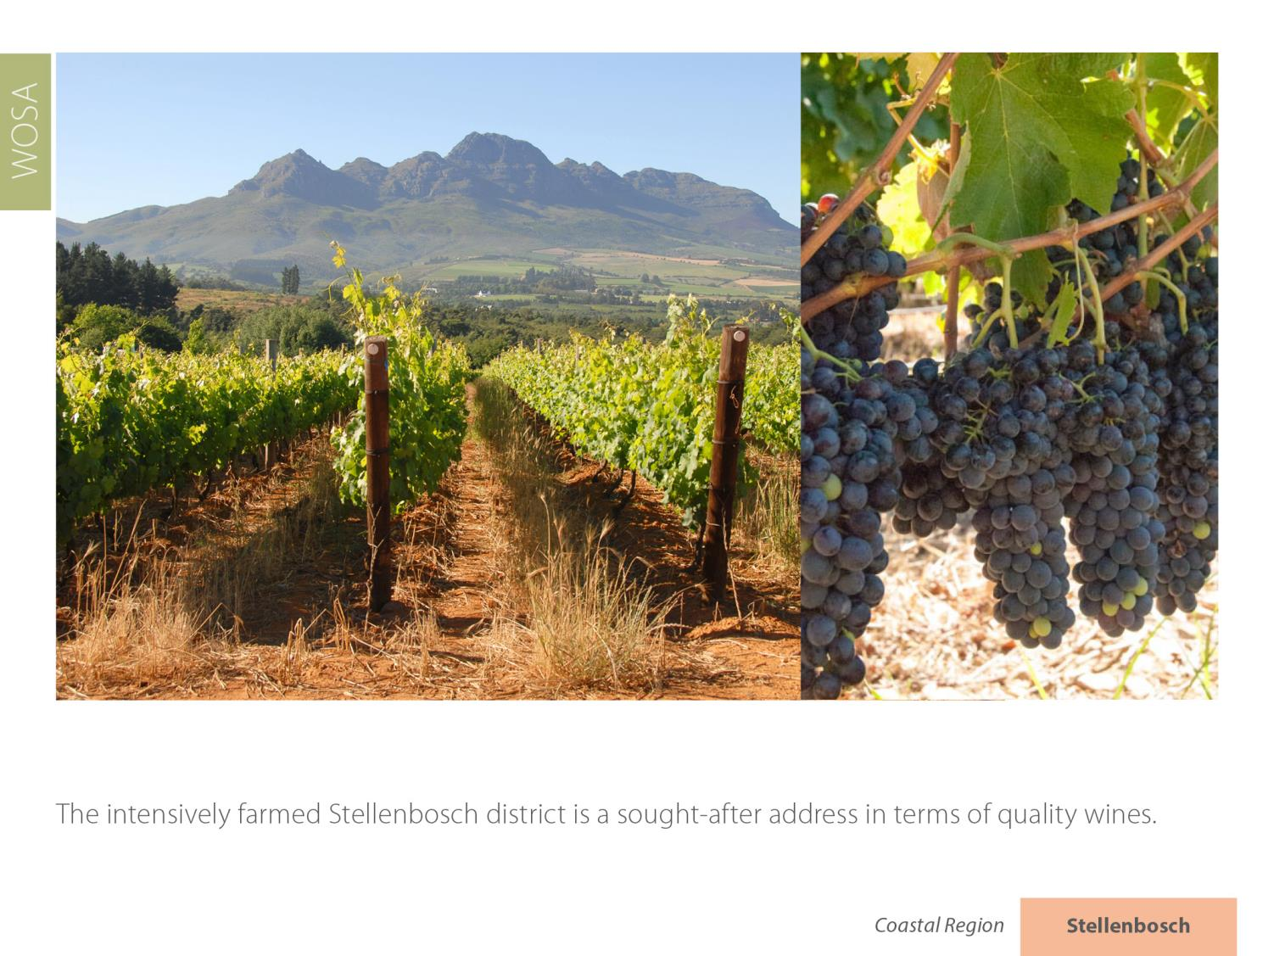
Stellenbosch
Coastal

Slide 19
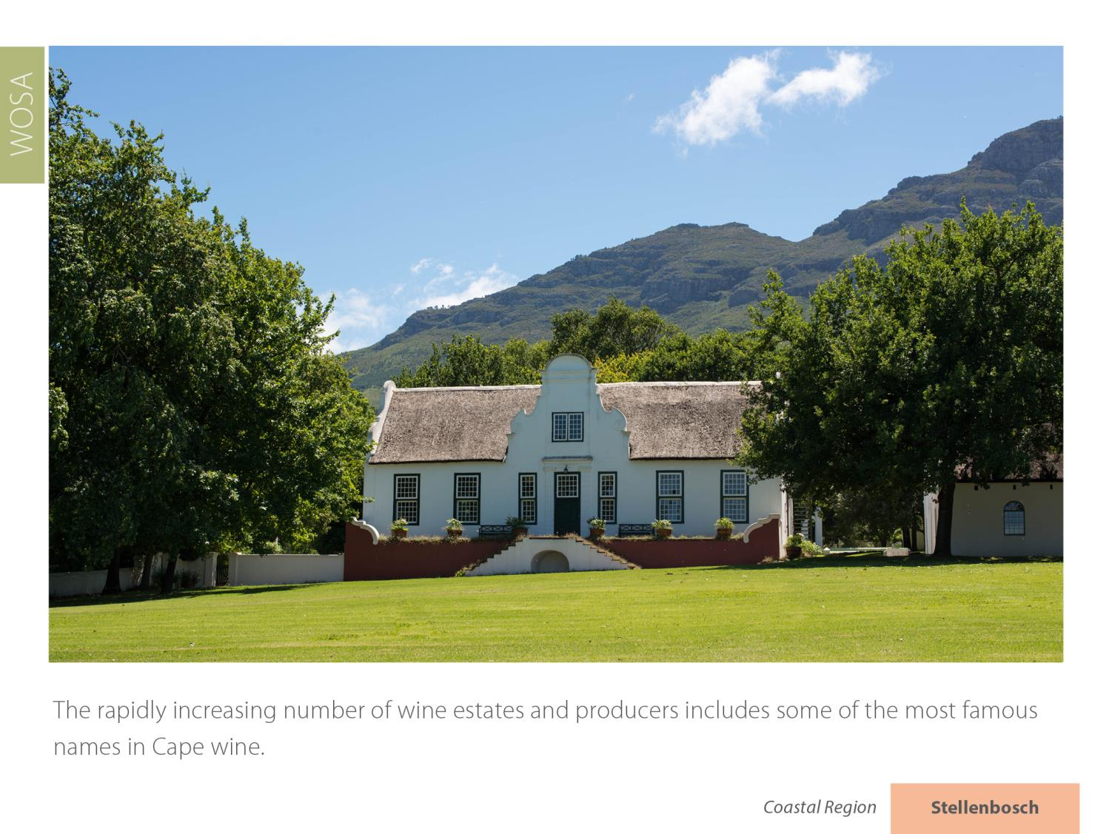
Stellenbosch
Coastal

Slide 20
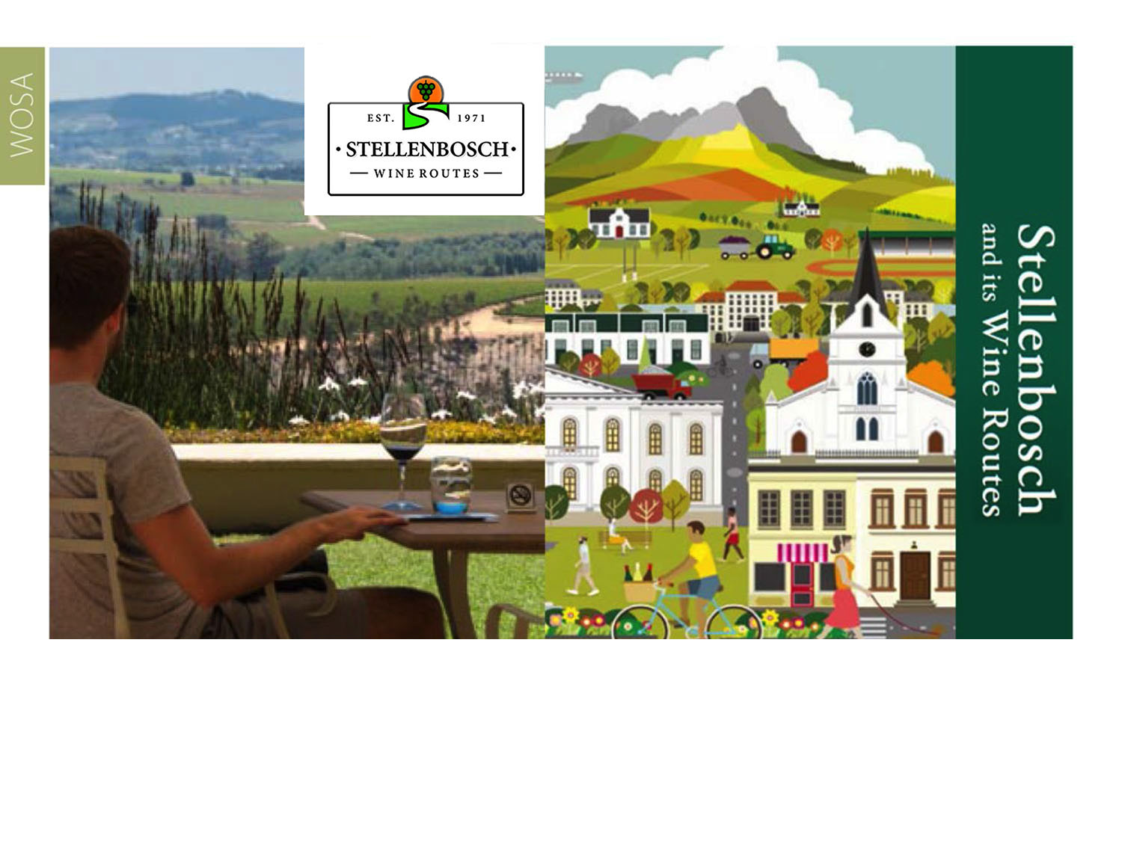
The Stellenbosch Wine Routes is one of the biggest tourist attractions in the Western Cape.
Stellenbosch
Coastal

Slide 21
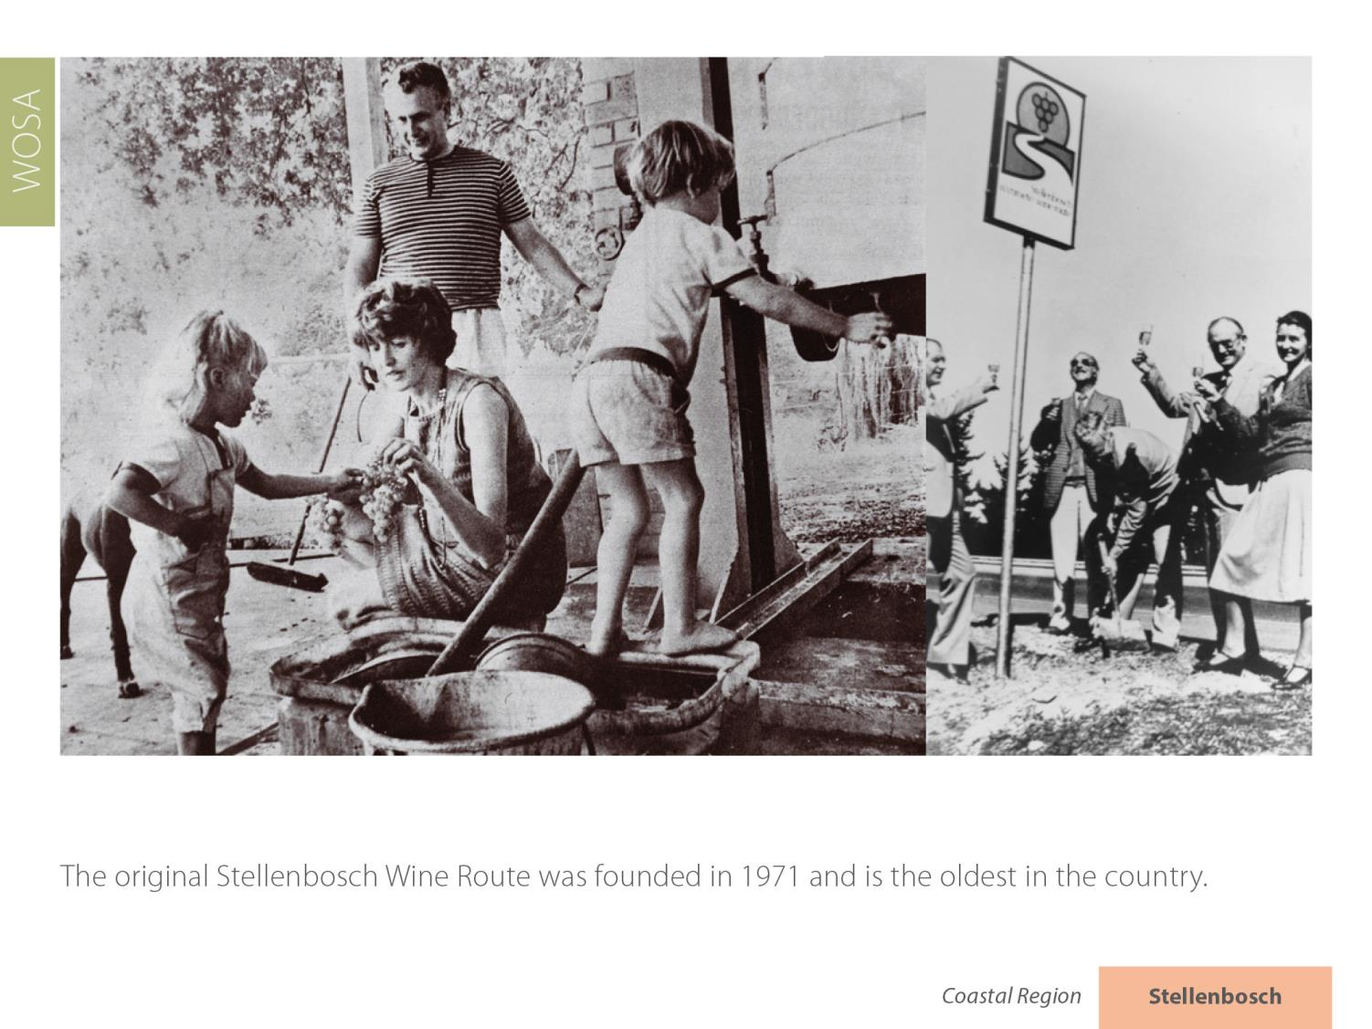
Stellenbosch
Coastal

Slide 22
Today the Stellenbosch Wine Routes represents more than 200 wine and grape producers within the boundaries of the Stellenbosch Wine of Origin classification.
Stellenbosch
Coastal

Slide 23
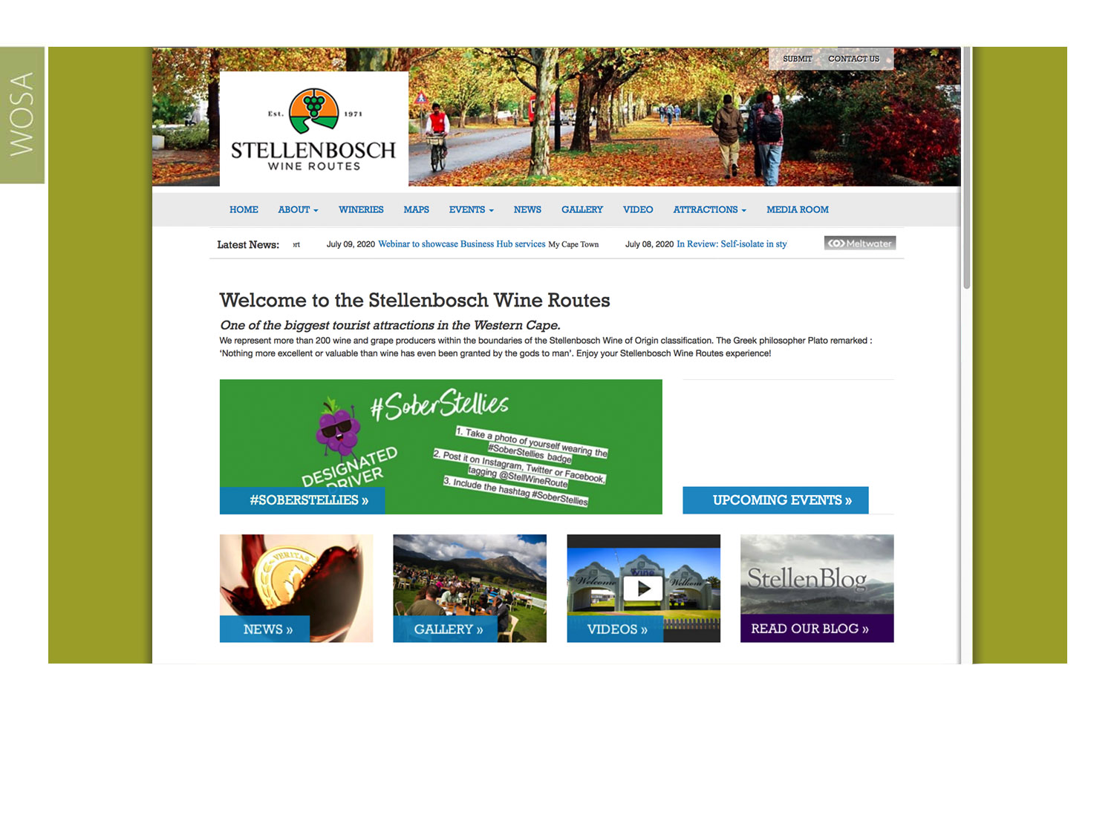
It is divided into five manageable sub-routes for tourists: Bottelary Hills, Greater Simonsberg, Helderberg, Stellenbosch Berg and Stellenbosch Valley.
Stellenbosch
Coastal

Slide 24
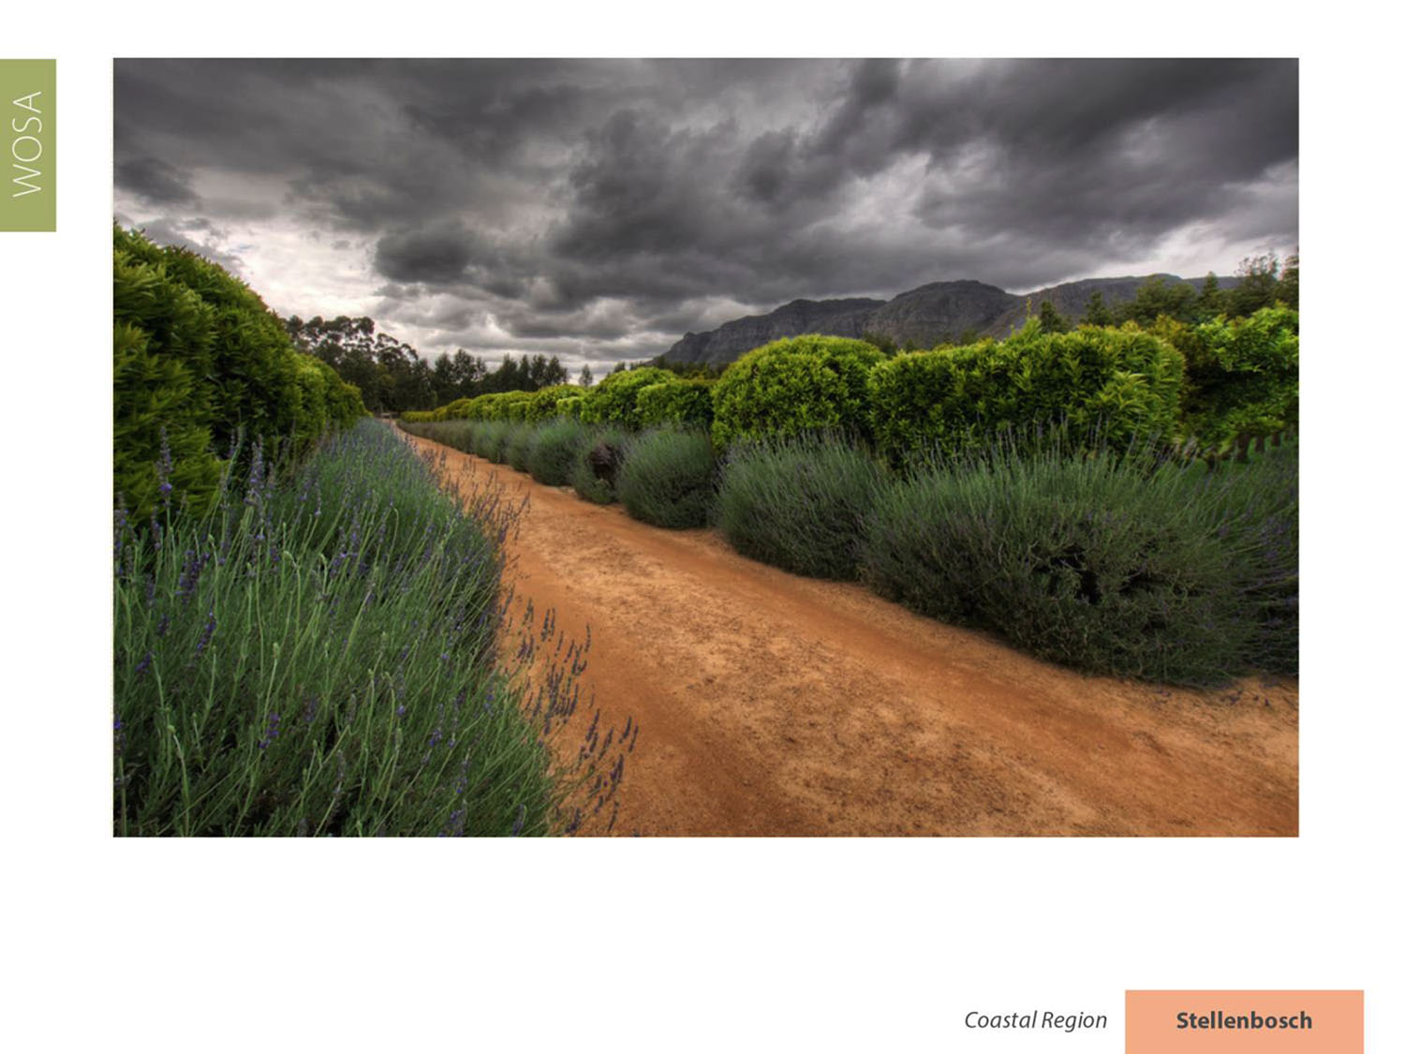
The average rainfall in the district varies from 600–800 mm a year.
Stellenbosch
Coastal

Slide 25
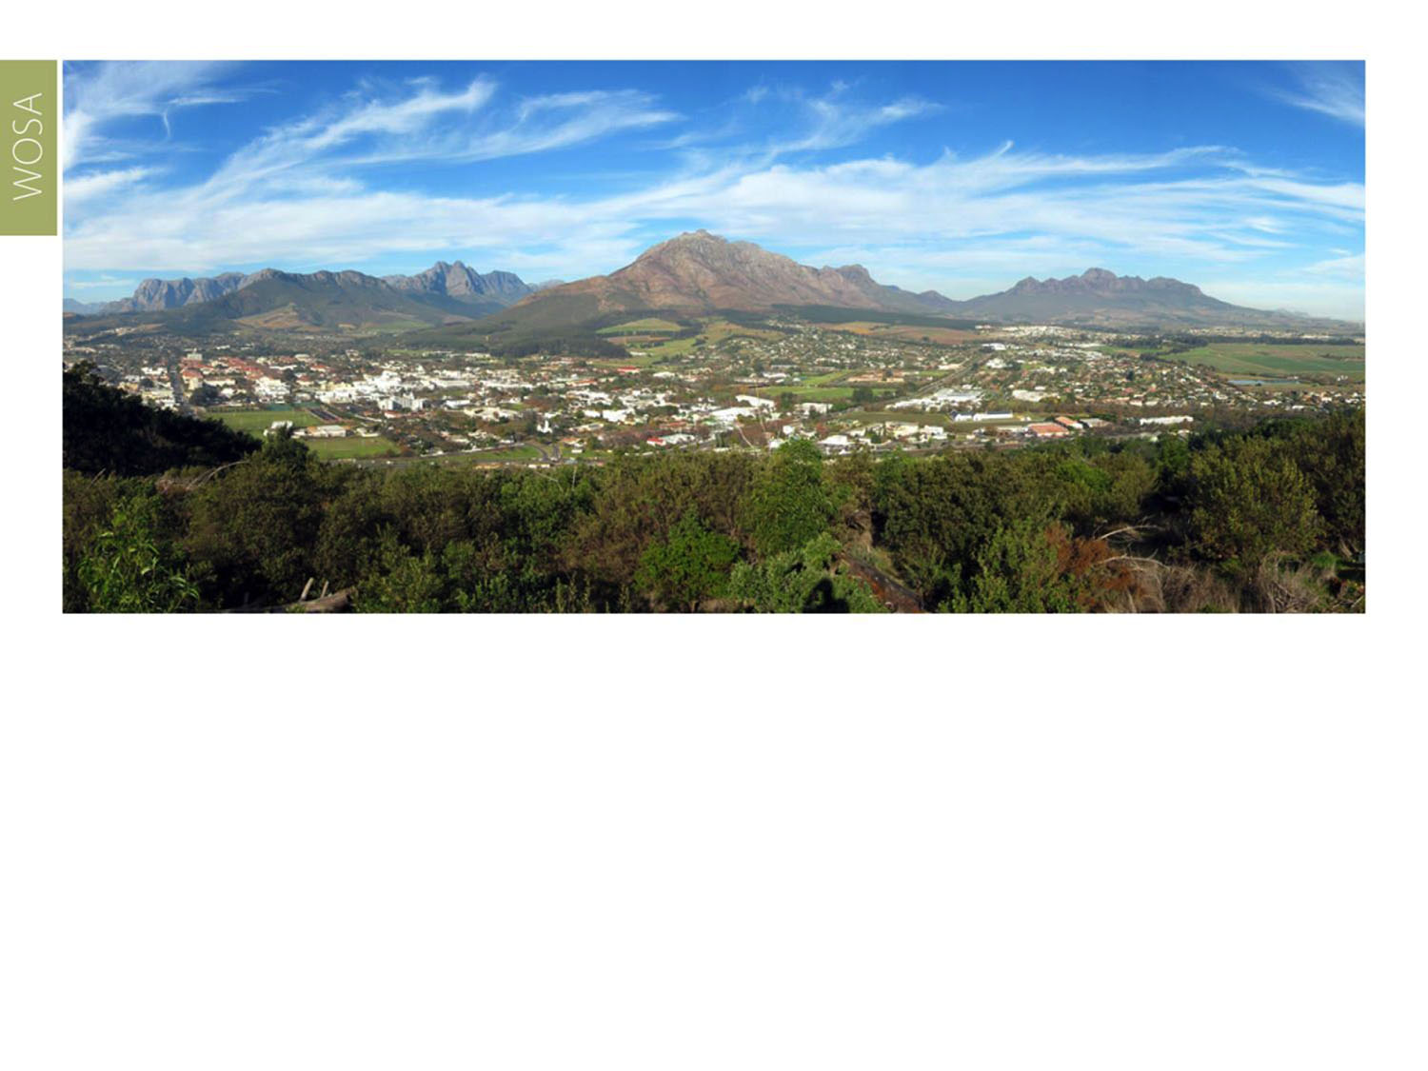
The mean February temperature is 21.5⁰C (Nietvoorbij Weather Station).
Stellenbosch
Coastal

Slide 26
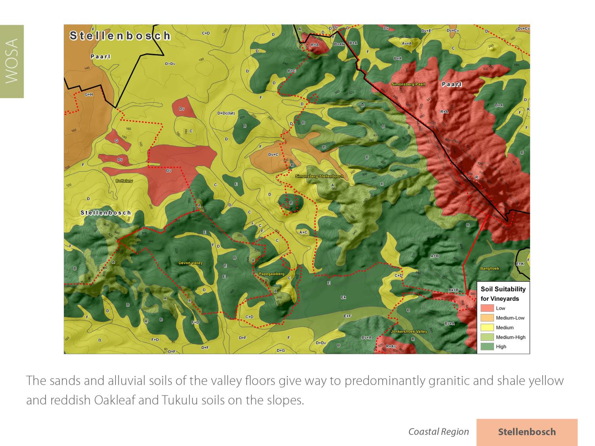
Stellenbosch
Coastal

Slide 27
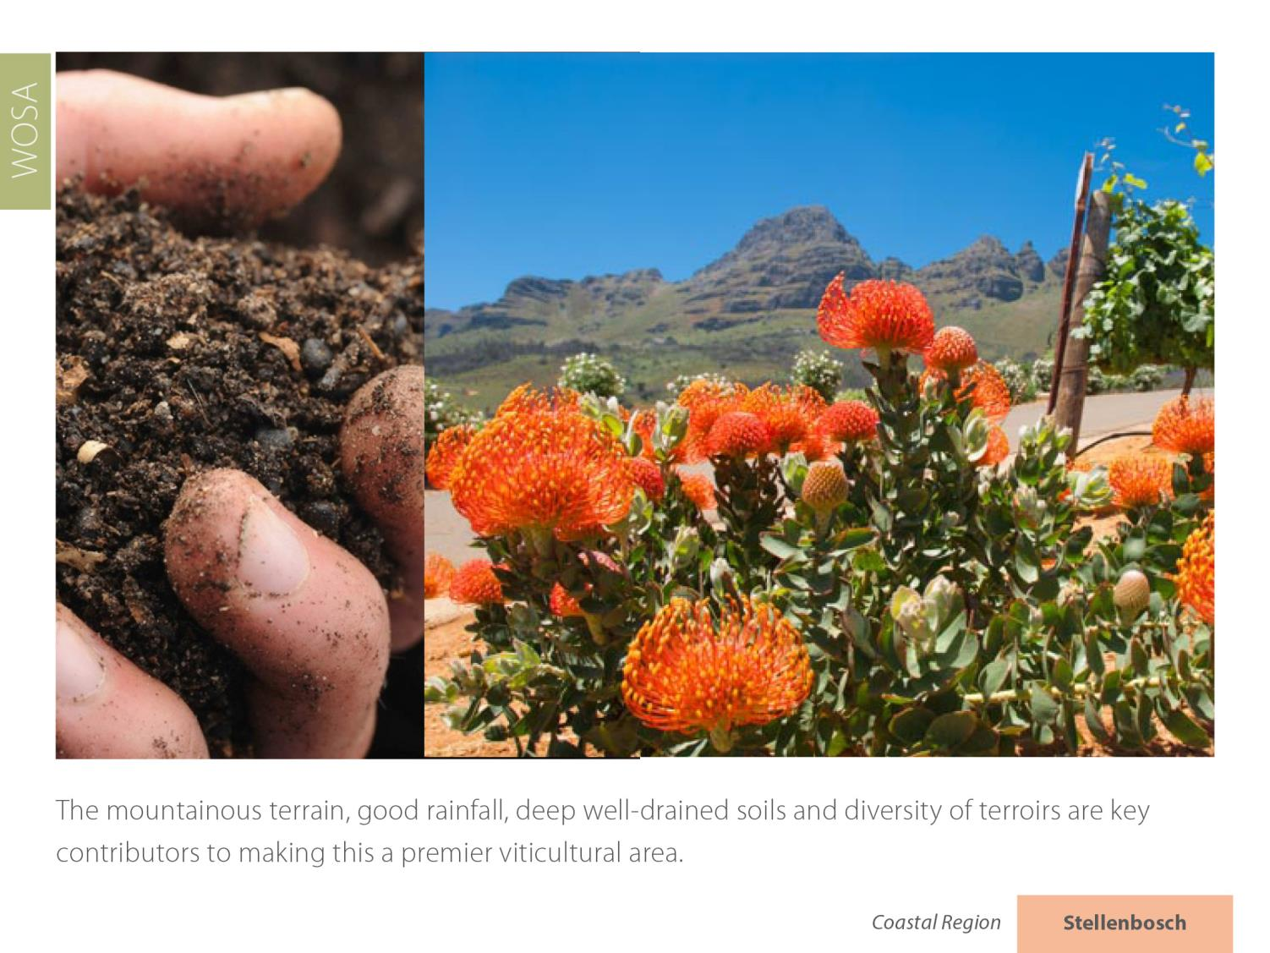
Stellenbosch
Coastal

Slide 28
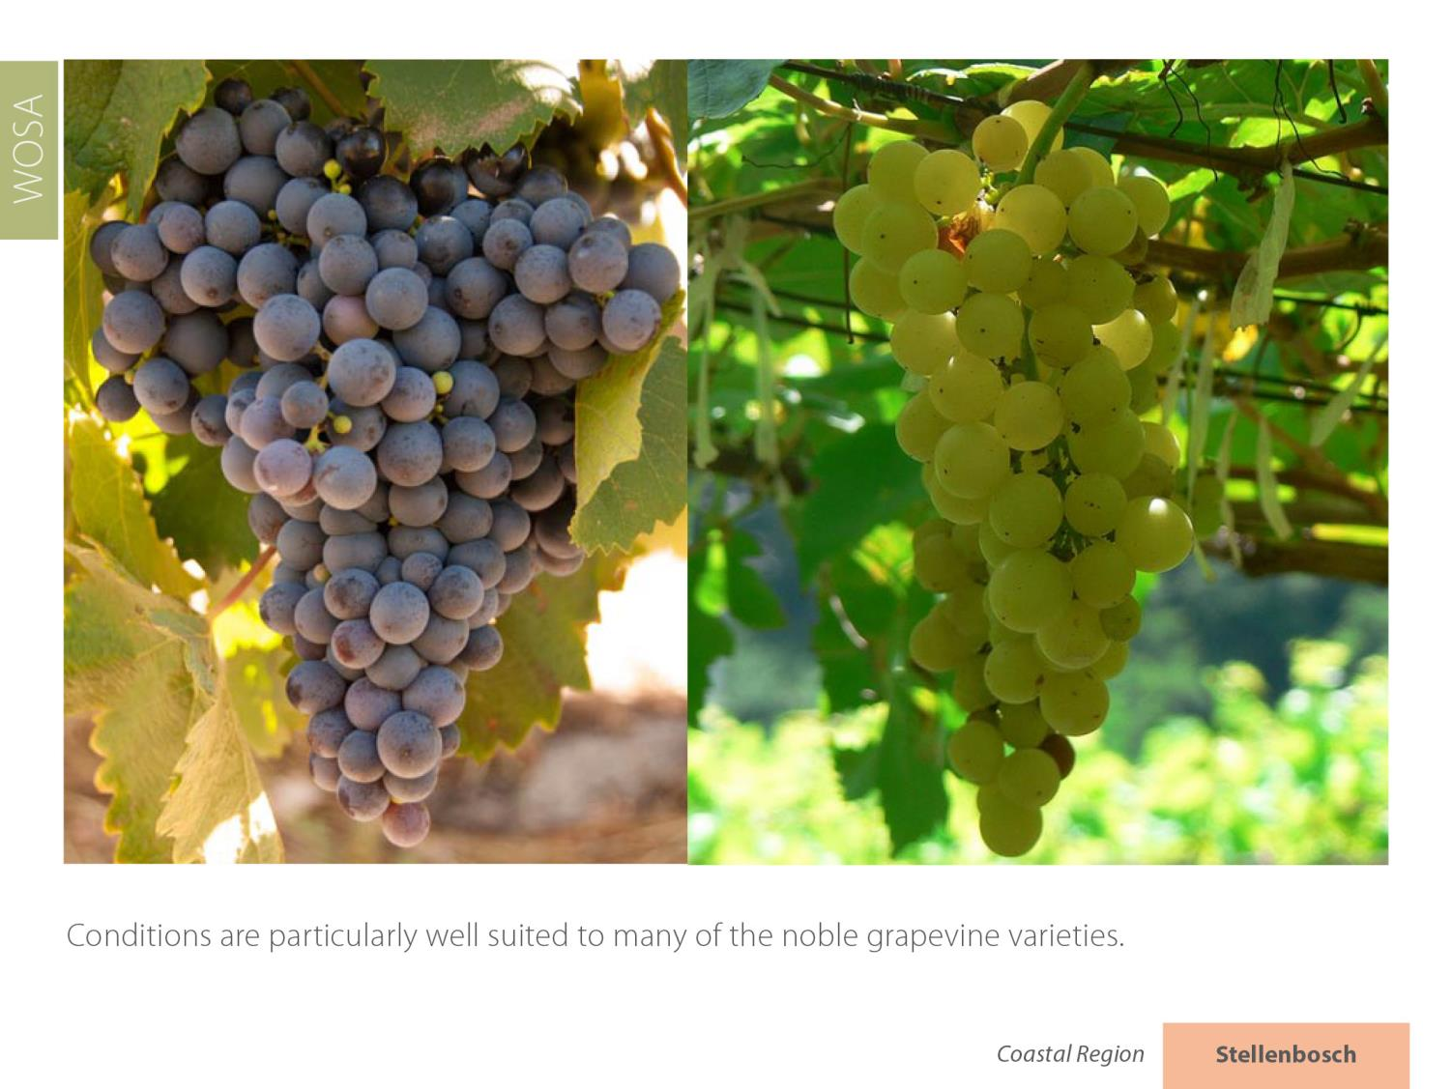
Stellenbosch
Coastal

Slide 29
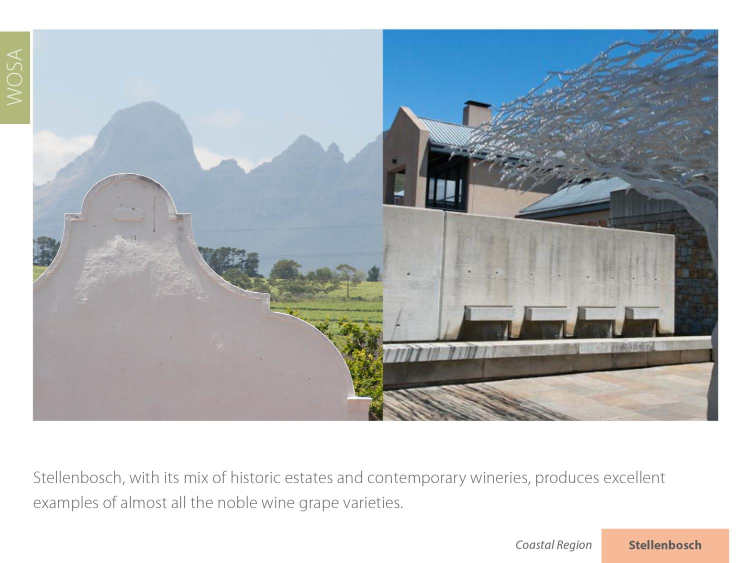
Stellenbosch
Coastal

Slide 30
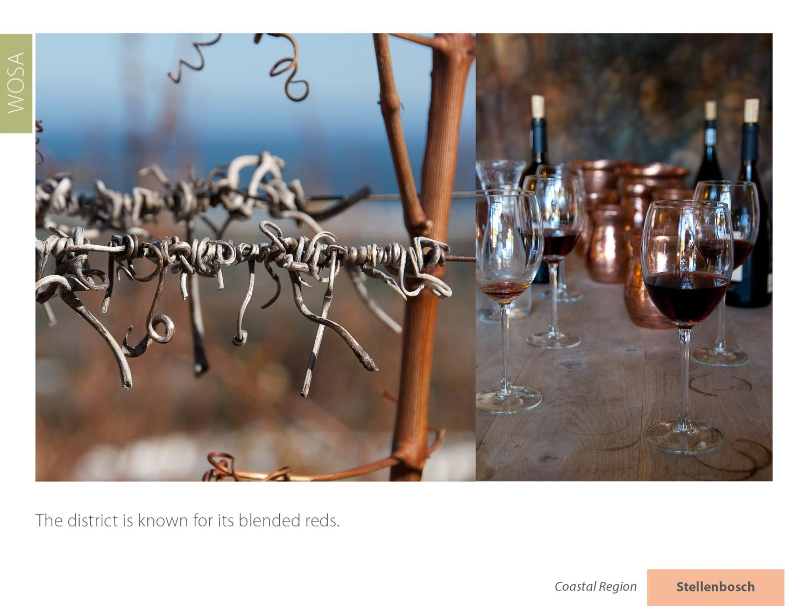
Stellenbosch is known for its Cabernet Sauvignon and its blended reds.
Stellenbosch
Coastal

Slide 31
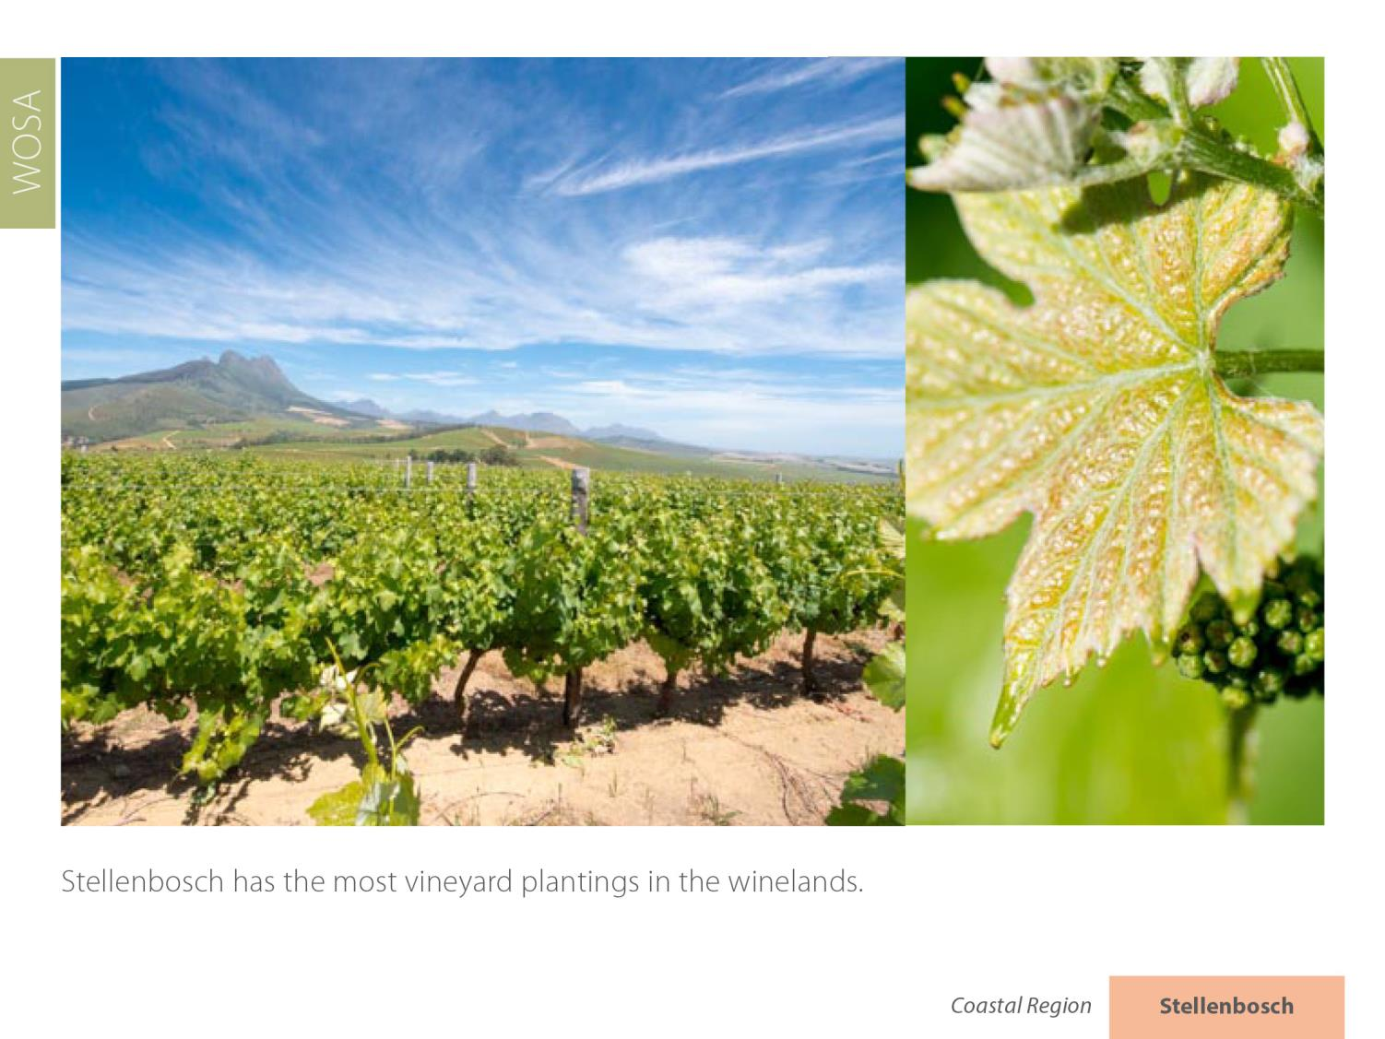
Stellenbosch
Coastal

Slide 32
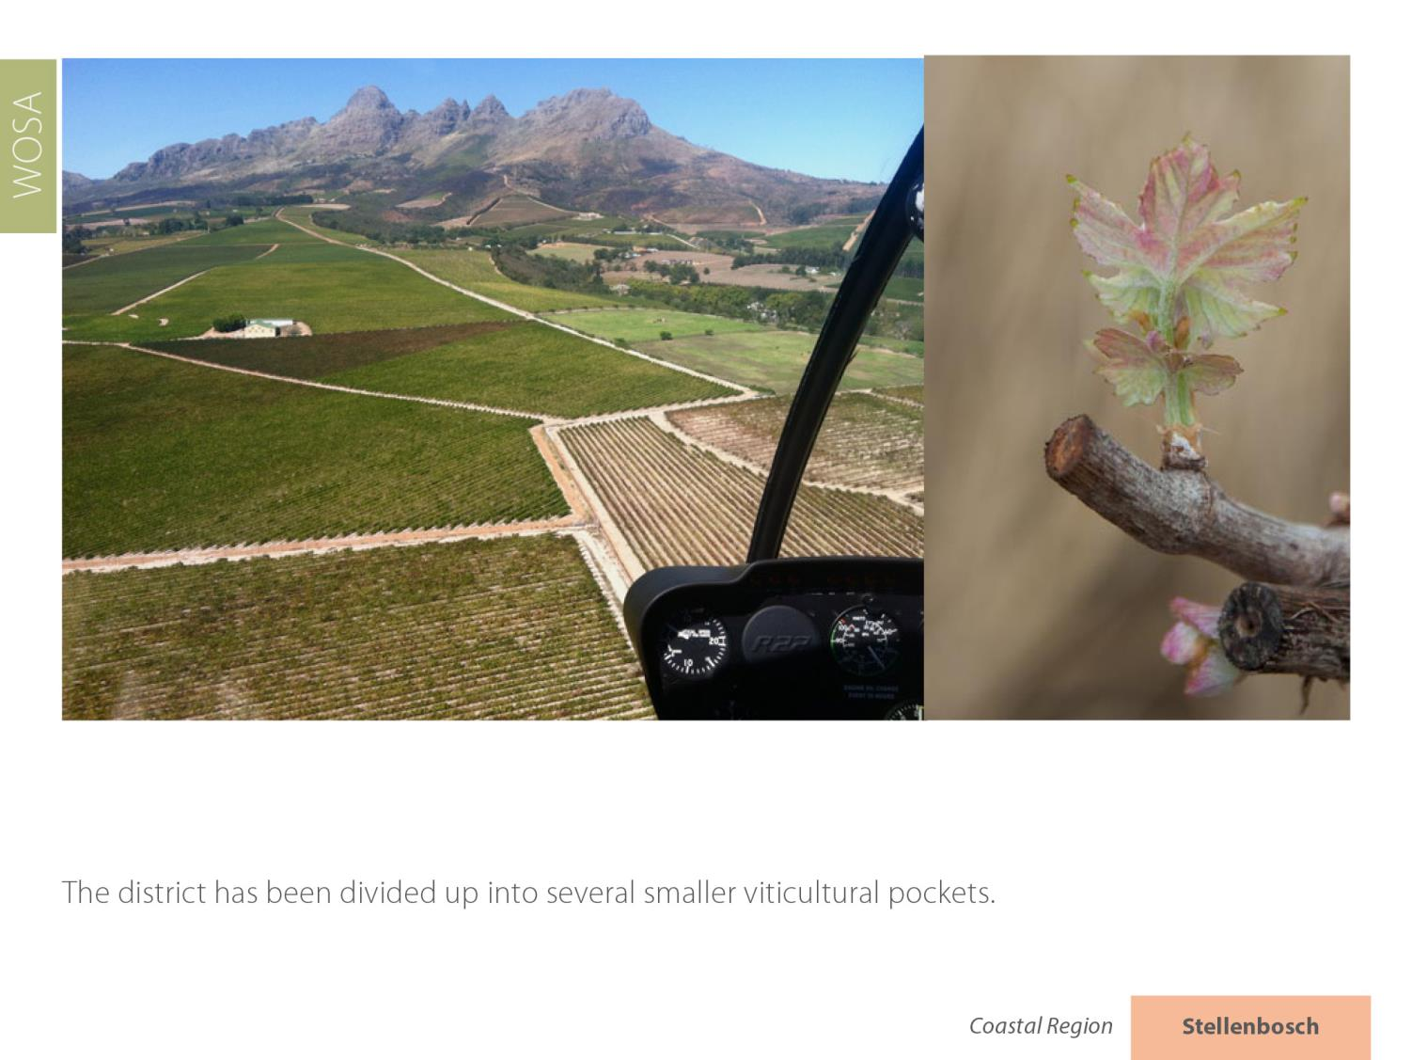
Stellenbosch
Coastal

Slide 33
There are eight wards: Banghoek, Bottelary, Devon Valley, Jonkershoek Valley, Papegaaiberg, Polkadraai Hills, Simonsberg-Stellenbosch and Vlottenburg.
Stellenbosch
Coastal

Slide 34
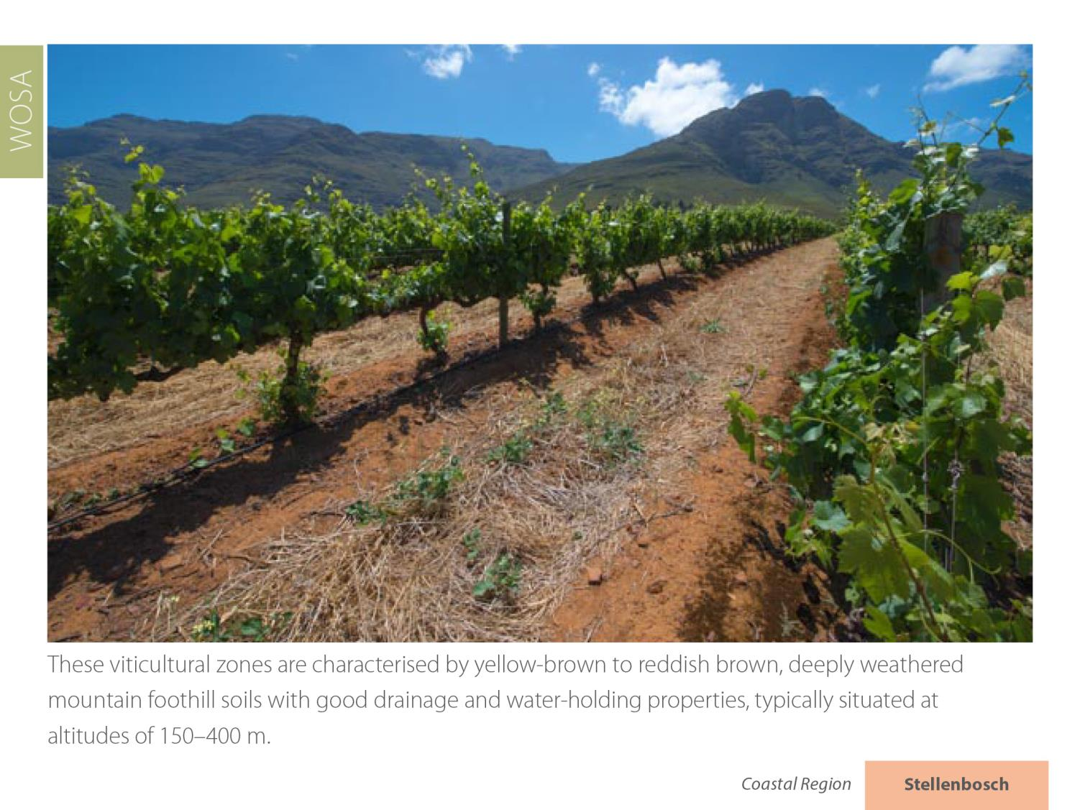
Stellenbosch
Coastal

Slide 35
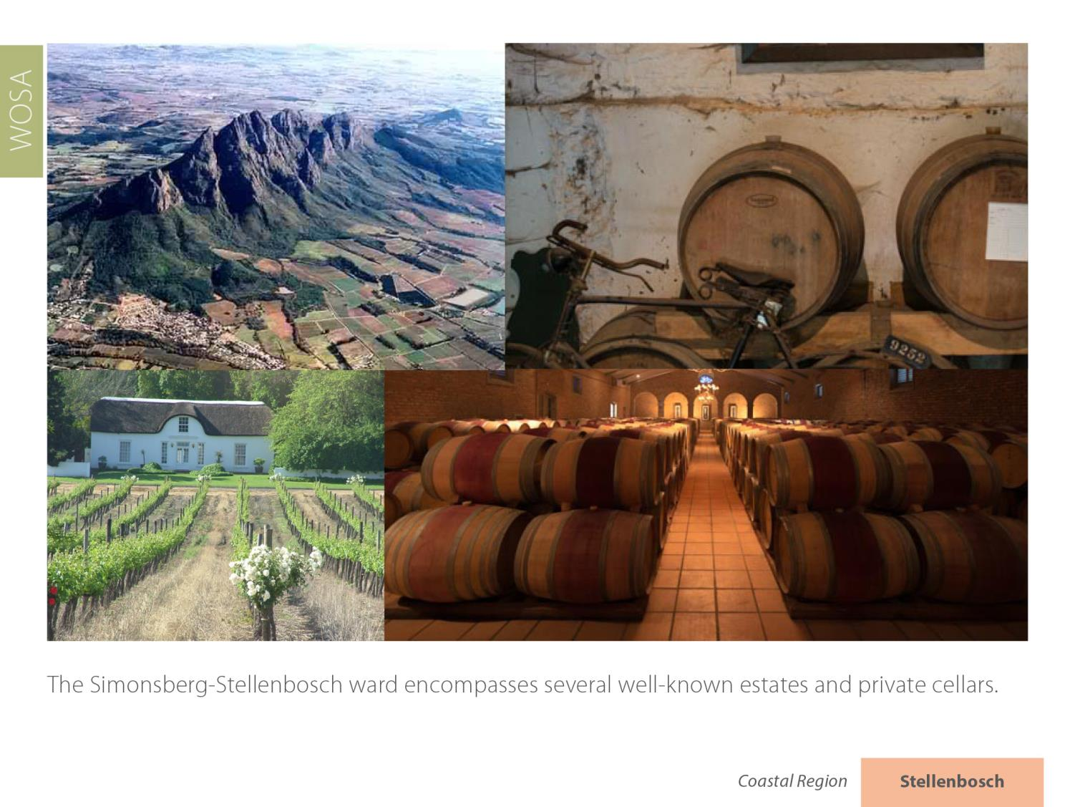
Stellenbosch
Coastal

Slide 36
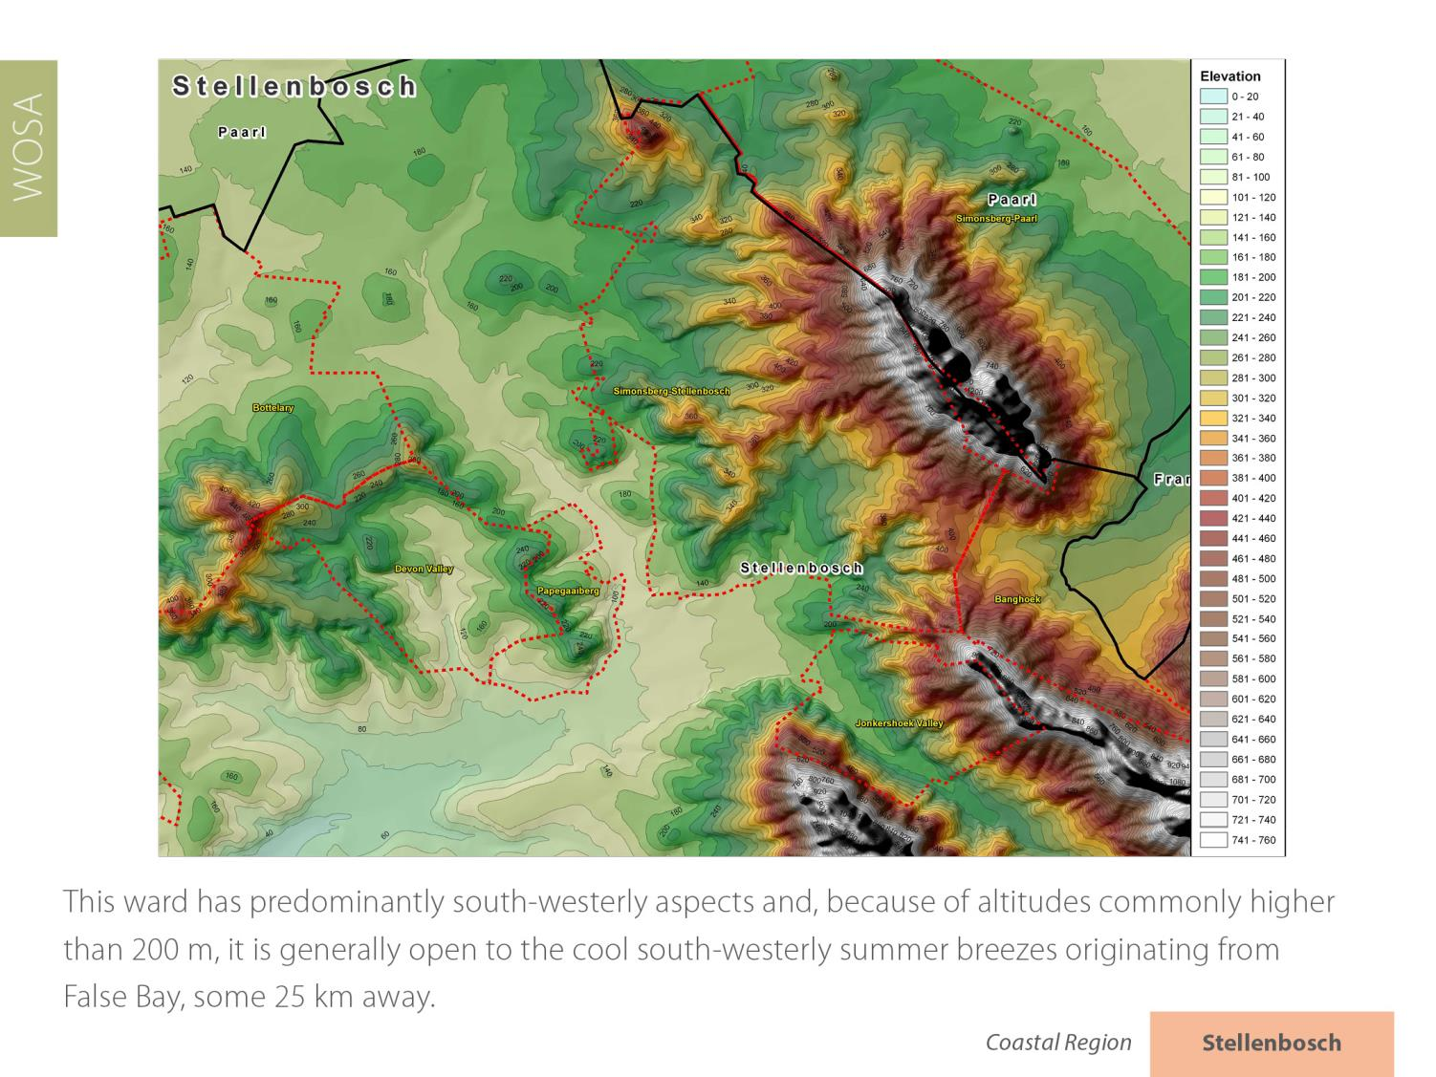
Stellenbosch
Coastal

Slide 37
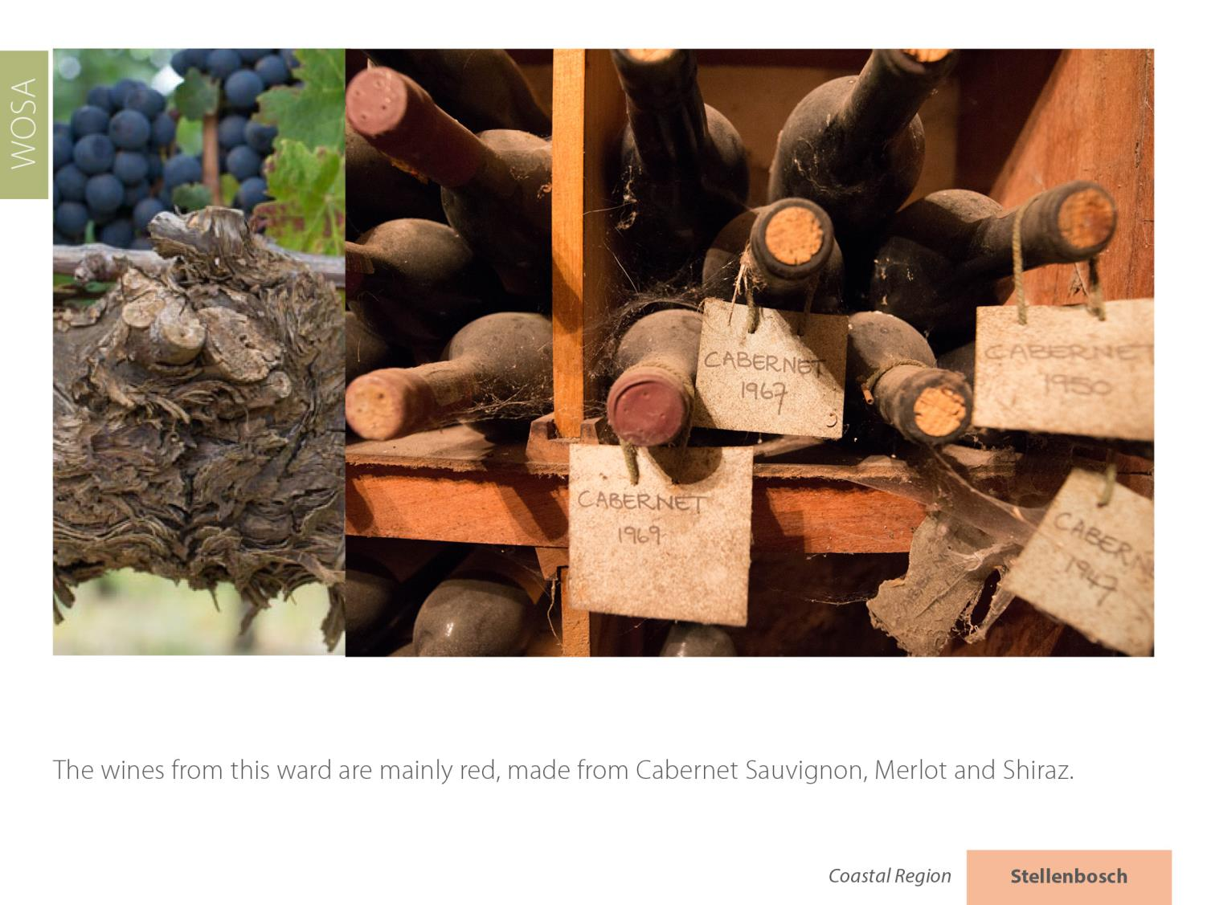
Stellenbosch
Coastal

Slide 38
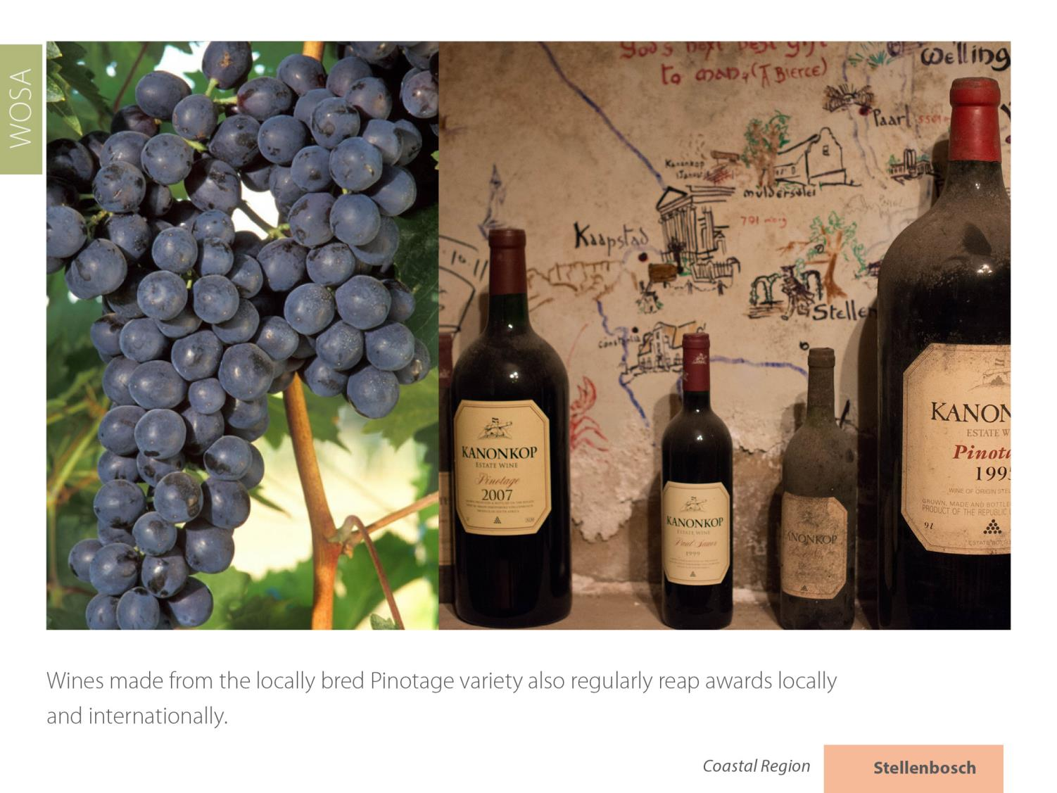
Stellenbosch
Coastal

Slide 39
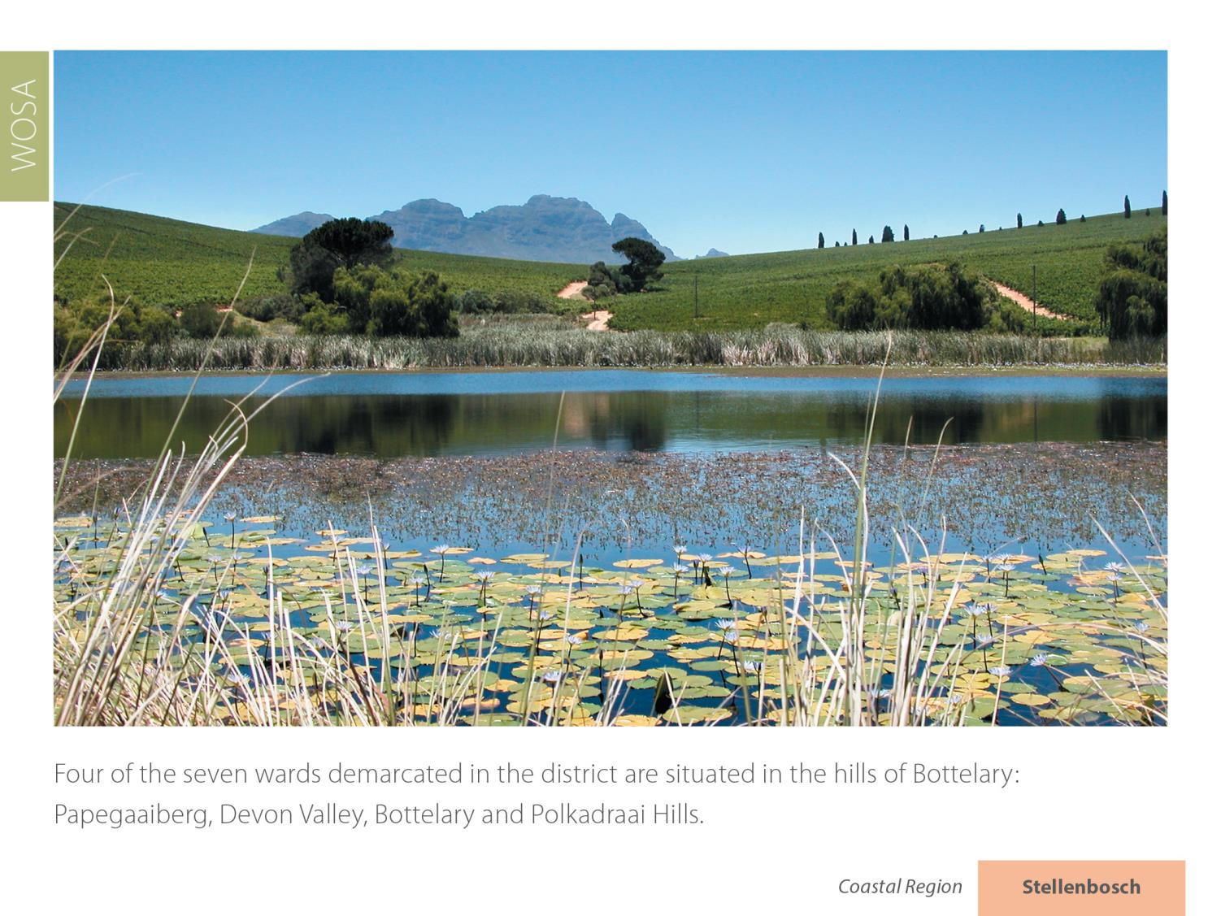
Stellenbosch
Coastal

Slide 40
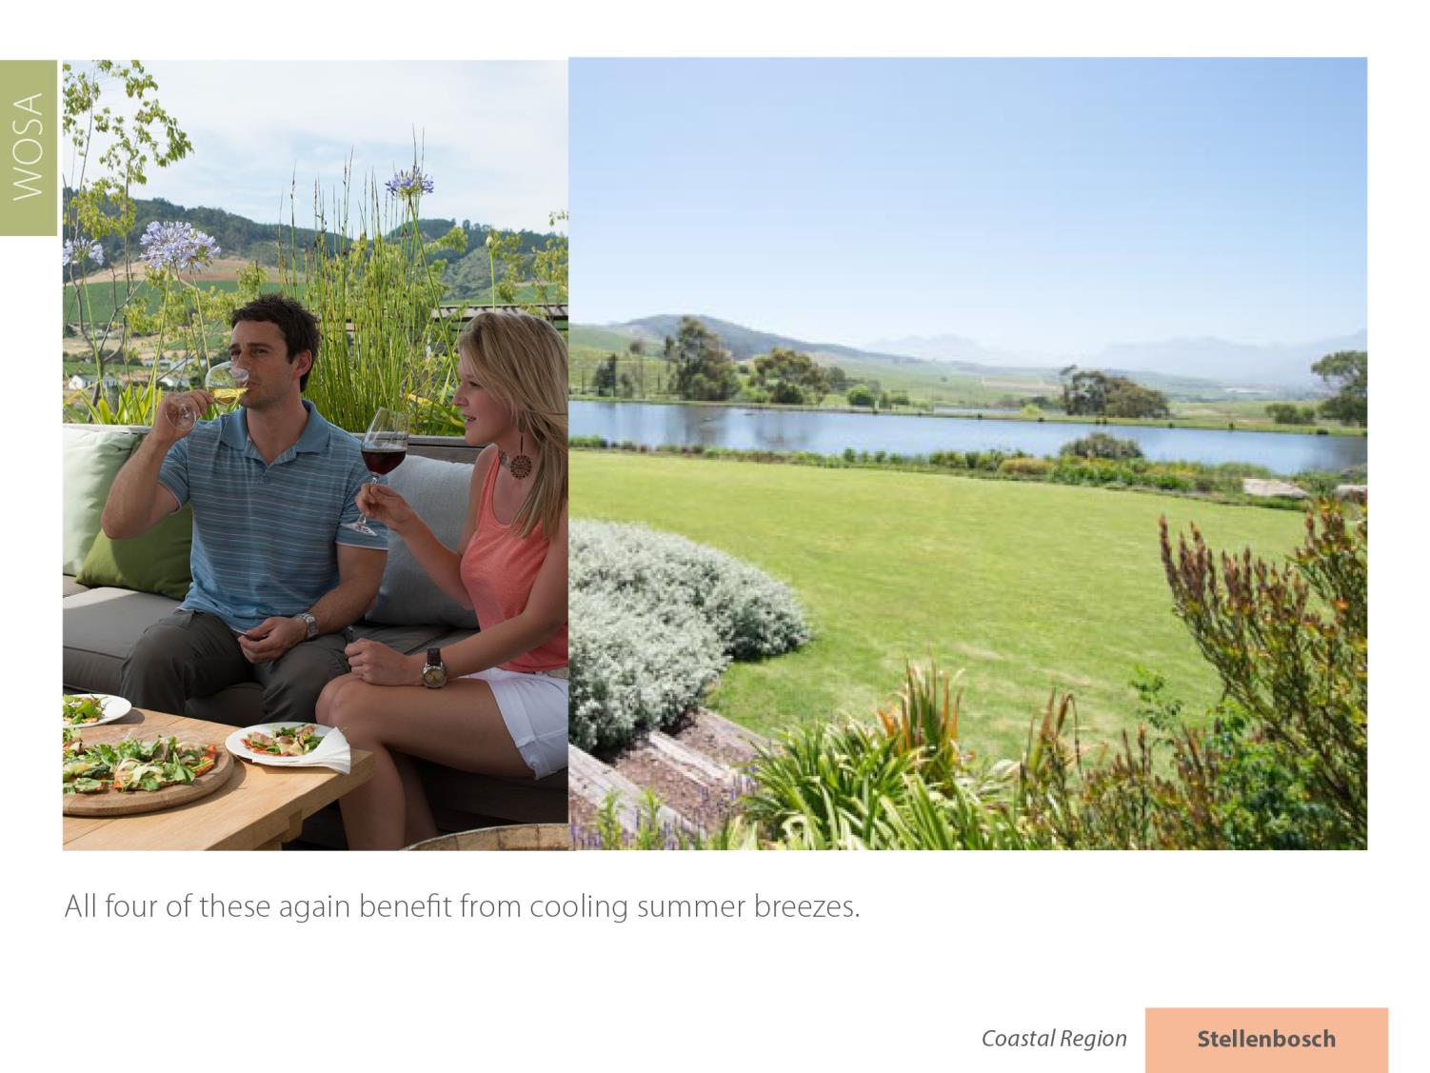
Stellenbosch
Coastal

Slide 41
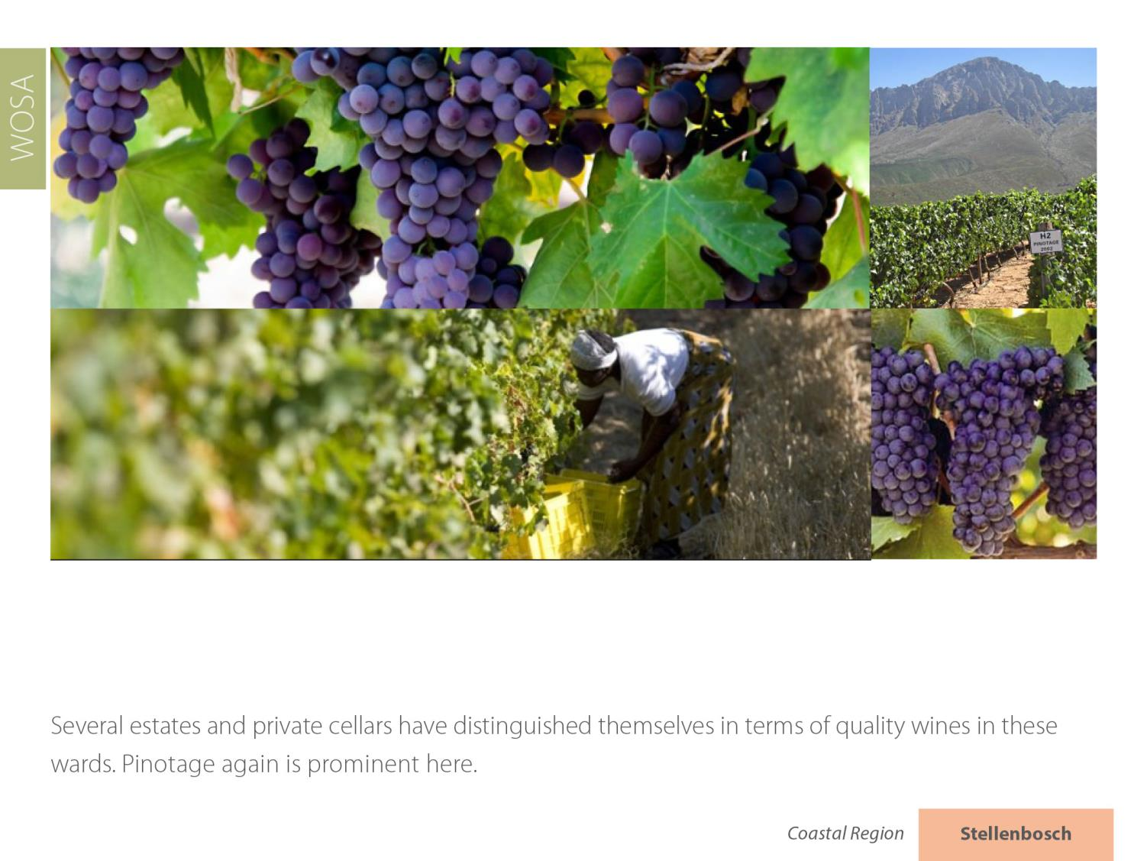
Stellenbosch
Coastal

Slide 42
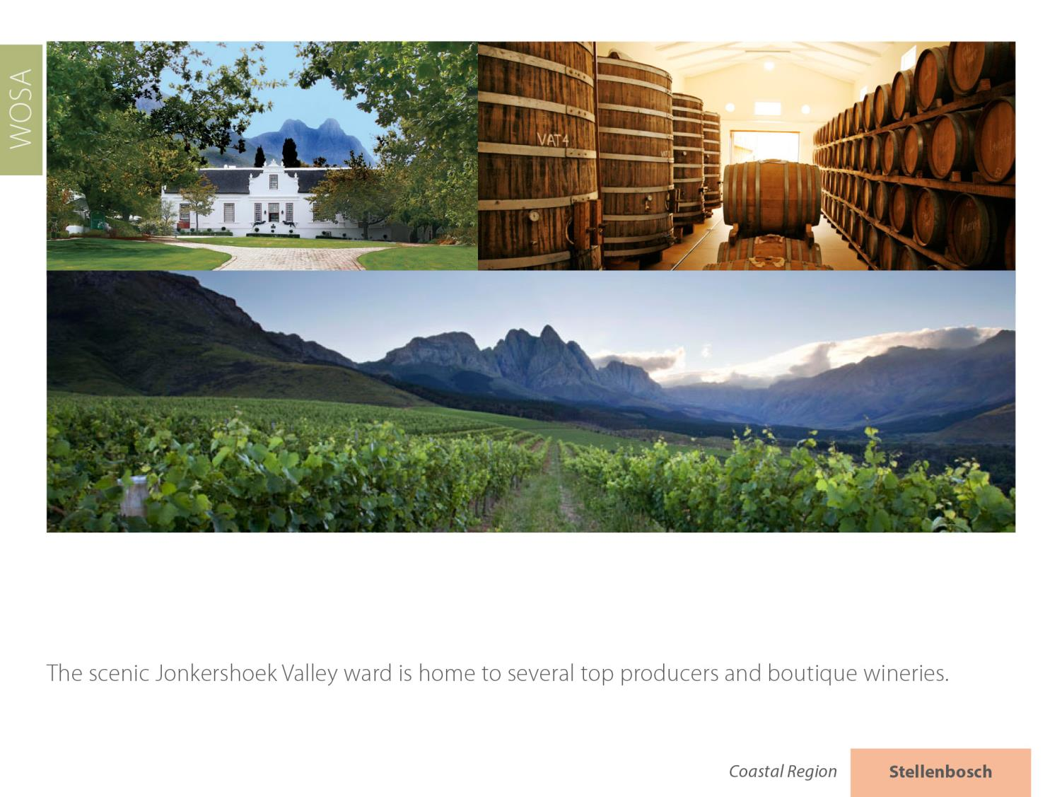
Stellenbosch
Coastal

Slide 43
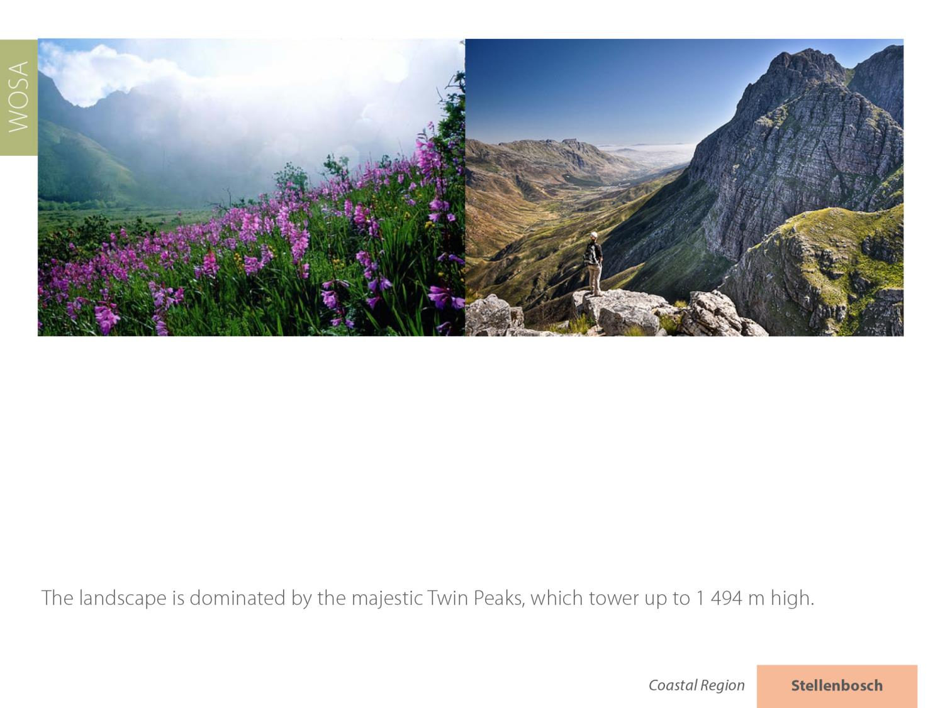
Stellenbosch
Coastal

Slide 44
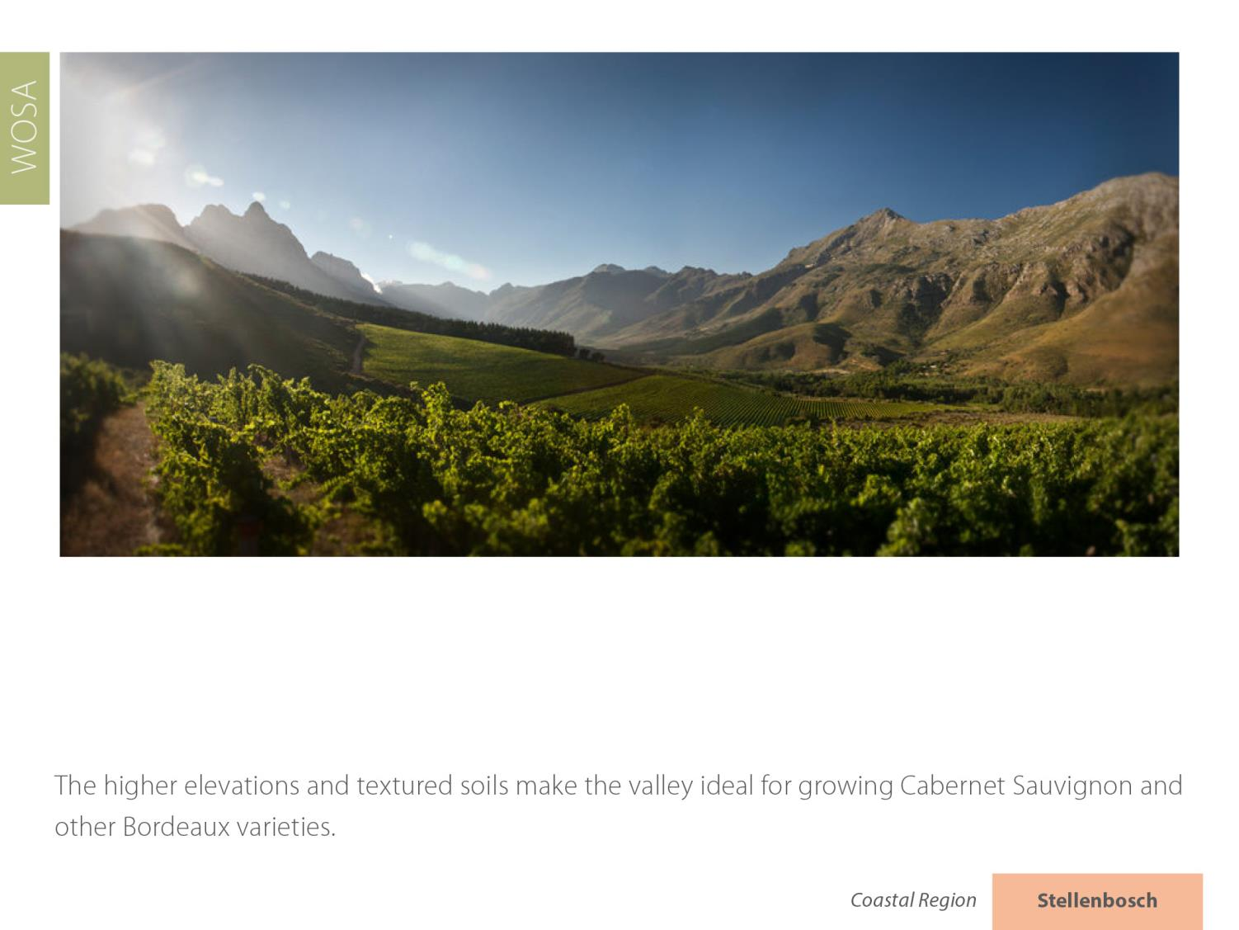
Stellenbosch
Coastal

Slide 45
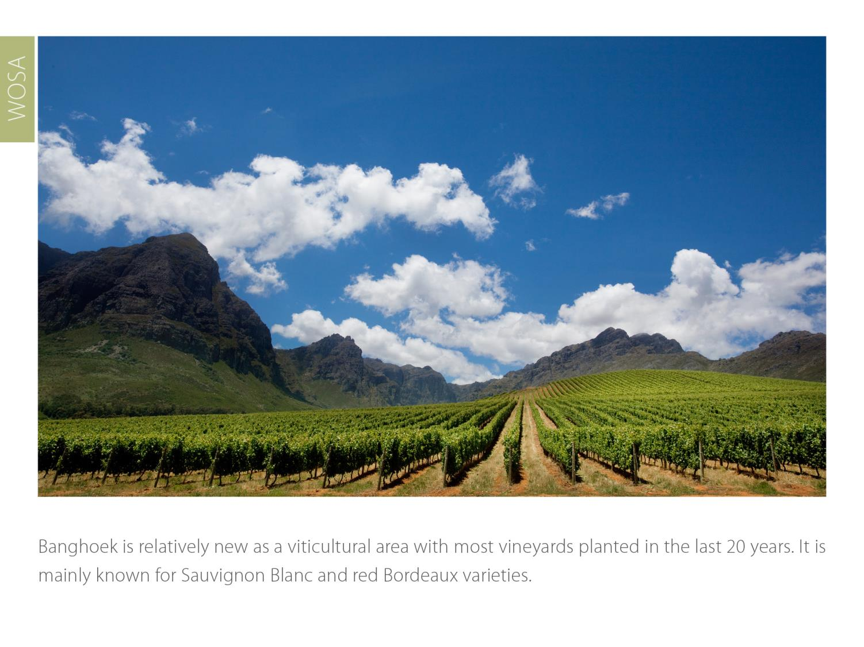
Stellenbosch
Coastal

Slide 46
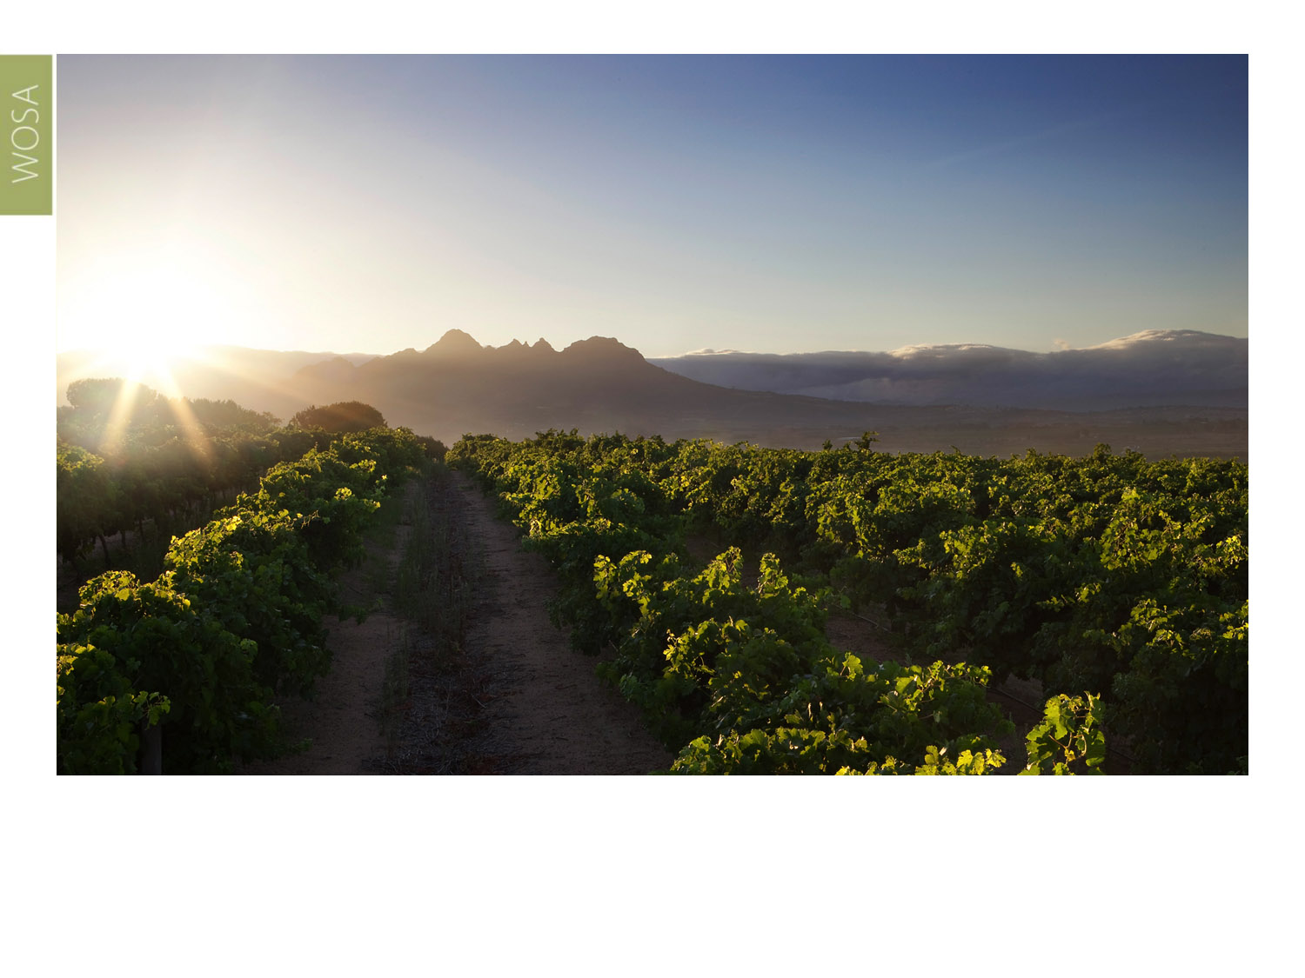
Vlottenburg, the most recently demarcated ward, has a generally convex hill landscape and abundant cooler southern slopes.
Stellenbosch
Coastal

Slide 47
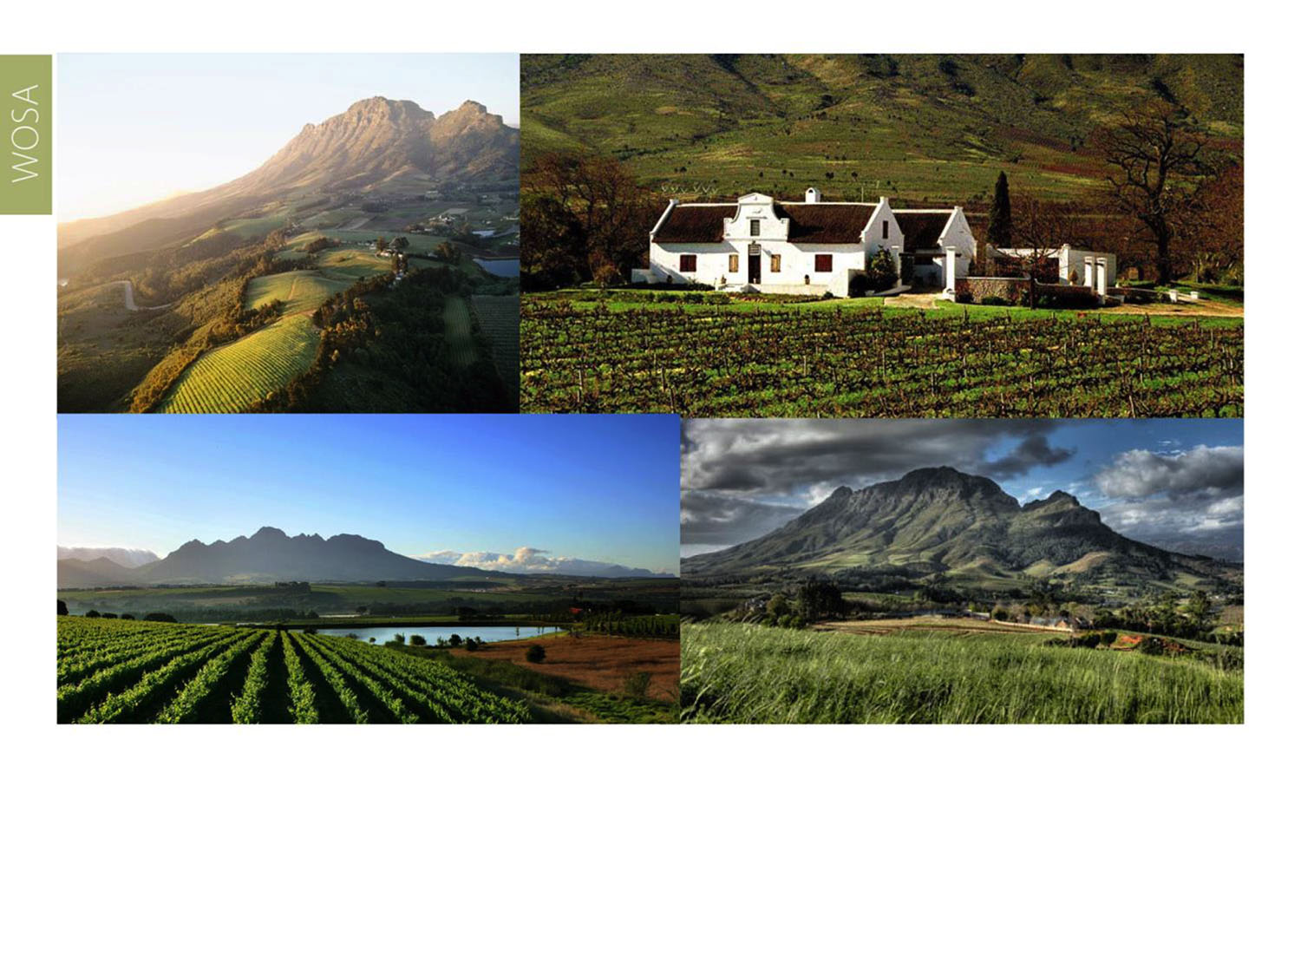
The images used in these presentations have been sourced from various producers, as well as industry and tourism bodies. These presentations are strictly for non-commercial, non-profit, educational purposes only and cannot be reproduced or transmitted in any form or by any means without written permission from Wines of South Africa (WoSA).

Slide 48
The Cape winelands, considered by many to be
the most beautiful in the world, have a network of
diverse and well-run wine routes, affording visitors
a varied and unforgettable experience.

Slide 49
THE END

