Slide 1
CAPE WINELANDS
TULBAGH

Slide 2
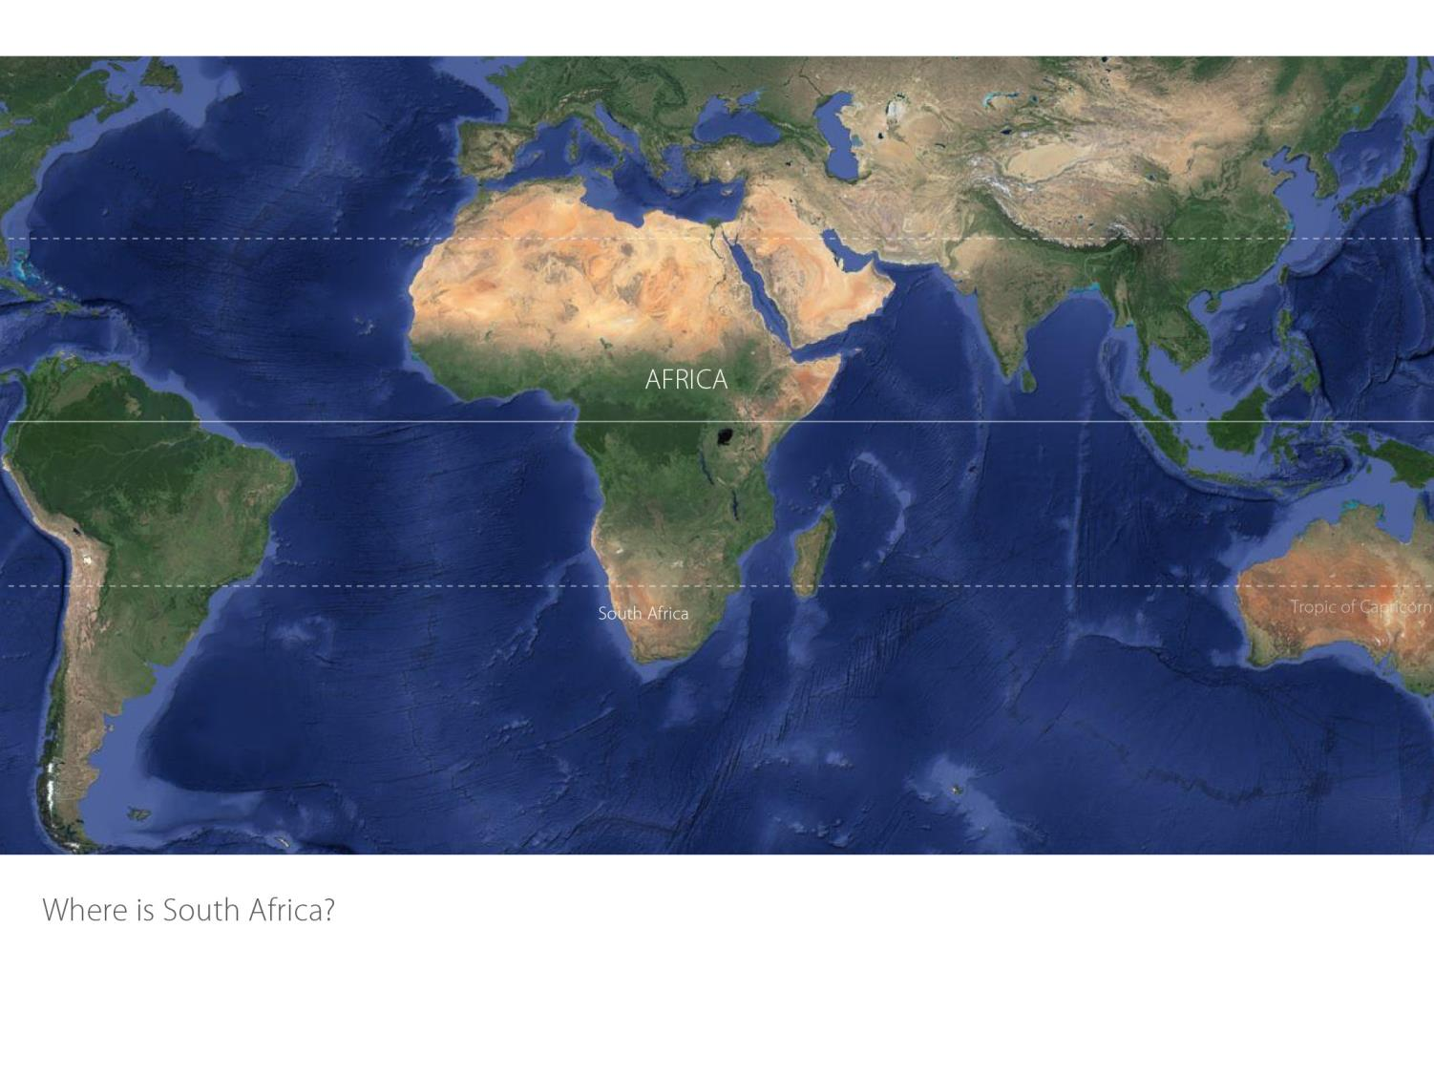

Slide 3
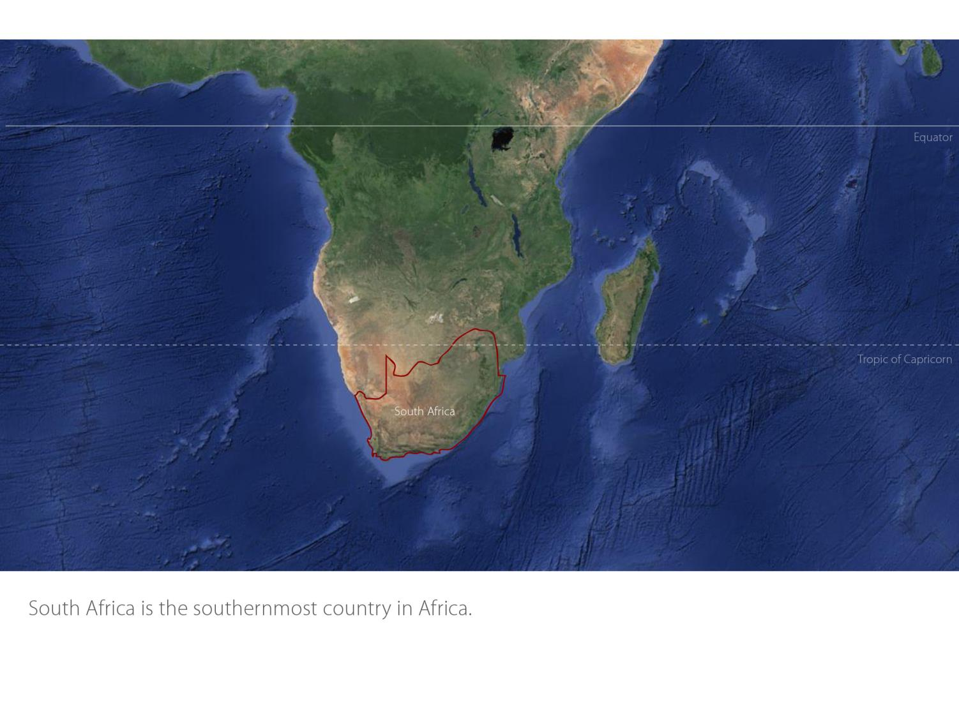

Slide 4
Our winelands are located at the very tip of South Africa.
Tulbagh
Coastal

Slide 5
Coastal
Tulbagh
Coastal
Tulbagh

Slide 6
Tulbagh
Coastal

Slide 7
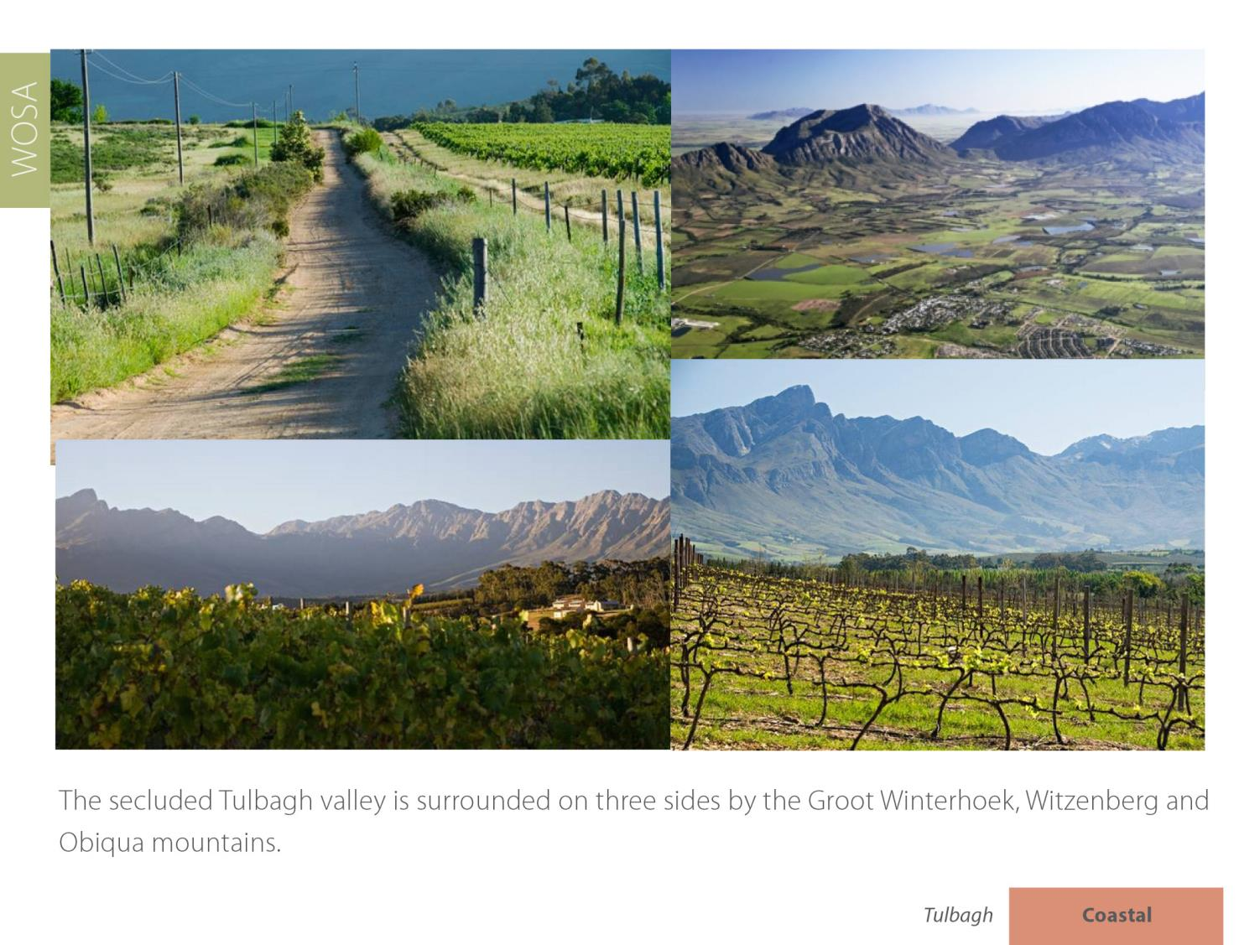
Tulbagh
Coastal

Slide 8
The town of Tulbagh boasts 32 provincial monuments on one street.
Tulbagh
Coastal

Slide 9
Here history and tradition work hand-in-hand with innovation.
Tulbagh
Coastal

Slide 10
Tulbagh
Coastal

Slide 11
The Wine Route is dotted with graceful old estates interspersed with conspicuously new vineyards and architecturally designed state-of-the-art cellars, as well as a handful of micro-producers and boutique wineries.
Tulbagh
Coastal

Slide 12
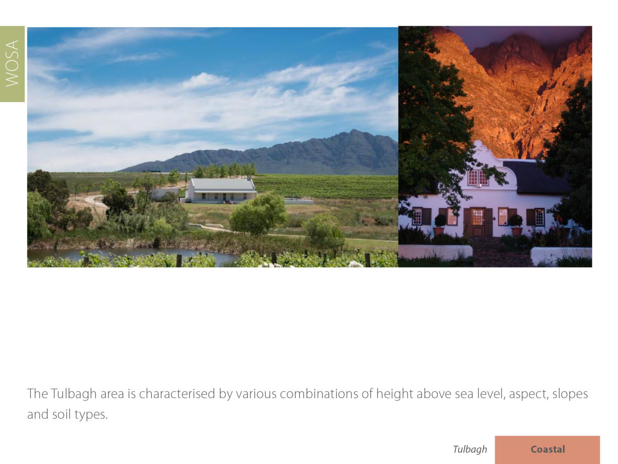
Tulbagh
Coastal

Slide 13
Unique to the valley’s geographical composition is the ‘cold trap’, a phenomenon which occurs as a result of the encapsulating mountains, shape like a horseshoe, with Tulbagh situated at the northern head of this ‘bowl’.
Tulbagh
Coastal

Slide 14
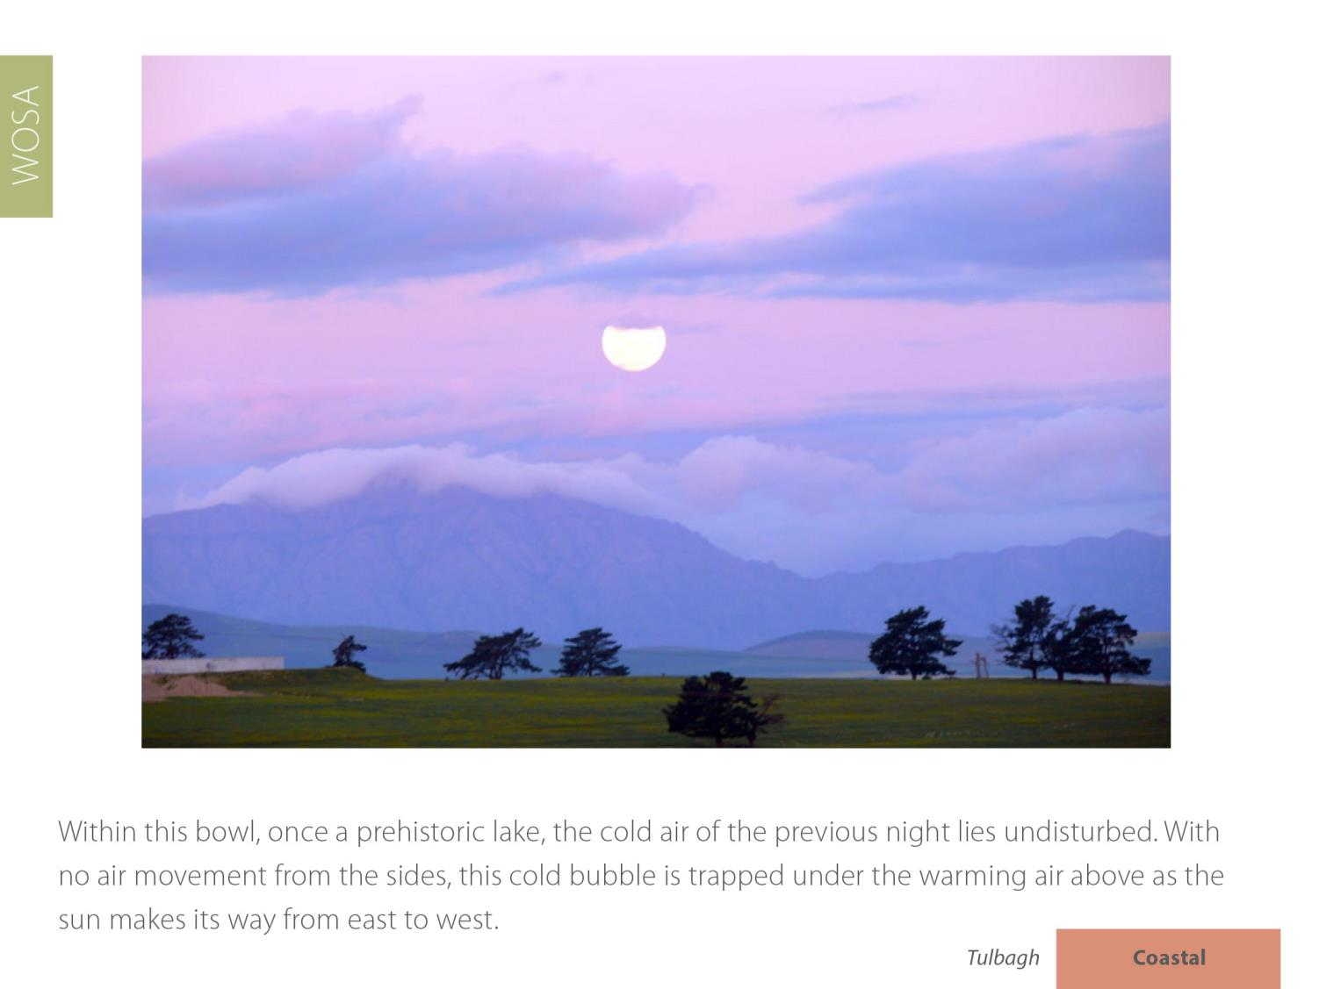
Tulbagh
Coastal

Slide 15
Average rainfall is 551 mm (Drostdy Wine Cellar Weather Station) but rainfall varies due to different microclimates. The average rainfall is much higher up against the mountains than lower down in the valley.
Tulbagh
Coastal

Slide 16
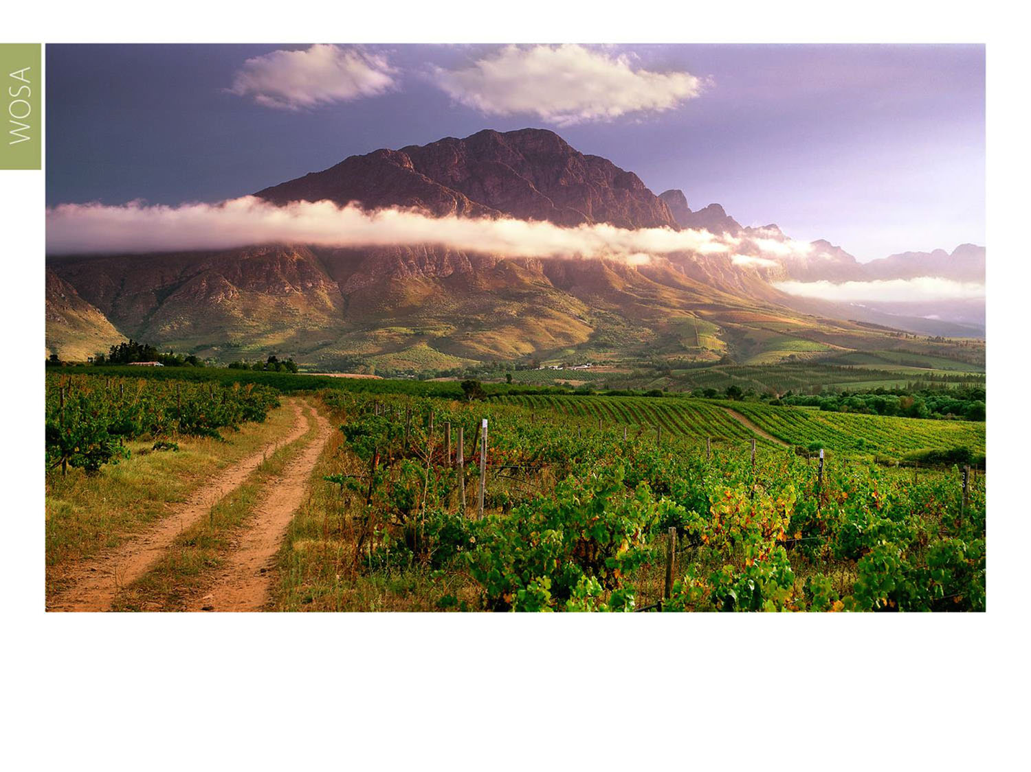
Summers are warm, with a mean February temperature of 24⁰C (Drostdy Wine Caller Weather Station), although the mountainous terrain creates numerous different mesoclimates which can be used to great advantage.
Tulbagh
Coastal

Slide 17
Tulbagh
Coastal

Slide 18
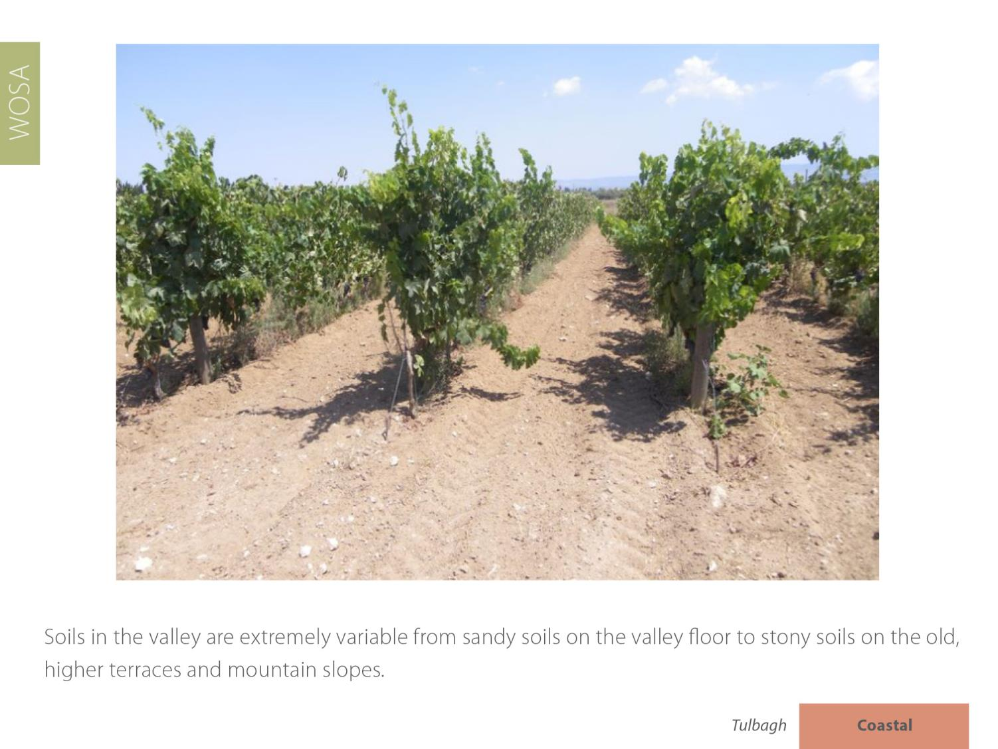
Tulbagh
Coastal

Slide 19
At higher altitudes, soils from the Malmesbury Supergroup schists and phyllites predominate, as well as more recent deep yellow boulder bed deposits which offer medium growing potential.
Tulbagh
Coastal

Slide 20
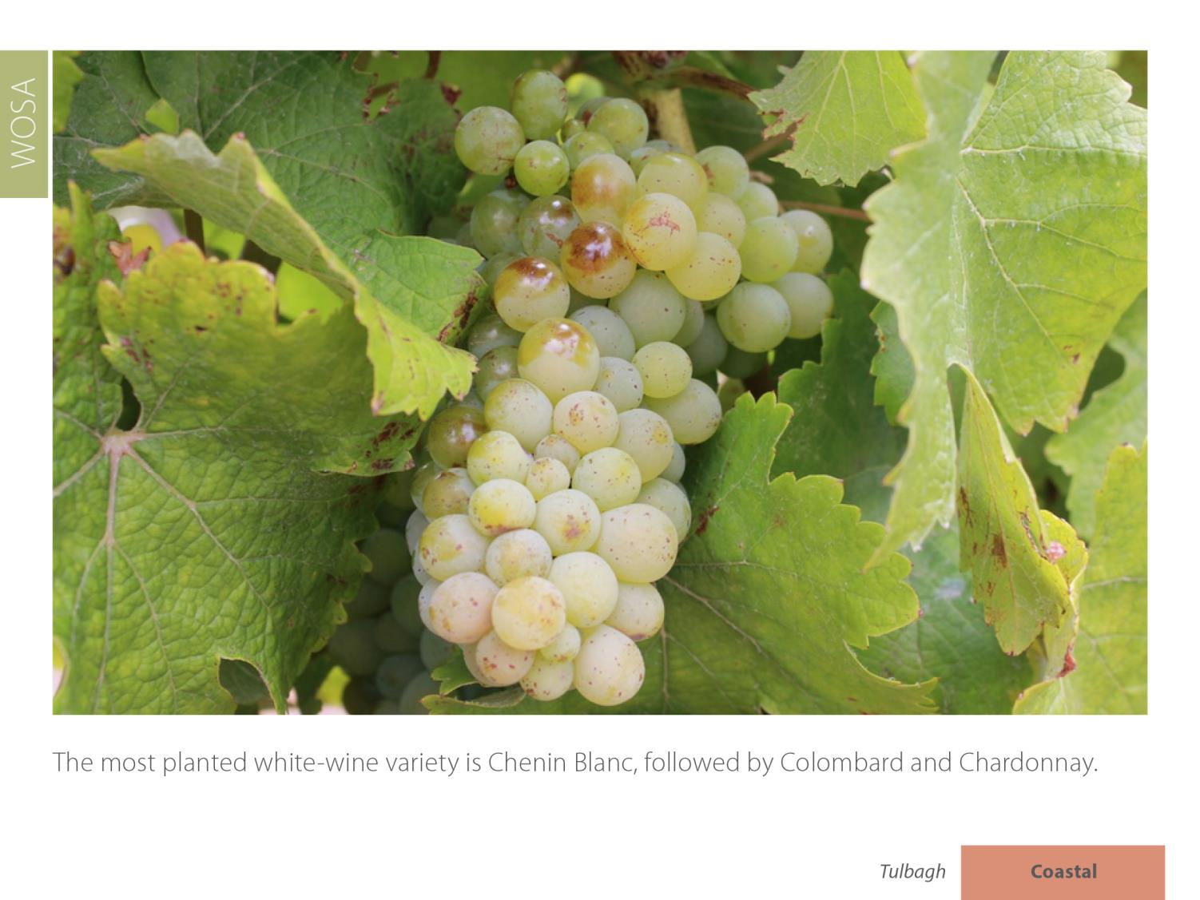
Tulbagh
Coastal

Slide 21
Red-wine varieties planted include predominantly Shiraz, Cabernet Sauvignon, Pinotage and Merlot.
Tulbagh
Coastal

Slide 22
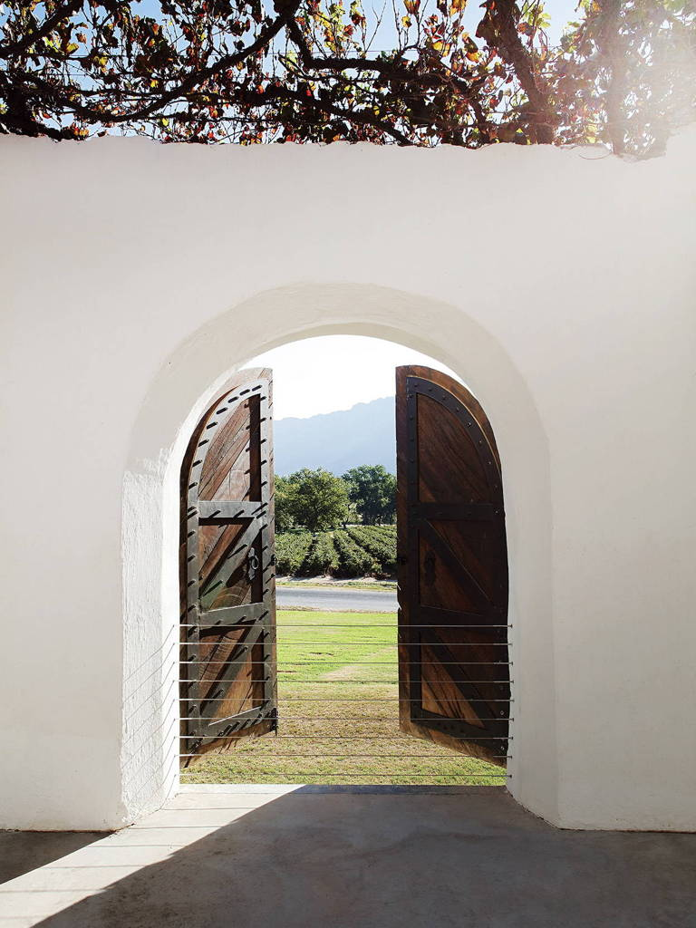
This inland district is noted for the quality of its Shiraz, which is consistently awarded the highest accolades, and its excellent Cap Classiques.
Tulbagh
Coastal

Slide 23
Tulbagh
Coastal

Slide 24
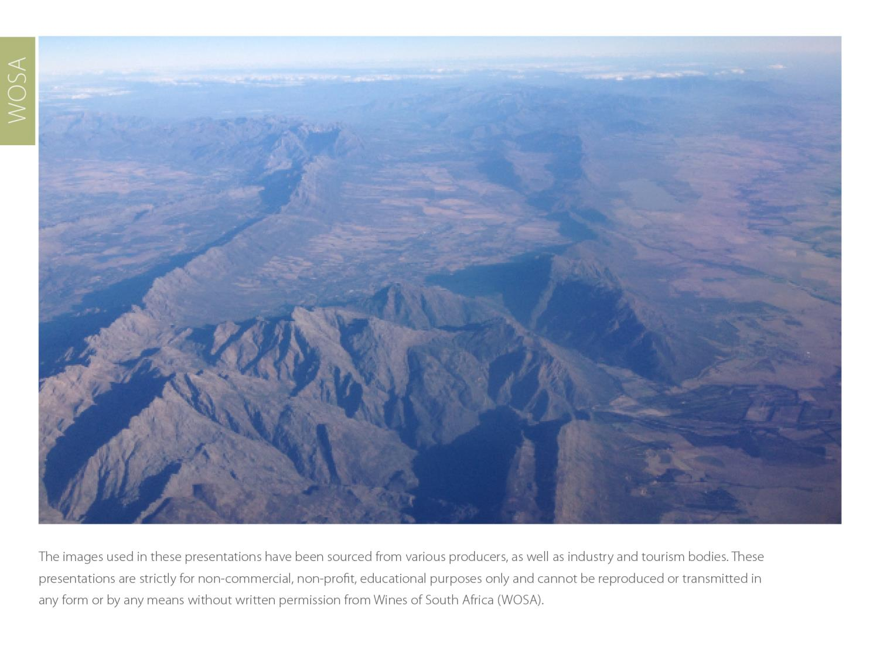
The images used in these presentations have been sourced from various producers, as well as industry and tourism bodies. These presentations are strictly for non-commercial, non-profit, educational purposes only and cannot be reproduced or transmitted in any form or by any means without written permission from Wines of South Africa (WoSA).

Slide 25
The Cape winelands, considered by many to be
the most beautiful in the world, have a network of
diverse and well-run wine routes, affording visitors
a varied and unforgettable experience.

Slide 26
THE END

