Slide 1

CAPE WINELANDS
WORCESTER

Slide 2
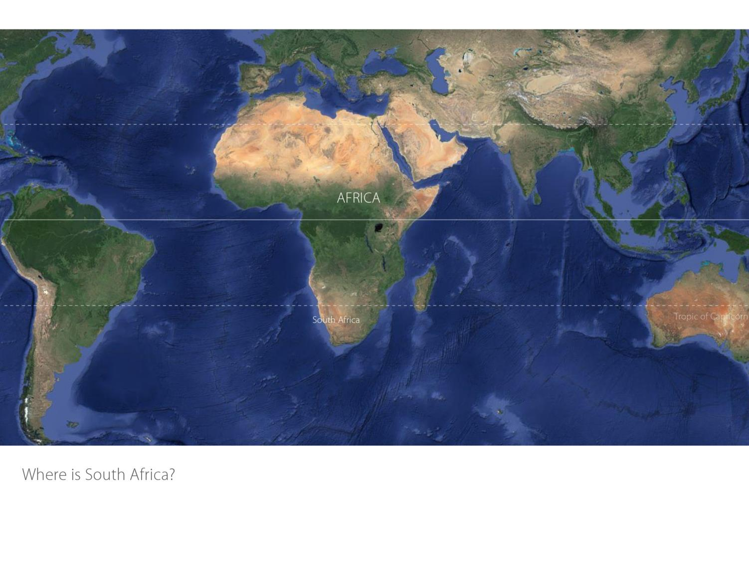

Slide 3
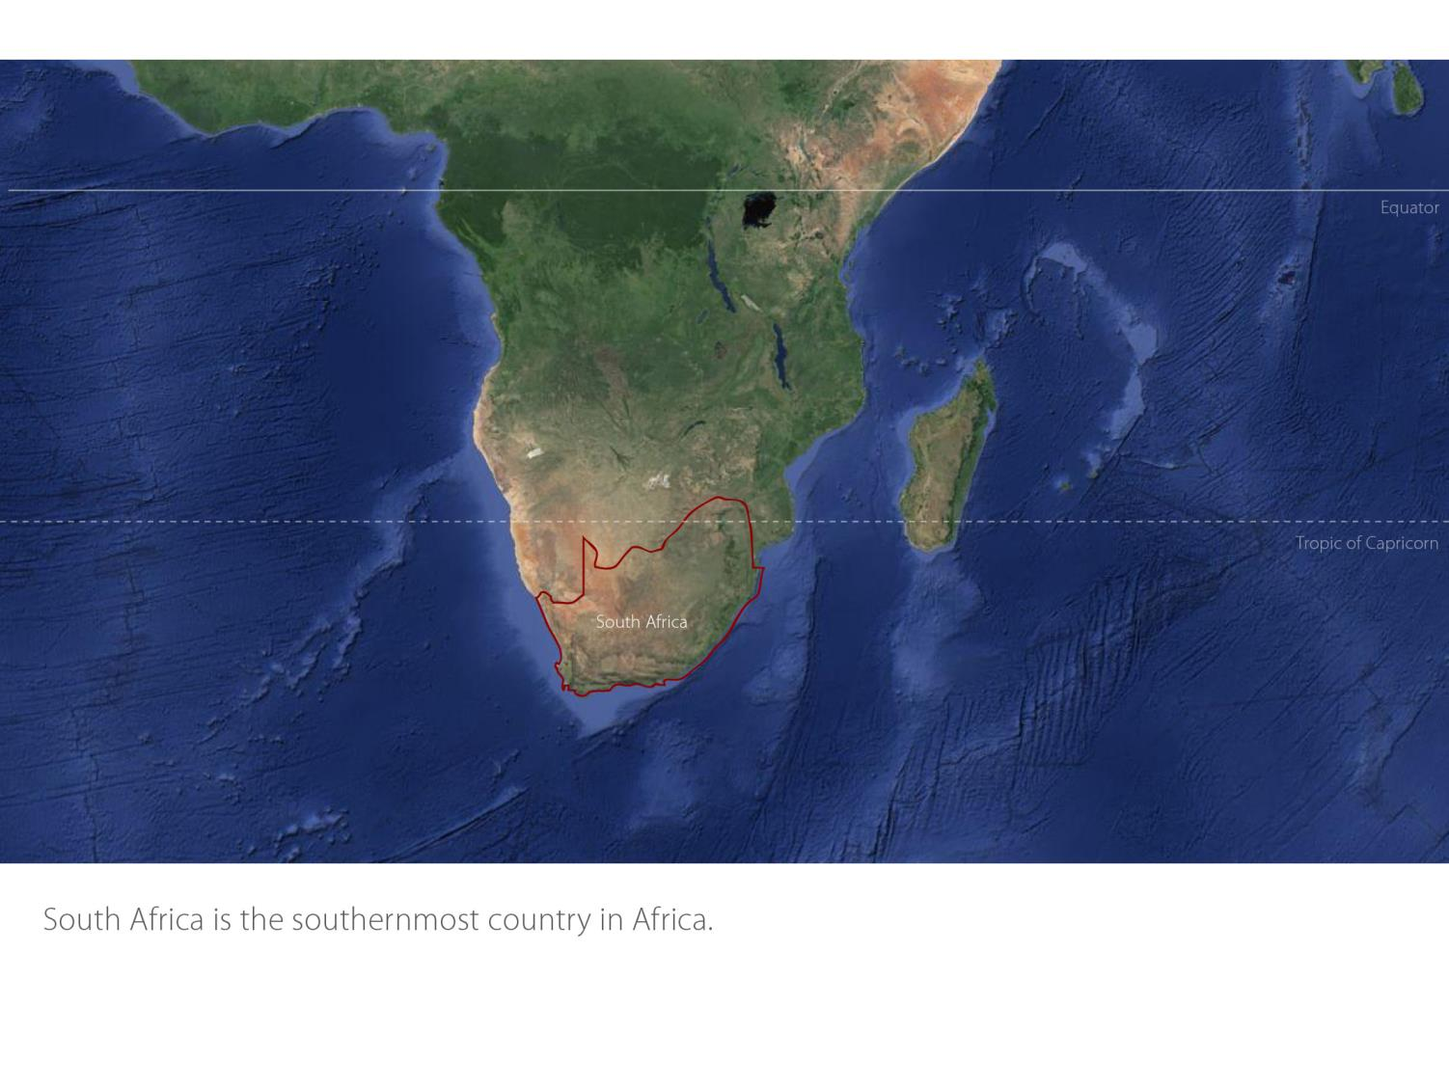

Slide 4
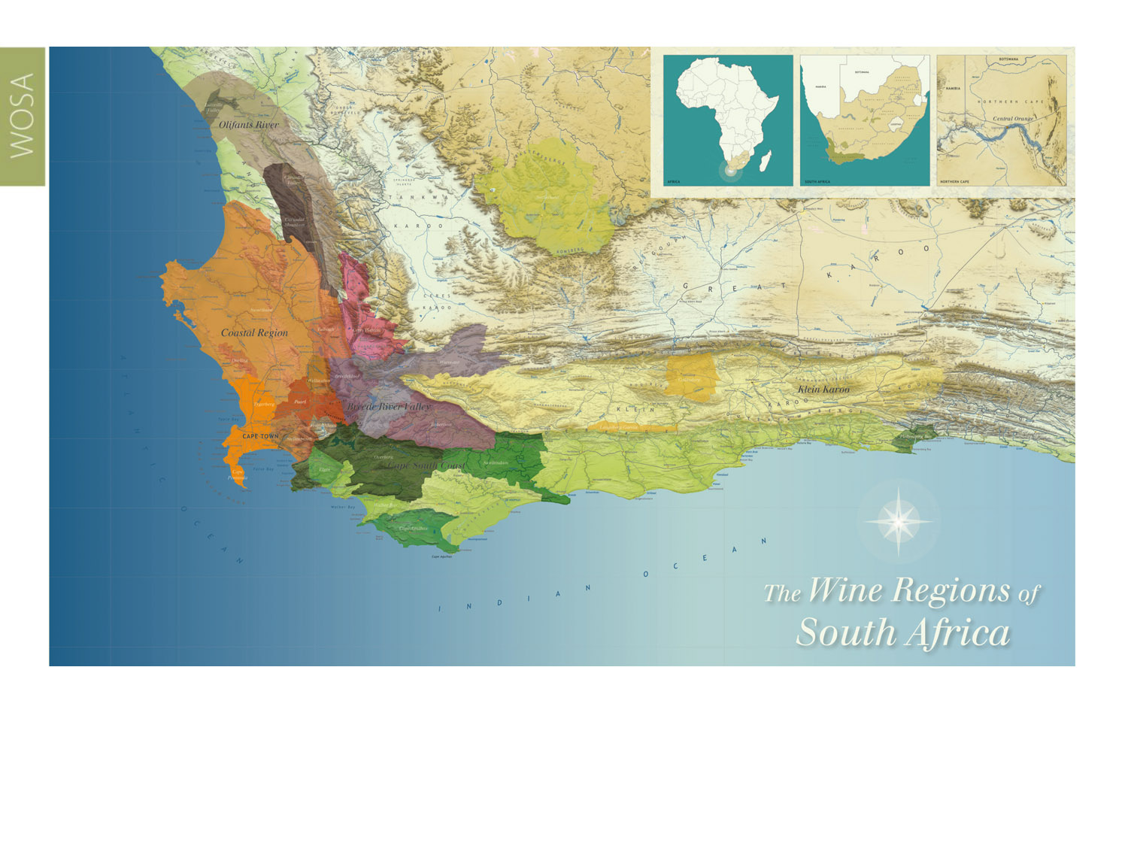
Our winelands are located at the very tip of South Africa.
Worcester
Coastal

Slide 5
Coastal
Region: Coastal
District: Worcester
Wards: Hex River Valley
Nuy
Scherpenheuvel
Stettyn
Worcester
Coastal

Slide 6
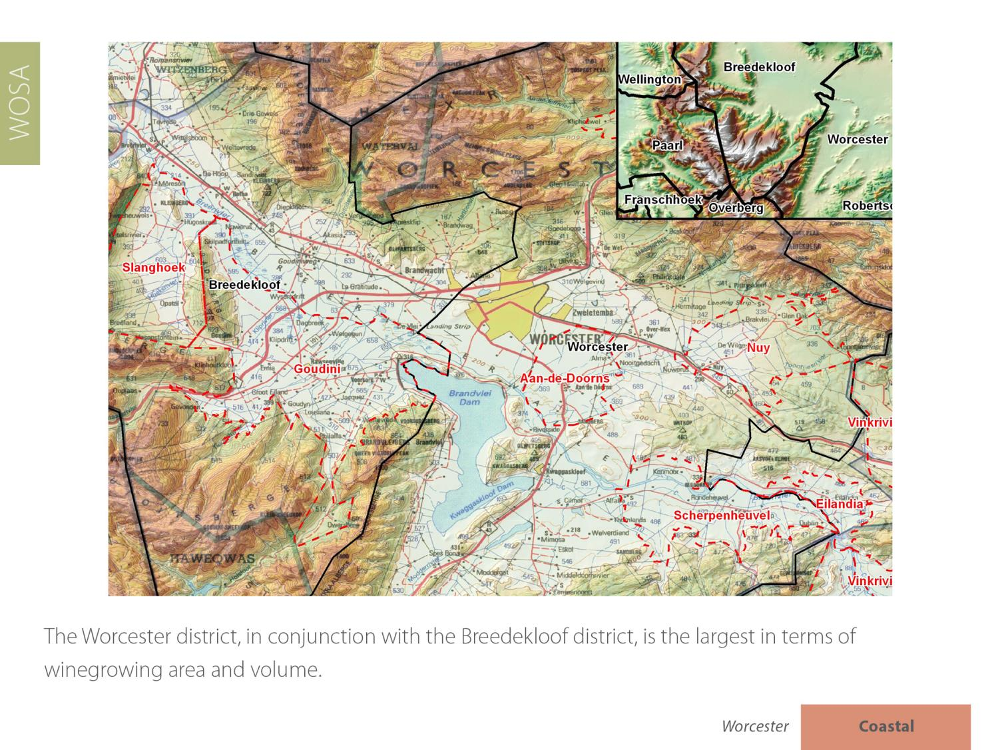

Slide 7
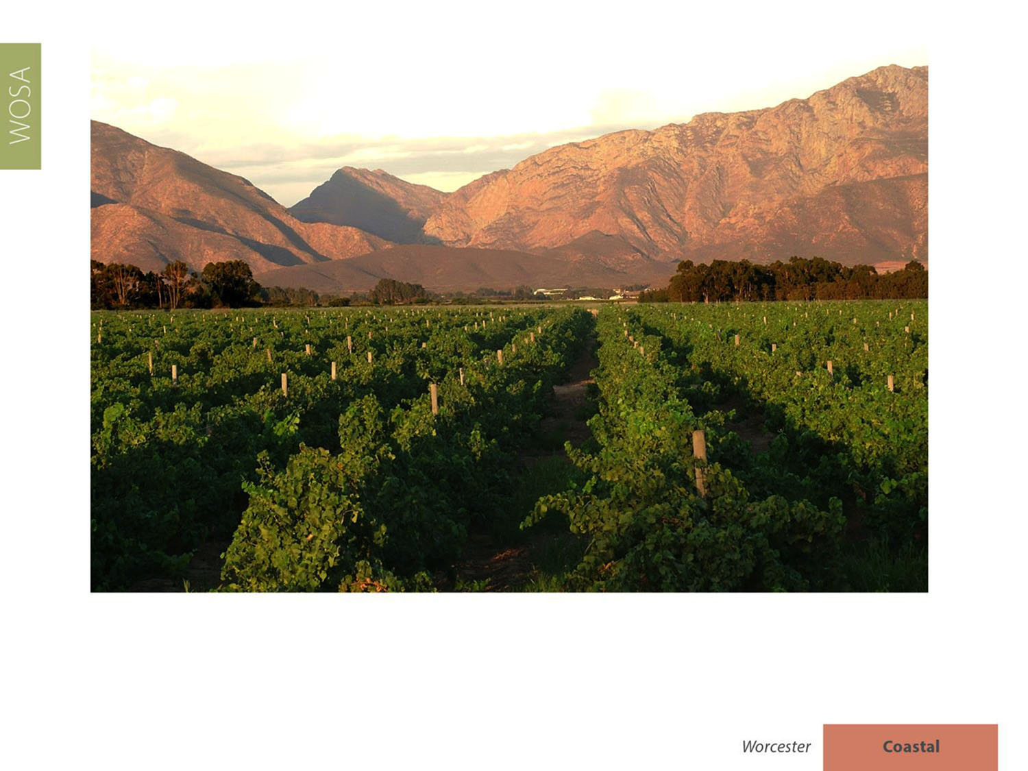
With around 19 101 ha planted, it accounts for nearly 21% of the national vineyards and produces close on 35% of South Africa's total volume of wine and spirits.

Slide 8
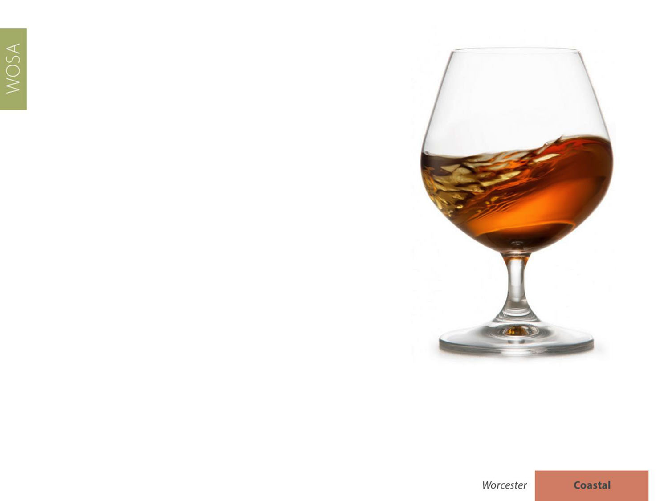
The Worcester district is the most important brandy-producing area in the winelands.

Slide 9
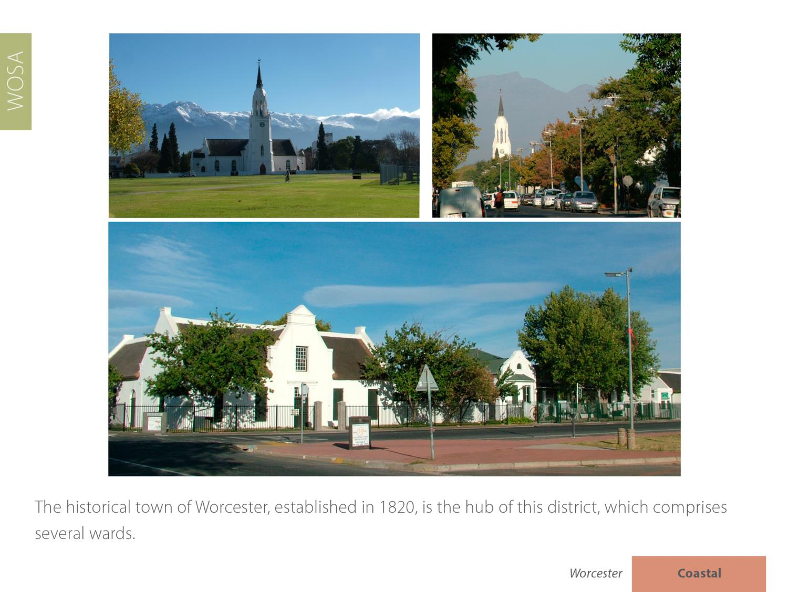

Slide 10
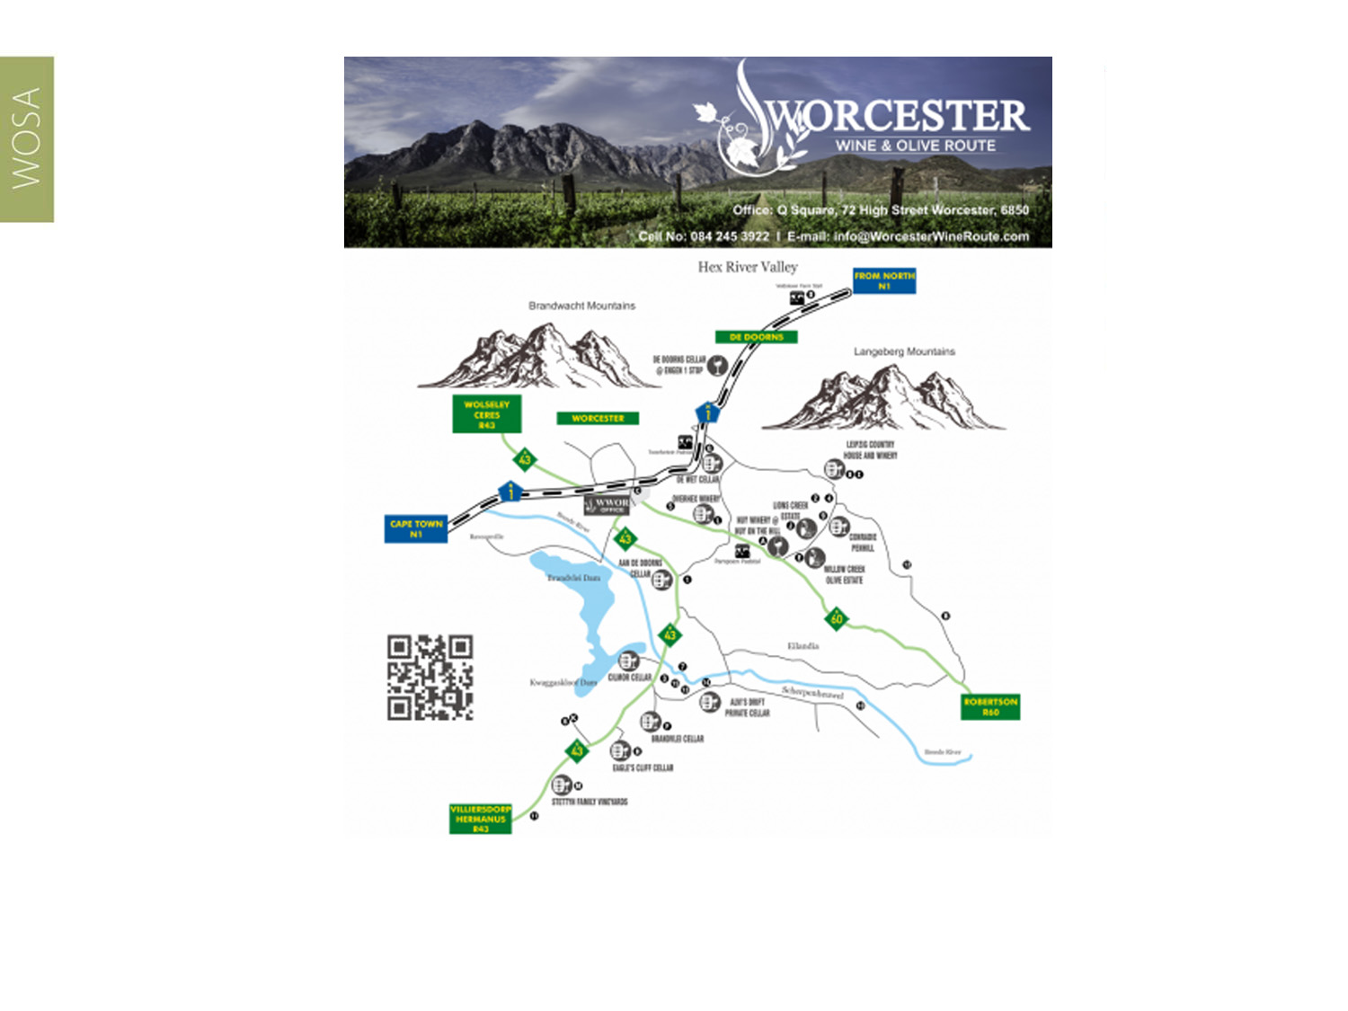
There are some 12 wine cellars on the Worcester Wine & Olive Route.
Worcester
Coastal

Slide 11
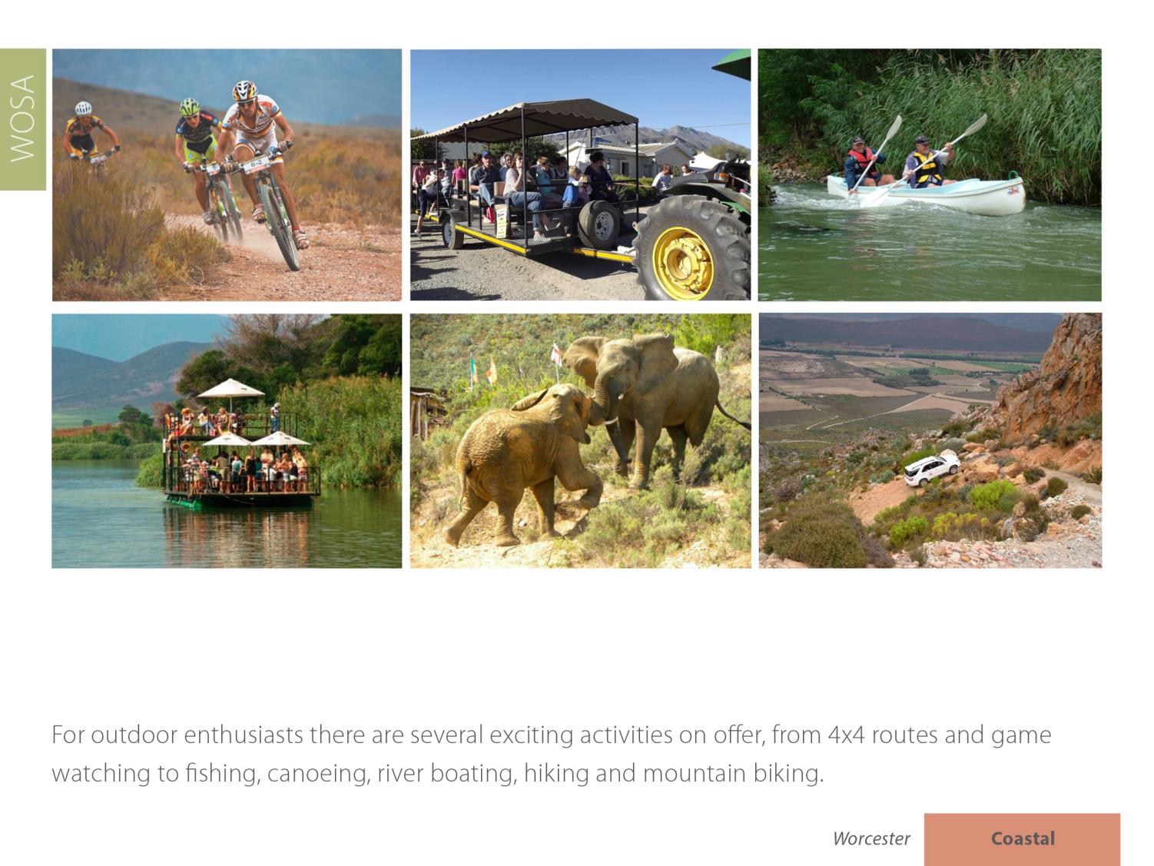

Slide 12
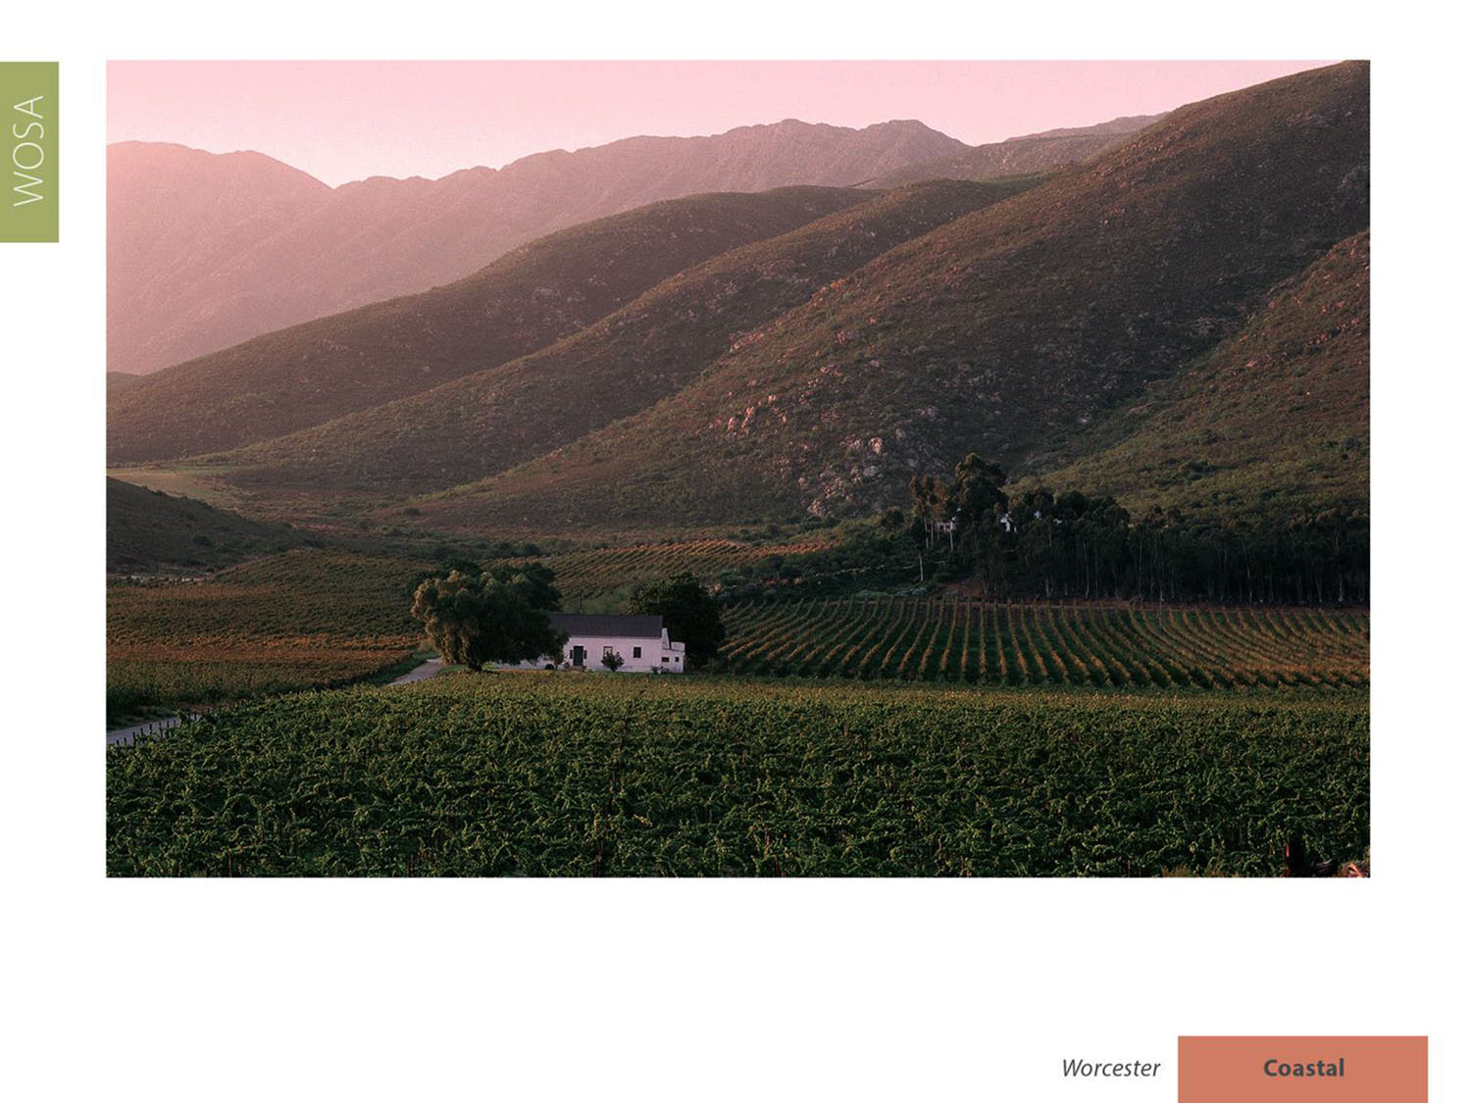
Between Worcester and Robertson in the Breede River Valley the climate is Mediterranean with a mean February temperature of 23.6⁰C for Worcester Weather Station and 22.2⁰C for Nuy Weather Station.

Slide 13
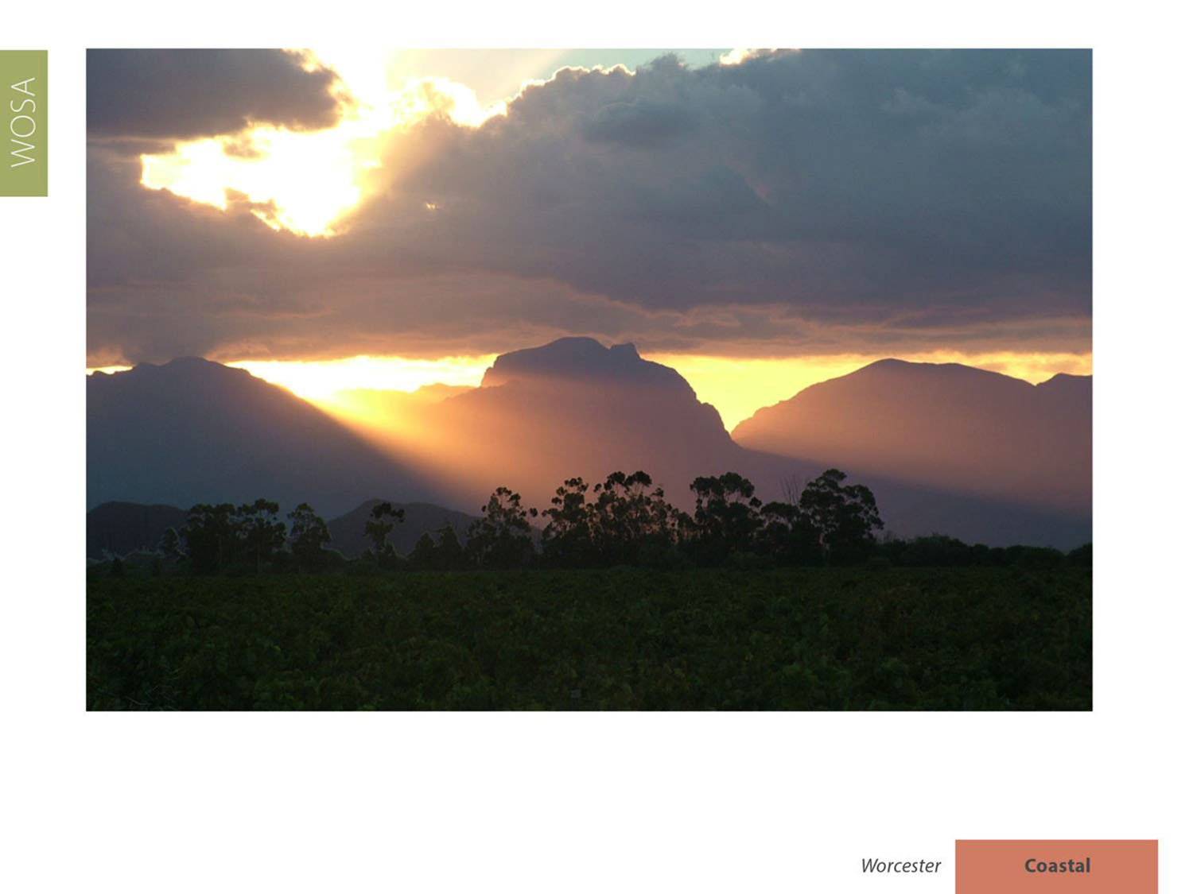
The rainfall is low, with an annual average of 201 mm (Nuy Weather Station).

Slide 14
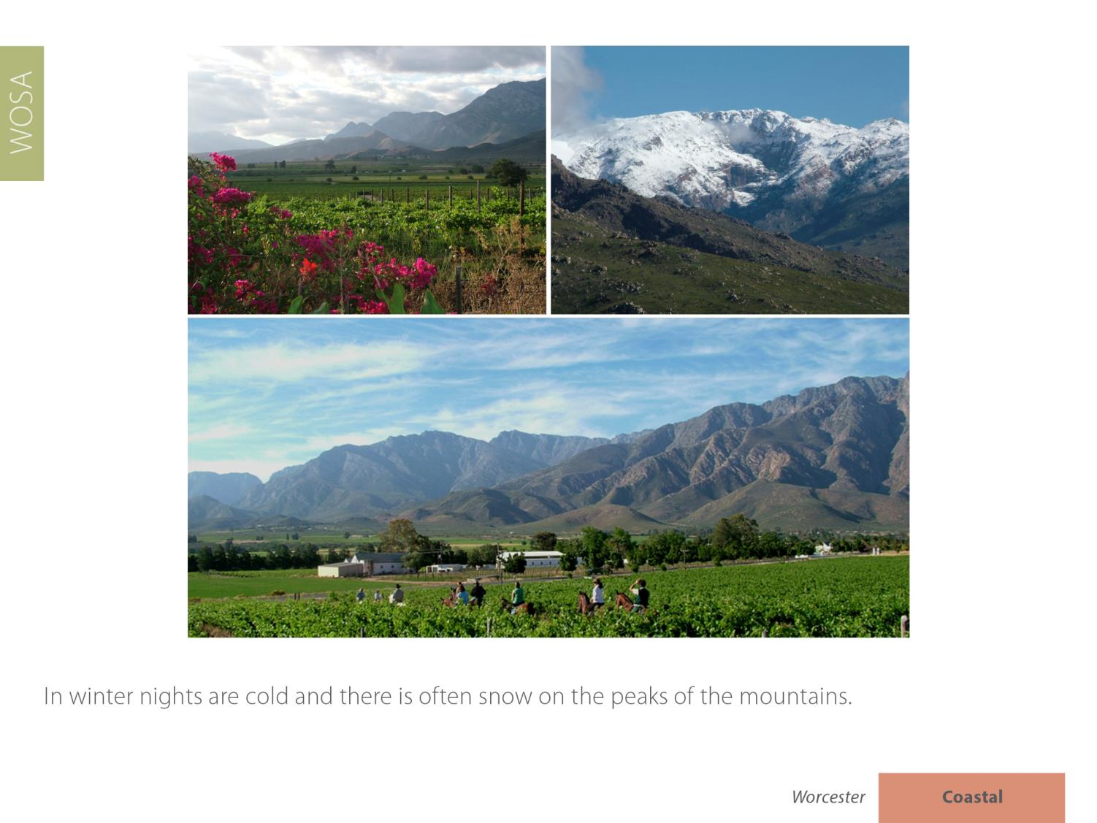

Slide 15
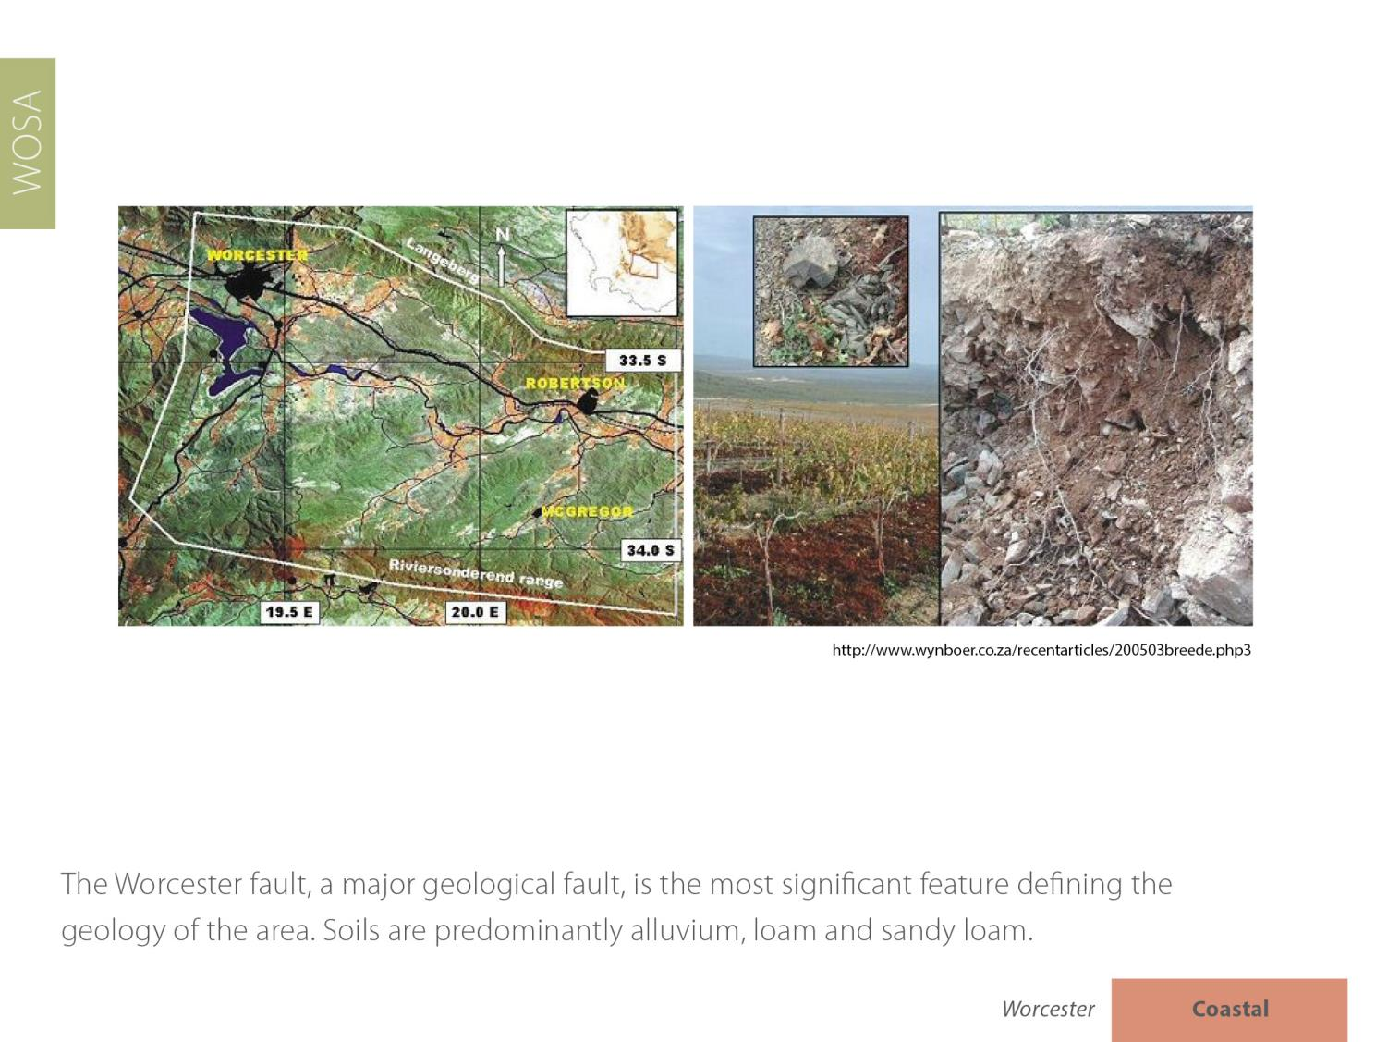


Slide 16
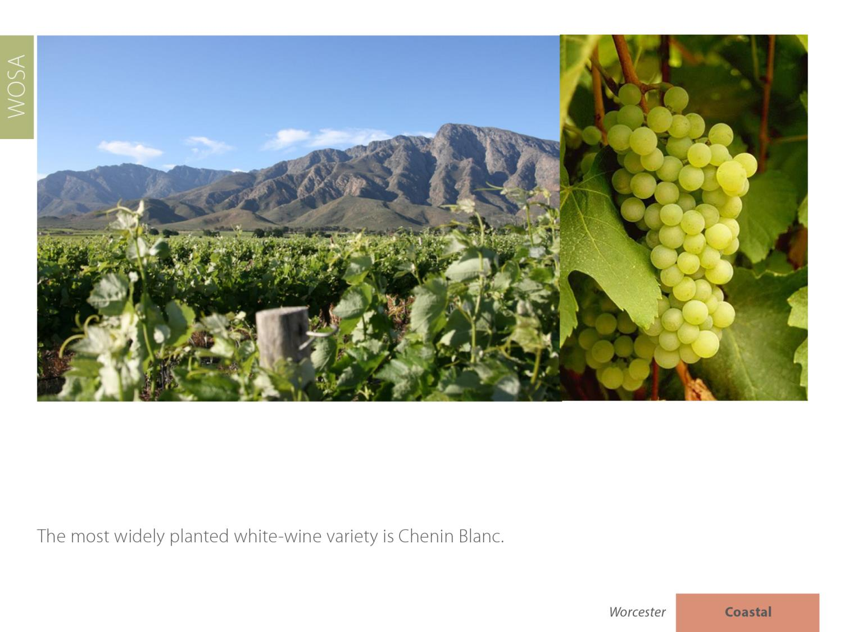

Slide 17
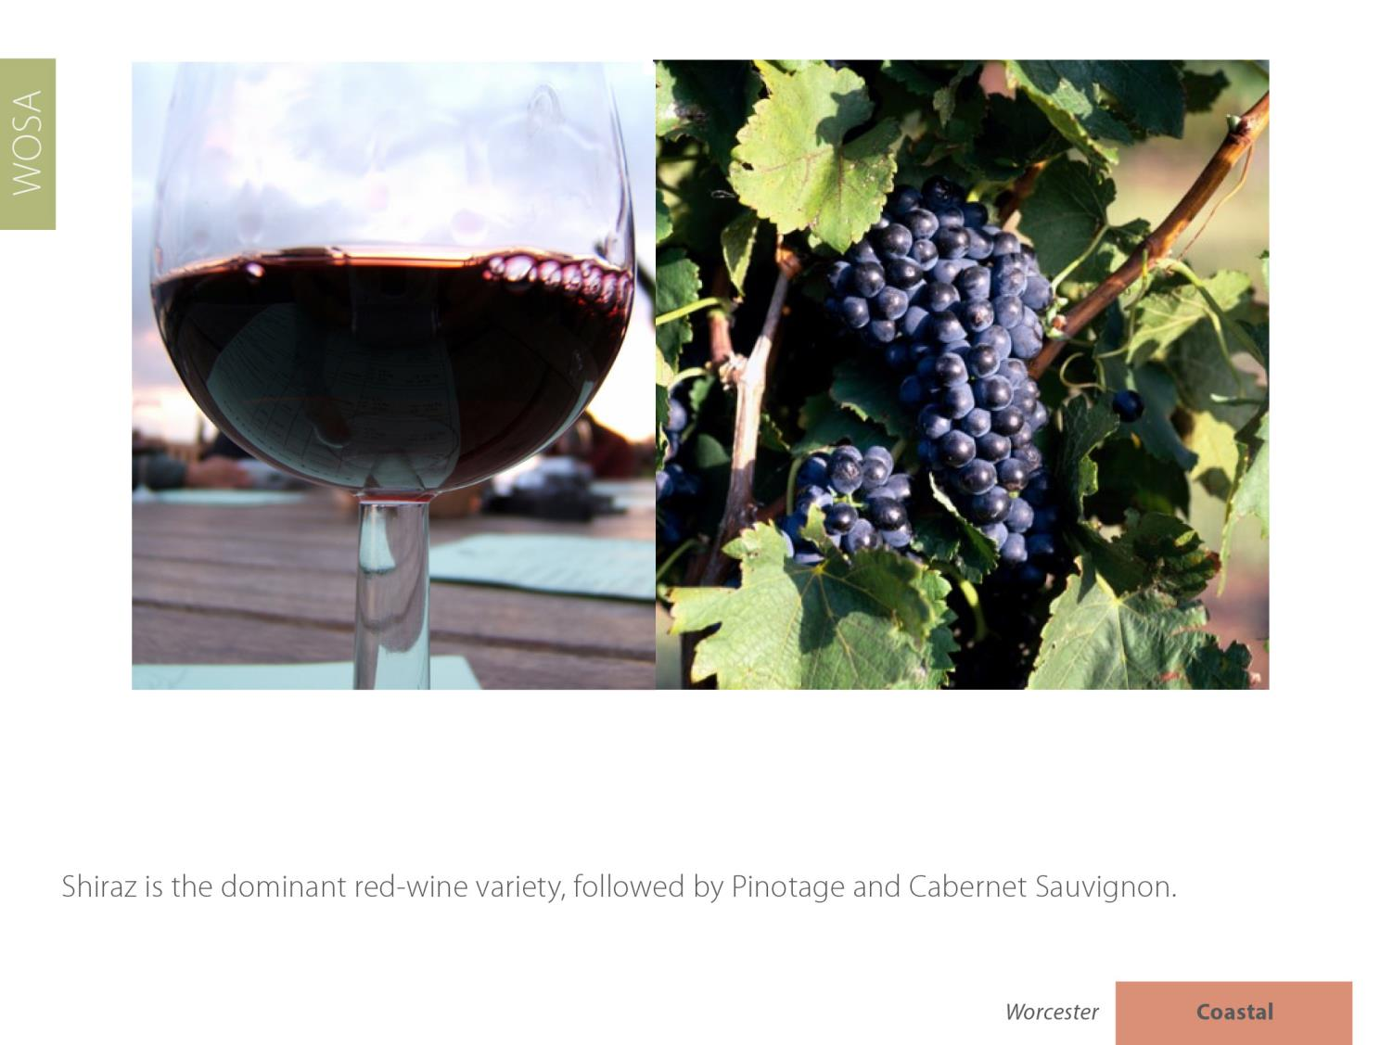

Pinotage is the dominant red-wine variety, followed by Shiraz and
Cabernet Sauvignon.

Slide 18
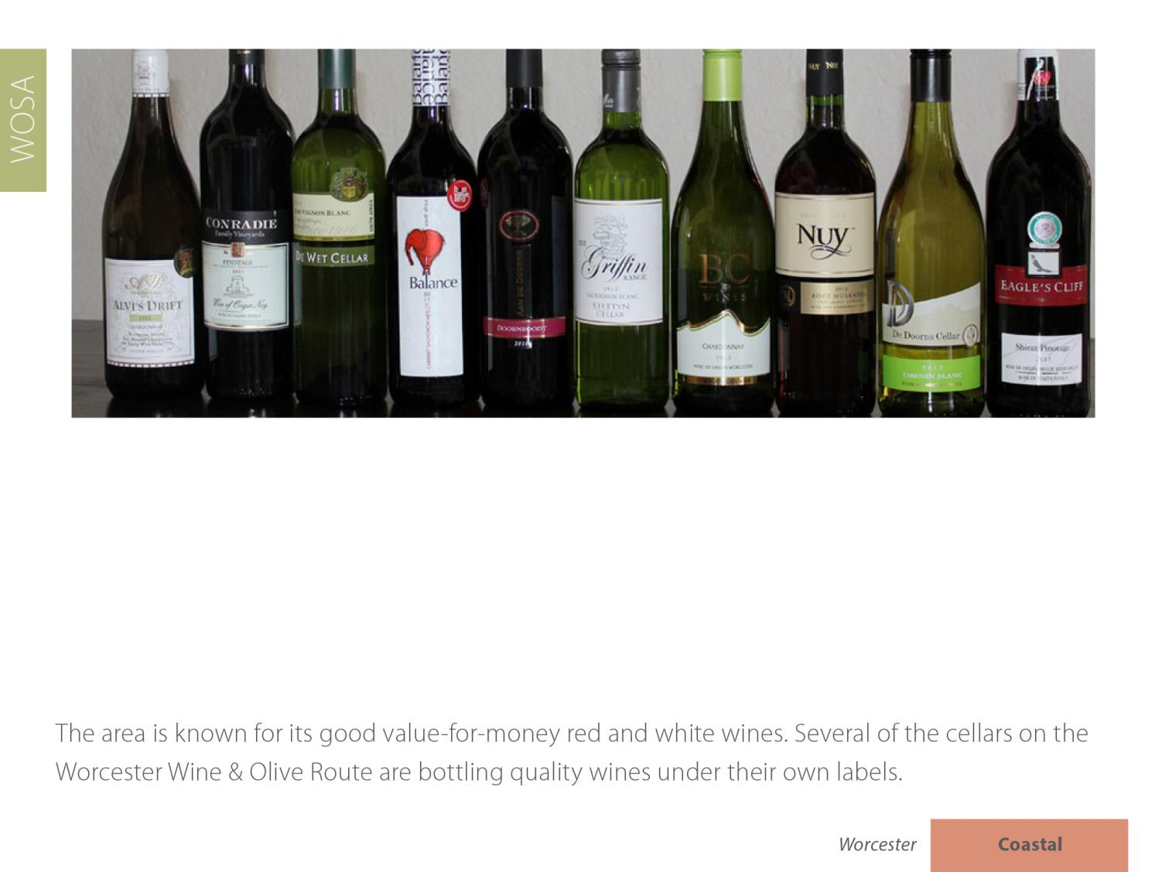

Slide 19
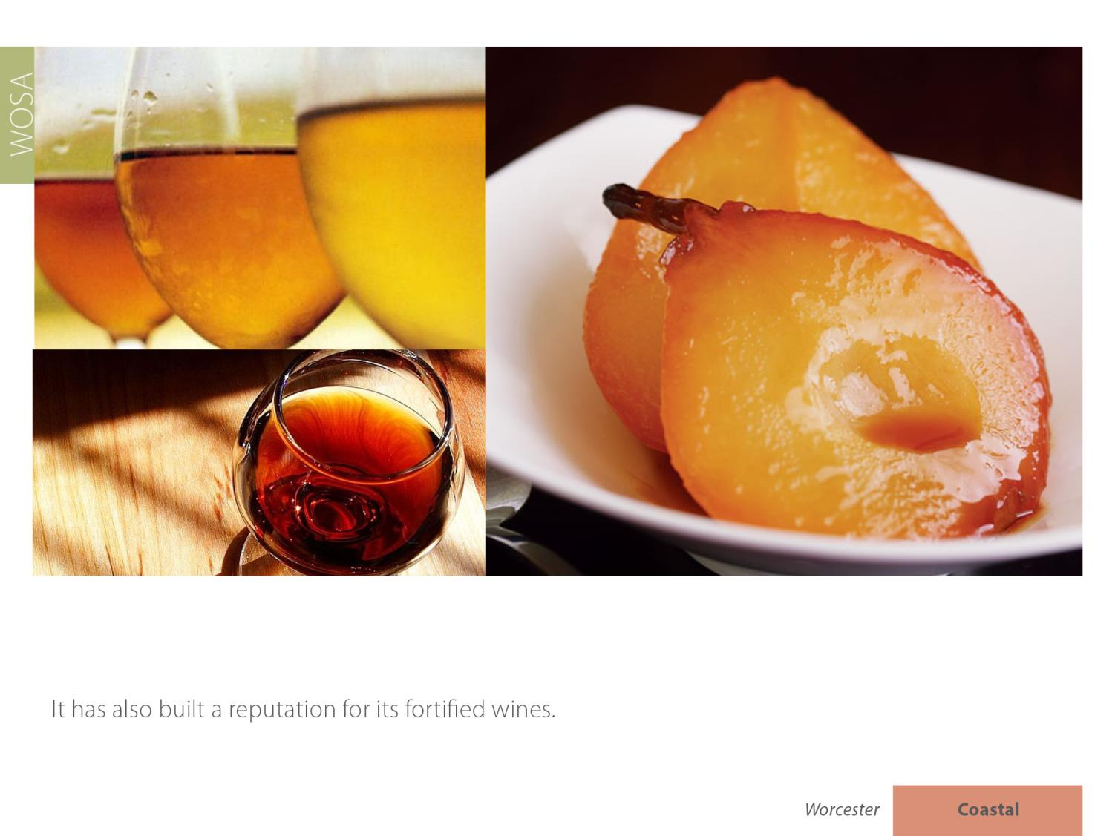

Slide 20
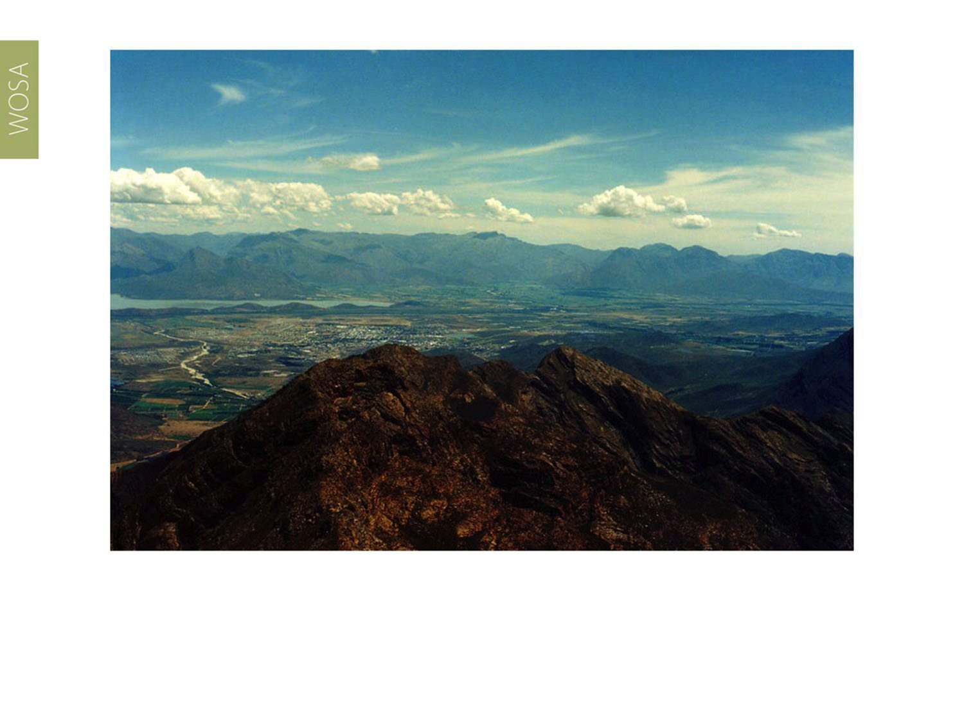
The images used in these presentations have been sourced from various producers, as well as industry and tourism bodies. These presentations are strictly for non-commercial, non-profit, educational purposes only and cannot be reproduced or transmitted in any form or by any means without written permission from Wines of South Africa (WoSA).

Slide 21
The Cape winelands, considered by many to be
the most beautiful in the world, have a network of
diverse and well-run wine routes, affording visitors
a varied and unforgettable experience.

Slide 22
THE END

