Slide 1

CAPE WINELANDS
BREEDEKLOOF

Slide 2
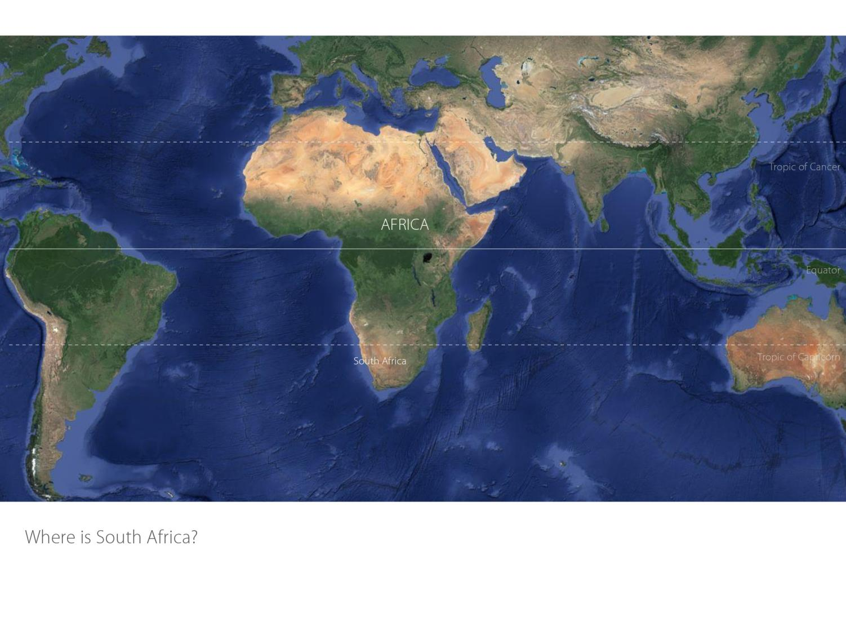

Slide 3
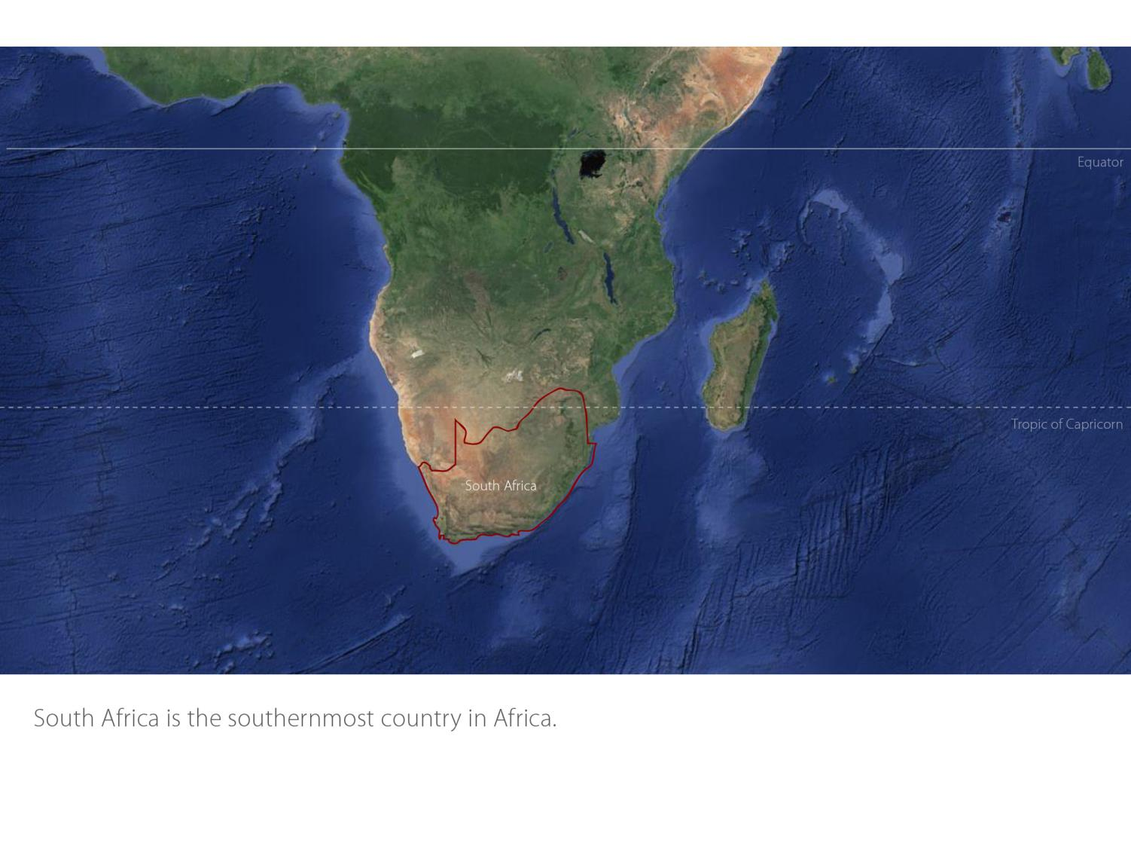

Slide 4
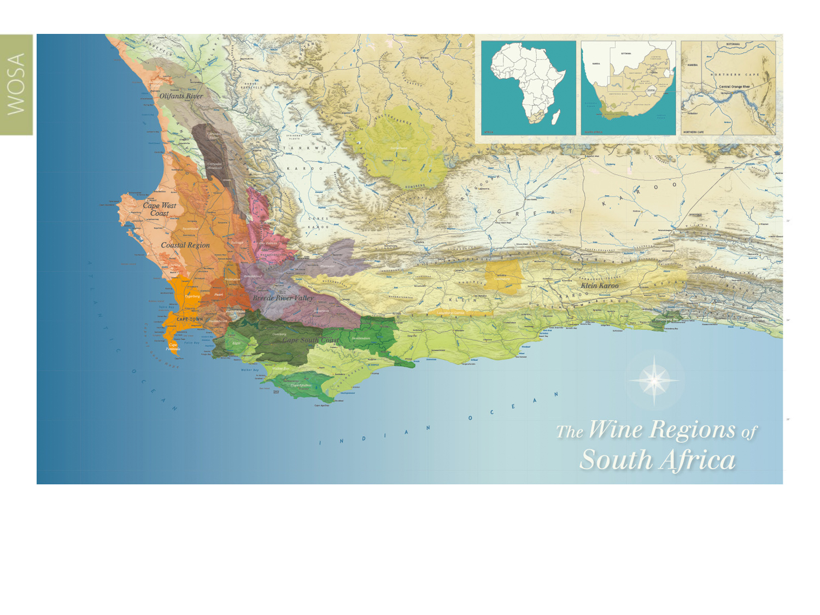
Our winelands are located at the very tip of South Africa.
Breedekloof
Breede River Valley

Slide 5
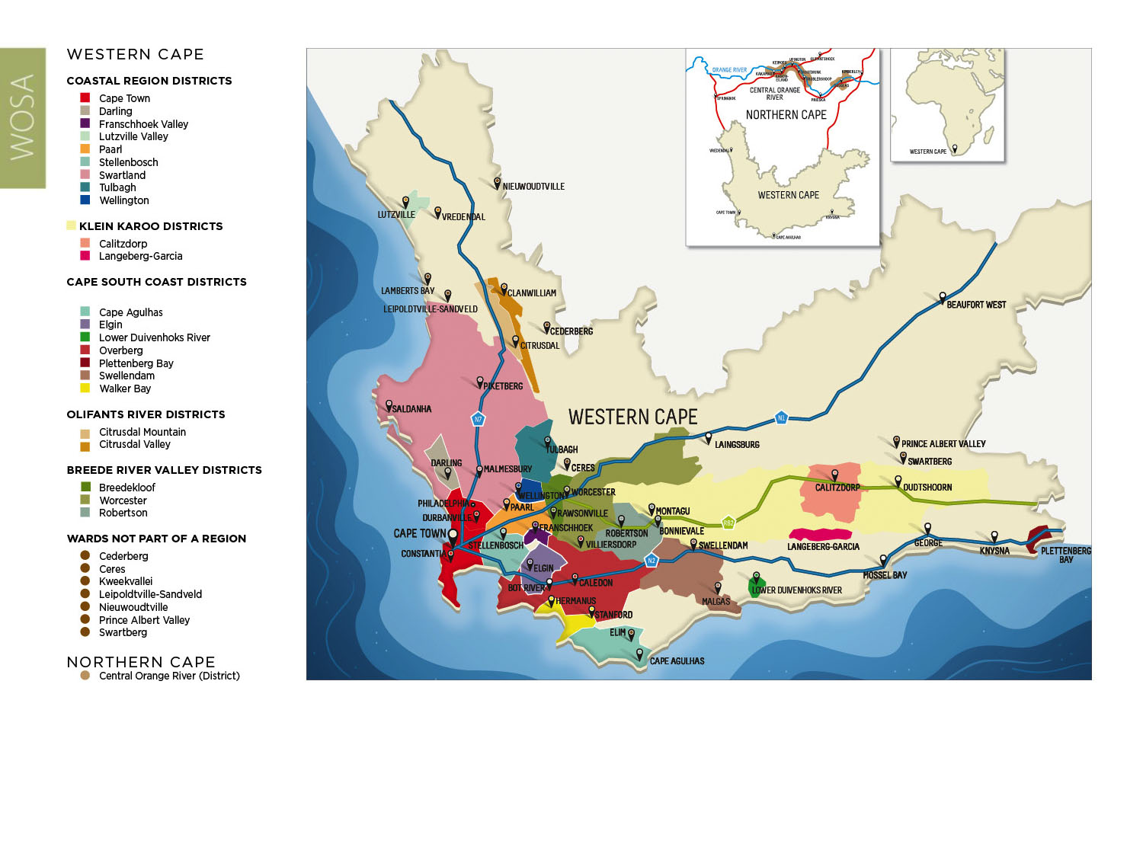
PRODUCTION AREAS: Districts of South Africa.
Breedekloof
Breede River Valley

Slide 6
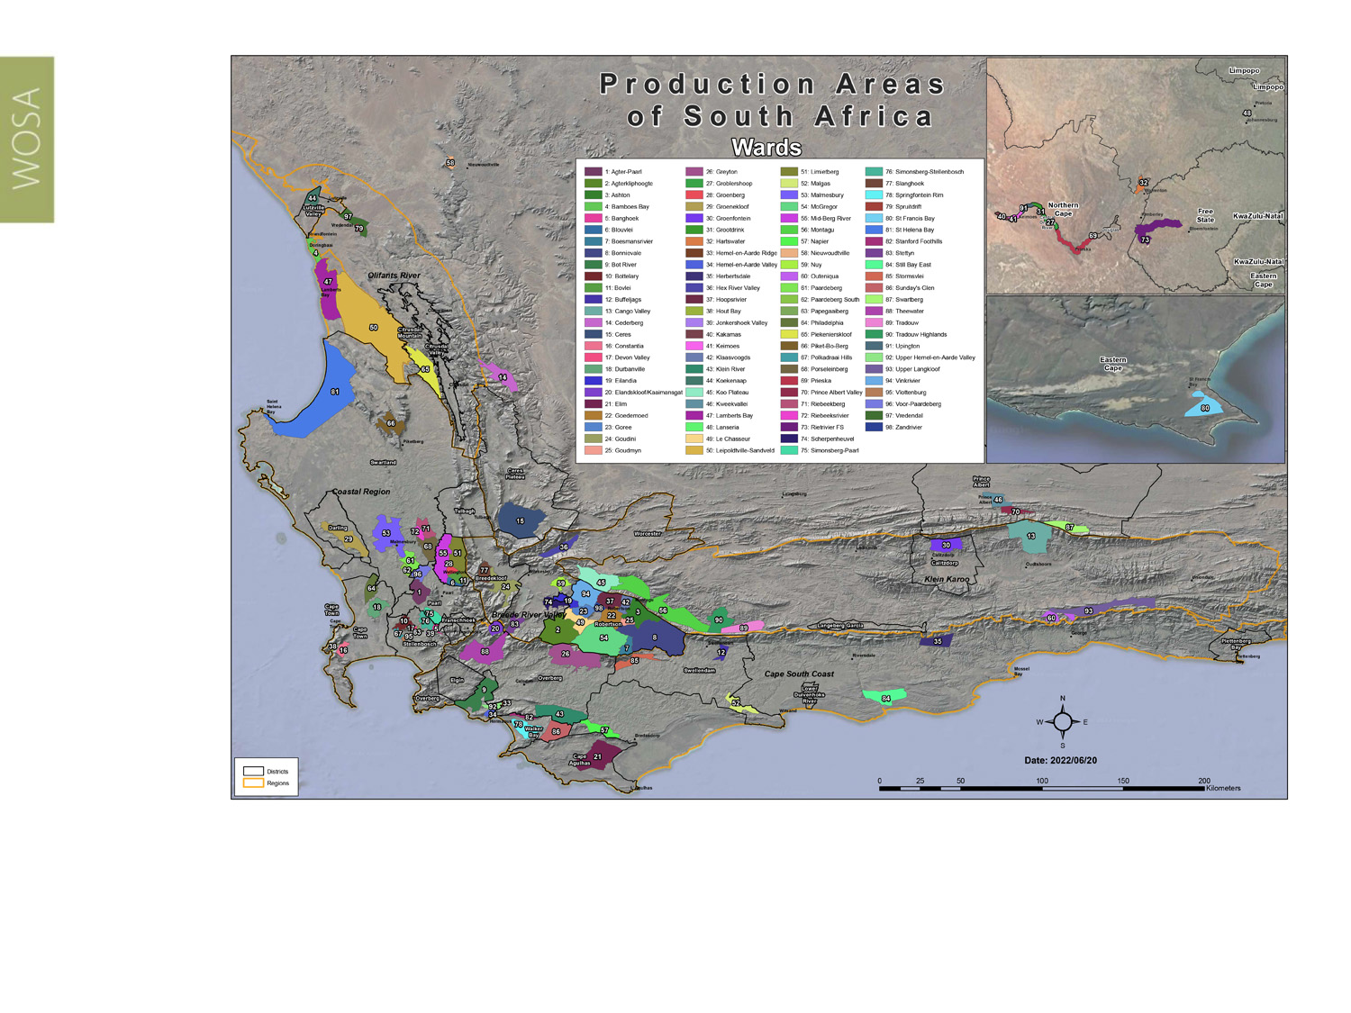
Wards of South Africa.
Breedekloof
Breede River Valley

Slide 7
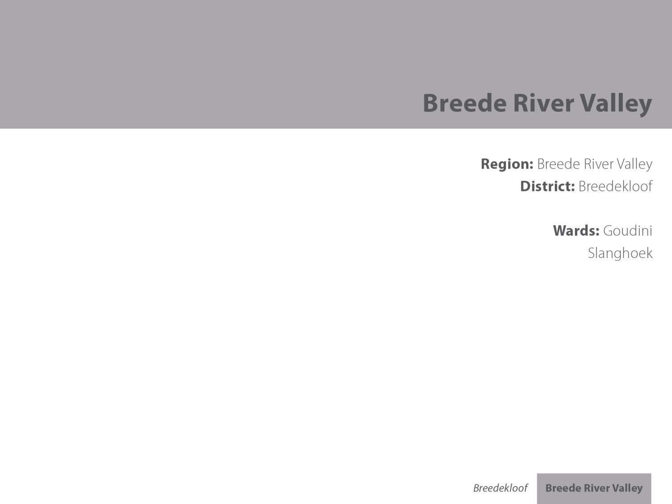
Breedekloof
Breede River Valley

Slide 8
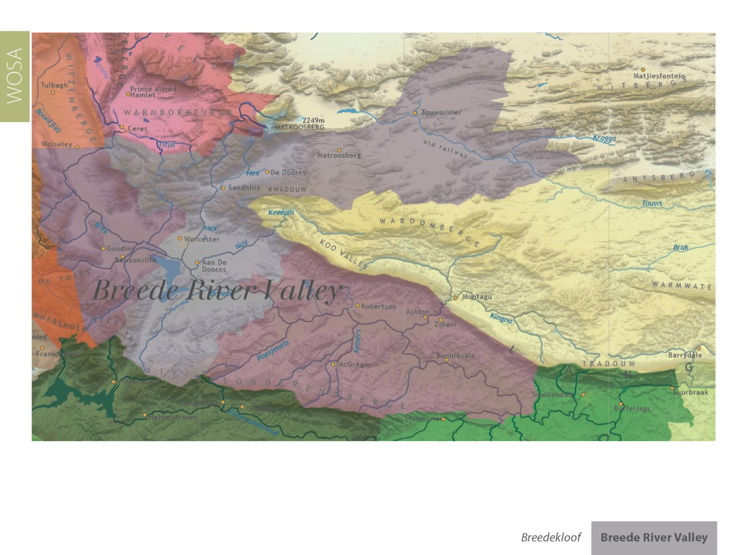
Breedekloof
Breede River Valley

Slide 9
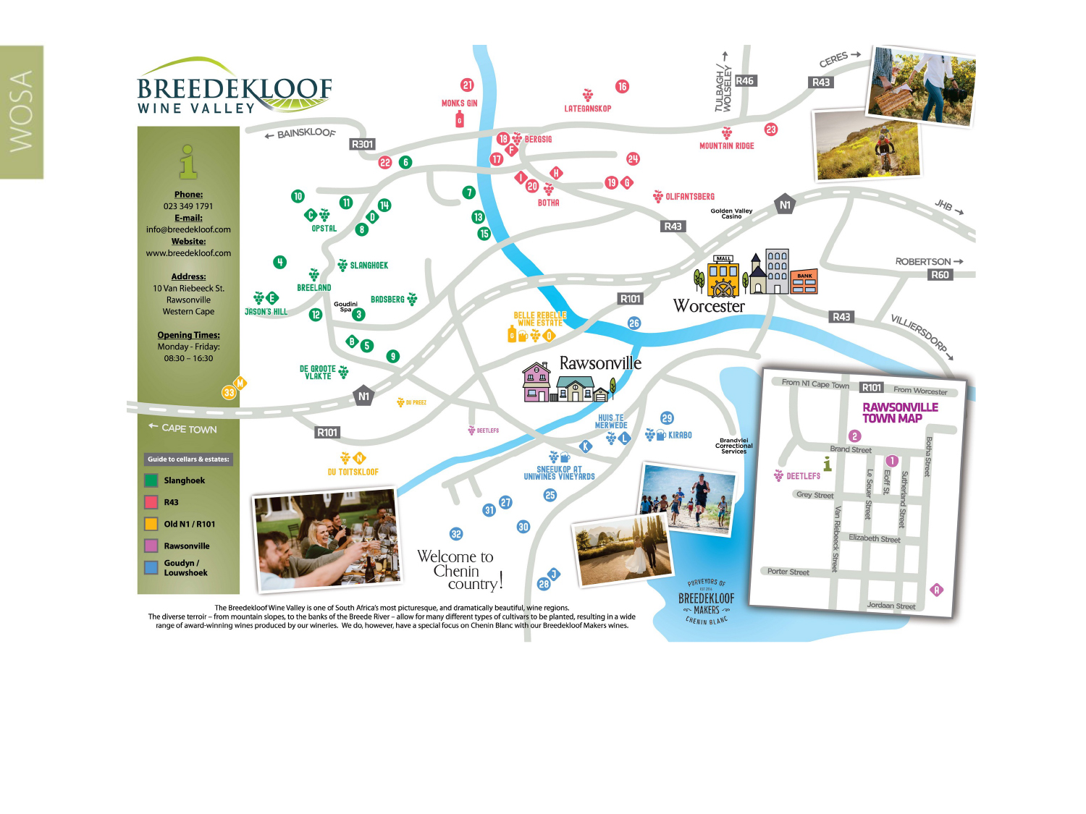
At the Breedekloof district’s hub is the village of Rawsonville, which is surrounded by vineyards with some 21 wineries in a 30 km radius. Many of the farms are fourth to eighth generation family owned, and the area is known for its warm, hospitable people.
Breedekloof
Breede River Valley

Slide 10
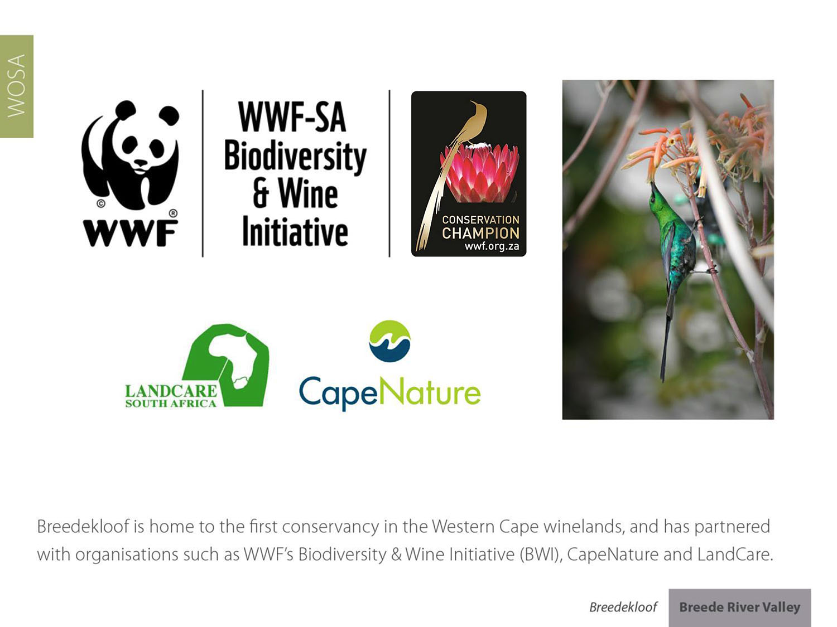
Breedekloof
Breede River Valley

Slide 11
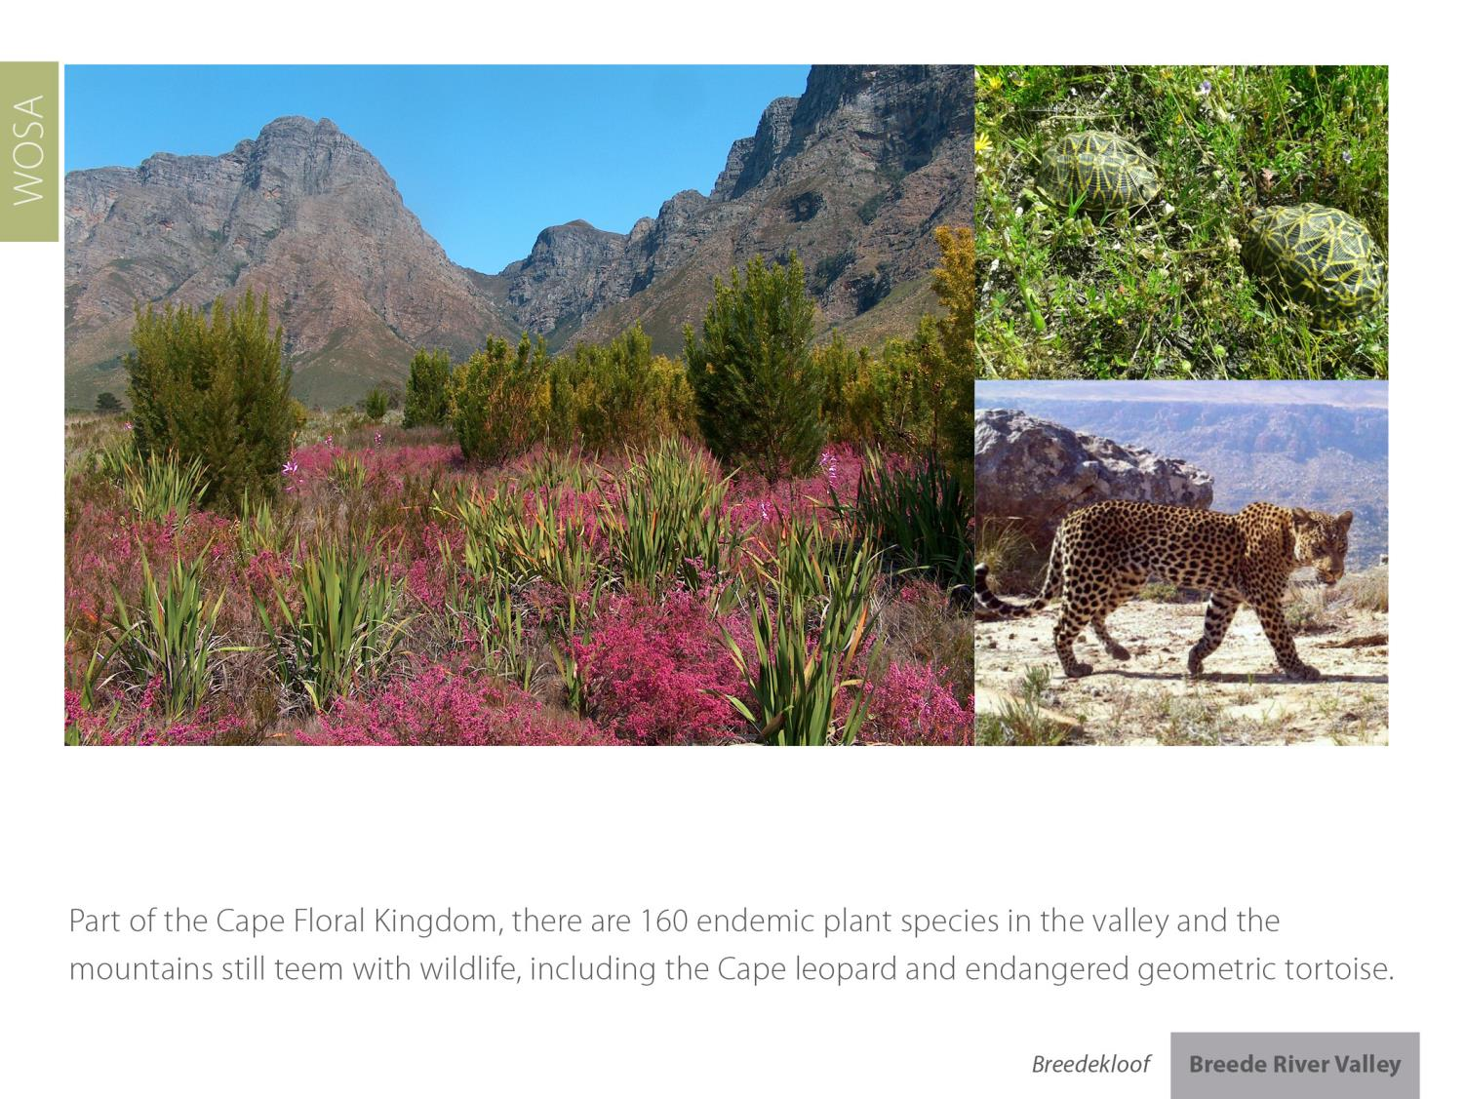
Breedekloof
Breede River Valley

Slide 12
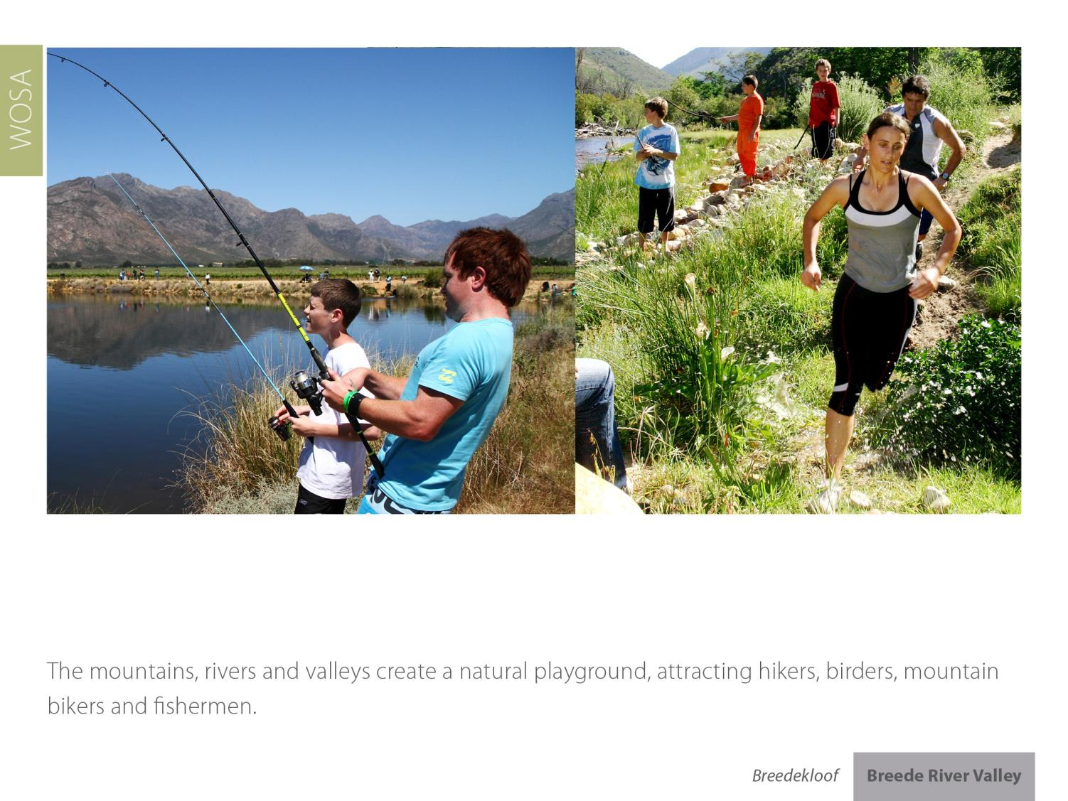
Breedekloof
Breede River Valley

Slide 13
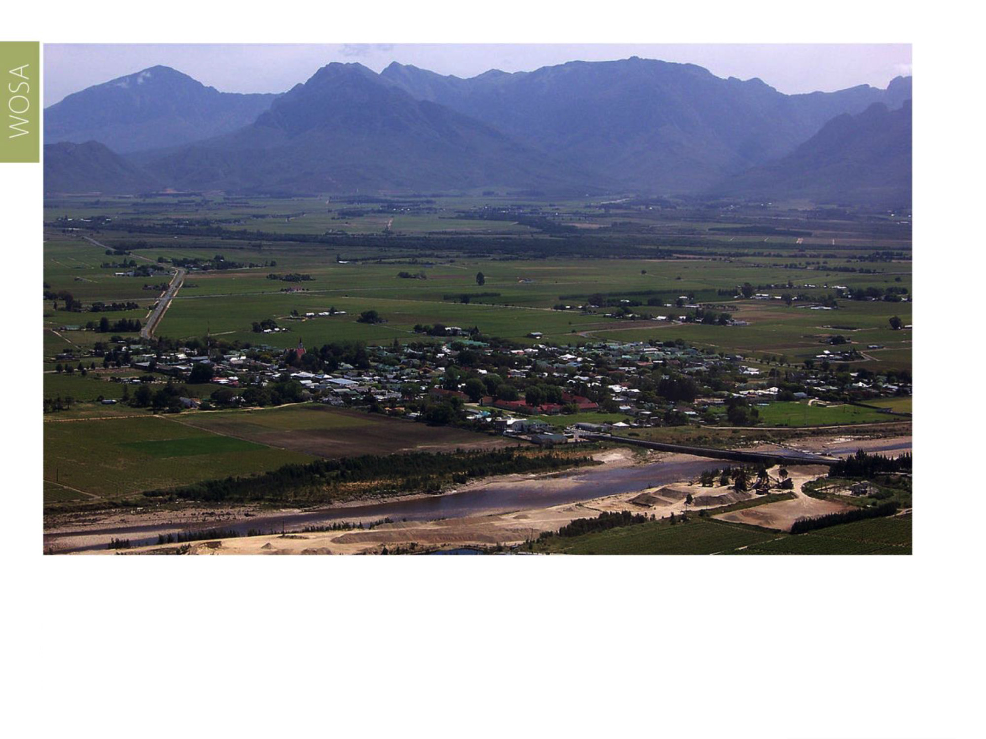
The wards of Goudini and Slanghoek lie within the rain belt caused by the first range of north-south lying mountains next to the south-western coast, where the rain is still sufficient enough for vineyards to flourish without irrigation. The average annual rainfall is 784 mm.
Breedekloof
Breede River Valley

Slide 14
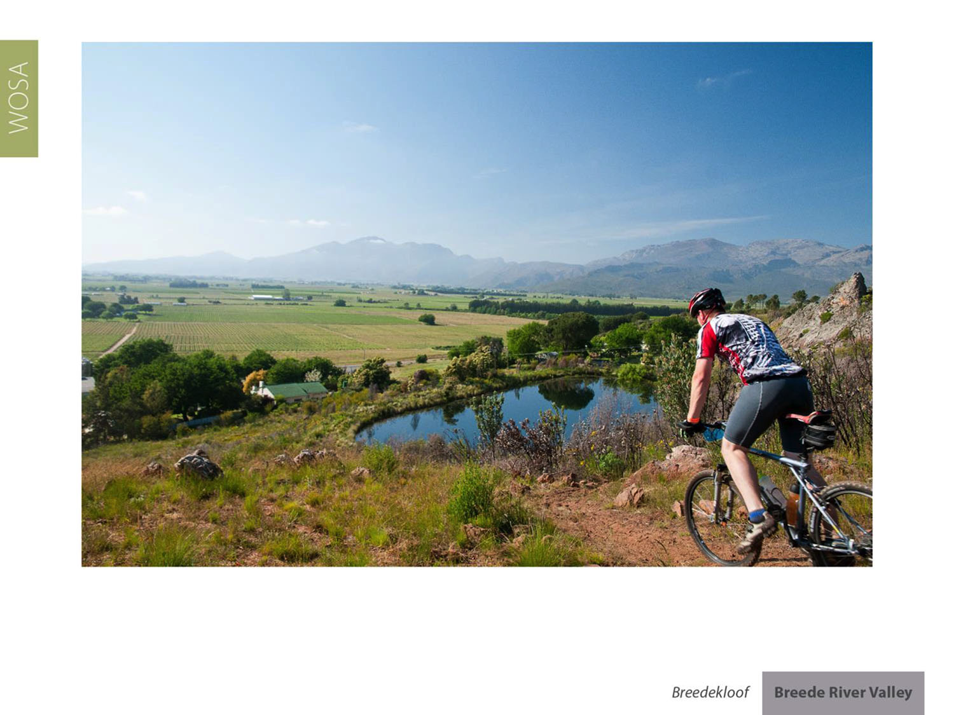
Summers are warm and the mean February temperature is 21.6⁰C.
Breedekloof
Breede River Valley

Slide 15
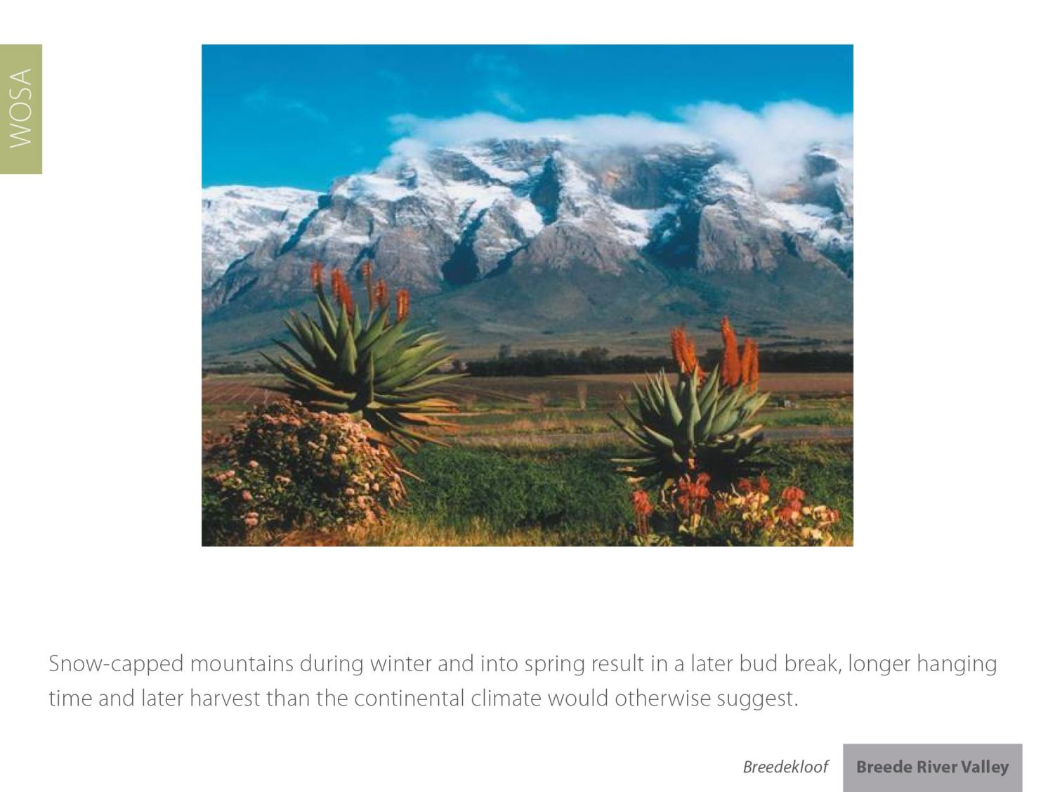
Breedekloof
Breede River Valley

Slide 16
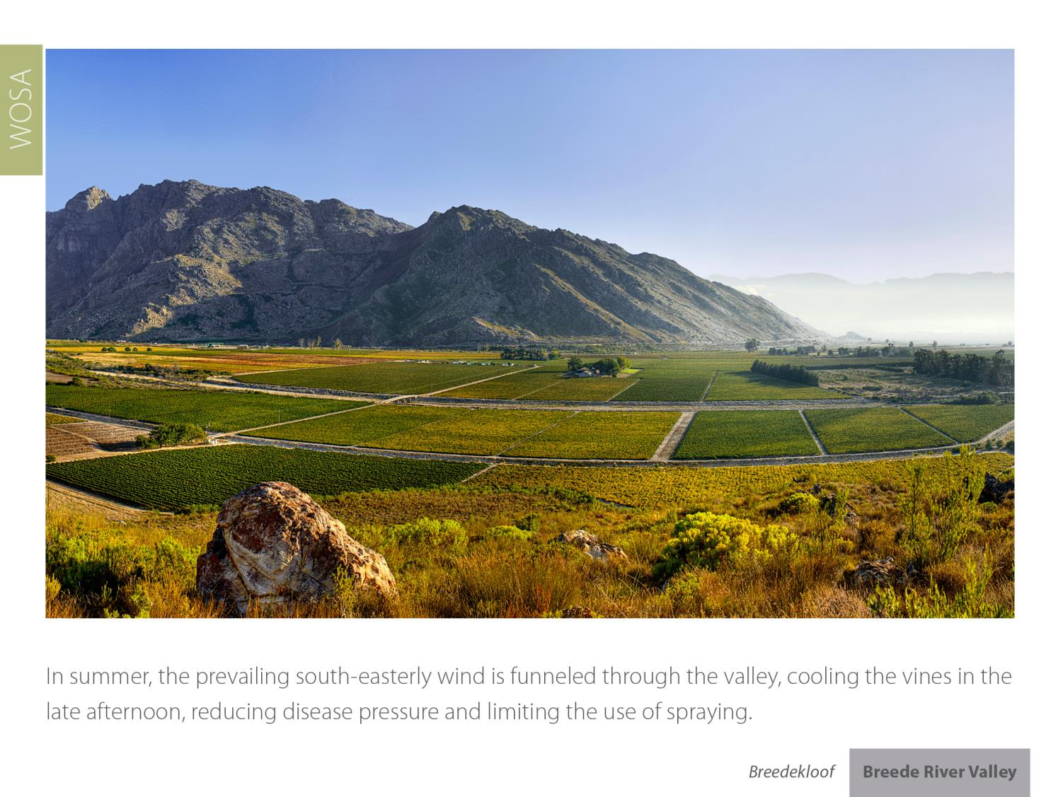
Breedekloof
Breede River Valley

Slide 17
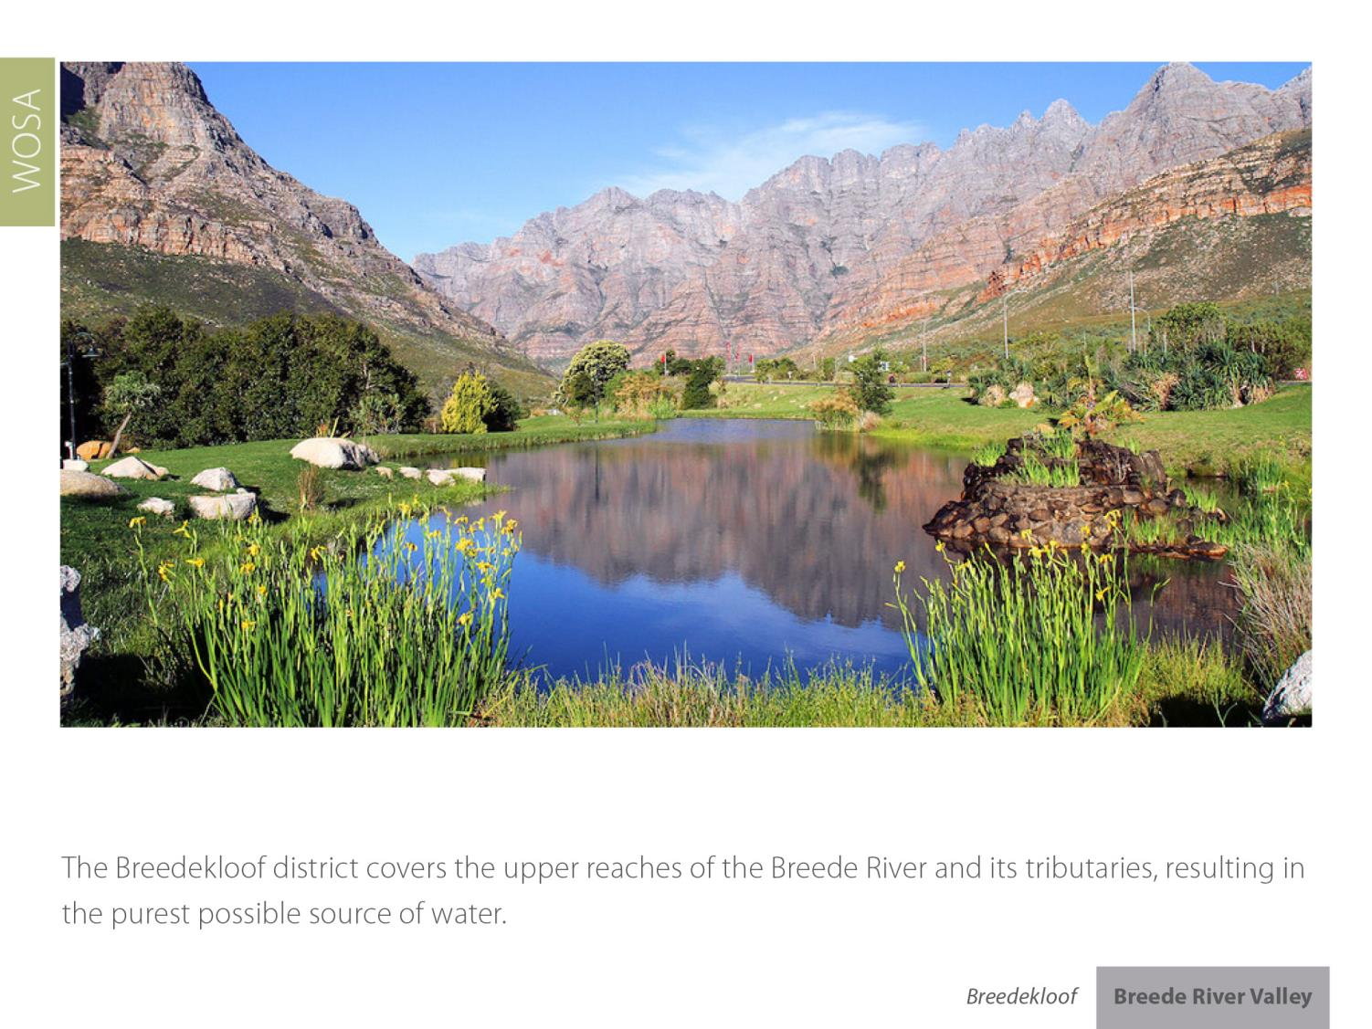
Breedekloof
Breede River Valley

Slide 18
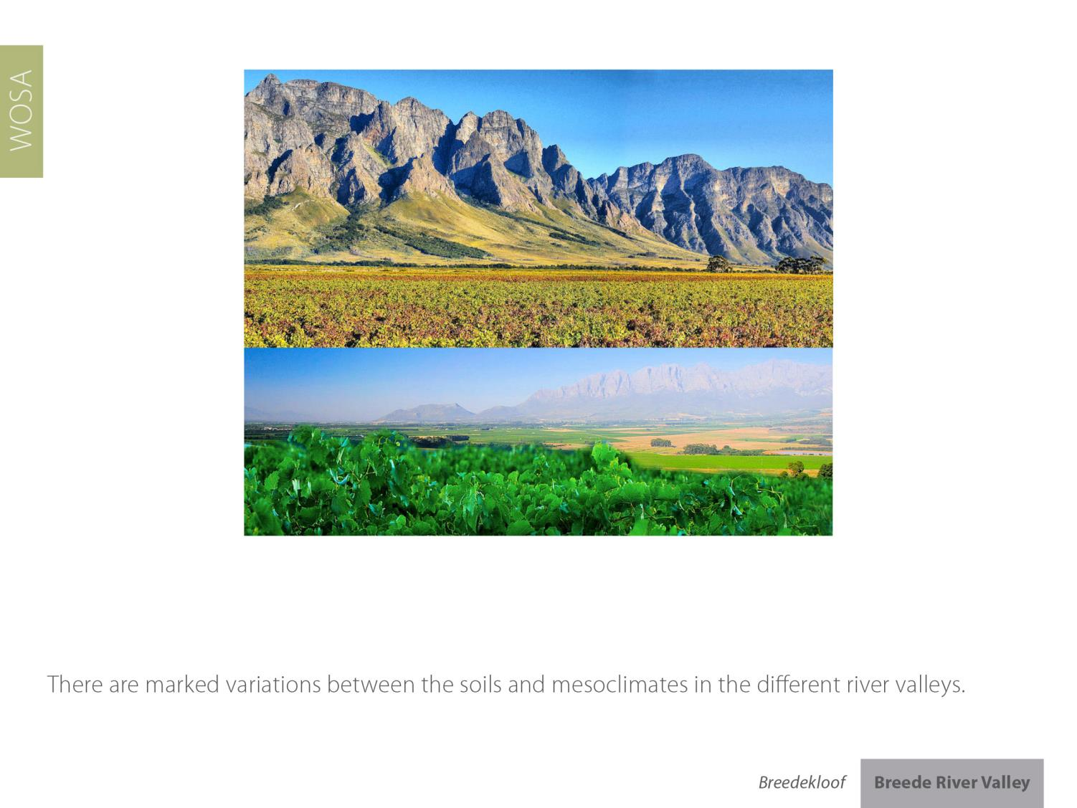
Breedekloof
Breede River Valley

Slide 19
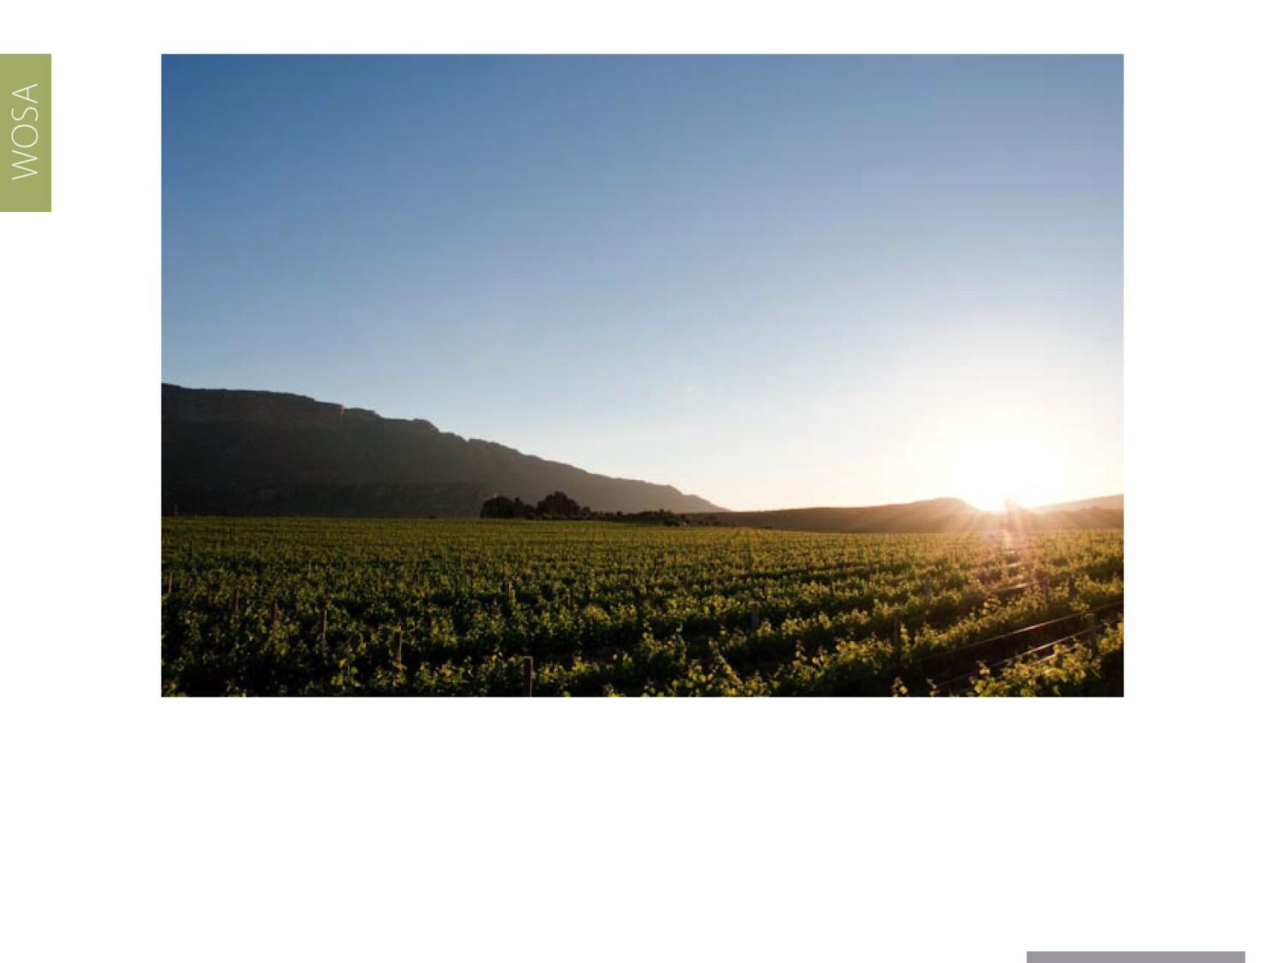
The Breedekloof is characterised mainly by vineyards which flourish on a flat landscape of alluvial valley soils with adequate drainage as they rest on a bed of river stones.
Breedekloof
Breede River Valley

Slide 20
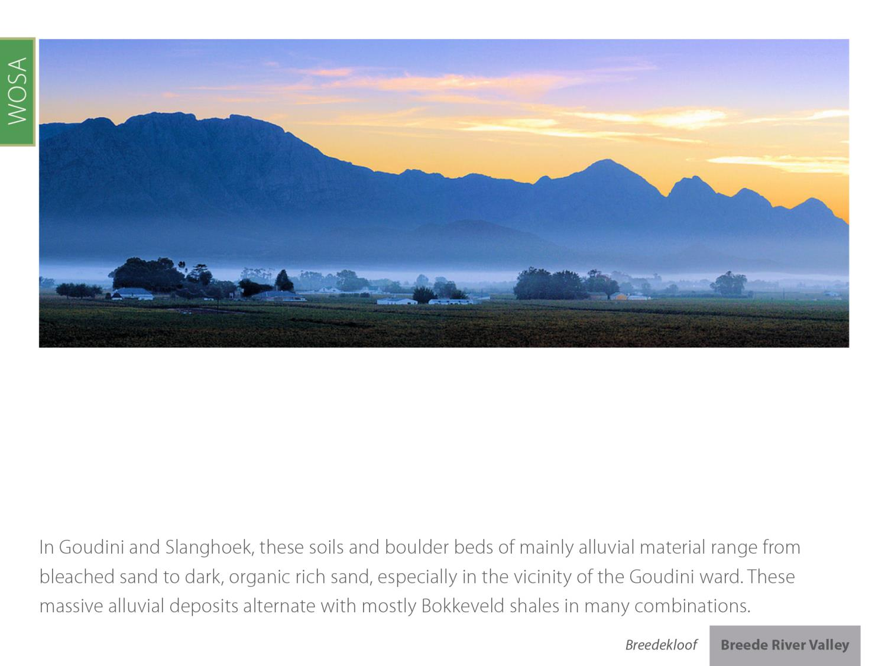
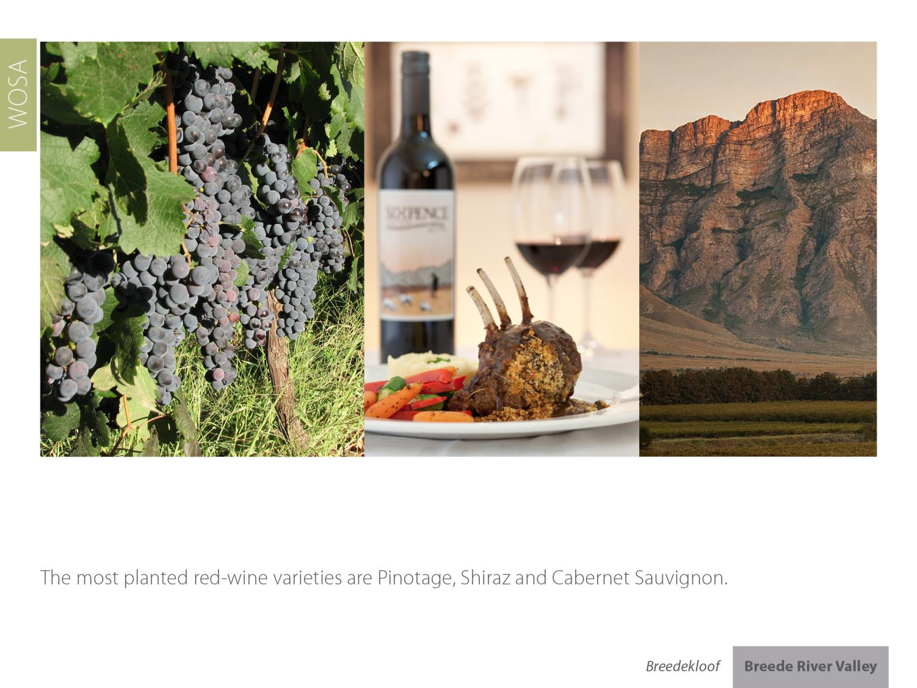
Breedekloof
Breede River Valley

Slide 21
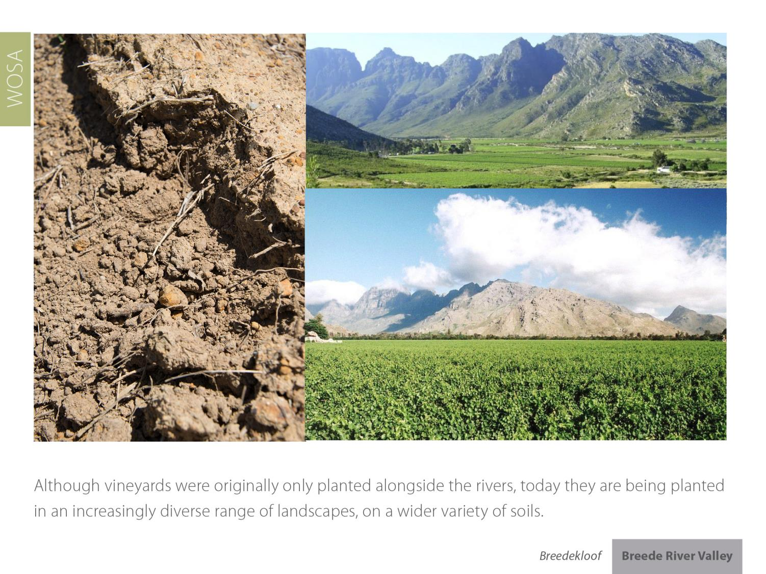
Breedekloof
Breede River Valley

Slide 22
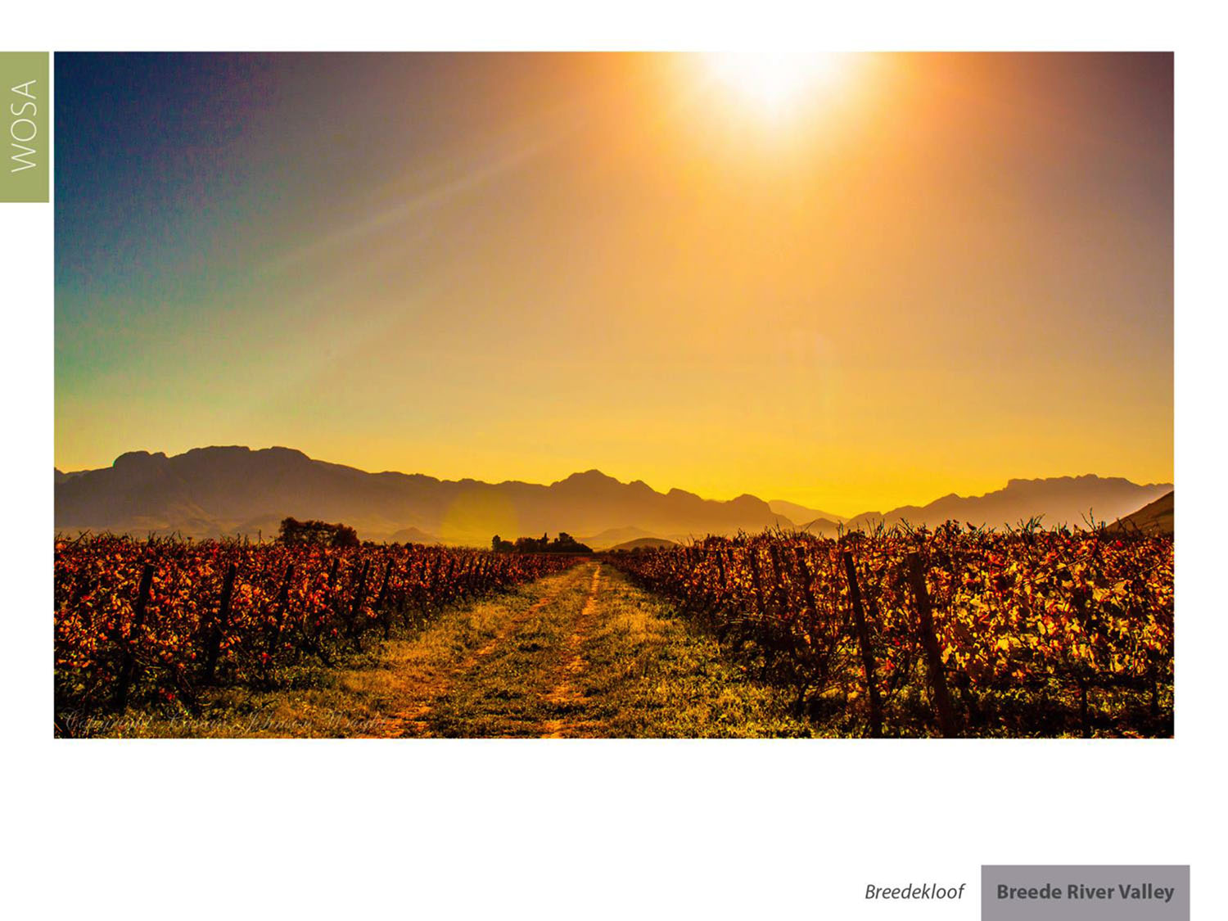
Breedekloof represents 14.4% of all hectares planted in South Africa – 17.02% of all white-wine grape hectares and 11.2% of all red-wine grape hectares.
Breedekloof
Breede River Valley

Slide 23
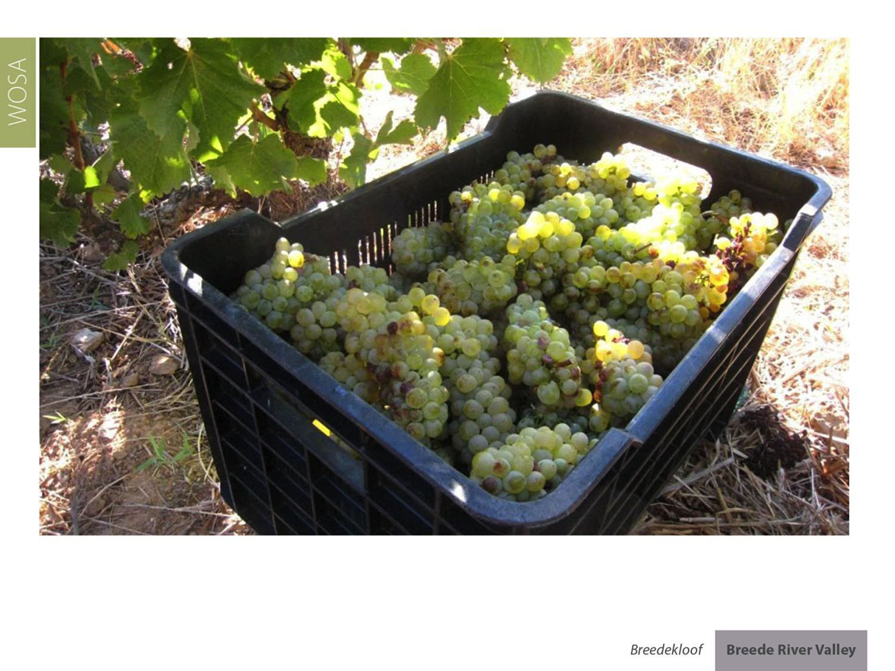
Chenin Blanc represents 18.4% of South Africa’s vineyards. Breedekloof has 16.9% of all Chenin plantings and supplies 23.1% of all wine made from Chenin.
Breedekloof
Breede River Valley

Slide 24

Breedekloof
Breede River Valley

Slide 25
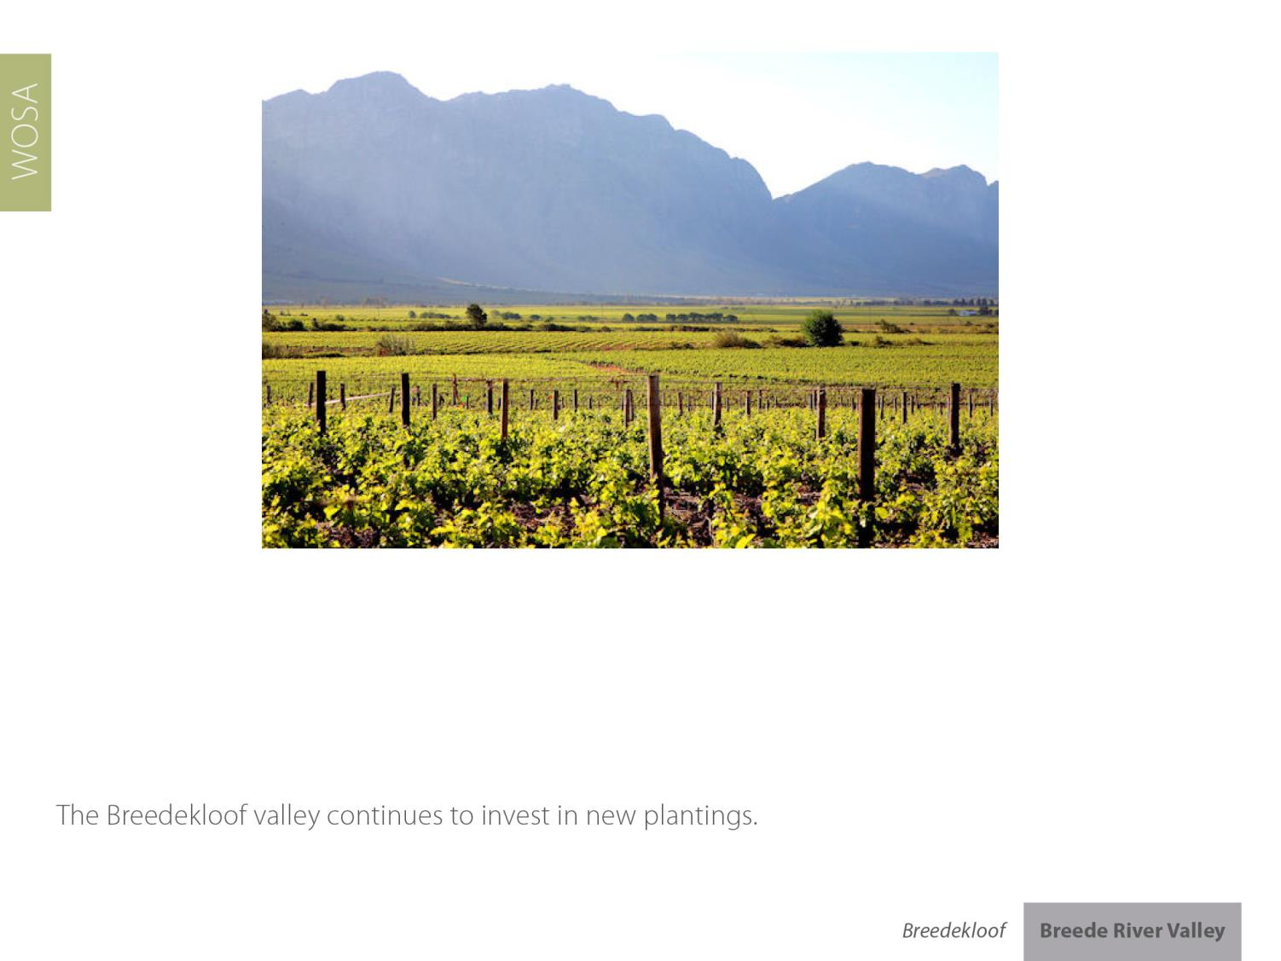
Breedekloof
Breede River Valley

Slide 26
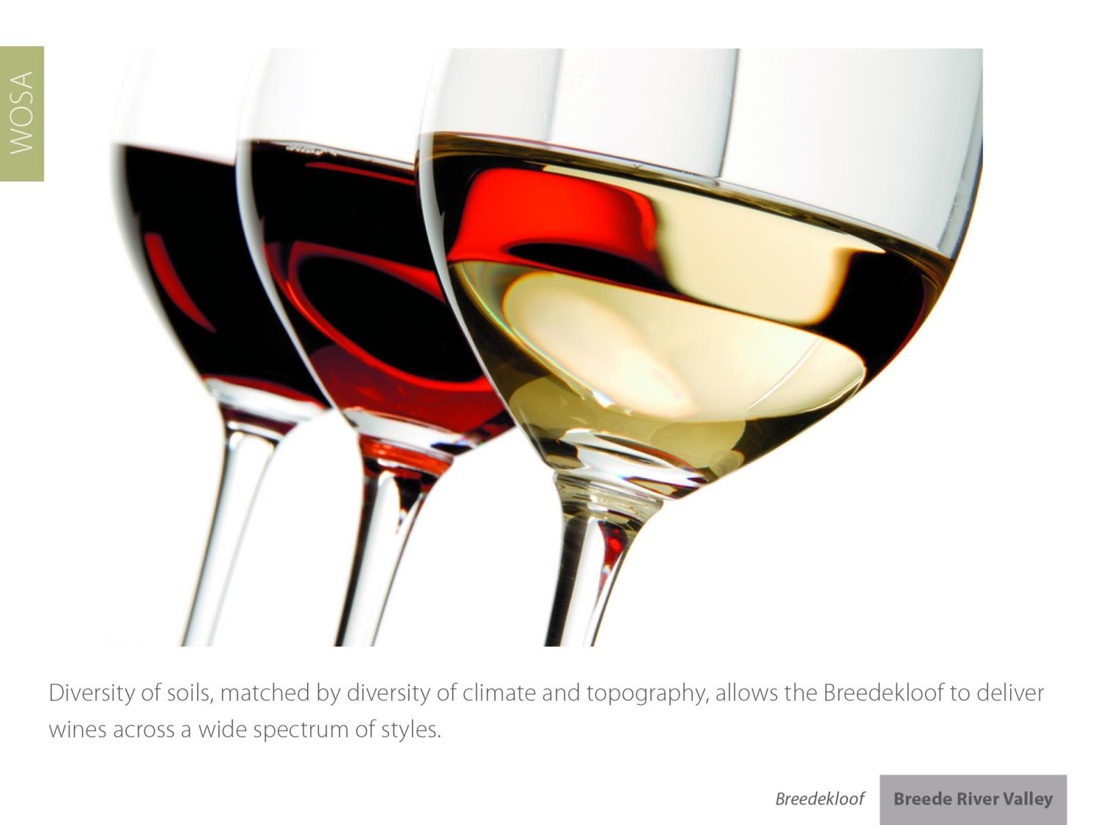
Breedekloof
Breede River Valley

Slide 27
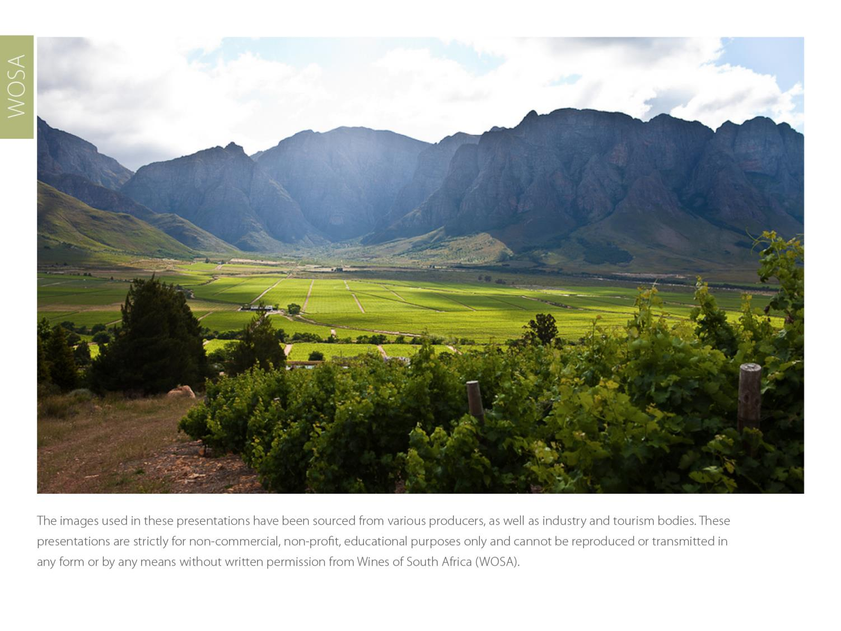
The images used in these presentations have been sourced from various producers, as well as industry and tourism bodies. These presentations are strictly for non-commercial, non-profit, educational purposes only and cannot be reproduced or transmitted in any form or by any means without written permission from Wines of South Africa (WoSA).

Slide 28
The Cape winelands, considered by many to be
the most beautiful in the world, have a network of
diverse and well-run wine routes, affording visitors
a varied and unforgettable experience.

Slide 29
THE END

