Slide 1
CAPE WINELANDS
DARLING

Slide 2
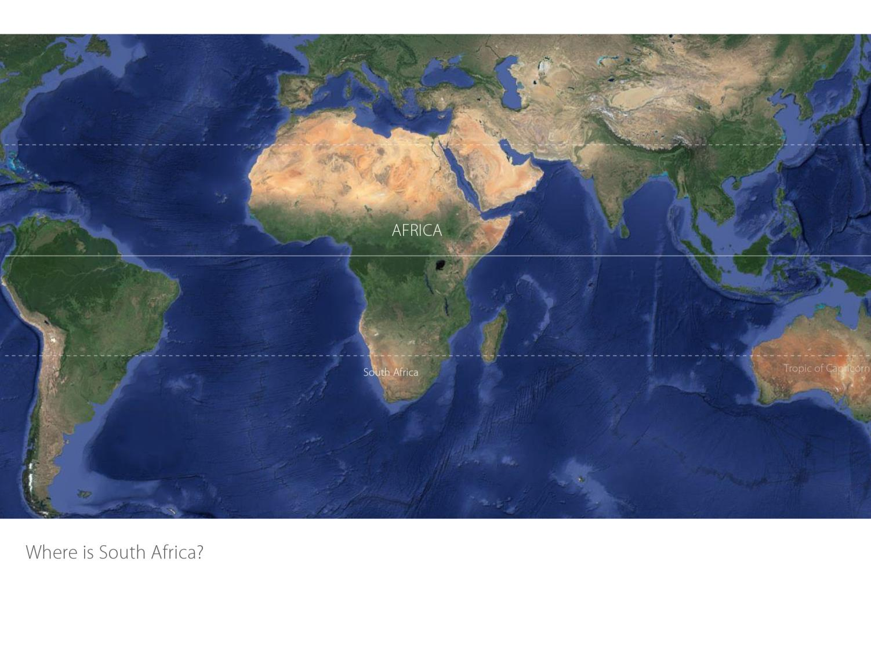

Slide 3
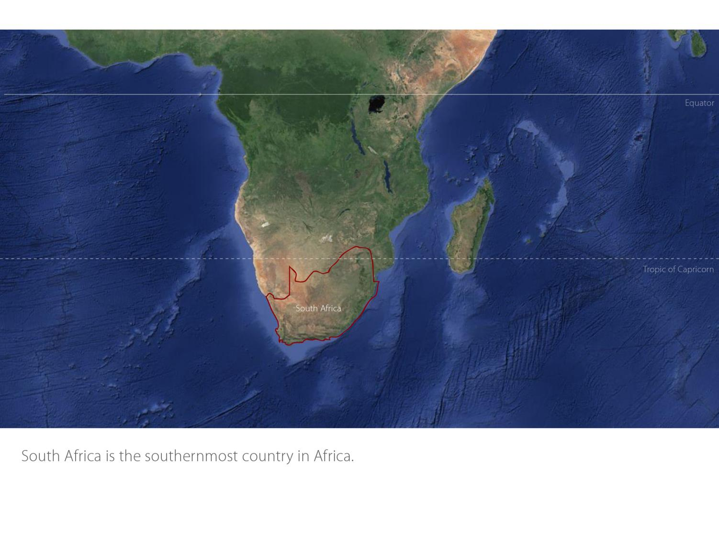

Slide 4
Our winelands are located at the very tip of South Africa.
Darling
Coastal

Slide 5
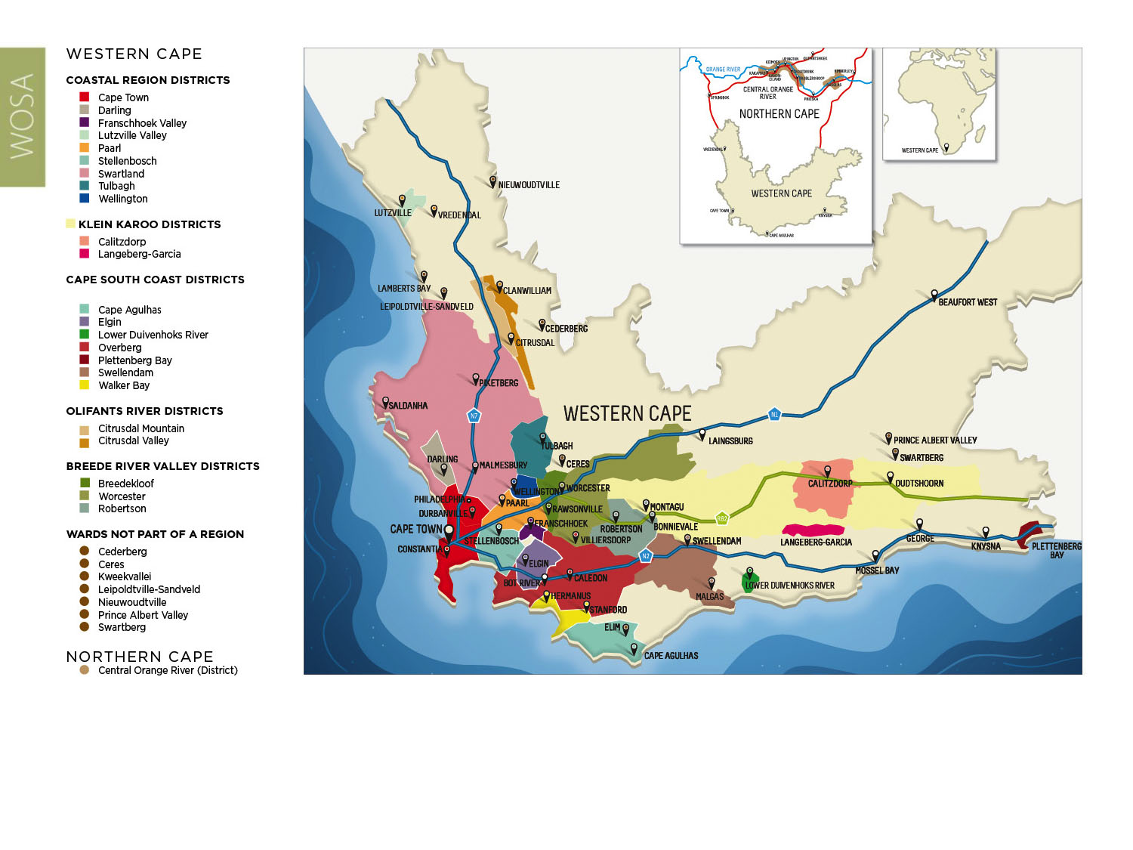
PRODUCTION AREAS: Districts of South Africa.
Darling
Coastal

Slide 6
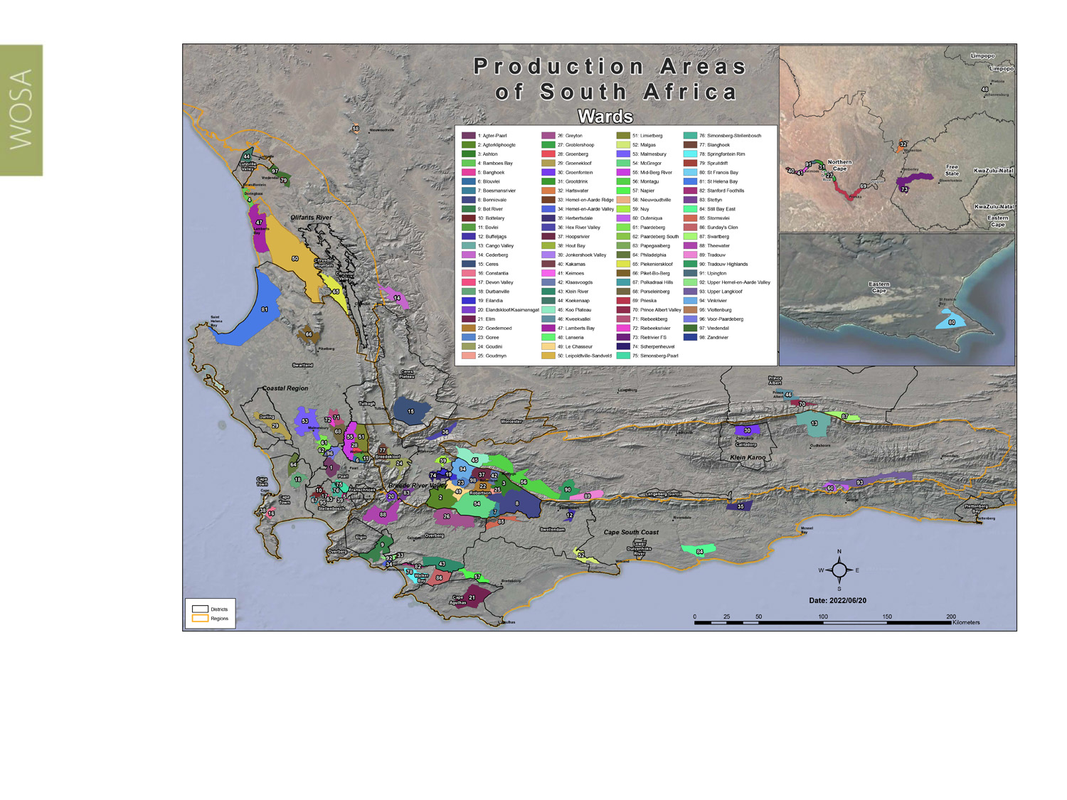
Wards of South Africa.
Darling
Coastal

Slide 7
Darling
Coastal

Slide 8
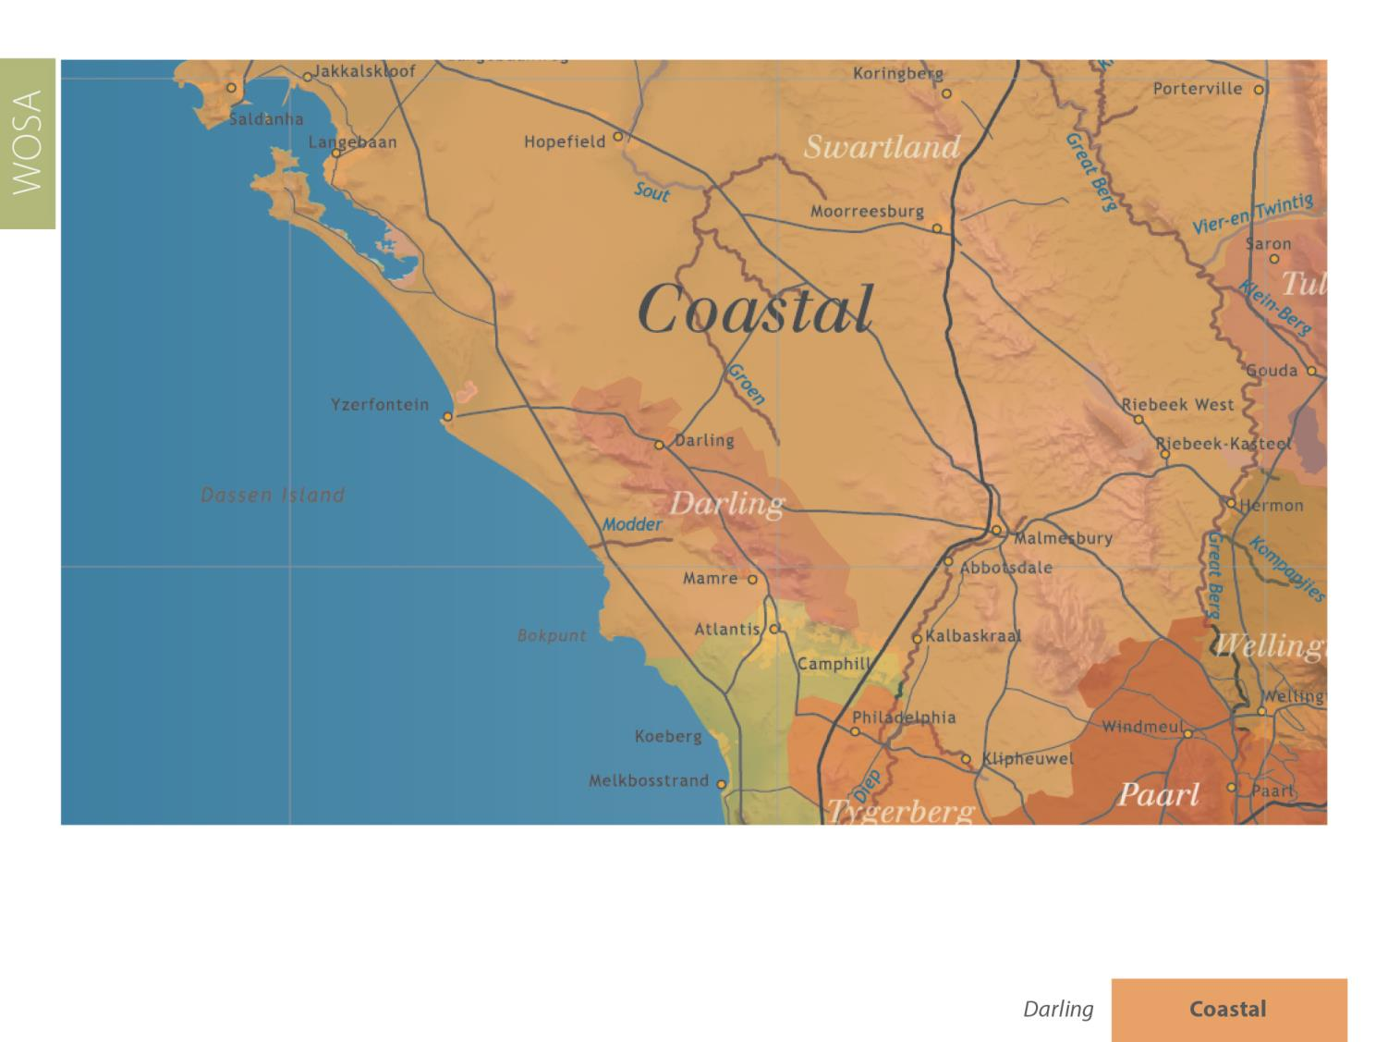
Darling
Coastal

Slide 9
Darling
Coastal

Slide 10
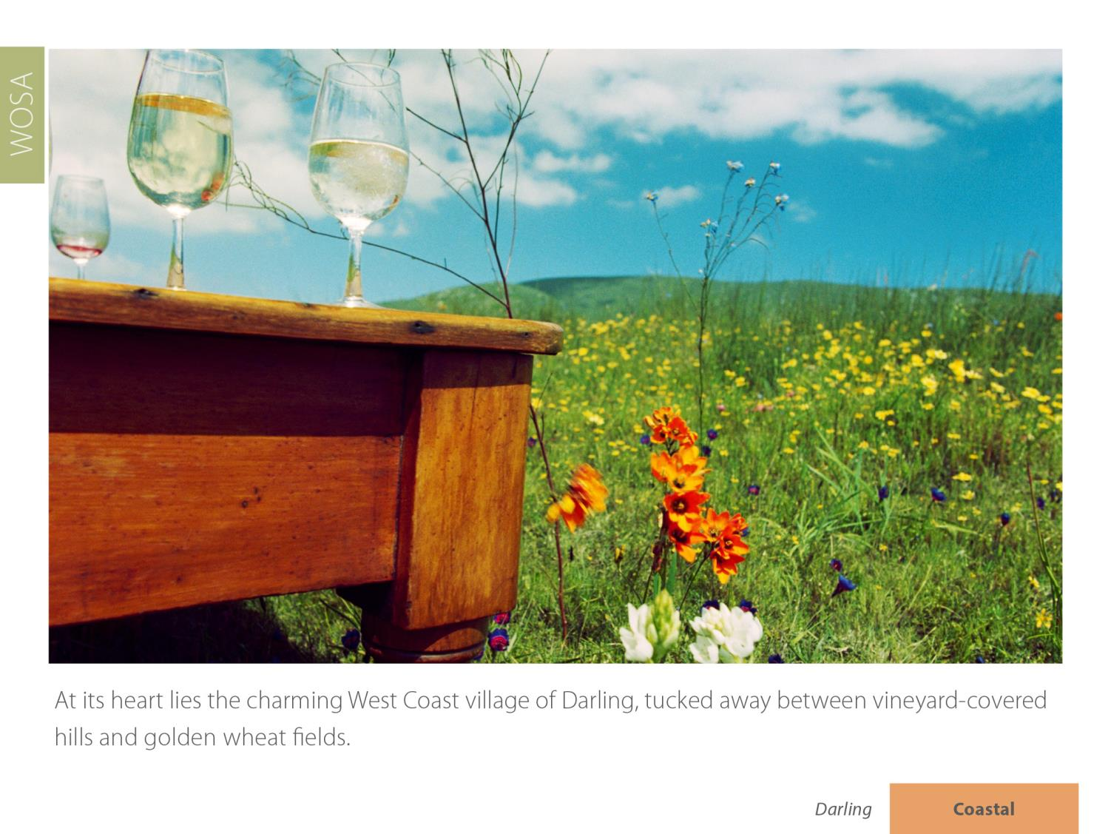
Darling
Coastal

Slide 11
Darling
Coastal

Slide 12
Darling
Coastal

Slide 13
All of the wineries on the route are conservation minded.
Darling
Coastal

Slide 14
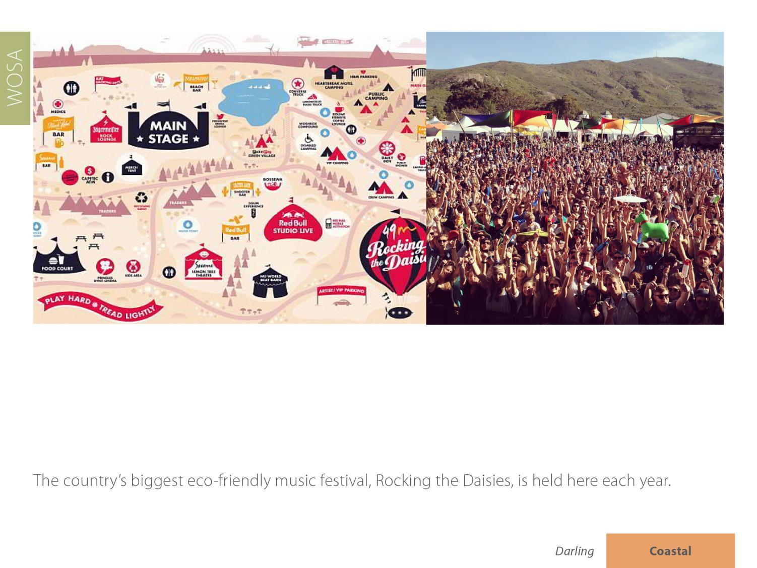
Darling
Coastal

Slide 15
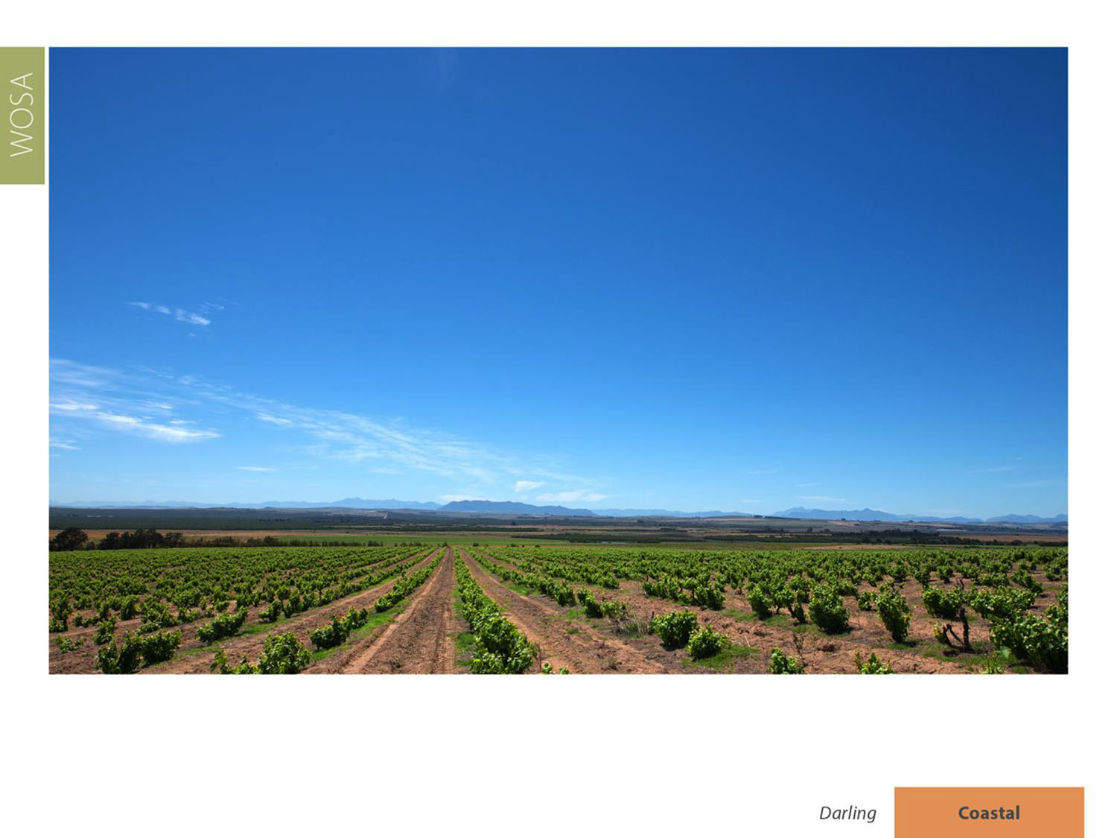
The district has a mean February temperature of 22.7⁰C.
Darling
Coastal

Slide 16
Average annual rainfall is 586 mm.
Darling
Coastal

Slide 17
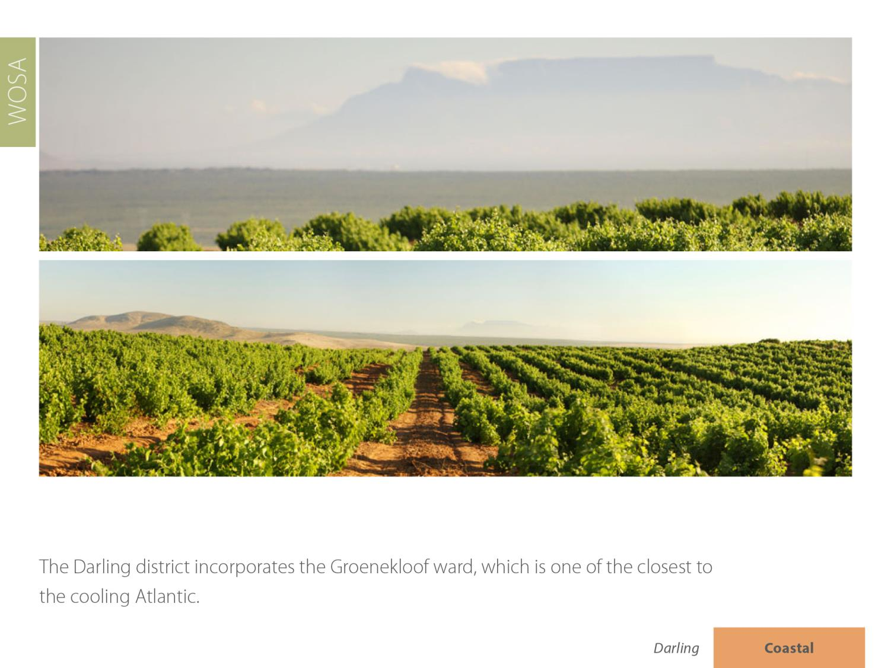
Darling
Coastal

Slide 18
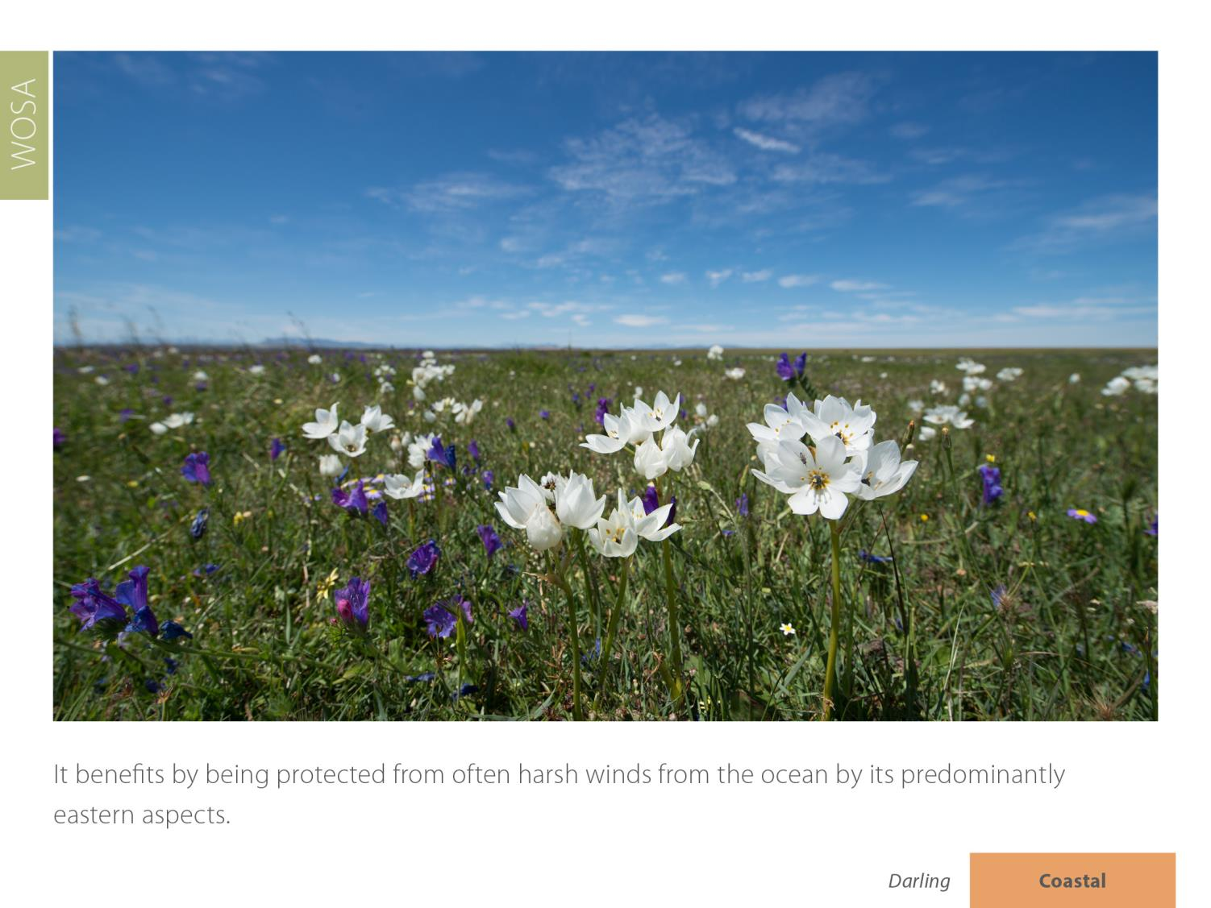
Darling
Coastal

Slide 19
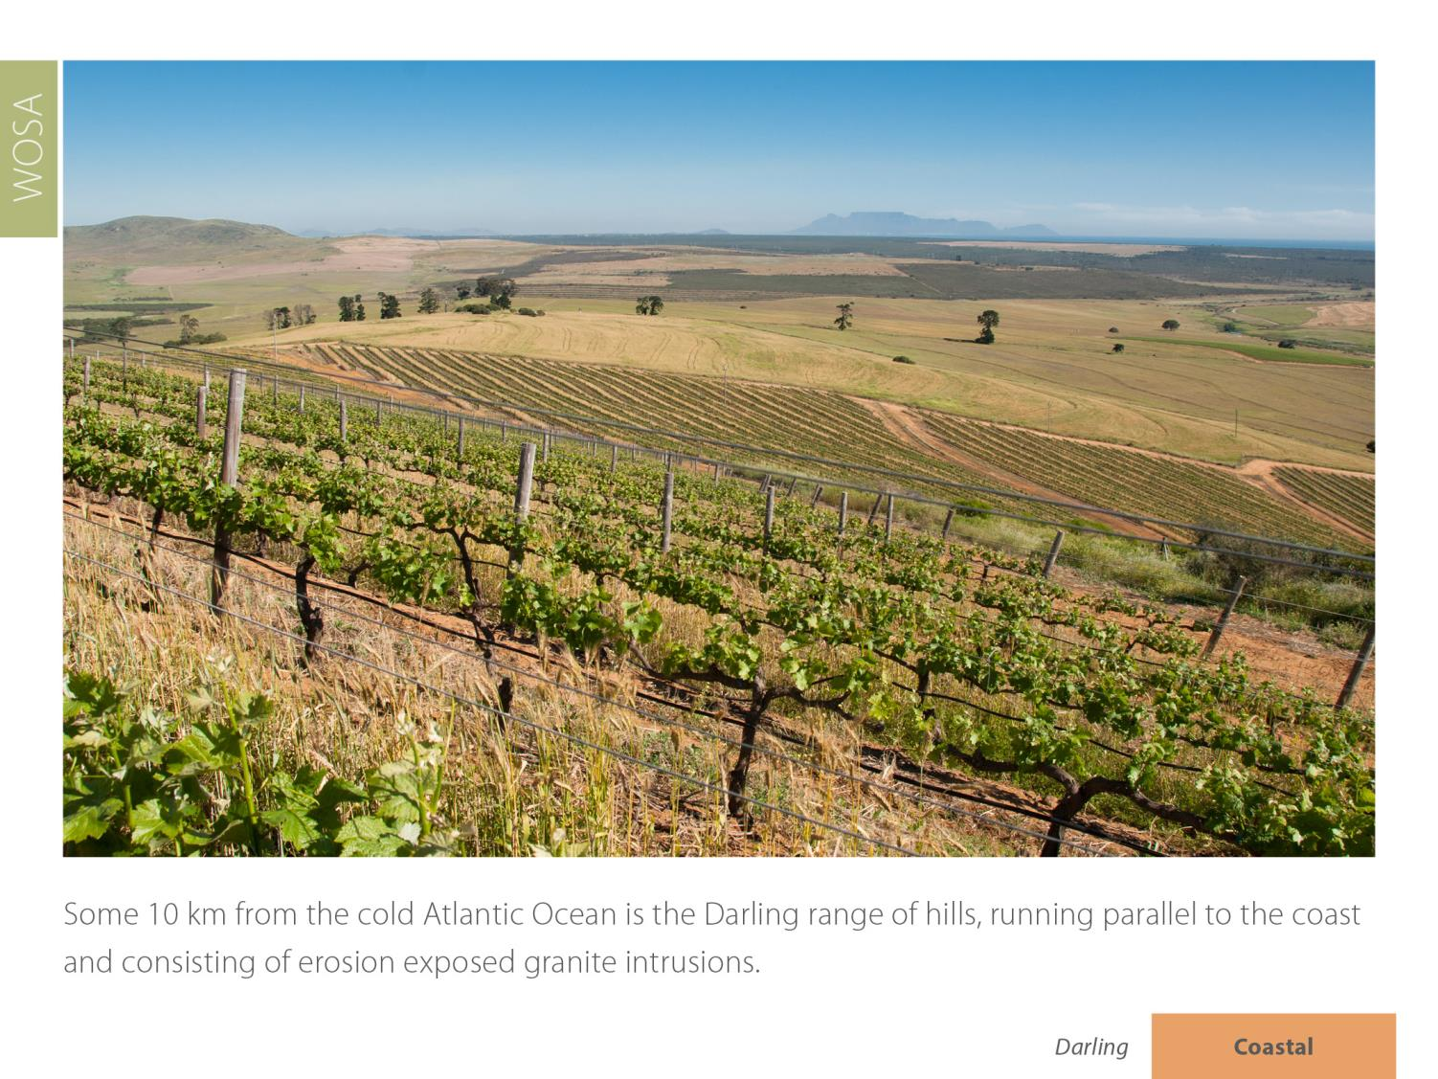
Darling
Coastal

Slide 20
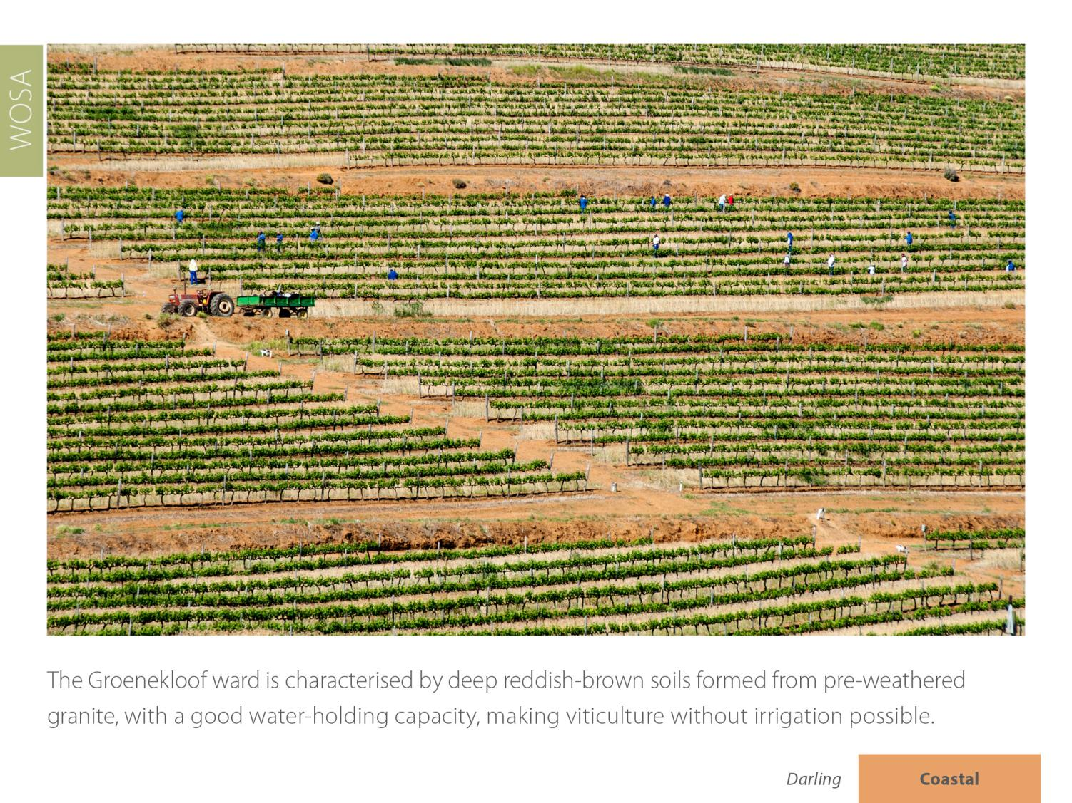
Darling
Coastal

Slide 21
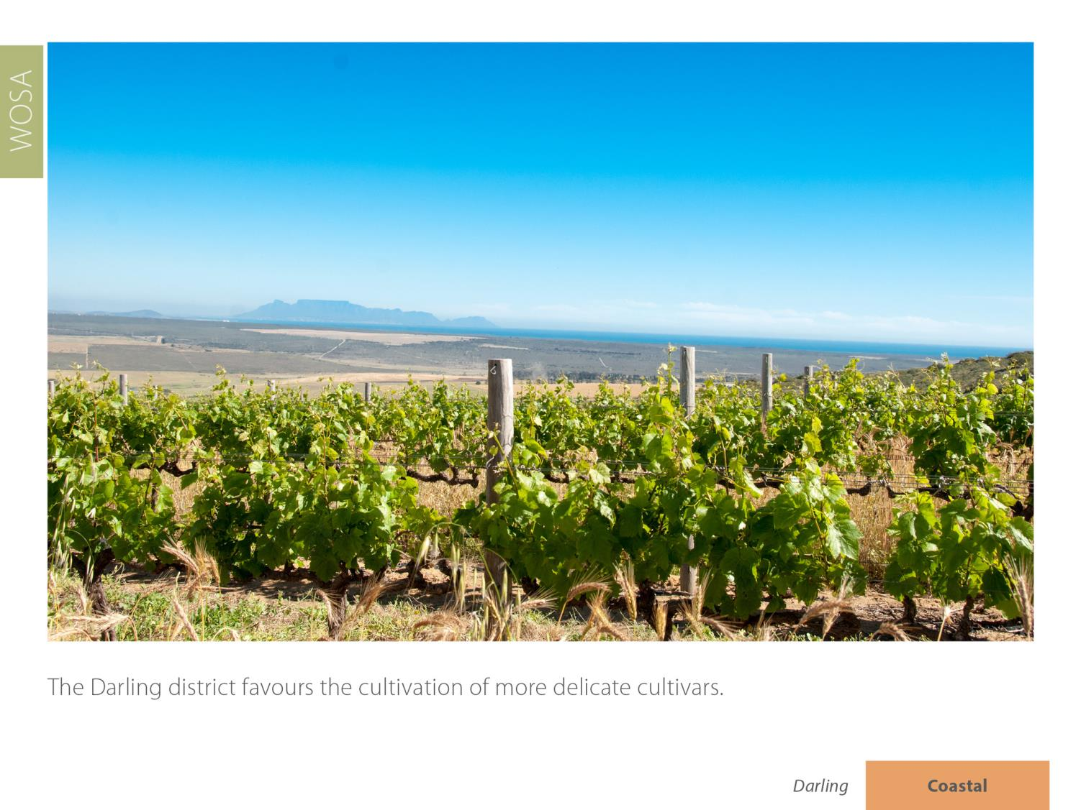
Darling
Coastal

Slide 22
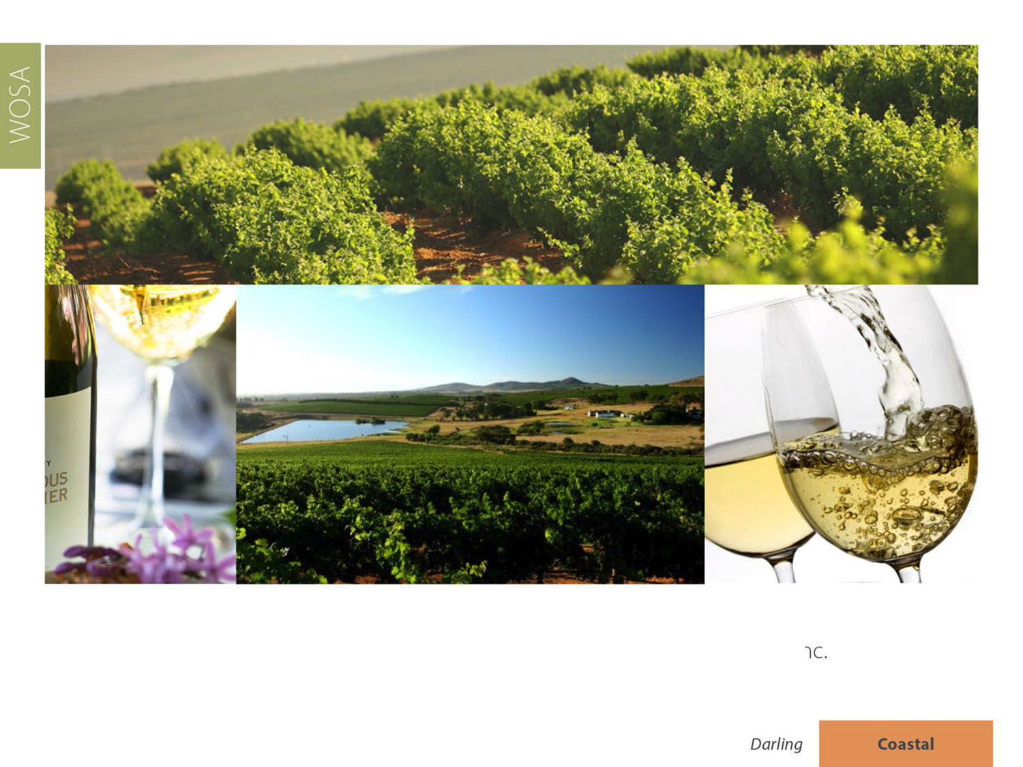
The most widely planted white-wine variety is Sauvignon Blanc, followed by Chenin Blanc and Chardonnay.
Darling
Coastal

Slide 23
The most widely planted red-wine variety is Cabernet Sauvignon, followed by Shiraz, Pinotage and Merlot.
Darling
Coastal

Slide 24
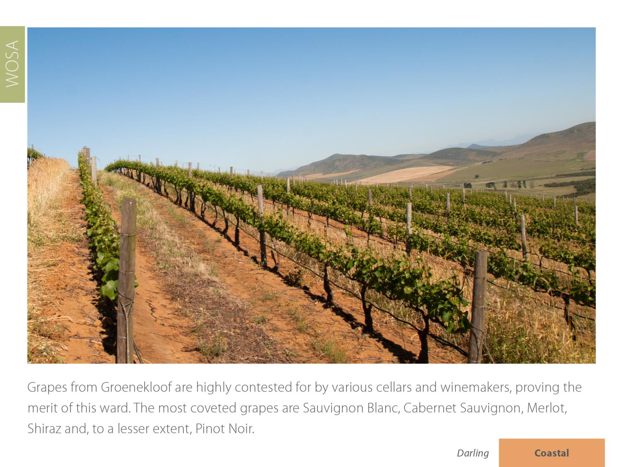
Darling
Coastal

Slide 25
Darling
Coastal

Slide 26
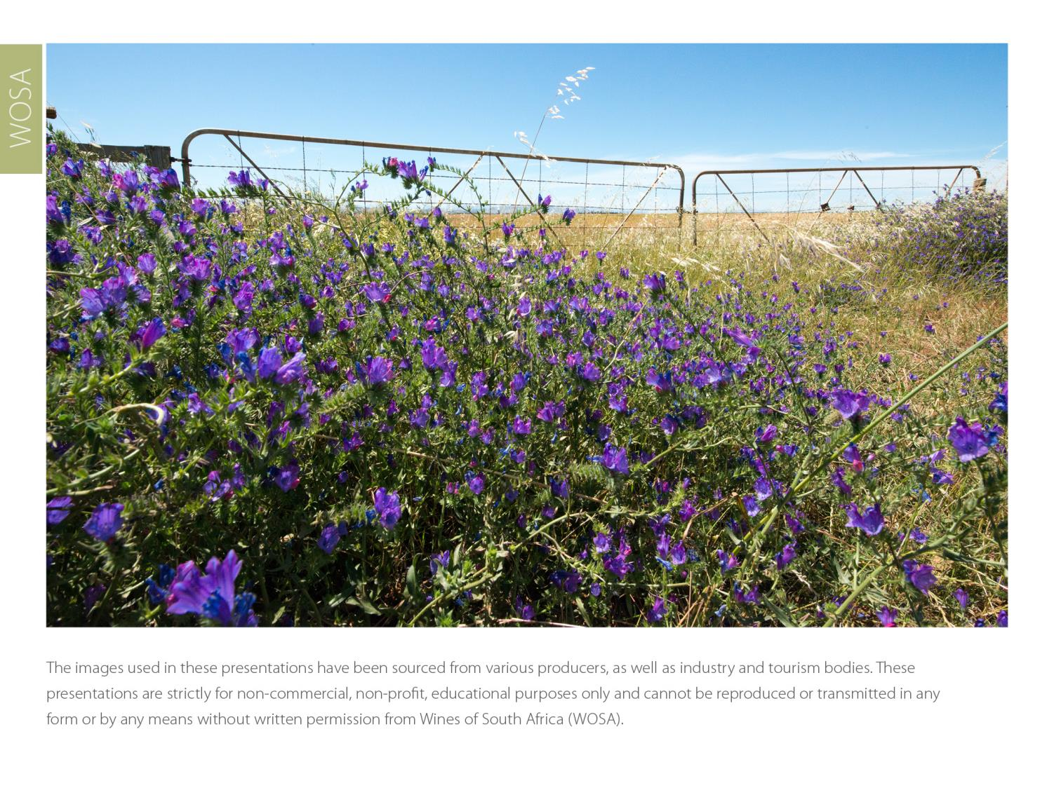
The images used in these presentations have been sourced from various producers, as well as industry and tourism bodies. These presentations are strictly for non-commercial, non-profit, educational purposes only and cannot be reproduced or transmitted in any form or by any means without written permission from Wines of South Africa (WoSA).

Slide 27
The Cape winelands, considered by many to be
the most beautiful in the world, have a network of
diverse and well-run wine routes, affording visitors
a varied and unforgettable experience.

Slide 28
THE END

