Slide 1
CAPE WINELANDS
SWARTLAND

Slide 2
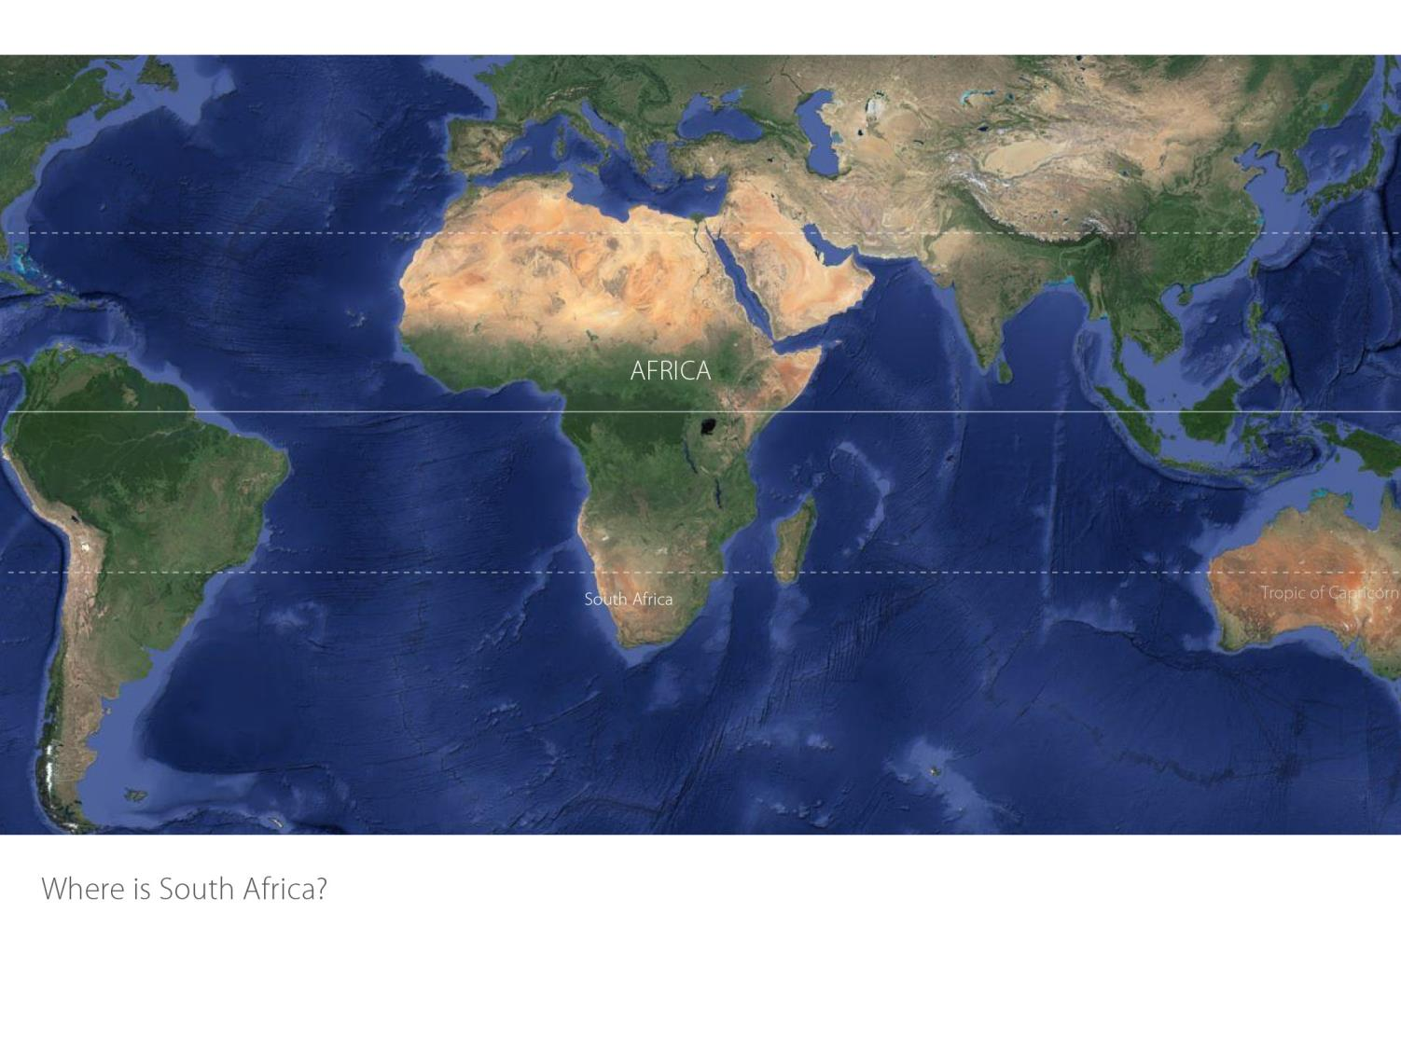

Slide 3
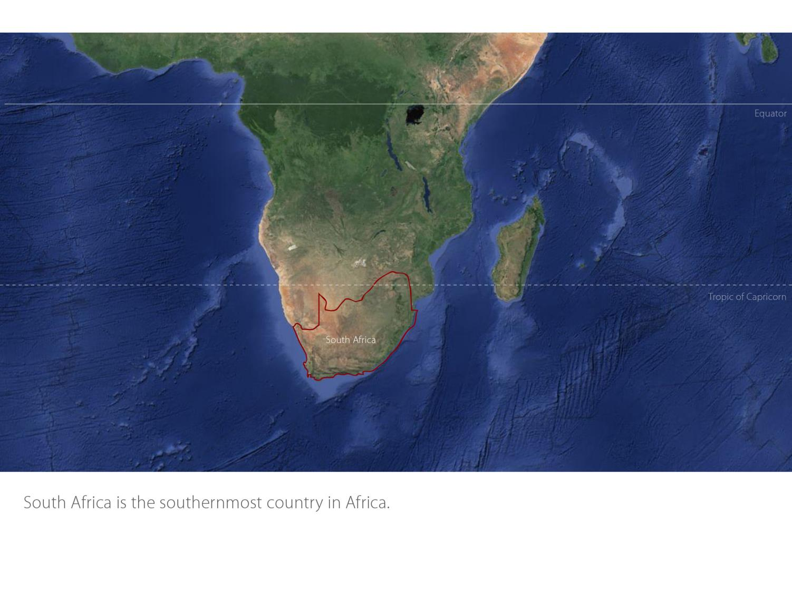

Slide 4
Our winelands are located at the very tip of South Africa.
Swartland
Coastal

Slide 5
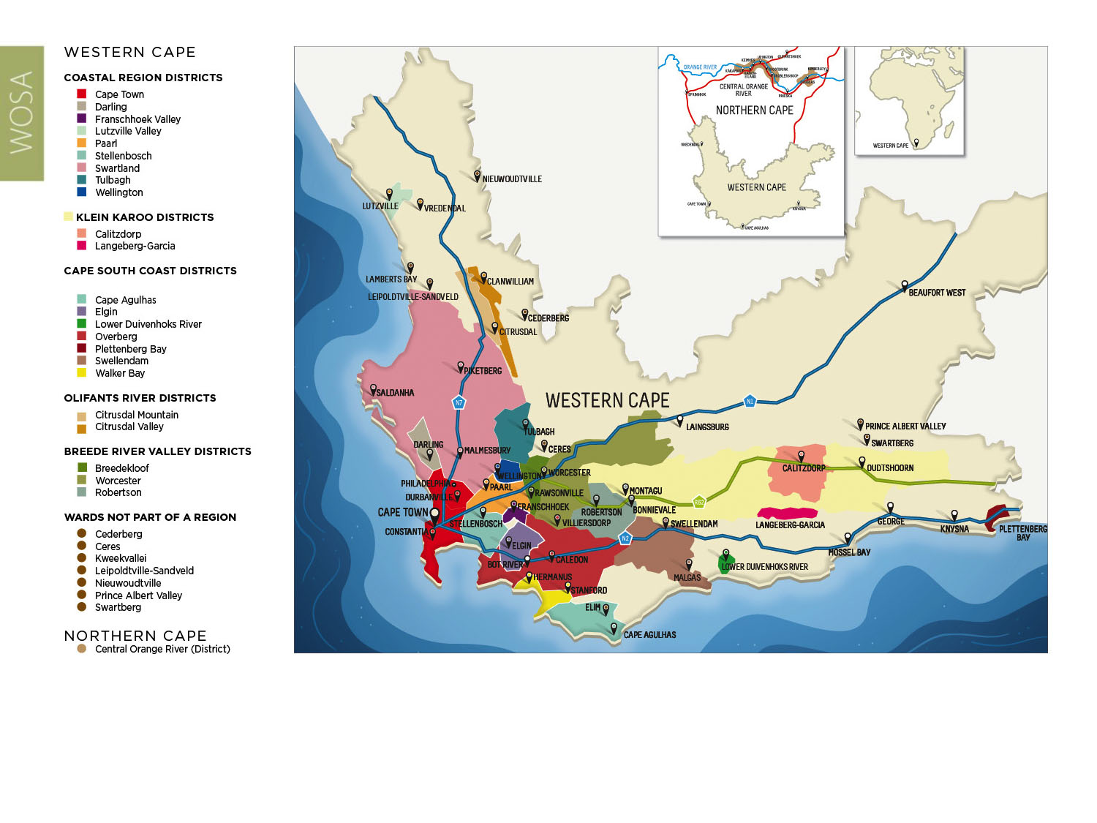
PRODUCTION AREAS: Districts of South Africa.
Swartland
Coastal

Slide 6
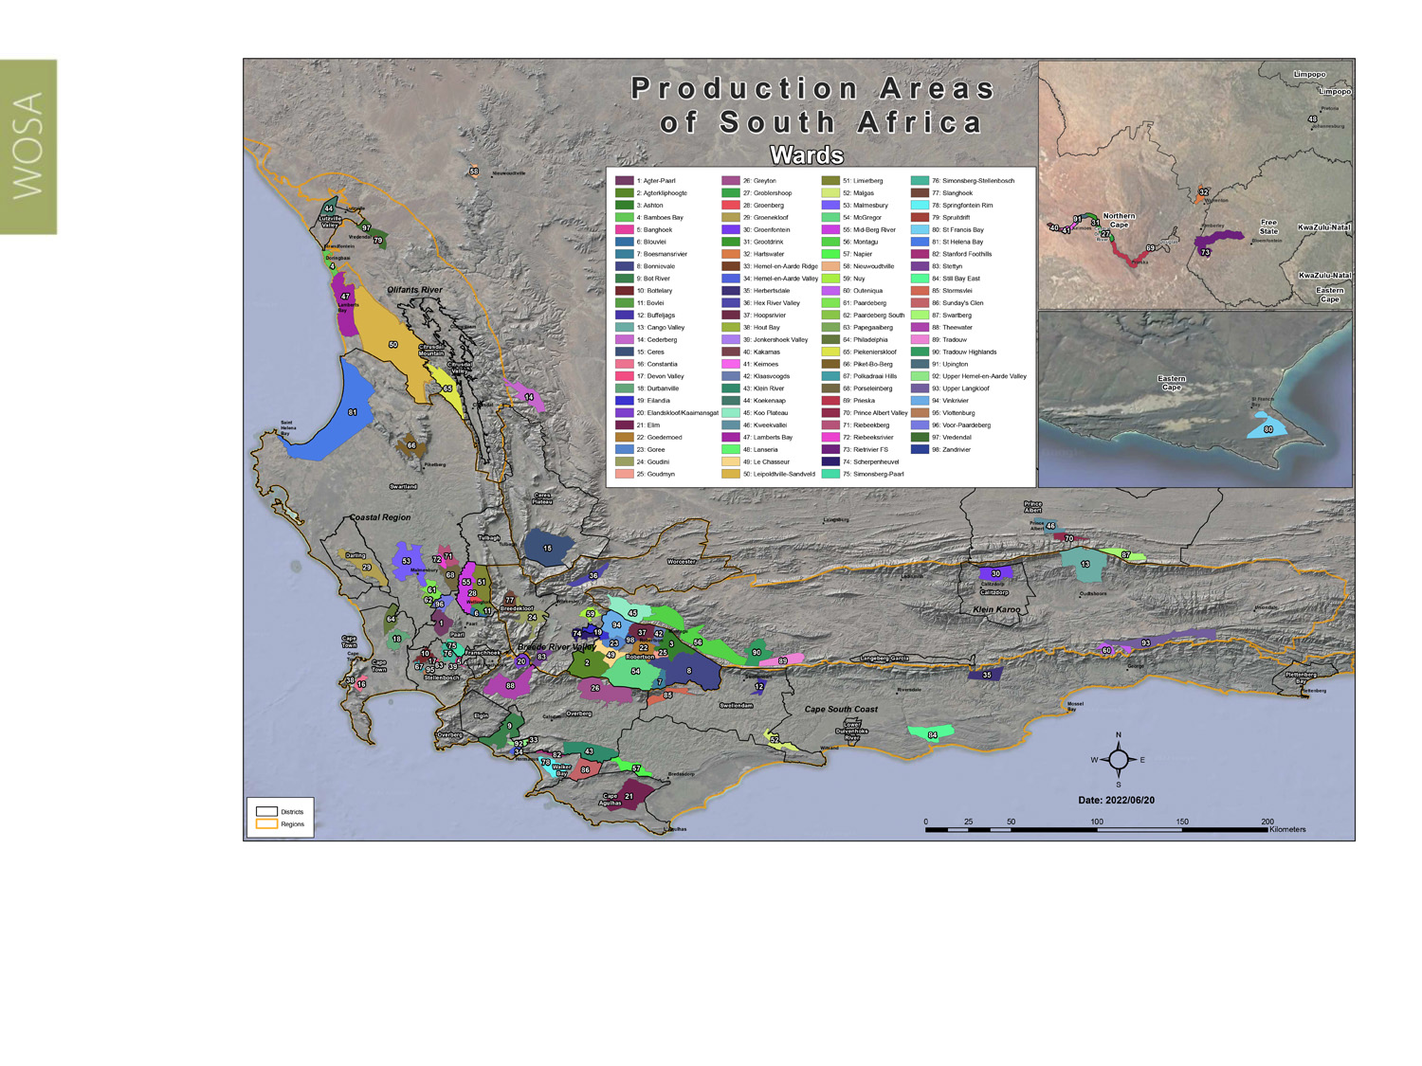
Wards of South Africa.
Swartland
Coastal

Slide 7
Coastal Region
Region: Coastal
District: Swartland
Wards: Malmesbury
Paardeberg/Perdeberg
Paardeberg South
Porseleinberg
Riebeekberg
Riebeeksrivier
Swartland
Coastal

Slide 8
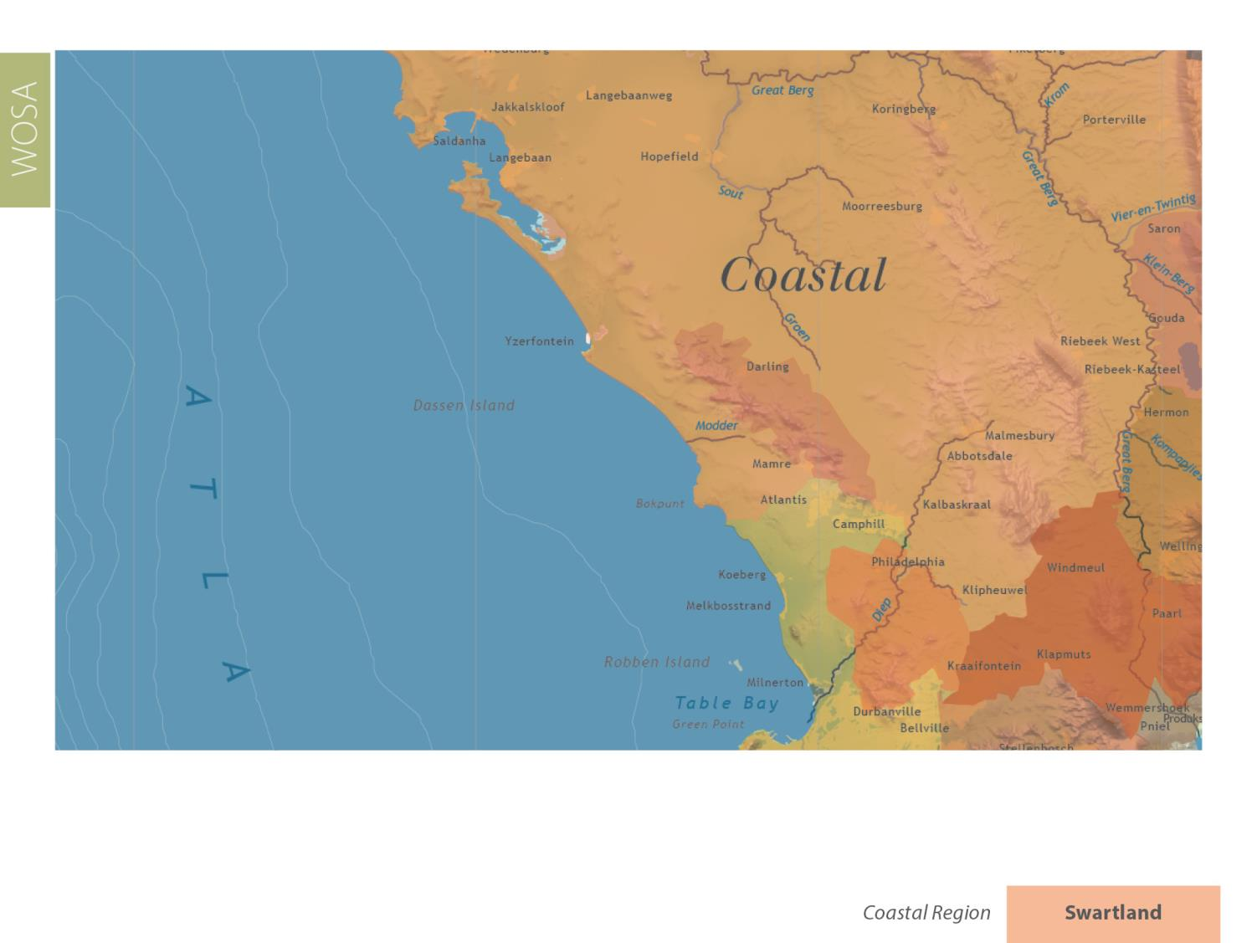
Swartland
Coastal

Slide 9
Swartland
Coastal

Slide 10
Swartland
Coastal

Slide 11
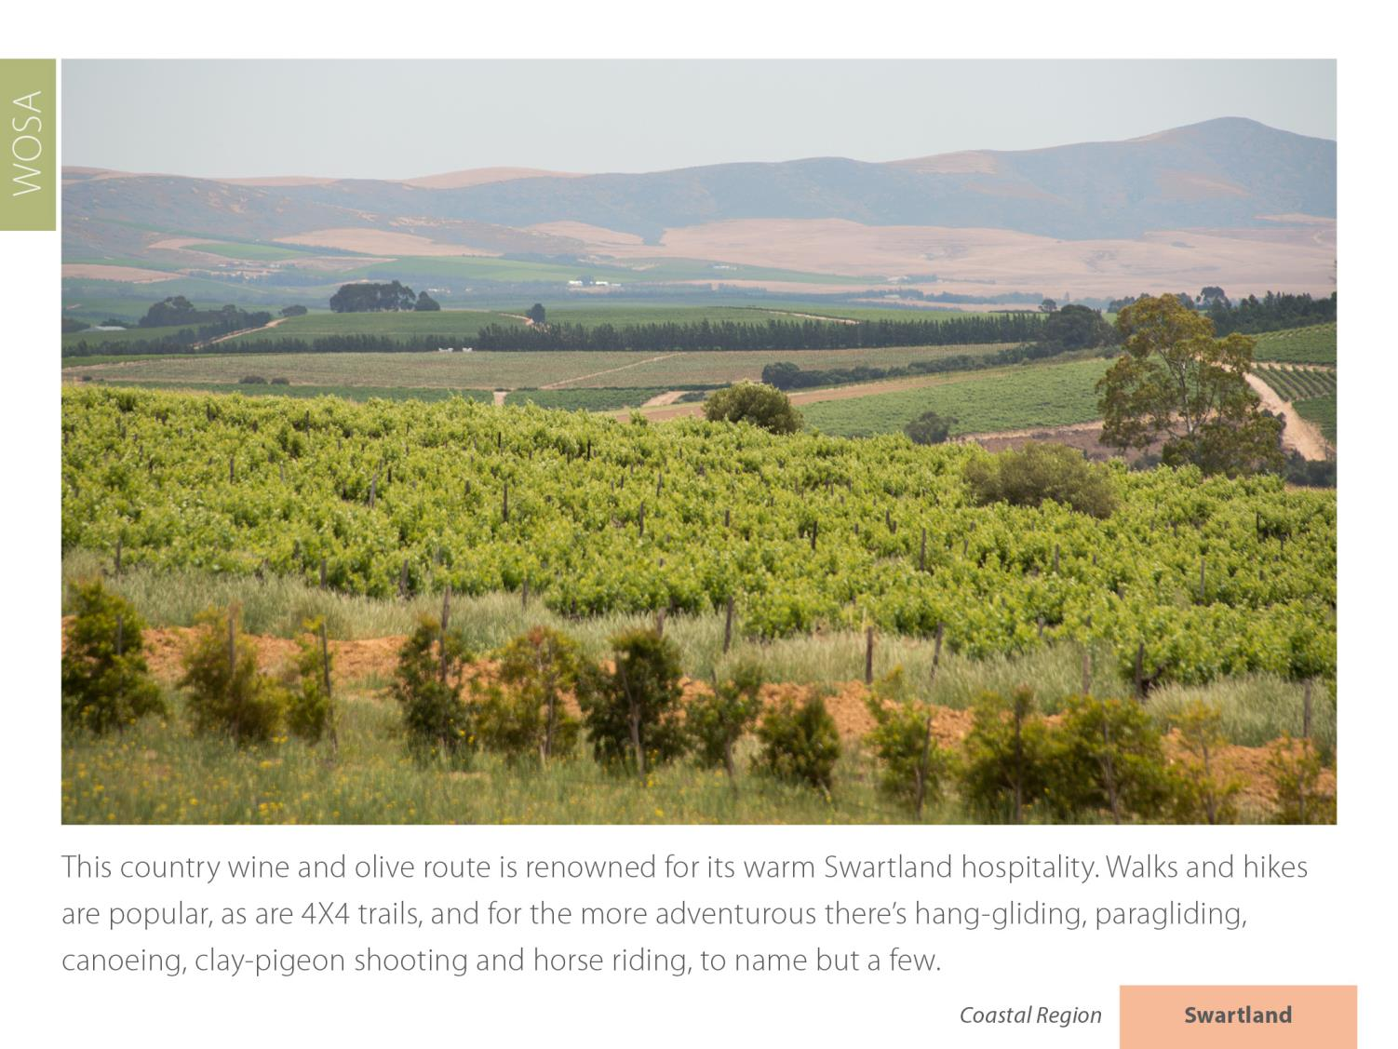
Swartland
Coastal

Slide 12
Swartland
Coastal

Slide 13
Swartland
Coastal

Slide 14
Swartland
Coastal

Slide 15
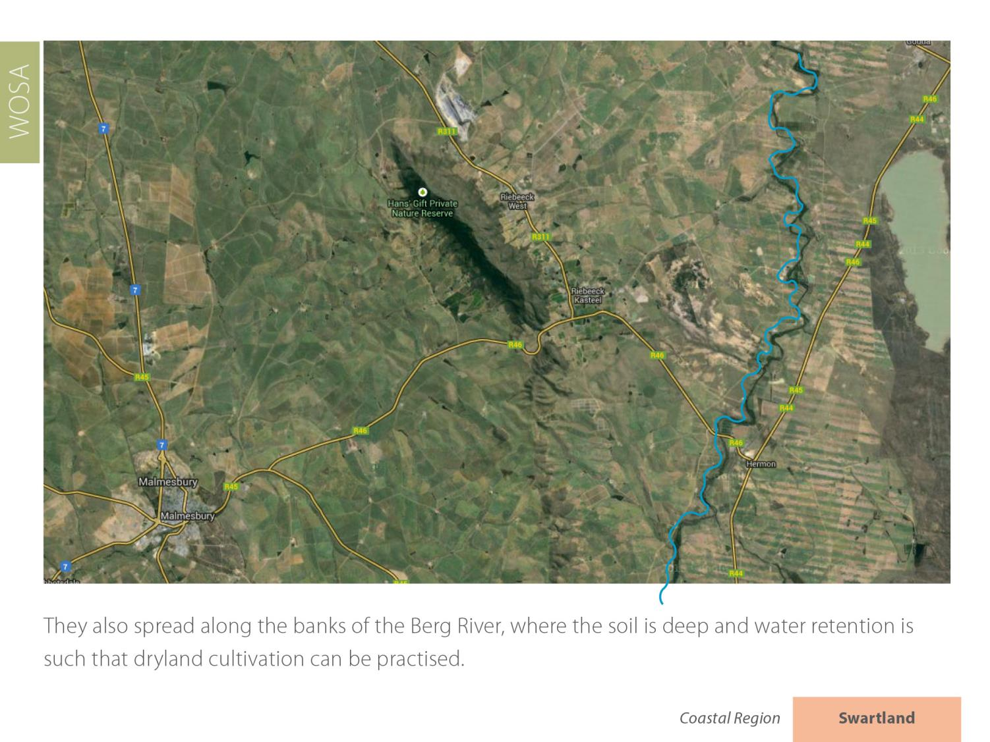
Swartland
Coastal

Slide 16
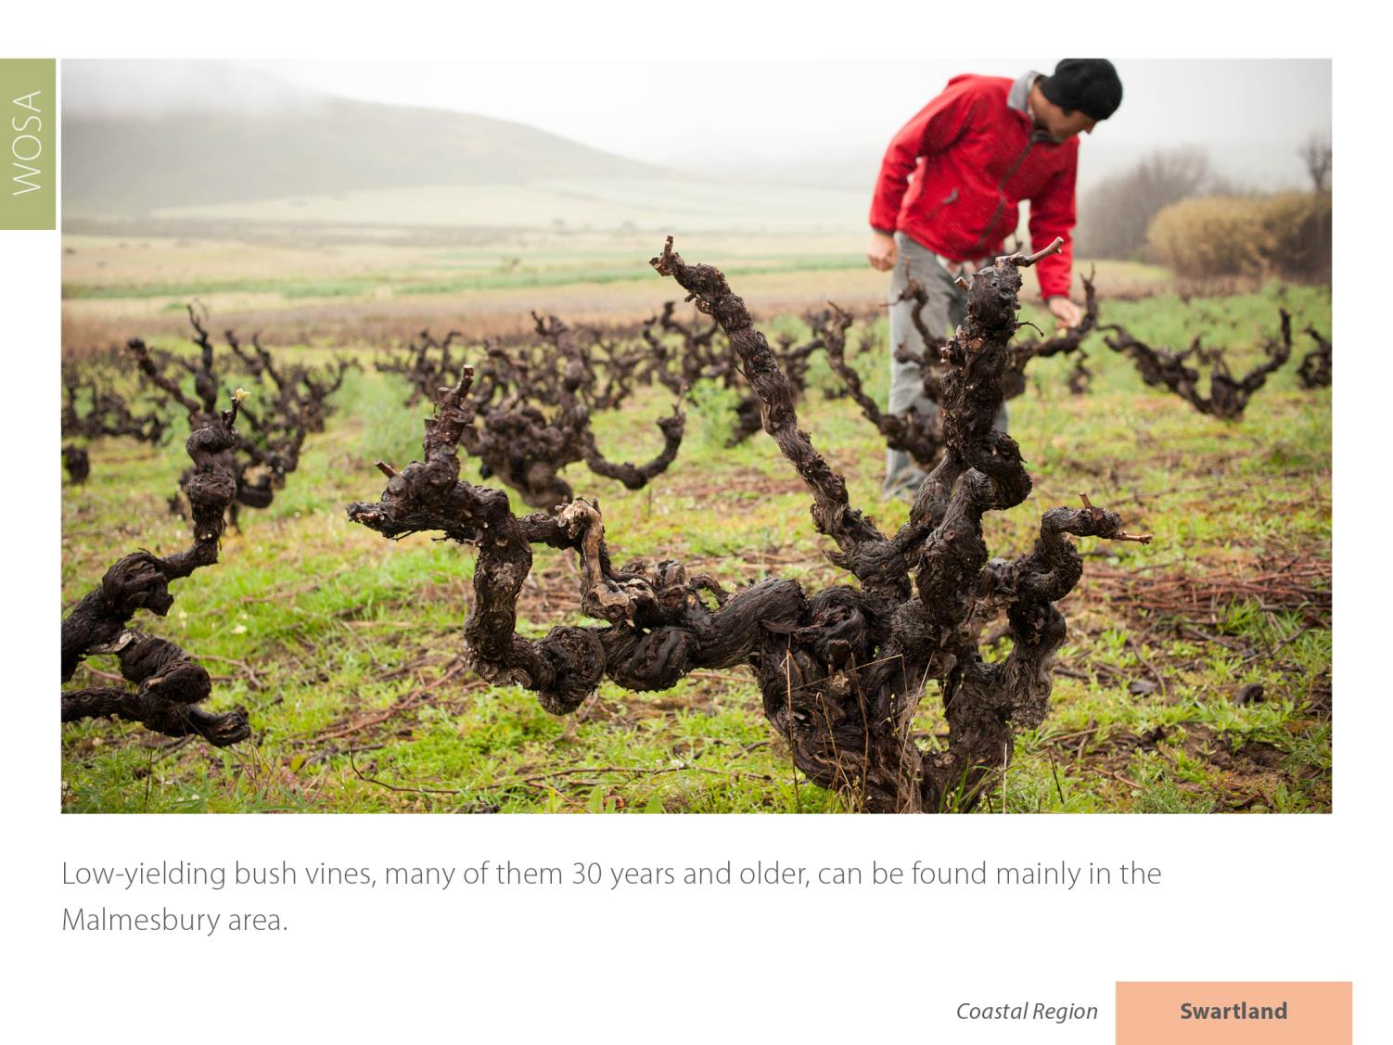
Swartland
Coastal

Slide 17
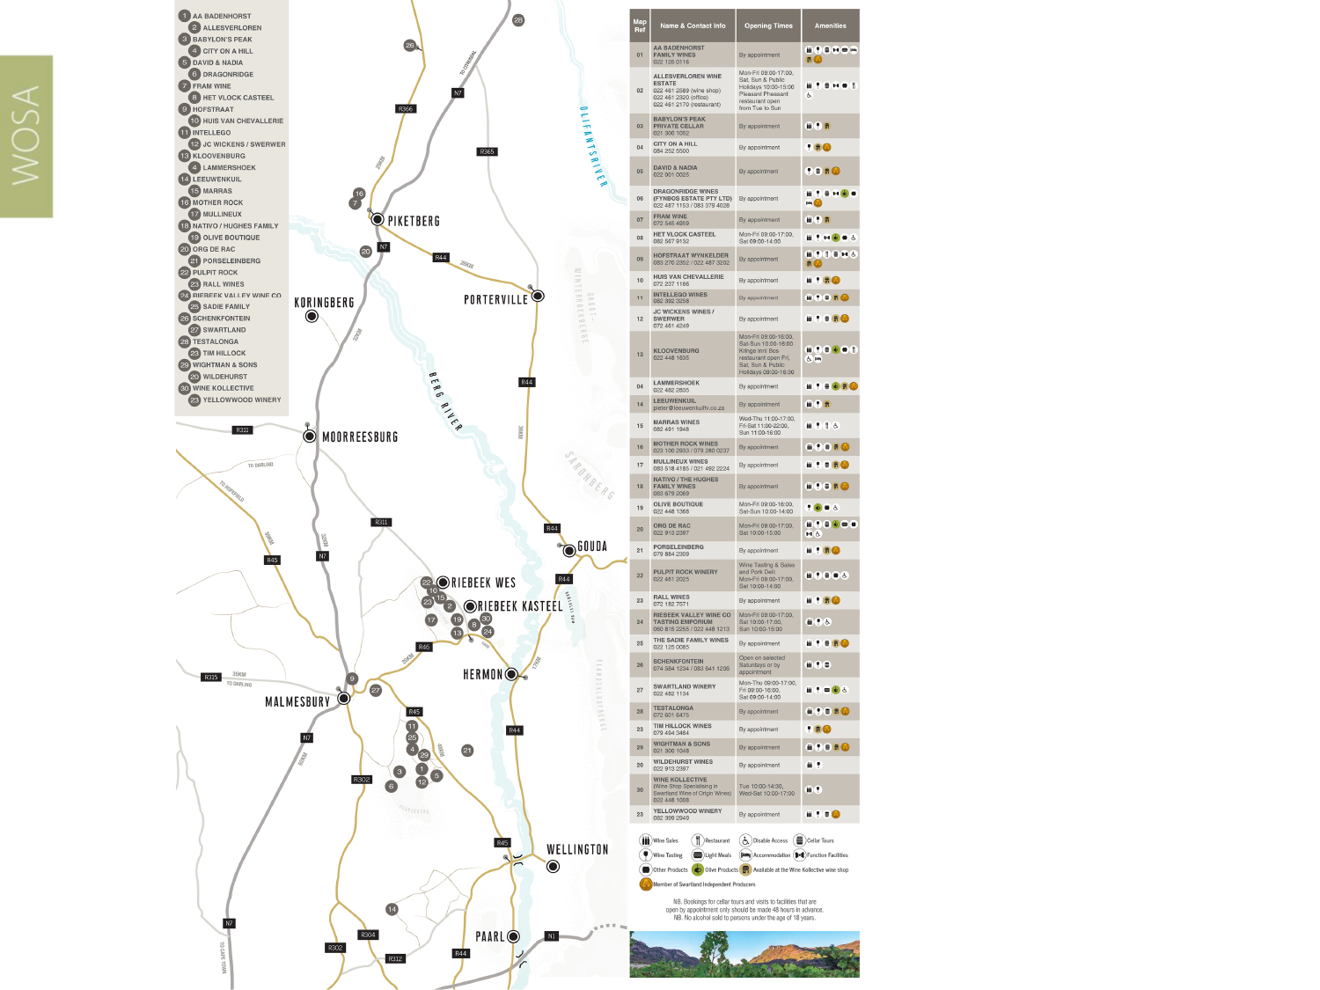
The district of Swartland borders Piketberg to the north, which is not dissimilar in both geography and climate.
Swartland
Coastal

Slide 18
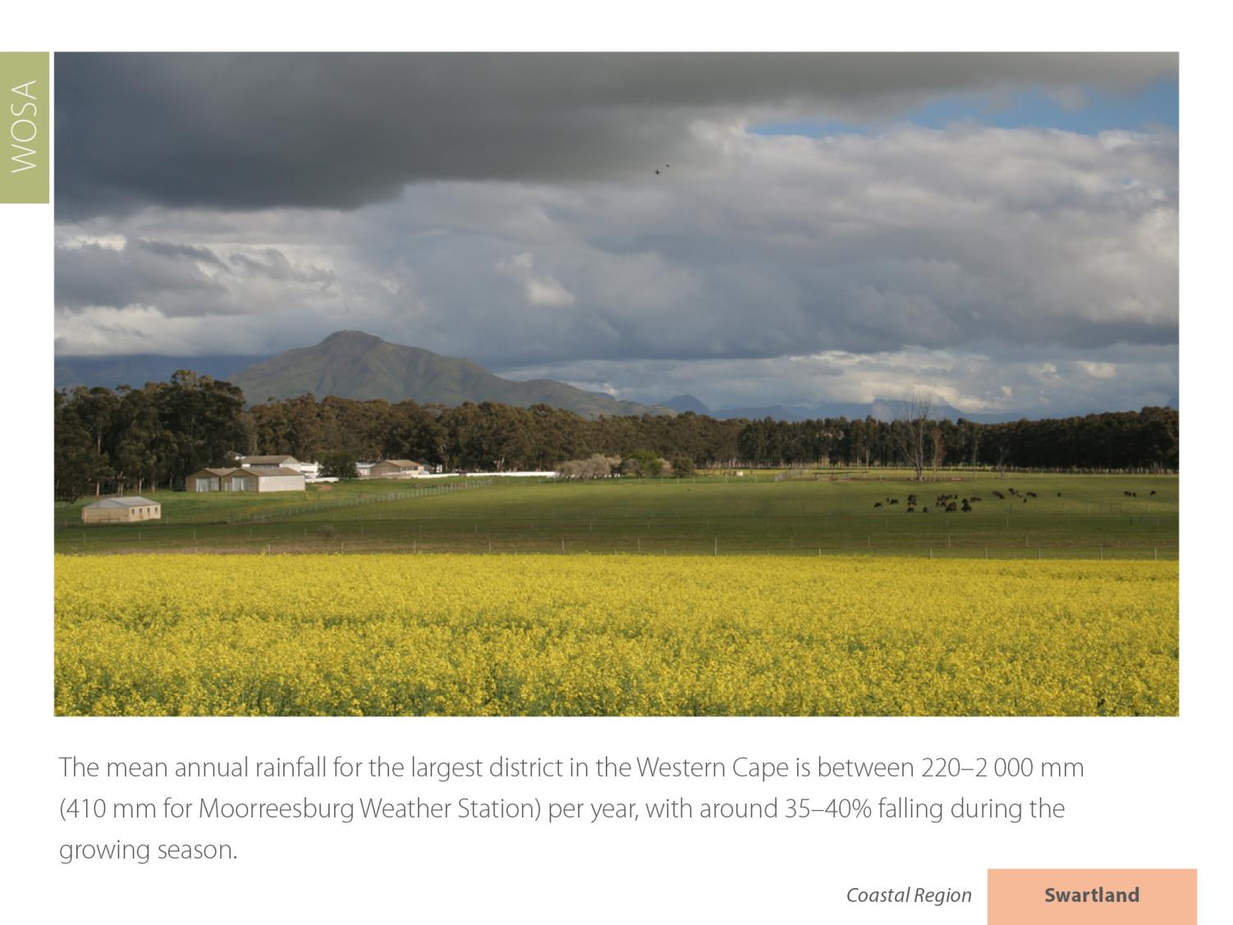
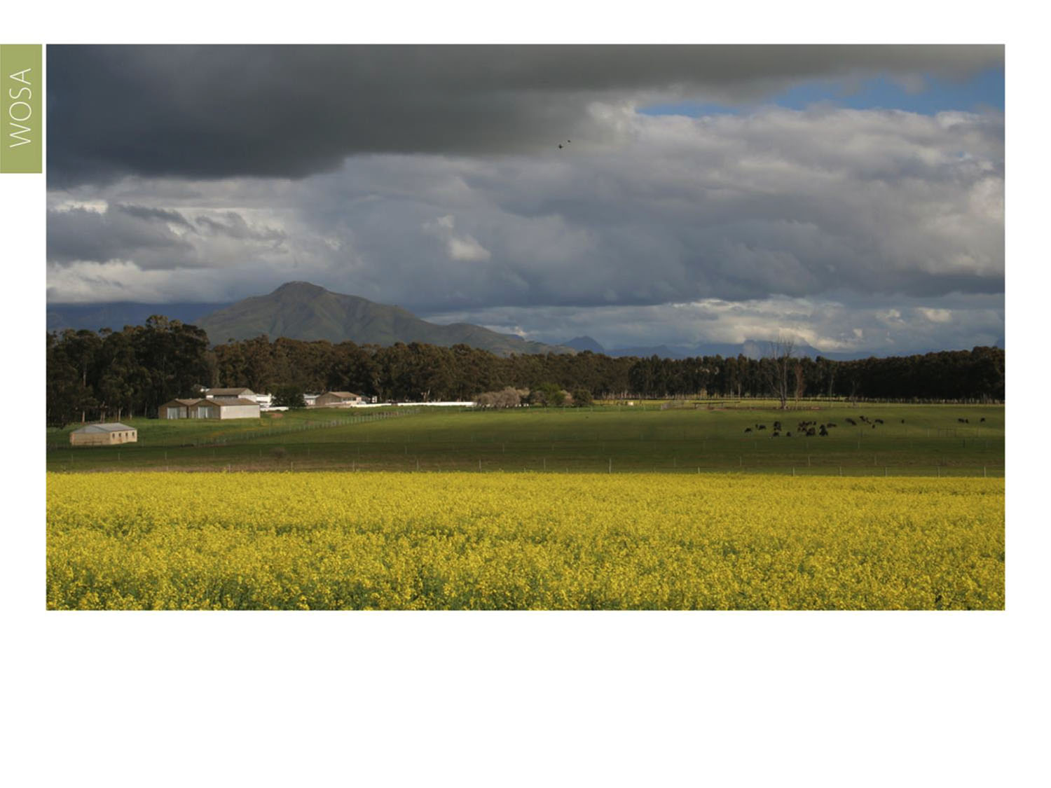
The average rainfall for the largest district in the Western Cape is between 300–500 mm per year, with around 35-40% falling during the growing season.
Swartland
Coastal

Slide 19
The mean February temperature is 23.3⁰C.
Swartland
Coastal

Slide 20
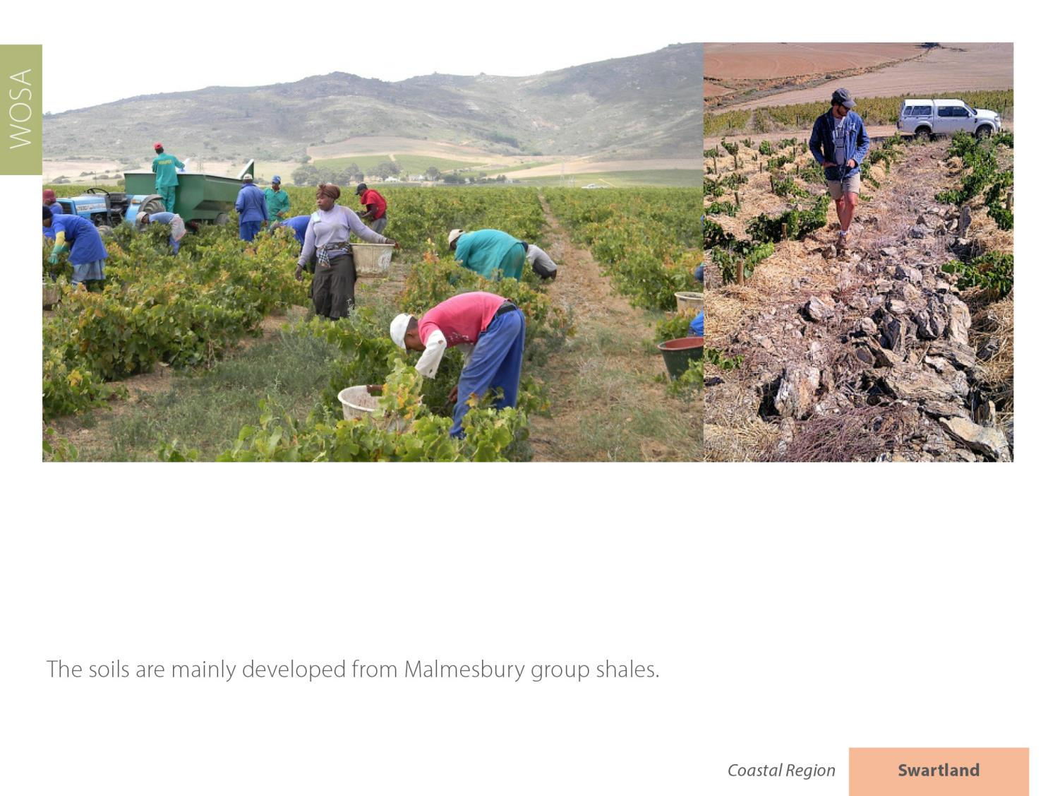
Swartland
Coastal

Slide 21
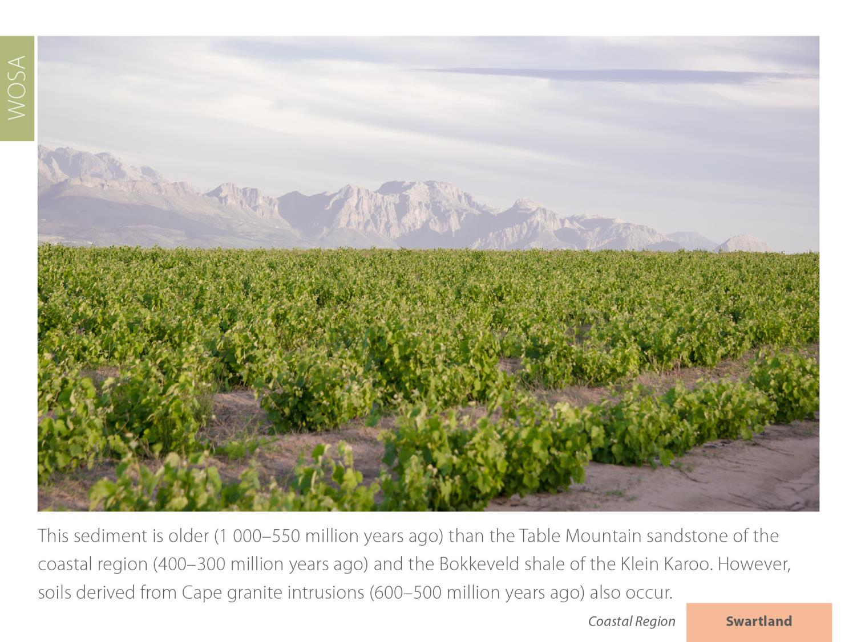
Swartland
Coastal

Slide 22
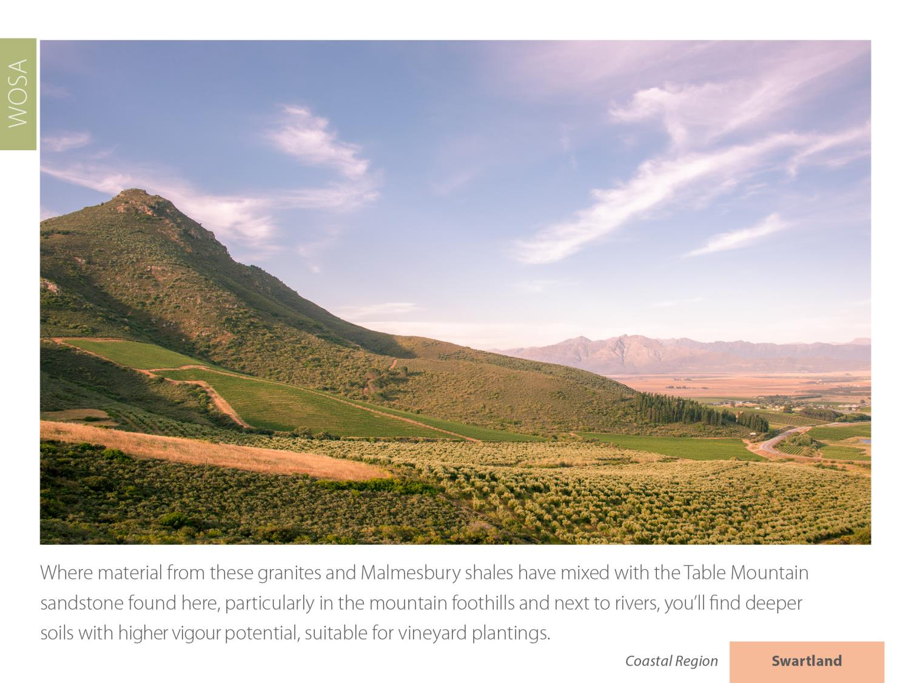
Swartland
Coastal

Slide 23
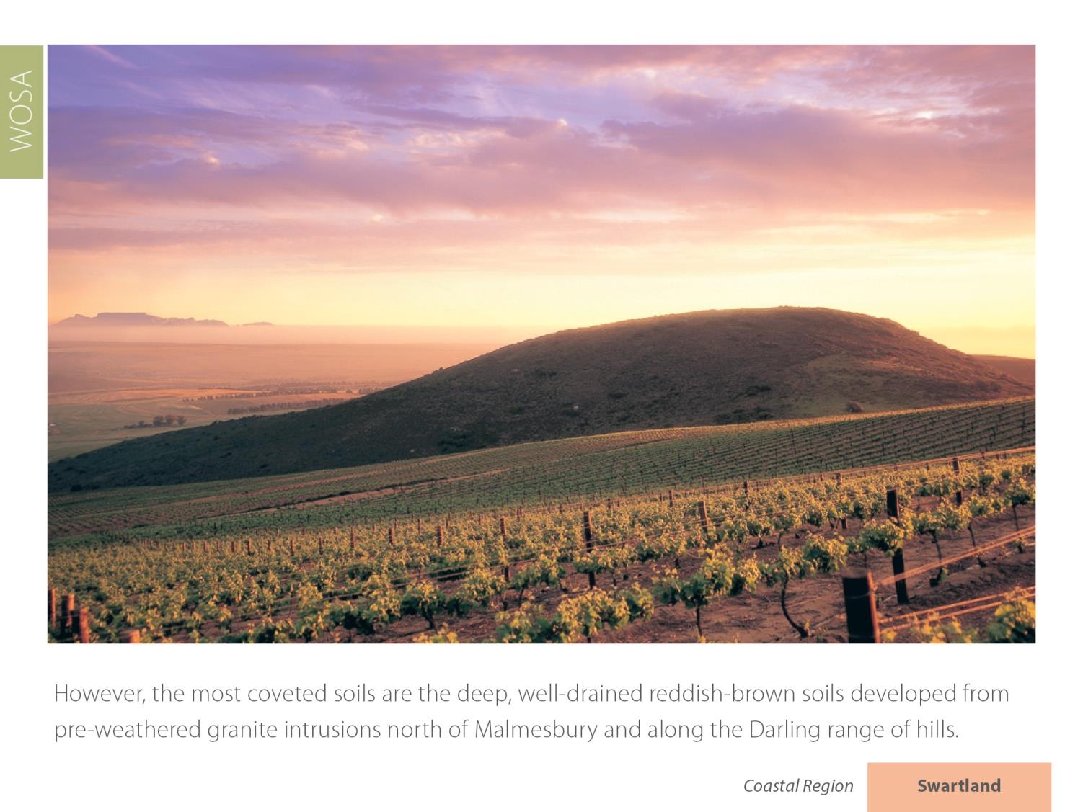
Swartland
Coastal

Slide 24
Swartland
Coastal

Slide 25
Swartland
Coastal

Slide 26
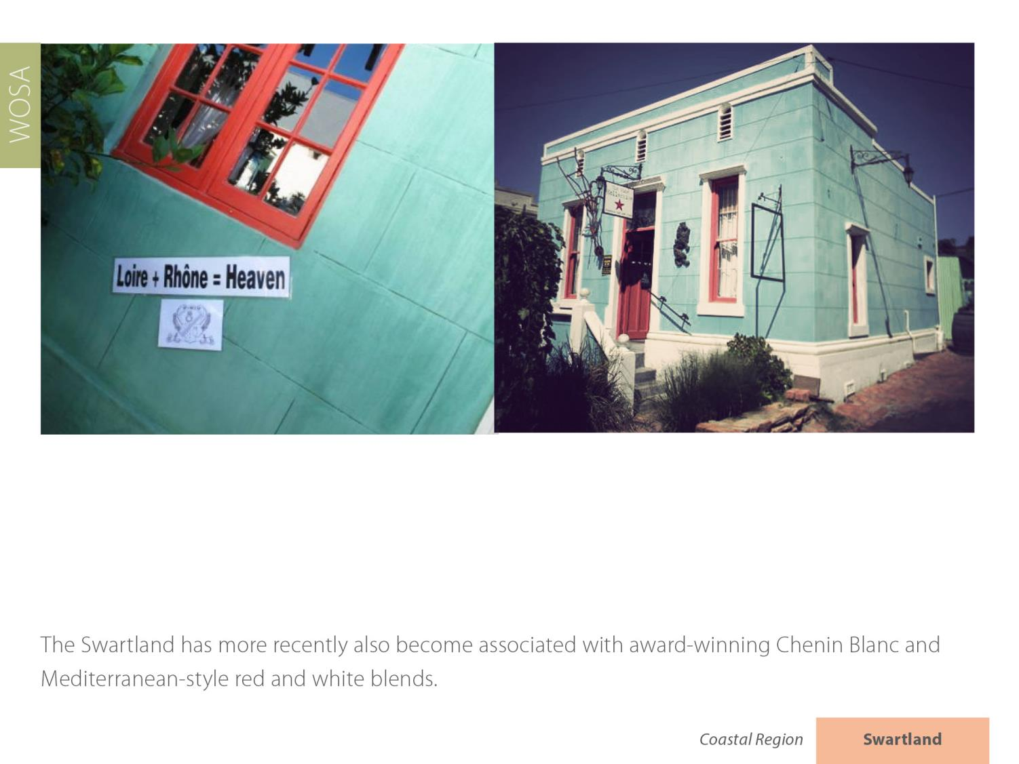
Swartland
Coastal

Slide 27
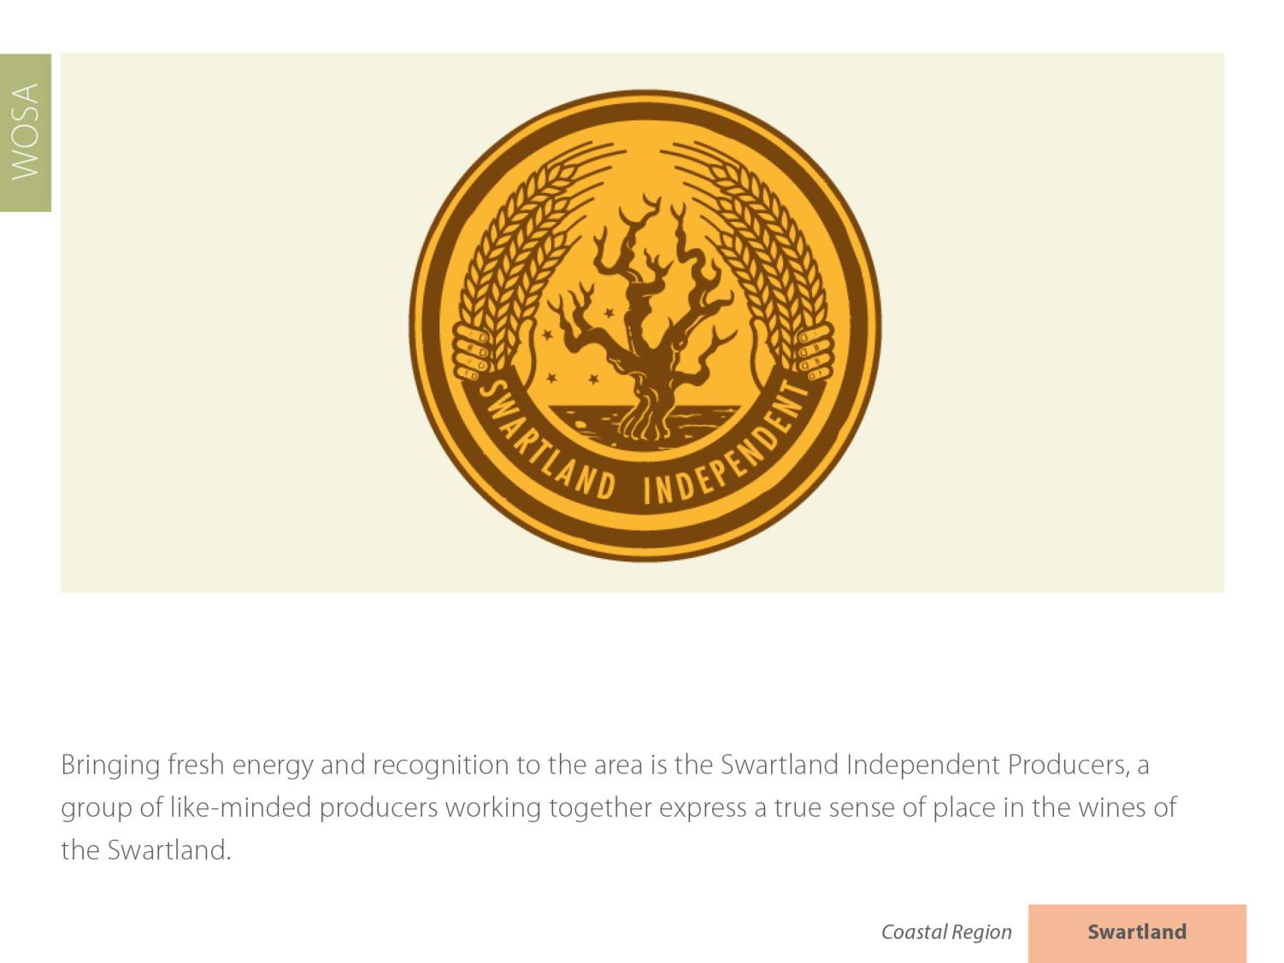
Swartland
Coastal

Slide 28
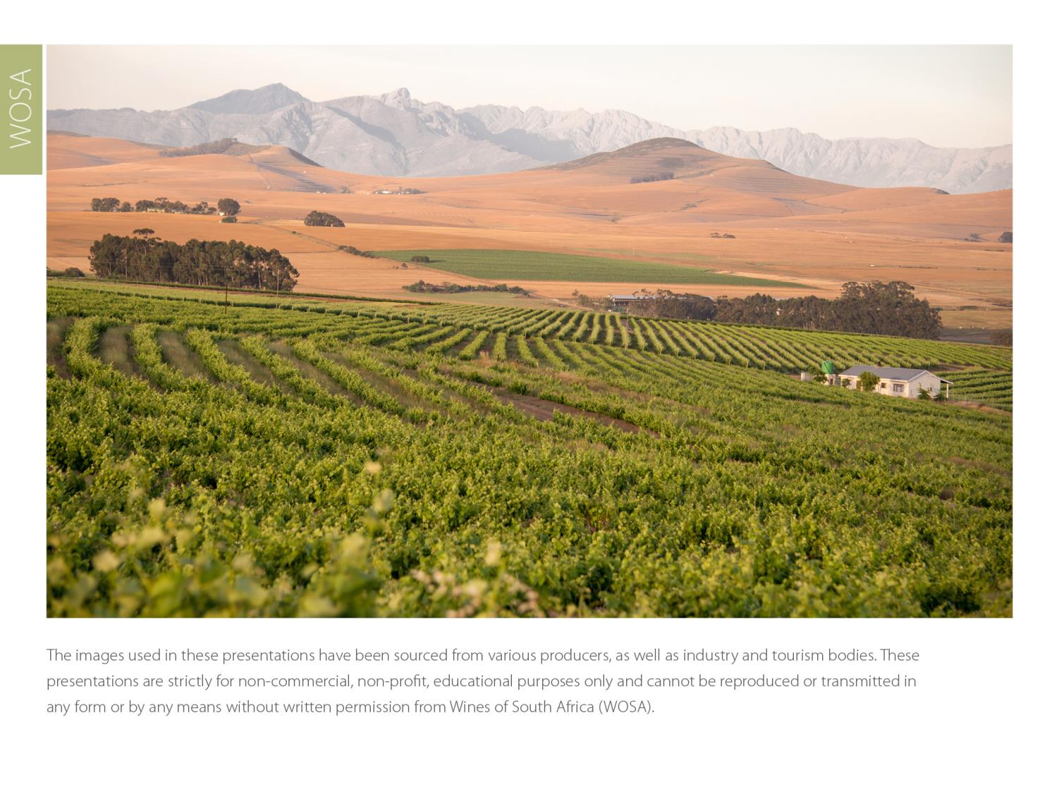
The images used in these presentations have been sourced from various producers, as well as industry and tourism bodies. These presentations are strictly for non-commercial, non-profit, educational purposes only and cannot be reproduced or transmitted in any form or by any means without written permission from Wines of South Africa (WoSA).

Slide 29
The Cape winelands, considered by many to be
the most beautiful in the world, have a network of
diverse and well-run wine routes, affording visitors
a varied and unforgettable experience.

Slide 30
THE END

