Slide 1
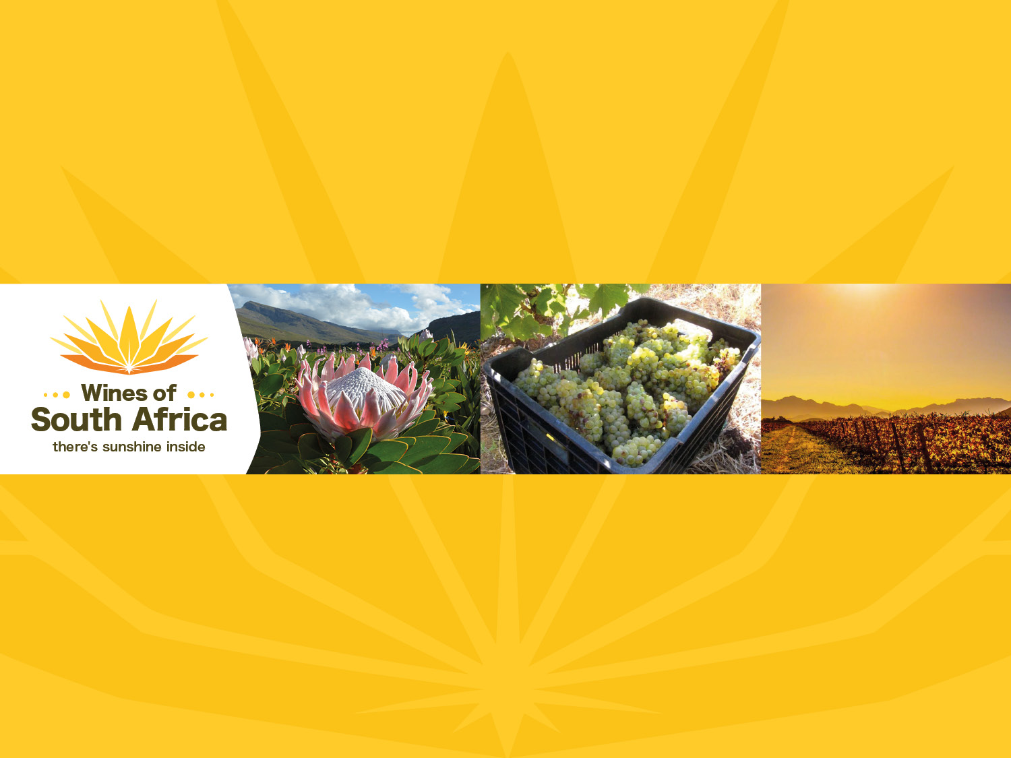
CAPE WINELANDS
BREEDEKLOOF
Notes:
Wines of South Africa

Slide 2

Where is South Africa?

Slide 3

South Africa is the southernmost
country in Africa.

Slide 4

Our winelands are located at the
very tip of South Africa.

Slide 5

PRODUCTION AREAS: Districts of South Africa.

Slide 6

Wards of South Africa.

Slide 7

Breed River Valley
Region: Breede River Valley
District: Breedekloof
Wards: Goudini
Slanghoek

Slide 8
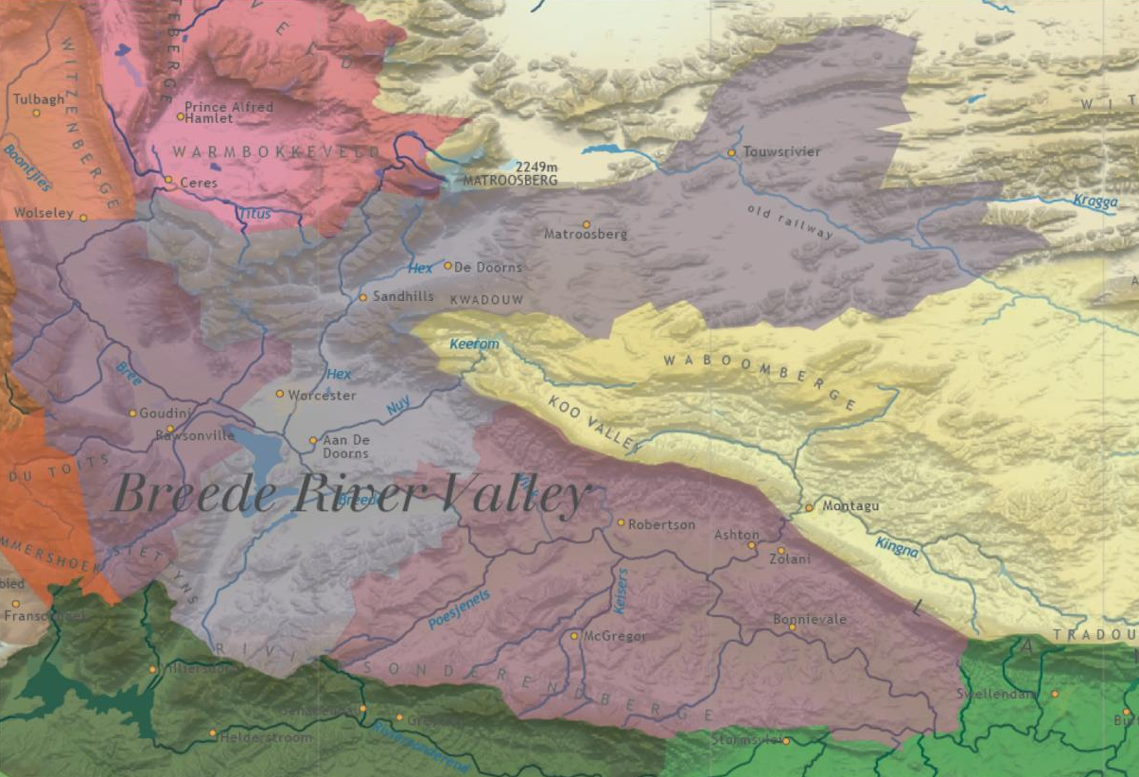

Slide 9
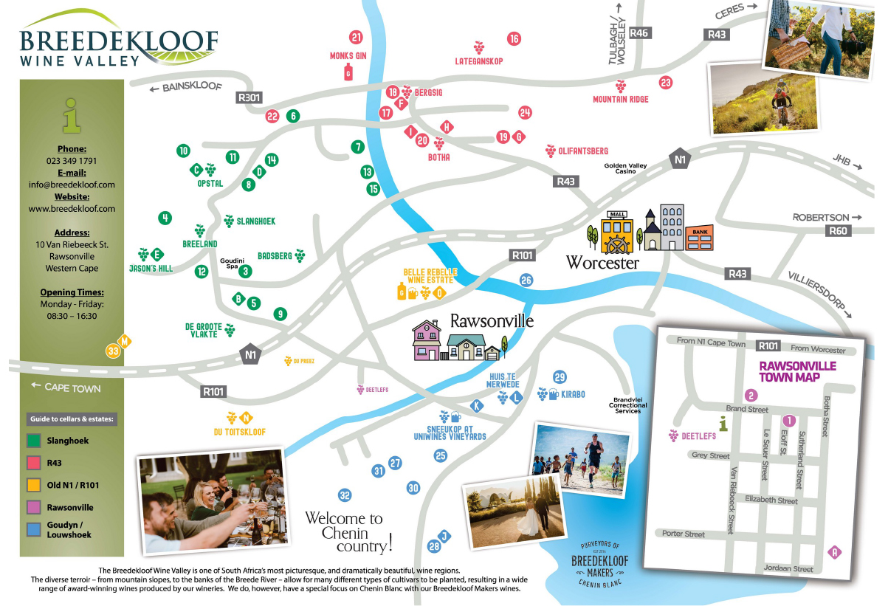
At the Breedekloof district’s hub is the village of Rawsonville, which is surrounded by vineyards with some 19 wineries in a 30 km radius. Many of the farms are fourth to eighth generation family owned, and the area is known for its warm, hospitable people.

Slide 10
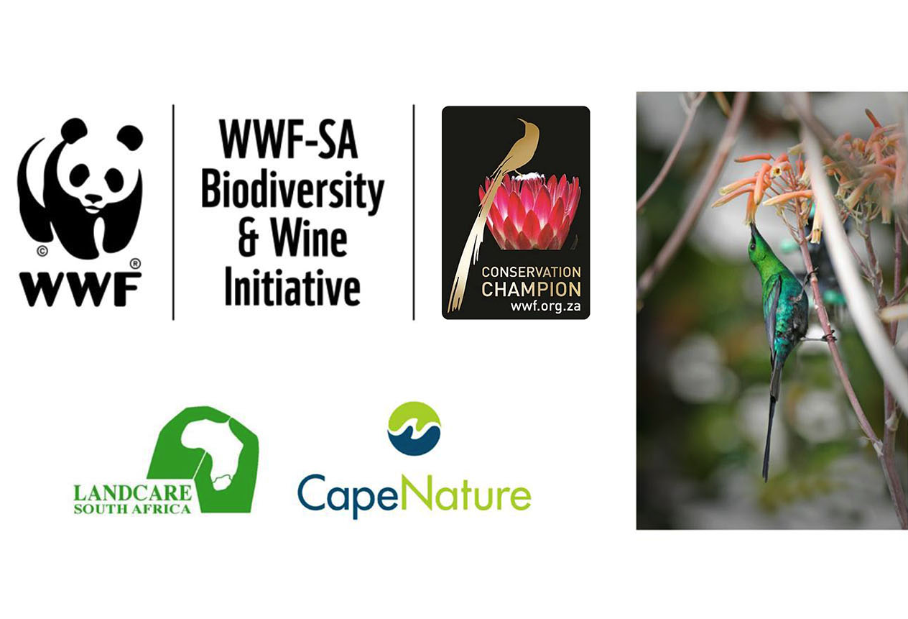
Breedekloof is home to the first conservancy in the Western Cape winelands, and has partnered with organisations such as WWF's Biodiversity & Wine Initiative (BWI), CapeNature and LandCare.

Slide 11
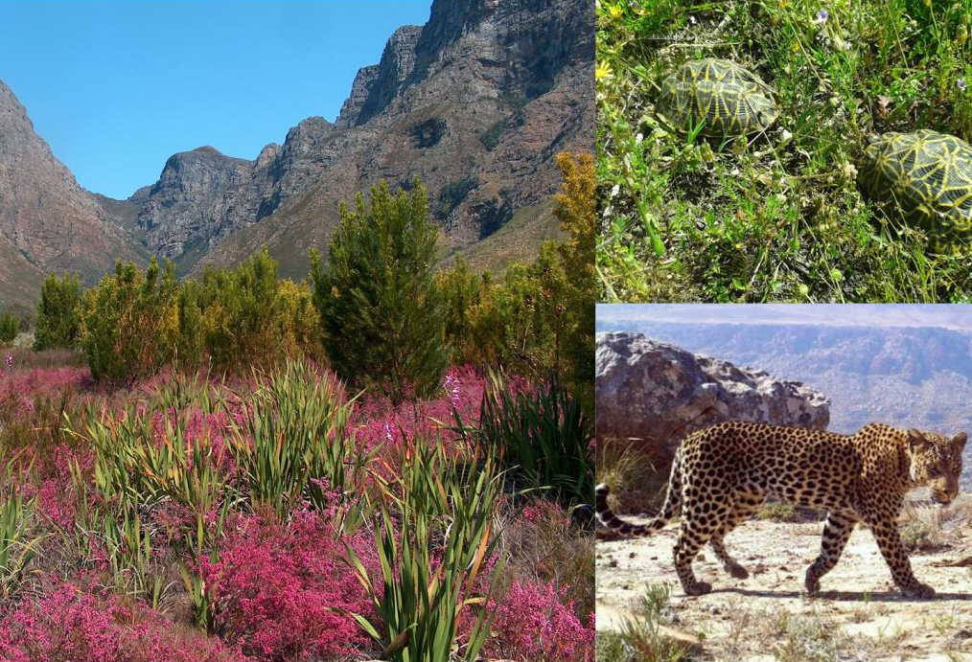
Part of the Cape Floral Kingdom, there are 160 endemic plant species in the valley and the mountains still teem with wildlife, including the Cape leopard and endangered geometric tortoise.

Slide 12
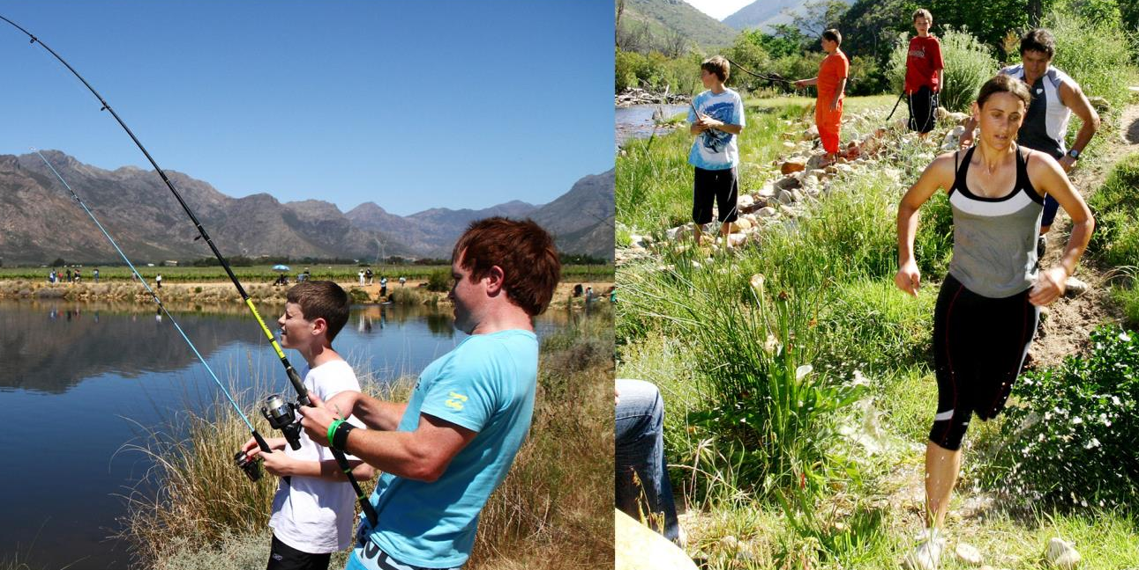
The mountains, rivers and valleys create a
natural playground, attracting hikers, birders,
mountain bikers and fishermen.

Slide 13
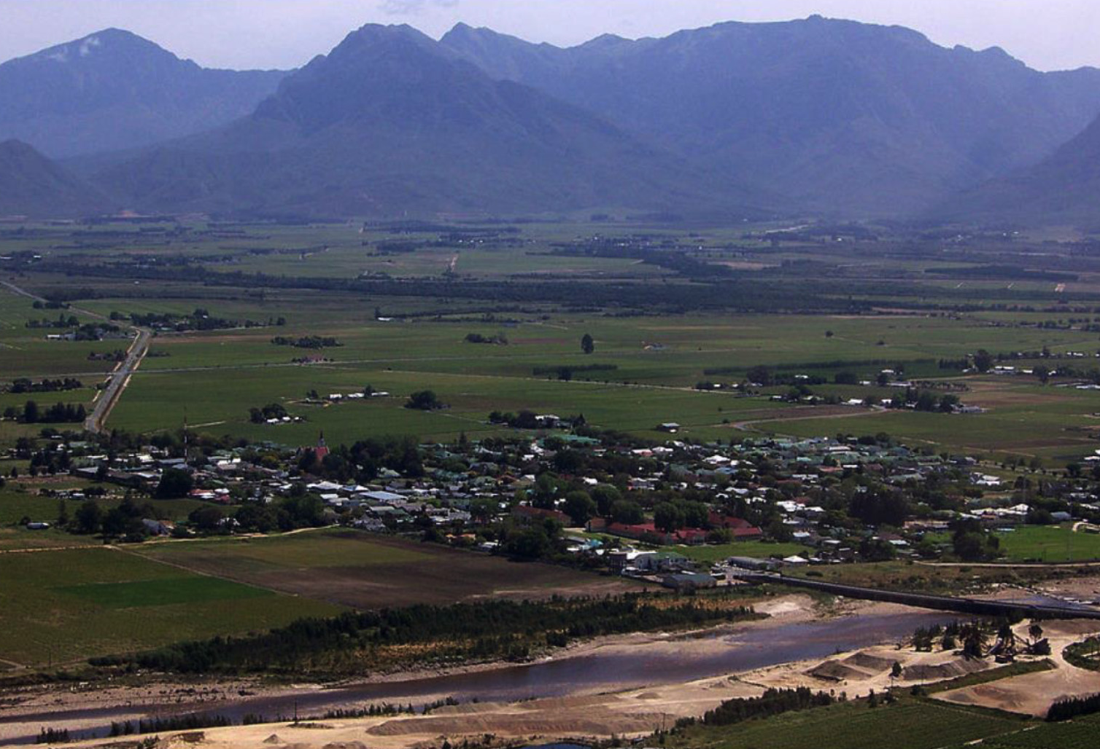
The wards of Goudini and Slanghoek lie within the rain belt caused by
the first range of north-south lying mountains next to the south-western coast, where the rain is still sufficient enough for vineyards to flourish
without irrigation. The average annual rainfall is 784 mm.

Slide 14
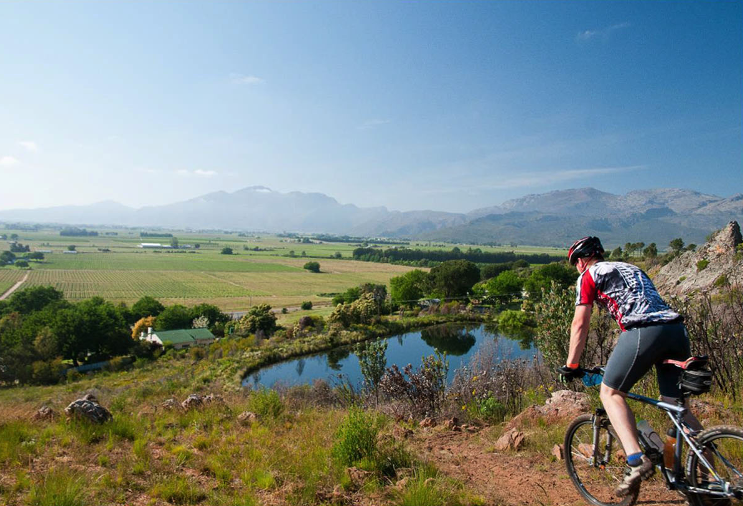
Summers are warm and the mean February
temperature is 21.6⁰C.

Slide 15
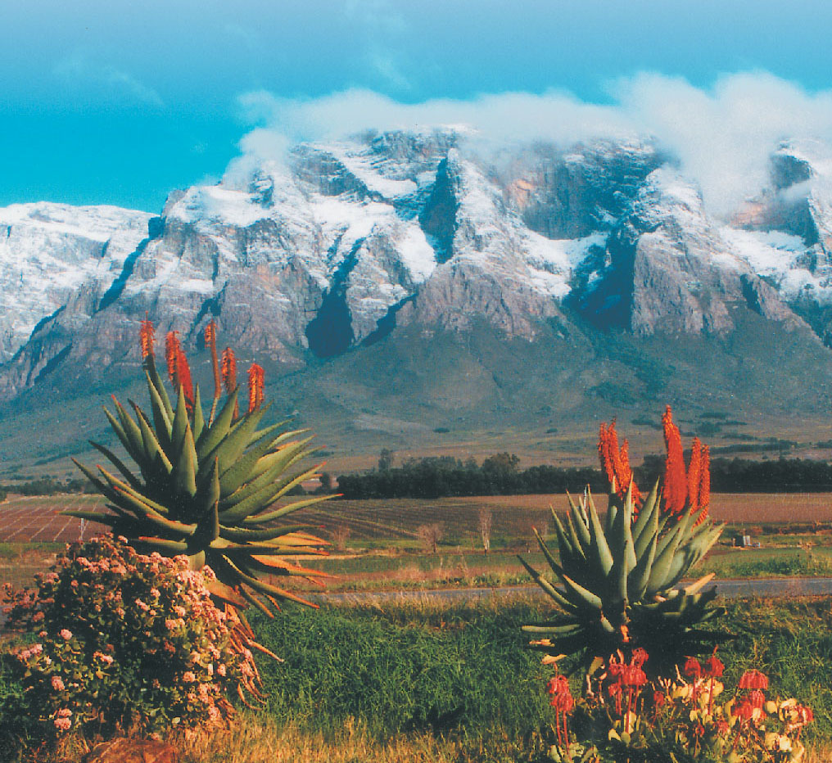
Snow-capped mountains during winter and into spring result in
a later bud break, longer hanging time and later harvest than the
continental climate would otherwise suggest.

Slide 16
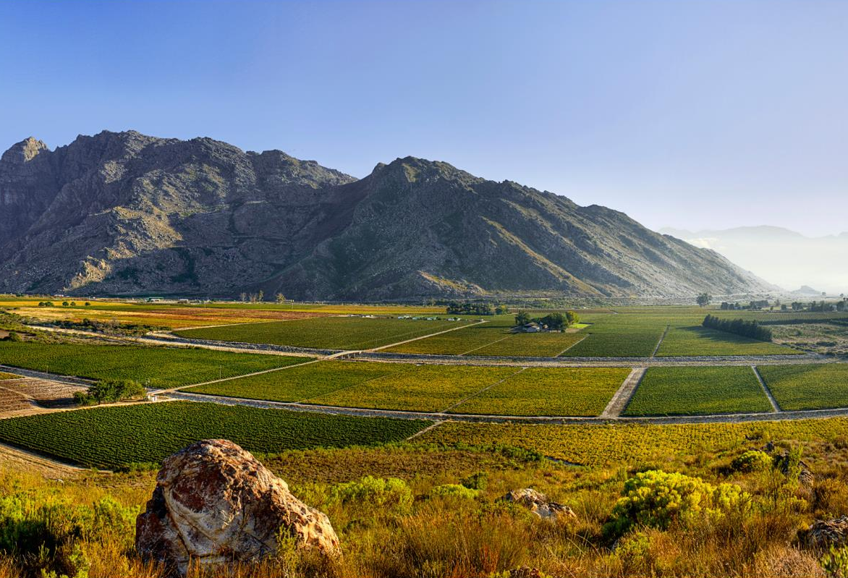
In summer, the prevailing south-easterly wind is funneled
through the valley, cooling the vines in the late afternoon, reducing
disease pressure and limiting the use of spraying.

Slide 17
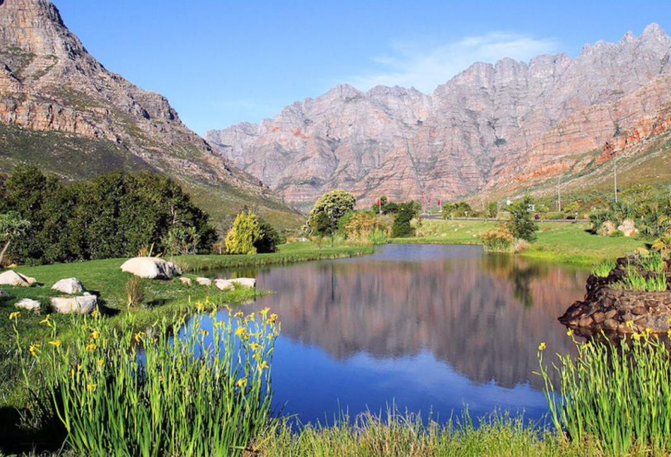
The Breedekloof district covers the upper reaches of the Breede River and its tributaries, resulting in the purest possible source of water.

Slide 18
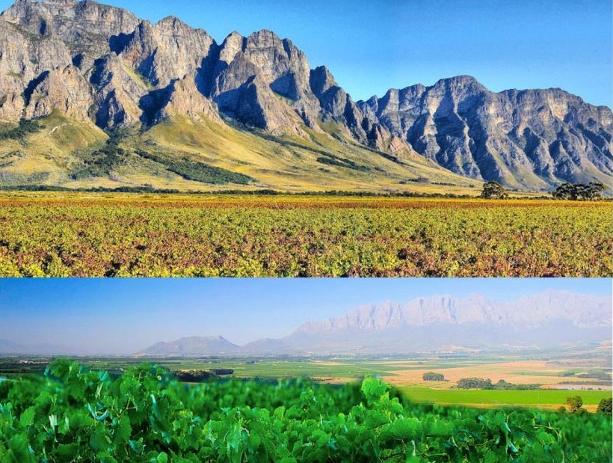
There are marked variations between the soils and mesoclimates in the different river valleys.

Slide 19
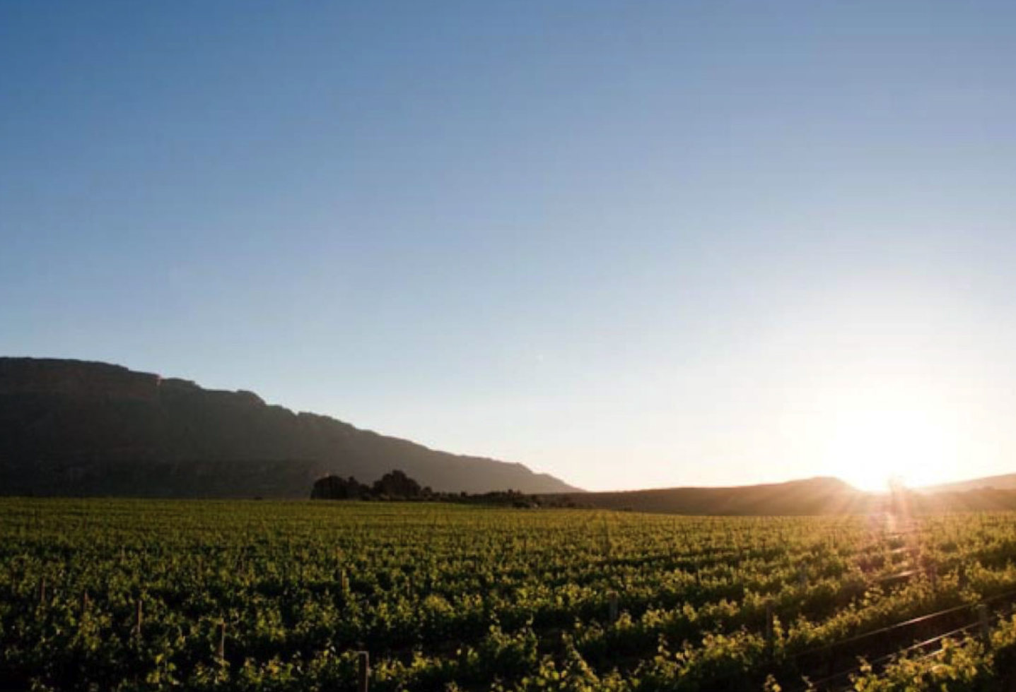
The Breedekloof is characterised mainly by vineyards which flourish on a flat landscape of alluvial valley soils with adequate drainage as they rest on a bed of river stones.

Slide 20
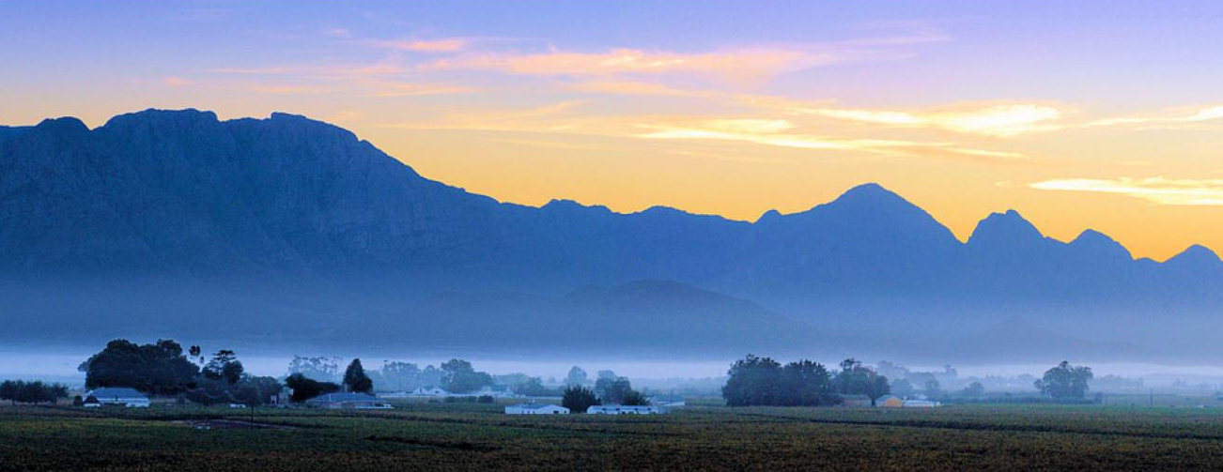
In Goudini and Slanghoek, these soils and boulder beds of mainly alluvial material range from bleached sand to dark, organic rich sand, especially in the vicinity of the Goudini ward. These massive alluvial deposits alternate with mostly Bokkeveld shales in many combinations.

Slide 21
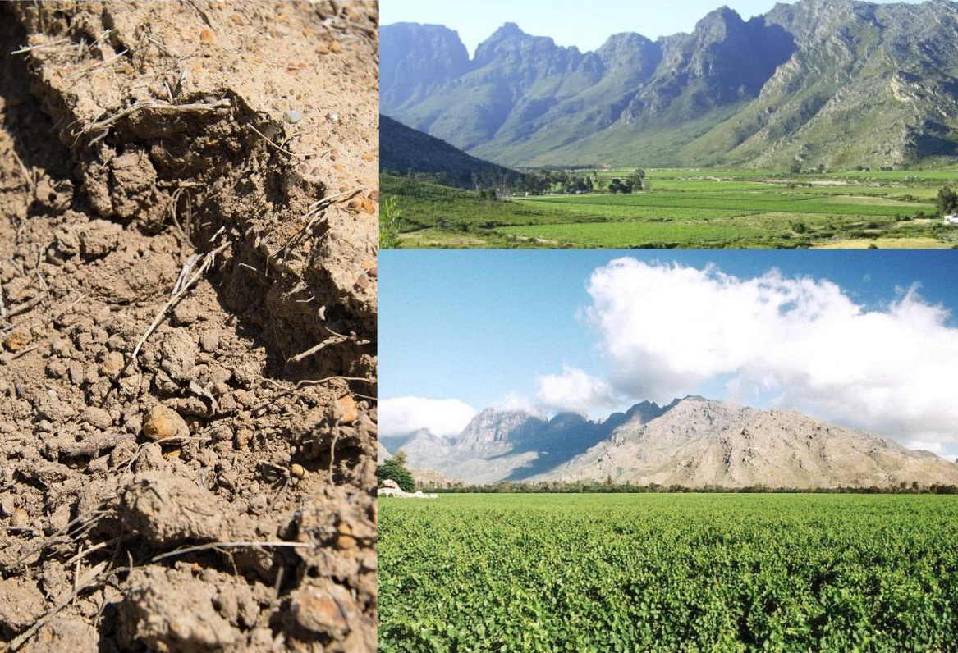
Although vineyards were originally only planted alongside the rivers, today they are being planted in an increasingly diverse range of landscapes, on a wider variety of soils.

Slide 22
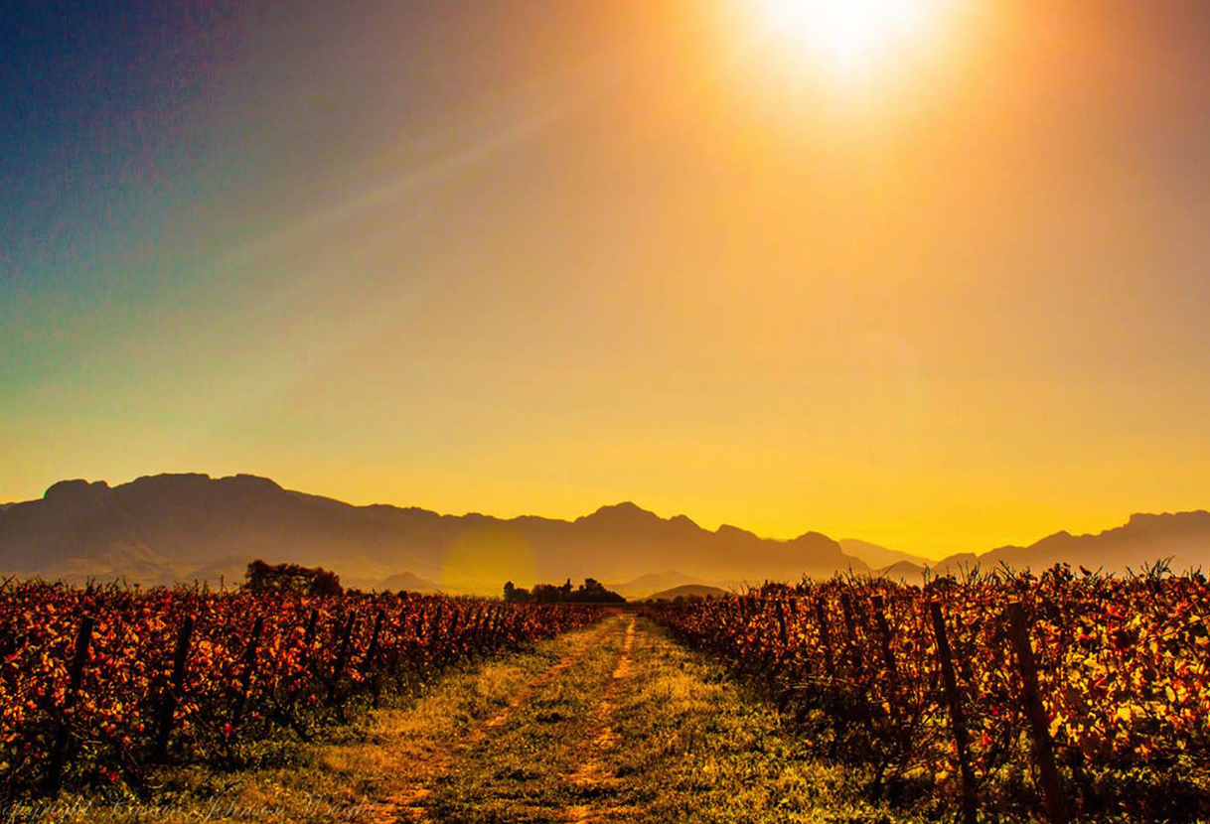
Breedekloof represents 14.4% of all hectares planted in South Africa – 17.1% of all white-wine grape hectares and 11.2% of all red-wine grape hectares.

Slide 23
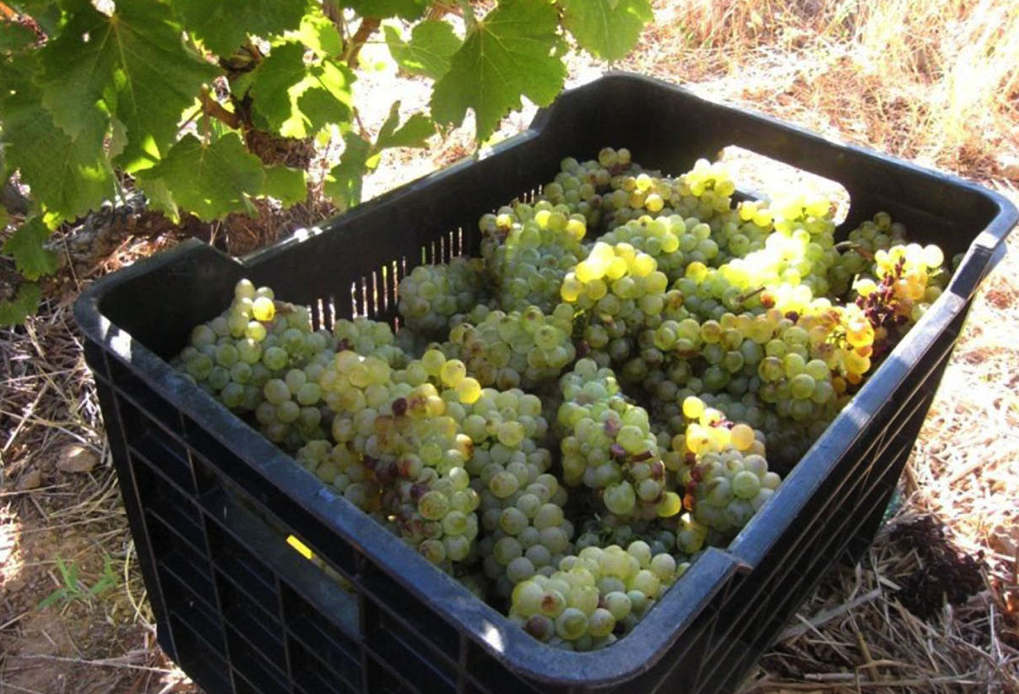
Chenin Blanc represents 18.4% of South Africa’s vineyards. Breedekloof has 17.1% of all Chenin plantings and supplies 21.7% of all wine made from Chenin.

Slide 24
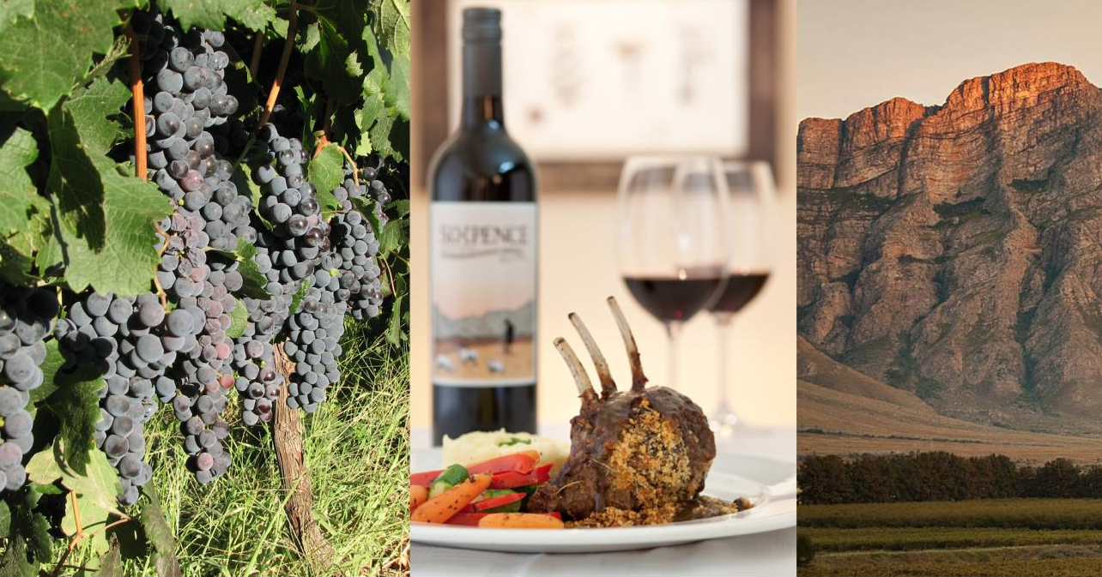
The most planted red-wine varieties are Pinotage,
Shiraz and Cabernet Sauvignon.

Slide 25
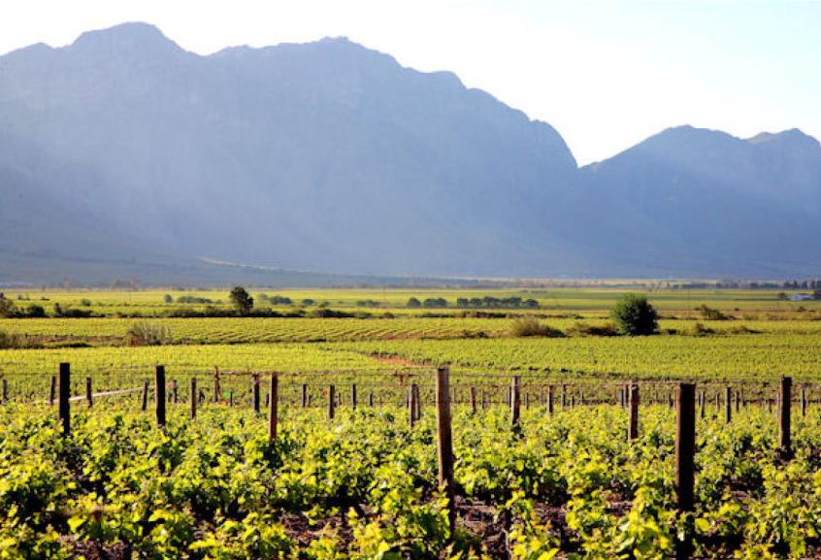
The Breedekloof valley continues to invest in
new plantings.

Slide 26
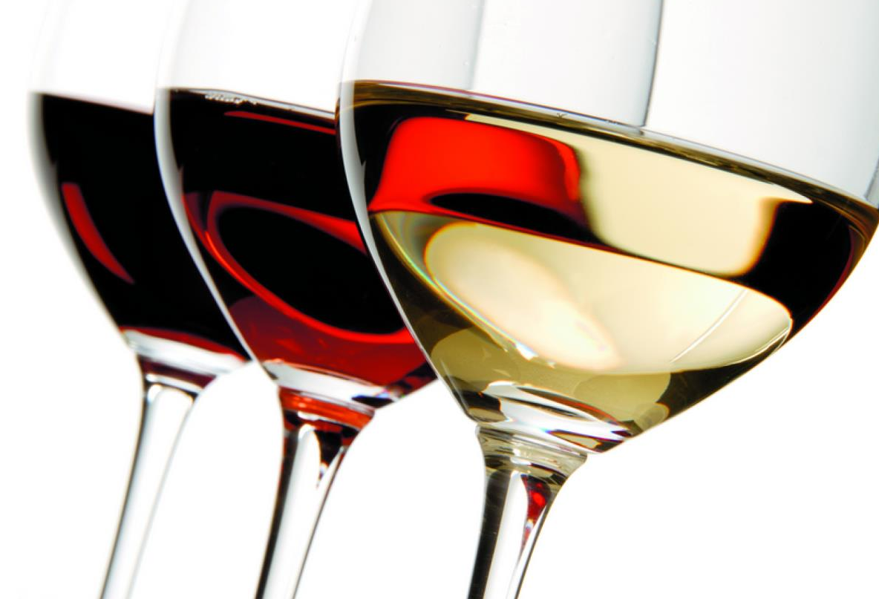
Diversity of soils, matched by diversity of climate and topography, allows the Breedekloof to deliver wines across a wide spectrum of styles.

Slide 27
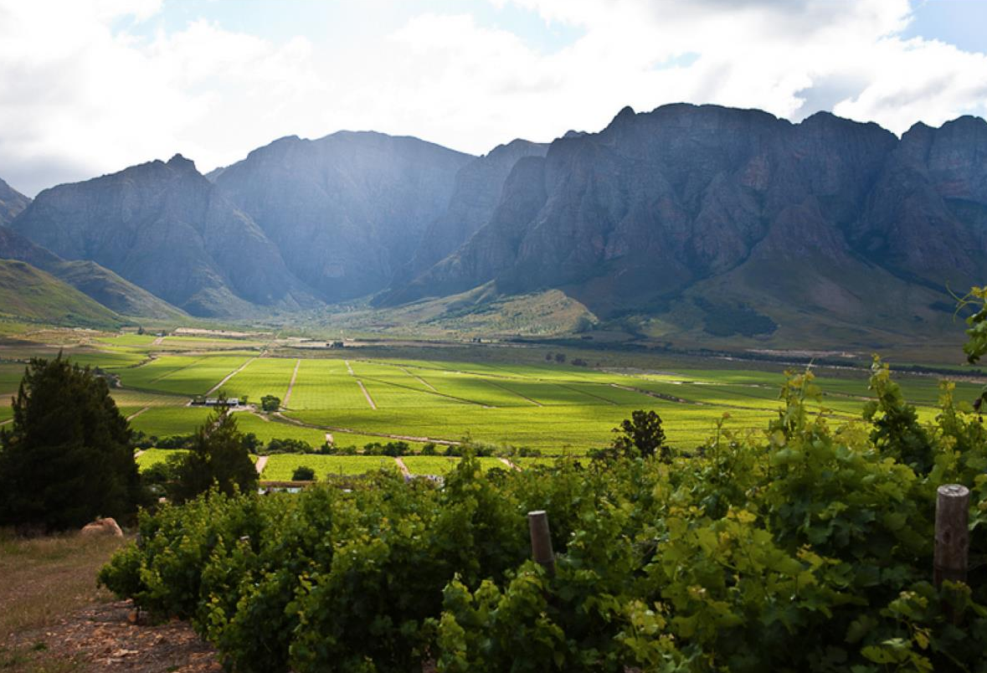
The images used in these presentations have been sourced from various producers, as well as industry and tourism bodies. These presentations are strictly for non-commercial, non-profit, educational purposes only and cannot be reproduced or transmitted in any form or by any means without written permission from Wines of South Africa (WoSA).

Slide 28
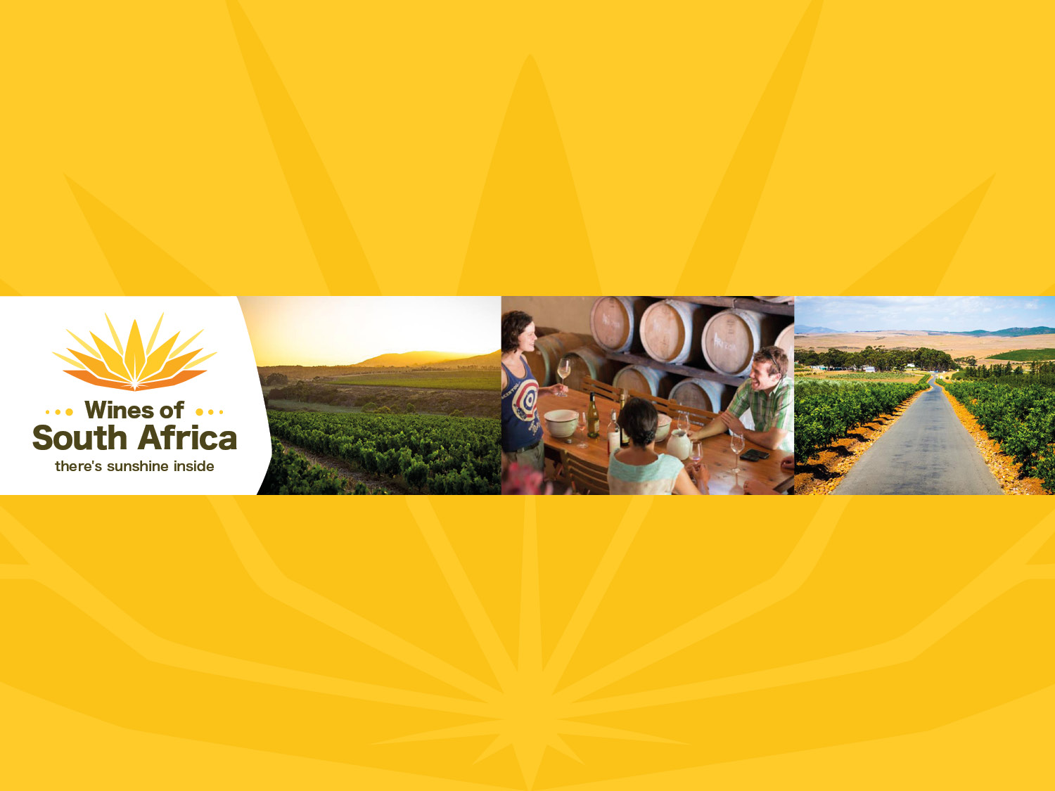
The Cape winelands, considered by many to be the most
beautiful in the world, have a network of diverse
and well-run wine routes, affording visitors a varied
and unforgettable experience.
The end
Notes:
The end

