Slide 1
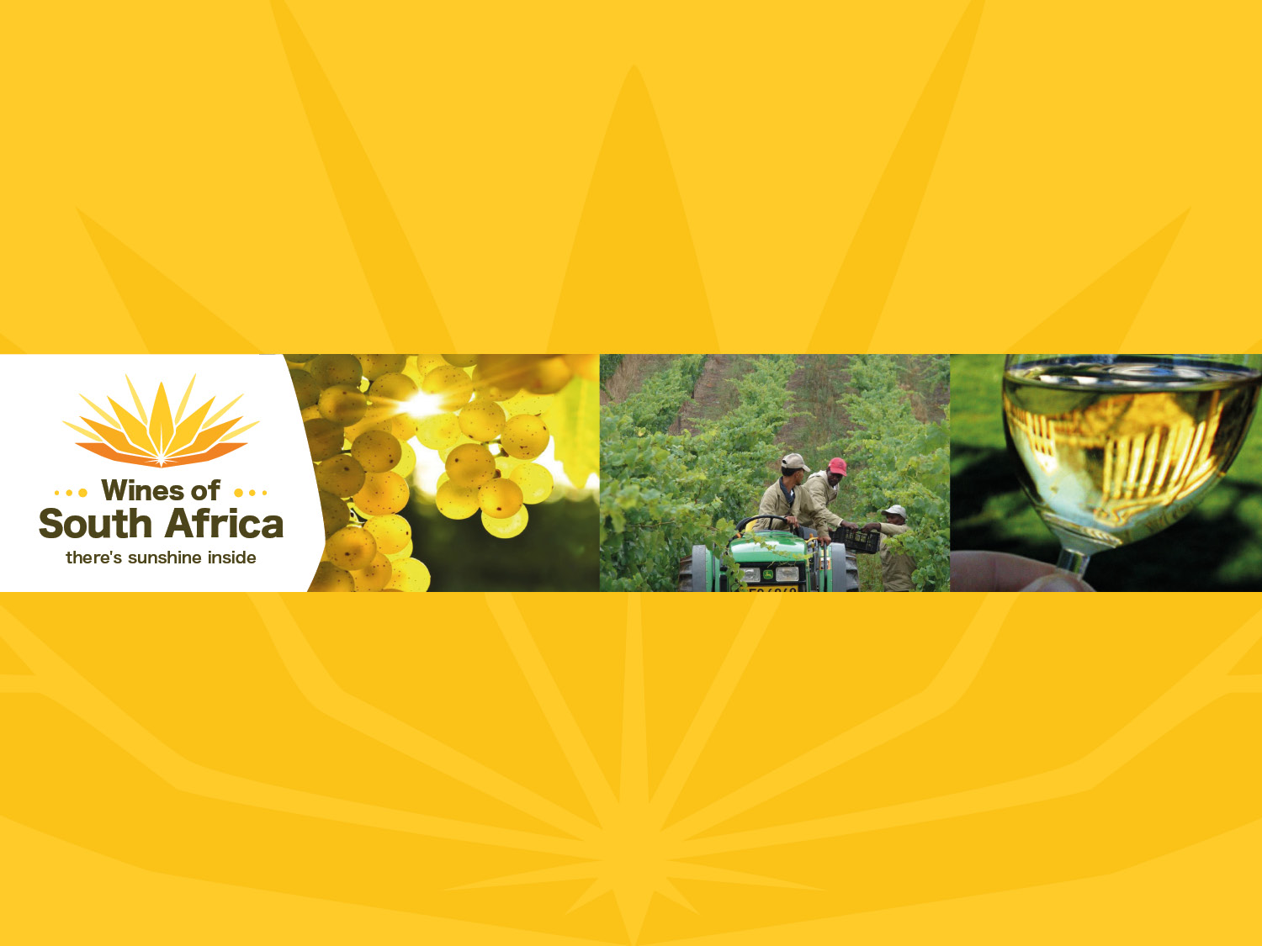
CHARDONNAY

Slide 2
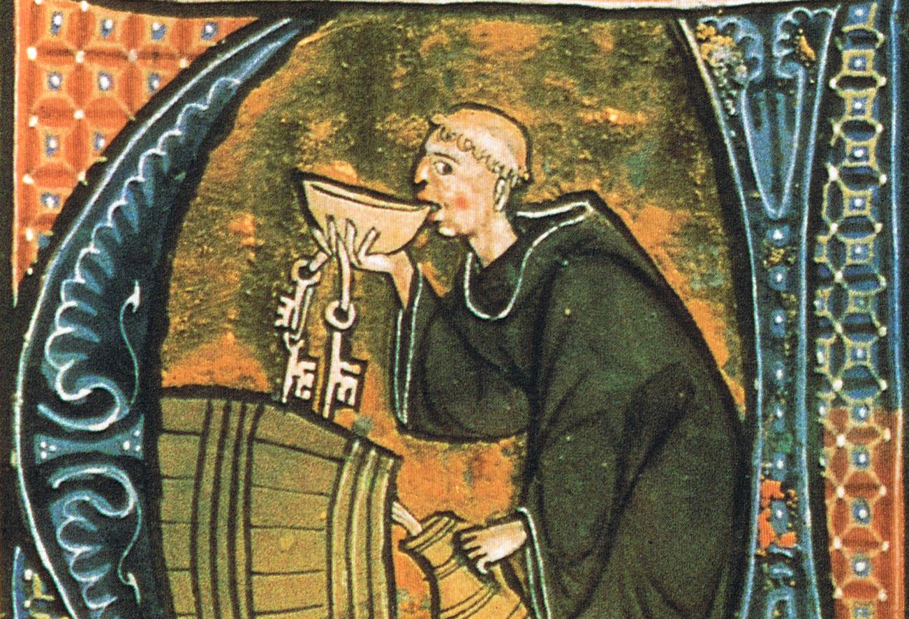
Notes:
A native of Burgundy, the earliest recorded historical reference to Chardonnay was made by the Cisternian monks in 1330.

Slide 3
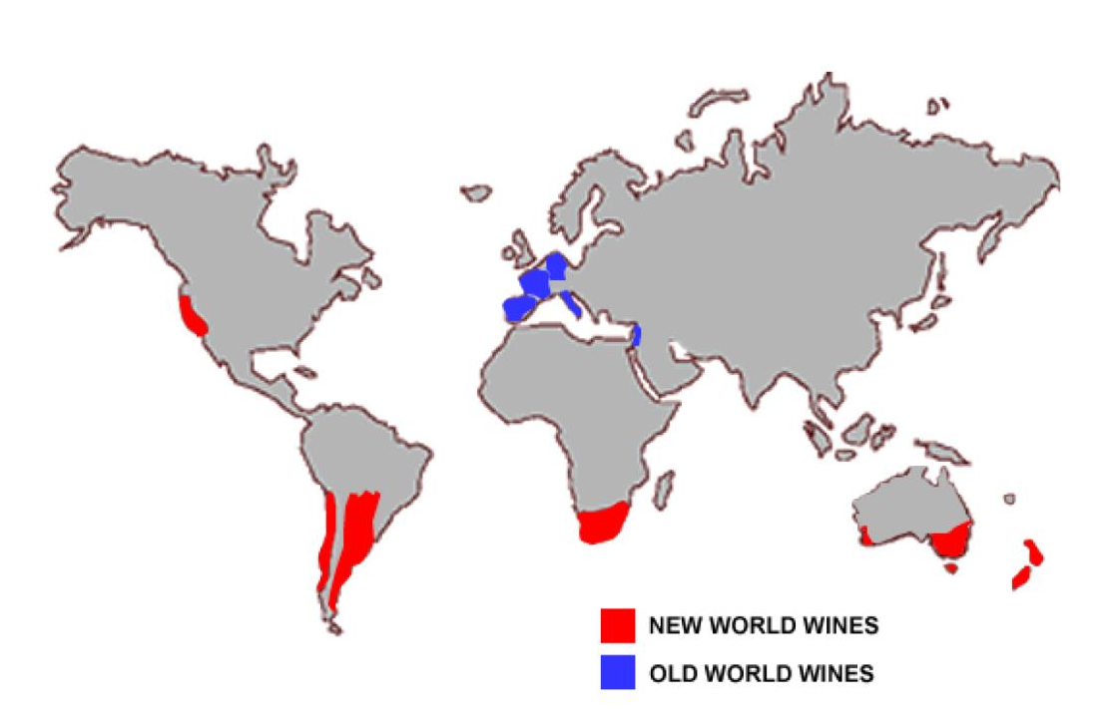
Notes:
Chardonnay is widely planted throughout the New World.

Slide 4
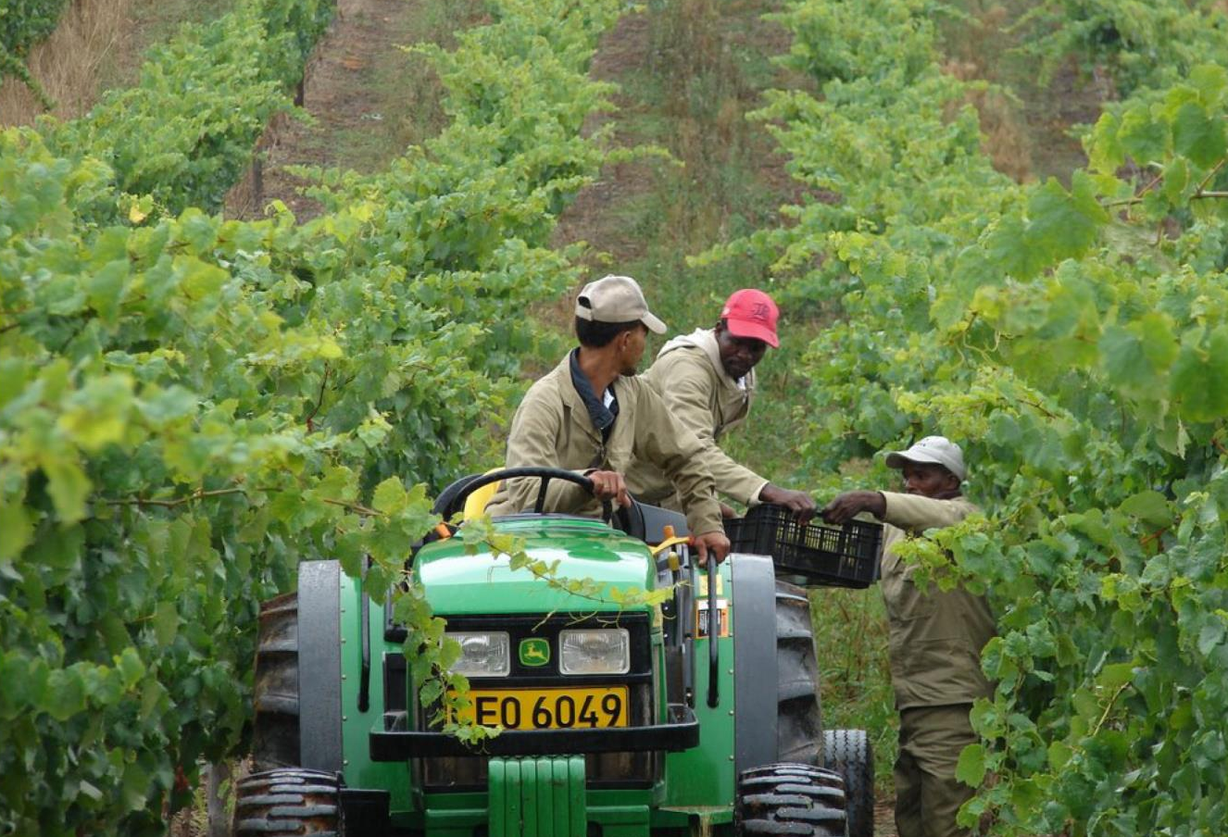
Notes:
South Africa, however, did not have access to Chardonnay plant material until the early 1980s, when forward-thinking producers opted to smuggle it into the country illegally!

Slide 5
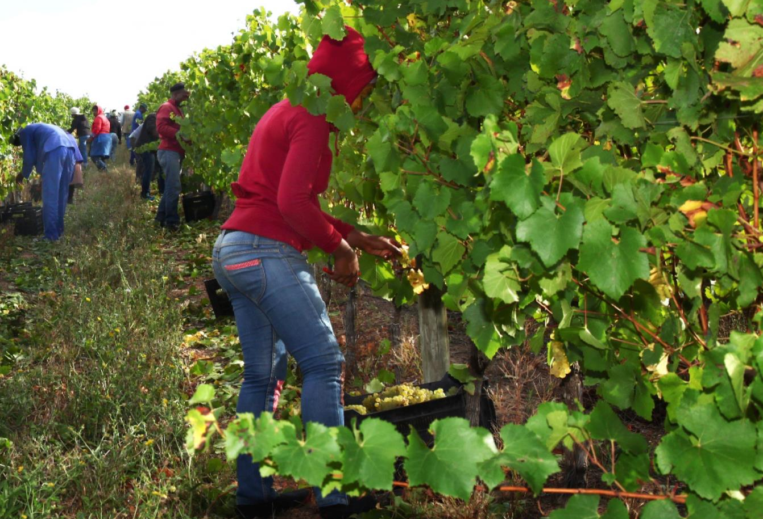
Notes:
Many new vineyards planted to this noble variety have come on stream in recent years.

Slide 6
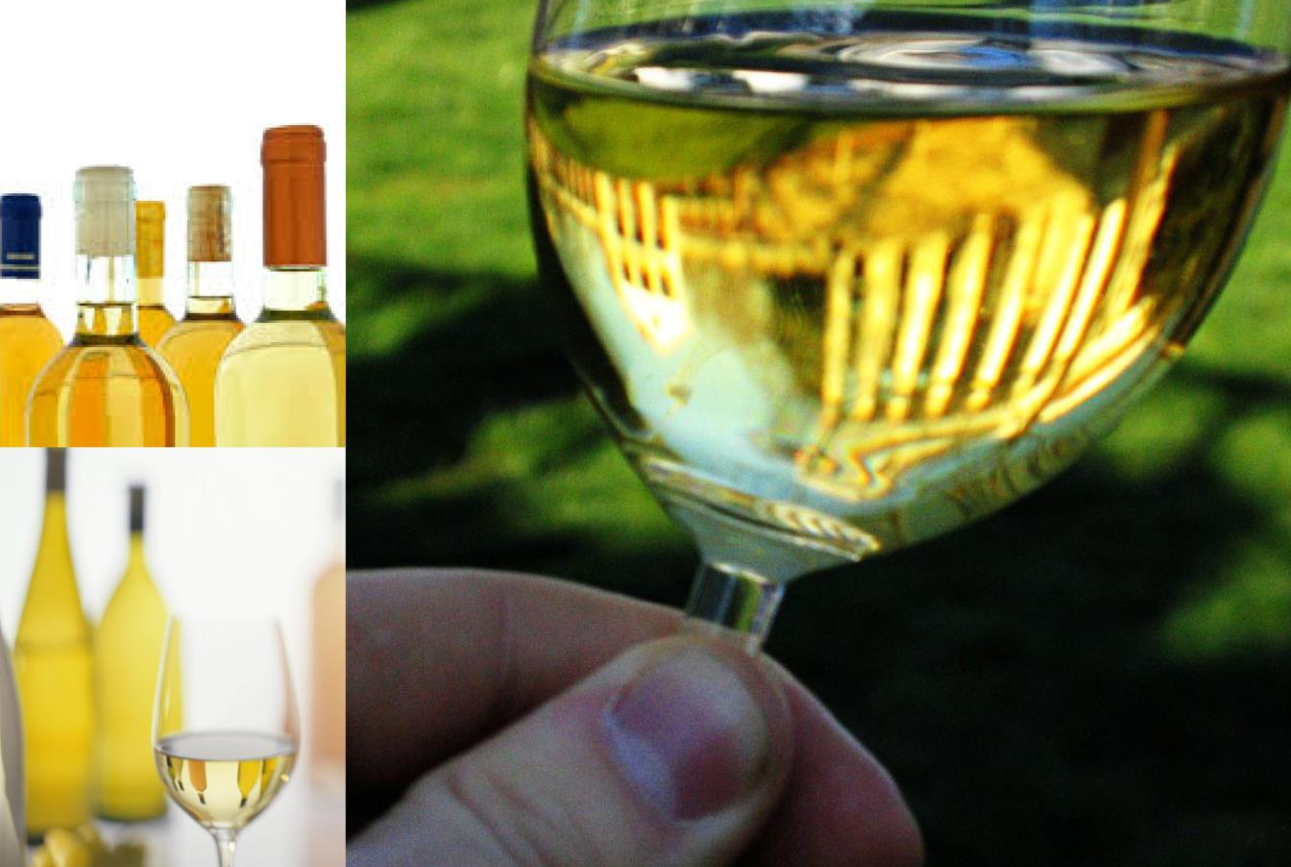
Notes:
While Burgundy remains the benchmark, South Africa offers Chardonnays of excellent quality across all price points and produces some outstanding top-end examples.

Slide 7
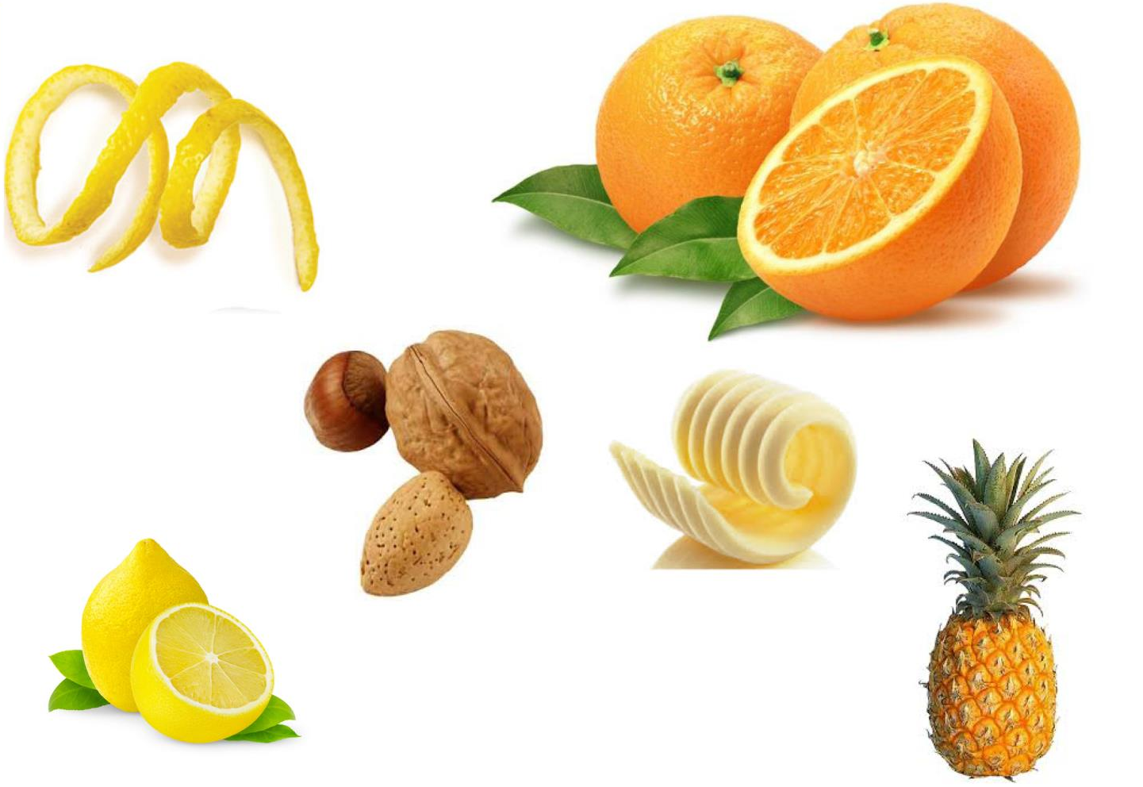
Notes:
A wide range of clones are associated with an extensive range of flavour profiles such as citrus, tropical, nutty or buttery, for example.

Slide 8
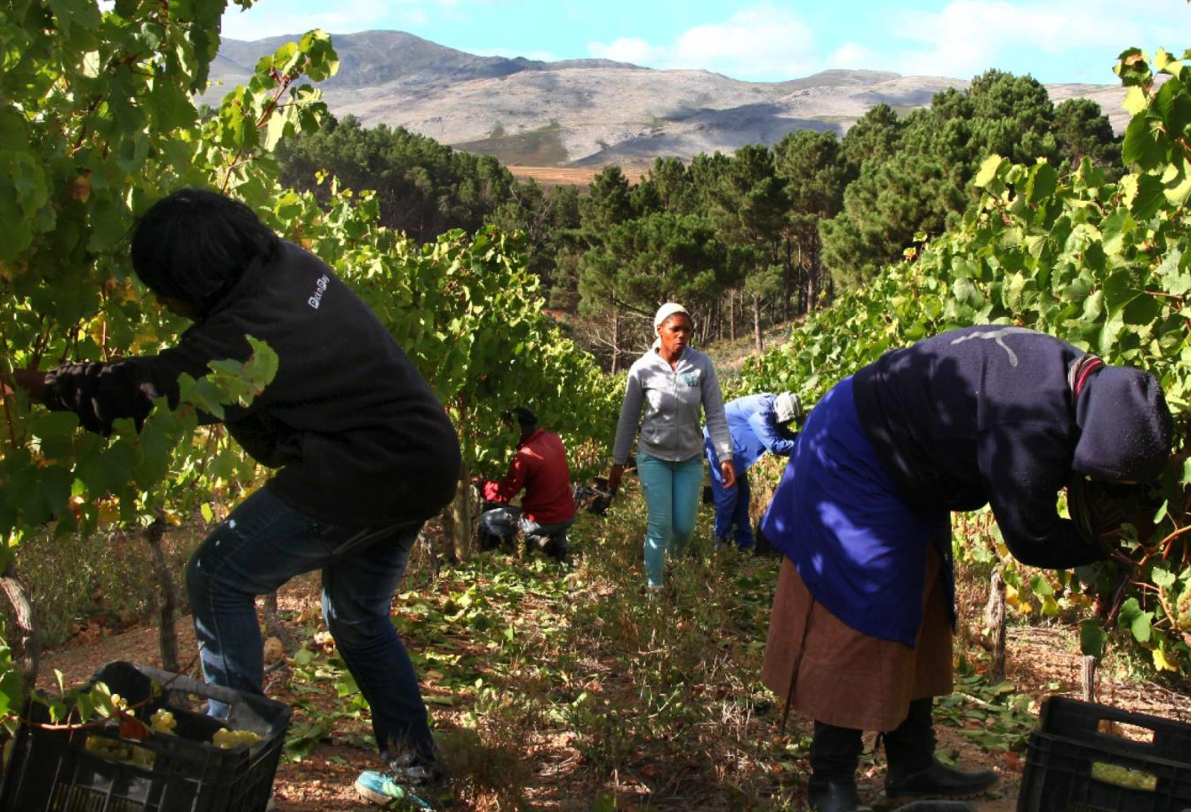
Notes:
Chardonnay is the fourth most planted white-wine variety in South Africa, with total plantings at the end of 2025 accounting for 6 574 ha (7.6% of the national vineyard).

Slide 9

Notes:
Robertson has the most plantings at 1 746 ha and has long had a well-deserved reputation for the quality of its Chardonnay wines. This is followed by Paarl at 1 164 ha and Stellenbosch at 994 ha (2025 figures).

Slide 10
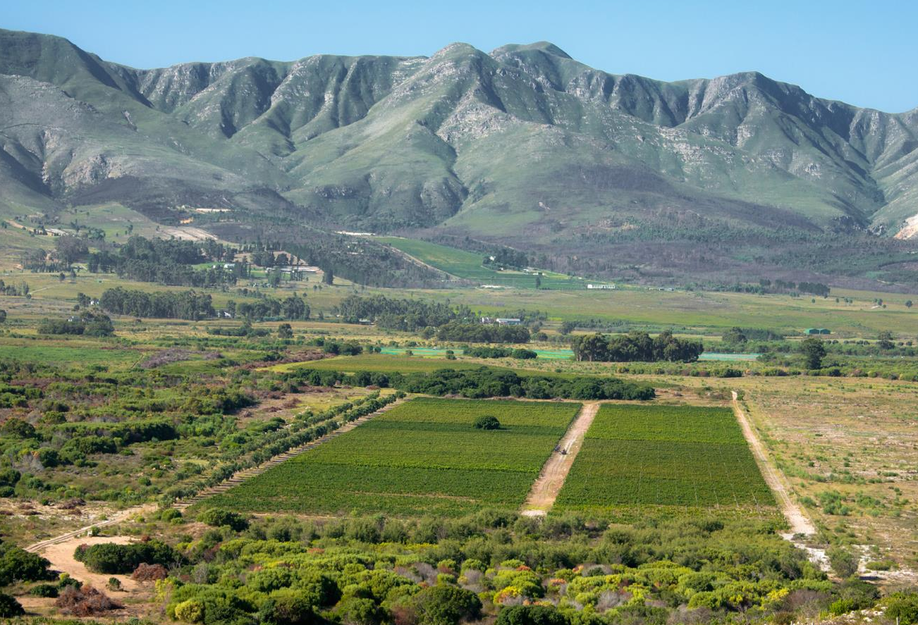
Notes:
Chardonnay wines have also emerged from cooler-climate areas such as Elgin and the Hemel-en-Aarde Valley.

Slide 11
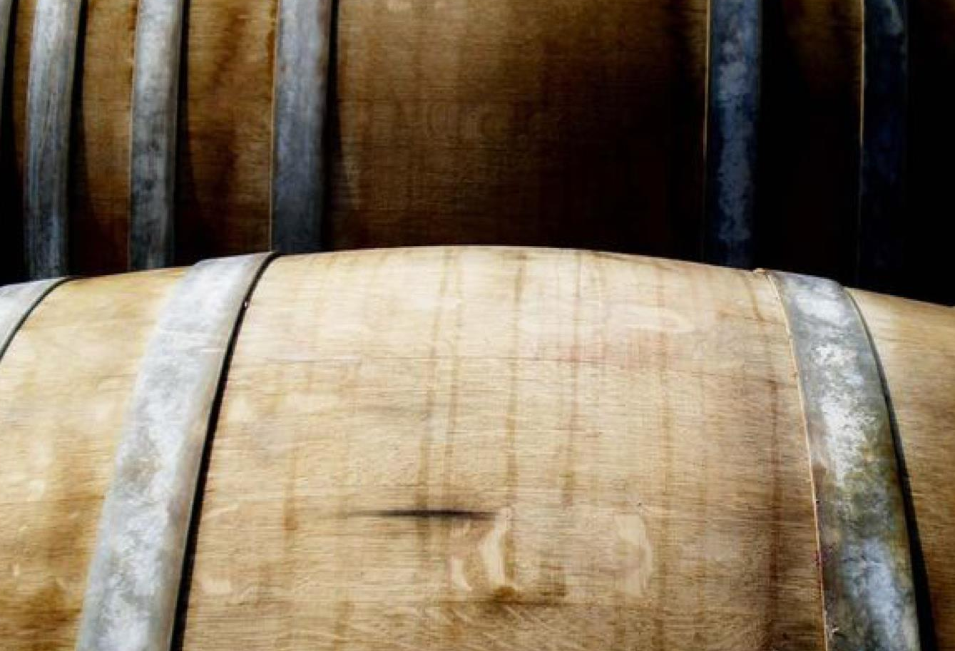
Notes:
Locally, much experimentation has been taking place, with barrel fermentation and the balanced use of oak during ageing of Chardonnay, and excellent varietal wines in a number of styles are being produced.

Slide 12
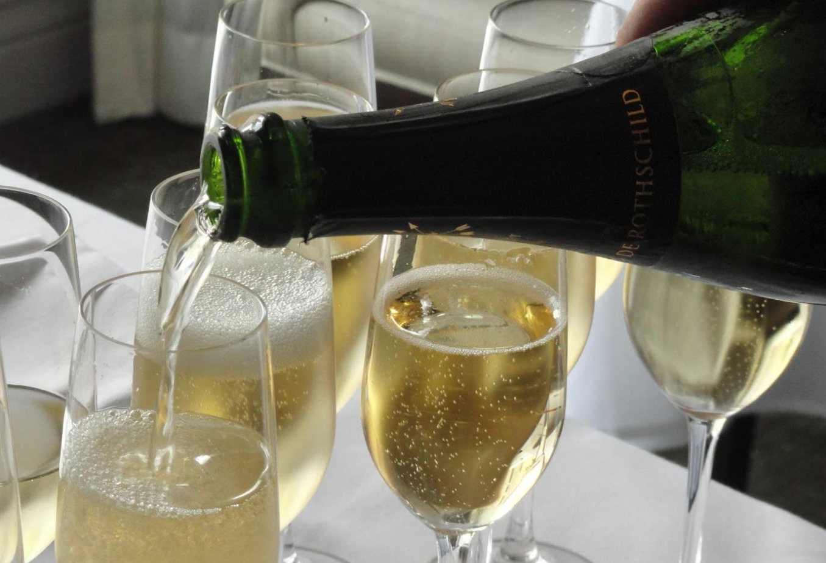
Notes:
Chardonnay is also used in some of the base wines from which Cap Classique sparkling wines are made, as well as in white blends, an increasingly successful category.

Slide 13
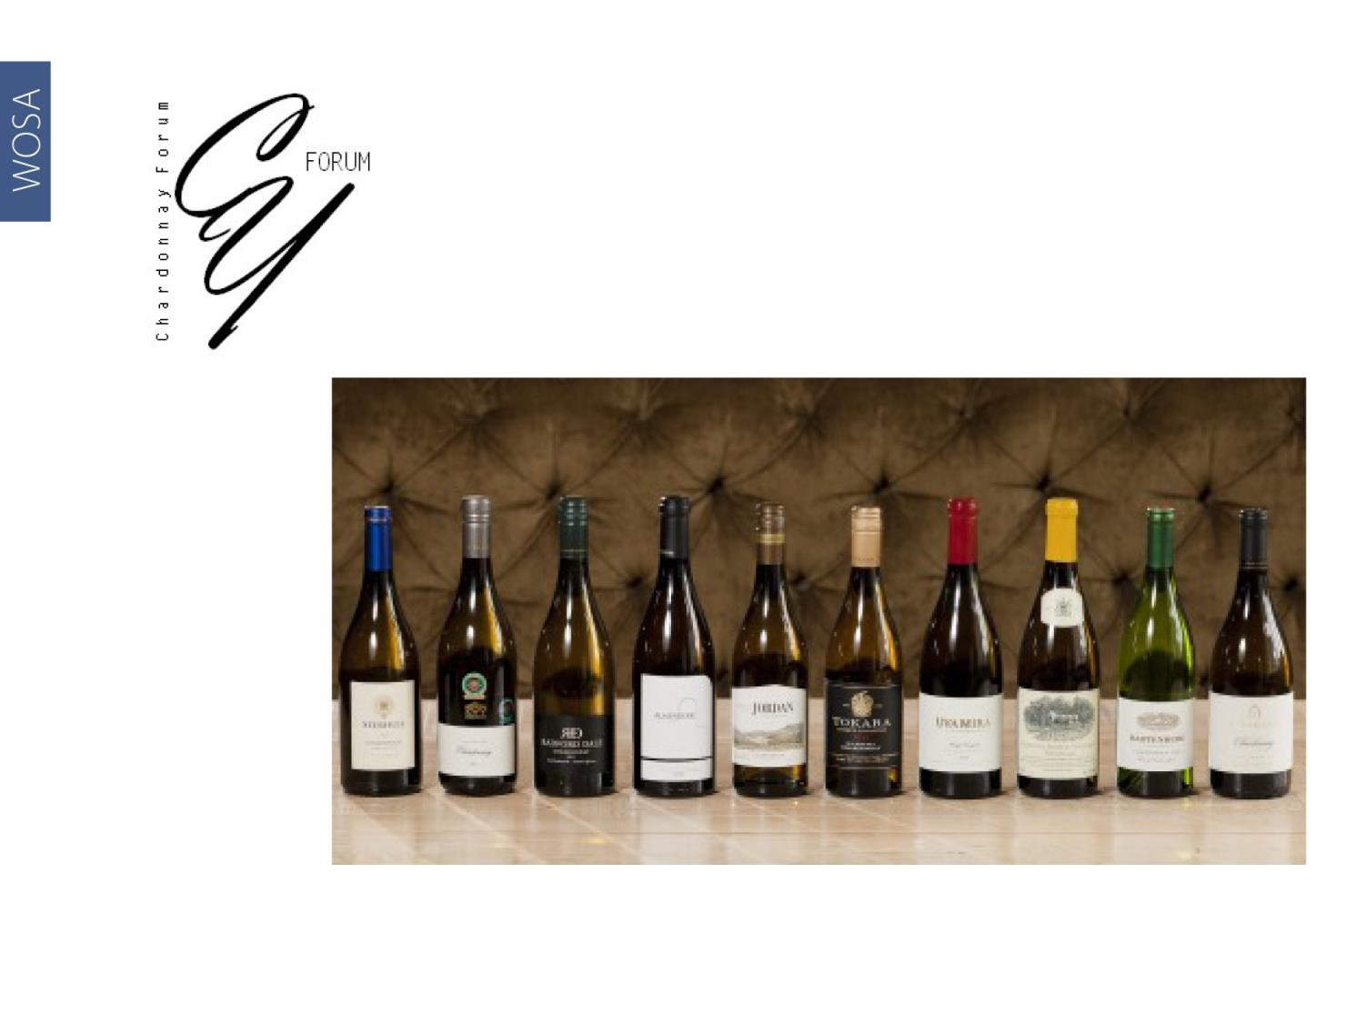
Visit http://on.fb.me/1nUcbsa for more information.
Notes:
The Chardonnay Forum of South Africa was formed in 2008 by a group of Chardonnay producers focused on raising the quality, image and awareness of South African Chardonnay among consumers, buyers, media and producers both locally and internationally. The forum evolved into the Chardonnay Association of South Africa in 2024. Visit www.chardonnayassociationsouthafrica.com for more information.

Slide 14
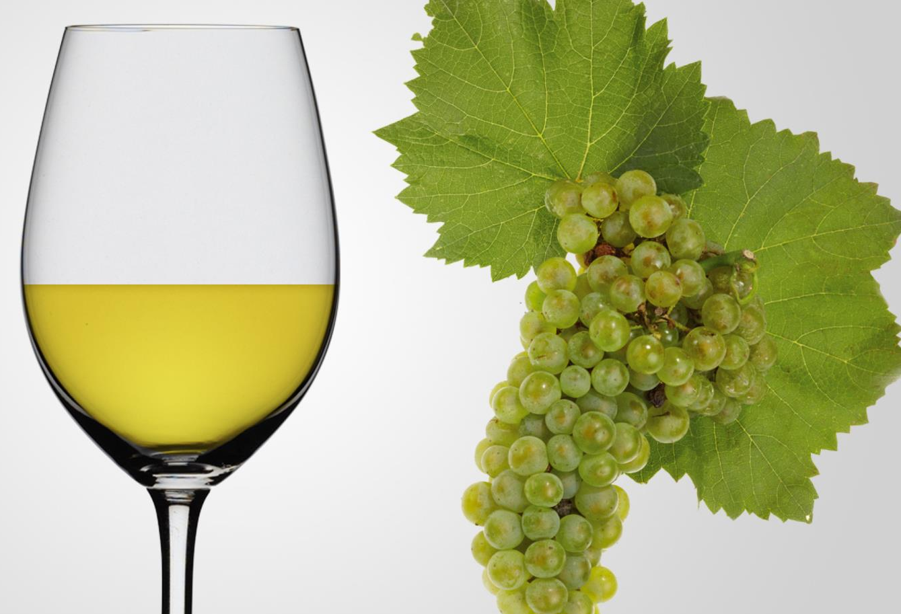
Notes:
Chardonnay comes in a wide range of styles and quality aimed at the relevant price points. The best examples have both substance and nuance, reflecting South Africa’s diverse winegrowing areas.

Slide 15
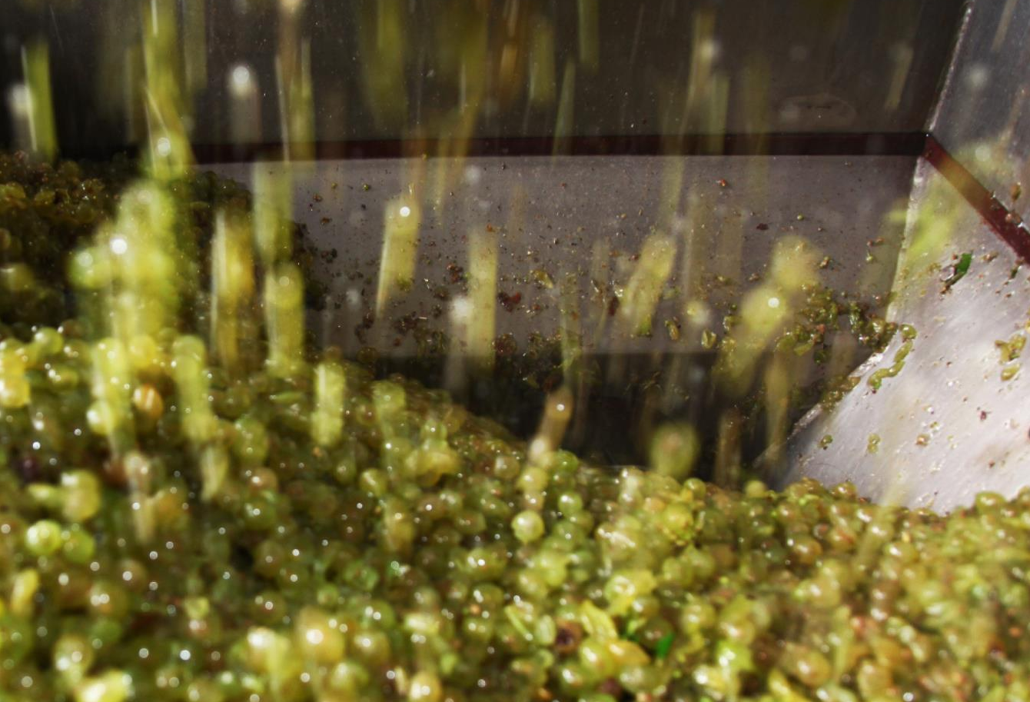
Notes:
This is thanks to more careful site selection but also a growing maturity among South Africa’s winemakers, who are increasingly unlikely to undertake major intervention in the cellar: there’s a more astute use of oak and a balanced winemaking approach, from malolactic fermentation to ageing on the lees. Winemakers are allowing more site specifics and purity of fruit to be expressed.

Slide 16
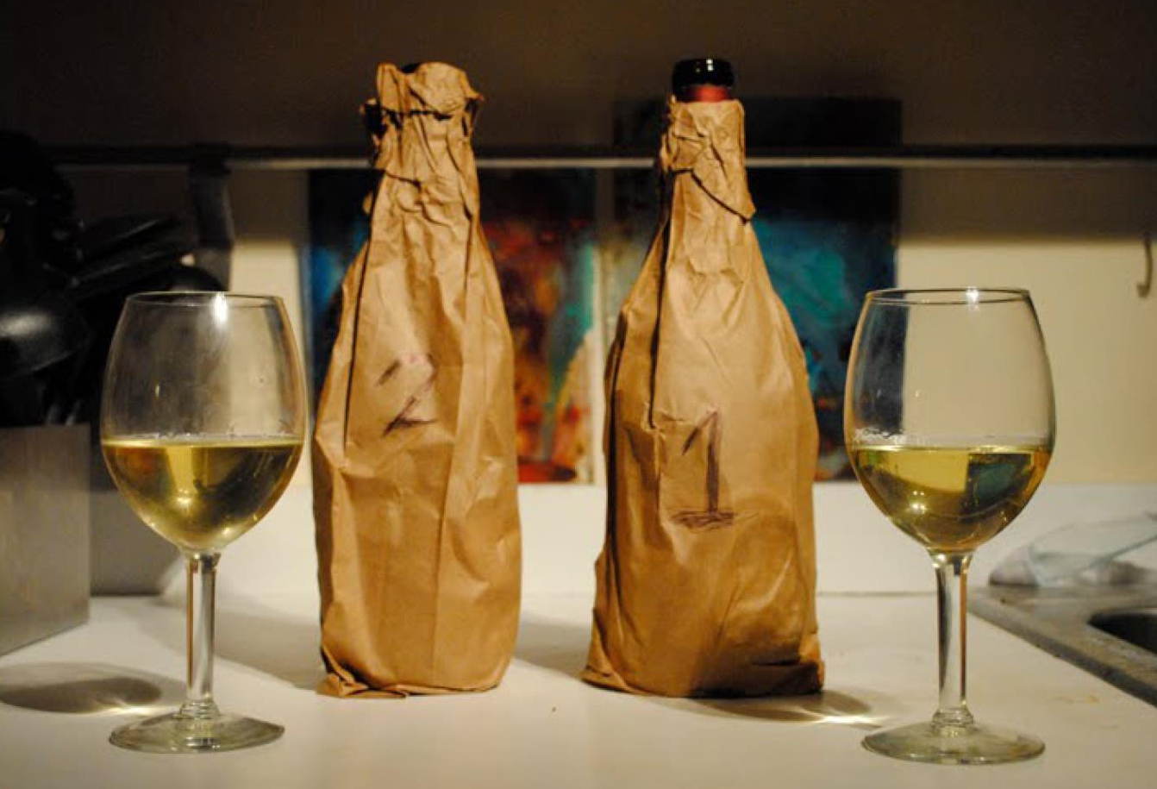
Notes:
Perhaps most exciting of all is the emergence of what might be termed a uniquely South African take on the variety. It is a cliché to refer to local wine as sitting stylistically somewhere between the Old and the New World, but increasingly we are seeing examples that simultaneously offer the complexity of the former and the fruit expression of the latter.

Slide 17
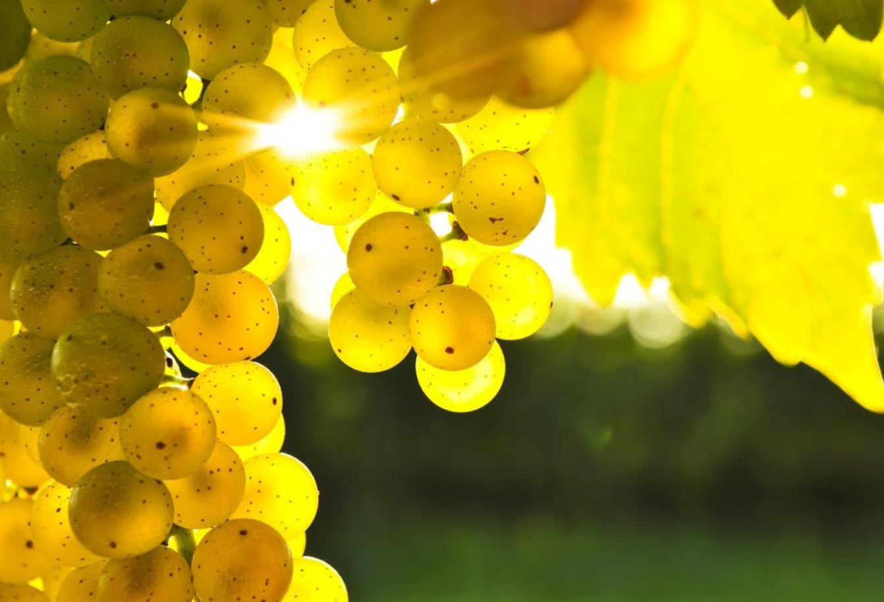
WOSA
Notes:
What seems to elevate the best South African Chardonnays is a purity of fruit that shines through no matter what treatment and wooding the wine underwent in the cellar.

Slide 18
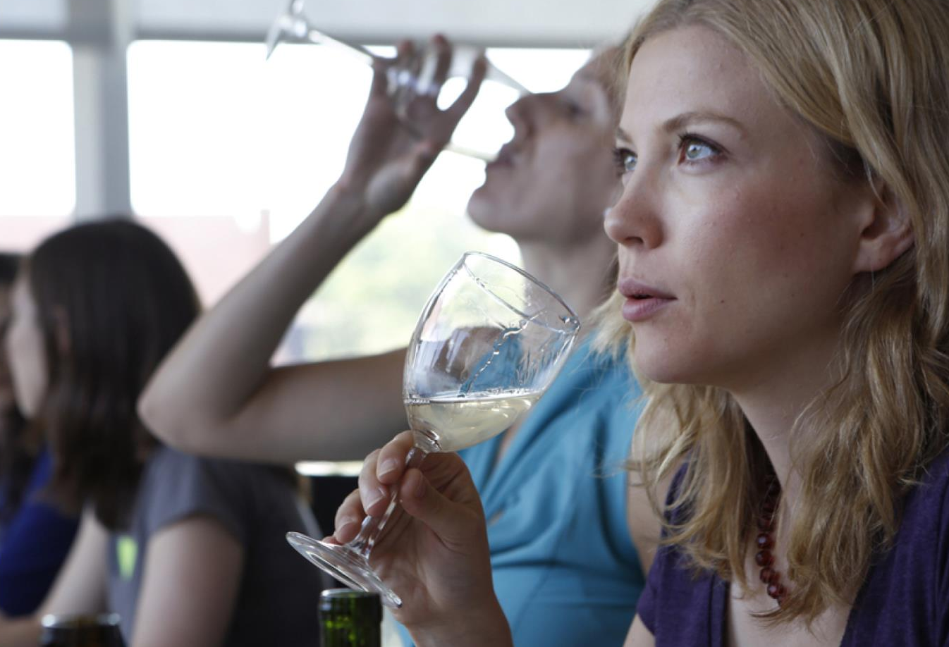
Notes:
Two distinct styles predominate in the more serious category: elegant wines with the emphasis on typical lemony freshness and pretty floral aromatics, with subtle oaking and a hint of creaminess and toastiness.

Slide 19
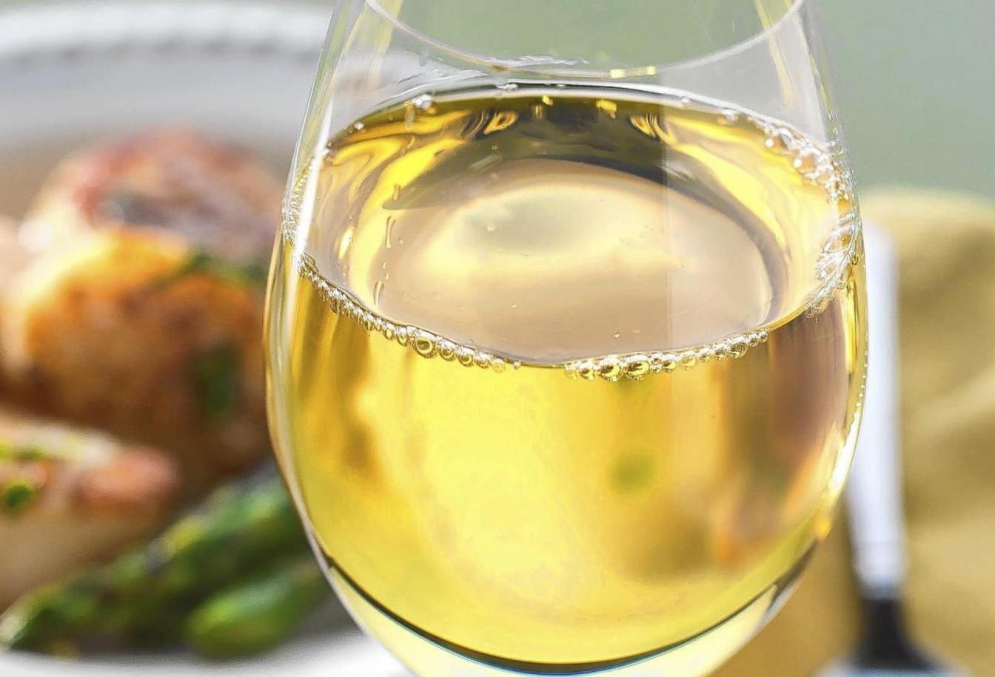
Notes:
And a richer, riper style that is more heavily wooded.

Slide 20
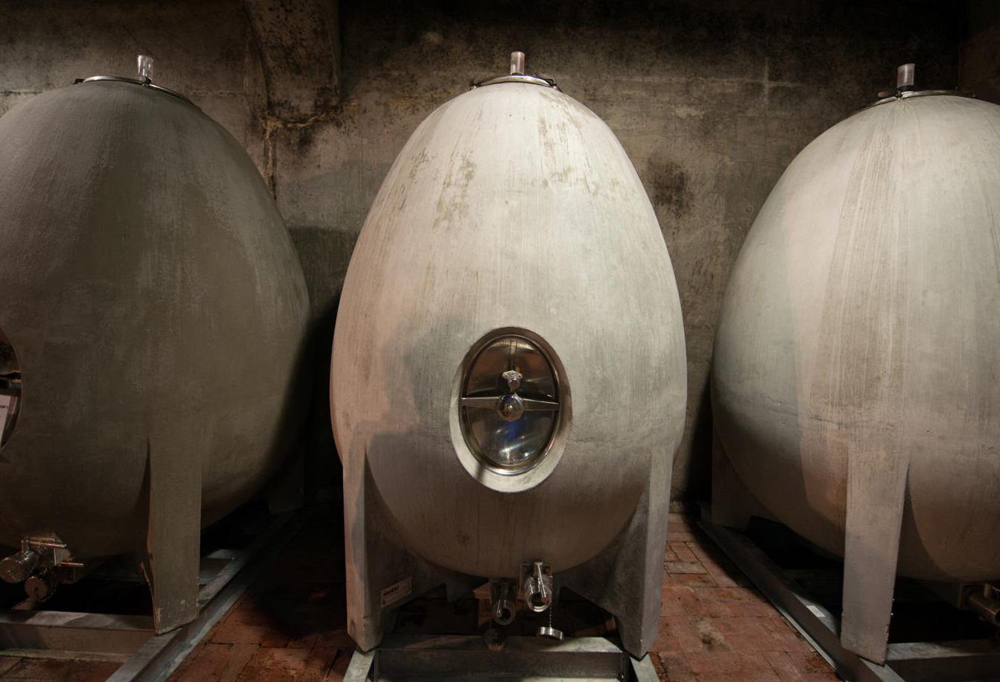
Notes:
A small but growing category is unwooded Chardonnay. These are sometimes vinified in a Nomblot egg-shaped concrete fermenter as opposed to tanks or barrels

Slide 21
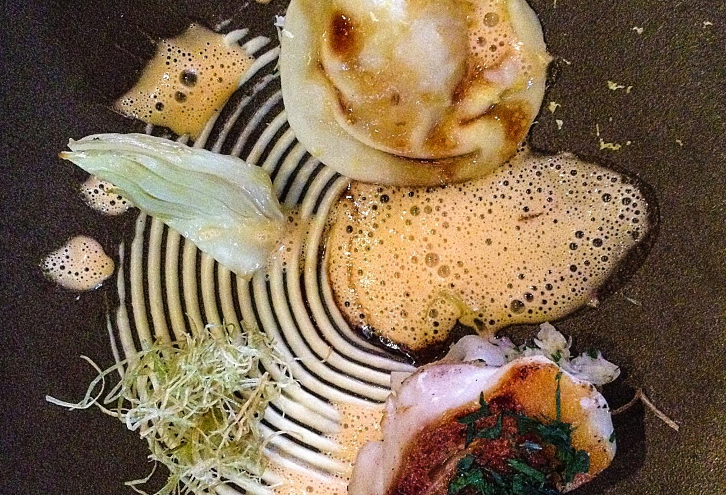
Notes:
Full-bodied Chardonnay pairs well with a variety of dishes with creamy sauces, from poultry, fish and veal to seafood pasta. A lighter style goes well with pâtés and terrines, fish pie and salmon fish cakes.

Slide 22

“We have such diverse sites
in South Africa.
Simply follow your taste and
choose your wine.”
– Sjaak Nelson, winemaker at Jordan Wine Estate and
chair of the Chardonnay Association

Slide 23
The end
Notes:
The end

