Slide 1
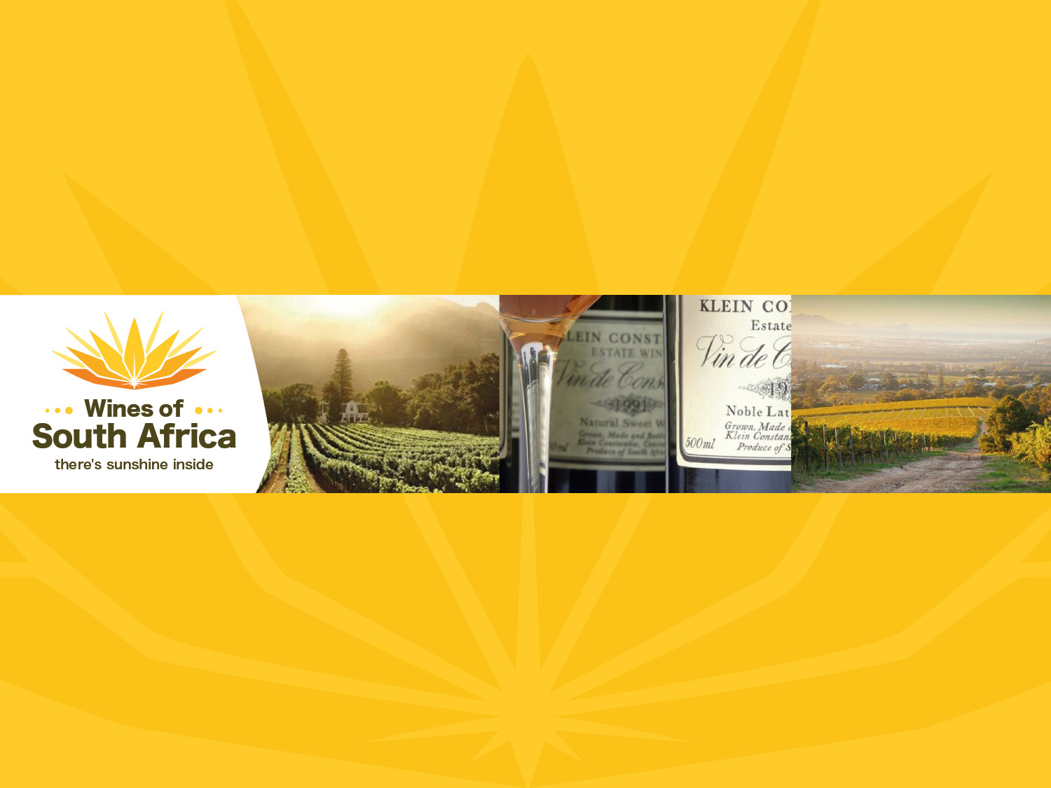
CAPE WINELANDS
CONSTANTIA
Notes:
Wines of South Africa

Slide 2

Where is South Africa?

Slide 3

South Africa is the southernmost
country in Africa.

Slide 4

Our winelands are located at the
very tip of South Africa.

Slide 5

PRODUCTION AREAS: Districts of South Africa.

Slide 6

Wards of South Africa.

Slide 7

Coastal
Region: Coastal
District: Cape Town
Wards: Constantia
Hout Bay

Slide 8
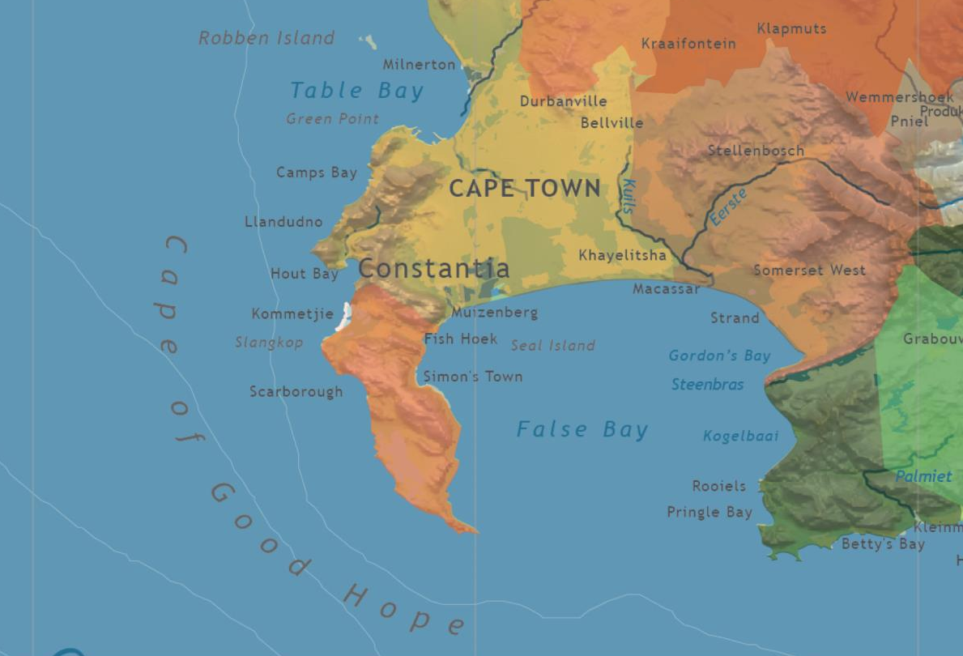

Slide 9
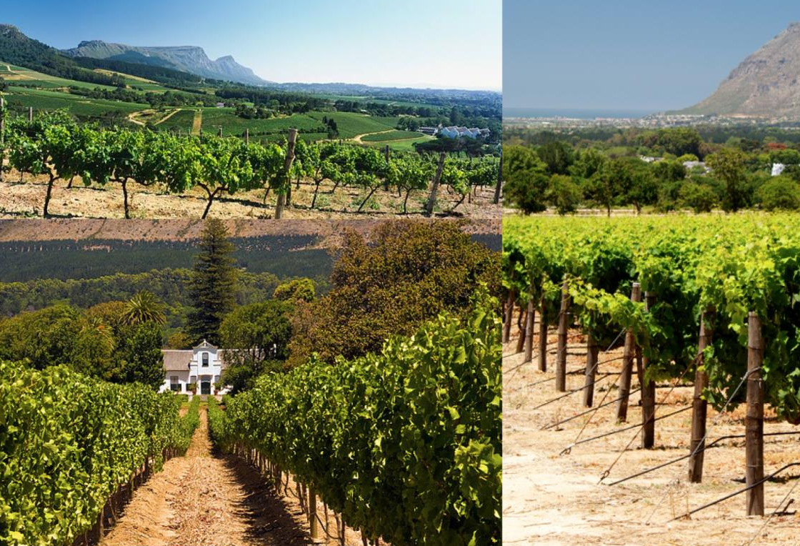
The vineyards in this premier viticultural ward climb up the east-facing slopes of Constantiaberg mountain.

Slide 10
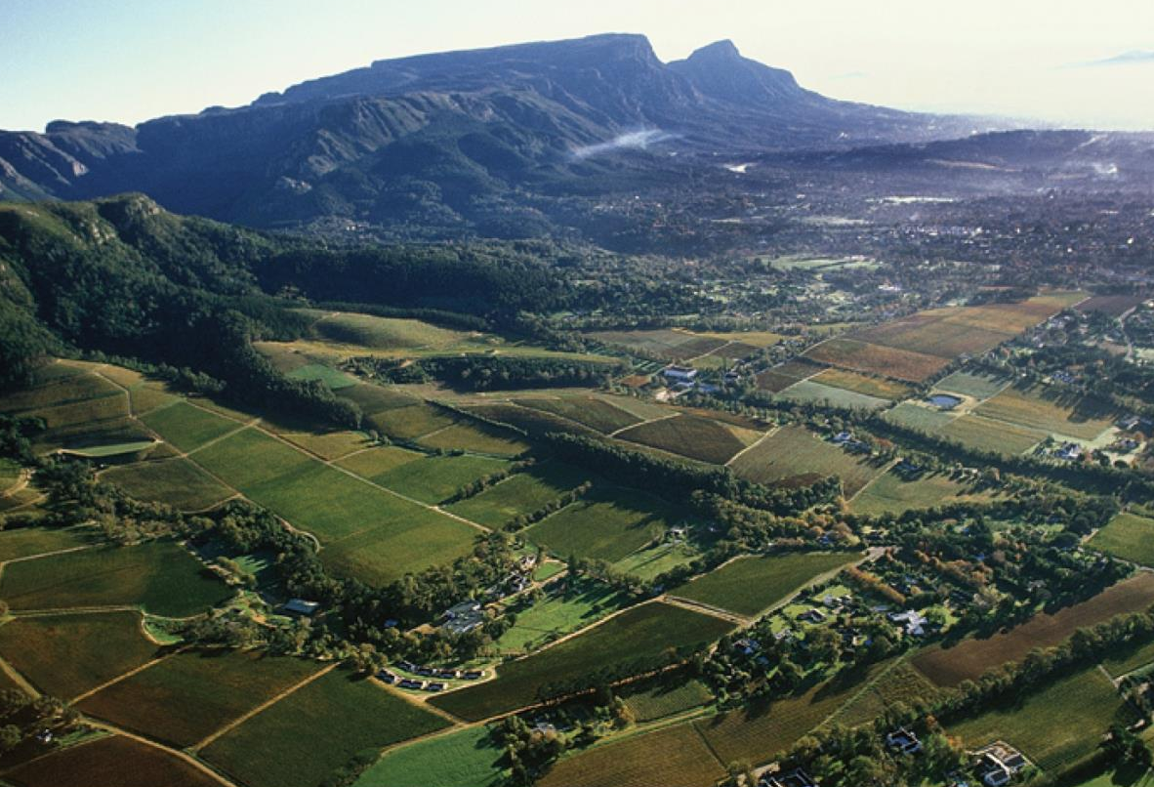
Constantiaberg mountain is a southern extension of Table Mountain, below which the city of Cape Town and its suburbs spread out. Constantia is a 20-minute drive from Cape Town's CBD.

Slide 11
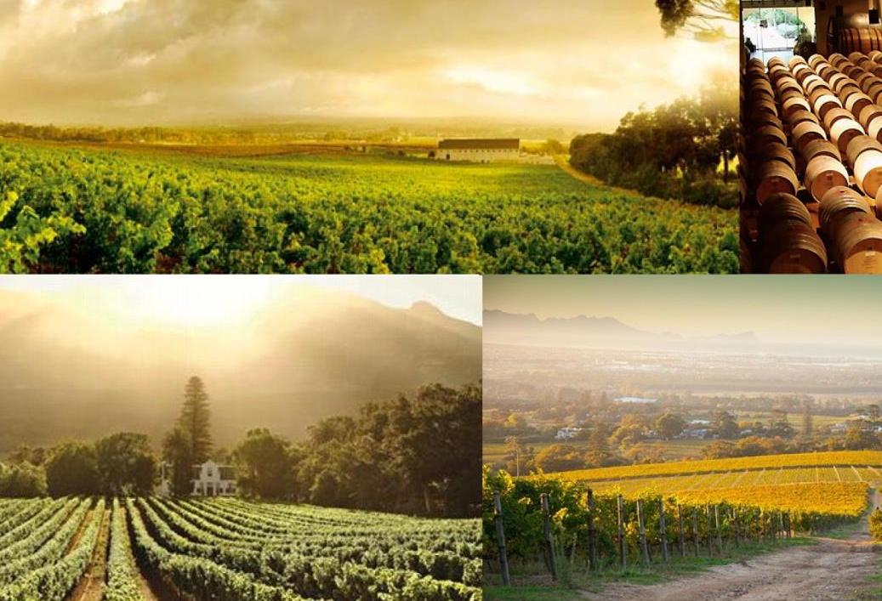
The Constantia valley was the cradle of winemaking in South Africa. It has a winemaking history dating back to 1685.

Slide 12
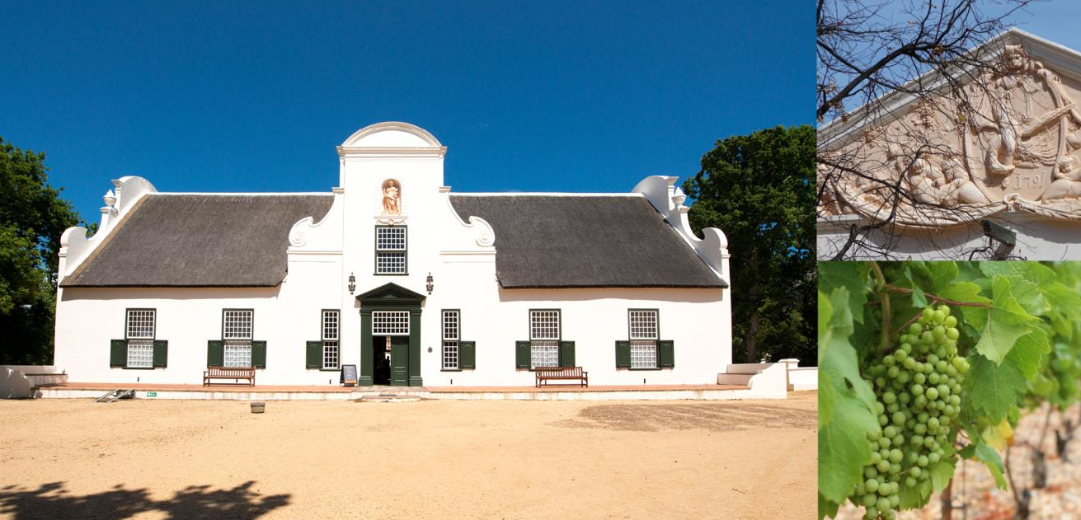
The manor house at Groot Constantia is considered
the finest surviving example of Cape Dutch architecture
in South Africa.

Slide 13
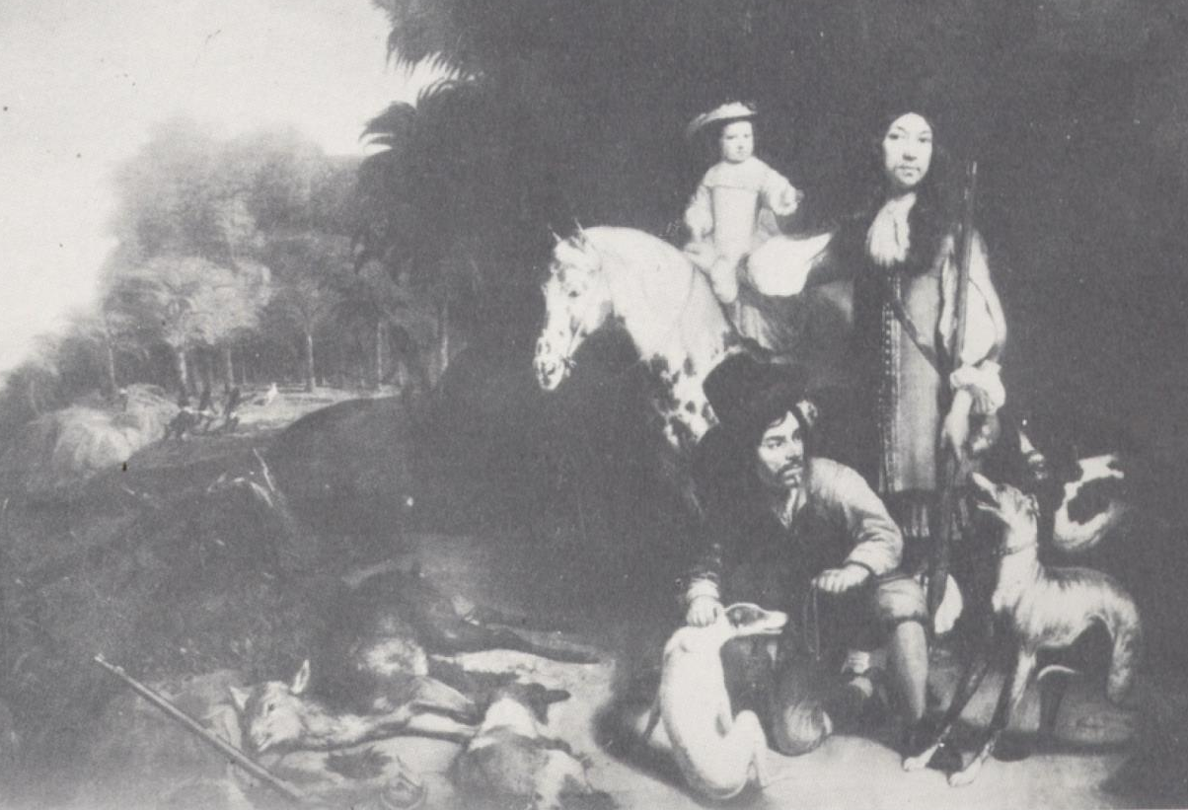
The valley was the site of Simon van der Stel’s
17th-century wine farm.

Slide 14
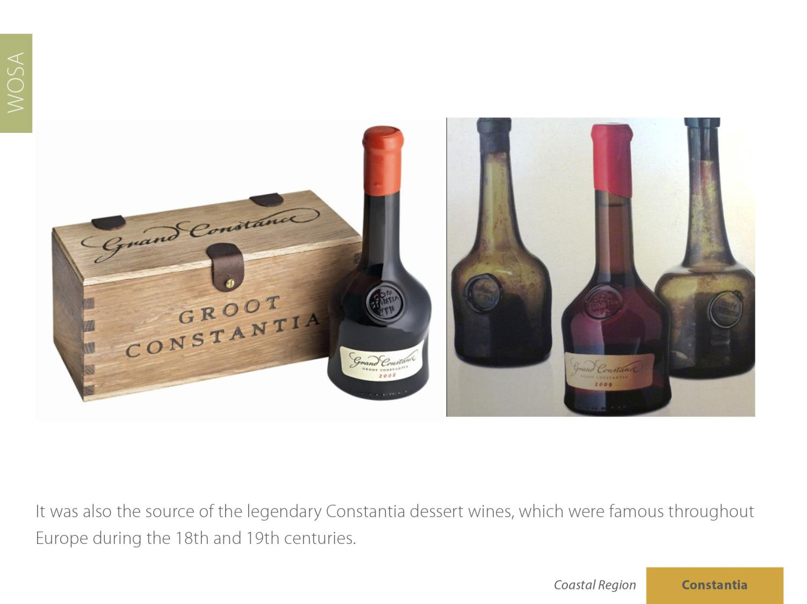
It was also the source of the legendary Constantia dessert wines, which were famous throughout Europe during the 18th and 19th centuries.

Slide 15
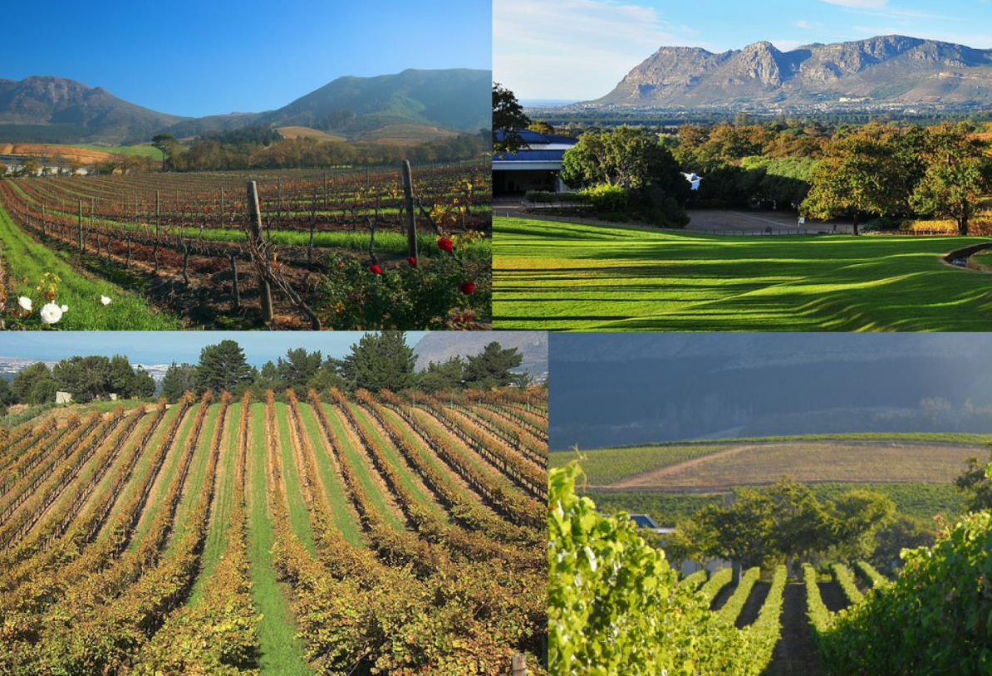
The vines benefit from a mild maritime climate with cool sea breezes blowing in from False Bay, which is some five to 10 km away.

Slide 16
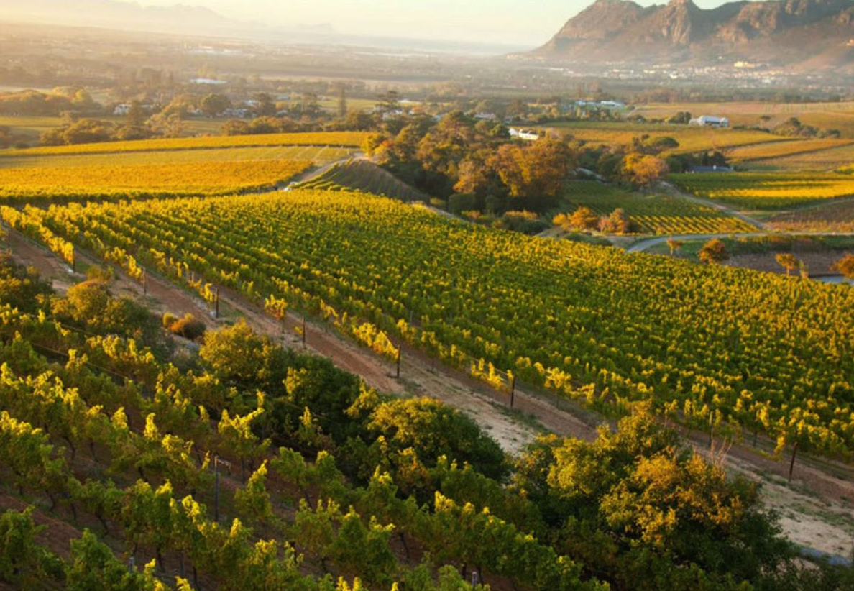
The ward receives an average of 1 000 mm of rain annually, making irrigation unnecessary.

Slide 17
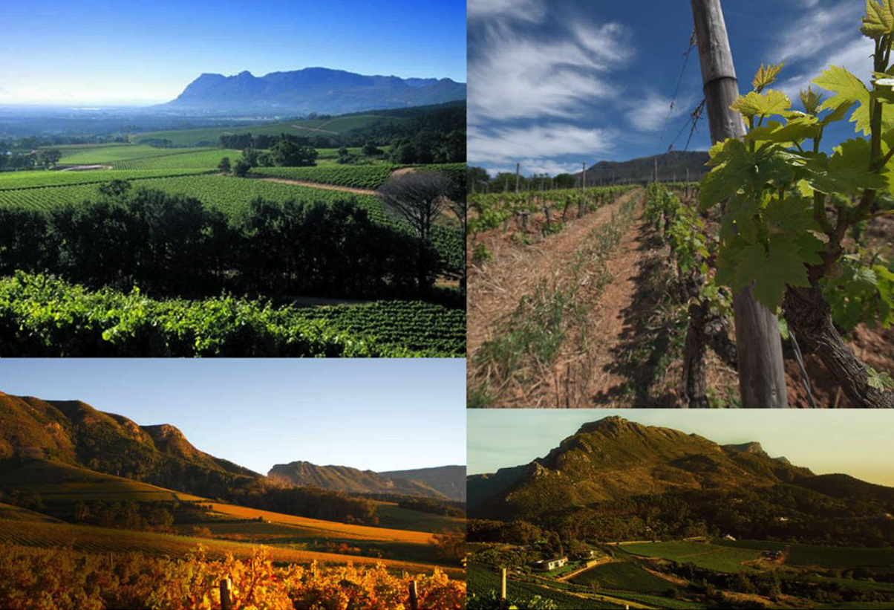
Constantia ward has a mean February temperature of 20.6˚C (Groot Constantia Weather Station).

Slide 18
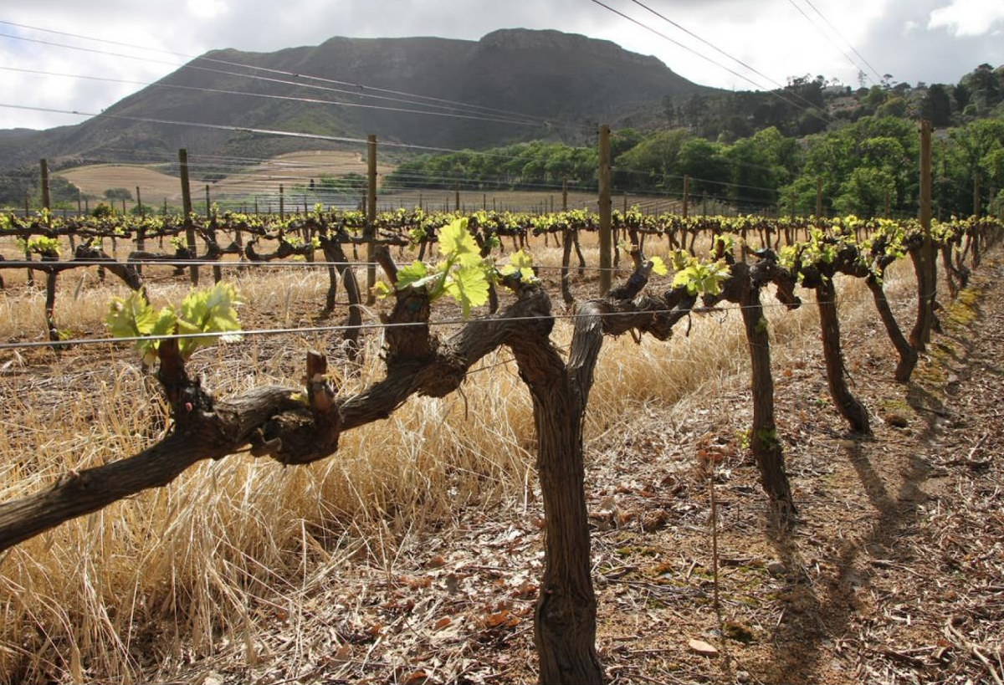
The deep, predominantly yellow-brown and reddish-brown well-drained soils are mainly derived from granite, which forms the base of the sandstone that constitutes the upper formations of the mountains.

Slide 19
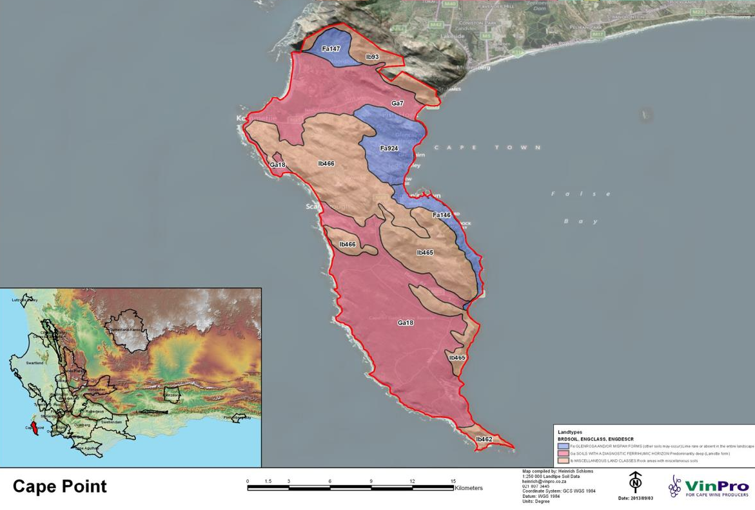

Slide 20
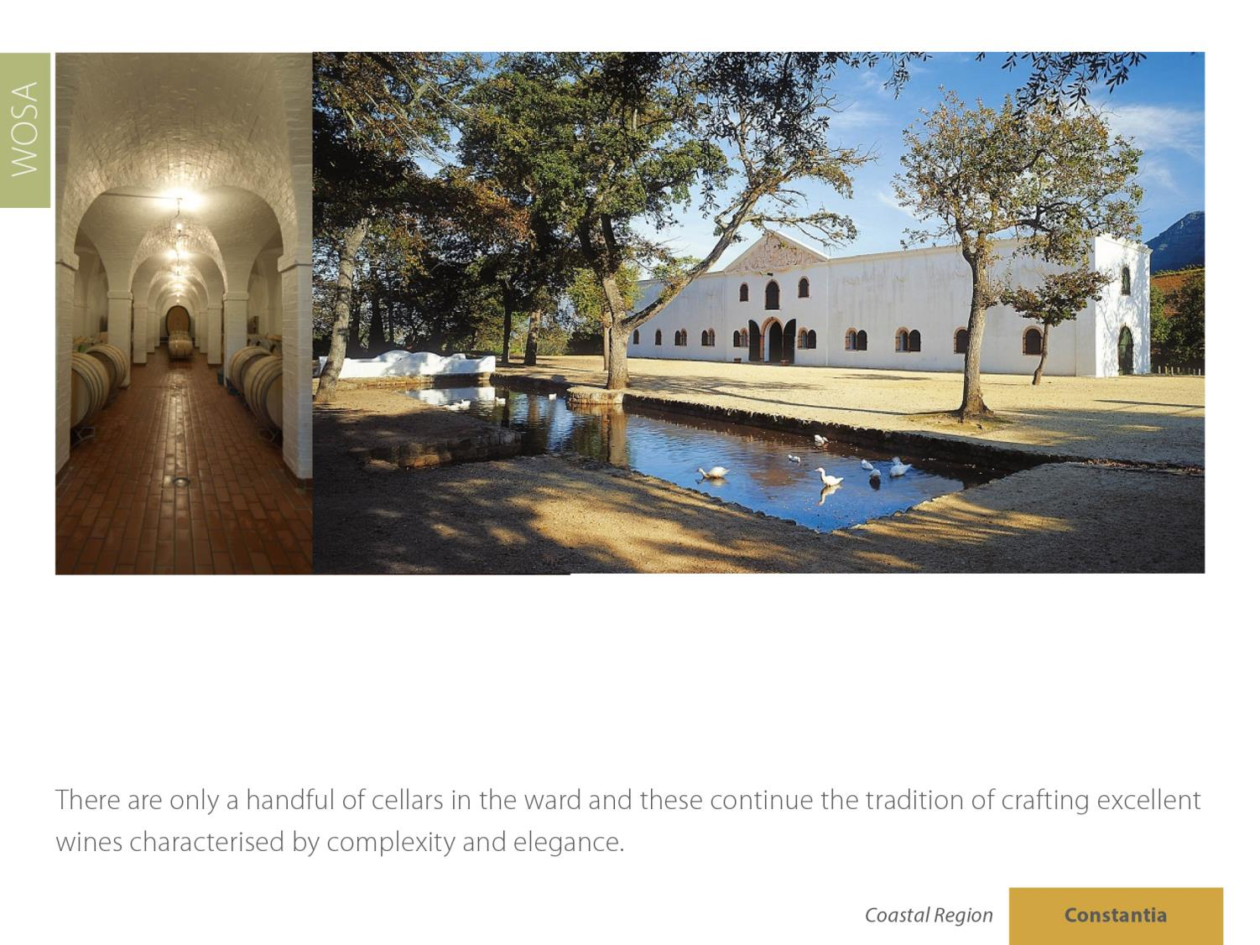
There are only a handful of cellars in the ward and these continue the tradition of crafting excellent wines characterised by complexity and elegance.

Slide 21
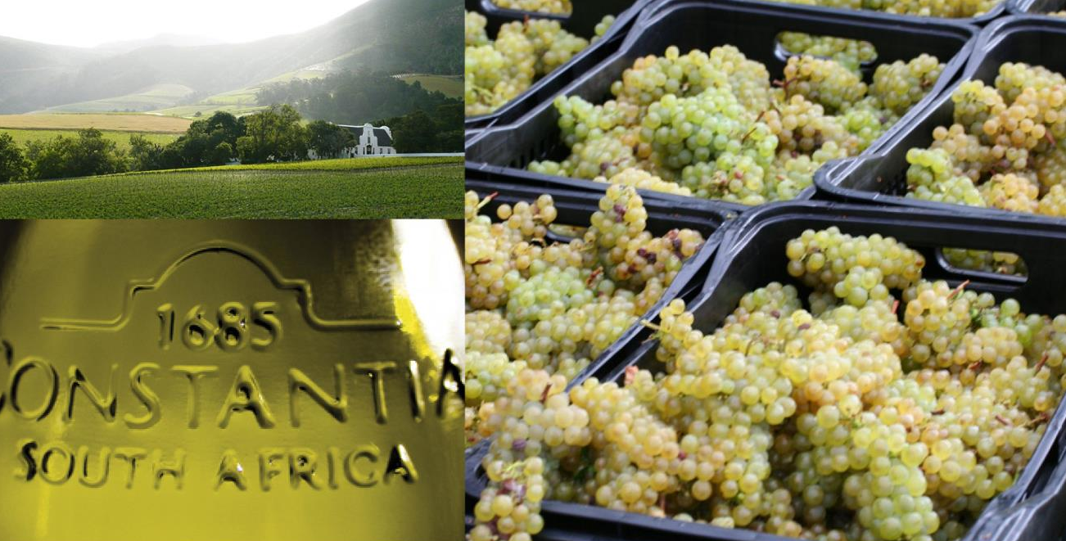
The cool climate favours the production of white wines, notably Sauvignon Blanc and Semillon.

Slide 22
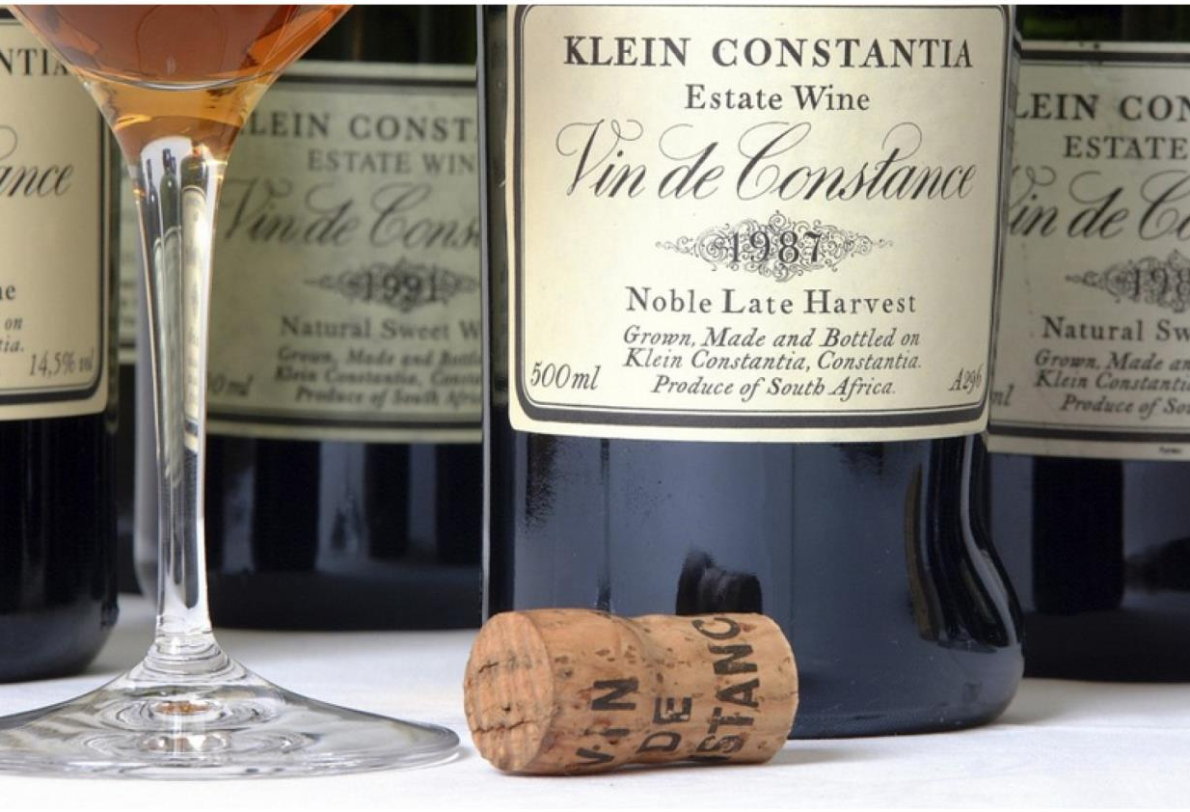
The tradition of producing luscious sweet Constantia wines was revived in 1986 to worldwide acclaim.

Slide 23
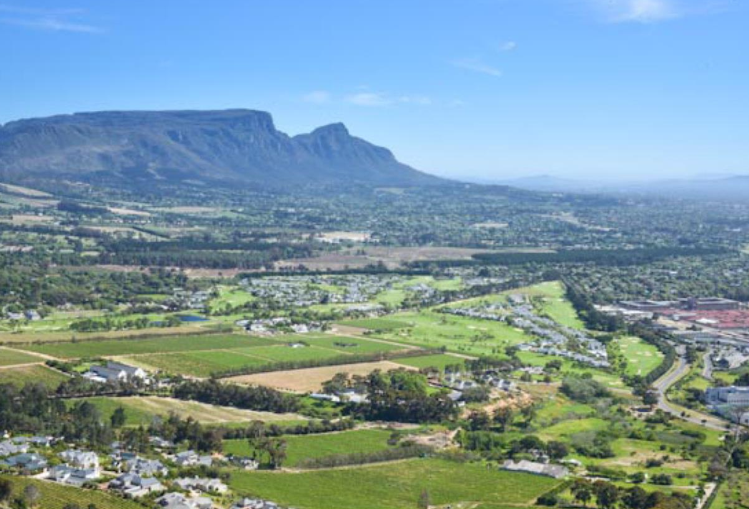
The images used in these presentations have been sourced from various producers, as well as industry and tourism bodies. These presentations are strictly for non-commercial, non-profit, educational purposes only and cannot be reproduced or transmitted in any form or by any means without written permission from Wines of South Africa (WoSA).

Slide 24
The Cape winelands, considered by many to be the most
beautiful in the world, have a network of diverse
and well-run wine routes, affording visitors a varied
and unforgettable experience.
The end
Notes:
The end

