Slide 1
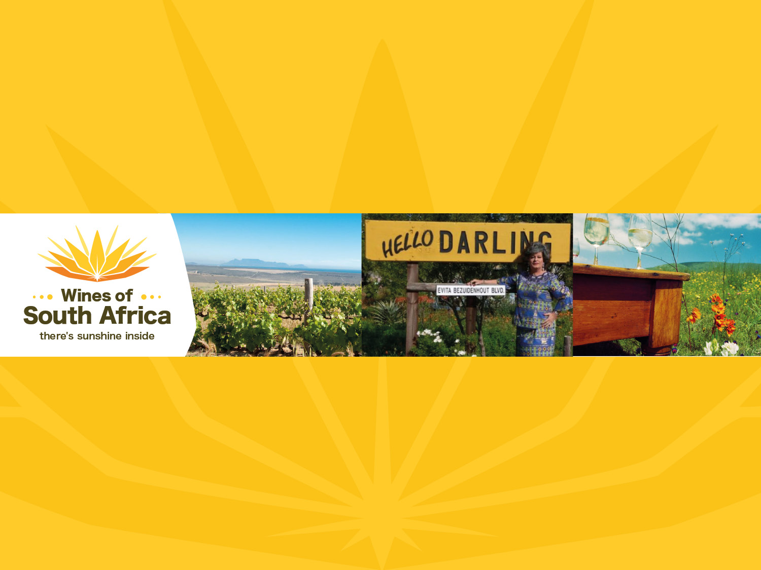
CAPE WINELANDS
DARLING
Notes:
Wines of South Africa

Slide 2

Where is South Africa?

Slide 3

South Africa is the southernmost
country in Africa.

Slide 4

Our winelands are located at the
very tip of South Africa.

Slide 5

PRODUCTION AREAS: Districts of South Africa.

Slide 6

Wards of South Africa.

Slide 7

Coastal
Region: Coastal
District: Darling
Ward: Groenekloof

Slide 8
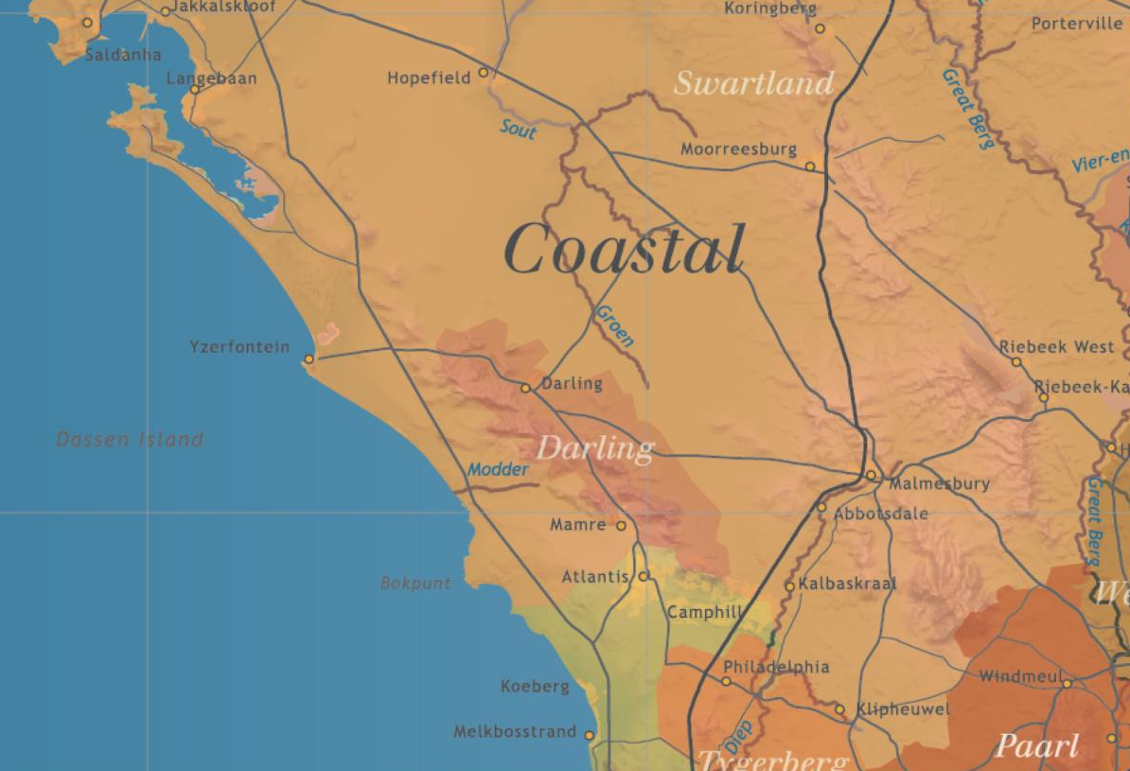

Slide 9
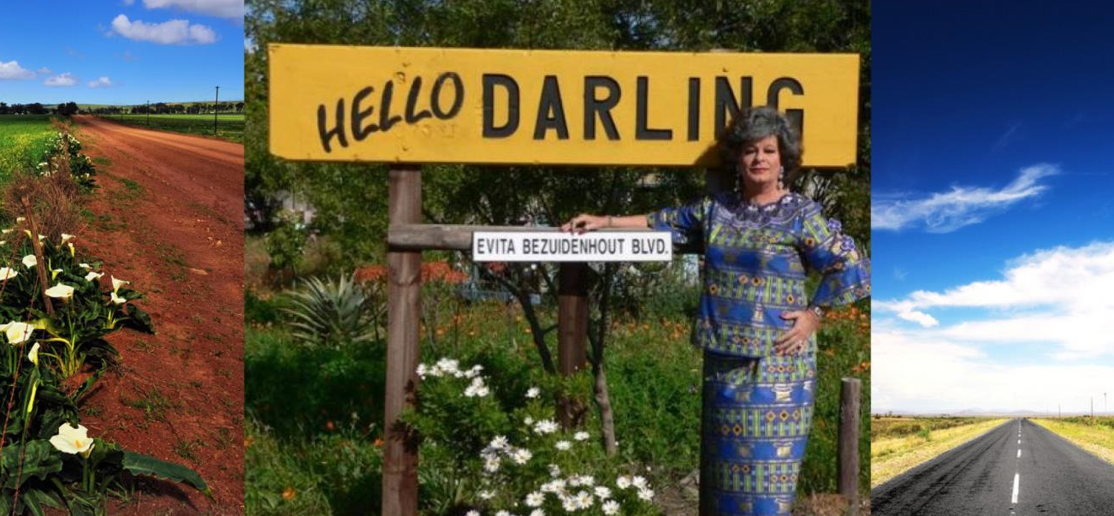
The Darling district, with its own wine route
and several tourist attractions, is just an hour's drive away from Cape Town.

Slide 10
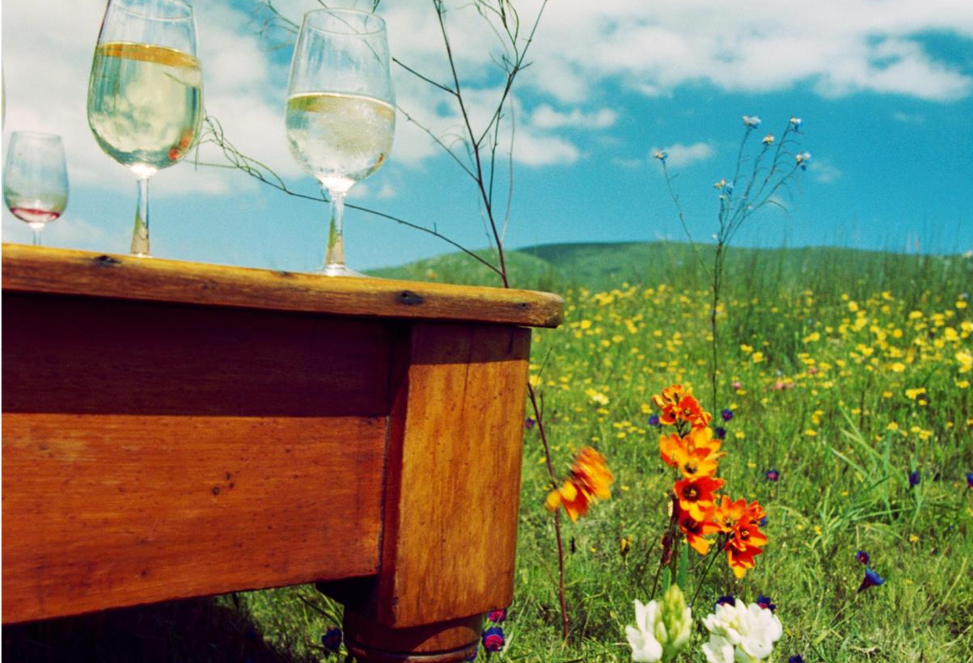
At its heart lies the charming West Coast village
of Darling, tucked away between vineyard-covered
hills and golden wheat fields.

Slide 11
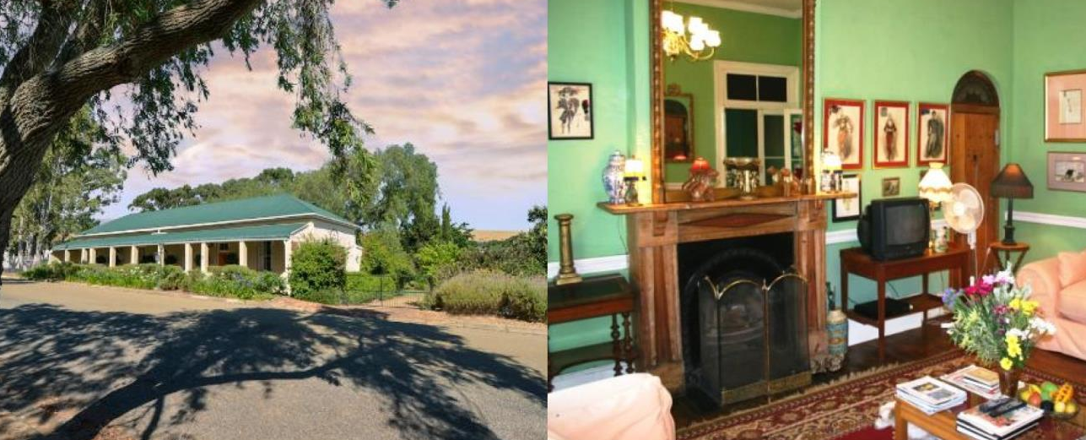
The village features beautifully restored Victorian houses.

Slide 12
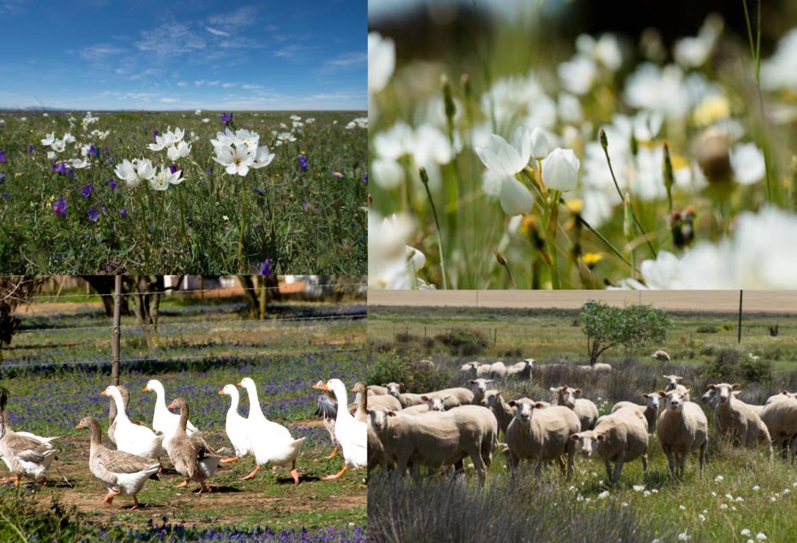
The area is famous for its colourful display
of wild flowers in spring and boasts several
wild flower reserves.

Slide 13
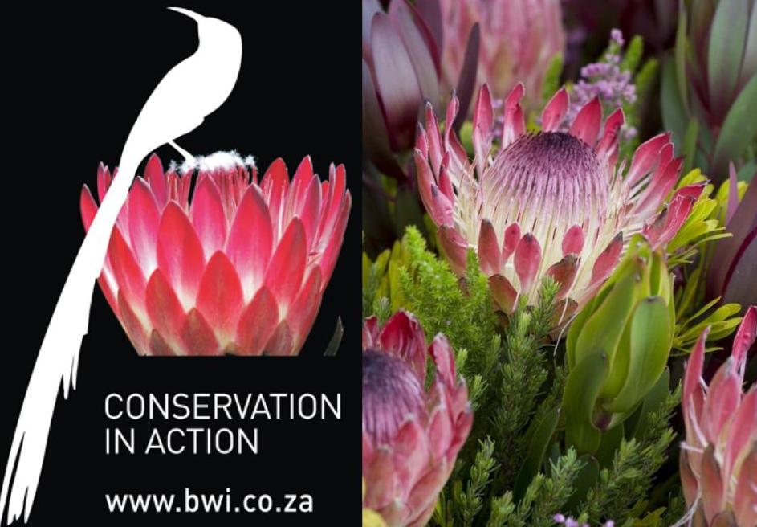
All of the wineries on the route belong to WWF-SA's Biodiversity & Wine Initiative (BWI).

Slide 14
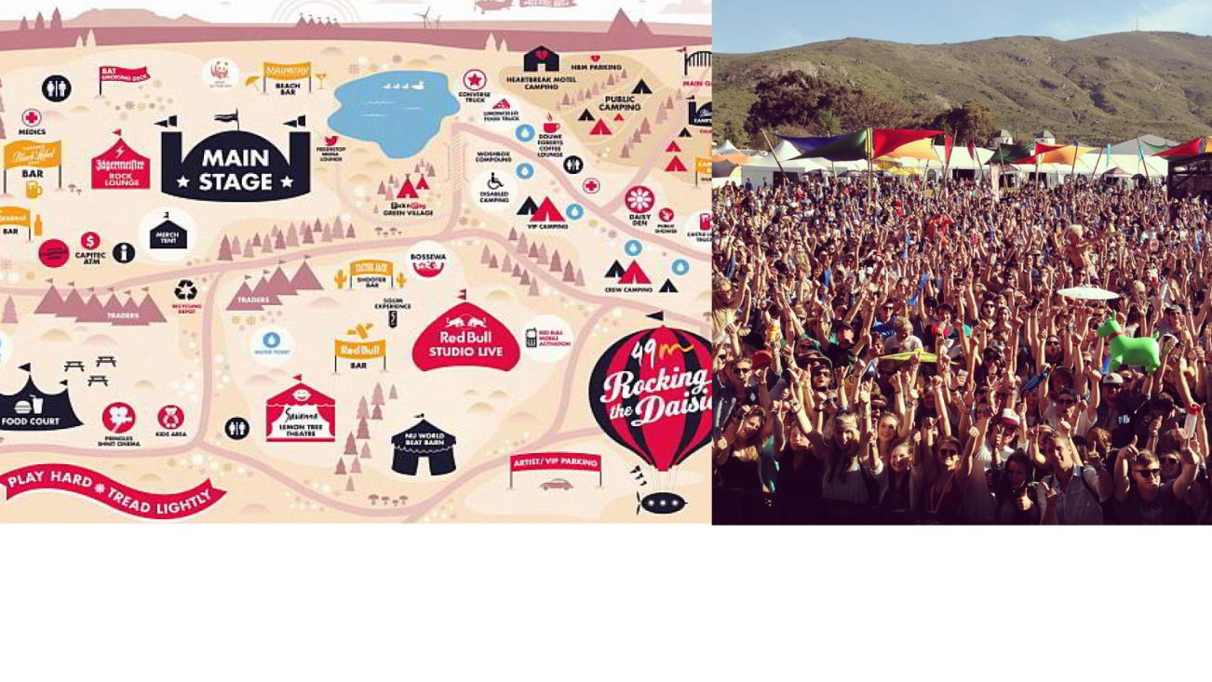
The country's biggest eco-friendly music festival,
Rocking the Daisies, is held here each year.

Slide 15
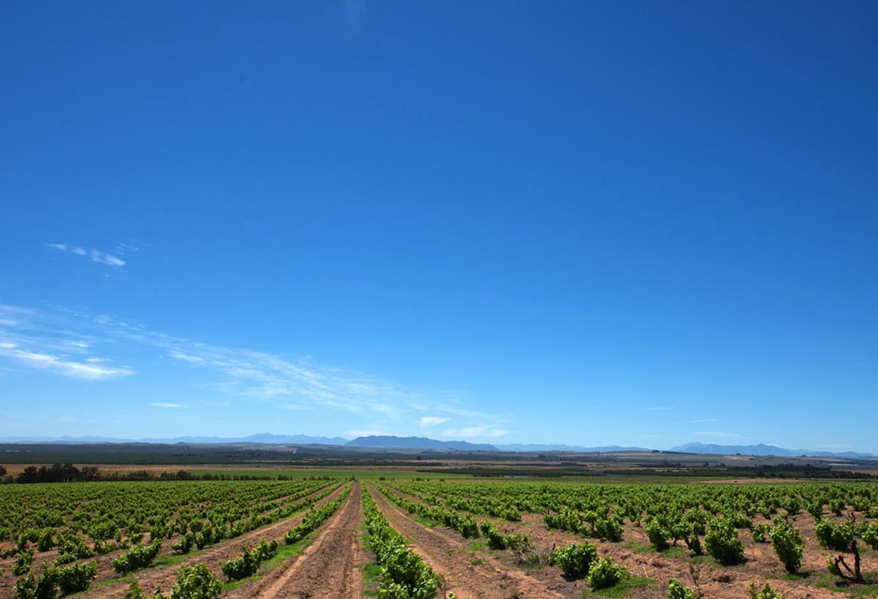
The district has a mean February temperature of 22.7⁰C.

Slide 16
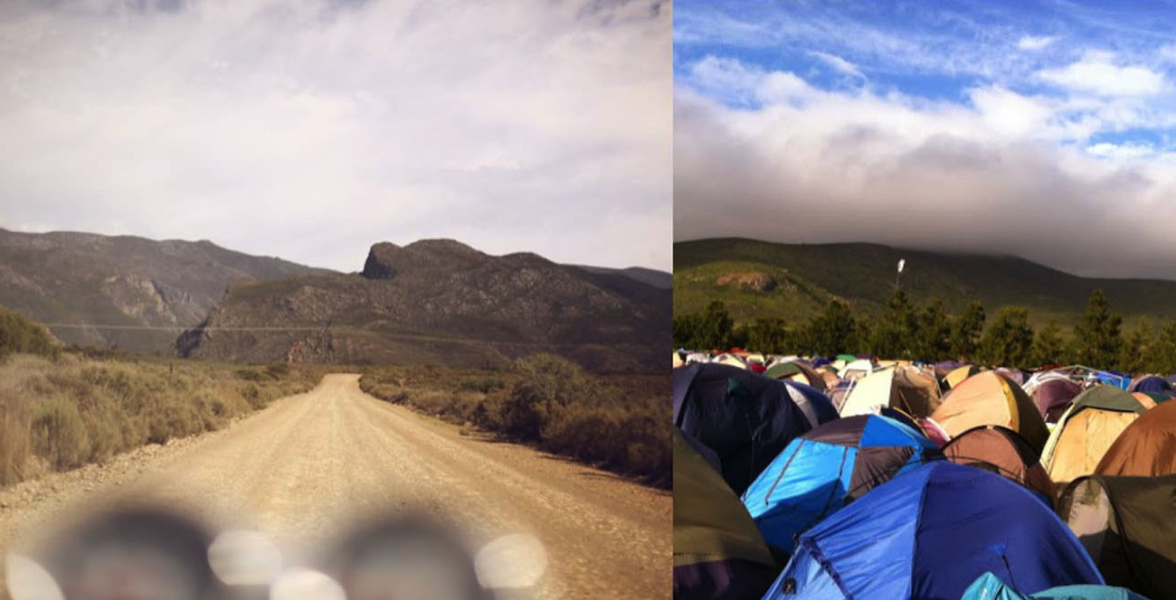
Average annual rainfall is 586 mm.

Slide 17
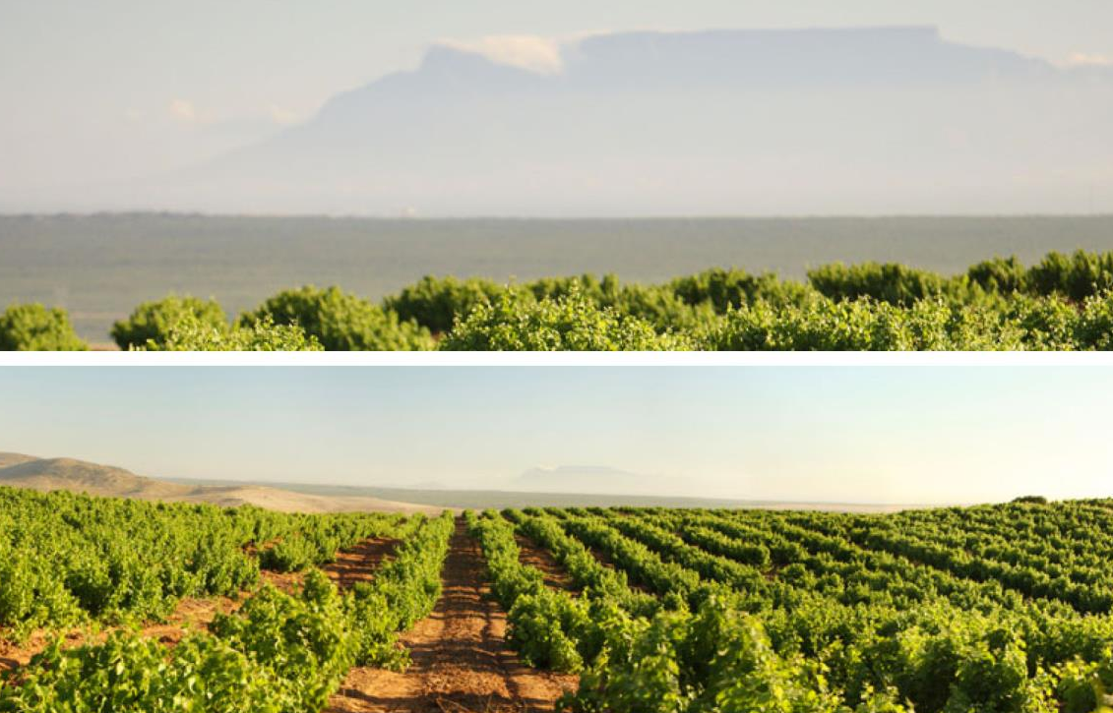
The Darling district incorporates the Groenekloof ward, which is one of the closest to the cooling Atlantic.

Slide 18
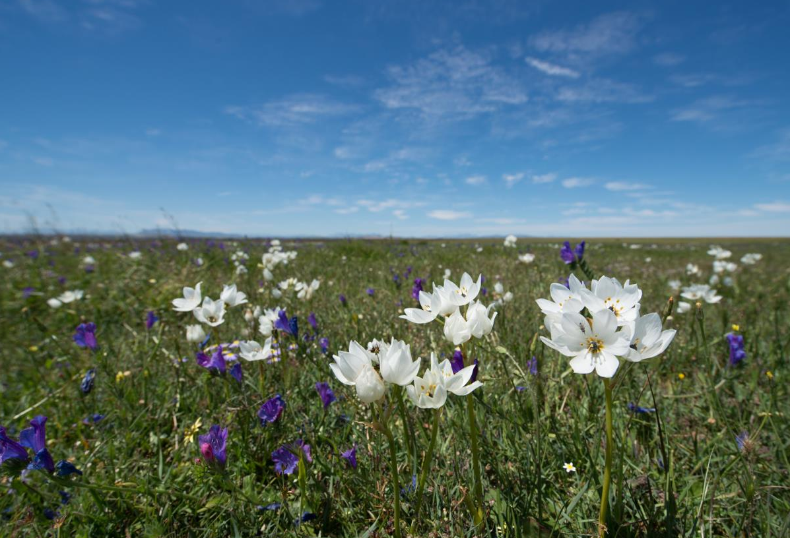
It benefits by being protected from often harsh winds from the ocean by its predominantly eastern aspects.

Slide 19
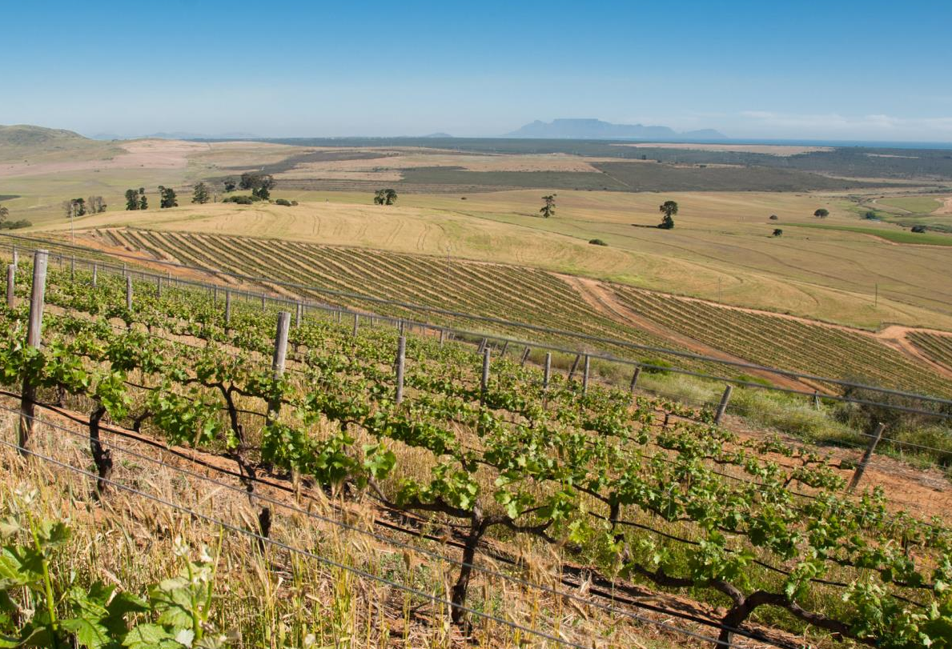
Some 10 km from the cold Atlantic Ocean is the Darling range of hills, running parallel to the coast and consisting
of erosion exposed granite intrusions.

Slide 20
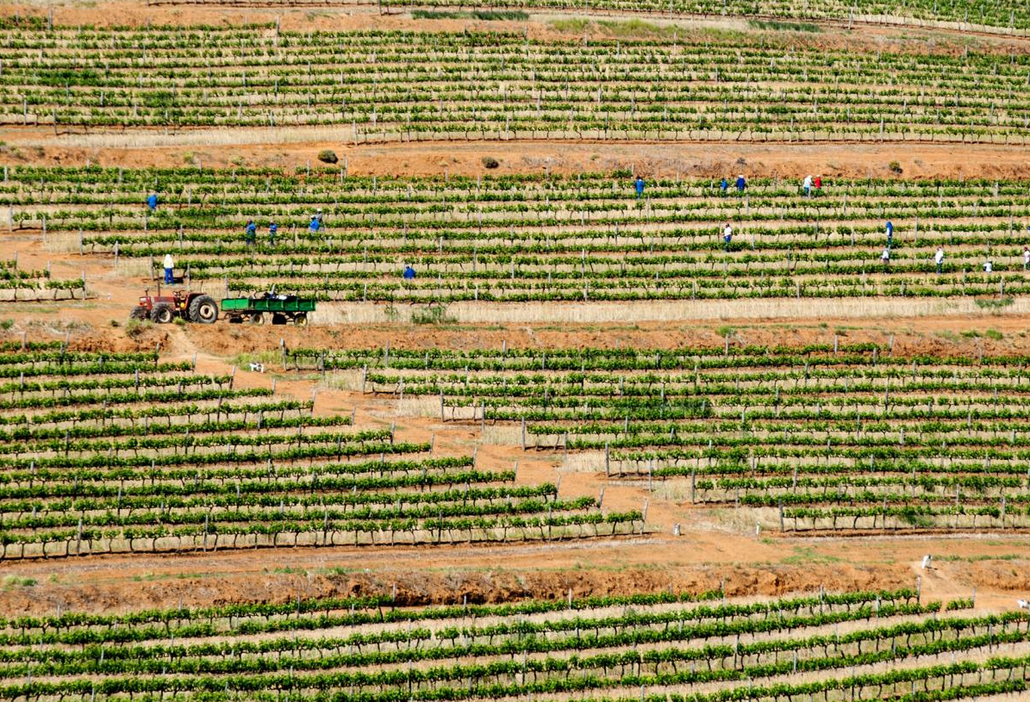
The Groenekloof ward is characterised by deep reddish-brown soils formed from pre-weathered granite, with a good water-holding capacity, making viticulture without irrigation possible.

Slide 21
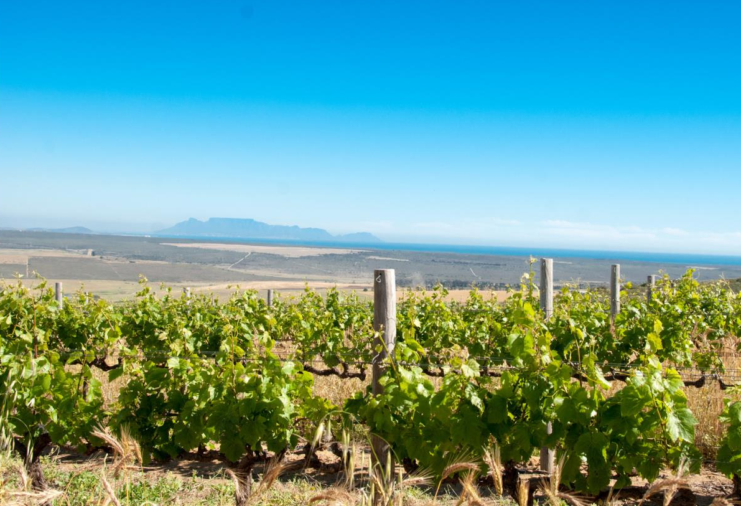
The Darling district favours the cultivation of
more delicate cultivars.

Slide 22
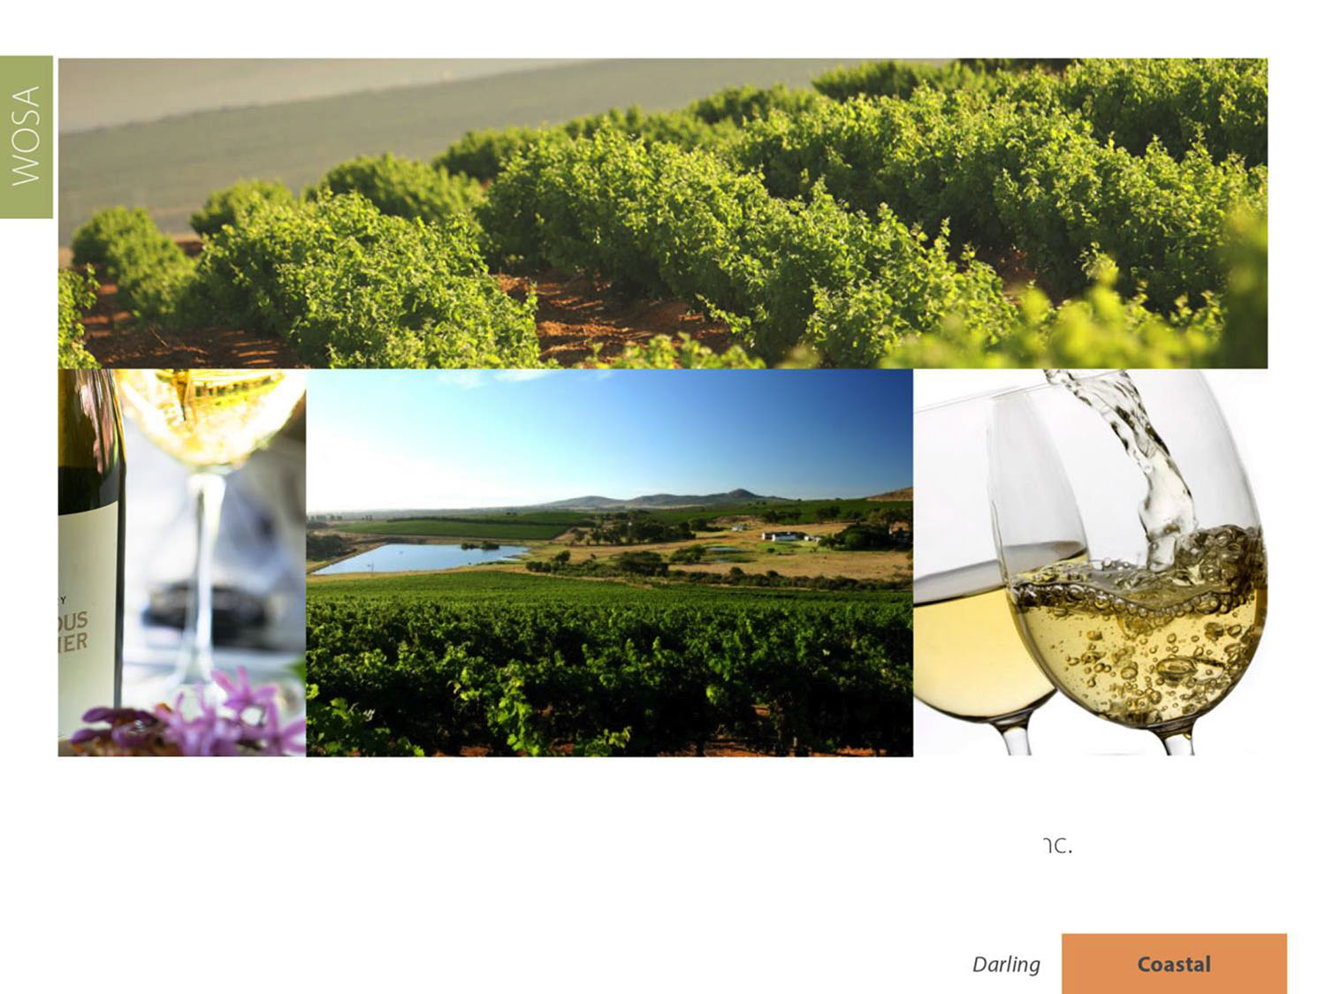
The most widely planted white-wine variety
is Sauvignon Blanc, followed by Chenin Blanc
and Chardonnay.

Slide 23
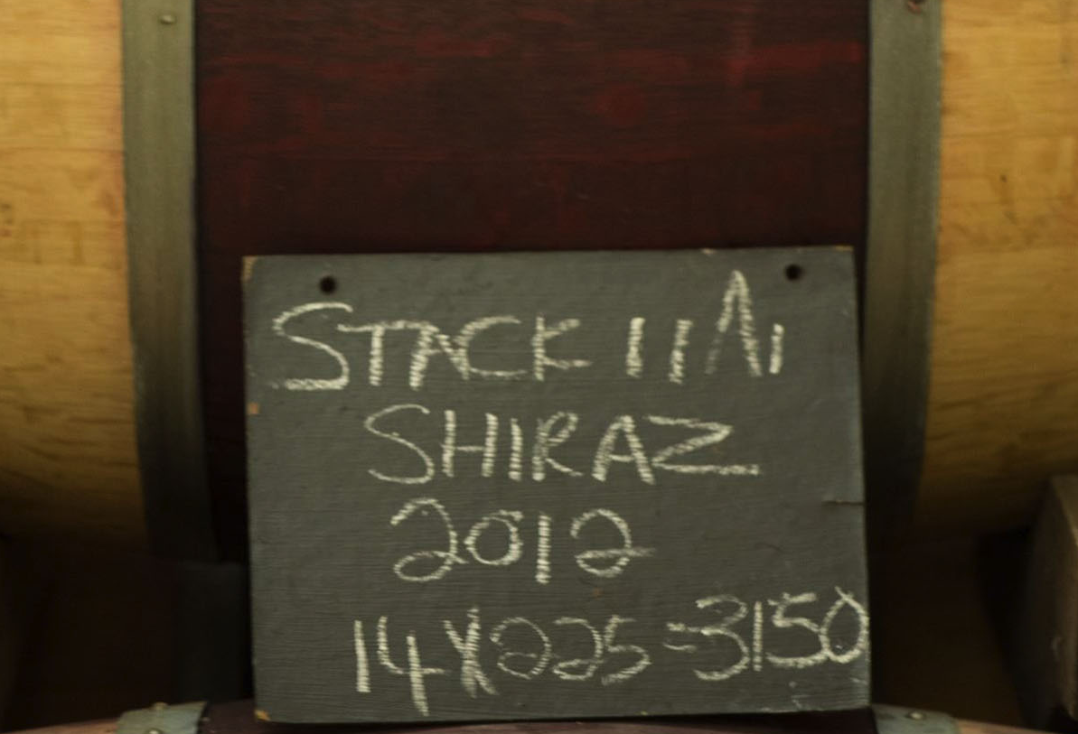
The most widely planted red-wine variety
is Cabernet Sauvignon, followed by Shiraz,
Pinotage and Merlot.

Slide 24
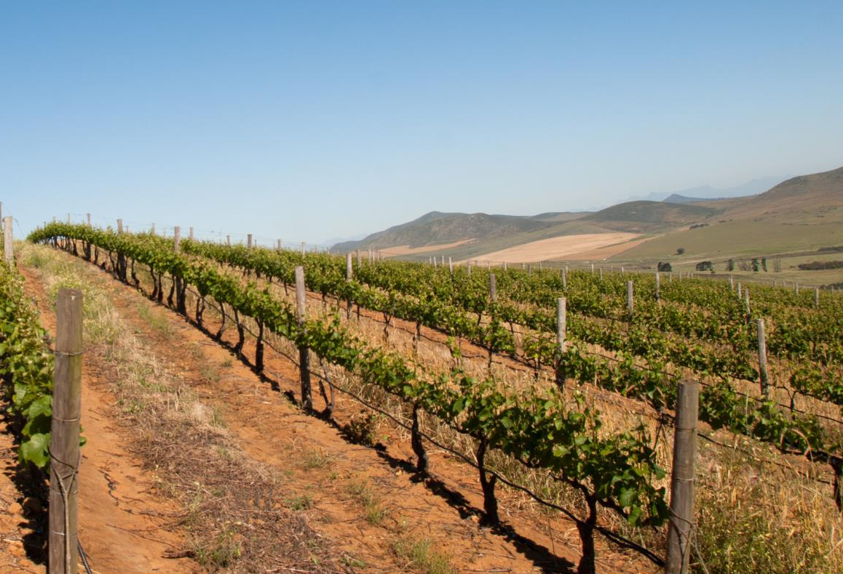
Grapes from Groenekloof are highly contested for by various cellars and winemakers, proving the merit of this ward. The most coveted grapes are Sauvignon Blanc, Cabernet Sauvignon, Merlot, Shiraz and, to a lesser extent, Pinot Noir.

Slide 25
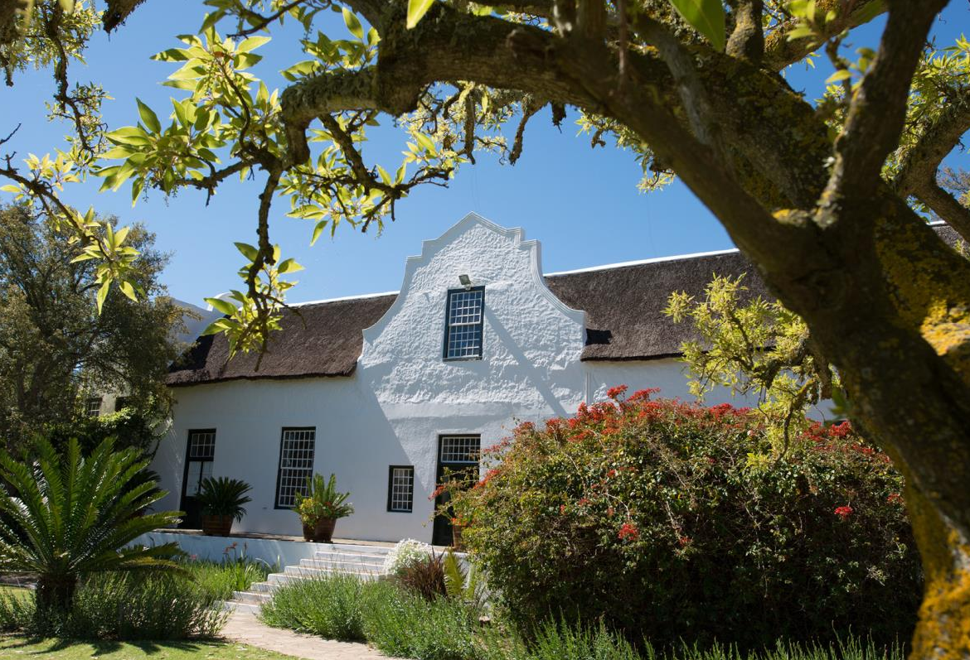
Darling is known for the exceptional quality of its Sauvignon Blanc, the variety which initially spearheaded the viticultural progress of this district.

Slide 26
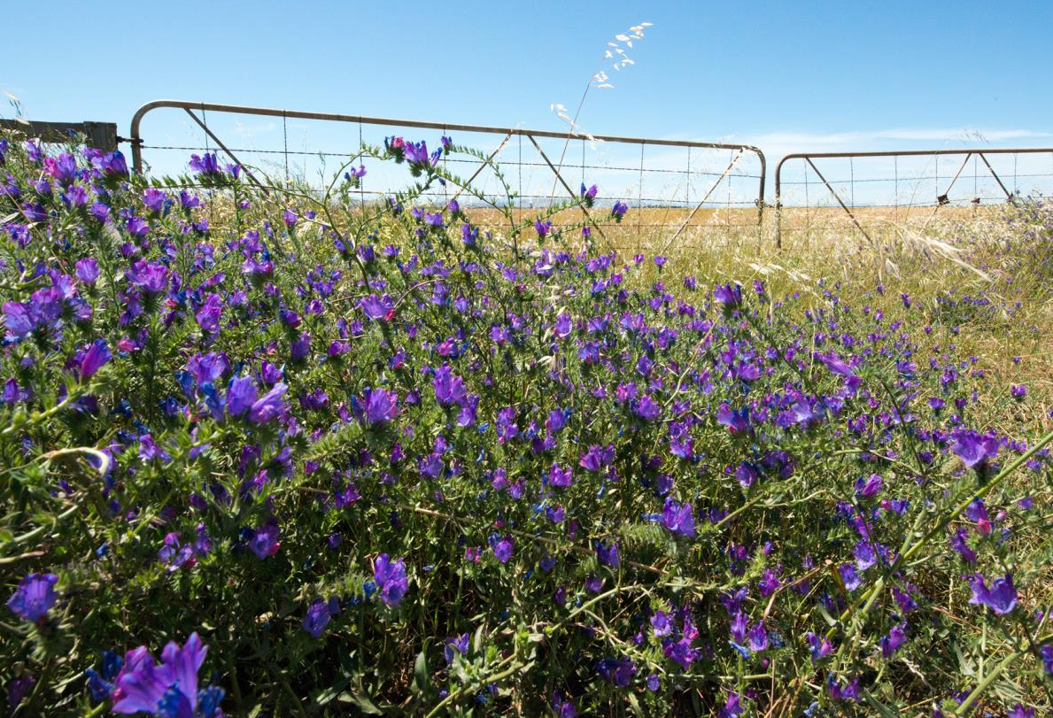
The images used in these presentations have been sourced from various producers, as well as industry and tourism bodies. These presentations are strictly for non-commercial, non-profit, educational purposes only and cannot be reproduced or transmitted in any form or by any means without written permission from Wines of South Africa (WoSA).

Slide 27
The Cape winelands, considered by many to be the most
beautiful in the world, have a network of diverse
and well-run wine routes, affording visitors a varied
and unforgettable experience.
The end
Notes:
The end

