Slide 1
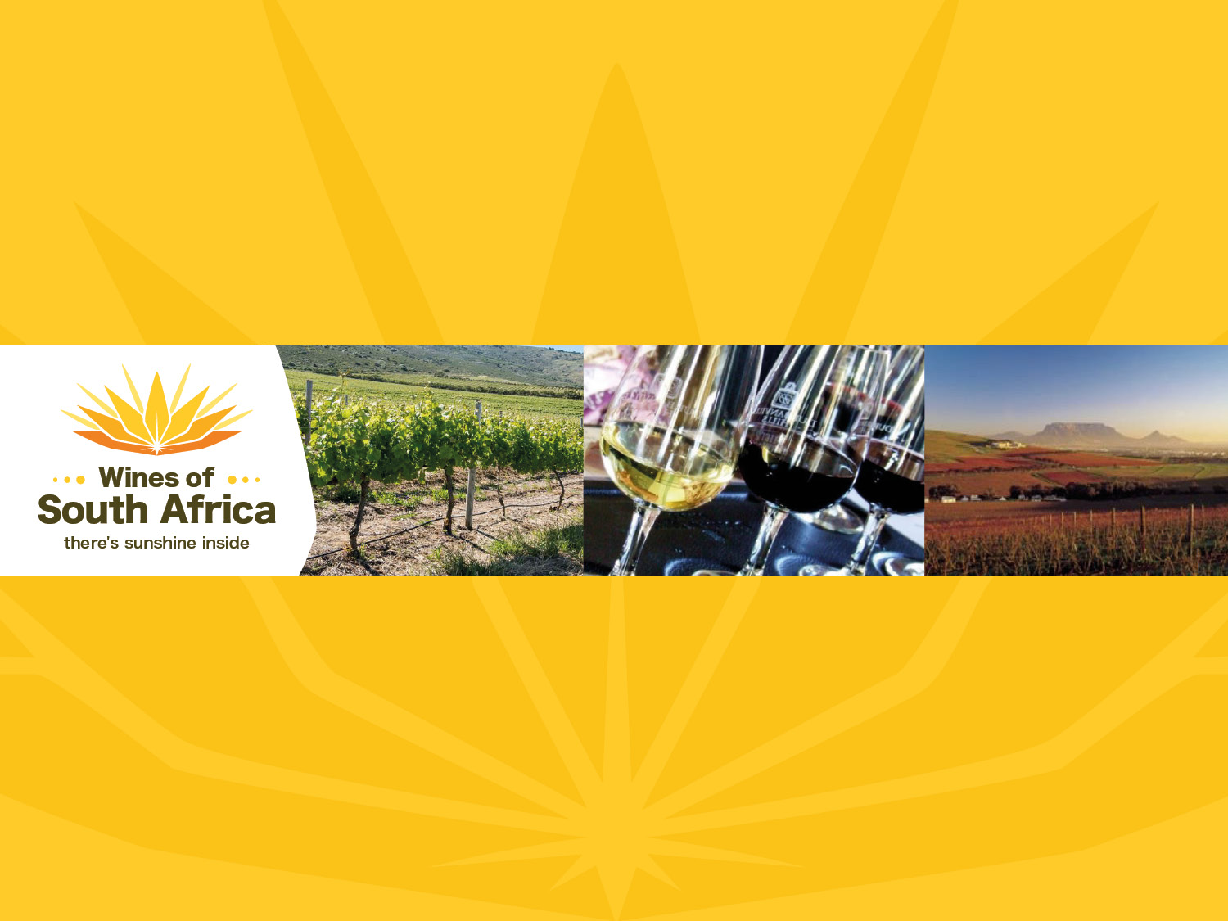
CAPE WINELANDS
DURBANVILLE
Notes:
Wines of South Africa

Slide 2

Where is South Africa?

Slide 3

South Africa is the southernmost
country in Africa.

Slide 4

Our winelands are located at the
very tip of South Africa.

Slide 5

PRODUCTION AREAS: Districts of South Africa.

Slide 6

Wards of South Africa.

Slide 7

Coastal
Region: Coastal
District: Cape Town
Wards: Durbanville
Philadelphia

Slide 8
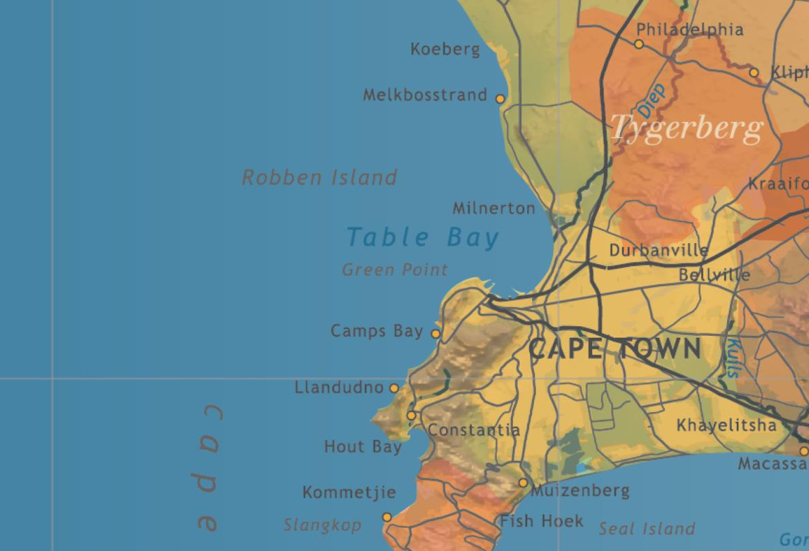
The vineyards of Durbanville, like those of Constantia, lie very close to Cape Town and border on the northern suburbs.

Slide 9
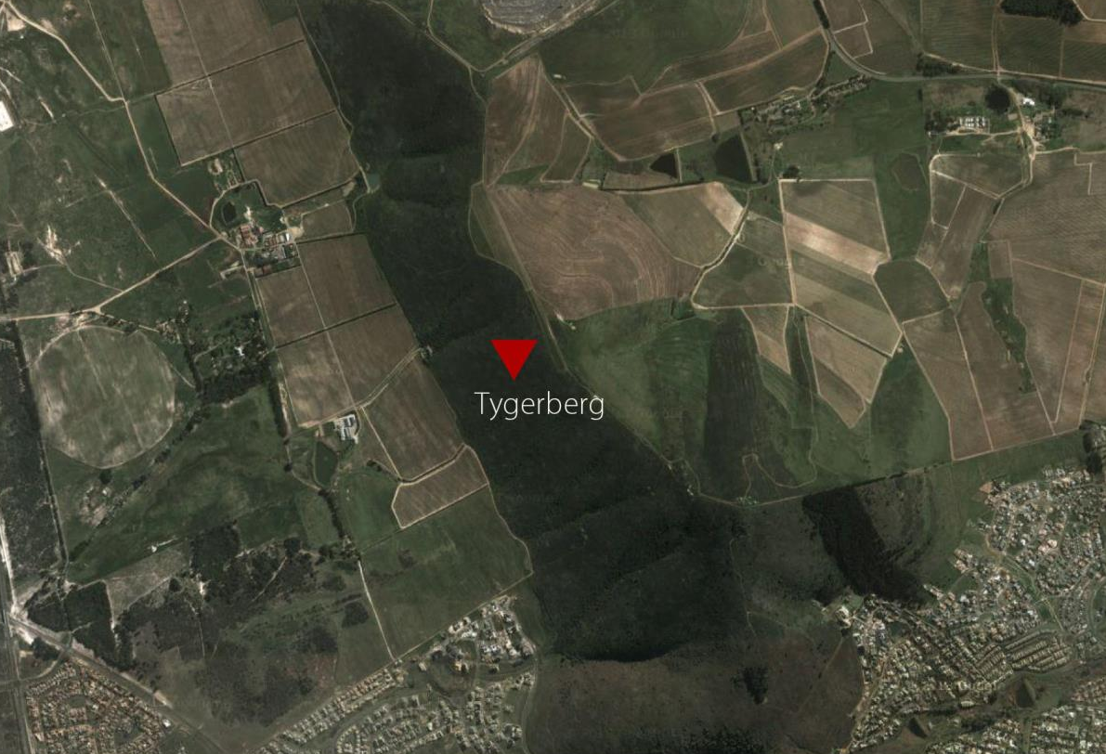
Durbanville is characterised by a south-north running range of hills known as Tygerberg, from which the district takes its name, and Kanonkop, open towards the west (10 km) and south (28 km) to the sea.

Slide 10
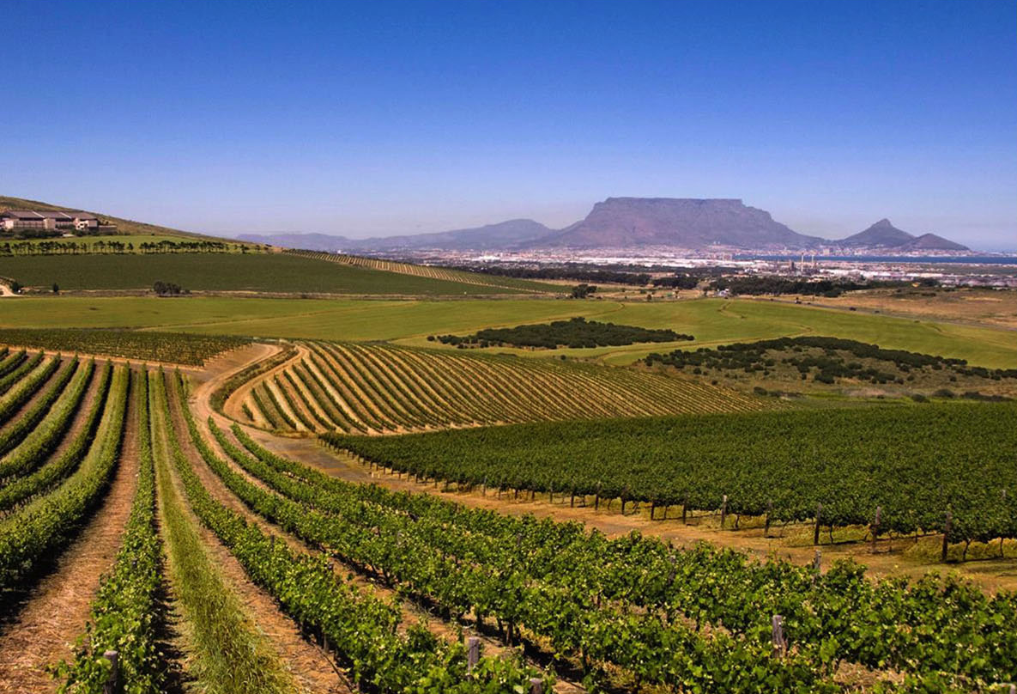
Although the mean February temperature is given as 22.8˚C, the duration of high temperatures during the day is short.

Slide 11
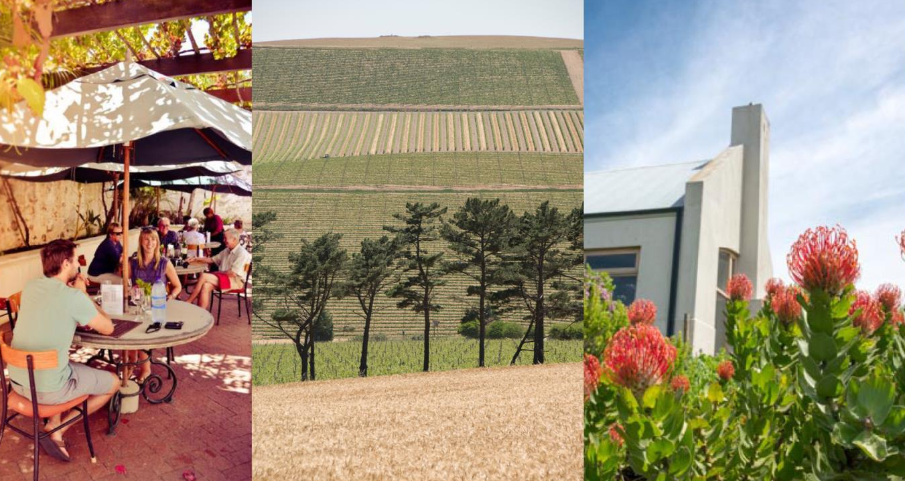
This is due to cooling by prevailing summer sea breezes from False Bay, which usually take effect at midday.

Slide 12
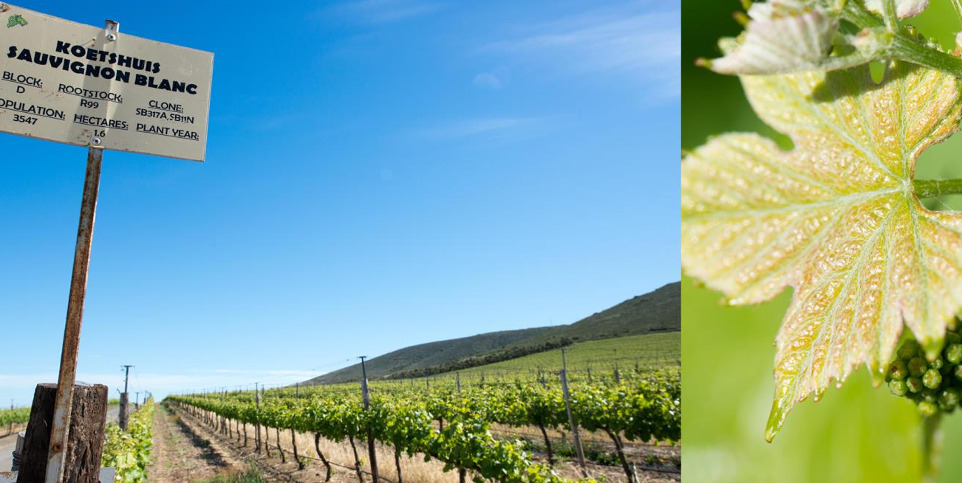
Research has shown that a temperature variation of up to 5°C can be found in adjoining vineyards where the one directly benefits from these maritime conditions and the other, situated behind the hill, does not.

Slide 13
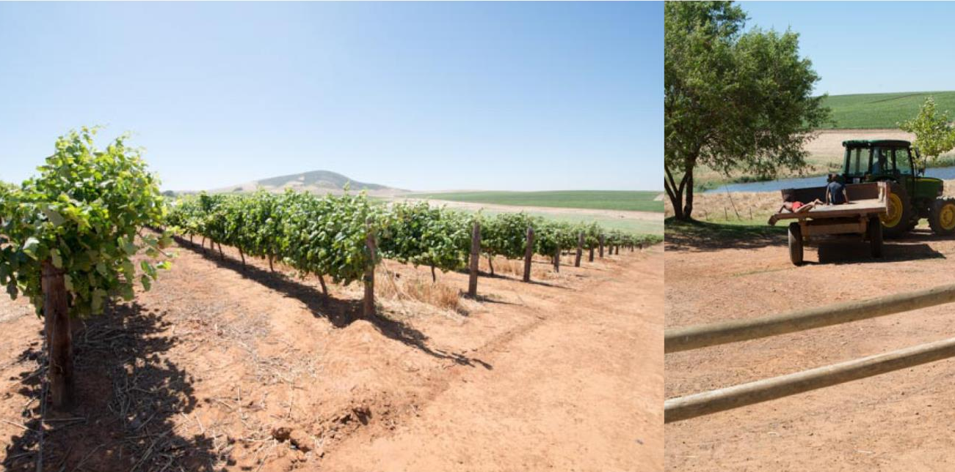
Deep soils, cooling sea breezes, night-time mists and close proximity to the ocean are beneficial factors when it comes to the quality of the grapes.

Slide 14
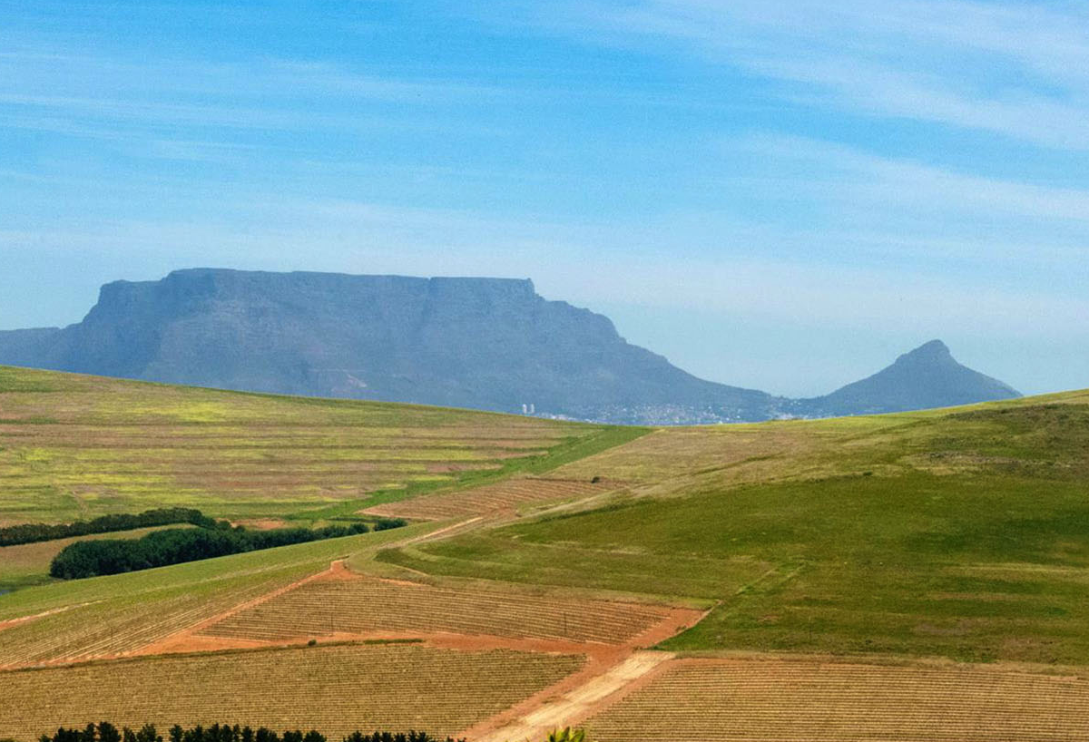
Durbanville has an average rainfall of only
481 mm on the eastern slopes and even less on the western slopes.

Slide 15
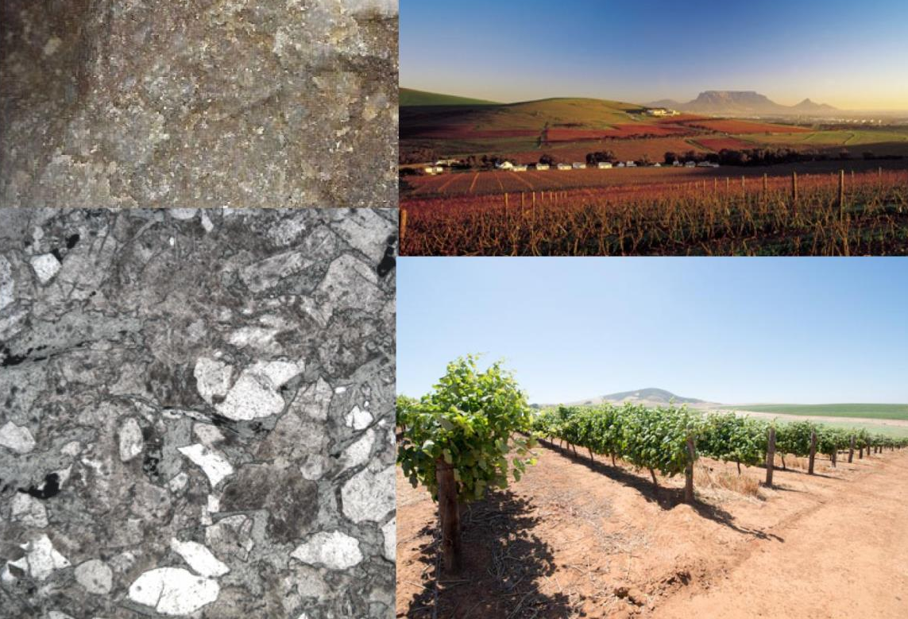
Soils are derived from greywacke and phyllitic shales, and are mainly reddish-brown, deep and well drained.

Slide 16
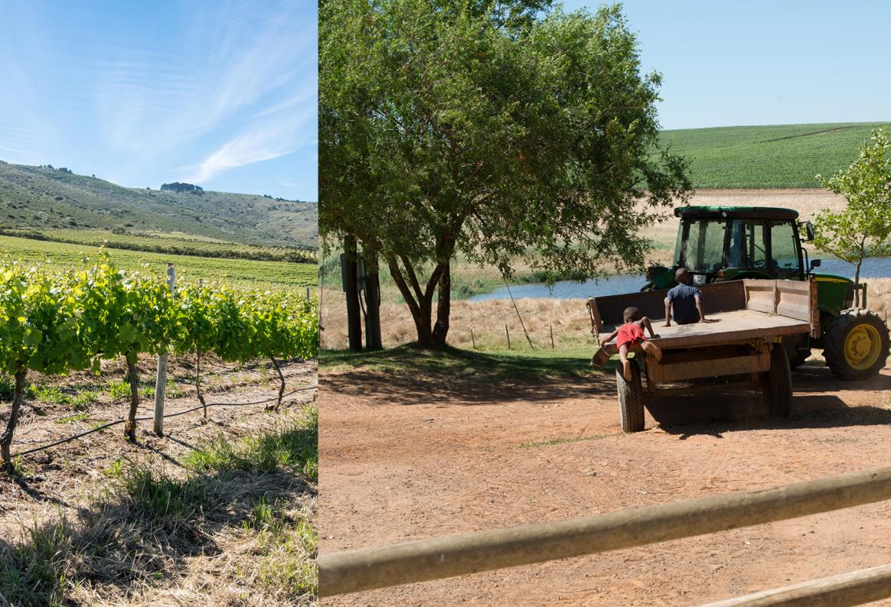
These soils are not acid, unlike typical Western Cape highly weathered soils, and have a good water-holding capacity, making dryland production possible.

Slide 17
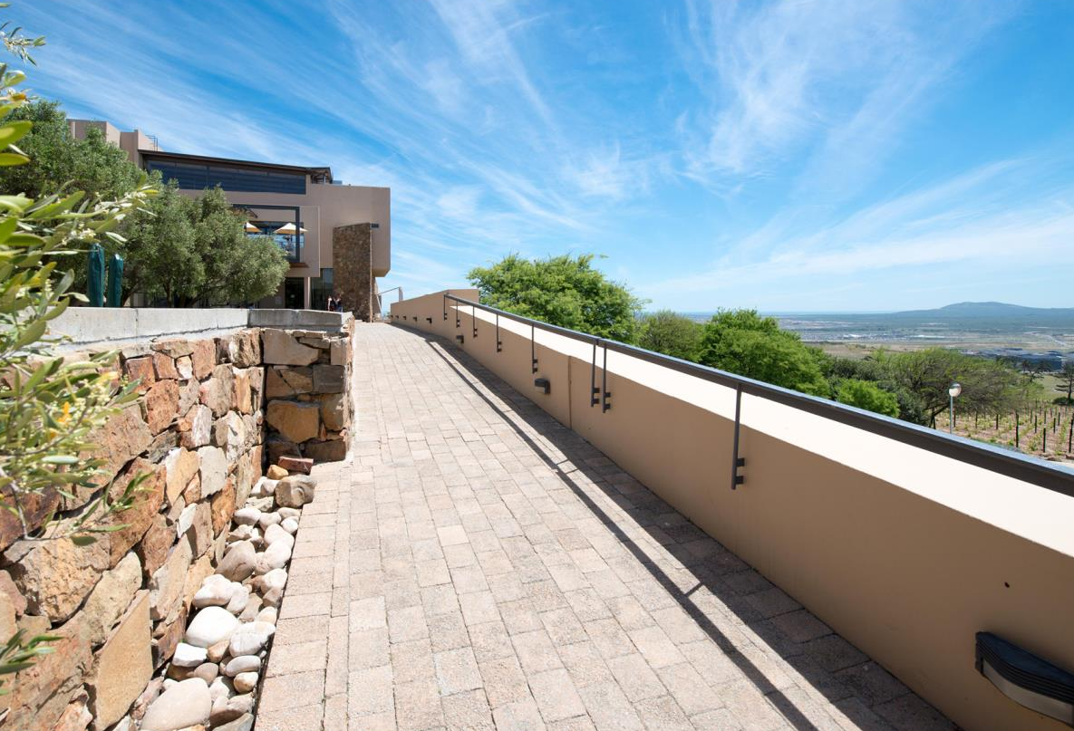
The vineyards are situated mainly on the eastern slopes at altitudes of 100-300 m.

Slide 18
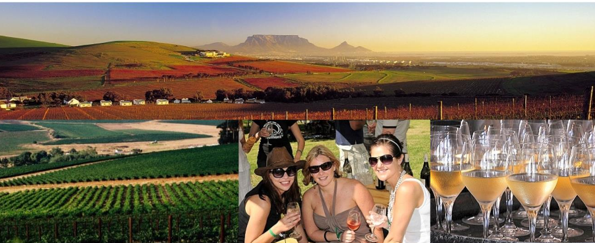
Sauvignon Blanc is the dominant variety in the valley.

Slide 19
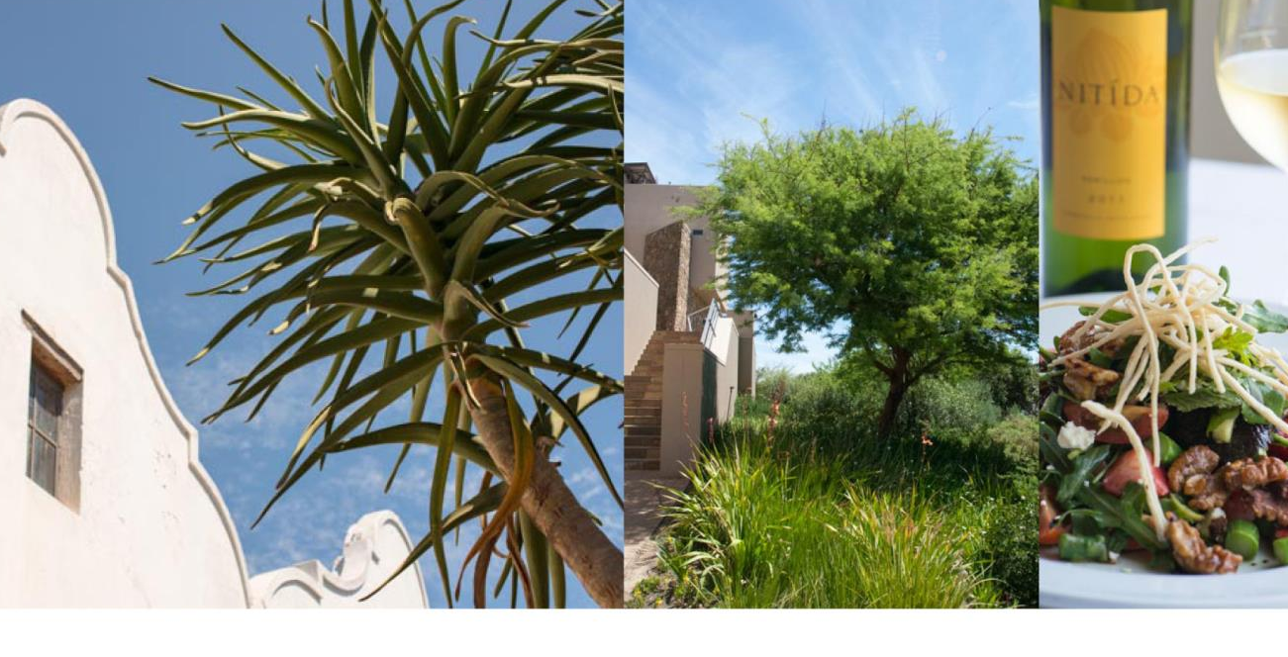
Some 13 estates and wineries, situated mainly on the rolling slopes with their various aspects and altitudes, continue to make a wide variety of wine styles.

Slide 20
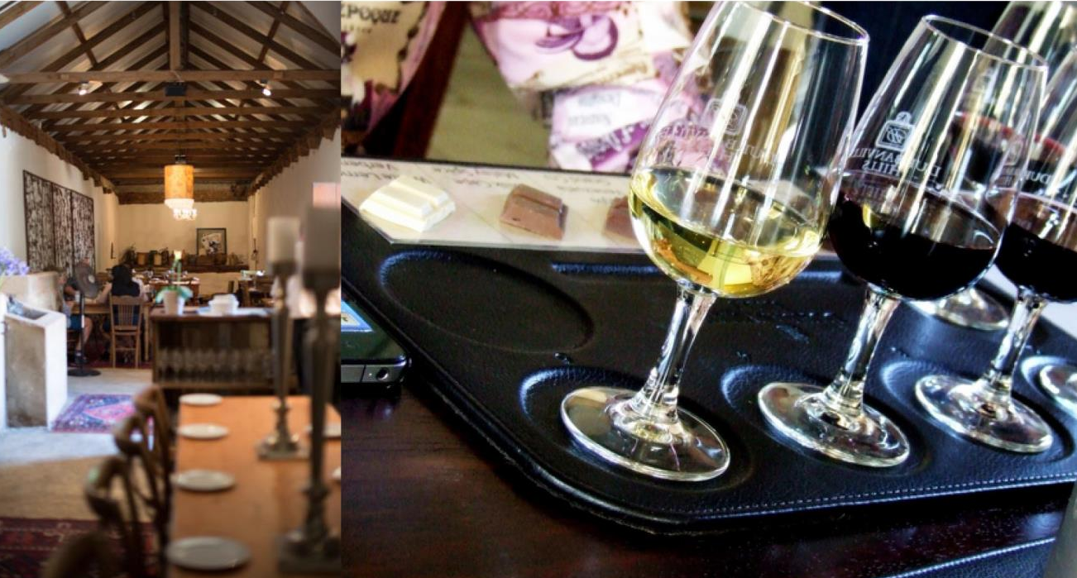
Wines from this ward attracting attention are Sauvignon Blanc, Chardonnay, Merlot, Pinotage and Cabernet Sauvignon.

Slide 21
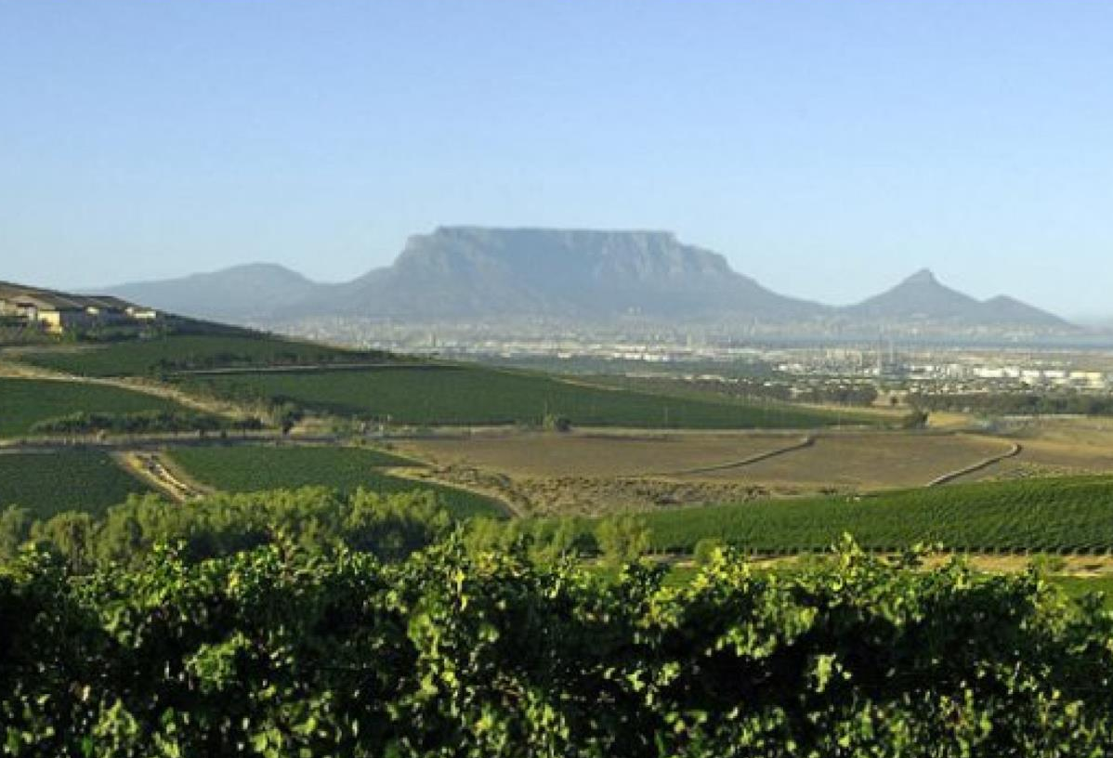
The images used in these presentations have been sourced from various producers, as well as industry and tourism bodies. These presentations are strictly for non-commercial, non-profit, educational purposes only and cannot be reproduced or transmitted in any form or by any means without written permission from Wines of South Africa (WoSA).

Slide 22
The Cape winelands, considered by many to be the most
beautiful in the world, have a network of diverse
and well-run wine routes, affording visitors a varied
and unforgettable experience.
The end
Notes:
The end

