Slide 1
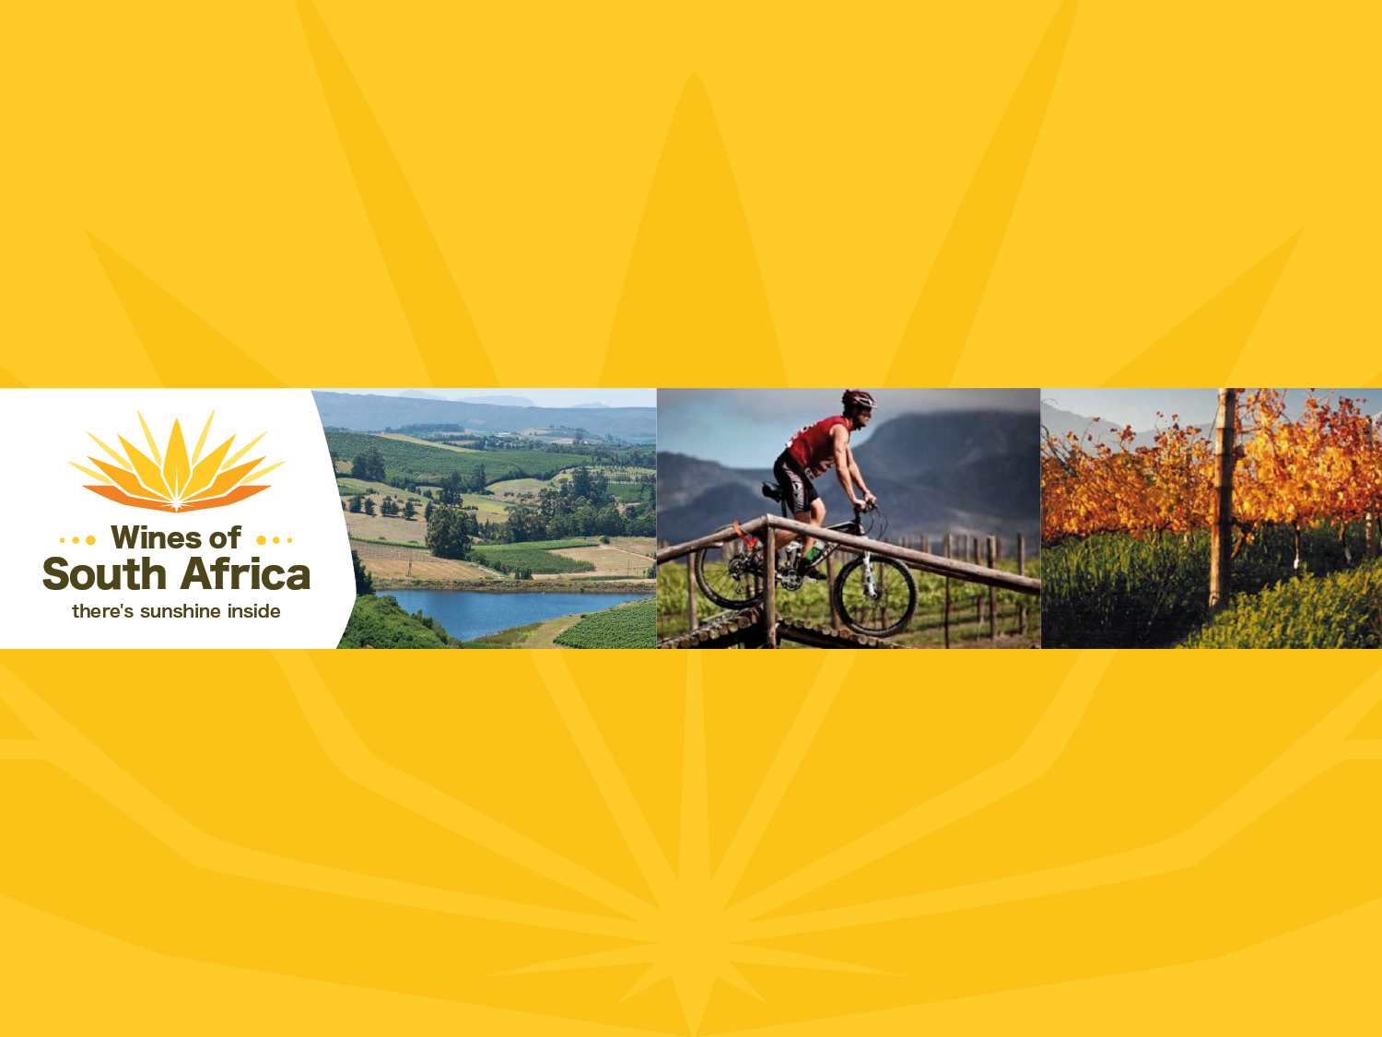
CAPE WINELANDS
ELGIN
Notes:
Wines of South Africa

Slide 2

Where is South Africa?

Slide 3

South Africa is the southernmost
country in Africa.

Slide 4

Our winelands are located at the
very tip of South Africa.

Slide 5

PRODUCTION AREAS: Districts of South Africa.

Slide 6

Wards of South Africa.

Slide 7

Cape South Coast
Region: Cape South Coast
District: Elgin

Slide 8
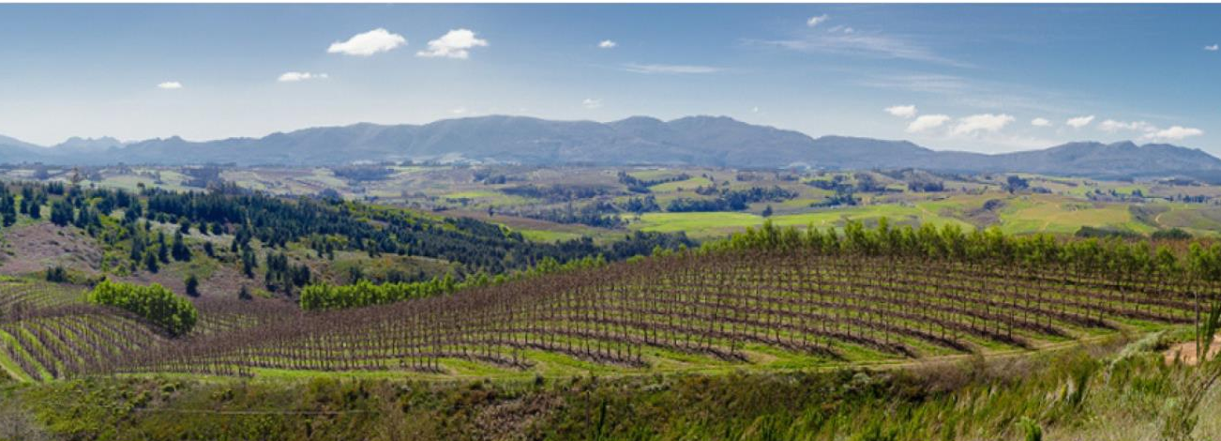
The high-lying cool-climate Elgin district lies cradled in an inland plateau surrounded by the ancient sandstone Hottentots Holland mountains.

Slide 9
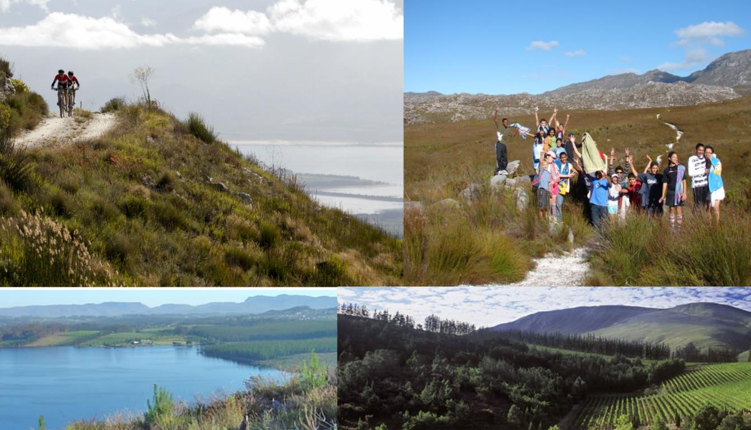
This large basin is situated at an altitude of 200–1 000 m.

Slide 10
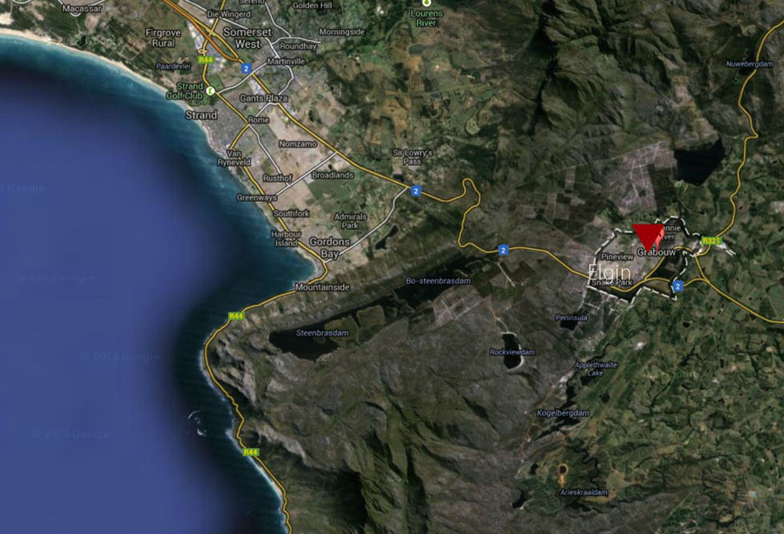
Elgin is approximately 70 km south-east of Cape Town and the southern part of the valley is only 4.5 km from the Atlantic Ocean.

Slide 11
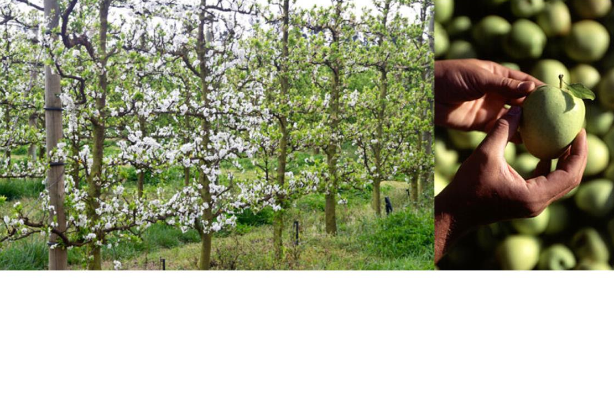
The valley was traditionally an apple-growing area.

Slide 12
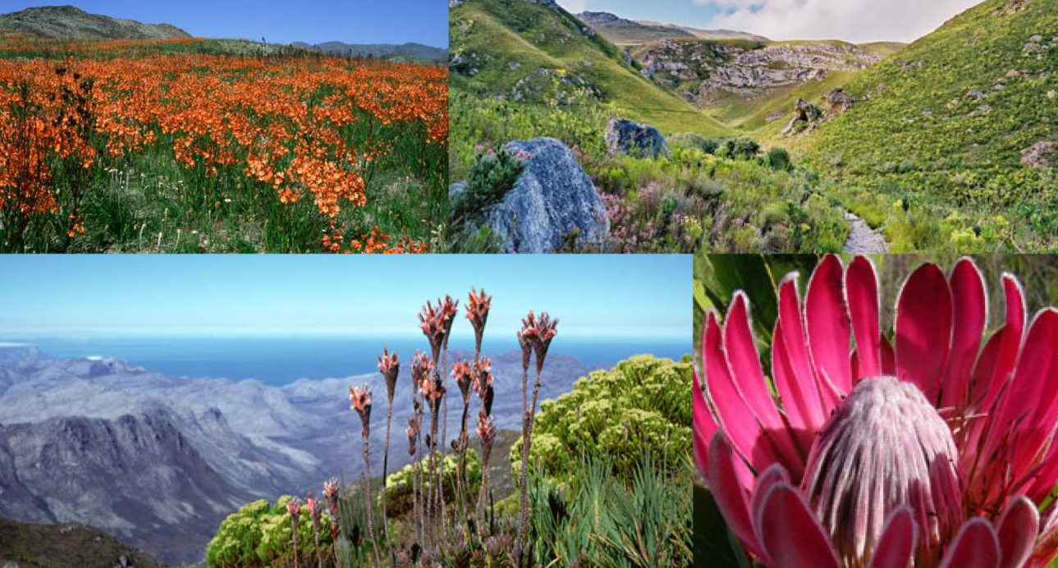
In keeping with an ethos of sustainable wine production, vines grow alongside pristine mountain fynbos in the Kogelberg Biosphere, UNESCO World Heritage Site and part of the spectacular Cape Floral Kingdom.

Slide 13
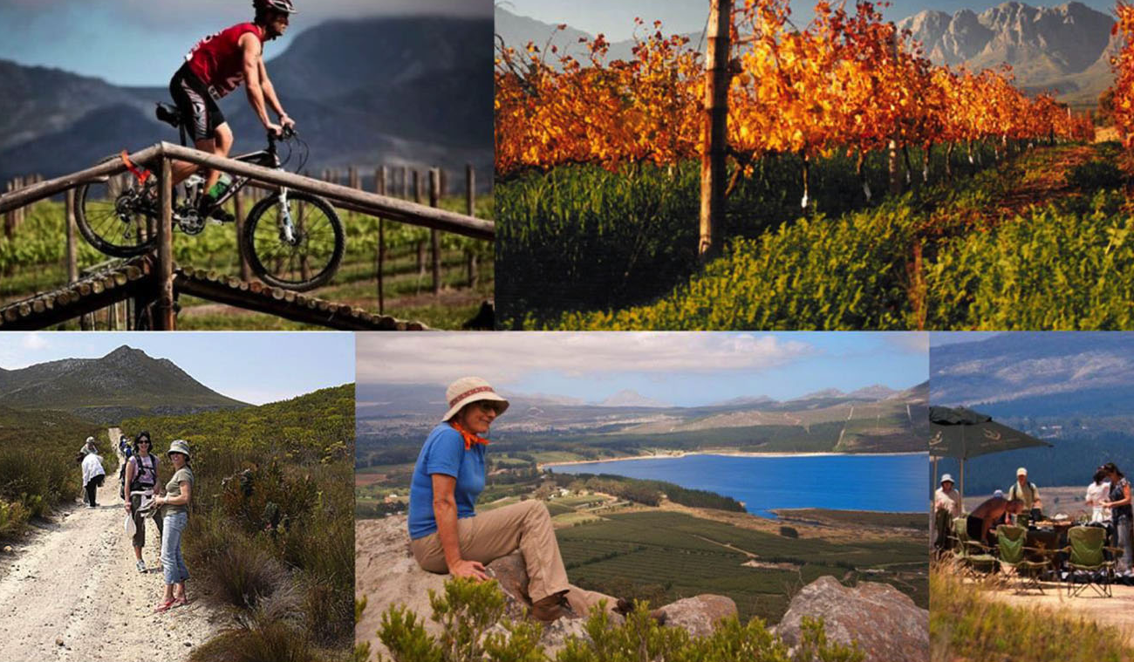
Elgin is part of the Green Mountain Trail,
the world’s first biodiversity wine route.

Slide 14
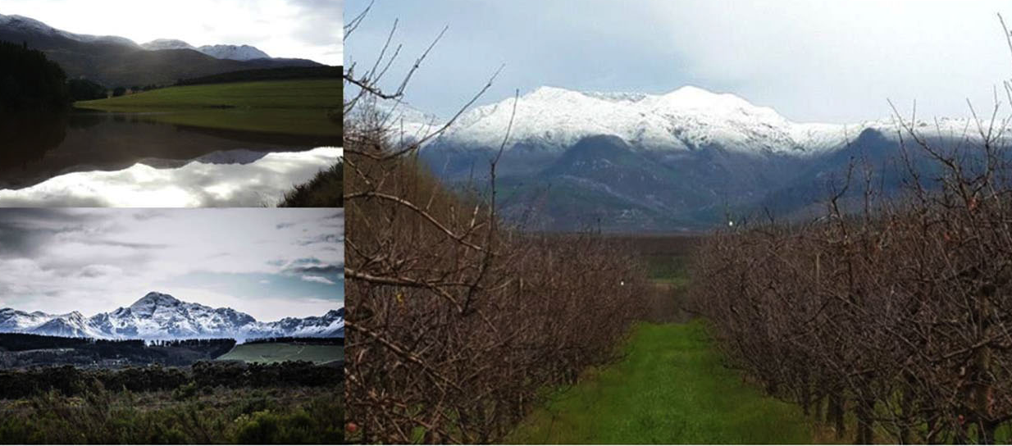
Winters are cold with abundant rain and average annual rainfall is 1 011 mm (Elgin Weather Station).

Slide 15
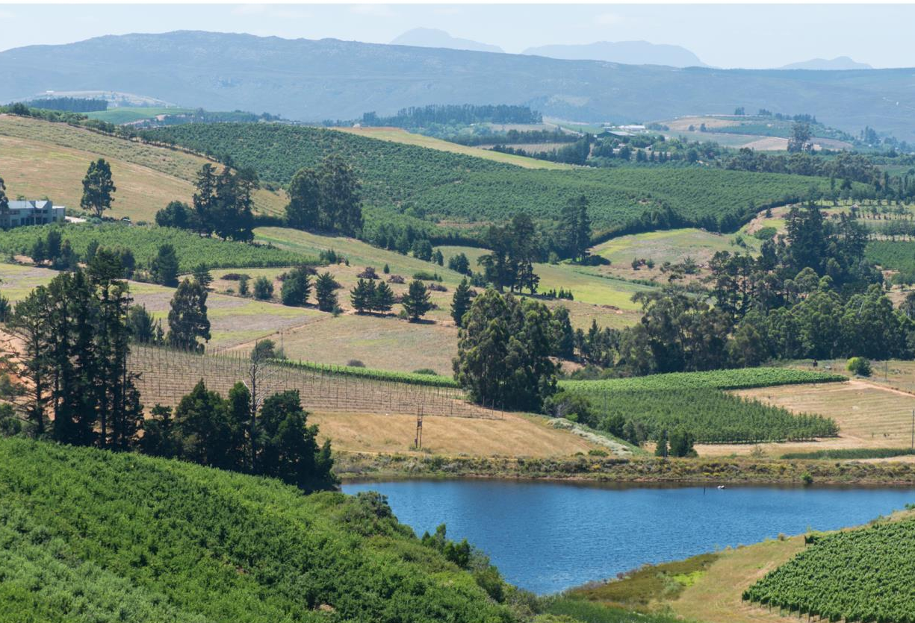
There are cool south-easterly sea breezes in the summer. The mean February temperature is 19.7°C
(Elgin Weather Station).

Slide 16
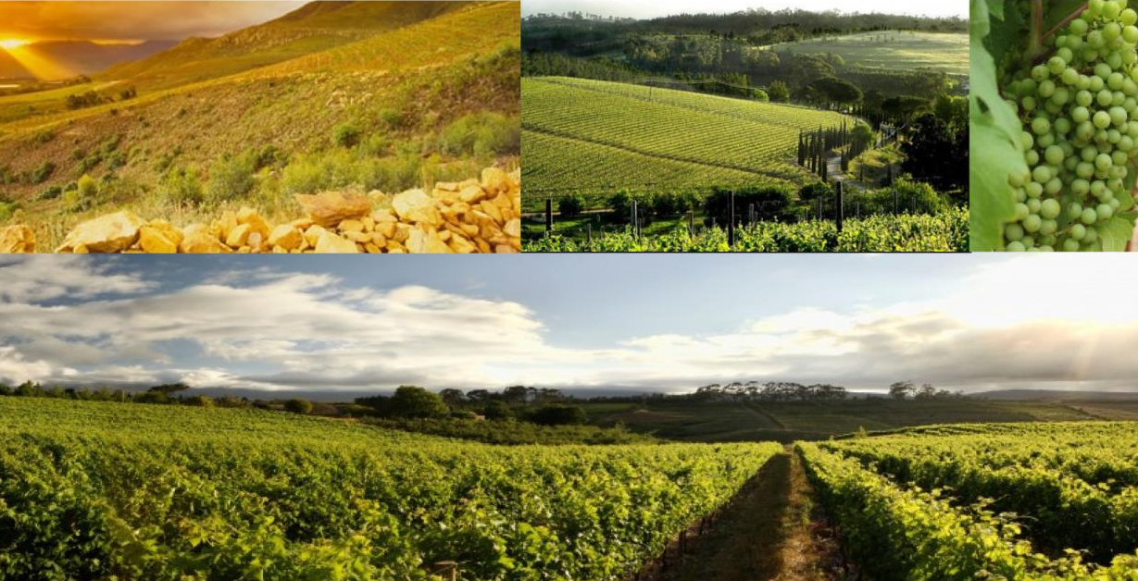
Vineyards benefit from high altitudes with some lying 400 m and more above sea level.

Slide 17
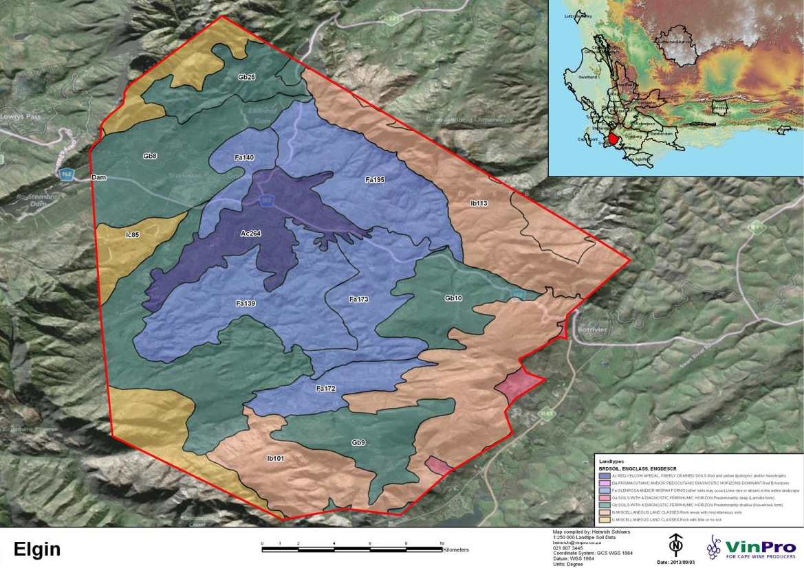
Medium-structured, often ferruginous soils developed from Devonian Bokkeveld shale parent material.

Slide 18
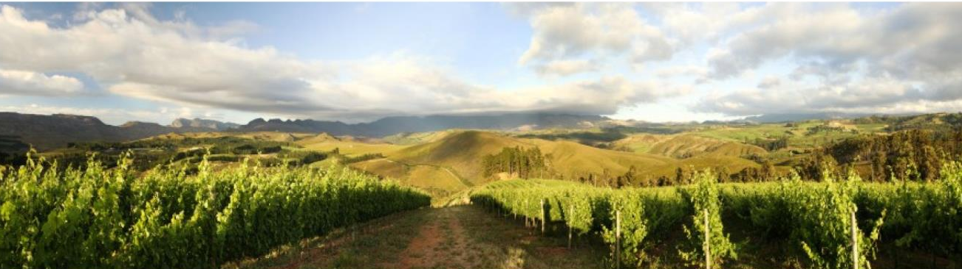
A series of rolling hills set in an undulating countryside present the perfect opportunities for vineyard site selection.

Slide 19
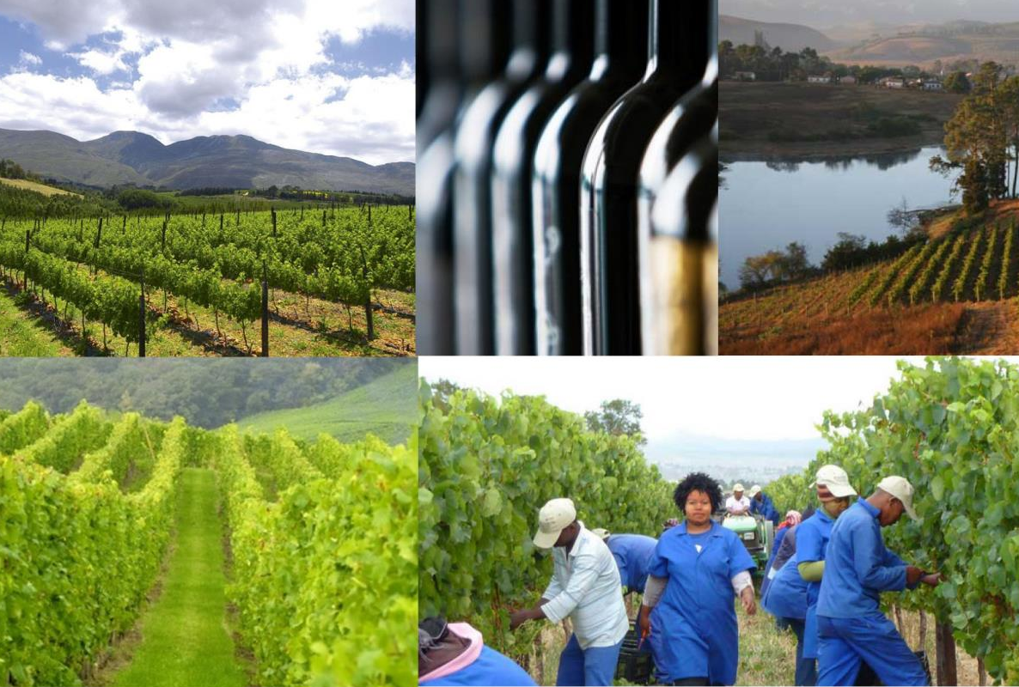
Sauvignon Blanc, Chardonnay, Riesling, Pinot Noir, Merlot and Shiraz do particularly well in this late-ripening zone.

Slide 20
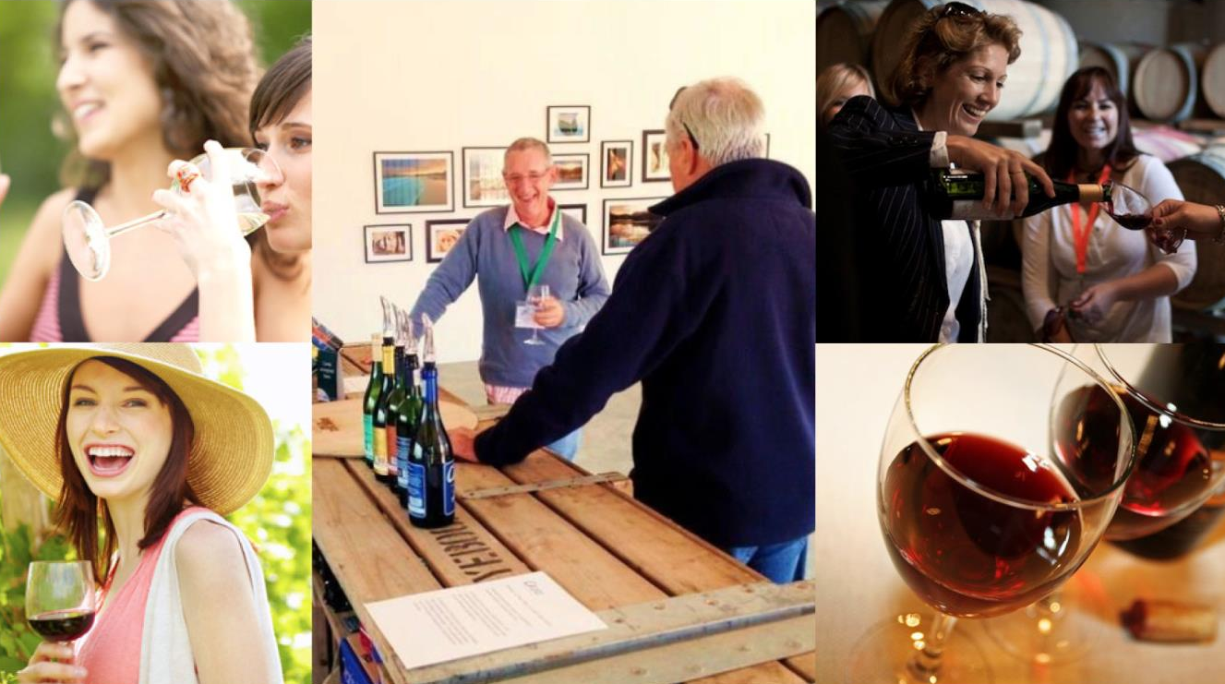
Longer ripening produces grapes that hold a broad spectrum of flavours which results in wines of character showing exceptional purity and density of fruit, complexity and elegance.

Slide 21
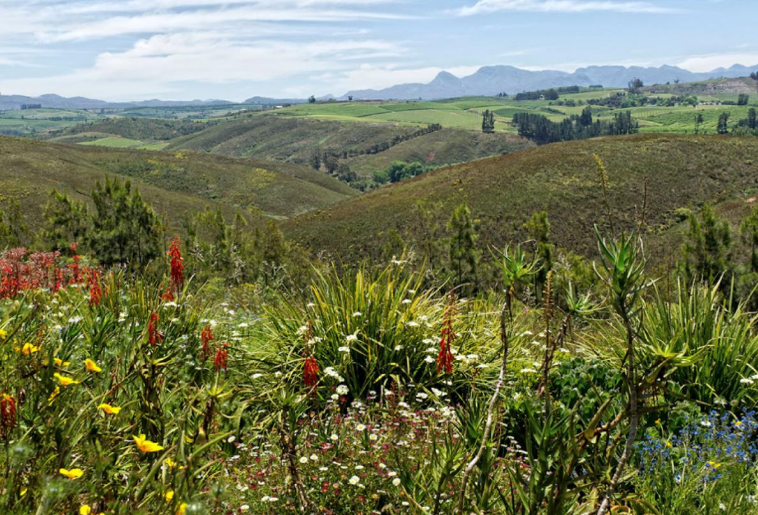
The images used in these presentations have been sourced from various producers, as well as industry and tourism bodies. These presentations are strictly for non-commercial, non-profit, educational purposes only and cannot be reproduced or transmitted in any form or by any means without written permission from Wines of South Africa (WoSA).

Slide 22
The Cape winelands, considered by many to be the most
beautiful in the world, have a network of diverse
and well-run wine routes, affording visitors a varied
and unforgettable experience.
The end
Notes:
The end

