Slide 1
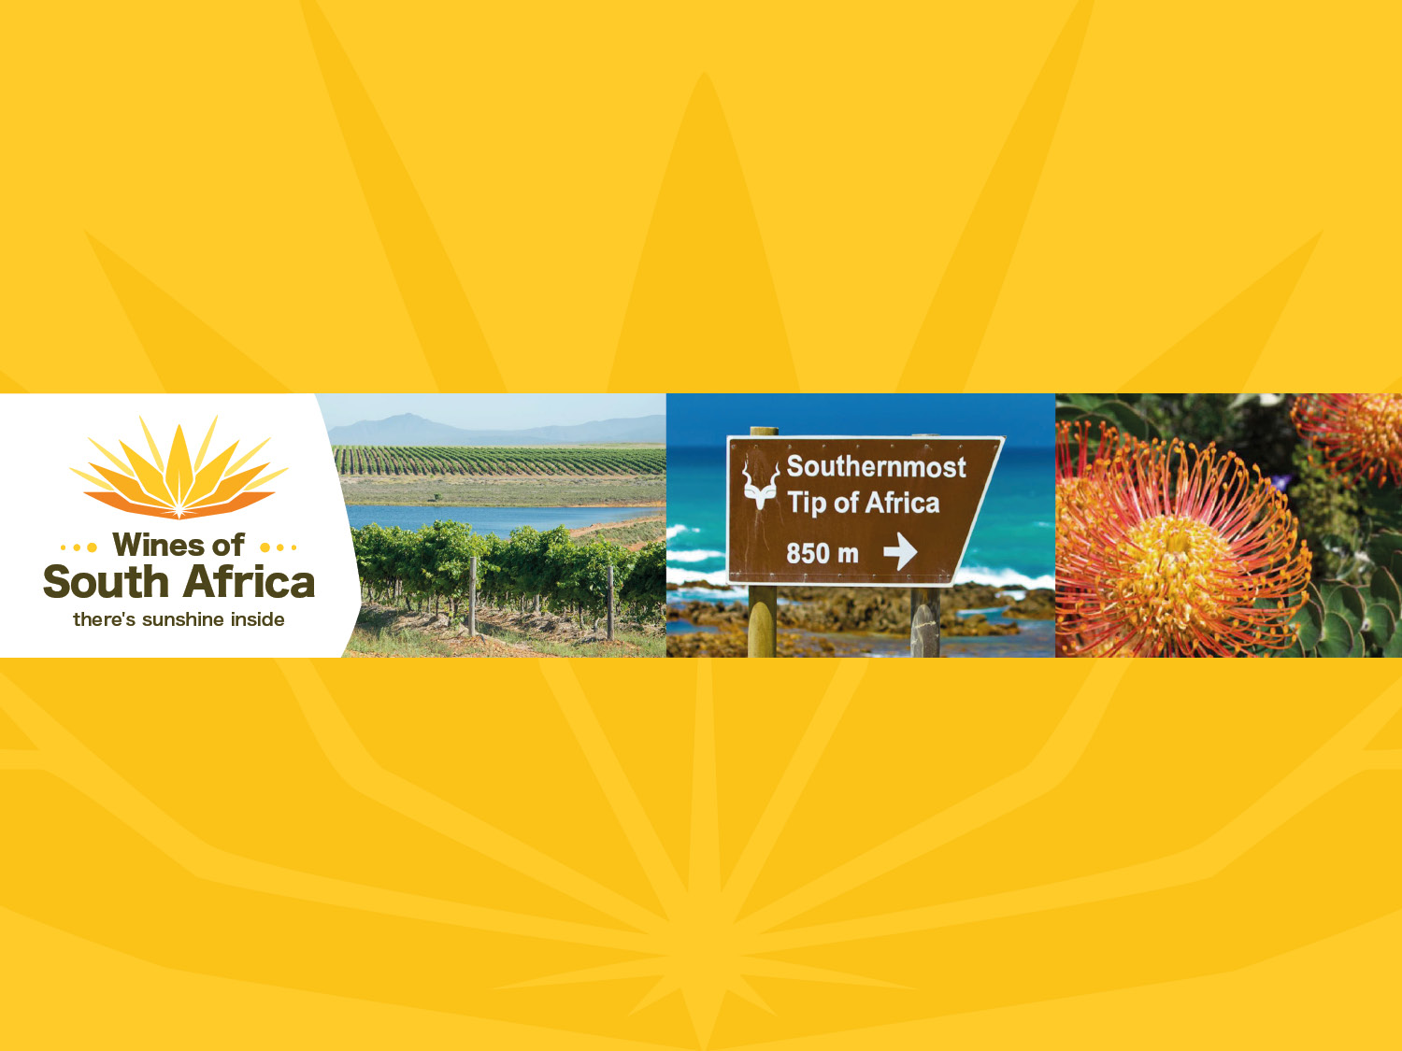
CAPE WINELANDS
ELIM
Notes:
Wines of South Africa

Slide 2

Where is South Africa?

Slide 3

South Africa is the southernmost
country in Africa.

Slide 4

Our winelands are located at the
very tip of South Africa.

Slide 5

PRODUCTION AREAS: Districts of South Africa.

Slide 6

Wards of South Africa.

Slide 7

Cape South Coast
Region: Cape South Coast
District: Cape Agulhas
Wards: Elim

Slide 8
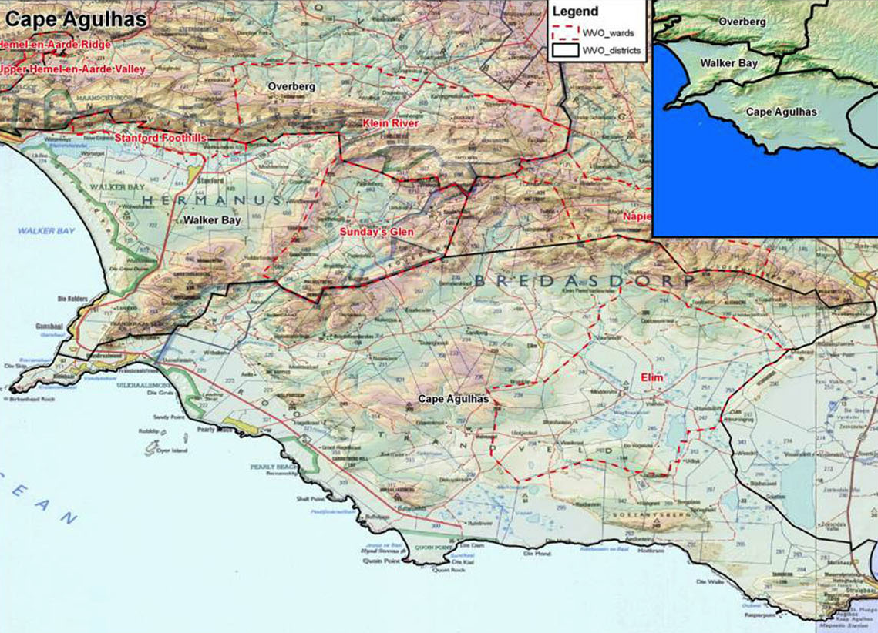

Slide 9
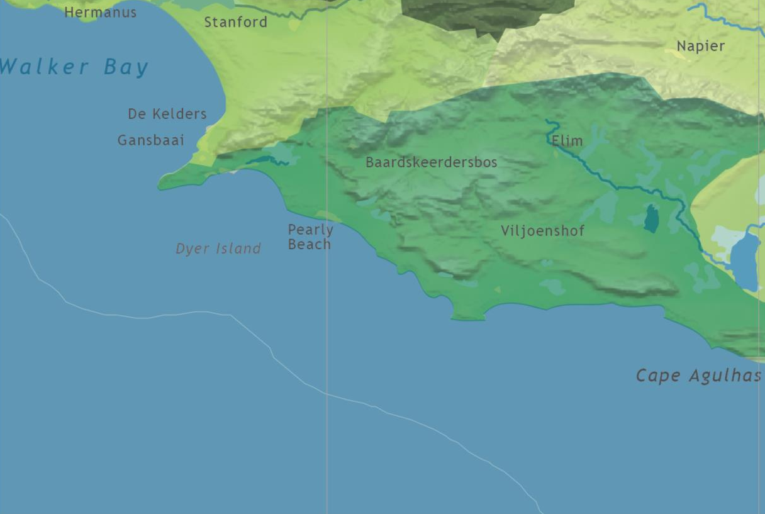

Slide 10
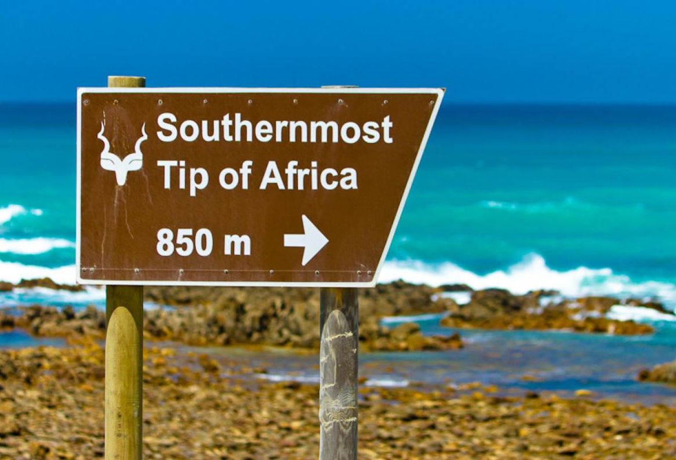
Cape Agulhas is Africa’s southernmost point. Elim is one of the exciting new winegrowing areas that have emerged in the Cape South Coast region since the turn of the century.

Slide 11
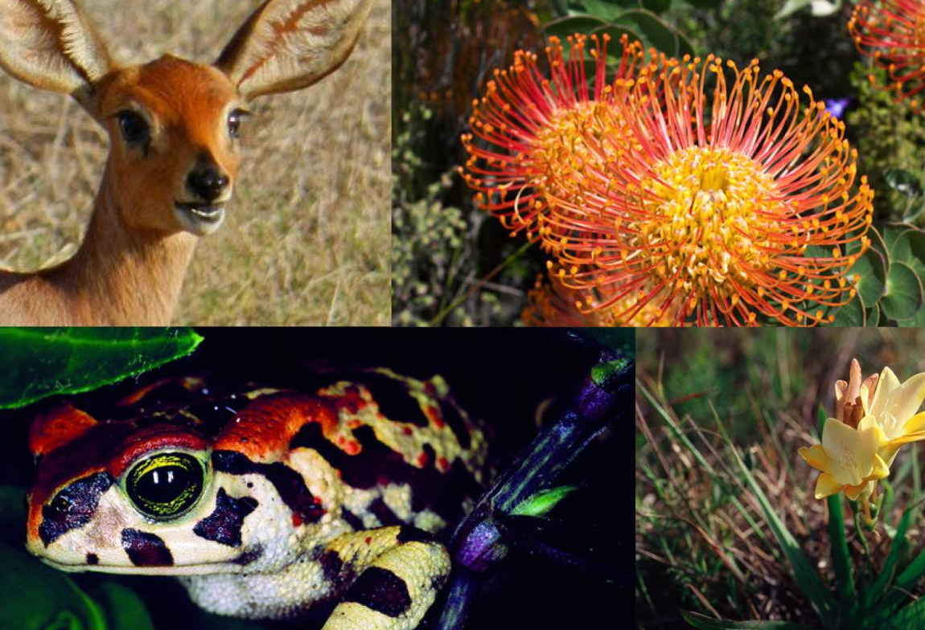
The Agulhas Plain is home to one of the richest biodiversities in the world, equivalent to that of a tropical rainforest.

Slide 12
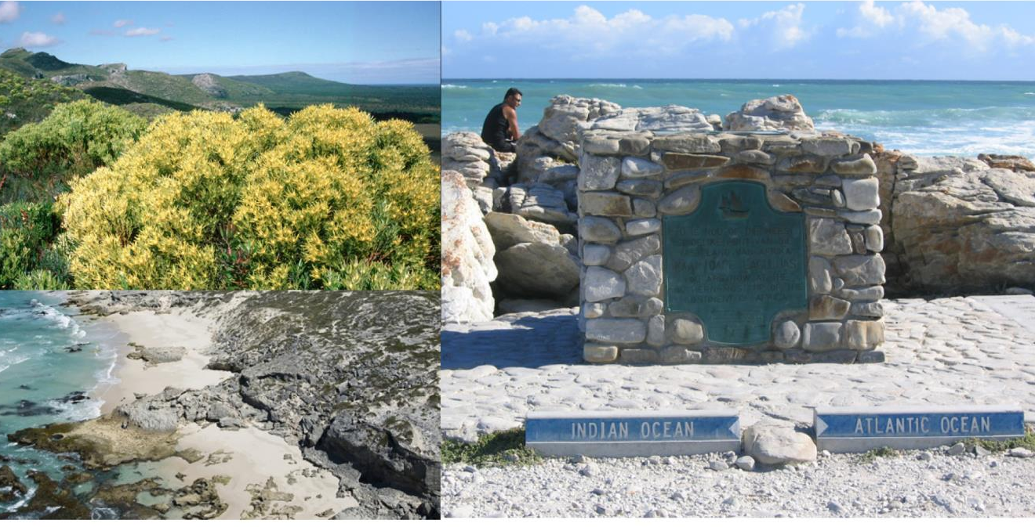
Thousands of flora species flourish in this ward characterised by outstretched sand plains, wetlands, gravelly bottomlands, and extensive limestone and calcareous dunes.

Slide 13
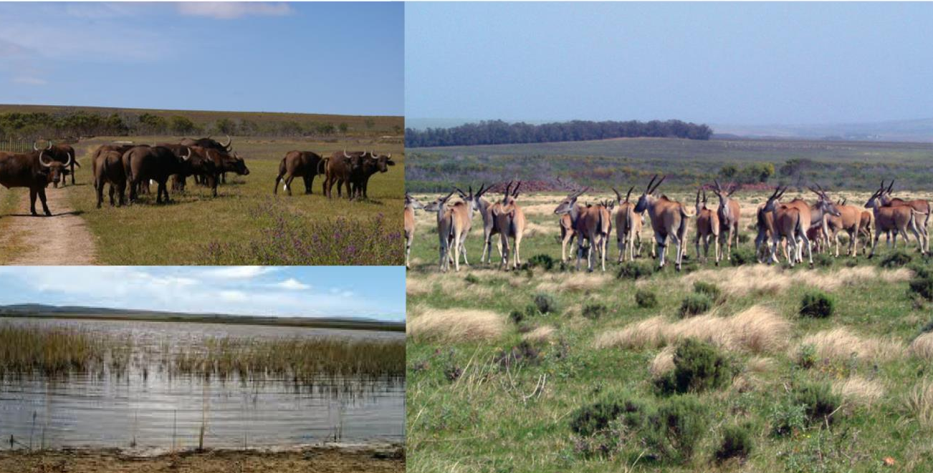
Wetlands have been restored and buffalo have been reintroduced in a pioneering project at the Nuwejaars Wetland Special Management Area.

Slide 14
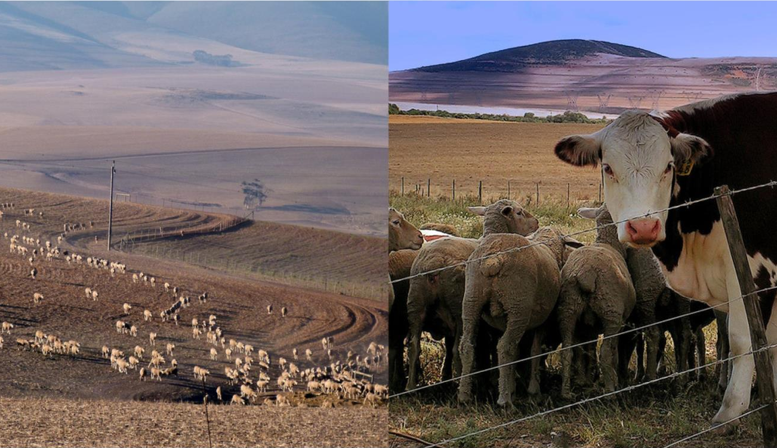
The area once featured predominantly grain or cattle and sheep farms.

Slide 15
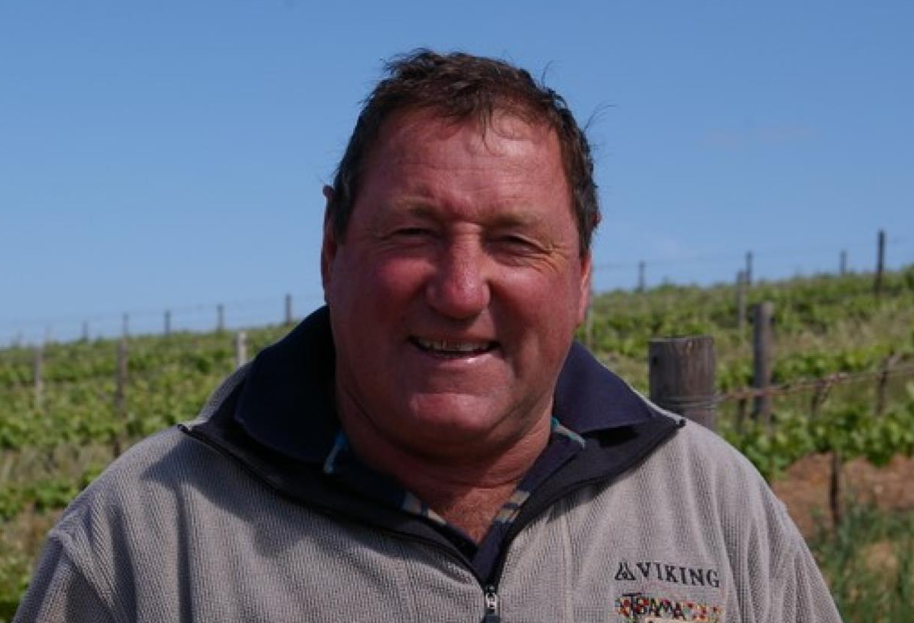
The first vines were planted in 1996.

Slide 16
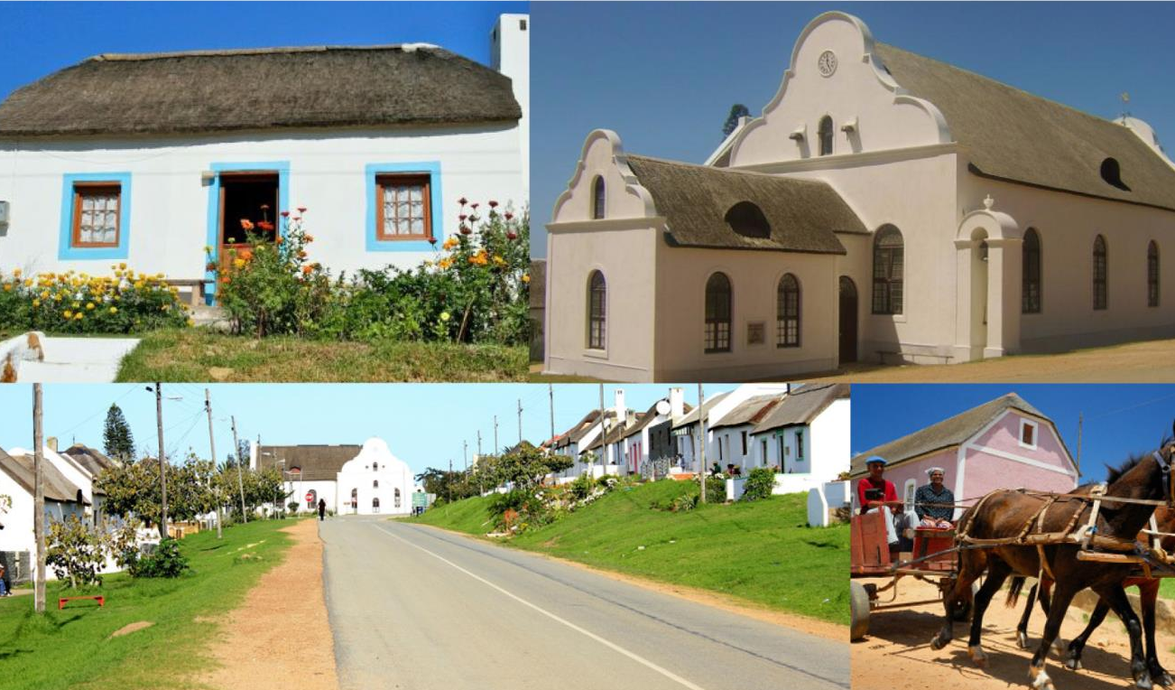
The entire picturesque village of Elim, which is a Moravian mission settlement that was founded in 1824, is a national monument.

Slide 17
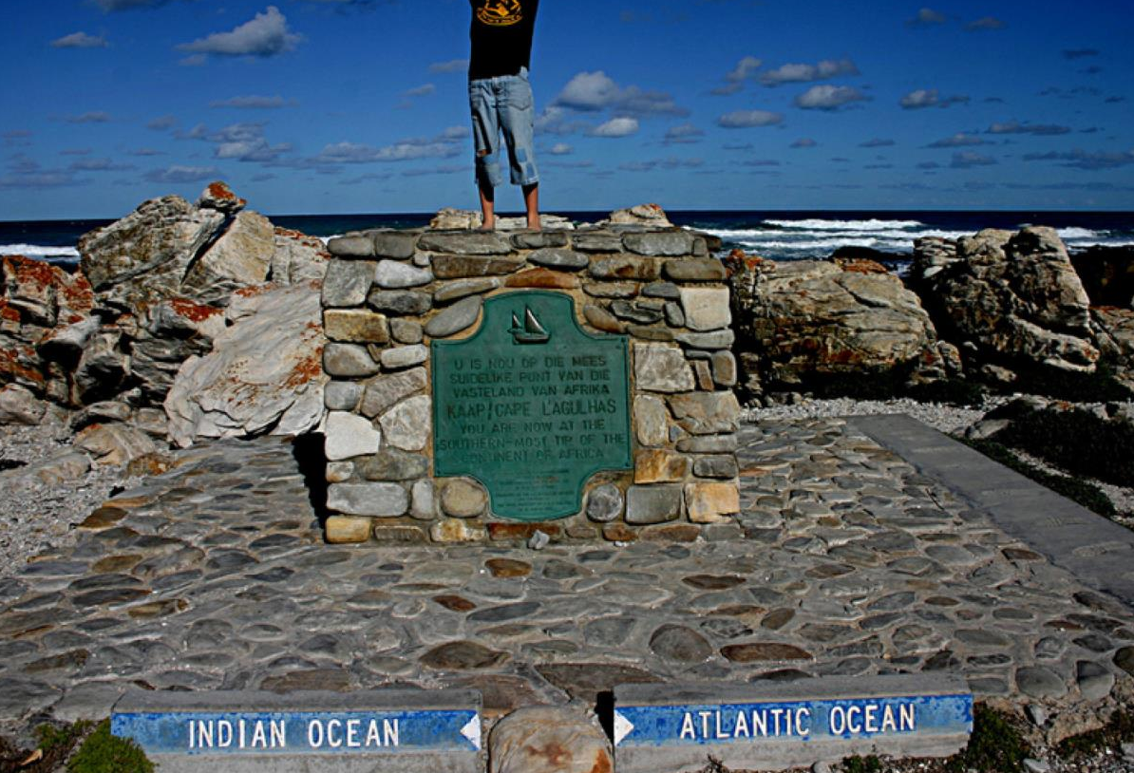
The vineyards are centred around the village, which lies on a peninsula washed by two oceans, the Indian and the Atlantic.

Slide 18
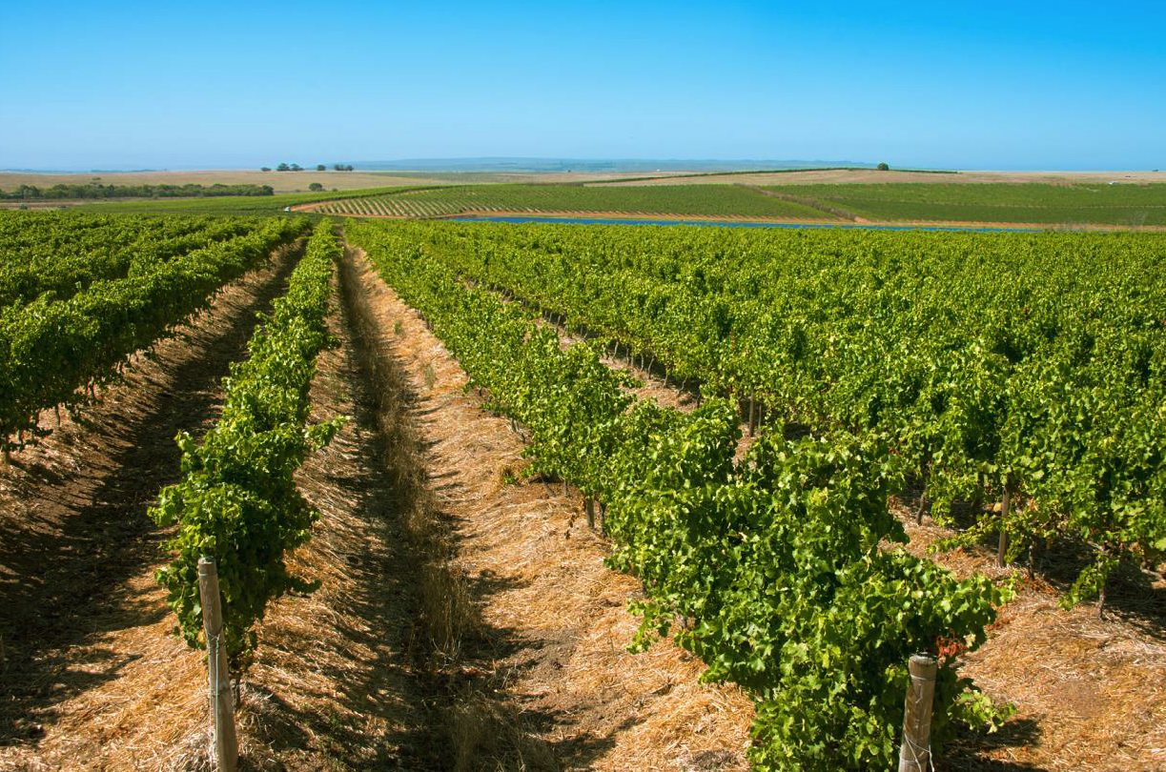
The Elim ward is the southernmost of the maritime vineyards.

Slide 19
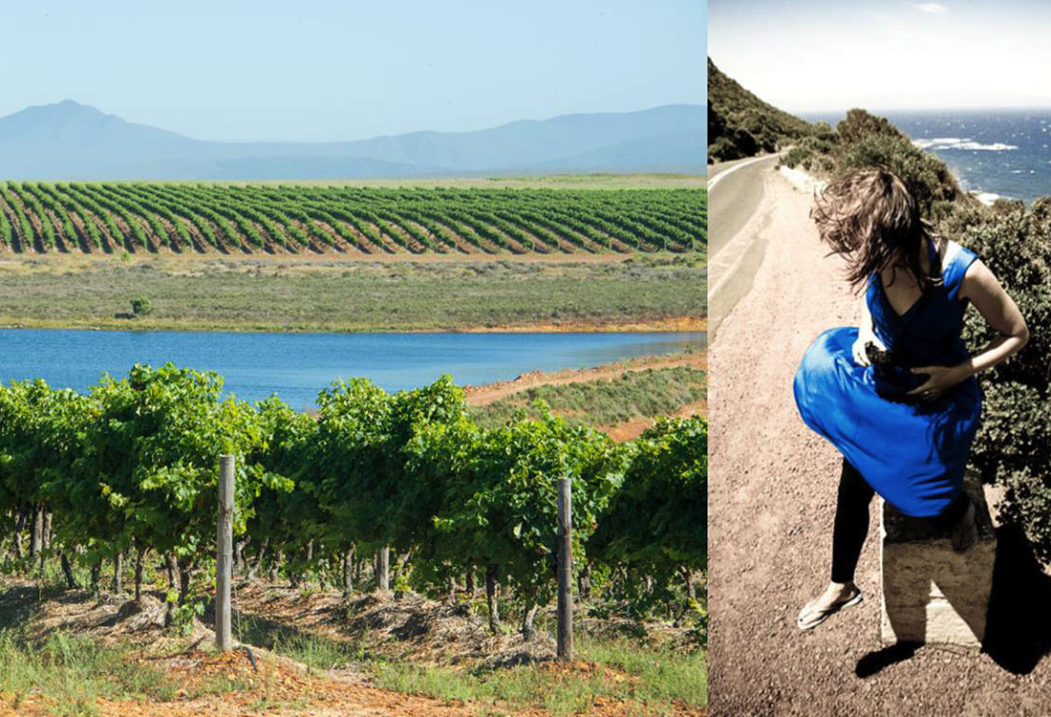
The vineyards are exposed to very strong south-easterly winds. These strong, cooling winds are prevalent in summer, ensuring a very cool ripening season. The mean February temperature is 20.3⁰C and the average annual rainfall is 535mm.

Slide 20
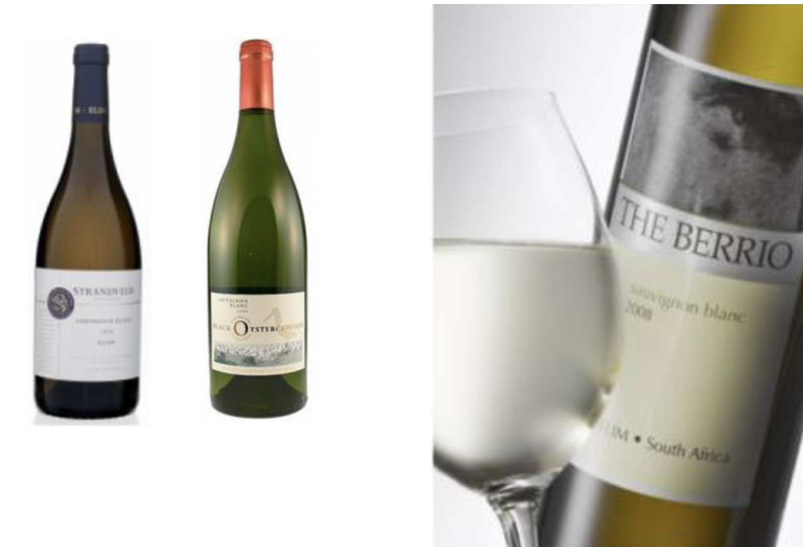
This is perfect for Sauvignon Blanc. It is also promising for Semillon and Shiraz.

Slide 21
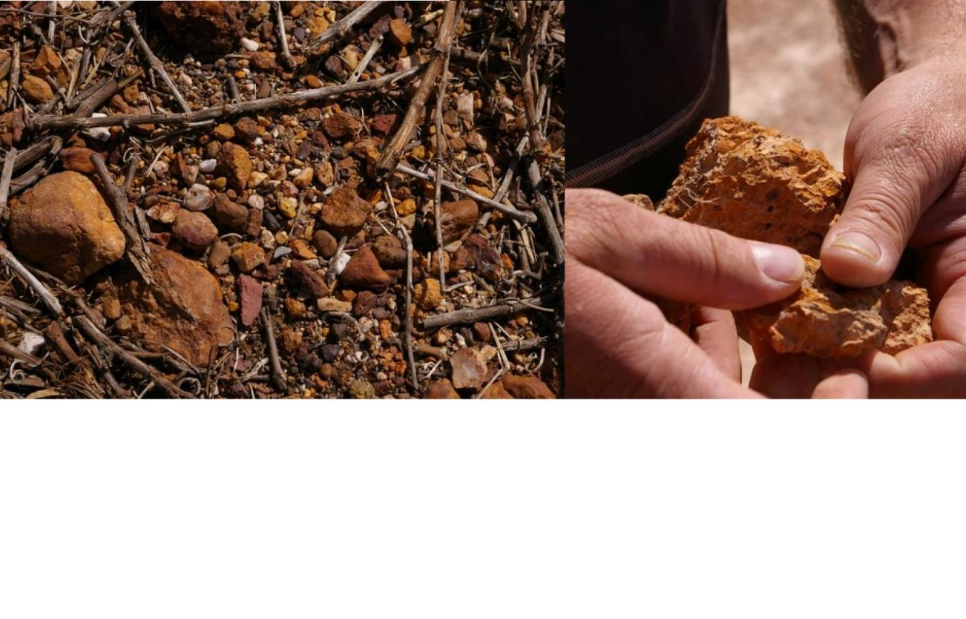
In Elim, with its mineral-rich soils, you will find up to five different soil types within a hectare of vineyard.

Slide 22
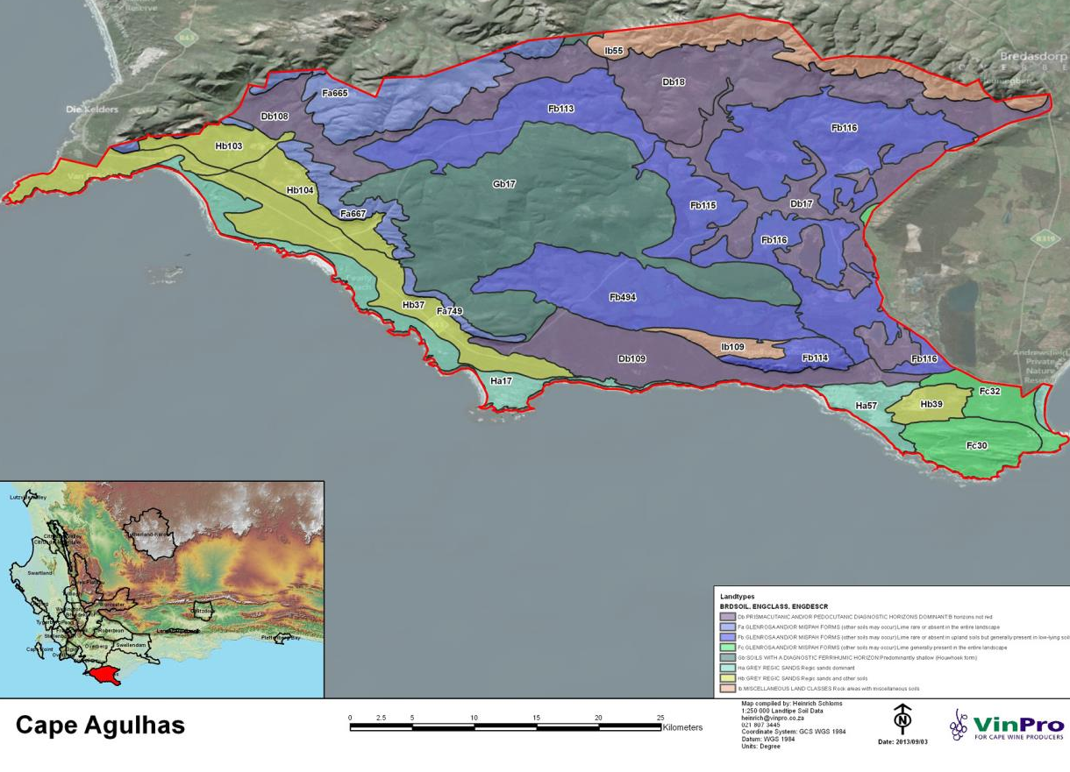

Slide 23
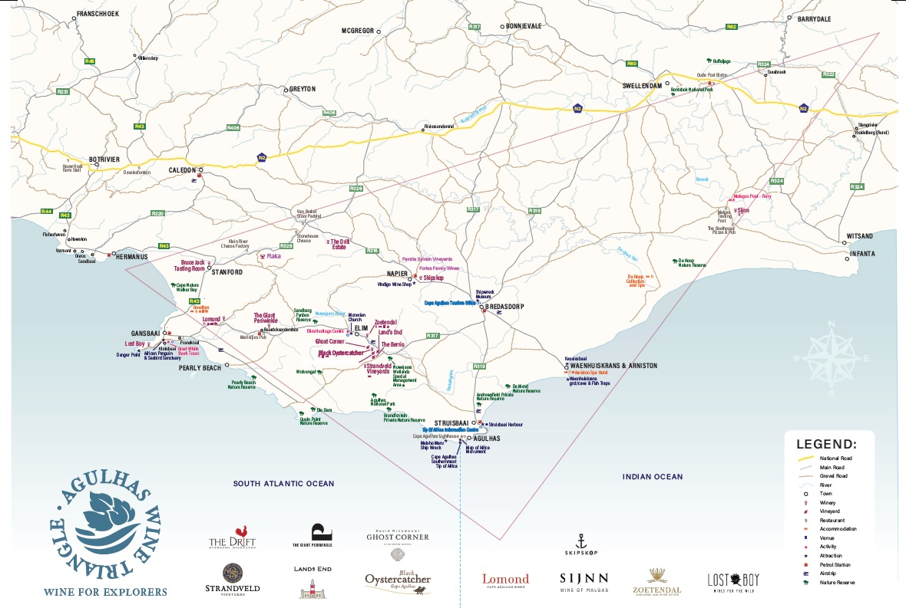
The Agulhas Wine Triangle was established in 2019 to showcase the wines of this wild and rugged region.

Slide 24
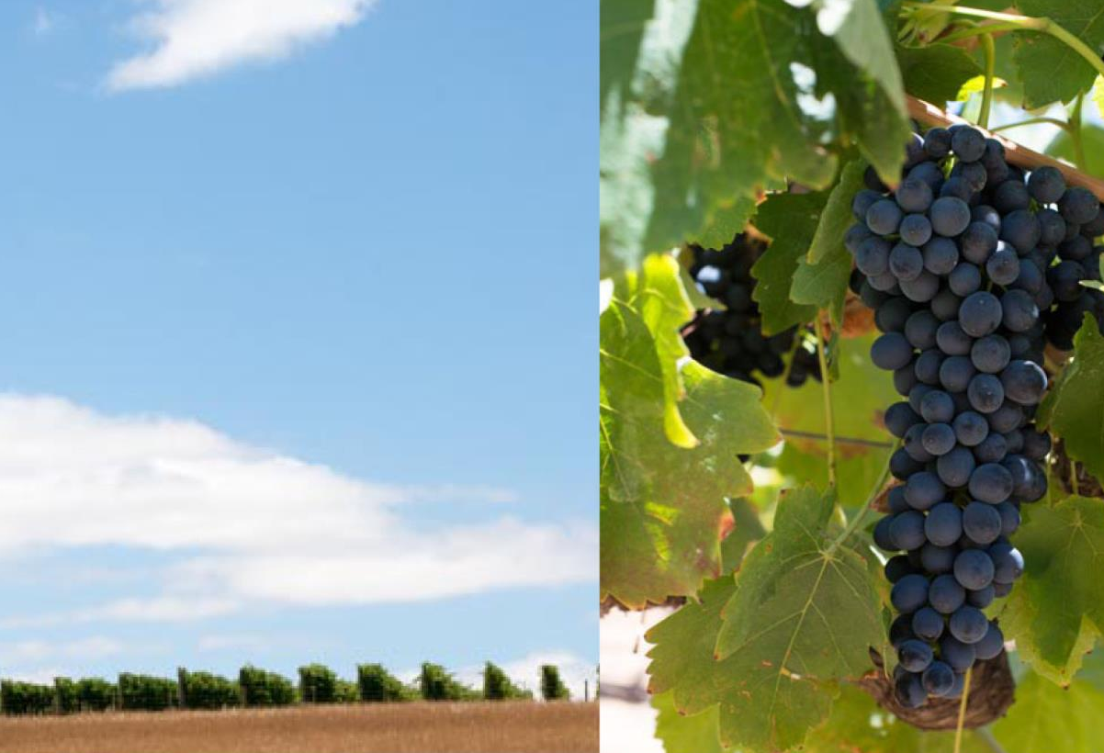
The grapes here develop unique and concentrated flavour profiles.

Slide 25
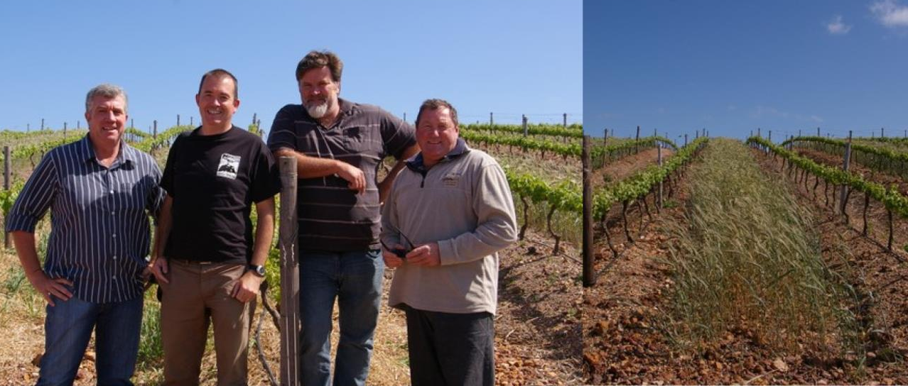
A ward generating much interest, Elim's still small hectarage has shown great potential.

Slide 26
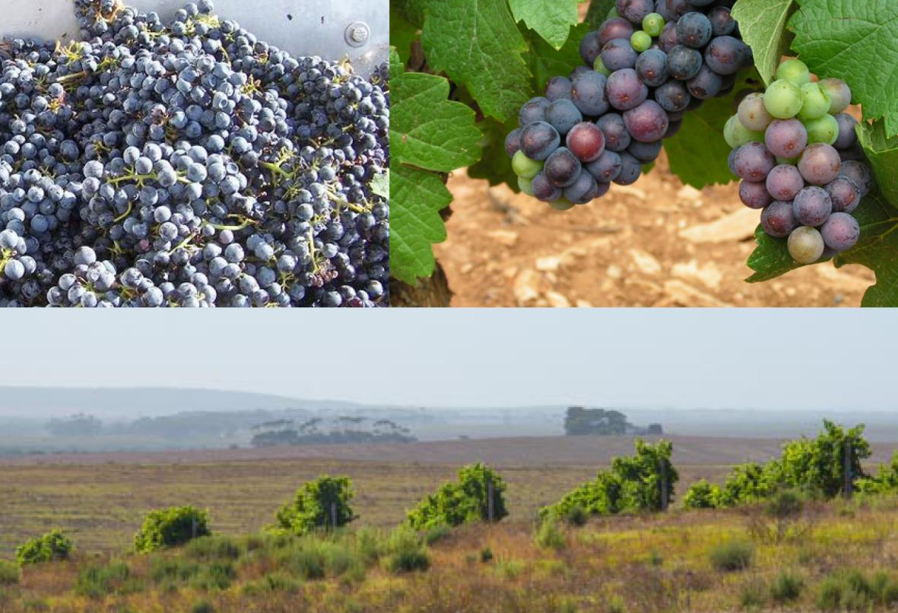
The window of opportunity to pick at optimum phenolic ripeness is far longer than in warmer areas.

Slide 27
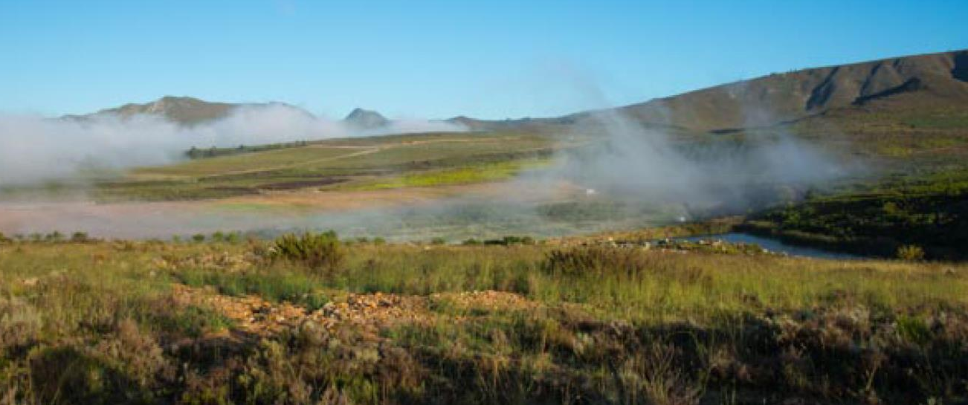
Cool-climate aromatics, a flinty minerality, distinct flavours and elegance are the signature of the Elim wines.

Slide 28
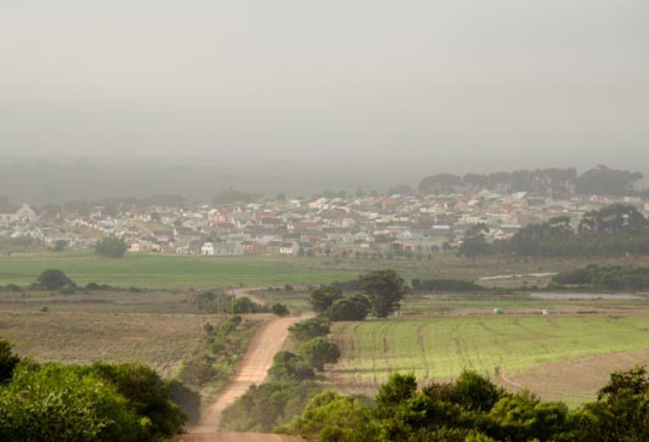
The images used in these presentations have been sourced from various producers, as well as industry and tourism bodies. These presentations are strictly for non-commercial, non-profit, educational purposes only and cannot be reproduced or transmitted in any form or by any means without written permission from Wines of South Africa (WoSA).

Slide 29
The Cape winelands, considered by many to be the most
beautiful in the world, have a network of diverse
and well-run wine routes, affording visitors a varied
and unforgettable experience.
The end
Notes:
The end

