Slide 1
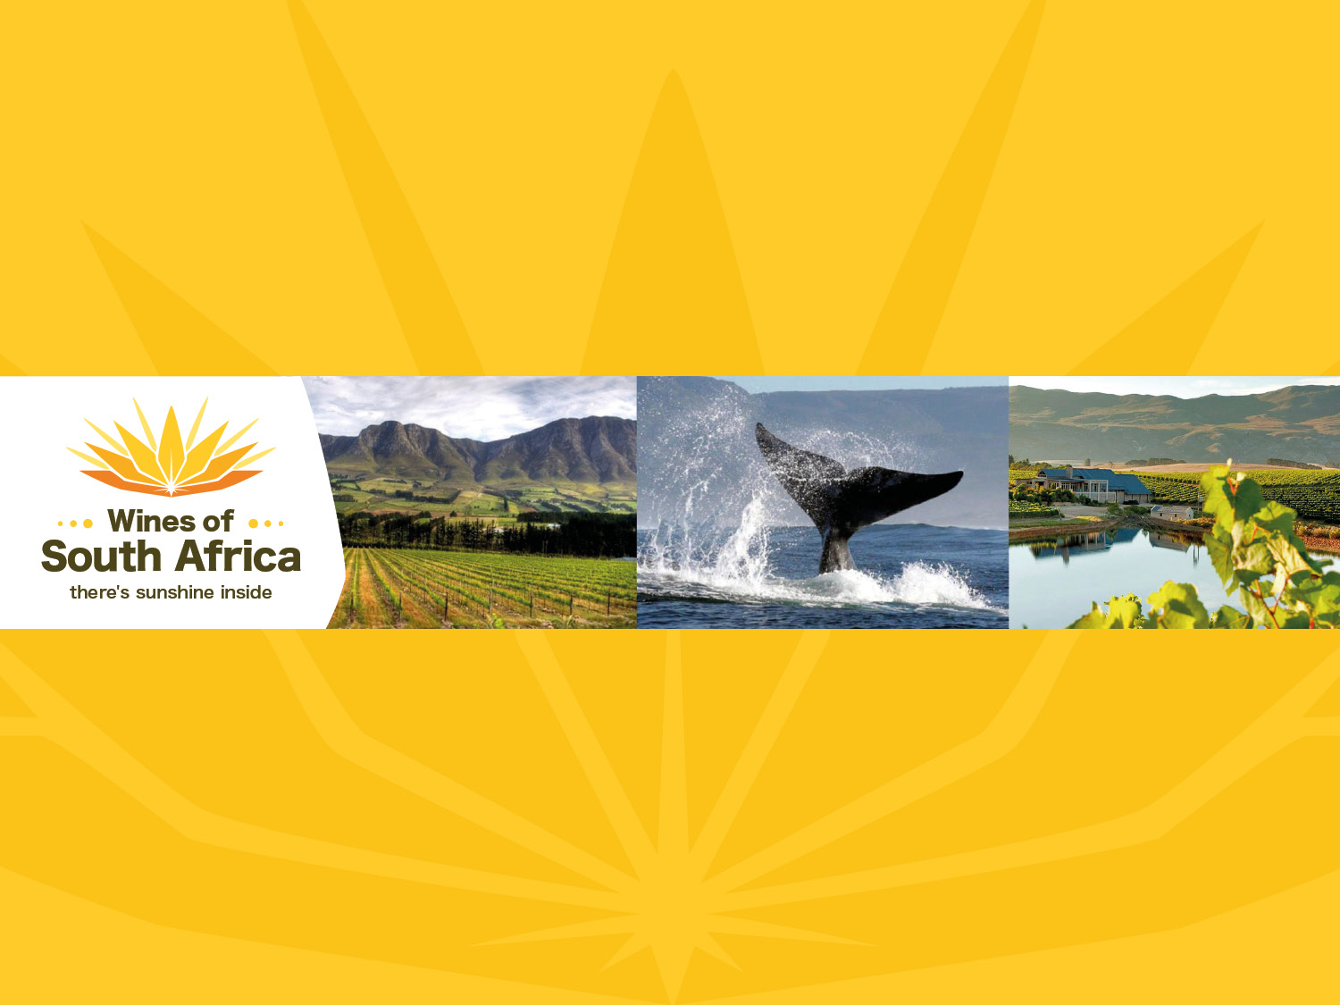
CAPE WINELANDS
HEMEL-EN-AARDE
Notes:
Wines of South Africa

Slide 2

Where is South Africa?

Slide 3

South Africa is the southernmost
country in Africa.

Slide 4

Our winelands are located at the
very tip of South Africa.

Slide 5

PRODUCTION AREAS: Districts of South Africa.

Slide 6

Wards of South Africa.

Slide 7
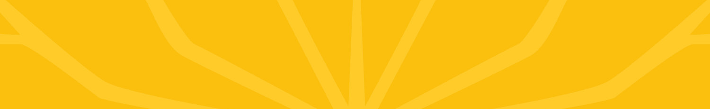
Cape South Coast
Region: Cape South Coast
District: Walker Bay
Wards: Hemel-en-Aarde Ridge
Hemel-en-Aarde Valley
Upper Hemel-en-Aarde Valley

Slide 8
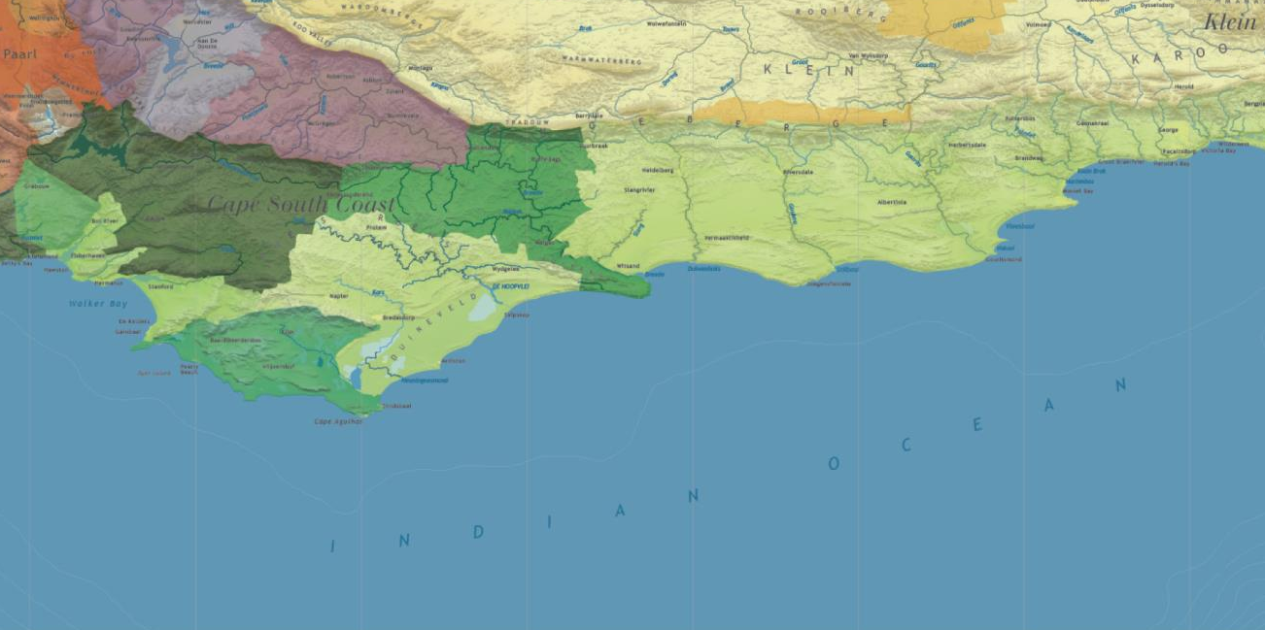

Slide 9
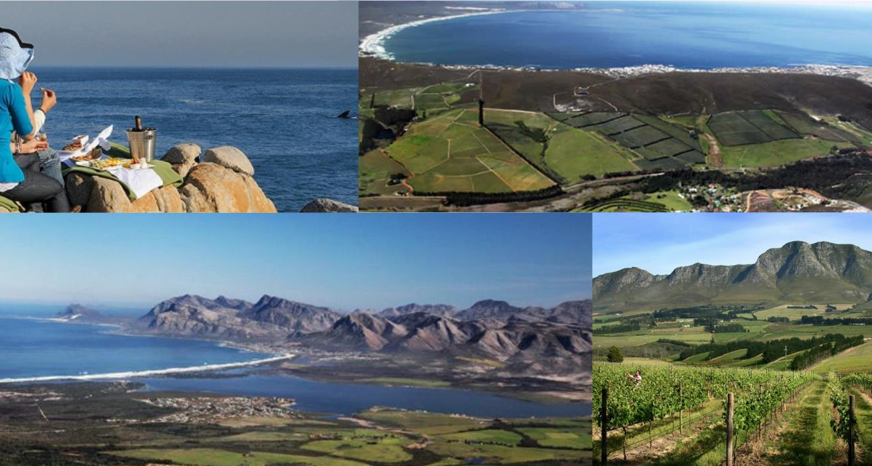
The Hemel-en-Aarde Valley lies within the highly regarded Walker Bay district, which surrounds the seaside town of Hermanus.

Slide 10
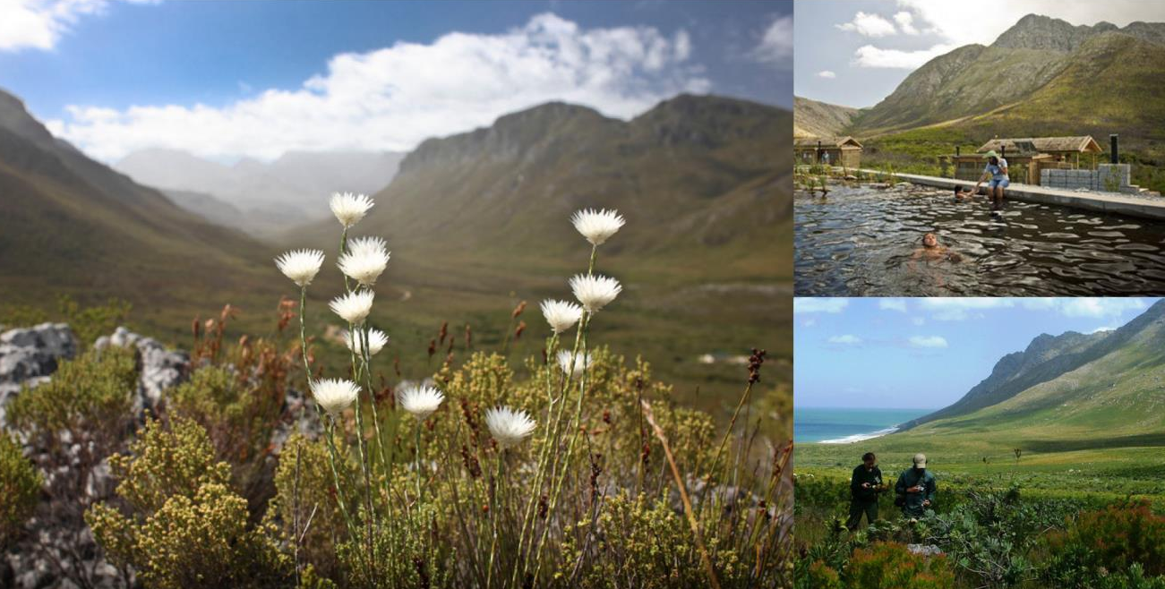
Both the Groenlandberg and Kogelberg reserves with their wealth of indigenous flora and fauna lie within this area.

Slide 11
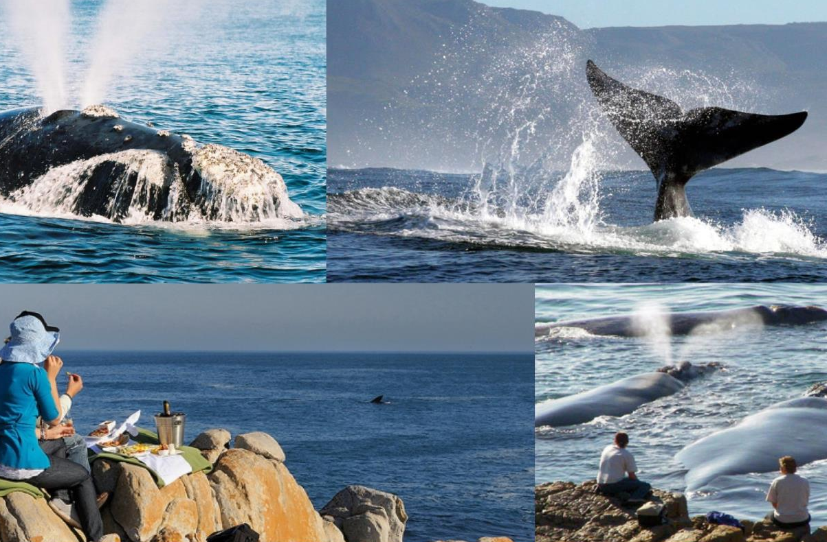
Hermanus also boasts some of the best land-based whale watching in the world in season (June to November).

Slide 12
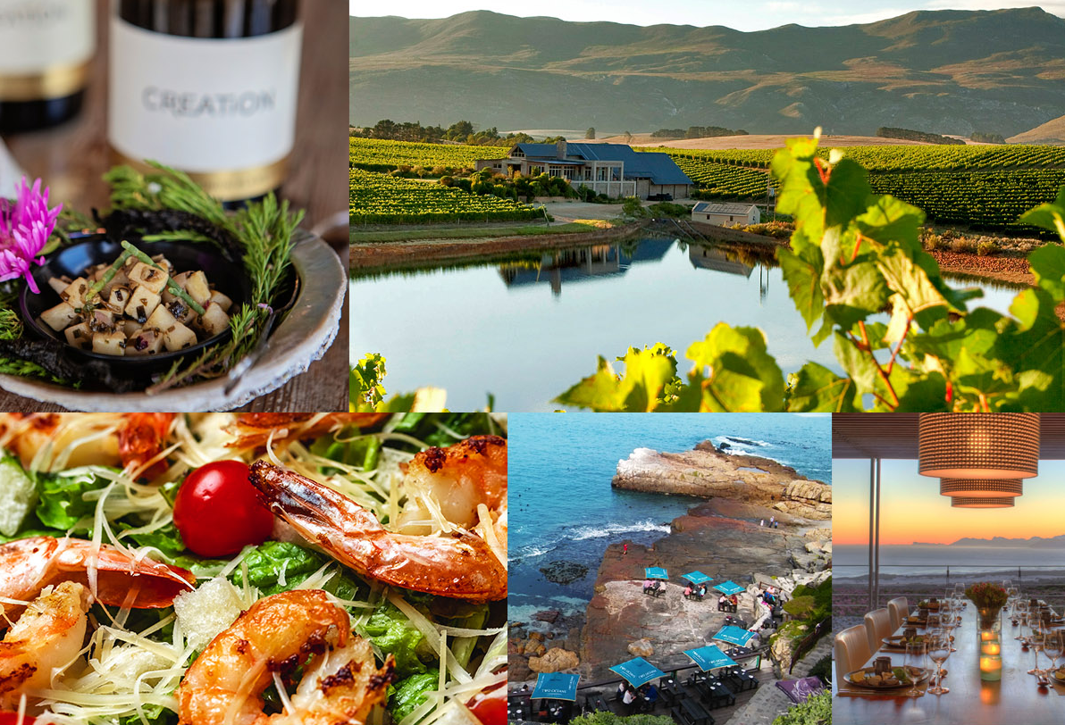
Hermanus is recognised as a UNESCO Creative City for Gastronomy, the first on the African continent to receive this distinction.

Slide 13
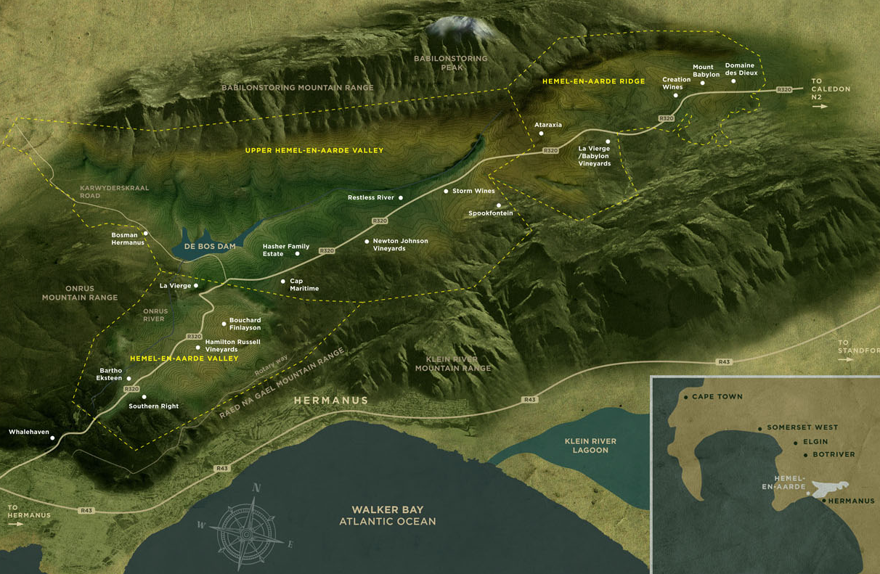
The valley encompasses three wards:
Hemel-en-Aarde Valley, Upper Hemel-en-Aarde Valley and Hemel-en-Aarde Ridge.

Slide 14
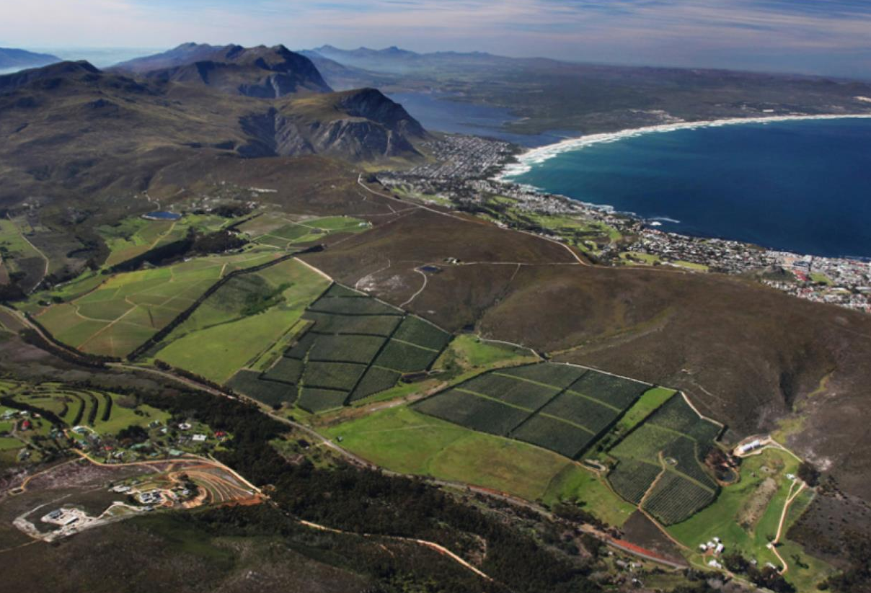
Hemel-en-Aarde Valley is the first appellation as you enter the valley, the closest to the Atlantic Ocean and home to the first vineyard planted in the area.

Slide 15
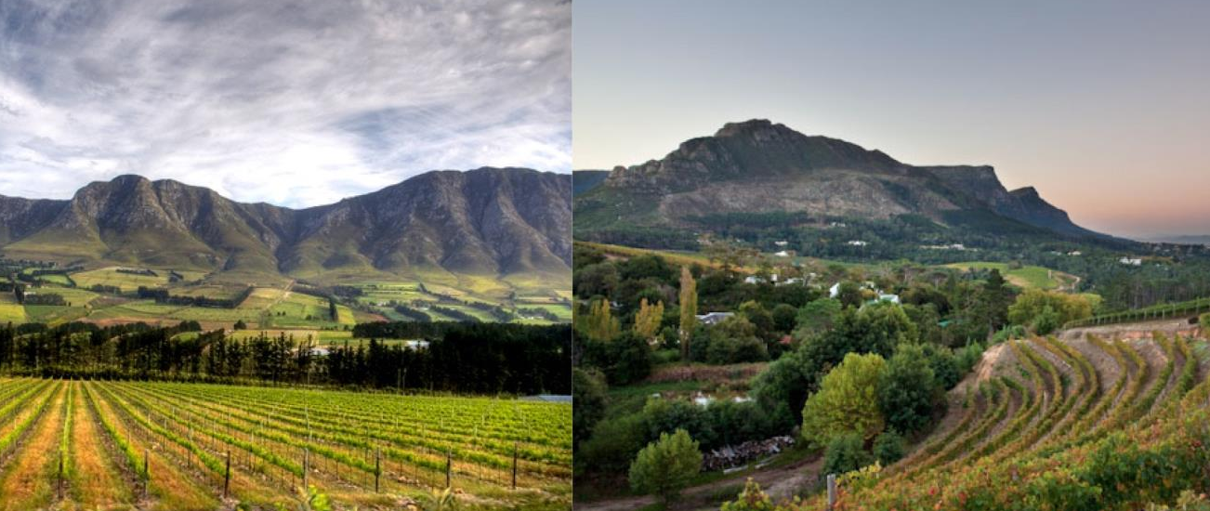
Upper Hemel-en-Aarde Valley is the second appellation as you proceed up the valley and the largest of the three.

Slide 16
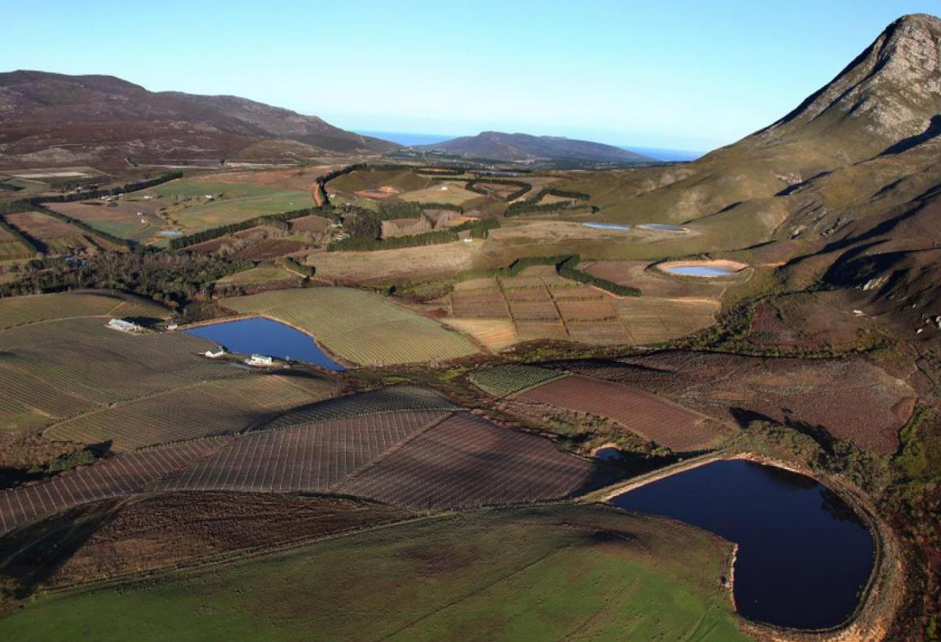
Hemel-en-Aarde Ridge is the third and smallest appellation, and the furthest from the sea.

Slide 17
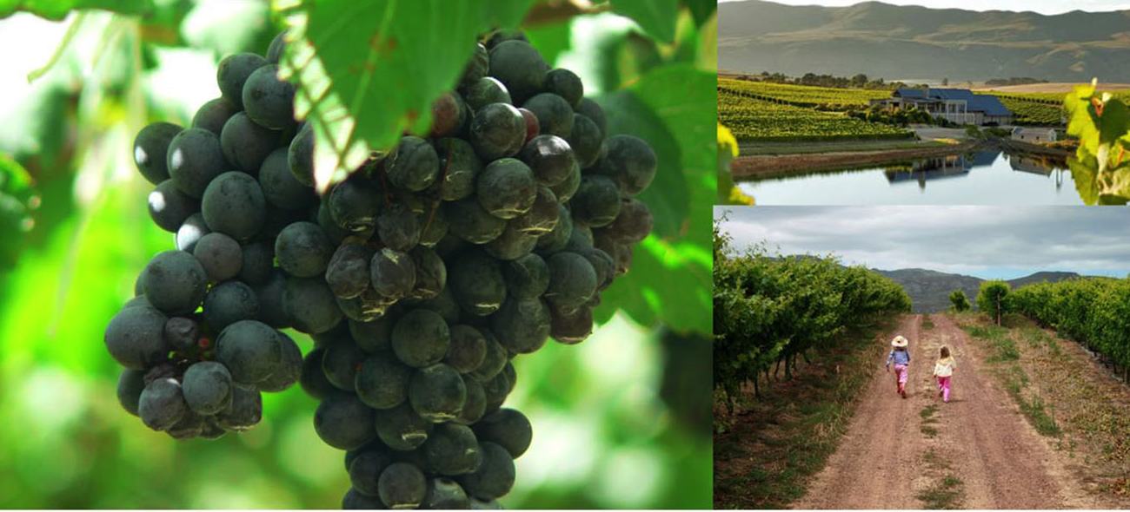
Ripening here generally occurs later than for the other two Hemel-en-Aarde appellations.

Slide 18
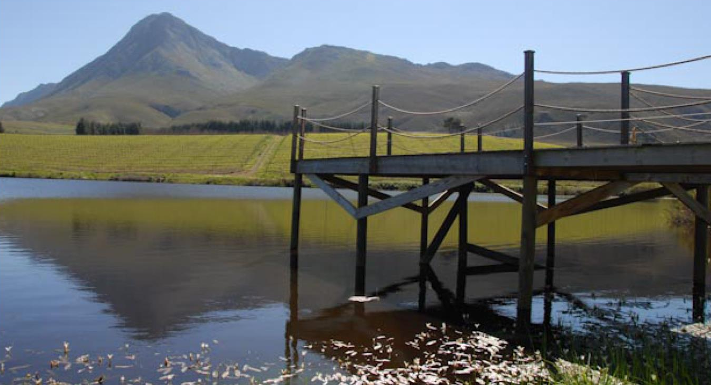
The cool climate is the sought-after attribute here. Cooling persistent winds from the ocean not only ensure favourable ripening conditions but also curtail excessive vigour, thus adding another dimension recognised as conducive to high quality.

Slide 19
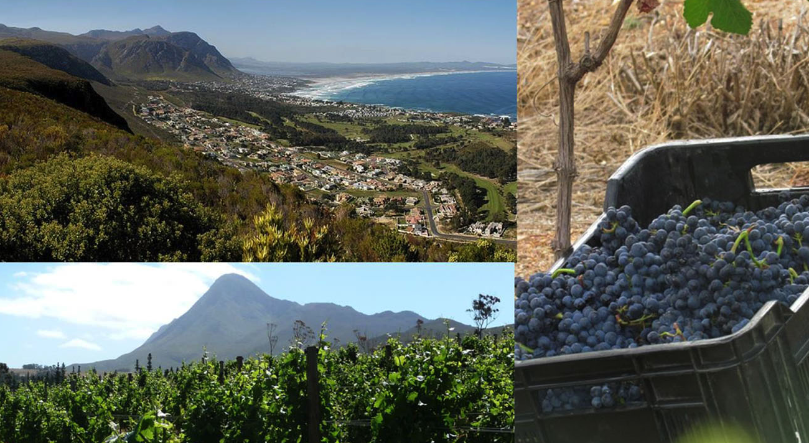
The average mean February temperature is 20.3⁰C (Oude Hemel-en-Aarde Weather Station).

Slide 20
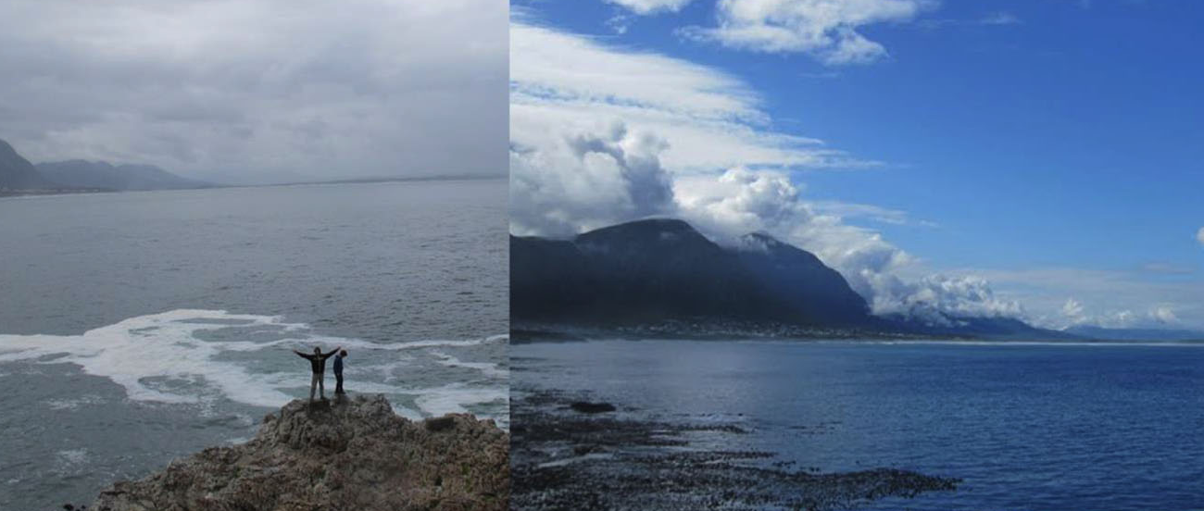
The average annual rainfall is 722 mm
(Oude Hemel-en-Aarde Weather Station).

Slide 21
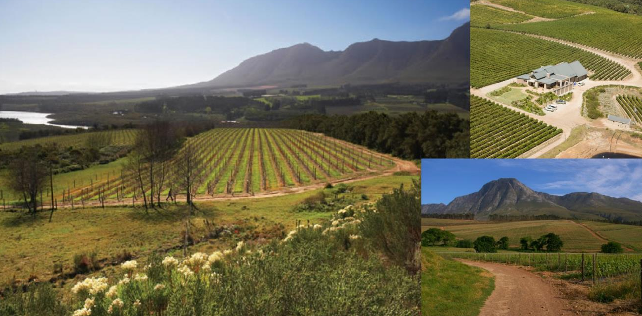
In these parts, the soils are generally extremely variable and derived from sandstone, shale or granite intrusions.

Slide 22
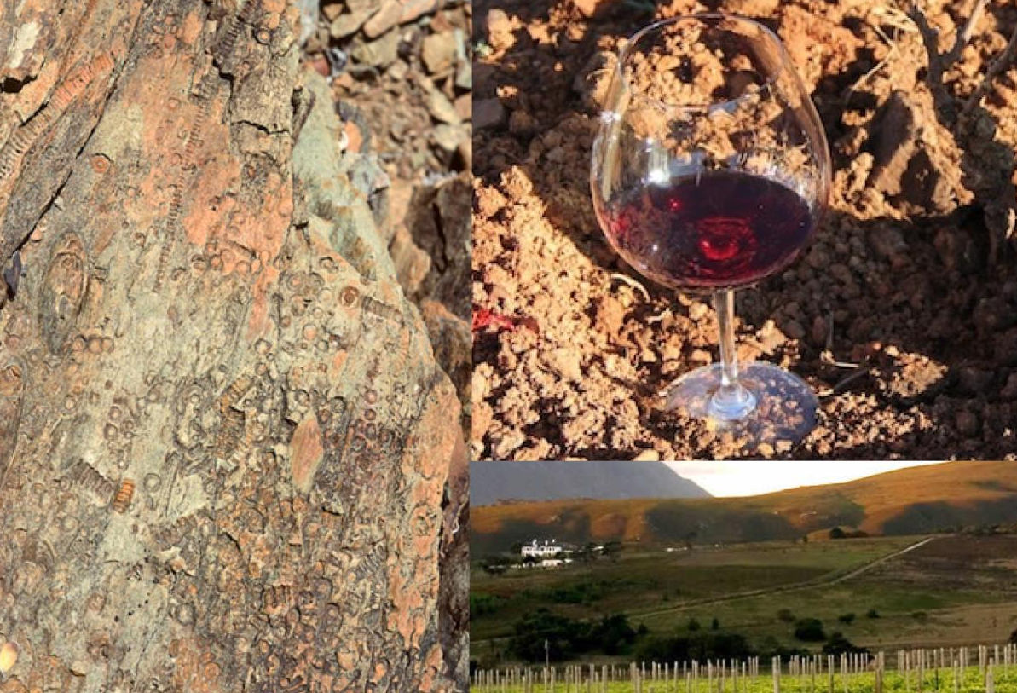
The overwhelming majority of the vineyards in this appellation are planted on northeast-, north- and northwest-facing slopes of Bokkeveld shale-derived soil on the southern side of the Onrust River.

Slide 23
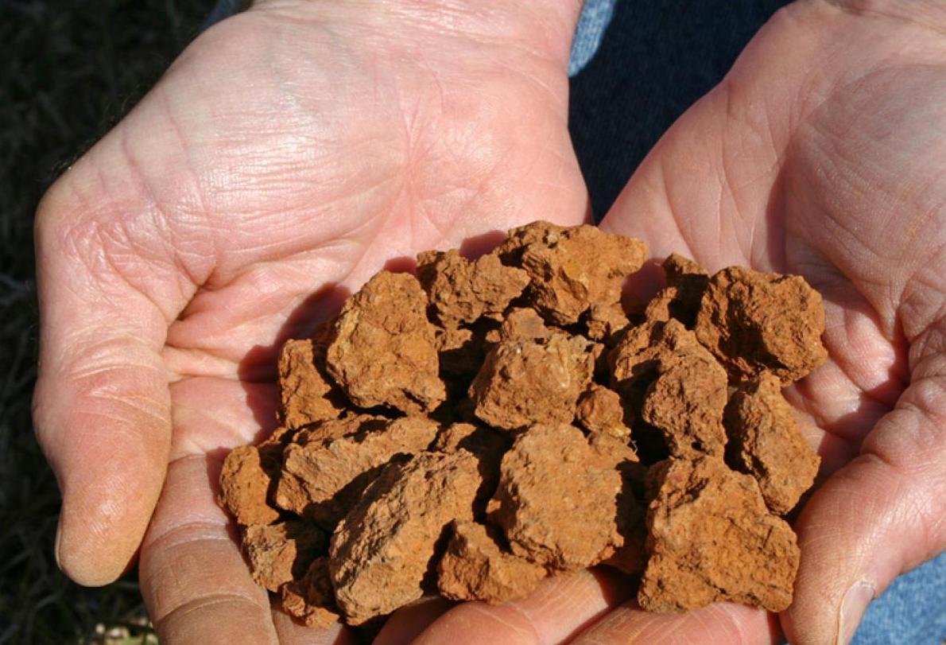
This soil has an unusually high clay content, which varies from 25% to 55%. The clay contents of these soils approximate the clay contents of the Côte d'Or in Burgundy, although they tend to be shallower and far stonier.

Slide 24
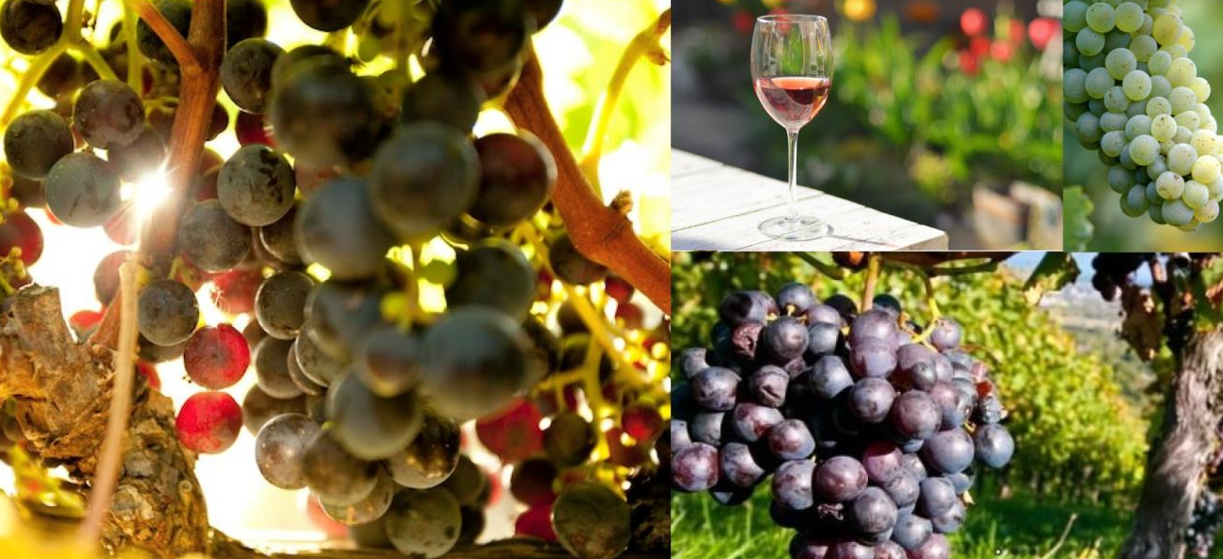
Recommended varieties are Chardonnay, Chenin Blanc, Sauvignon Blanc, Merlot, Pinotage, Pinot Noir and Shiraz on the coolest landscape positions.

Slide 25
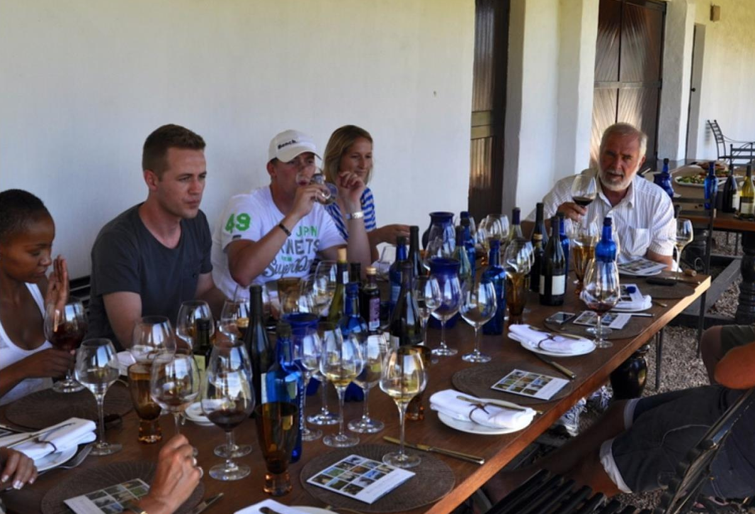
The Hemel-en-Aarde Valley is reputed for its benchmark Chardonnay and Pinot Noir wines.

Slide 26
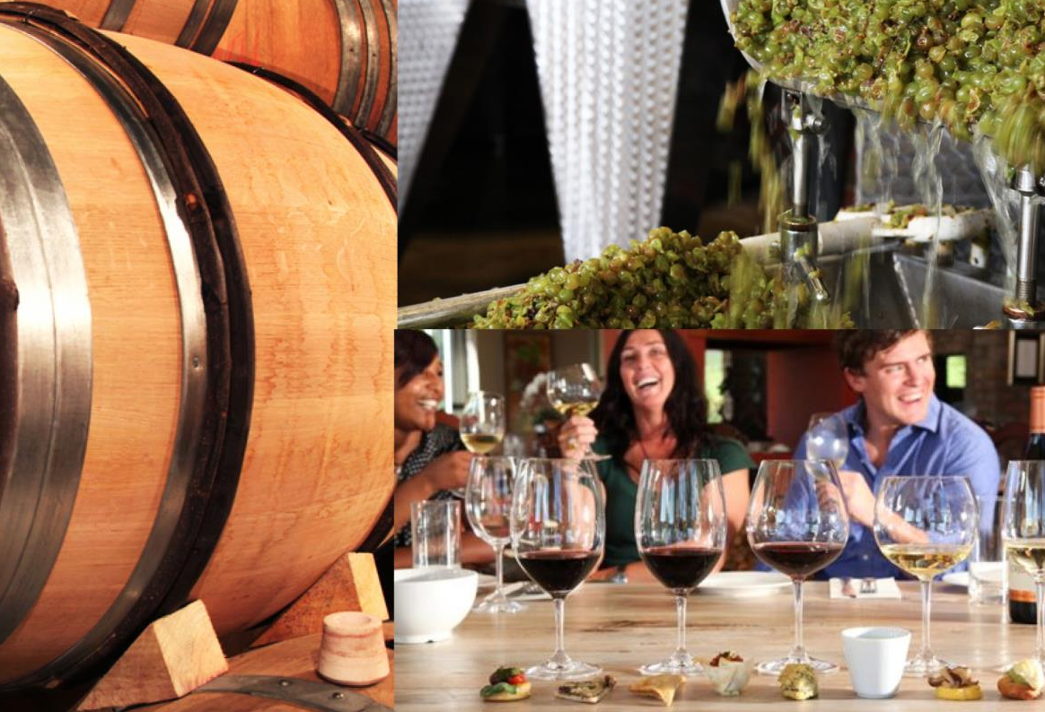
Fine examples of Sauvignon Blanc, Merlot and Shiraz are also being produced here. The area is also being noticed for the outstanding and consistent quality of its Pinotage.

Slide 27
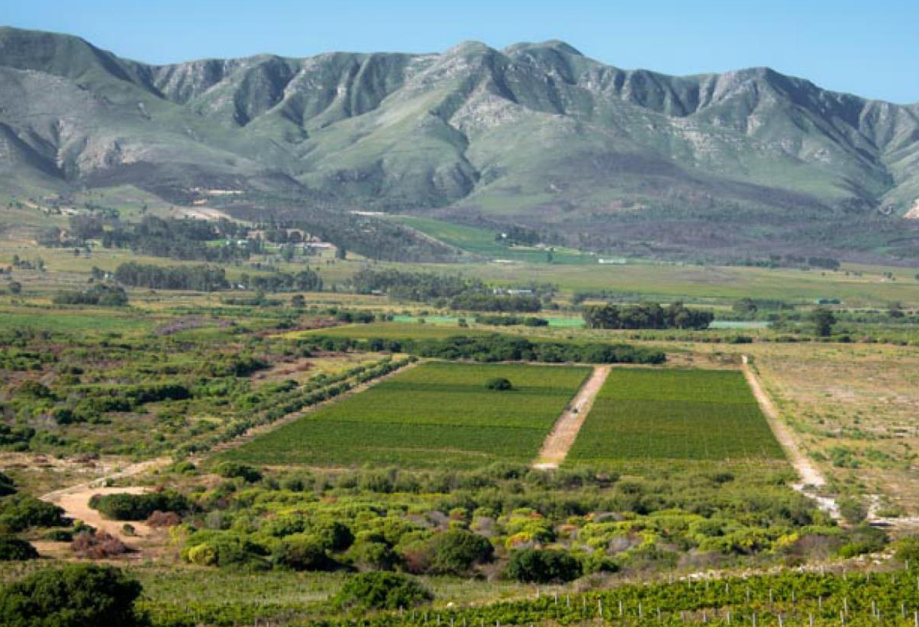
The images used in these presentations have been sourced from various producers, as well as industry and tourism bodies. These presentations are strictly for non-commercial, non-profit, educational purposes only and cannot be reproduced or transmitted in any form or by any means without written permission from Wines of South Africa (WoSA).

Slide 28
The Cape winelands, considered by many to be the most
beautiful in the world, have a network of diverse
and well-run wine routes, affording visitors a varied
and unforgettable experience.
The end
Notes:
The end

