Slide 1
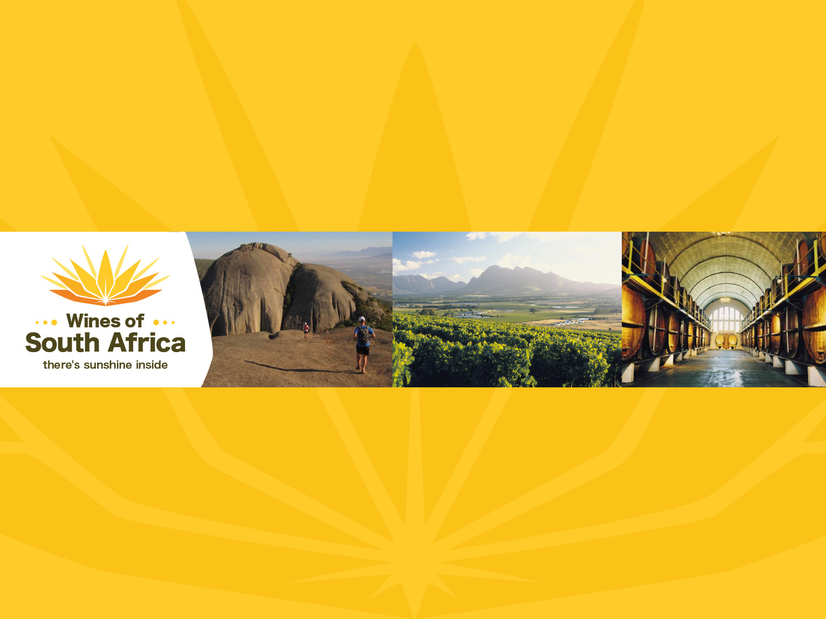
CAPE WINELANDS
PAARL
Notes:
Wines of South Africa

Slide 2

Where is South Africa?

Slide 3

South Africa is the southernmost
country in Africa.

Slide 4

Our winelands are located at the
very tip of South Africa.

Slide 5

PRODUCTION AREAS: Districts of South Africa.

Slide 6

Wards of South Africa.

Slide 7

Coastal
Region: Coastal
District: Paarl
Wards: Agter-Paarl
Simonsberg-Paarl
Voor-Paardeberg

Slide 8
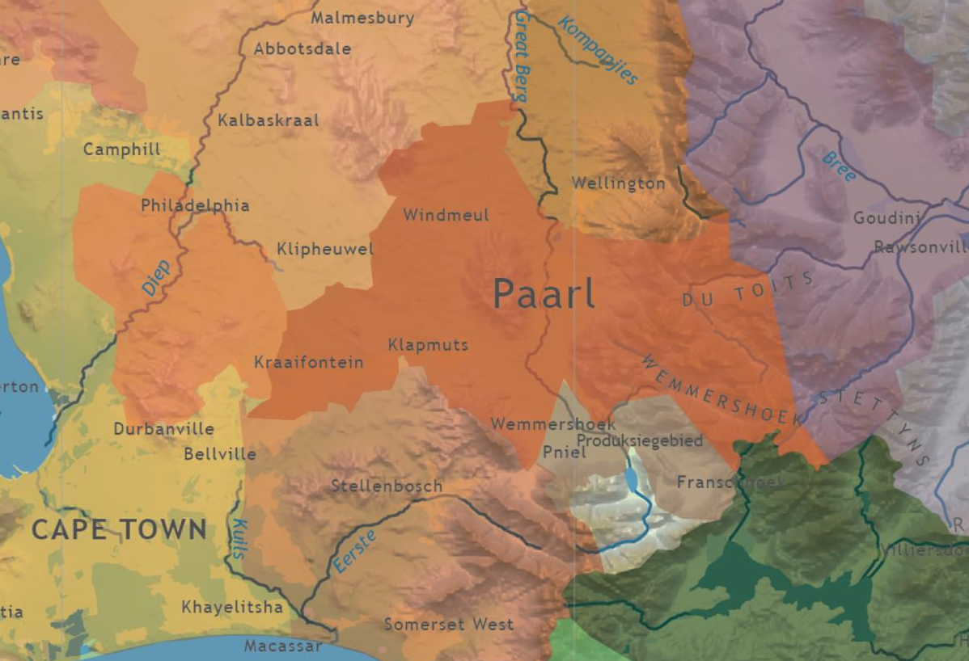

Slide 9
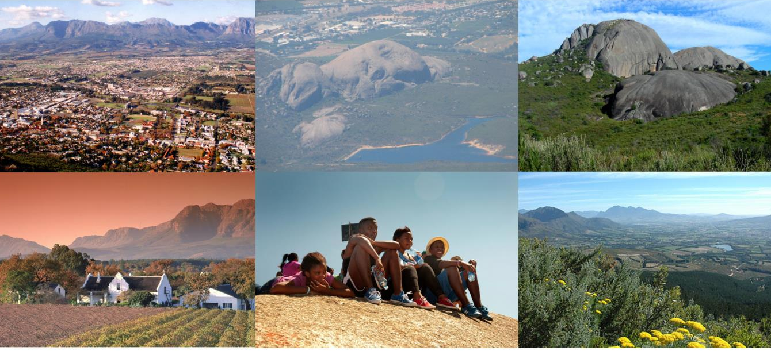
Paarl, a scenic town some 50 km from Cape Town, is situated beneath a large granite outcrop.

Slide 10
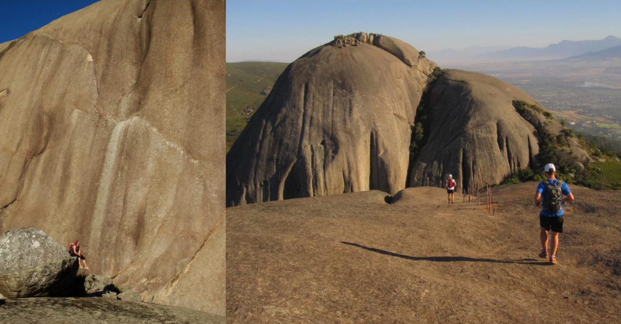
It is the second largest in the world, the biggest being Uluru (previously Ayers Rock) in Australia. This is formed by three rounded domes, the most prominent of which is named Paarl Rock.

Slide 11
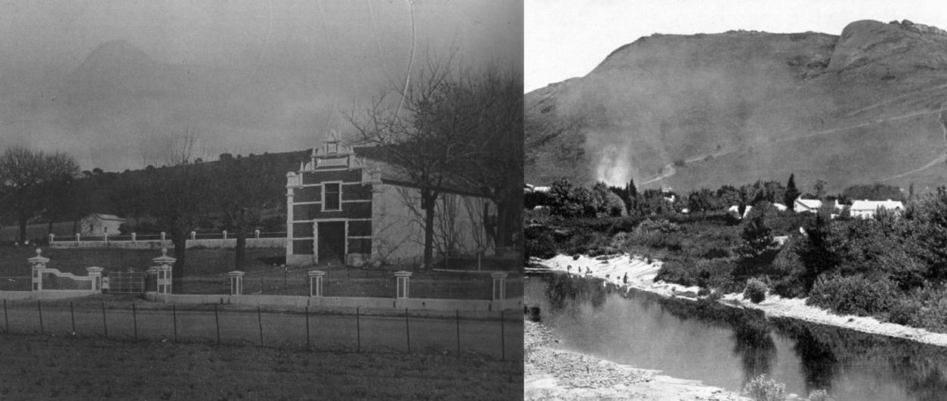
Paarl is South Africa's third-oldest
European settlement.

Slide 12
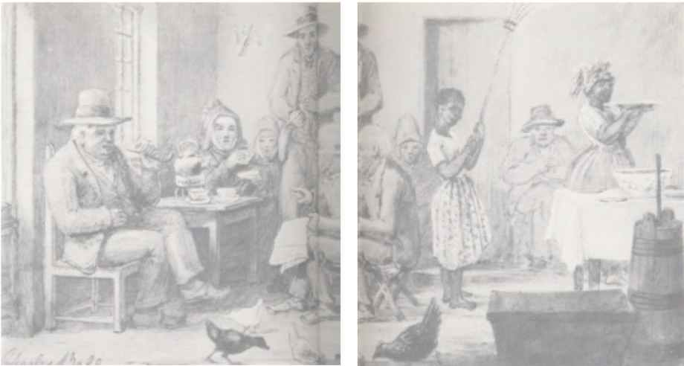
In 1687, Cape Governor Simon van der Stel granted 21 farms along the Berg River to Dutch Free Burghers.

Slide 13
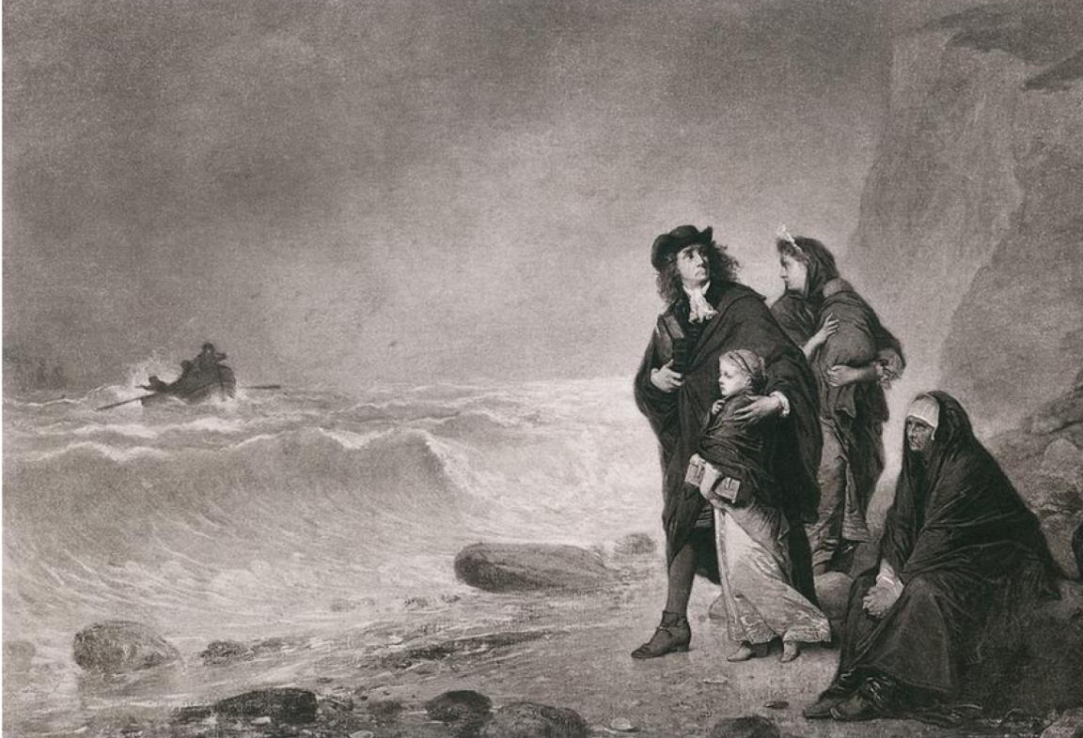
They were followed in 1688, by the first influx of French Huguenots (Protestant refugees who fled religious persecution in their homeland).

Slide 14
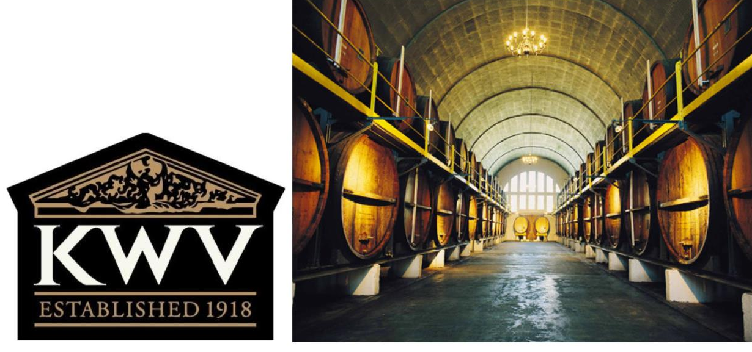
The second-oldest wine route in South Africa, it is home to KWV, the first branded wine cellar in the country.

Slide 15
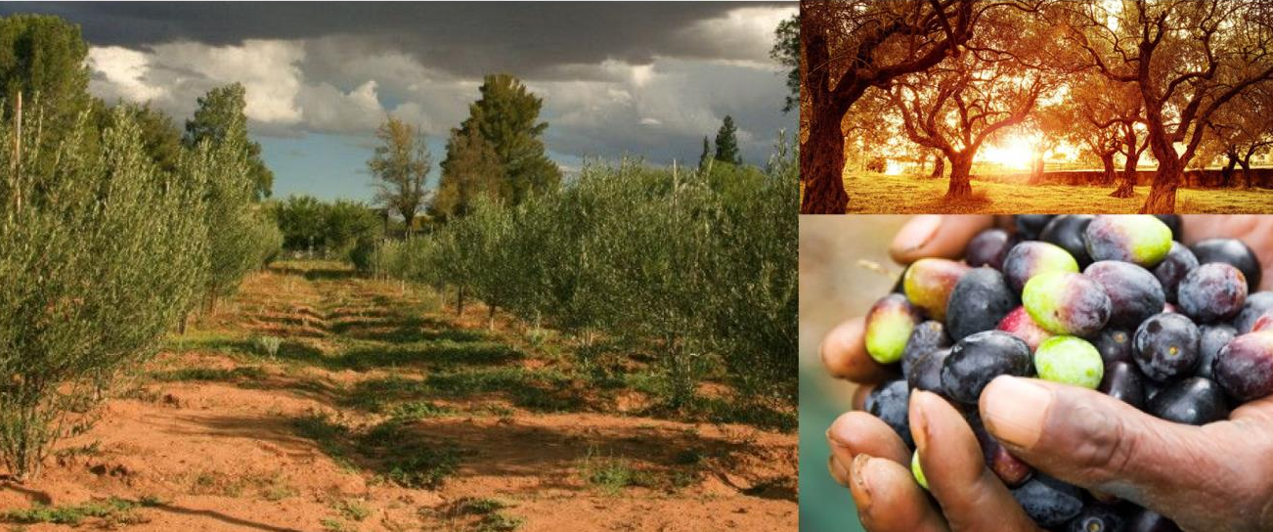
Paarl has several olive farms and boasts some of the most well-known brands of olive-related products in the country.

Slide 16
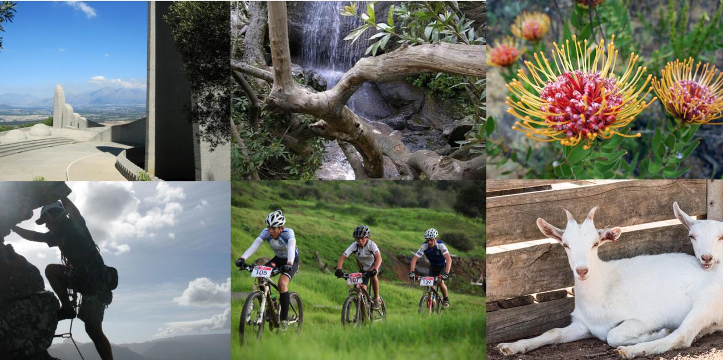
The district encompasses a large area of unspoilt natural beauty and offers several outdoor activities.

Slide 17
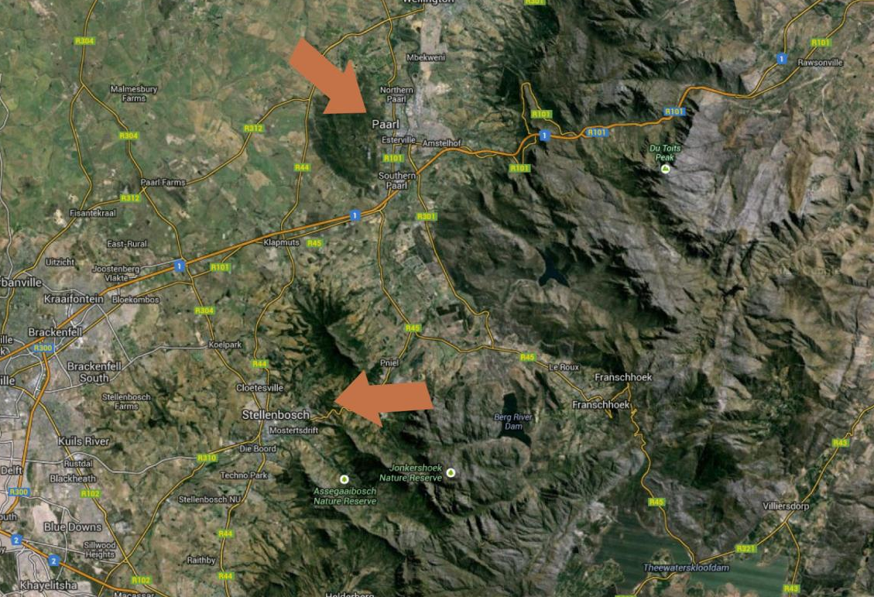
The Paarl wine district lies to the north of Stellenbosch.

Slide 18
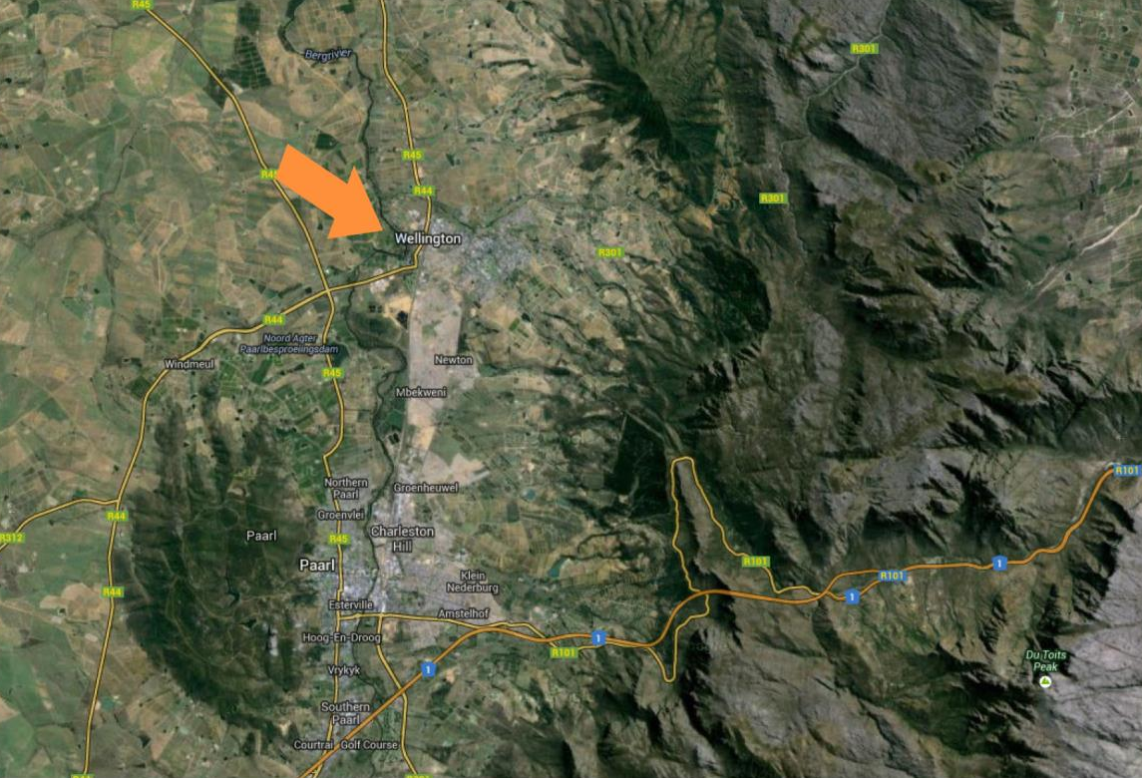
The district is bordered by the town of Wellington to the north-east.

Slide 19
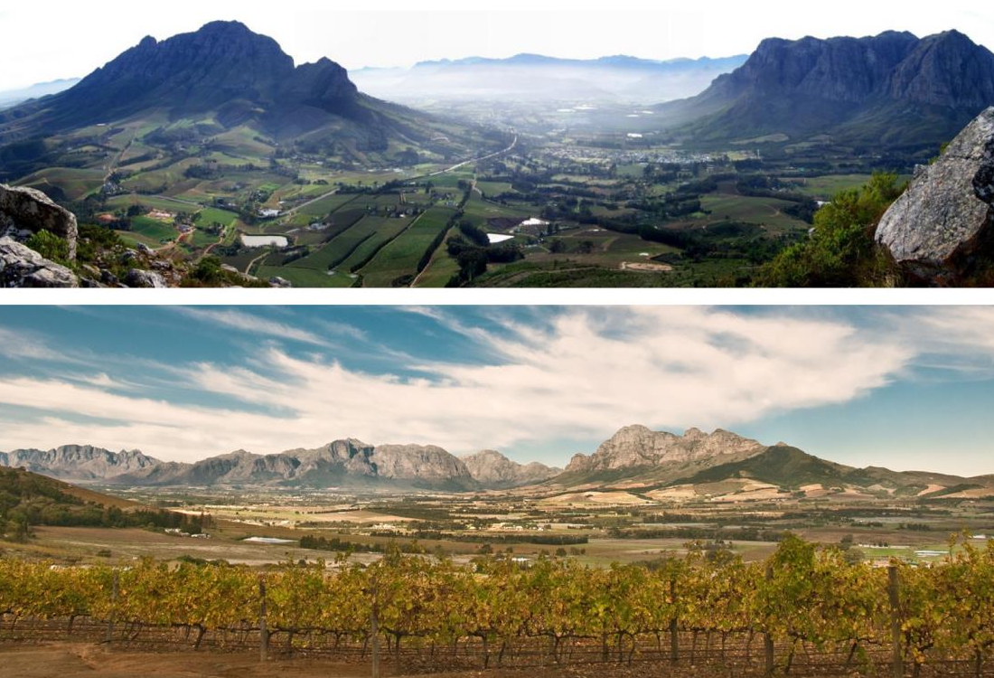
And the mountains of the Groot and Klein Drakenstein and Franschhoek ranges to the south-east.

Slide 20
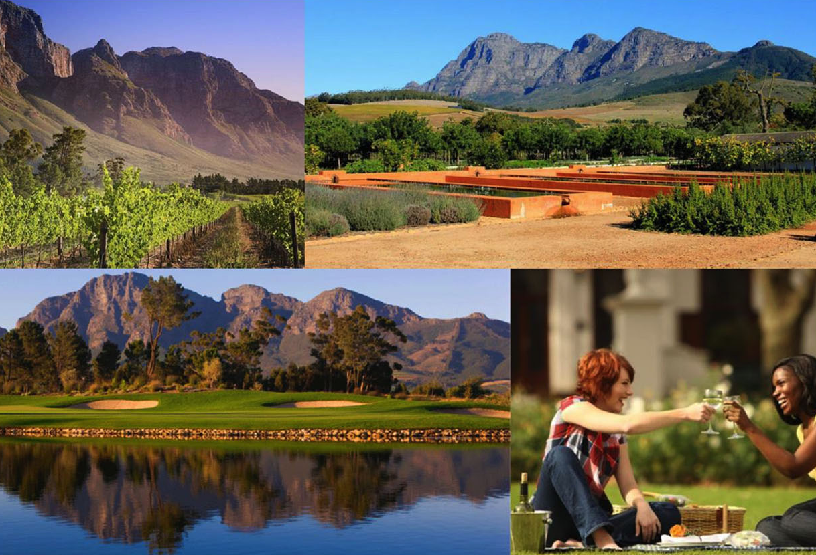
Paarl enjoys a typically Mediterranean climate. The summers are long and warm, and the mean February temperature is 23.2⁰C (Bellevue Weather Station).

Slide 21
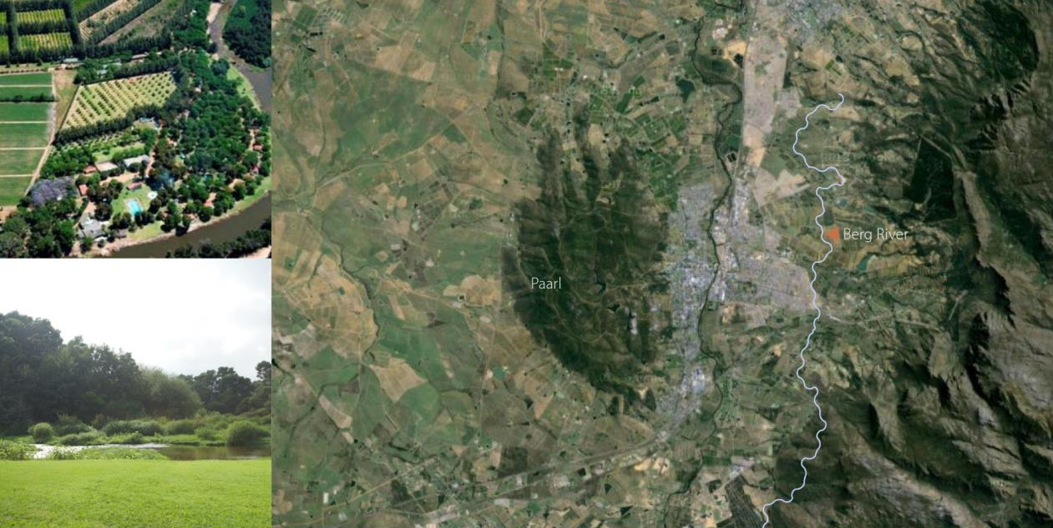
The Berg River flows through the length of the valley and supplies a natural source of irrigation.

Slide 22
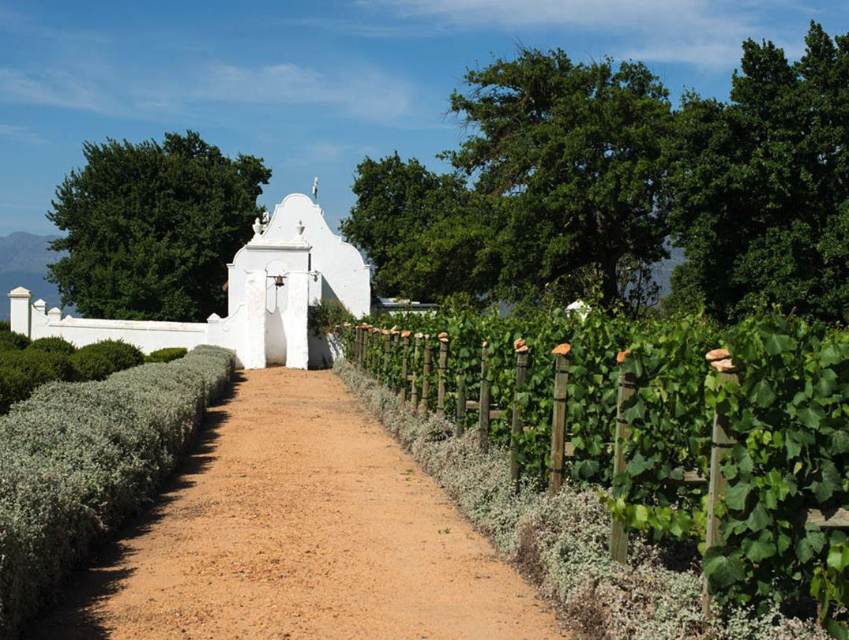
Annual rainfall varies between 800–900 mm (890 mm for Paarl Weather Station) – not as high as Constantia’s, for example, but enough to make irrigation advantageous only in exceptional circumstances.

Slide 23
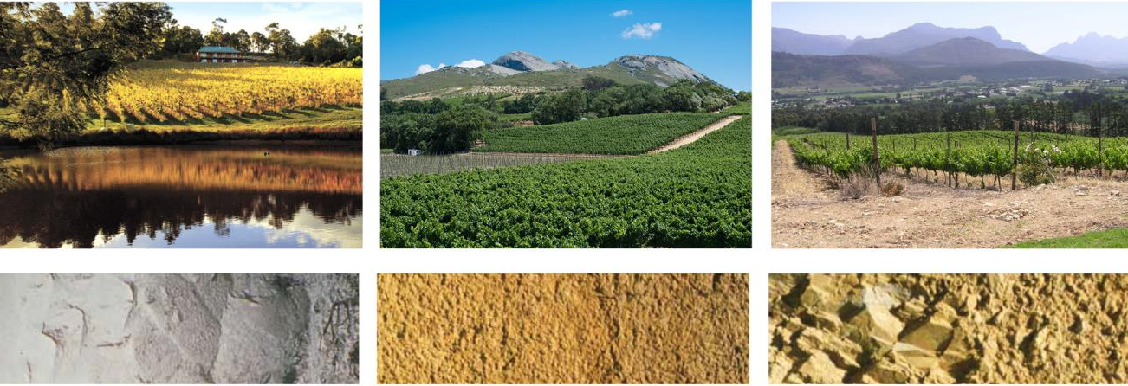
Local soils fall into three main types: Table Mountain Sandstone-derived soils along the Berg River, granite soils in the vicinity of Paarl itself: and weathered shales to the north.

Slide 24
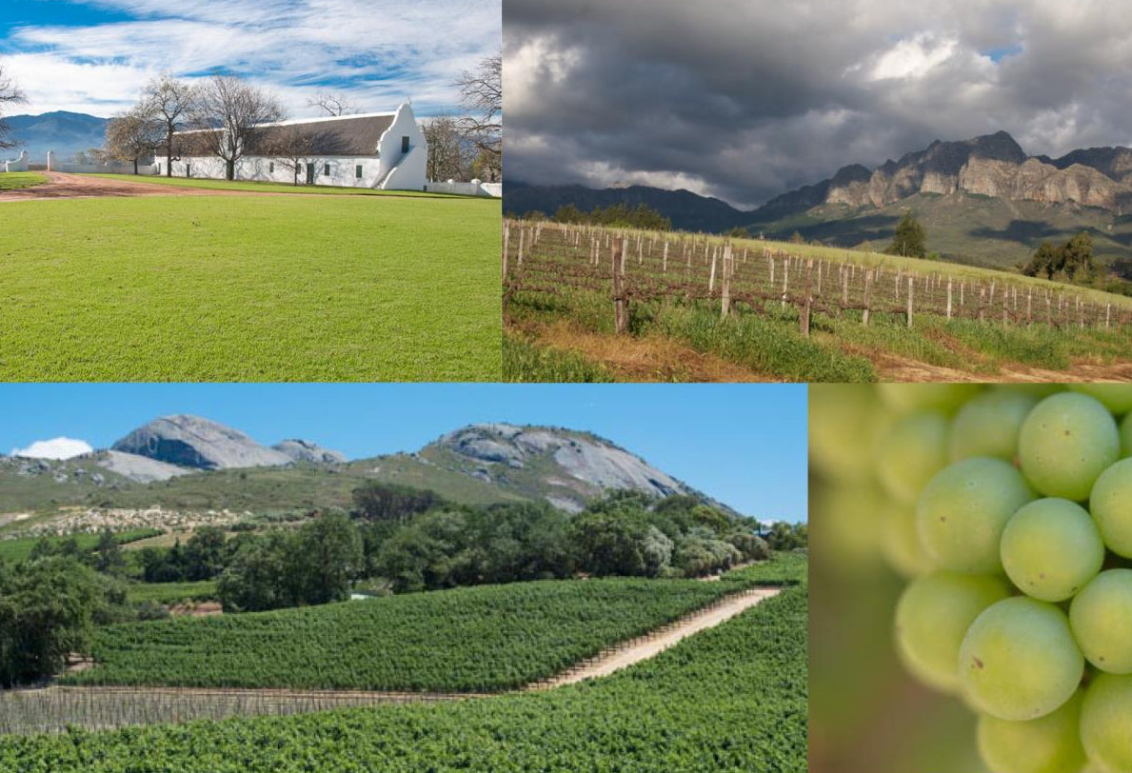
The Paarl district has many different mesoclimates and it thus succeeds with a wide range of styles and varieties.

Slide 25
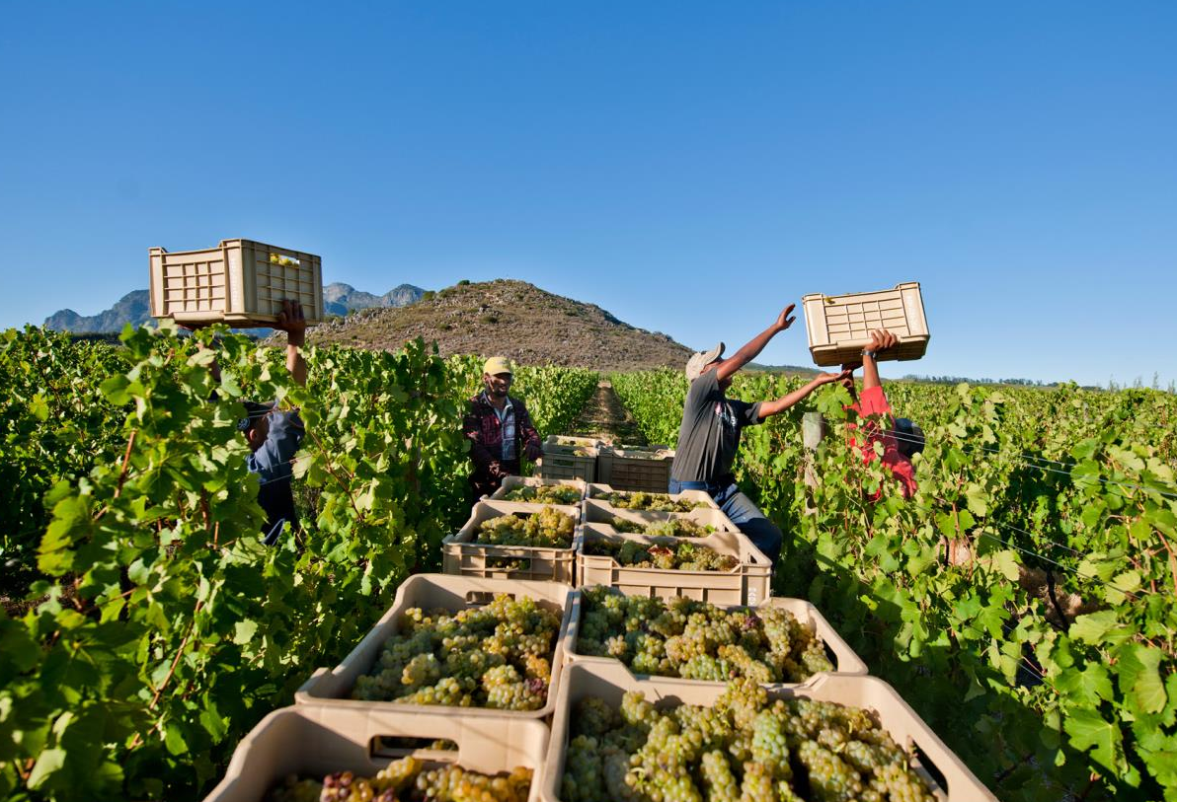
A wide variety of grapes are grown in Paarl, which has the second most vineyard plantings in the winelands. These include Chardonnay, Chenin Blanc, Cabernet Sauvignon, Pinotage and Shiraz, which have the best potential, particularly the latter.

Slide 26
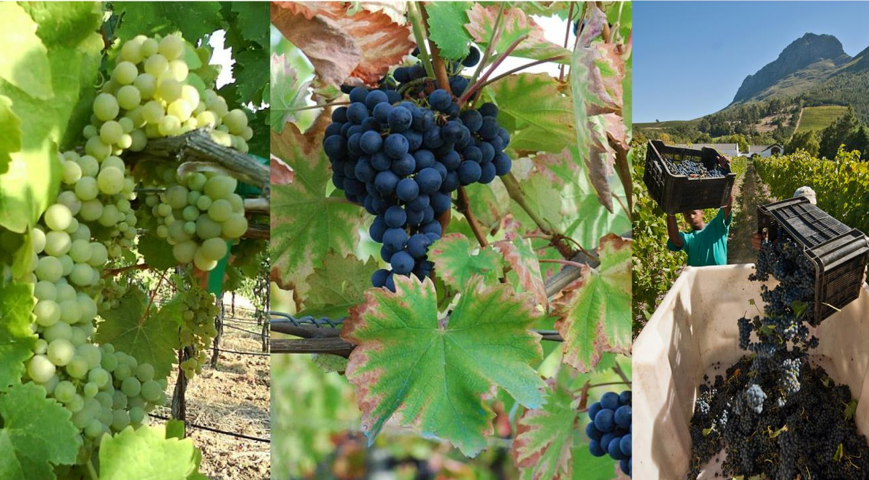
More recently, typically Mediterranean varieties such as Viognier and Mourvèdre have been planted on warmer slopes.

Slide 27
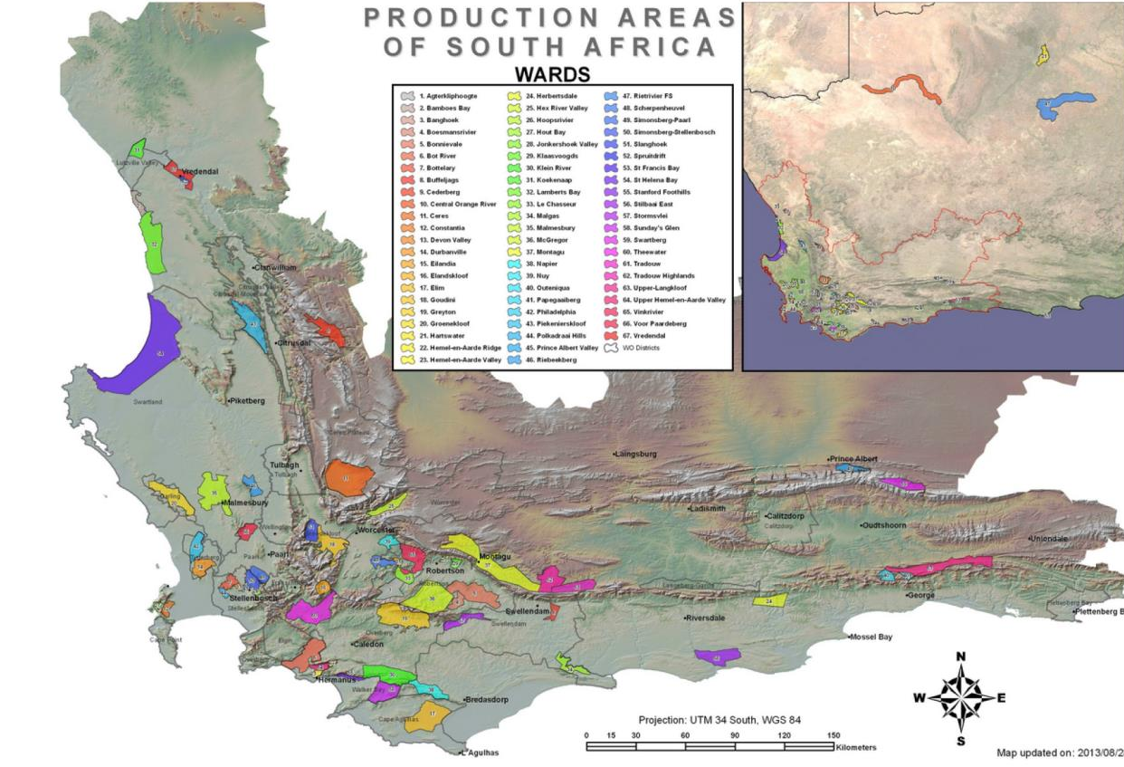
The Paarl district includes three wards, each with its own characteristics.

Slide 28
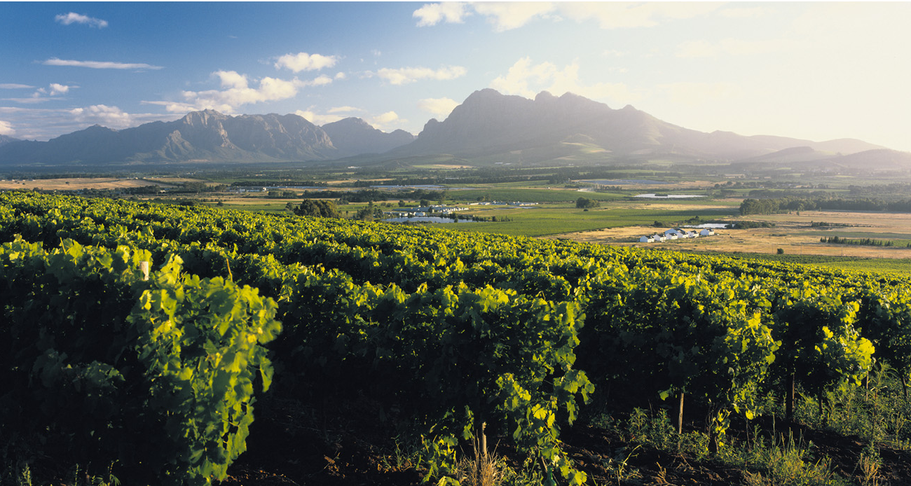
The most recently proclaimed of the three wards, Agter-Paarl encompasses the southwestern slopes of Paarl mountain.

Slide 29
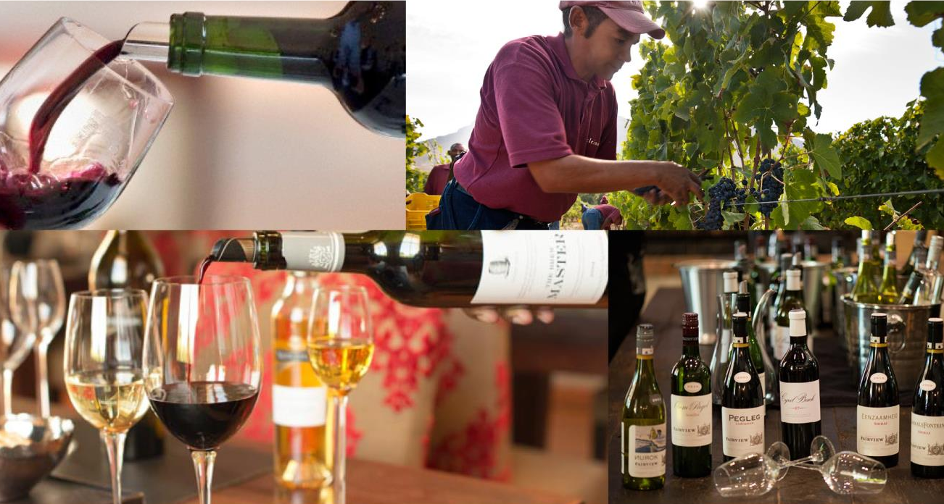
Simonsberg-Paarl on the northern foothills of the Simonsberg, prime wine-growing terroir recognised for Chardonnay, Shiraz and red blends.

Slide 30
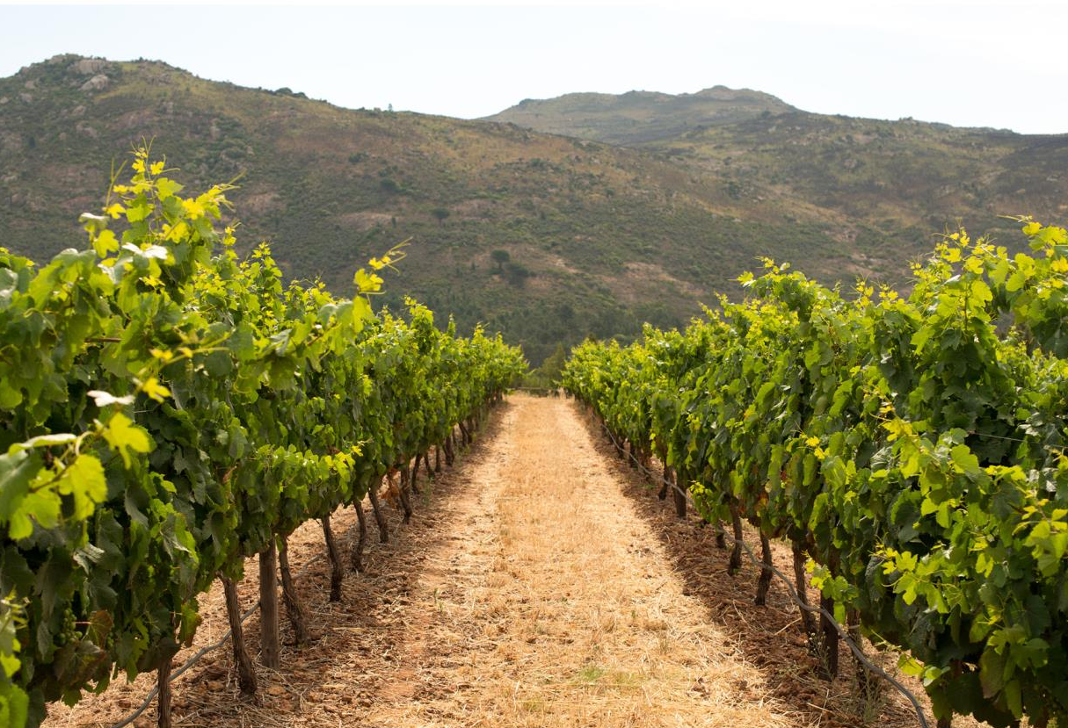
And Voor-Paardeberg with its distinctive granite outcrop, long a source of top-quality grapes for top producers and now becoming a star in its own right.

Slide 31
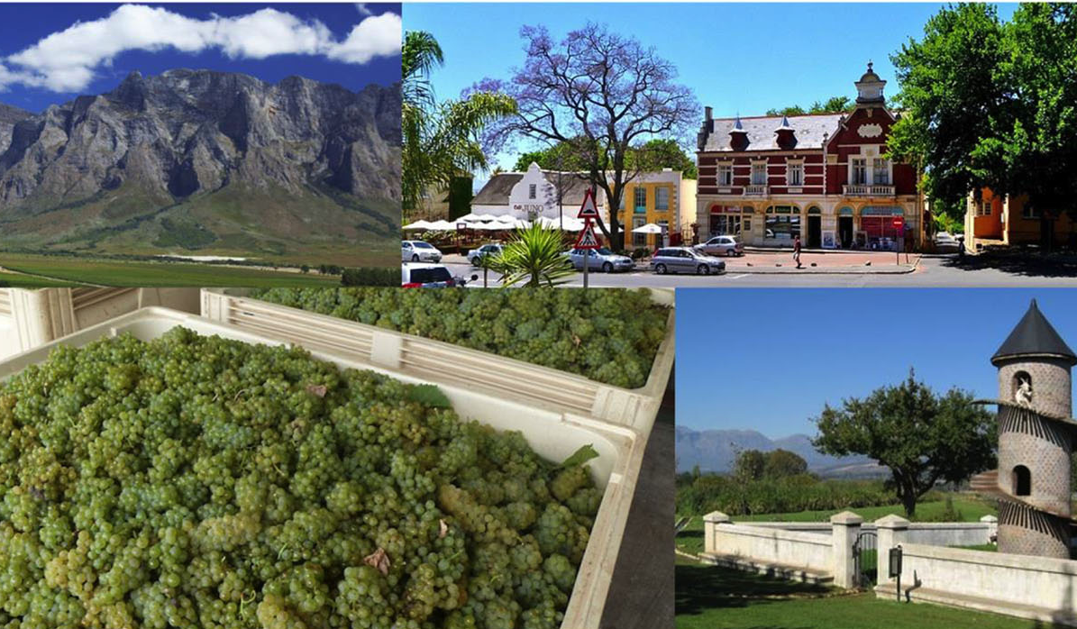
The images used in these presentations have been sourced from various producers, as well as industry and tourism bodies. These presentations are strictly for non-commercial, non-profit, educational purposes only and cannot be reproduced or transmitted in any form or by any means without written permission from Wines of South Africa (WoSA).

Slide 32
The Cape winelands, considered by many to be the most
beautiful in the world, have a network of diverse
and well-run wine routes, affording visitors a varied
and unforgettable experience.
The end
Notes:
The end

