Slide 1
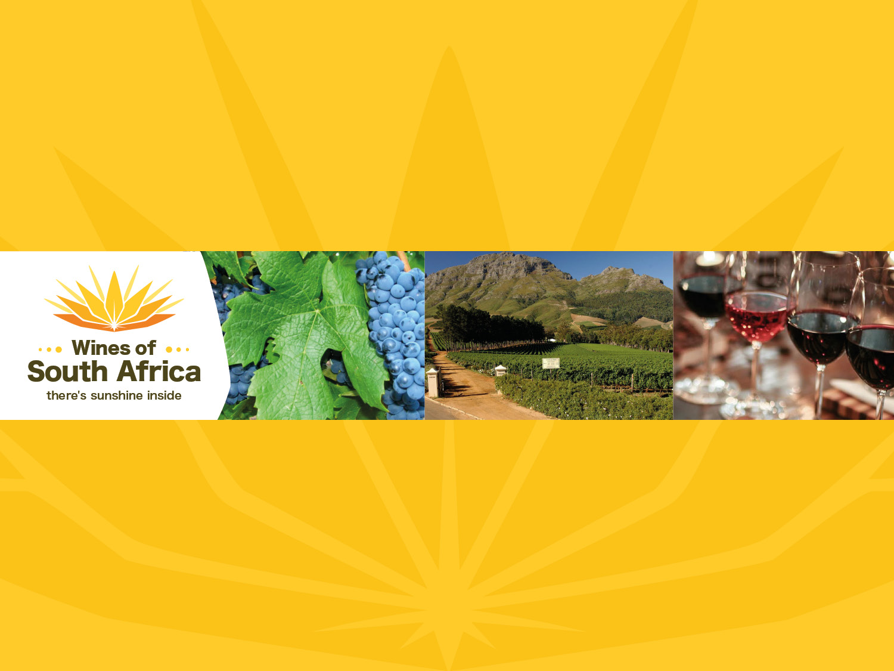
PINOTAGE

Slide 2
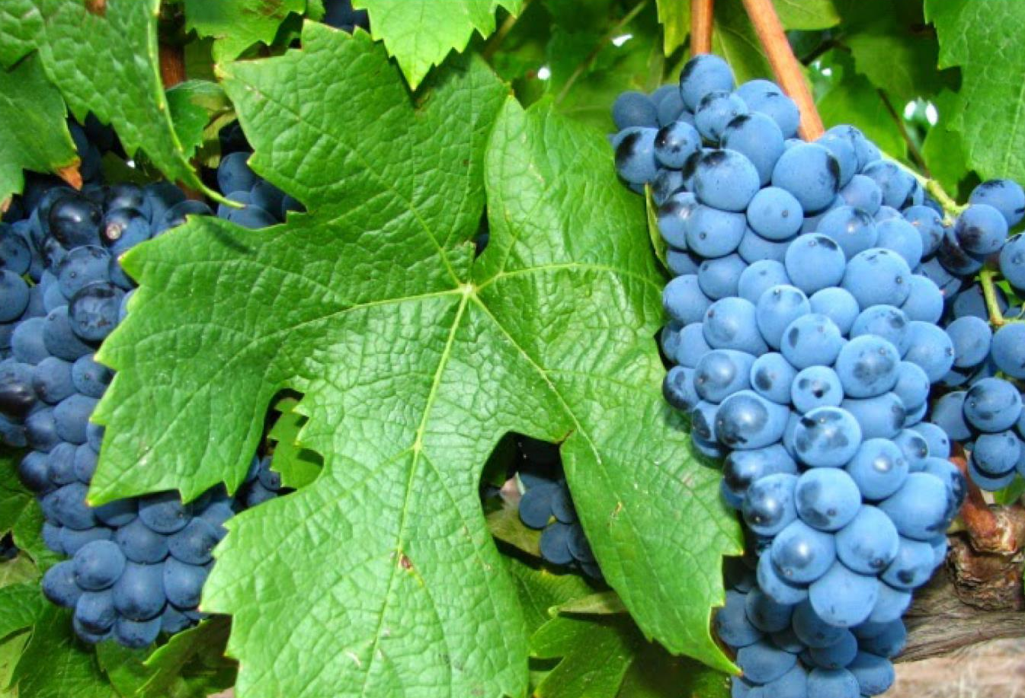
Notes:
In 1925, Pinotage came into being when Professor Abraham Perold crossed Pinot Noir with Cinsaut (then known as Hermitage and hence the contraction).

Slide 3
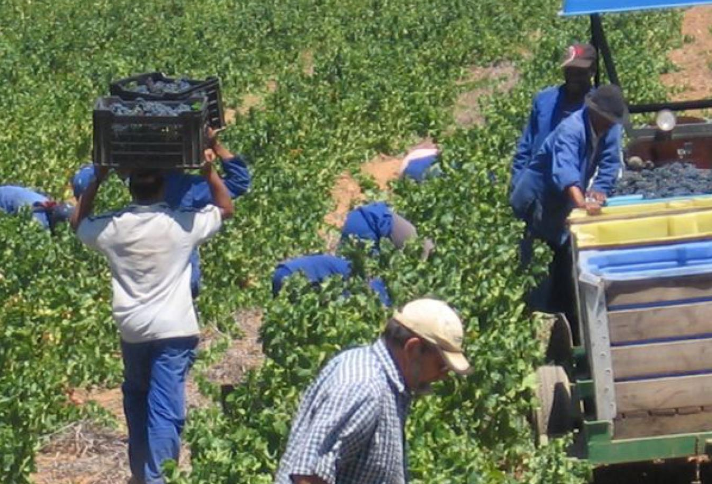
Notes:
The intention was to combine the noble characteristics of Pinot Noir with the reliability of Cinsaut.

Slide 4
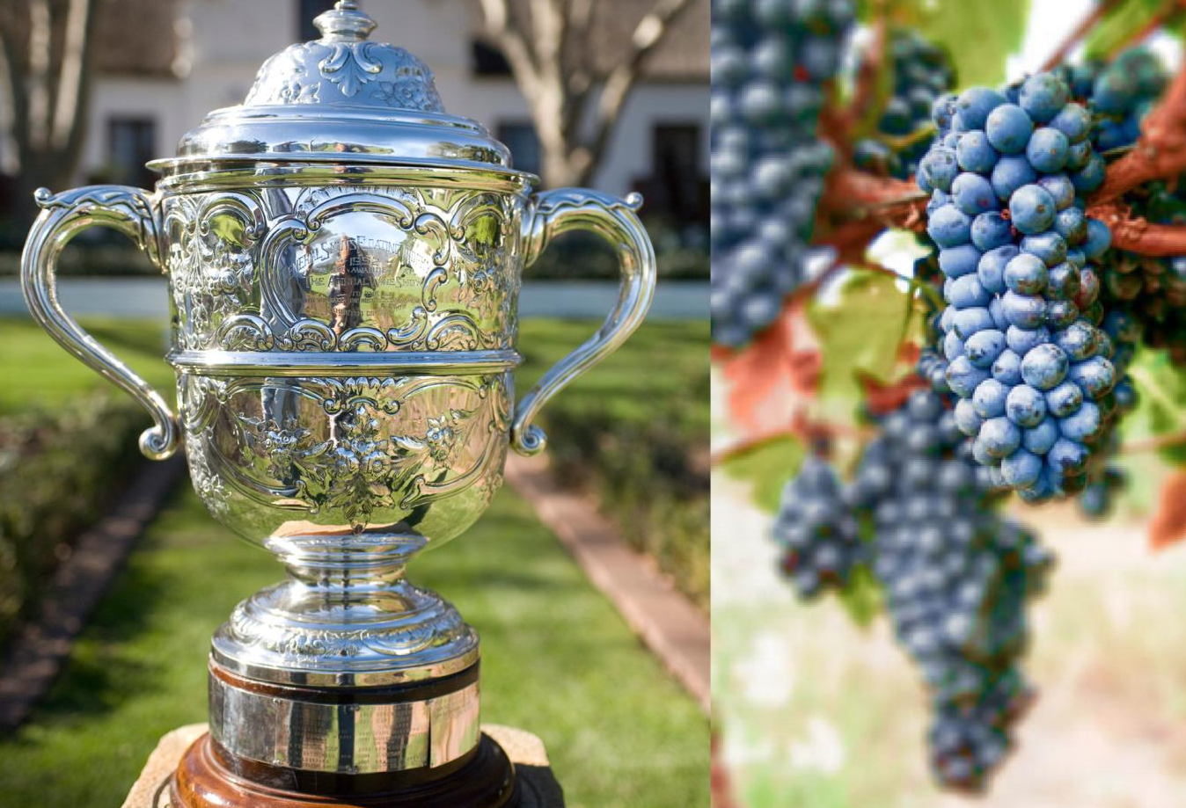
Notes:
Pinotage first received recognition at the Cape Young Wine Show in 1959. The winning wine was made by Bellevue.

Slide 5
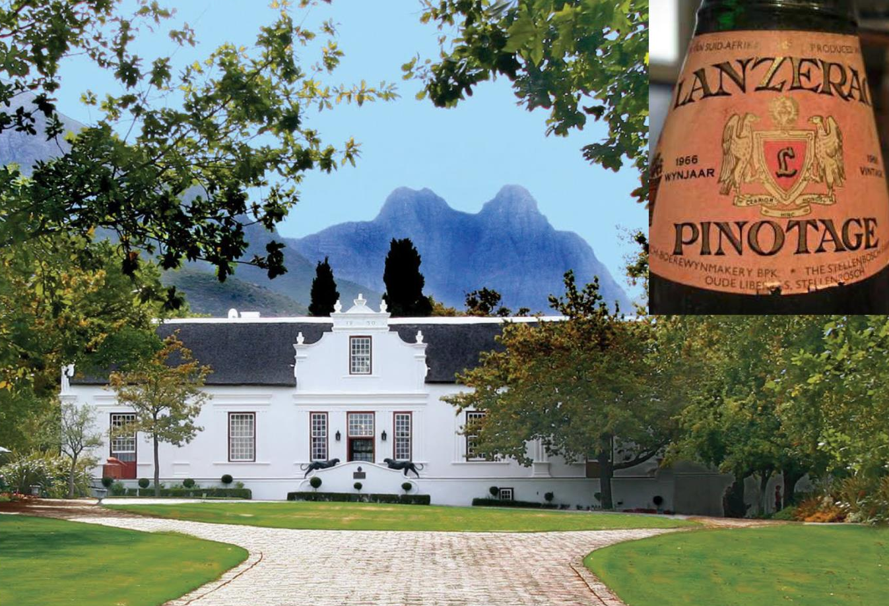
Notes:
The first commercial Pinotage was released in 1961 – a 1959 vintage under the Lanzerac label.

Slide 6
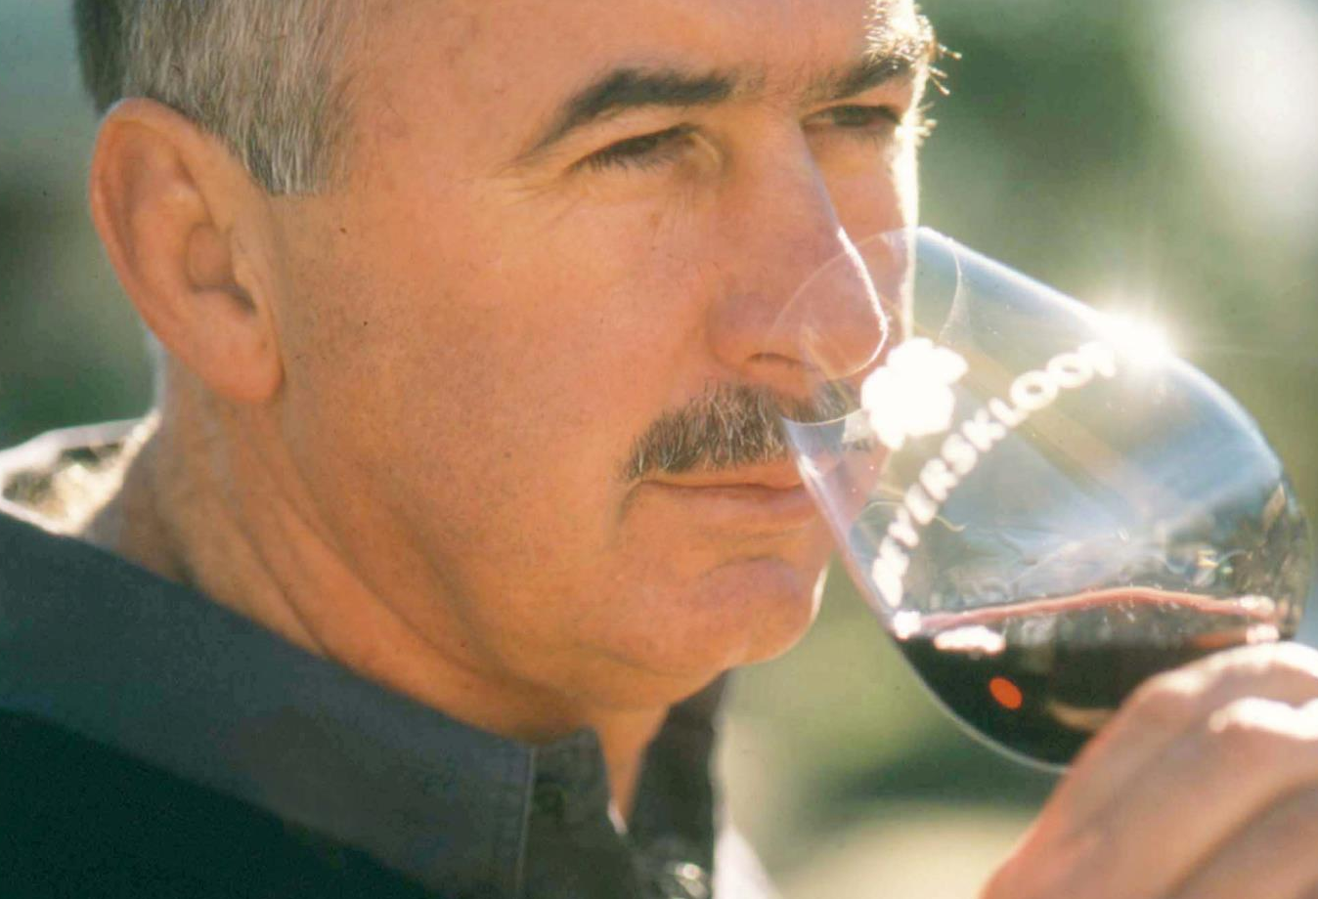
Notes:
1991 was a watershed year for Pinotage. Kanonkop’s Beyers Truter was named International Winemaker of the Year at the International Wine and Spirit Competition for his 1989 Pinotage.

Slide 7
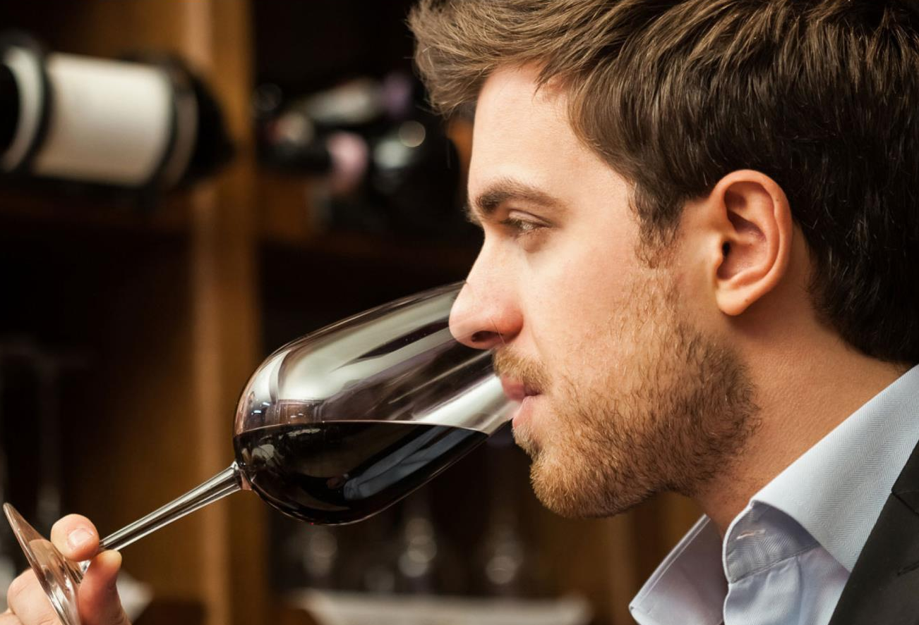
Notes:
Great strides have been made in the making and quality of Pinotage and South Africa’s own variety has achieved international success, both as a varietal bottling and in blends.

Slide 8
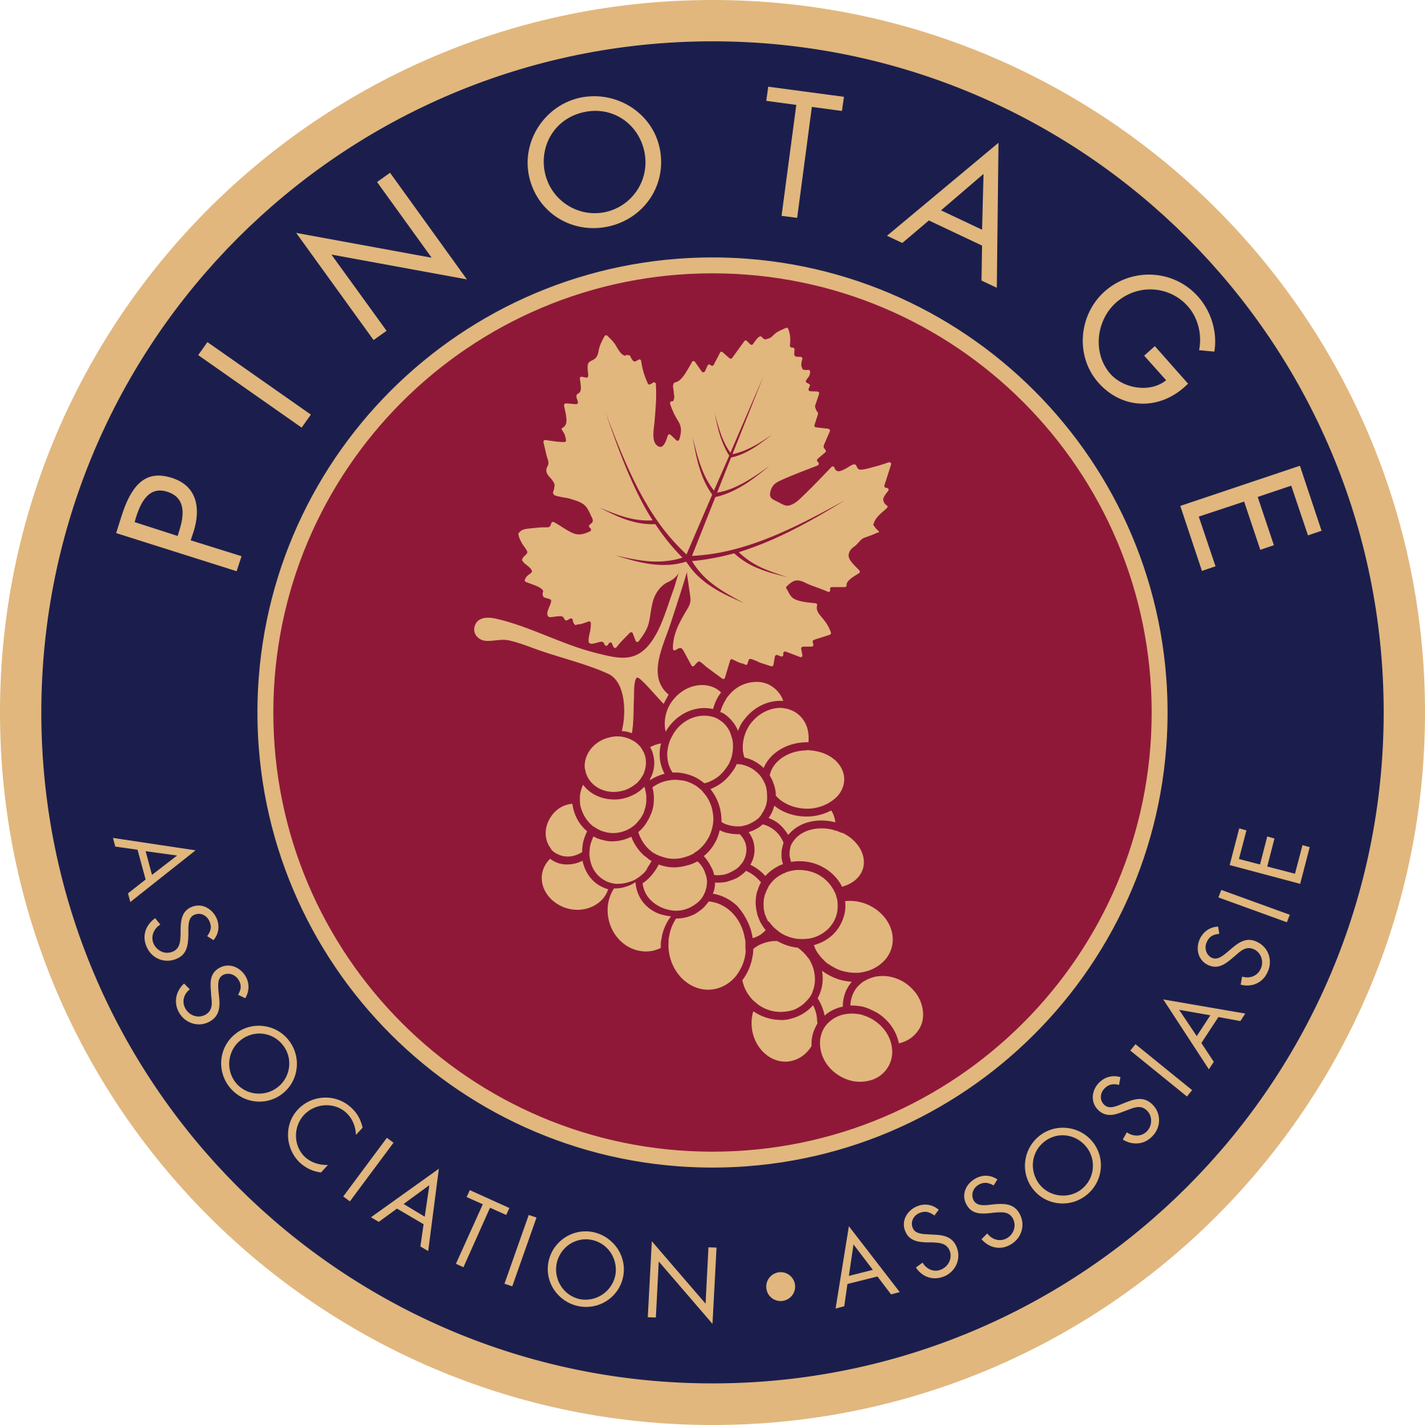
www. pinotage.co.za
Notes:
The Pinotage Association was formed in 1995 to increase awareness of the variety, share experience and knowledge with its members, serve as a forum to exchange ideas on production and marketing, and also pinpoint problems and prioritise research. Visit www.pinotage.co.za for more information.

Slide 9
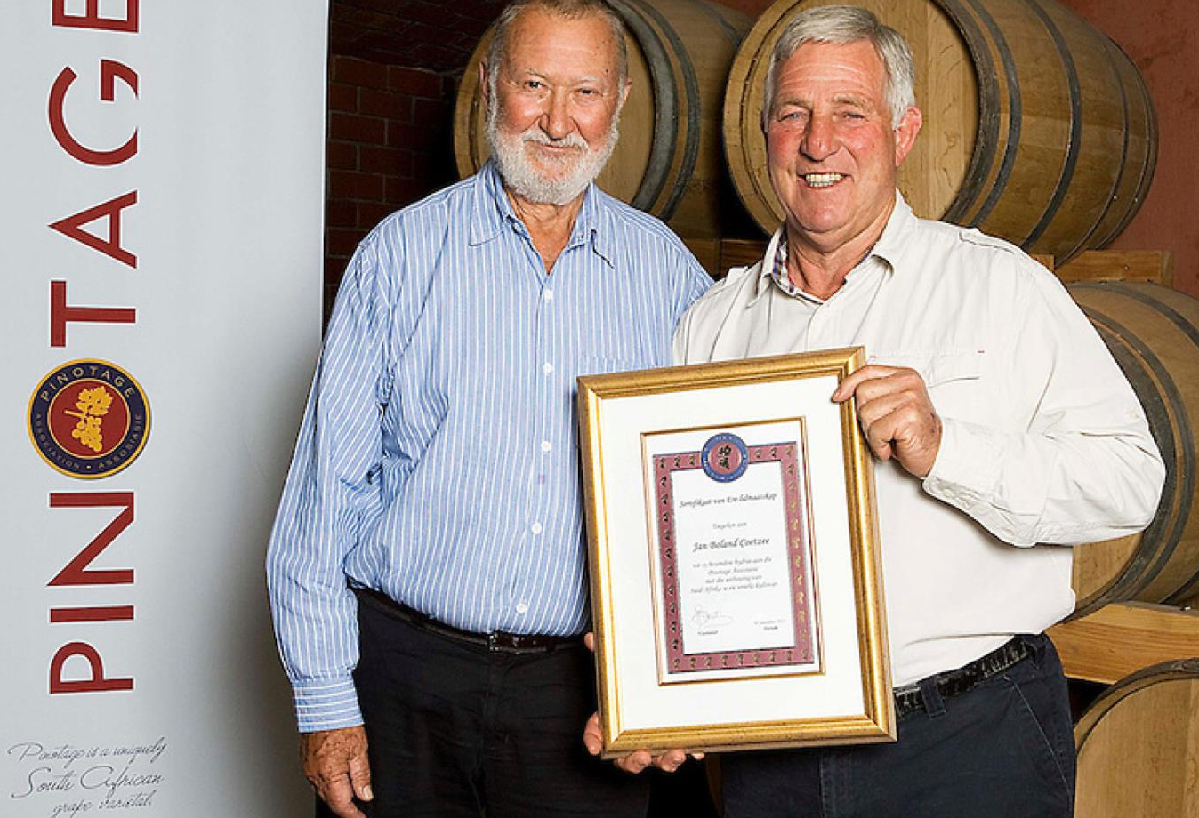
Notes:
A key element of the promotional strategy is the annual ABSA Top Ten Pinotage Competition. This was launched in 1997 and is now well established as one of South Africa’s more prestigious wine competitions.

Slide 10
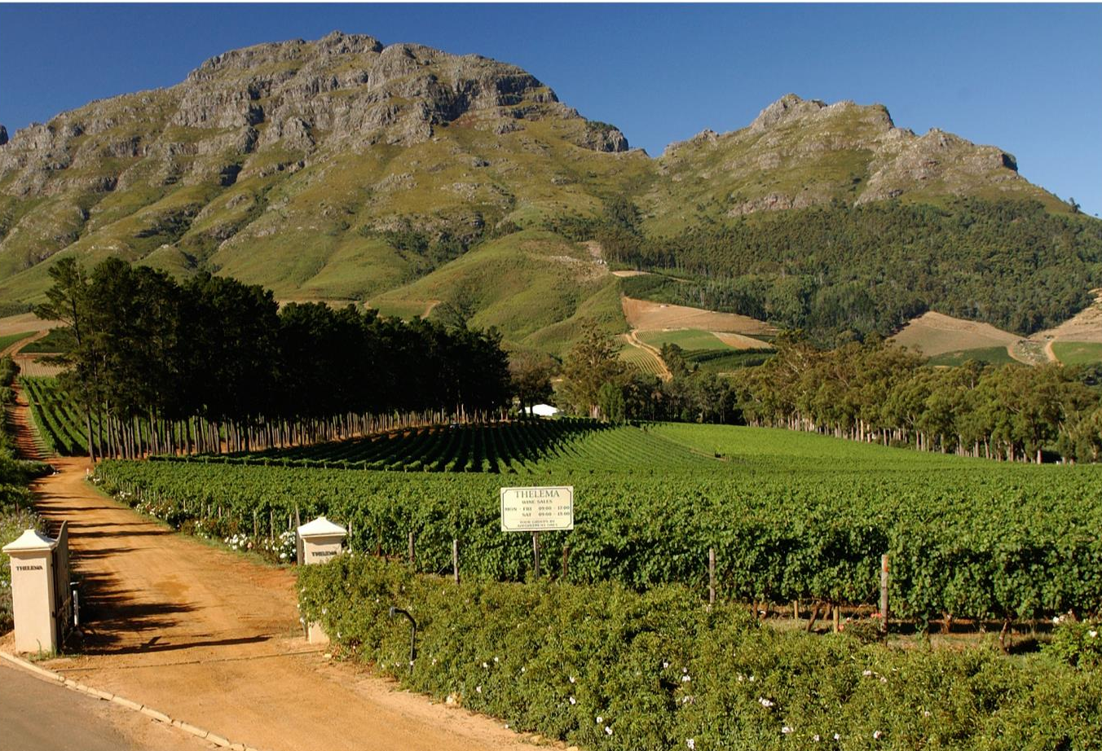
Notes:
Pinotage is the third most planted red-wine variety in South Africa, with total plantings at the end of 2025 accounting for 6 619 ha (7.6% of the national vineyard).

Slide 11

Notes:
The most plantings are found in the Swartland, closely followed by Paarl and then Stellenbosch.

Slide 12
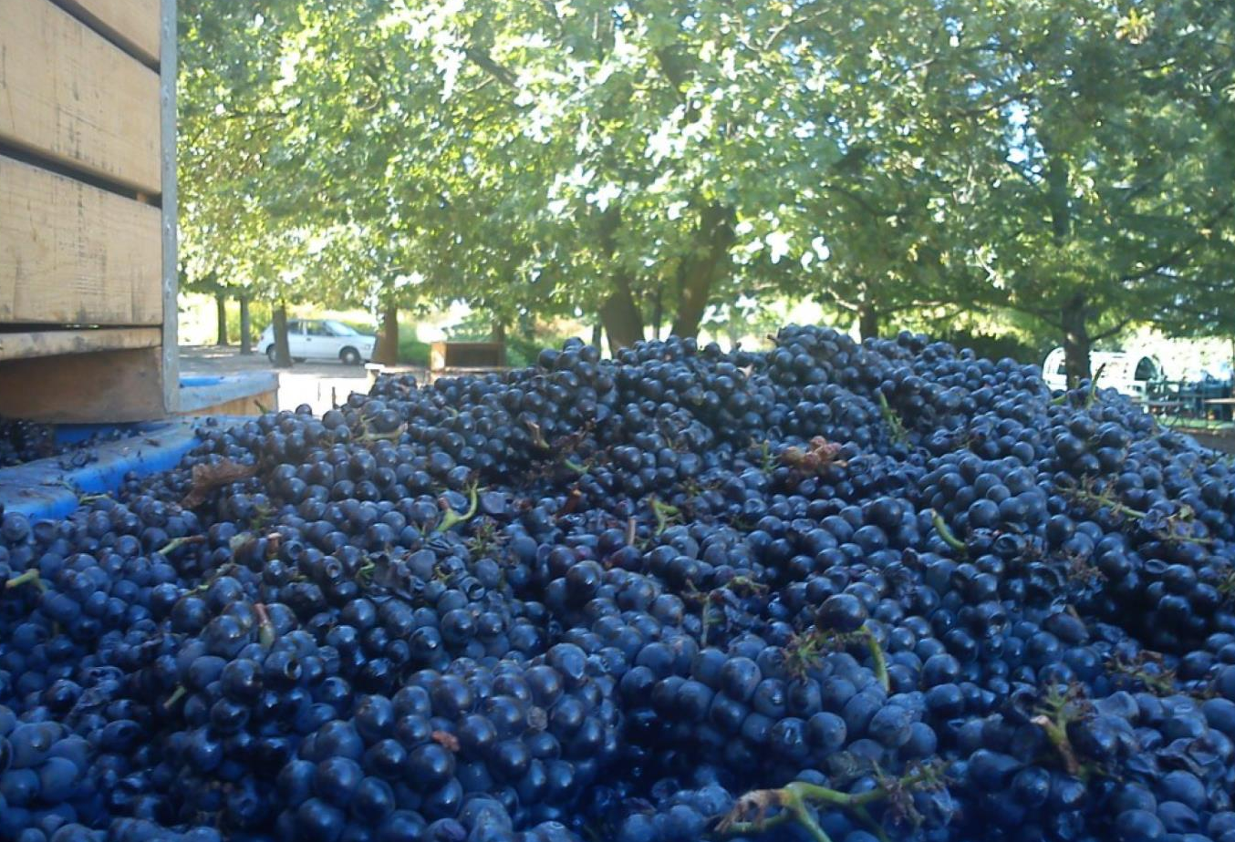
Notes:
Unique to South Africa, it can produce complex wines with age but is also often very drinkable when young.

Slide 13
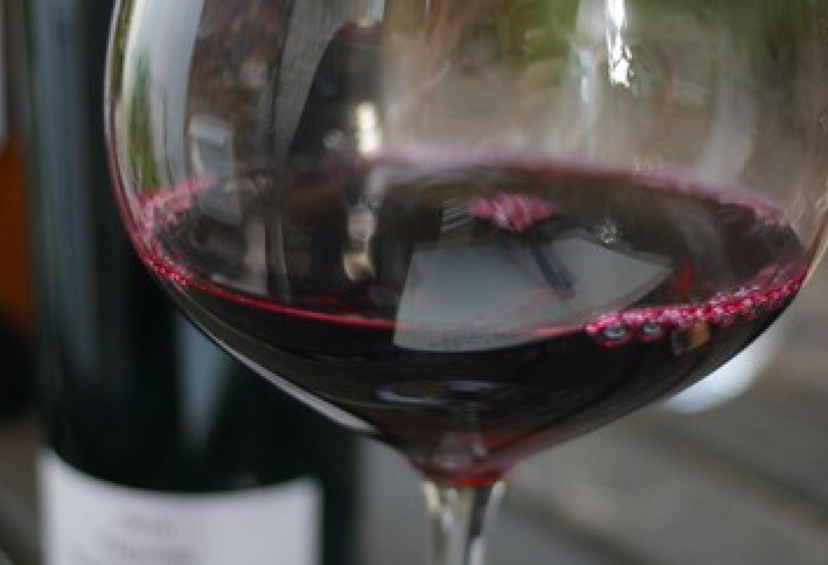
Notes:
Versatile Pinotage is made in a range of styles, from easy-drinking and fruity to more ambitious well-oaked complex examples that are rich and spicy.

Slide 14
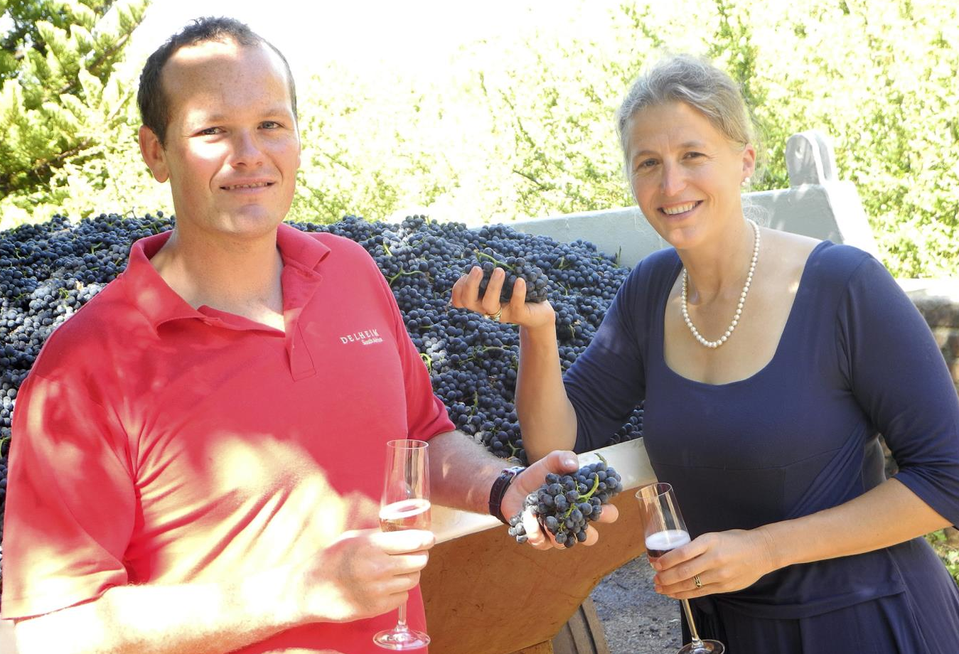
Notes:
Pinotage is also used to make Rosé, both still and Cap Classique.

Slide 15
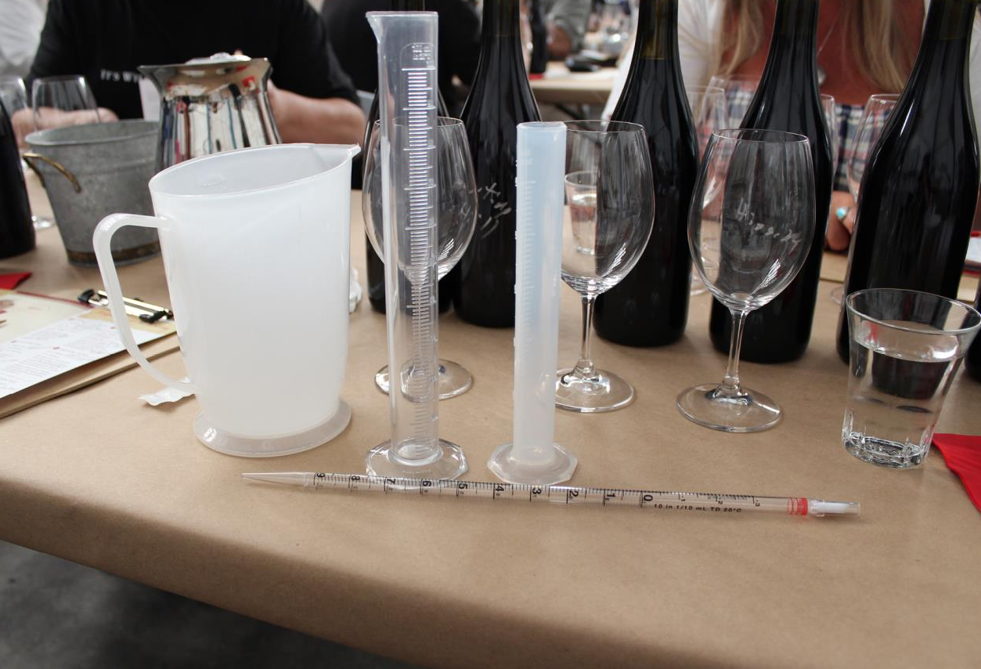
Notes:
The ‘Cape blend’ is an evolving term established by South African wine producers which generally denotes a red blend with Pinotage as a component making up 30 to 70 percent of the wine. Wines entered into the annual ABSA Perold Cape Blends competition must adhere to this requirement.

Slide 16
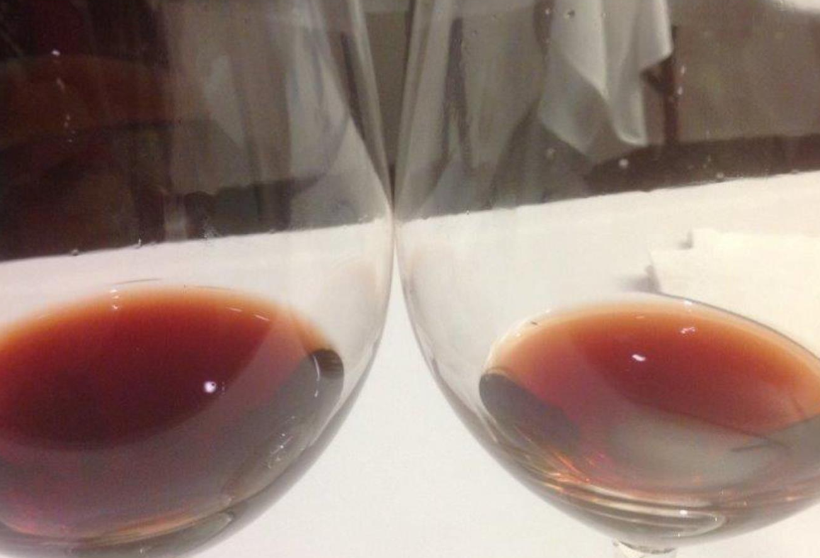
Notes:
In the centre Pinotage is an intense deep ruby to crimson and from fuchsia-purple to brick red on the edge.

Slide 17
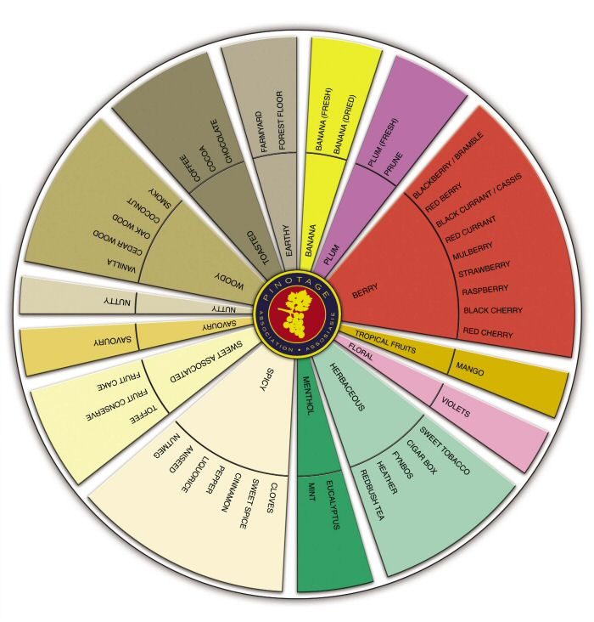
Notes:
When it comes to the aroma, associations include plum, black cherry, mulberry, strawberry, occasionally raspberry and bramble, sometimes spice and cloves.

Slide 18
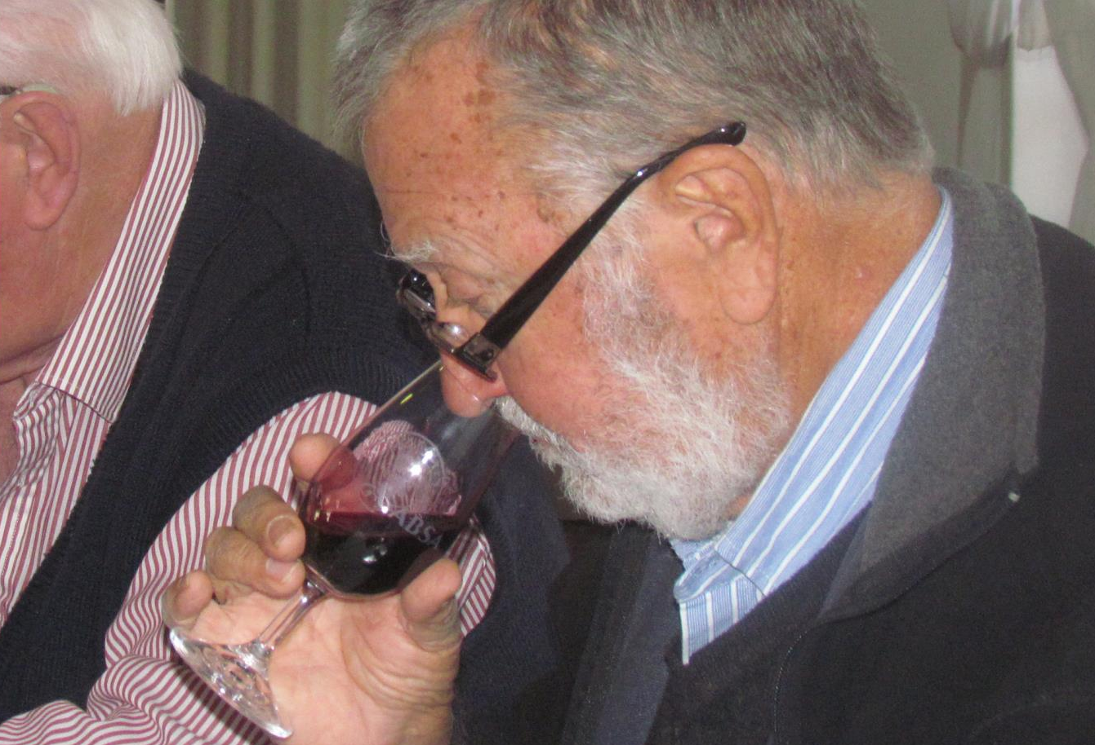
Notes:
Wines made from Pinotage range from light to full-bodied in weight.

Slide 19
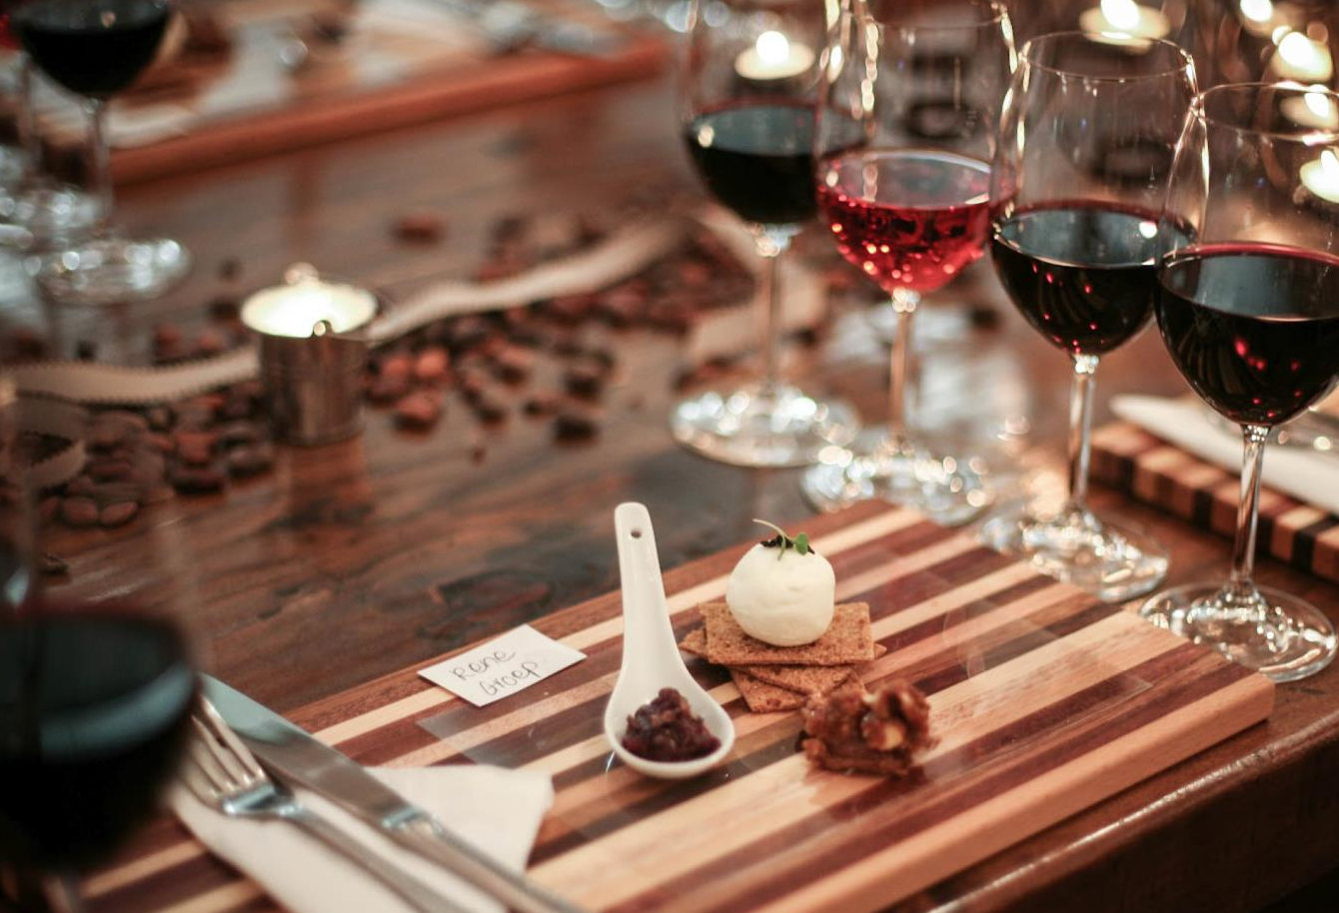
Notes:
When young, Pinotage is packed with plum and berry flavours, then it softens and develops associations with prune, cherry and cassis, as well as red and black berries.

Slide 20
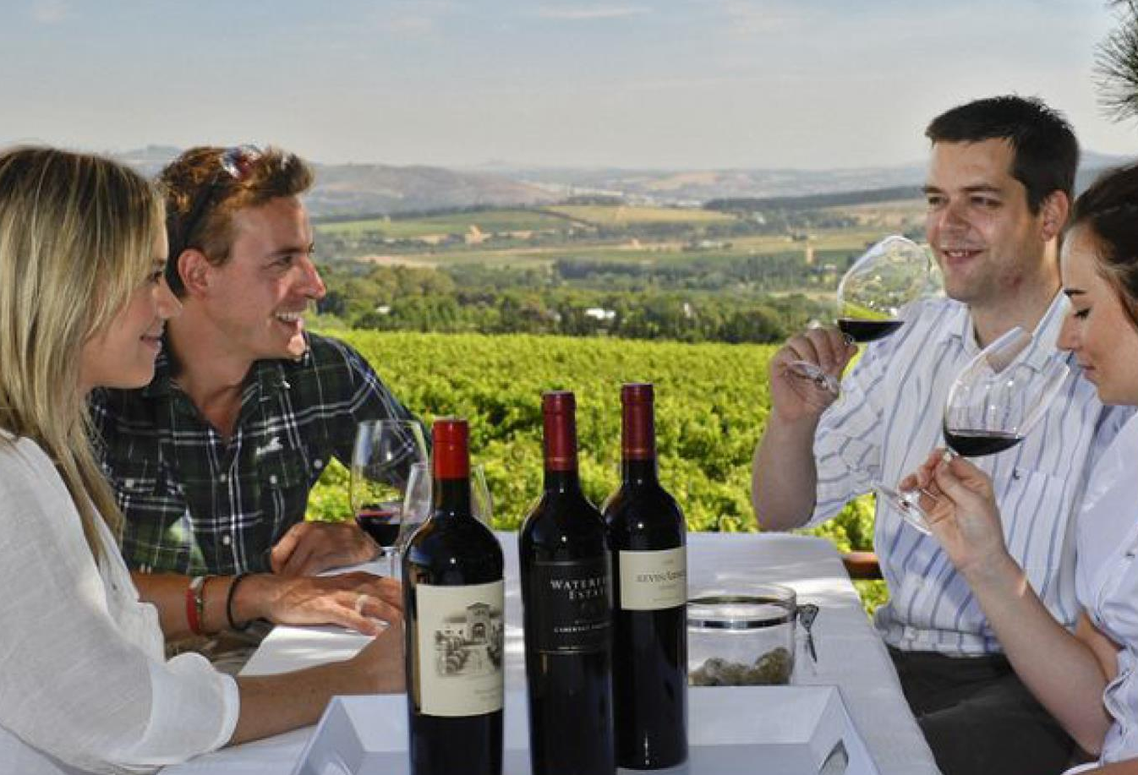
Notes:
In terms of flavour profile, Stellenbosch Pinotage typically displays black cherry, plum and black currant fruit with firm tannins.

Slide 21
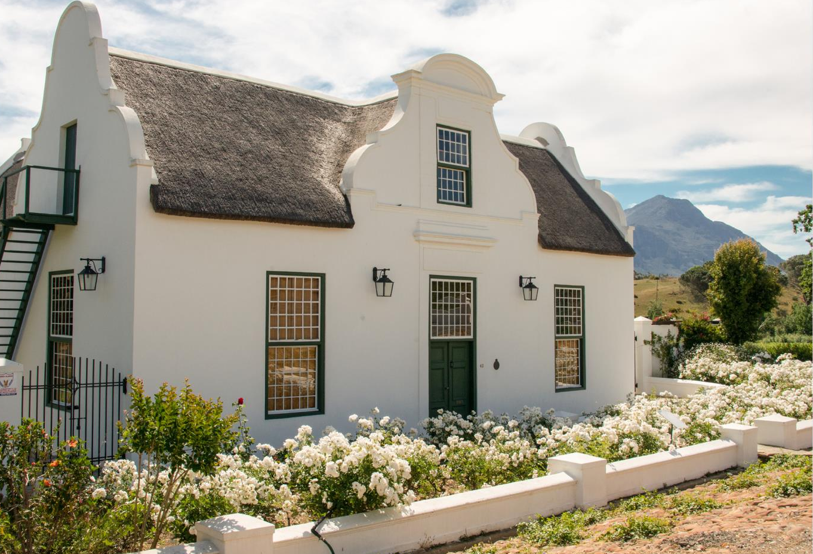
Notes:
More inland areas such as Tulbagh produce wines of even more pronounced dark fruit flavour and are typically very rich and full.

Slide 22
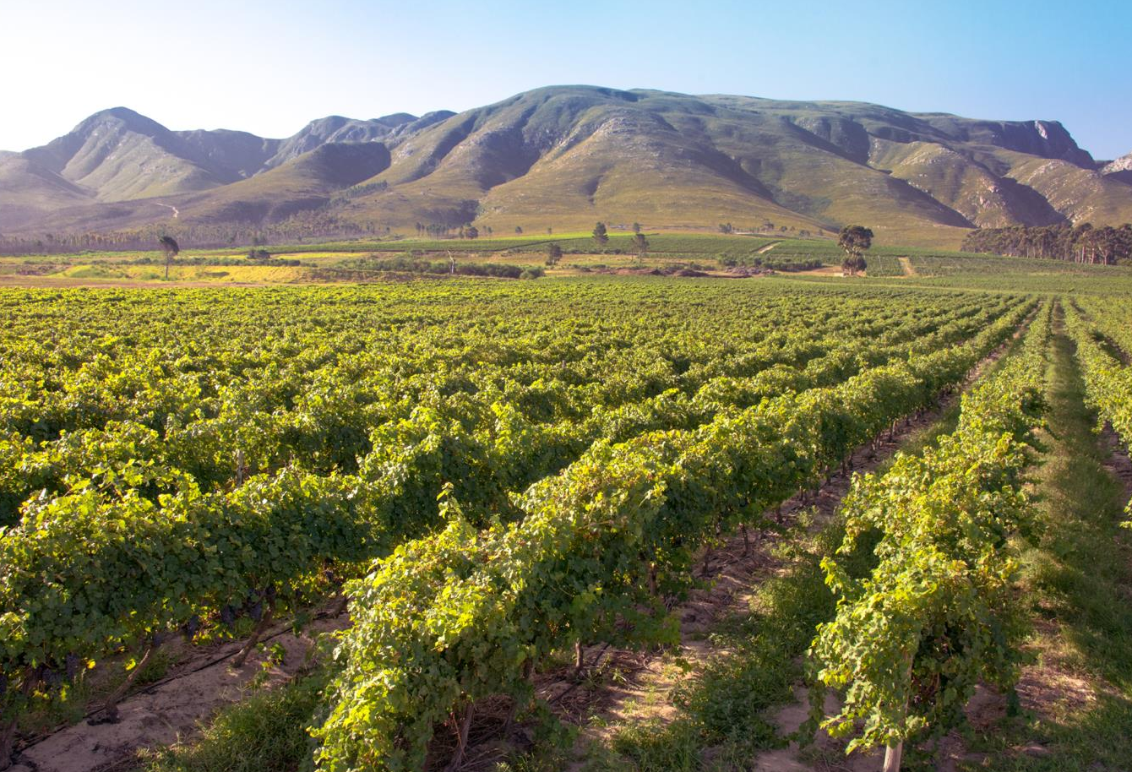
Notes:
While more maritime areas such as Walker Bay give wines that are more red-fruited, medium bodied and reminiscent of Pinot Noir.

Slide 23
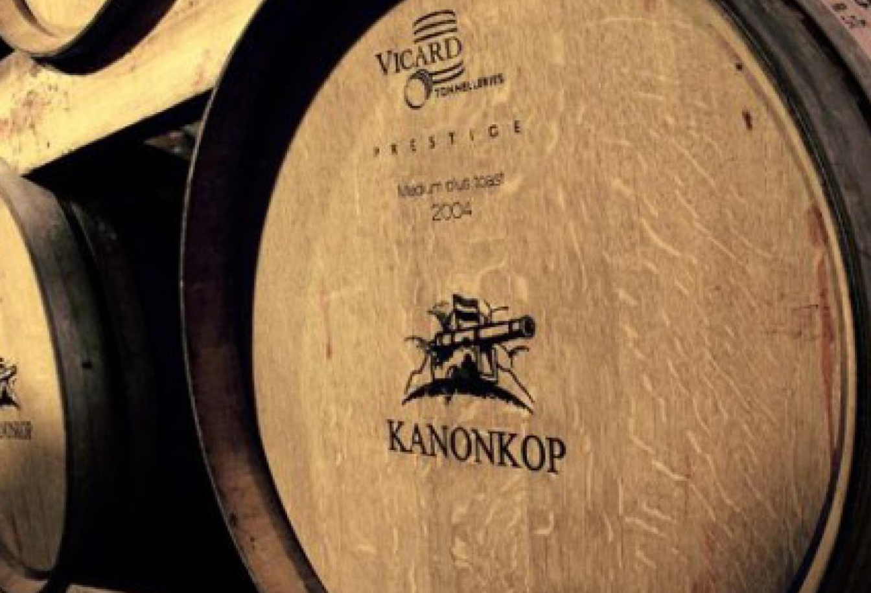
Notes:
Maturation in oak barrels can add cedar, vanilla and toasted flavours.

Slide 24
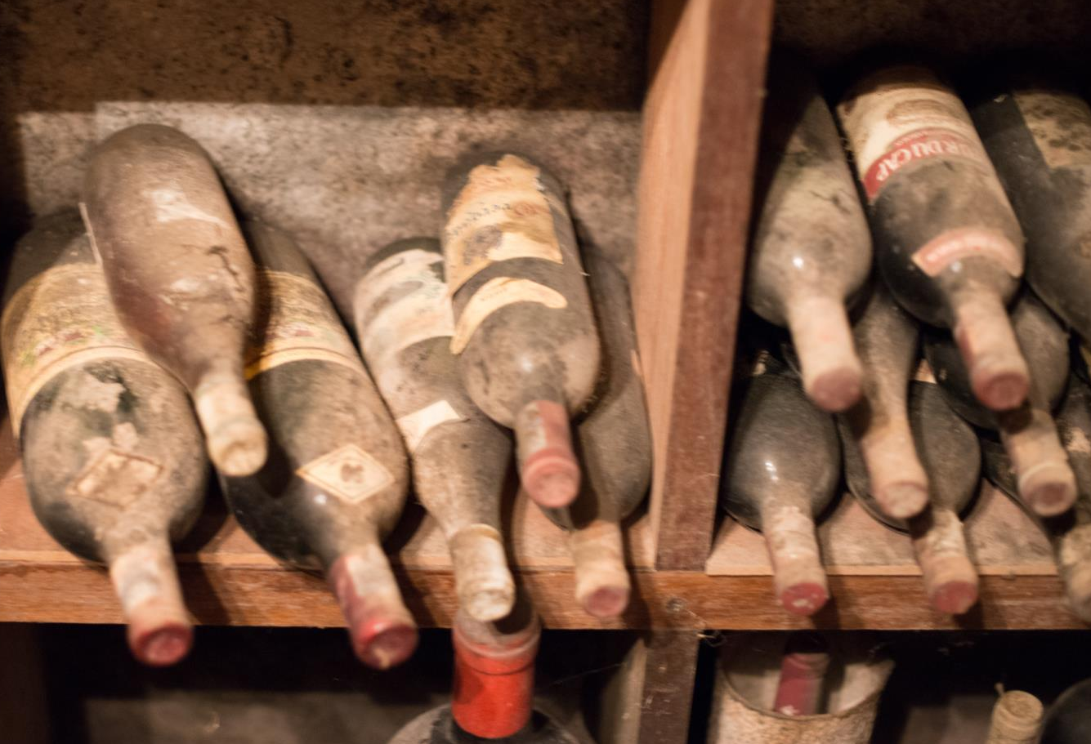
Notes:
A well-made Pinotage improves with age and its complexity allows it to mature in the bottle for up to 10 years and more.

Slide 25
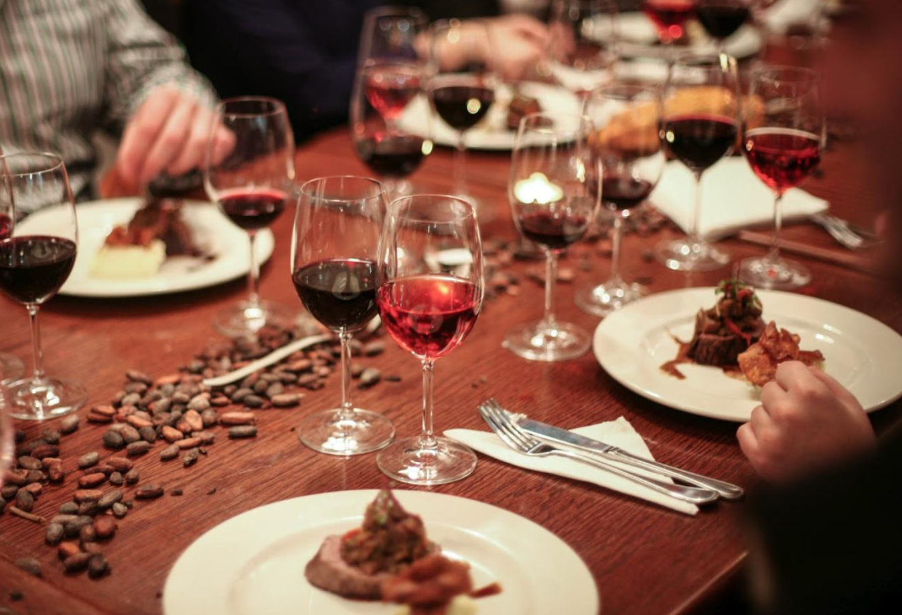
Notes:
Pinotage wines go very well with food. Unwooded, medium-bodied and fruity Pinotages go well with lamb, braaied boerewors (barbecued farmer’s sausage) and game fish, a hearty winter soup, ratatouille, and young cheddar or gouda cheese.

Slide 26
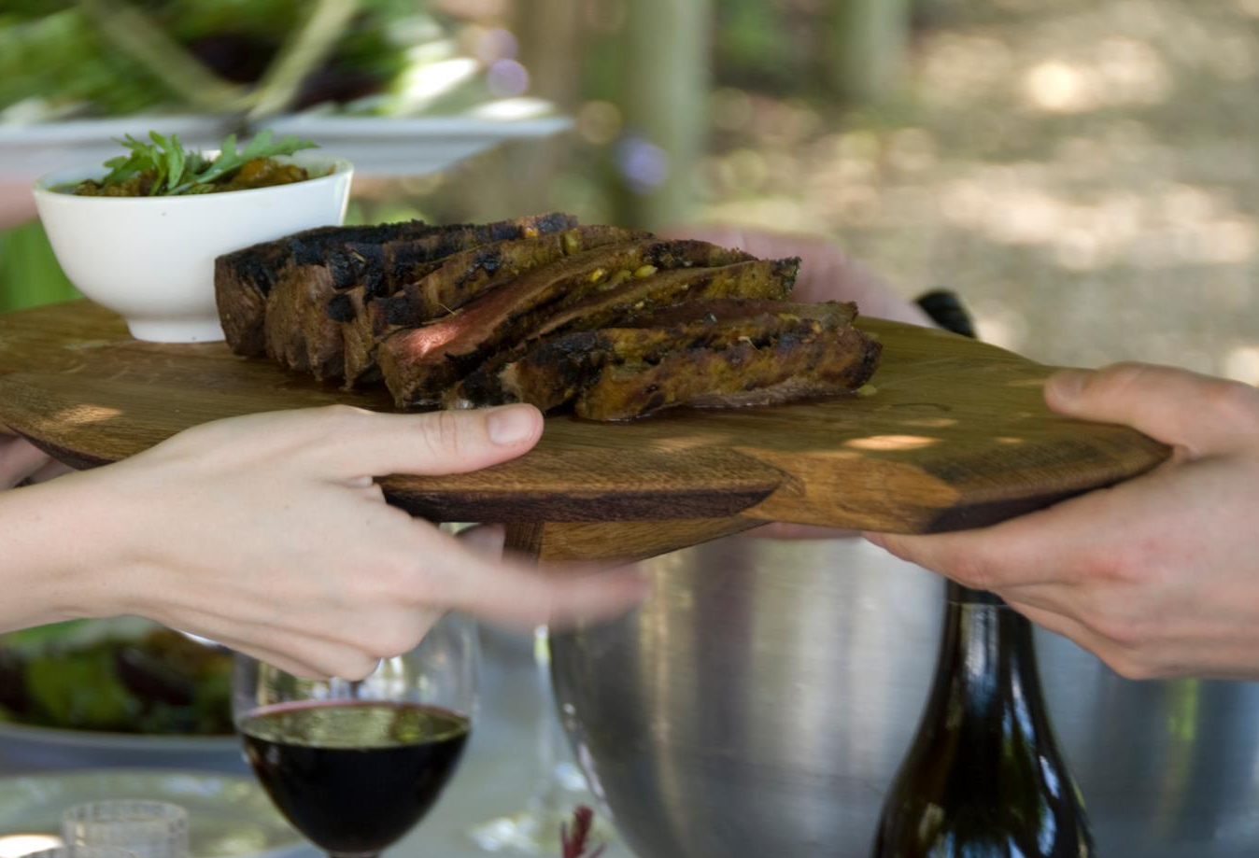
Notes:
Fruity Pinotages also work well with bobotie, lamb curry and spicier dishes. Or try a fruity example with carpaccio or sashimi and sushi, or even chilled with oysters!

Slide 27
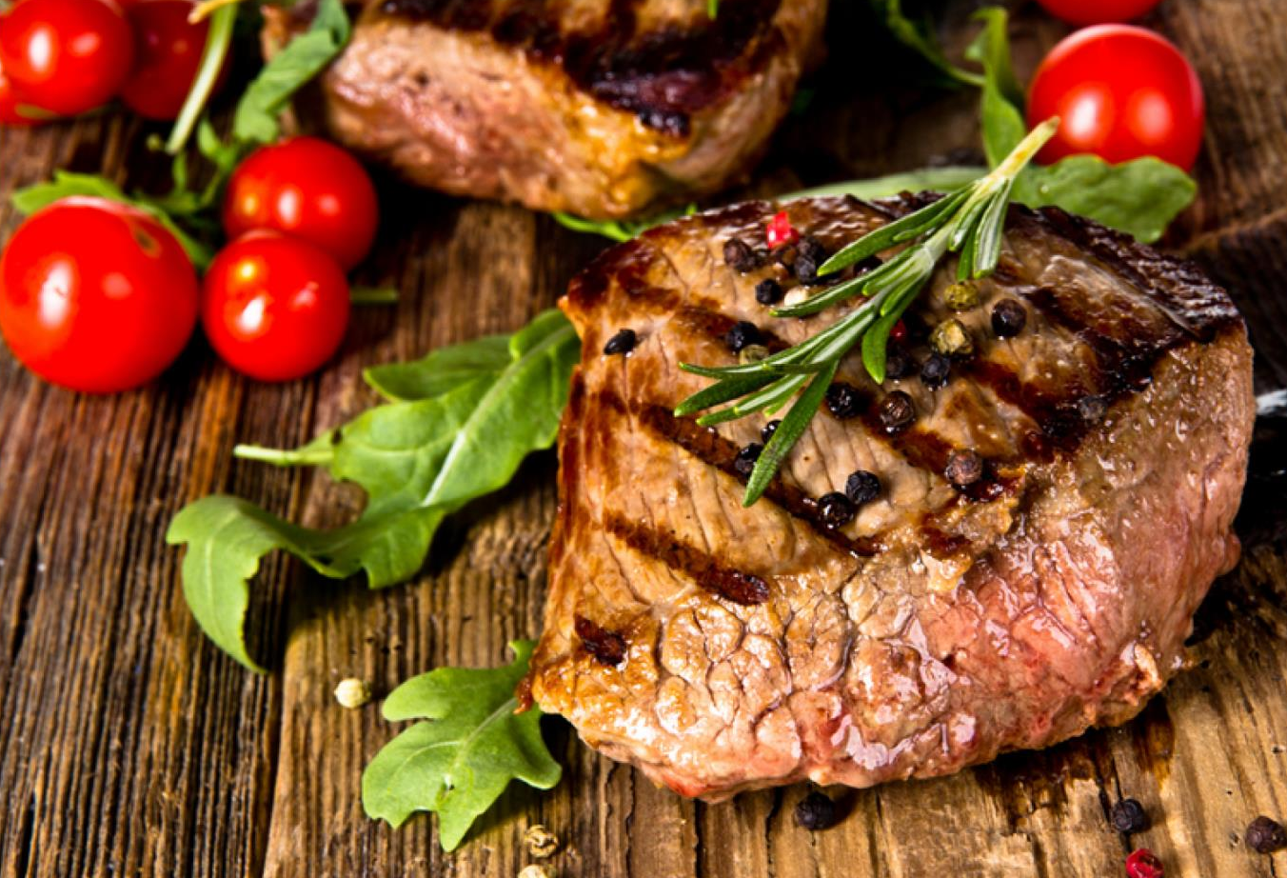
Notes:
Wooded, full-bodied Pinotage is the perfect partner to full-flavoured game fish, spare ribs, steak, venison dishes such as ostrich, guinea fowl, kudu and springbok, and osso buco.

Slide 28

“Pinotage seems to develop beautifully,
and also consistently, compared to
other varieties. There's earthiness,
forest floor and spice, as well as a
bit of red fruit – a very stable character in Pinotage as it develops.”
– Abrie Beeslaar, owner/cellarmaster at Beeslaar Wines
and former cellarmaster at Kanonkop

Slide 29
The end
Notes:
The end

