Slide 1
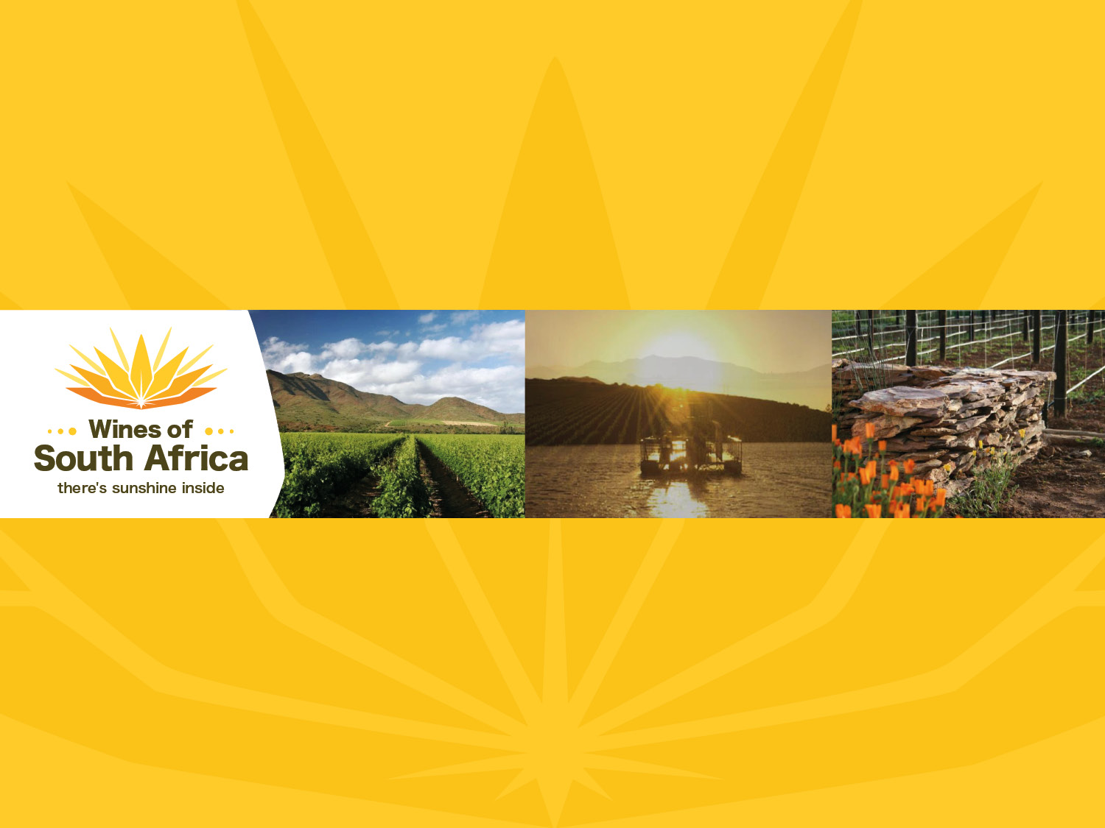
CAPE WINELANDS
ROBERTSON
Notes:
Wines of South Africa

Slide 2

Where is South Africa?

Slide 3

South Africa is the southernmost
country in Africa.

Slide 4

Our winelands are located at the
very tip of South Africa.

Slide 5

PRODUCTION AREAS: Districts of South Africa.

Slide 6

Wards of South Africa.

Slide 7

Breed River Valley
Region: Breede River Valley
District: Robertson
Wards:
Agterkliphoogte
Ashton
Bonnievale
Boesmansrivier
Eilandia
Goedemoed
Goree
Goudmyn
Hoopsrivier
Klaasvoogds
Le Chasseur
McGregor
Vinkrivier
Zandrivier

Slide 8
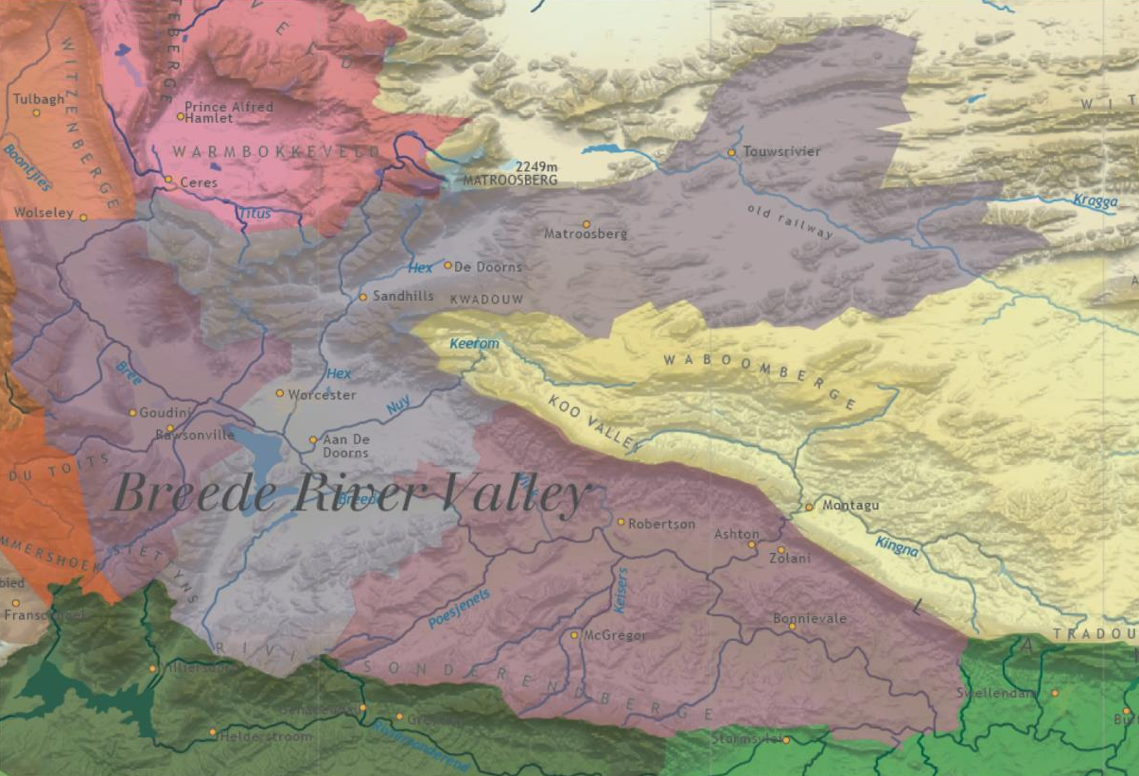

Slide 9
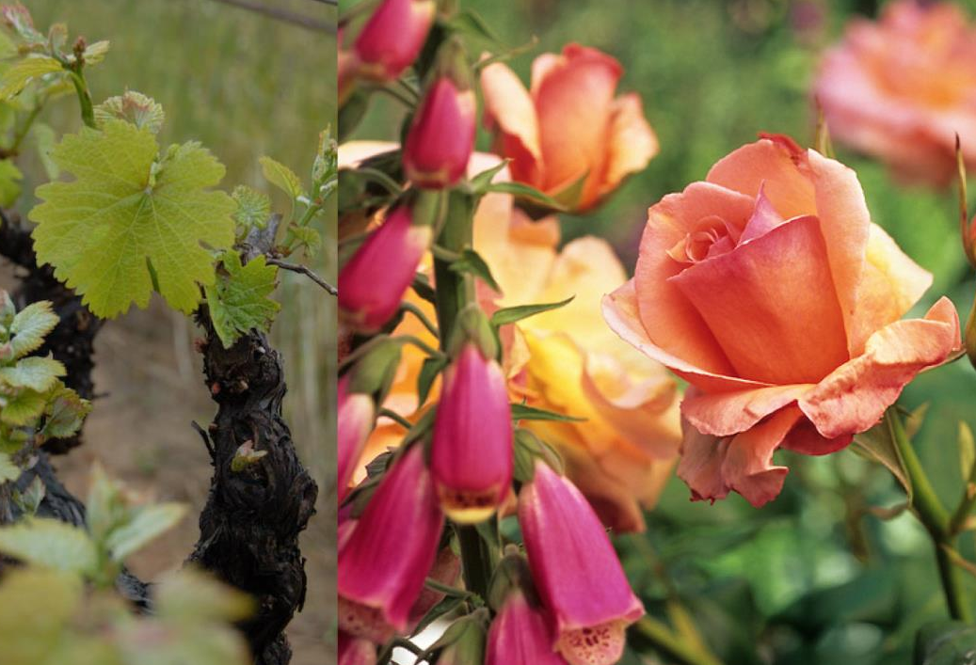
Robertson is dubbed the 'valley of vines and roses'.

Slide 10
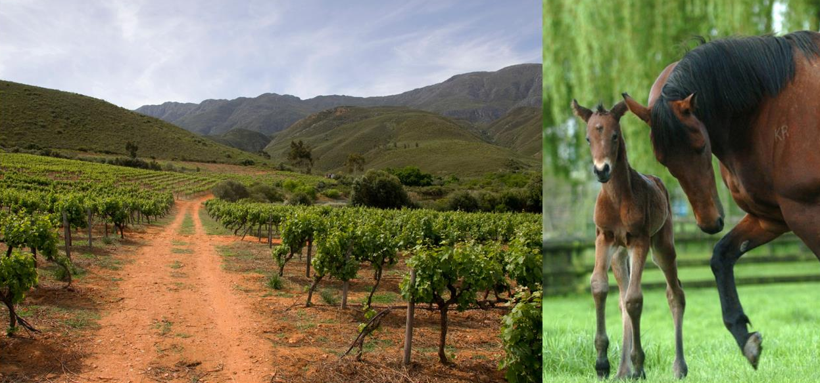
Its lime-rich soils make the area eminently suitable for racehorse stud farming and also, of course, for winegrowing. Many of the farms have been owned by the same family for generations.

Slide 11
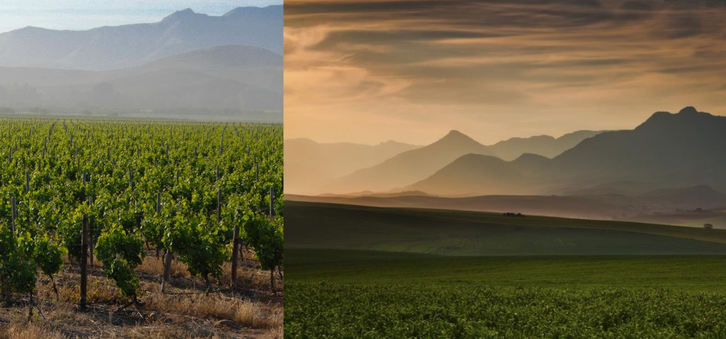
The Robertson district runs along the Breede River between the Langeberg and Riviersonderend mountain ranges.

Slide 12
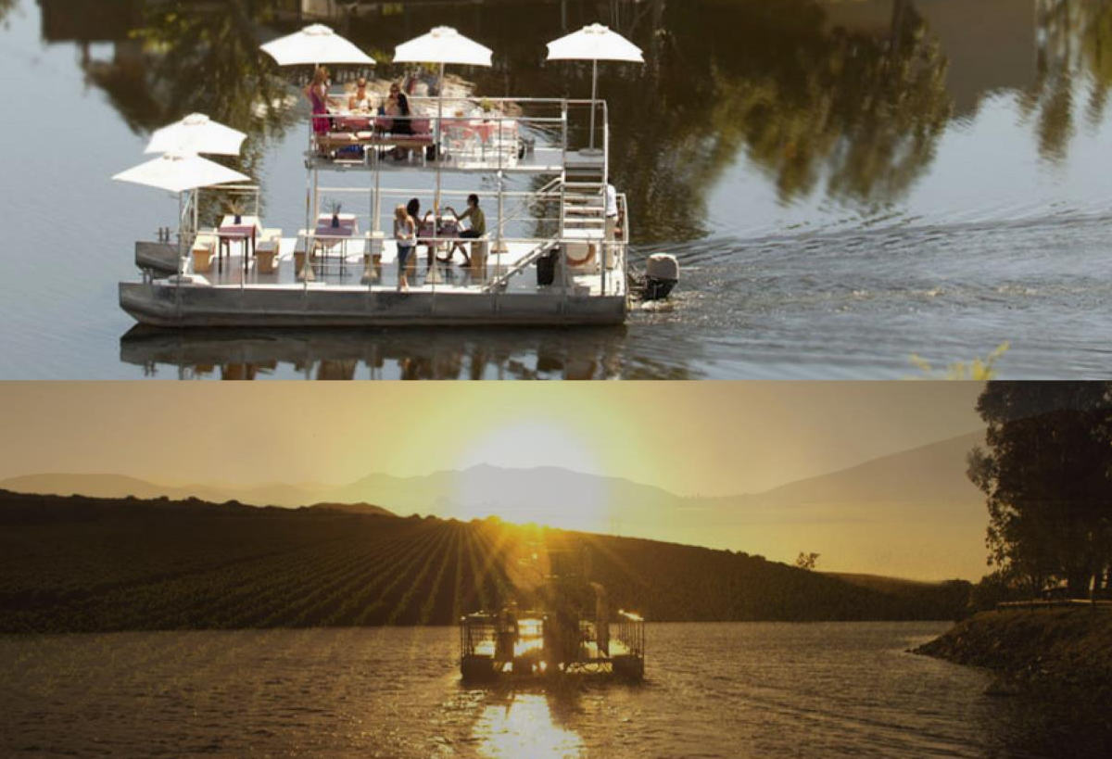
The valley offers many attractions and exciting outdoor activities, from river cruises to rafting, hiking and mountain biking.

Slide 13
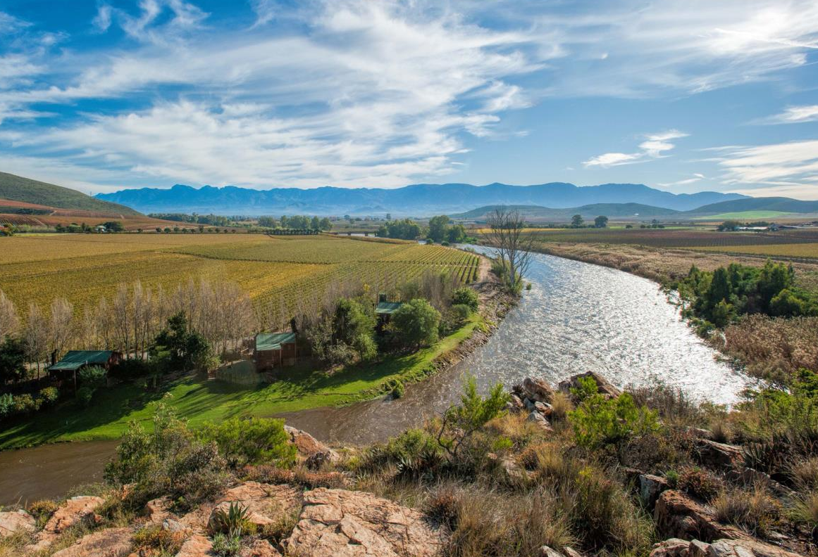
The broad river with its early morning mists is the lifeblood of this lower rainfall district.

Slide 14
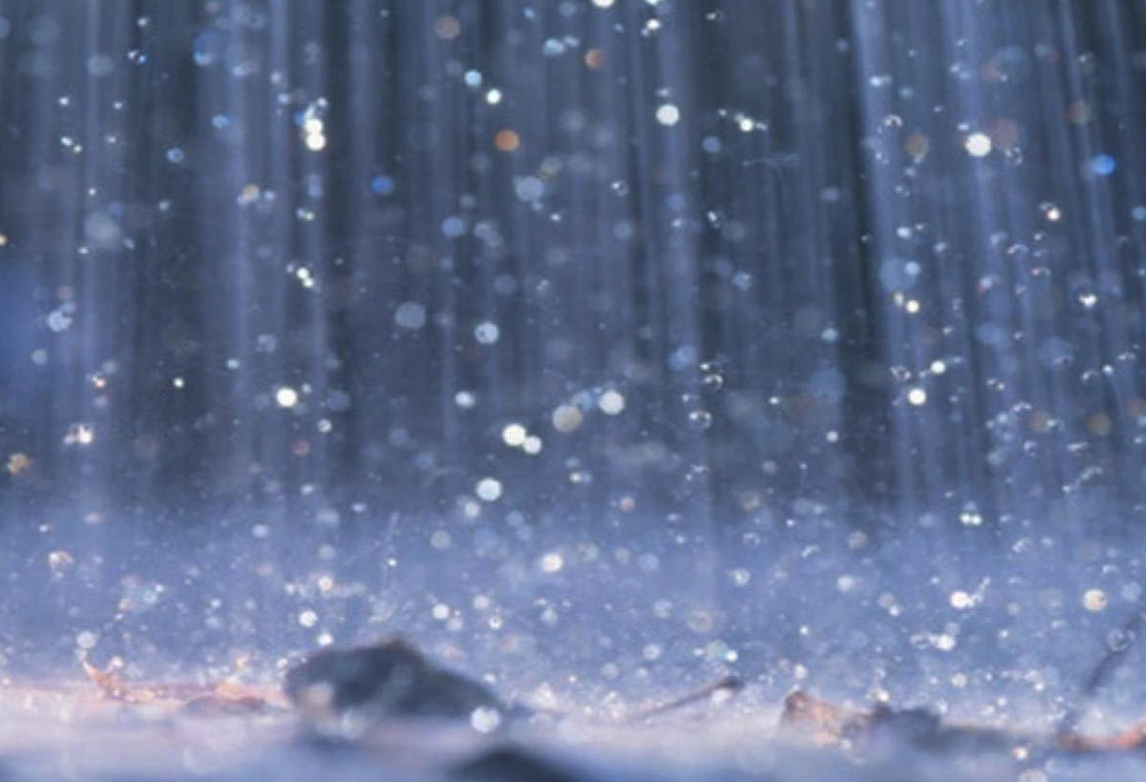
It has an average annual rainfall of around 280–400 mm.

Slide 15
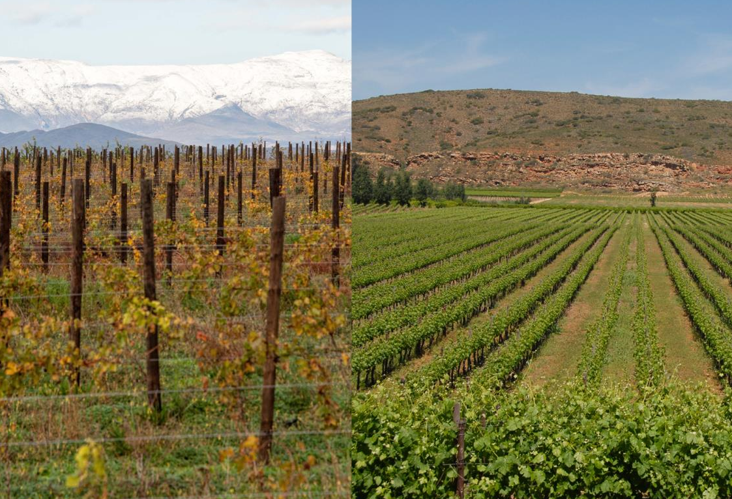
The valley is characterised by extreme differences in day and night temperatures.

Slide 16
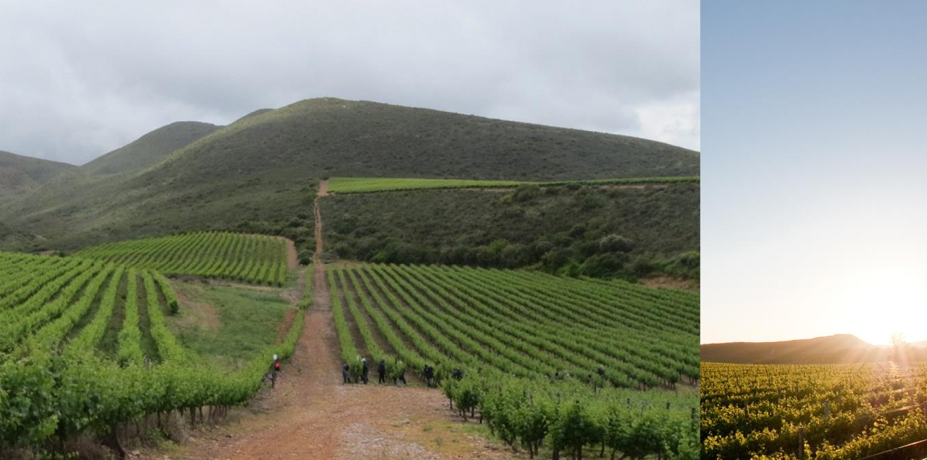
Although summer temperatures can be high, cooling south-easterly winds channel moisture-laden air into the valley.

Slide 17
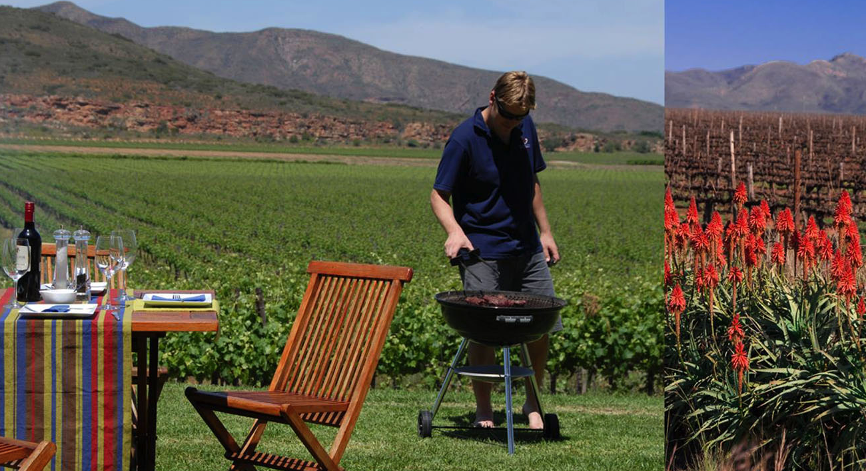
The mean February temperature is 23⁰C.

Slide 18
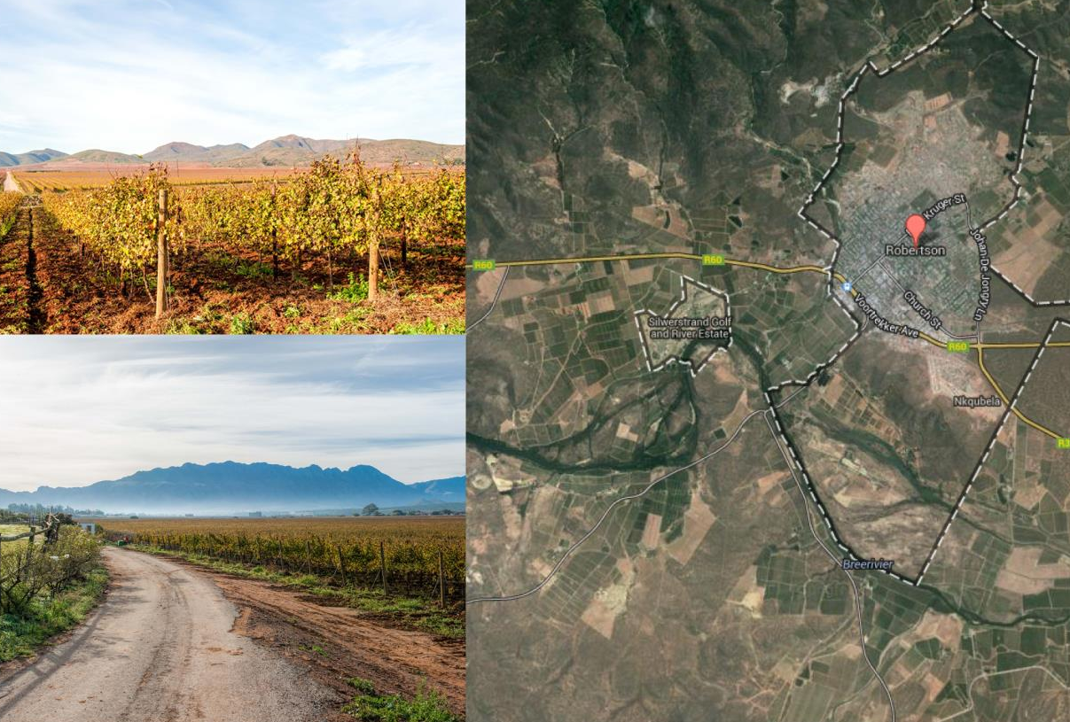
The district of Robertson incorporates several wards.

Slide 19
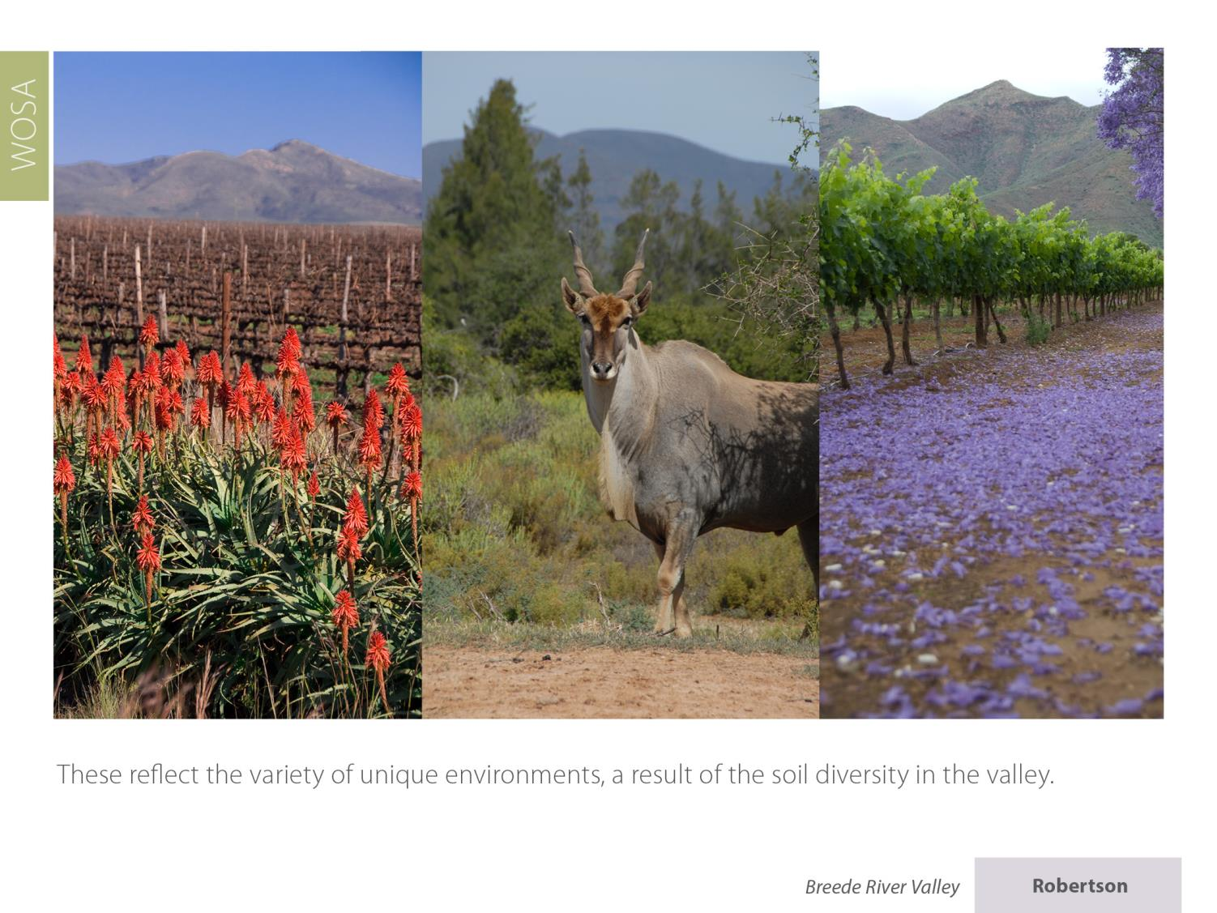
These reflect the variety of unique environments, a result of the soil diversity in the valley.

Slide 20
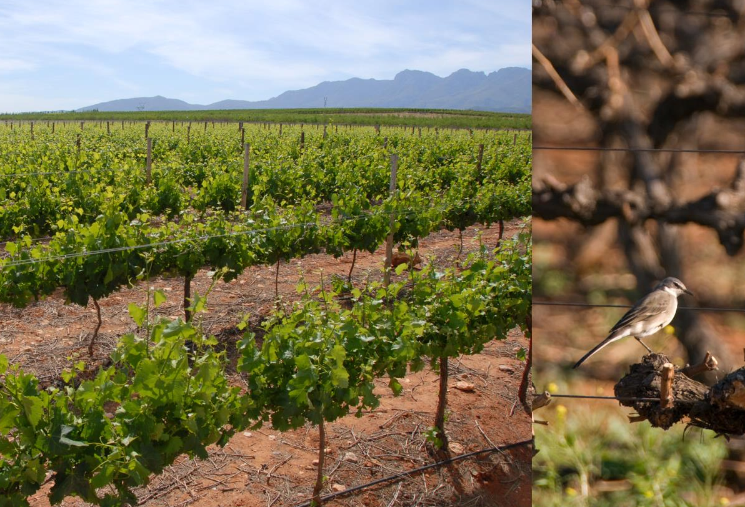
This winegrowing area features three main soil types.

Slide 21
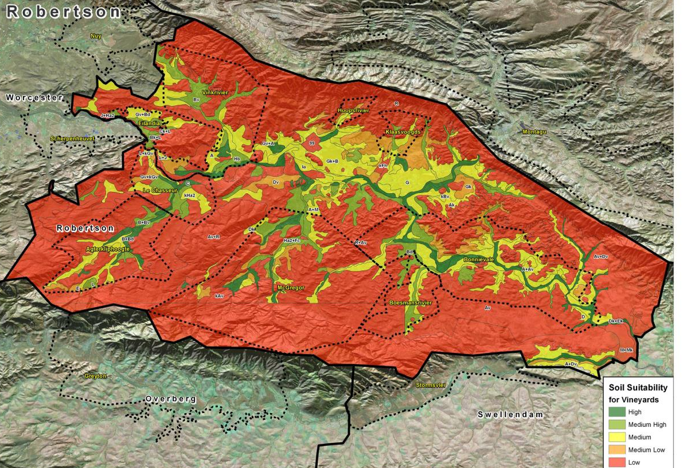

Slide 22
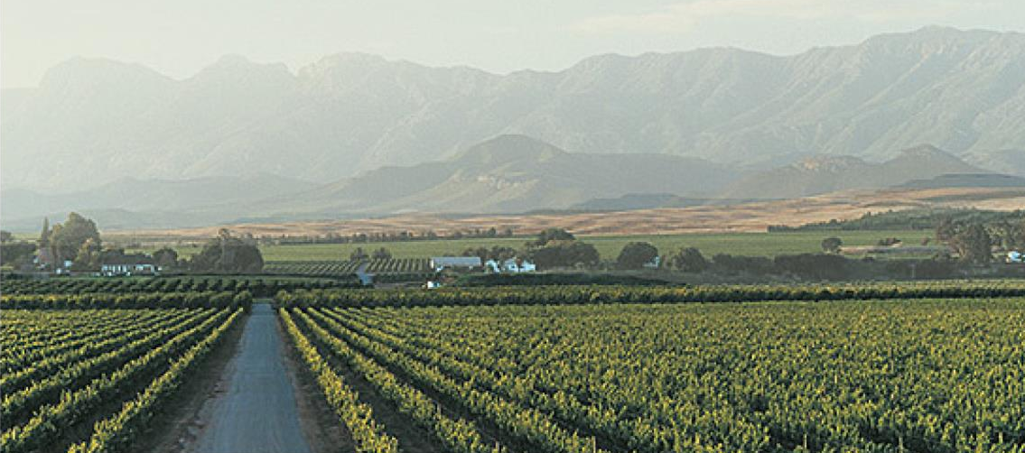
Dark-coloured, light-textured, humid alluvial soils on the lower riverine terraces which induce vigorous growth.

Slide 23
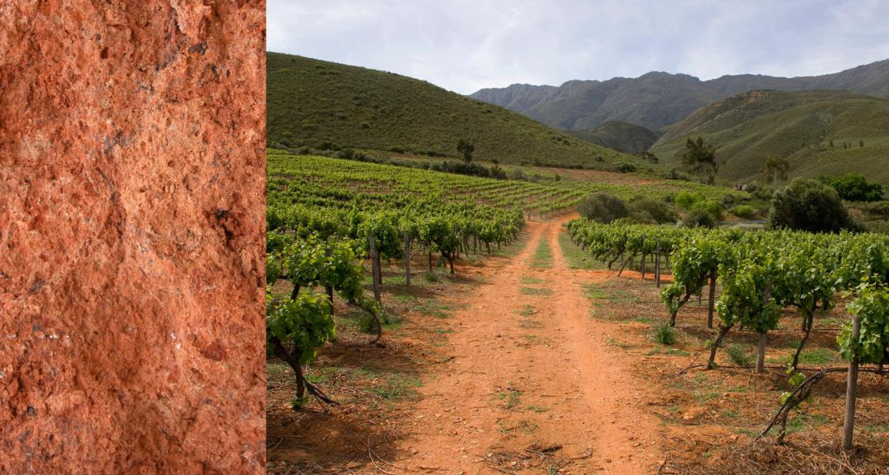
Reddish-brown, heavy-textured soils, often calcareous, on older, higher terraces which, depending on the salt content and structure, also promote vigorous growth of vines.

Slide 24
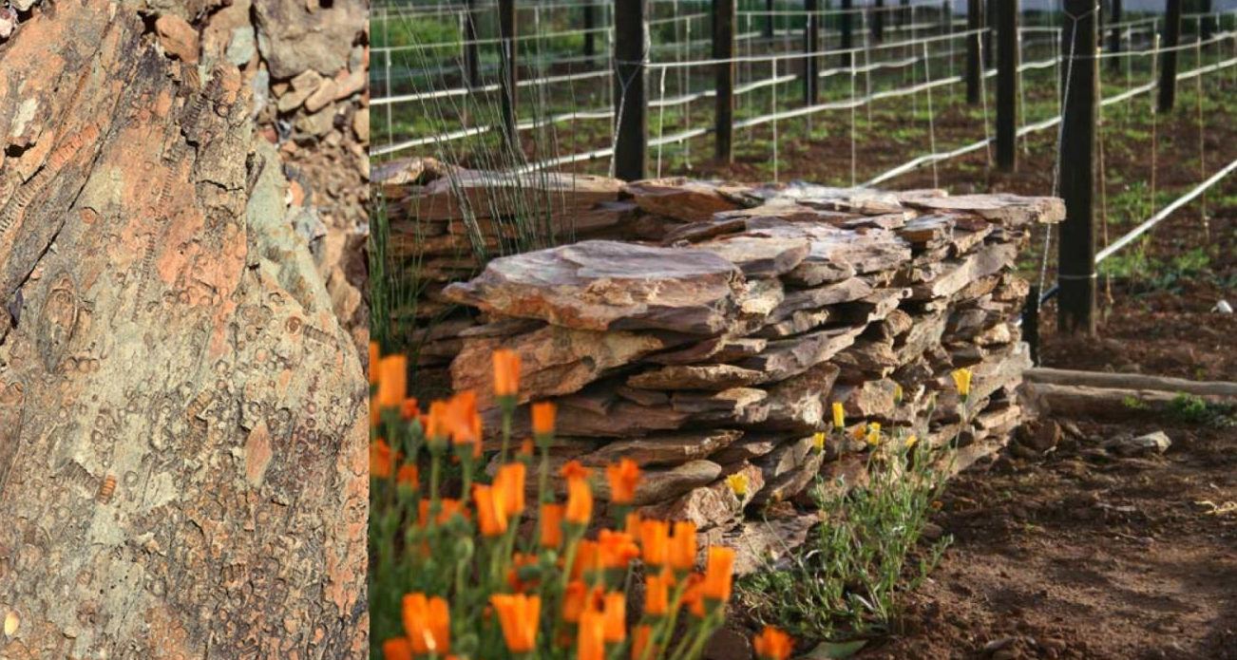
And relatively shallow soils on Bokkeveld shale which induce moderate vigour and yields if properly prepared.

Slide 25
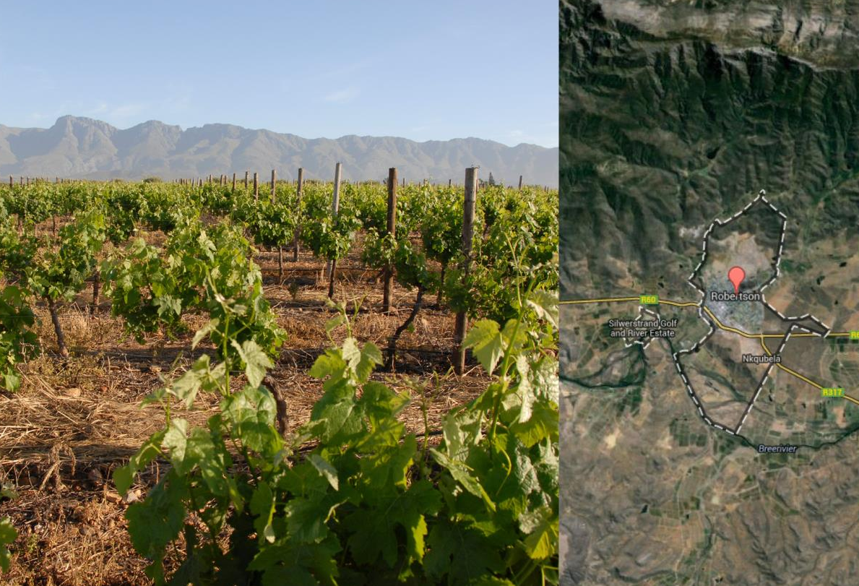
Robertson has the third-most hectarage of vineyard plantings in South Africa.

Slide 26
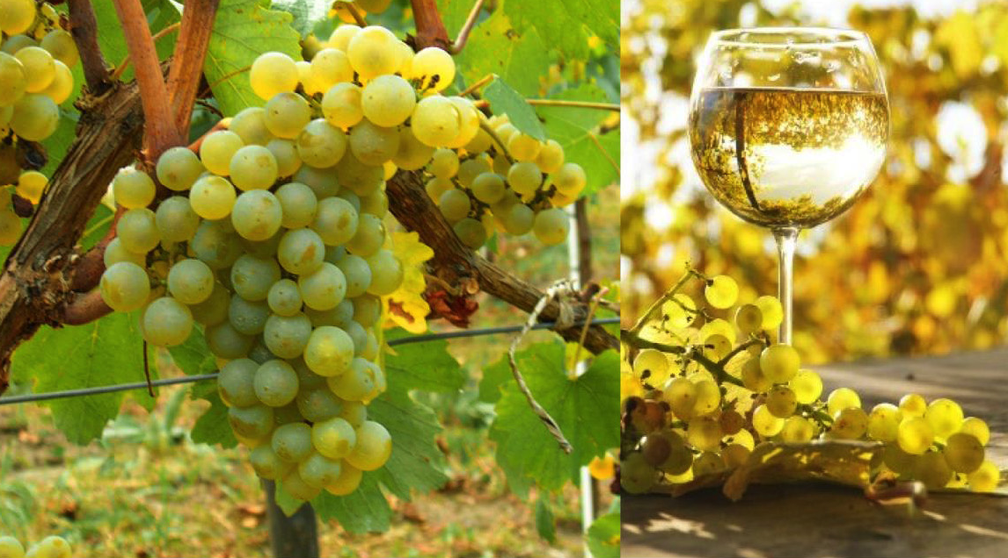
Plantings of Sauvignon Blanc account for the most hectarage of white-wine varieties, followed by Colombard , Chardonnay and Chenin Blanc.

Slide 27
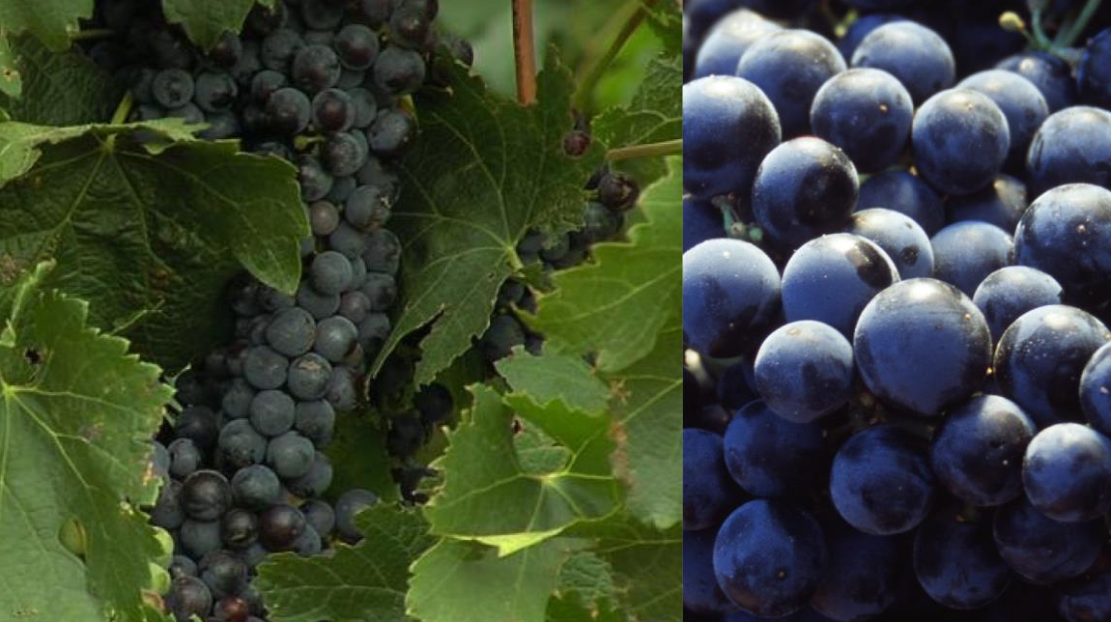
The most widely planted red-wine variety is Cabernet Sauvignon, followed by Pinotage and Shiraz.

Slide 28
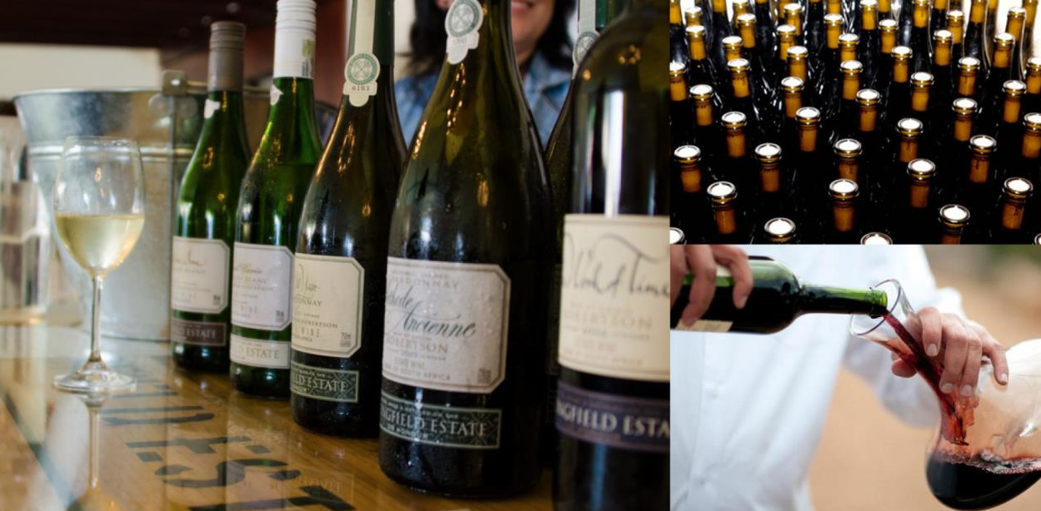
Robertson is renowned for the quality of its wines.

Slide 29
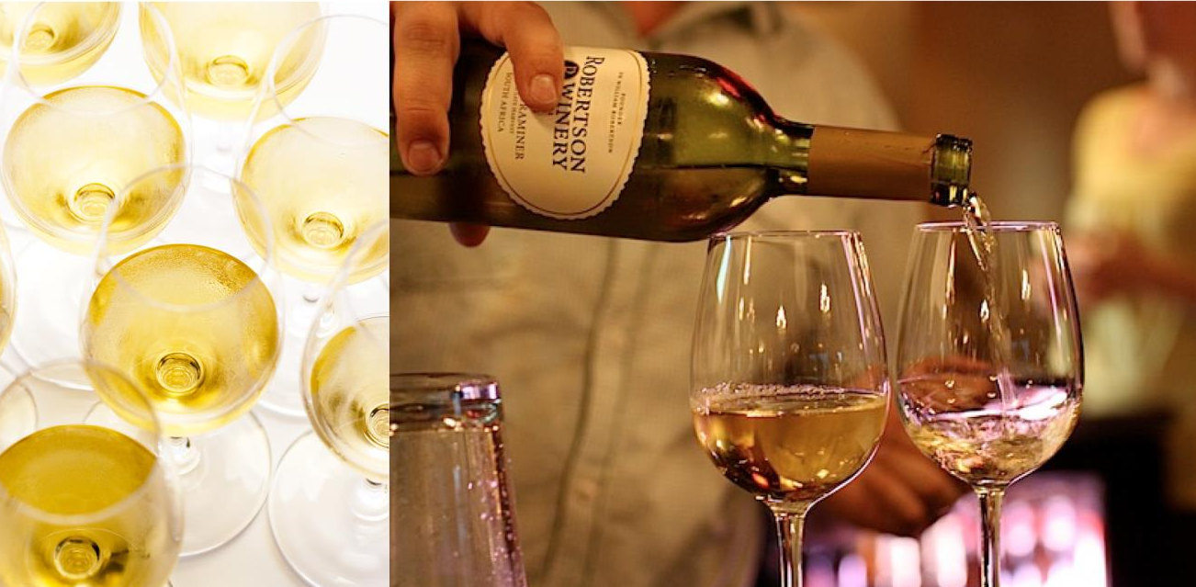
Traditionally considered white-wine territory, the district is known mainly for its Chardonnay and more recently for the quality of its Sauvignon Blanc.

Slide 30
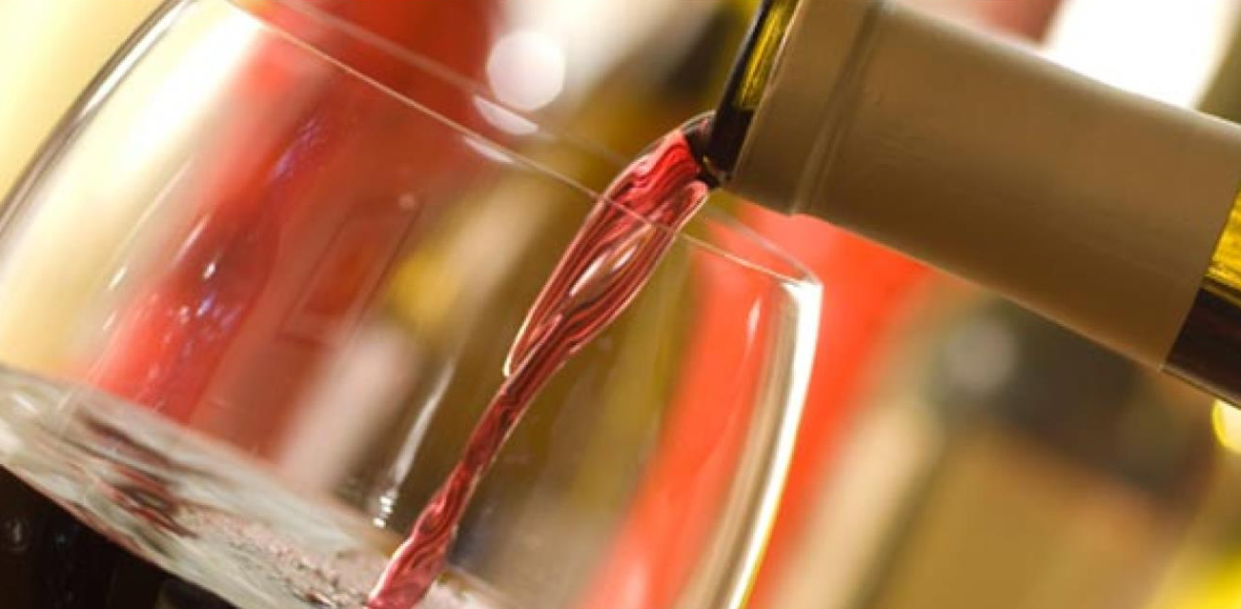
Robertson it is also increasingly being recognised for its fine red wines, particularly Cabernet Sauvignon and Shiraz.

Slide 31
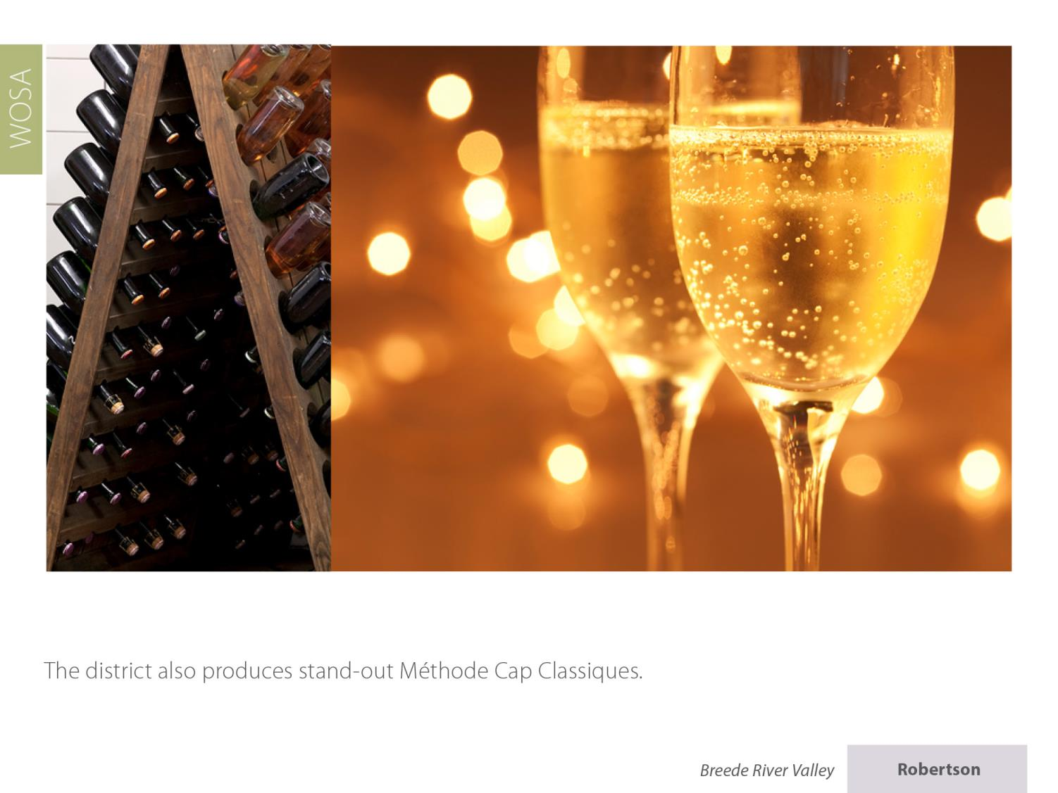
The district also produces stand-out Cap Classiques.

Slide 32
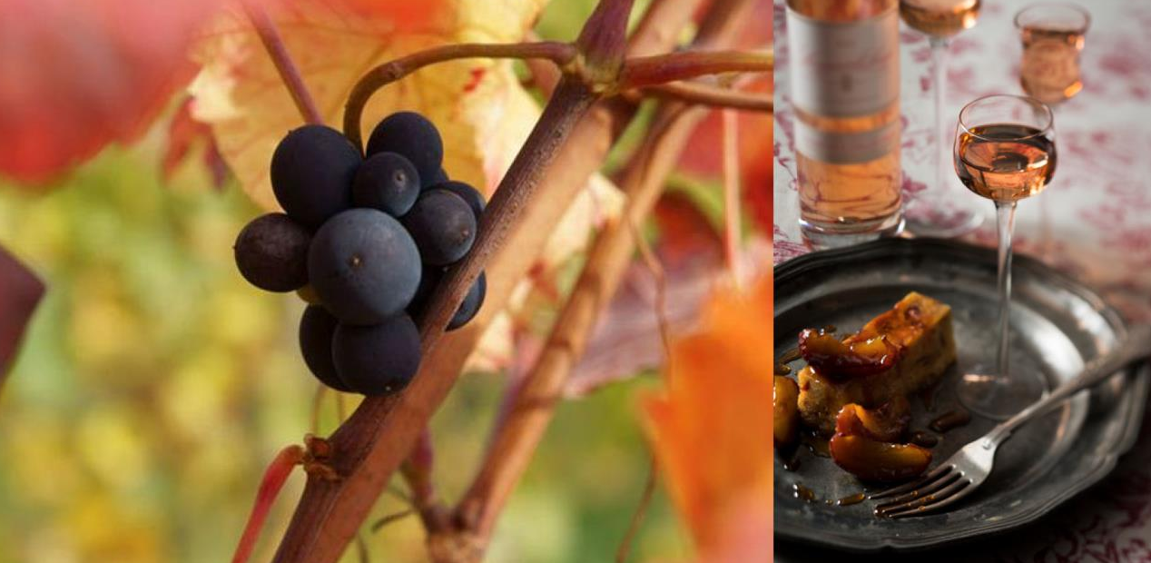
As well as the distinctive fortified dessert wines for which it was originally famed.

Slide 33
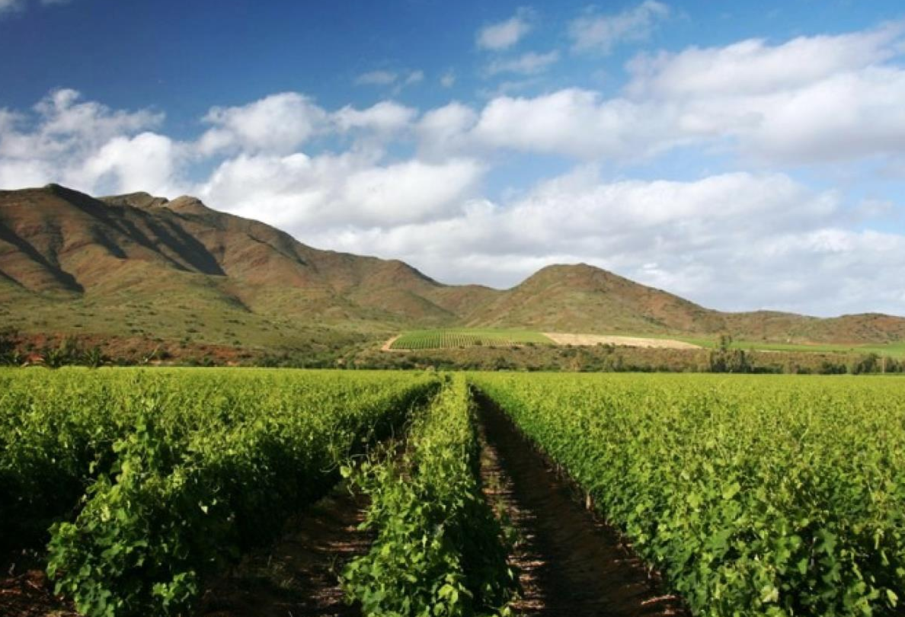
The images used in these presentations have been sourced from various producers, as well as industry and tourism bodies. These presentations are strictly for non-commercial, non-profit, educational purposes only and cannot be reproduced or transmitted in any form or by any means without written permission from Wines of South Africa (WoSA).

Slide 34
The Cape winelands, considered by many to be the most
beautiful in the world, have a network of diverse
and well-run wine routes, affording visitors a varied
and unforgettable experience.
The end
Notes:
The end

