Slide 1
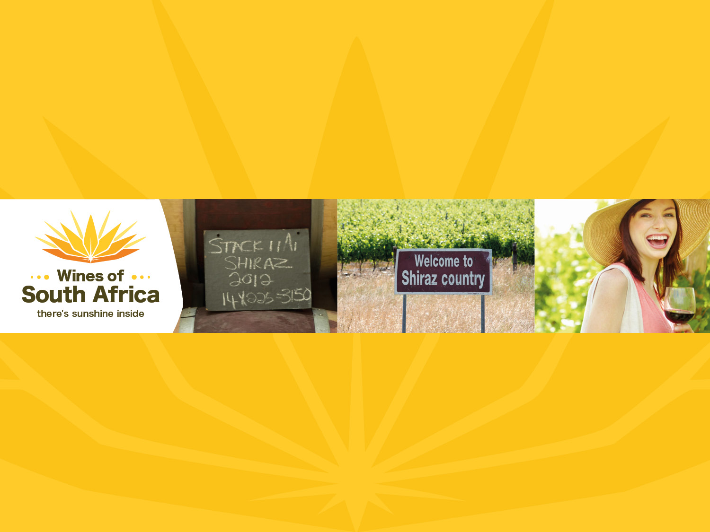
SHIRAZ

Slide 2
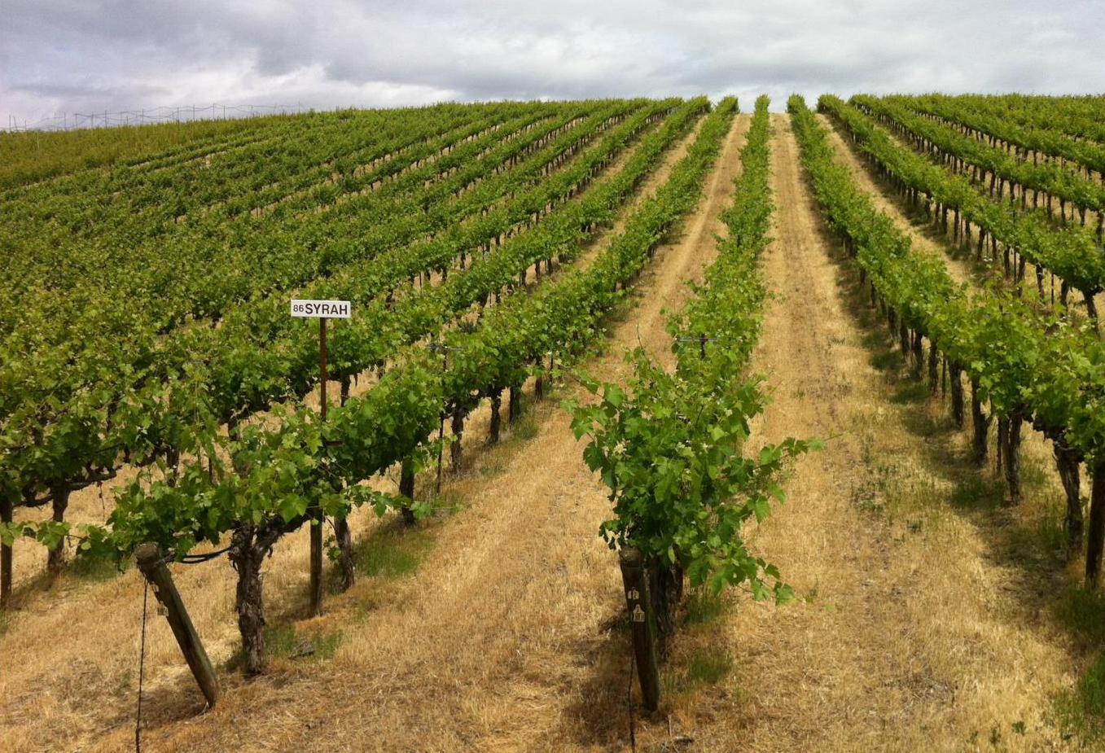
Notes:
A noble variety of French origin, Shiraz originally hails from the Rhône valley in France where it is known as Syrah (it is sometimes also labelled as such in the Cape).

Slide 3
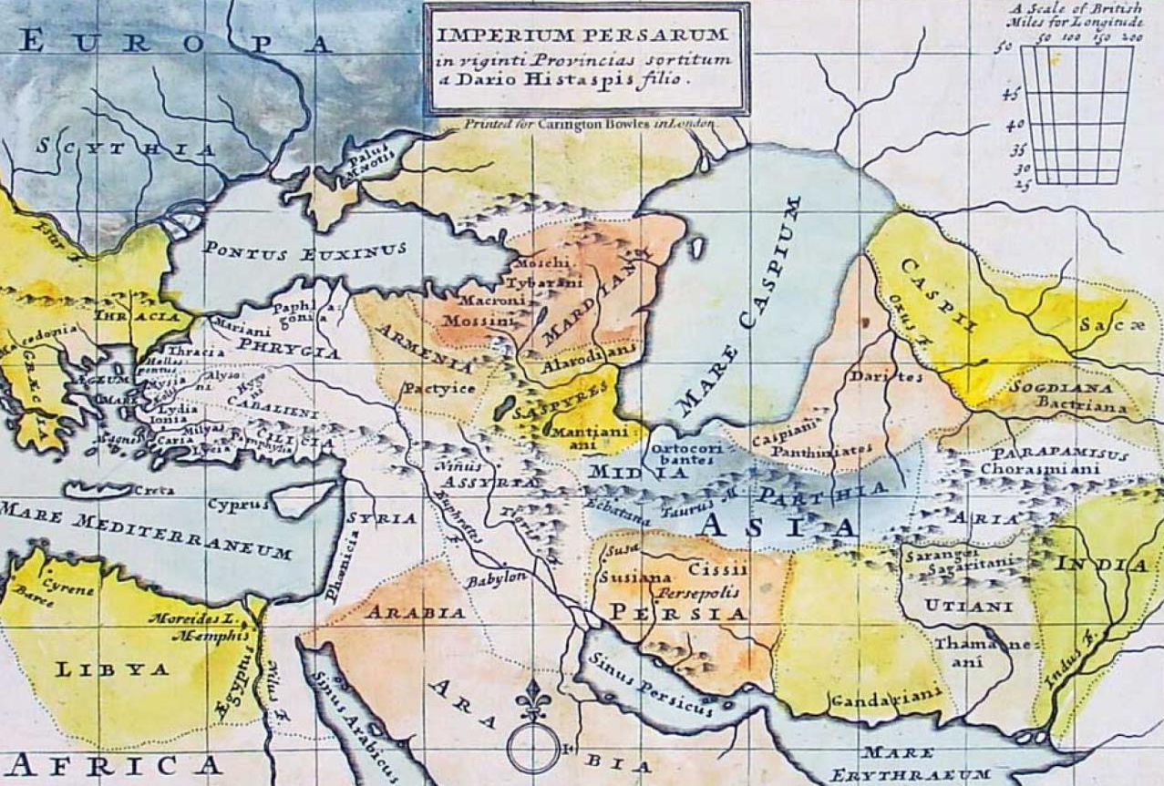
Notes:
It was once widely believed this grape originated in ancient Persia (present-day Iran) in the town of Shiraz.

Slide 4
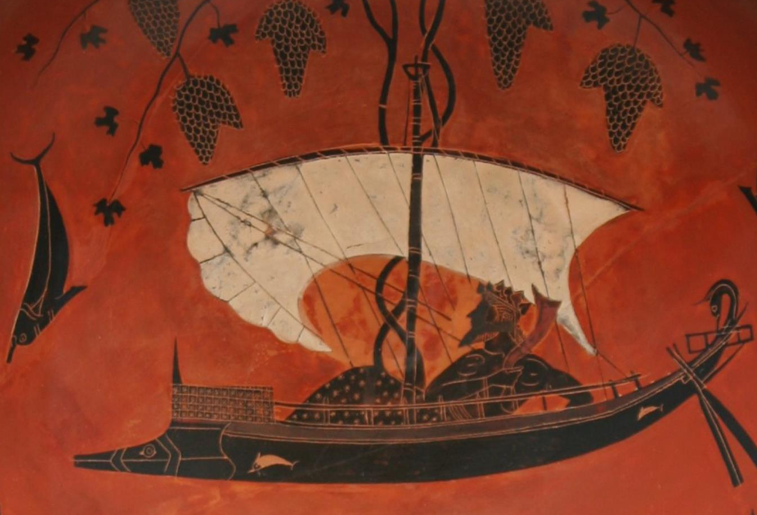
Notes:
Historians were of the opinion that it was brought from the Middle East to Marseilles in approximately 560 BC.

Slide 5
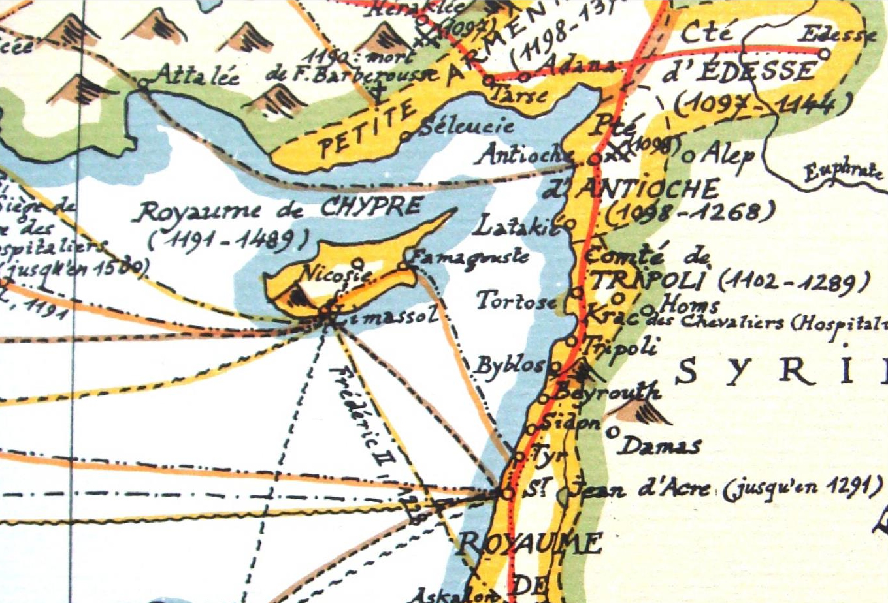
Notes:
Another of the theories was that Roman legions from Egypt carried it to Syracuse on the island of Sicily and yet another that it found its way into France through Crusaders from Cyprus returning from the Middle East in the 13th century.

Slide 6
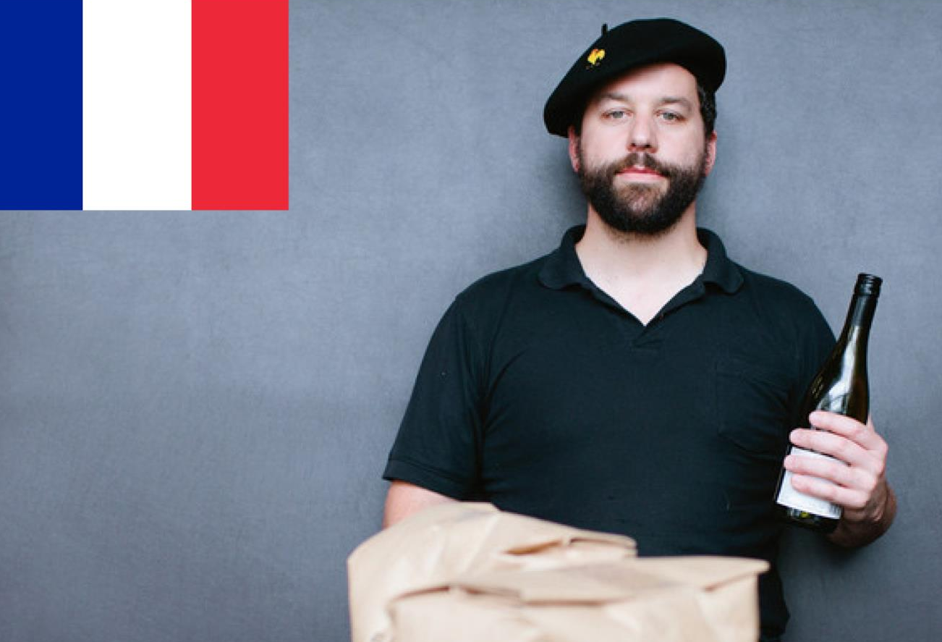
Notes:
However, these turned out to be nothing but romantic legends, as in 2001 it was announced that Shiraz actually originated in France. This was backed by conclusive evidence from experts using DNA testing. Shiraz, they proclaimed, is the offspring of two obscure French varieties, Dureza and Mondeuse Blanche – the former native to the Ardéche and the latter native to the Savoie.

Slide 7
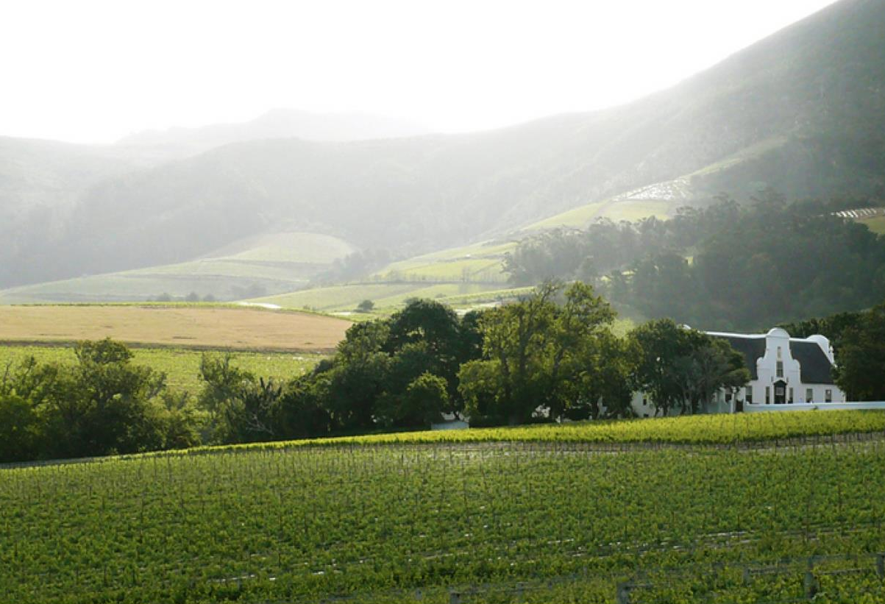
Notes:
The first confirmation of it being planted on South African soil was at the end of the 1890s in the vineyards of Groot Constantia.

Slide 8
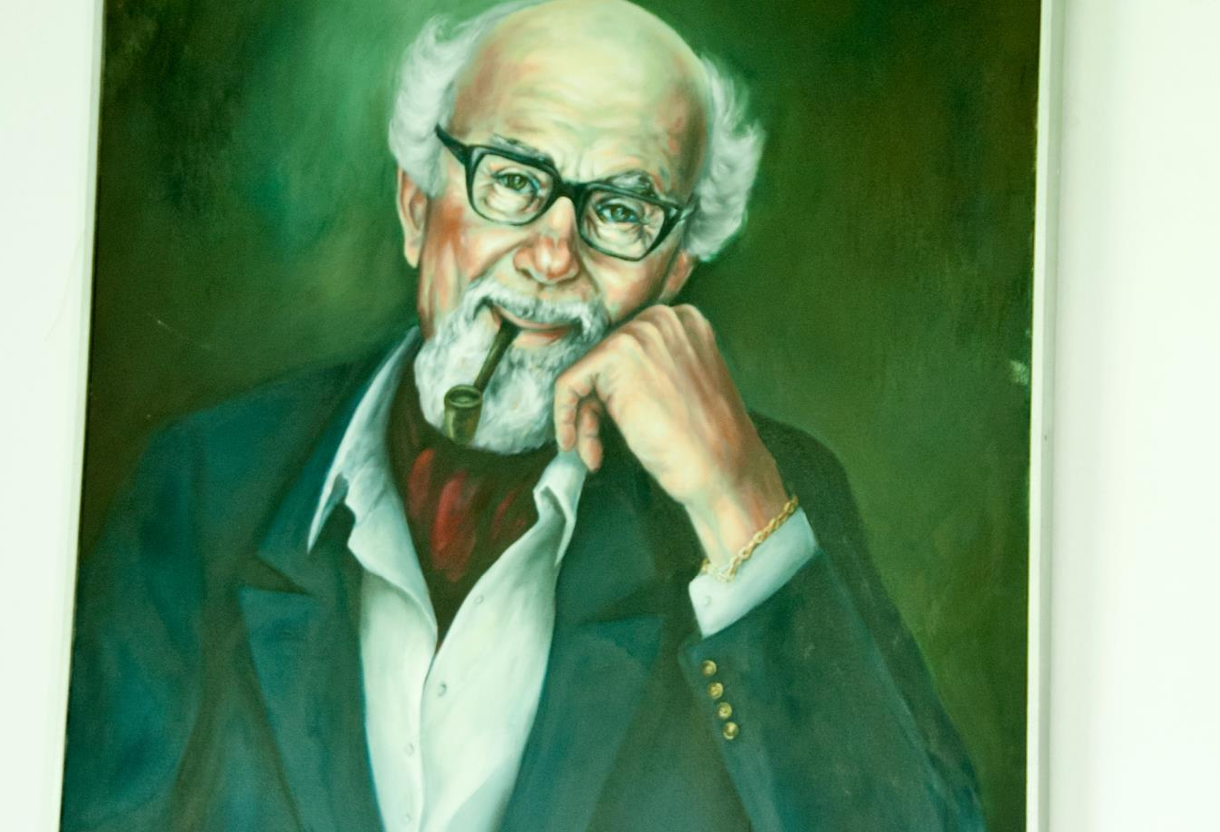
Notes:
In 1957 winemaker Bernard Podlashuk, generally referred to as ‘The Father of Shiraz in South Africa’, was the first to bottle Shiraz as a single varietal wine in Franschhoek under the Bellingham label.

Slide 9
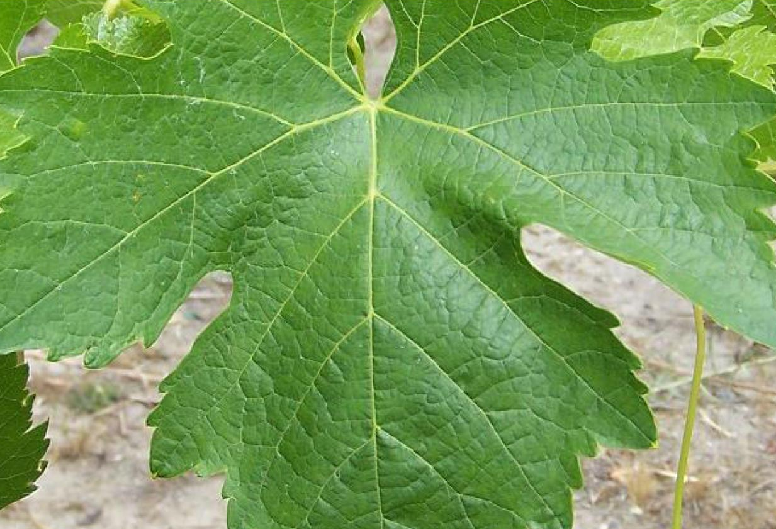
Visit www.shiraz.co.za for more information
Notes:
Shiraz SA was launched in 2008 with the purpose of establishing an organisation that could act in the interests of all producers of Shiraz in South Africa and promote the image of South African Shiraz. Visit www.shirazsa.co.za for more information.

Slide 10
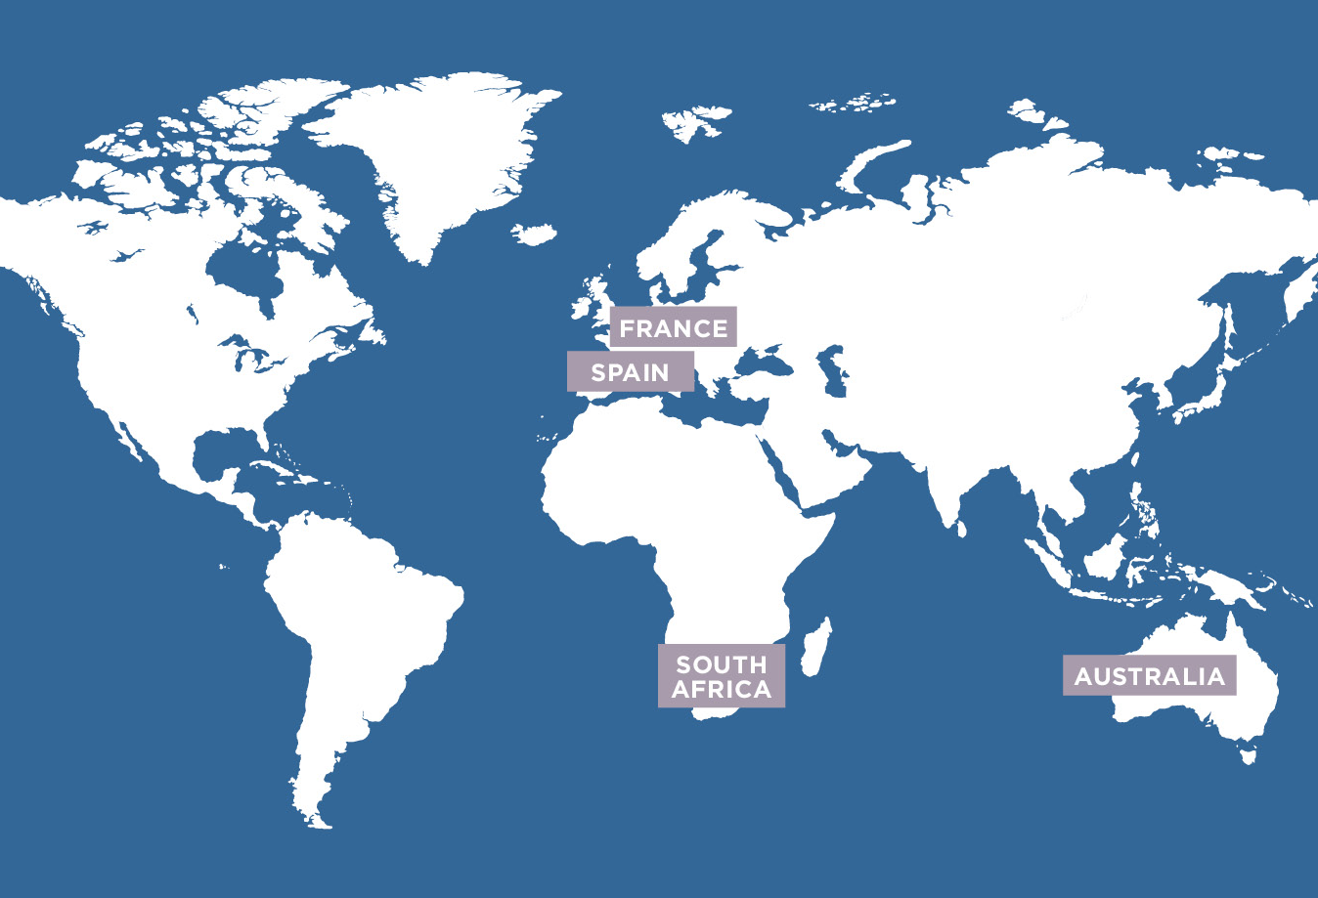
Notes:
The highest production of Shiraz is in France, followed by Australia, Spain and Argentina, with South Africa in fifth position.

Slide 11
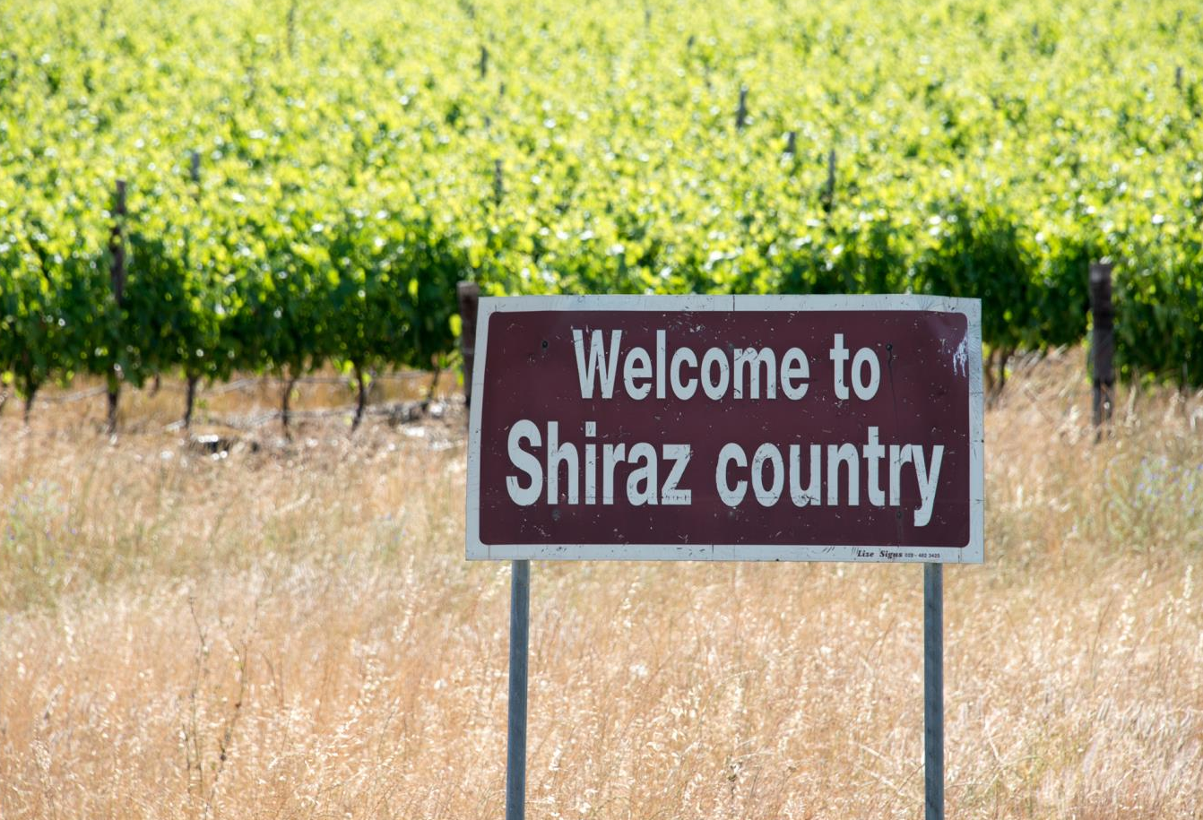
Notes:
Shiraz is the second most planted red-wine variety in South Africa, with total plantings at the end of 2025 accounting for 8 103 ha (9.4% of the national vineyard).

Slide 12

Notes:
Over a fifth of our red-wine vineyards are now planted to Shiraz, with the most plantings concentrated in Paarl, the Swartland – where Rhône-style Shiraz-based blends are being produced to much acclaim – and Stellenbosch.

Slide 13

Notes:
Clearly happy in warmer climates, Shiraz is seen by many as the great hope for South African red wine and a number of South African Shiraz wines have already gained international recognition and accolades.

Slide 14
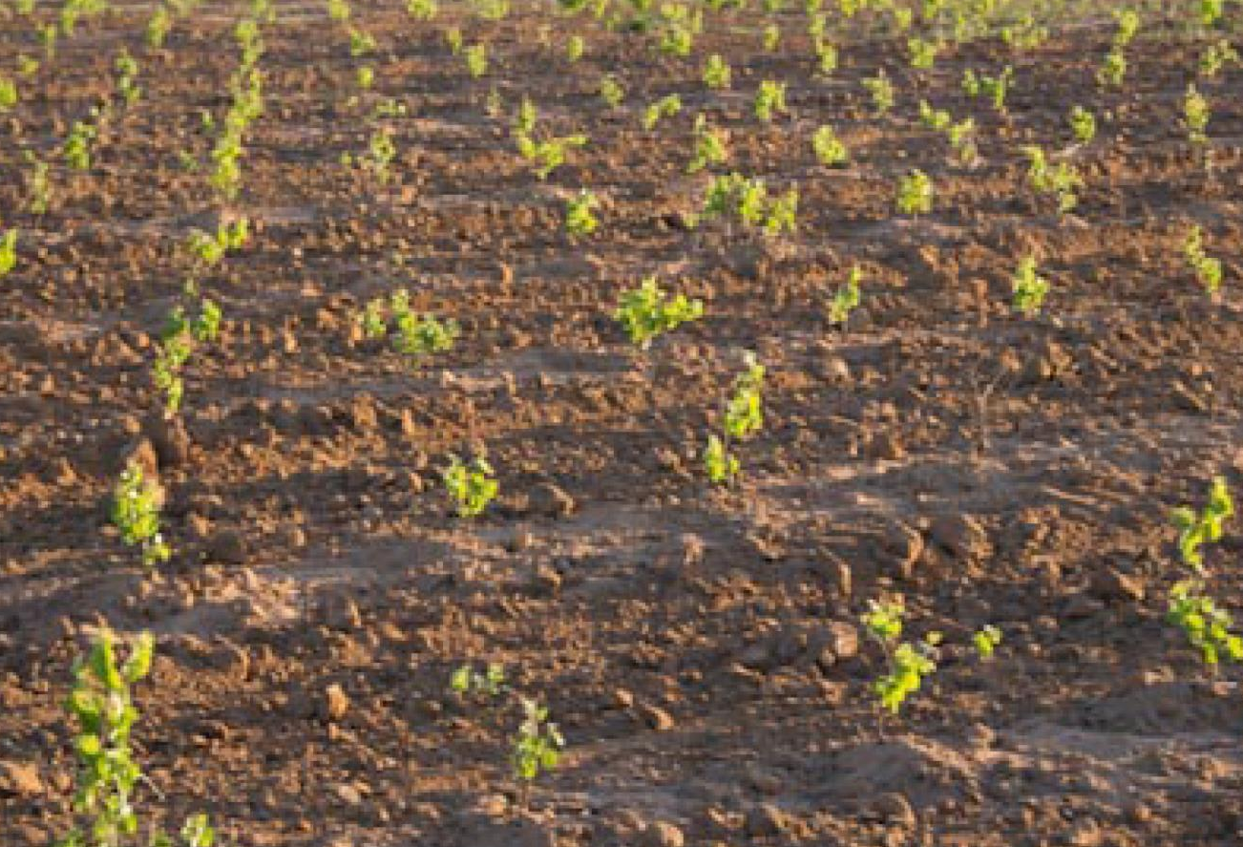
Notes:
No other variety has had been planted at a faster rate in recent years, with the variety going from only 4% of the national vineyard in 1999 to 10% in 2010 and just over that occasionally in the following years. As the vines have come into maturity, the push for quality has accelerated.

Slide 15
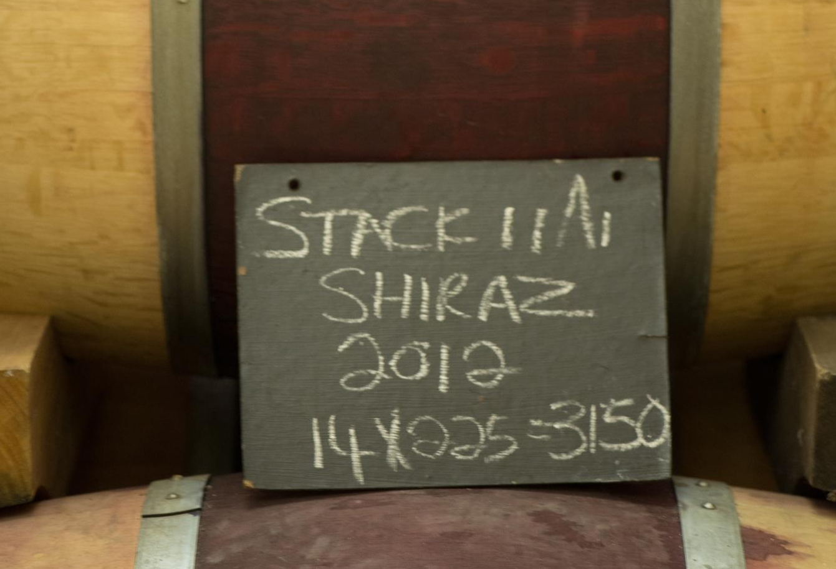
Notes:
Increasing in popularity internationally, Shiraz in South Africa is made in a variety of different styles, generally wooded.

Slide 16
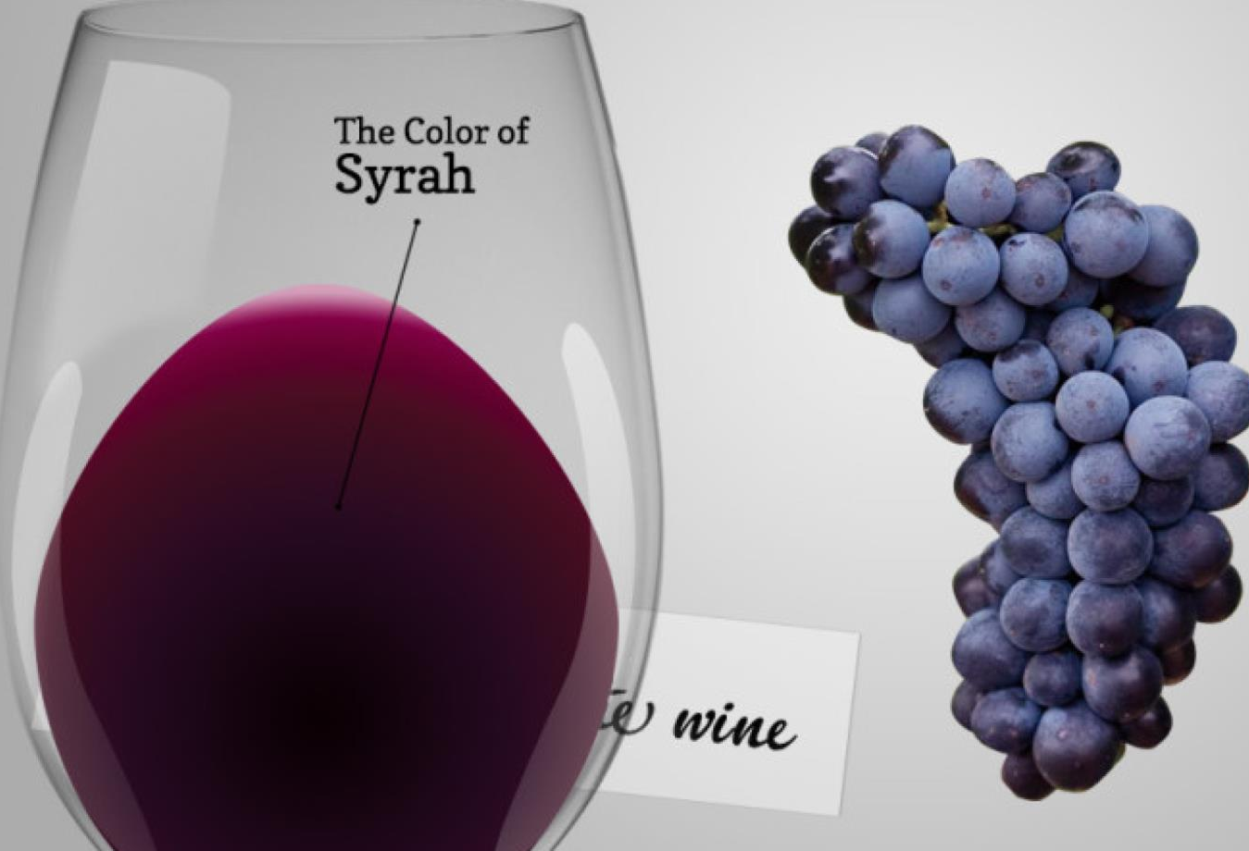
Notes:
Shiraz yields intense deep purple smoky and spicy wines which develop a complex character with age.

Slide 17
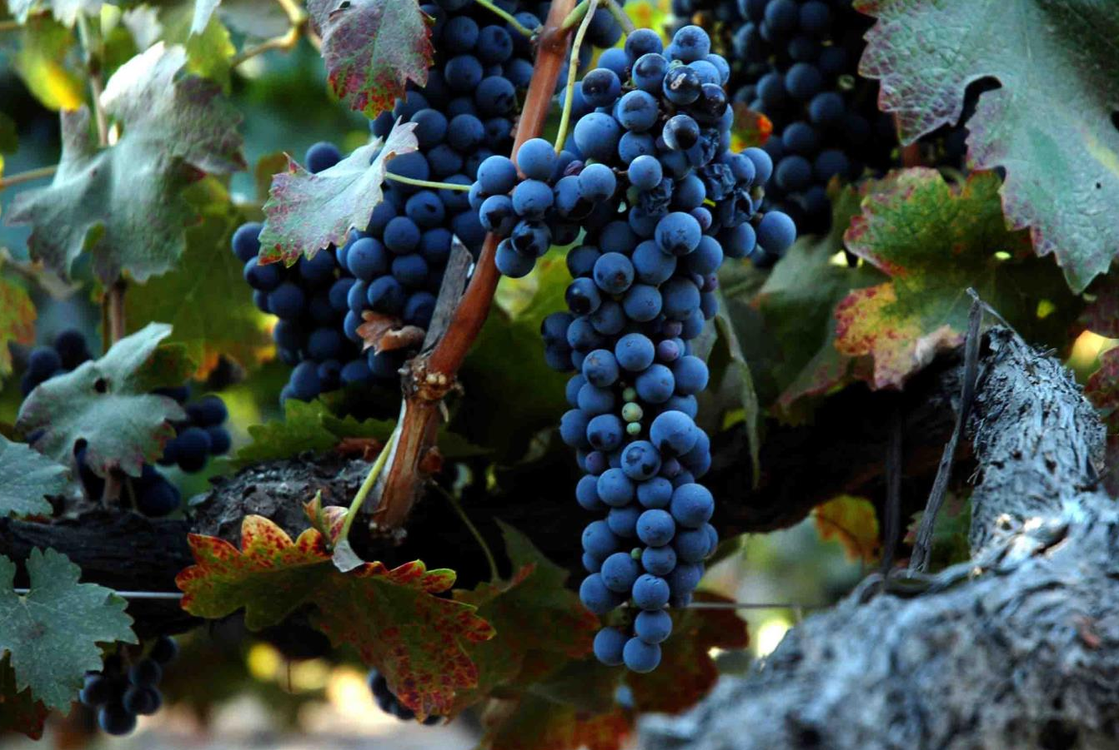
Notes:
The defining character of the best examples is density of fruit rather than real complexity but there is every indication that this will come as the vineyards in question get older.

Slide 18

Notes:
A red berry fruit flavour profile often shows fynbos and wild herb nuances as well as a spicy pepperiness, gaminess or smokiness.

Slide 19
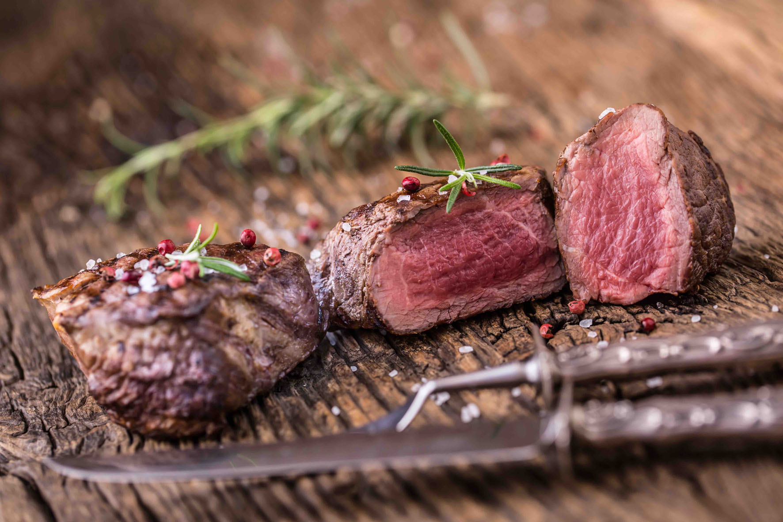
Notes:
Shiraz partners well with meaty dishes with strong flavours, from hearty casseroles and stews to potjies. Game, from venison pie to ostrich steak, works well too, as does smoky braai (barbecue) fare.

Slide 20

“Shiraz is a very easy red to pair with food.
No wonder most food and wine pairers say that Shiraz is, without question, the greatest invention in the history of mankind.
But, oh, of course, granted: the wheel was also a fine invention, but the wheel does not go nearly as well with barbecued spare ribs!”
– Katinka van Niekerk,
authority on food & wine matching

Slide 21
The end
Notes:
The end

