Slide 1
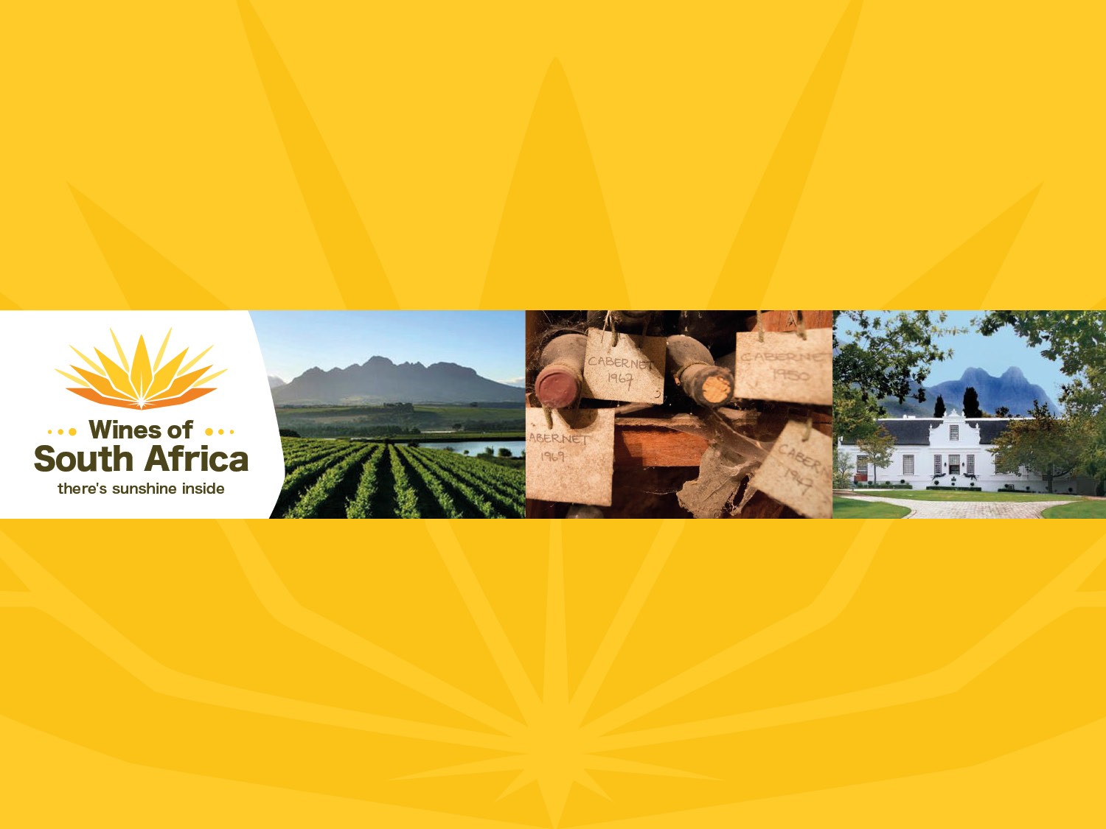
CAPE WINELANDS
STELLENBOSCH
Notes:
Wines of South Africa

Slide 2

Where is South Africa?

Slide 3

South Africa is the southernmost
country in Africa.

Slide 4

Our winelands are located at the
very tip of South Africa.

Slide 5

PRODUCTION AREAS: Districts of South Africa.

Slide 6

Wards of South Africa.

Slide 7

Coastal
Region: Coastal
District: Stellenbosch
Wards:
Banghoek
Bottelary
Devon Valley
Jonkershoek Valley
Papegaaiberg
Polkadraai Hills
Simonsberg-Stellenbosch
Vlottenburg

Slide 8
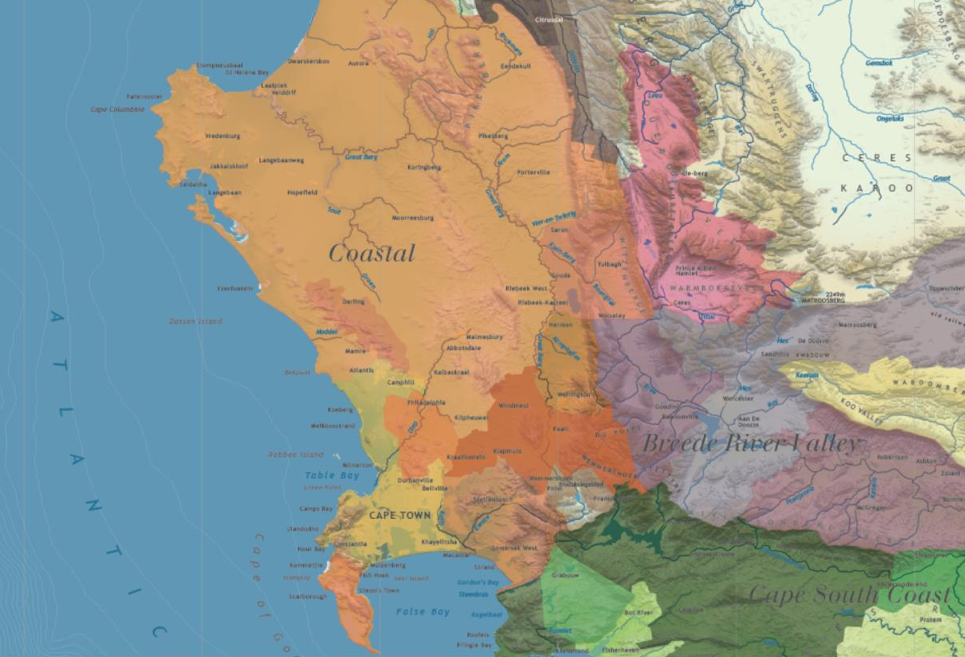

Slide 9
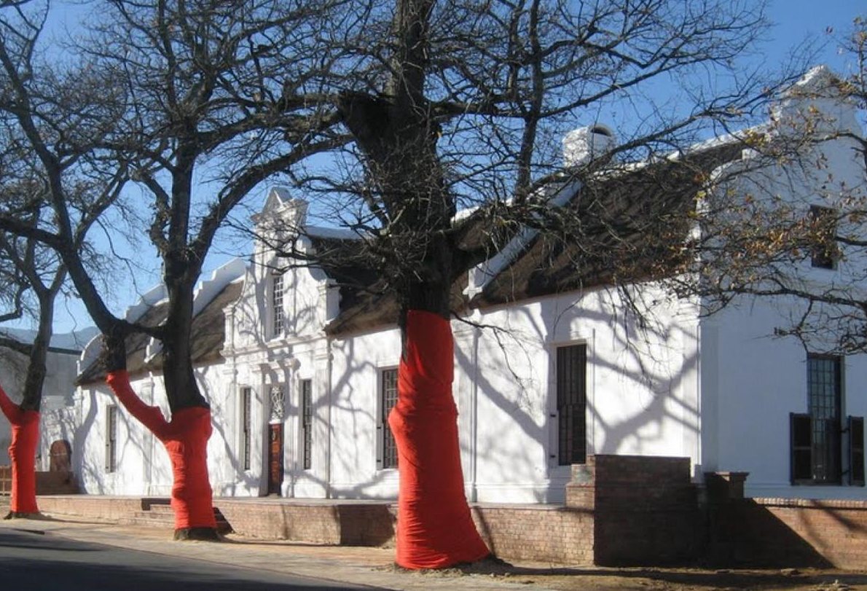
The historical town of Stellenbosch, the 'town of oaks, boasts a winemaking tradition that stretches back to the mid-17th century.

Slide 10
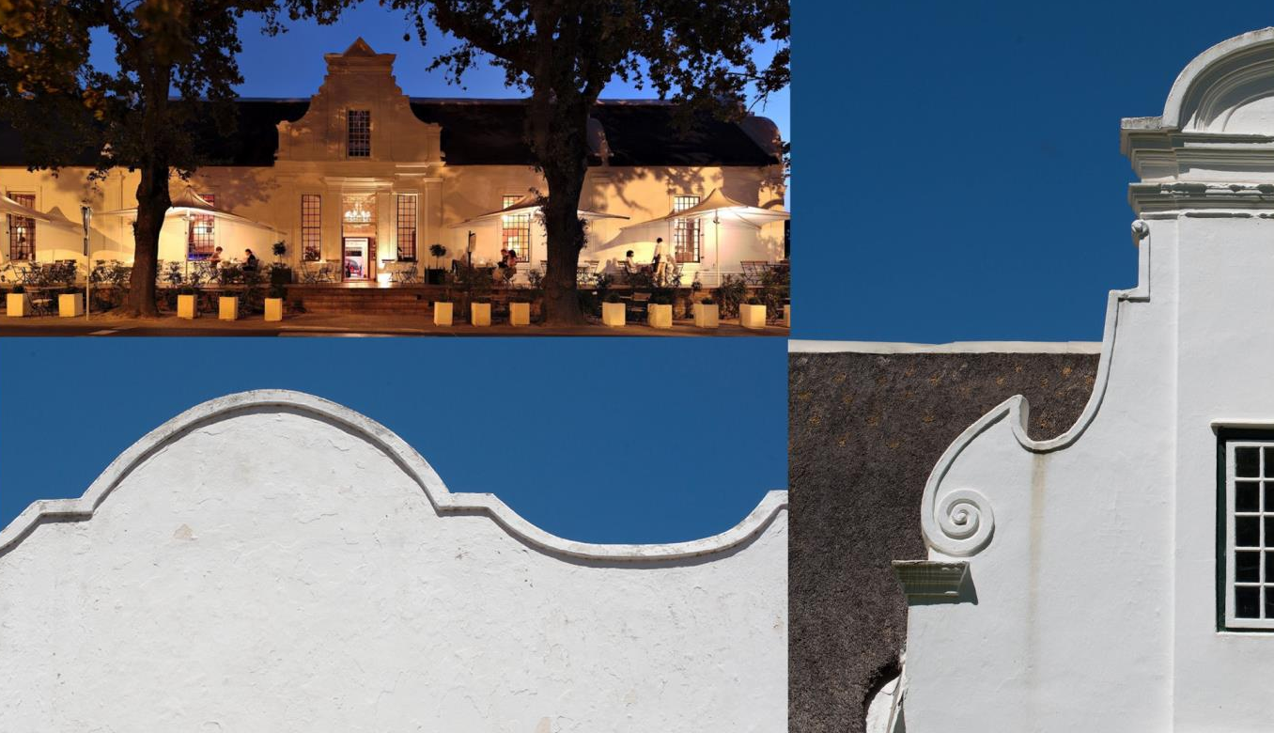
The town and surrounding farms feature some of the finest examples of Cape Dutch architecture in the winelands.

Slide 11
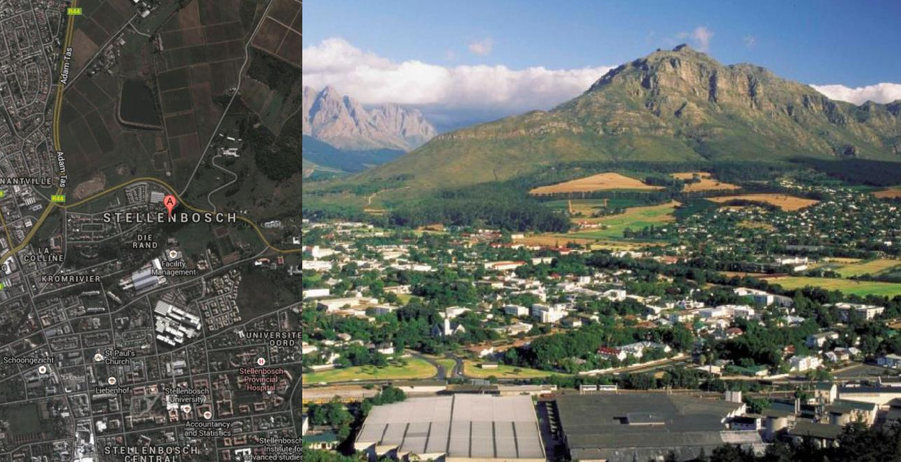
Stellenbosch is the business hub of the South African wine industry.

Slide 12
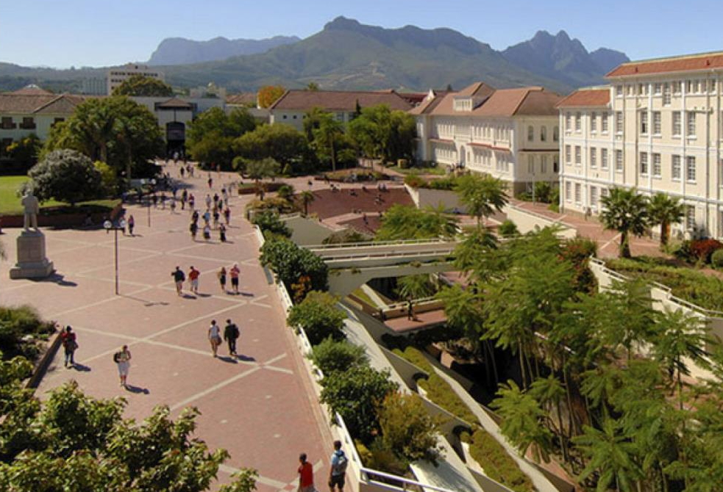
Stellenbosch is also the educational and research centre of the winelands.

Slide 13
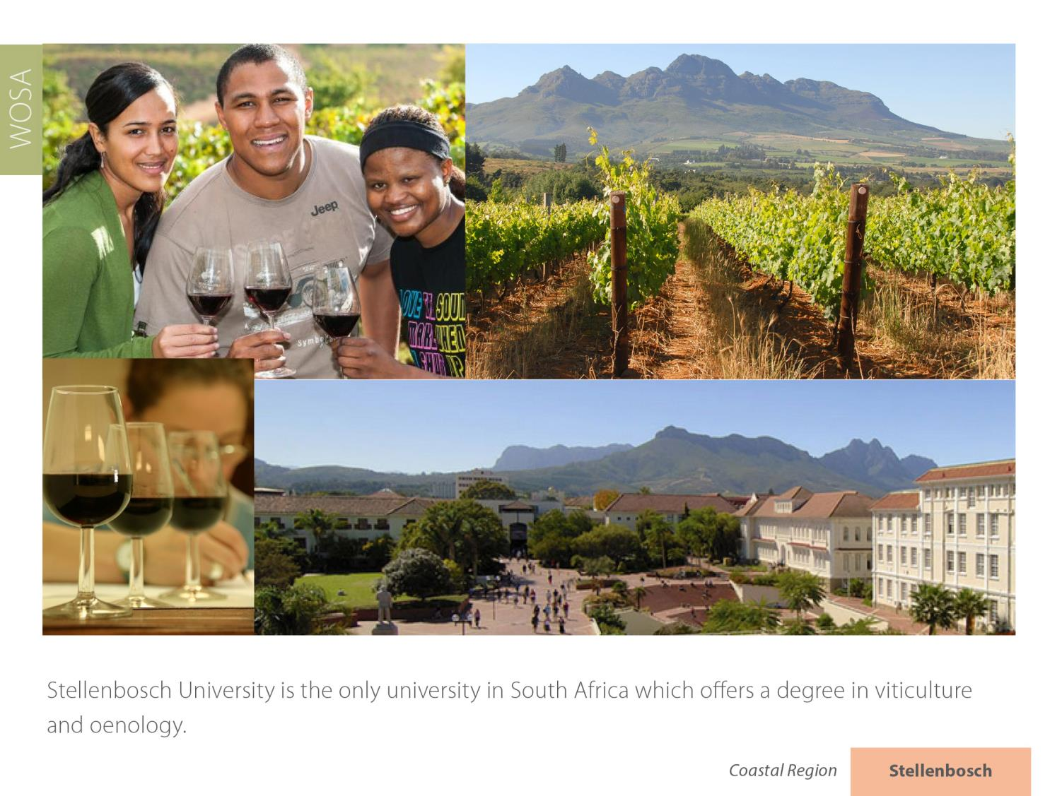
Stellenbosch University is the only university in South Africa which offers a degree in viticulture and oenology.

Slide 14
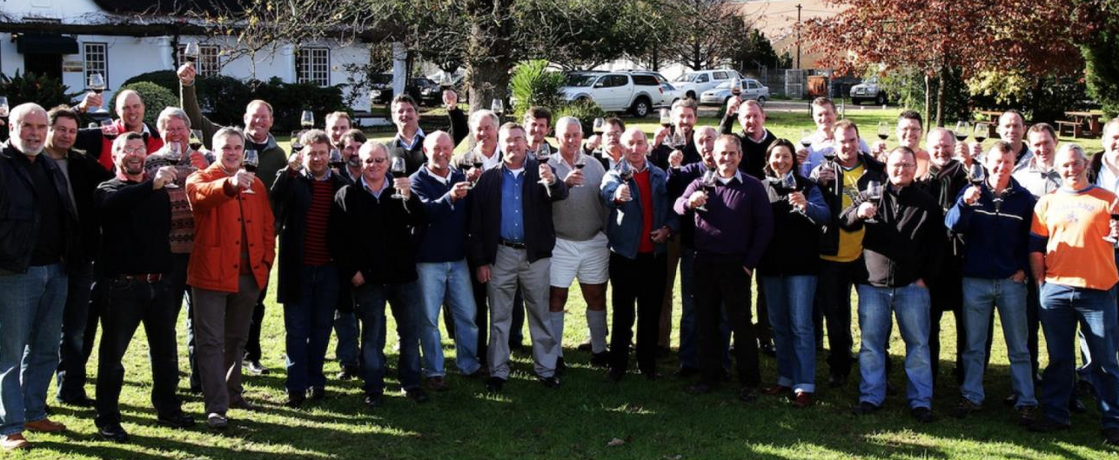
The university has many of the country's most successful winemakers as alumni.

Slide 15
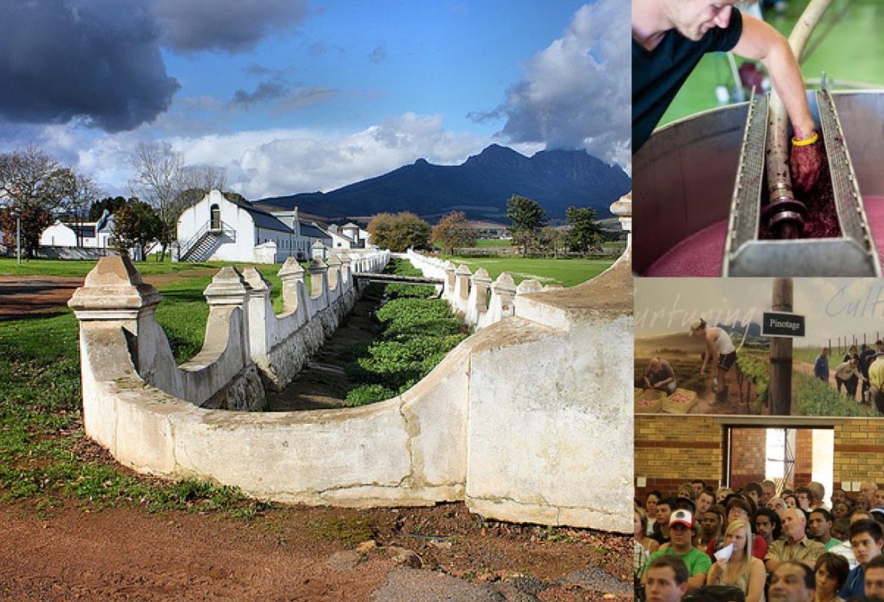
The Elsenburg School of Agriculture is also near Stellenbosch.

Slide 16

The ARC Infruitec-Nietvoorbij Institute for Viticulture and Oenology in Stellenbosch has one of the most modern experimental wineries in the world.

Slide 17
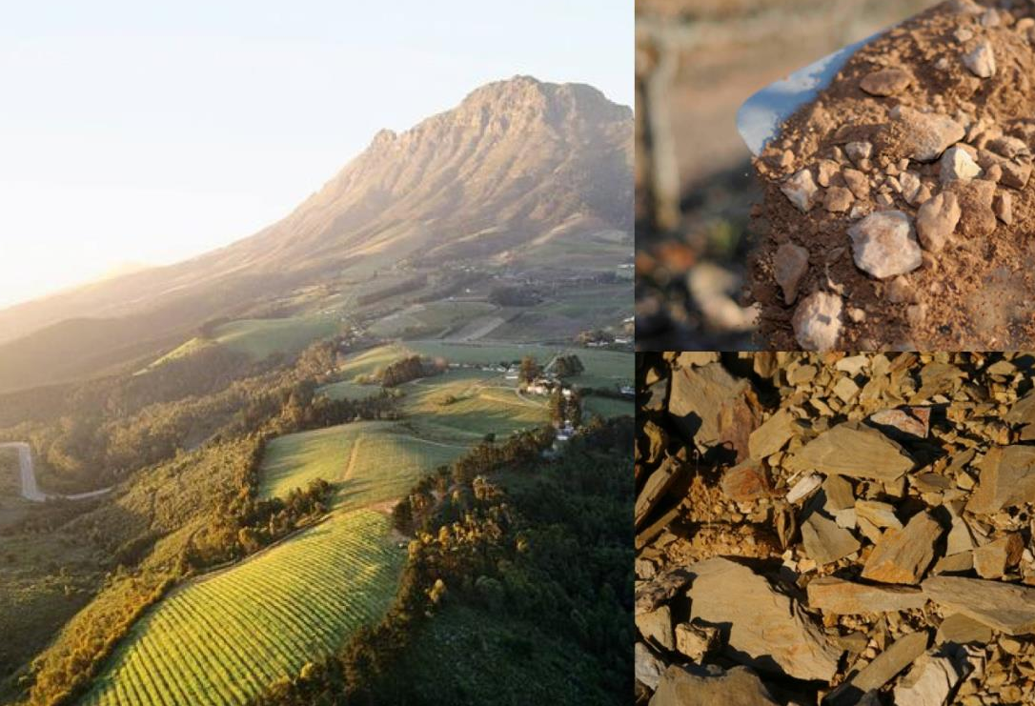
South Africa has become a New World leader in terroir research, the basis of a multi-disciplinary programme carried out by the institute and the university.

Slide 18
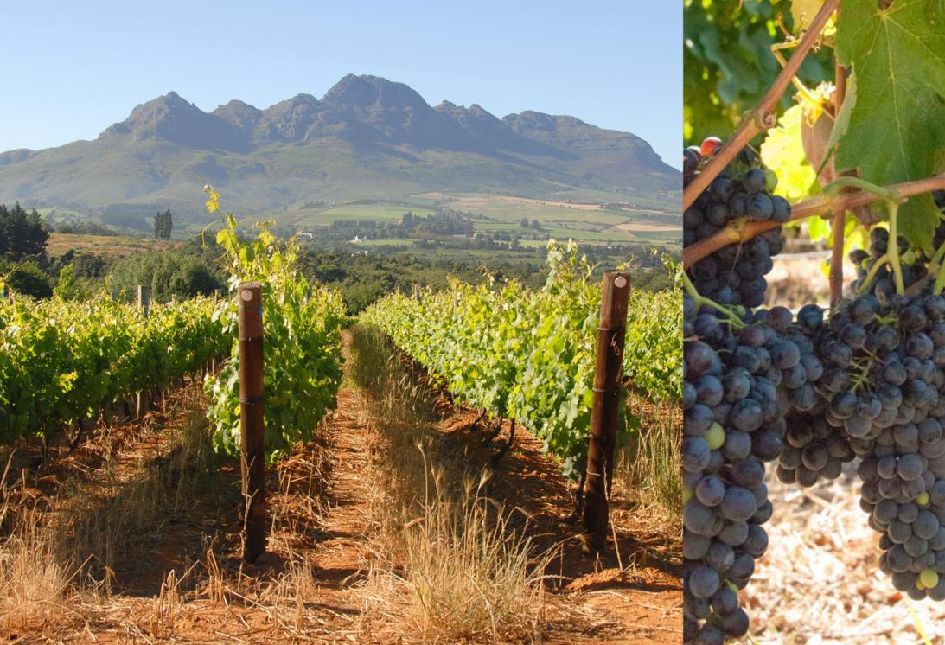
The intensively farmed Stellenbosch district is a sought-after address in terms of quality wines.

Slide 19
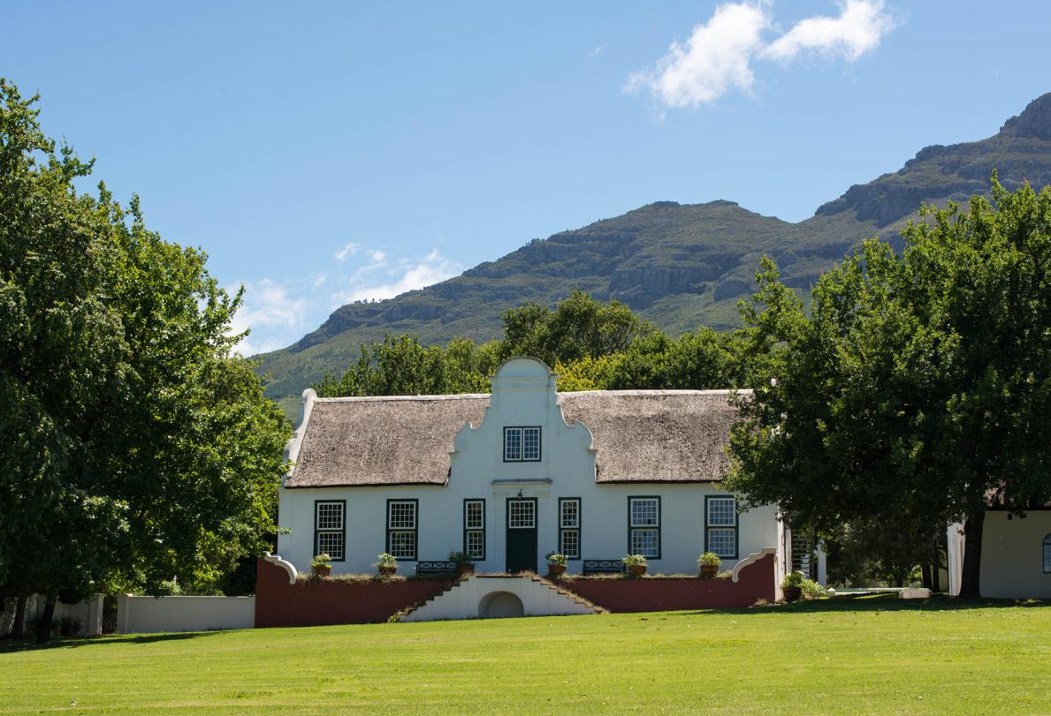
The rapidly increasing number of wine estates and producers includes some of the most famous names in Cape wine.

Slide 20
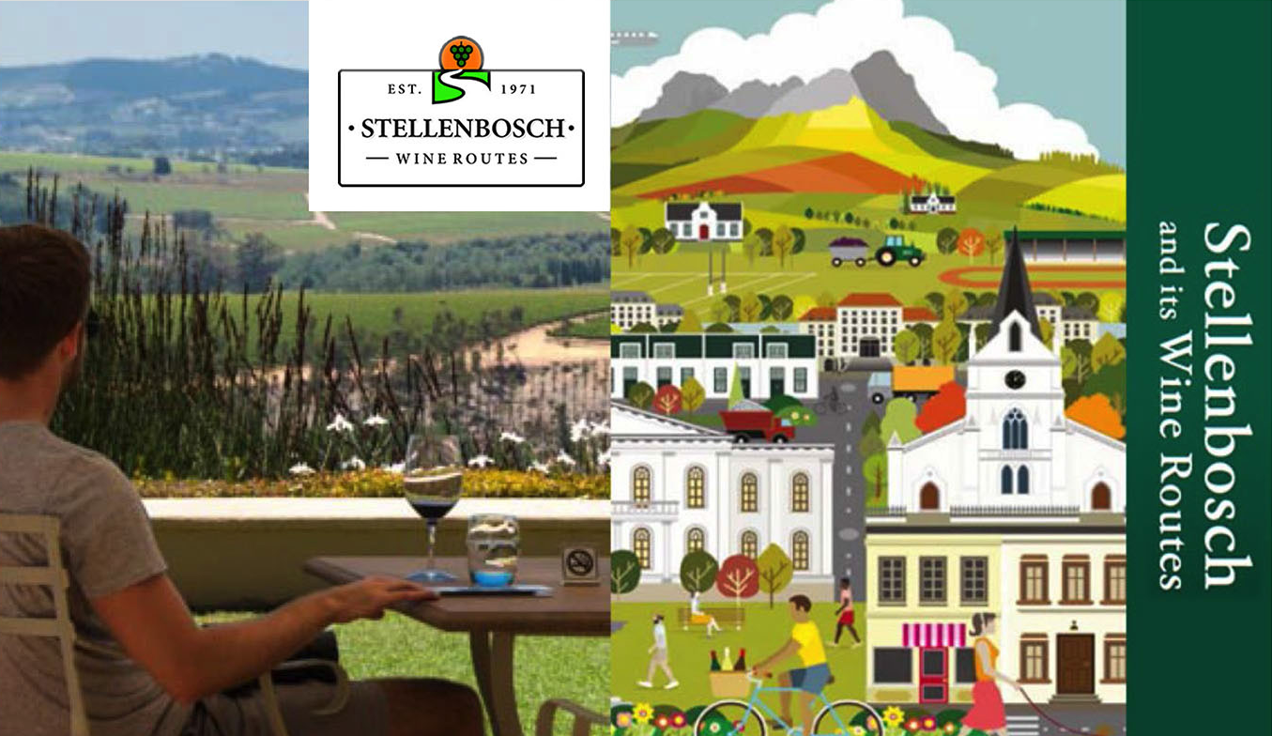
The Stellenbosch Wine Routes is one of the biggest tourist attractions in the Western Cape.

Slide 21
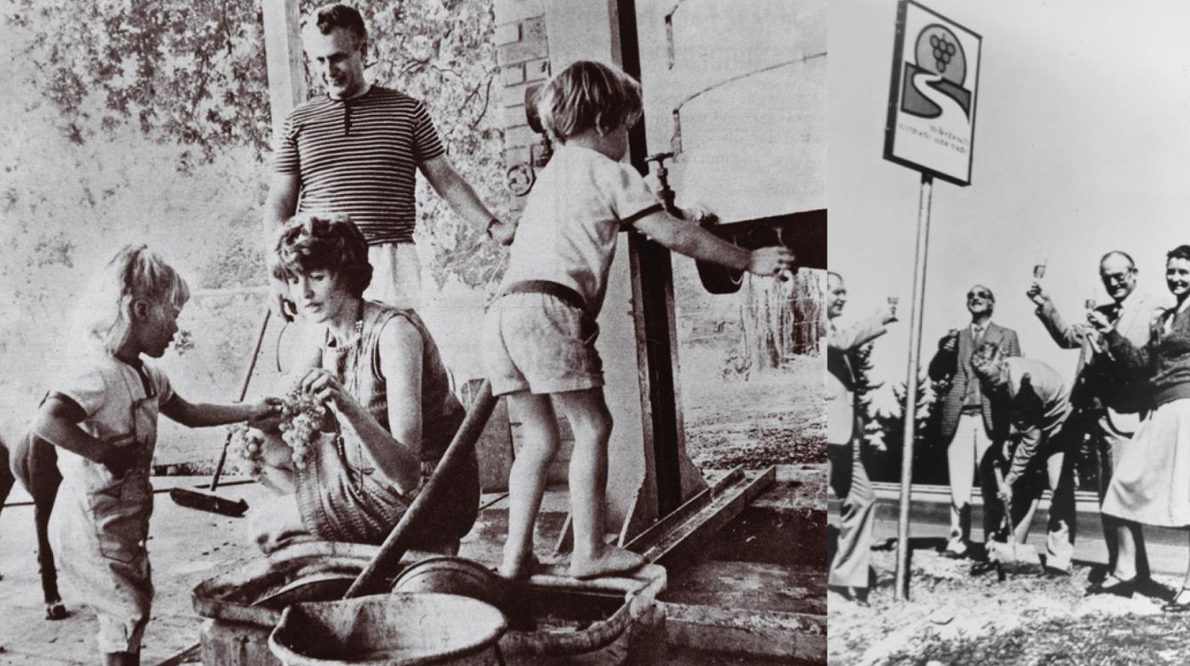
The original Stellenbosch Wine Route was founded in 1971 and is the oldest in the country.

Slide 22
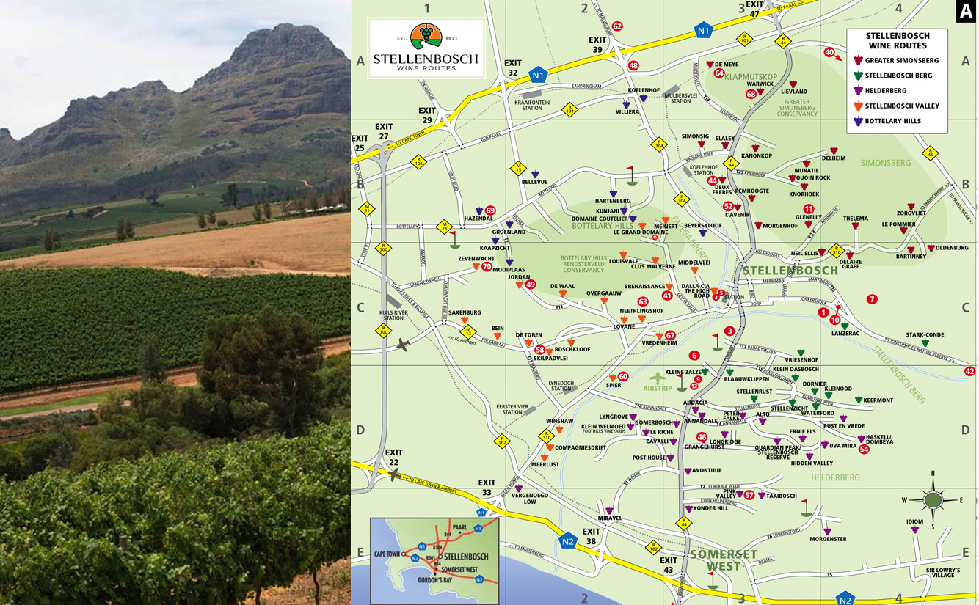
Today the Stellenbosch Wine Routes represents more than 200 wine and grape producers within the boundaries of the Stellenbosch Wine of Origin classification.

Slide 23
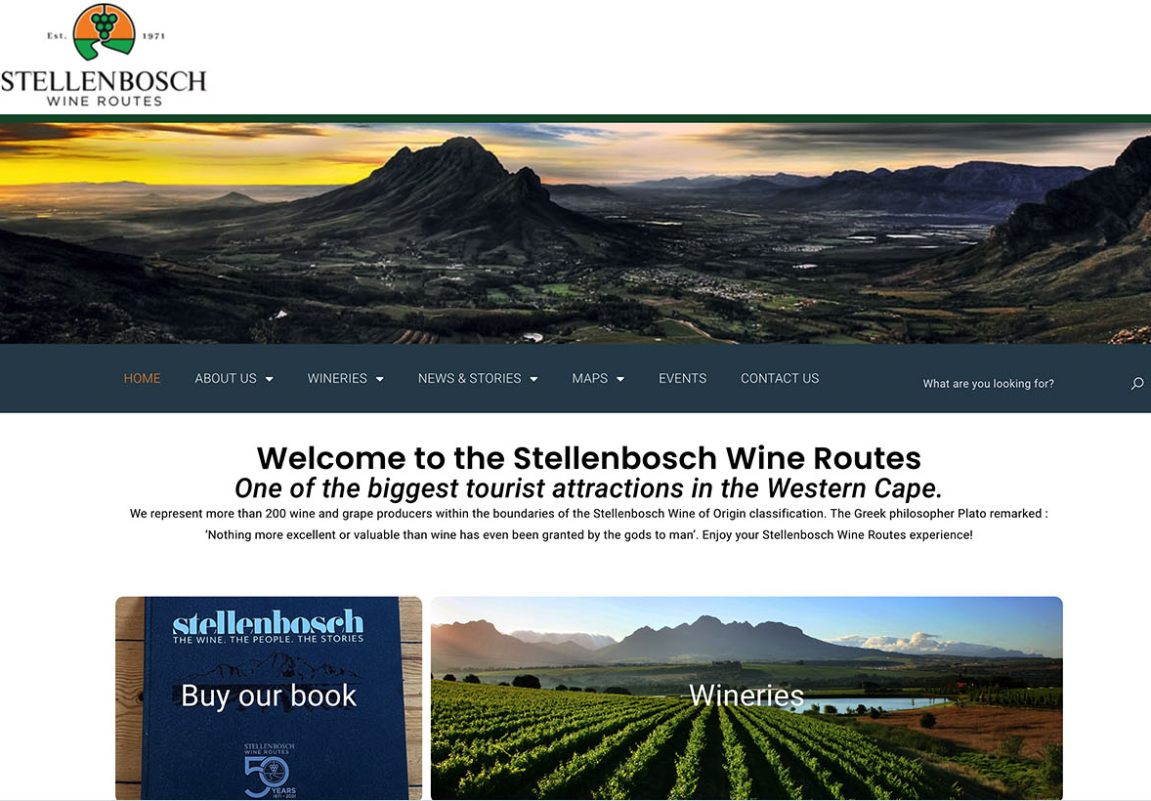
It is divided into five manageable sub-routes for tourists: Bottelary Hills, Greater Simonsberg, Helderberg, Stellenbosch Berg and Stellenbosch Valley.

Slide 24
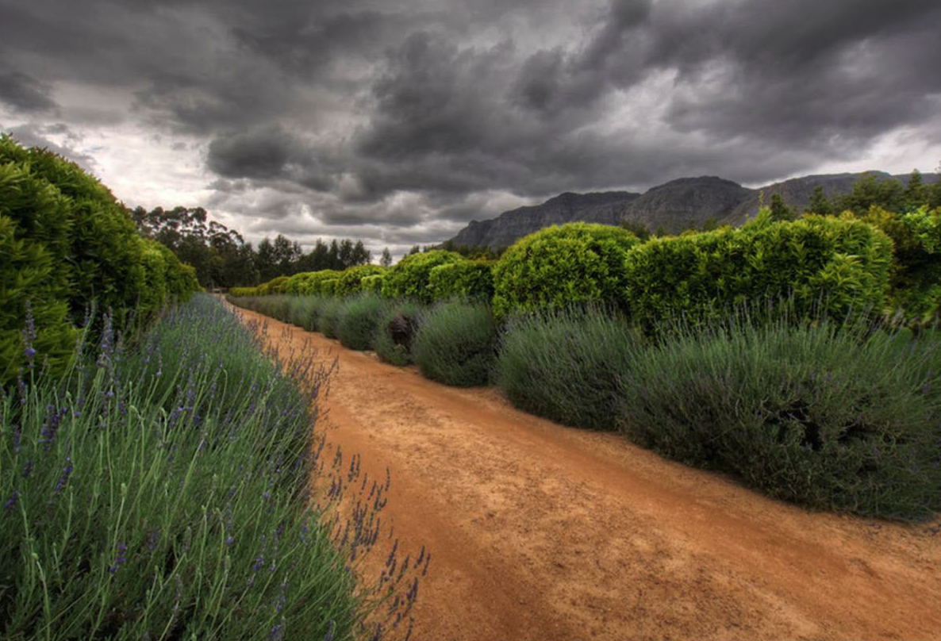
The average rainfall in the district varies
from 600–800 mm a year.

Slide 25
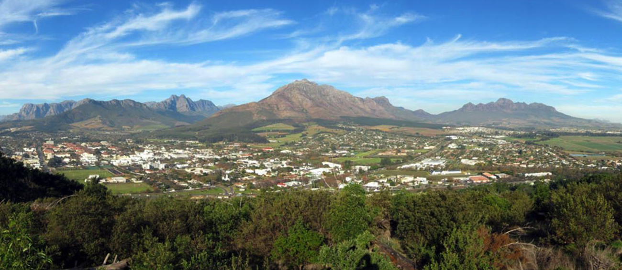
The mean February temperature is 21.5⁰C (Nietvoorbij Weather Station).

Slide 26
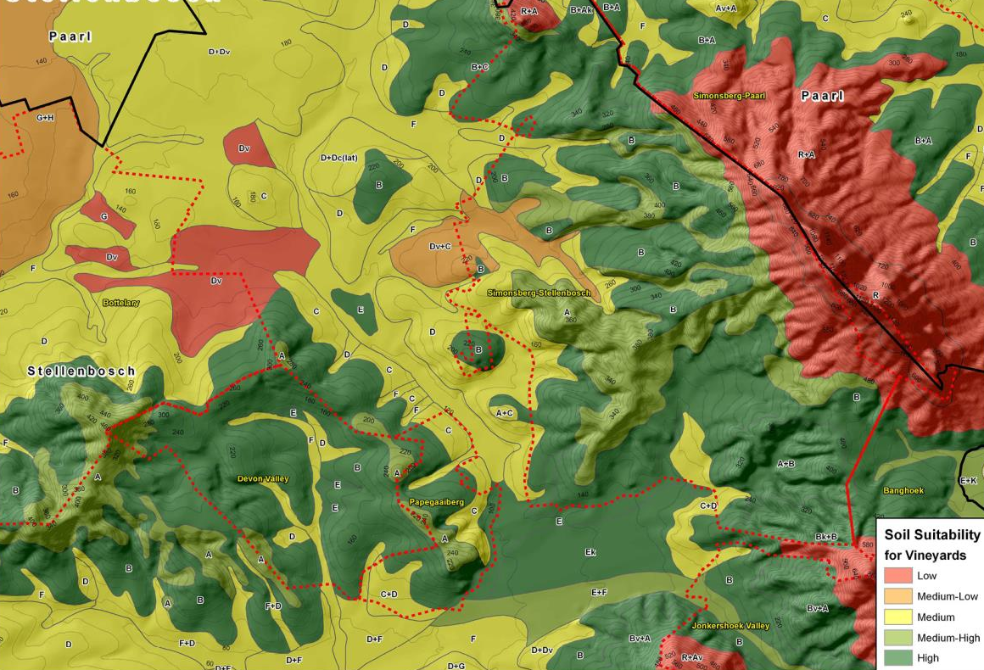
The sands and alluvial soils of the valley floors give way to predominantly granitic and shale yellow and reddish Oakleaf and Tukulu soils on the slopes.

Slide 27
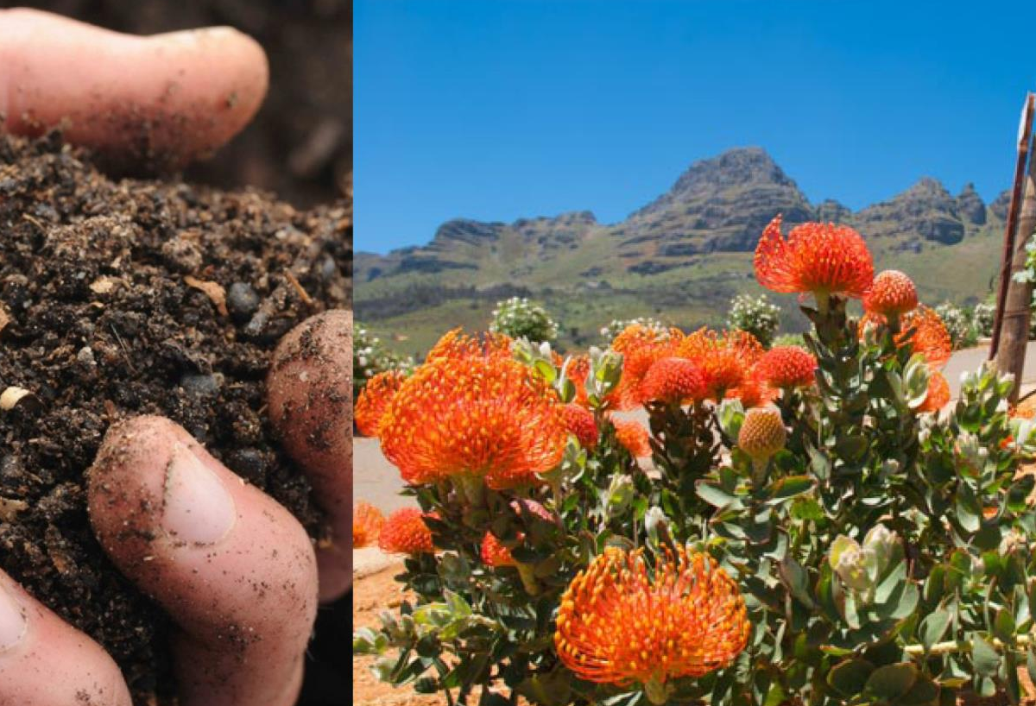
The mountainous terrain, good rainfall, deep well-drained soils and diversity of terroirs are key contributors to making this a premier viticultural area.

Slide 28
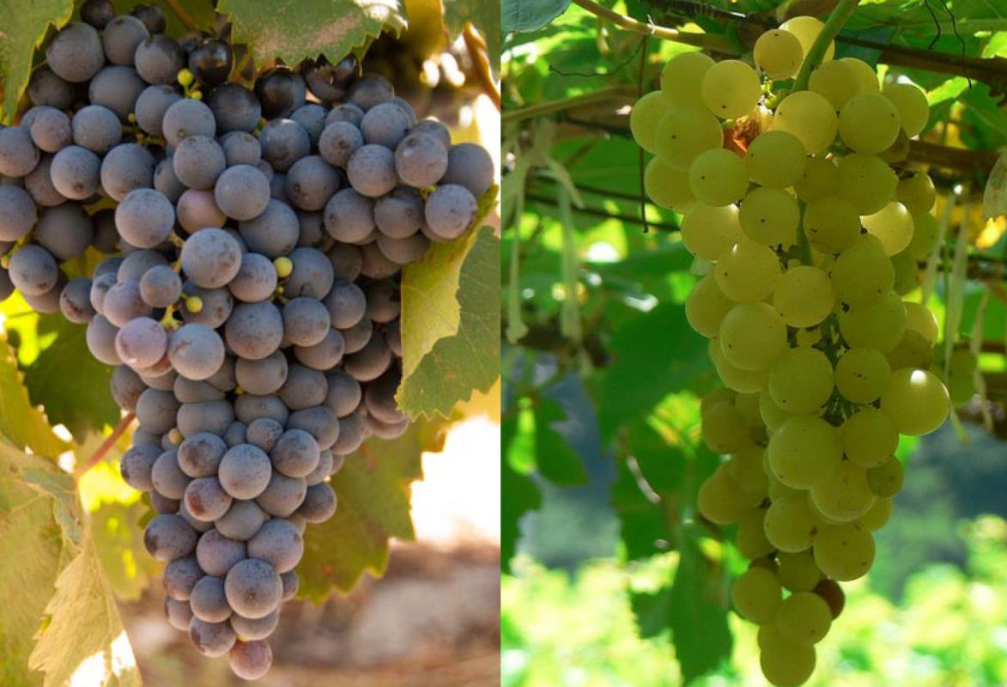
Conditions are particularly well suited to many of the noble grapevine varieties.

Slide 29
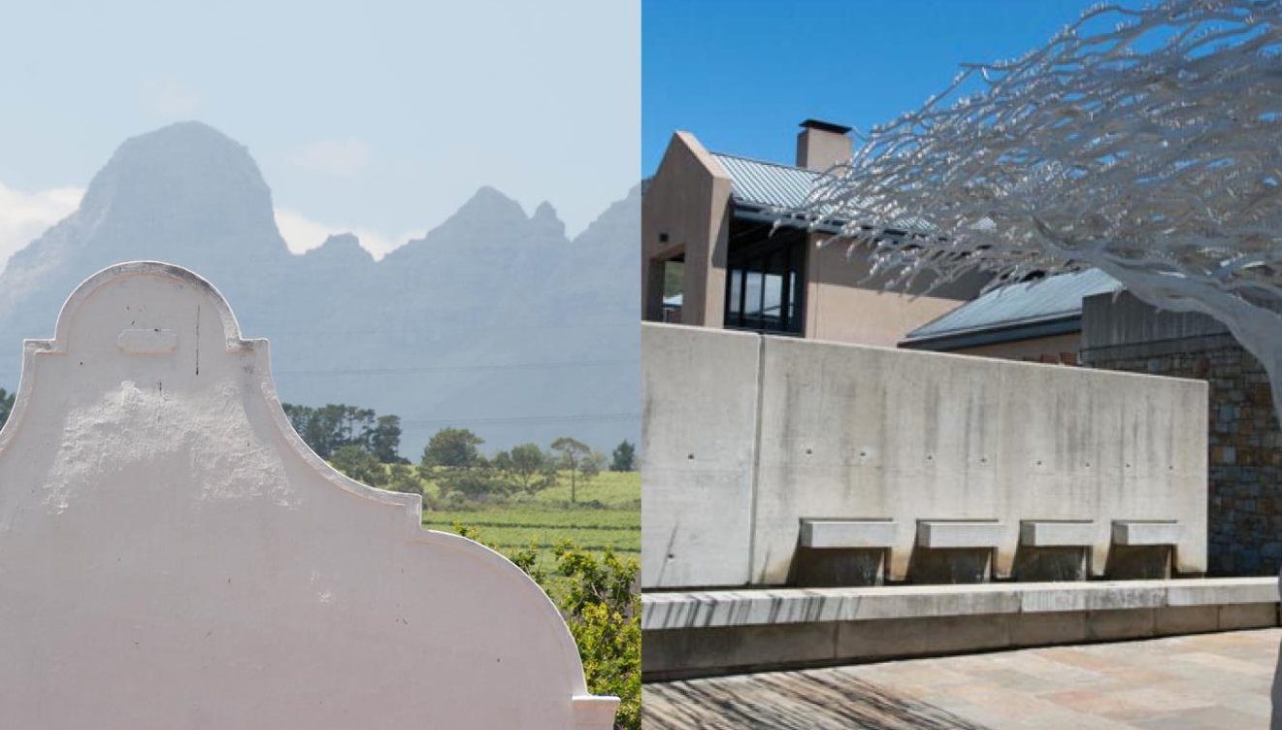
Stellenbosch, with its mix of historic estates and contemporary wineries, produces excellent examples of almost all the noble wine grape varieties.

Slide 30
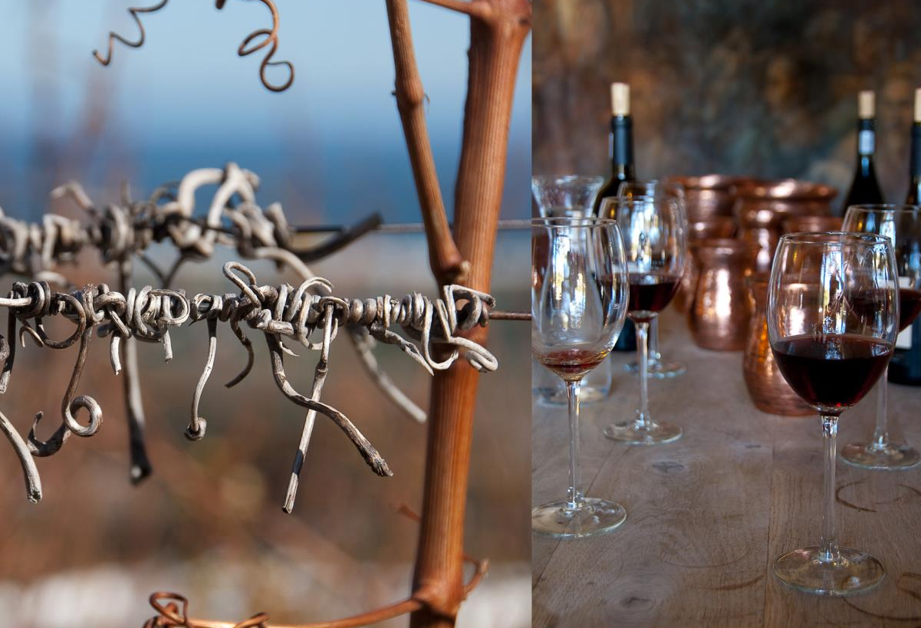
Stellenbosch is known for its Cabernet Sauvignon and its blended reds.

Slide 31
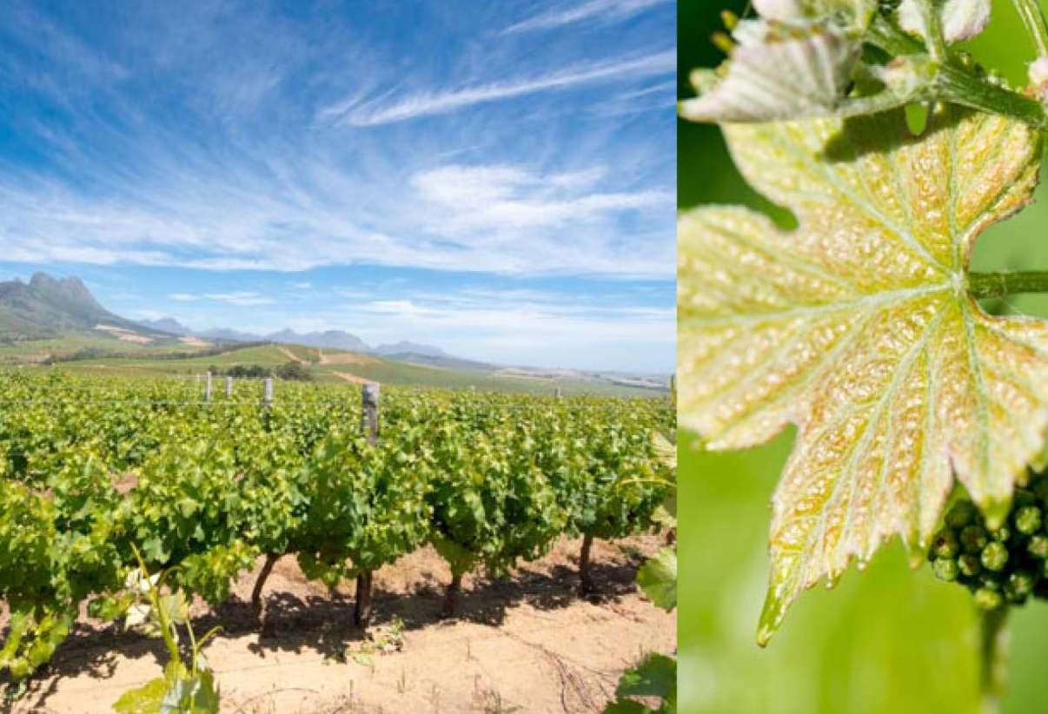
Stellenbosch has the fourth most vineyard plantings in the winelands.

Slide 32
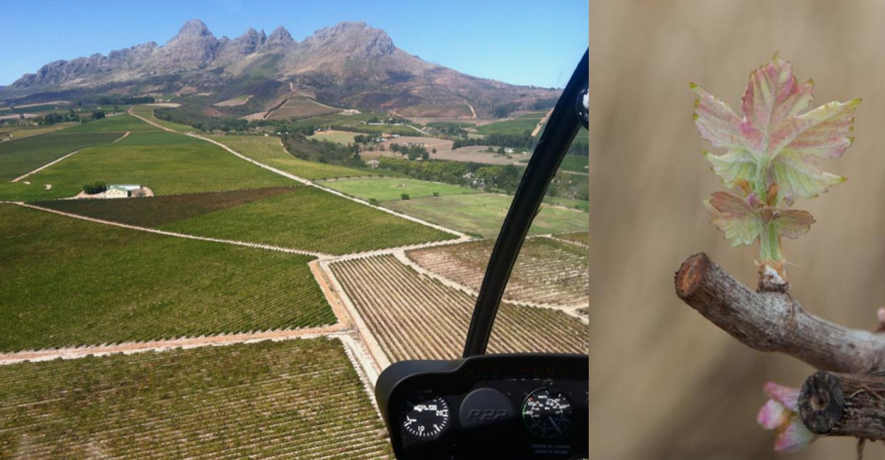
The district has been divided up into several smaller viticultural pockets.

Slide 33
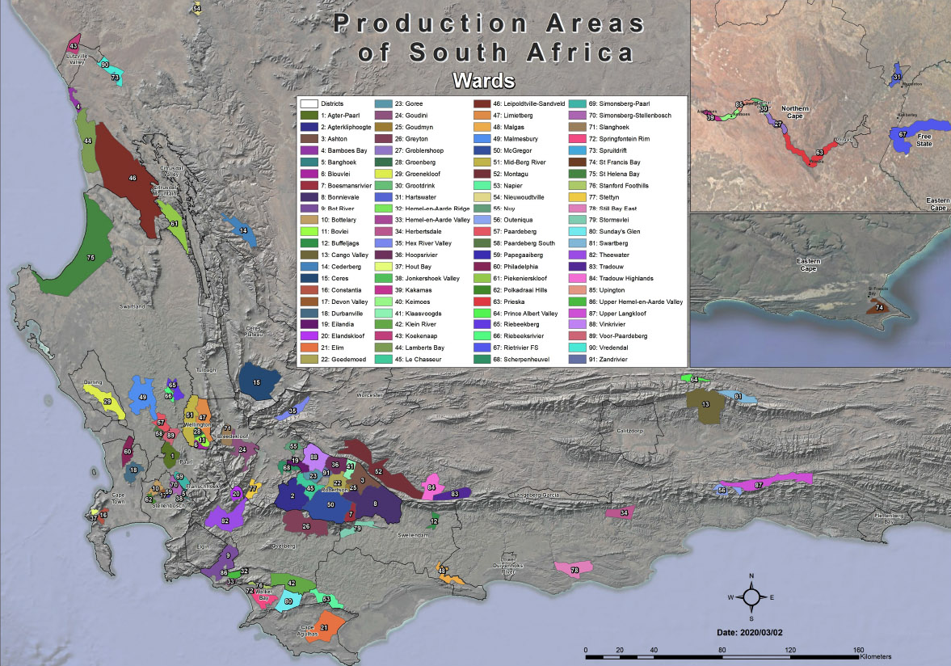
There are eight wards: Banghoek, Bottelary, Devon Valley, Jonkershoek Valley, Papegaaiberg, Polkadraai Hills, Simonsberg-Stellenbosch and Vlottenburg.

Slide 34
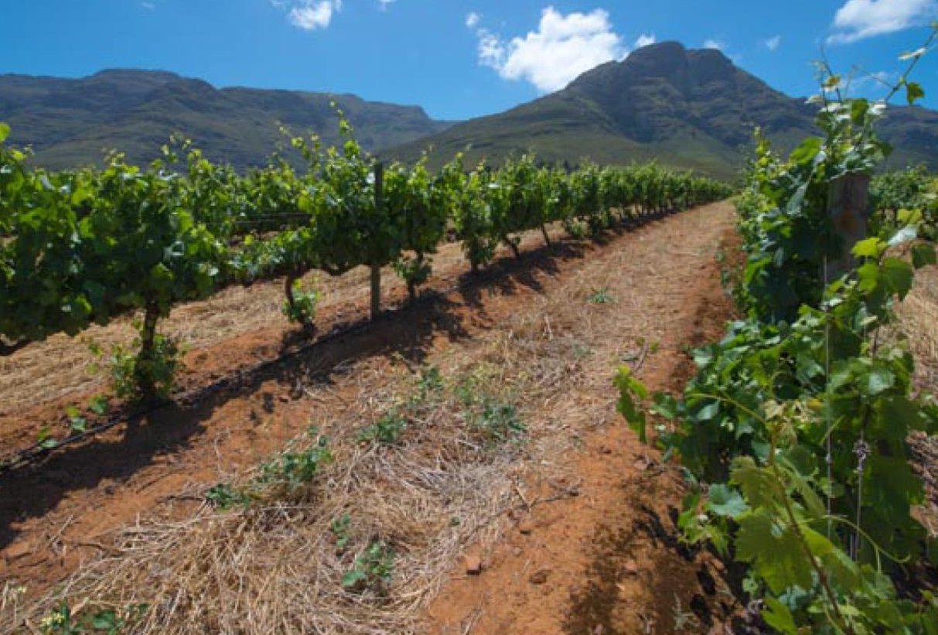
These viticultural zones are characterised by yellow-brown to reddish brown, deeply weathered mountain foothill soils with good drainage and water-holding properties, typically situated at altitudes of 150-400 m.

Slide 35
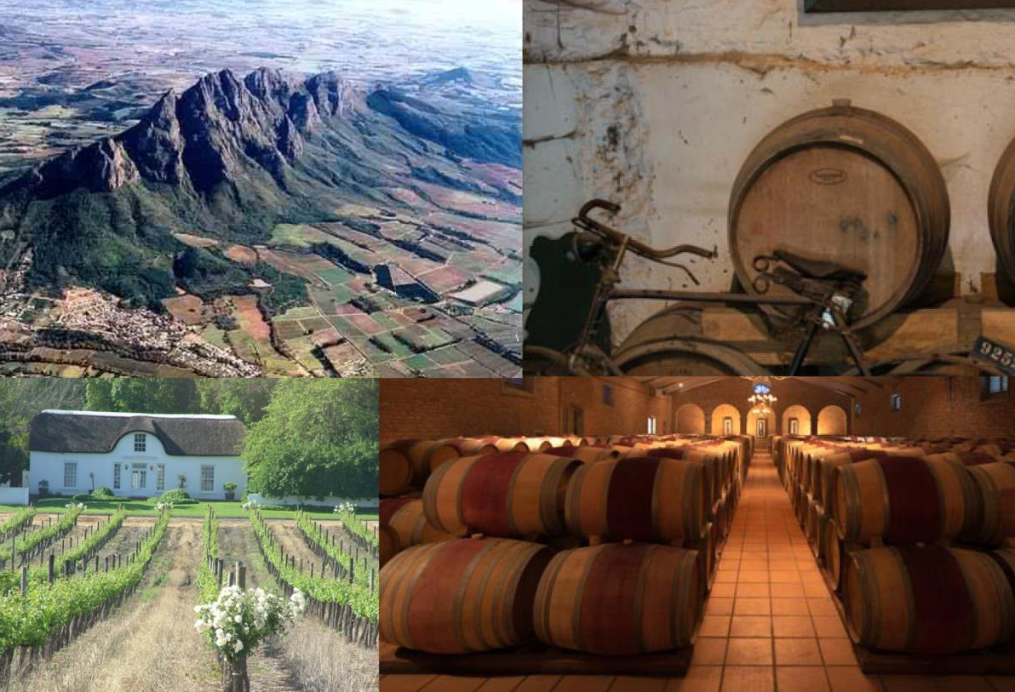
The Simonsberg-Stellenbosch ward encompasses several well-known estates and private cellars.

Slide 36
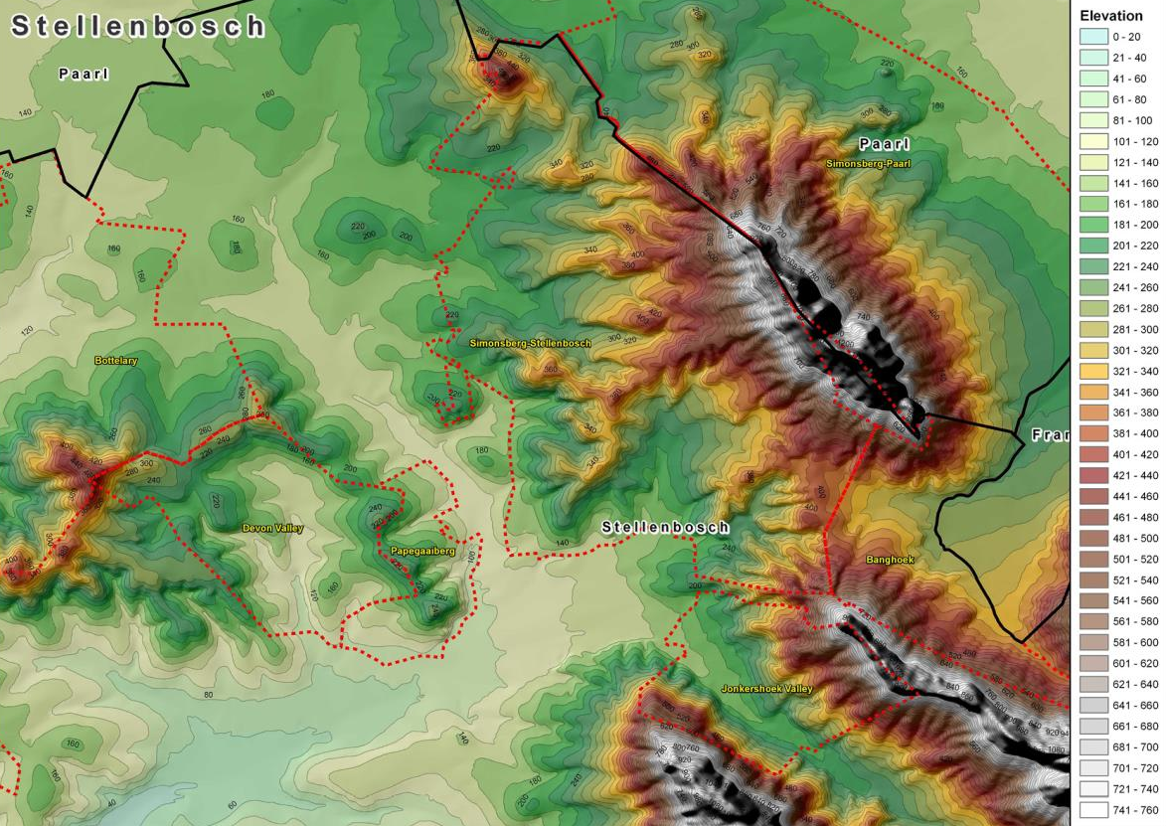
This ward has predominantly south-westerly aspects and, because of altitudes commonly higher than 200 m, it is generally open to the cool south-westerly summer breezes originating from False Bay, some 25 km away.

Slide 37
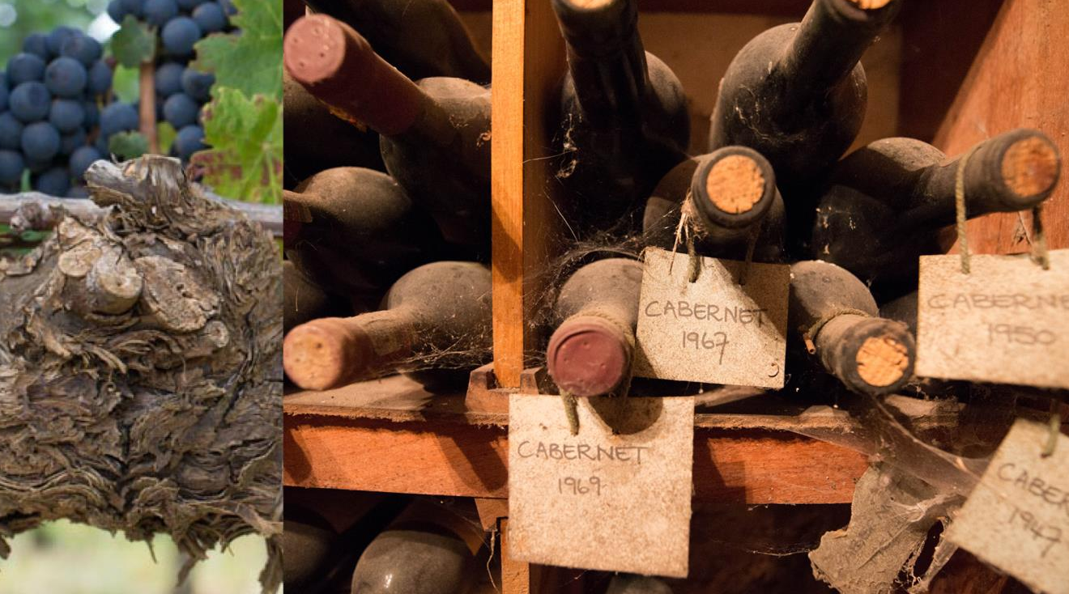
The wines from this ward are mainly red, made from Cabernet Sauvignon, Merlot and Shiraz.

Slide 38
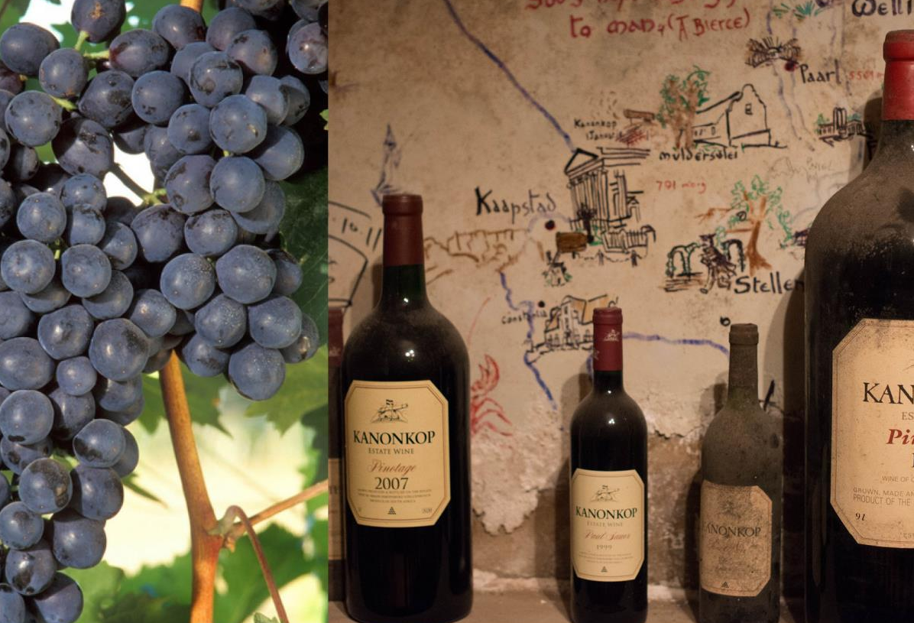
Wines made from the locally bred Pinotage variety also regularly reap awards locally and internationally.

Slide 39
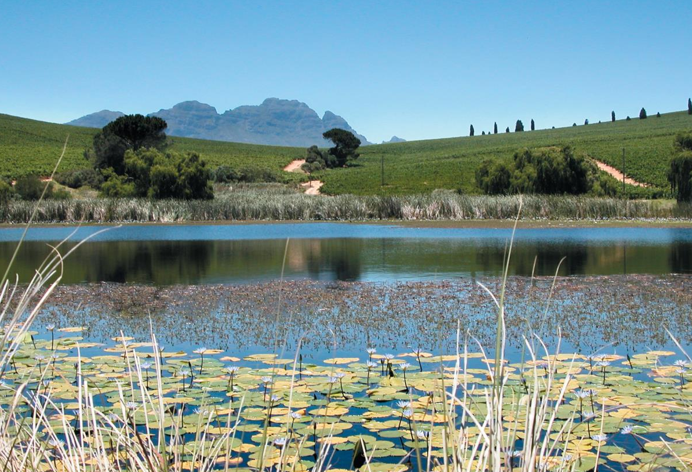
Four of the seven wards demarcated in the district are situated in the hills of Bottelary: Papegaaiberg, Devon Valley, Bottelary and Polkadraai Hills.

Slide 40
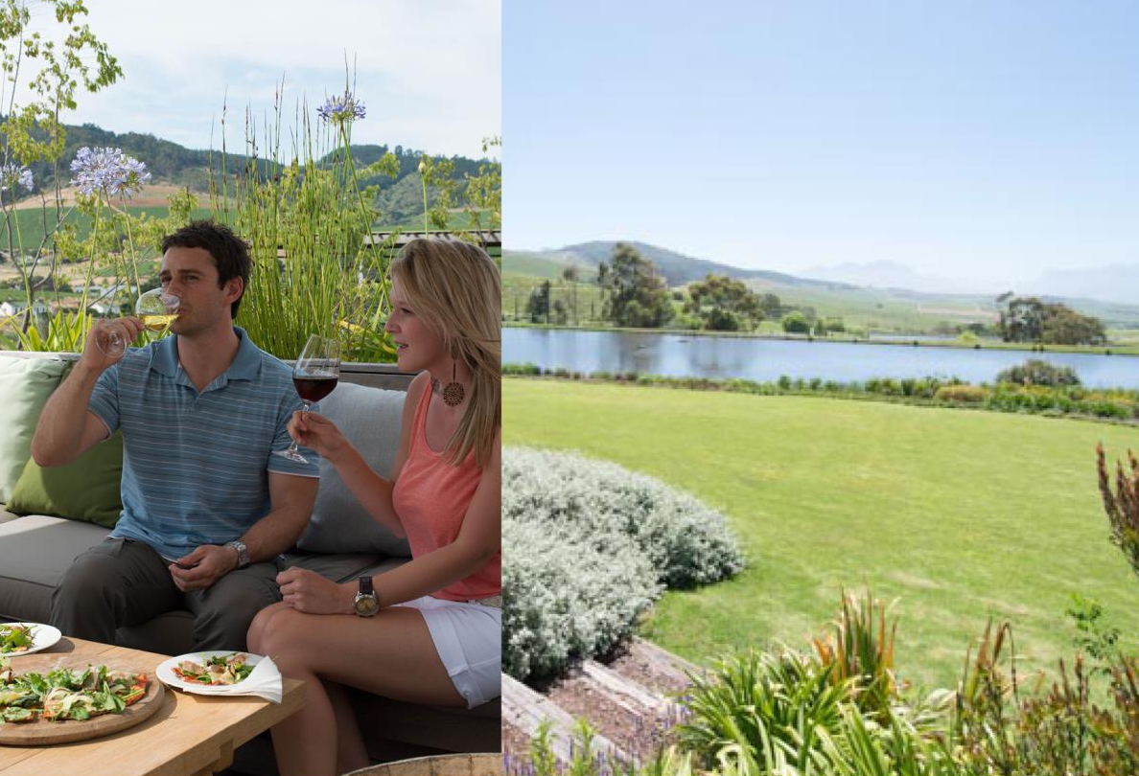
All four of these again benefit from cooling summer breezes.

Slide 41
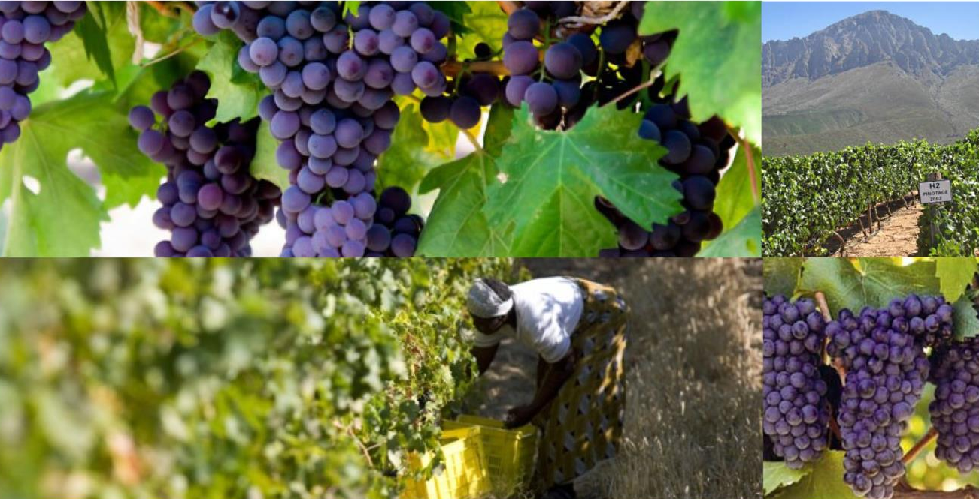
Several estates and private cellars have distinguished themselves in terms of quality wines in these wards. Pinotage again is prominent here.

Slide 42
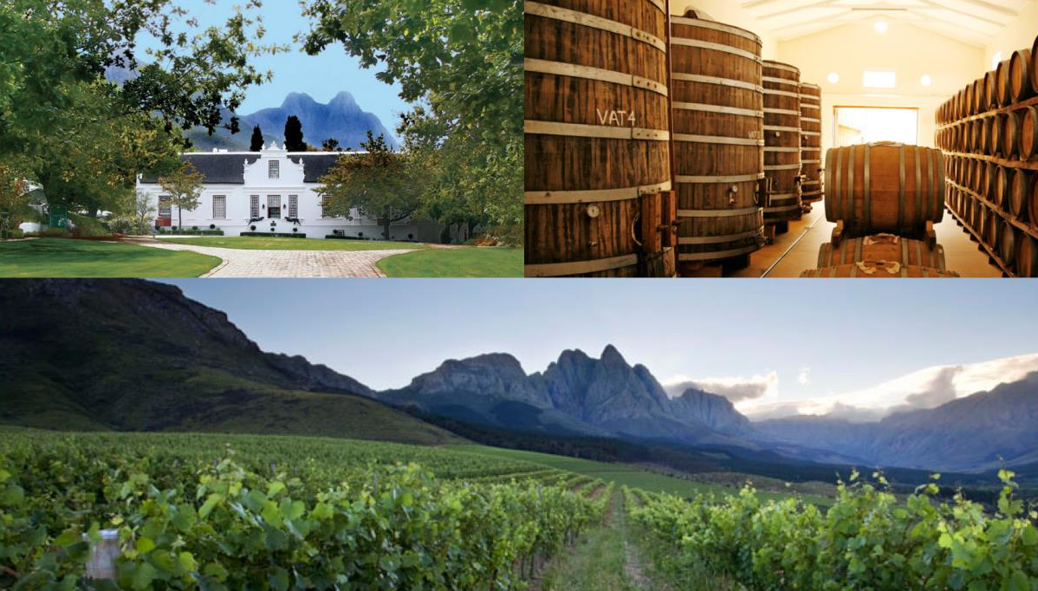
The scenic Jonkershoek Valley ward is home to several top producers and boutique wineries.

Slide 43
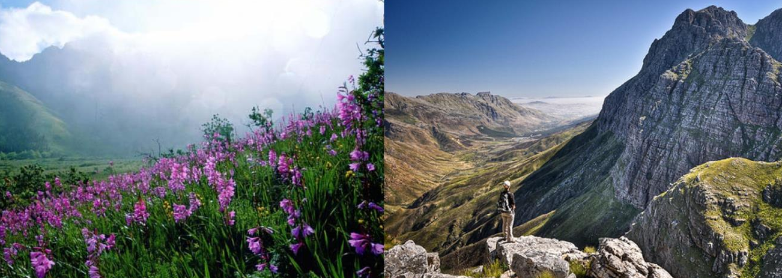
The landscape is dominated by the majestic Twin Peaks, which tower up to 1 494 m high.

Slide 44
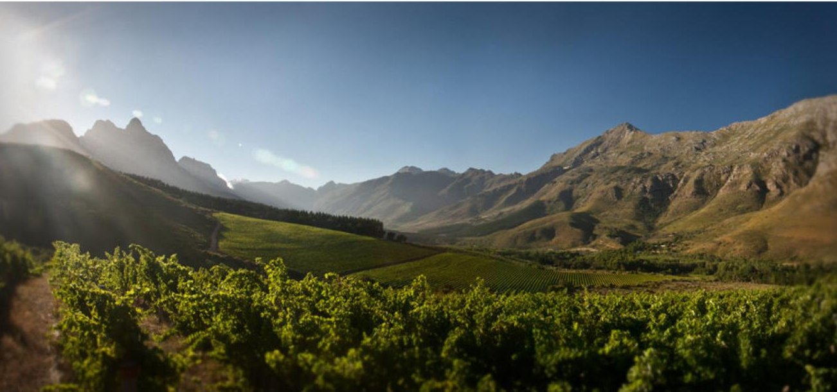
The higher elevations and textured soils make the valley ideal for growing Cabernet Sauvignon and other Bordeaux varieties.

Slide 45
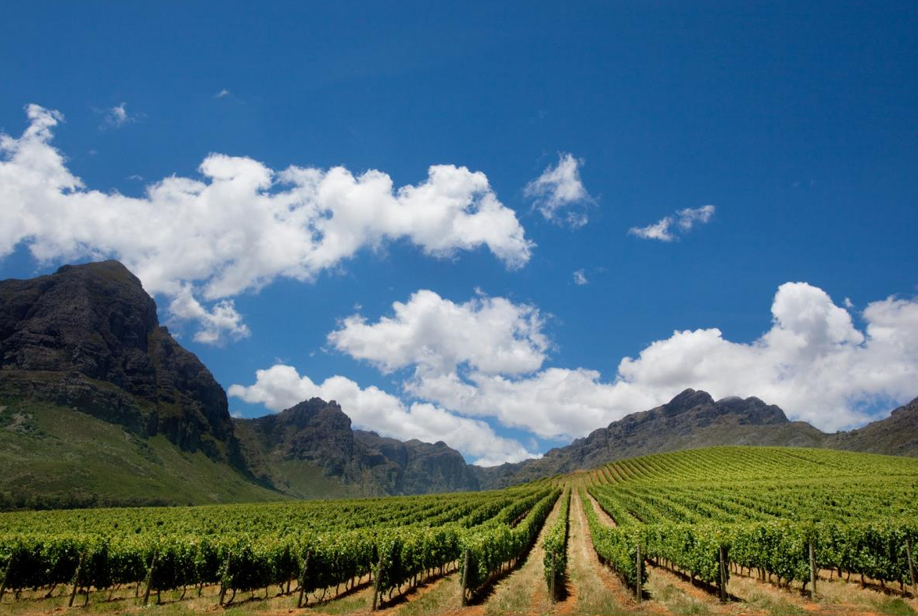
Banghoek is relatively new as a viticultural area with most vineyards planted in the last 20 years. It is mainly known for Sauvignon Blanc and red Bordeaux varieties.

Slide 46
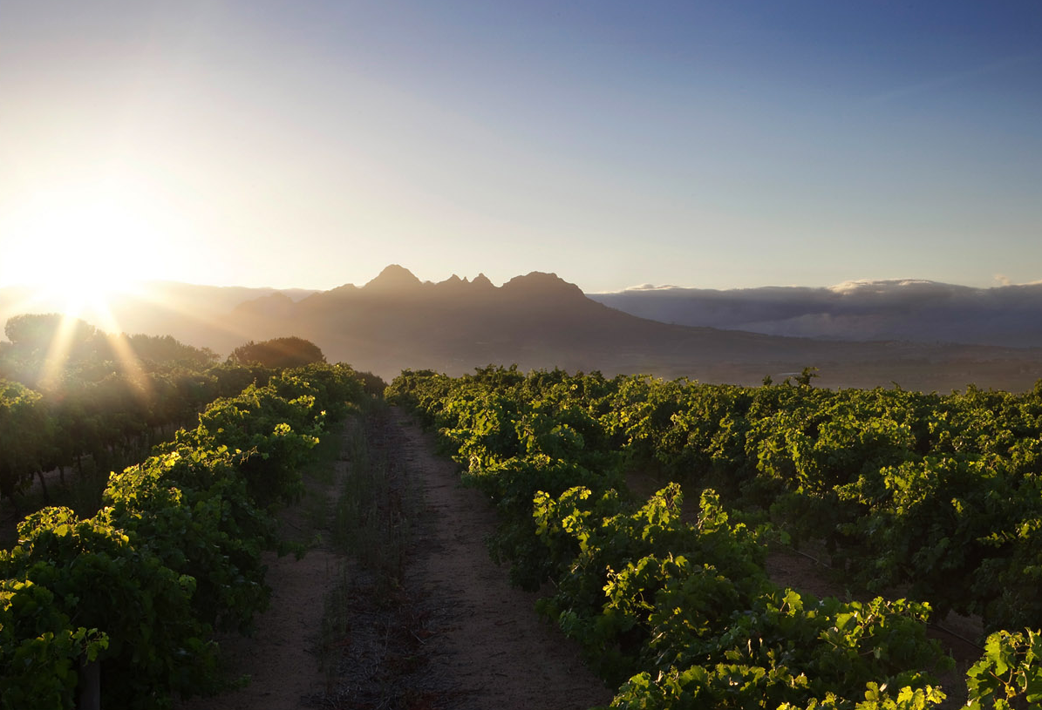
Vlottenburg, the most recently demarcated ward, has a generally convex hill landscape and abundant cooler southern slopes.

Slide 47
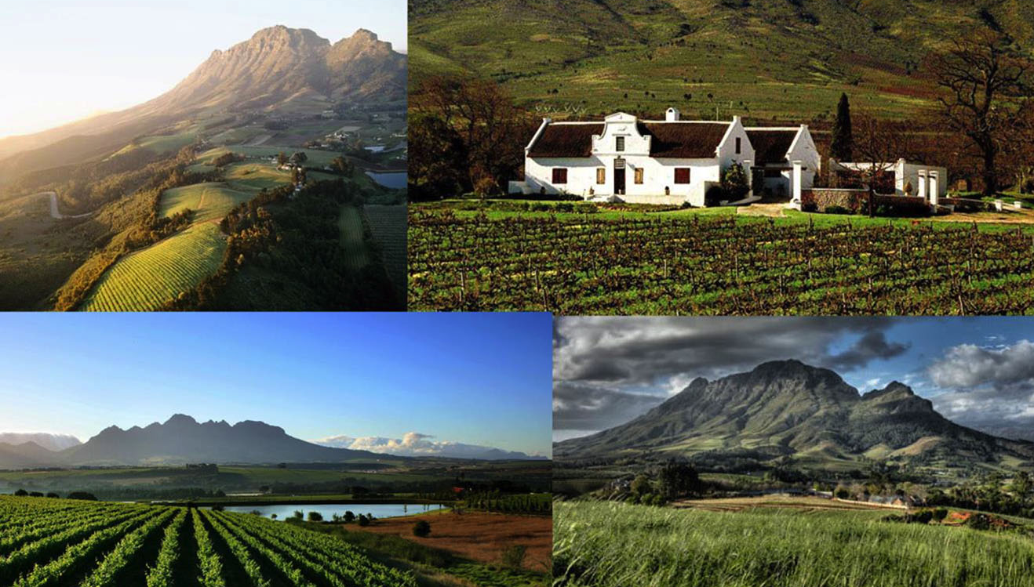
The images used in these presentations have been sourced from various producers, as well as industry and tourism bodies. These presentations are strictly for non-commercial, non-profit, educational purposes only and cannot be reproduced or transmitted in any form or by any means without written permission from Wines of South Africa (WoSA).

Slide 48
The Cape winelands, considered by many to be the most
beautiful in the world, have a network of diverse
and well-run wine routes, affording visitors a varied
and unforgettable experience.
The end
Notes:
The end

