Slide 1
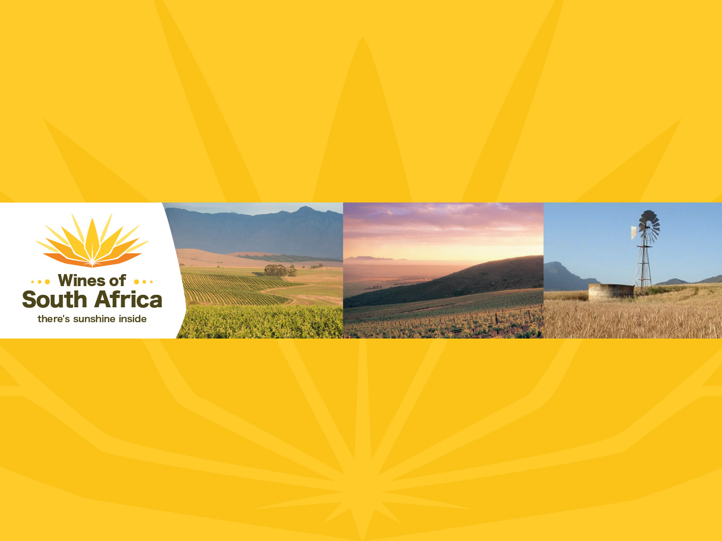
CAPE WINELANDS
SWARTLAND
Notes:
Wines of South Africa

Slide 2

Where is South Africa?

Slide 3

South Africa is the southernmost
country in Africa.

Slide 4

Our winelands are located at the
very tip of South Africa.

Slide 5

PRODUCTION AREAS: Districts of South Africa.

Slide 6

Wards of South Africa.

Slide 7

Coastal
Region: Coastal
District: Swartland
Wards:
Malmesbury
Paardeberg/Perdeberg
Paardeberg South
Porseleinberg
Riebeekberg
Riebeeksrivier

Slide 8
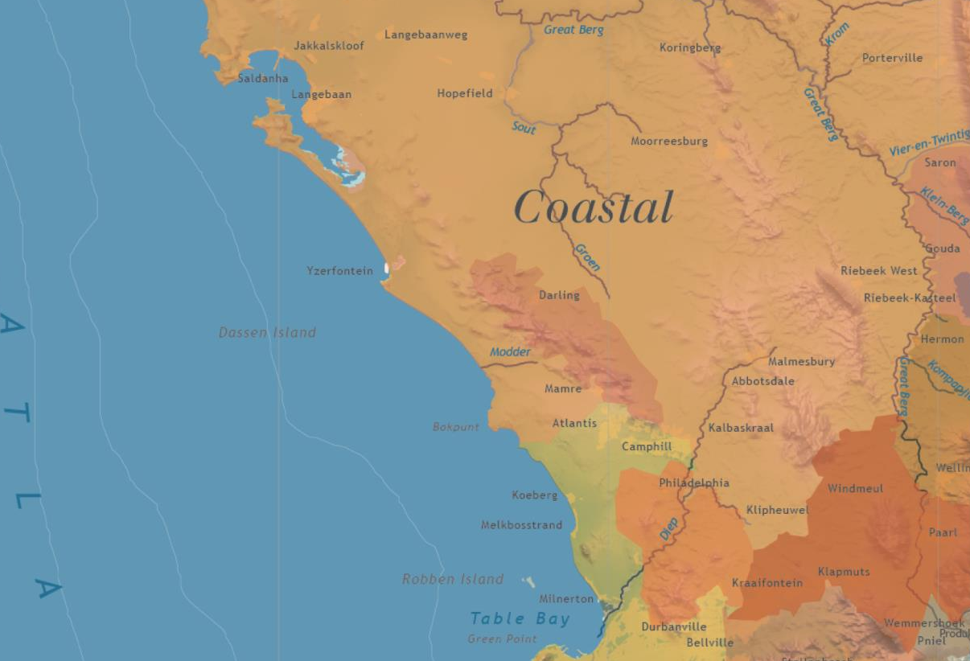

Slide 9
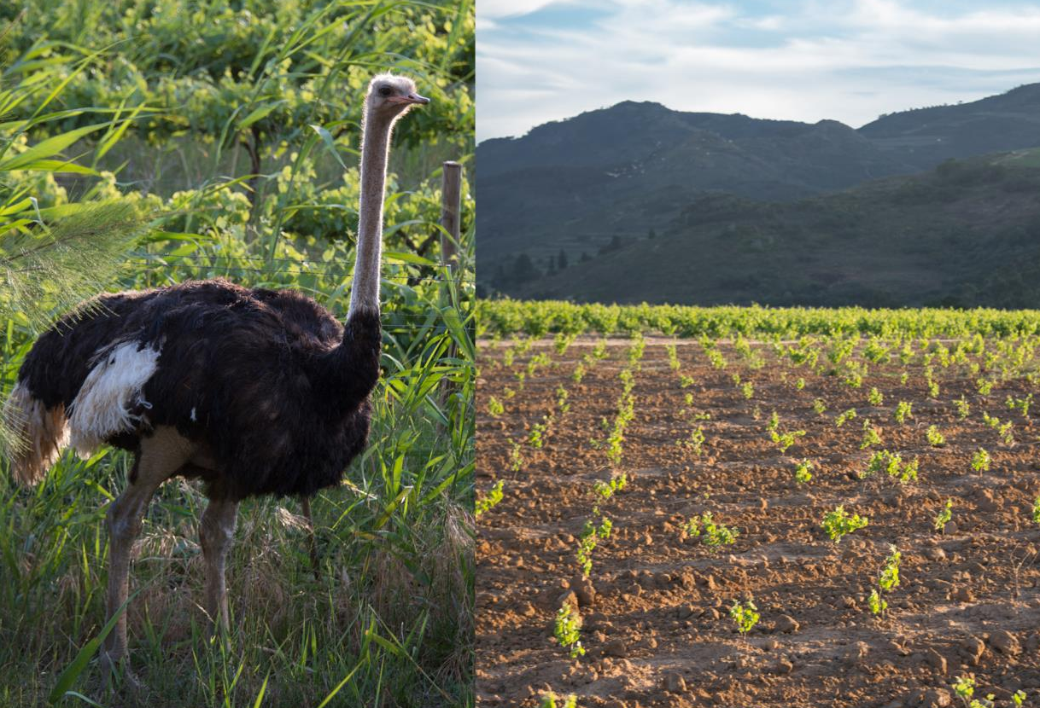
The Swartland literally translated means 'the black land.

Slide 10
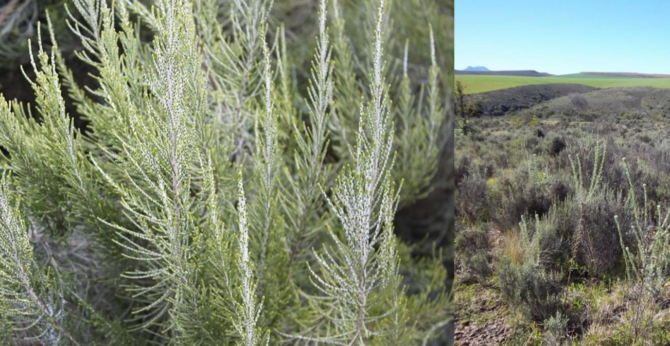
The area takes its name from the now endangered indigenous renosterbos (rhino bush) which once turned the landscape a dark colour at certain times of the year.

Slide 11
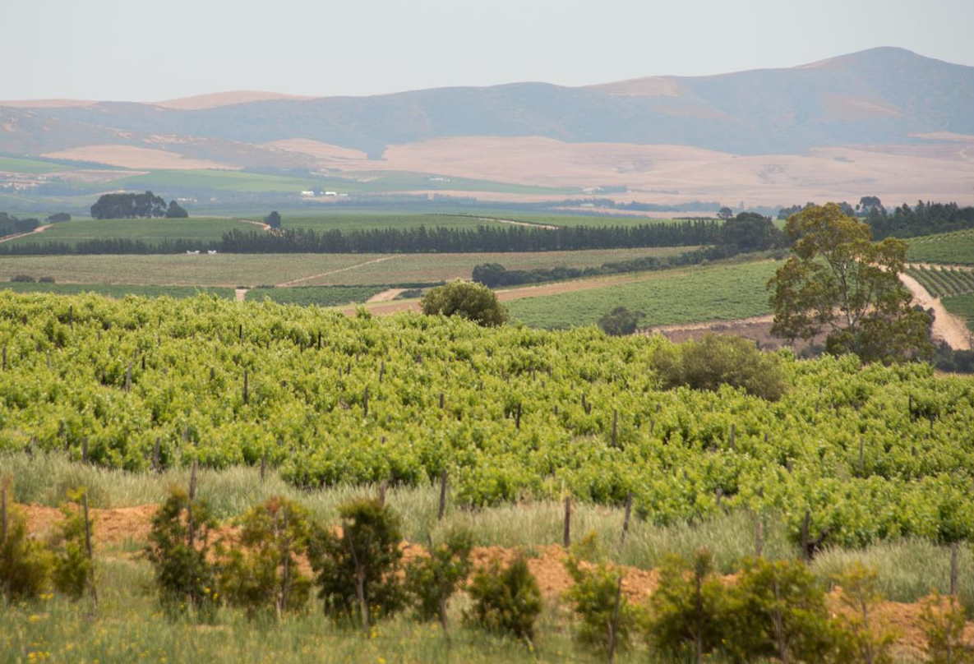
This country wine and olive route is renowned for its warm Swartland hospitality. Walks and hikes are popular, as are 4X4 trails, and for the more adventurous there's hang-gliding, paragliding, canoeing, clay-pigeon shooting and horse riding, to name but a few.

Slide 12
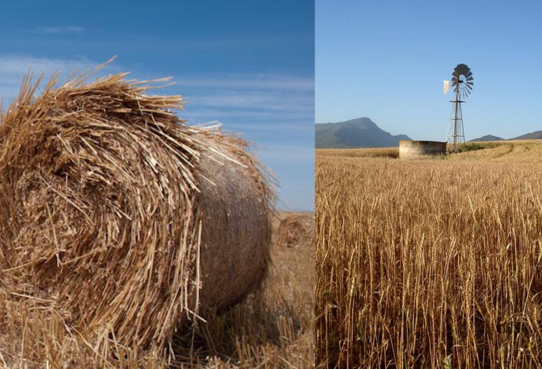
The Swartland was traditionally a
grain-producing area.

Slide 13
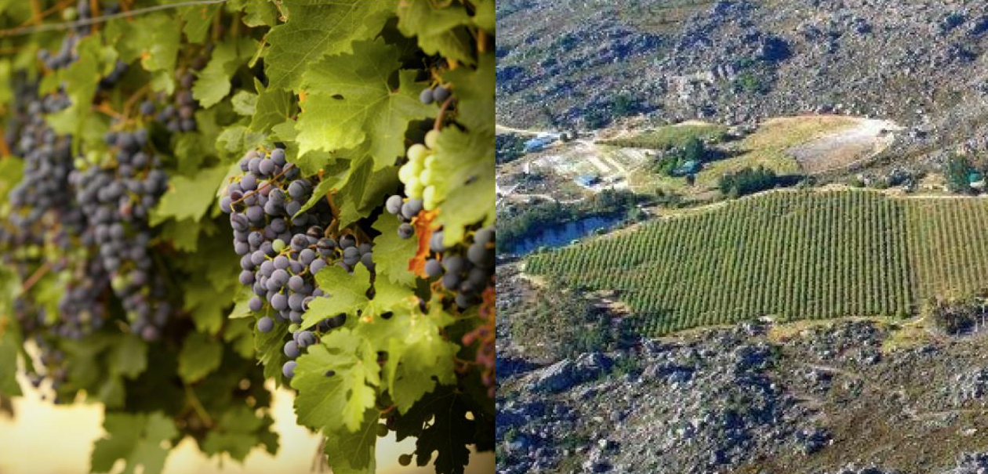
In summer, the district is marked by green pockets of vineyards.

Slide 14
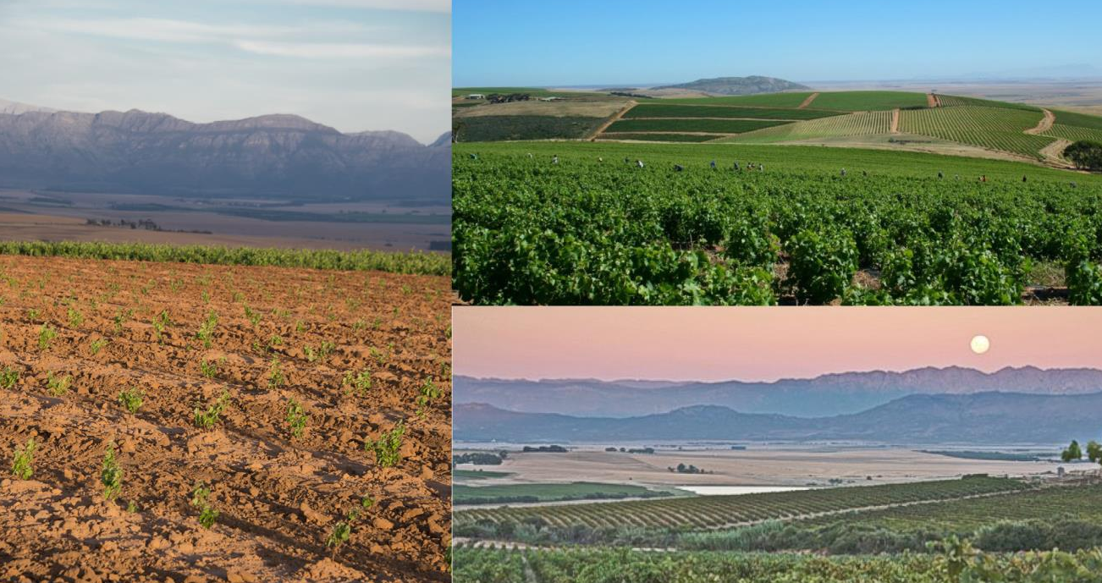
These clamber up the foothills of the mountains (Piketberg, Porterville, Riebeekberg and Perdeberg).

Slide 15
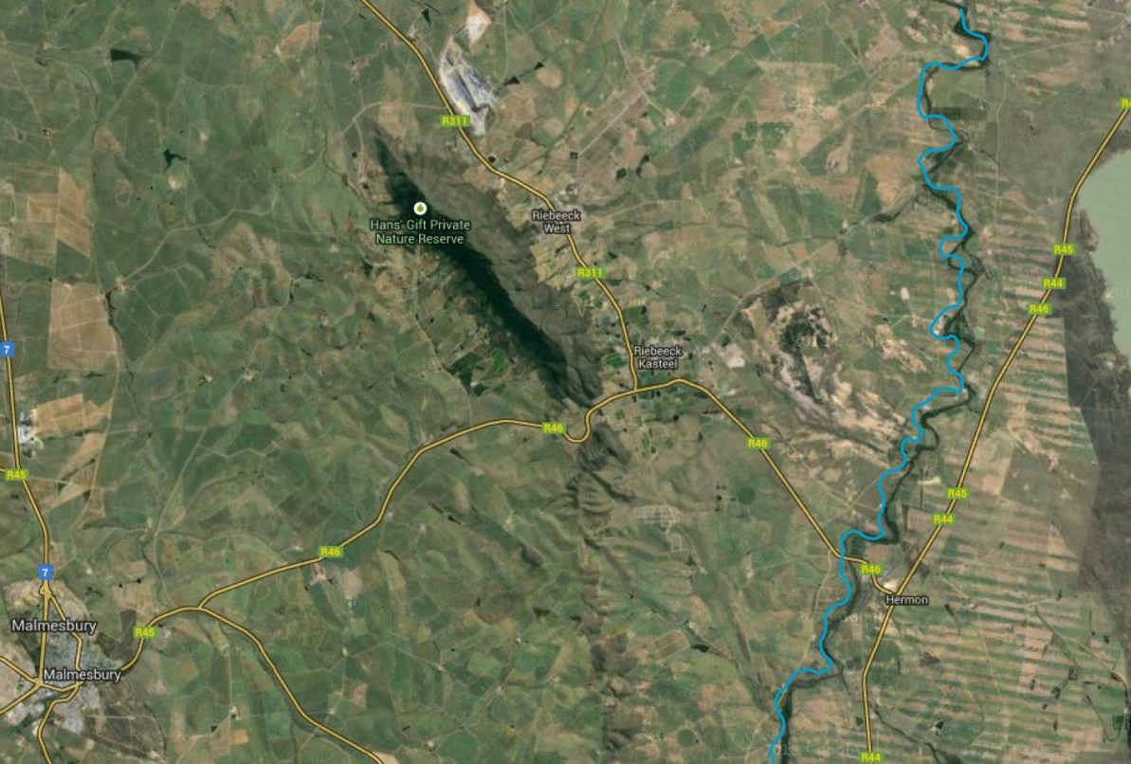
They also spread along the banks of the Berg River, where the soil is deep and water retention is such that dryland cultivation can be practised.

Slide 16
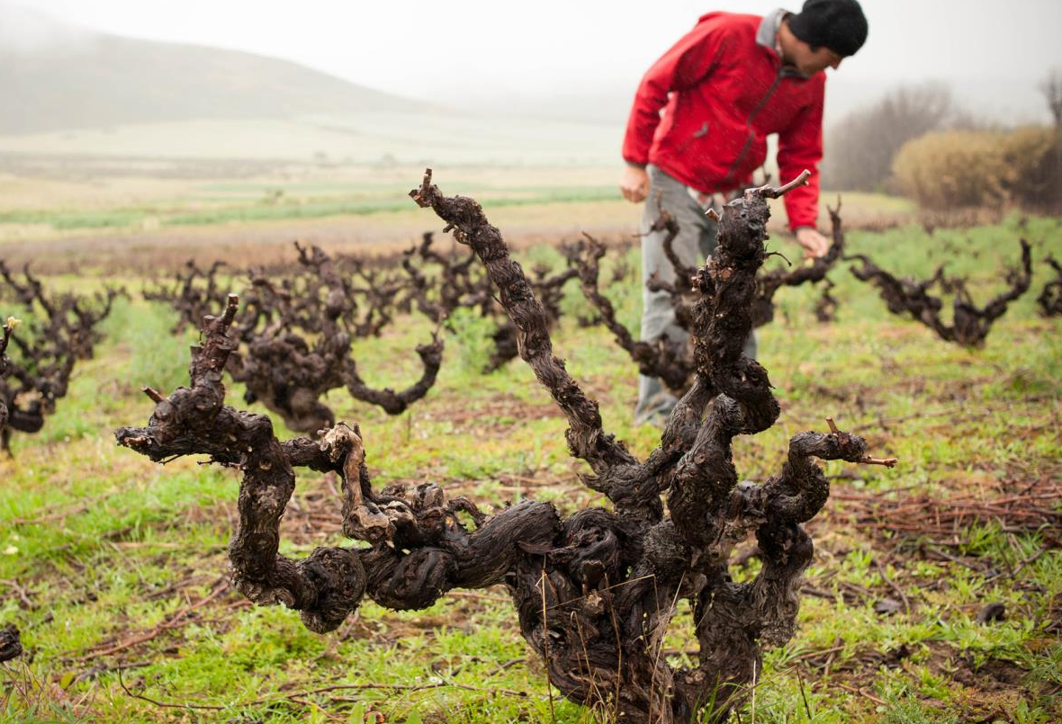
Low-yielding bush vines, many of them 30 years and older, can be found mainly in the Malmesbury area.

Slide 17
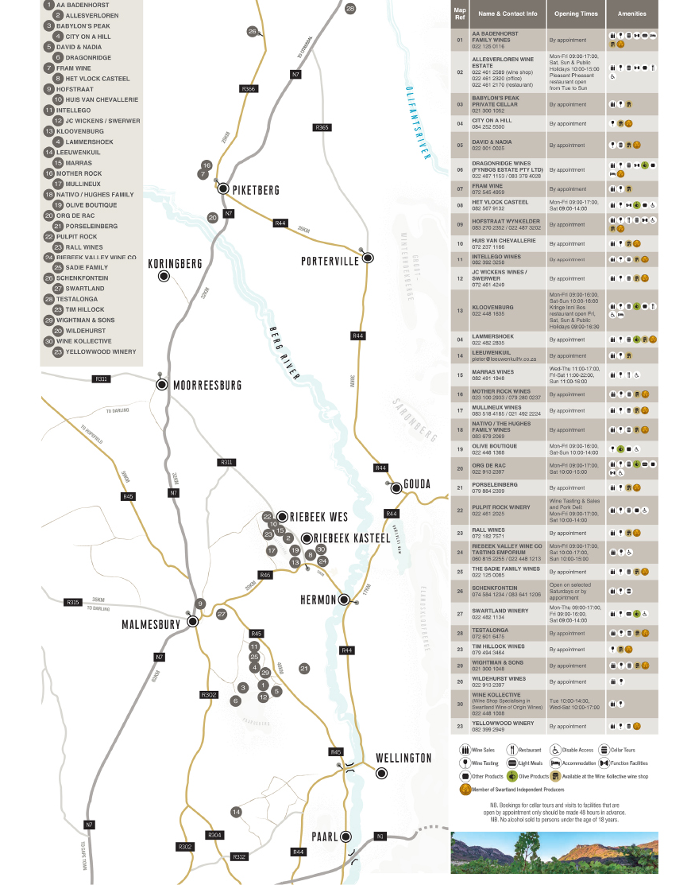
The district of Swartland borders Piketberg to the north, which is not dissimilar in both geography and climate.

Slide 18
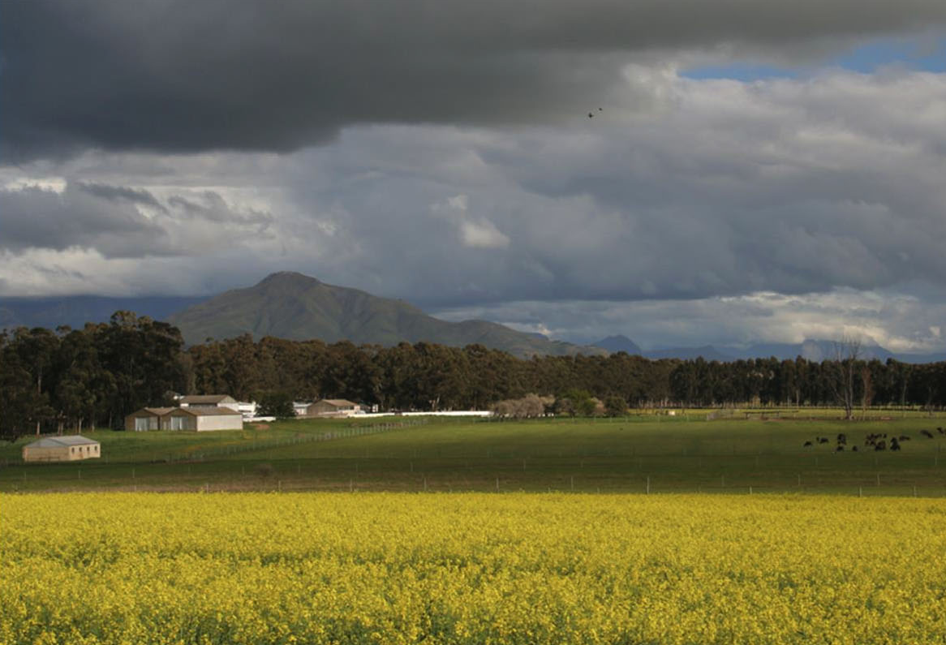
The average rainfall for the largest district in the Western Cape is between 300–500 mm per year, with around 35-40% falling during the growing season.

Slide 19
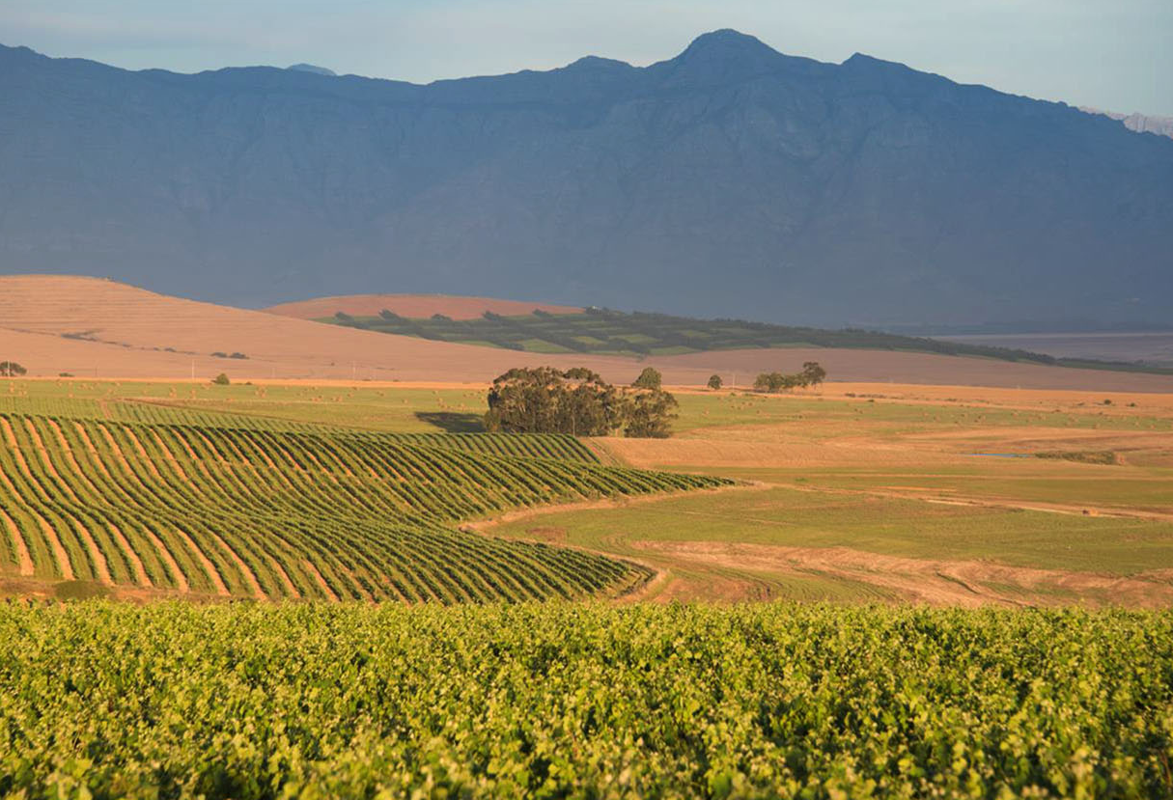
The mean February temperature is 23.3⁰C.

Slide 20
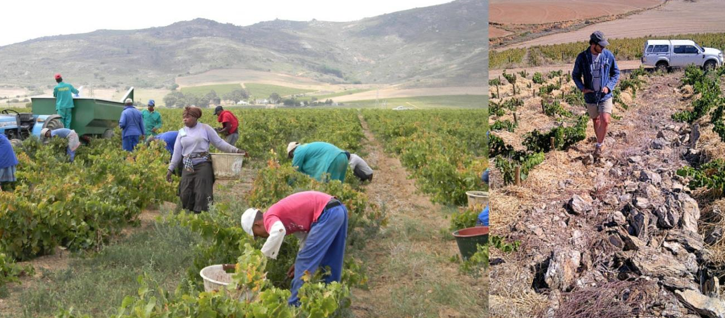
The soils are mainly developed from Malmesbury group shales.

Slide 21
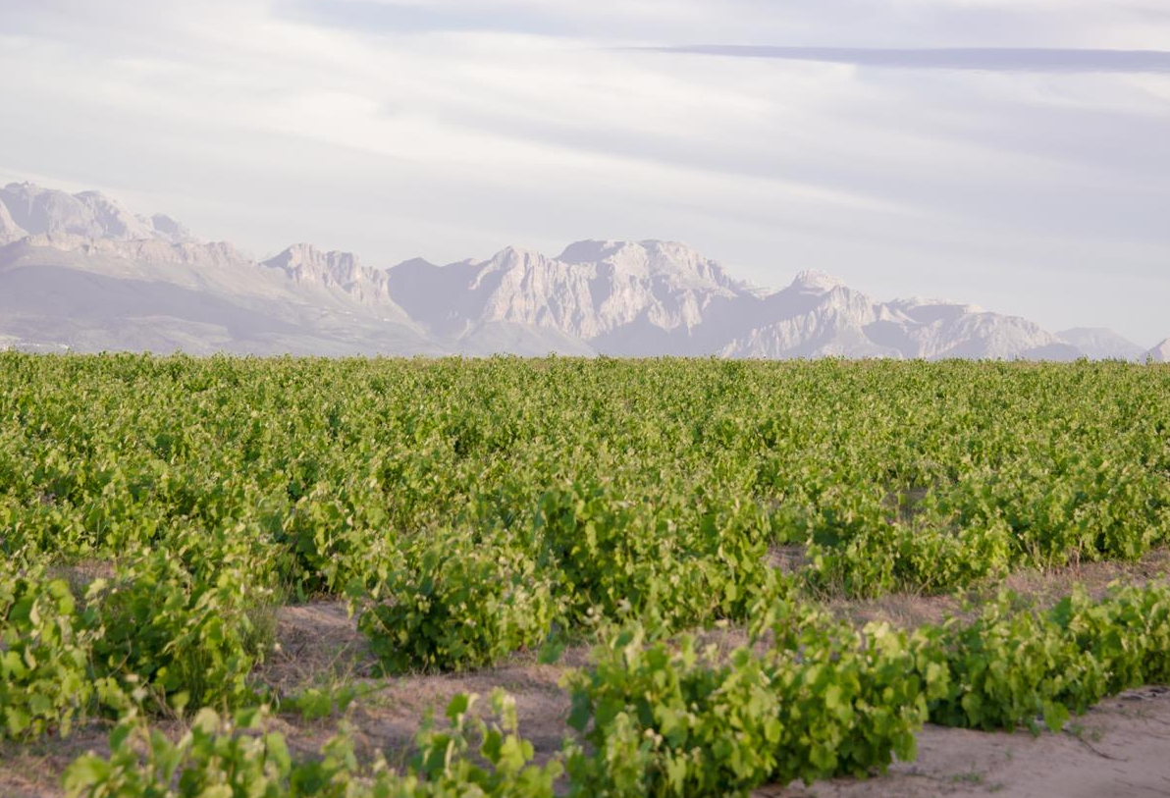
This sediment is older (1 000-550 million years ago) than the Table Mountain sandstone of the coastal region (400-300 million years ago) and the Bokkeveld shale of the Klein Karoo. However, soils derived from Cape granite intrusions (600-500 million years ago) also occur.

Slide 22
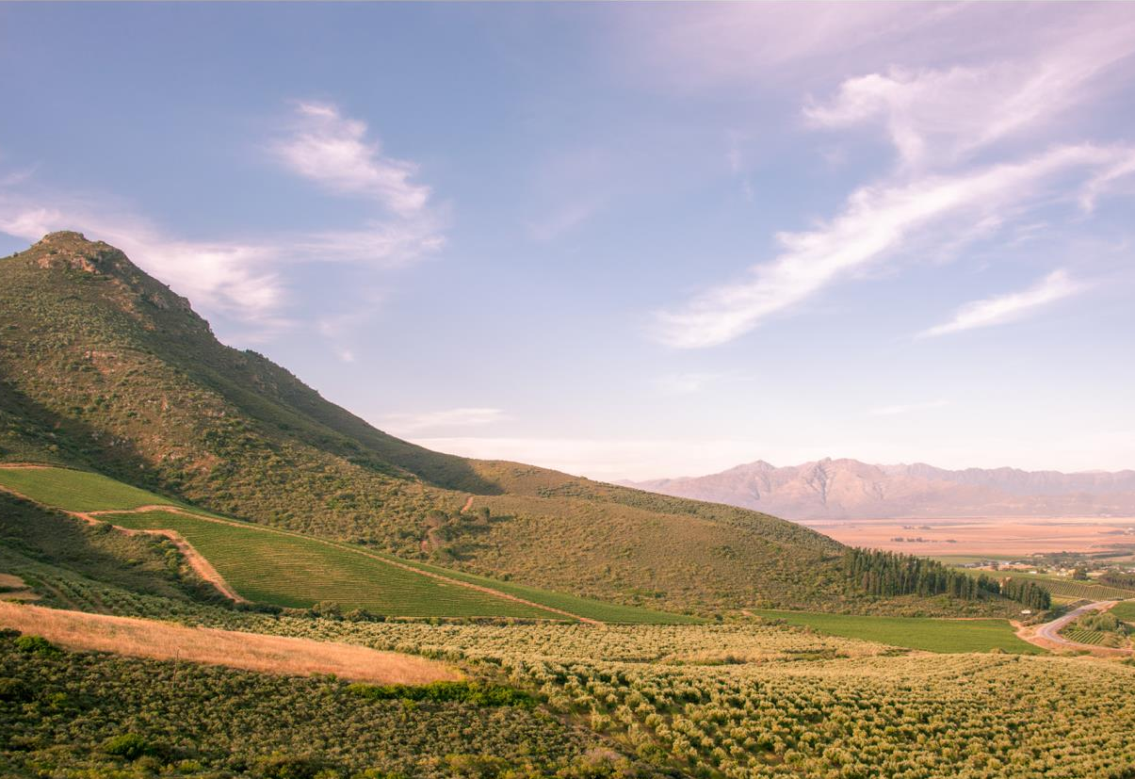
Where material from these granites and Malmesbury shales have mixed with the Table Mountain sandstone found here, particularly in the mountain foothills and next to rivers, you'll find deeper soils with higher vigour potential, suitable for vineyard plantings.

Slide 23
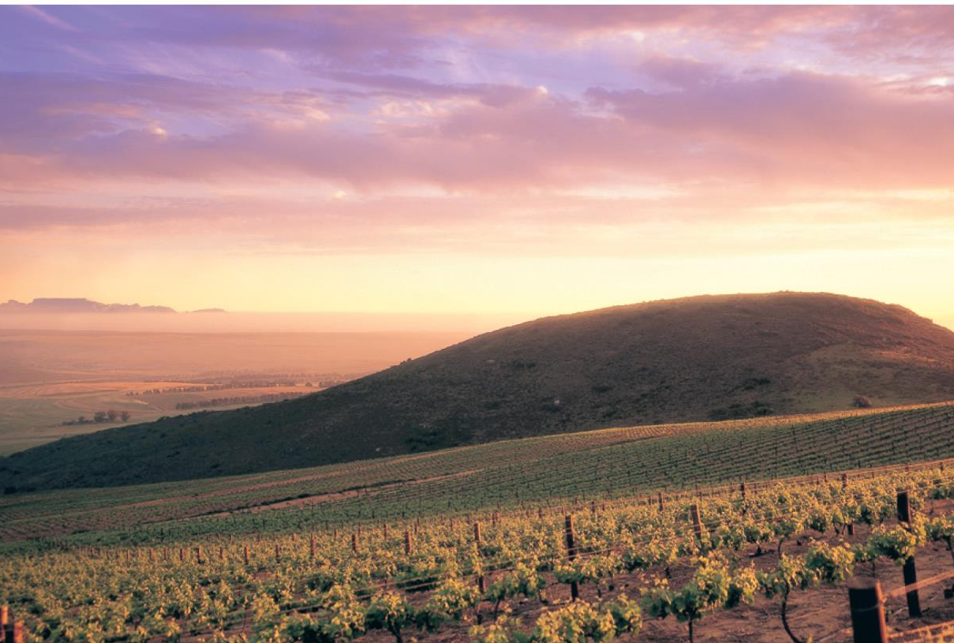
However, the most coveted soils are the deep, well-drained reddish-brown soils developed from pre-weathered granite intrusions north of Malmesbury and along the Darling range of hills.

Slide 24
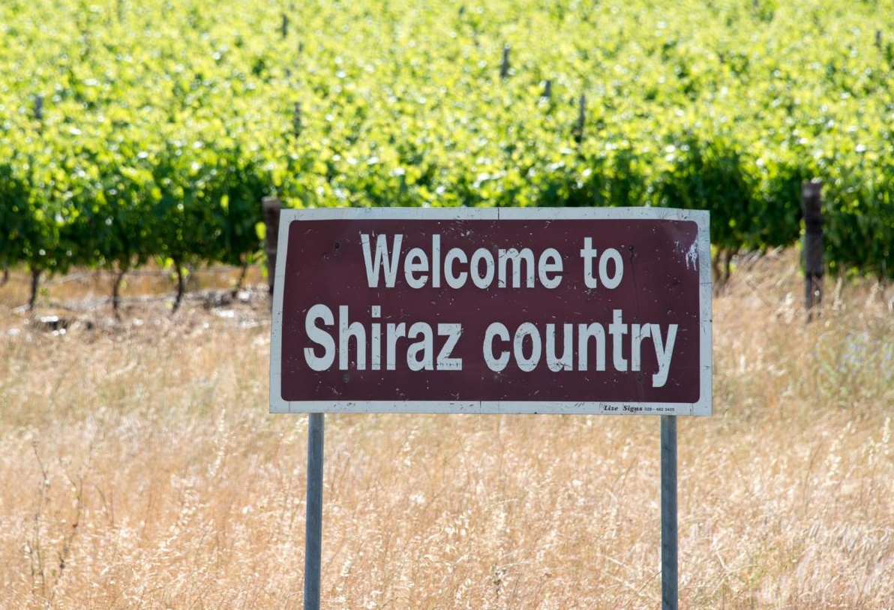
Increasing percentages of reds including Cabernet Sauvignon, Pinotage and Shiraz are being grown here, as well as Chardonnay, Chenin Blanc and Sauvignon Blanc.

Slide 25
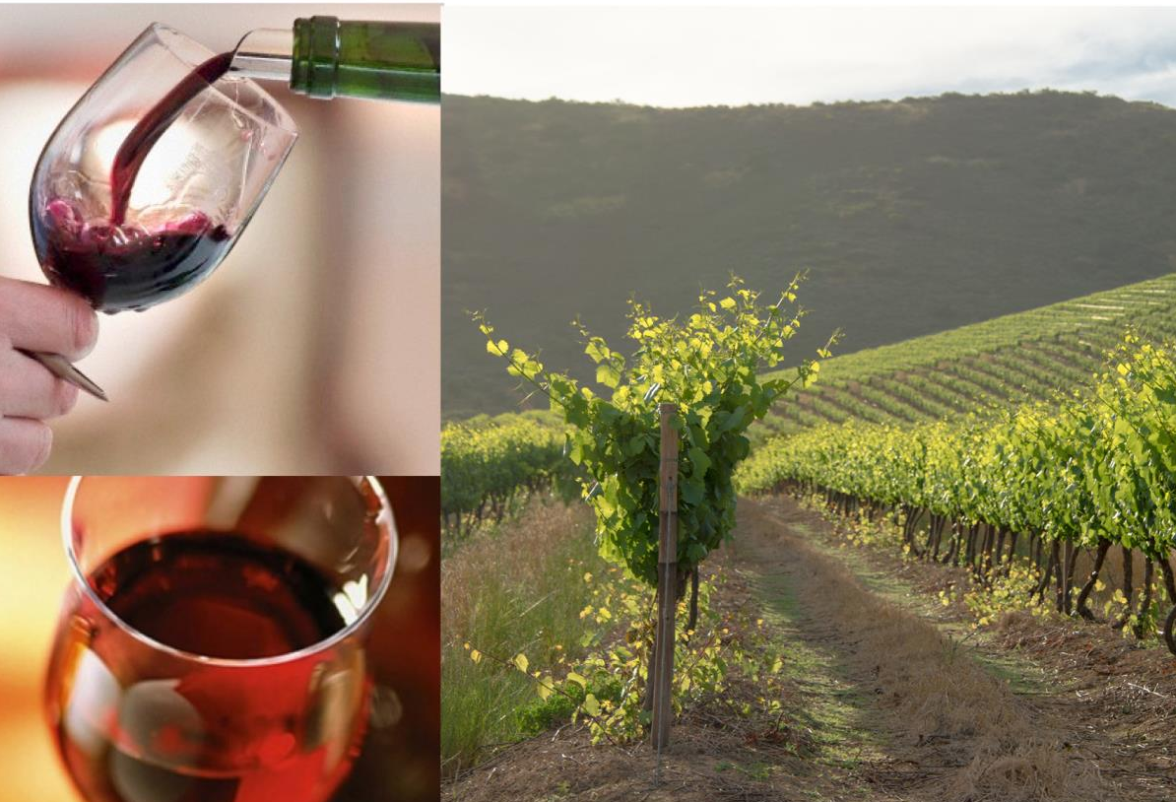
The district was traditionally a source of robust, full-bodied red wines and high quality fortified wines.

Slide 26
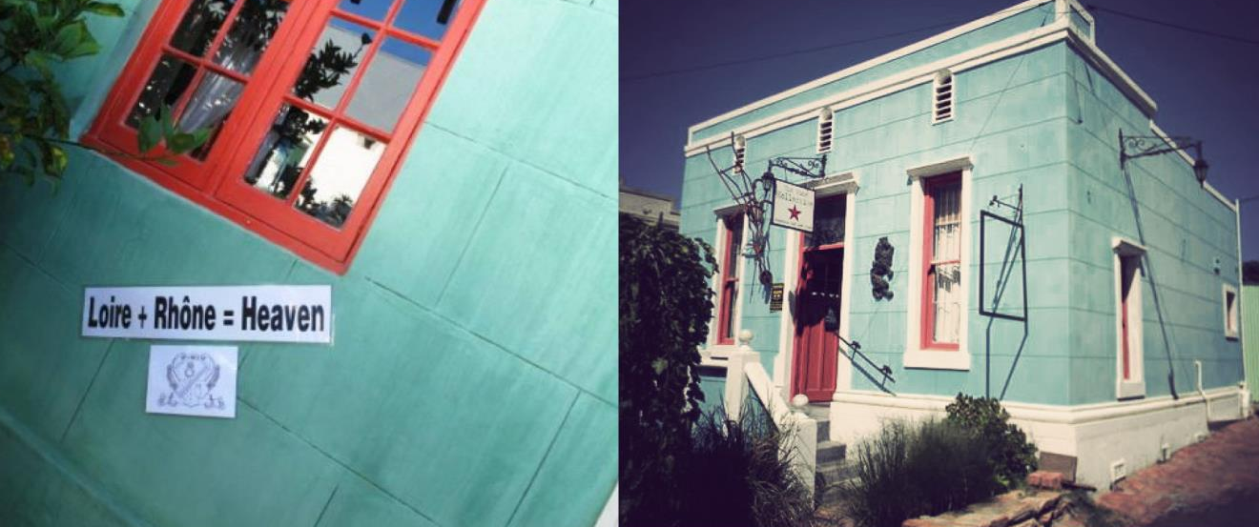
The Swartland has more recently also become associated with award-winning Chenin Blanc and Mediterranean-style red and white blends.

Slide 27
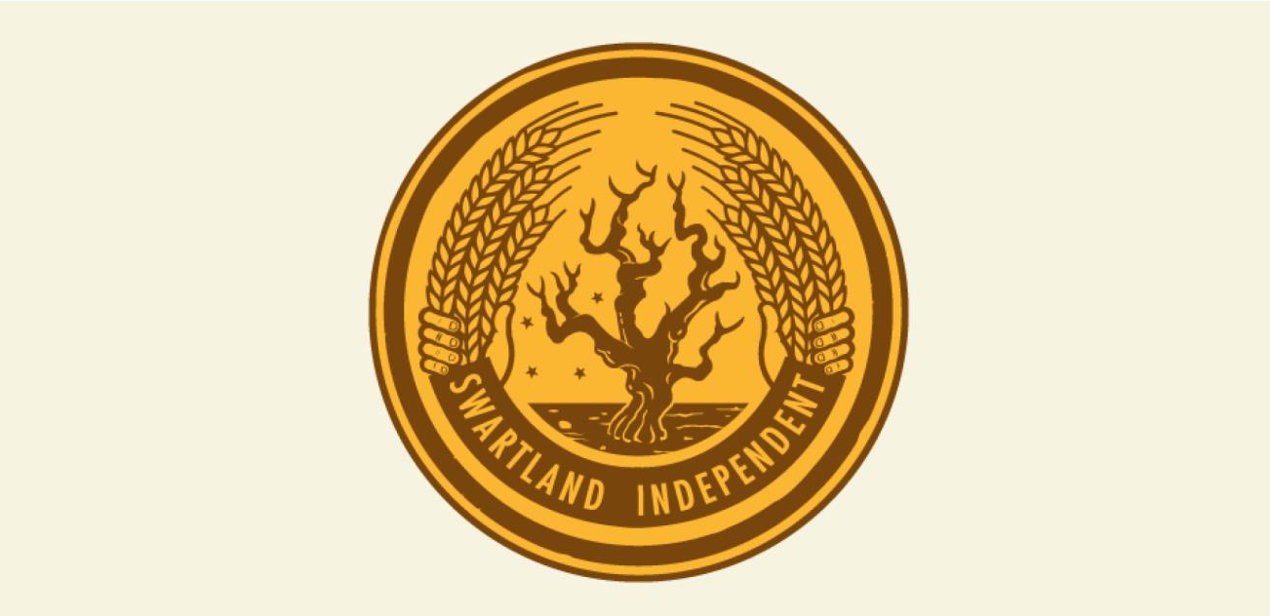
Bringing fresh energy and recognition to the area is the Swartland Independent Producers, a group of like-minded producers working together to express a true sense of place in the wines of the Swartland.

Slide 28
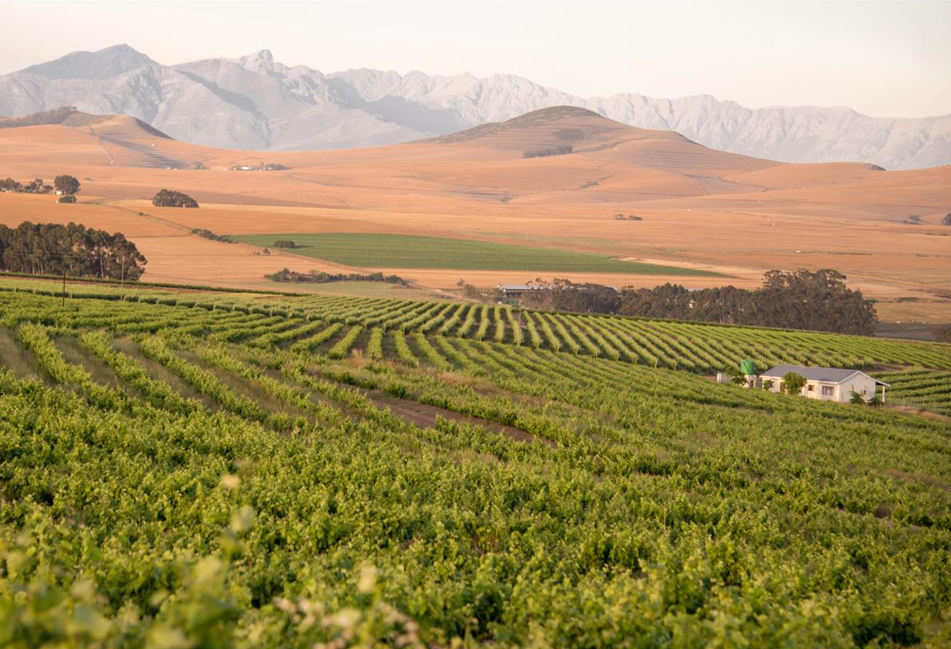
The images used in these presentations have been sourced from various producers, as well as industry and tourism bodies. These presentations are strictly for non-commercial, non-profit, educational purposes only and cannot be reproduced or transmitted in any form or by any means without written permission from Wines of South Africa (WoSA).

Slide 29
The Cape winelands, considered by many to be the most
beautiful in the world, have a network of diverse
and well-run wine routes, affording visitors a varied
and unforgettable experience.
The end
Notes:
The end

