Slide 1
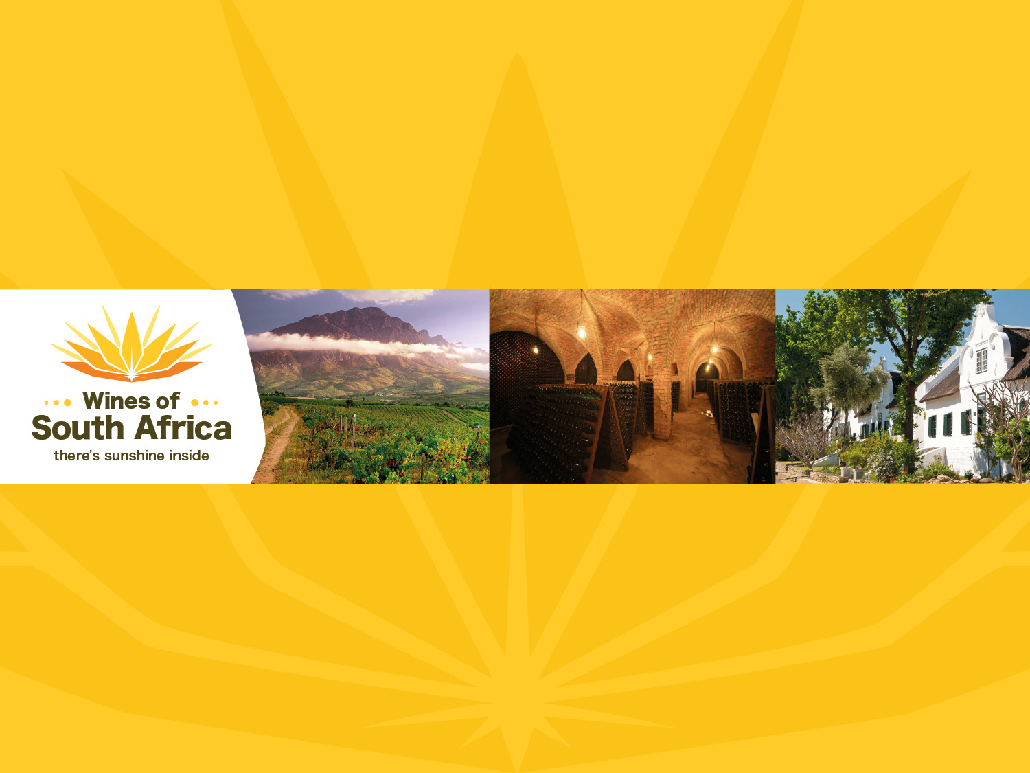
CAPE WINELANDS
TULBAGH
Notes:
Wines of South Africa

Slide 2

Where is South Africa?

Slide 3

South Africa is the southernmost
country in Africa.

Slide 4

Our winelands are located at the
very tip of South Africa.

Slide 5

PRODUCTION AREAS: Districts of South Africa.

Slide 6

Wards of South Africa.

Slide 7

Coastal
Region: Coastal
District: Tulbagh

Slide 8
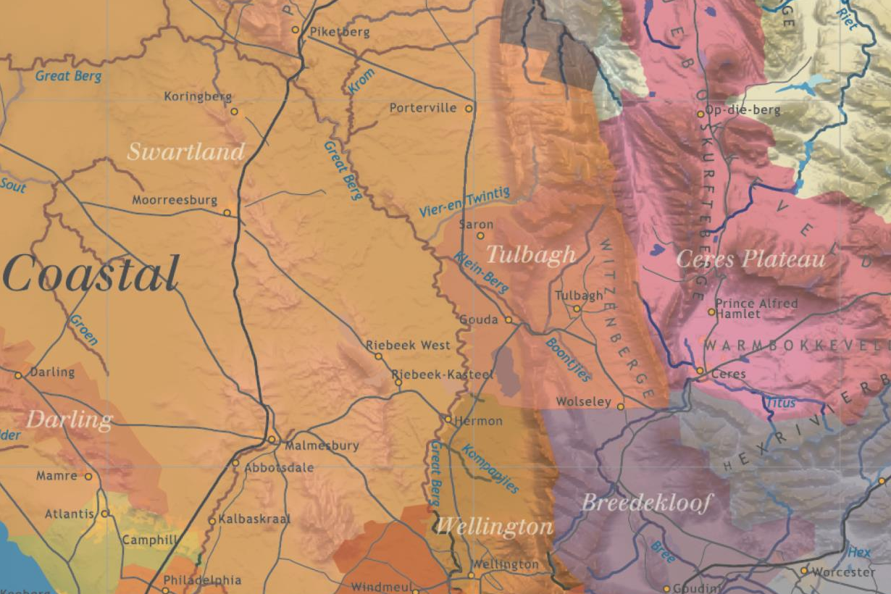

Slide 9
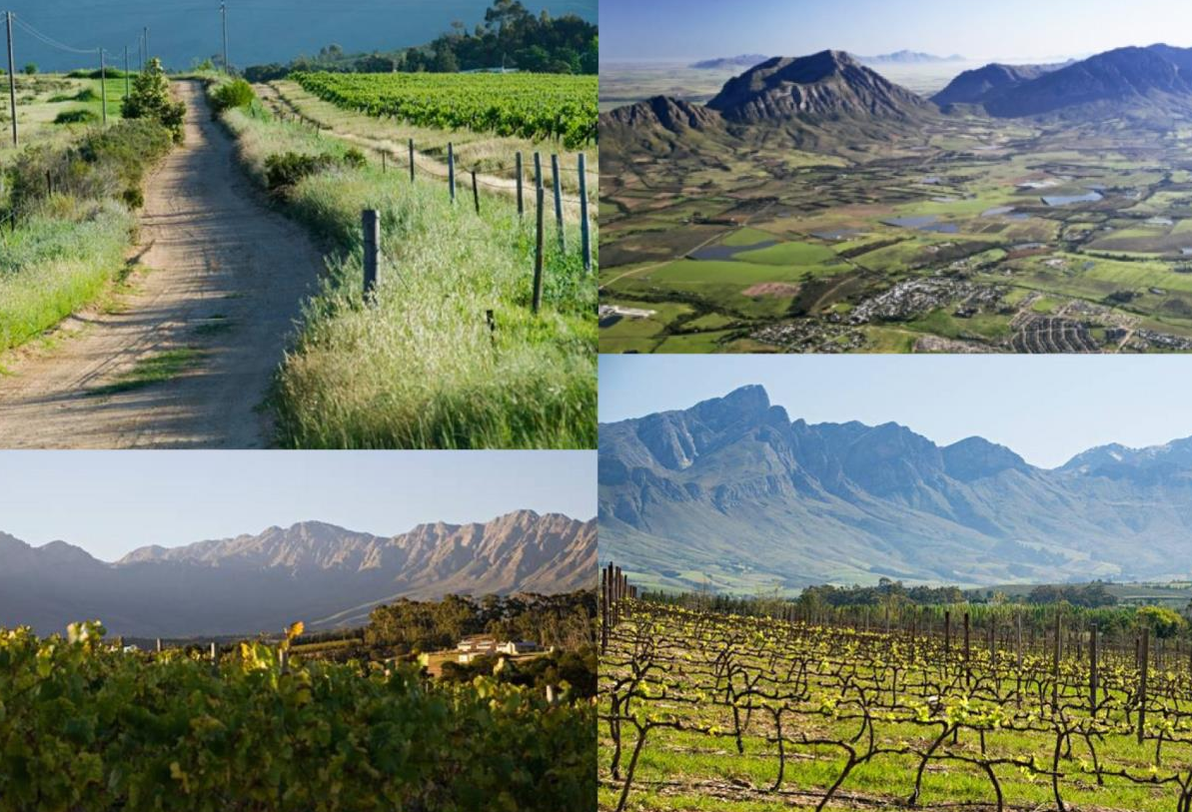
The secluded Tulbagh valley is surrounded on three sides by the Groot Winterhoek, Witzenberg and Obiqua mountains.

Slide 10
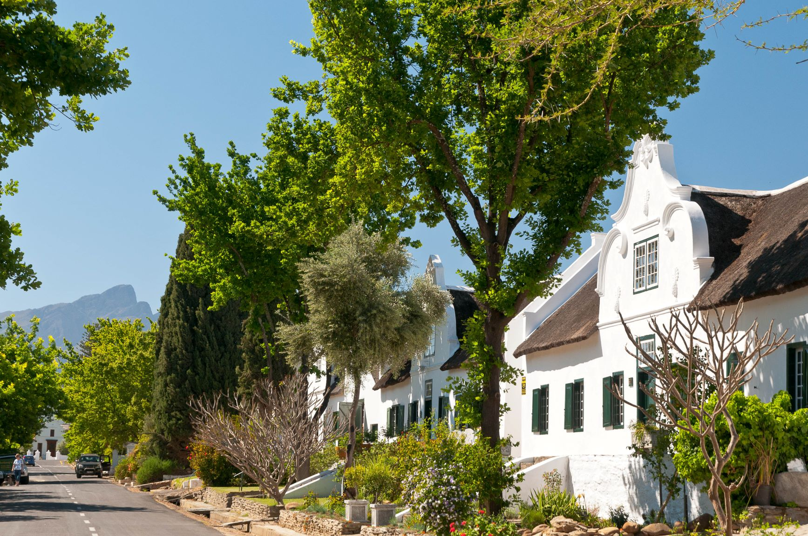
The town of Tulbagh boasts 32 provincial monuments on one street.

Slide 11
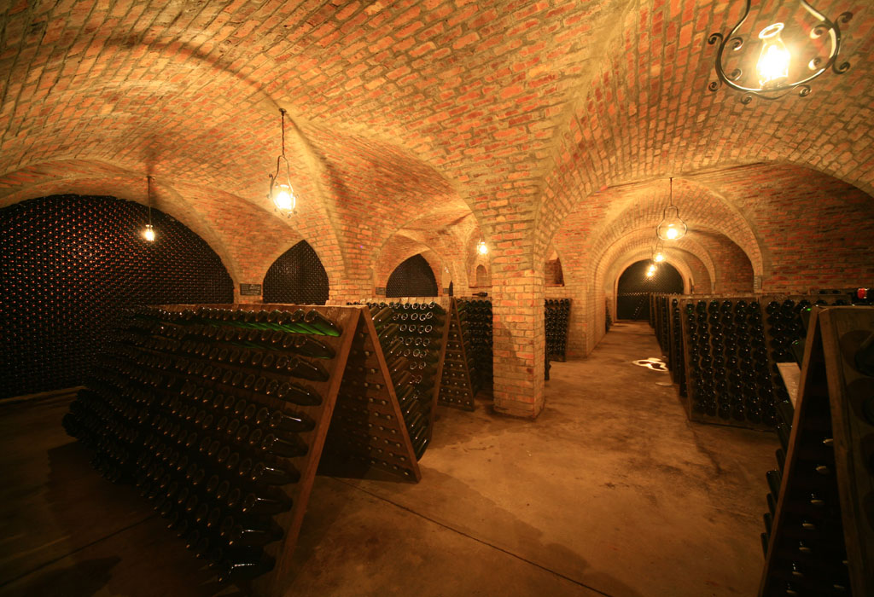
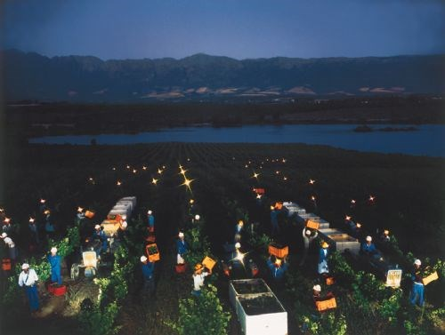
Here history and tradition work hand-in-hand with innovation.

Slide 12
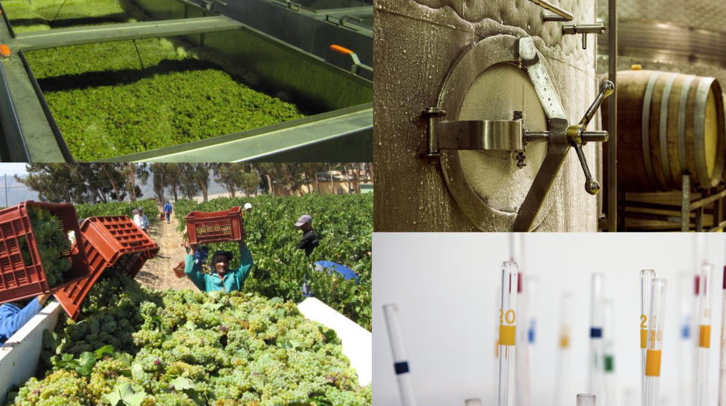
With today's high-tech water management and advanced viticultural practices, the true potential of this area is starting to be realised.

Slide 13
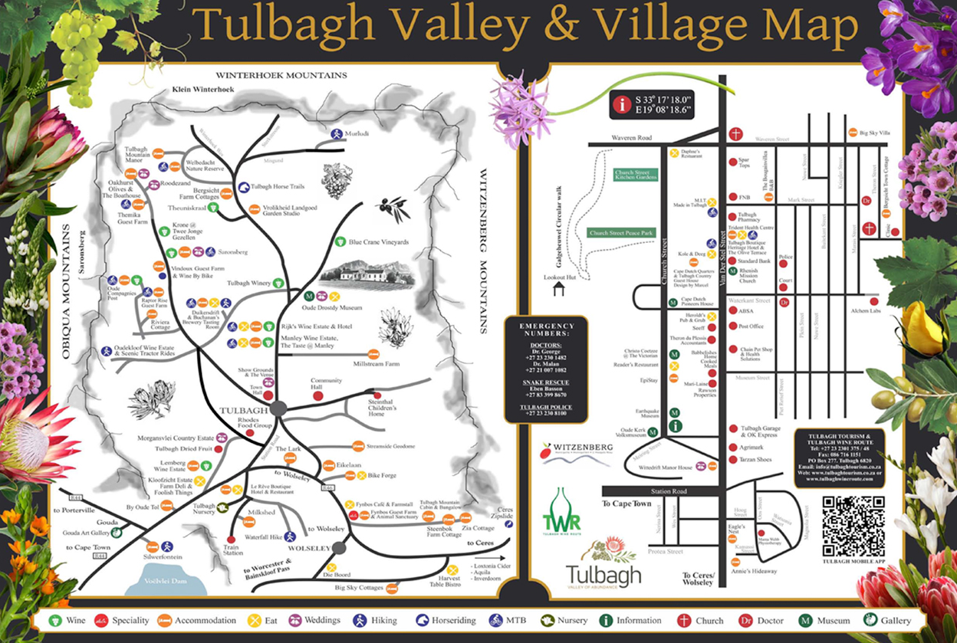
The Wine Route is dotted with graceful old estates interspersed with conspicuously new vineyards and architecturally designed state-of-the-art cellars, as well as a handful of micro-producers and boutique wineries.

Slide 14
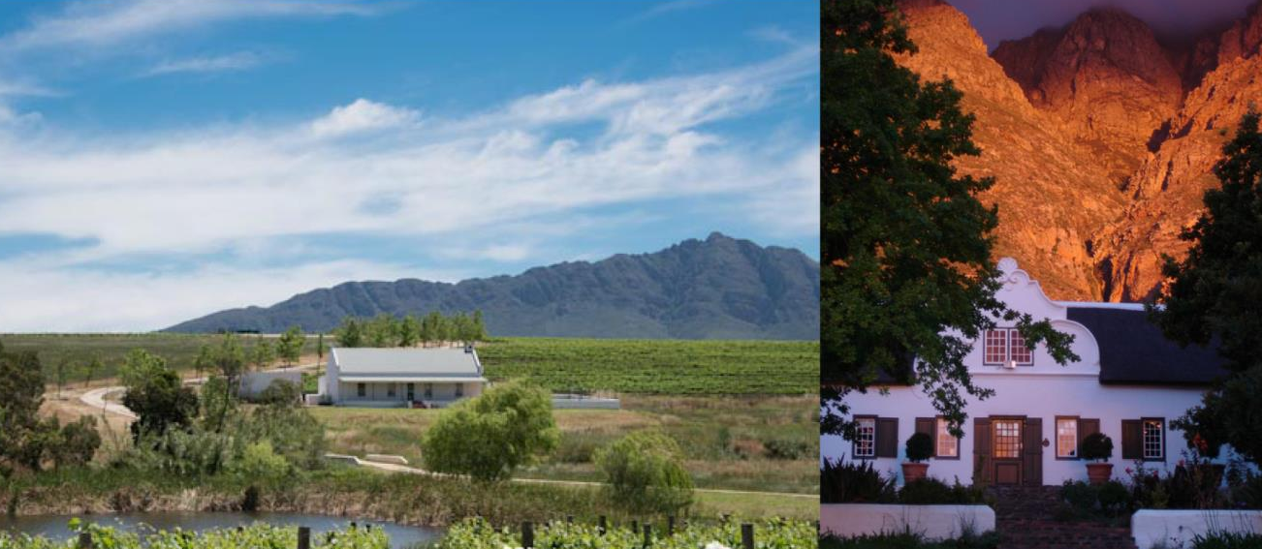
The Tulbagh area is characterised by various combinations of height above sea level, aspect, slopes and soil types.

Slide 15
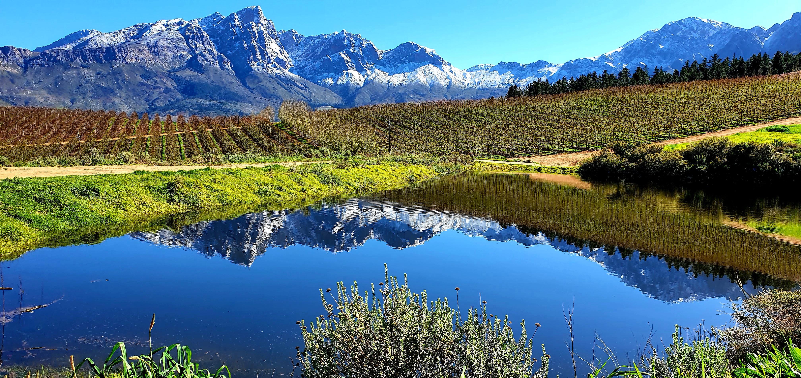
Unique to the valley’s geographical composition is the ‘cold trap’, a phenomenon which occurs as a result of the encapsulating mountains, shape like a horseshoe, with Tulbagh situated at the northern head of this ‘bowl’.

Slide 16
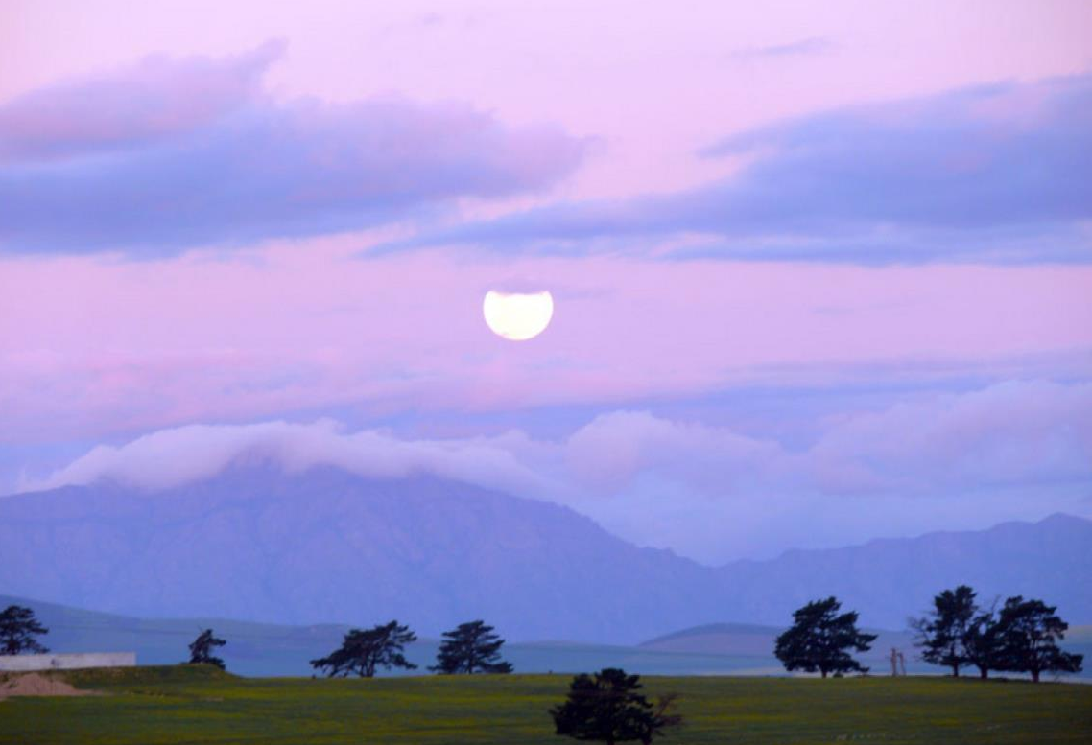
Within this bowl, once a prehistoric lake, the cold air of the previous night lies undisturbed. With no air movement from the sides, this cold bubble is trapped under the warming air above as the sun makes its way from east to west.

Slide 17
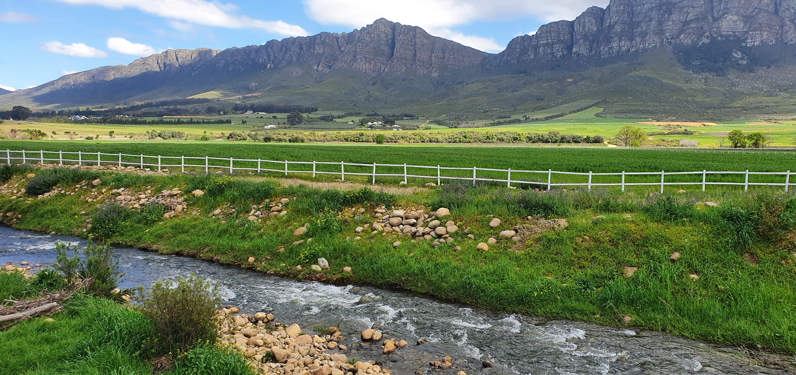
Average rainfall is 551 mm (Drostdy Wine Cellar Weather Station) but rainfall varies due to different microclimates. The average rainfall is much higher up against the mountains than lower down in the valley.

Slide 18
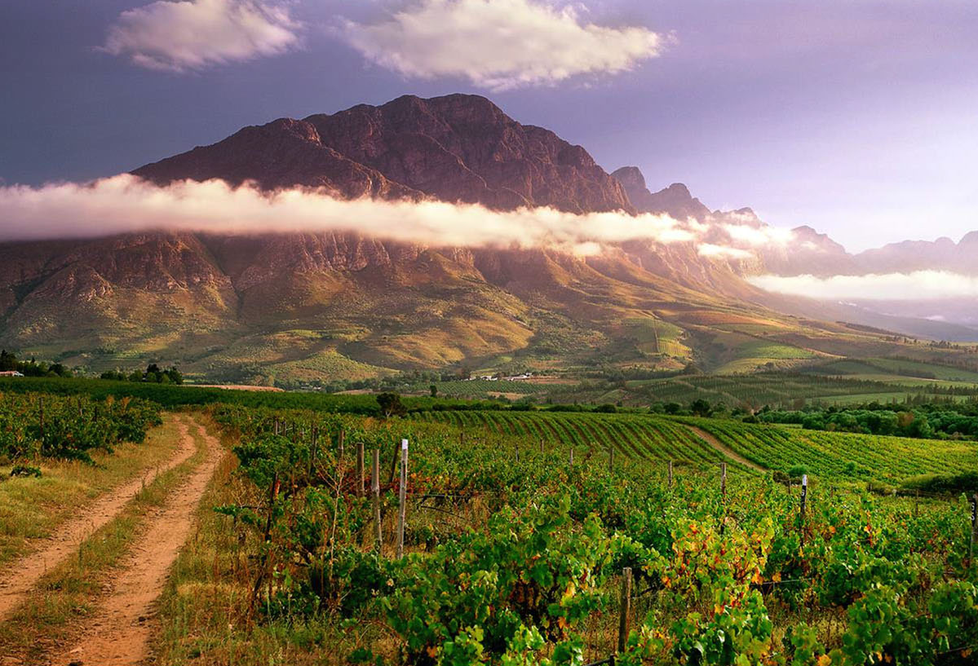
Summers are warm, with a mean February temperature of 24⁰C (Drostdy Wine Caller Weather Station), although the mountainous terrain creates numerous different mesoclimates which can be used to great advantage.

Slide 19
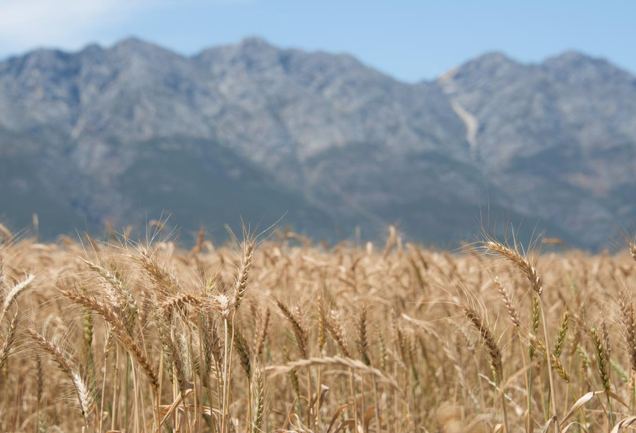
The vineyards grow alongside orchards and fields of wheat.

Slide 20
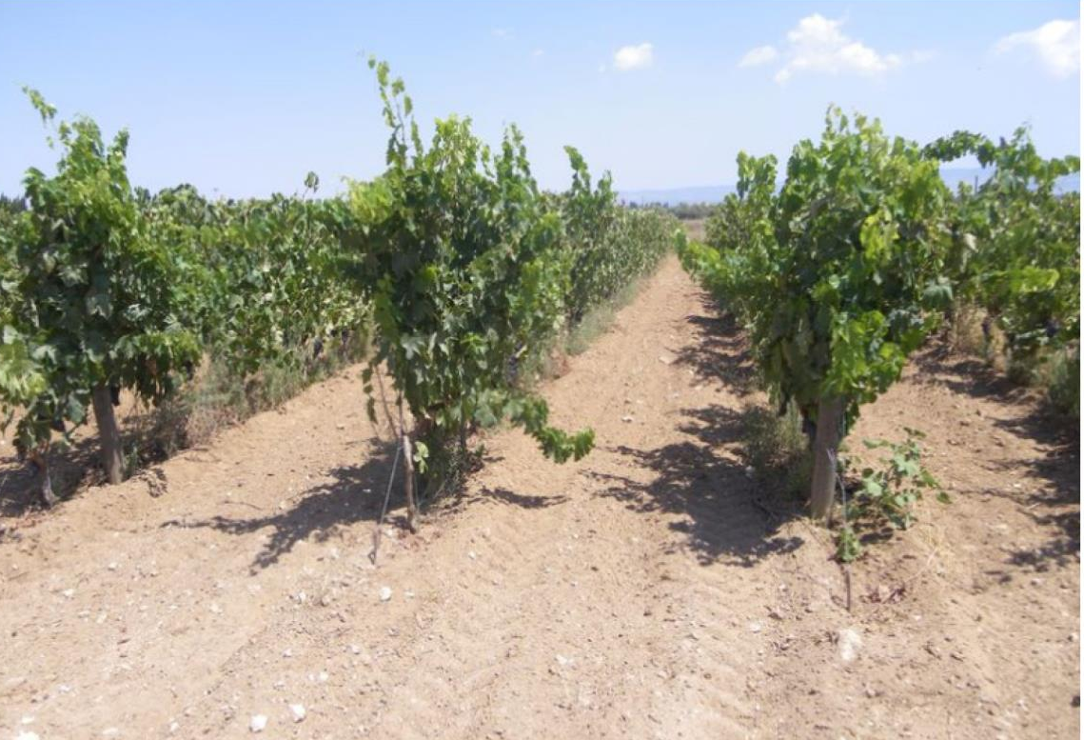
Soils in the valley are extremely variable from sandy soils on the valley floor to stony soils on the old, higher terraces and mountain slopes.

Slide 21
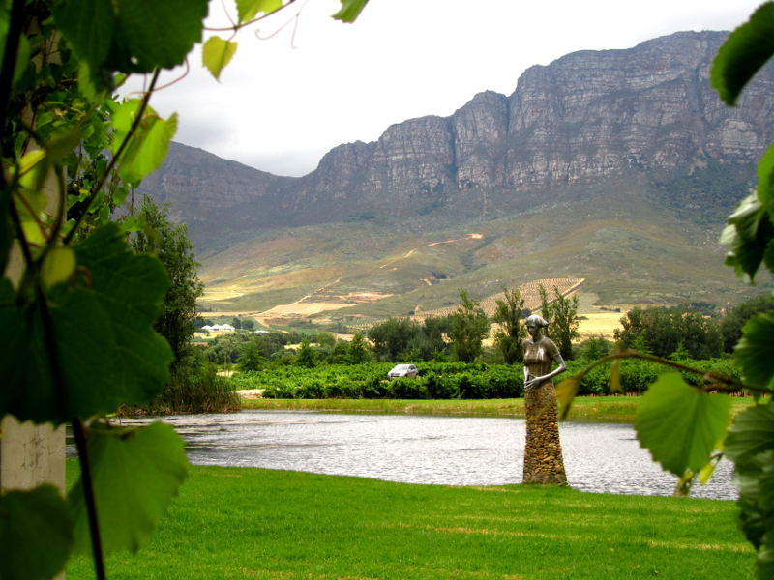
At higher altitudes, soils from the Malmesbury Supergroup schists and phyllites predominate, as well as more recent deep yellow boulder bed deposits which offer medium growing potential.

Slide 22
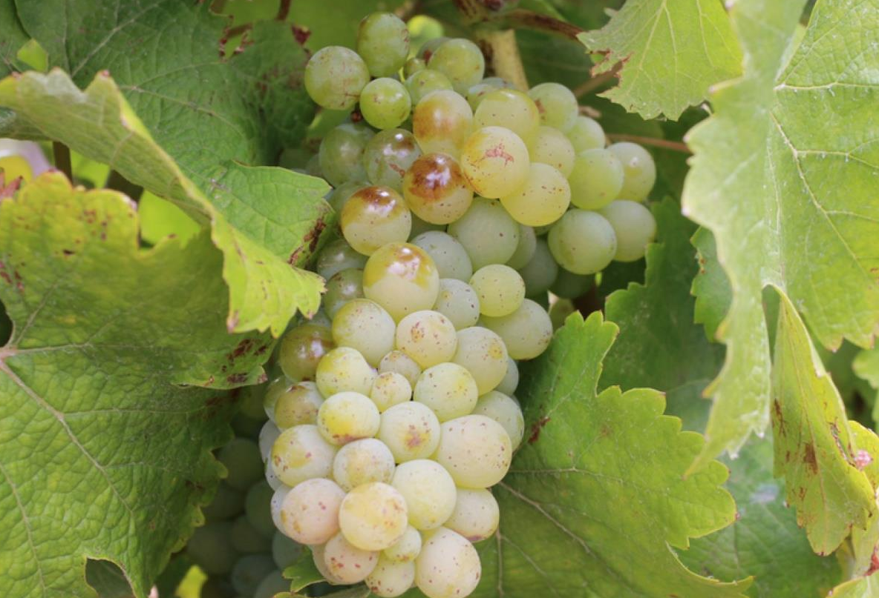
The most planted white-wine variety is Chenin Blanc, followed by Colombard and Chardonnay.

Slide 23
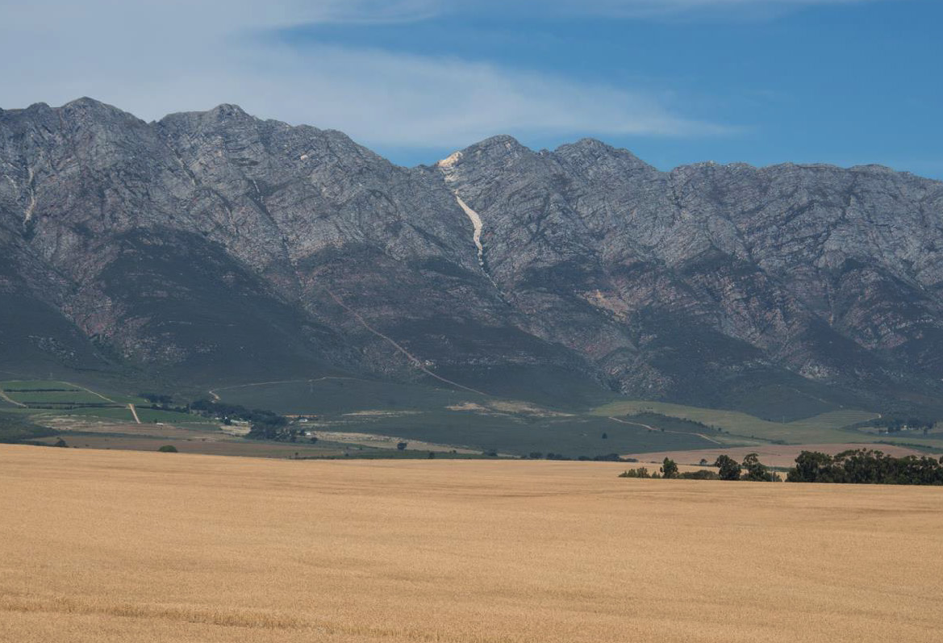
Red-wine varieties planted include predominantly Shiraz, Cabernet Sauvignon, Pinotage and Merlot.

Slide 24
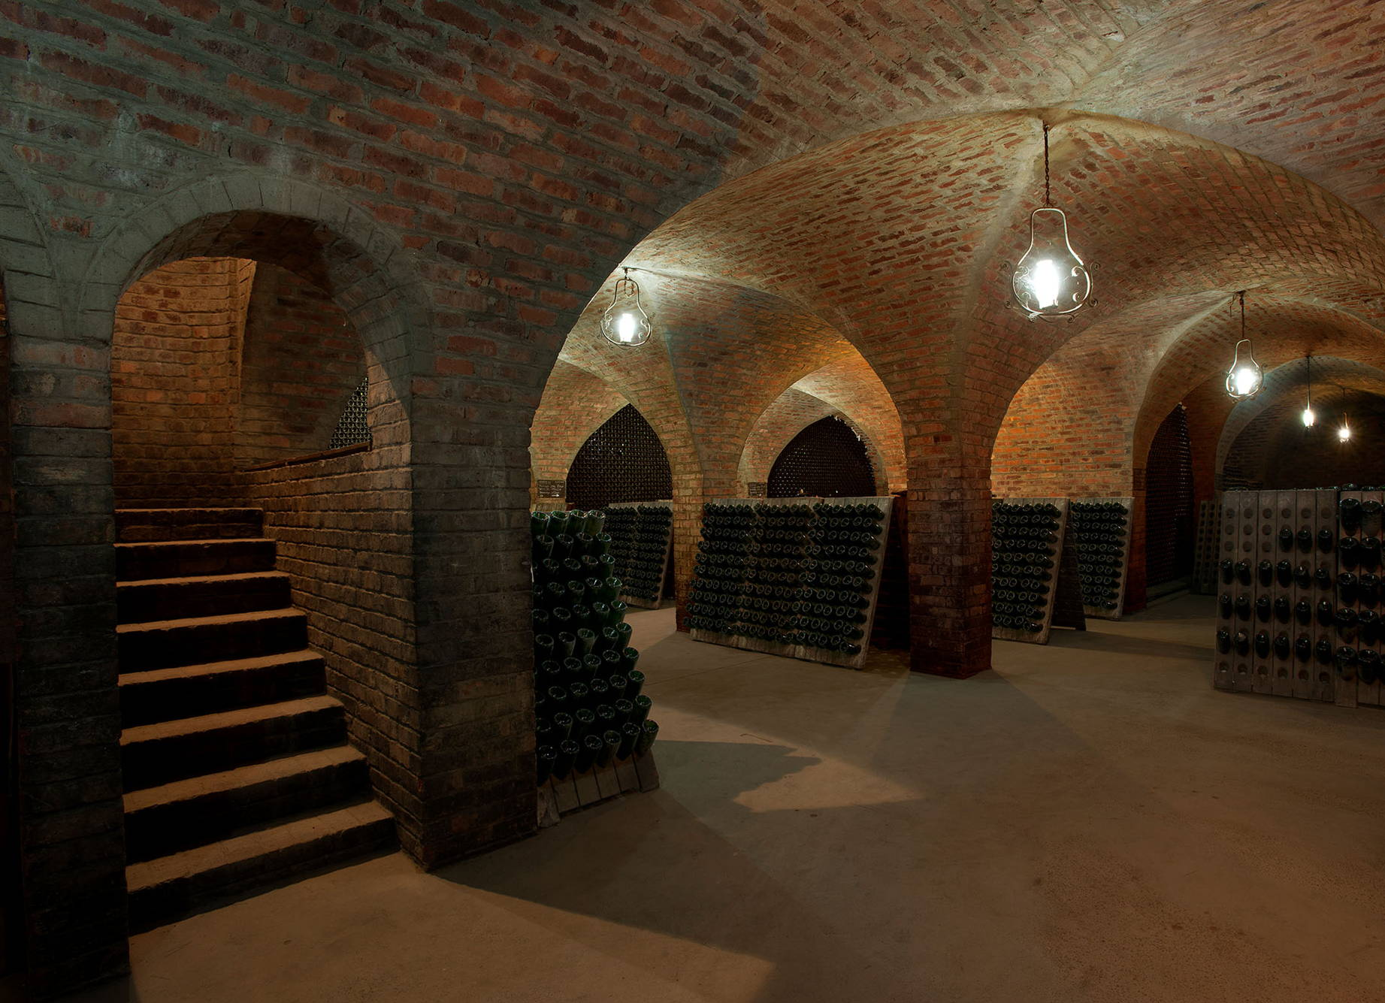
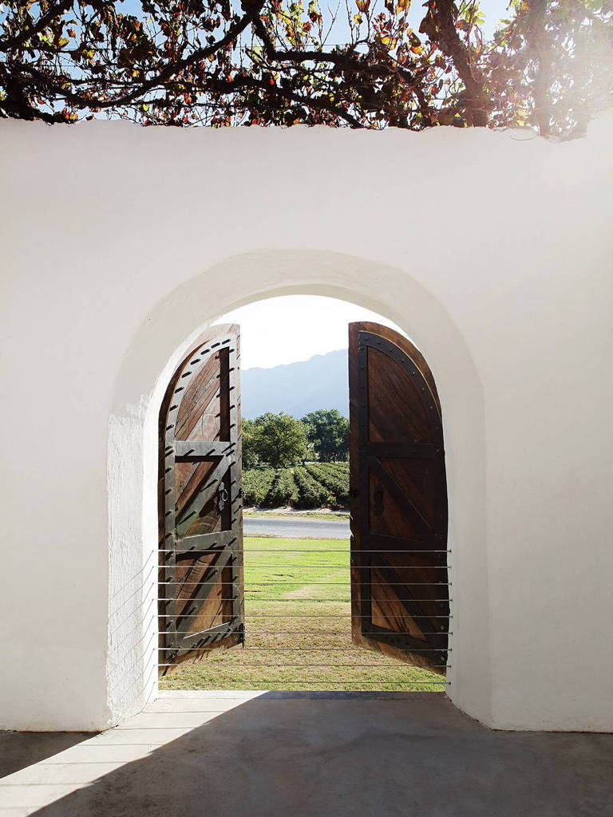
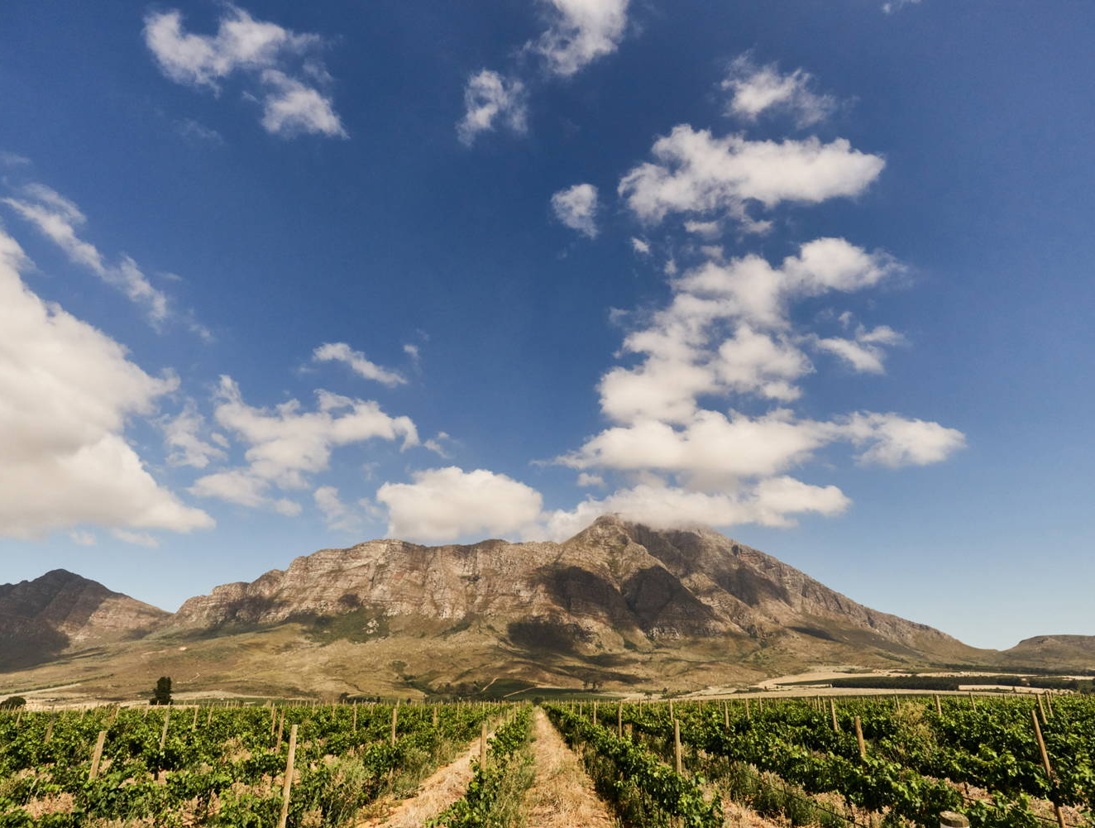
This inland district is noted for the quality of its Shiraz, which is consistently awarded the highest accolades, and its excellent Cap Classiques.

Slide 25
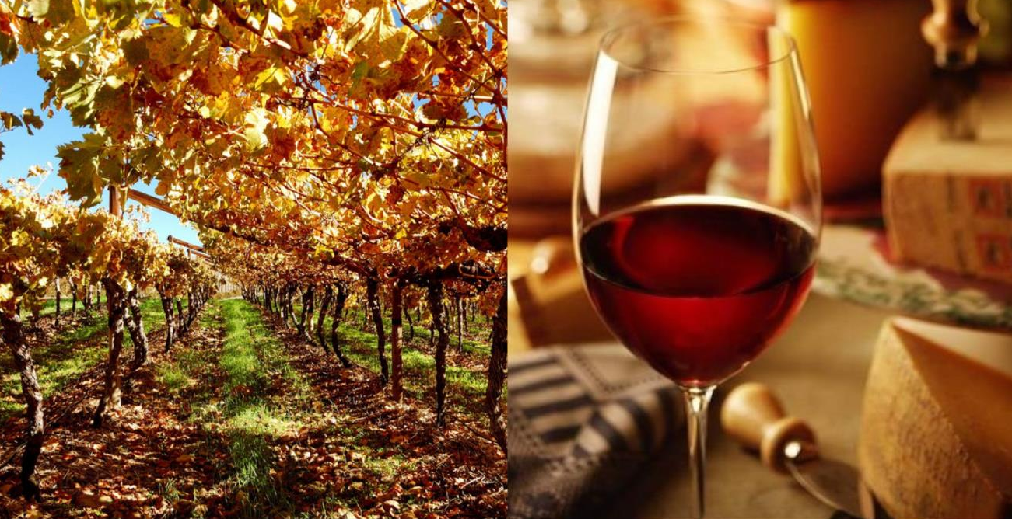
Tulbagh has also gained a reputation for its top quality Pinotage and red blends.

Slide 26
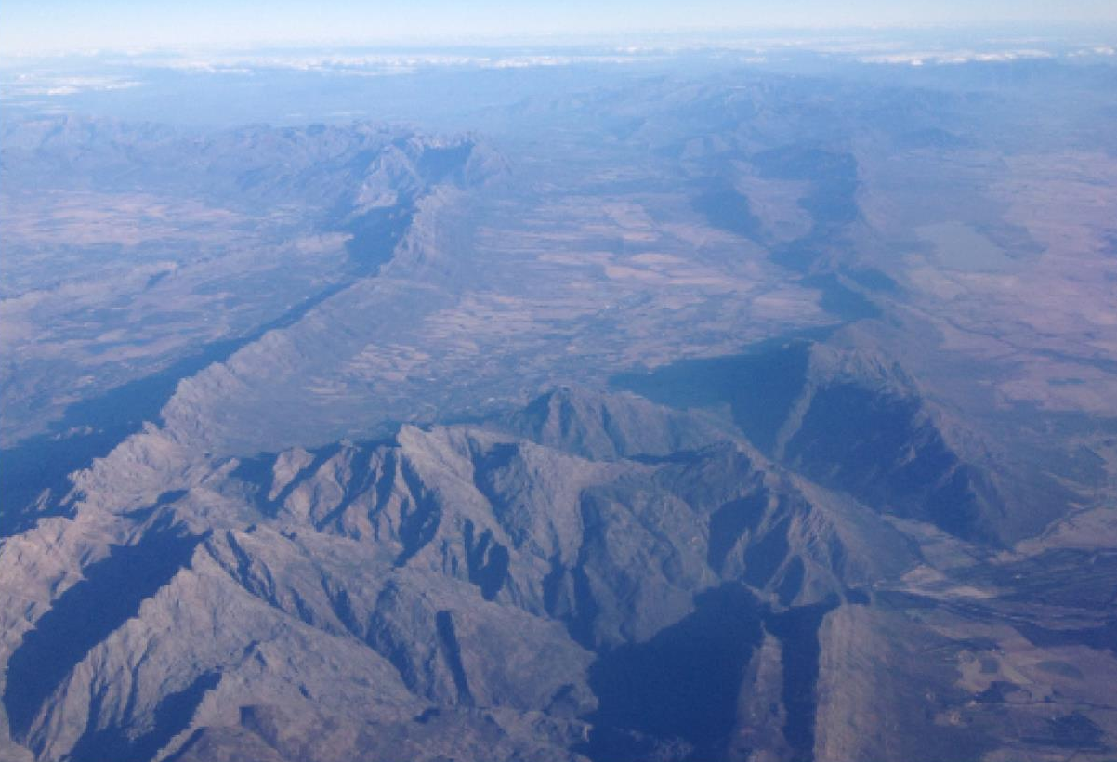
The images used in these presentations have been sourced from various producers, as well as industry and tourism bodies. These presentations are strictly for non-commercial, non-profit, educational purposes only and cannot be reproduced or transmitted in any form or by any means without written permission from Wines of South Africa (WoSA).

Slide 27
The Cape winelands, considered by many to be the most
beautiful in the world, have a network of diverse
and well-run wine routes, affording visitors a varied
and unforgettable experience.
The end
Notes:
The end

