Slide 1
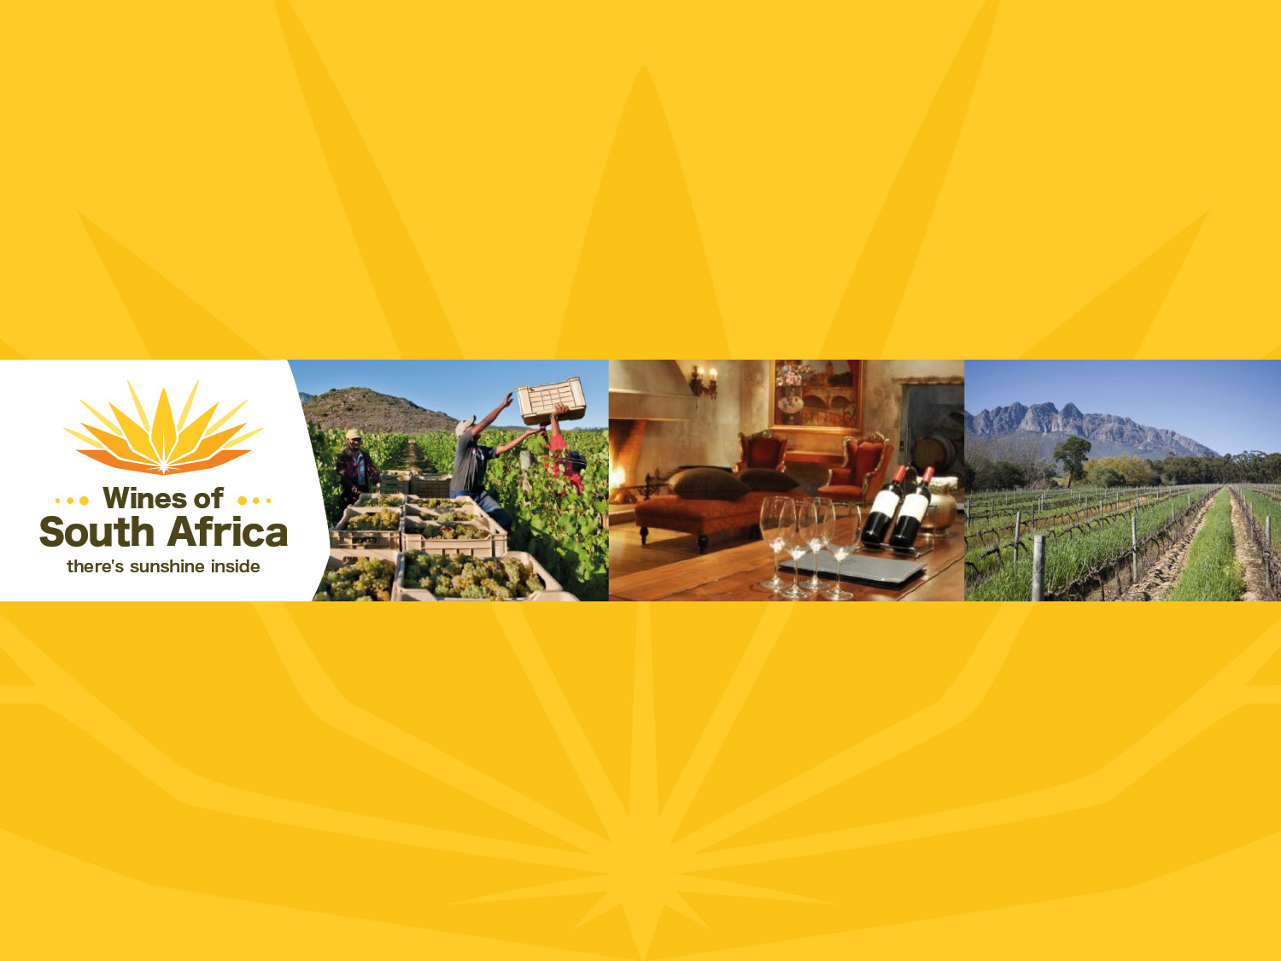
CAPE WINELANDS
WELLINGTON
Notes:
Wines of South Africa

Slide 2

Where is South Africa?

Slide 3

South Africa is the southernmost
country in Africa.

Slide 4

Our winelands are located at the
very tip of South Africa.

Slide 5

PRODUCTION AREAS: Districts of South Africa.

Slide 6

Wards of South Africa.

Slide 7
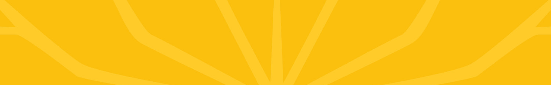
Coastal
Region: Coastal
District: Wellington
Wards:
Wellington
Bovlei
Groenberg
Limietberg
Mid-Berg River

Slide 8
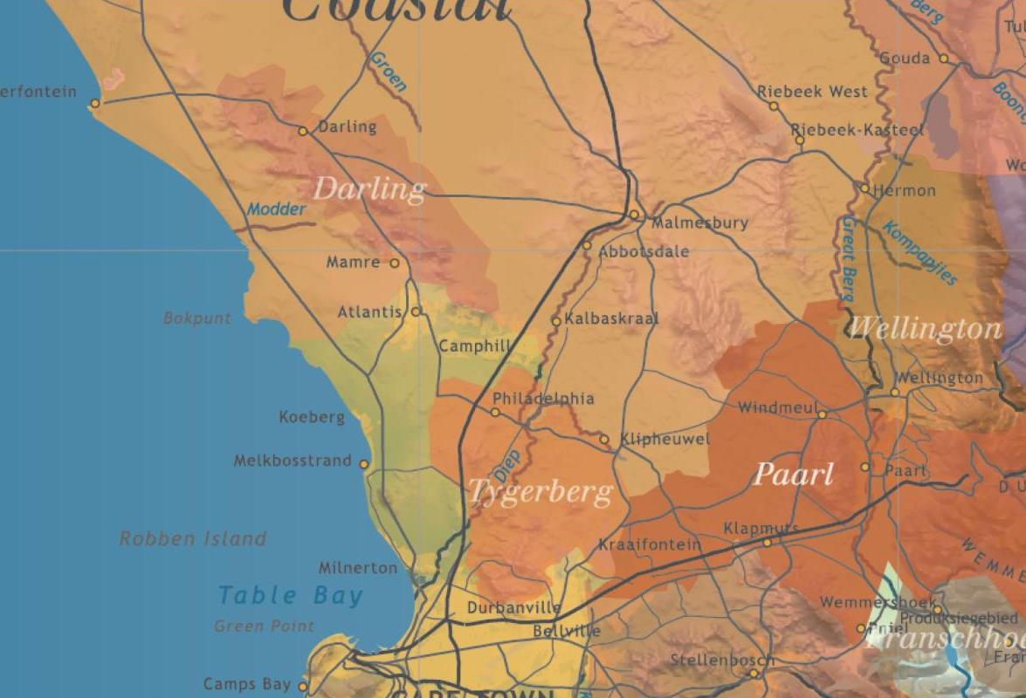
This burgeoning wine district is a mere 45-minute drive from Cape Town.

Slide 9
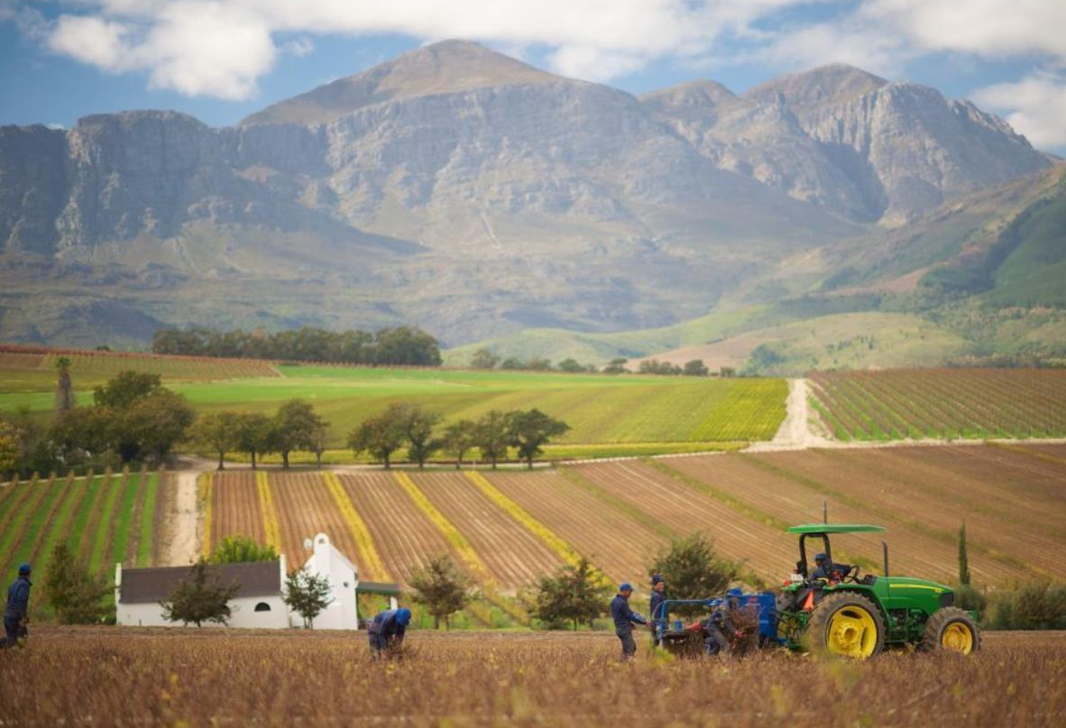
Some of the wineries stretch over alluvial terraces towards the Swartland's rolling hills and wheat fields.

Slide 10
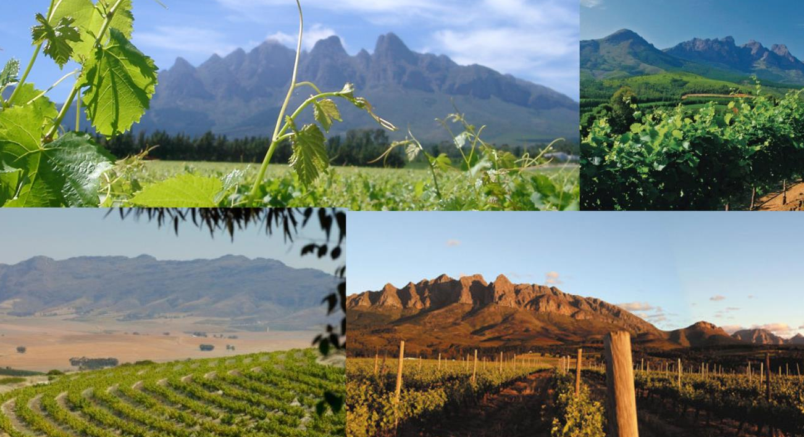
While others are found in the foothills of the towering Hawequa mountains, where folds and valleys create unique mesoclimates.

Slide 11
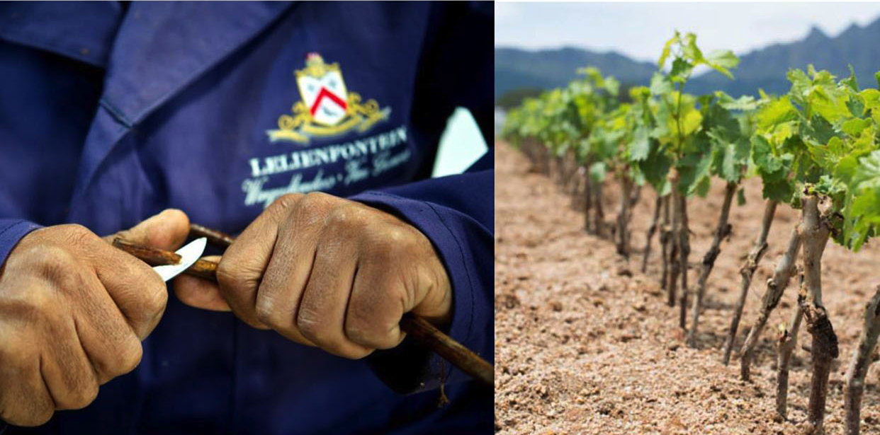
Wellington supplies 85% of the South African wine industry with cuttings.

Slide 12
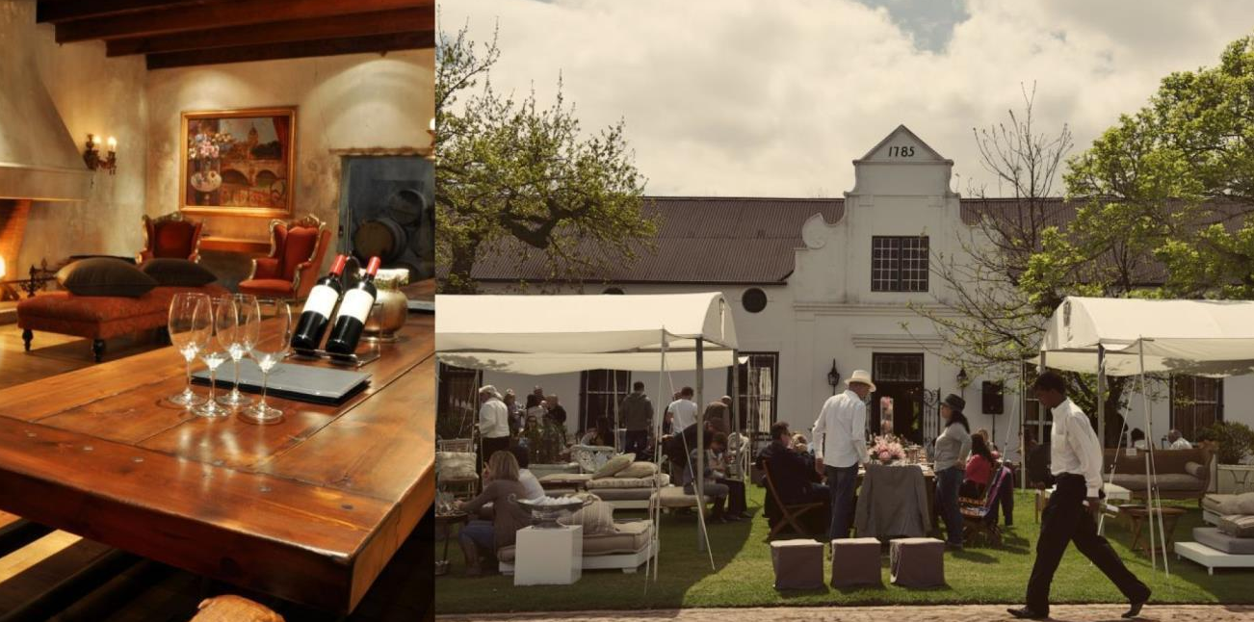
The district also boasts some 17 wine producers ranging from historical estates to boutique wineries.

Slide 13
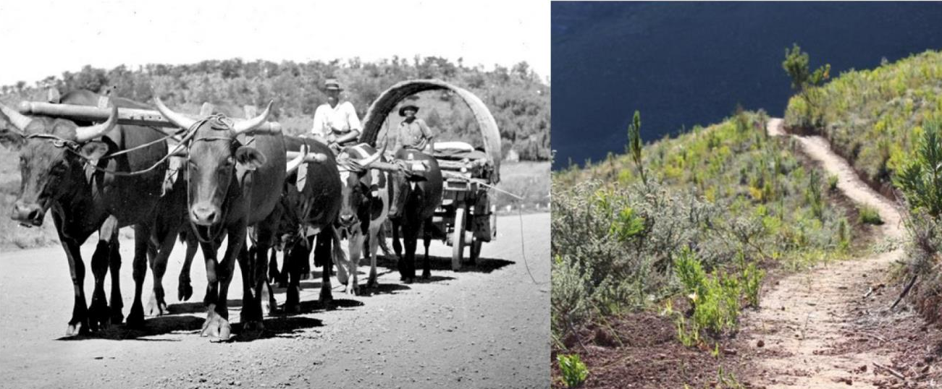
The valley was initially called Val du Charron (Valley of the Wagonmakers) and was the last outpost before adventurers, pioneers and travellers attempted the arduous journey into the hinterland with their ox-drawn wagons.

Slide 14
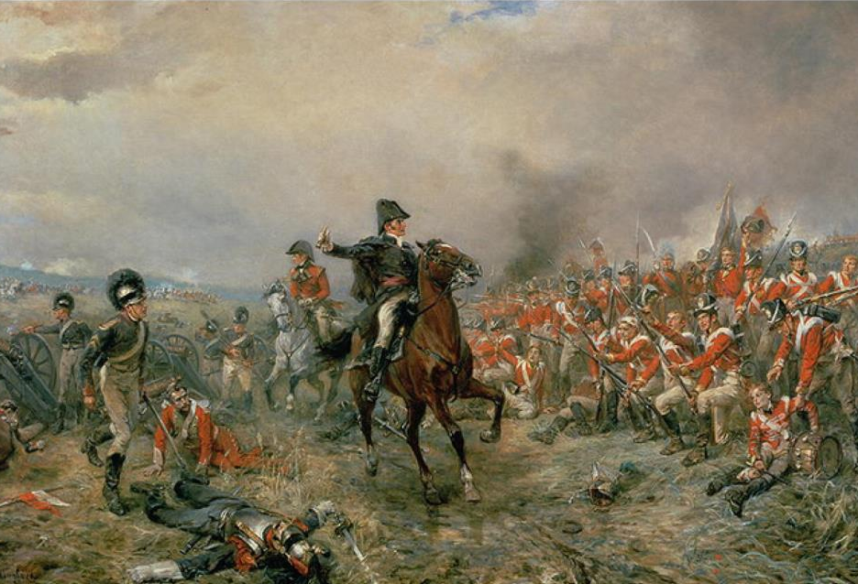
There were two attempts to name Wellington but it was only when
Sir George Napier suggested that the town should be named after 'England's greatest soldier' that, in 1840, the town of Wellington was proclaimed after the Duke who defeated Napoleon at Waterloo.

Slide 15
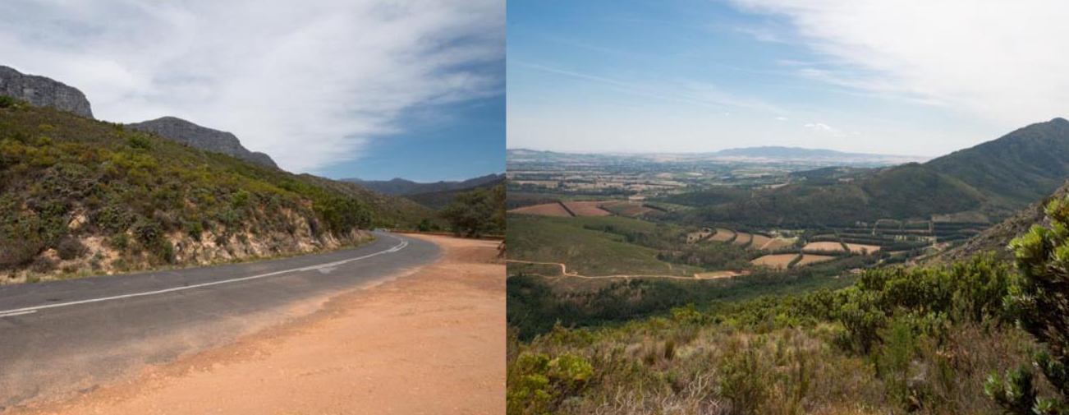
The Bainskloof Pass, built by the famous Scotsman Andrew Geddes Bain in 1840, was initially the only gateway to the north until the
Du Toitskloof Pass was opened in 1949.

Slide 16
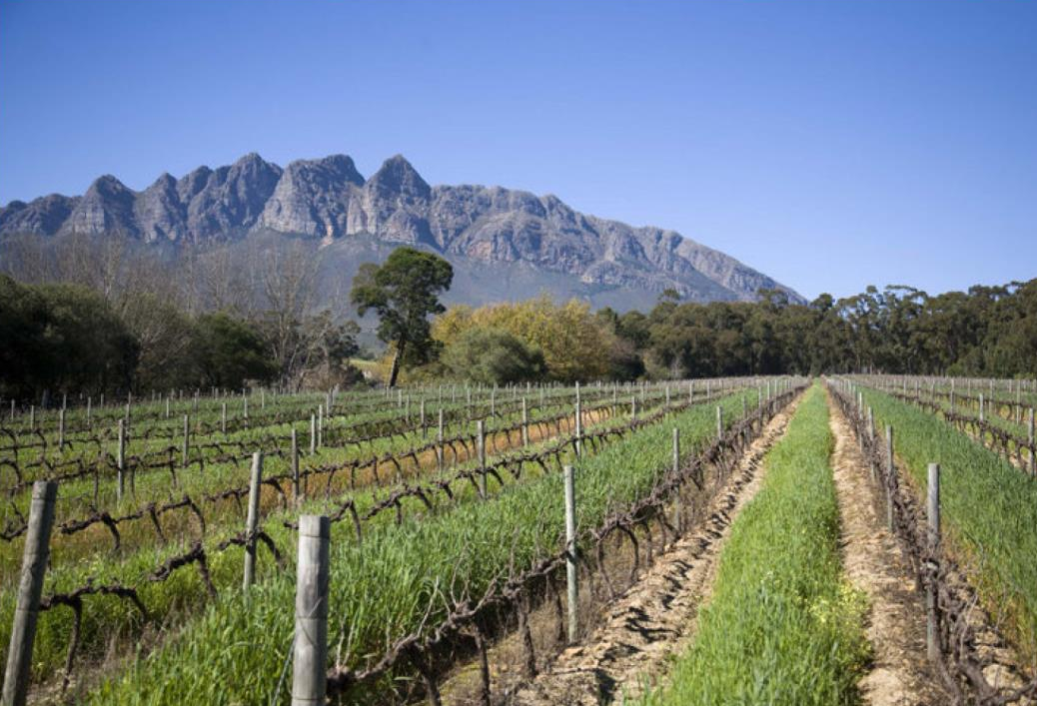
In winter, snow sometimes covers the mountain tops and night temperatures are generally cooler than at the coast some 60 km away.

Slide 17
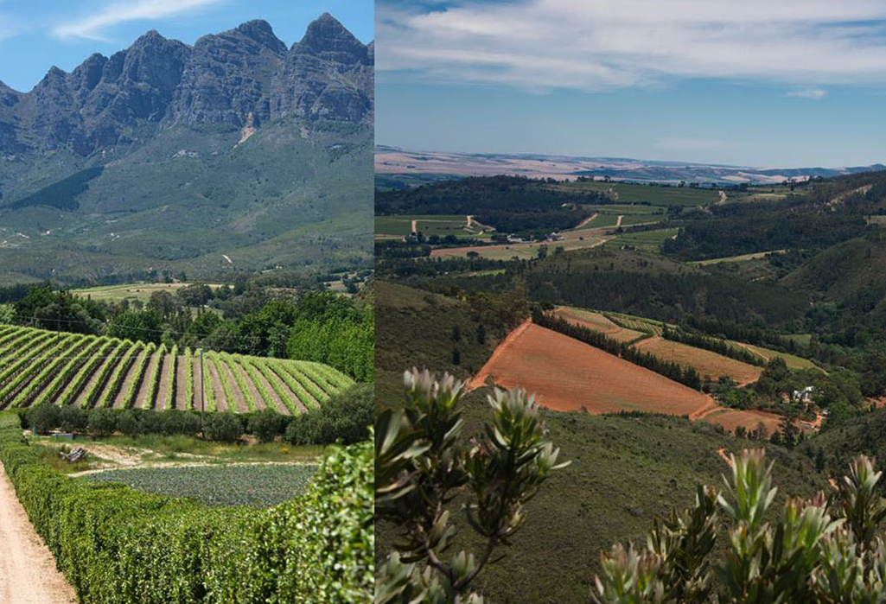
The average rainfall is 741 mm and the mean February temperature is 23.2⁰C
(Abenrude Weather Station).

Slide 18
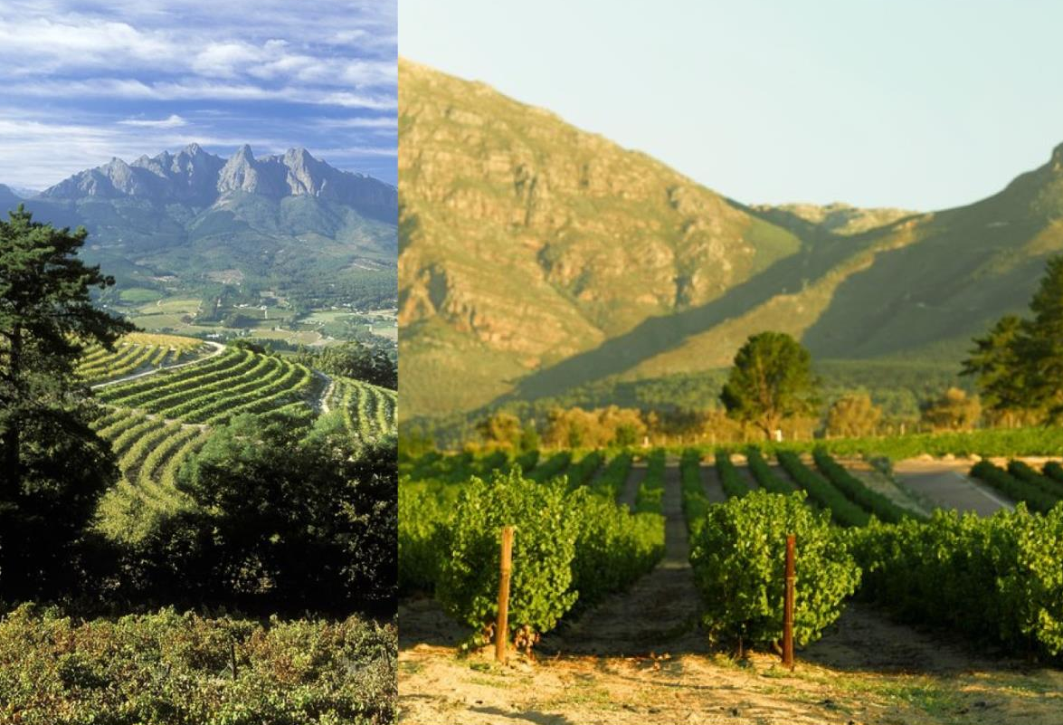
Soils here are predominantly derived from granite and Table Mountain sandstone, with Clovelly and Hutton types prevalent.

Slide 19
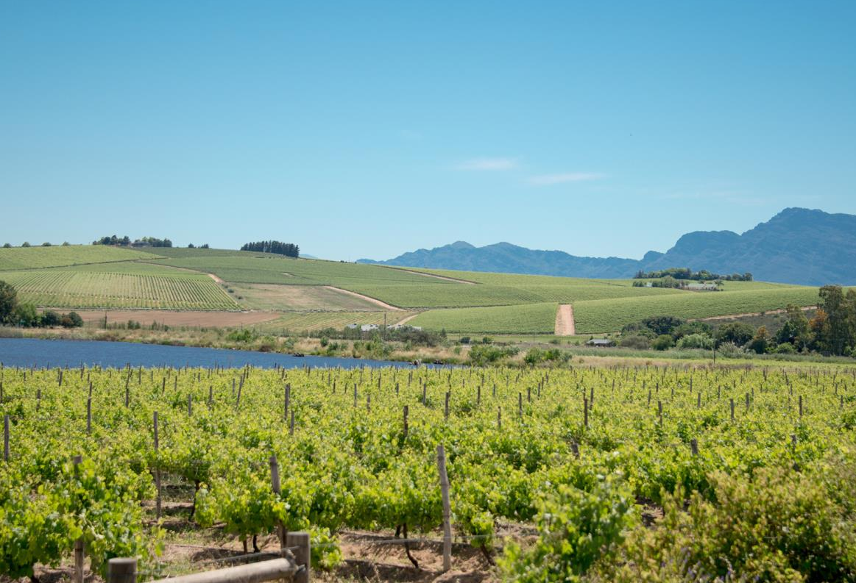
Closer to the Berg River, alluvial soils are found, as well as soils derived from Malmesbury shale on the rolling hills landscapes.

Slide 20
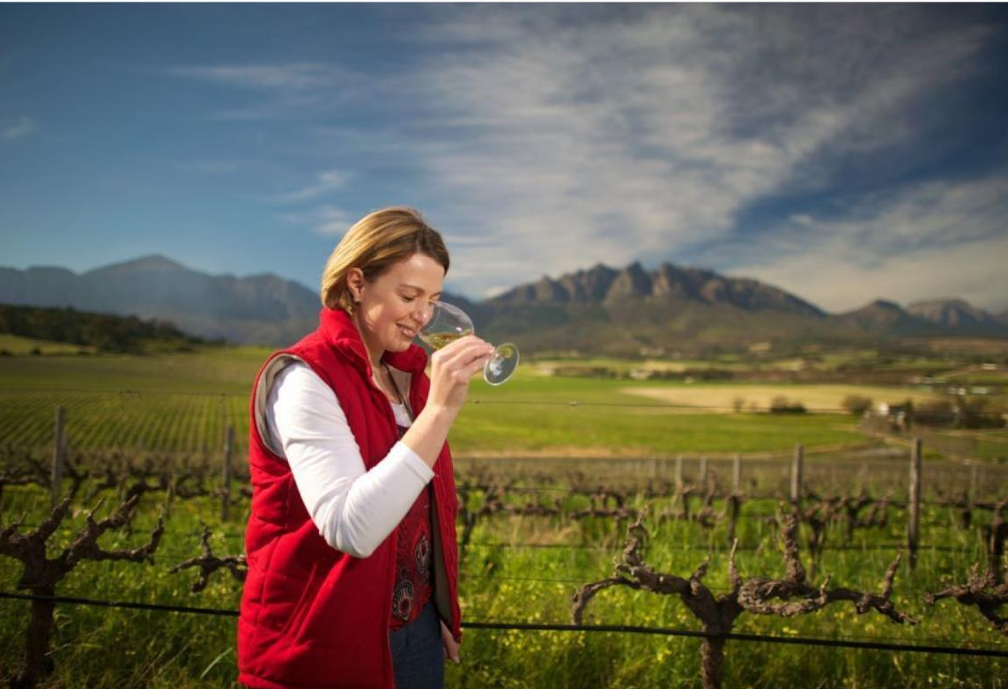
The most widely planted white-wine variety is Chenin Blanc.

Slide 21
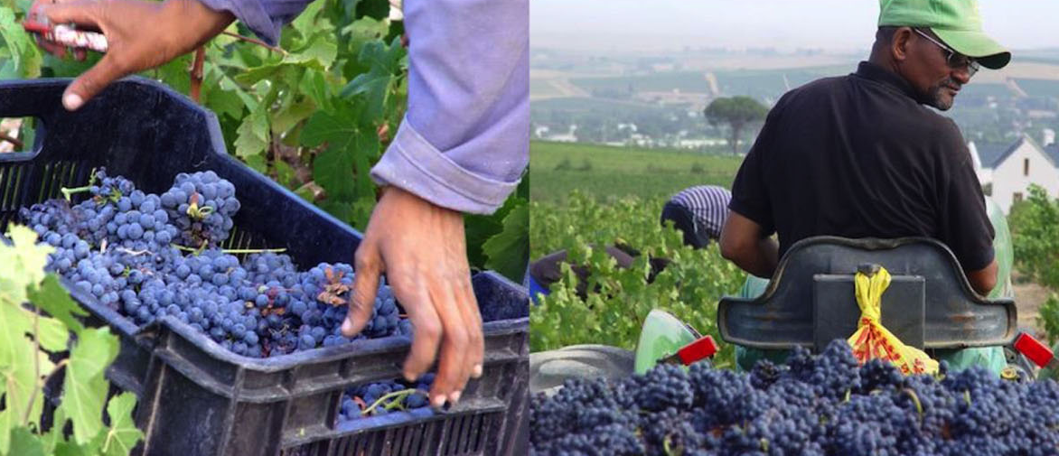
When it comes to red-wine varieties, Shiraz leads the way, followed by Cabernet Sauvignon and Pinotage.

Slide 22
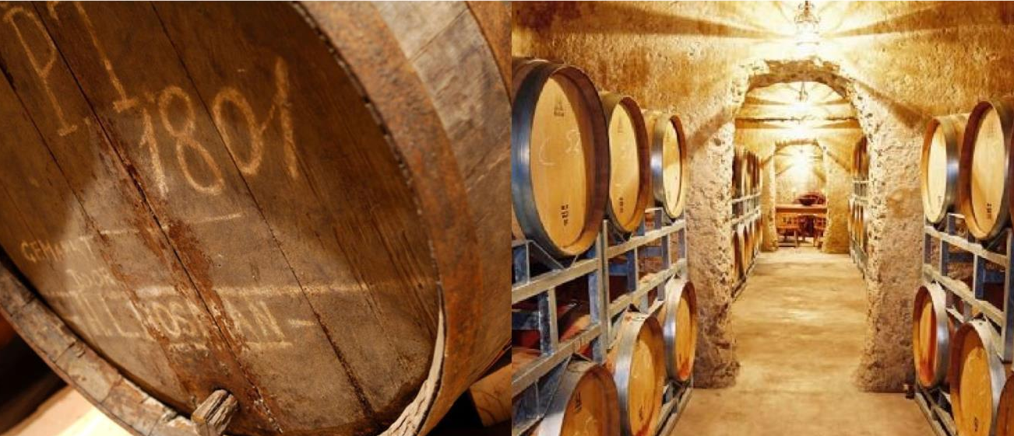
The Wellington district is increasingly being reputed for the quality of its reds, Shiraz in particular, and red blends.

Slide 23
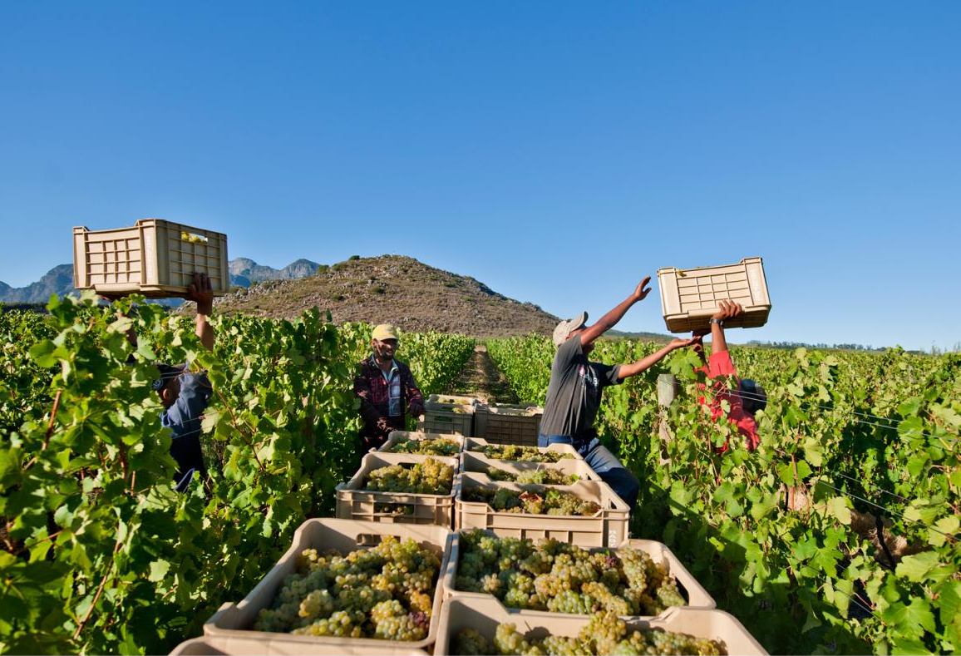
The Cape winelands, considered by many to be the
most beautiful in the world, has a network of diverse and well-run wine routes, affording visitors a varied and unforgettable experience.

Slide 24
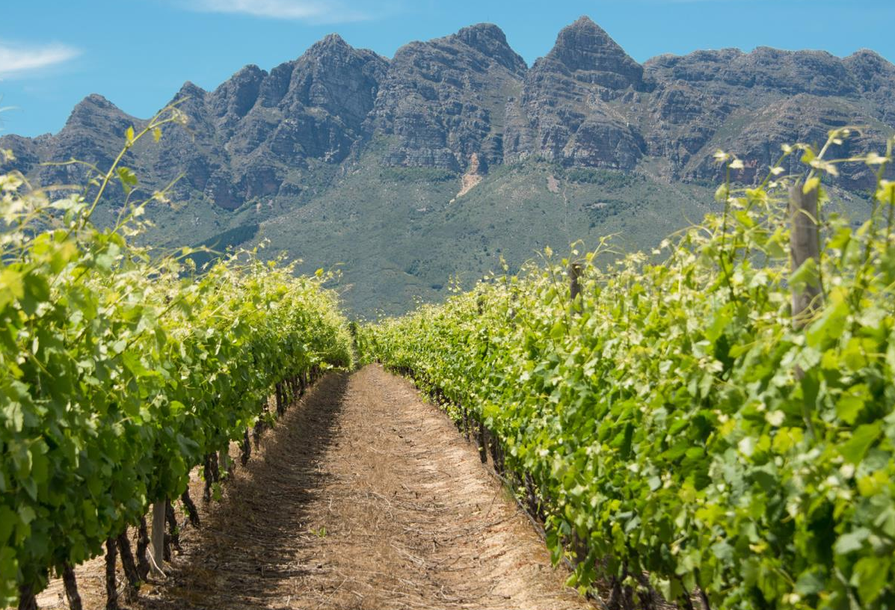
The images used in these presentations have been sourced from various producers, as well as industry and tourism bodies. These presentations are strictly for non-commercial, non-profit, educational purposes only and cannot be reproduced or transmitted in any form or by any means without written permission from Wines of South Africa (WoSA).

Slide 25
The Cape winelands, considered by many to be the most
beautiful in the world, have a network of diverse
and well-run wine routes, affording visitors a varied
and unforgettable experience.
The end
Notes:
The end

