Slide 1
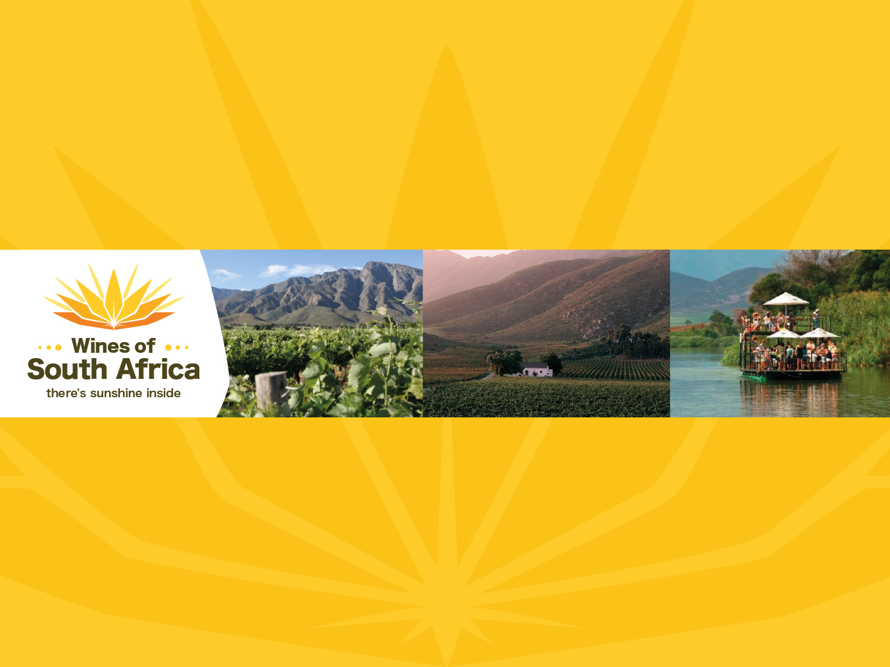
CAPE WINELANDS
WORCESTER
Notes:
Wines of South Africa

Slide 2

Where is South Africa?

Slide 3

South Africa is the southernmost
country in Africa.

Slide 4

Our winelands are located at the
very tip of South Africa.

Slide 5

PRODUCTION AREAS: Districts of South Africa.

Slide 6

Wards of South Africa.

Slide 7

Coastal
Region: Coastal
District: Worcester
Wards:
Hex River Valley
Keeromsberg
Moordkuil
Nuy
Rooikrans
Scherpenheuvel
Stettyn

Slide 8
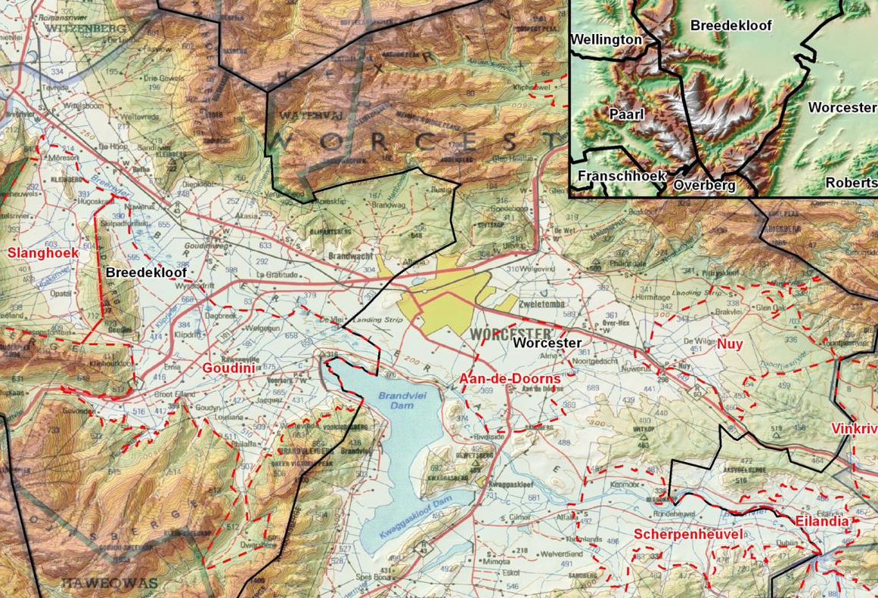
The Worcester district, in conjunction with the Breedekloof district, is the largest in terms of winegrowing area and volume.

Slide 9
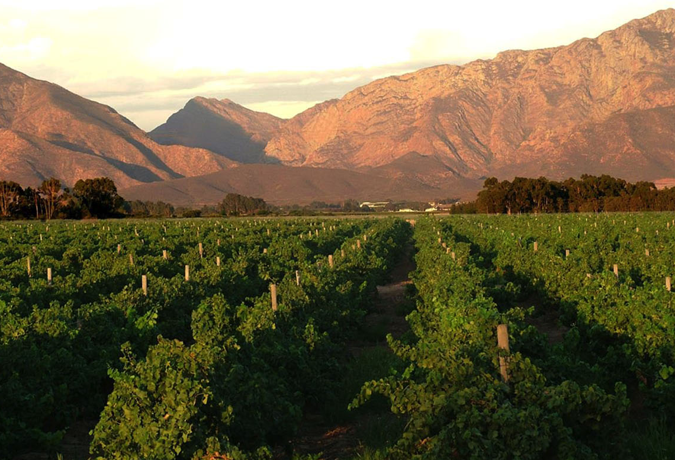
With around 19 078 ha planted, it accounts for nearly 22% of the national vineyards and produces close on 34% of South Africa's total volume of wine and spirits.

Slide 10
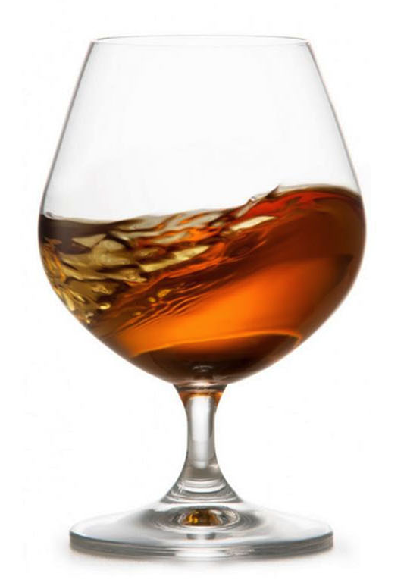
The Worcester district is the most important brandy-producing area in the winelands.

Slide 11
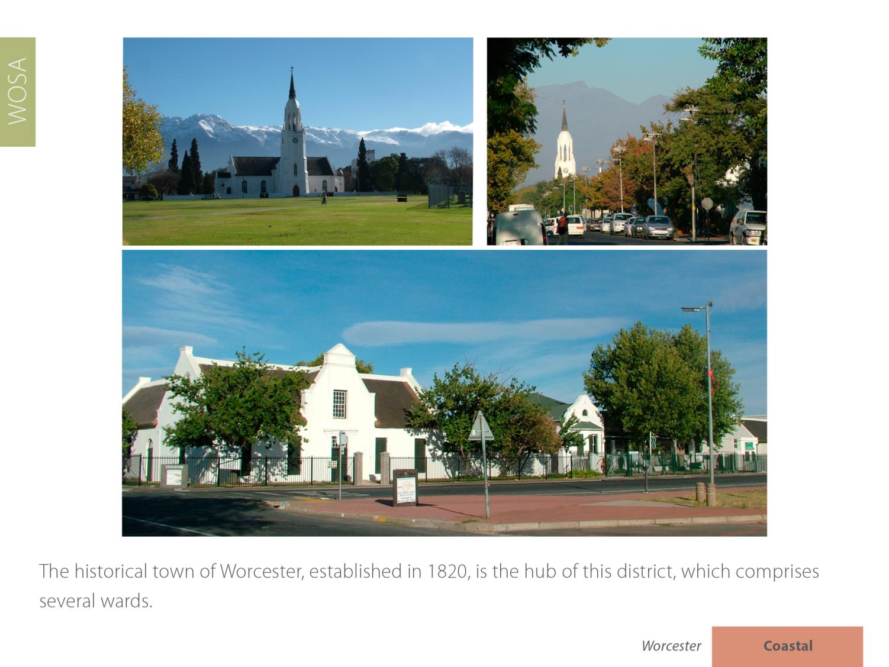
The historical town of Worcester, established in 1820, is the hub of this district, which comprises several wards.

Slide 12
There are some
12 wine cellars on the Worcester Wine & Olive Route.

Slide 13
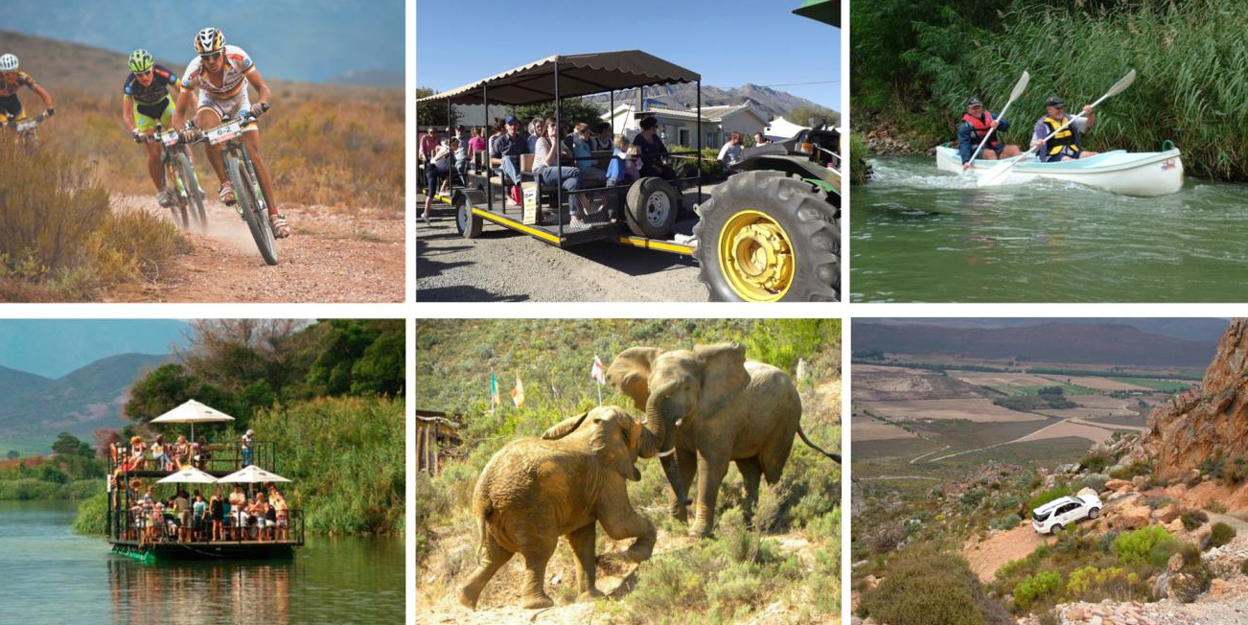
For outdoor enthusiasts there are several exciting activities on offer, from 4x4 routes and game watching to fishing, canoeing, river boating, hiking and mountain biking.

Slide 14
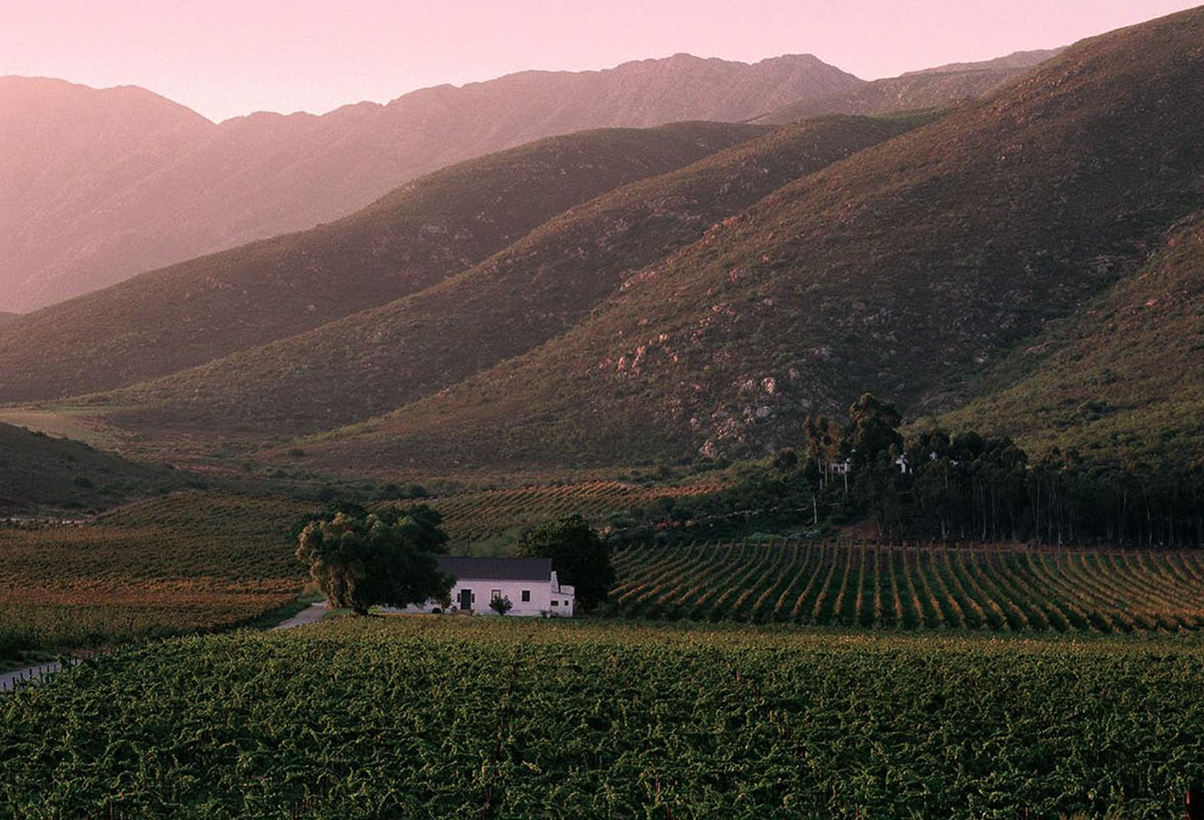
Between Worcester and Robertson in the Breede River Valley the climate is Mediterranean with a mean February temperature of 23.6⁰C for Worcester Weather Station and 22.2⁰C for Nuy Weather Station.

Slide 15
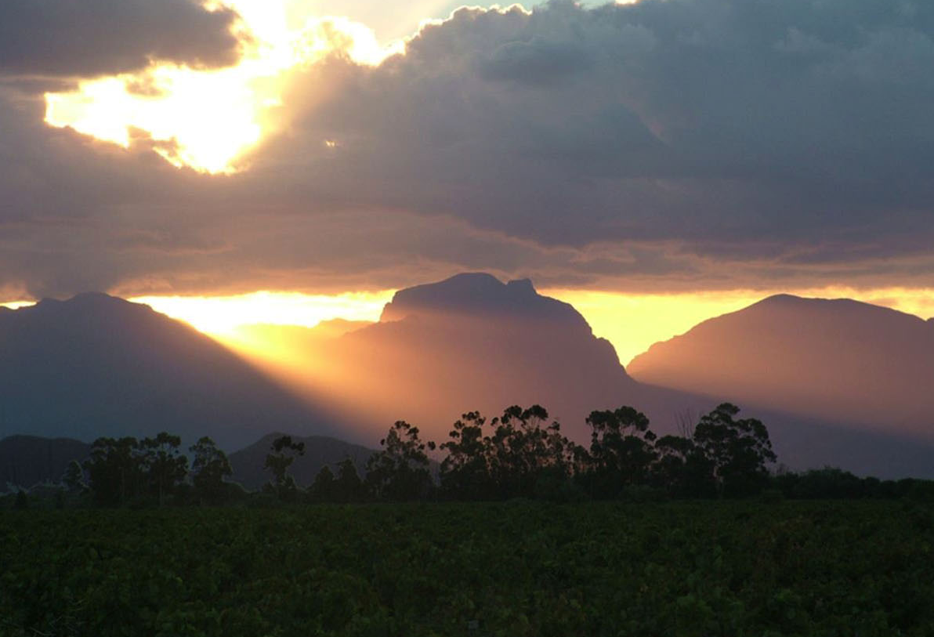
The rainfall is low, with an annual average of 201 mm (Nuy Weather Station).

Slide 16
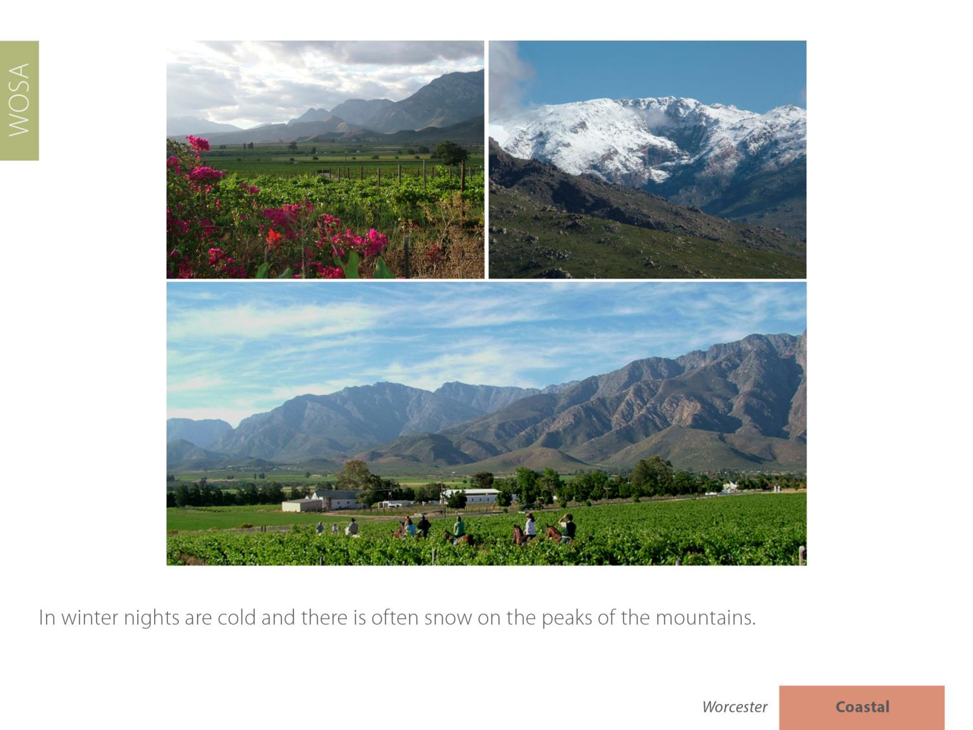
In winter nights are cold and there is often snow on the peaks of the mountains.

Slide 17
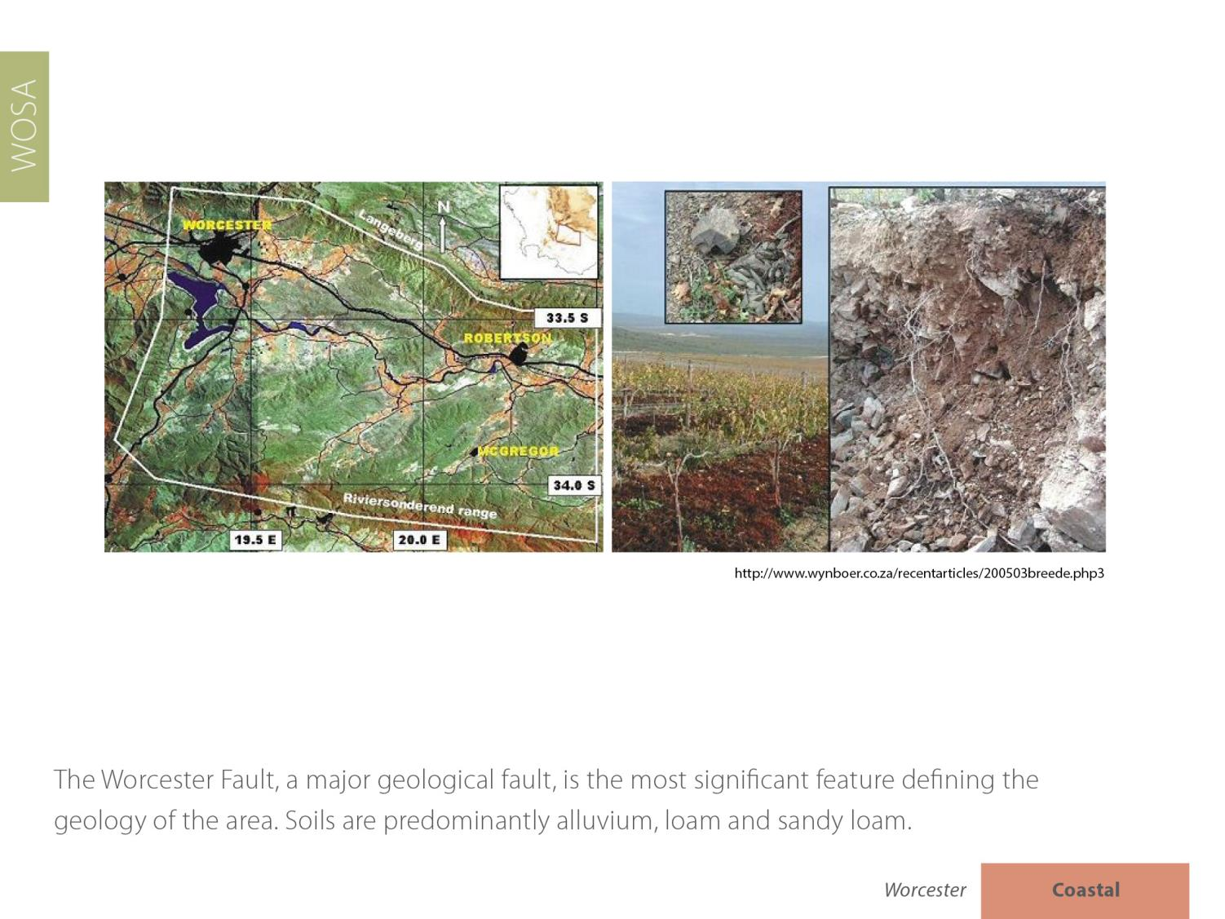
The Worcester Fault, a major geological fault, is the most significant feature defining the geology of the area. Soils are predominantly alluvium, loam and sandy loam.

Slide 18
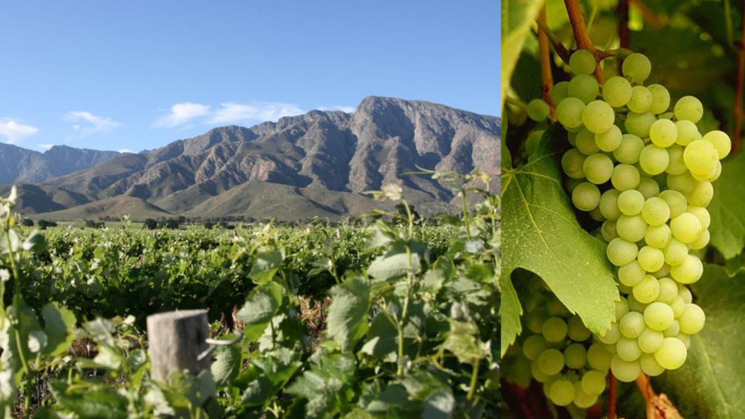
The most widely planted white-wine variety is Chenin Blanc.

Slide 19
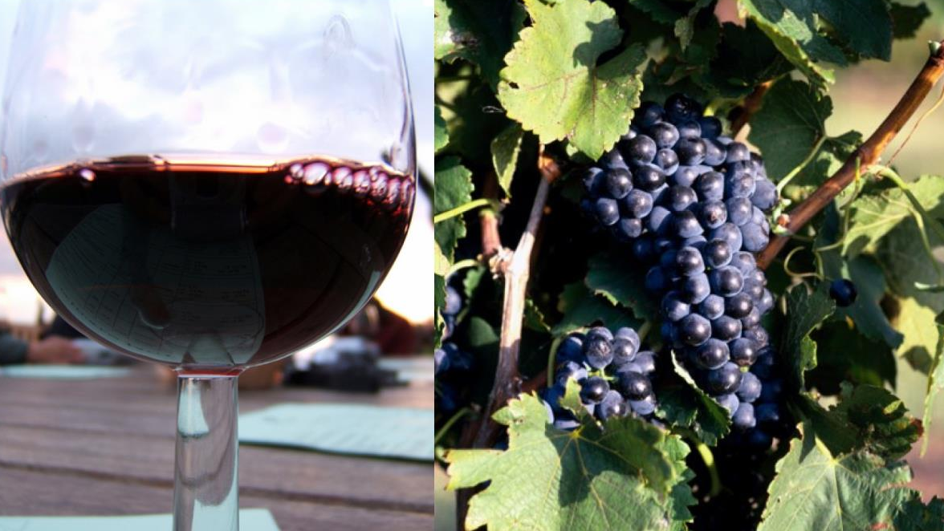
Pinotage is the dominant red-wine variety, followed by Shiraz and Cabernet Sauvignon.

Slide 20
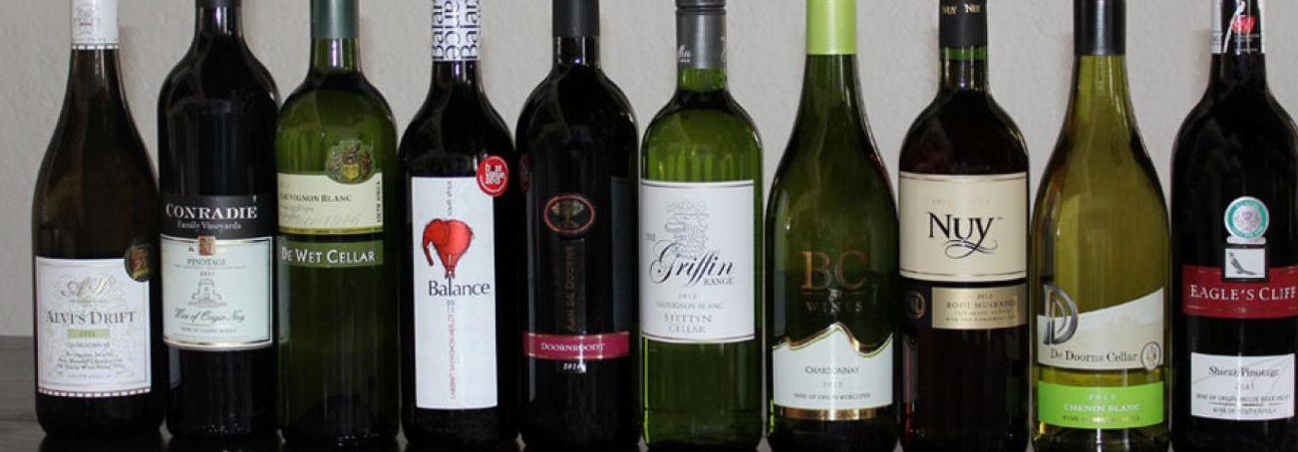
The area is known for its good value-for-money red and white wines. Several of the cellars on the Worcester Wine & Olive Route are bottling quality wines under their own labels.

Slide 21
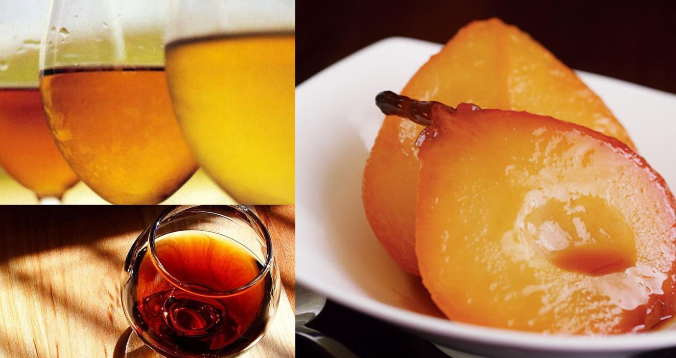
It has also built a reputation for its fortified wines.

Slide 22
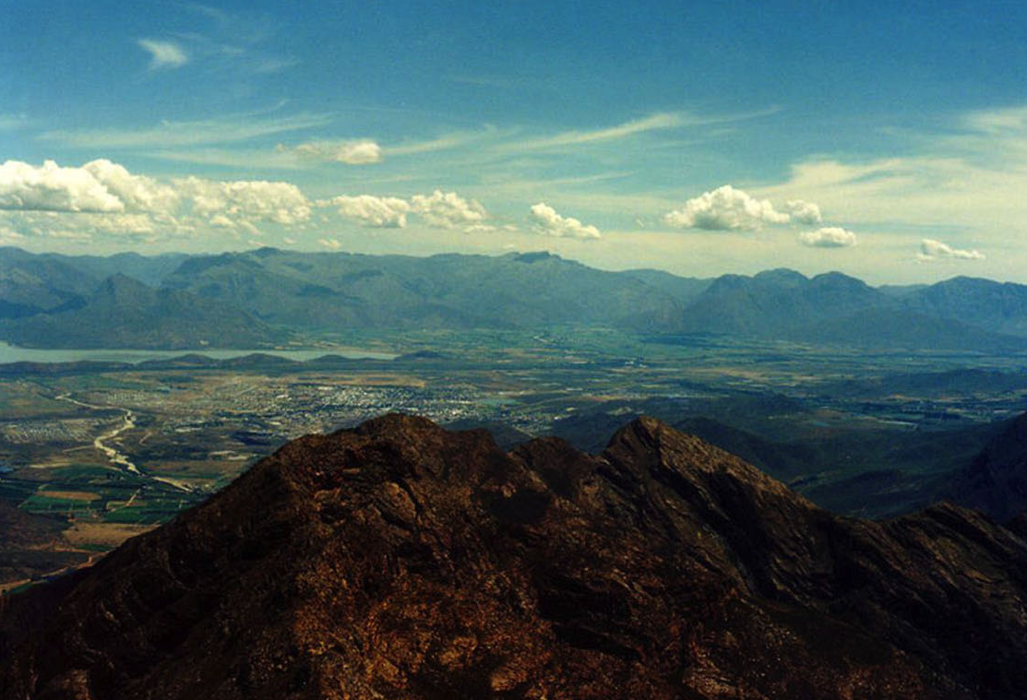
The images used in these presentations have been sourced from various producers, as well as industry and tourism bodies. These presentations are strictly for non-commercial, non-profit, educational purposes only and cannot be reproduced or transmitted in any form or by any means without written permission from Wines of South Africa (WoSA).

Slide 23
The Cape winelands, considered by many to be the most
beautiful in the world, have a network of diverse
and well-run wine routes, affording visitors a varied
and unforgettable experience.
The end
Notes:
The end

